Slide 1
PhD Thesis Proposal Defense
Edwin Alexani
Rochester Institute of Technology

Slide 2
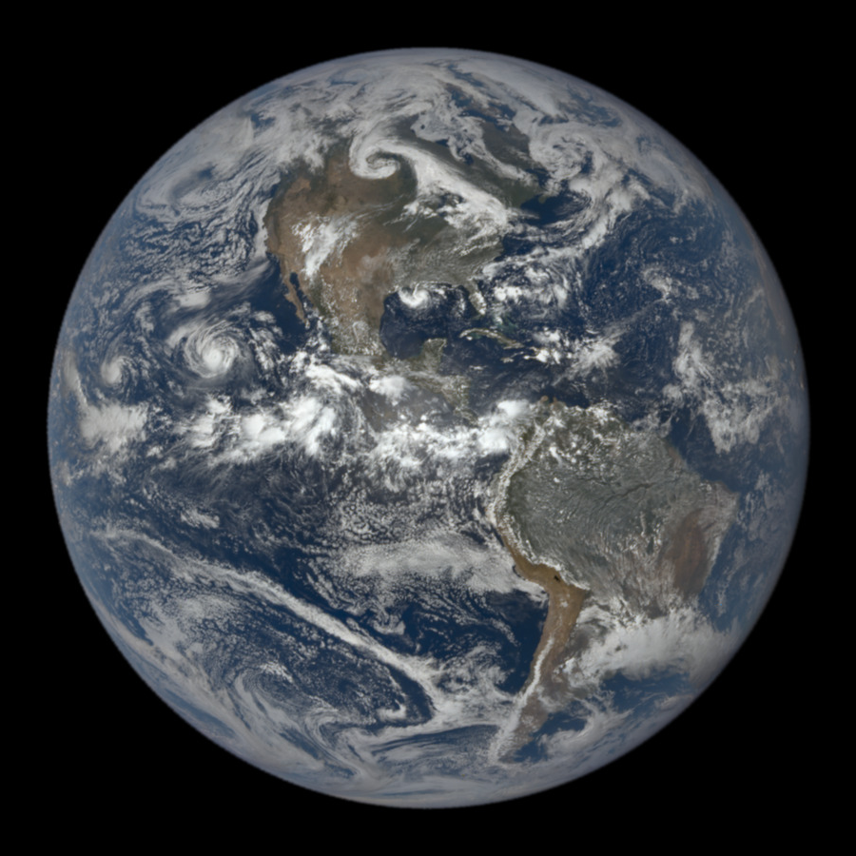
Overview
Goals of Proposal Defense
  Motivate PhD Thesis relevance, novelty, and timeliness
  Introduce relevant science and technology
  Present completed work in relation to PhD Thesis
  Describe remaining work and success criteria
  Present timeline of remaining work
Motivating Questions
Science Introduction
Technology Introduction
Completed Work
Remaining Work
Overview Effect

Slide 3
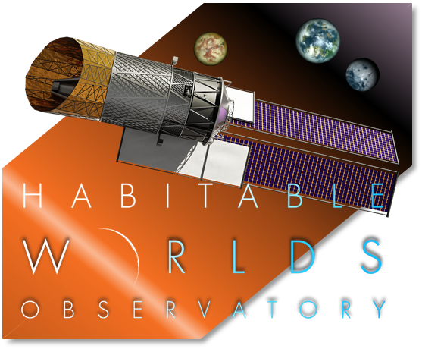
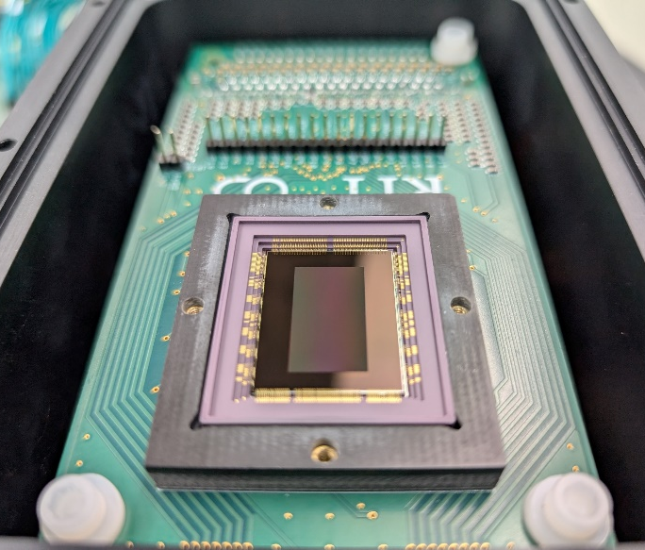
2. Motivating Questions
Can current state-of-the-art (SOTA) single photon sensing CMOS (SPSCMOS) detectors satisfy the requirements of the Habitable Worlds Observatory (HWO) science applications?
What is the performance of SOTA SPSCMOS detectors?
Are there any previously unknown characteristics in current SOTA SPSCMOS detectors?
Are there any improvements that must be made to current SOTA SPSCMOS detectors in order to satisfy HWO requirements?
Are there any data processing methods that can leverage the single-photon sensing nature of SPSCMOS to improve the signal-to-noise ratio (SNR) of measurements?

Slide 4
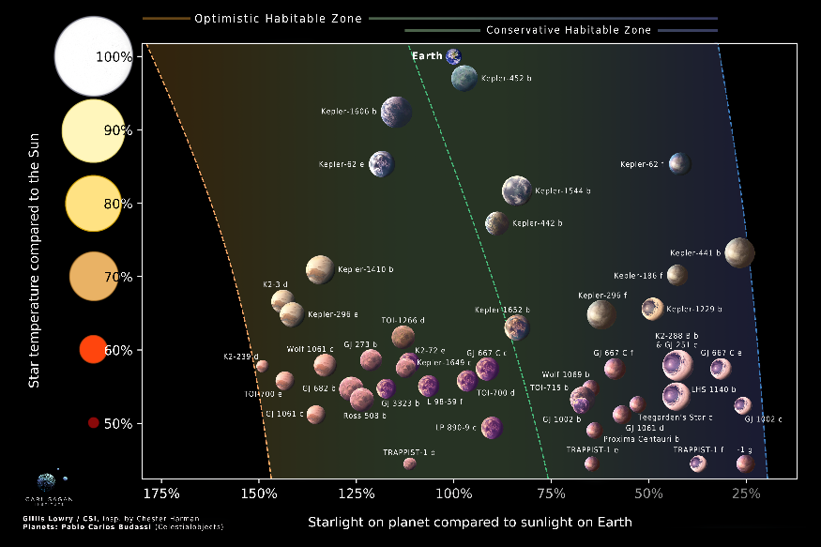
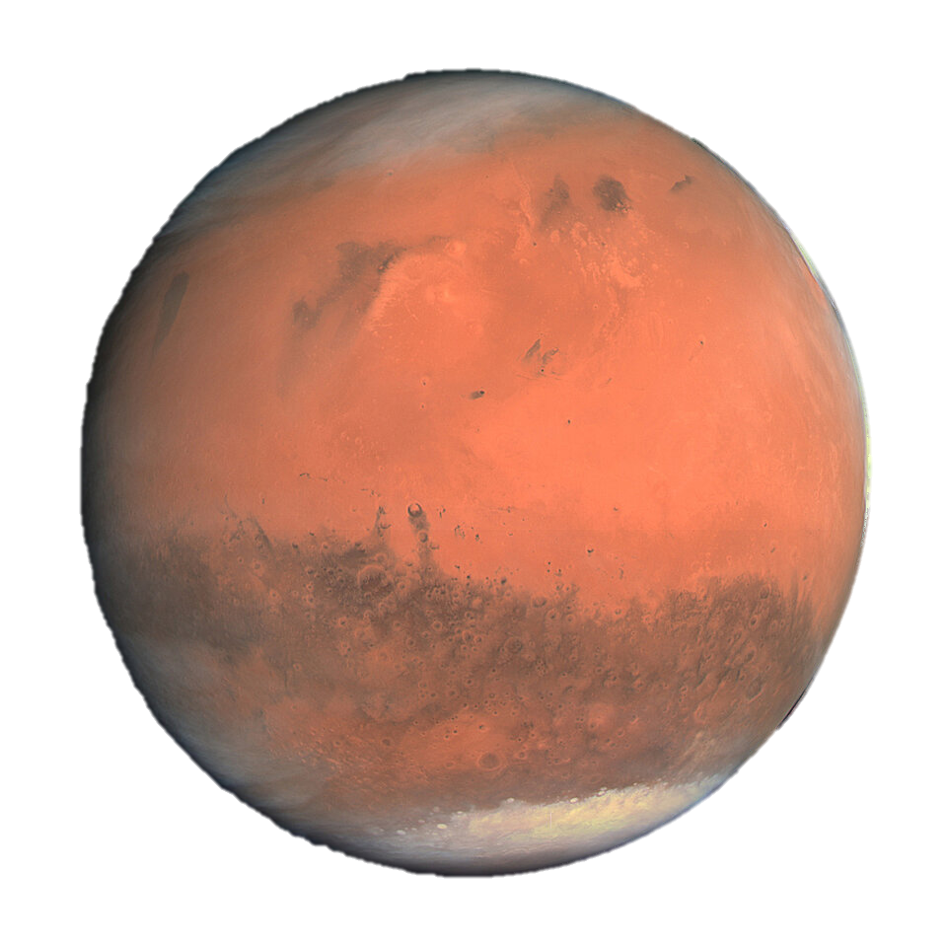
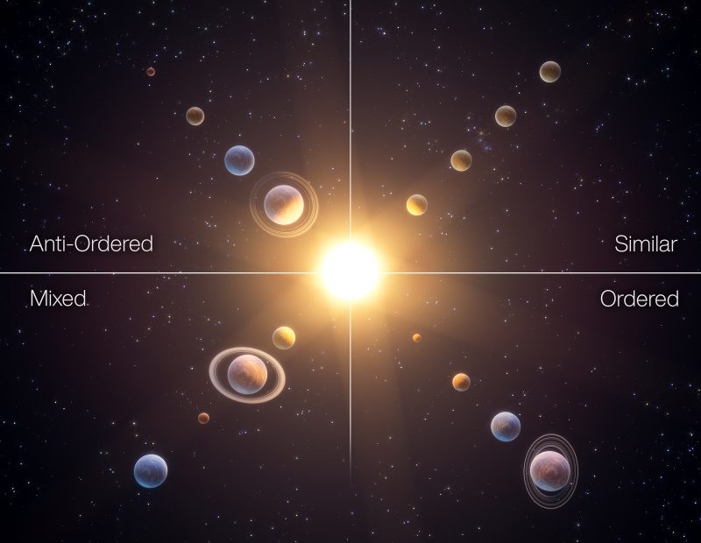
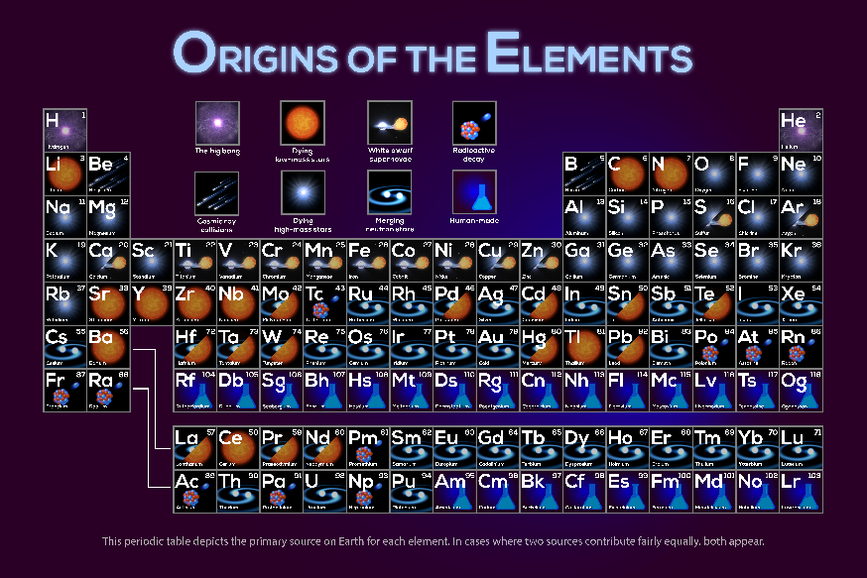
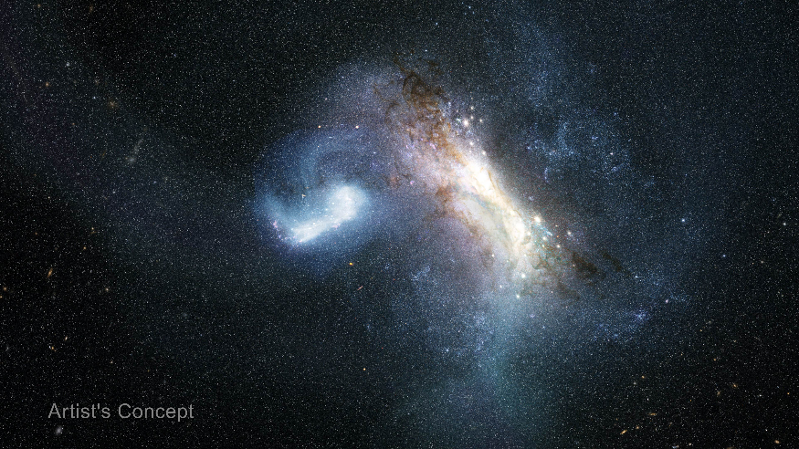
3. Science Introduction
HWO is NASA’s current New Great Observatory concept.
HWO will observe the universe in the UV/O/IR wavelengths.
The HWO website lists the following primary mission goals:
  Discovering Living Worlds
  Understanding the Solar System in its Galactic Context
  Uncovering the Drivers of Galaxy Growth
  Following the Evolution of Elements Over Cosmic Time
“Discovering Living Worlds” requires the accurate detection of photons at rates of a few photons per hour.
“Discovering Living Worlds” presents the largest detector technology gap for mission success.
Venus
191%
Mars
43%

Slide 5
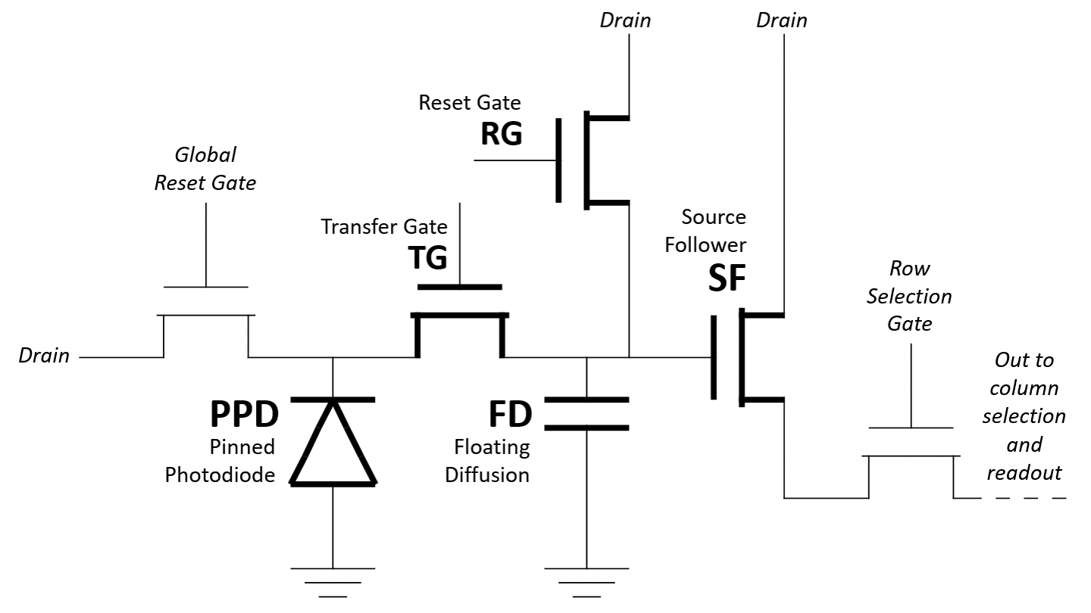
4. Technology Introduction
The SPSCMOS we are characterizing is the Fairchild Imaging HWK4123 detector.
The HWK4123 is increasingly relevant in astrophysics (i.e., Subaru Telescope, Lazuli Space Observatory).
The HWK4123 has 5T pixels, with a diagram shown on the right. The order of operation is shown below the diagram.
The capacitance of the floating diffusion is small, which produces a large voltage response to a single charge carrier.
This response exceeds the read noise significantly.
Reset FD by opening RG.
Measure “off” signal of FD using SF after reset.
Charge integrates in PPD.
Transfer charge to FD by opening TG.
Measure “on” signal of FD using SF after reset.
Use “on” and “off” values in CDS sampling of signal.
Single-slope ADC converts analog voltage to digital value.
Reset FD by opening RG.

Slide 6
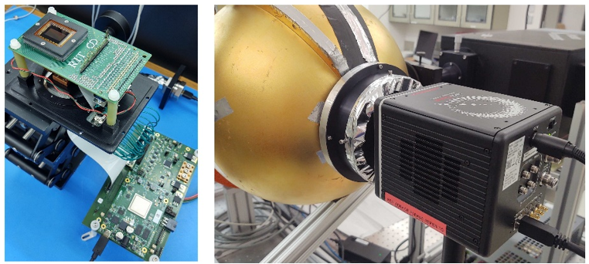
5. Completed Work and Results
Published Papers
Dark Current
Read Noise and Bit Error Rate
Crosstalk
Conversion Gain
Capacitance of Floating Diffusion
Quantum Efficiency
Persistence
Telescope Observing Results
Simulation of Earthlike Exoplanet

Slide 7
5.1. Published Papers
Single-photon counting CMOS detectors for the Habitable Worlds Observatory
Edwin Alexani, Justin P. Gallagher, Donald F. Figer. JATIS, in press. 2026.
Single-photon sensing CMOS detectors for the Habitable Worlds Observatory
Justin P. Gallagher, Anthony Tavana, Dylan Filosa, Edwin Alexani, Scott Adler, Nova Solvason, Donald F. Figer. Proceedings of SPIE. 2026
Edwin Alexani, Donald F. Figer, Pradip Gatkine. Proceedings of SPIE. 2024.
Single-Photon CMOS detectors for HWO
Edwin Alexani, Justin P. Gallagher, Donald F. Figer. HWO25 Proceedings Part II: Mission Framework, Technology, and Broader Contributions. 2025.
Characterizing radiation-tolerant single photon resolving CMOS detectors
Justin P. Gallagher, Lazar Buntic, Edwin Alexani, Kato Bouthsarath, Donald F. Figer. Proceedings of SPIE. 2024.
Simulation of a single photon counting photonic spectrograph for exoplanet atmospheric characterization
Lazar Buntic, Donald F. Figer, Justin P. Gallagher, Edwin Alexani. Proceedings of SPIE. 2024.
Advancing large format MCT/Si infrared detectors for astrophysics research
Nicholas G. Ferraro, Jean L. Turner, Sara C. Beck, Edwin Alexani, Runa Indrei, Bethany M. Welch, Tunhui Xie. The Astrophysical Journal. 2024.
VLA 22 GHz Imaging of Massive Star Formation in Local Wolf-Rayet Galaxies

Slide 8
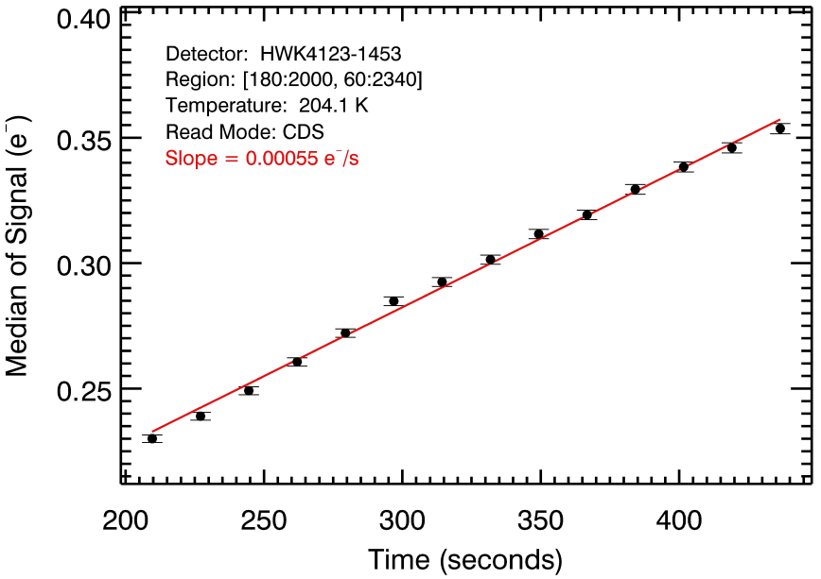
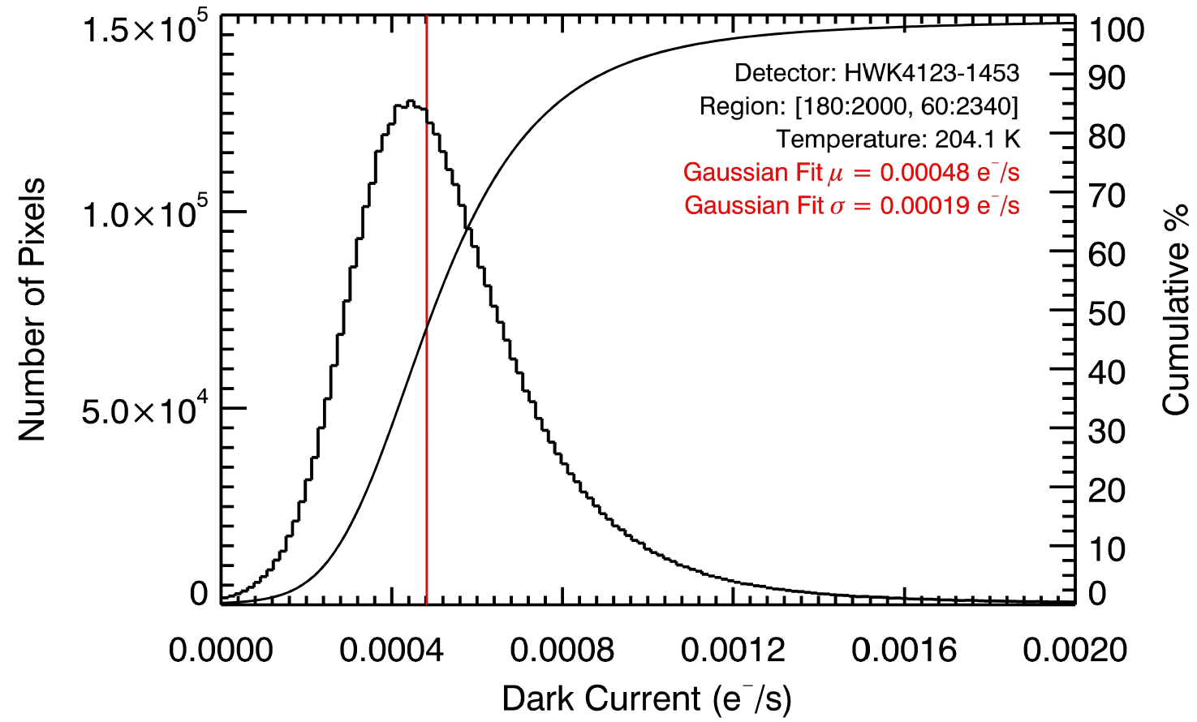
5.2 Dark Current
DC is the rate at which charge accumulates in a detector in the absence of light.
Significant sources of DC include thermally-activated electron-hole pair generation and recombination, electron diffusion into the charge collection region, and generation at Si-SiO₂ interface states.
We measure DC by integrating the charge in the pixel in a dark environment and increase the integration time, at different temperatures.
The lowest DC measurement we have is 0.00041 e⁻/s/px at 184.5 K.

Slide 9
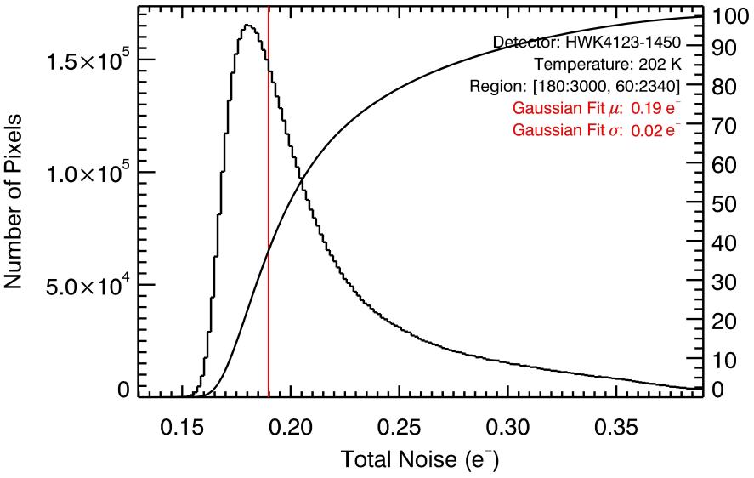
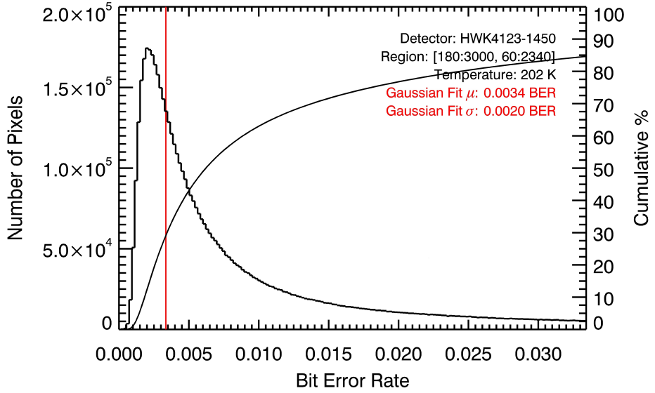
5.3 Read Noise and Bit Error Rate
Read noise (RN) is the uncertainty in a pixel’s measured signal.
Stochastic processes during readout contribute to RN, including thermal Johnson-Nyquist noise, reset kTC noise, 1/f flicker noise, column amplifier noise, and analog-to-digital converter (ADC) quantization.
We measure read noise by taking the standard deviation of the signal in dark frames at short exposure times, for which read noise dominates.
The lowest read noise we measure is 0.19 e⁻.
RN introduces a random fluctuation into the analog signal before digitization, which may alter the reported digital value.
The bit error rate (BER) is the probability that a pixel reports an incorrect digital value during photon-counting operation.
We use RN to calculate BER.

Slide 10
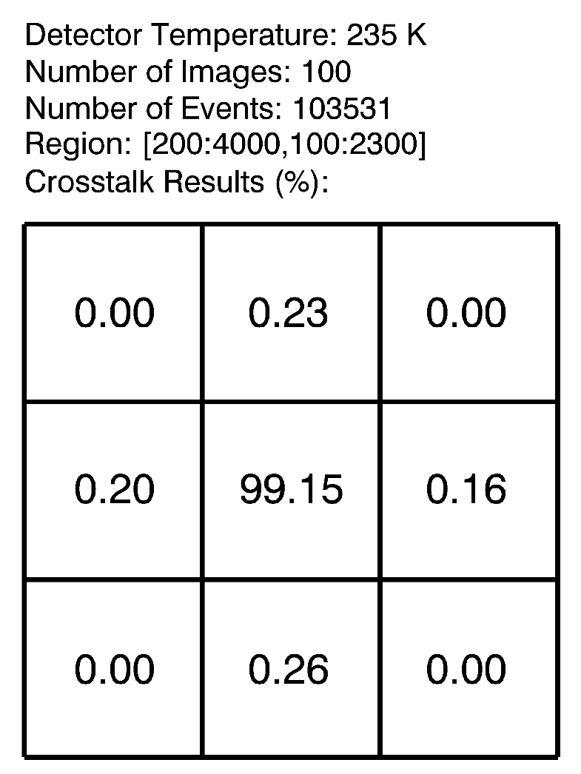
5.4 Crosstalk
Crosstalk is the phenomenon where signal in one pixel is correlated with the signal in a nearby pixel.
Sources of crosstalk include interpixel capacitance, charge diffusion, and incomplete settling.
We measure crosstalk using cosmic ray secondary particles and an ⁵⁵Fe source.
We select centrally and normally incident impacts, and compare the signal in the affected pixel and nearby pixels.

Slide 11
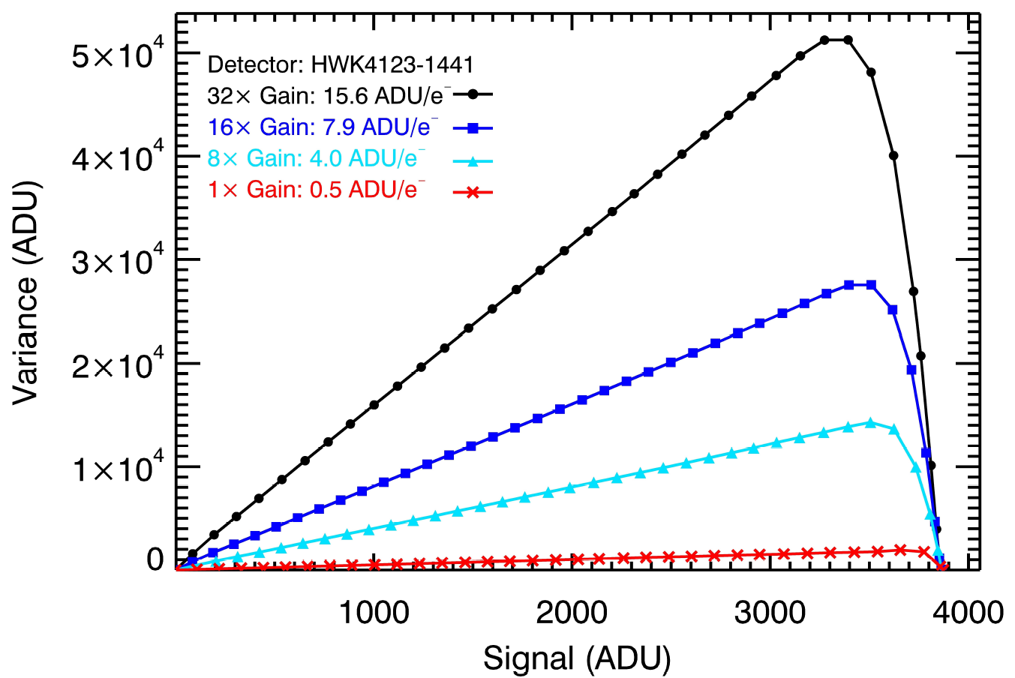
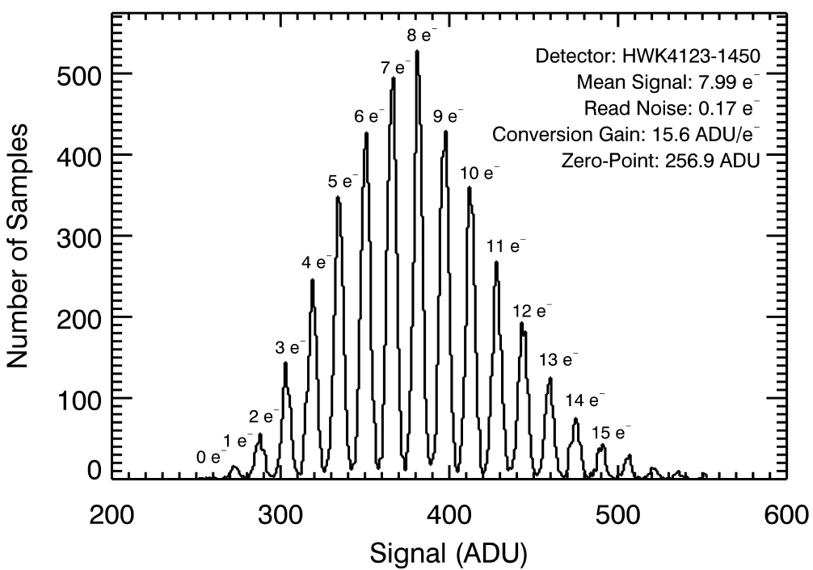
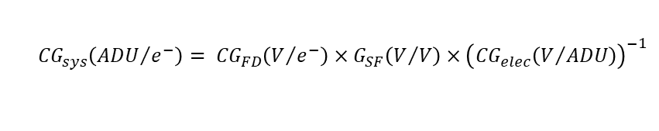
5.5 Conversion Gain
There are many “conversion gains” in a pixel. Unless stated otherwise, we mean “system conversion gain” (CG) which is ADU/e⁻ from start to finish.
We measure this using two methods: the photon transfer experiment (PTE), and the photon counting histogram (PCH).
The system conversion gain value depends on the programmable gain amplifier used.
The CG in the PTE comes from the inverse of the slope of the photon transfer curve, which is the variance of the signal as a function of signal.
The CG in the PCH comes from the spacing between resolved electron peaks.
$${CG}_{sys}\left({ADU}/{e^{−}}\right)= {CG}_{FD}\left(V/{e^{−}}\right)×{G_{SF}\left(V/V\right)×\left({CG}_{elec}\left(V/{ADU}\right)\right)}^{−1}$$

Slide 12
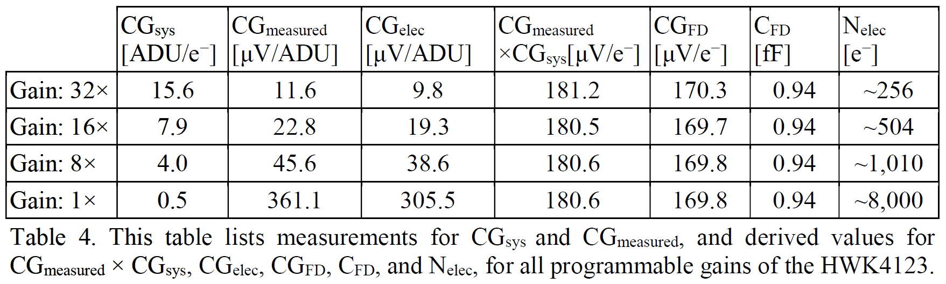
5.6 Capacitance of the Floating Diffusion
The capacitance of the floating diffusion defines the magnitude of the voltage response of the pixel to a single charge carrier.
In SPSCMOS, the voltage response to a single charge carrier exceeds the voltage due to read noise such that quantized electron packets are distinguishable.
We measure different gain stages in the pixel and readout circuitry to calculate the capacitance of the floating diffusion.

Slide 13
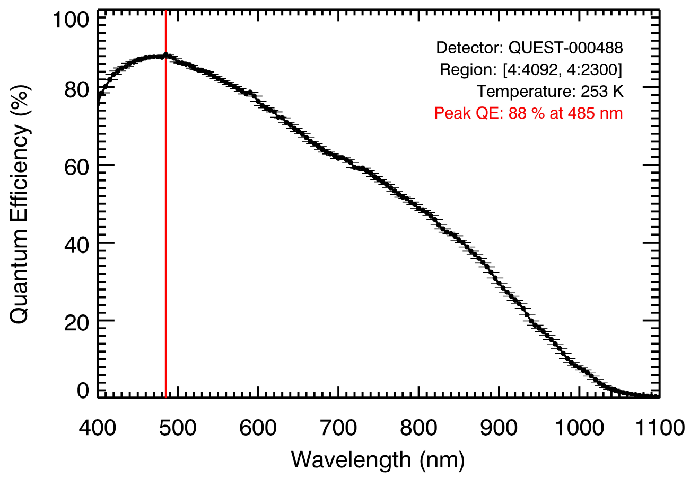
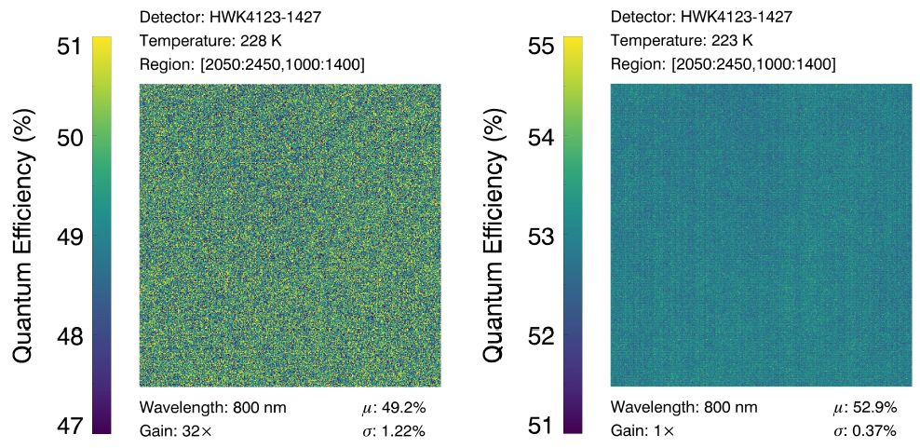
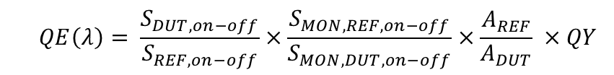
5.7 Quantum Efficiency
Quantum efficiency (QE) is the ratio of the number of electrons measured by the detector to the number of photons incident on the detector.
This definition is “total QE” where we do not distinguish between external and internal QE.
We measure QE using the diode replacement method.
The results presented here are not yet corrected for quantum yield or low-signal nonlinearity.
$$QE\left(λ\right)= \frac{S_{DUT,on−off}}{S_{REF,on−off}}×\frac{S_{MON,REF,on−off}}{S_{MON,DUT,on−off}}×\frac{A_{REF}}{A_{DUT}} ×QY$$

Slide 14
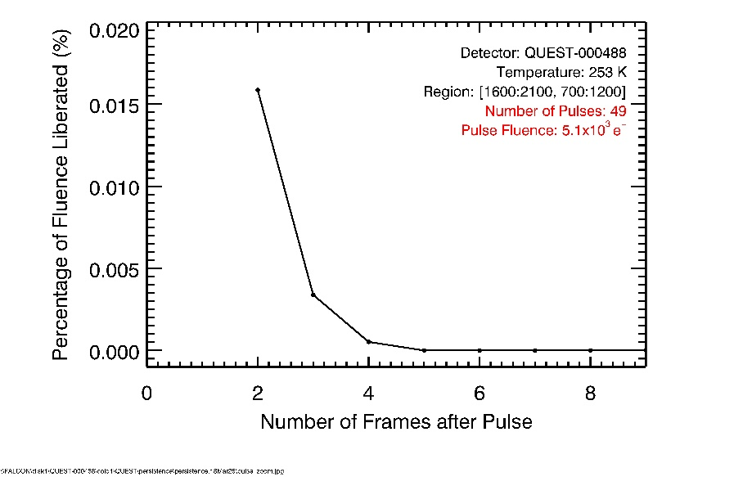
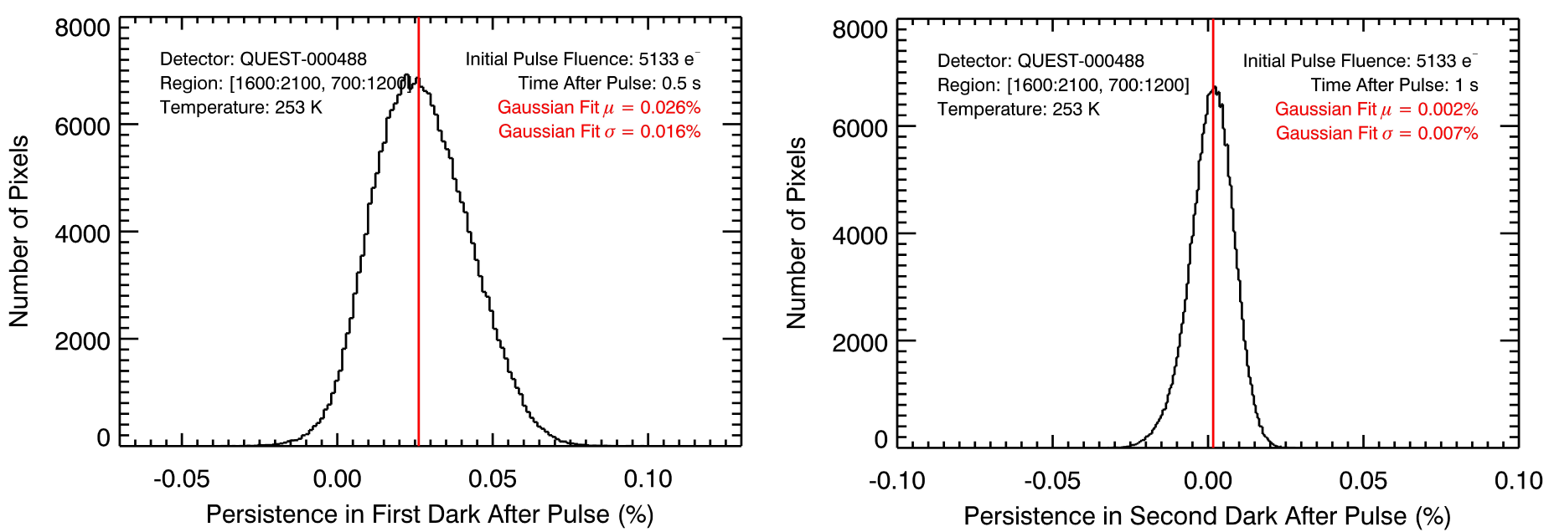
5.8 Persistence
Persistence, also called lag, is the portion of a pixel’s signal due to charge carriers produced by sources in previous images.
Persistence is caused by trapped charges. Traps can be permanent defects in the material lattice, or temporary potential wells caused by the voltages applied to the pixel during readout.
We measure persistence by exposing the detector to a pulsed laser and monitoring the signal in subsequent dark frames.
The pulse illuminates the detector, and the interval between pulses provides a dark environment. Any residual signal above the baseline dark current and read noise is attributable to persistence from the laser pulse.

Slide 15
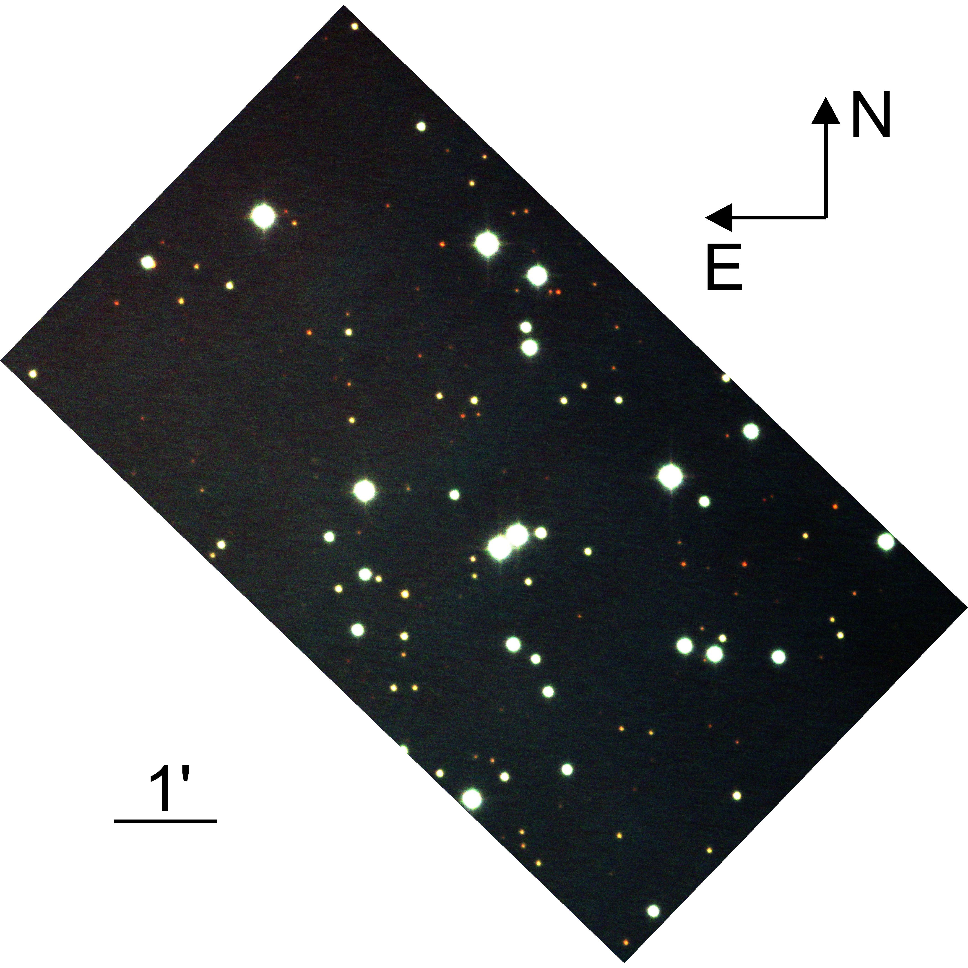
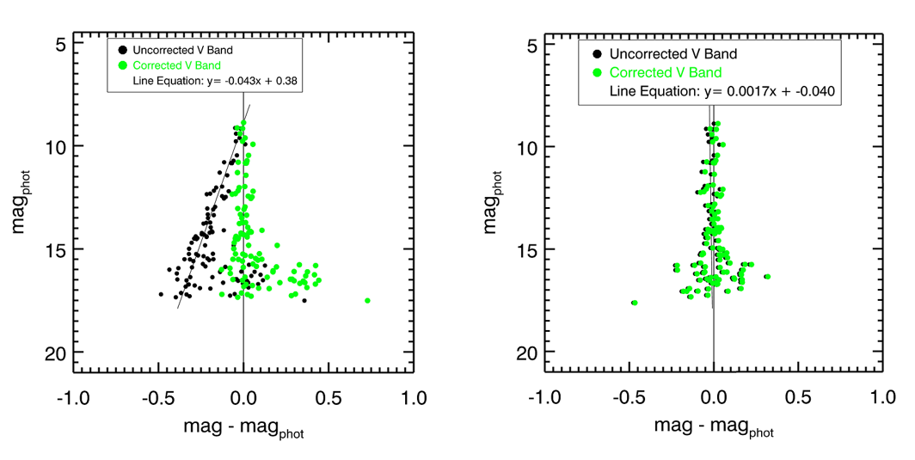
5.9 Telescope Observing Results
We have observed multiple objects at the C.E.K. Mees Observatory, such as open clusters, globular clusters, solar system objects, nebulae, galaxies, and a supernova.
Our reduction has focused on the open cluster M36 in the B, V, and R bands.
We notice nonlinearity in the data, consistent with low-signal nonlinearity in the sensor.

Slide 16
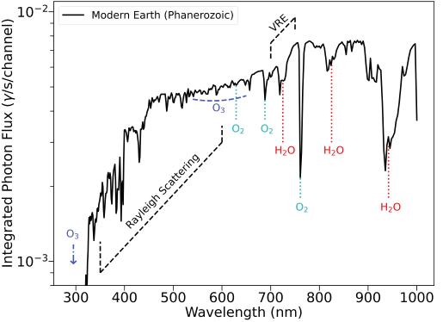
5.10 Simulation of Earthlike Exoplanet
A future goal of astrophysics is to directly image earthlike exoplanets and characterize their atmospheres.
We have simulations of Earth in the habitable zone of stars spanning all spectral types, for a system that is 10 pc away.
We use the results of those simulations for systems relevant to HWO.
Relevant systems are those for which the habitable zone of the host star is observable in the zone between the inner working and outer working angles of the coronagraph, and for stars that allow for sufficient time for life to develop.
The spectra from these simulated observations provide our SNR models with the astronomical sources of light.

Slide 17
6. Remaining Work
What Causes Low Signal Nonlinearity?
How Do We Characterize Quantum Yield?
What Causes the Dark Current Plateau?
What is the Impact of a Rounding Step on SNR?
What improvements can we make to SPSCMOS?
Schedule

Slide 18
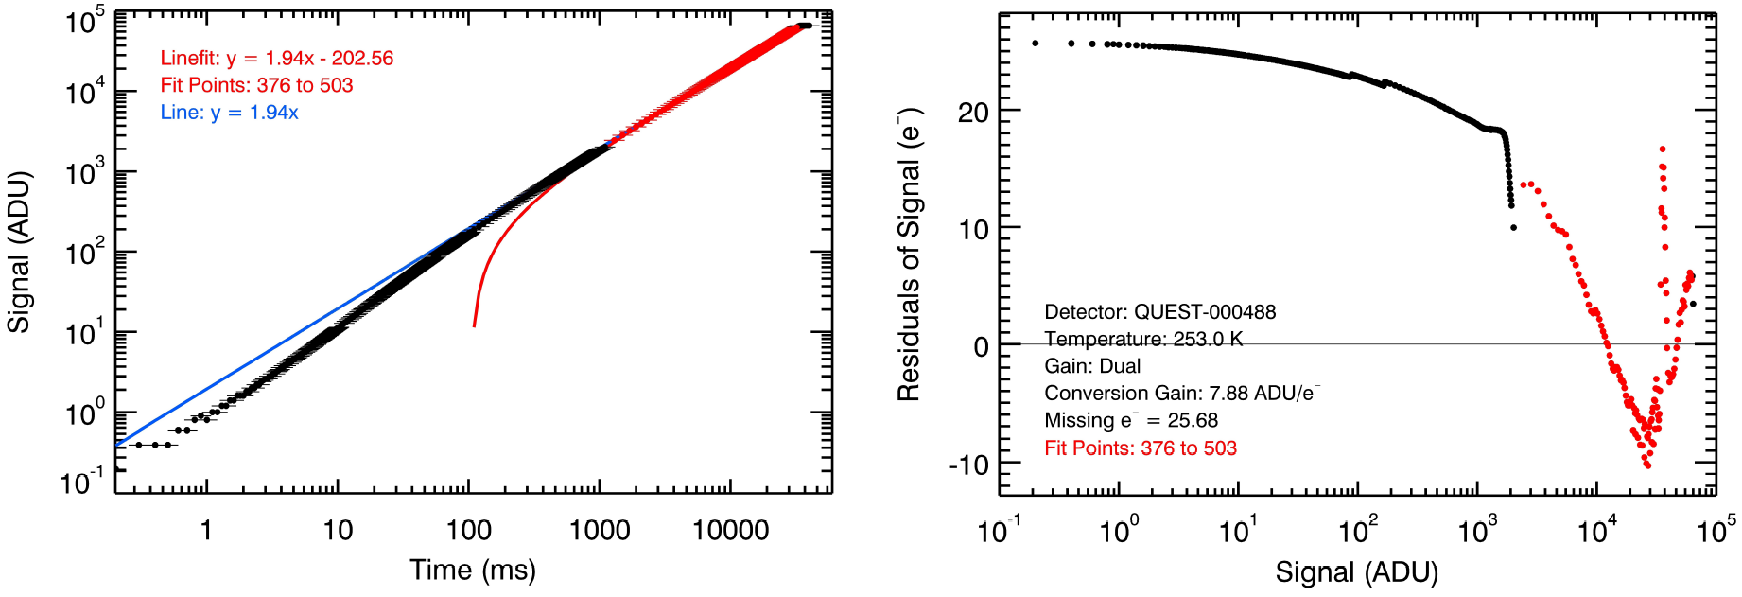
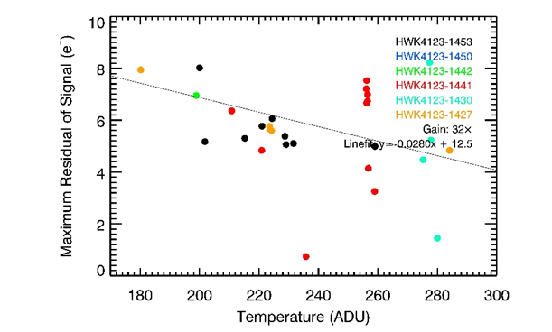
6.1 What Causes Low-Signal Nonlinearity?
We have measured low-signal nonlinearity (LSNL), where the reported signal is too low.
Potential causes of LSNL are lattice defect traps, potential well traps during charge collection, or other processes after the programmable gain stage.
LSNL due to lattice defect traps should depend on temperature.
LSNL due to potential well traps should depend on voltages and clocking of the transfer gate.
Other processes beyond the programmable gain stage would show LSNL dependence on the programmable gain used.

Slide 19
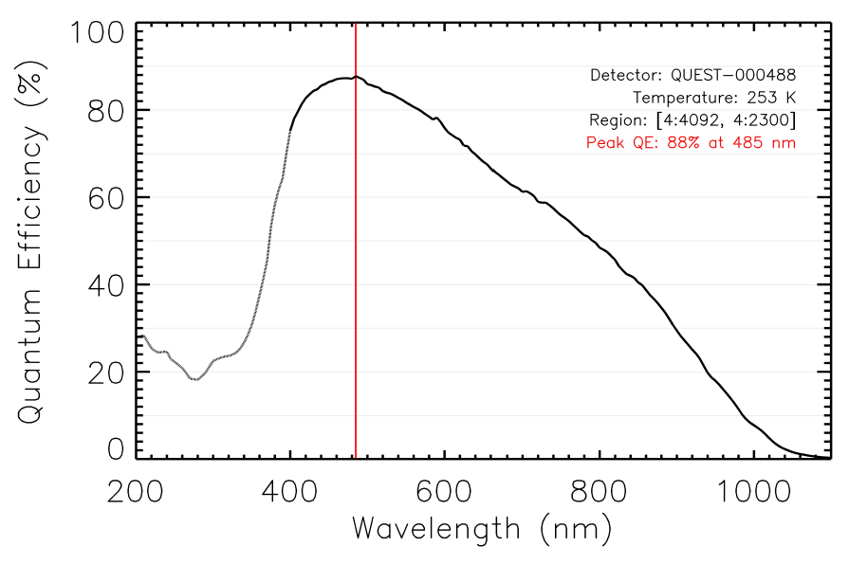
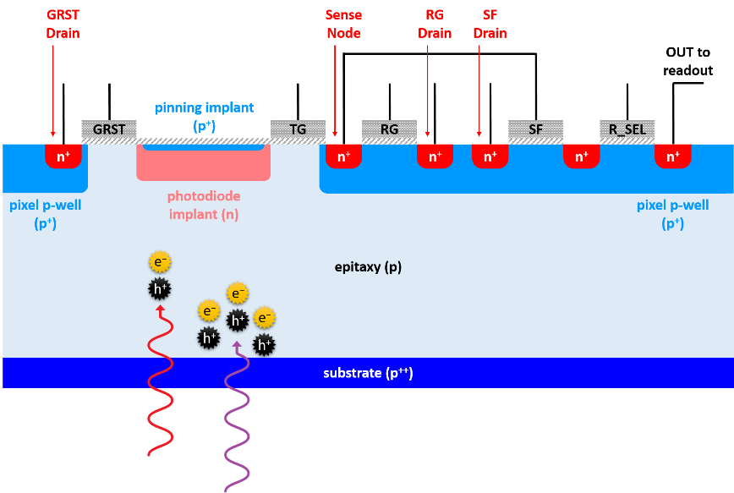
6.2 How Do We Characterize Quantum Yield ?
Quantum yield (QY) is the number of electrons generated per absorbed photon.
For 400 – 1000 nm, we assume quantum yield is 1.
For wavelengths shorter than 400 nm, QY is greater than 1.
We need to measure and correct for QY at shorter wavelengths.
One method suggests measuring the CG at different wavelengths using the PTE, then taking a ratio of the CG to calculate QY.
Risk: the thermal light source generates low flux levels below 400 nm, and measurements may be in the LSNL regime.
Mitigation: expose the detector to integration times long enough to avoid the LSNL regime when characterizing below 400 nm.

Slide 20
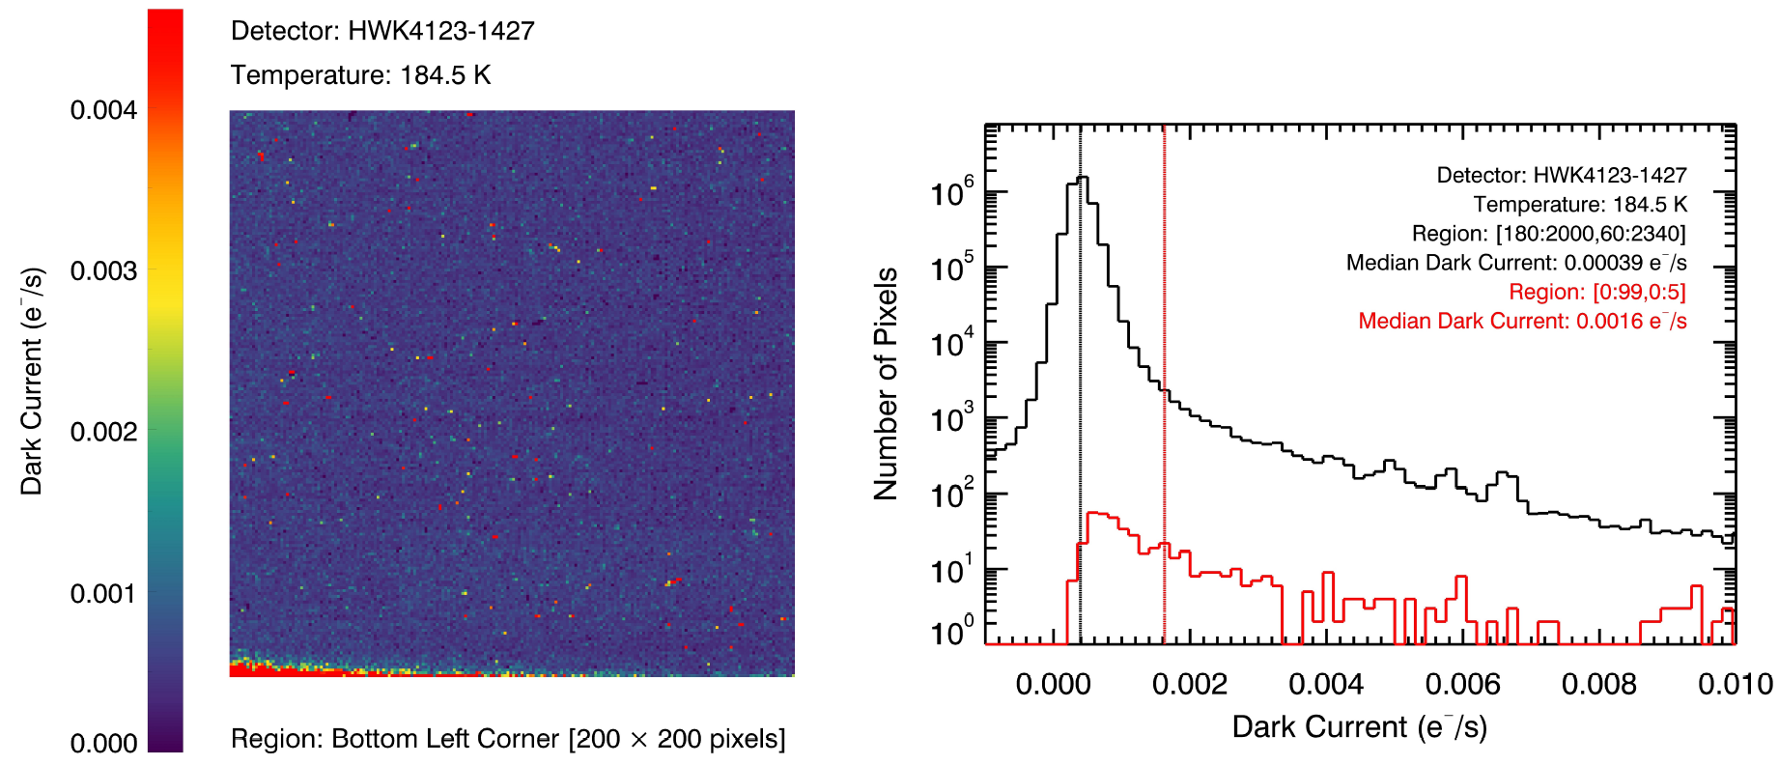
6.3 What Causes the Dark Current Plateau?
Silicon devices encounter a dark current plateau at lower temperatures.
If there is a nonthermal component, is it from the detector or the system?
Glow may contribute to the nonthermal component (multiplexer glow has been found, do we have unit cell glow?)
Risk: we may be unable to provide a system in which the background light level is below the measured dark current.
Mitigation: physically shield the detector surface from light using optically black coating or other mechanism.

Slide 21
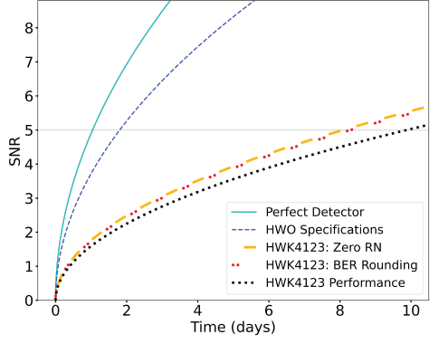
6.4 What is the Impact of a Rounding Step on SNR?
SPSCMOS resolve electron numbers, as show by the PCH.
We can assign floating point electrons values to their corresponding integer number with a rate of failure equal to the BER.
The uncertainty associated with reporting the final value changes from analog read noise to the variance of a Bernoulli trial.
We then simulate an observation using a single pixel and a flux of one photon per hour, which is a photon arrival rate consistent with expected HWO exoplanet observations.
We simulate the observation for different detector performance values and data processing techniques.

Slide 22
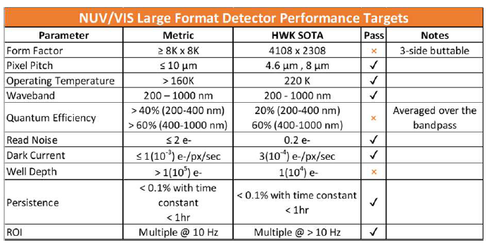
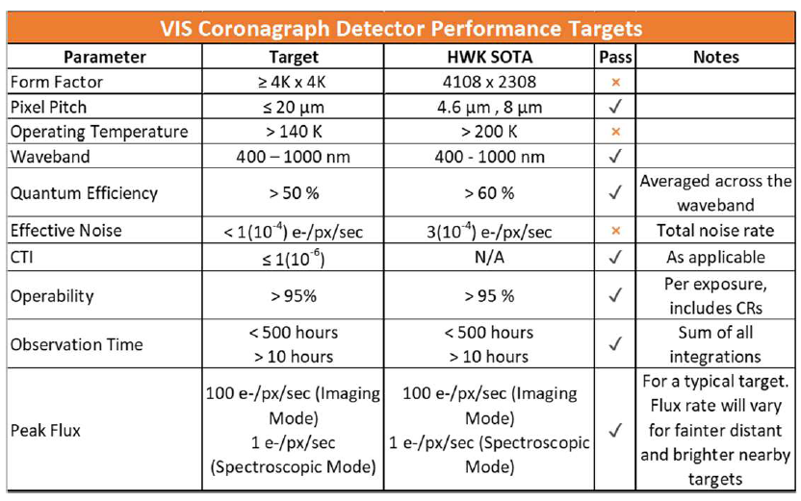
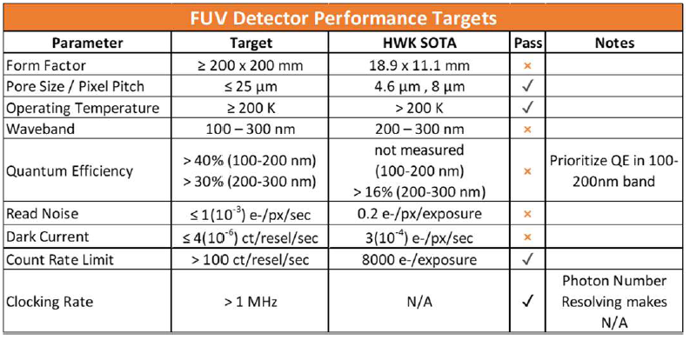
6.5 What improvements can we make to SPSCMOS?
SPSCMOS detectors need higher QE at NUV wavelengths. This can be achieved with different backside processing methods.
SPSCMOS detectors need lower RN. This can be achieved by implementing pixel circuitry that accommodates CMS instead of CDS.
SPSCMOS detectors need lower DC, which may be achieved with smaller pixels, and after a better understanding of the DC plateau.

Slide 23
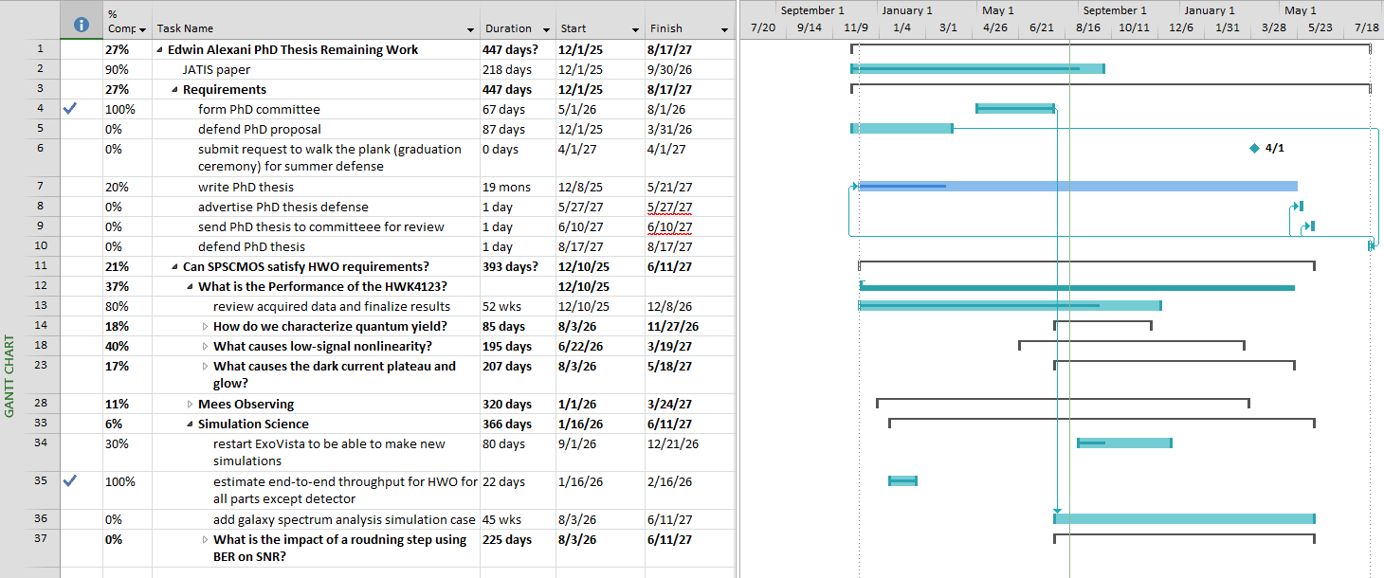
6.6 Schedule

Slide 24


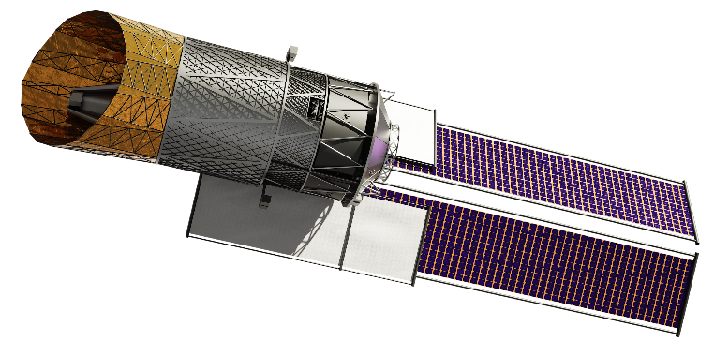




Slide 25
3
2
4
1
5

