Slide 1
Simulation of a Single Photon Counting Photonic Spectrograph for Direct Imaging of Exoplanet Atmospheres with the Habitable Worlds Observatory
Edwin Alexani - Don Figer
RIT – Friday, July 19th, 2024
Notes:
Hello everyone!
Thank you Don for the warm introduction.
I’m excited to share with you the Simulation of a Single Photon Counting Photonic Spectrograph for Direct Imaging of Exoplanet Atmospheres with the Habitable Worlds Observatory.
In short, I am trying to make a new instrument.
Let’s take a look at the structure of this talk.

Slide 2
Overview
Introduction
Detection Methods
The Habitable Worlds Observatory and Direct Imaging
Astrophotonic Spectrographs
Single Photon Counting Detectors
Single Photon Counting Photonic Spectrograph
Astronomical Sources
Signal-to-Noise Ratio
Simulations
Results
Requirements Flow Down
Discussion
Conclusion
Notes:
There are four main sections, represented by the colored star shades.
First, I will give you the background and motivation for my research.
Then, I will introduce the technology that used in this study.
Next, I will explain the simulated observations.
Finally, I connect the observations to design considerations for the proposed instrument and address areas of improvement.

Slide 3
Introduction
Notes:
Let’s get started.

Slide 4
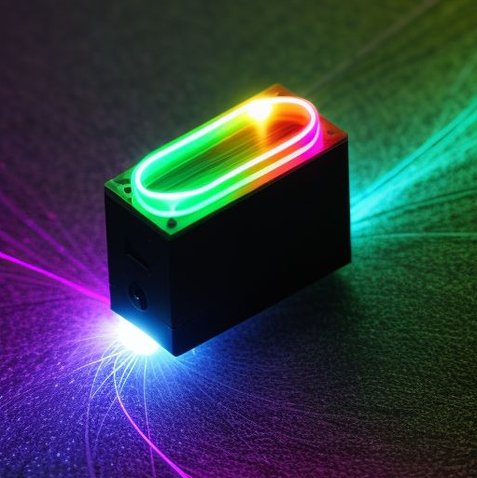
Introduction
Direct imaging requires suppression of starlight. One way to do this using a coronagraph and/or starshade. Direct imaging also requires sensitive detectors. Spectrographs are needed for spectra.
We propose to combine CMOS single photon counting detectors (SPCD) with astrophotonic spectrographs (APS). We aim to provide a compact and sensitive instrument for space applications.
NASA plans to launch New Great Observatories, and prioritizes the Habitable Worlds Observatory (HWO).
One of the main objectives of HWO is to directly image terrestrial exoplanets and obtain their spectra.
Notes:
NASA wants to update its great observatories by launching new ones.
The Habitable Worlds Observatory is prioritized. It will operate in the infrared, optical, and ultraviolet.
HWO will directly image exoplanets, which is difficult.
You need to get rid of the starlight, you need very good detectors, and you need a spectrograph look for biosignatures in the planet spectrum.
Now my plan is to use a CMOS Single Photon Counting Detector, which can sense individual photons, and combine it with a compact, on-chip astrophotonic spectrograph.
This instrument could be used for very low light applications, and would be compact which is good for keeping space observatories smaller and the mission cheaper.

Slide 5
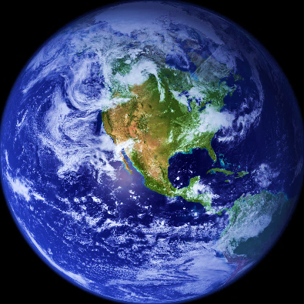
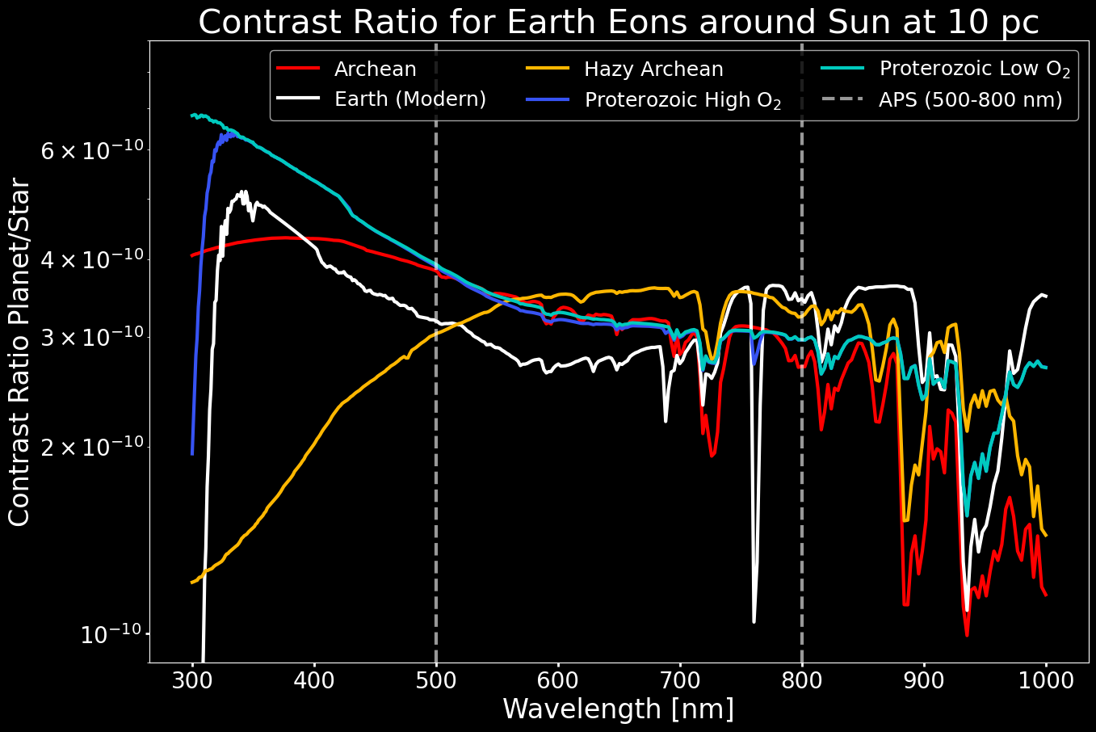
Introduction
Photosynthesis is responsible for modern oxygen levels.
The O₂-A band biosignature at 760nm indicates the presence of oxygen in the Earth’s atmosphere. This project focuses on its detectability.
O₂-A Band
Notes:
As I mentioned, we need to look for biosignatures to assess the habitability of a planet. We have a great example, the Earth.
The y-axis of the plot shows the contrast ratio for earth and the sun. You divide the light from the earth by that of the sun. The x-axis shows the wavelength.
I chose the O2-A band in the Earth’s spectrum as the target biosignature. It is shown in the pink box. Current oxygen levels are maintained by photosynthesis, which is a biological process, so the O2-A band indicates that modern Earth has life. Not all planets with life will show this feature, in fact, if you look at the other curves which show the earth’s historical atmospheres, you don’t see O2-A.

Slide 6
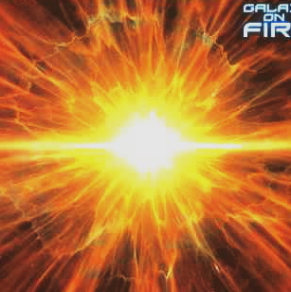
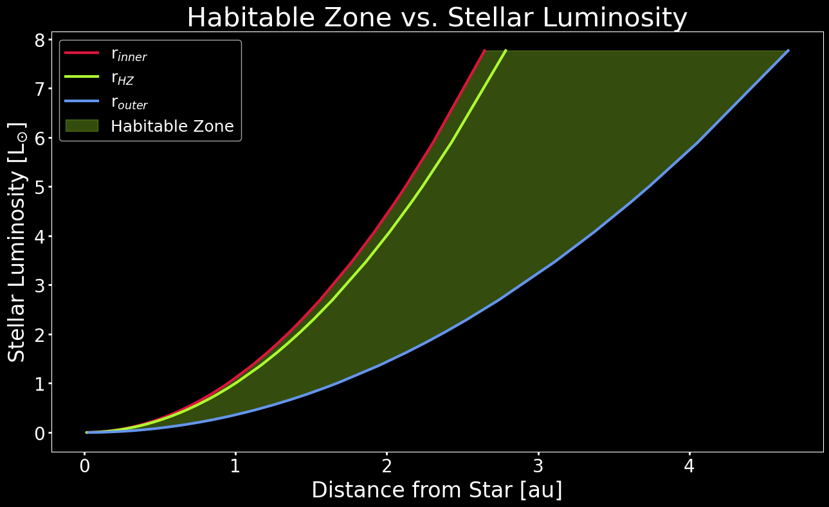
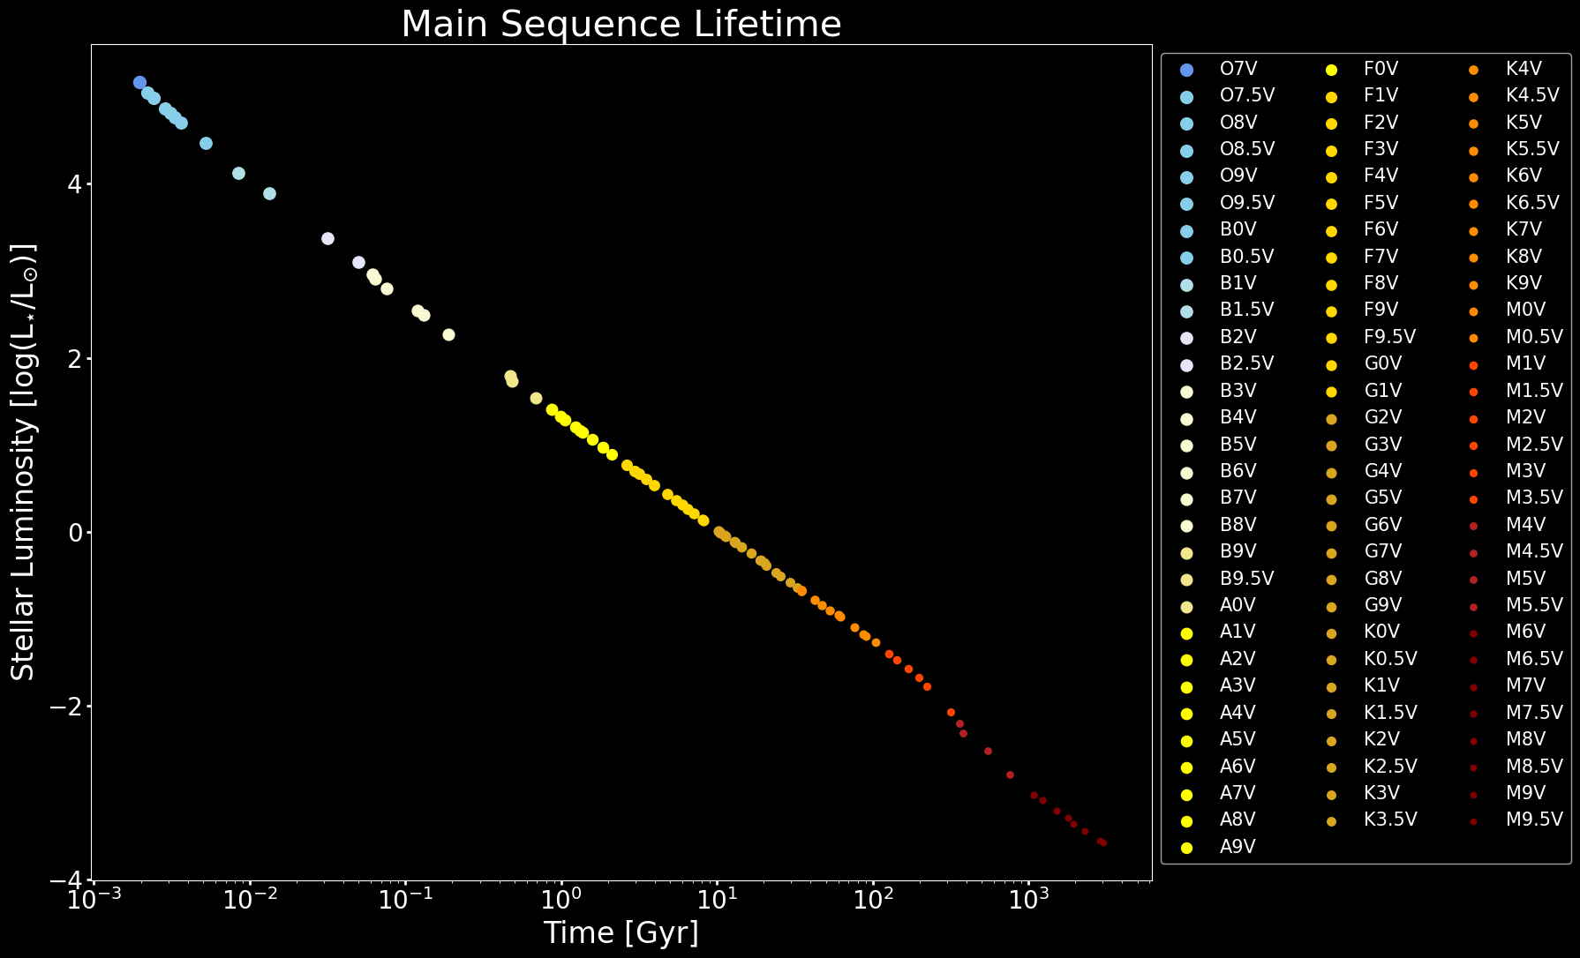
Introduction
The host star’s mass and luminosity affect the habitable zone, the system’s main sequence lifetime, and the detectability of the habitable zone due to instrumental limitations by the coronagraph.
Notes:
Another consideration is the host star’s spectral type. The mass and luminosity of the star determine the location of the habitable zone which affects detectability. The plot here shows the stellar luminosity on the y axis. The x-axis shows the habitable zone in AU. The brighter a star is, the farther and larger the habitable zone gets. The spectral class also affects the system lifetime and thus the opportunity for life to form. This plot shows the star’s luminosity against its main sequence lifetime. For this study, we restrict the stars from F0V which last 2 billion years, to K5V for observational constraints.

Slide 7
Detection Methods
Notes:
Now, if we know about exoplanets, that means we have found some. Let’s see how!

Slide 8
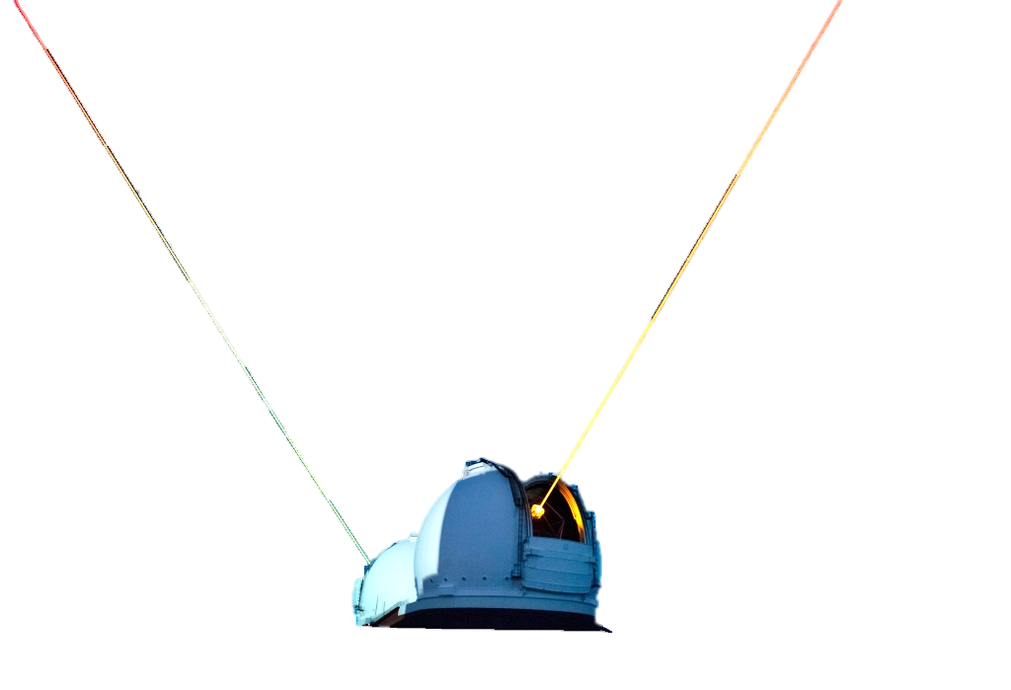
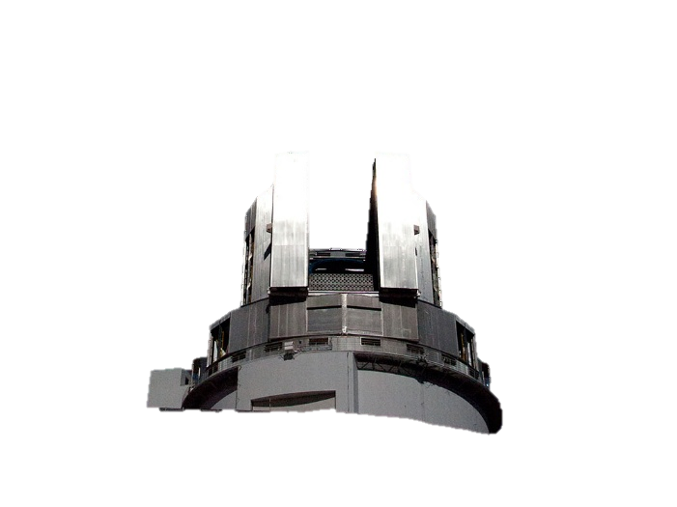
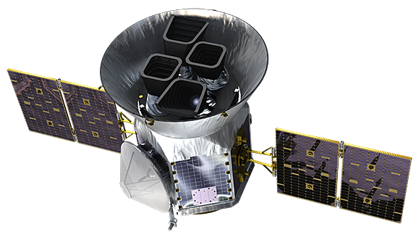
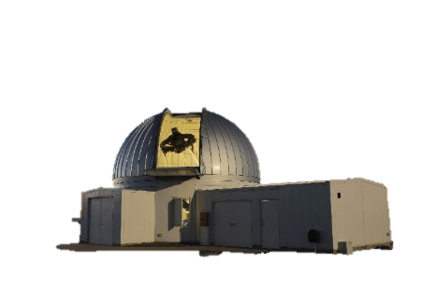
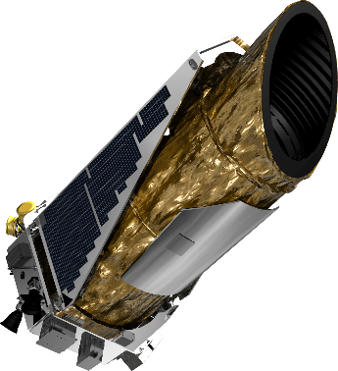
Detection Methods
Subaru
Keck
TESS
Kepler
KMTNet
Notes:
74% of exoplanets have been found by transit, and another 19% by radial velocity.
That leaves 7% to other methods.
Remember that I said HWO wanted to do direct imaging?
That’s only 2% of what we have found so far.
So why do we want to do direct imaging? Let’s look at the top 2 methods first.

Slide 9
Detection Methods: Transit
Flux
Time
Notes:
The transit method looks for planets that pass in front of their star, causing a dip in the flux of the star, which we measure.

Slide 10
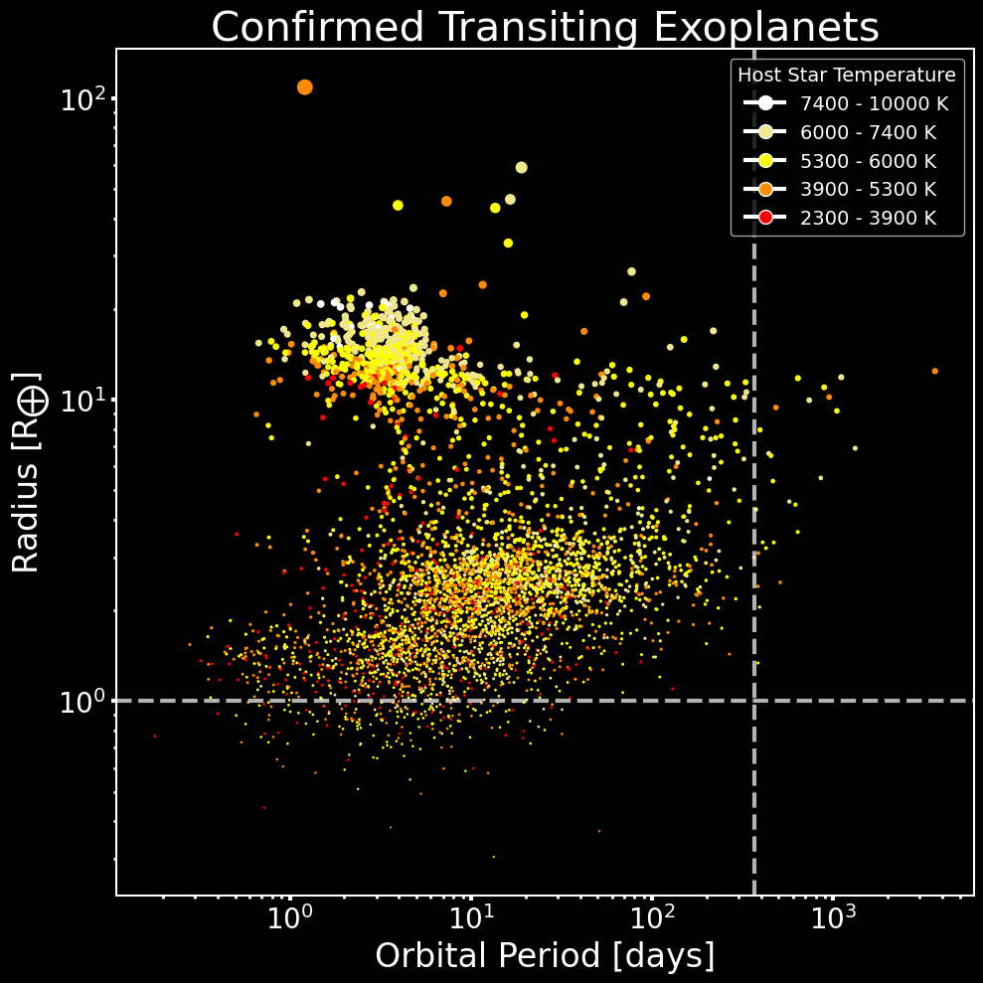
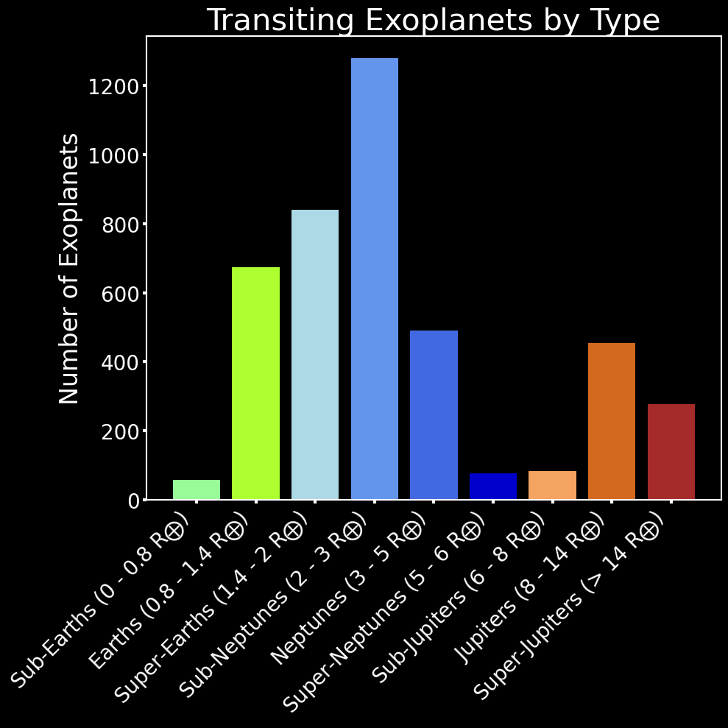
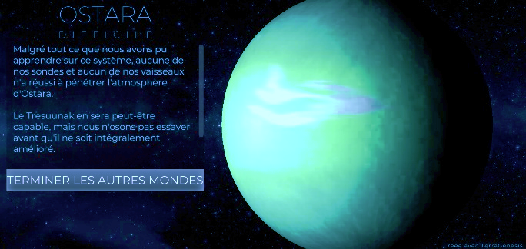
Detection Methods: Transit
The transit method finds planets passing in front of stars, causing it to appear dimmer. This method has mostly found warm sub-Neptunes and super-Earths.
Notes:
This method works best with planets that have smaller orbits, and are sub-Neptune sized.
This plot shows the confirmed transiting planets, by radius and orbital distance. The color indicates the host star’s surface temperature. The crosshairs indicate where Earth is. There is nothing there. We can see some hot Jupiters clustering in the top left.
The circle here shows the majority of planets found by transit, which are classified in the histogram.
Now yes, there is the famous TRAPPIST-1 system, but that is sadly part of the exception of this method.

Slide 11
Detection Methods: Radial Velocity
Barycenter
Barycenter
Flux
Flux
Wavelength
Wavelength
Notes:
Next we have the radial velocity method.
As a planet tugs on its star, the star moves, and we can see a Doppler shift in starlight.
When the star comes toward us, we see a blue shift.
When the star moves away from us, we see a red shift.

Slide 12
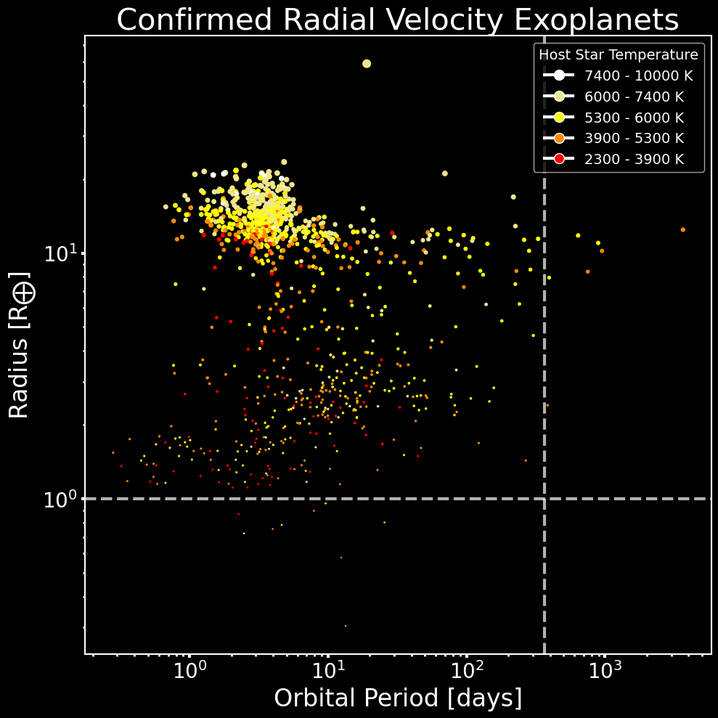
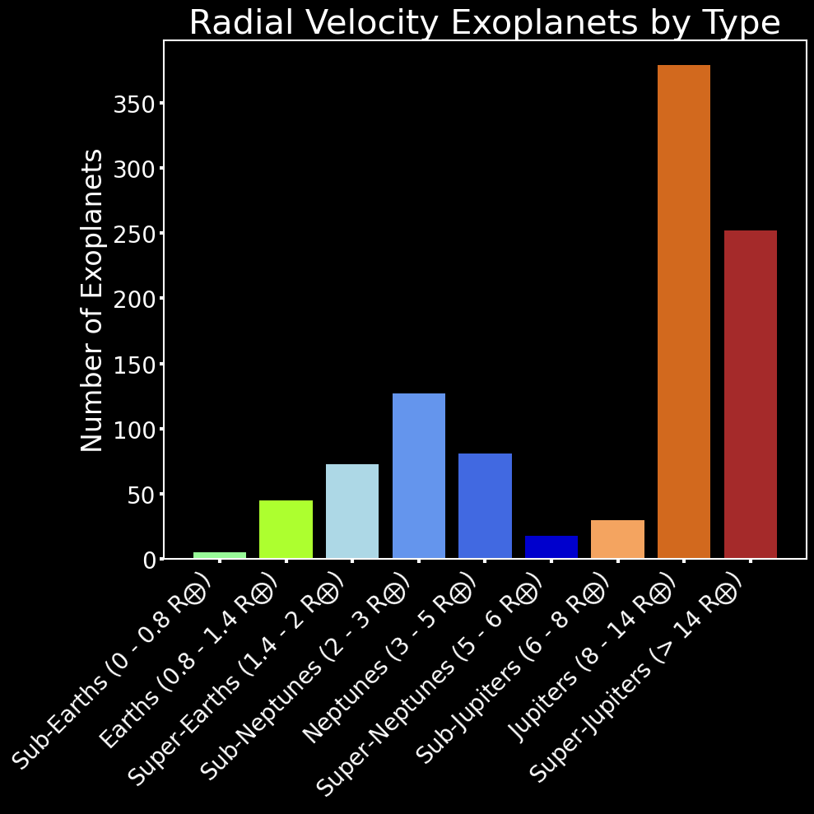
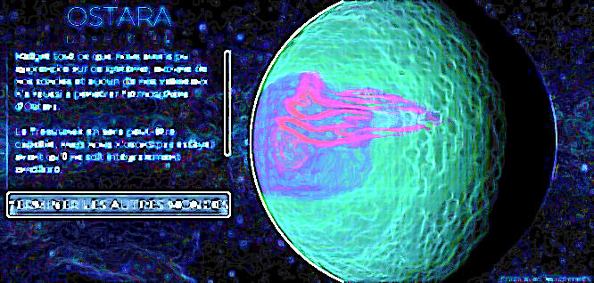
Detection Methods: Radial Velocity
The radial velocity method identifies Doppler shifts the stellar spectrum caused by an orbiting planet. This method mainly returns Hot Jupiters.
Notes:
This method works best with Hot Jupiters.
They are massive and close to the star, producing dramatic Doppler shifts.
Here is the same plot as the last one, but for radial velocity planets. We see the Hot Jupiters circled in the top left are the majority, as shown by the histogram.
And again, there is nothing in the parameter space for earth. Many of the earth-sized planets are too close to their star.

Slide 13
Detection Methods: Direct Imaging via Coronagraph
Starlight
Mirror (deformable)
Planet light
Inner Working Angle (IWA)
Coronagraphic Mask
Lens
Lyot Stop
Outer Working Angle (OWA)
Mirror
Notes:
So how can direct imaging help?
Unlike the other methods, this method does need a specific configuration to take advantage of.
Instead, it manipulates the light. The light from the planet and star reach a deformable mirror. This is just like in adaptive optics, to try and fix the wave front.
Next, the light reaches a coronagraph. The job of the coronagraph is to block the light of the star.
It does this, and reveals the much fainter planets around it. The central blocked portion limit the inner working angle. What if the habitable zone in is the IWA?
The next step is to get rid of the flaring of the light from the coronagraph. We use a Lyot stop. Both of these are what set the outer working angle, again, think about habitable zone implications for this.
Now at the white dashed lines is where you can put an instrument, that is where I would come in.
Currently, most direct imaging has been done from the ground with extreme adaptive optics.
It has been successful with big bright planets only, partly because the coronagraphs have not yet reached what HWO needs.

Slide 14
The and Direct Imaging
Notes:
So let’s talk about it, what does HWO want?

Slide 15
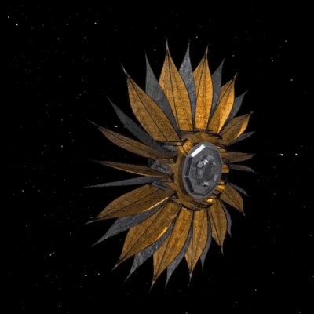
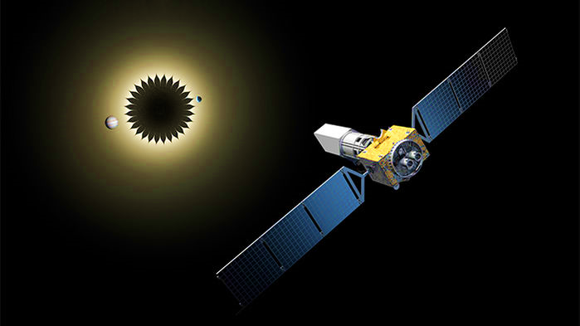
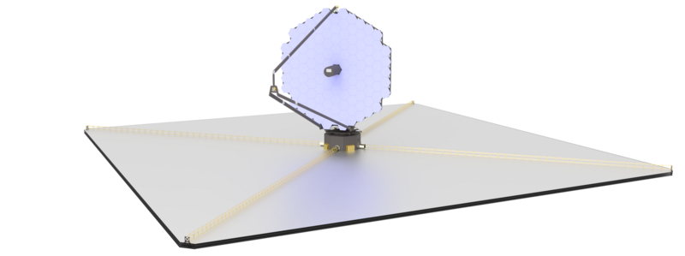
The and Direct Imaging
LUVOIR-A [15m]
HabEx [4m]
Starshade [52m]
The Habitable Worlds Observatory (HWO) will be in space. It will have a coronagraph with 10⁻¹⁰ contrast. HWO draws from past designs like LUVOIR and HabEx.
LUVOIR-B [8m]
Notes:
HWO will be in space and have a coronagraph with a 10-10 contrast ratio.
There is no full design yet for HWO. However, there are past concepts like LUVOIR and HabEx that will inspire HWO.
LUVOIR has 2 designs, a 15m and 8m telescope. The detector on them would operate at 170K.
Next, we have HabEx, a 4m telescope with a 52m starshade. The detector would operate at 70 or 153K.
These telescopes would all be warm otherwise, at 270K.

Slide 16
The and Direct Imaging
Diameter: 8m
Throughput*: 20%
Inner Working Angle (IWA) = 3.5 λ/D
Outer Working Angle (OWA) = 64 λ/D
Contrast Ratio: 10⁻¹⁰
LUVOIR-B is the telescope used in this study. Its architecture and deployment method have JWST heritage.
Dark Current: 3×10⁻⁵ e⁻/pix/s
Read Noise: 0 e⁻
Detector Temperature: 170 K
Instrument: ECLIPS-B
Telescope Temperature: 270 K
Notes:
For this project, I am pretending that LUVOIR-B is HWO. Here are all the specifications for it.

Slide 17
Astrophotonic Spectrographs
Notes:
Alright, technology time. Since you are still fresh, I will introduce the lesser known technology first.

Slide 18
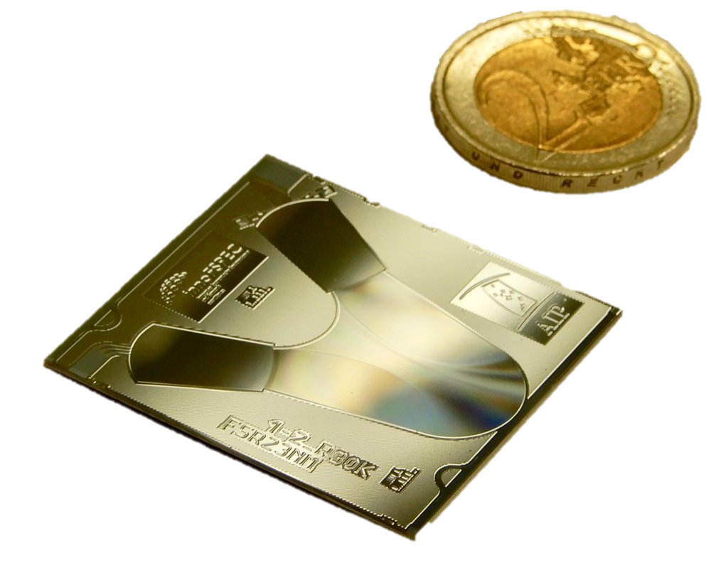
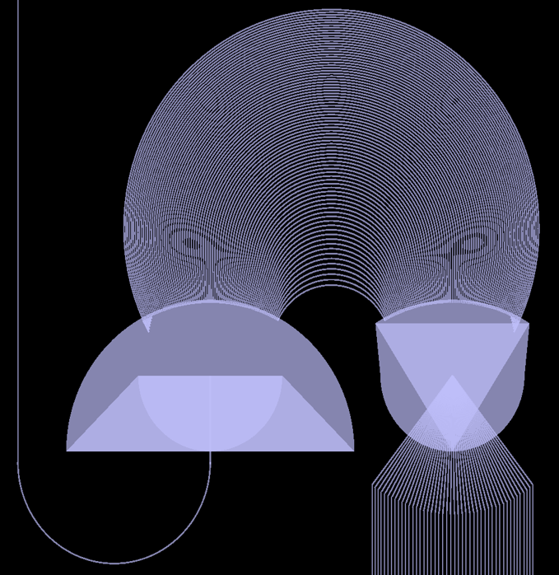
Astrophotonic Spectrographs (APS)
AWG
Single Mode Input Fiber
Arrayed Waveguide Grating (AWG)
APS use AWG to create a discretized spectrum. The waveguides in the AWG have a length difference of mλ.
This light constructively interferes along the Rowland circle and give the discrete spectrum.
Rowland Circle
Free Propagation Region (FPR)
FPR
Output Waveguides
Output Spectrum
Source: Pradip Gatkine
Notes:
Astrophotonic spectrographs originate from the telecom field, with optical fibers. Here is how it works.
Light comes in from the fiber into the free propagation region. There, it reaches the arrayed waveguide grating. Each waveguide is m lambda longer than the previous one. This allows constructive interference at the Rowland circle to get a discretized spectrum.
So here is the Rowland circle, the AWG feeds the same light to this region. Then, you can see the blue light will land at a specific place, which is where you would put the output waveguide. The same is done for the other channels.
The APS is very compact, you can see it next to a 2 euro coin, which is the size of a quarter.

Slide 19
Single Photon Counting Detectors
Notes:
Next, single photon counting detectors.

Slide 20
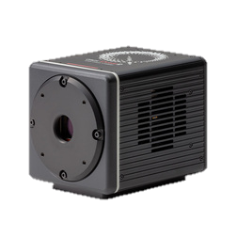
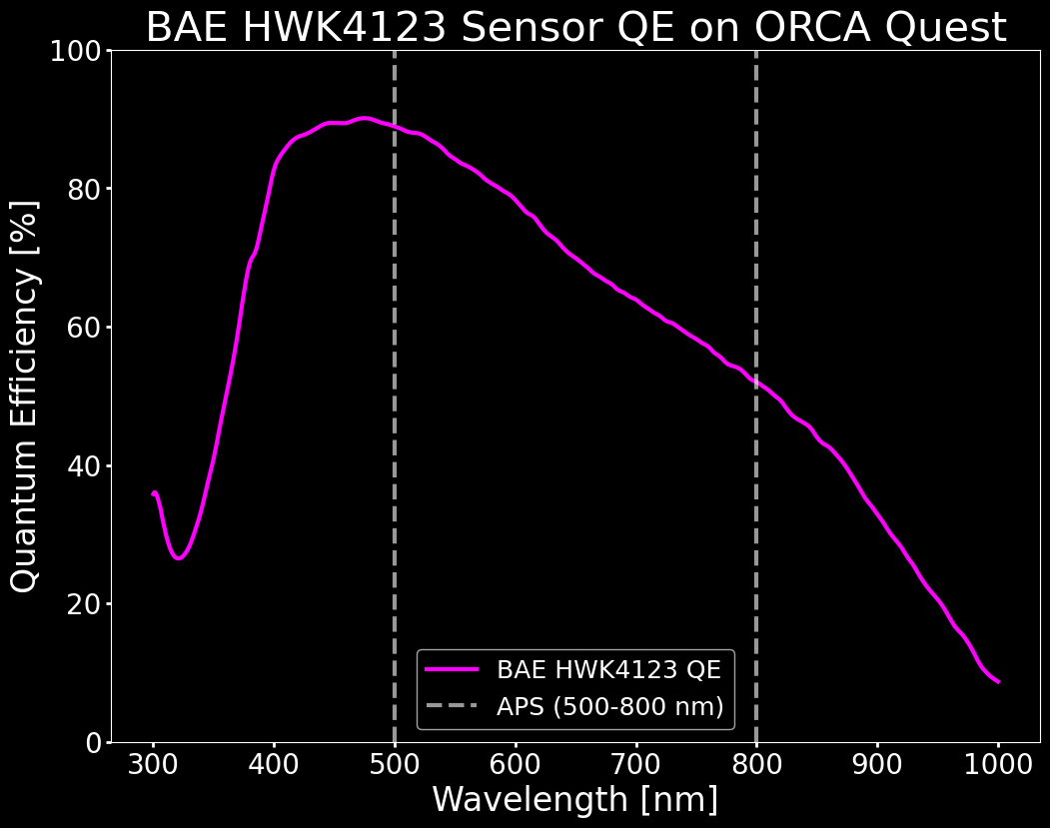
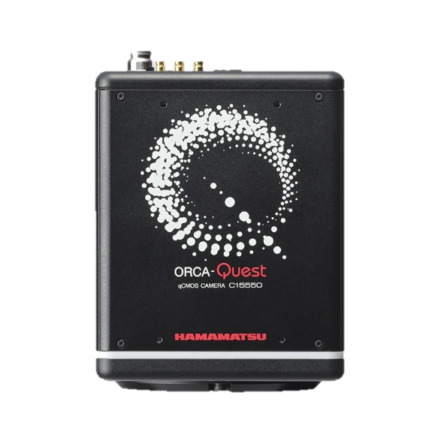
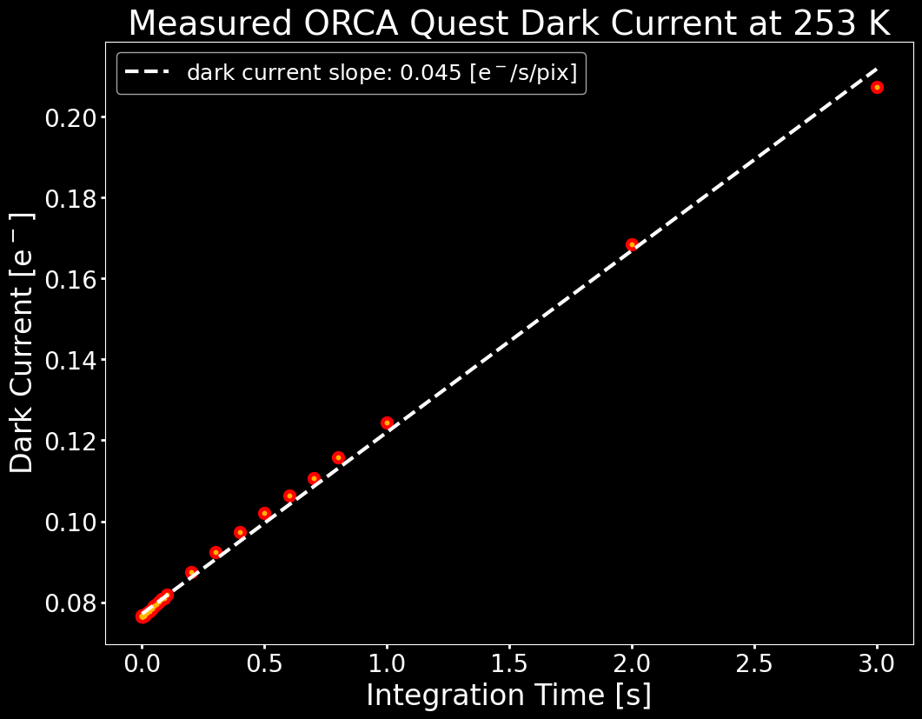
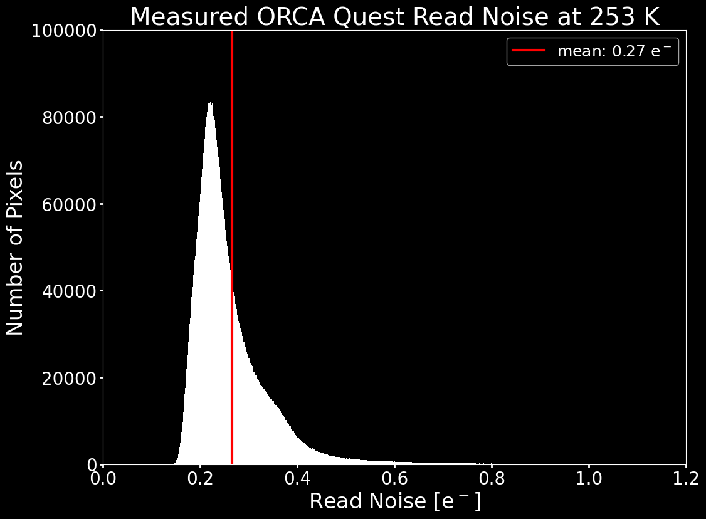
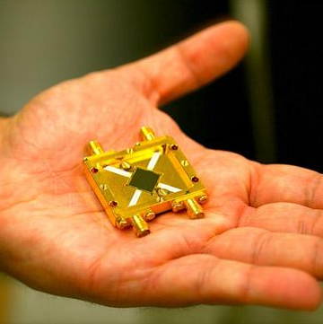
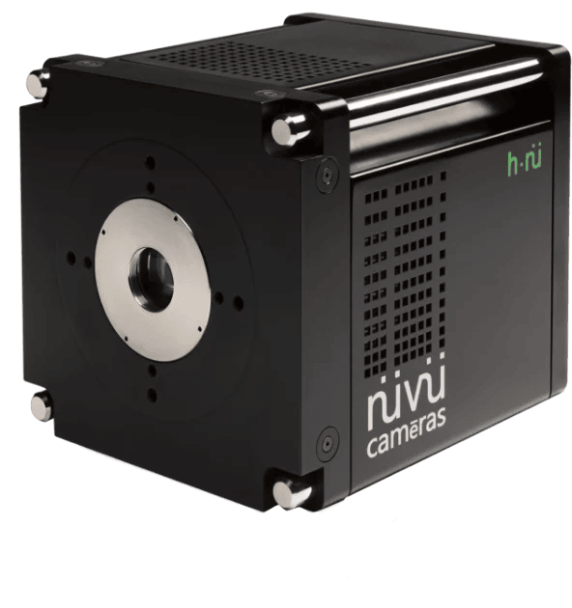
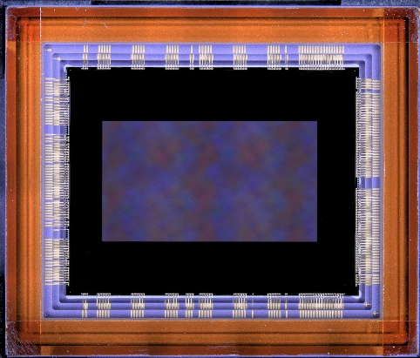
Single Photon Counting Detectors
Hamamatsu
ORCA Quest
CMOS: Complementary Metal-Oxide Semiconductor.
CMOS has faster readout, per pixel (radiation tolerant). CMOS are typically Silicon devices (Vis), found in different formats, and are part of the cellphone camera industry. CMOS sensors are used in this study.
CMOS: Complementary Metal-Oxide Semiconductor.
The quantum efficiency of the sensor will be used in SNR equations. The QE will affect all astronomical sources.
CMOS: Complementary Metal-Oxide Semiconductor.
Dark current is the thermal generation of electrons. It is evaluated as the following:
$$DC=n_{pix}⋅i_{dark} [e^{−}/s]$$
We estimated i_{dark} = 5.3x10⁻³ e⁻/s/pix at 170K.
CMOS: Complementary Metal-Oxide Semiconductor.
Read noise is the uncertainty on the voltage in a pixel. It is evaluated as the following:
$$RN=n_{pix}⋅n_{reads}⋅rn [e^{−}]$$
We used “rn” = 0.27 e⁻.
MKIDs: Microwave Kinetic Inductance Detectors.
They are radiation tolerant, sensitive from UV to NIR, but need a lot of equipment for cooling to superconductivity.
EMCCDs: Electron Multiplying Charge-Coupled Devices.
They perform similarly to CMOS detectors, with slower readout, per row. They are typically Silicon devices (Vis).
BAE HWK4123 CMOS Sensor
Notes:
First, we have MKIDS. They can resolve single photons, but the need a lot of equipment, which is the opposite of what I want.
EMCCDs perform similarly to CMOS devices, and are made with Silicon, but they have slower readout which may be a problem with cosmic rays. They also read per row, so any defective pixel or single event upset propagates.
CMOS devices are great, they can read out faster, they read out per the pixel, and we actually have some at the Center for Detectors. We have the ORCA Quest from Hamamatsu and BAE HWK sensors. And it turns out the ORCA Quest uses those same sensors.
Here is the QE for the ORCA Quest as reported by Hamamatsu. We need for the signal to noise calculations later.
Dark current is the amount of signal in a dark environment, mainly from thermal generation of electrons.
Here is the dark current that we have measured at 253K. This is not at 170K like LUVOIR needs. So I had to estimate, and got . This is no the 3*10-5 that LUVOIR needs, but let’s see how far we can get. The formula for dark current is: …..
Read noise is the uncertainty on the measurement. Here is what we have measured so far.

Slide 21
Single Photon Counting Photonic Spectrograph
Notes:
Finally, I can show you the instrument I would like to build, the single photon counting photonic spectrograph!

Slide 22
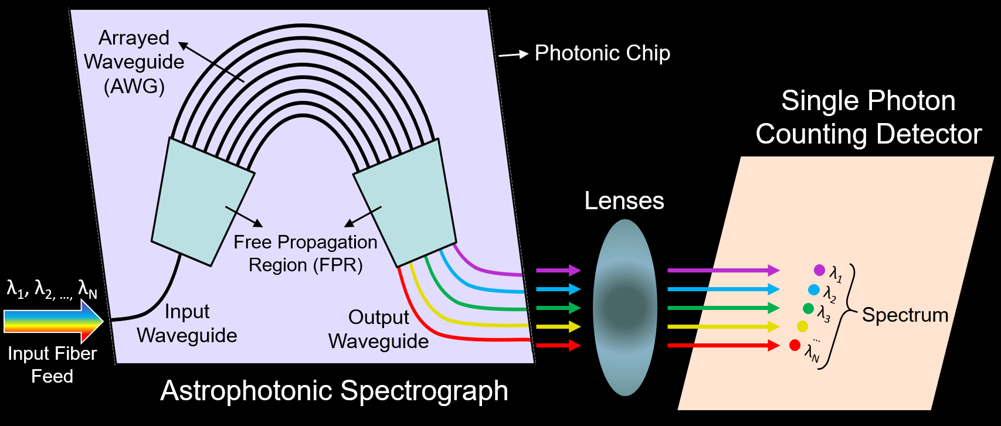
Single Photon Counting Photonic Spectrograph
Notes:
Here is the basic layout of the SPCPS. The astrophotonic chip receives the light and outputs a discrete spectrum. We then have two lenses in between to focus the light. Then, we have the CMOS detector at the end. This setup is not showing readout circuitry or equipment needed to cool down the detector.

Slide 23
Astronomical Sources
Notes:
So, now that we know what we are looking for, and how, we need to know exactly what we will be seeing.

Slide 24
Astronomical Sources
The star would be the highest source of shot noise, if not for the coronagraph (10¹⁰ suppression). Speckles can also appear due to the optics (not modelled here, may use random walk or linear process).
Exozodiacal dust reflects the starlight before the starlight is suppressed by the coronagraph. Exozodiacal dust is a significant contributor to background flux. Zodiacal dust in the solar system is similar.
The planet’s spectrum is the desired signal. It includes the planet’s light and the reflected starlight. This also introduces shot noise.
Cosmic rays limit the maximum amount of time the detector can collect light. This constrains the readout rate (not modelled).
Notes:
The planet is the science target, and is accounted for as the signal. However, all signals have shot noise, including the planet.
There are cosmic rays reaching the detector from all sides. They limit the amount of time for which the detector can collect light and still provide a good frame.
This has not been modelled. Instead, we stick to letting the pixels become half full with photoelectrons, to avoid saturation.
Next, we have the star light. It is heavily, but not entirely, suppressed by the coronagraph.
Finally, there is dust in stellar systems. This dust will reflect starlight, and this light is not suppressed by the coronagraph. The exozodiacal dust is likely the highest astronomical background source. There is also zodiacal dust in the solar system, which behaves similarly.

Slide 25
Signal-to-Noise Ratio
Notes:
As with every observation, we can determine its quality with the signal to noise ratio.

Slide 26
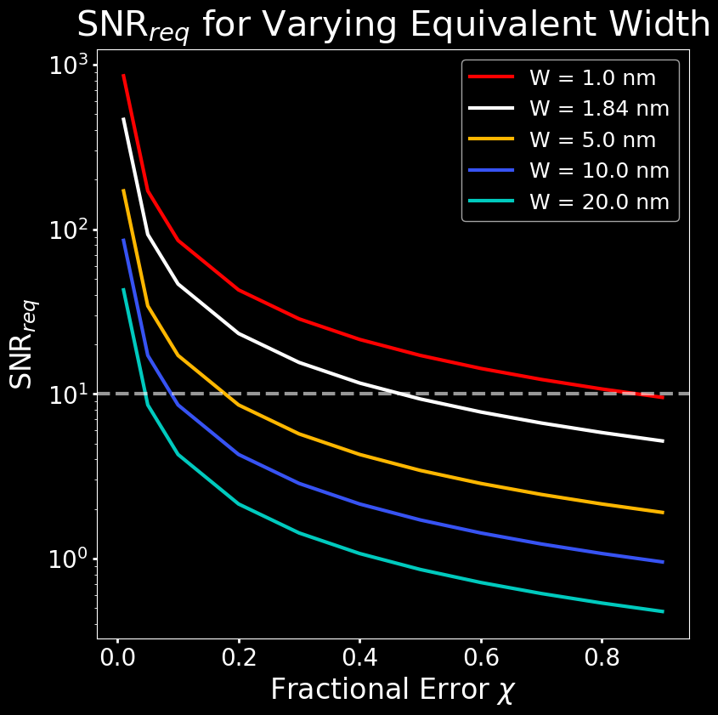
Signal-to-Noise Ratio: Required
Error on Equivalent Width
$$∆W= \frac{1.5 \sqrt{FWHM⋅Δλ_{APS}}}{{SNR}_{req}}$$
R. Cayrel, 1988
$$∆W= χ⋅W$$
Signal-to-Noise Ratio
Assuming a flat continuum and a Gaussian feature, we can derive the SNR of an absorption band based on the error on the equivalent width.
$${SNR}_{req}= \frac{1.5 \sqrt{FWHM⋅Δλ_{APS}}}{χ⋅W}$$
O₂-A Band 760 nm
FWHM = 5.00 nm
W = 1.84 nm
$Δλ_{APS}$ = 6.50 nm
Notes:
If you assume a flat continuum, with a Gaussian absorption feature, then you can define the SNR in terms of the error on the equivalent width of a feature. Then, you can write the error on the equivalent width as the equivalent width, W, times the fractional error, chi. This way, you can rewrite the equation for the SNR in terms of W. The y axis of the plot shows the required SNR as a function of the acceptable fractional error. The white curve is the O2 A band case, and the other curves show the effect of different equivalent widths while keeping the FWHM constant. For this study, I selected SNR 10 with an acceptable error of 45% on the equivalent width.

Slide 27
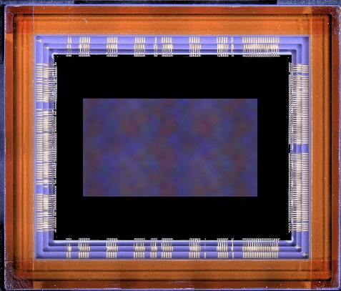
Signal-to-Noise Ratio: Achieved
Once the required (desired) SNR is known, the sources of noise and system parameters can be accounted for to give an integration time to reach the SNR.
$${SNR}_{achi}=\frac{S_{λ,p}⋅t}{\sqrt{\left(S_{λ,p}+K_{CR}S_{λ,⋆}+DC+ZD+XZD\right)⋅t+{RN}^{2}}}$$
$$S_{λ,p}$$
$$K_{CR}S_{λ,⋆}$$
$$ZD, XZD$$
$$DC, RN$$
Notes:
Now that we know what SNR we need to reach, we can figure out how long this would take for a given set of observables. In this case, you plug in the observed values, as well as the required SNR in place of the achieved SNR, and solve for time.

Slide 28
Simulations
Notes:
It is now time to explain how the observables are simulated in this study.

Slide 29
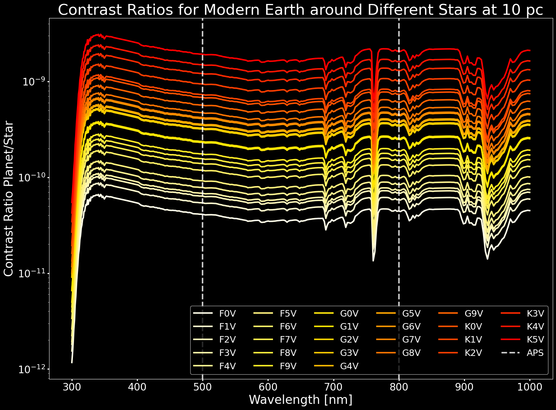
Simulations: ExoVista Planet Contrast Ratios
ExoVista returns the planet’s contrast ratio for a given orbital position. This is the spectrum of the planet divided by the star’s.
Notes:
I used the open source code ExoVista made by Christopher Stark. ExoVista can generate stellar systems at a certain distance away. I chose 10 parsecs away to match literature. One of the files returned by ExoVista is the contrast ratio of the planet. This means dividing the light coming from the planet by the light coming from the star. The y axis shows the ratio, and the x-axis is the wavelength. The different curves show the earth at different eons, with modern earth in white. Note again the O2 A band at 760nm. The plot on the left shows modern earth only, around different stars. Notice that for redder, dimmer stars, the contrast ratio increases, it improves. This is because all the planets are placed in the habitable zones of their stars. They should receive the same flux, although the spectrum will be different. So they should all reflect the same amount of light. But the stars have much different brightness, which is why we see this effect.
Now that we have the contrast ratio, we can recover the planet’s flux.

Slide 30
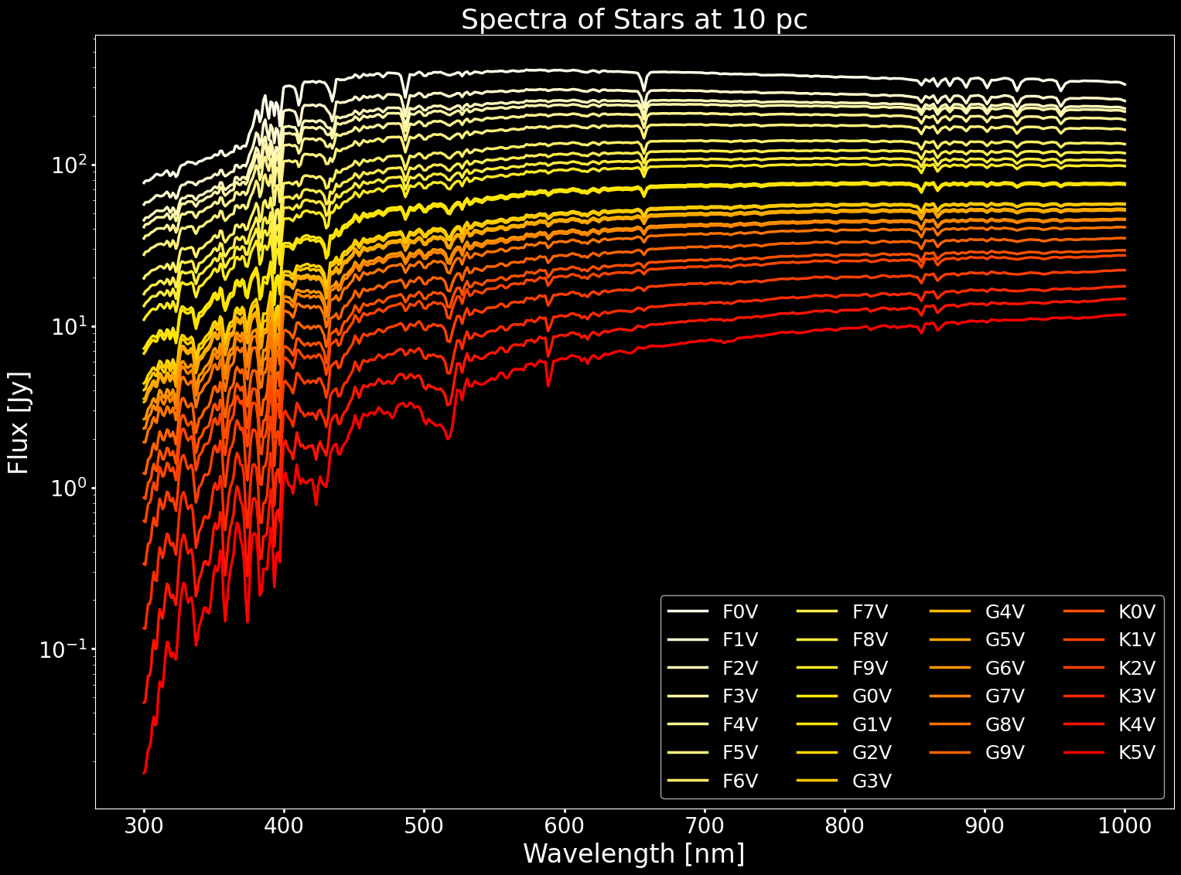
Simulations: ExoVista Stellar Spectra
ExoVista returns the stellar host’s spectral flux. Notice the different absorption lines and general shape based on spectral type.
Notes:
To do this, we multiply by the stellar spectrum. The plots show the stellar spectra of the stars considered in this study, with the y-axis reporting the flux in Jansky.

Slide 31
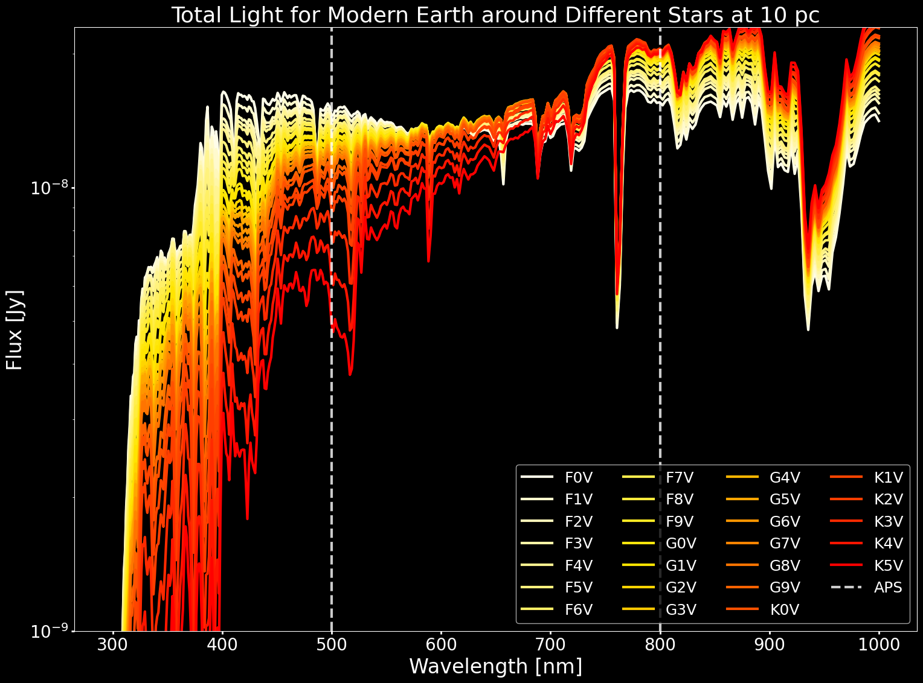
Simulations: ExoVista Planet Total Light
Multiplying the contrast ratios by the stellar spectrum gives the total light coming from the planet.
Notes:
Multiplying the stellar flux and contrast ratios gives the planetary spectra. Again, we show earth at different times on the right, and only modern earth on the left for different stars. As I said earlier, the planets should emit about the same flux since they are modelled in the habitable zone.

Slide 32
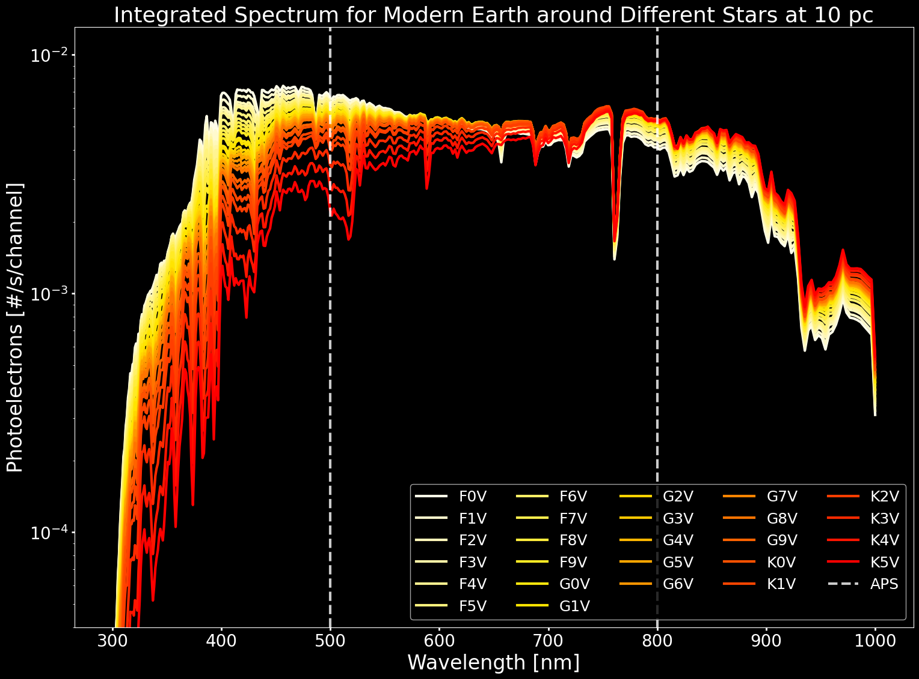
Simulations: ExoVista Channels
Integrating the object flux for each exoVista channel yields photoelectron numbers.
$$S_{λ,p,ExoV}=F_{λ,p,ExoV} \frac{c}{λ^{2}}\frac{λ}{hc}{Δλ}_{λ,ExoV}⋅{QE}_{λ,det}⋅{TP}_{tel}⋅A_{tel}⋅\left(1×{10}^{−23} erg s^{−1}{cm}^{−2}{Hz}^{−1}{Jy}^{−1}\right) [e^{−}/s/{channel}_{ExoV}]$$
Notes:
Now that we have a flux, we need to convert this into a photoelectron number. We need to integrate the flux. In the equation above, the flux F represents the results shown just before this slide. We then divide by the photon energy, multiply by the telescope throughput, the telescope collecting area, and the detector quantum efficiency, to get the correct number of photons in each ExoVista channel. This gives us photoelectron numbers, which we will need to rebin to accommodate the discrete astrophotonic spectrograph channels. We also do this for the star light, since we already had the flux data for them.

Slide 33
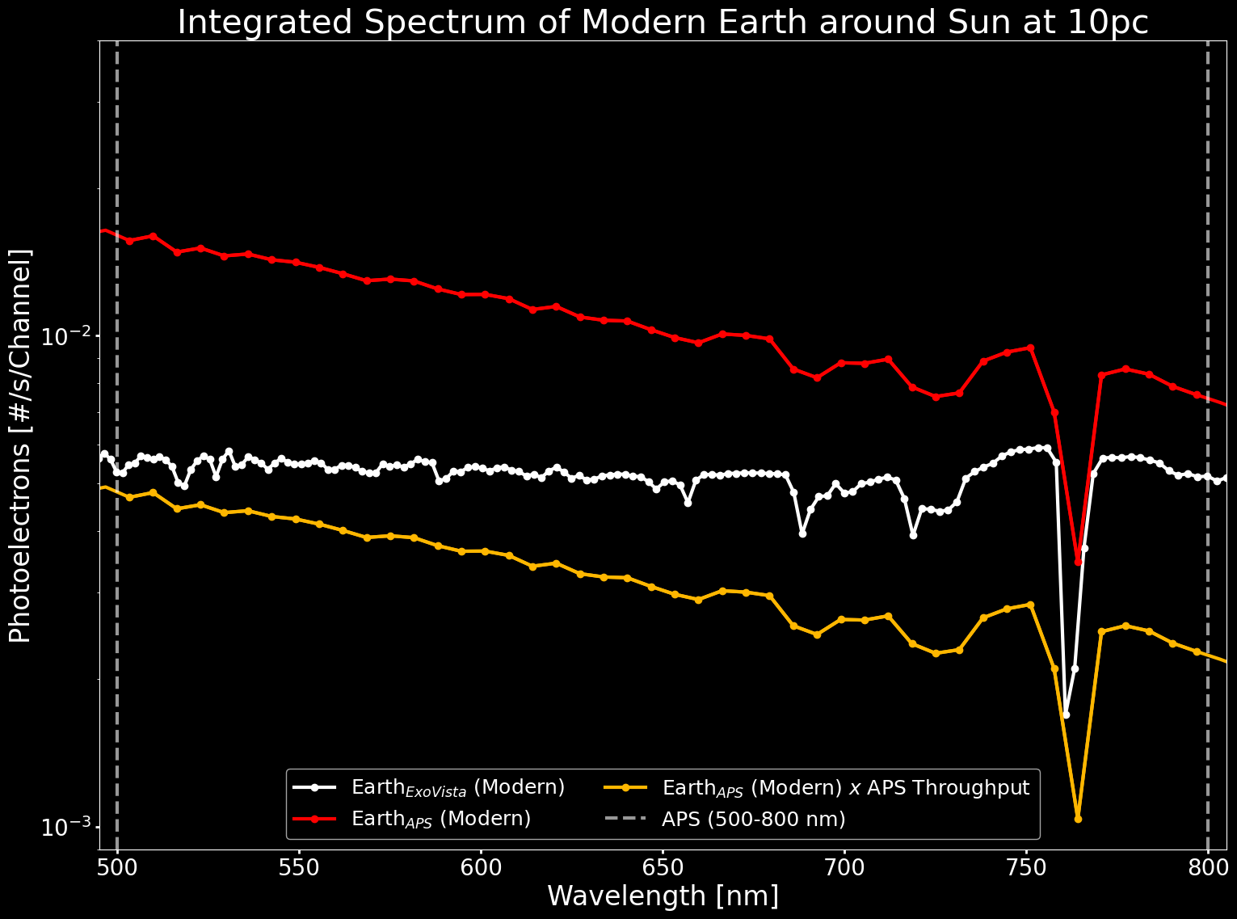
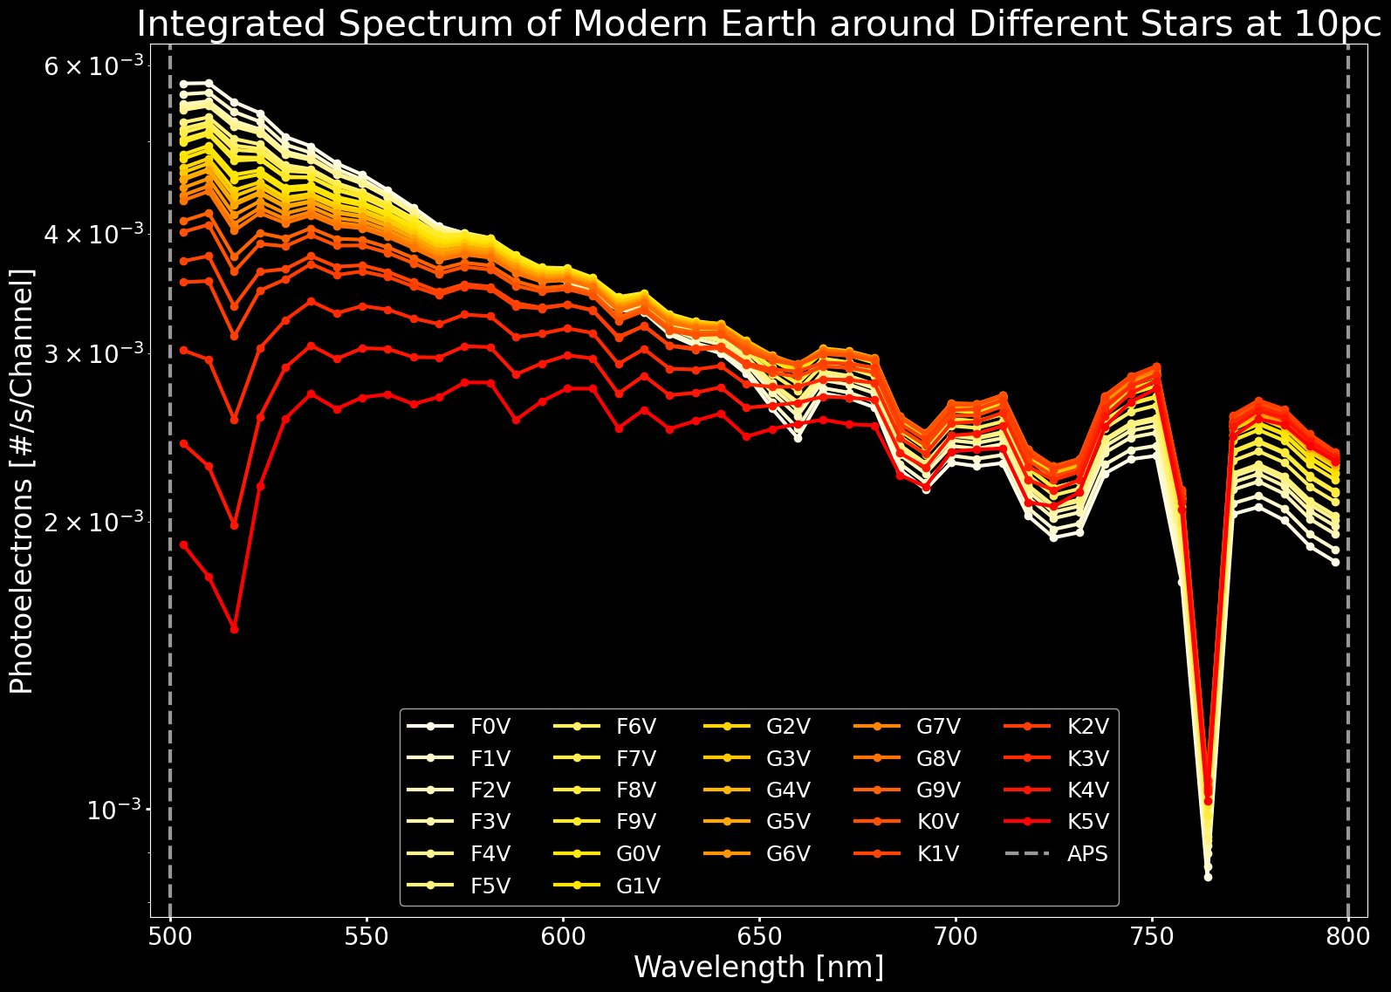
Simulations: APS Channels
The photoelectron numbers are rebinned to match the astrophotonic spectrograph channels.
$$S_{λ,p,APS}={TP}_{λ,APS} \sum_{i=λ_{1}}^{λ_{2}}{\frac{w_{i}⋅S_{i,p,ExoV}}{{Δλ}_{λ,APS}}} [e^{−}/s/{channel}_{APS}]$$
Notes:
The last step is to rebin the data so that we know how many photons make it into each of the spectrograph, the APS channels. The equation above shows that we need the throughput of the APS channel, and the sum of the exovista channels that would fall into the APS channels. Each ExoVista channel is multiplied by a weight that account for the percentage of the channel that goes in the APS channel. We then divide by the width of the APS channel. In the plot on the left, the white curve represent the plots we saw on the previous slide, the exovista channels. In red, we see the APS channels, but we have not yet multiplied by throughput. Finally in gold, we account for throughput. The gold curve is what we can use in the SNR equation. Now this plot shows the gold curve, but for the modern earth around different stars. Overall, these plots tell us that we can expect only a handful of photoelectrons per hour from the planet.

Slide 34
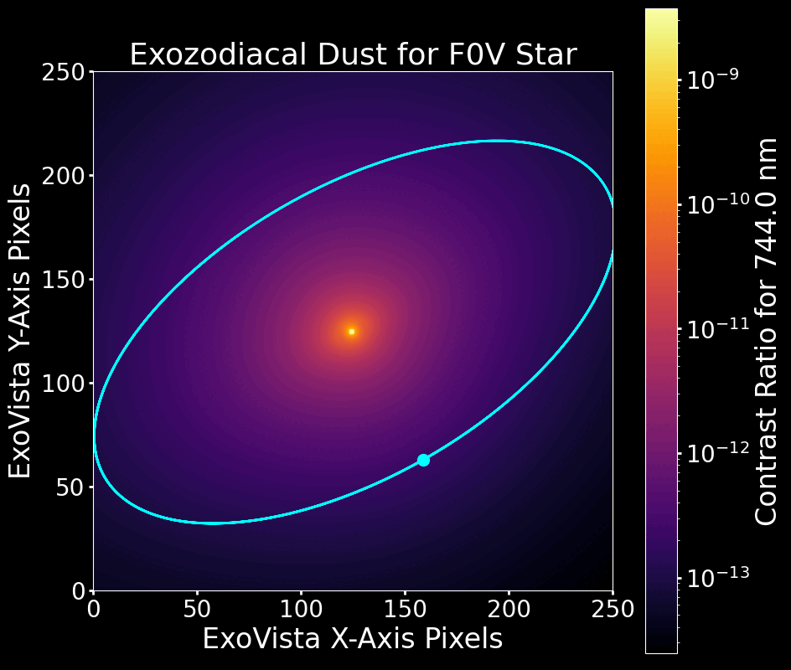
Simulations: Exozodiacal and Zodiacal Dust
ExoVista gives a contrast ratio for the exozodiacal dust. The same treatment used for the planet is applied to the dust.
The solar system’s zodiacal dust is viewed from “within,” and is approximated as half of the exozodiacal dust.
Notes:
Now, we need to account for exozodiacal dust and zodiacal dust. The dust map shows the exozodiacal dust distribution around the different stars considered. The circle shows the planet’s orbit in the habitable zone, and the dot is the planet. Please note the effect of spectral type on the location of the habitable zone.
So, for exozodiacal dust, exoVista also gives a contrast ratio. So we repeat the entire process I just described, but for the dust at the location of the planet. Then, we can approximate the solar system’s zodiacal dust as half of the exozodiacal dust, since we are looking at the cloud from within, and not the entire cloud. Finally, I will mention that each pixel on these map are 2 mas in length. The earth would be about 230 times smaller in length, and so we assume a restrictive aperture to isolate the planet and improve SNR.

Slide 35
Simulations: Achieved SNR
Once the required (desired) SNR is known, the sources of noise and system parameters can be accounted for to give an integration time to reach the SNR. Hidden in the equation are detector temperature (DC) and the number of pixels used (DC, RN).
$${SNR}_{achi}=\frac{S_{λ,p}⋅t}{\sqrt{\left(S_{λ,p}+K_{CR}S_{λ,⋆}+DC+ZD+XZD\right)⋅t+{RN}^{2}}}$$
$$S_{λ,p}$$
$$K_{CR}S_{λ,⋆}$$
$$ZD, XZD$$
$$DC, RN$$
Notes:
Before I go on to explain how these simulations help drive the design, let’s remember how they fit in the SNR equation. We have found all the parts we need for the SNR equation. We do not control the astronomical objects, but we do control the detector’s temperature and how many pixels we use to look at the spectrograph’s channels. This is how we can influence the integration time, and in turn the design of the SPCPS.

Slide 36
Results
Notes:
Let’s take a look at the results from the detector temperature and pixel number parameter space.

Slide 37
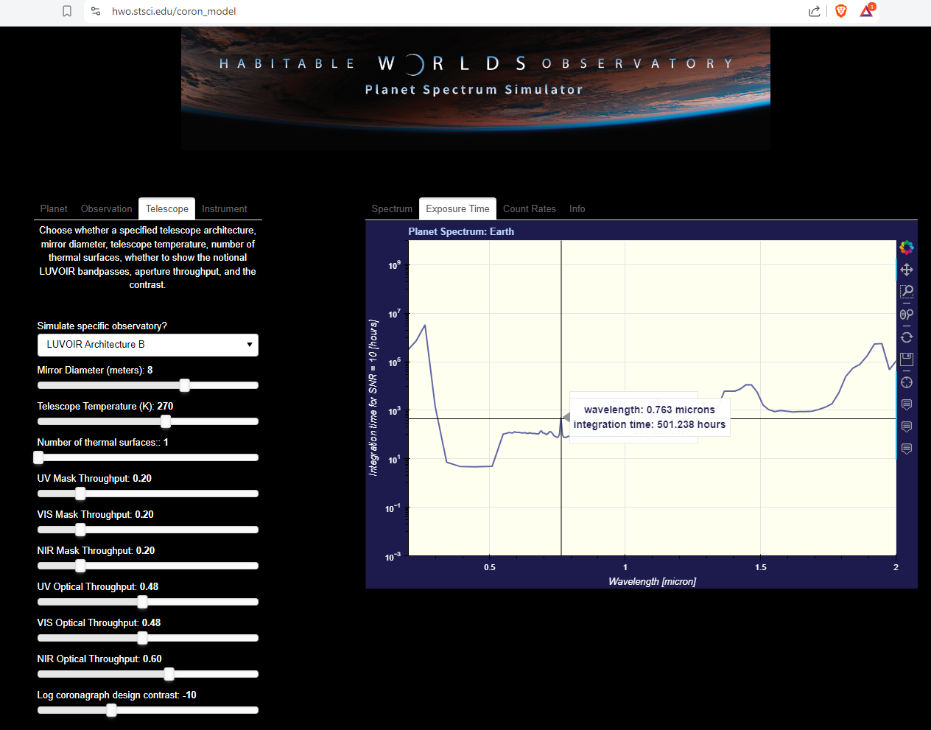
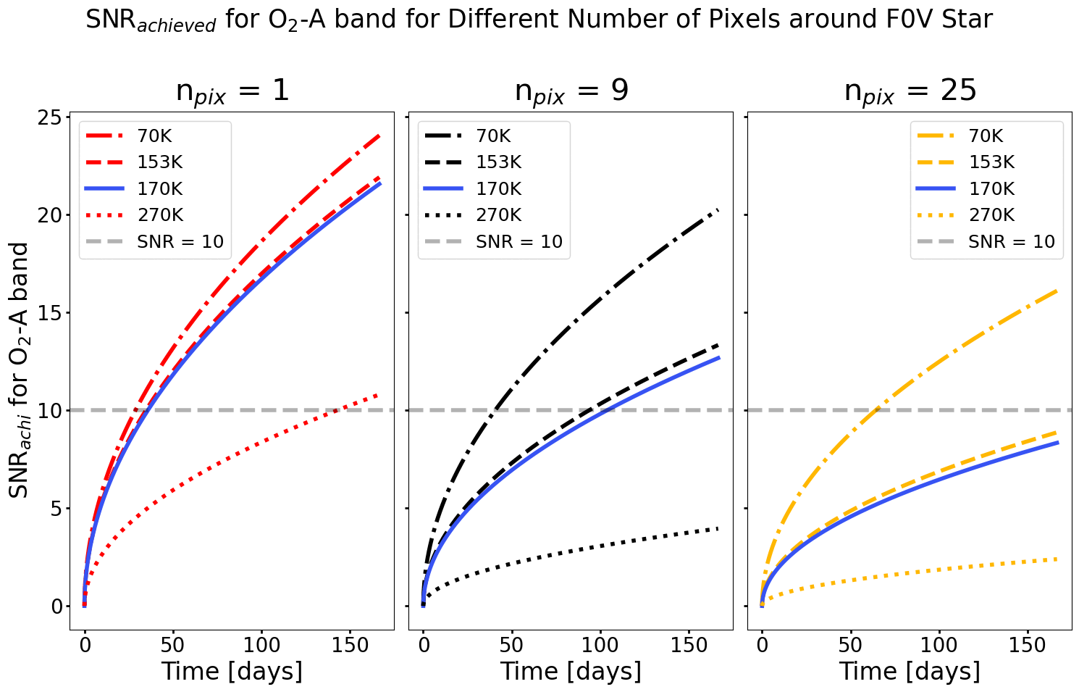
Results
G2V Star | 1 pixel | 9 pixels | 416 pixels
Time [days] | 17.43 | 62.95 | 2381.4
SNR [70 K] | 11.71 | 17.48 | 23.73
SNR [153 K] | 10.23 | 10.58 | 10.73
SNR [170 K] | 10.00 | 10.00 | 10.00
SNR [270 K] | 4.42 | 2.98 | 2.72
The main source of noise is the dark current (temperature and number of pixels).
Each additional pixel costs 5.7 days in integration time.
Notes:
The blinking plots over here show the achieved SNR for the O2 A band as a function of time. Each frame represents a star. Each tile represents the number of pixels used. Each curve represents a detector temperature. The blinking frames mainly show that we get SNR 10 faster with dimmer stars, up to a certain point where we hit a plateau. Let’s now look at the table. I have chosen to show the amount of time needed to reach SNR 10 for the 170K, which is the detector temperature for LUVOIR B. The other temperatures are for HabEx, and 270 is the telescope temperature. If we let the light of the APS channel reach one pixel only, it would take 17 days to reach SNR 10. One pixel has advantages. You can decrease dark current and read noise. However, you are taking a big risk. What if that pixel gets damaged? What if it gets hit by a cosmic ray? You lose the channel. If we spread the light over 9 pixels, it would take 2 months to reach SNR 10. That’s a lot of time, but not as crazy as one might think. The HWO simulator says it would take about 20 days to reach SNR 10. However, they use lower dark current values than we did. The 416 pixel case is the “maximum allowed”, which we will see in a moment. Now that we know we want to use 9 pixels, we can finally flow this requirement down to the design.

Slide 38
Requirements Flow Down
Notes:
Let’s take a look at the geometry of the light output from the spectrograph.

Slide 39
Requirements Flow Down
Focal Plane
APS
$$d_{max}=\frac{0.5 (channel core spacing −waveguide diameter)}{\tan{θ_{99\%}}}$$
6 µm
θ_{99%} is the opening angle for which 99% of the Gaussian emission profile is spanned by. It is 40⁰ in this case.
100 µm
θ_{99%}
d_{max} is 56 µm, the channel image is 416 pixels.
Collimating Lens
d_{max}
d_{max}
Notes:
Remember the APS has discrete channels. The light comes out with a Gaussian profile, which I have represented as cones. These cones expand, and eventually may overlap each other. We don’t want this overlap, otherwise the detector will no longer know how to distinguish the channels.
I defined the maximum offset, d max, using trigonometry.
I also defined theta 99%, the angle for which 99% of the Gaussian intensity profile is emitted into.
We have an angle, we have the leg of the triangle, so we find dmax.
It is 56 microns, which would create a circle covering 416pixels

Slide 40
Requirements Flow Down
Focal Plane
Focal Plane
APS
Collimating Lens
Camera Lens
Sensor
offset ~8 µm

Slide 41
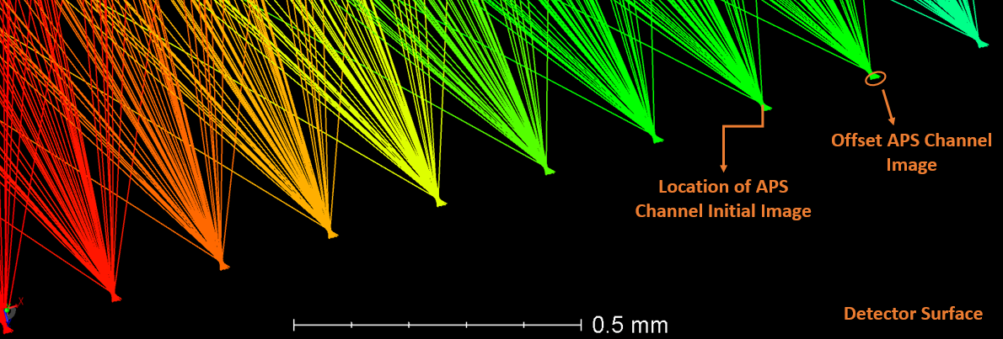
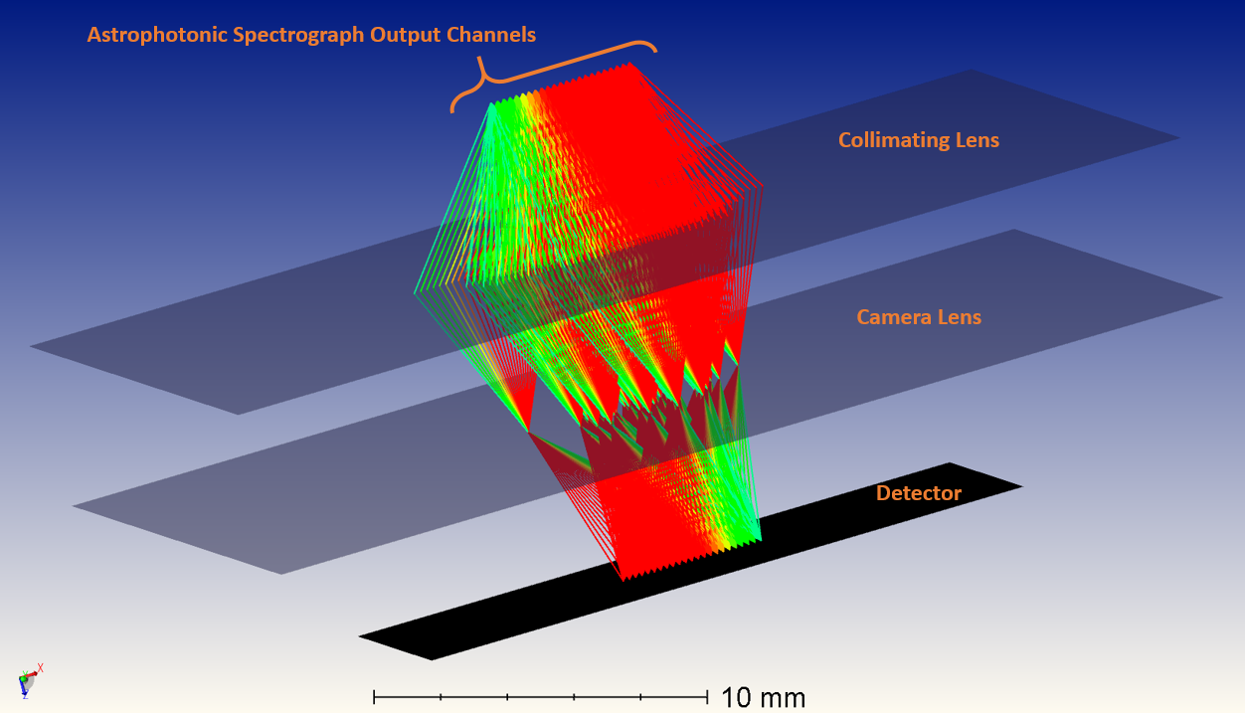
Requirements Flow Down

Slide 42
Discussion

Slide 43
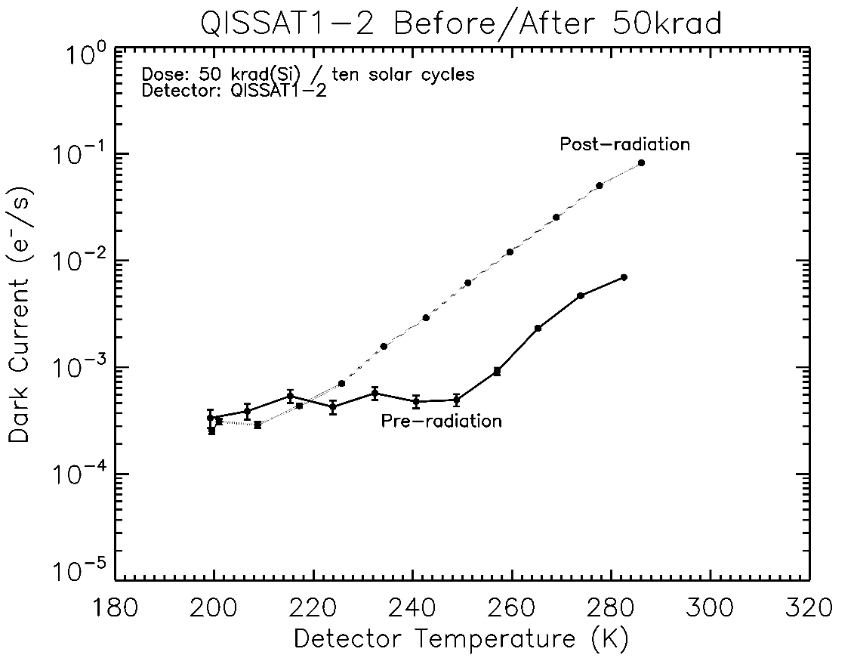
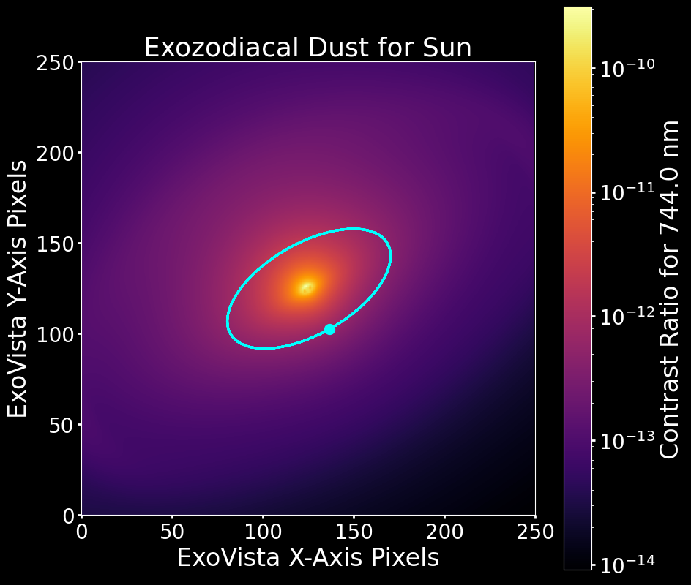
Discussion
?
NO DATA
The assumptions made below will be rectified and affect results:
Dark current
Zodiacal dust
No cosmic rays
Paraxial Lenses
The SPCPS is able to achieve SNR = 10 for the O₂-A band within 10³ hours, which is in agreement with current HWO models for this biosignature.
Source: J. Gallagher, L. Buntic, W. Deng, E. Fossum, and D. F. Figer, “Radiation Tolerance of a Single Photon Counting CMOS Image Sensor,” Journal of Astronomical Telescopes, Instruments, and Systems, 2024, accepted.

Slide 44
Conclusion

Slide 45
Conclusion
NASA wants to directly image exoplanets with the HWO.
This is challenging and will require new technologies.
The SPCPS can resolve the O₂-A band biosignature in ~10³ hours. The preliminary design is compact and simple. The SPCPS is a promising instrument that will be further investigated.
NASA wants to directly image exoplanets with the HWO.
This is challenging and will require new technologies.
CMOS single photon detectors and astrophotonic spectrographs are new, promising technologies for this application.
The simulated observations and detector parameters provide a good first order estimate for the SNR, but will be improved.
The simulated observations and detector parameters provide a good first order estimate for the SNR, but will be improved.
CMOS single photon detectors and astrophotonic spectrographs are new, promising technologies for this application.

Slide 46
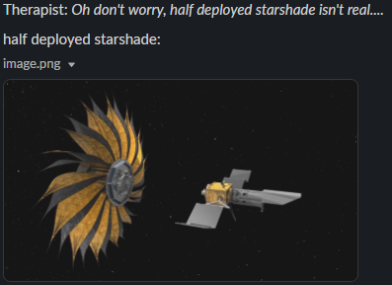
QUESTIONS
PSPSPSPSPS
SPCPS
Source: Justin Gallagher
Source: this one is me

Slide 47
EXTRA SLIDES: current objective - survive

Slide 48
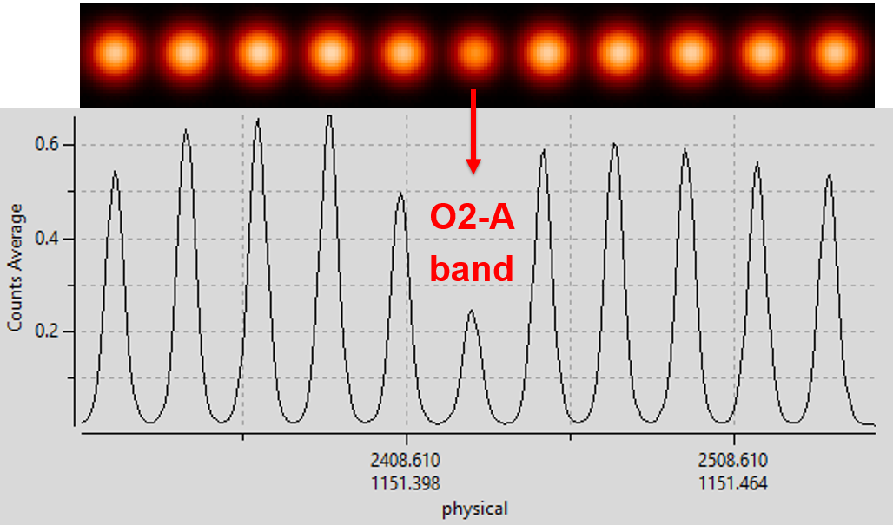

Slide 49
Direct imaging has been mostly done from the ground. Telescopes use coronagraphs and extreme adaptive optics. This method favors bright, large planets.

Slide 50
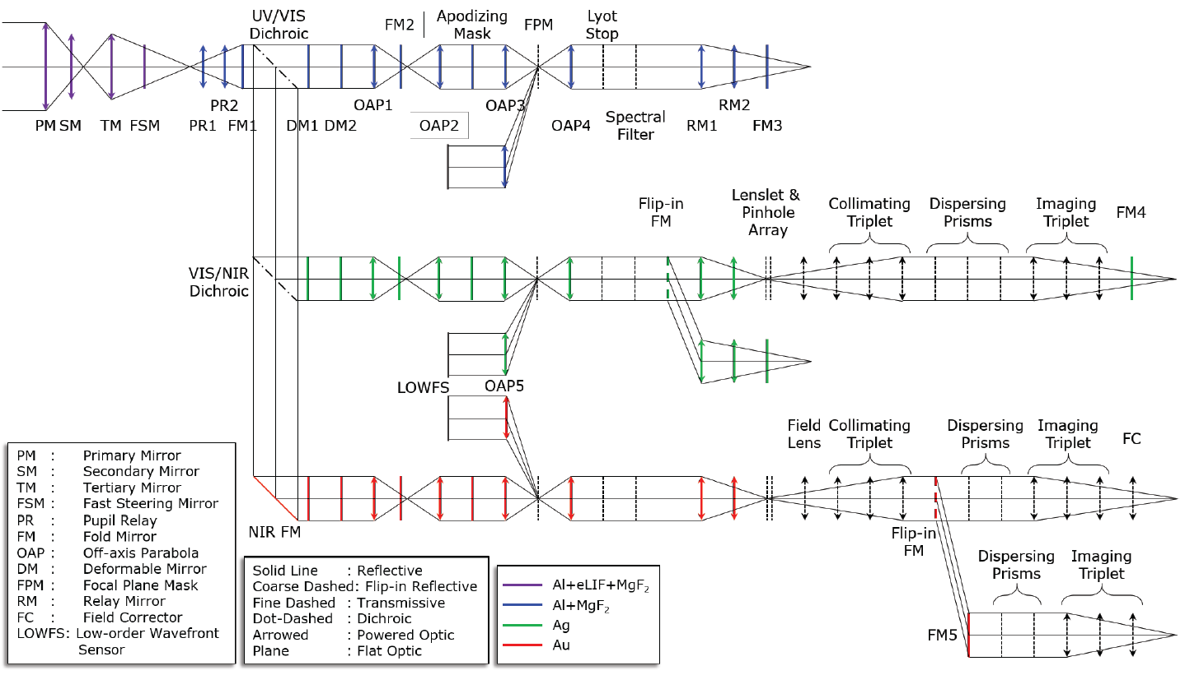

Slide 51
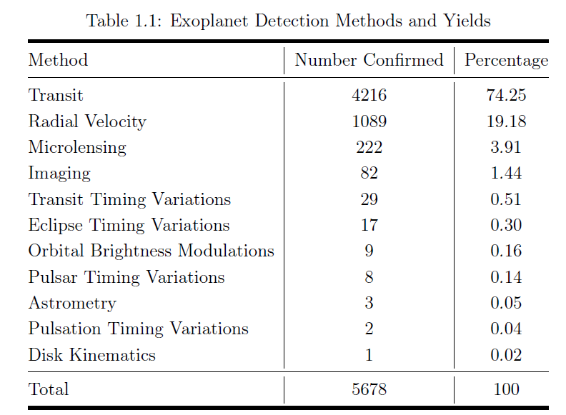

Slide 64
Left: The closed HPD ADR cryostat. Center: The 40mK stage with the housing for measurement of waveguide MKID devices mounted. Right: Fixture to make resistance vs. temperature measurements down to 40 mK with an aluminum test structure mounted using wire bonds.
Source: https://astro.uni-koeln.de/honingh/development-of-mkid

Slide 65
Source: https://hamamatsu.magnet.fsu.edu/articles/emccds.html

