Slide 1
Simulating New Instruments for Direct Imaging of Exoplanets
Edwin Alexani
RIT – Monday, October 6th, 2024

Slide 2
Why do I do what I do?
I always loved astronomy!
Where does all the data come from?
How can I help the community get more data?
Long days, but fulfilling!
Define achievable tasks to complete along the way.
Break the work in smaller chunks that fit together.
Research is not linear, it often branches!
Have a “big picture plan” to refer back to and keep research organized.
Technology gives me flexibility and transferable skills to many applications.

Slide 3
Overview
Introduction
The Habitable Worlds Observatory and Direct Imaging
Astrophotonic Spectrographs
Single Photon Counting Detectors
Single Photon Counting Photonic Spectrograph
Astronomical Sources
Signal-to-Noise Ratio
Simulations
Results
Requirements Flow Down
Conclusion

Slide 4
Introduction

Slide 5
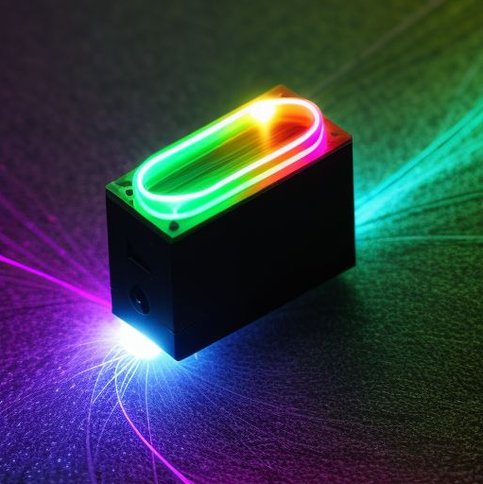
Introduction
Direct imaging requires suppression of starlight. One way to do this using a coronagraph and/or starshade. Direct imaging also requires sensitive detectors. Spectrographs are needed for spectra.
We propose to combine CMOS single photon counting detectors (SPCD) with astrophotonic spectrographs (APS). We aim to provide a compact and sensitive instrument for space applications.
NASA plans to launch New Great Observatories, and prioritizes the Habitable Worlds Observatory (HWO).
One of the main objectives of HWO is to directly image terrestrial exoplanets and obtain their spectra.

Slide 6
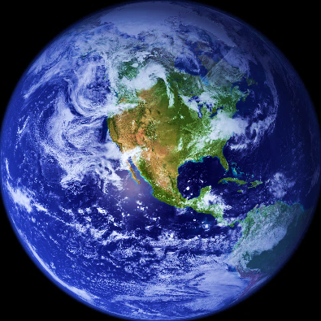
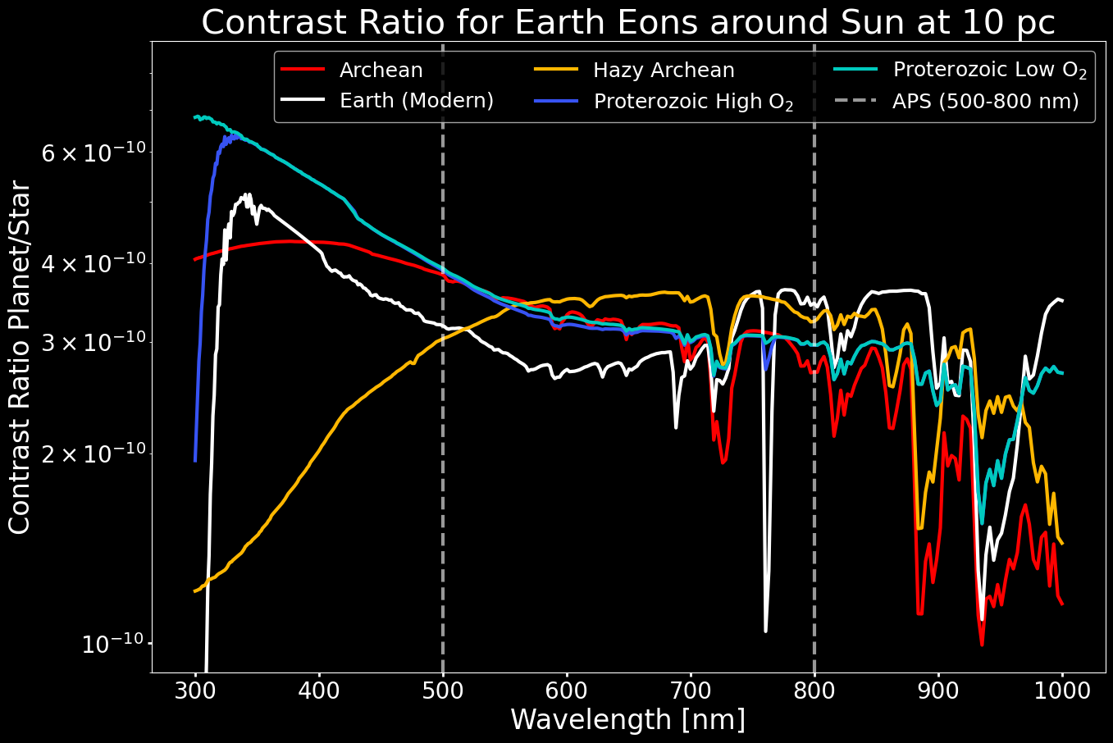
Introduction
Photosynthesis is responsible for modern oxygen levels.
The O₂-A band biosignature at 760nm indicates the presence of oxygen in the Earth’s atmosphere. This project focuses on its detectability.
O₂-A Band

Slide 7
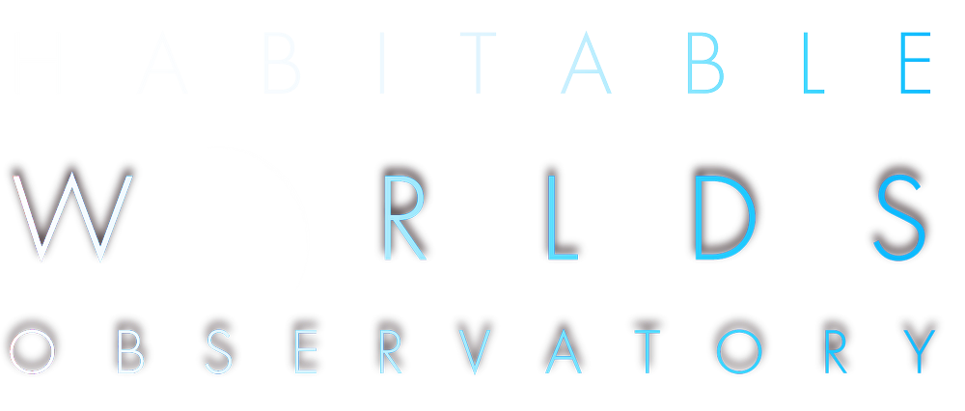
The and Direct Imaging

Slide 8
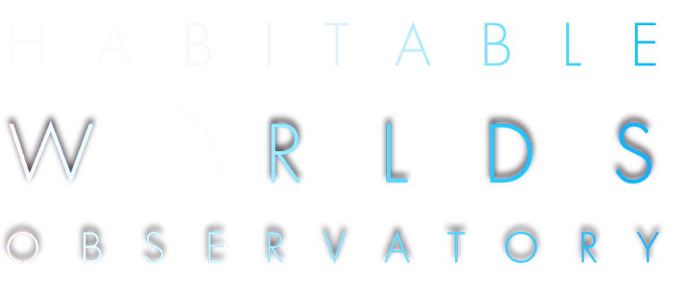
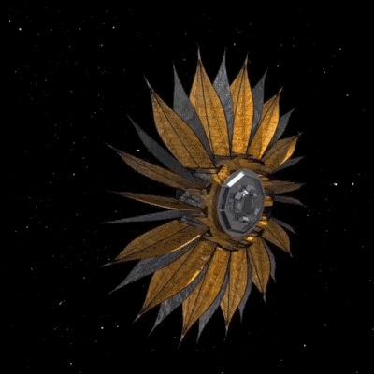
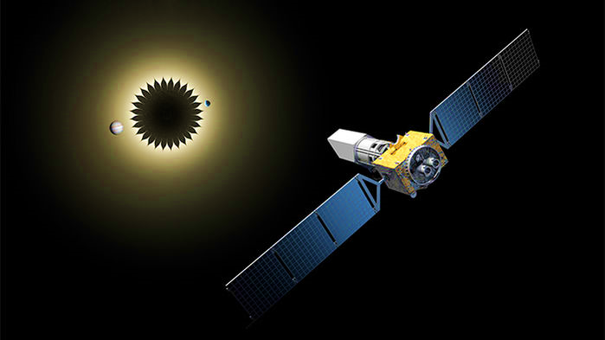
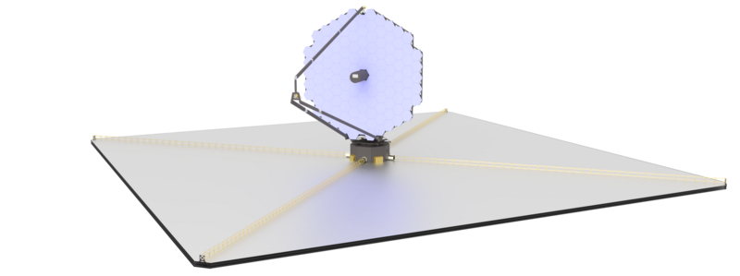
The and Direct Imaging
LUVOIR-A [15m]
HabEx [4m]
Starshade [52m]
The Habitable Worlds Observatory (HWO) will be in space. It will have a coronagraph with 10⁻¹⁰ contrast. HWO draws from past designs like LUVOIR and HabEx.
LUVOIR-B [8m]

Slide 9
The and Direct Imaging
Diameter: 8m
Throughput*: 20%
Inner Working Angle (IWA) = 3.5 λ/D
Outer Working Angle (OWA) = 64 λ/D
Contrast Ratio: 10⁻¹⁰
LUVOIR-B is the telescope used in this study. Its architecture and deployment method have JWST heritage.
Dark Current: 3×10⁻⁵ e⁻/pix/s
Read Noise: 0 e⁻
Detector Temperature: 170 K
Instrument: ECLIPS-B
Telescope Temperature: 270 K

Slide 10
Astrophotonic Spectrographs

Slide 11
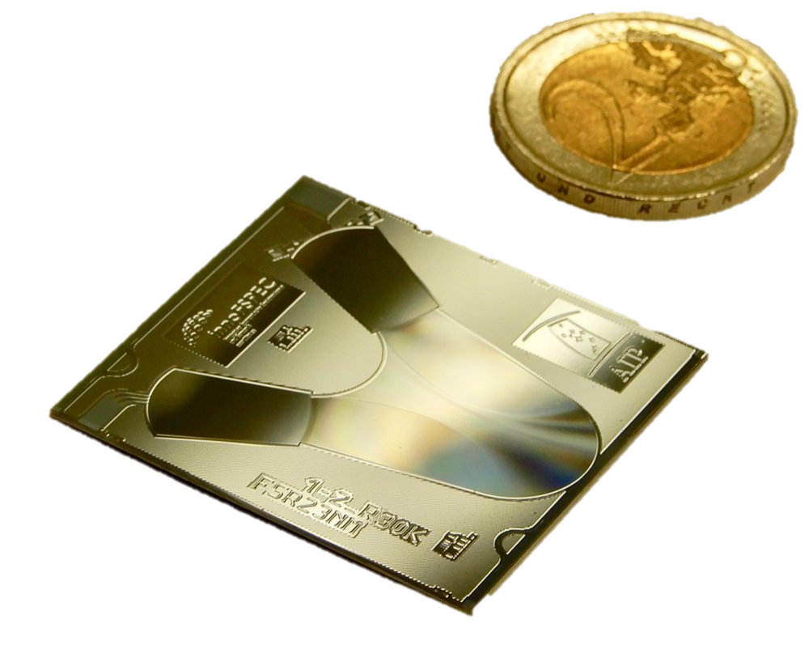
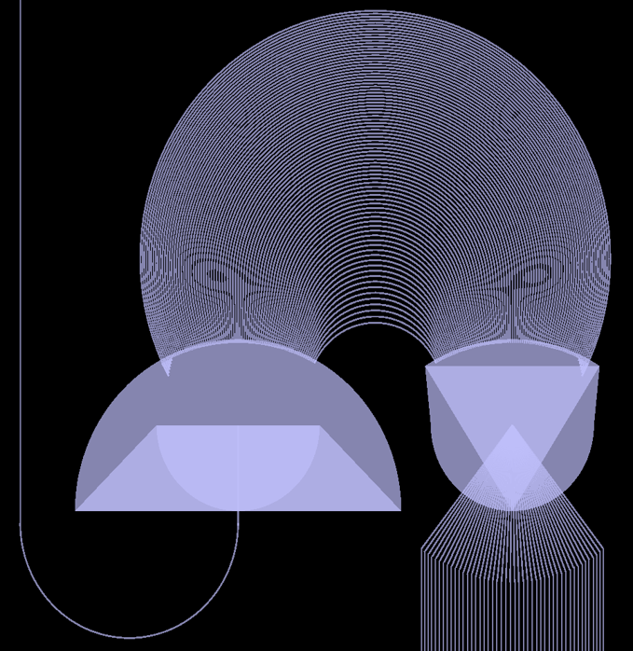
Astrophotonic Spectrographs (APS)
AWG
Single Mode Input Fiber
Arrayed Waveguide Grating (AWG)
APS use AWG to create a discretized spectrum. The waveguides in the AWG have a length difference of mλ.
This light constructively interferes along the Rowland circle and give the discrete spectrum.
Rowland Circle
Free Propagation Region (FPR)
FPR
Output Waveguides
Output Spectrum
Source: Pradip Gatkine

Slide 12
Single Photon Counting Detectors

Slide 13
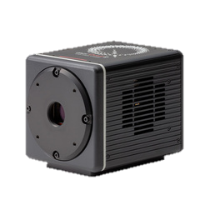
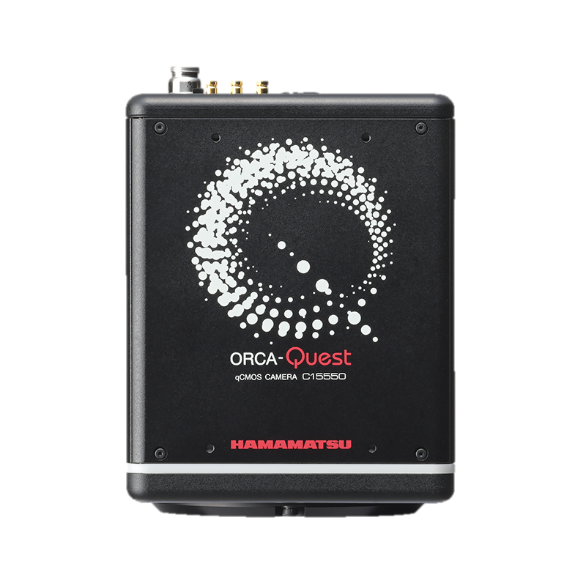
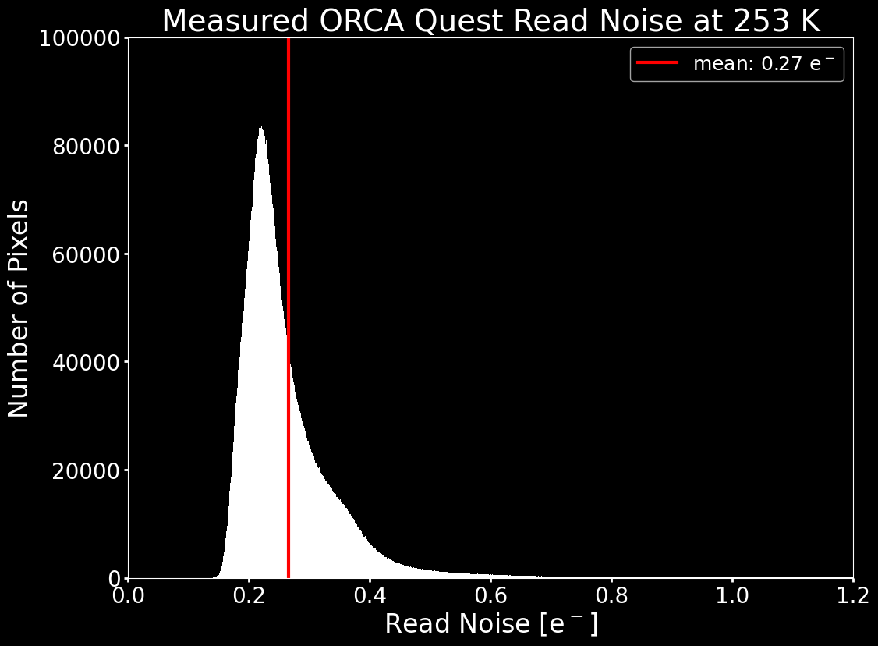
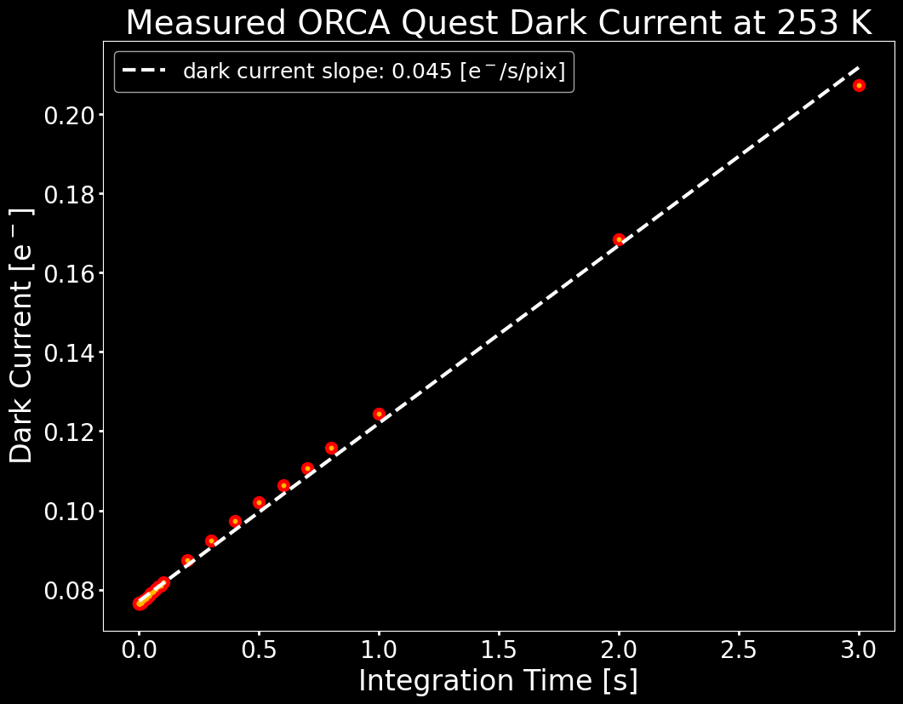
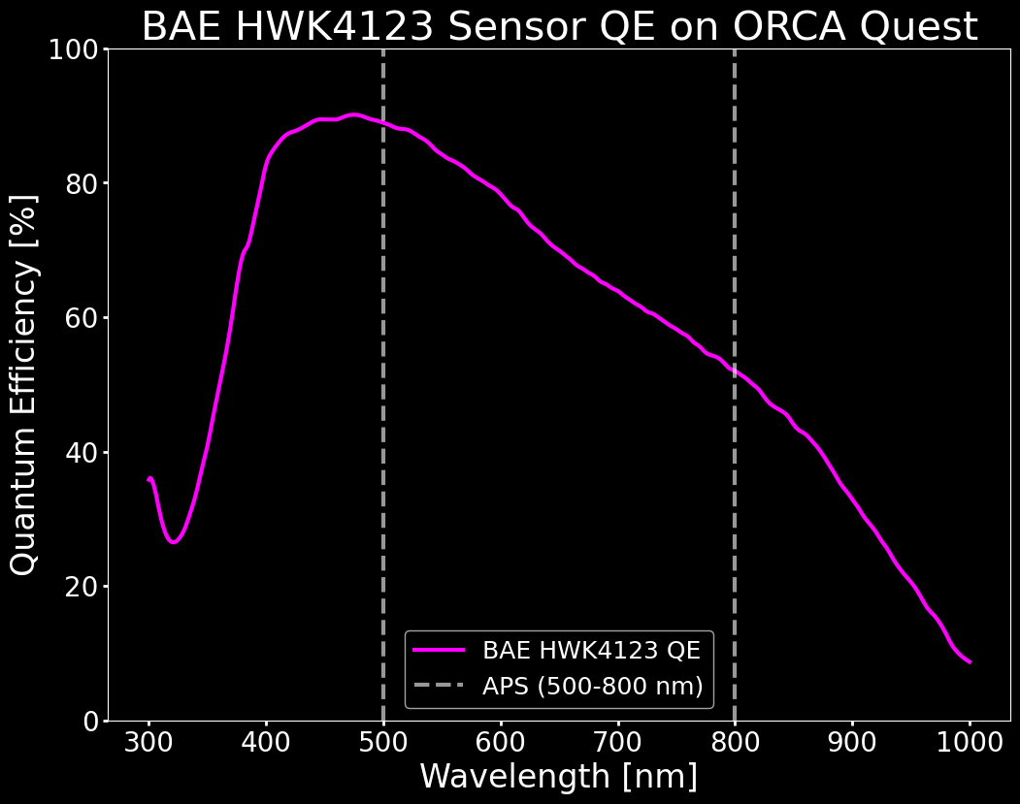
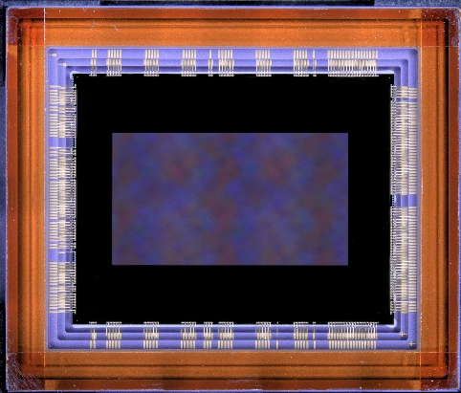
Single Photon Counting Detectors
Hamamatsu
ORCA Quest
CMOS: Complementary Metal-Oxide Semiconductor.
CMOS has faster readout, per pixel (radiation tolerant). CMOS are typically Silicon devices (Vis), found in different formats, and are part of the cellphone camera industry. CMOS sensors are used in this study.
BAE HWK4123 CMOS Sensor

Slide 14
Single Photon Counting Photonic Spectrograph

Slide 15
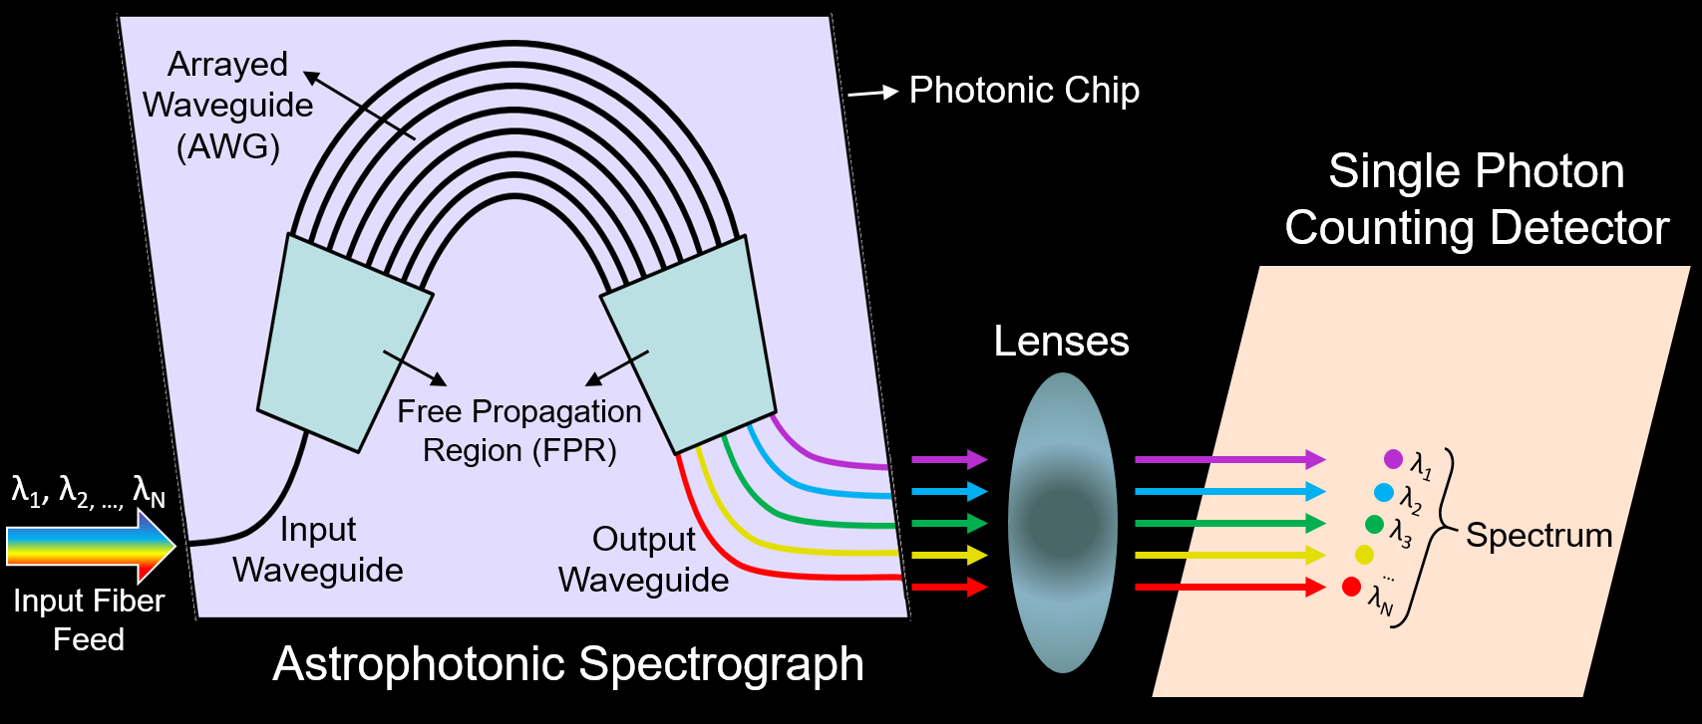
Single Photon Counting Photonic Spectrograph (SPCPS)

Slide 16
Astronomical Sources

Slide 17
Astronomical Sources
The star would be the highest source of shot noise, if not for the coronagraph (10¹⁰ suppression). Speckles can also appear due to the optics (not modelled here, may use random walk or linear process).
Exozodiacal dust reflects the starlight before the starlight is suppressed by the coronagraph. Exozodiacal dust is a significant contributor to background flux. Zodiacal dust in the solar system is similar.
The planet’s spectrum is the desired signal. It includes the planet’s light and the reflected starlight. This also introduces shot noise.
Cosmic rays limit the maximum amount of time the detector can collect light. This constrains the readout rate (not modelled).

Slide 18
Signal-to-Noise Ratio

Slide 19
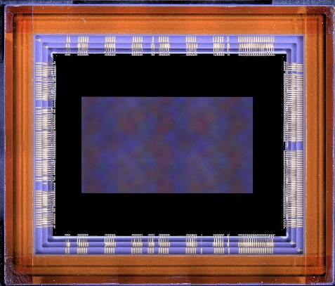
Signal-to-Noise Ratio: Achieved
Once the required (desired) SNR is known, the sources of noise and system parameters can be accounted for to give an integration time to reach the SNR.
$${SNR}_{achi}=\frac{S_{λ,p}⋅t}{\sqrt{\left(S_{λ,p}+K_{CR}S_{λ,⋆}+DC+ZD+XZD\right)⋅t+{RN}^{2}}}$$
$$S_{λ,p}$$
$$K_{CR}S_{λ,⋆}$$
$$ZD, XZD$$
$$DC, RN$$

Slide 20
Simulations

Slide 21
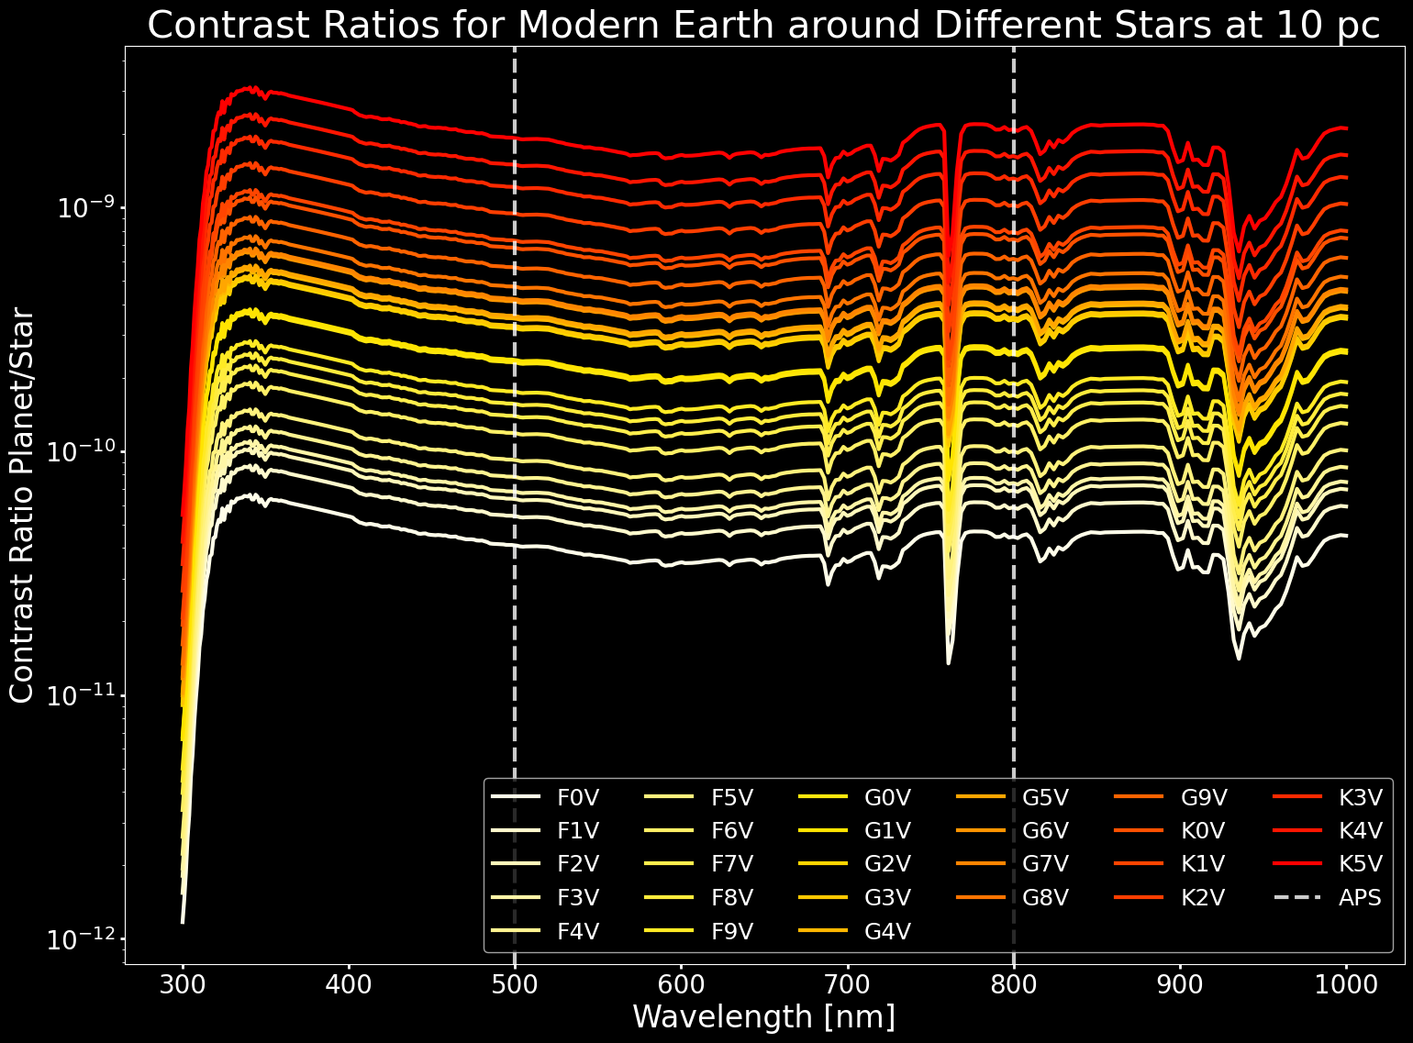
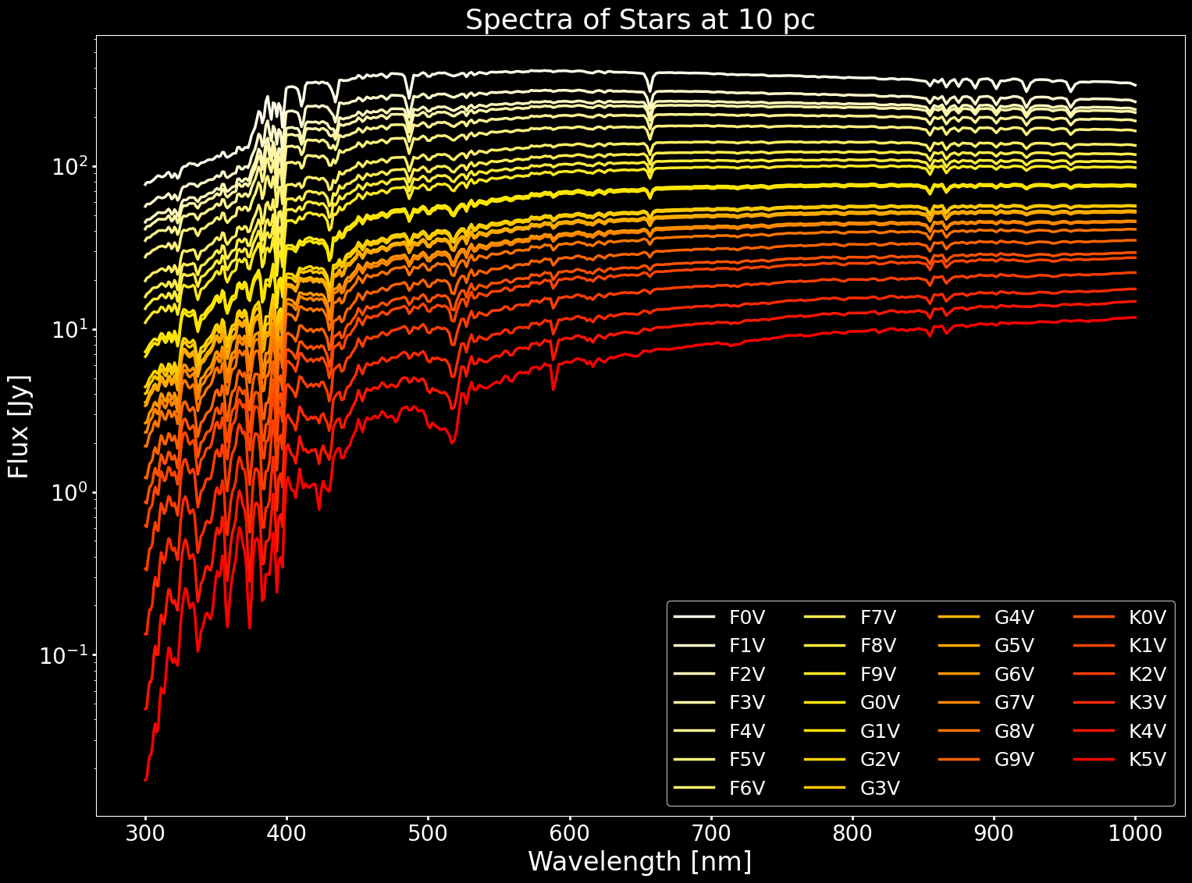
Simulations: Contrast Ratios and Stellar Spectrum
ExoVista returns the planet’s contrast ratio for a given orbital position, and the stellar spectrum.

Slide 22
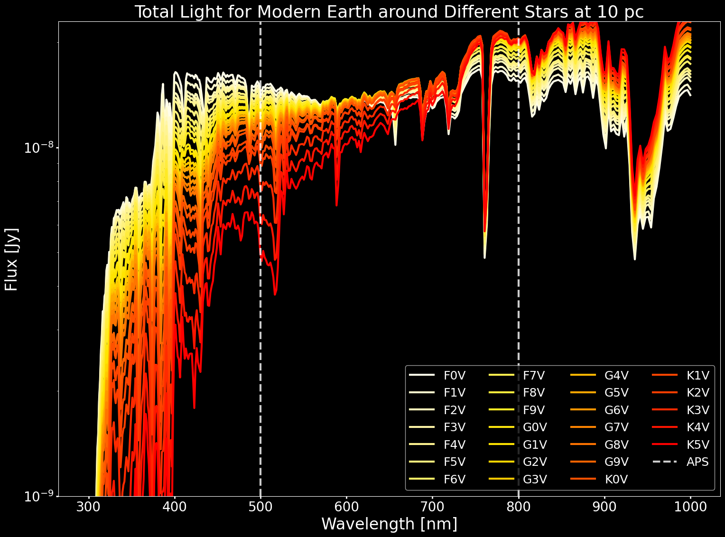
Simulations: ExoVista Planet Total Light
Multiplying the contrast ratios by the stellar spectrum gives the total light coming from the planet.
Notes:
Multiplying the stellar flux and contrast ratios gives the planetary spectra. Again, we show earth at different times on the right, and only modern earth on the left for different stars. As I said earlier, the planets should emit about the same flux since they are modelled in the habitable zone.

Slide 23
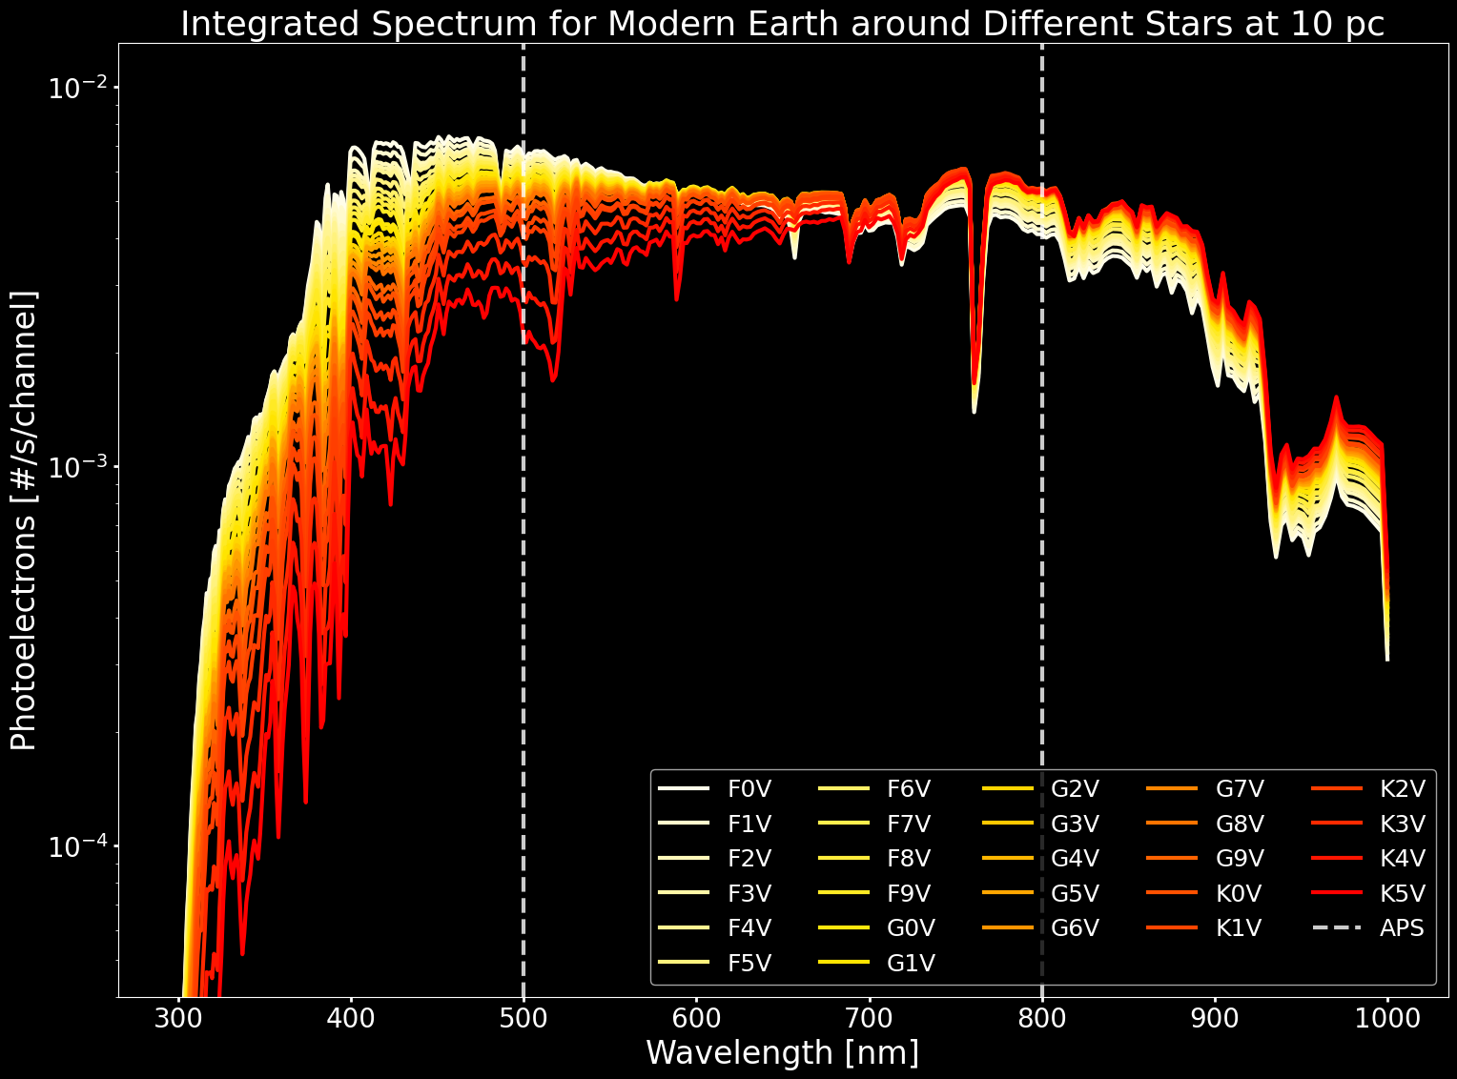
Simulations: ExoVista Channels
Integrating the object flux for each exoVista channel yields photoelectron numbers.
$$S_{λ,p,ExoV}=F_{λ,p,ExoV} \frac{c}{λ^{2}}\frac{λ}{hc}{Δλ}_{λ,ExoV}⋅{QE}_{λ,det}⋅{TP}_{tel}⋅A_{tel}⋅\left(1×{10}^{−23} erg s^{−1}{cm}^{−2}{Hz}^{−1}{Jy}^{−1}\right) [e^{−}/s/{channel}_{ExoV}]$$
Notes:
Now that we have a flux, we need to convert this into a photoelectron number. We need to integrate the flux. In the equation above, the flux F represents the results shown just before this slide. We then divide by the photon energy, multiply by the telescope throughput, the telescope collecting area, and the detector quantum efficiency, to get the correct number of photons in each ExoVista channel. This gives us photoelectron numbers, which we will need to rebin to accommodate the discrete astrophotonic spectrograph channels. We also do this for the star light, since we already had the flux data for them.

Slide 24
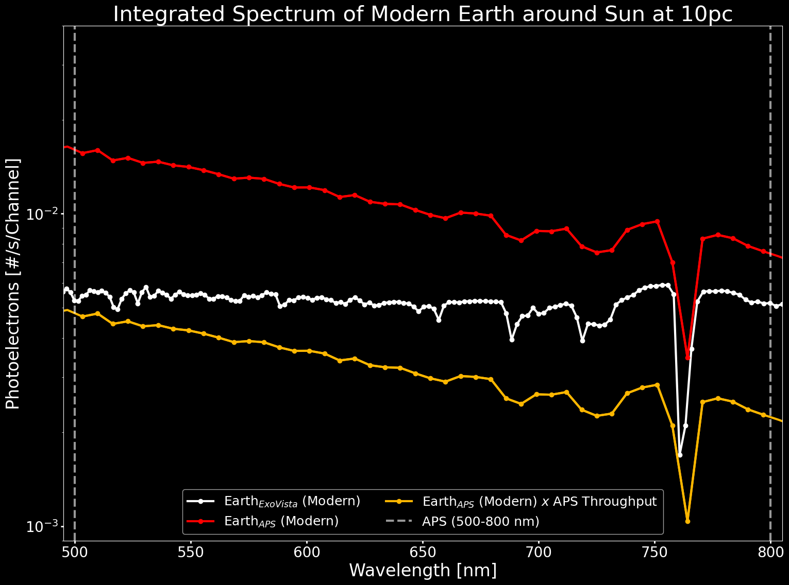
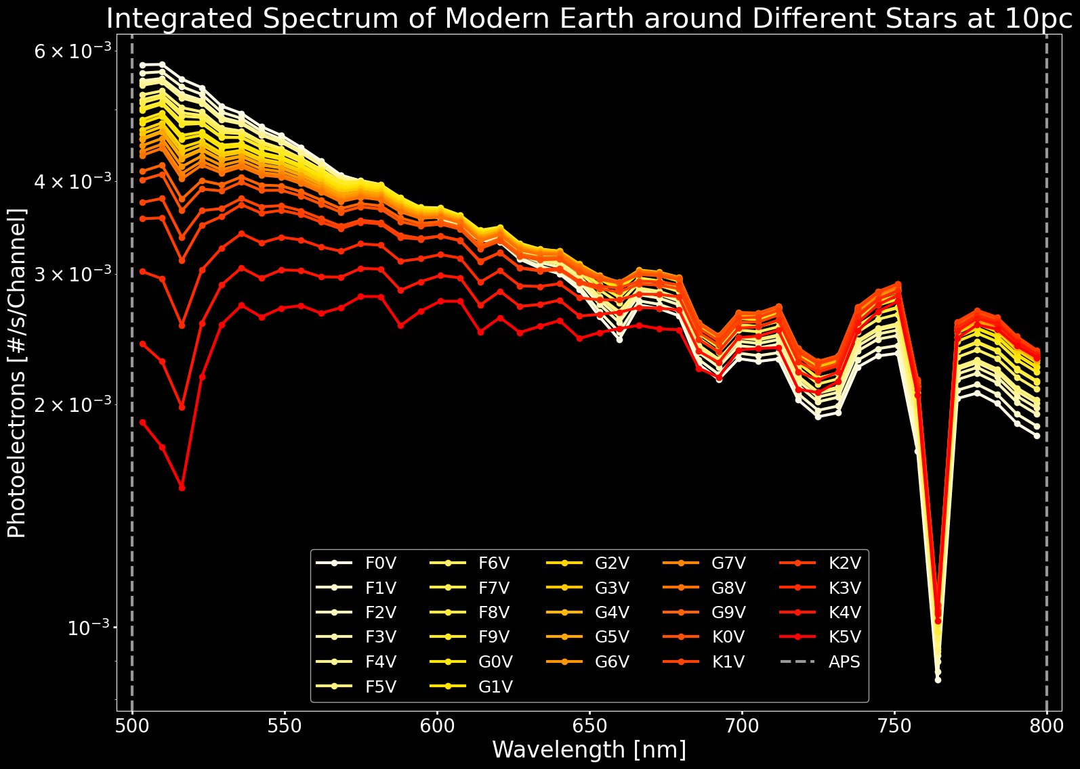
Simulations: APS Channels
The photoelectron numbers are rebinned to match the astrophotonic spectrograph channels.
$$S_{λ,p,APS}={TP}_{λ,APS} \sum_{i=λ_{1}}^{λ_{2}}{\frac{w_{i}⋅S_{i,p,ExoV}}{{Δλ}_{λ,APS}}} [e^{−}/s/{channel}_{APS}]$$

Slide 25
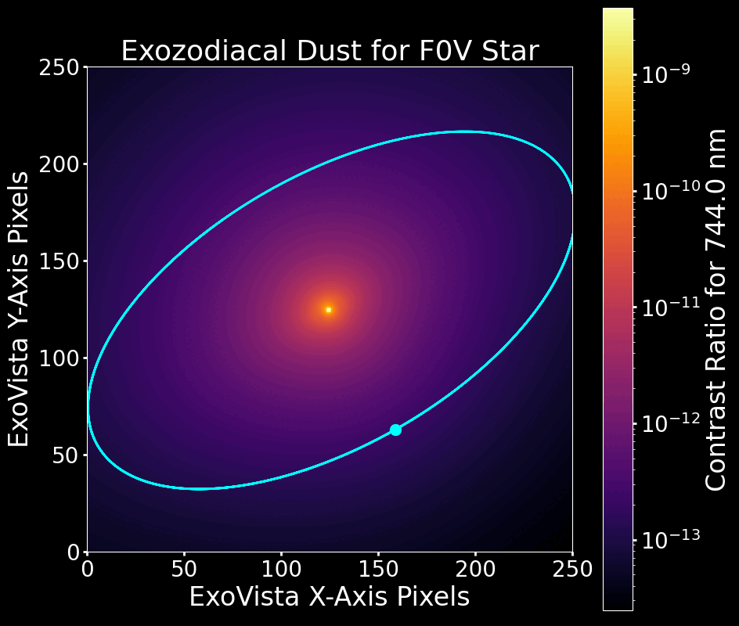
Simulations: Exozodiacal and Zodiacal Dust
ExoVista gives a contrast ratio for the exozodiacal dust. The same treatment used for the planet is applied to the dust.
The solar system’s zodiacal dust is viewed from “within,” and is approximated as half of the exozodiacal dust.

Slide 26
Simulations: Achieved SNR
Once the required (desired) SNR is known, the sources of noise and system parameters can be accounted for to give an integration time to reach the SNR. Hidden in the equation are detector temperature (DC) and the number of pixels used (DC, RN).
$${SNR}_{achi}=\frac{S_{λ,p}⋅t}{\sqrt{\left(S_{λ,p}+K_{CR}S_{λ,⋆}+DC+ZD+XZD\right)⋅t+{RN}^{2}}}$$
$$S_{λ,p}$$
$$K_{CR}S_{λ,⋆}$$
$$ZD, XZD$$
$$DC, RN$$

Slide 27
Results
Notes:
Let’s take a look at the results from the detector temperature and pixel number parameter space.

Slide 28
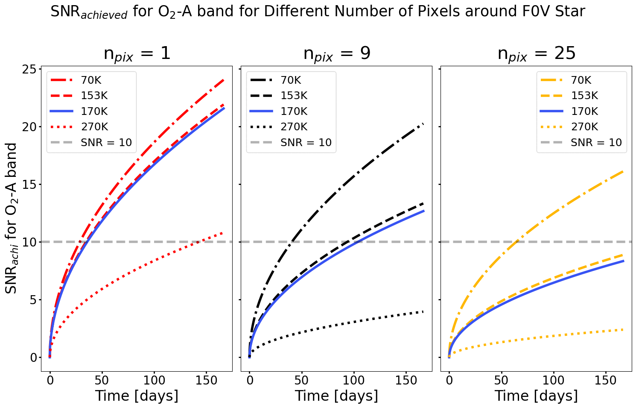
Results
G2V Star | 1 pixel | 9 pixels | 416 pixels
Time [days] | 17.43 | 62.95 | 2381.4
SNR [70 K] | 11.71 | 17.48 | 23.73
SNR [153 K] | 10.23 | 10.58 | 10.73
SNR [170 K] | 10.00 | 10.00 | 10.00
SNR [270 K] | 4.42 | 2.98 | 2.72
The main source of noise is the dark current (temperature and number of pixels).
Each additional pixel costs 5.7 days in integration time.

Slide 29
Requirements Flow Down

Slide 30
Requirements Flow Down
Focal Plane
Focal Plane
APS
Collimating Lens
Camera Lens
Sensor
offset ~8 µm

Slide 31
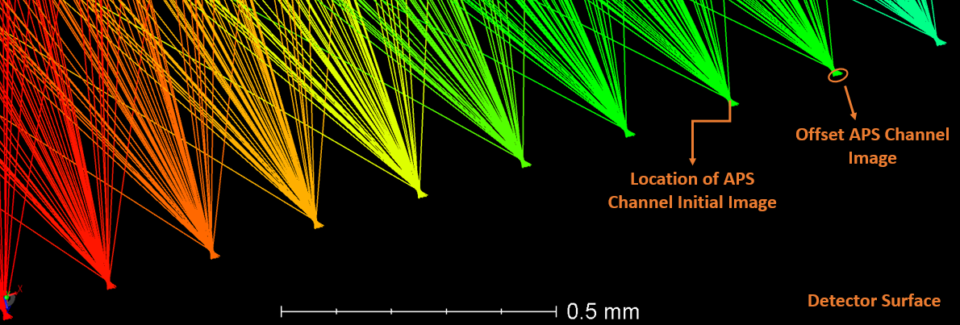
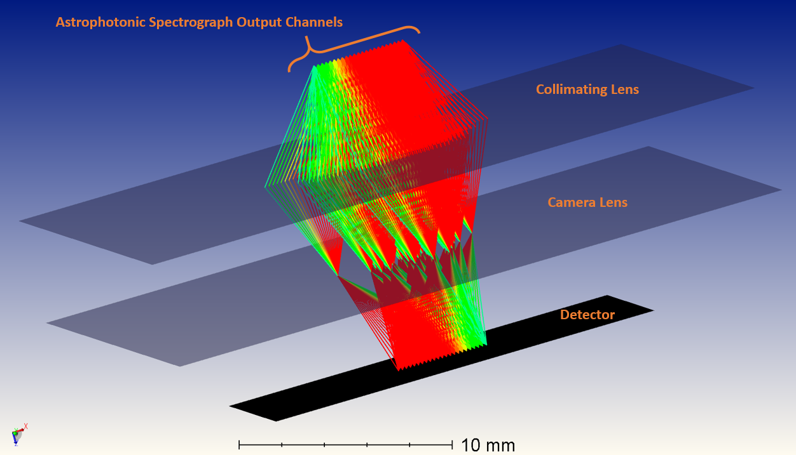
Requirements Flow Down

Slide 32
Conclusion

Slide 33
Conclusion
NASA wants to directly image exoplanets with the HWO.
This is challenging and will require new technologies.
The SPCPS can resolve the O₂-A band biosignature in ~10³ hours. The preliminary design is compact and simple. The SPCPS is a promising instrument that will be further investigated.
NASA wants to directly image exoplanets with the HWO.
This is challenging and will require new technologies.
CMOS single photon detectors and astrophotonic spectrographs are new, promising technologies for this application.
The simulated observations and detector parameters provide a good first order estimate for the SNR, but will be improved.
The simulated observations and detector parameters provide a good first order estimate for the SNR, but will be improved.
CMOS single photon detectors and astrophotonic spectrographs are new, promising technologies for this application.

Slide 34
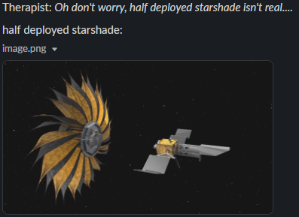
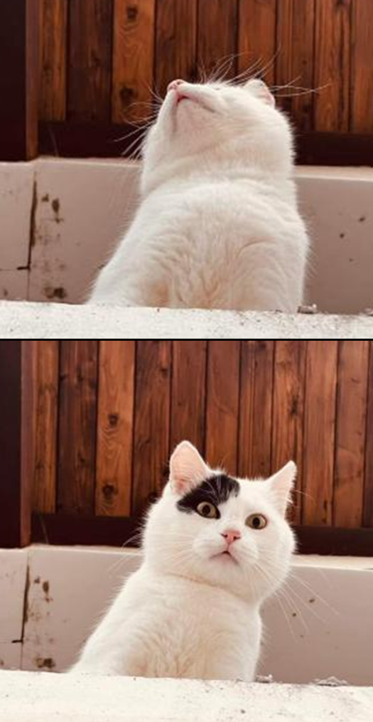
QUESTIONS
PSPSPSPSPS
SPCPS
Source: Justin Gallagher
Source: this one is me

