Slide 1
Future Photon Initiative
Center for Detectors
CMOS Imaging Detectors for Space
Don Figer
College of Science, Professor
Future Photon Initiative, Director
Center for Detectors, Director
December 5, 2024

Slide 2
Outline
Speaker Bio
Future Photon Initiative
Center for Detectors
CMOS Imaging Detectors for Space

Slide 3
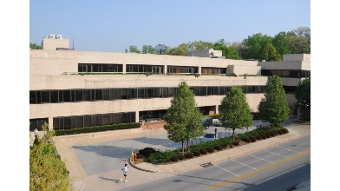
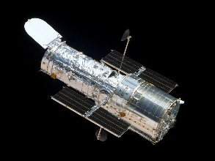
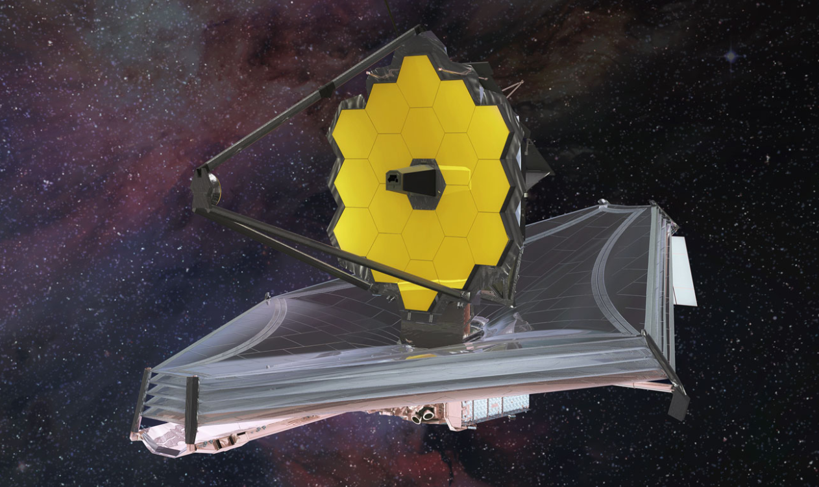
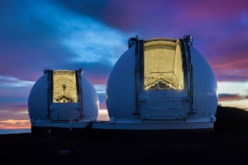
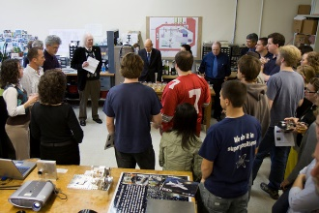
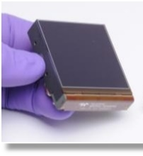
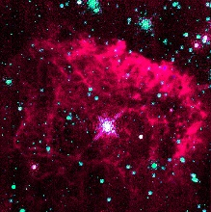
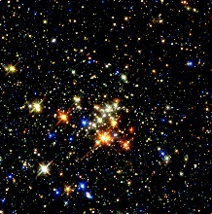
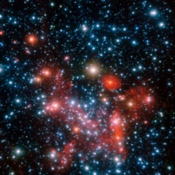
Don Figer - Speaker Bio
Professor in College of Science at RIT
Professor in Astrophysical Sciences and Technology Graduate Program
Director of the Center for Detectors
Director of the Future Photon Initiative
At RIT since 2006
Previously
  Space Telescope Science Institute (operates Hubble and JWST)
  UCLA (designed optics for infrared spectrograph on Keck)
Research Interests: Detectors, Massive Stars, Massive Star Clusters, Galactic Center

Slide 4
Future Photon Initiative

Slide 5
Future Photon Initiative
The Future Photon Initiative develops photonic devices in pursuit of answers to grand questions, leveraging efforts of existing RIT research groups using the generation, transmission, manipulation, absorption, and detection of photons.
FPI cross-disciplinary teams collaborate with external university groups, industry, and national laboratories to develop new photonic device technology.
Areas include solar energy, biophotonics, high performance imaging, astrophysics, quantum, and communication.
Eight groups: Center for Detectors, Integrated Photonics Group, Nanolithography Research Lab, NanoPower Research Labs, Photonic Systems Lab, Photonics and Optics Workforce Education Research, Semiconductor Nanofabrication Lab, and the Simone Center for Innovation and Entrepreneurship.

Slide 6
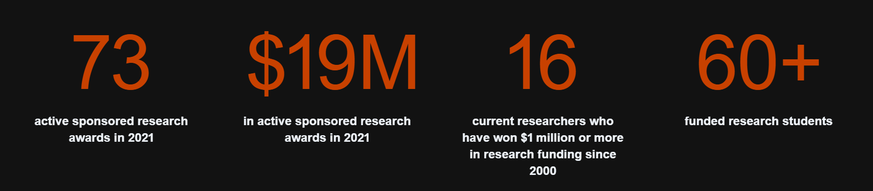
FPI Research Funding

Slide 7
Center for Detectors

Slide 8
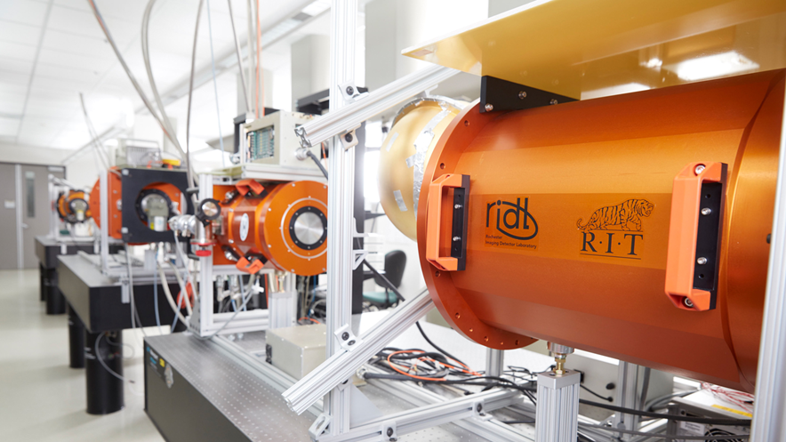
Center for Detectors
CfD designs, develops, and implements photon devices to enable scientific discoveries. | CfD trains students through research and development in detectors, instrumentation, observational astrophysics, nanostructures, silicon photonics, quantum optics and photonics, and wide bandgap materials. | The CfD was established in 2010, and includes seven professors and over two dozen students at all levels of matriculation. | Staff and student researchers investigate high impact engineering and development problems through external financial support from federal agencies, private foundations, national laboratories, and industry. | The CfD operates nine laboratories in three buildings and has an average of 32 externally funded projects (~$2.5M/year).

Slide 9
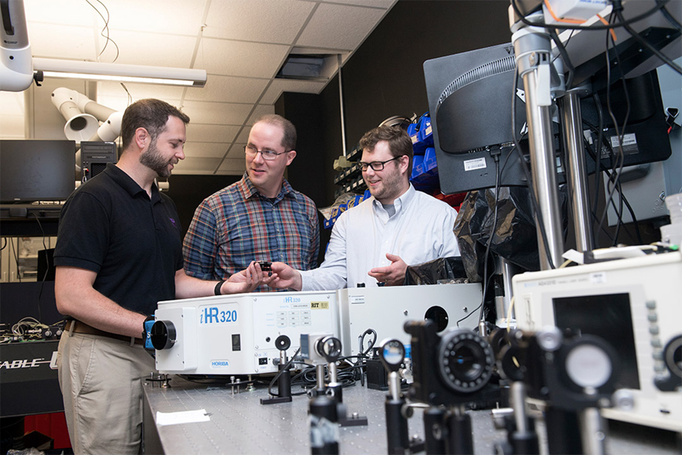
Integrated Photonics Group
The RIT Integrated Photonics Group conducts research in the Lobozzo Photonics and Optical Characterization lab. | Dr. Preble and his team develop high performance nanophotonic devices and systems using complementary metal-oxide-semiconductor compatible materials and processes. | Their work enables unique performance and efficiency by leveraging the inherently high bandwidths and low power of photons with the intelligence of electronics.

Slide 10
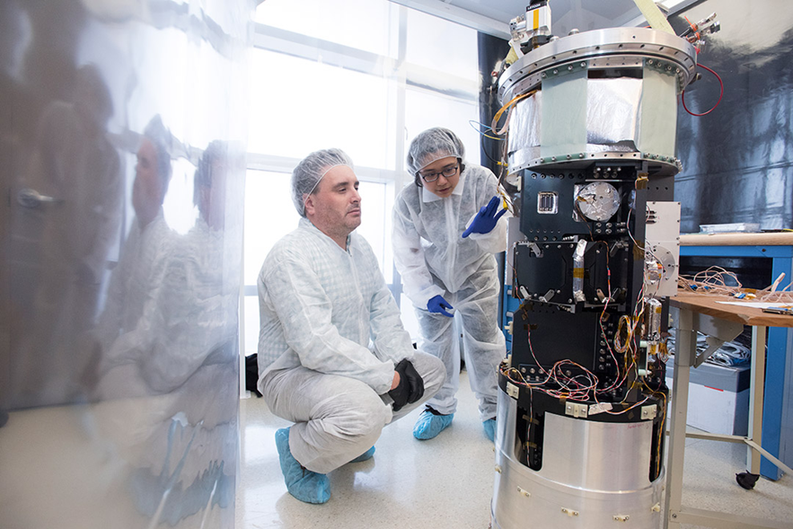
Suborbital Astrophysics Lab
The Suborbital Astrophysics Laboratory designs, integrates, and launches sounding rocket payloads for astrophysical science. | It includes clean facilities to allow disassembly and assembly of rocket instruments, optical and electronic development and validation instruments, and cryogenic and vacuum capabilities. | In this lab, Dr. Zemcov and his team prepared the CSTARS and CIBER-2 payloads for flight at White Sands Missile Range, NM.

Slide 11
CMOS Imaging Detectors for Space

Slide 12
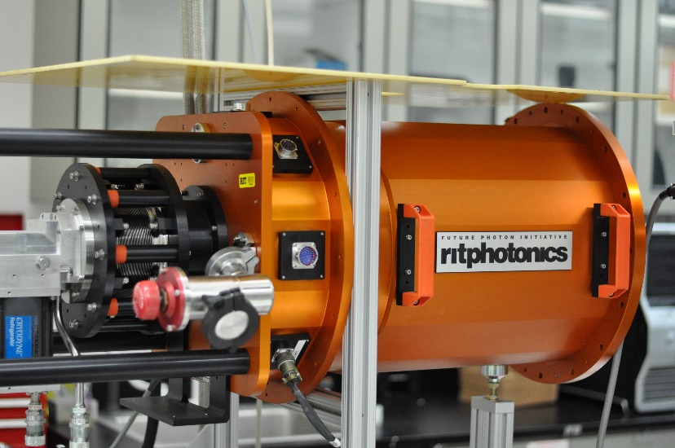
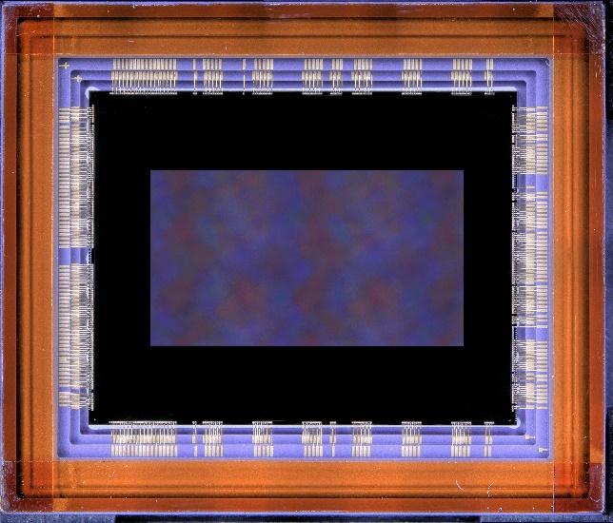
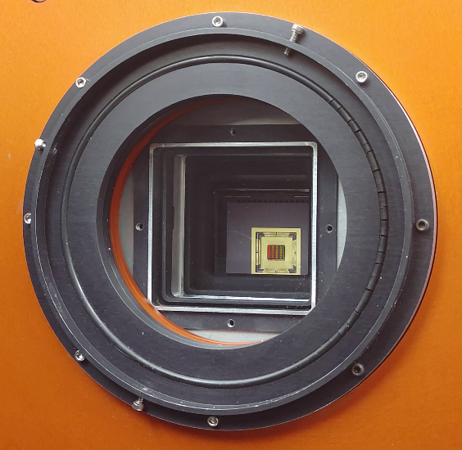
Advancing Radiation-Tolerant CMOS
Detectors for NASA Missions
Strategic Astrophysics Technology 2022: 80NSSC24K0372
Early Stage Innovations 2023: 80NSSC24K0279
PI: Don Figer

Slide 13
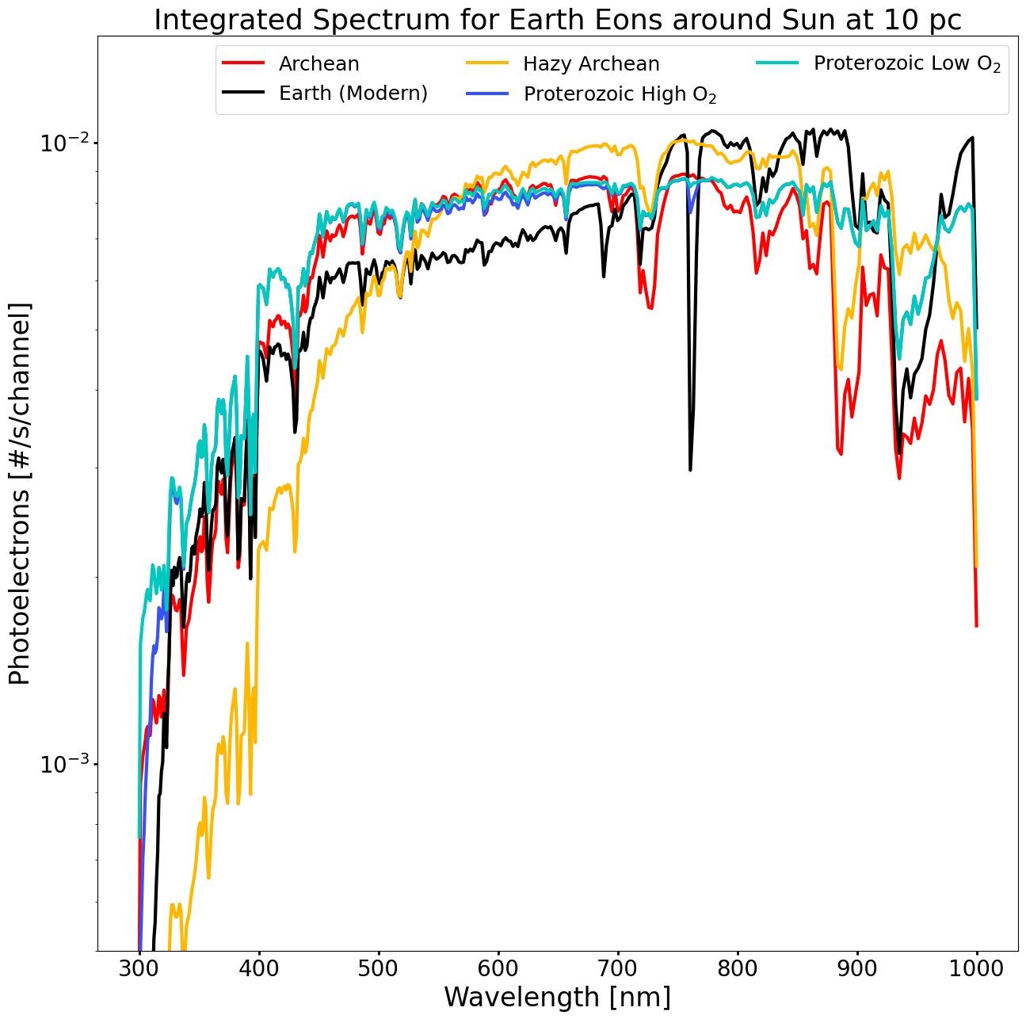

Life in the Universe

Slide 14
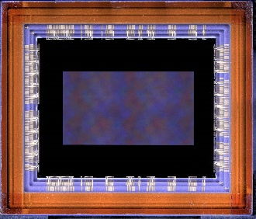
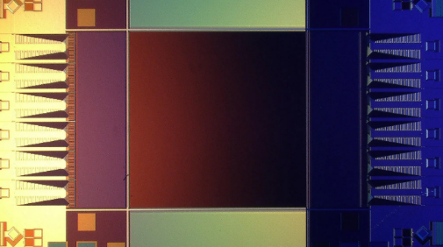
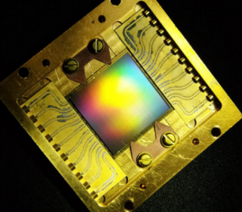
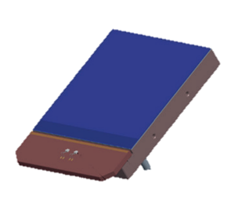
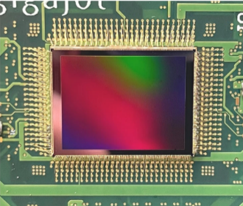
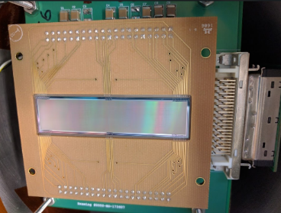
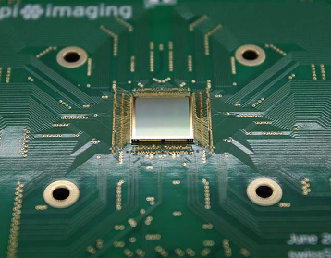
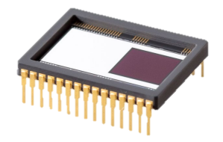
State of the Art Detector Candidates for Future Missions
challenging requirements for UV/O/IR observations
single-photon sensing
low dark current
near-zero read noise
multiple candidate detector technologies
CMOS: 9.4 Mpix
BAE HWK4123
SNSPD: 0.4 Mpix (Adam McCaughan/NIST)
MKID: 20 kpix (Mazin Lab, Breckenridge 2021)
CMOS: Teledyne e2v CIS301/302
EMCCD: Teledyne e2v CCD351-00
CMOS: 163 Mpix QIS (Ma et al. 2022)
Skipper CCD: 3.5 Mpix (SENSEI Collaboration)
SPAD: Pi Imaging SPAD 512² (Antolovic et al. 2022)

Slide 15
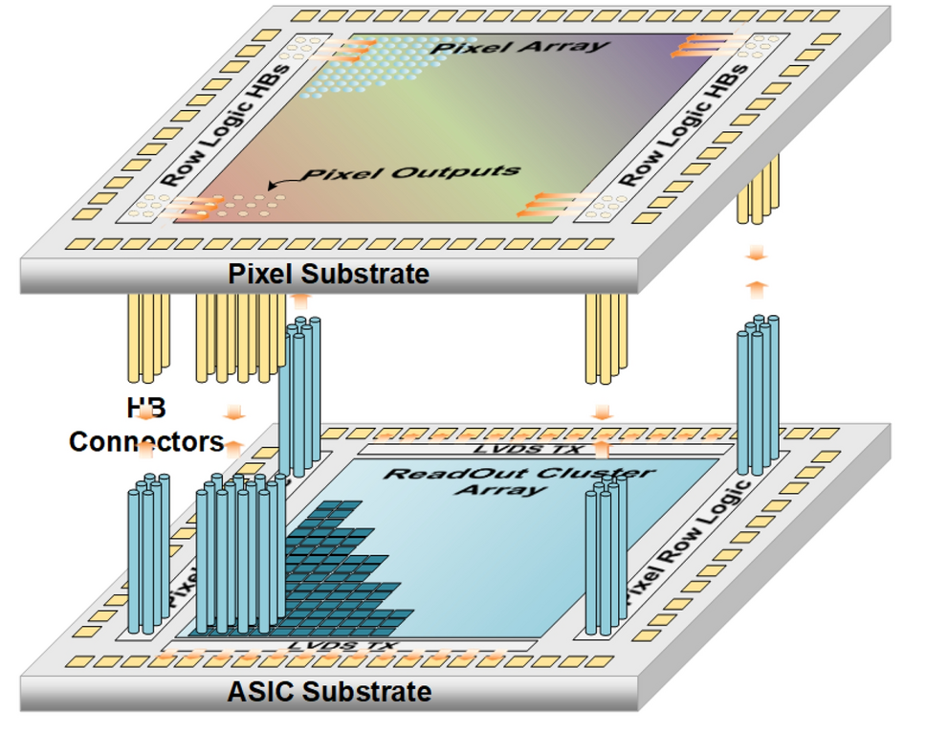
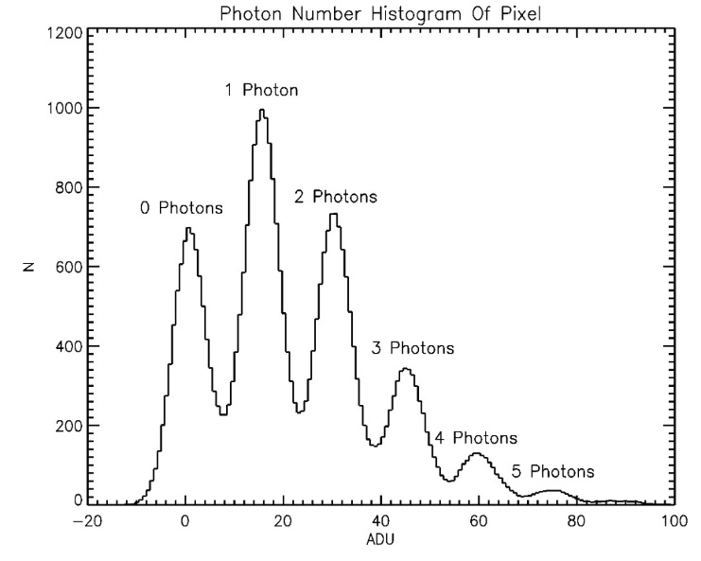
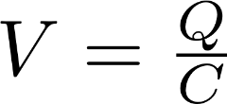
Single Photon Sensitivity
low-capacitance floating diffusion sense node
high-gain response of >320 μV/e-
exceeds electronics read noise
correlated double/multiple sampling
discrete photoelectron peaks
Ma, J. et al. Ultra-high-resolution quanta image sensor with reliable photon-number-resolving and high dynamic range capabilities. Sci Rep 12, 13869 (2022). https://doi.org/10.1038/s41598-022-17952-z

Slide 16
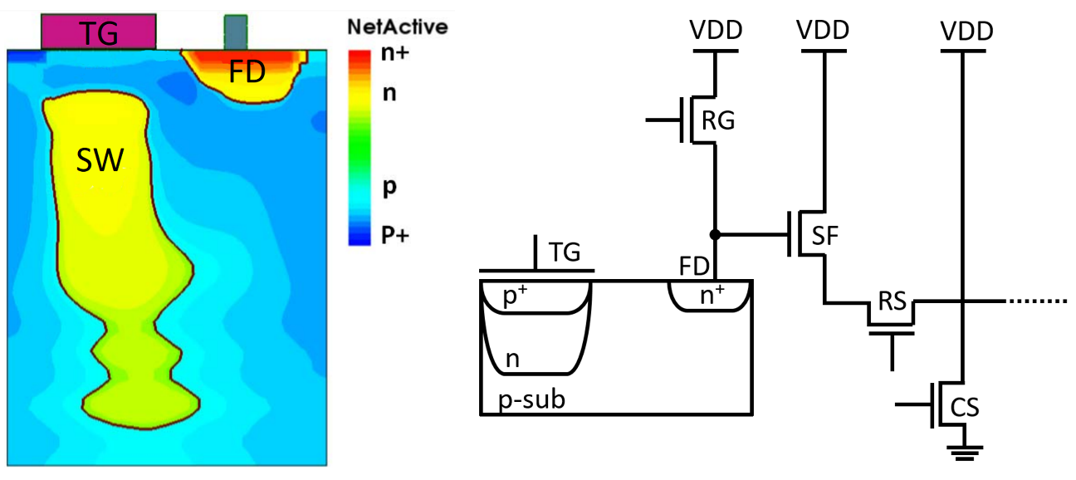

Single Photon Detector Operation

Slide 17
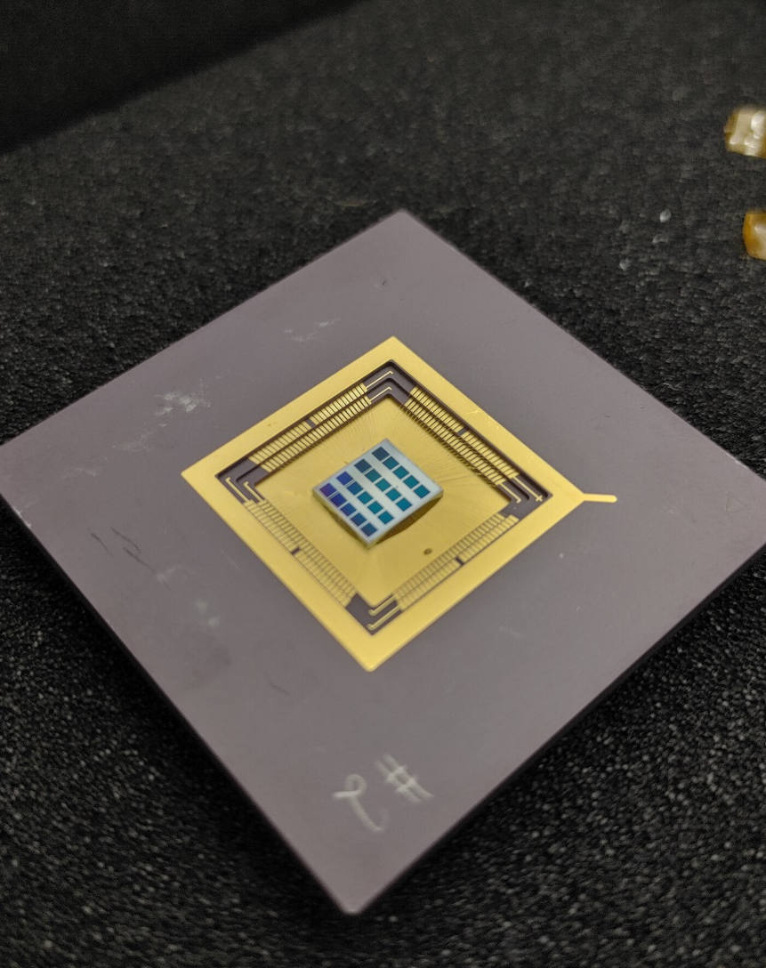
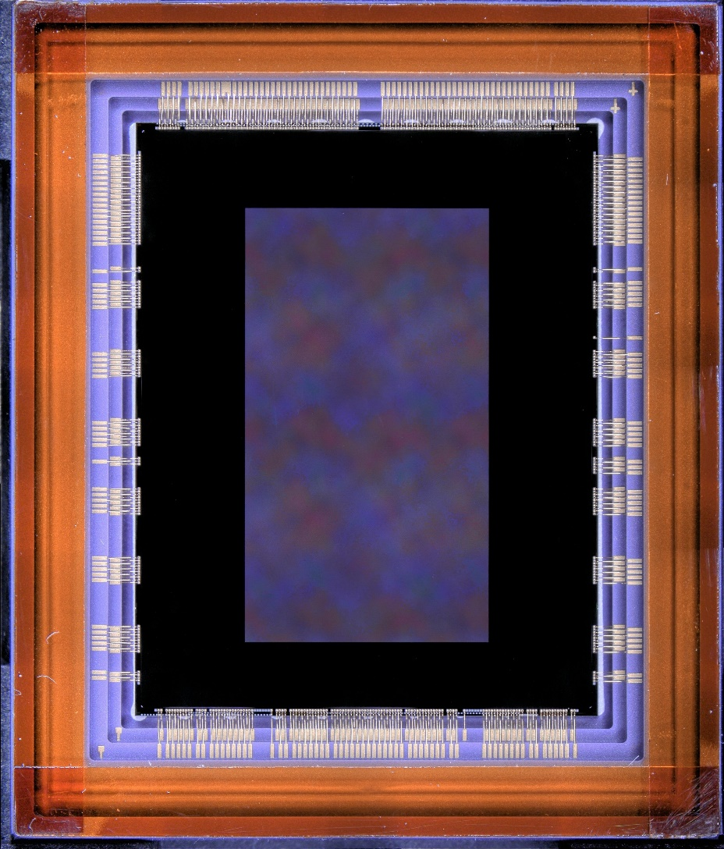
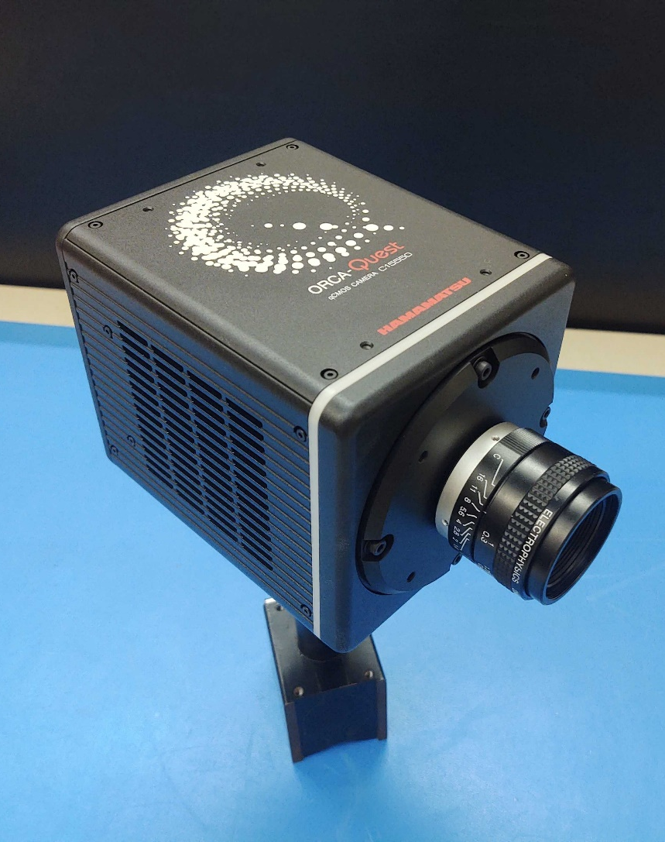
Single-Photon CMOS Image Sensors
QIS CMOS
1 Megapixel Sensors
1.1 μm pixels
HWK4123
9.4 Megapixel
4.6 μm pixels
ORCA-QUEST
HWK4123

Slide 18
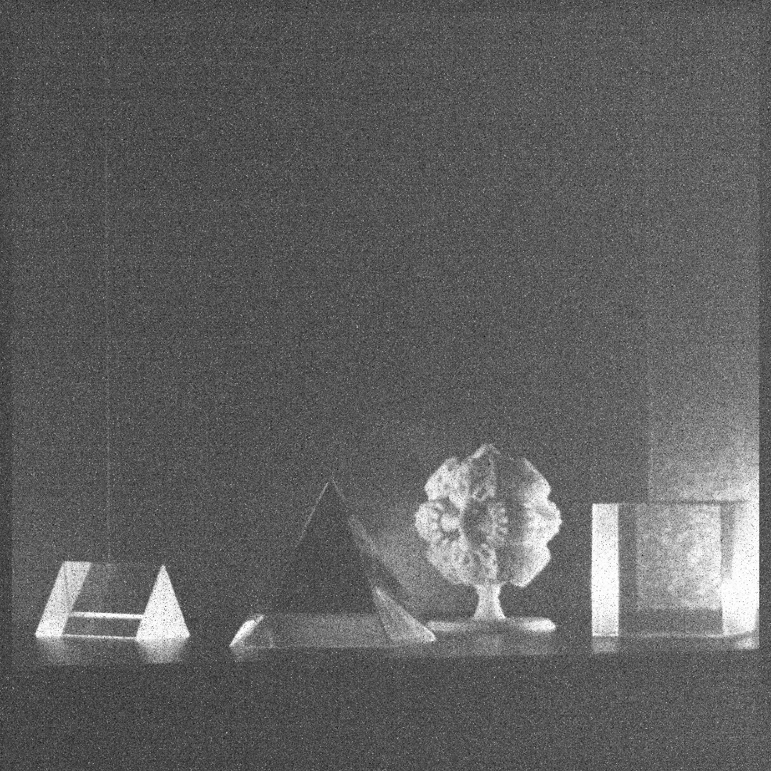
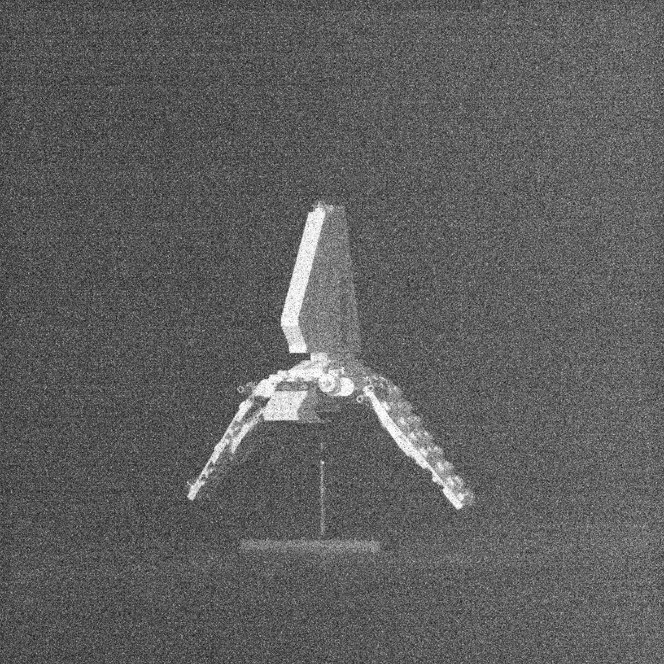
Single Photon Images
e⁻
e⁻
e⁻
e⁻
e⁻
e⁻
e⁻
e⁻

Slide 19
Sensor Parameters and Performance
Sensor Parameters
Parameter | Unit | QISSAT1-2 | HWK4123
Format | - | 1024 × 1024 | 4096 × 2304
Pixel Size | μm | 1.1 | 4.6
Sensor Performance Metrics
Dark Current | e⁻/pix/s | 0.0004 (253 K) | 0.006 (233 K)
Quantum Efficiency | % (325 nm) | 35 | 60
 | % (500 nm) | 83 | 87
 | % (940 nm) | 7 | 36
Read Noise (median) | e⁻ | 0.27 | 0.23
Full Well Depth | e⁻ | 275 | 7000
Fill Factor | % | 100 | 100
Frame Rate | fps | up to 30 | up to 120
Current TRL | - | 5 (pixels) 4 (ROIC) | 4

Slide 20
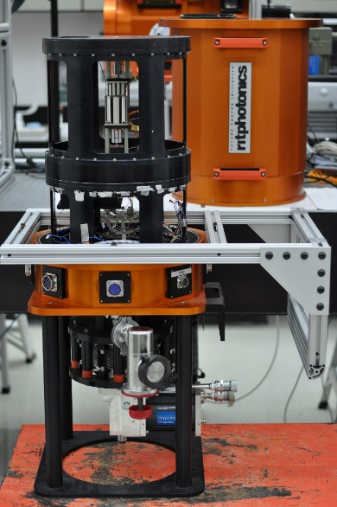
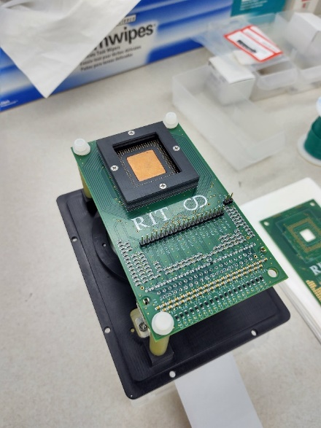
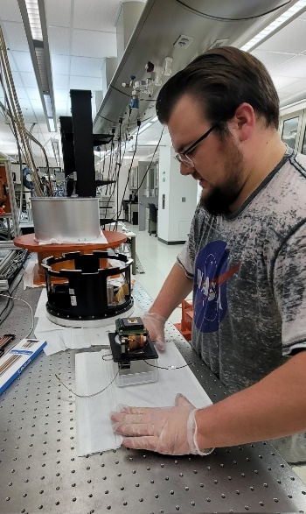
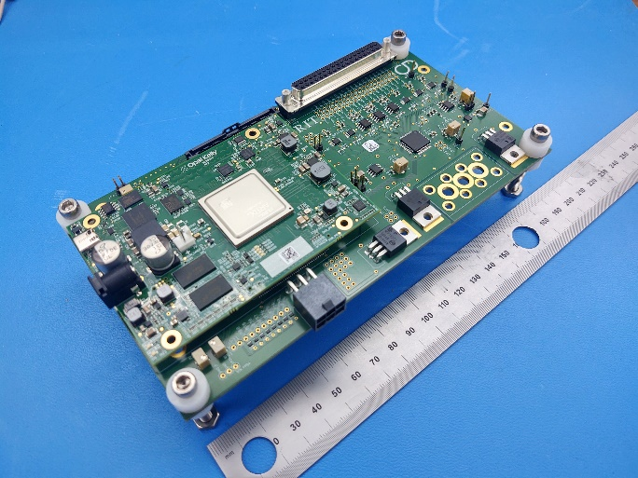
New FPGA-based Electronics

Slide 21
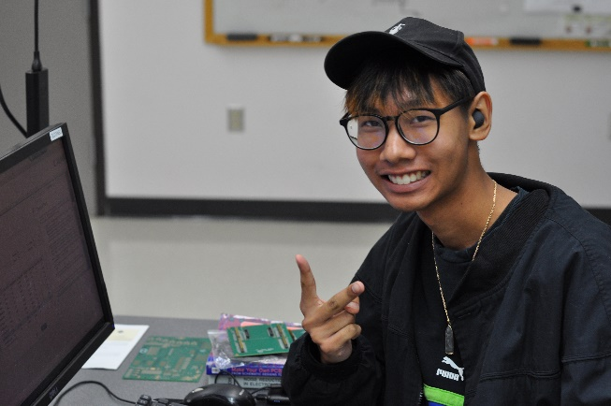
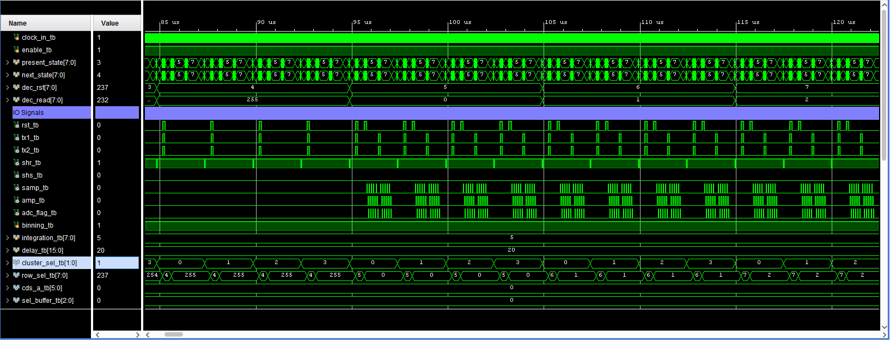
Radiation Mitigation Readout Modes
create and validate single event upset mitigation readout modes
develop and test damage mitigation operational modes
leverage CMOS digital pixel multiplexing
generate modular waveforms for custom readout
verify performance of custom modes at radiation beam line
advance new readout modes beyond TRL2

Slide 22
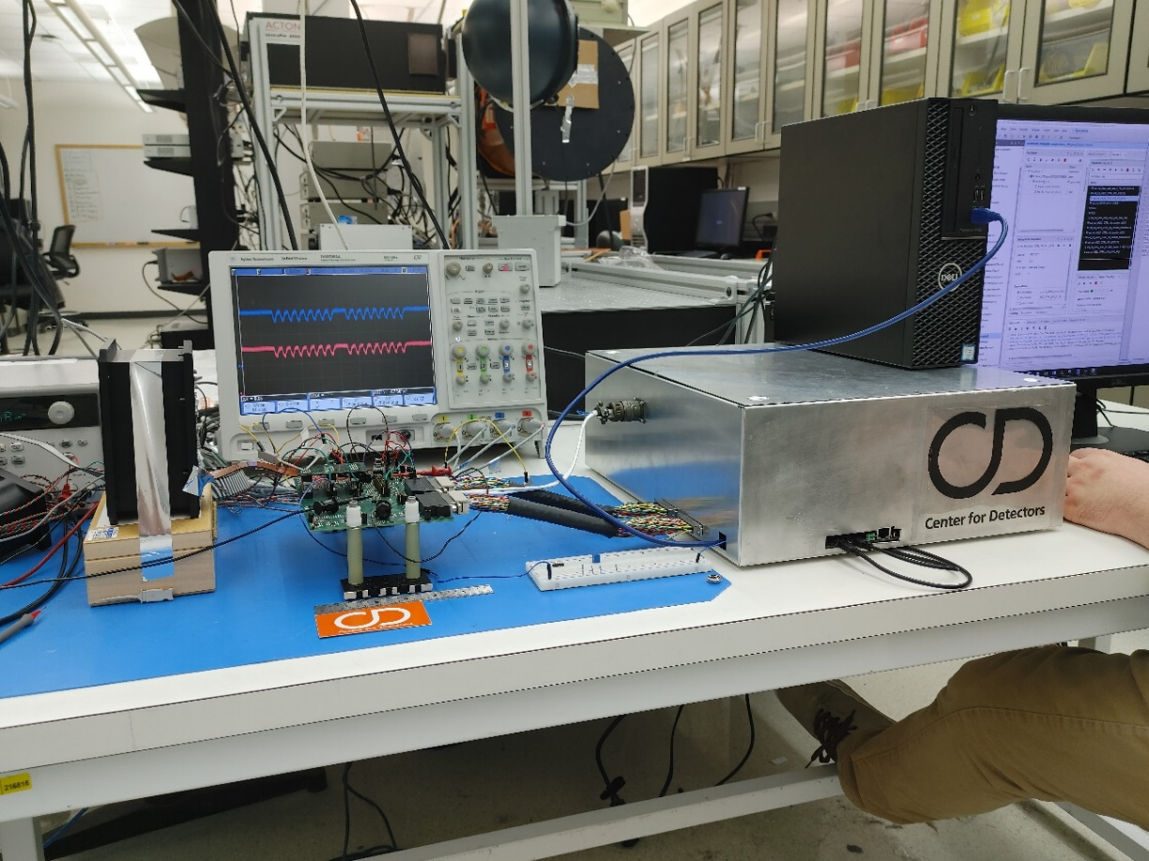
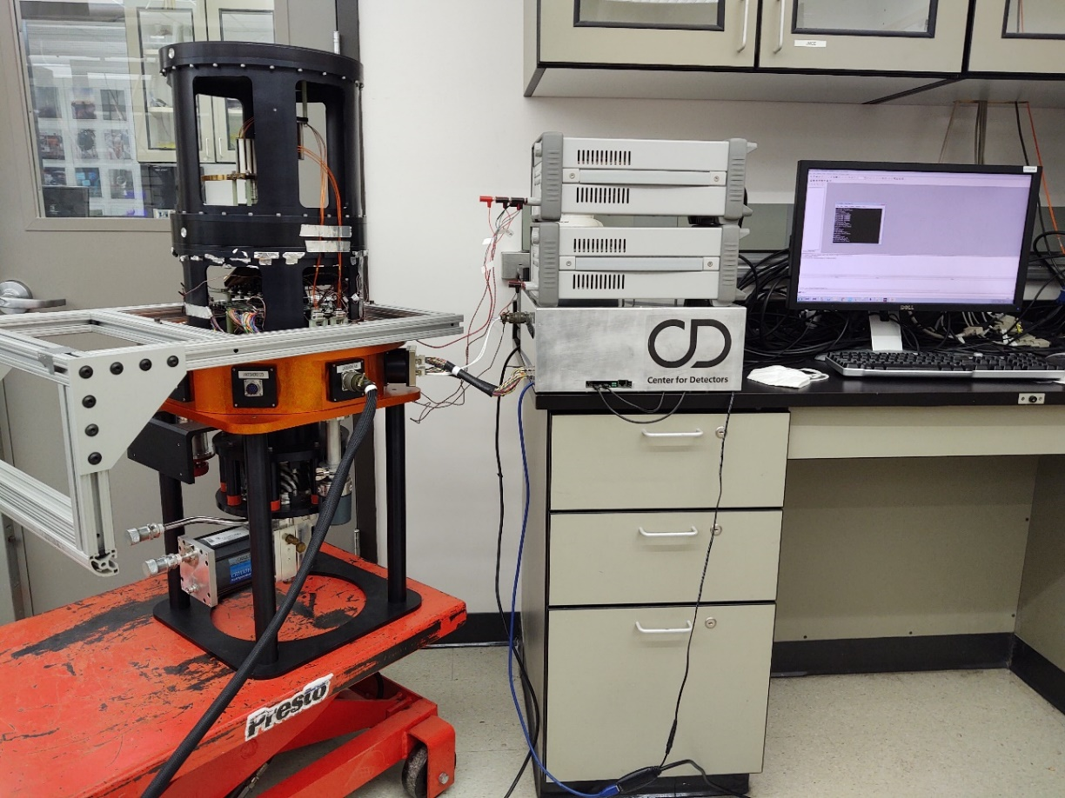
Custom Cryogenic and Vacuum Safe Readout Electronics

Slide 23
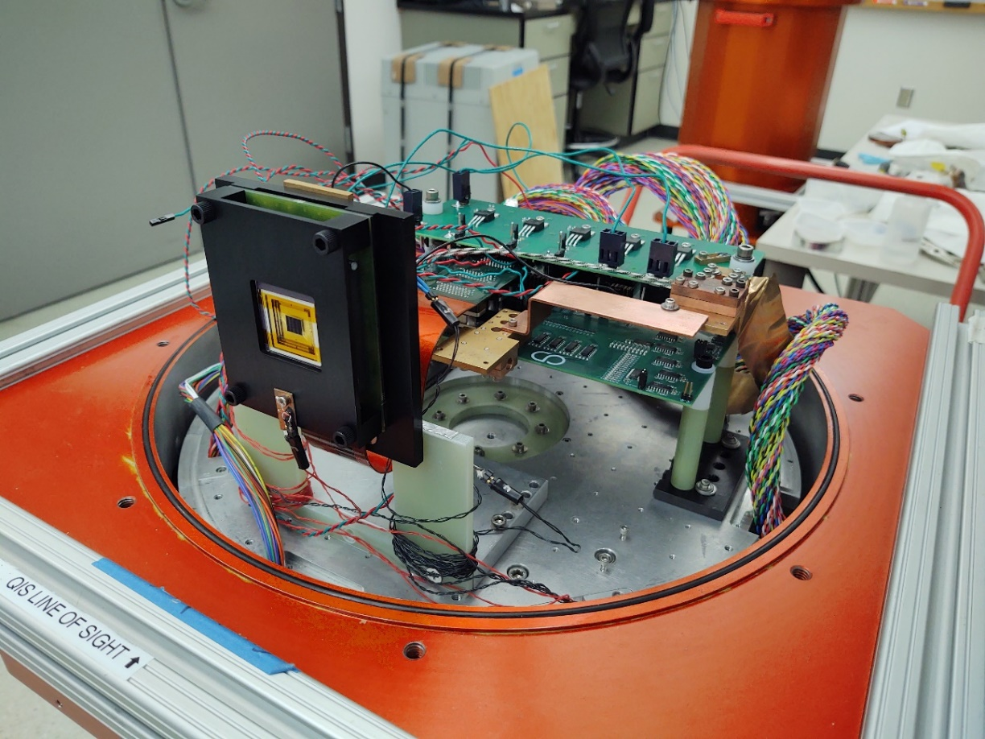
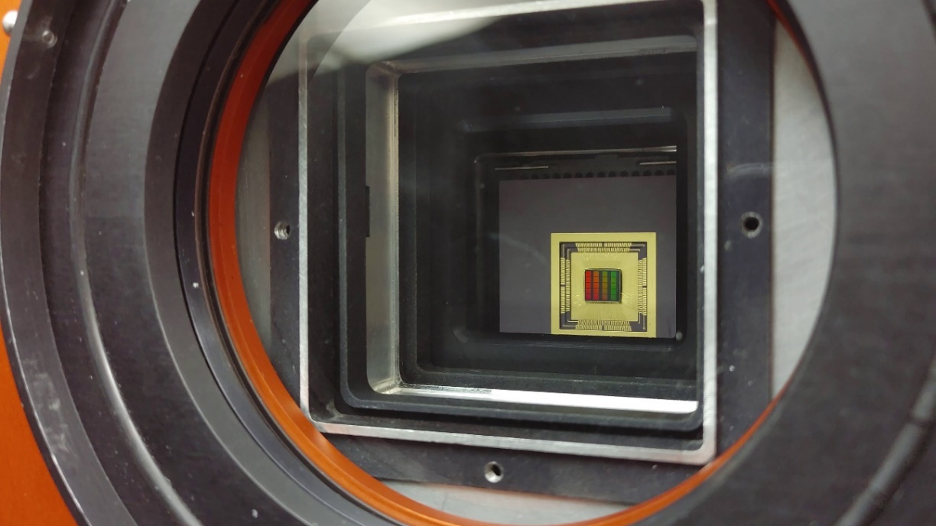
Detector Mounted for Radiation (left) and Optical (right) Testing

Slide 24
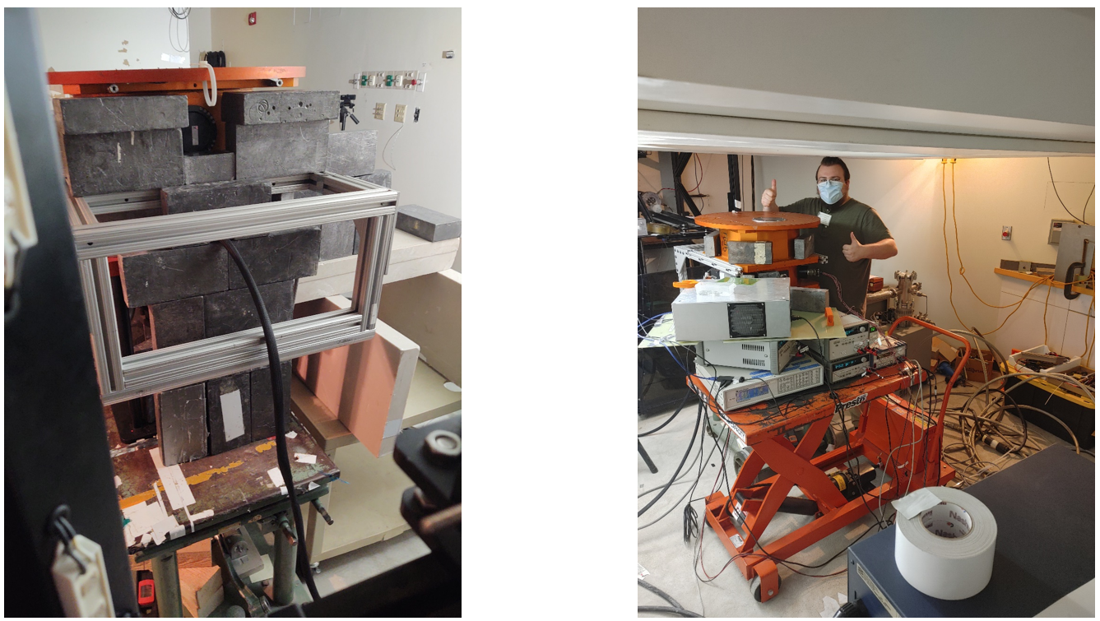
Dewar and Detector at the Proton Radiation Testing Facility

Slide 25
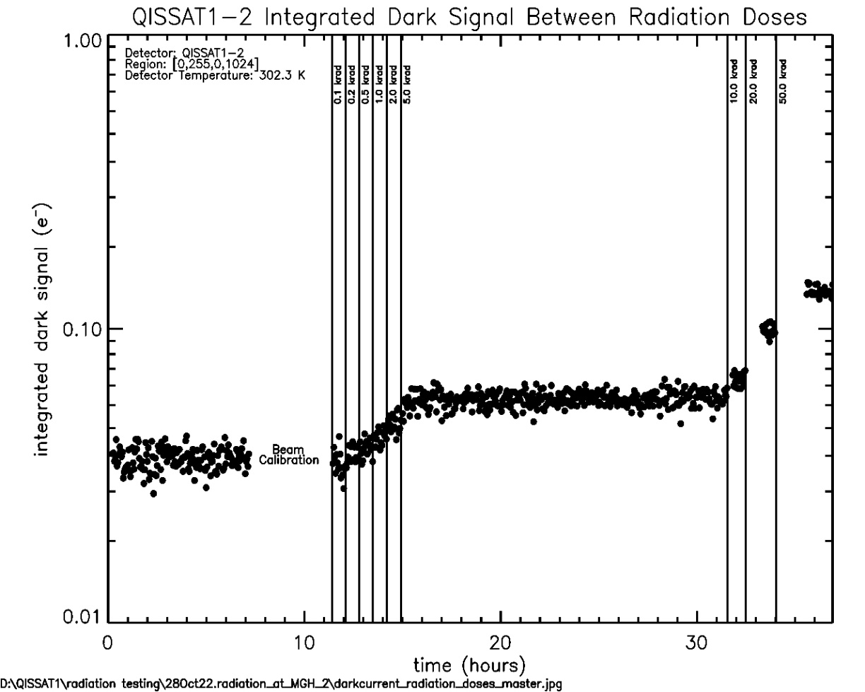
Integrated Dark Signal as a Function of Radiation Dose

Slide 26
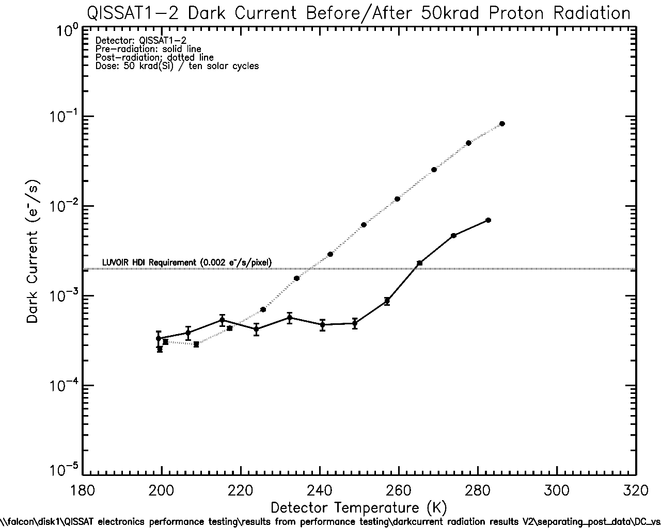
Dark Current After Irradiation
Doubling Temperature =~8.5K

Slide 27
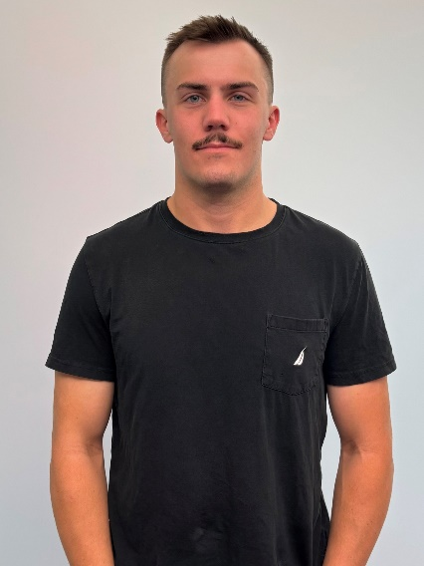
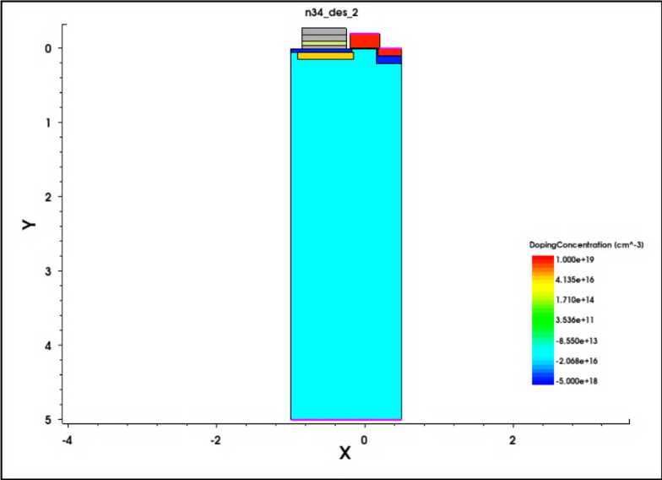
Single-Photon Sensing NIR Photodiode
develop Si TCAD model of pixel using Synopsys Sentaurus
demonstrate pixel operation and low-capacitance sense node
migrate structure to MCT material platform
simulate photodiode performance and compare to Si predecessor
advance single-photon sensing and photon-number resoling NIR photodiode beyond TRL2

Slide 28
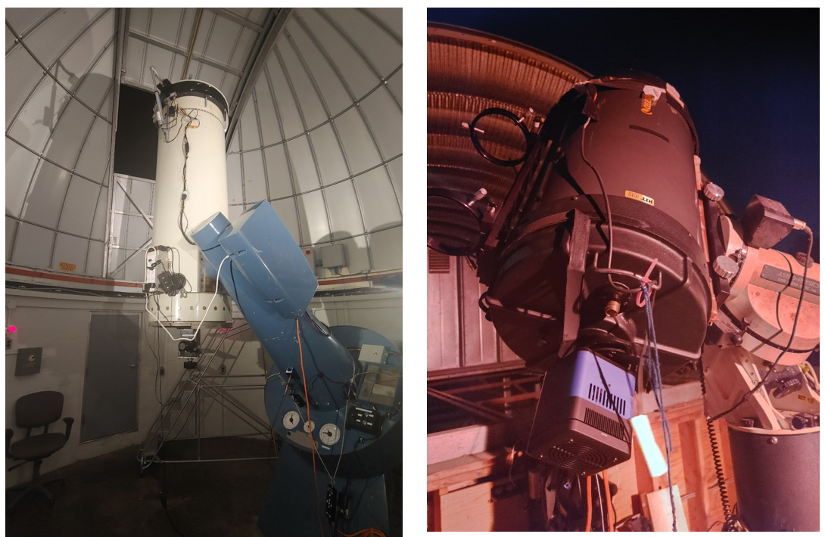
Telescopes at UofR’s Observatory (left) and RIT’s Observatory (right)

Slide 29


Image of Lunar Terminator and Saturn
Gallagher, J., Buntic, L., Figer, D. F., and Deng, W. 2022, “Characterization of single-photon sensing and photon-number resolving CMOS image sensors,” SPIE Astronomical Telescopes and Instrumentation, Montreal, Paper 12191-28

Slide 30

Raw image of M67 using QISCDK
Gallagher, J., Buntic, L., Figer, D. F., and Deng, W. 2022, “Characterization of single-photon sensing and photon-number resolving CMOS image sensors,” SPIE Astronomical Telescopes and Instrumentation, Montreal, Paper 12191-28

Slide 31


Team Members

Slide 32

Summary
challenging science
observe low photon flux sources
detect biosignatures on exoplanets
develop detector technologies for HWO single-photon sensing in UV, optical, and NIR
Recent Publications:
Gallagher, J. P., Buntic, L., Deng, W., Fossum, E. R., and Figer, D. F. 2024, Radiation tolerance of a single-photon counting complementary metal-oxide semiconductor image sensor, J. Astron. Telesc. Instrum. Syst. 10(3), 036003, doi: 10.1117/1.JATIS.10.3.036003.
Gallagher, J. P., Buntic, L., Alexani, E., Bouthsarath, K., and Figer, D. F. 2024, Characterizing radiation-tolerant single photon resolving CMOS detectors, Proceedings Volume 13103, X-Ray, Optical, and Infrared Detectors for Astronomy XI; 131030S, Yokohama, Japan, https://doi.org/10.1117/12.3019105.
Gallagher, J. P., Buntic, L., Figer, D. F., Deng, W. 2024, Characterization of single-photon sensing and photon-number resolving CMOS image sensors, Proc. SPIE 12191, X-Ray, Optical, and Infrared Detectors for Astronomy X, Montreal, Canada, https://doi.org/10.1117/12.2629006

Slide 33







































CfD Students

Slide 34







CfD Professors
Don Figer
Stefan Preble
Zoran Ninkov
Parsian K. Mohseni,
Dorin Patru
Michael Zemcov
Jing Zhang

Slide 35
FPI Professors

Slide 36


Don Figer
Ed Hach
Director | Future Photon Initiative | Center for Detectors
Professor | College of Science
Assistant Professor | School of Physics & Astronomy
Dr. Figer researches massive stars, massive star clusters, the Galactic center and advanced detectors for cross-disciplinary applications. Other research interests include developing integrated sensor systems on a wafer and development of a single photon sensing and photon number resolving detector.
Dr. Hach researches quantum information processing using entanglement as a practical manageable resource. His work considers single and multi-photon interactions that provide higher sensitivity and lower power operation than electronic components with similar functionality. He also investigates continuous variable quantum systems for use in quantum systems.
.
figer@cfd.rit.edu
eehsps@rit.edu

Slide 37


Karl Hirschman
Mishkat Bhattacharya
Director | Semiconductor & Microsystems Fabrication Laboratory
Professor | Elec. & Microelectronic Eng.
Professor
School of Physics and Astronomy
College of Science
Dr. Hirschman researches silicon and metal-oxide thin-film electronics in the Thin Film Electronics group. The group’s thin-film transistors using sputter-deposited Indium-Gallium-Zinc-Oxide demonstrate results among the best reported in the literature. His research focuses on low-temperature polycrystalline silicon explores alternative methods of crystallization using a flash-lamp annealing process.
Dr. Mishkat Bhattacharya is a Professor of Physics and Astronomy at the Rochester Institute of Technology. He is a program faculty in the Center for Imaging Sciences at RIT and a member of the Center for Coherence and Quantum Optics at the University of Rochester. Dr. Bhattacharya teaches freshman mechanics, modern physics, quantum mechanics, and quantum optics. He reviews regularly for journals such as Physical Review Letters, the Journal of Physics B, and the American Journal of Physics.
kdhemc@rit.edu
mxbsps@rit.edu

Slide 38


Seth Hubbard
Santosh Kurinec
Director | NanoPower Research Labs
Professor | School of Physics & Astronomy | PhD Microsystems Engineering
Professor | Electrical & Microelectronic Engineering
Dr. Hubbard leads a team of undergraduate and graduate students and research staff working on the epitaxial growth, fabrication and characterization of nanostructured solar photovoltaic devices. His group's expertise involves vapor phase epitaxy of photovoltaic devices and nanostructures, nanostructured device design, photovoltaic characterization as well as testing.
Dr. Kurinec’s research activities include nonvolatile memory, photovoltaics, advanced integrated circuit materials and processes. Her nonvolatile memory research has focused on magnetic tunneling and phase change memory devices. Her photovoltaics research is collaborative with other research centers, where she brings her experience of integrating a wide range of electronic materials on silicon platforms.
smhsps@rit.edu
skkemc@rit.edu

Slide 39


Cristian Linte
Drew Maywar
Associate Professor | Biomedical Engineering
Associate Professor | Electrical, Computer, and Telecommunications Engineering Technology
Dr. Linte’s research interests focus on exploring the use of medical imaging to generate new paradigms for image-guided visualization and navigation for minimally invasive therapy. His research endeavors employ both technologies and techniques toward the development, evaluation, and pre-clinical integration of image guidance environments for surgical navigation of minimally invasive cardiac interventions.
Dr. Maywar researches fiber-optic networks and communication systems, all-optical signal processing, photonics and opto-electronics, optical phenomenon, and nonlinear optics. The Photonics Systems Research group investigates both digital and analog optical-communication systems, with particular interest in polarization diversity, multi-level phase and power modulation schemes, and nonlinear optical-domain signal processing.
calbme@rit.edu
drew.maywar@rit.edu

Slide 40


Parsian Mohseni
Jie Qiao
Assistant Professor | Microsystems Engineering PhD
Associate Professor
Chester F. Carlson Center for Imaging Science
College of Science
Dr. Mohseni’s research interests are cross-disciplinary in nature, spanning the fields of solid state physics, optoelectronics, materials characterization, nano-engineering, and physical chemistry. His research aims to establish innovative synthesis paradigms that allow for precise manipulation of material properties at the nanometer scale and enable next-generation device technologies in optoelectronics, photonics, nanoelectronics, and photovoltaic energy conversion.
Jie Qiao is an Associate Professor in the Carlson Center for Imaging Science at Rochester Institute of Technology. She leads the Advanced Optical Fabrication, Instrumentation & Metrology Laboratory where her team of graduate students and postdocs work on ultrafast-lasers-enabled advanced photonics/optics / waveguide laser fabrication, wavefront sensing, and spatial-temporal control of laser beams.
pkmohseni@rit.edu

Slide 41


Zoran Ninkov
Robert Pearson
Professor | Chester F. Carlson Center for Imaging Science
Associate Professor | Electrical and Microelectronic Engineering
Dr. Ninkov researches and develops instruments and detectors for astronomy, remote sensing, and other applications. His group is developing digital micromirror devices for use in space, Terahertz detector technology for inspection applications, and quantum dot coated detector arrays for enhanced deep ultraviolet sensitivity. He and his team are building a multi-object spectrograph for the SOAR 4.1 meter telescope in Chile.
Dr. Pearson researches semiconductor processing, device characterization, micro-electro-mechanical systems design, device simulation, fabrication and testing. Dr. Pearson teaches VLSI design, semiconductor processing, semiconductor devices, memory systems, and electronics.
ninkov@cis.rit.edu
repemc@rit.edu

Slide 42


Stefan Preble
Alireza Vahid
Professor | Microsystems Engineering Ph.D
Associate Professor
Kate Gleason College of Engineering
Dr. Preble researches silicon photonic devices with the goal of realizing applications that leverage high speed, bandwidth and sensitivity of light. His Integrated Photonics group develops silicon photonic chips that will revolutionize computing, communication, and sensing systems. The group’s key research areas are optical interconnects for chip-to-chip and on-chip low energy communications, silicon compatible nonlinear optics, quantum optical computing and communication, and ultra-sensitive optical sensing.
Dr. Vahid’s research is inspired by the challenges of wireless networks beyond 5G (B5G), sequence assembly, and modern data storage technologies. He is a Gleason Endowed Associate Professor of Electrical and Microelectronic Engineering and a member of ESL Global Cybersecurity Institute at Rochester Institute of Technology.
sfpeen@rit.edu
arveme@rit.edu

Slide 43


Sean Rommel
Ke Xu
Director| Microelectronic Engineering
Professor | Electrical and Microelectronic Engineering
Assistant Professor
School of Physics and Astronomy
College of Science
Dr. Rommel researches nanoelectronic devices and circuits, photonic and optoelectronic devices/circuits, and advanced semiconductor fabrication techniques. He develops III-V material systems for growth on silicon substrates and has demonstrated the co-integration of CMOS devices and resonant interband tunnel diodes.
Dr. Ke Xu’s research is focused on two-dimensional (2D) materials-based nanoelectronic and iontronic (Ion-controlled electronic) devices, with the focus on understanding ion-electron transport at the molecular level, for application in next-generation energy-efficient electronic devices at the limit of scaling for memory, logic, energy storage, neuromorphic computing, and quantum information science.
slremc@rit.edu
ke.xu@rit.edu

Slide 44


Michael Zemcov
Jing Zhang
Assistant Professor | School of Physics & Astronomy
Assistant Professor | Electrical and Microelectronic Engineering
Dr. Zemcov’s research focus is instrumentation for cosmological observations, including the cosmic microwave and infra-red backgrounds. He develops instruments and data analysis methods for a varitey of platforms, including ground-based, sub-orbital rockets, and orbital observatories. An additional scientific focus is on the epoch of reionization, secondary anisotropies in the cosmic microwave background, and studies of the history of the star formation in the Universe using novel techniques and experiments.
Dr. Zhang’s research focuses on developing highly efficient III-Nitride and GaO semiconductor based photonic, optoelectronic, and electronic devices. Her research group is working on the development of novel quantum well active regions and substrates for enabling high-performance ultraviolet and visible LEDs/ lasers, as well as engineering of advanced device concepts for nanoelectronics.
zemcov@cfd.rit.edu
jzeme@rit.edu

Slide 45

Ben Zwickl
Assistant Professor | School of Physics & Astronomy
Dr. Zwickl researches how students develop experimental and research skills in the undergraduate curriculum and how those skills are applied after graduation. His group investigates the early careers of technicians, engineers, and researchers in optics and photonics to better understand the transition from school to career.
ben.zwickl@rit.edu

