Slide 1



SPW 2011 Single Photon Workshop 2011
Monday 27th June 2011 – Thursday 30th June 2011
PTB Braunschweig, Germany
Single Photon Imaging Array Detectors for
Astrophysics and Biophotonics
Don Figer¹ and Brian Aull²
¹Director, Center for Detectors, Rochester Imaging Detector Laboratory
Professor, College of Science, Astrophysical Sciences and Technology PhD Program, Microsystems PhD Program, Imaging Science
²Staff, MIT Lincoln Laboratory
CfD
Notes:
This talk describes applications for single photon counting imaging array detectors. It also describes projects to develop these detectors. The goal of the Moore project is to develop zero read noise detectors for the Thirty Meter Telescope and other applications. It is a collaboration between personnel at RIT and Lincoln Lab. The duration of the project is four years, and the second year is over. At this stage, a 256x256 hybrid is being tested.

Slide 2
Outline
Motivation for Single Photon Detectors
Applications
  Outer Space: the Universe
  Inner Space: Biophotonics
Status of Current Projects
  photon-counting detector for astrophysics
  imaging LIDAR detector for planetary missions
Future Directions
Notes:
This slide gives the outline of the whole talk.

Slide 3
Motivation for Single Photon Detectors
Notes:
This section motivates the desire for single photon detectors.

Slide 4
Detector Properties and SNR
Notes:
Signal to noise ratio depends on detector properties. By reducing detector read noise, SNR increases. Also, the time to achieve a fixed SNR decreases. For photon-starved applications, zero read noise is very important.
4

Slide 5
Quantum-Limited Imaging Detectors
limited by the information carried by a photon
  existence in time and space (x, y, z, t)
  wavelength (λ)
  polarization
“easier said than done…..”
Notes:
Quantum-limited detectors produce signal-to-noise ratio that is dominated by the inherent uncertainty in the photon stream.
5

Slide 6
Outline
Motivation for Single Photon Detectors
Applications
  Outer Space: the Universe
  Inner Space: Biophotonics
Status of Current Projects
  photon-counting detector for astrophysics
  imaging LIDAR detector for planetary missions
Future Directions
Notes:
This slide gives the outline of the whole talk.

Slide 7
Outer Space Applications
Notes:
Outer space applications correspond to “Astrophysics”

Slide 8
Read Noise
Notes:
Lower read noise enables observation of fainter objects, like solar mass stars in the Arches cluster near the Galactic Center.
8

Slide 9
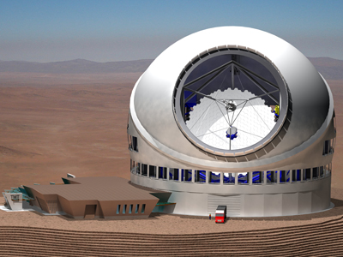
Aperture vs. Read Noise
Notes:
A zero read noise detector would effectively quadruple the collecting power of a telescope in photon-starved applications.
9

Slide 10
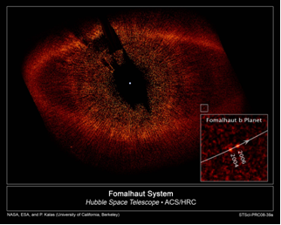
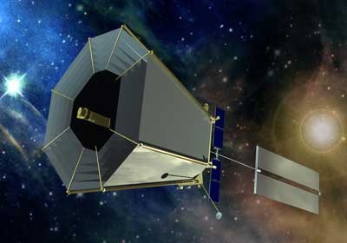
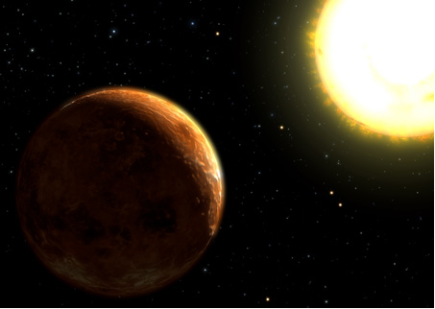
Finding an “Earth”
Notes:
Direct imaging is the method that will be used in a future terrestrial planet finder mission.

Slide 11
Very Low Light Level - ExoPlanet Imaging
The exposure time required to achieve SNR=1 is dramatically reduced for a zero read noise detector, as compared to detectors with state of the art read noise.
Notes:
The table gives exposures times to produce SNR=1 for a typical planet detection space mission. Note the dramatic reduction in time required for a zero noise detector. Ρ=100 is assumed, where R is the ratio of the wavelength to the spectral bandwidth of the system. The effective planet flux is about 10 photons/hour per pixel. The nearby starlight is suppressed at the 10^-10 level by optical nulling. Zodiacal light contributes about 0.0015 electrons/s/pixel.

Slide 12
Hunt for Dark Energy
Brown 2007, PhD Thesis
Notes:
These plots show the error in estimating brightness of supernovae as a function of detector characteristics, i.e. read noise, dark current, and quantum efficiency. Ultimately, these errors map into our understanding of the nature of the Universe, including whether it will expand forever. The Greek letter mu is the conventional symbol for the surface brightness of a celestial object in magnitudes per square arcsec.
12

Slide 13
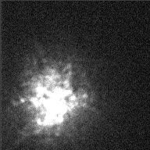
Blurring Effects of Atmosphere
Notes:
The atmosphere is turbulent, and it has a blurring effect on starlight. This movie shows the image of Alpha Orionis as seen through the atmosphere.
13

Slide 14
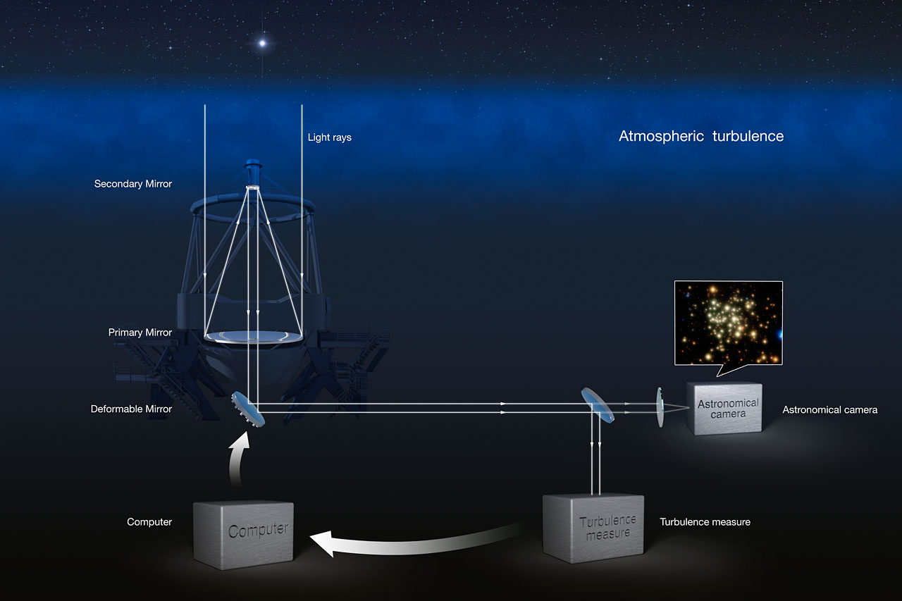
Adaptive Optics System
Notes:
An adaptive optics system removes the blurring effects of the turbulent atmosphere. A deformable mirror adds aberrations to the beam that perfectly remove the aberrations from the atmosphere.
14

Slide 15
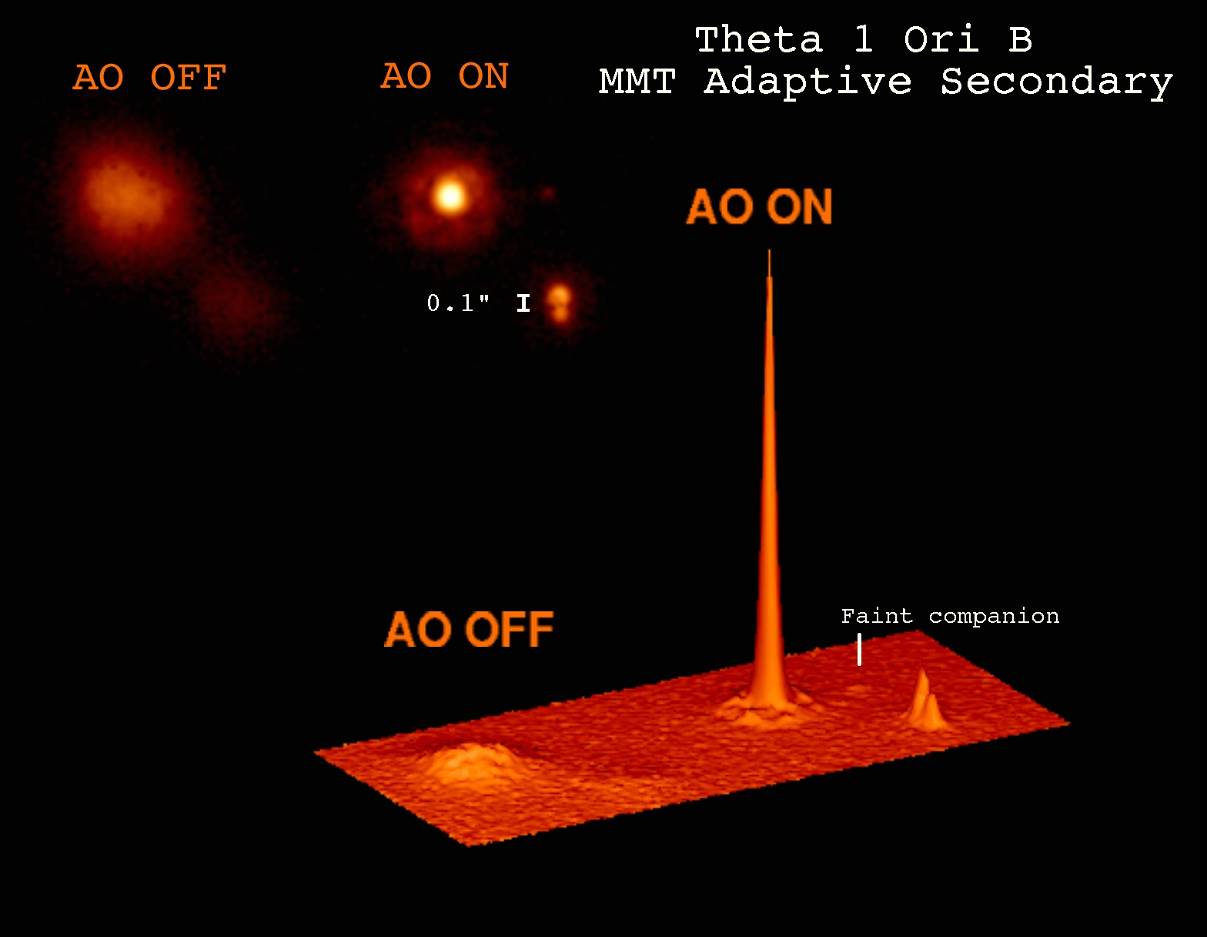
Adaptive Optics Performance
Notes:
A typical AO system will produce a much sharper point spread function, but only if the sampling frequency is much faster than the atmospheric perturbation frequency.
15

Slide 16
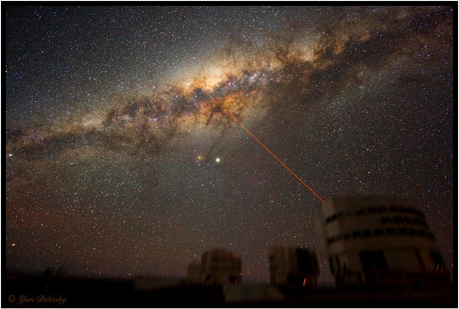
Adaptive Optics Laser Guide Star
Notes:
PARSEC, a joint project by MPE (Garching) and MPIA (Heidelberg), is a sodium line laser which can produce a high quality 12W continuous wave output beam. It is currently installed on Yepun, the fourth 8.2-m unit telescope of the VLT in Chile, as part of the Laser Guide Star Facility. The aim of the LGSF is to substantially increase the sky coverage available to, and hence the scientific potential of, the adaptive optics cameras CONICA (with NAOS) and SPIFFI (as part of SINFONI). This has been achieved as a collaborative effort between the Max Planck Institutes and the European Southern Observatory (who were responsible for the laser clean room, the beam relay, and the launch telescope).
16

Slide 17
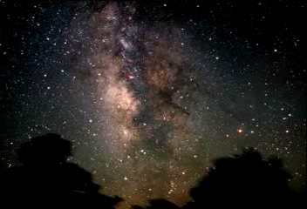
Notes:
The movie shows a “journey” into the Galactic Center, starting with optical wavelengths and then transitioning to IR wavelengths. The supermassive black hole, and surrounding young population of blue stars, can be seen at the end of the movie.

Slide 18

Lick 3-m (1994)
Notes:
This series of images shows the Arches cluster at progressively better spatial resolution.

Slide 19
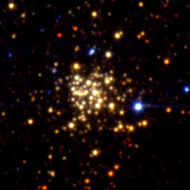
Keck 10-m (1997)

Slide 20
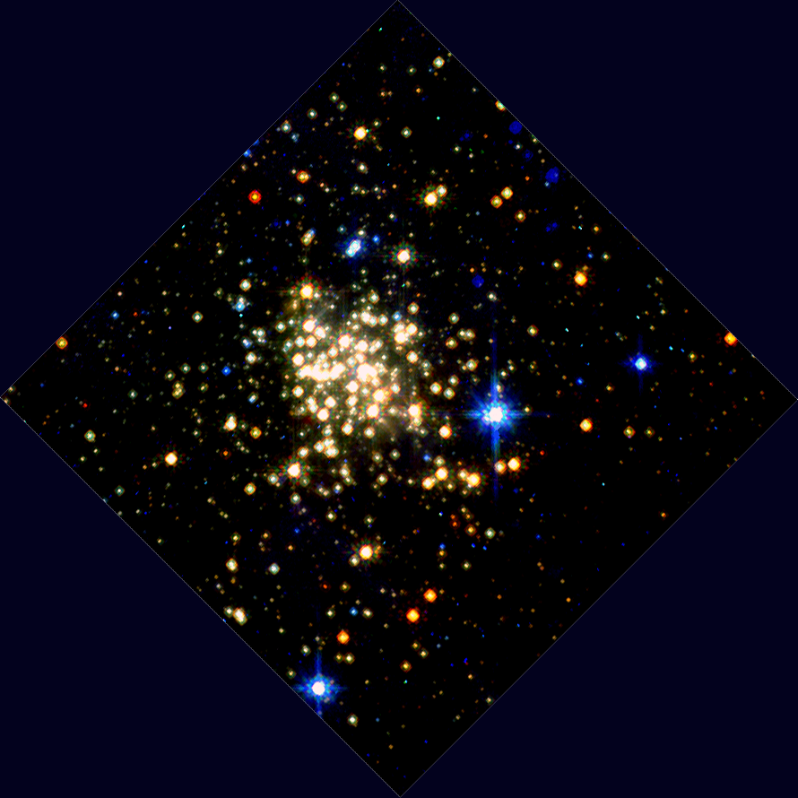
HST/NICMOS (1997)

Slide 21
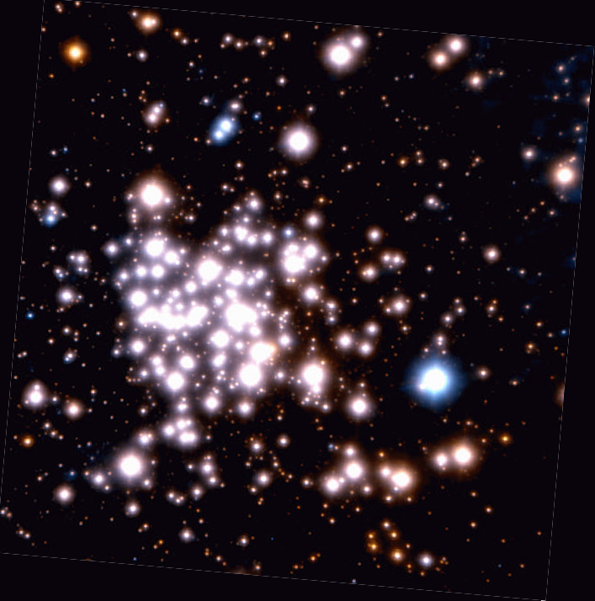
VLT/AO (2002)

Slide 22
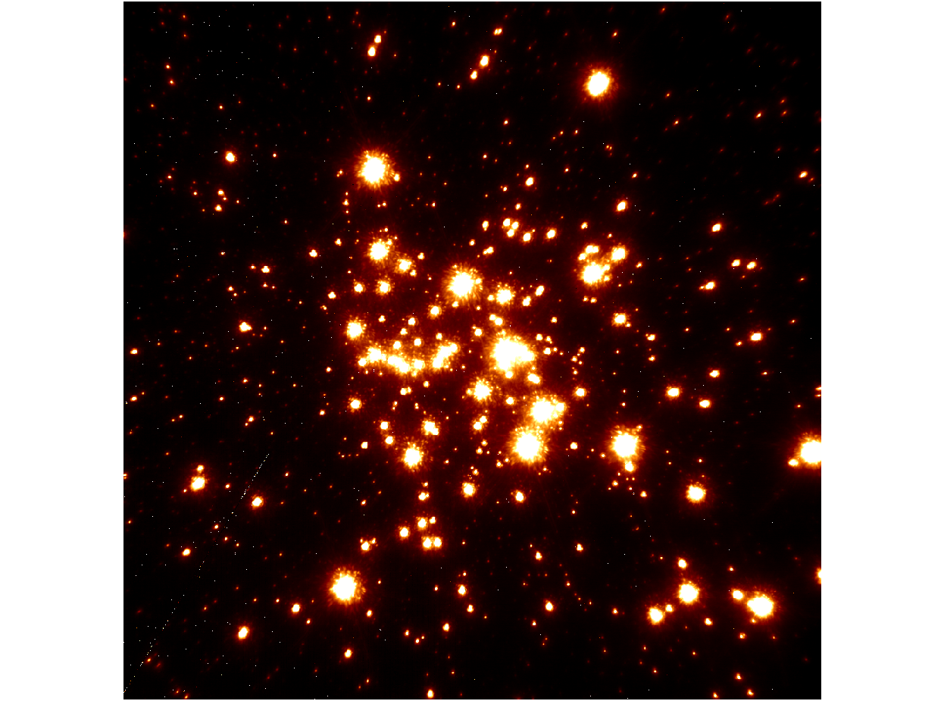
Keck/LGSAO (2006)

Slide 23
Spatial Resolution
Notes:
This figure shows the dramatic improvement in the spatial resolution of one of the most massive young star clusters in the Galaxy obtained over a ten year period, leading to the determination of the full mass function from 130 Msun down to 2 Msun.
23

Slide 24
IR Wavefront Sensor Sensitivity
Notes:
This table gives the limiting magnitude for a wavefront sensing star as a function of read noise and quantum efficiency. A typical detector that is available today has properties that correspond to the red box. The green box shows that a zero noise detector will be able to probe the sky by more than 3 magnitudes fainter, even if it has much less QE.

Slide 25
IR Wavefront Sensor Goals
Notes:
This table shows reasonable goals for a fast IR wavefront sensor that uses GM-APDs.

Slide 26
IR Wavefront Sensor Challenge
Notes:
One challenge with InGaAs APDs is the self-emission. This figure shows the peak in the spectrum of self emission around 1 micron. Below that is continuum emission suggestive of a black body source. The peak could be blocked with a filter.

Slide 27
Outline
Motivation for Single Photon Detectors
Applications
  Outer Space: the Universe
  Inner Space: Biophotonics
Status of Current Projects
  photon-counting detector for astrophysics
  imaging LIDAR detector for planetary missions
Future Directions
Notes:
This slide gives the outline of the whole talk.

Slide 28
Inner Space Applications
Notes:
Inner space corresponds to inside the body.

Slide 29
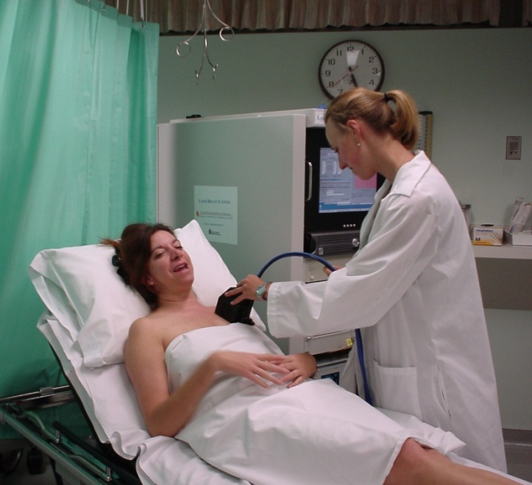
Some Inner Space Applications
breast cancer detection
Notes:
Bio applications include, transillumination, single molecule fluorescence, bioluminescence, breast cancer detection and monitoring, and infant cognitive functioning studies.
29

Slide 30
Biophotonics
Using (~optical) photons for biomedical purposes
Applications
  cognitive functioning
  brain hematoma
  breast cancer
  neuron action potential
Hardware systems
Notes:
In general, biophotonics refers to using optical light to probe biology. Principle applications covered in this talk include cognitive function, brain hematoma, breast cancer, and neuron action potential imaging.
30

Slide 31

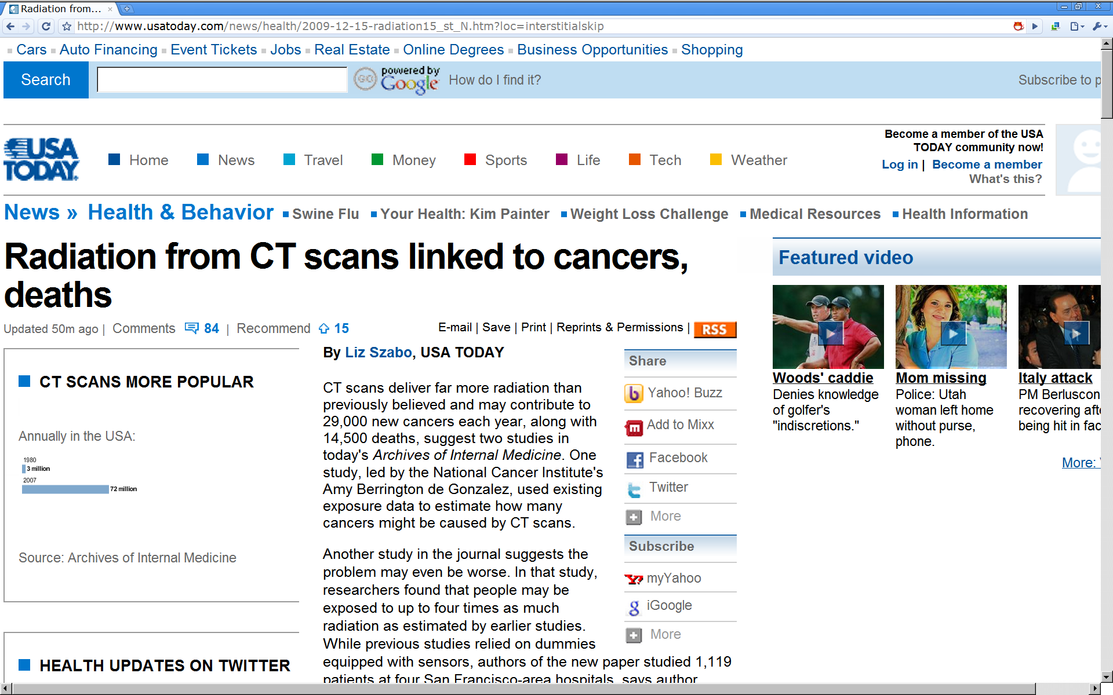
Motivation for Optical Biophotonics
Alternate modalities
Low mass, cost, power, volume
Safe
Notes:
Of many motivations for optical biophotonics, safety is key. Dominant modalities at the present time use high energy photons which can cause tissue damage and cancer. Optical light is safe.
31

Slide 32
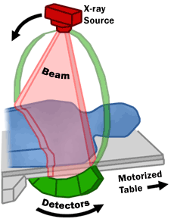
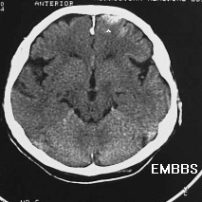
Ballistic Photons
CT-scan (x-ray)
numerical
reconstruction
sources
detectors
scattering << absorption ⇒ paths = straight lines
(courtesy F. Bevilacqua)
Notes:
32
High energy photons are ballistic, and they are used to produce “shadow” images.

Slide 33
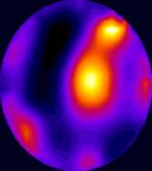
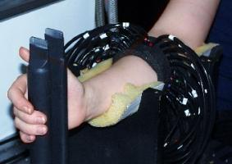
Scattered Photons
near-infrared light
sources
detectors
scattering >> absorption ⇒ broad probability of paths
(courtesy F. Bevilacqua)
http://www.medphys.ucl.ac.uk/research/borg/index.htm
Notes:
33
Optical light is heavily scattered in the turbid medium of the human body. Mathematical reconstruction techniques are important in this case.

Slide 34
Diffuse Optical Imaging (Phantom)
Konecky et al. 2008, Optics Express
Notes:
Despite the strong optical scattering in tissue, it is possible reconstruct an image from the light emerging from tissue. This figure shows reconstructed images of light travelling through phantom sources that mimic the optical scattering and absorption properties of human tissue.
34

Slide 35
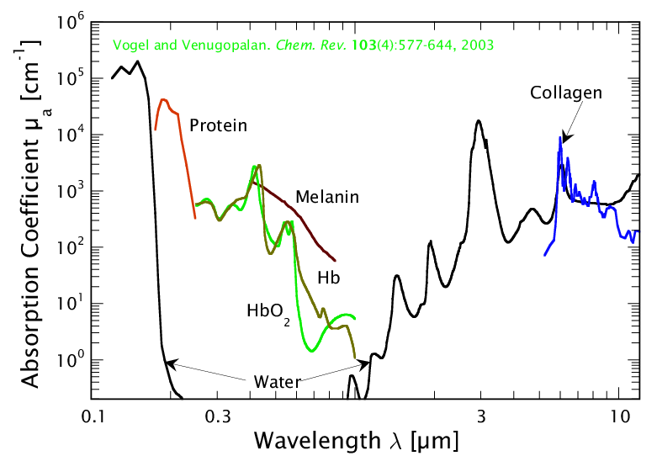
Spectroscopy in Biological Tissue
DNA
biological
window
courtesy V. Venugopalan, http://www.osa.org/meetings/archives/2004/BIOMED/program/#educ
Notes:
35
Melanin may not really be "asborbing". Also, remember its small physical distance. Some additional points: in biological window, fat (lipid) is another important absorber, at its body concentration. Also, in vibrational regime, if you dry out the sample you can get a lot of analytes to contribute.

Slide 36
Important Near-IR Absorbers
19 M
water
32 mM HbO₂
11mM Hb
0.3 g/cm³
fat
Notes:
36
By observing light at contrasting wavelengths, it is possible to make images that highlight variations in the matter being probed. For instance, an image taken at 890 nm would have lower signal than one taken at 720 nm in the case that the target has more oxygenated hemoglobin.

Slide 37
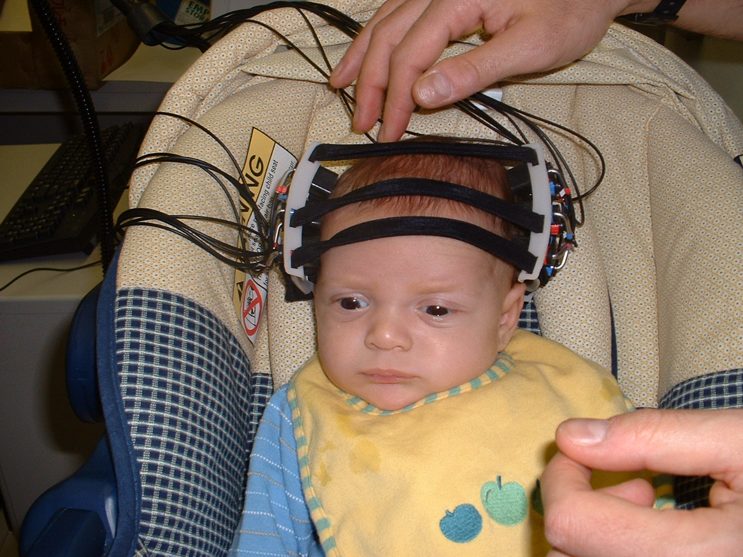
What is He Thinking?
Notes:
37
discuss motivation here: infants are small, uncommunicative, lots of good questions, can’t hold still…

Slide 38
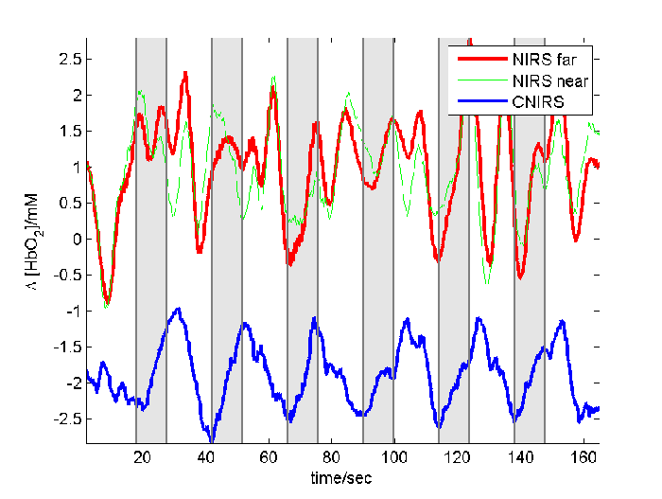
Response to Visual Stimulation
Notes:
38
This figure shows oxygenation level versus time as a baby’s eyes are being stimulated with a flashing light.

Slide 39
Brain Monitoring System Layout
Analog Out
DAQ Card
830 nm
Source 1
690 nm
High Speed DAQ
Card for demultiplexing
830 nm
Avalanche photodiodes
Source 2
near
690 nm
near
Decoded Wavelength Data
far
far
λ₈₃₀
far
λ₆₉₀
far
far
far
Sample
Notes:
39
Typical biophotonic systems use single-element avalance photodiodes at two wavelengths.

Slide 40
Cognitive Functioning
Wolf et al. 2007, Journal of Biomedical Optics
Notes:
Wolf has published some of the best studies of infant cognitive function using biophotonics.
40

Slide 41
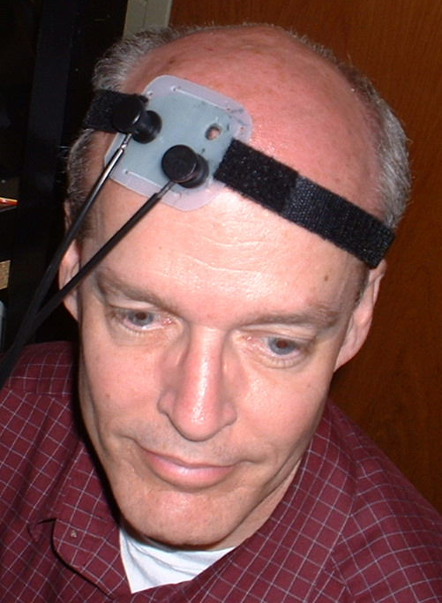
Cerebral Blood Monitoring
light in (690, 830 nm)
light out
Notes:
41
In an adult brain, the absorption is too high for light to traverse the whole target, so one can do the experiment in reflection where the source and detector are on the same side of the brain.

Slide 42
Parallel Plate Breast Scanner
Frequency Domain detectors
Choe et al. 2009, Journal of Biomedical Optics
Notes:
The breast can be observed with optical light. In this picture, the light source and detector are on the same side of the breast and a CCD camera is used for registration.
42

Slide 43

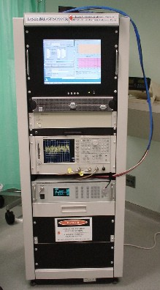
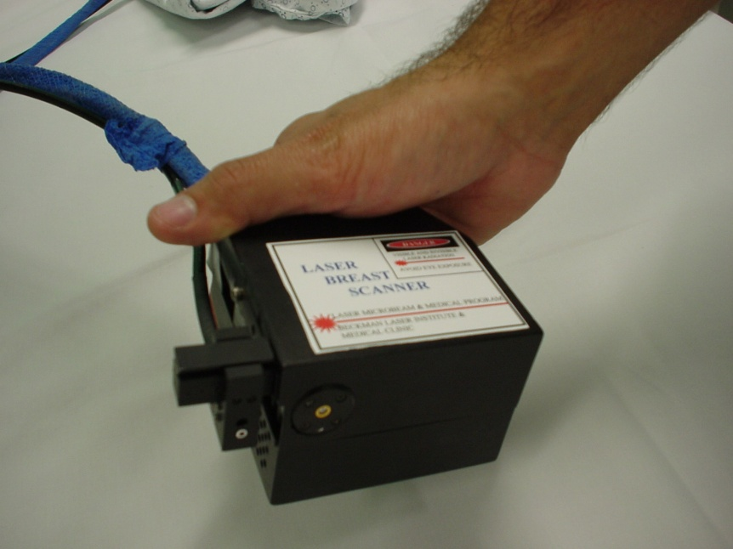
Hand-Held Optical Breast Scanner
Pham, TH., et al. Review of Scientific Instruments, 71 , 1 – 14, (2000).
Bevilacqua, F., et al. Applied Optics, 39, 6498-6507, (2000).
Jakobowski et al., J. Biomed. Opt., 9(1), 230-238 (2004).
(courtesy F. Bevilacqua)
Notes:
43
Beckman Laser Institute have developed a hand-held optical breast scanner.

Slide 44
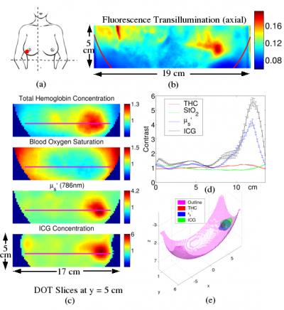
Breast Cancer Detection
Tromberg et al., 2009
Notes:
The optical breast cancer can be used to reveal the presence of extraordinary amounts of oxygenation and blood. By analyzing this information, it is possible to identify and monitor breast cancer.
44

Slide 45
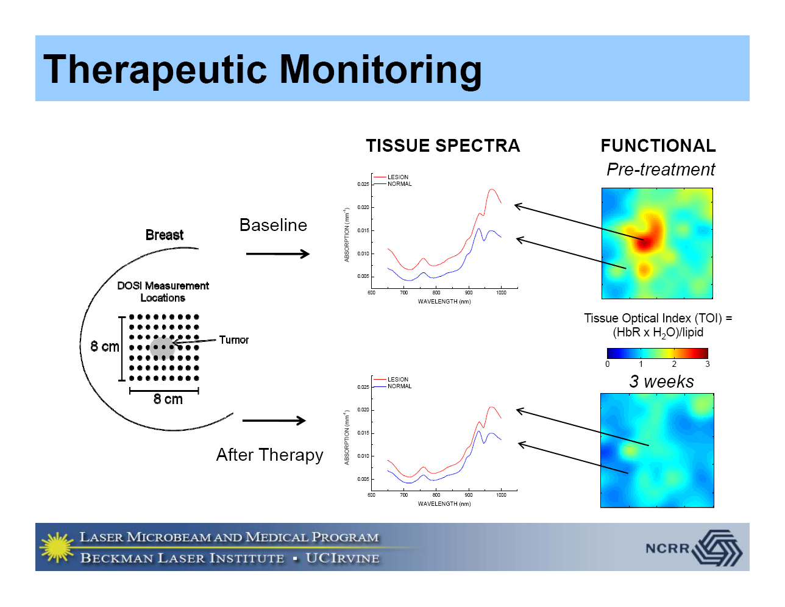
DOSI: Monitoring and Therapy
Notes:
45
Used in high cadence, it is possible to have effective therapeutic monitoring of disease response.

Slide 46
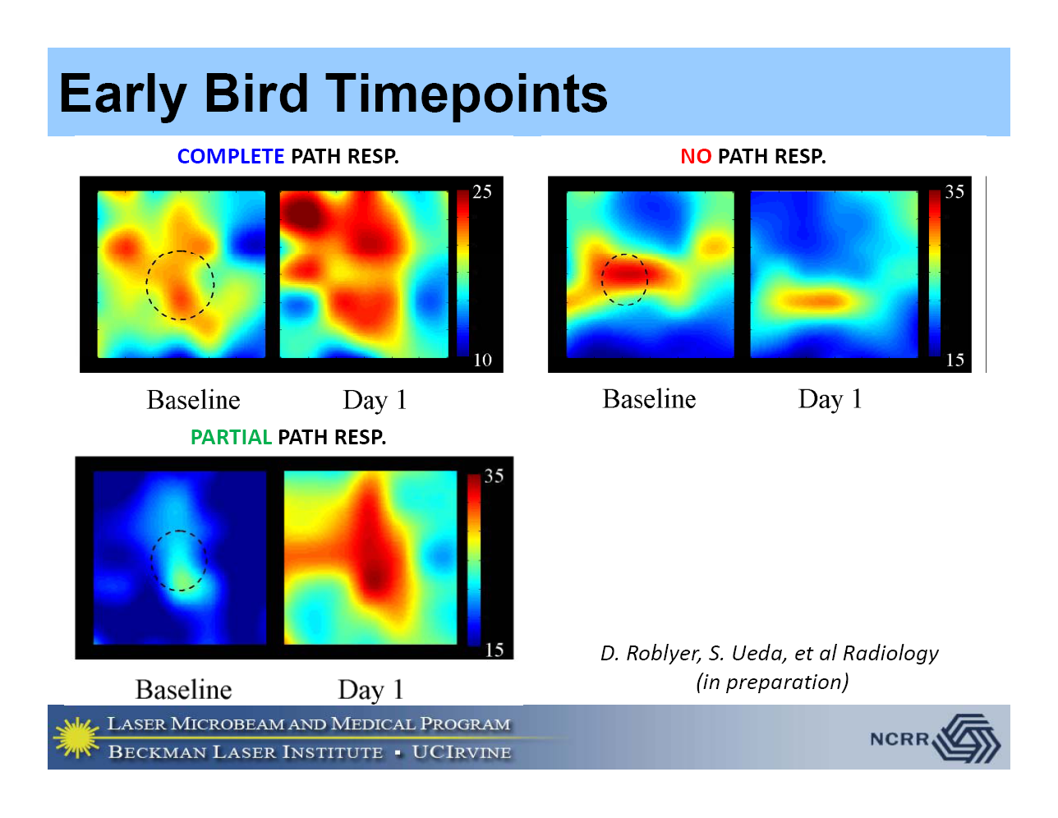
DOSI: Rapid Monitoring
Notes:
46
In some cases, it can even be important to get a picture of response to therapy even one day after treatment.

Slide 47
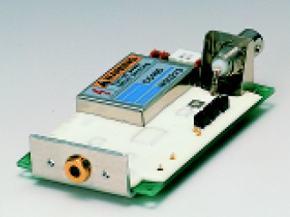
Typical Detector
Hamamatsu ~few element silicon avalanche photodiode modules
Frequency rolloff in low MHz to GHz
Spectral response out to 1000 nm
Notes:
47
A typical detector is shown in this picture.

Slide 48
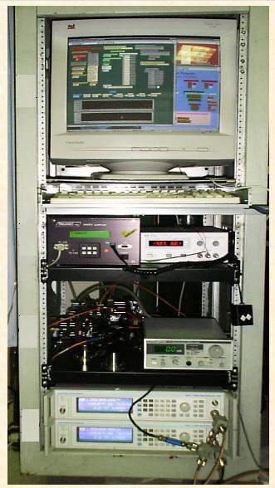
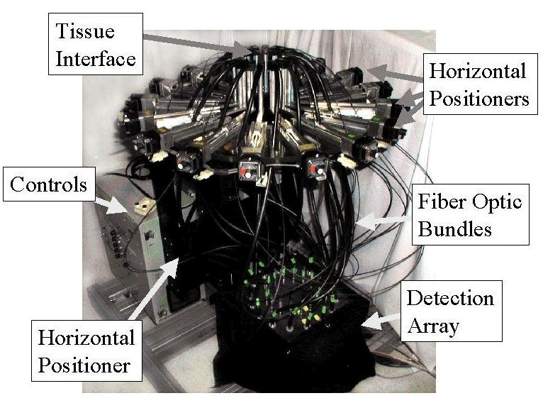
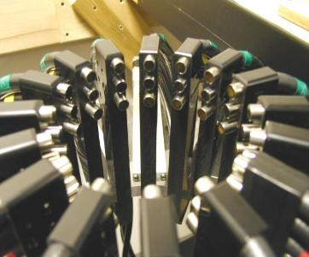
Optical Multiplexing Hardware
http://www-nml.dartmouth.edu/nir/instrumentation.html
Notes:
48
These images show a prototype biophotonic testbed. The phantom sample would be placed in the middle of the multifibers.

Slide 49
Outline
Motivation for Single Photon Detectors
Applications
  Outer Space: the Universe
  Inner Space: Biophotonics
Status of Current Projects
  photon-counting detector for astrophysics
  imaging LIDAR detector for planetary missions
Future Directions
Notes:
This slide gives the outline of the whole talk.

Slide 50
Photon-Counting Detector
Notes:
This section describes the photon counting detector being developed by LL and RIT.

Slide 51
Introduction to Photon-Counting Detectors
Photon-counting detectors detect individual photons.
They typically use an amplification process to produce a large pulse for each absorbed photon.
Current devices typically have one element (pixel).
These types of detectors would be useful in low-light and high dynamic range applications
  nighttime surveillance
  daytime imaging
  faint object astrophysics
  high time resolution biophotonics
  real-time hyperspectral monitoring of urban/battlefield environments
  orbital debris identification and tracking
Notes:
This slide gives the reasons why we use Geiger-Mode Avalanche Photodiodes (GM-APDs) for photon counting.

Slide 52
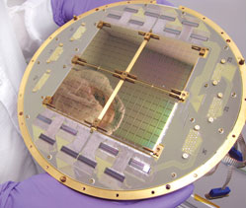
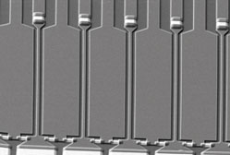
Single Photon Technologies
Table 1. Quantum-limited Detector Technologies.
Superconductors |  | Semiconductors
Transition Edge Sensor (TES) energy resolution operating temperature of tens of mK |  | Electron Multiplying CCD (EMCCD) commercially available excess noise factor
Superconducting Tunnel Junction (STJ) energy resolution operating temperature of mK, leakage current |  | Linear Mode Avalance Photodiode (LM-APD) ns time constant excess noise factor (although MCT has ~no excess noise)
Kinetic Inductance Detector (KID) energy resolution ms time constant |  | Geiger Mode Avalance Photodiode (GM-APD) large pulse per photon afterpulsing
Superconducting Single Photon Detectors (SSPD) ns time constant low fill-factor (?), polarized, few K
Notes:
These plots show the error in estimating brightness of supernovae as a function of detector characteristics, i.e. read noise, dark current, and quantum efficiency. Ultimately, these errors map into our understanding of the nature of the Universe, including whether it will expand forever.
52

Slide 53
Avalanche Diode Architecture
Notes:
53
This cartoon is a schematic cross-section of a GM-APD. It shows the low field region where photons are converted into electron-hole pairs and the high field region where electrons are accelerated.

Slide 54
Operation of Avalanche Diode
Linear
on
Geiger
mode
mode
on
Linear
Geiger
quench
mode
mode
Current
avalanche
Current
Current
Current
off
off
arm
V_{dc} + ΔV
V
V
br
br
Voltage
Voltage
Notes:
54
The GM-APD is held above breakdown. An avalanche occurs when a free charge enters the high field region. The avalanche is quenched by a circuit that brings the voltage below breakdown.

Slide 55
Performance Parameters
Photon detection efficiency (PDE)
  The probability that a single incident photon initiates a current pulse that registers in a digital counter
Dark count Rate (DCR)/Probability (DCP)
  The probability that a count is triggered by dark current instead of incident photons
Single photon input
APD output
time
Discriminator
level
time
Digital comparator output
time
time
time
Successful
single photon
detection
Photon absorbed but insufficient gain – missed count
Dark count – from dark current
Notes:
55
PDE and DCR are two of the most important characterization parameters for GM-APDs.

Slide 56
Zero Read Noise Detector Project
Goals | To design, fabricate, develop, and test a large scale, operational, megapixel array detector that has zero read noise.
Schedule | October 2008 – October 2012
Sponsor | Gordon and Betty Moore Foundation
Collaborators | MIT Lincoln Laboratory
56
Notes:
The Moore project is a 2-phase project that will develop large scale detector arrays for the Thirty Meter Telescope. It is a 4 year program in collaboration with MIT LL.
56

Slide 57
Zero Read Noise Detector ROIC
57
Notes:
This is a floorplan and picture of the 256x256 ROIC for the Moore project.
57

Slide 58
Zero Noise Detector Project Goals
Operational
  Photon-counting
  Wide dynamic range: flux limit to >10⁸ photons/pixel/s
  Time delay and integrate
Technical
  Backside illumination for high fill factor
  Moderate-sized pixels (25 μm)
  Megapixel array
Notes:
The Moore detector will have extraordinary capabilities in a competitive device and pixel size format. It will be capable of delivering high dynamic range and ultra-fast imaging.

Slide 59
Zero Noise Detector Specifications
Optical (Silicon) Detector Performance
Parameter | Phase 1 Goal | Phase 2 Goal
Format | 256x256 | 1024x1024
Pixel Size | 25 µm | 20 µm
Read Noise | zero | zero
Dark Current (@140 K) | <10⁻³ e⁻/s/pixel | <10⁻³ e⁻/s/pixel
QEª Silicon (350nm,650nm,1000nm) | 30%,50%,25% | 55%,70%,35%
Operating Temperature | 90 K – 293 K | 90 K – 293 K
Fill Factor | 100% | 100%
ªProduct of internal QE and probability of initiating an event. Assumes antireflection coating match for wavelength region.
Notes:
The proposed performance for the optical (silicon) Moore detector is shown in the table. In Phase 1, we will fabricate and test a moderate-size detector, and in Phase2, we will do the same for a large detector.

Slide 60
Zero Noise Detector Specifications
Infrared (InGaAs) Detector Performance
Parameter | Phase 1 Goal | Phase 2 Goal
Format | Single pixel | 1024x1024
Pixel Size | 25 µm | 20 µm
Read Noise | zero | zero
Dark Current (@140 K) | TBD | <10⁻³ e⁻/s/pixel
QEª (1500nm) | 50% | 60%
Operating Temperature | 90 K – 293 K | 90 K – 293 K
Fill Factor | NA | 100% w/o μlens
ªProduct of internal QE and probability of initiating an event. Assumes antireflection coating match for wavelength region.
Notes:
The proposed performance for the infrared (InGaAs) Moore detector is shown in the table. In Phase 1, we will fabricate and test a single test structure, and in Phase2, we will do the same for a large detector. Note that we will likely only pursue an optical OR infrared detector in Phase 2, depending on the maturity of both paths.

Slide 61
Zero Noise Detector Project Status
A 256x256x25μm diode array has been bonded to a ROIC.
An InGaAs array has been hybridized and tested.
Testing is underway.
Depending on results, megapixel silicon or InGaAs arrays will be developed.
Notes:
The slide describes the status of the Moore project.

Slide 62
GM APD Device Characterization:
Motivation
A very significant increase in dark count rate at short quench times is measurable for devices with high fill-factor.
The affect is uncharacteristic of high thermal carrier generation, tunneling, or trap-induced afterpulsing, indicating another mechanism.
Characterization of the mechanism, its effect on device performance, and its governing physics is crucial to finding a solution to the problem.
Notes:
This slide describes the single-element GM-APD characterization that is being done to support the zero noise detector project.

Slide 63
GM APD Device Characterization:
Active Quench Circuit
t_{arm}
V_{trigger}
V_{arm}
V_{quench}
t_{quench}
Notes:
Animation shows a rudimentary summary of the active quench circuit function for one detection cycle.

Slide 64
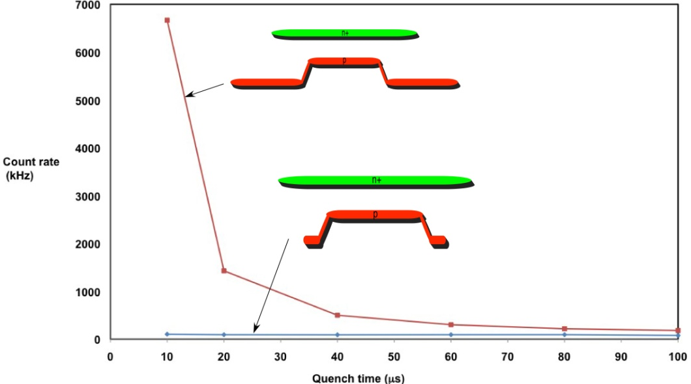
GM APD Device Characterization:
Motivation
HFF
LFF
Notes:
Previous testing results for HFF vs. LFF device dark count rate as a function of quench time.

Slide 65
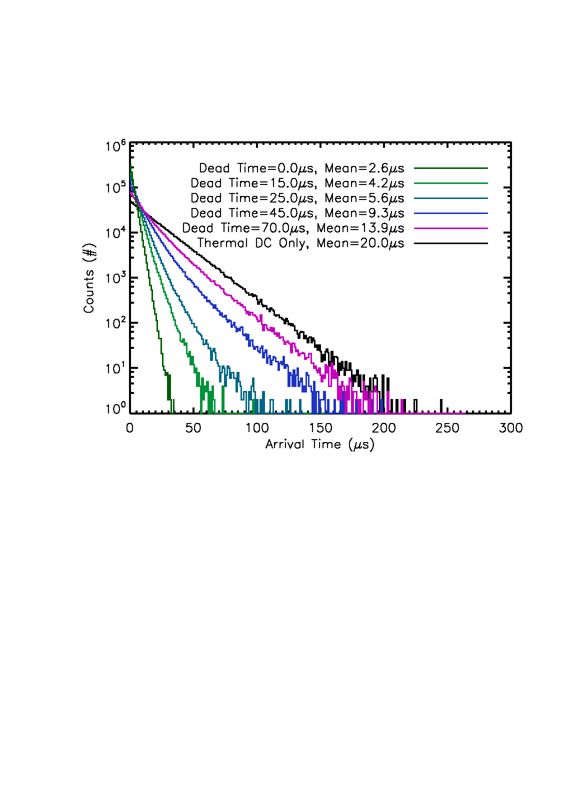
GM APD Device Characterization:
Time-dependent Processes
Arrival Time Due to Afterpulsing and Thermal Carrier Combined Processes as a Function of Device Dead Time
Notes:
Simulation of expected histogram of avalanche arrival times measured for a combined, partially time-dependent process.
Note the curvature of the color histograms, which should appear linear for a constant-rate process (see black line) on this log-linear plot.

Slide 66
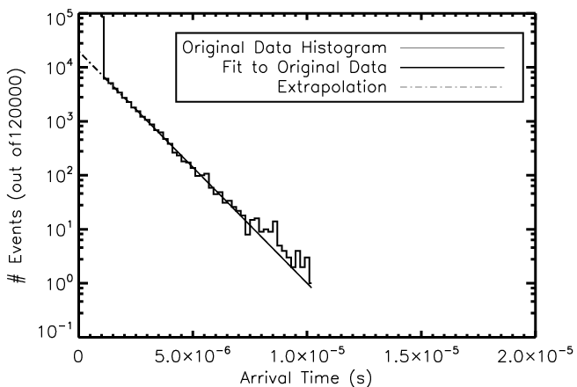
GM APD Device Characterization:
Self-Retriggering
Simulated Histogram of Avalanche Arrival Times
Notes:
Self-retriggering occurs when photons are generated by the recombination of carriers in an avalanche and are absorbed in the device. This absorption liberates a carrier that induces another avalanche when the device is reset. These carriers have a high probability of causing immediate avalanches.
The number of events in the first bin represents all the cases in which the avalanche occurred while the arm pulse was held high.
Using a fit of the histogram (excluding the first bin), the fit is extrapolated back to the beginning of the arm pulse.
The discrepancy between the expected and actual counts represents the first-bin avalanches caused by self-retriggering.

Slide 67
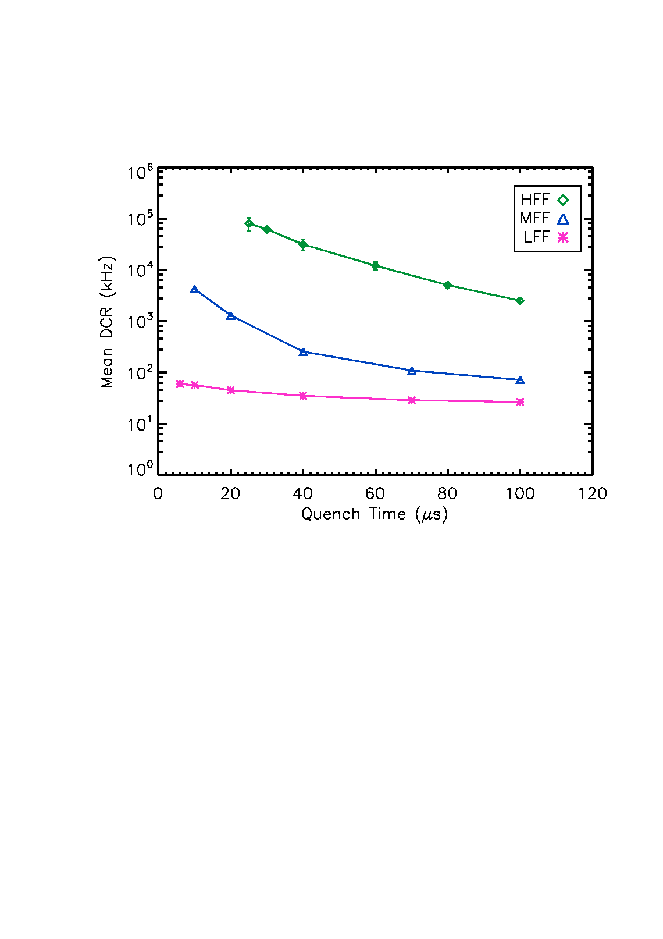
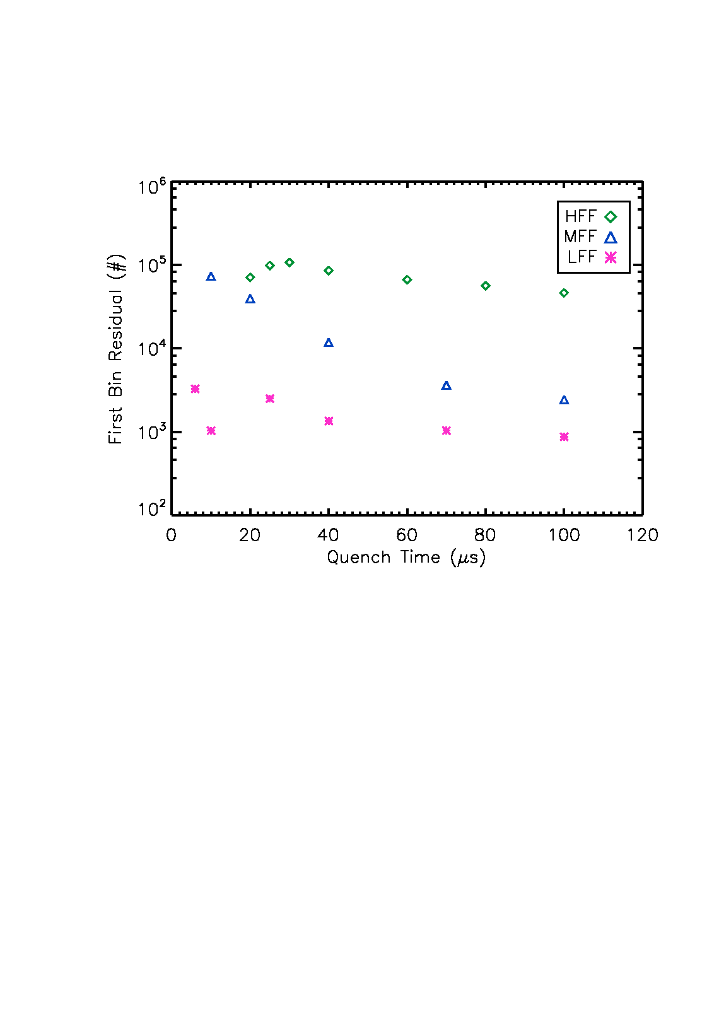
GM APD Device Characterization:
Experimental Results
Mean DCR vs Quench Time
1st Bin Residual vs Quench Time
Notes:
Overall results for mean dcr and 1st bin residual as a function of quench time for three devices: LFF, MFF, and HFF.

Slide 68
GM APD Device Characterization:
Simulation
Minimum
chi-squared value at
(1,1,1)
A=[1,2,3]
B=[10,20,30]
C=[0.1,0.2,0.3]
2
1
0
Best Fit:
A=2
B=20
C=0.2
A
Axes represent subscript addresses of the vector value.
0 1 2
0 1 2
C
B
The current simulation results in a 6-dimensional “cube”.
Notes:
The simulation files chi-squared values in an n-dimensional cube based on subscripts of the input vectors that resulted in that fit. The minimum value is addressed, and from that index the best fit parameters can be reported. This minimizes the sum of the squares of the errors between experimentally measured values and the value resulting from the the fit.

Slide 69
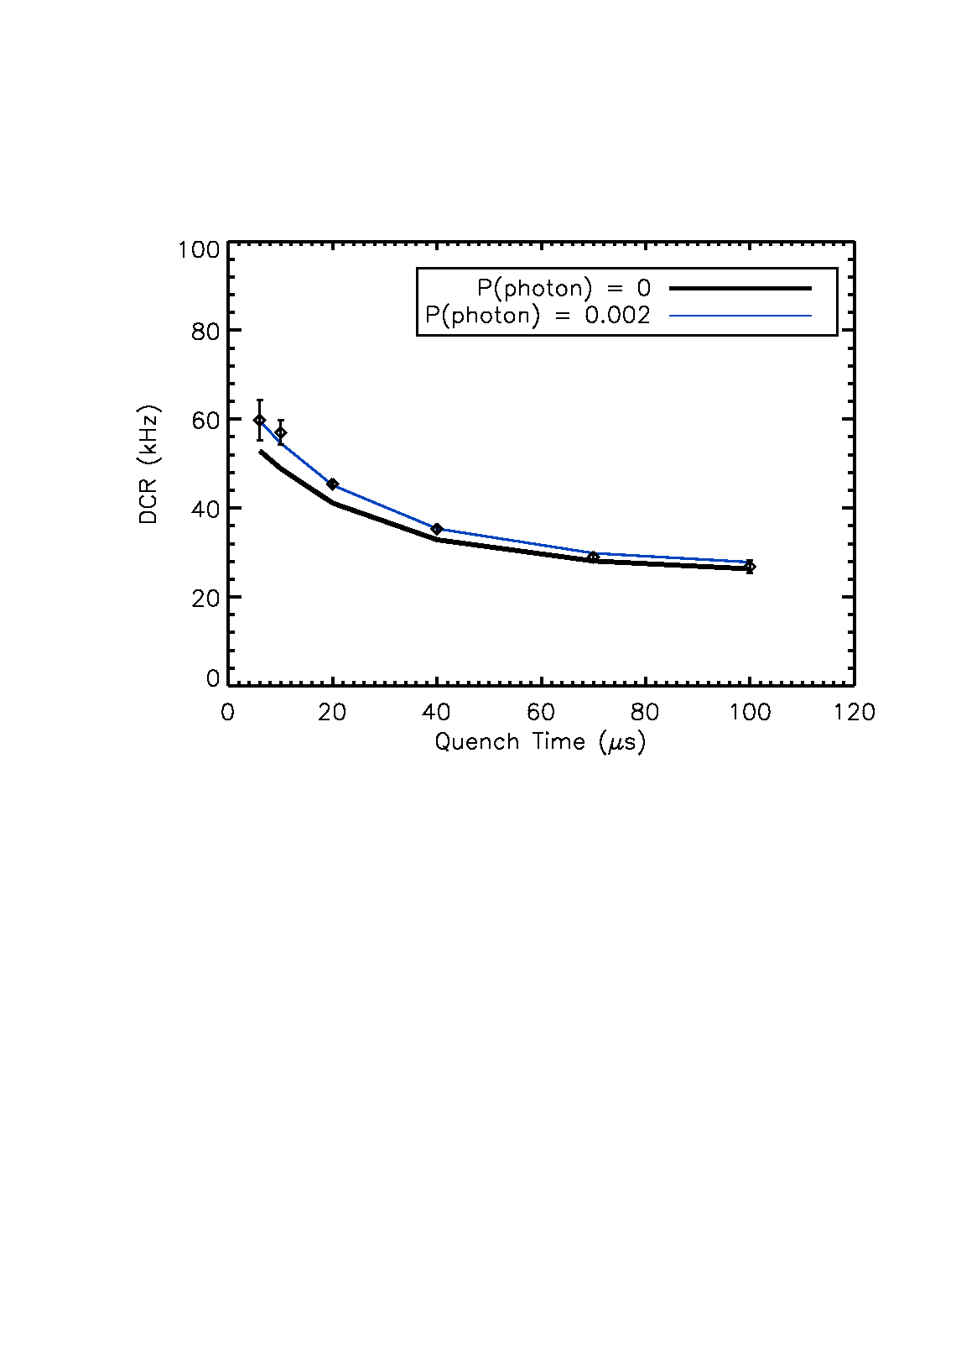
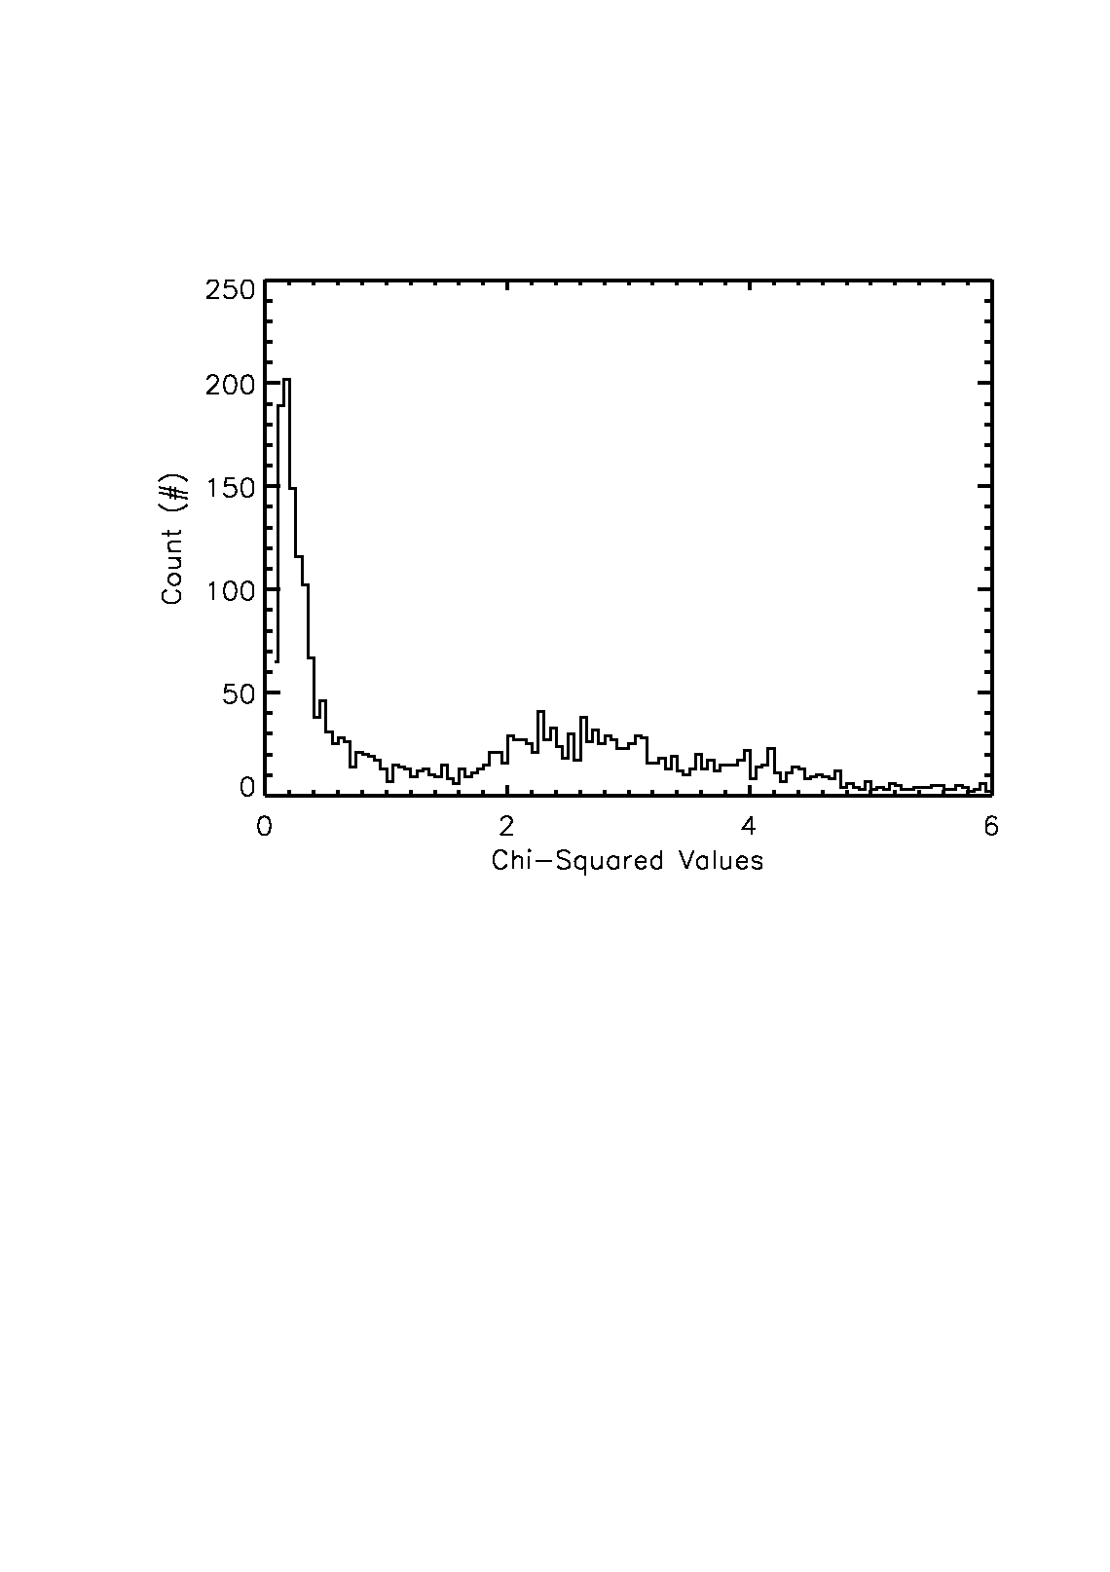
GM APD Device Characterization:
Simulation Results
LFF Simulation Match Input Values
 | Parameter | Value
 | Avalanche Initiation Probability | 0.8
 | Thermal DCR | 25.75 kHz
 | Number of Filled Traps | 2
 | Detrapping Lifetime | 35 µs
 | Carrier Lifetime | 10 µs
 | P_{phot} | 0.002
 | χ² (normalized data) | 0.024
DCR vs Quench Time for LFF Device
Notes:
Best-Fit characterization is somewhat degenerate, but adding first-bin analysis as an output criteria will greatly improve the uniqueness of fit.

Slide 70
Outline
Motivation for Single Photon Detectors
Applications
  Outer Space: the Universe
  Inner Space: Biophotonics
Status of Current Projects
  photon-counting detector for astrophysics
  imaging LIDAR detector for planetary missions
Future Directions
Notes:
This slide gives the outline of the whole talk.

Slide 71
Imaging LIDAR Detector
Notes:
This section of the talk describes the imaging LIDAR detector project.

Slide 72
Introduction to LIDAR
LIght Detection And Ranging (LIDAR) measures photon time-of-flight, and thus distance to a target.
LIDAR detectors typically have one element and are scanned.
A LIDAR “imaging” detector is pixellated and can be used to produce a 3D data set.
Notes:
This slide gives an introduction to LIDAR.

Slide 73
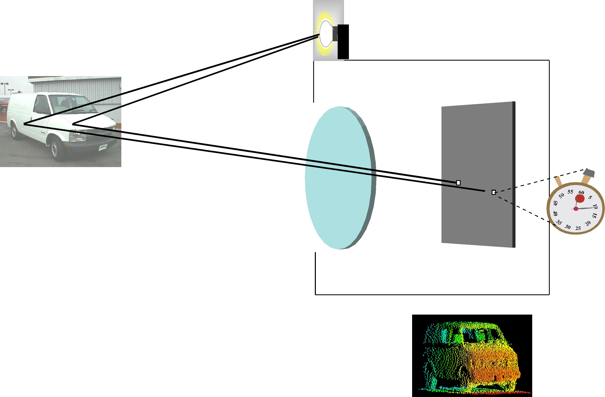
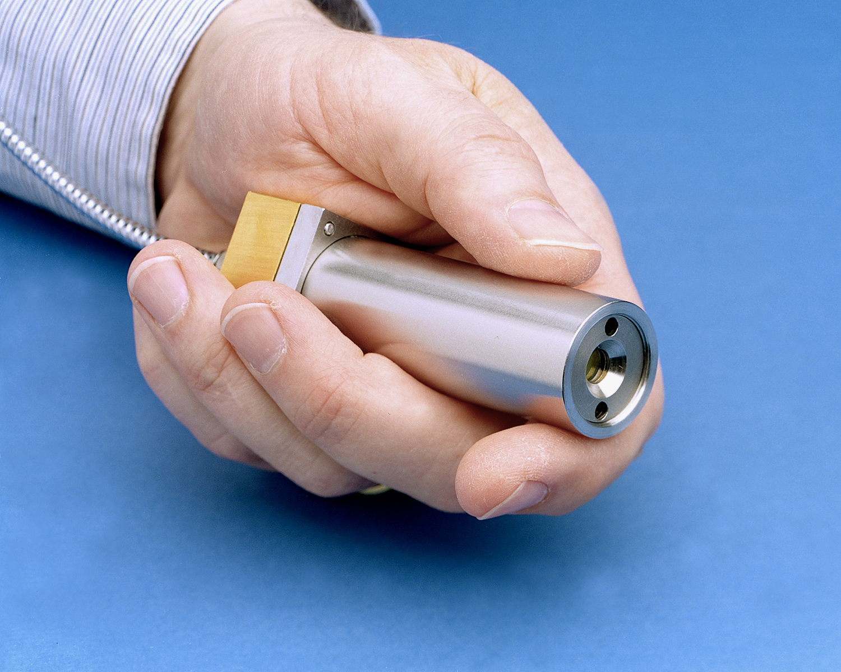
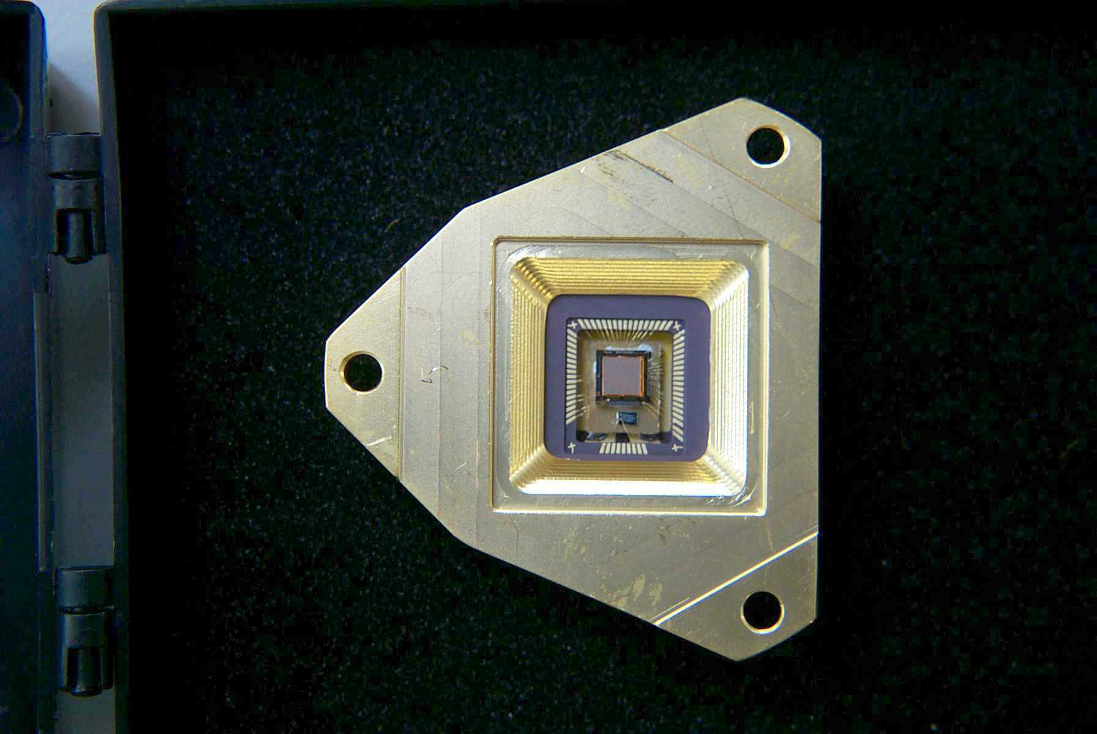
LIDAR Imaging System
Microchip laser
Geiger-mode APD array
Imaging system photon starved. Each detector must precisely time a weak optical pulse.
Color-coded
range image
Notes:
A flash ladar system is like a flash camera, except the flash bulb is a laser that puts out short light pulses, and the pixel measures the arrival time of the light rather than its intensity.

Slide 74
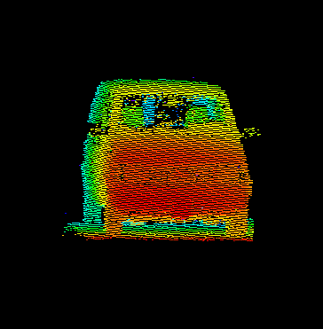
LIDAR 3D Imaging
Taken at noontime on a sunny day
Notes:
1
1
This slide shows a photo of the Gen I ladar system, and a 3D image of a Chevy van taken by the Gen I at noontime on a sunny day.

Slide 75
A LIDAR Imaging Detector for NASA Planetary Missions
Parameter | Current | Goal
Space-Qualifiable | NO | YES
Scalable to Large Format | NO | YES
CMOS ROIC Timing Resolution | 250 ps | 250 ps
Pixel Size | 50 μm | 50 μm
Multiplied Dark Current (@140 K) | unknown | <10⁻³ e⁻/s/pixel
QE (350nm,650nm,1000nm)ª | 45%,65%,5% | 45%,65%,10%
Operating Temperature | 293 K | 90 K – 293 K
Radiation Limit | unknown | 50 Krad(Si)^{b}
Technology Readiness Level^{c} | 2 | 4
Notes:
RIT and LL are funded to develop a LIDAR imaging detector for planetary missions. “QE” is a product of internal QE and probability of initiating Geiger mode avalanche; it does not assume anti-reflection coatings.

Slide 76
Outline
Motivation for Single Photon Detectors
Applications
  Outer Space: the Universe
  Inner Space: Biophotonics
Status of Current Projects
  photon-counting detector for astrophysics
  imaging LIDAR detector for planetary missions
  technology demonstration for exoplanet missions
Future Directions
Notes:
This slide gives the outline of the whole talk.

Slide 77
Future Directions
Notes:
This concluding section summarizes future directions.

Slide 78
Future Directions
In the short term, we plan to develop GM-APD detectors
  final fabrication
  lab testing
  field testing
  radiation testing
In the medium term, we plan to deploy detectors for
  astrophysics, planetary science
  biophotonics
In the long term, we plan to develop multi-mode quantum-limited detectors.
Notes:
In the near term, we want to make a working zero noise detector. In the medium term, we want to deploy them into systems. In the long term, we want to exploit all properties of a photon.

Slide 79
Center for Single Photon Detectors
NSF Science and Technology Center
“The Center will fuse breakthroughs in nano and quantum science to establish the knowledge needed to create devices that exploit all the properties of every single photon.”
10 year lifetime, $50M
RIT, UofR, UNM, UCI, US Labs, Industry, 12 countries
Notes:
We are proposing an NSF center for single photon detectors.

Slide 80
Center for Single Photon Detectors
Notes:
These are the partner organizations for the proposed center.

Slide 81
Questions
Notes:
This concluding section summarizes future directions.

Slide 82
LM-APD Progress (Don Hall and Raytheon)
Notes:
This concluding section summarizes future directions.

Slide 83
LM-APD
16 mV
14
12
10
8
6
4
2
0
0 ns
10
20
30
40
50
Notes:
The figure shows increasing signal in a Linear Mode APD. The x-axis covers hundreds of nanoseconds and the y-axis is in volts. A photon produces an easily-identifiable blip, as does a dark current. Unmultiplied dark current produces a gradually increasing slope in the signal.

Slide 84
Outline
Overview of HgCdTe APD & LADAR Receivers at Raytheon
Motivation for Linear Single Photon Counting
Semiconductor Candidates for Single Photon Counting: HgCdTe, InAlAs…
End to End Performance Model and Predictions
Early Demonstration of Photon Counting
Recent Breakthrough Results
Fundamental Performance Limits (SWIR and MWIR APDs)
Summary and Future Work

Slide 85
HgCdTe Excess Noise
Conventional PIN or PN Detector
Fex
~1
APD (
With Gain
=4)
electrons & hole ionize with equal probability
Fex
~ 5
photon
electrons
holes
N+
N
P+
P+
electron
N+
hole
Vbias
Vbias
Ge k =1
APD (
With Gain
=4)
“
Noiseless
”
APD (With Gain =4)
hole only ionize
Fex
~ 2
electrons only ionize with no lossy scattering Fex ~ 1
electron
electron
hole
P+
N+
p+
holes
N+
Vbias
Engineered HgCdTe k=0 & Deterministic
~Si k<.02
Ionization by 1 carrier type only (electrons or holes) reduces randomness and Fex
No Excess Noise for Engineered HgCdTe APDs

Slide 86
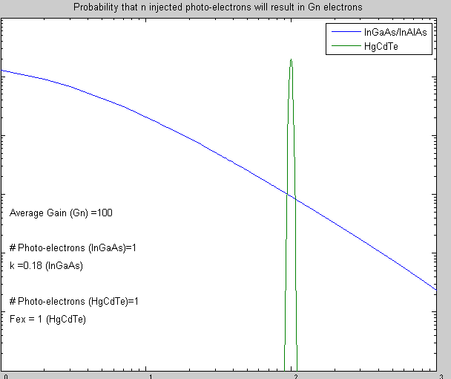
High Performance HgCdTe APDs
High Gain/No Excess Noise
Previous
Most APD obey the McIntyre excess noise equation
HgCdTe electron injection show gain and excess noise properties indicative of deterministic single carrier gain
  Excess Noise Factor, Fex is ~1 (Ideal Amplifier)
Significance: electron event to event gain is close to average value
  Achieves a higher probability of detection than III-V or Silicon APDs
HgCdTe APD Measurements Fex ~1
InAlAs
K=0.2
K=0.02
Si
Limit Fex (excess noise factor) =2
K=0.0
Fex =1
HgCdTe NIP
Prob. Injected Carrier Achieves A Gain
10⁰
Mean Gain =100
10⁻¹
InAlAs
10⁻²
Low Gain Events not seen by InAlAs APDS
HCT APDs Tight Gain Distribution
Probability that Injected Carrier Achieves a Specific Gain
10⁻³
10⁻⁴
HgCdTe has a significant performance
advantage over competing materials
10⁻⁵
10⁻⁶
1
10
100
1000
Gain

Slide 87
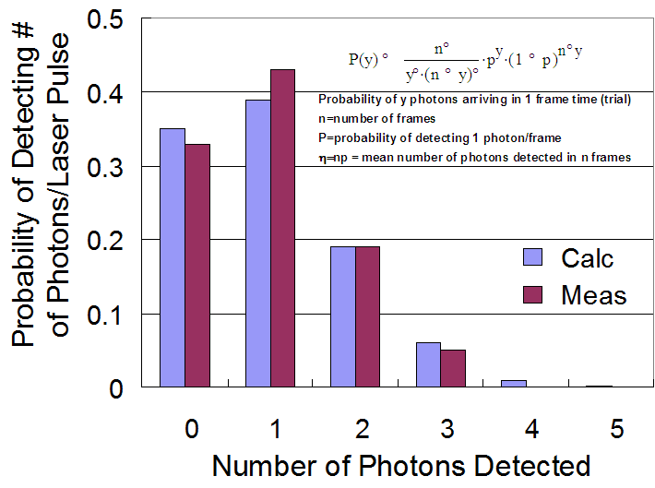
Linear Photon Detection with No Afterpulsing & Preservation of Amplitude (Photon Distribution) CIRCA 2007
Results for 100 Pulsed Laser Exposures at Calibrated Level of <1ph>_{av} per Exposure

Slide 88
Modifications in Design Process and ROIC Operation Implemented to Reduce Dark Counts
Parameters | 2007 | 2010 | Improvement
APD Design | Baseline A Design | Improved B Design
Process | Conventional Surface Preparation | Improved Clean Surface Preparation
Operating Voltages | Nominal | Lowered to Eliminate Glow from ROIC
Operating Temperature (K) | 80-120 | 80-180 or greater | 2X
Maximum Gain | 80-100 | 200-350 | 3X
Dark Counts Rate (DCR) (counts/sec) at M=100 | 500,000 – 1,000,000 | 30,000 | >10X
Surface Dark Current (Amp.) | 1E-9 | 1E-13 | >10,000X
Max Integration Time w/o Reset (μs) | 0.1 – 1 | 1000 – 10,000 | >10,000X
Operability at high gain & low dark count | 50% | >90% | 2X

Slide 89
Breakthroughs in Design & Process Chip Operation Enable10-100x Lower DCR & .01s Integration Times
Single Photon
Shallow slope
Single Photon Step is ~ 1/100th of dynamic range
Shallow Surface Dark Current Slope Allows Integration Time to >10ms without resetting

Slide 90
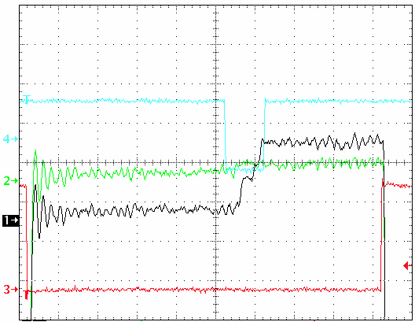
Recent Data from U of H Testing Demonstrates Simultaneous 2- Channel Operation & Photon Counting
LED
LED
1 photon ch11
1 photon ch6
0 photon ch11
1 photon ch6
RESET
RESET
IR photon counting events observed with the KSPEC test facility at MHz band-pass for a 10 μsec reset/ 90 μsec exposure.
LED Illumination at ~ 1 photon /pulse – Location within 10μsec window
Zero and 1 photons observed – vary as expected within the 10μsec LED pulse
2 Channels Displayed Trace: #1 –> Output 6, Trace #2 –> Output 11,
Trace #3 Reset and, #4 IR LED on. The horizontal scale is 10 μsec/division.

Slide 91
Study Fundamental Limits of Dark Count Rates for SWIR & MWIR APDs
Objectives:
  Determine Limiting Sources of Dark Counts (Bulk Dark Current) as a function of Temperature and Gain
  Parameterize Performance vs Major Dark Current Contributers for example Trap Assisted Tunneling
  Guide Improvements in Design, and Wavelength Selection
Application:
  Next Generation of Photon Counting Imagers
    Long Range Surveillance
    Astronomy
  Goal to Achieve DCR ~ 1/sec or less

Slide 92
Method of Analysis
SWIR APD Gain vs Bias Measured & Modeled (80K & 120K)
Detailed Analytic Model Includes
  diffusion,
  generation/recombination,
  trap-assisted-tunneling,
  band-band tunneling
  Impact ionization
  Gain is included via calculation of ionization coefficients
Measurements compared to model.
  Agrees well with measured data vs voltage and temperature.
MWIR APD Gain vs Bias Measured & Modeled (80K)
Notes:
92

