Slide 1


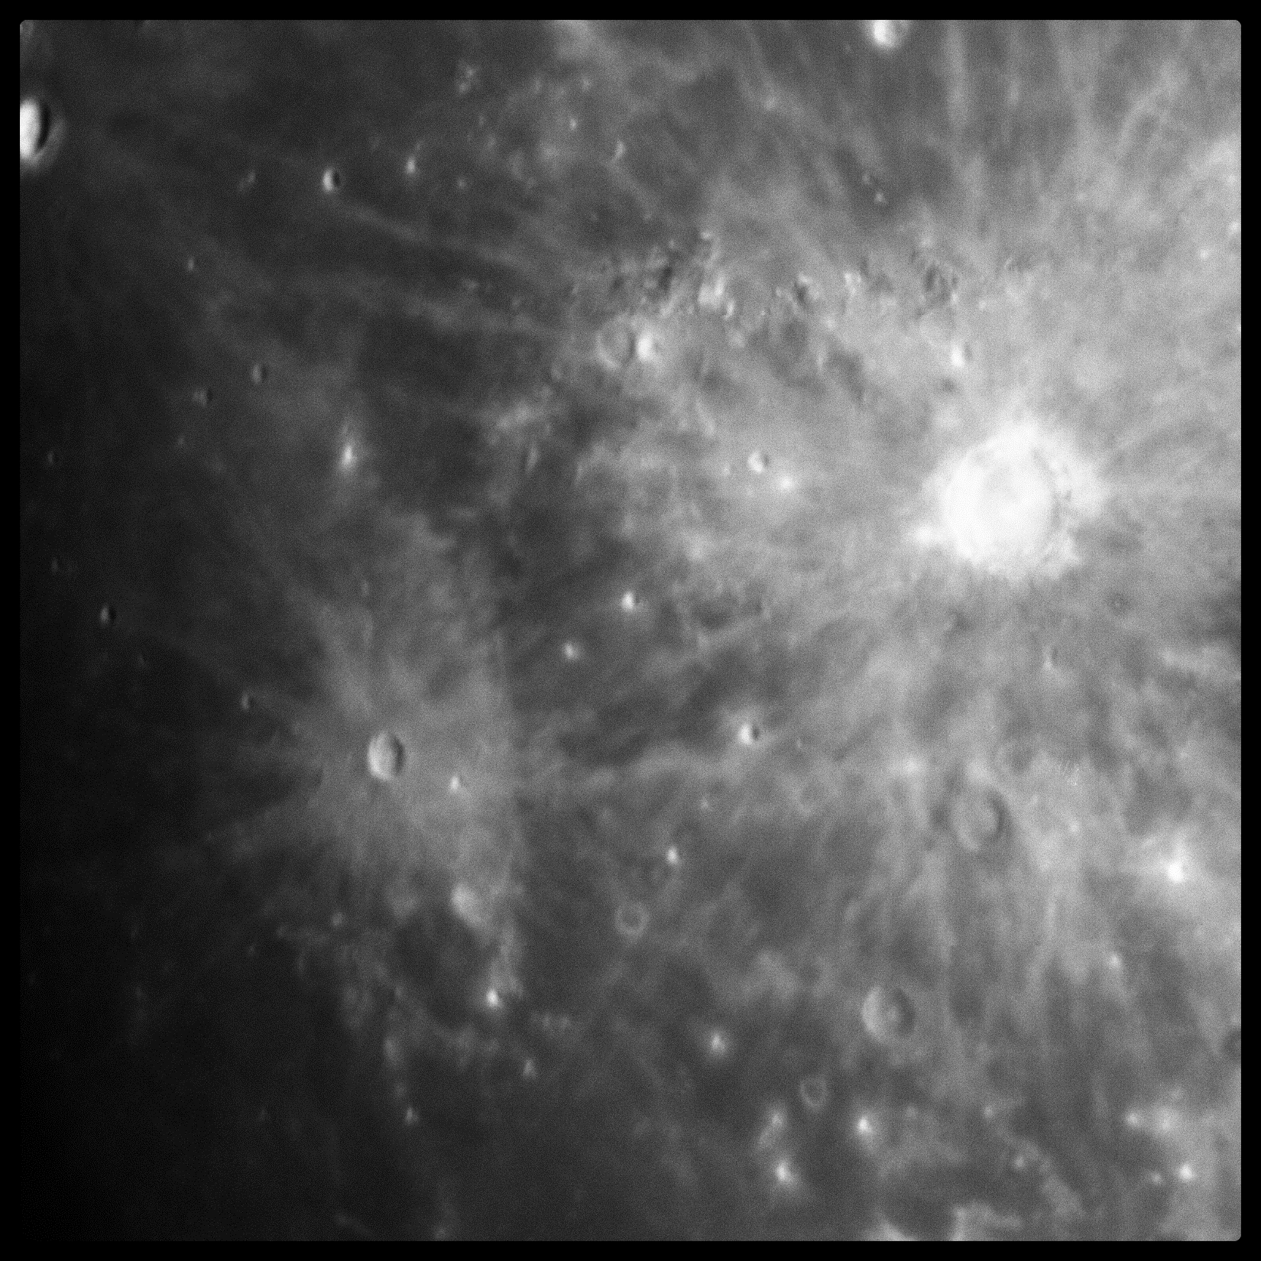

Characterization of single-photon sensing and photon-number resolving CMOS image sensors
Justin P. Gallagher, Lazar Buntic, Don F. Figer
Center for Detectors, Rochester Institute of Technology, Rochester, NY

Slide 2
Outline
Testing Equipment and Image Sensors
Detector Characterization
Astronomical Observations
Conclusions

Slide 3
Testing Equipment AND Image Sensors

Slide 4
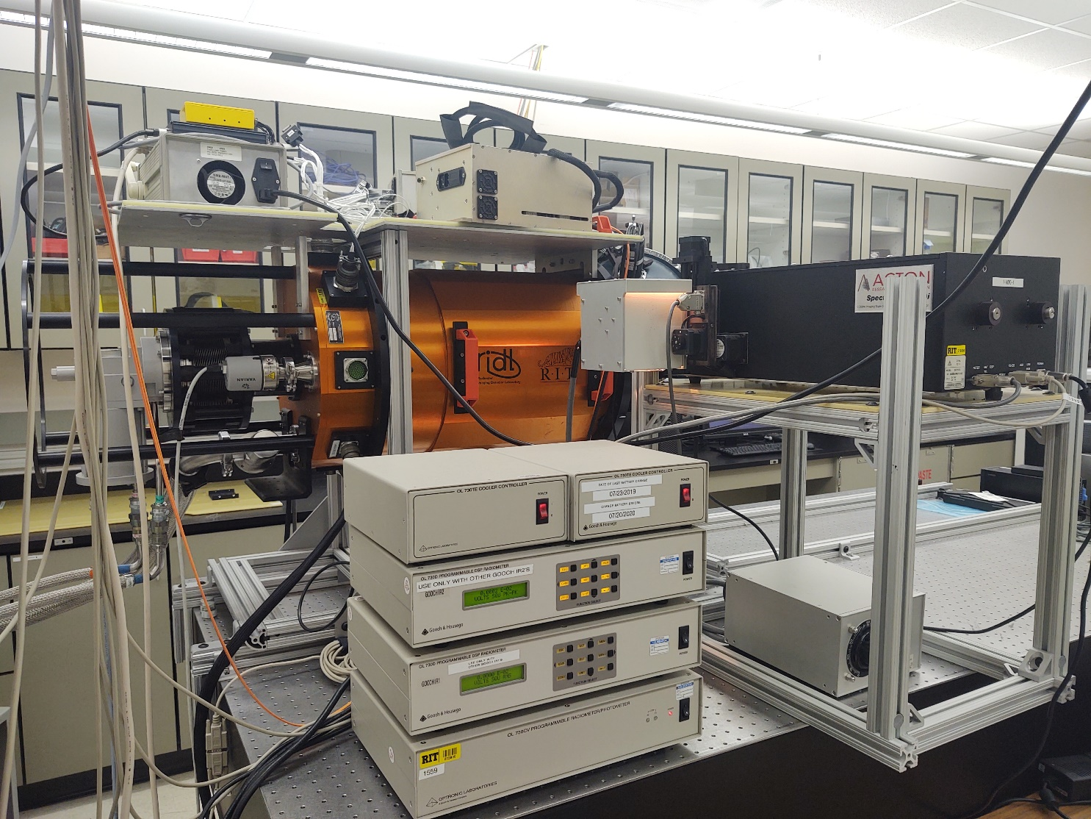
Rochester Imaging Detector Lab (RIDL)
Experiment Test Suite
SpectraPro-2500i
SP-2555
Spectrometer
QTH
Light Source
Filter Wheel
Slit
Diode
Integrating Sphere
Port for Detector/Dewar

Slide 5
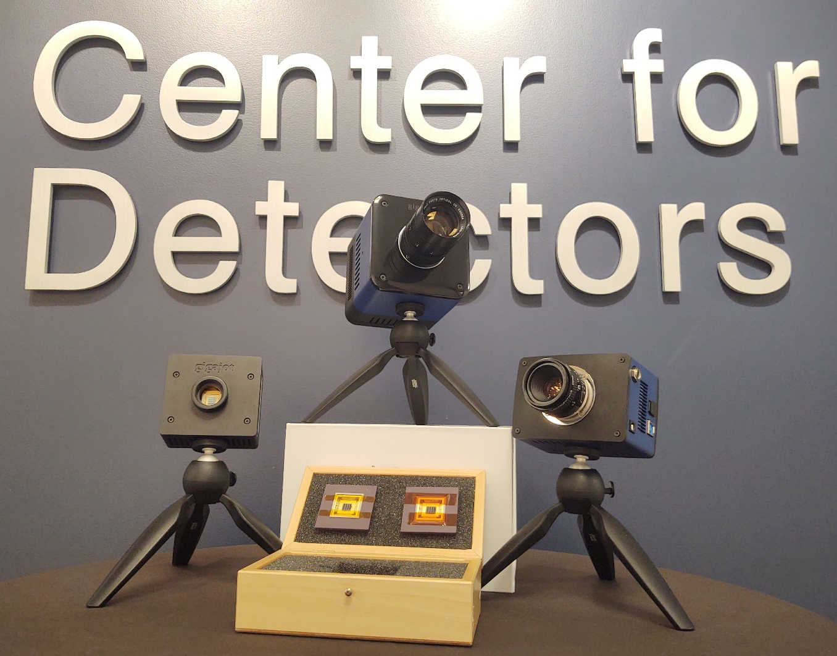
The Quanta Image Sensor (QIS)

Slide 6
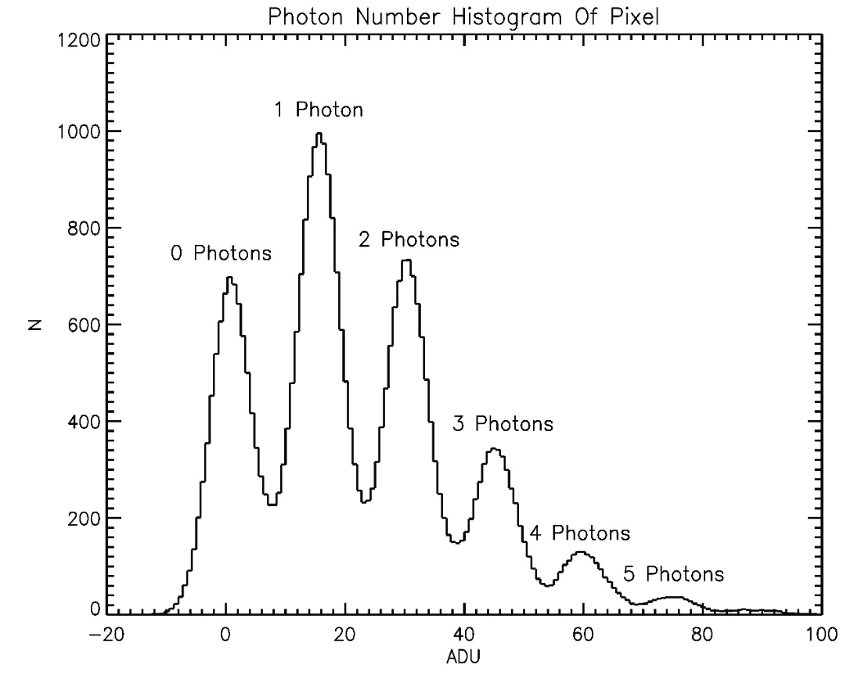
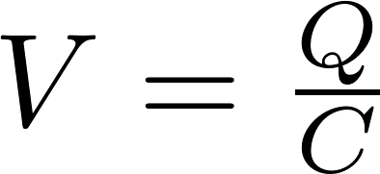
The QIS Concept
Eric R. Fossum (Dartmouth College), Gigajot Technology Inc.
small floating diffusion (FD) sense node
small FD capacitance increases voltage response to charge
single-electron voltage response much larger than read noise
correlated multiple sampling to further reduce noise
discrete photoelectron peaks become resolved

Slide 7
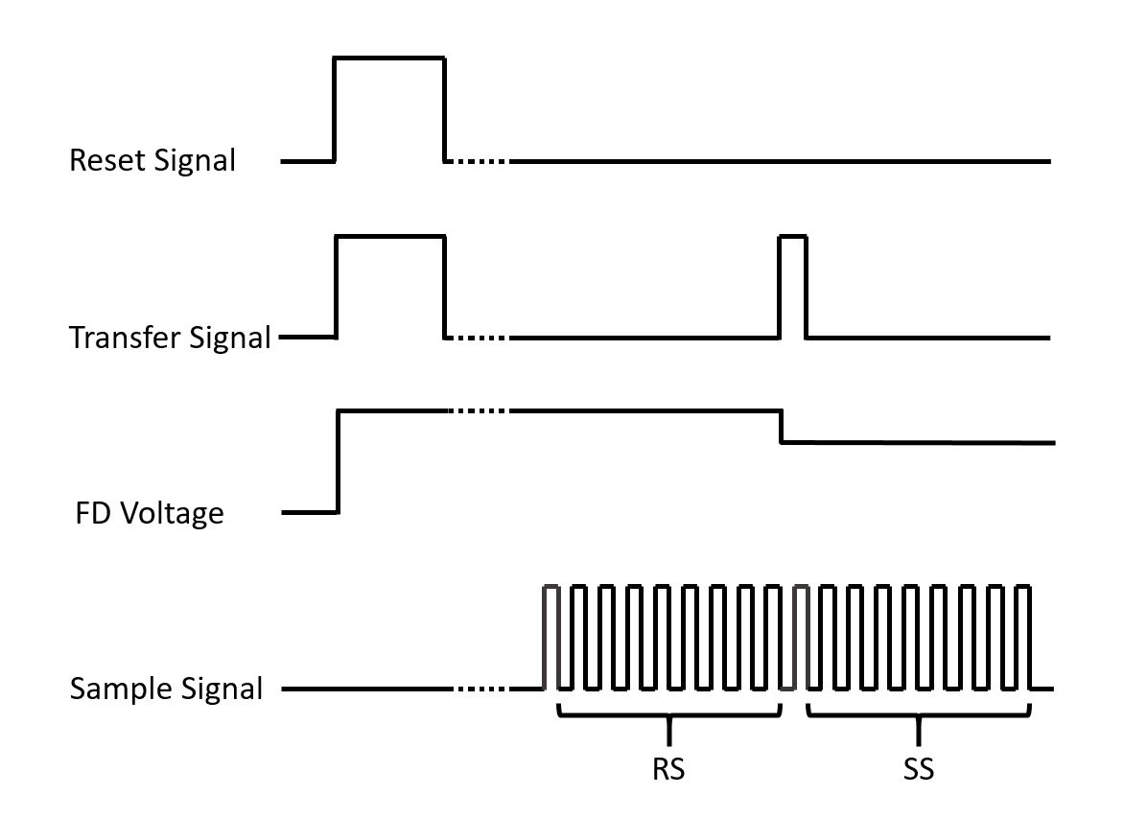
Correlated Multiple Sampling (CMS)

Slide 8
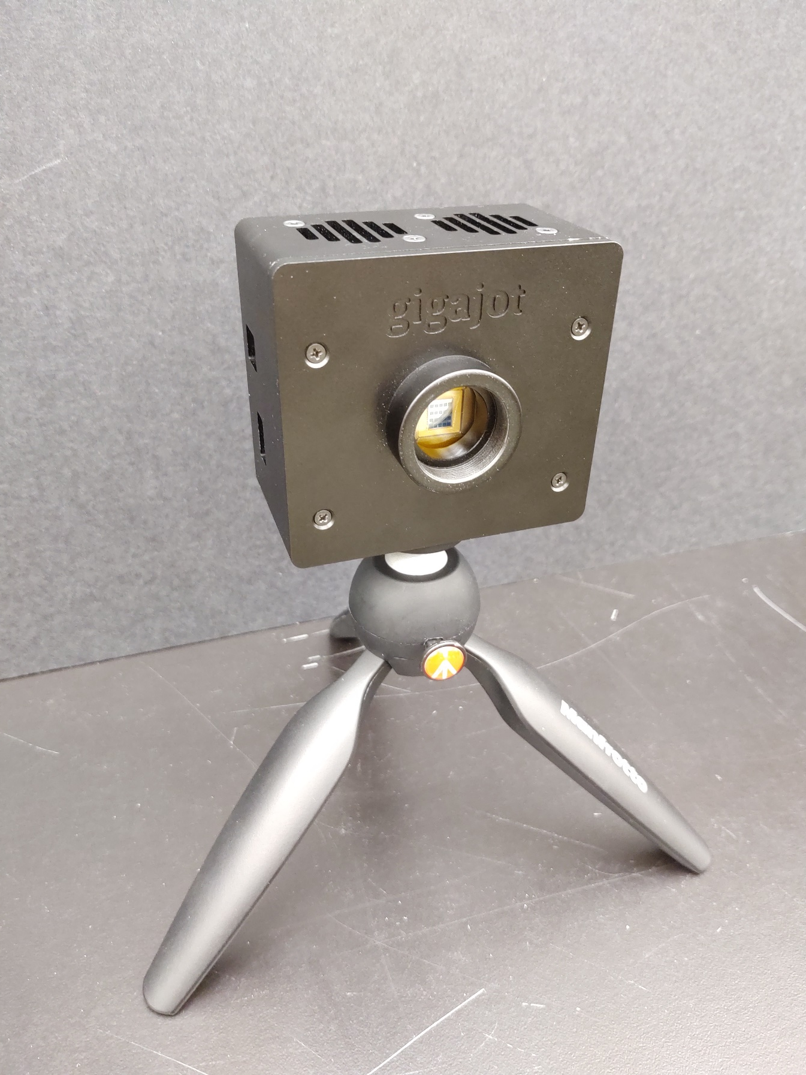
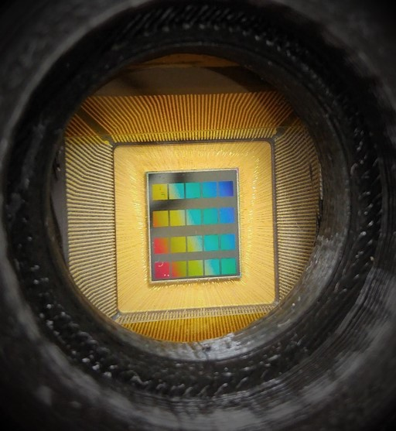
The QIS Pathfinder
twenty 1Mpix QIS
1024×1024 pixels
1.1 μm pixel pitch
parallel-cluster rolling shutter
optional: 1(H)×2(V) pixel charge domain binning

Slide 9
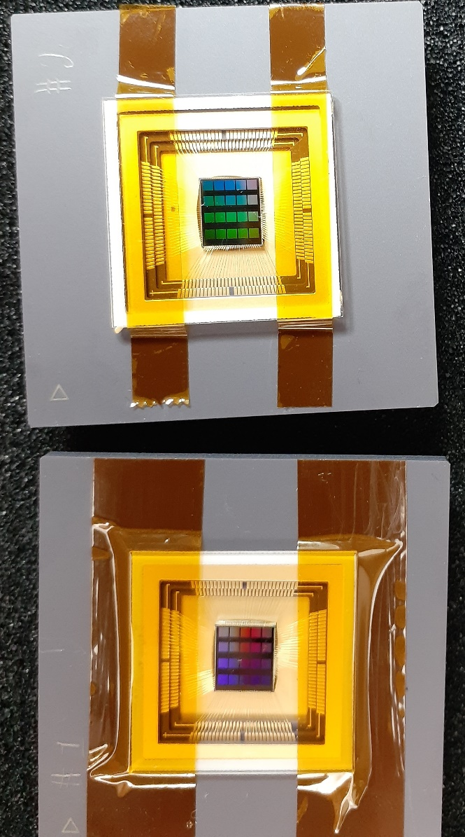
The QIS for Cryogenic Testing (QISSAT)
near identical chip to QISPF
mounted on 224-pin ceramic chip carrier
operated by custom electronics developed by RIT
operated at 200 K – 300 K in vacuum
presented results are from one image sensor on one chip

Slide 10
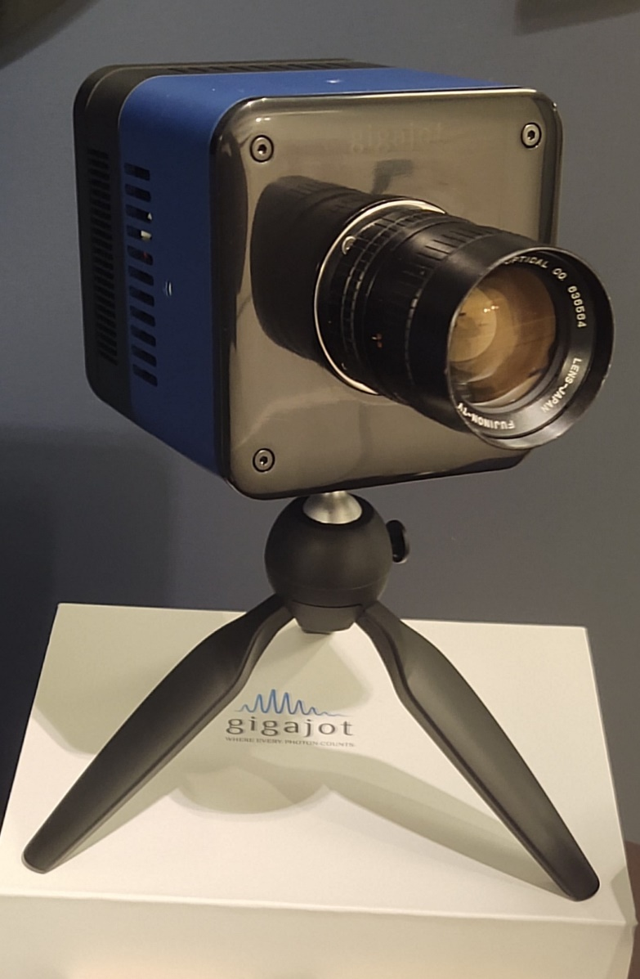
The QIS Camera Development Kit (QISCDK)
16.7 Mpix QIS (GJ01611)
4096×4096 pixels
1.1 μm pixel pitch
parallel-cluster rolling shutter
thermoelectric cooler keeps sensor at 10C
USB3.0 data rate limits camera to 14 fps

Slide 11
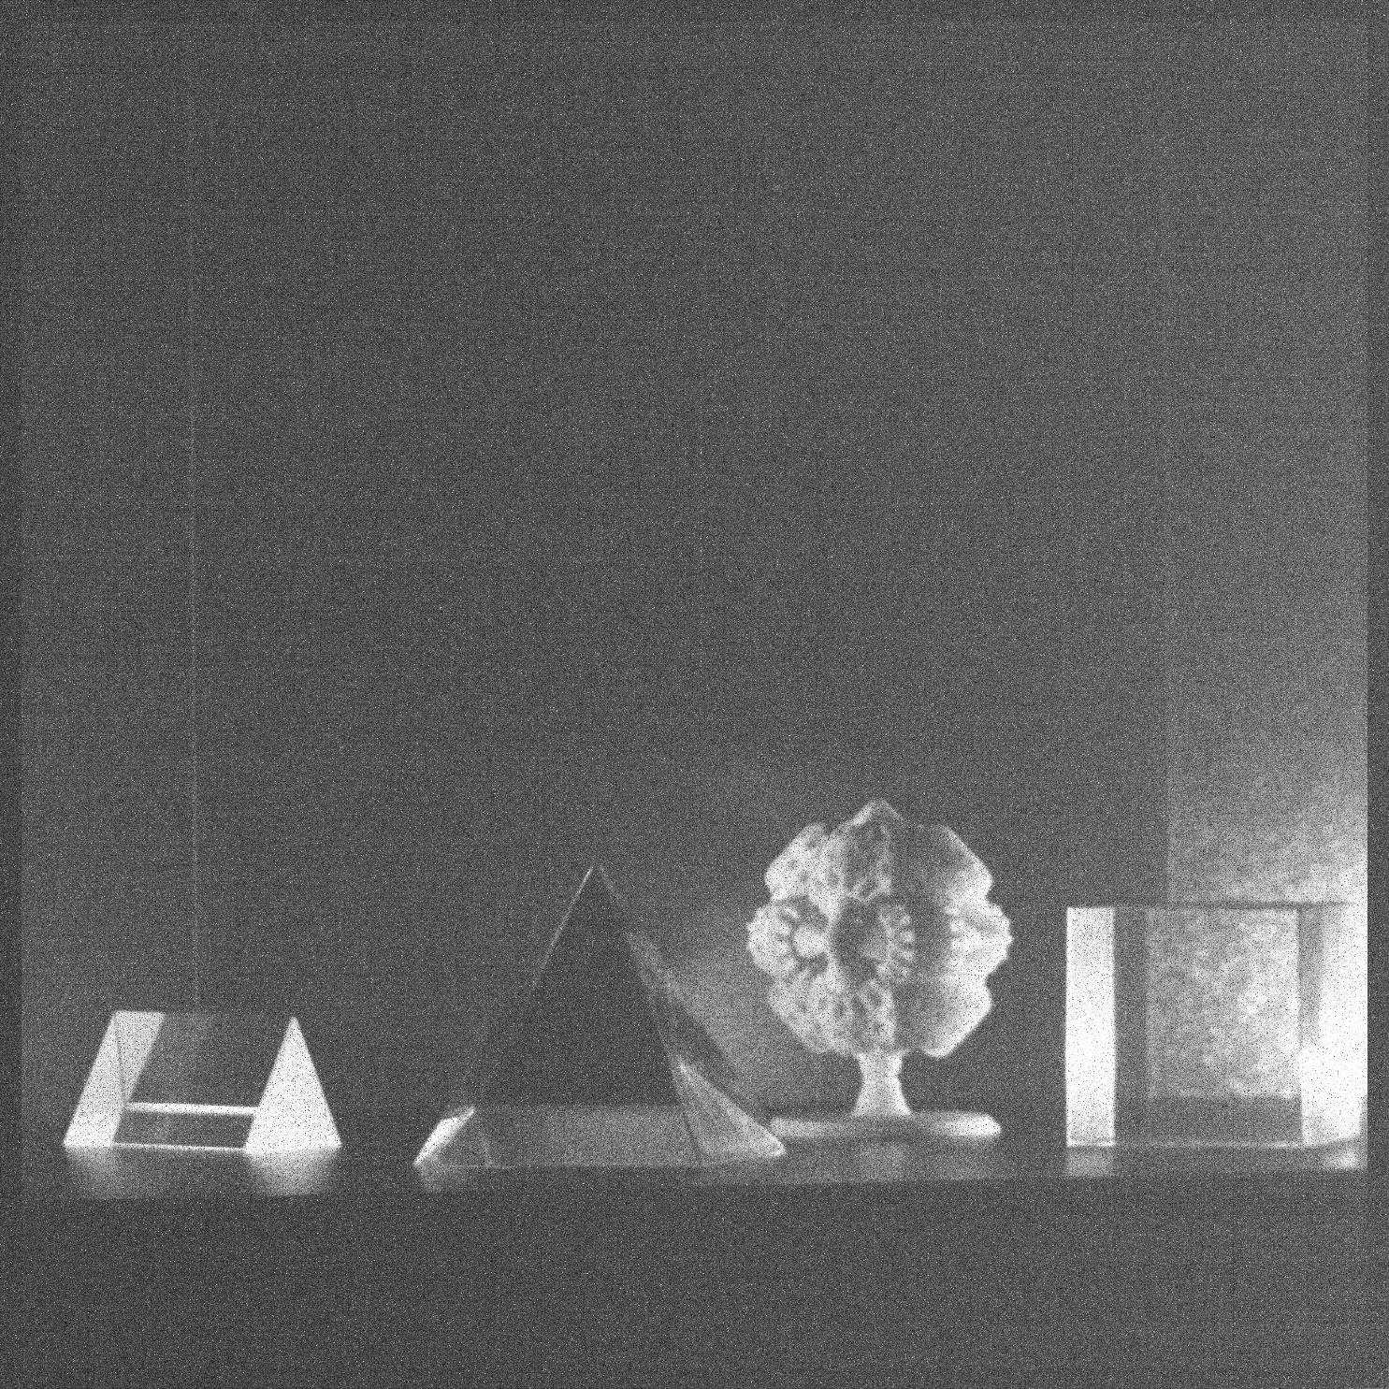
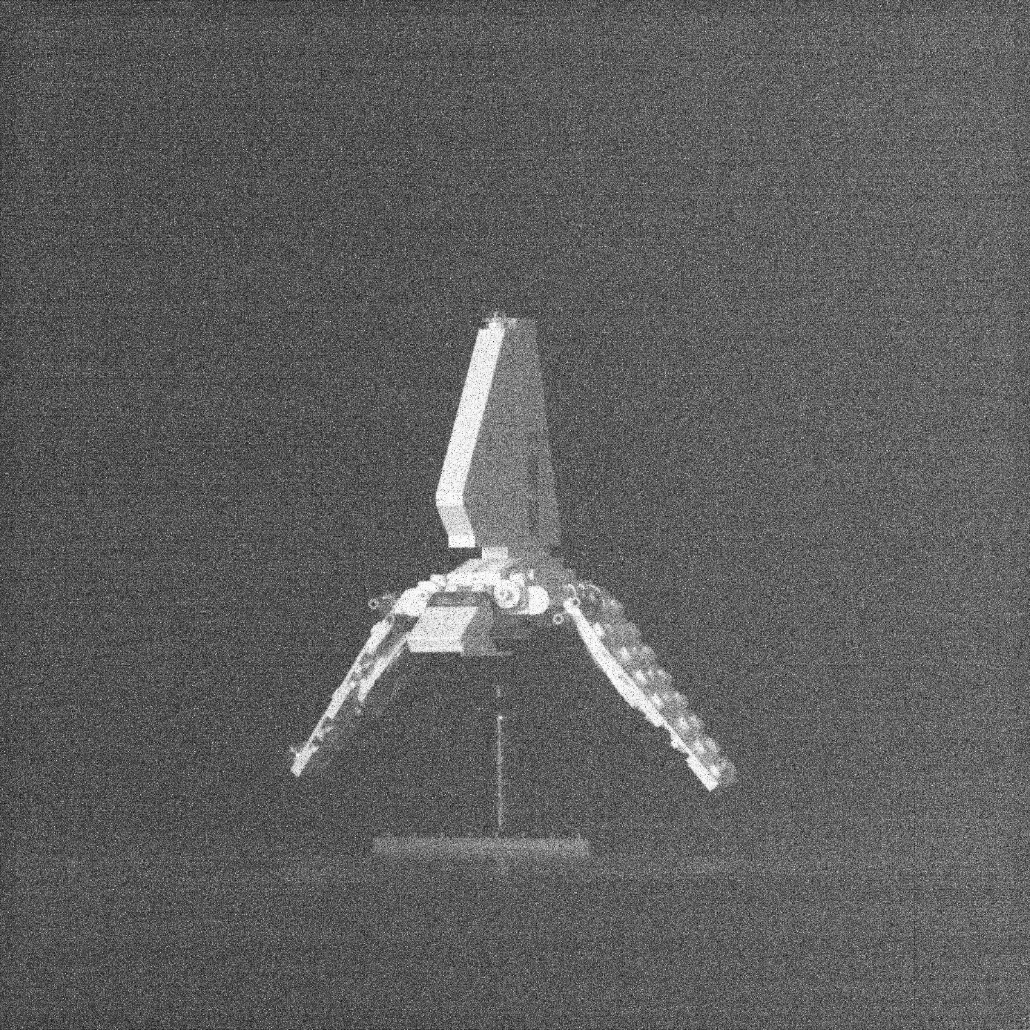
QISCDK: Low Light 16.7 Mpix Images

Slide 12
Detector Characterization

Slide 13
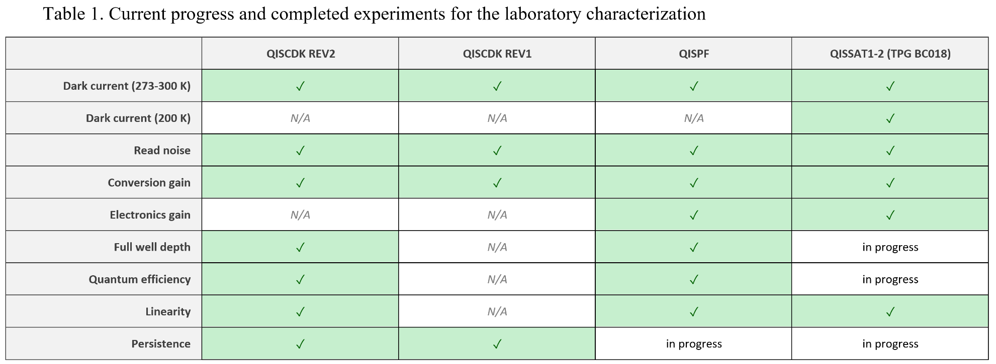
Detector Characterization Table

Slide 14
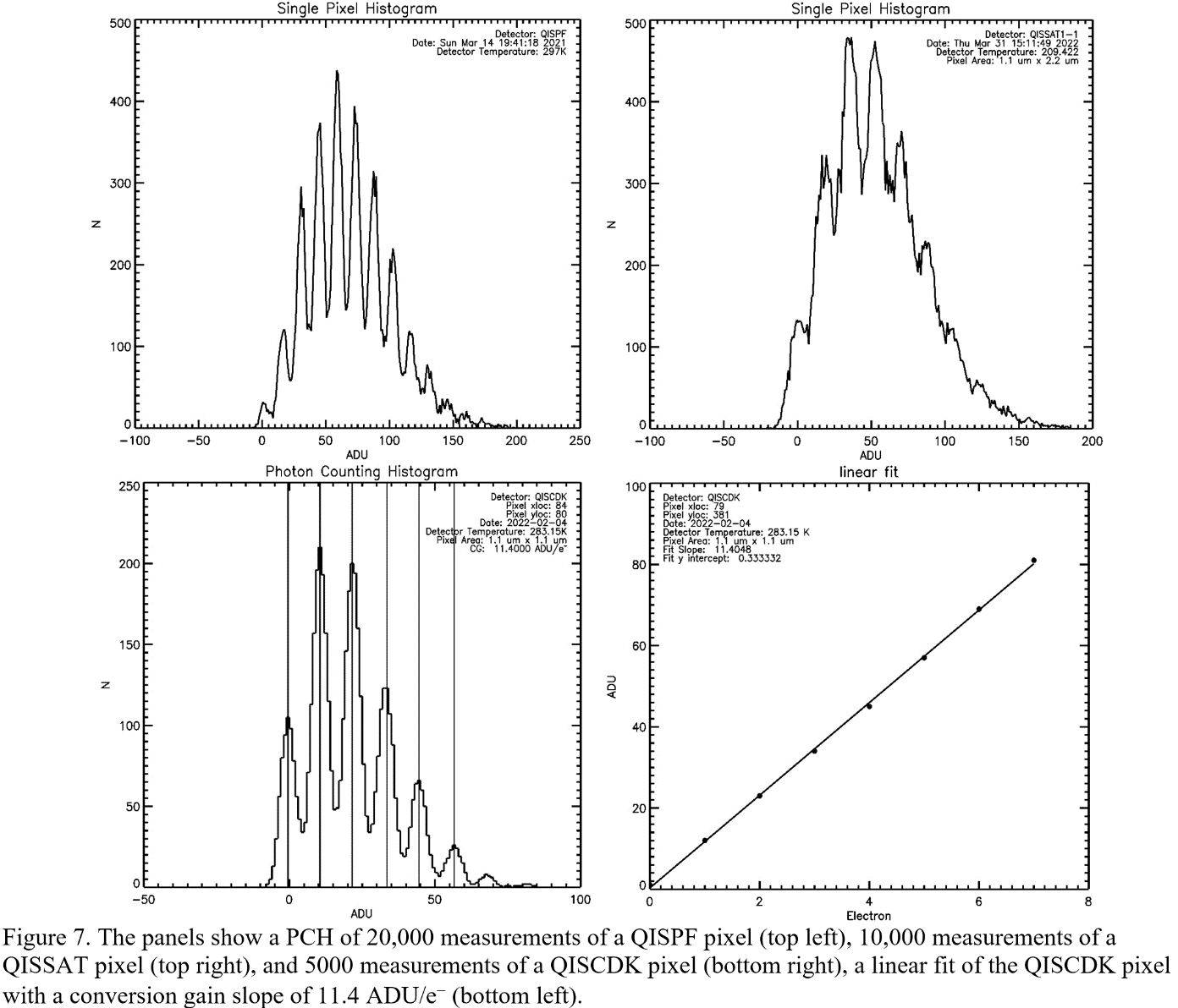
Photon-Number Resolution

Slide 15
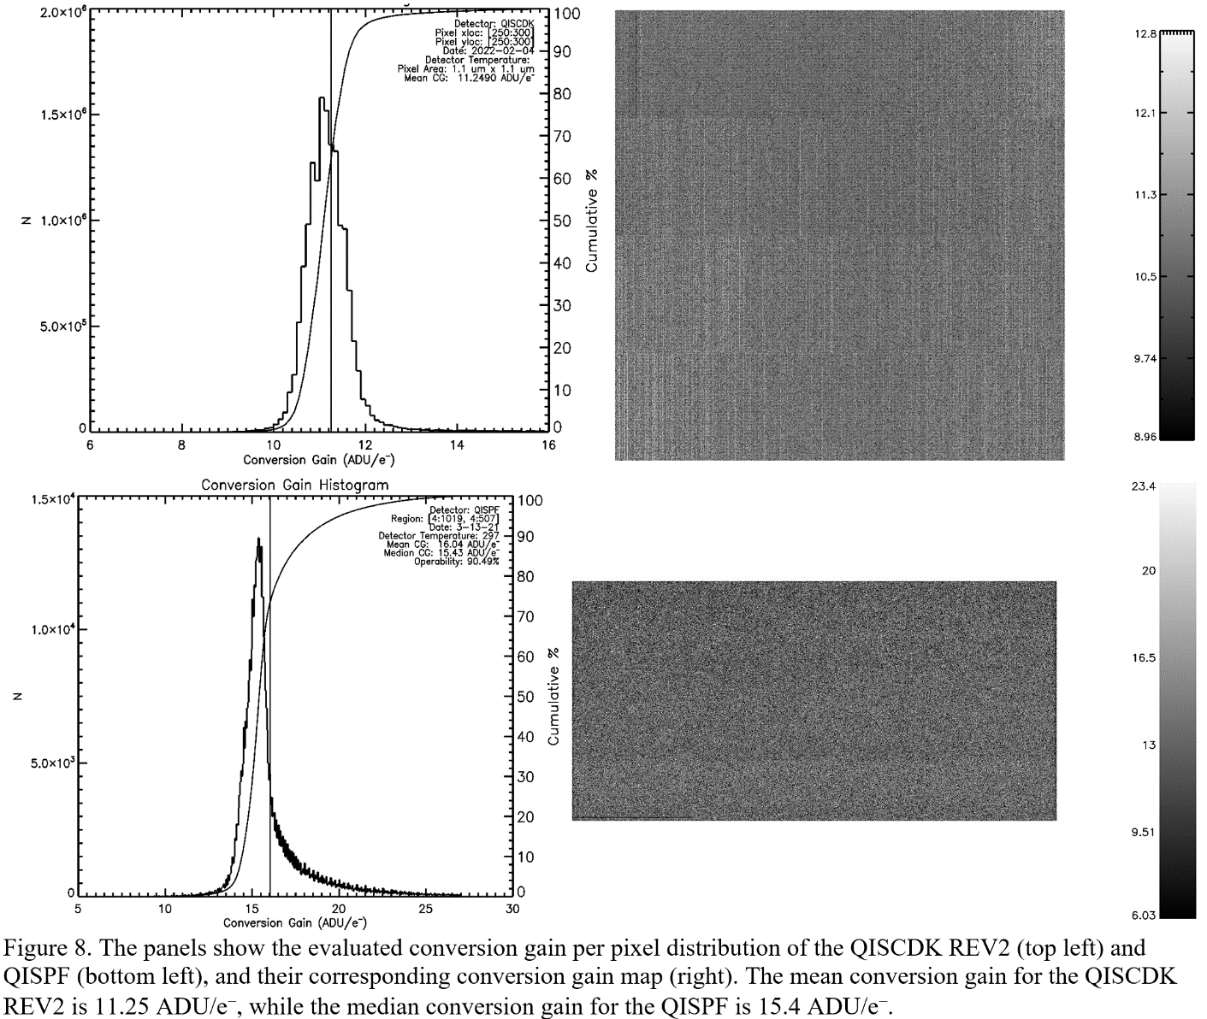
Conversion Gain of Sensor Array

Slide 16
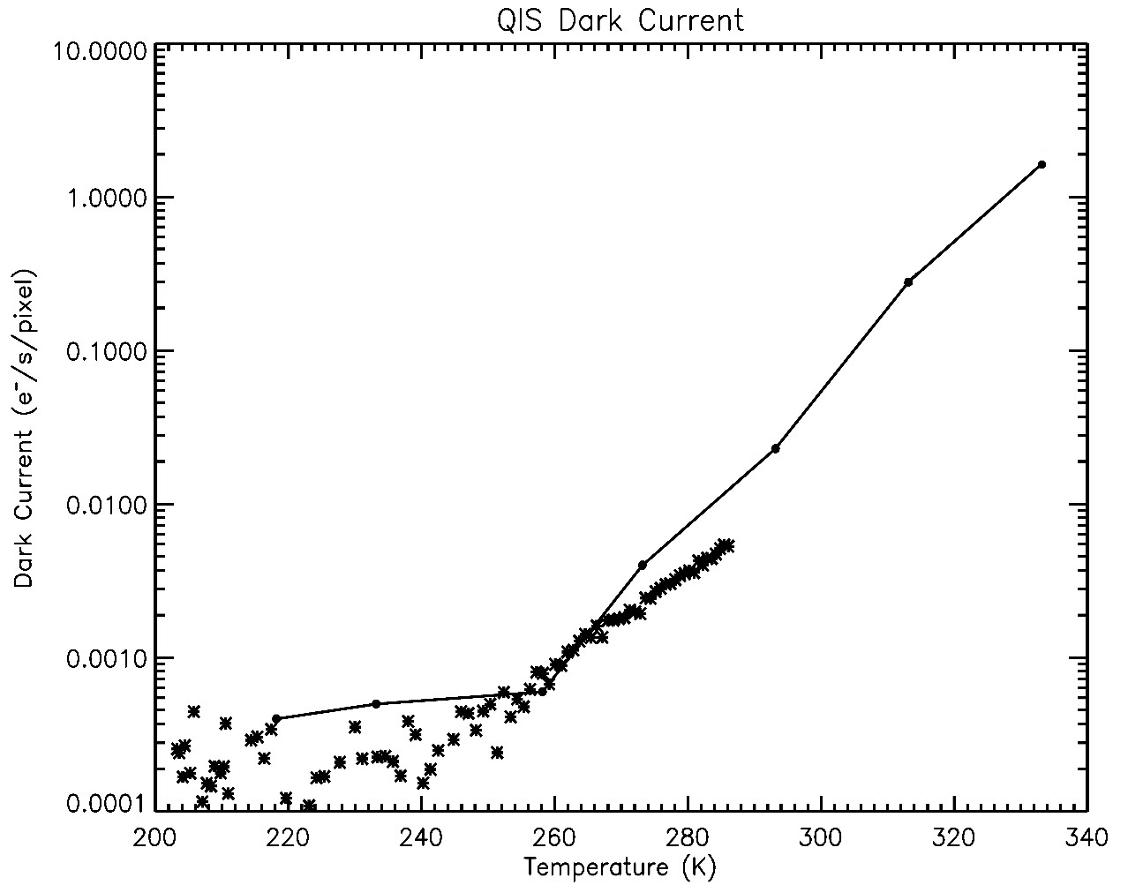
Dark Current vs Temperature

Slide 17
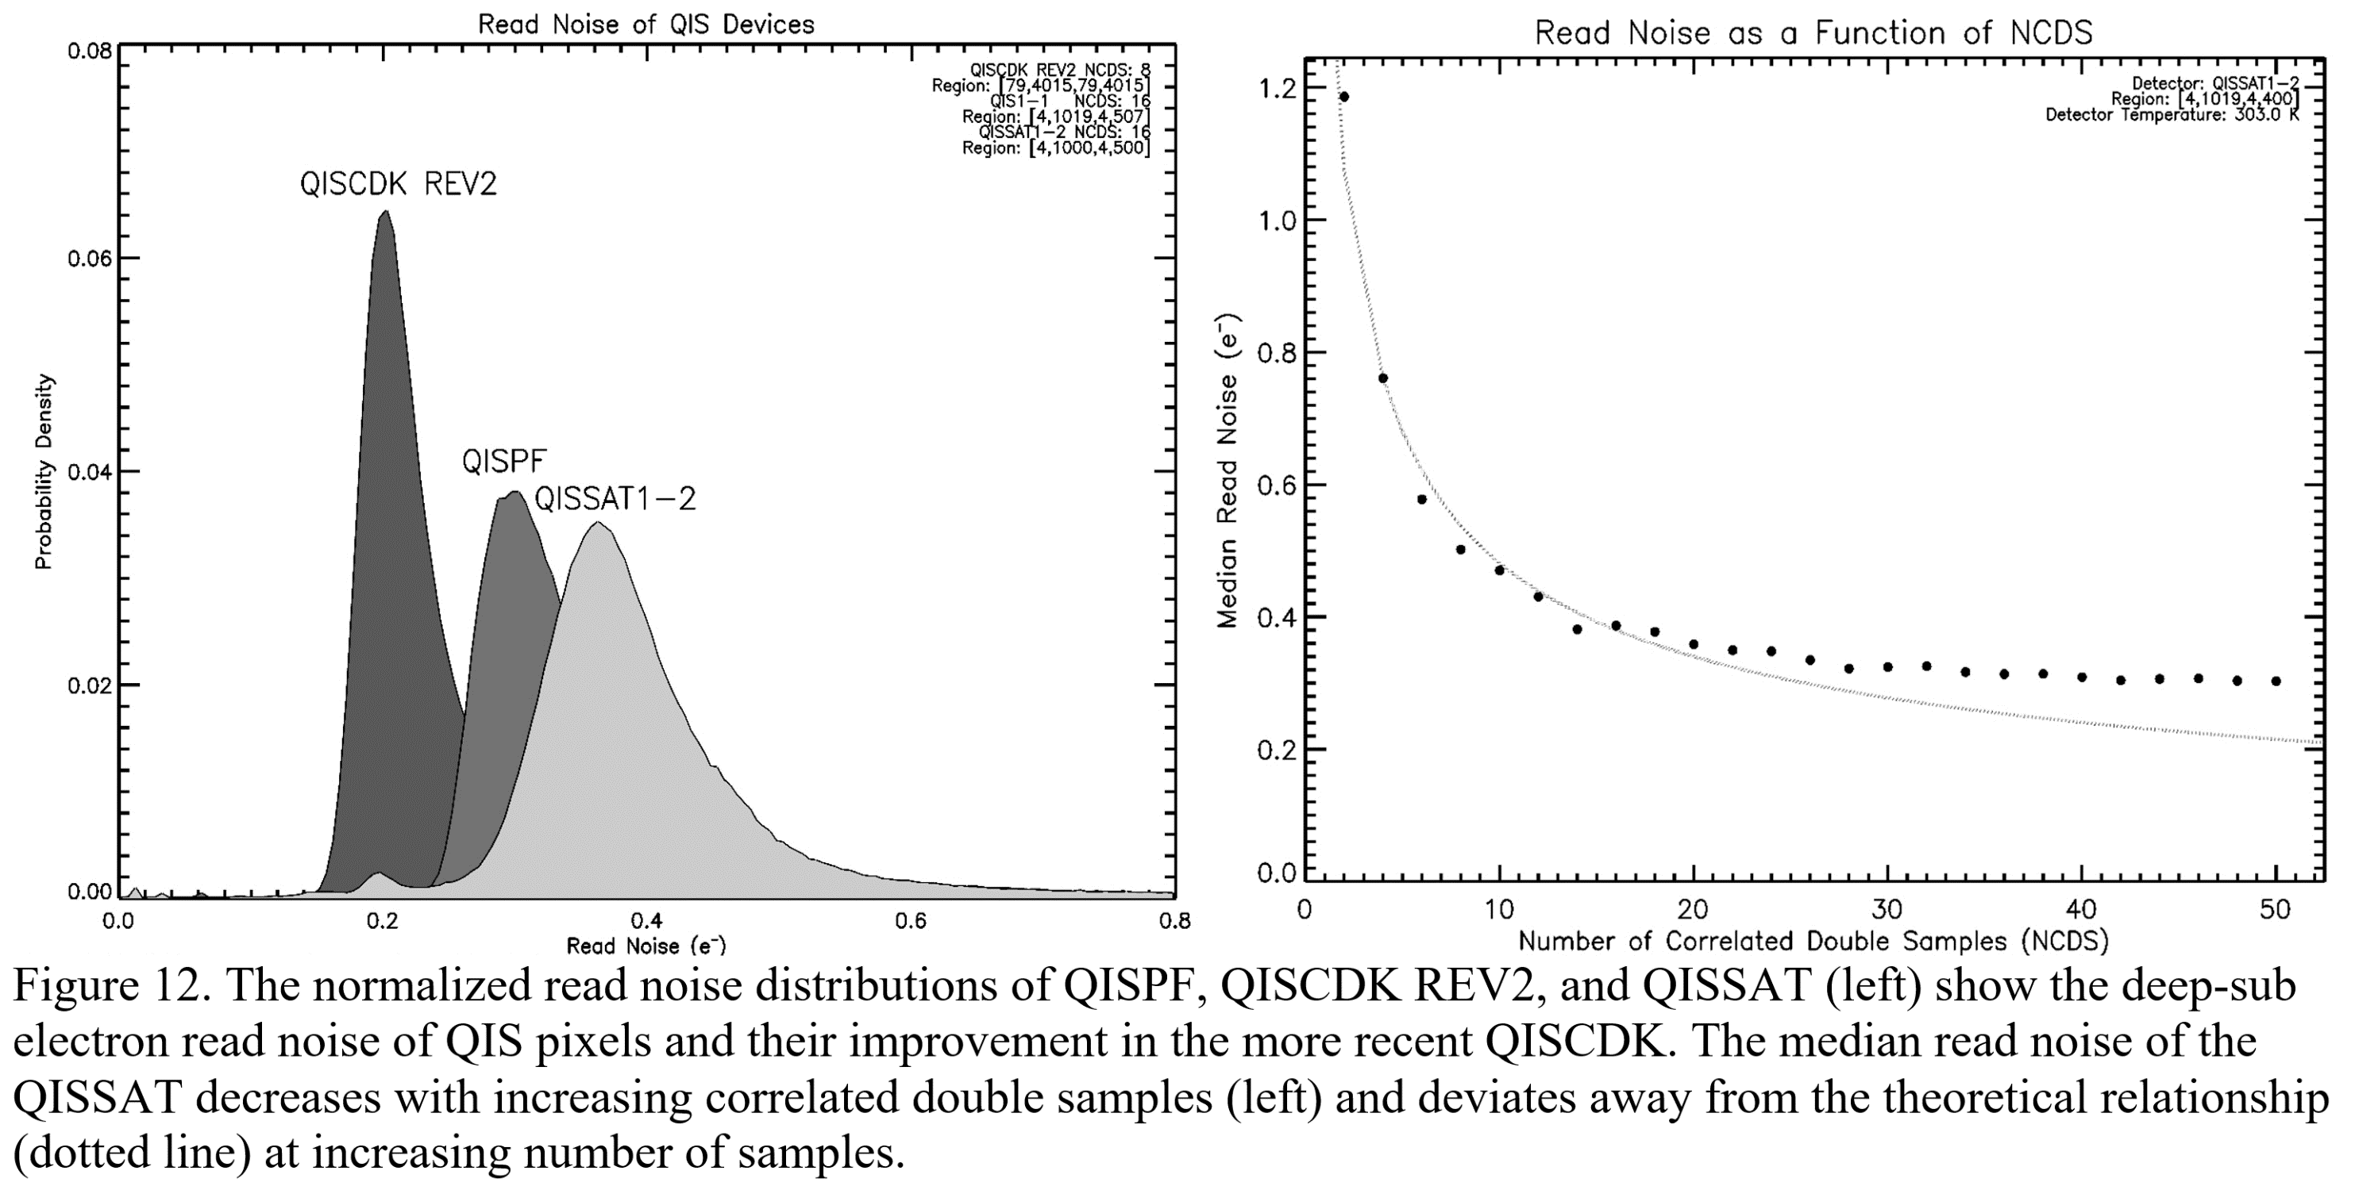
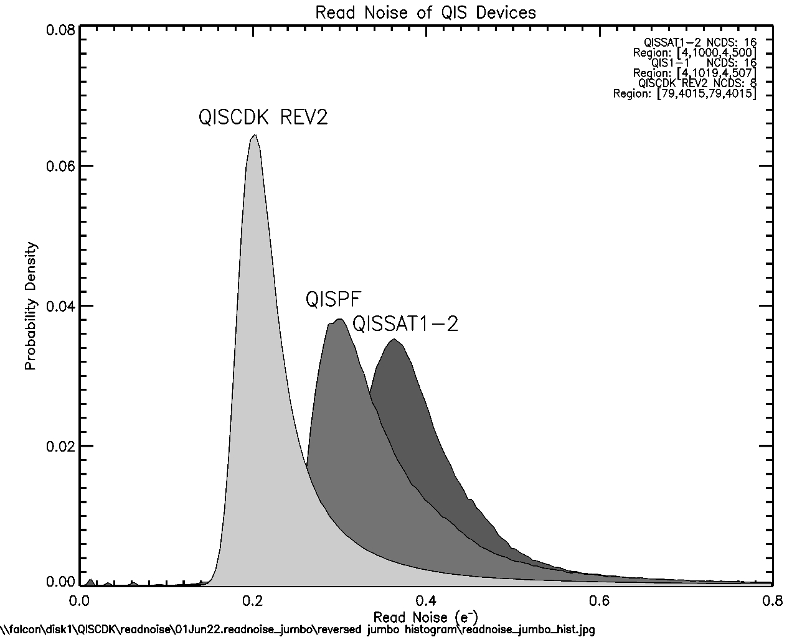
Read Noise and CMS

Slide 18
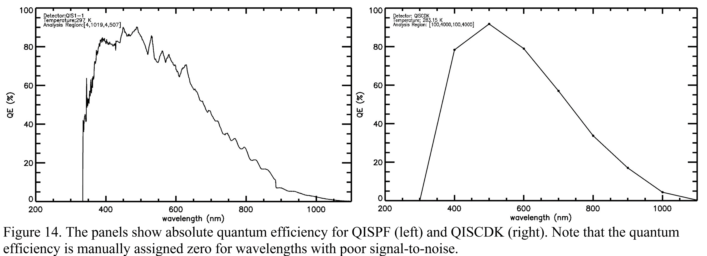
Quantum Efficiency

Slide 19
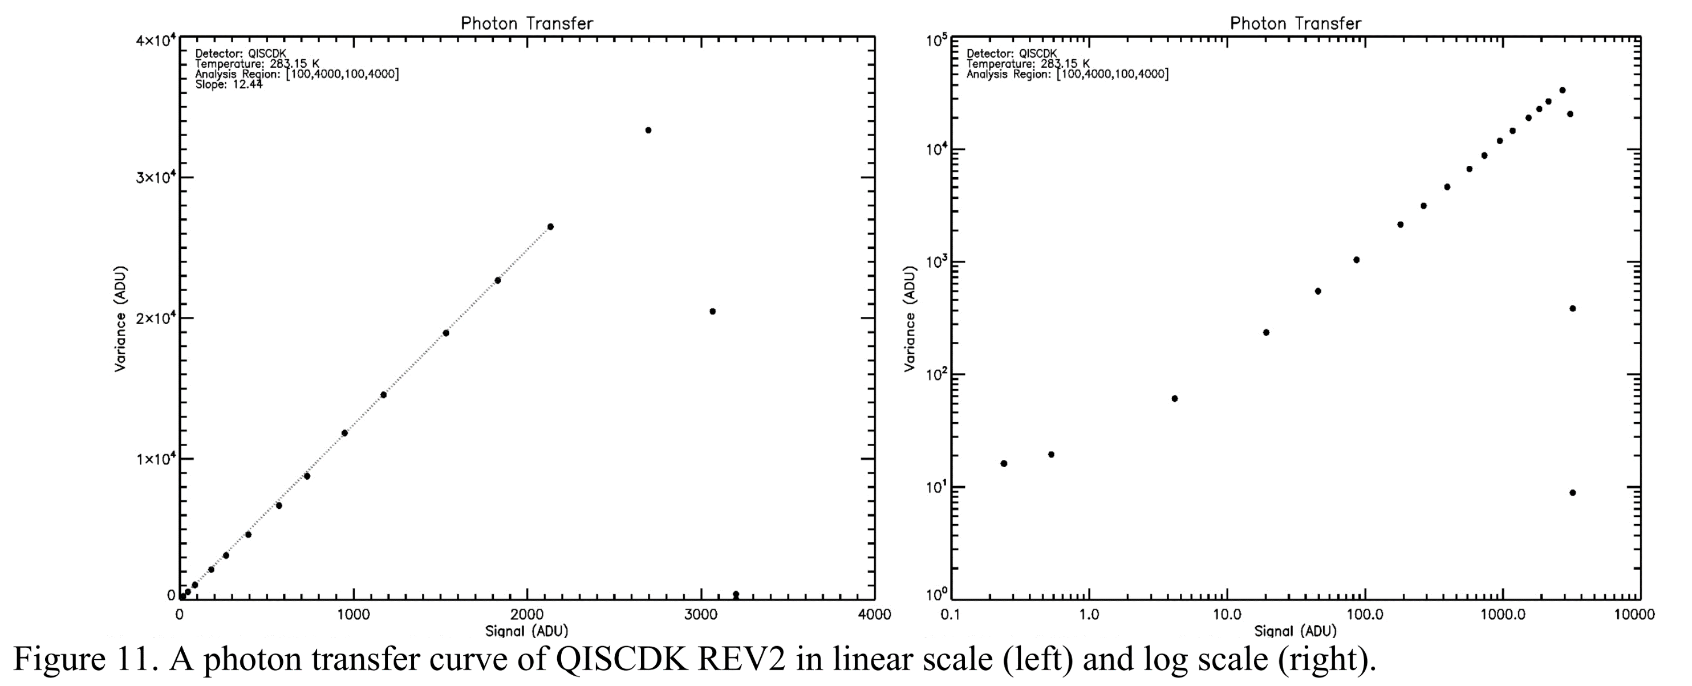
Photon Transfer:
Linearity and Full-Well Depth

Slide 20
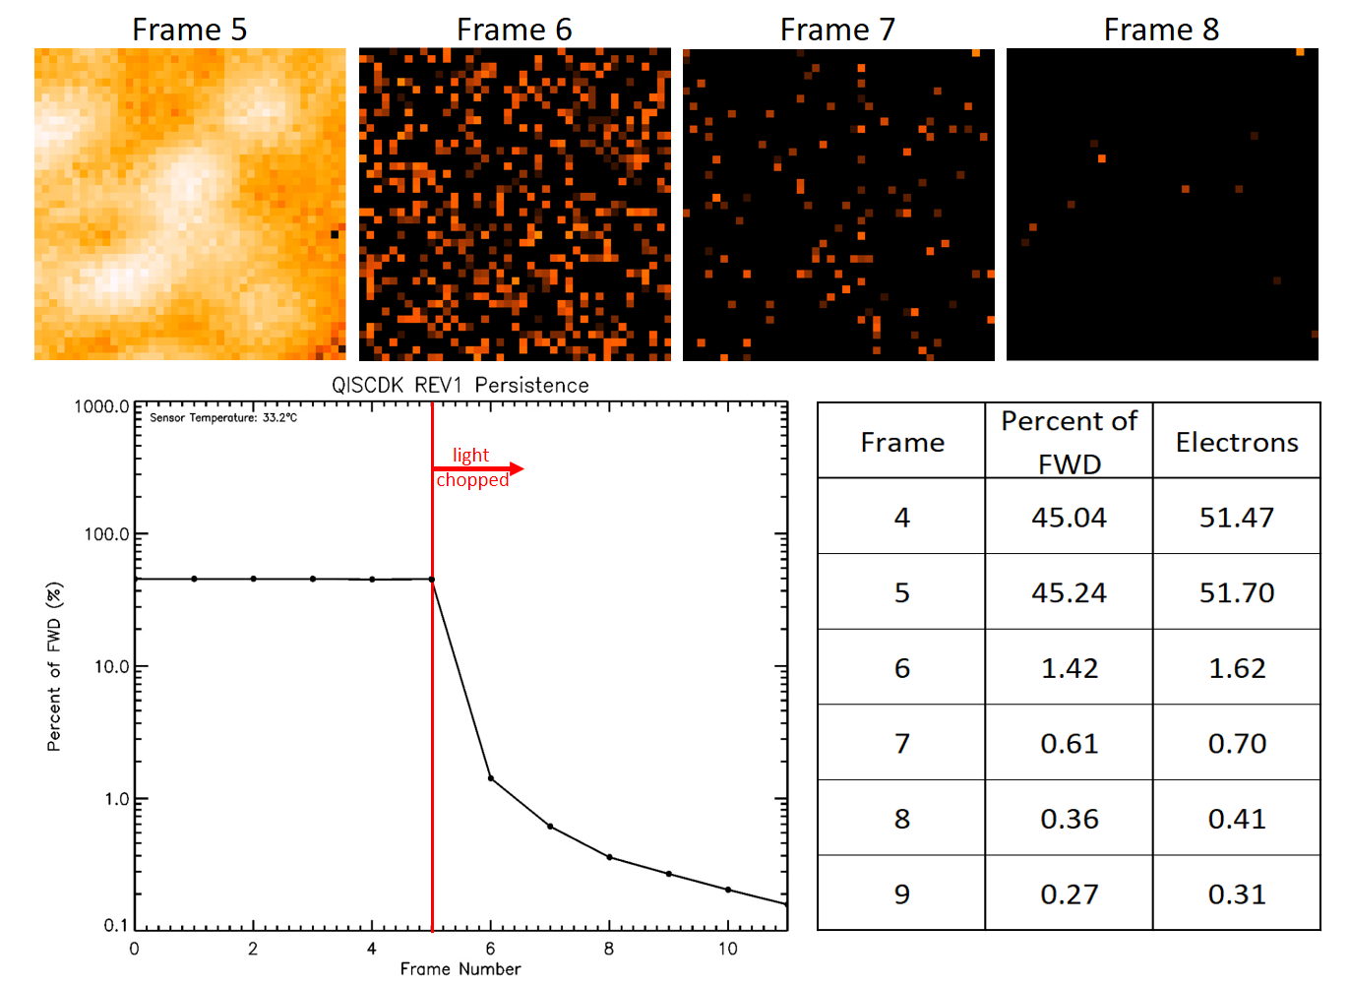
Persistence

Slide 21
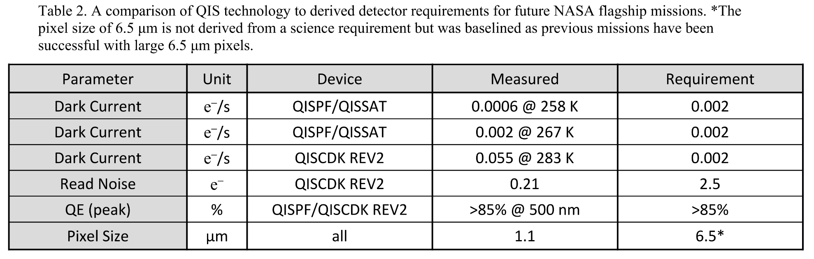
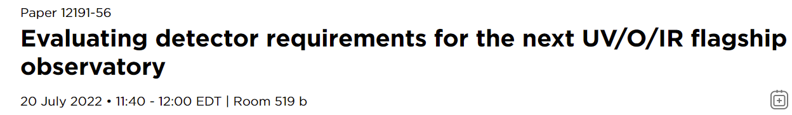
Characterization Summary for NASA Applications

Slide 22
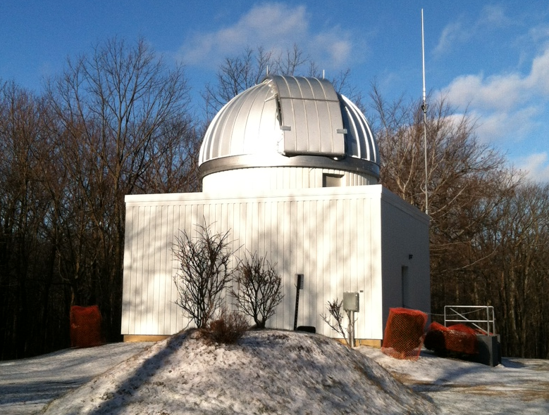
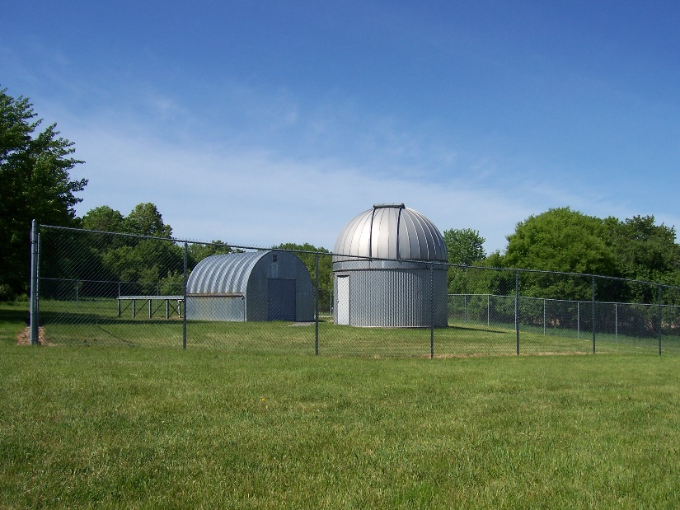
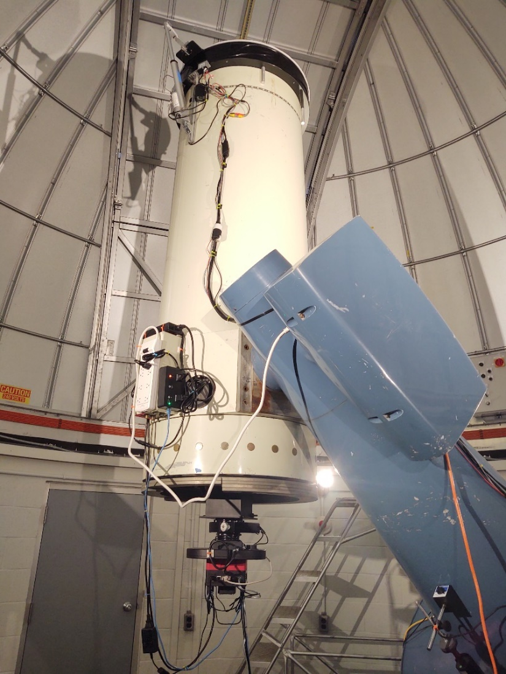
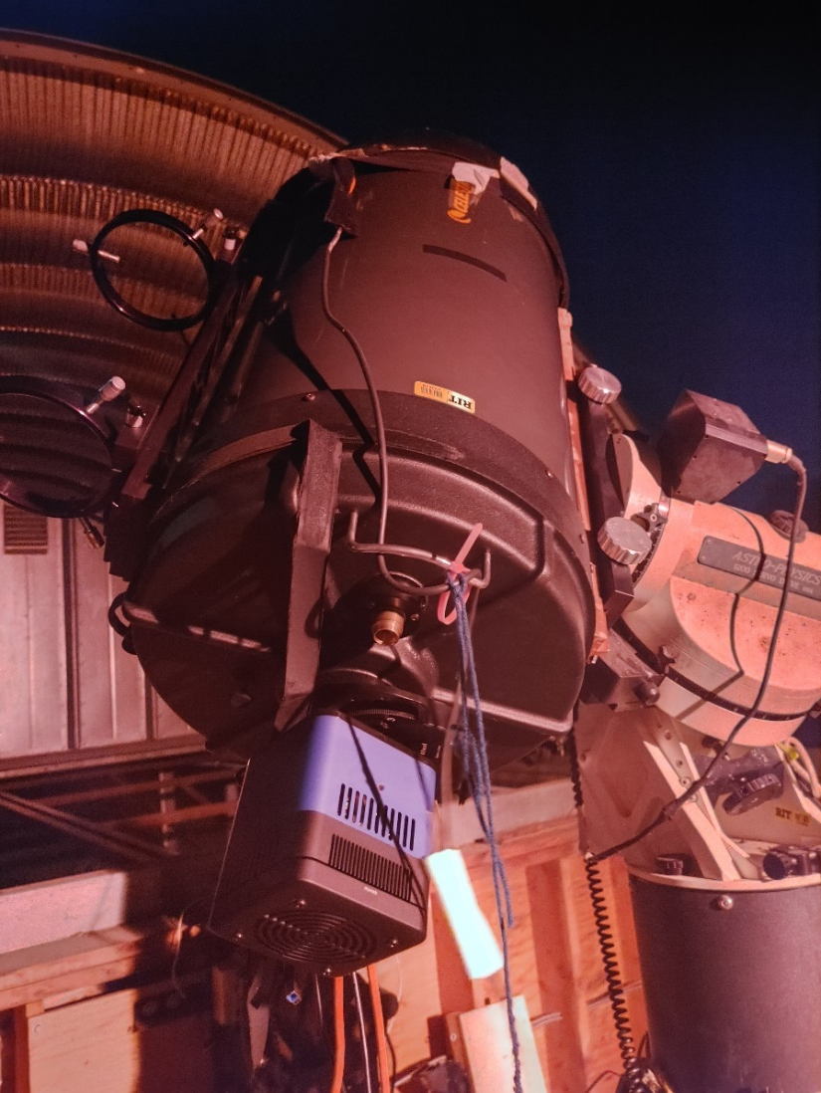
Astronomical
Observations

Slide 23
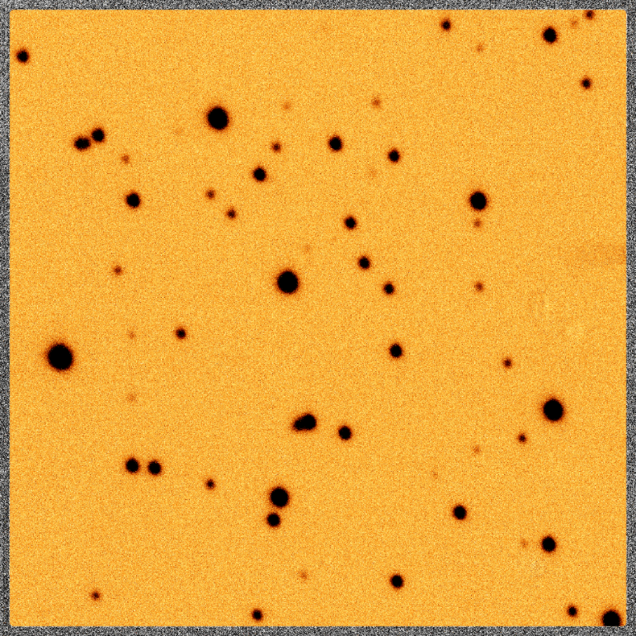
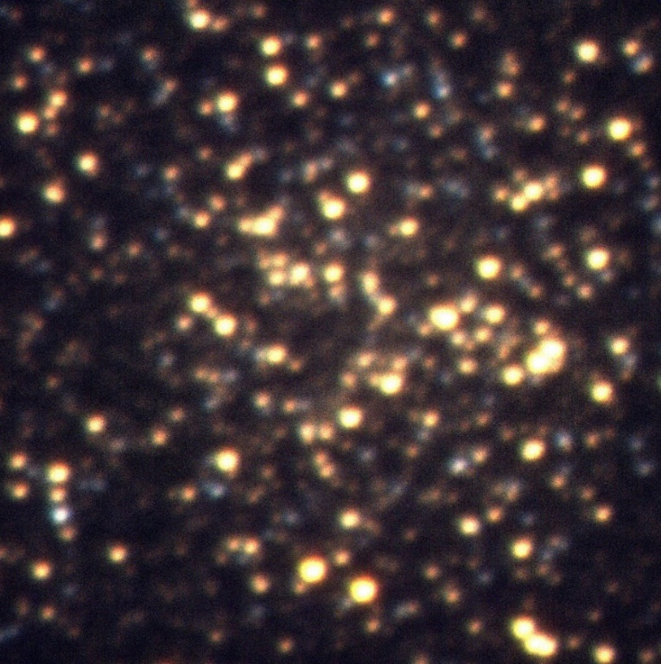

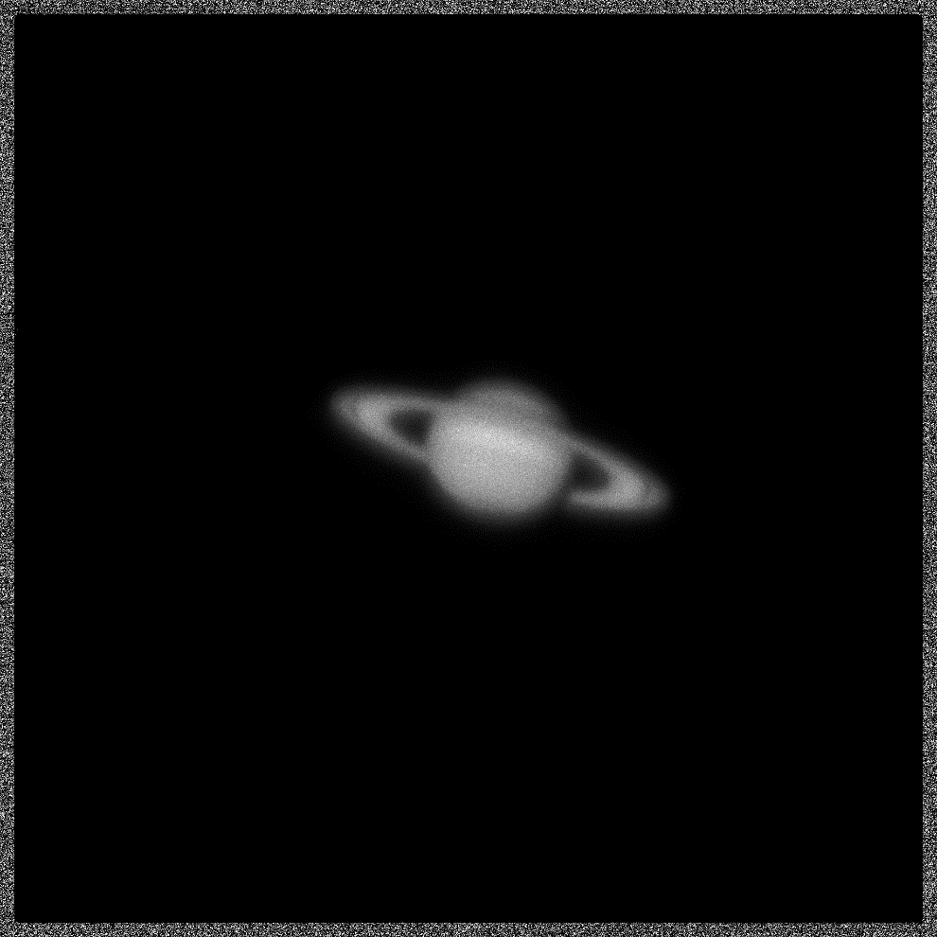
Raw and Processed Images from Observations
M13 Raw Inverse-Heatmap
M67 Process False Color Image
The Lunar Surface of Copernicus, Kepler, and the Mare Insularum
Saturn (70 ms integration)
Notes:
The lunar surface photo includes Copernicus (large rightmost crater), Kepler (middle crater), and Aristarchus (top left crater on photo edge). Mare Insularum (Sea of islands) located between Copernicus and Kepler.

Slide 24
Conclusions

Slide 25
Summary
four single-photon sensing and photon-number resolving 1.1 μm QIS devices were tested
dark current of 0.002 e⁻/s at 267 K
median read noise of 0.21 e⁻
QE of >85% at 500nm
QE of >17% at 920nm (water vapor absorption)
aperture photometry of M13 and M67
preparing devices for radiation testing in future

Slide 26

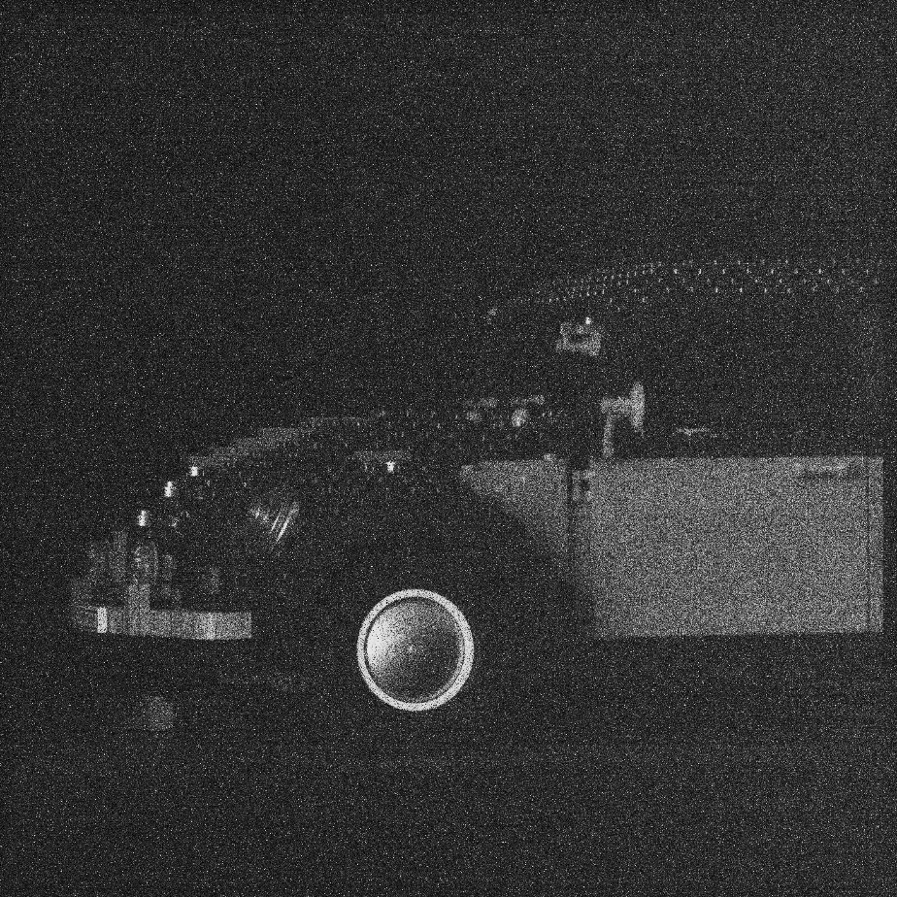
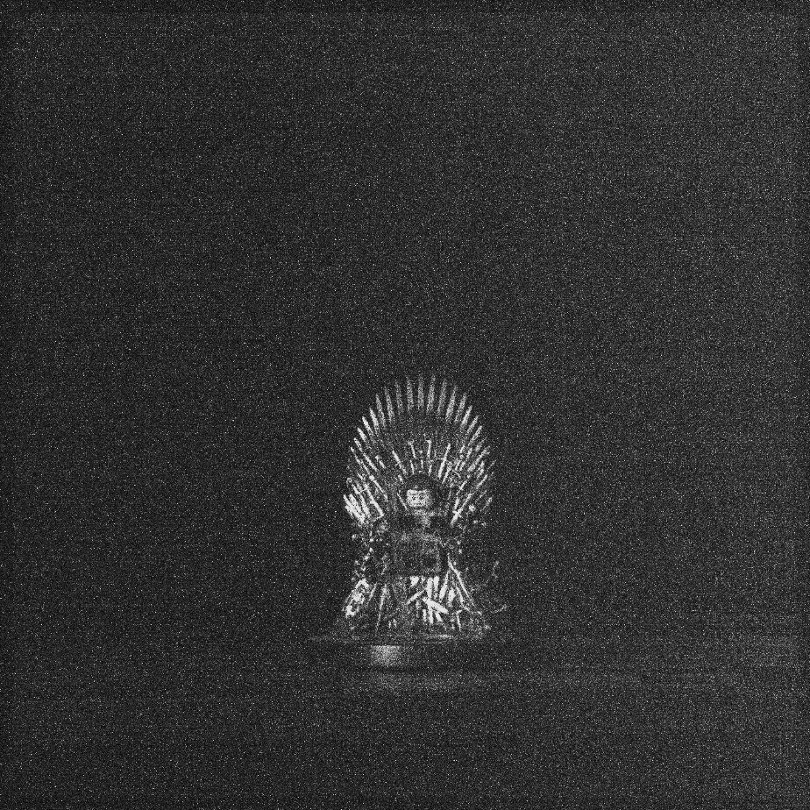
Thank you
Justin P. Gallagher
jpgcfd@rit.edu
Donald F. Figer
figer@cfd.rit.edu
Lazar Buntic
lb4525@rit.edu

Slide 27
Backup Slides

Slide 28
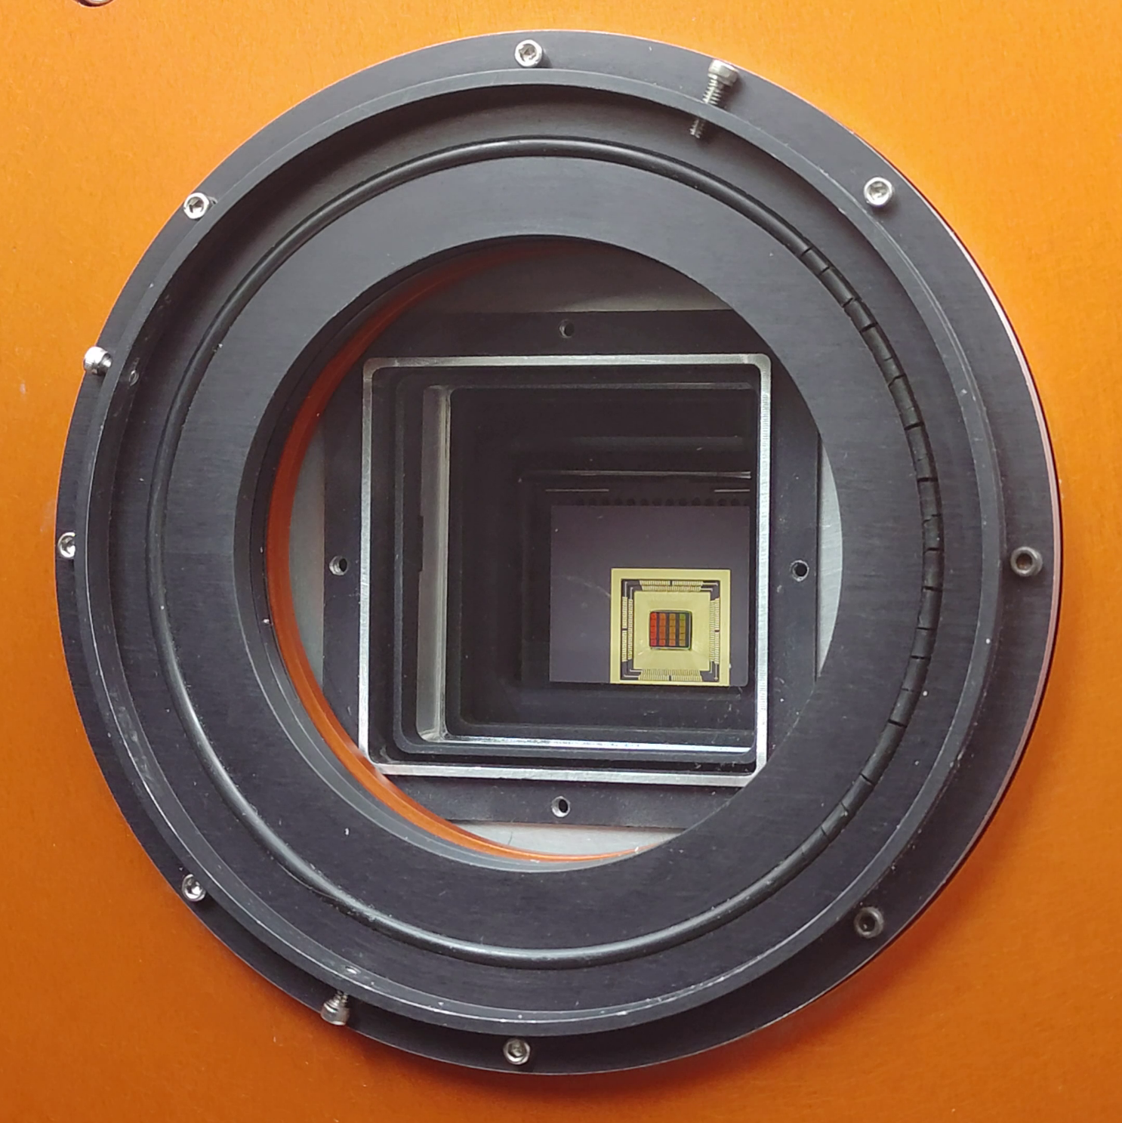
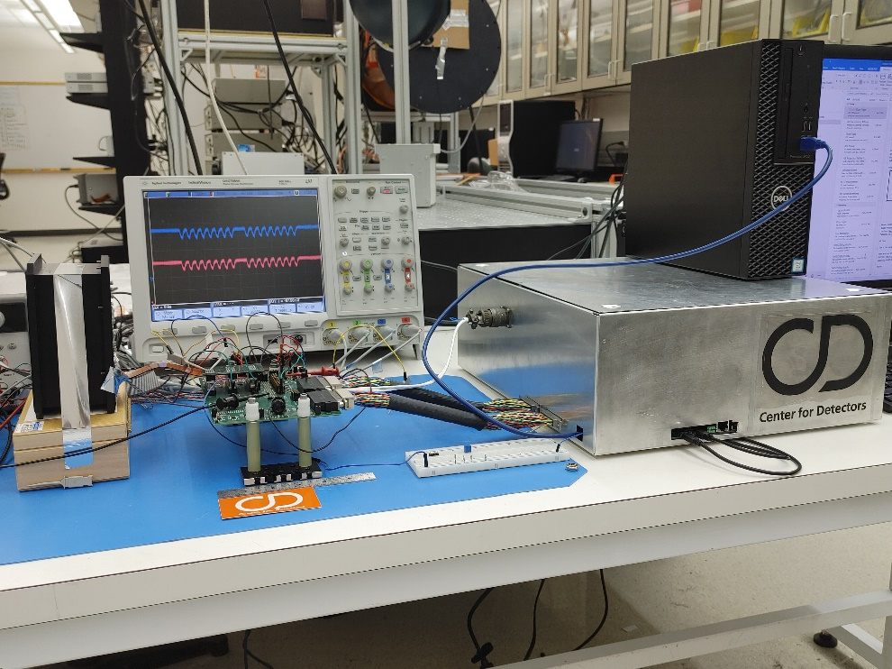
QISSAT: Dewar and Custom Electronics

Slide 29
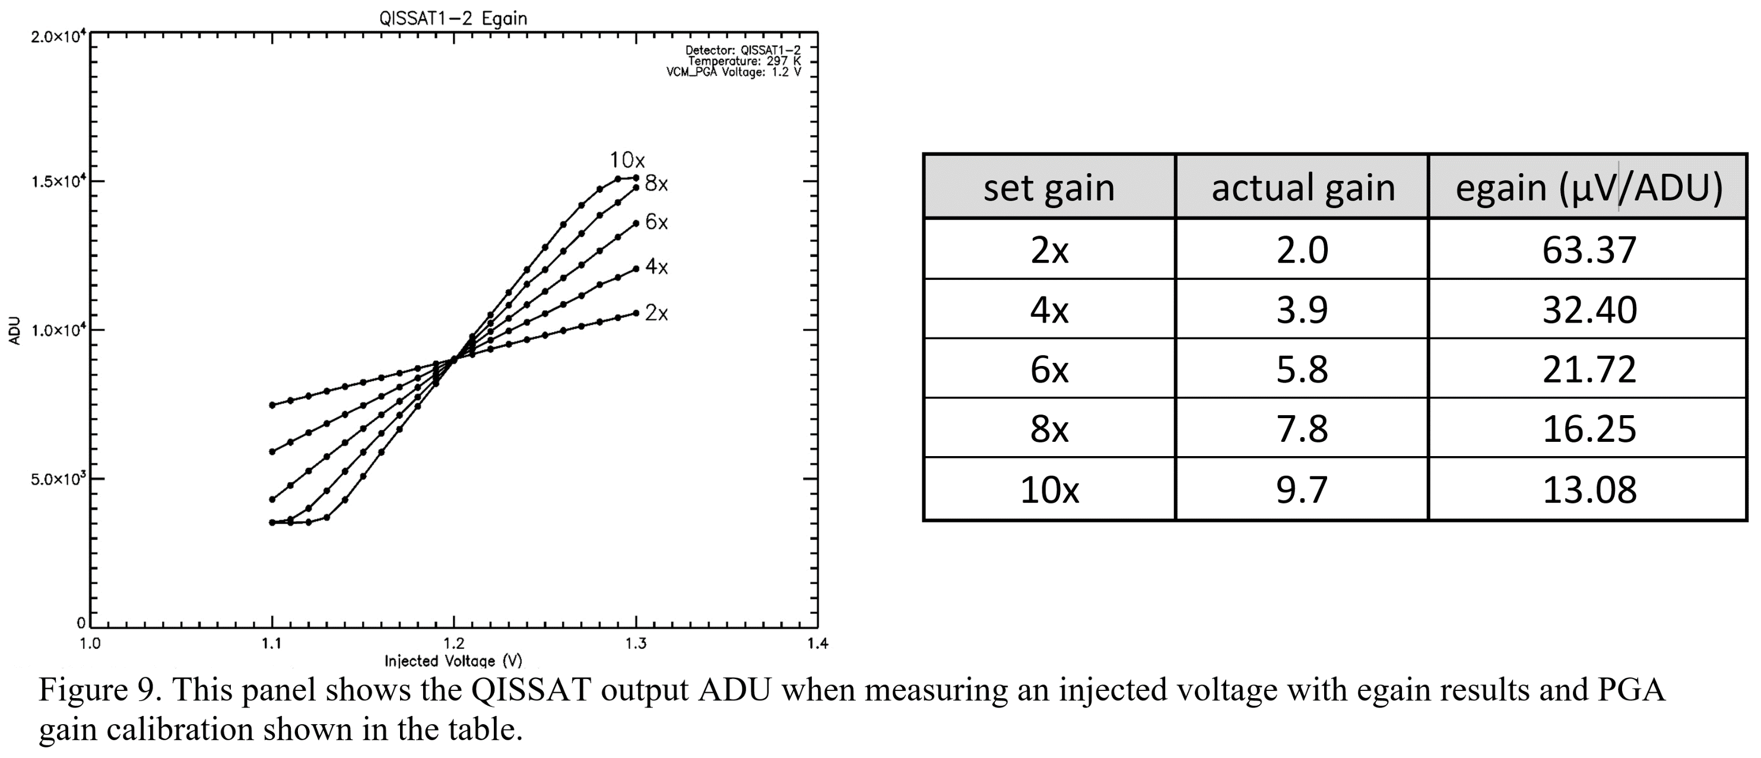
Electronic Gain

Slide 30
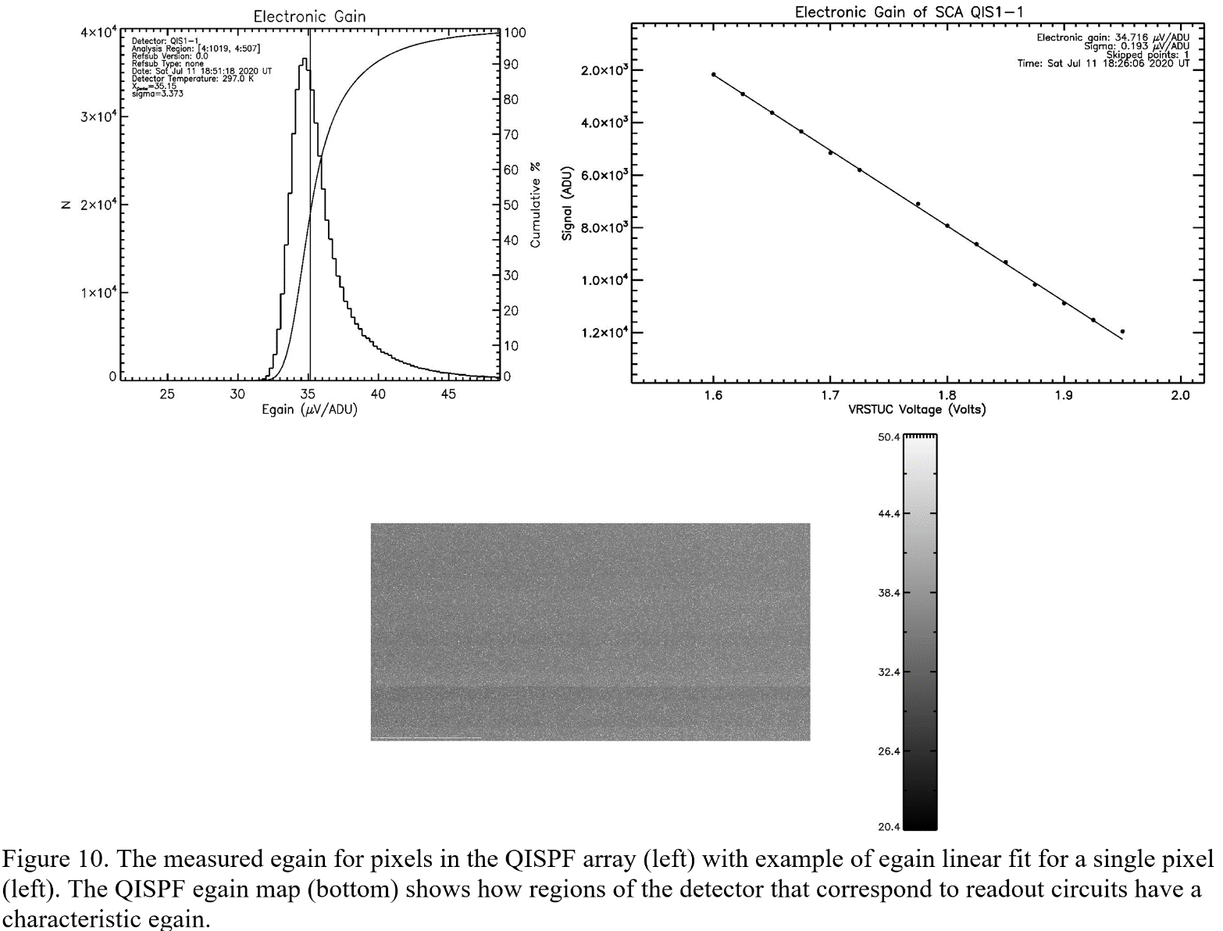
Electronic Gain

Slide 31
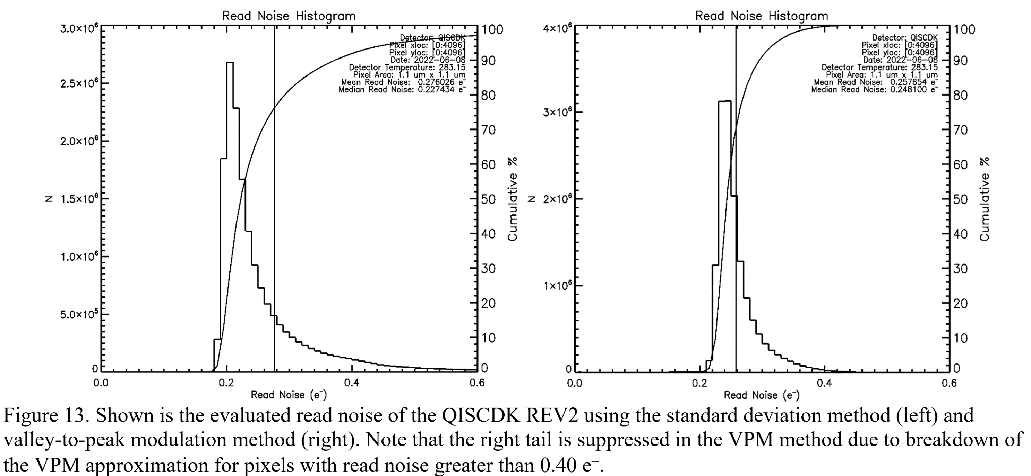
Read Noise Evaluated from Two Different Methods

Slide 32
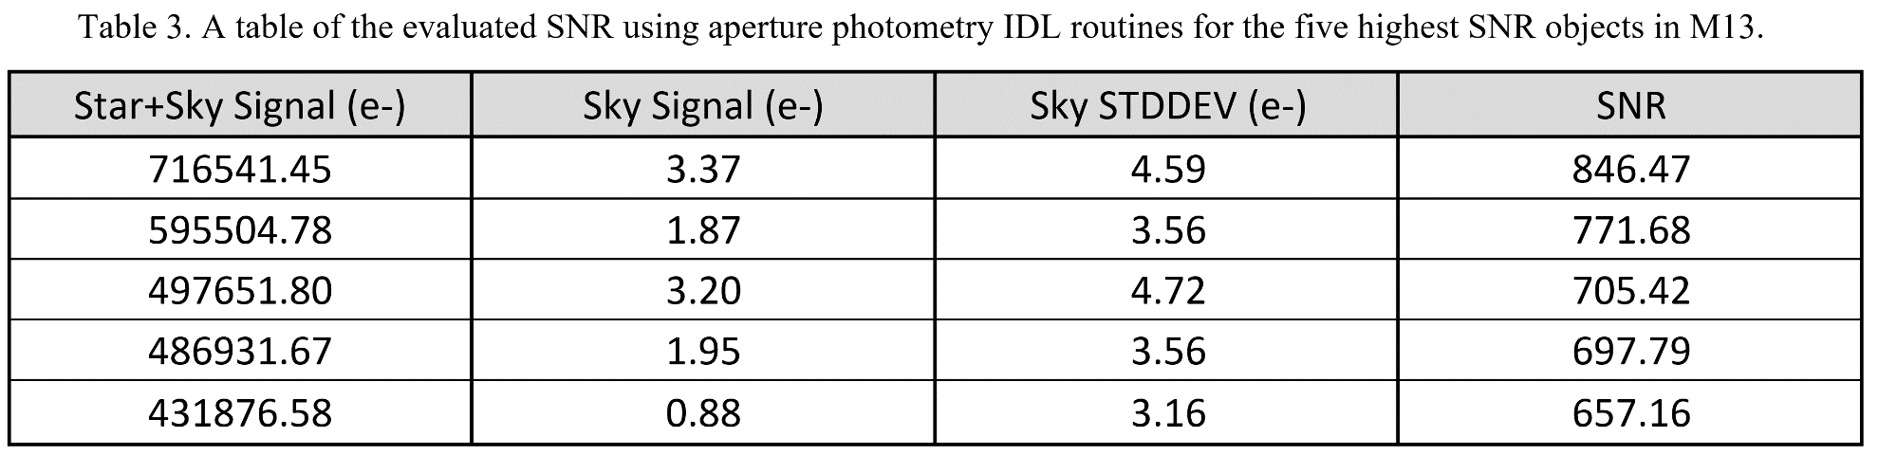
M13 aperture photometry

Slide 33
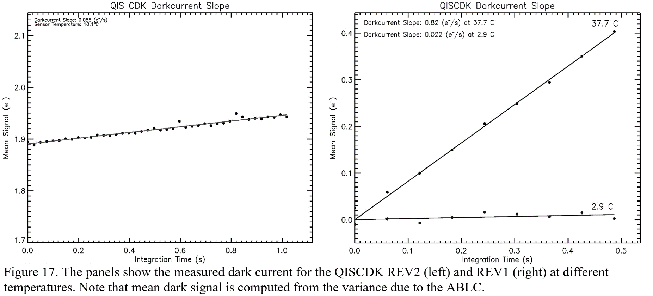
Dark Current Slopes

