Slide 1




The SATIN Infrared Detector Development Program and the Road to HELLSTAR
Donald F. Figer,ª Justin P. Gallagher,ª Lazar Buntic,ª Jon Getty,^{b} Stefan Lauxtermann,^{c}
ªCenter for Detectors, Rochester Institute of Technology, Rochester, NY
^{b}Raytheon Vision Systems, 75 Coromar Dr., Goleta, CA 93117
^{c}Sensor Creations Inc., 5251 Verdugo Way, Suite I, Camarillo, CA 93012

Slide 2
Outline
The SATIN program
Detector characterization
The road to HELLSTAR

Slide 3
SATIN DETECTOR DEVELOPMENT PROGRAM

Slide 4
SATIN
SATIN is the Short-wave infrared Advanced Technologies and Instrumentation program for NASA and NSF.
The aim is to develop large-format infrared detectors for astrophysics using HgCdTe grown on silicon substrates.
RVS designed and fabricated the devices, while the CfD characterized them.
We used the VIRGO ROIC as a test vehicle.
SATIN is now complete.
We are on the road to HELLSTAR (HgCdTe Extremely Large Layout Sensor Technology for Astrophysics Research).

Slide 5
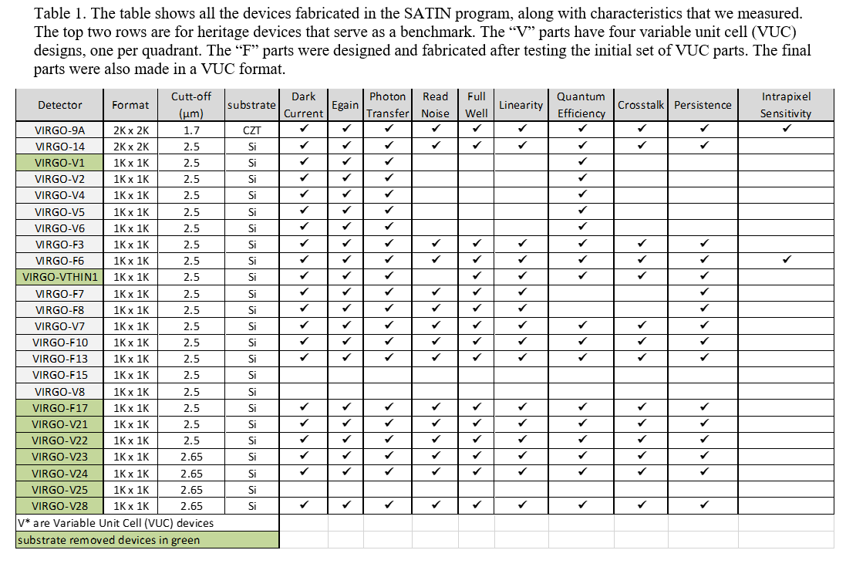
Table of SATIN Detectors

Slide 6
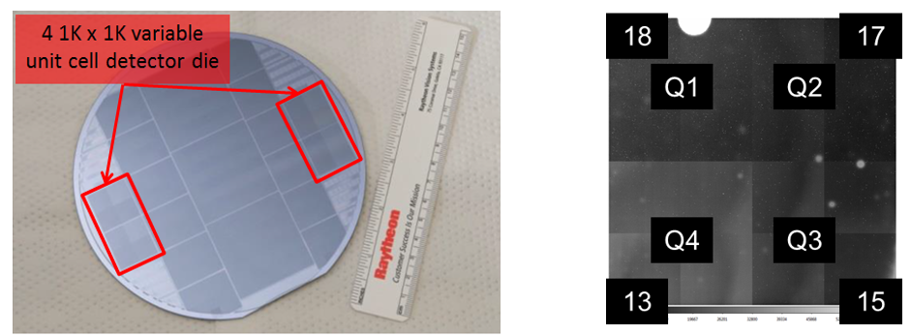
Variable Unit Cell Design (VUC)

Slide 7
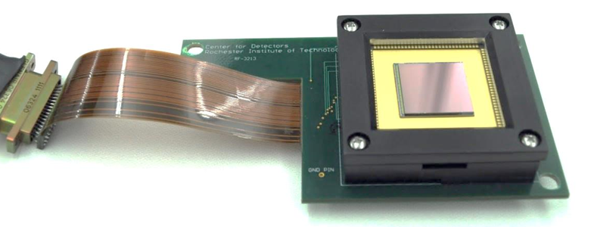
Detector Package

Slide 8
DETECTOR CHARACTERIZATION

Slide 9
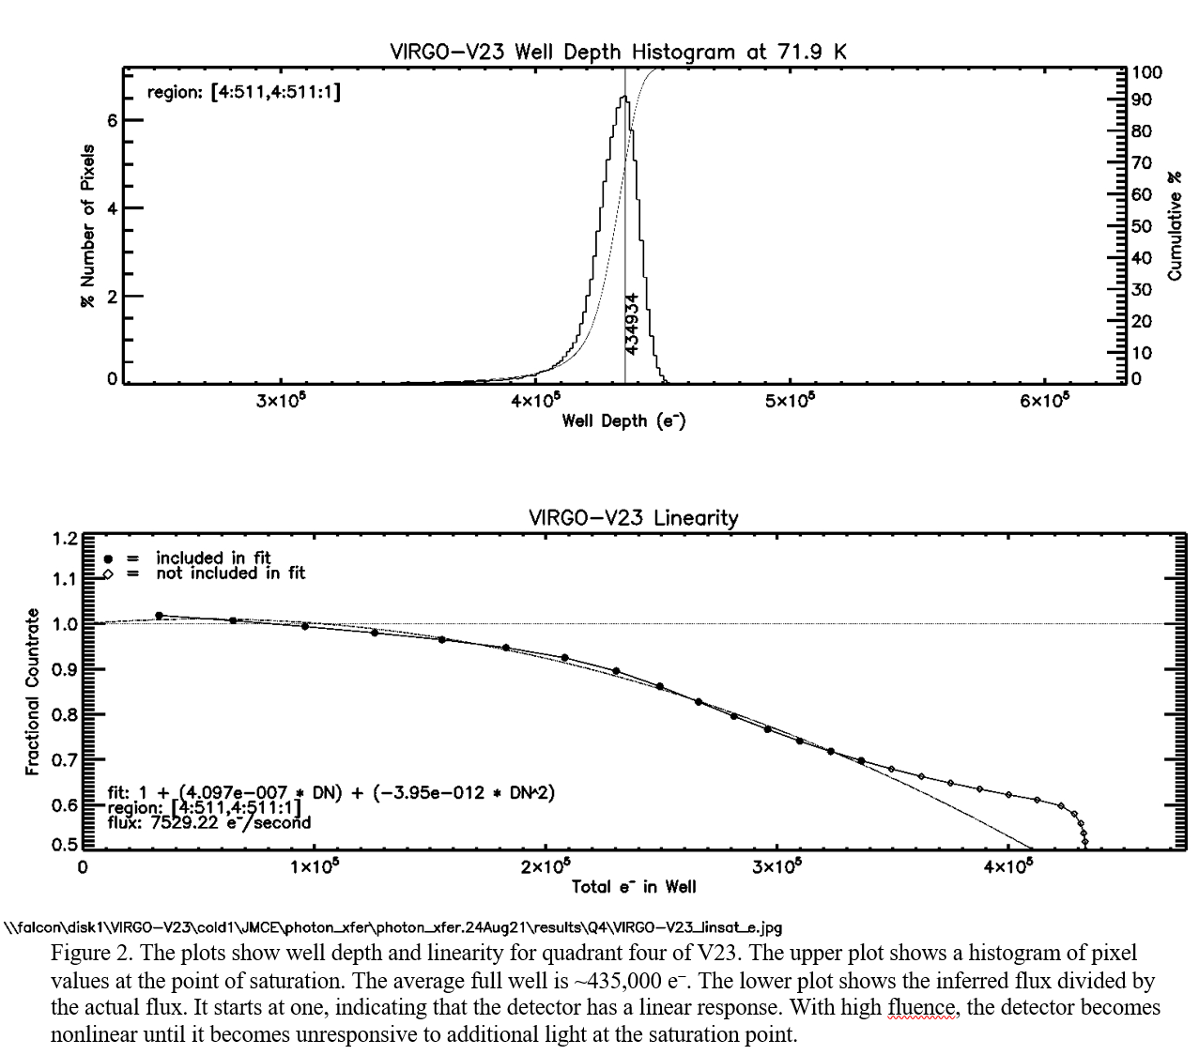
Linearity, Well Size, Conversion Gain

Slide 10
Flat Field

Slide 11
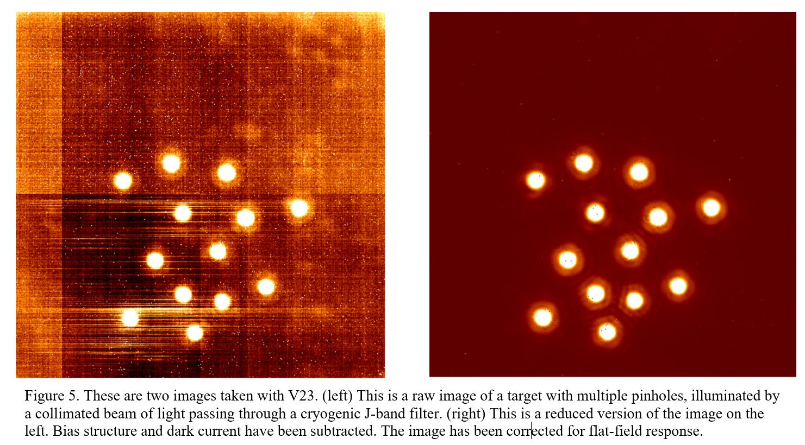
Simulated Star Field

Slide 12
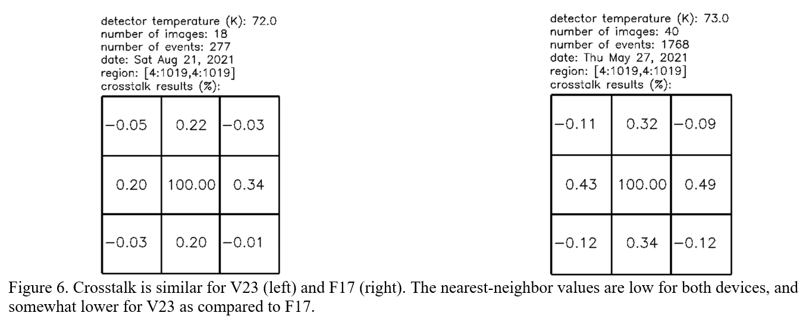
Crosstalk (3 by 3 pixel grid)

Slide 13
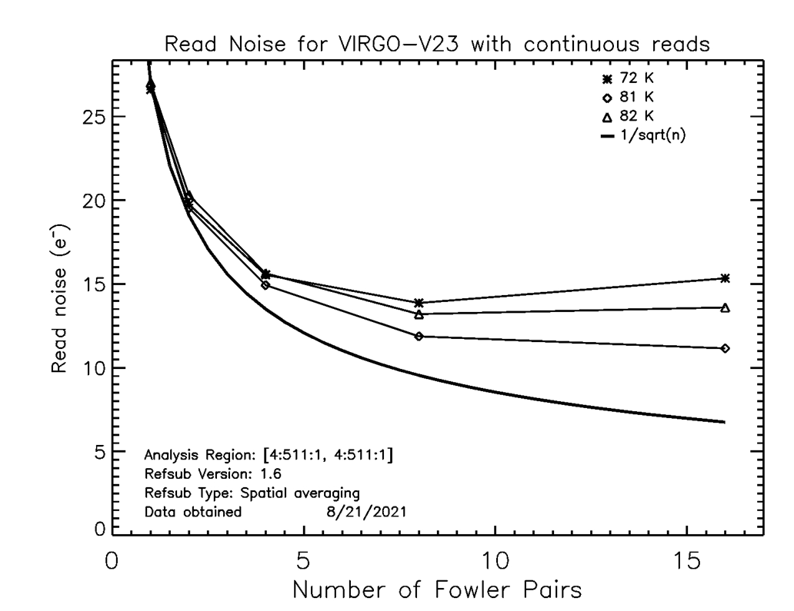
Read Noise

Slide 14
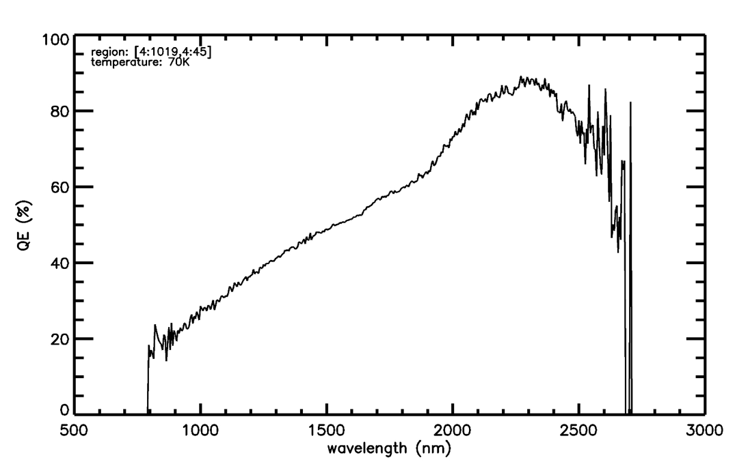
Quantum Efficiency

Slide 15
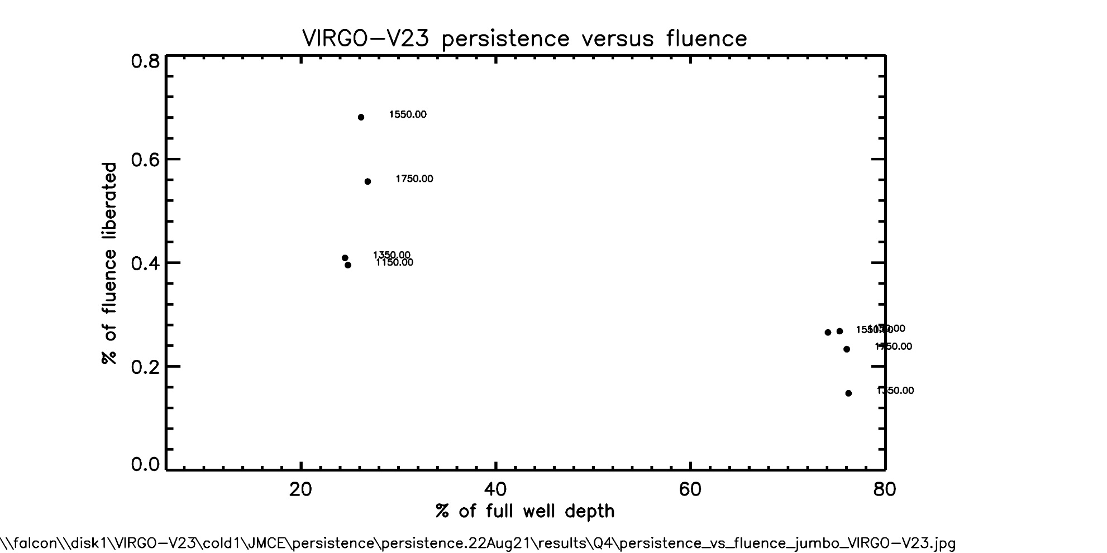
Persistence

Slide 16
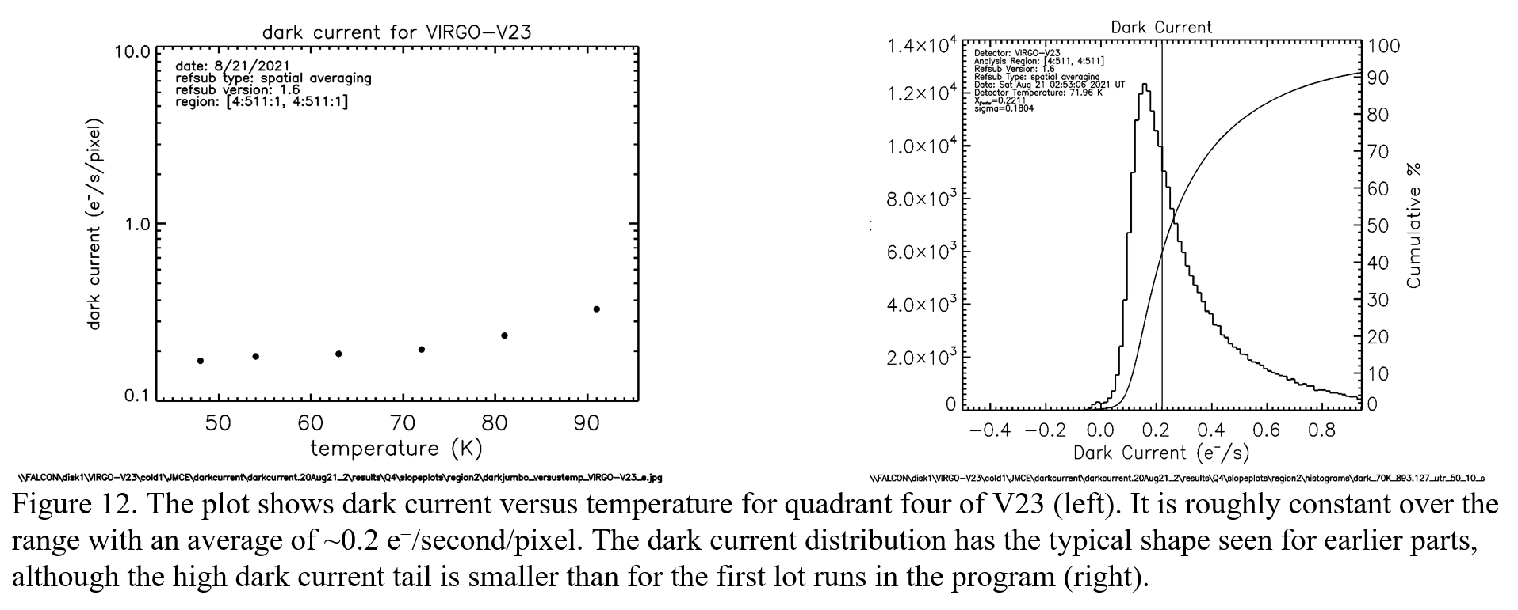
Dark Current

Slide 17
the road to hellstar

Slide 18
Requirements
Table 3. The table shows HELLSTAR goals compared to SATIN performance.
Parameter | SATIN Performance | HELLSTAR Goals
Format | 1K×1K and 2K×2K | 4K×6K
Pixel Size (µm) | 20 | 10
Read Noise (e⁻ CDS) | 27 | 20
Wavelength Range (µm) | 0.8 – 2.55 | 0.8 – 2.65
Dark Current (e⁻/s/pixel)* | 0.5 @ 70 (95% Operability) | 0.1
Minimum readout time (s) | 0.3 | 1
Well size (e⁻) | 400,000 | 300,000
Peak QE (w/AR coating) | >90% | >70% in K-band
Persistence (after 100% saturation) | <0.1% | <0.1%

Slide 19
ROIC

Slide 20
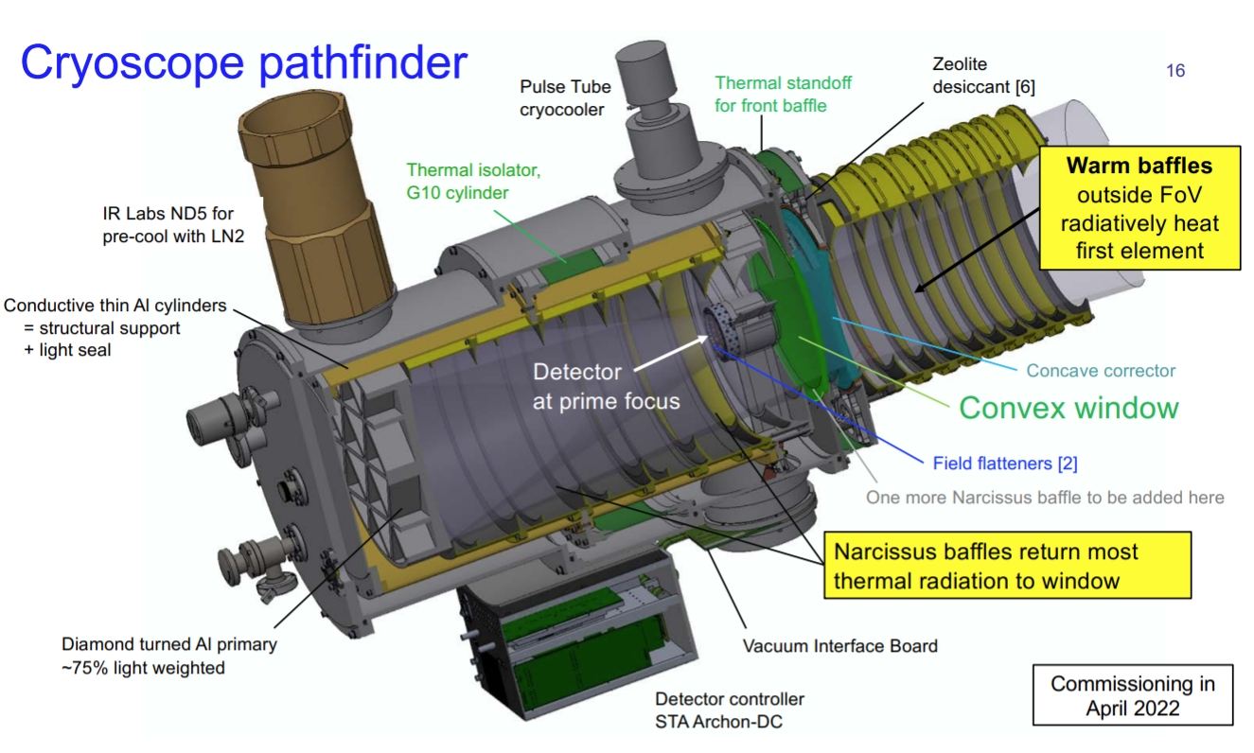
Cryoscope

Slide 21
Summary
RIT and RVS developed new infrared detectors for astrophysics applications.
The CfD demonstrated high performance for these detectors.
The team, along with SCI, will now develop HELLSTAR, a 4K×6K infrared detector.
The first application is Cryoscope at the South Pole.

Slide 22
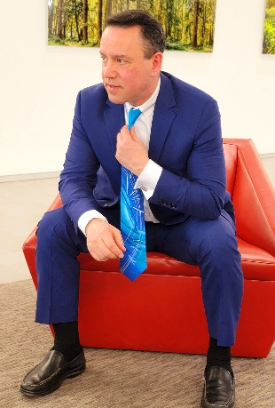

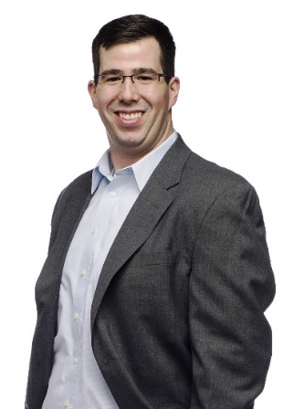
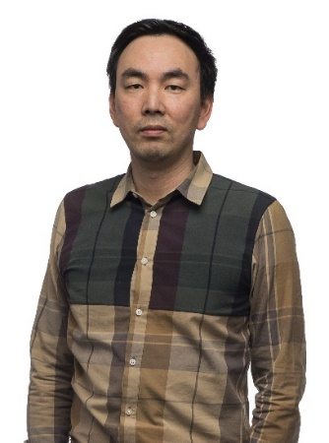
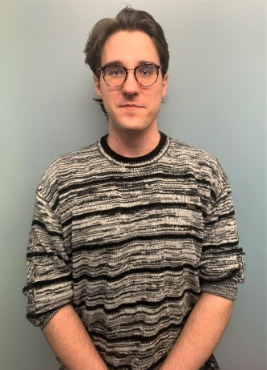


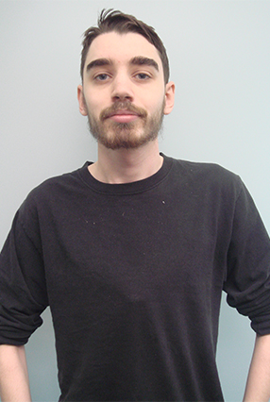
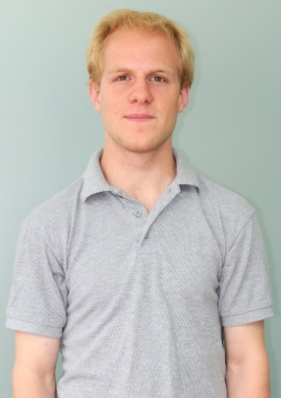
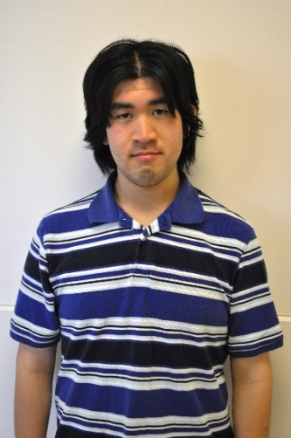
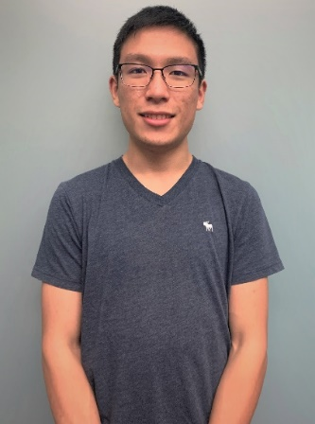

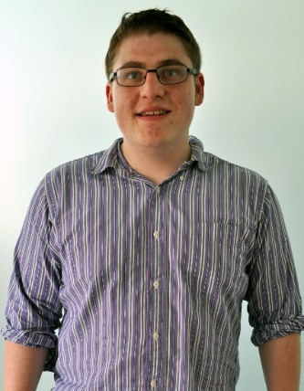
Current* and Past Project Personnel
FINESST!!!
Donald F. Figer*
Justin Gallagher*
Valerie Fleischauer
Brandon Hanold
Joong Lee
Lazar Buntic*
Tre Dipassio
Austin Ford
Neil Guertin
John Hatakeyama
Michael Kha
Gabrielle Picher

Slide 23
backup

Slide 24
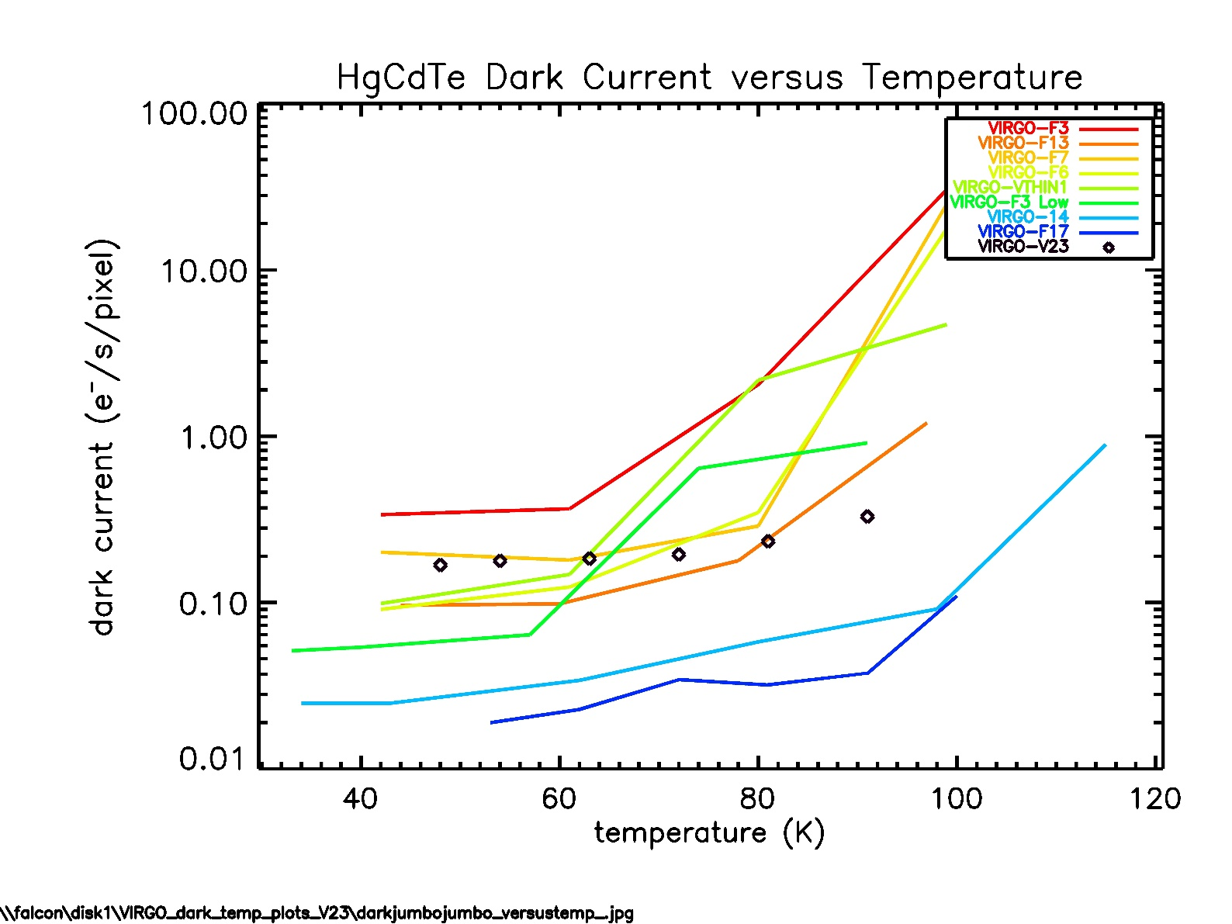
Dark Current of VIRGO Devices

