Slide 1


Evaluating detector requirements for the next UV/O/IR flagship observatory
Lazar Buntic, Donald F. Figer, and Justin P. Gallagher
Center for Detectors, Rochester Institute of Technology, Rochester, NY

Slide 2
Outline
the UV/O/IR flagship
LUVOIR science goals
evaluating detector requirements
comparing extant technologies

Slide 3
UV/O/IR Flagship
2020 Decadal Survey for Astronomy and Astrophysics recommends the next generation flagship observatory as a cross between LUVOIR-B and HabEx
flagship goal is to achieve the primary mission objectives of the LUVOIR and HabEx missions
2020 Decadal Survey describes the Great Observatory Mission Technology Maturation Program (GOMTMP), which will determine promising technologies and fund development for the next generation flagship

Slide 4
The LUVOIR Science Goals

Slide 5
Relevant Science Objectives
perform astrometry of bright stars
  limited by full well depth and frame rate
observe dim solar analogs (v_mag = 30-35)
  background limited, must have low read noise and dark current
take low-medium resolution spectra of comets, minor planets, and belt objects (v_mag < 22)
  low-medium resolution described as R = 500 – 28,000
  R = 28,000 increases importance of low read noise

Slide 6
Model Instruments
6 meter LUVOIR-B analog
  6 meter aperture
  same detector performance as LUVOIR-B
  most plotted results are for this model
CfD team collaborated with Bob Woodruff to develop a simple model of a LUVOIR-like telescope: “GigaCam”
  3 mirror anastigmat
  6 meter aperture
  proof of concept for lowering F/# with smaller detector pixels

Slide 7
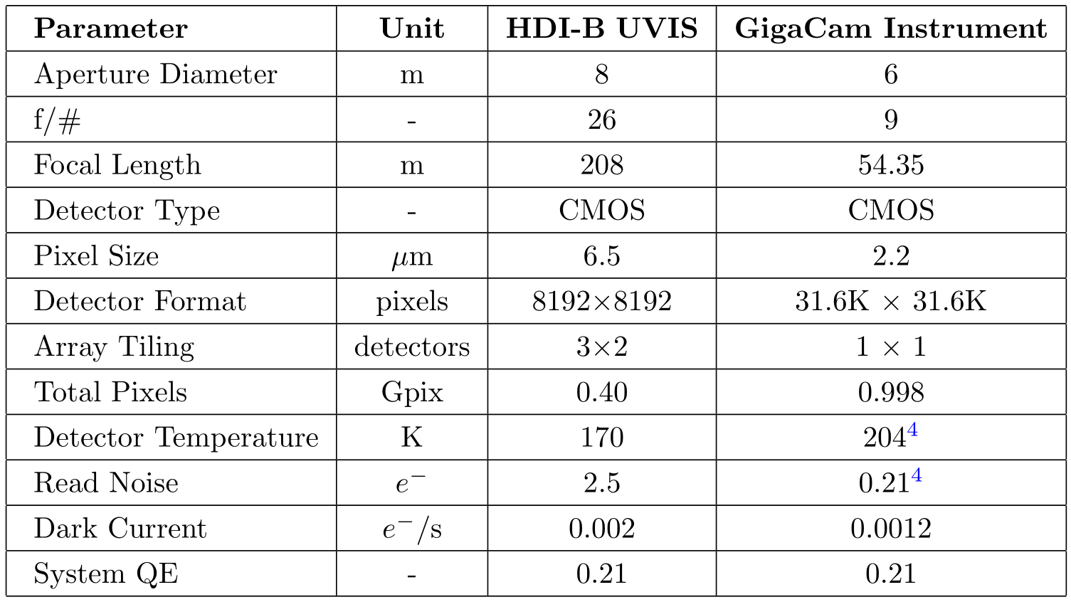
Model Instrument Parameters

Slide 8
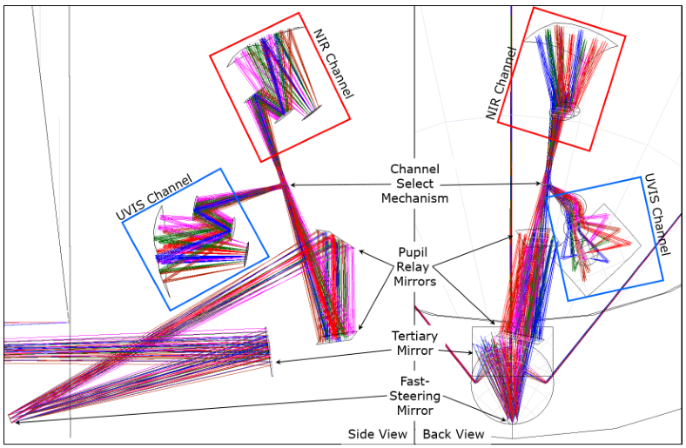
LUVOIR HDI-B
Notes:
this type of instrument is notionally represented by the focal plane on the next slide

Slide 9
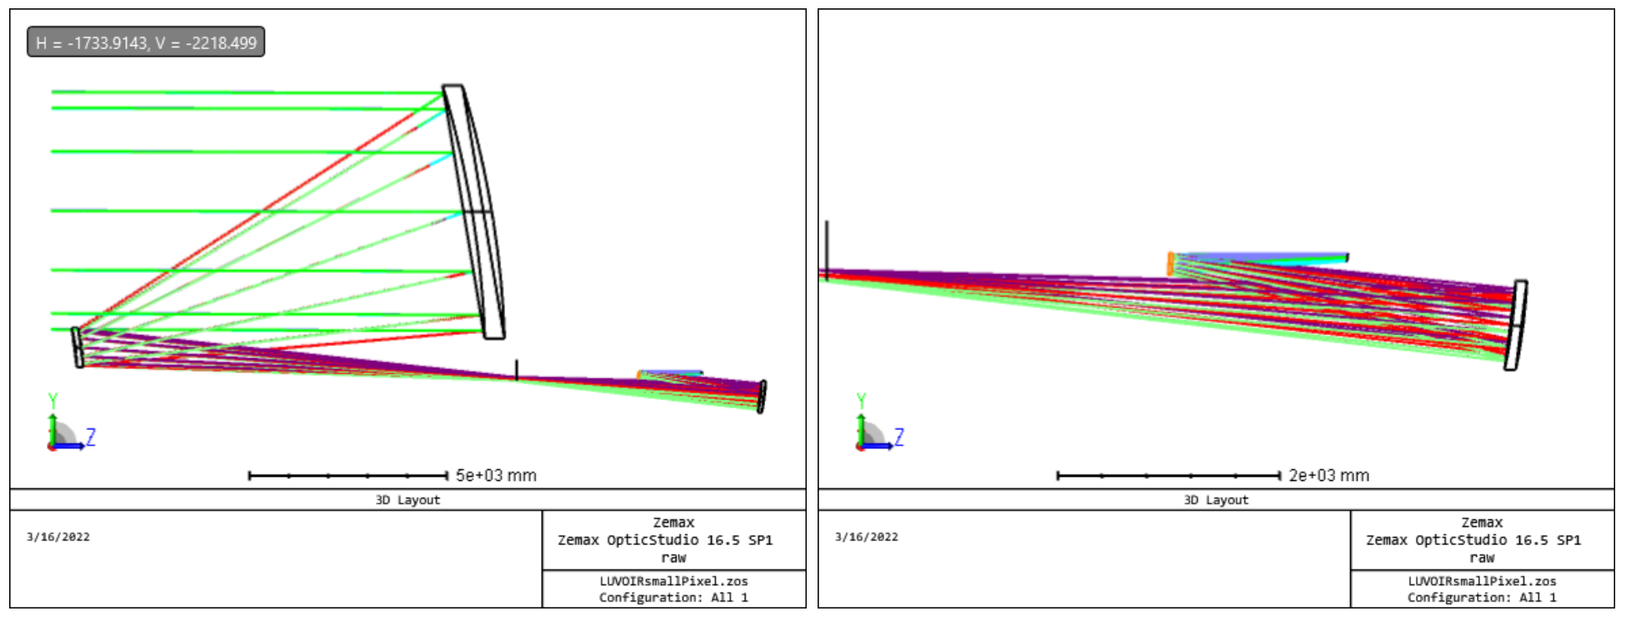
GigaCam Instrument

Slide 10
Evaluating detector requirements

Slide 11
What parameters matter?
dark current (DC)
  thermal generation of electrons in detective bulk
  can be reduced by lowering detector temperature
read noise (RN)
  noise generated by process of digitizing signal from pixel
  low RN is important for enabling photon-counting detector technology
pixel pitch
  size of the pixels
  important to consider when determining the size of the telescope (focal length, instrument size, mass of payload)
full well depth (FWD)
  amount of charge that can be stored in a pixel
  high FWD enables HDR and lower readout speeds

Slide 12
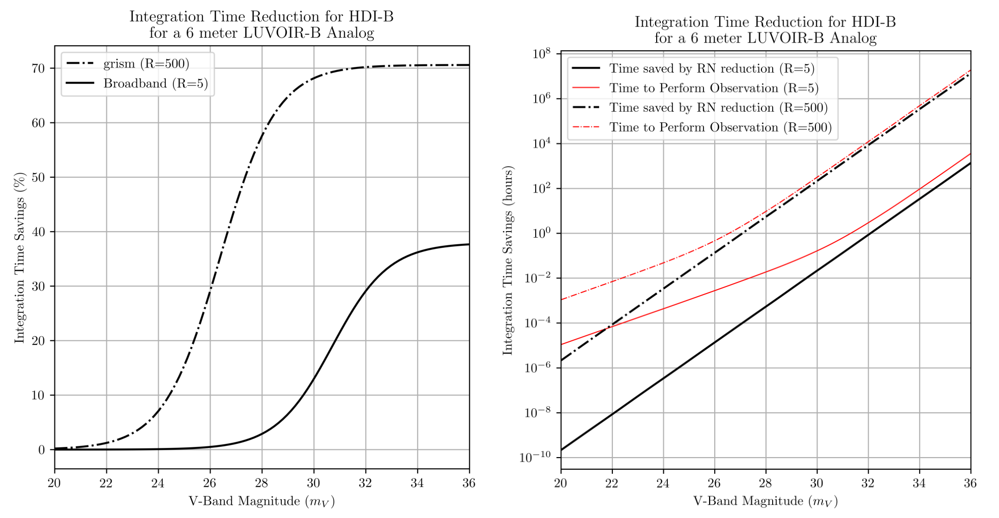
Time Reduction Simulations (RN 2.5 -> 0.25)

Slide 13
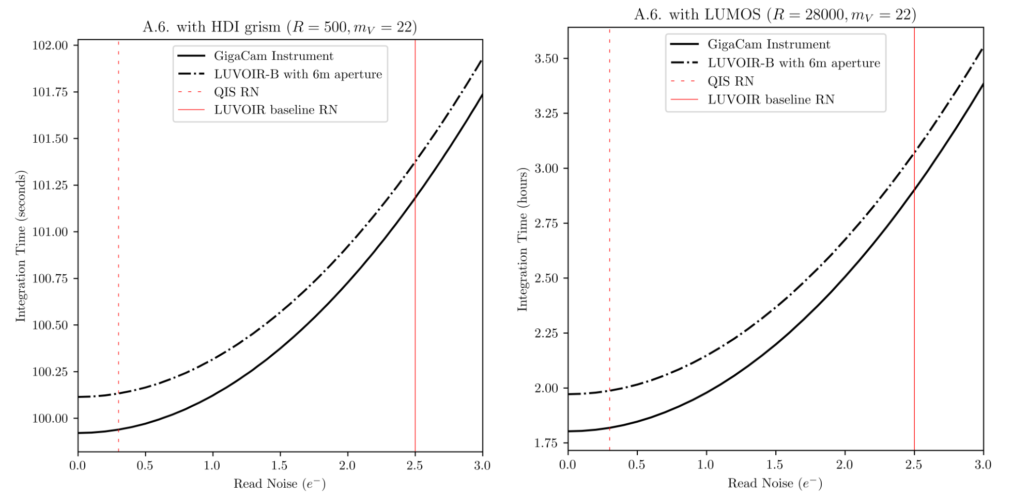
Integration Time Simulations

Slide 14
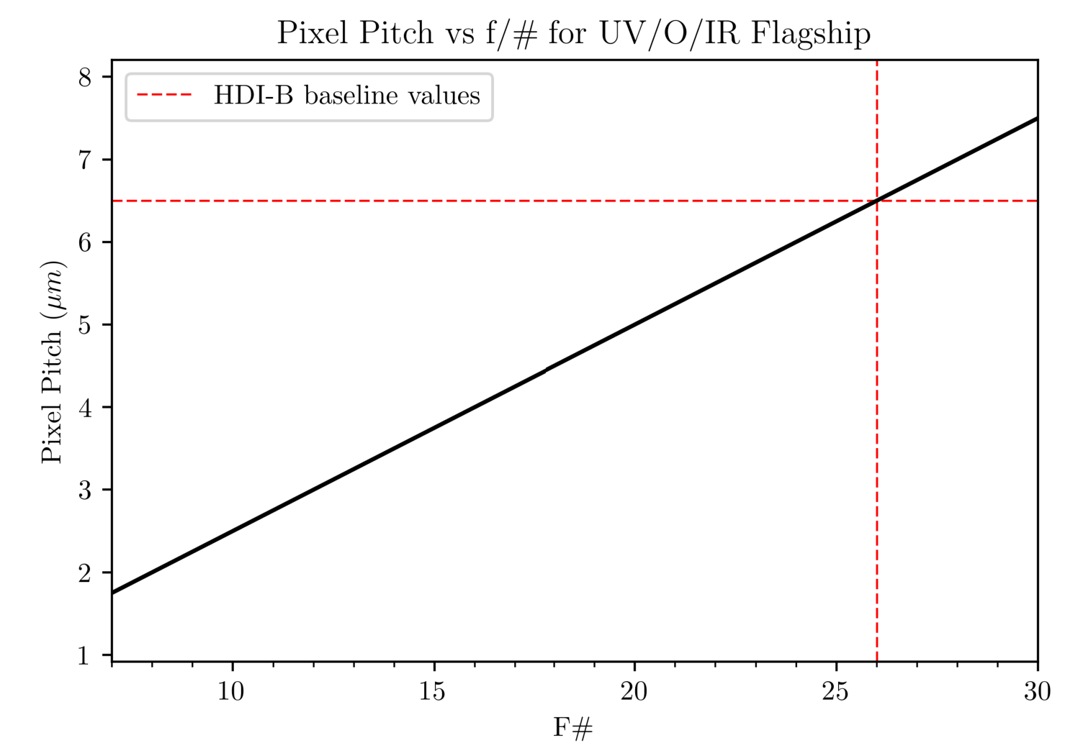
Pixel Pitch
Notes:
4.88 pixels across airy diameter for diffraction limited nyquist sampling at 500nm

Slide 15
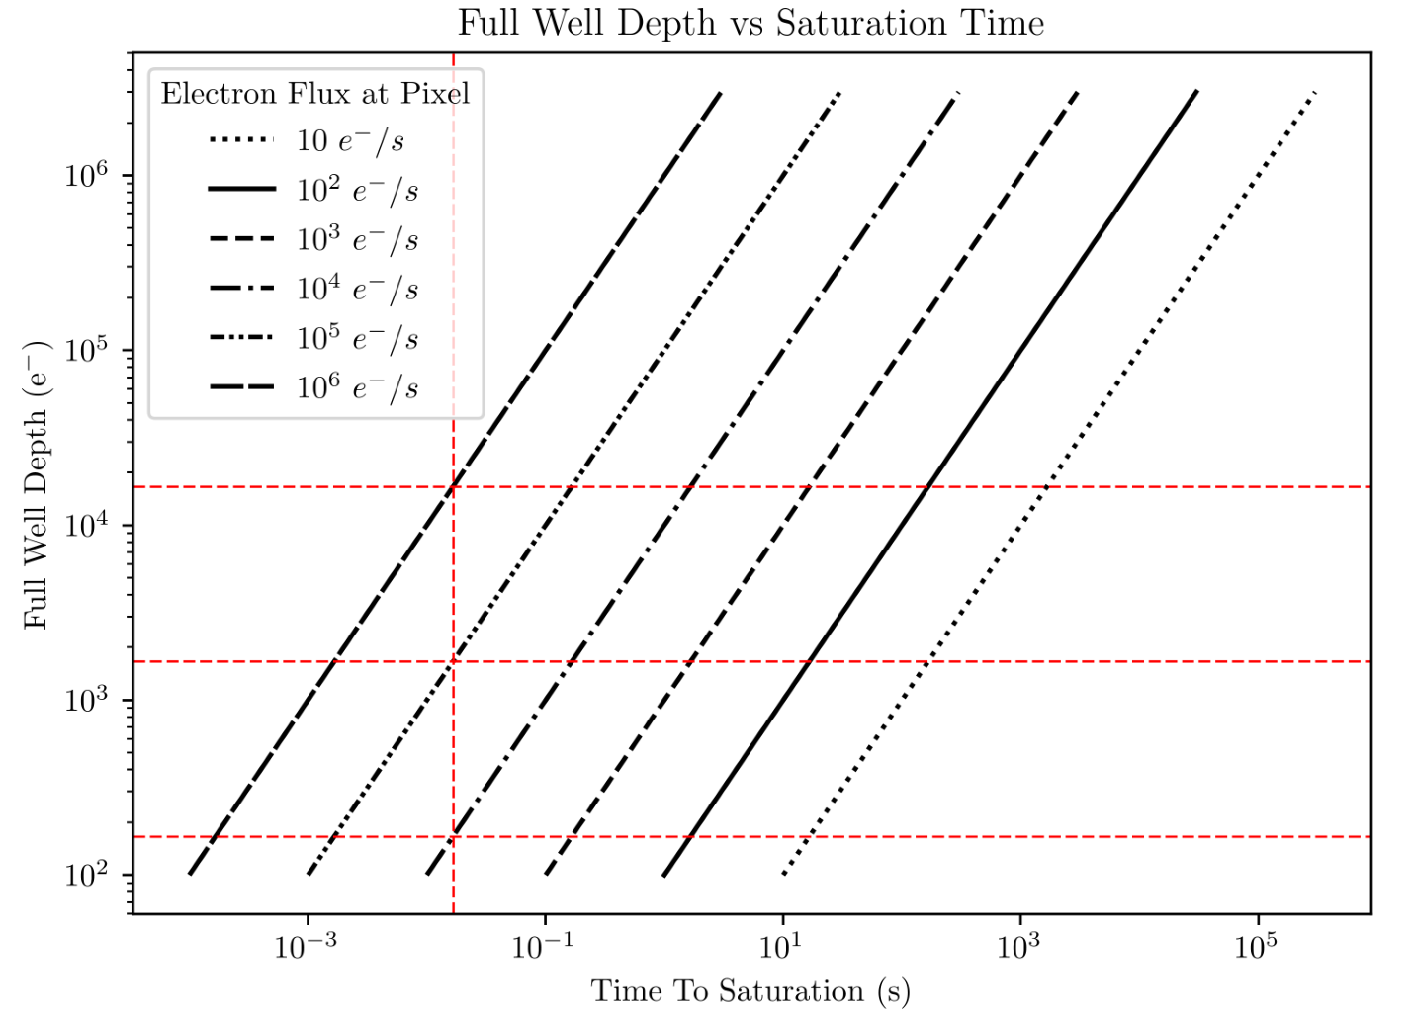
FWD vs Saturation Time

Slide 16
Comparing Extant technologies

Slide 17
Comparisons
what sort of detectors are prime candidates for the next generation missions?
  CMOS
  EMCCD
  MKID
in what way can we compare them?
  scalability to mega-pixel formats
  ability to maximize SNR
  attendant technologies

Slide 18
Scalability to (and beyond) Megapixel Formats
the most important factor for future detectors
CMOS and EMCCD exist in formats greater than 4K×4K and commercial devices with science-grade performance are widely available
MKIDs have been demonstrated in arrays as large as 20,440 pixels, but do not currently exist in Mpix formats
Notes:
CFD team has 16 Mpix device and GJ has made 41 Mpix devices with 2um pixels

Slide 19
Maximizing SNR
photon-counting CMOS
  high conversion gain (upwards of 300 uV/e-)
  low noise (RN = 0.21 e-)
EMCCD
  high gain via multiplication registers (up to 1000x)
  Excess Noise Factor (1.4 for EMCCD)
MKID
  no dark counts
  response proportional to energy of photon

Slide 20
Attendant Technologies
photon-counting CMOS
  require minimal cooling (photon counting at 283K demonstrated, 0.002 e-/s DC at ~250K for 2.2 um pixels)
  readout electronics are light, relatively low power
EMCCD
  require cooling to below 190K
  readout electronics are similar to CMOS in size and power requirements
MKID
  require cooling to superconducting temperatures
  readout electronics are bulky, though they are being developed to be lighter and more efficient

Slide 21
Conclusions
mission planning should put more emphasis on building around the sensors we put in the instruments (as opposed to the reverse)
most extant technologies perform at a level capable of achieving the performance required by our mission objectives
future development of these technologies will seek to increase array sizes without loss of performance

Slide 22
Questions?

