Slide 1
FPGA implementation of a DCDS processor
Simon Tulloch
European Southern Observatory

Slide 2
Hardware
DAC to produce
synthetic CCD video
waveform
Commercial Xilinx Artix
FPGA board
(Opal Kelly)
Dual 20MHz 16-bit ADC
Regulator
Dual low-noise
video pre-amps with DC restoration
Preamp test connectors

Slide 3
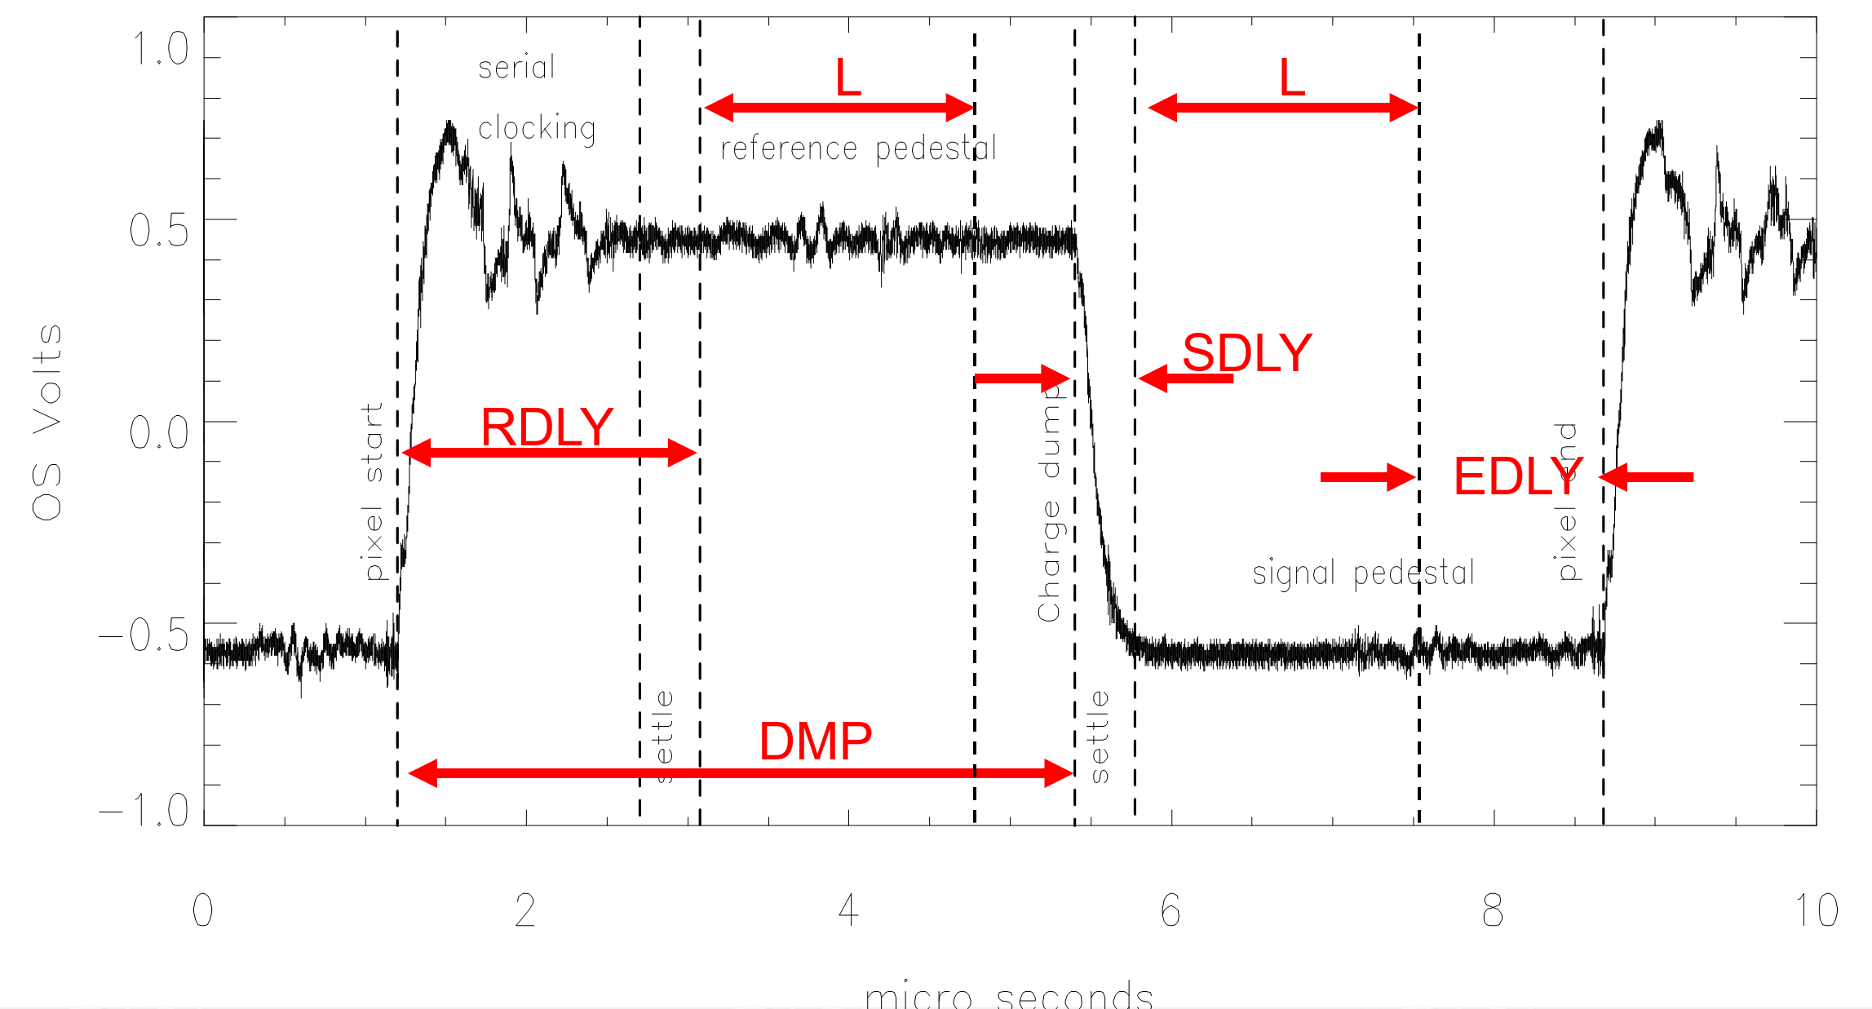
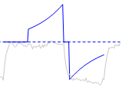

FPGA IP
Configuration Registers (7 needed) to define which parts of the video waveform we want to process
Serial register length:
NSERIAL
Samples per pedestal:
L
Delay prior to reset pedestal:
RDLY
Delay prior to signal pedestal:
SDLY
Charge dump event:
DMP
Delay at end of pixel:
EDLY
ADC pipeline delay:
ADCPL
Loaded from host
Xilinx IP library: Block Memory Generator
: DSP slice used as multiplier
: Accumulator
Custom VHDL : FSM sequencers
: Event timers
Pixel to host
512 x 8-bit
Dual-Port
Coefficient
RAM
(sample
weighting)
OUTPUT FIFO
DSP48 slice
16
X
24-bit up/down
Accumulator
Divider
(to perform average of weighted samples)
8
24
32
16
CCD video waveform
sampled at 20MHz

