Slide 1

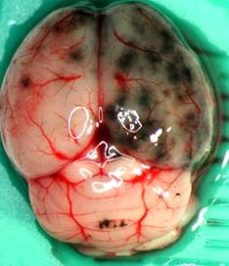
Multiplex Raman Spectroscopy
TU Dresden, Krafft

Slide 2
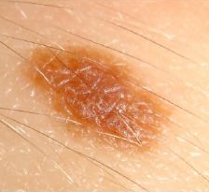
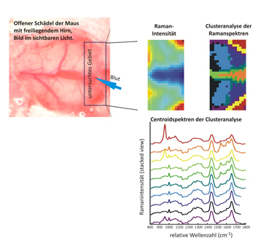
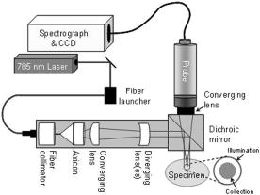
State-of-the-Art:
„single-pixel“ Raman Spectroscopy
TU Dresden
J. Biomed. Opt. 11(6), 060502 (December 13, 2006)

Slide 3
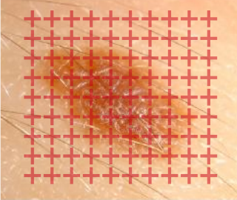
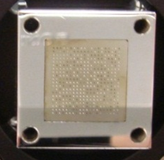
Innovation:
MUSE Reference Spectrograph
am AIP
Multiplex Raman Spectroscopy
400
points

Slide 4
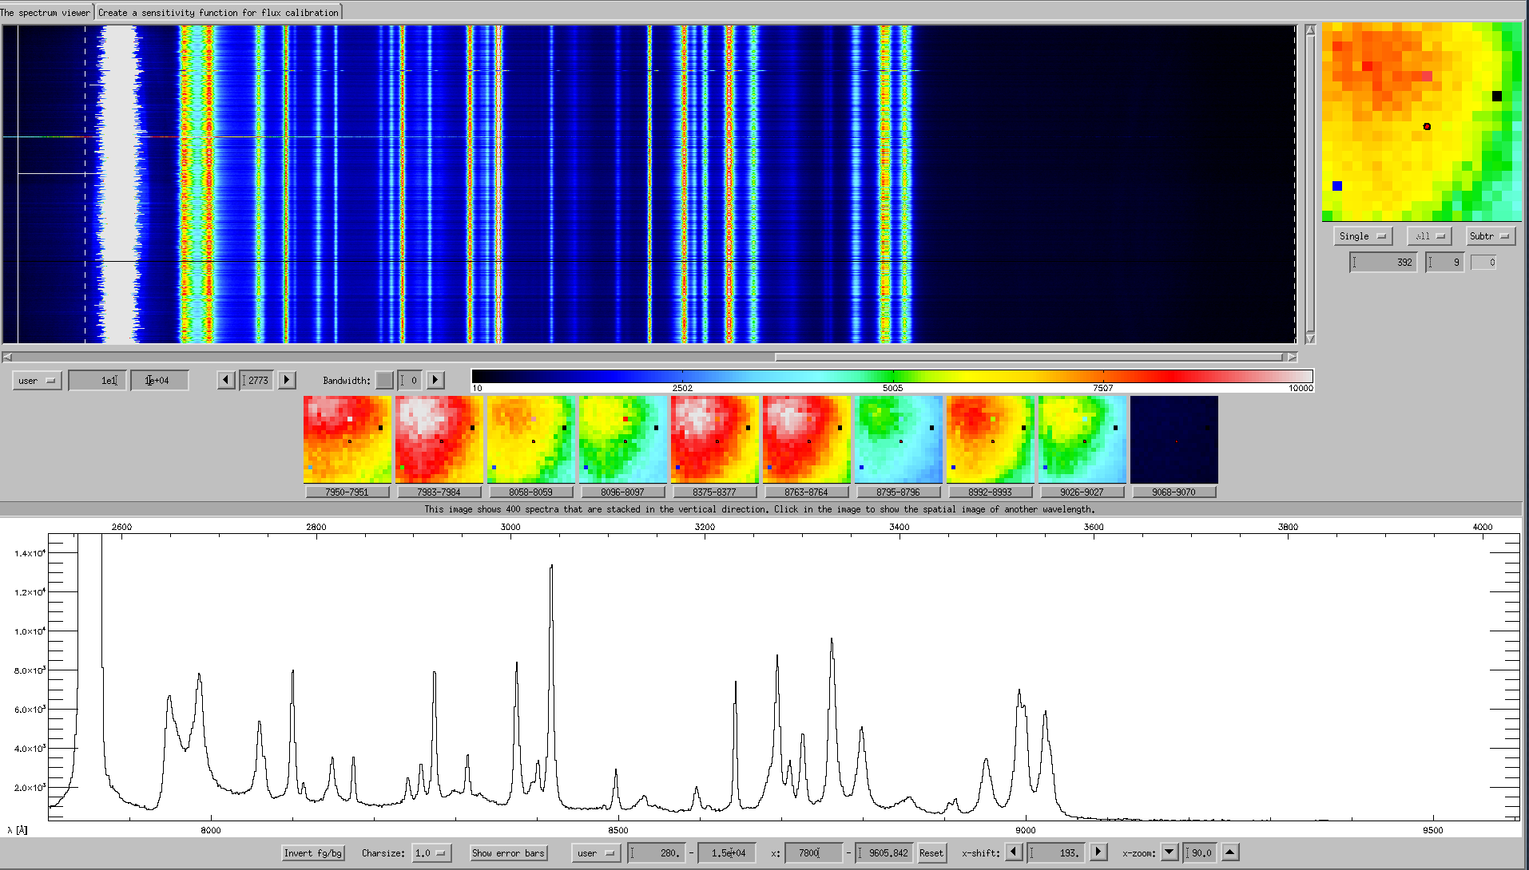
world‘s 1st 3D Raman Spectra
fibres
Wavelength

Slide 5

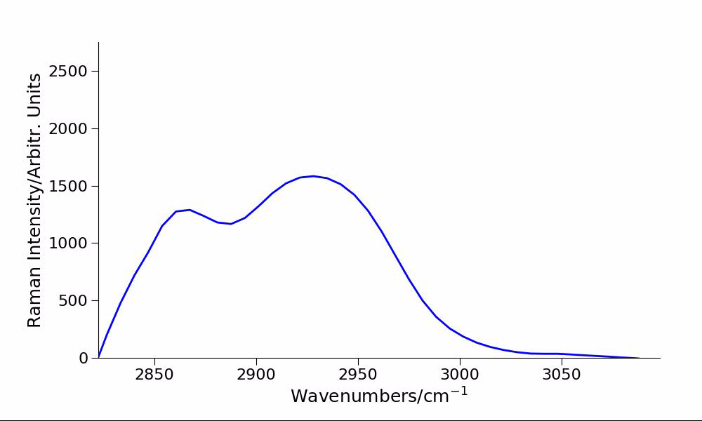
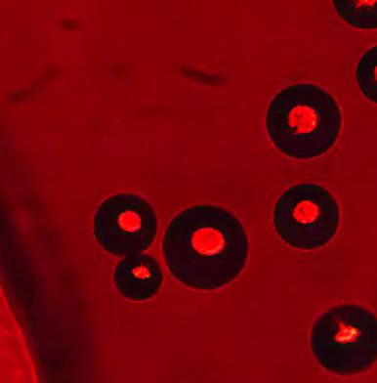
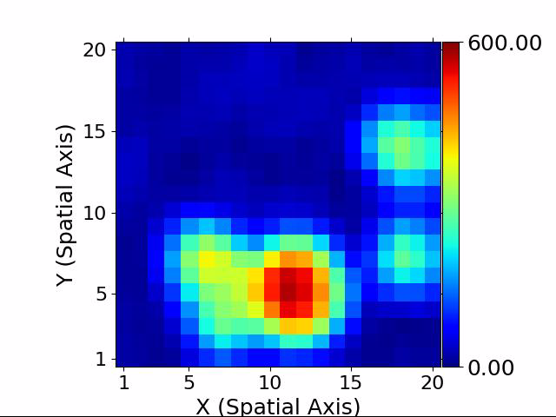
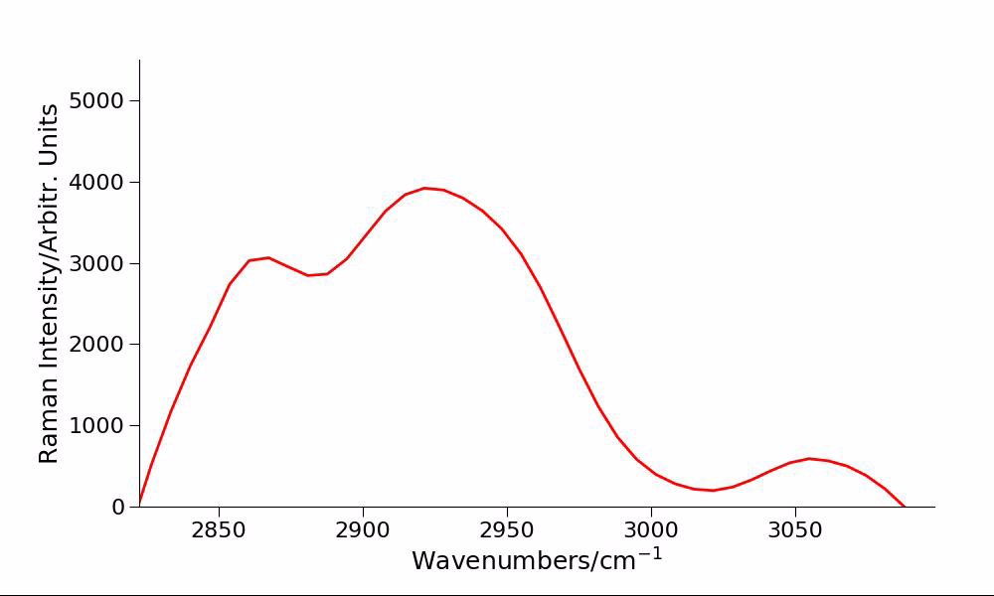
world‘s 1st 3D Raman VIDE0
50 µm Polystyrene Beads in Microfluid Plate
20× Microscpe objective, 532 nm laser excitation
1 s recording time + 2.4 s readout time per frame
50 μm

