Slide 1
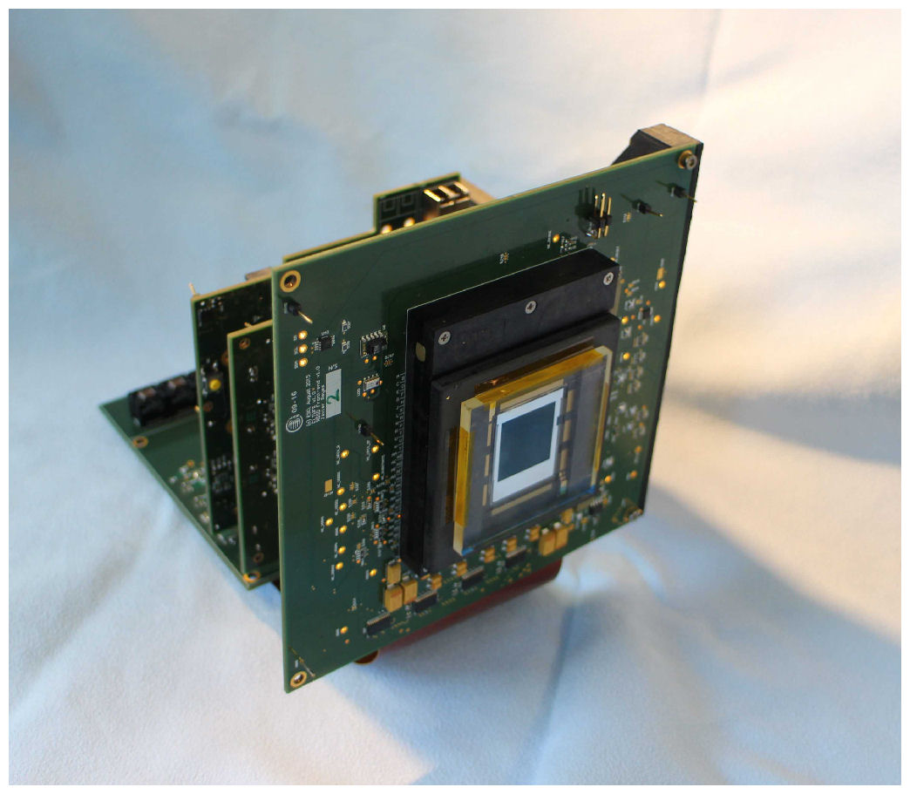
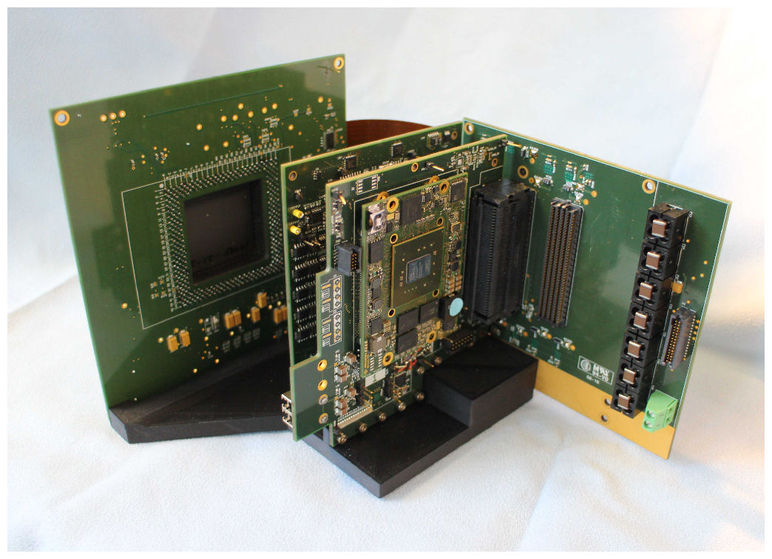
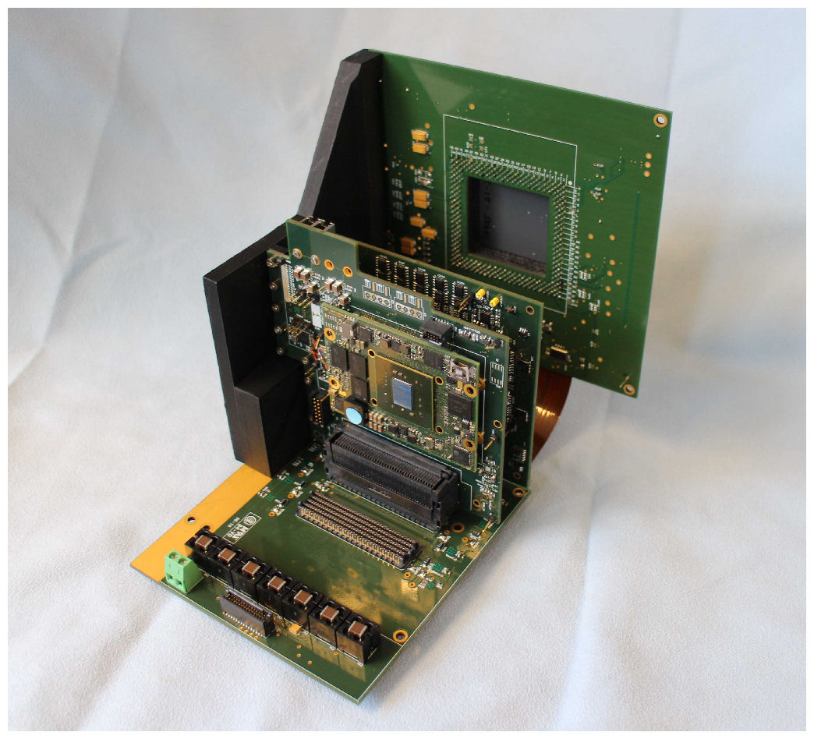
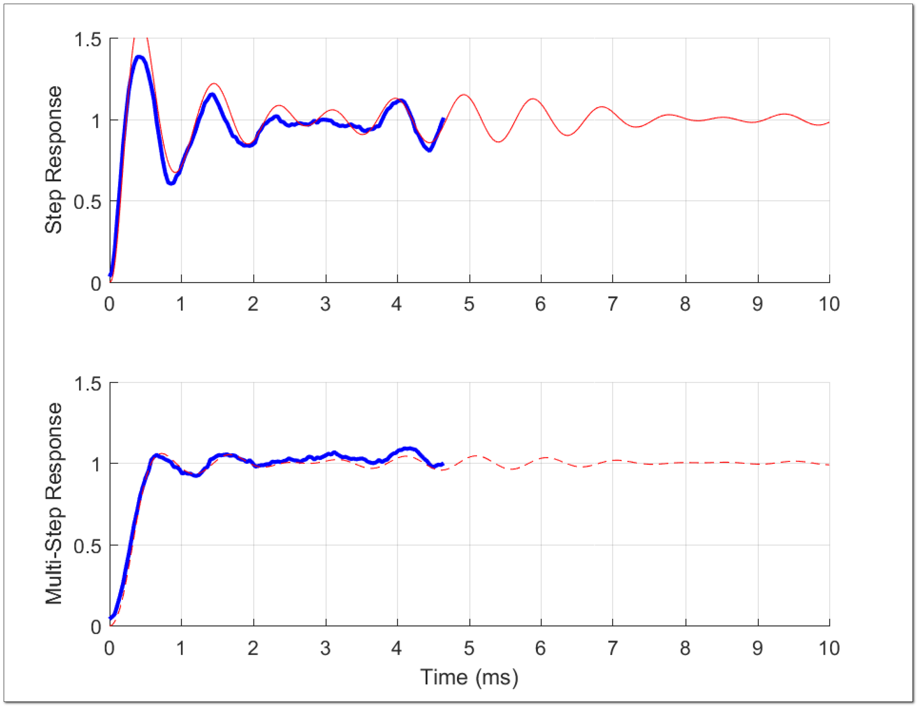
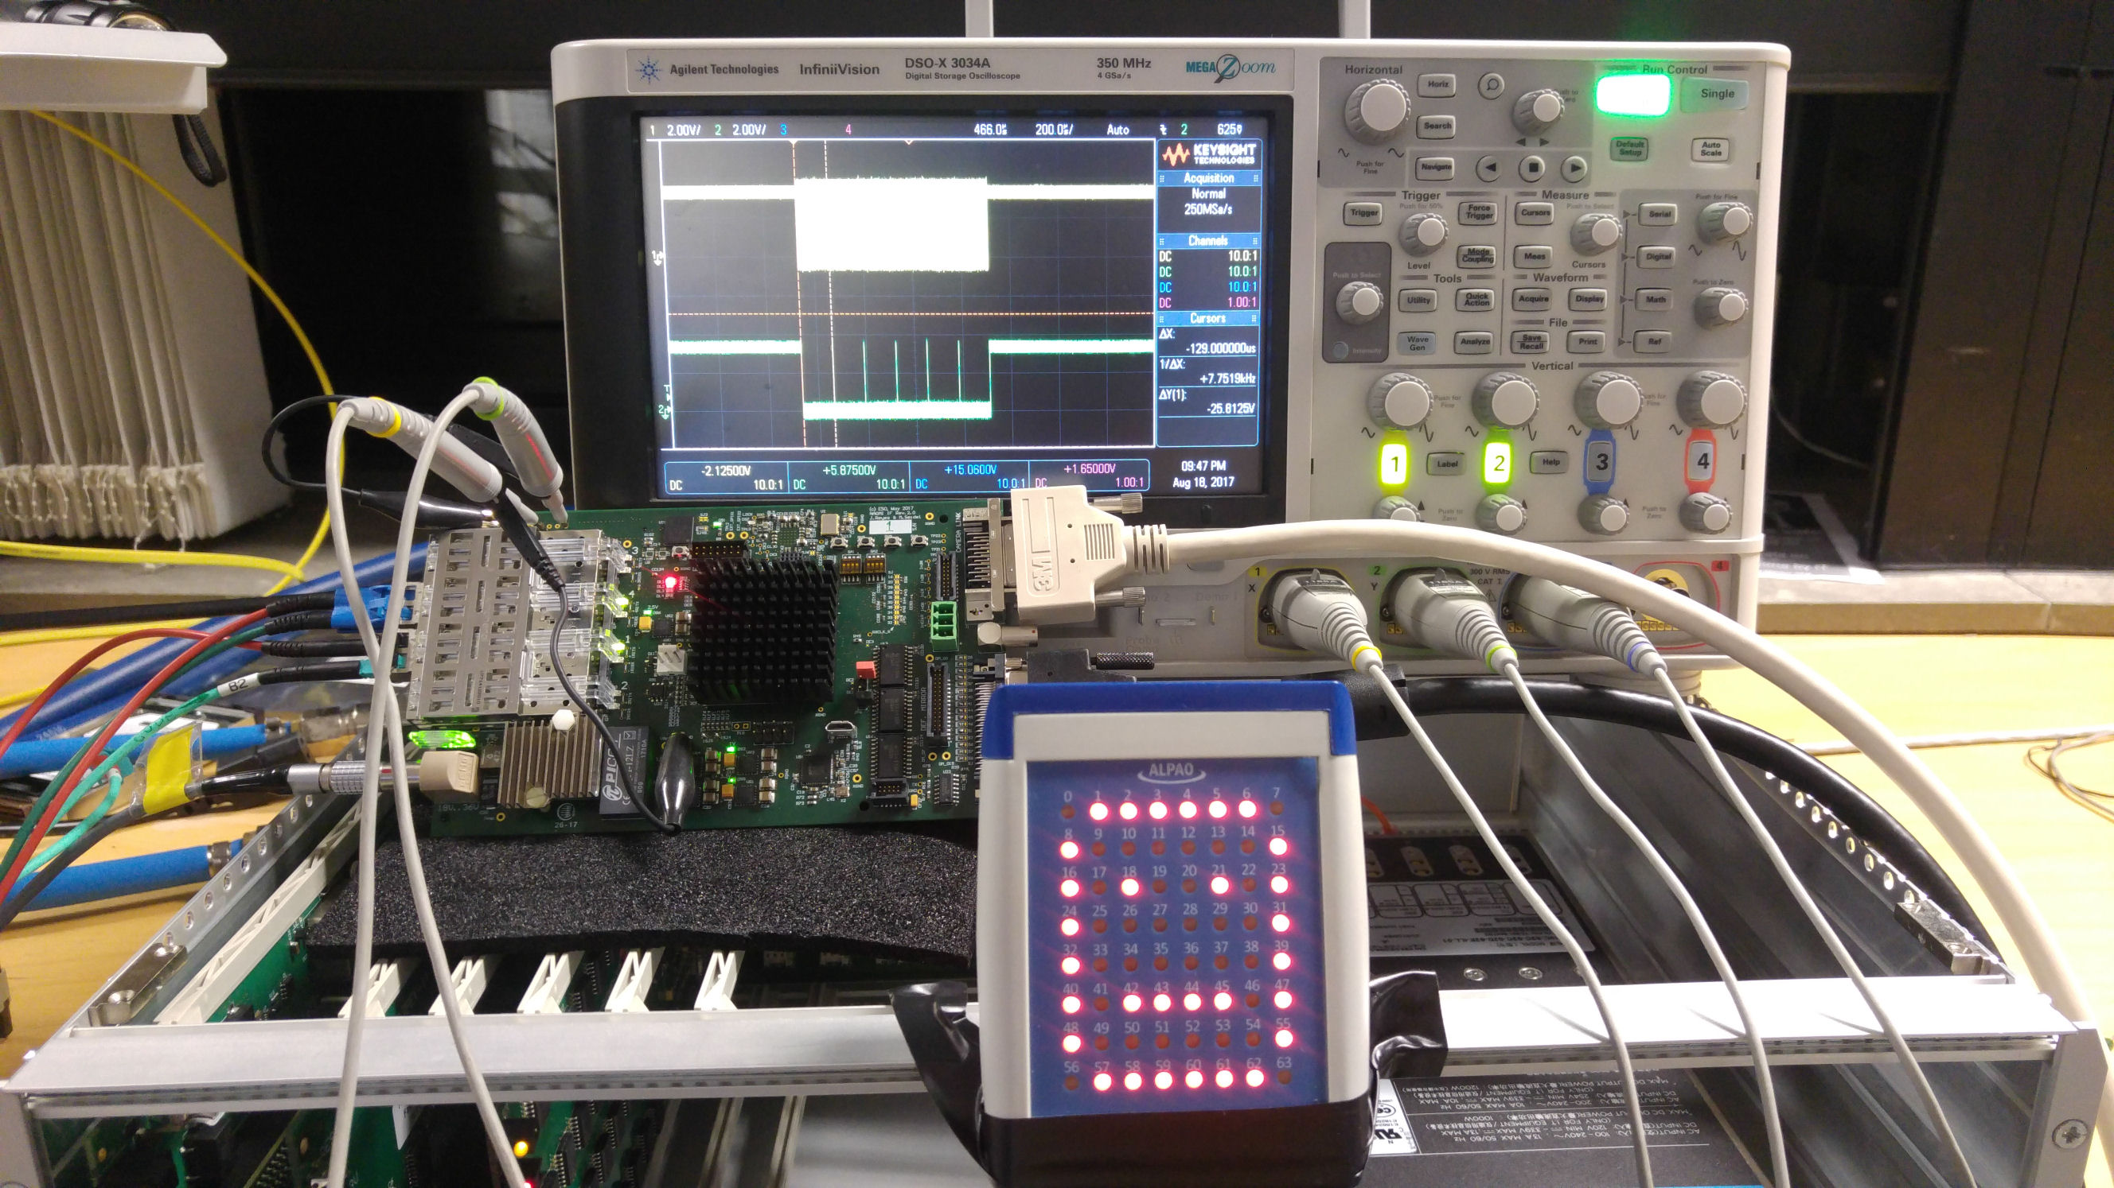
ESO AO Large Size CMOS Detector Controller
Javier Reyes
European Southern Observatory, ESO http://www.eso.org
jreyes@eso.org
FPGA-based Real-Time Computer and Deformable Mirror Interface
Switching-mode Power Supply for Scientific Detectors
Scientific Detector Conference 2017 - Baltimore

Slide 2
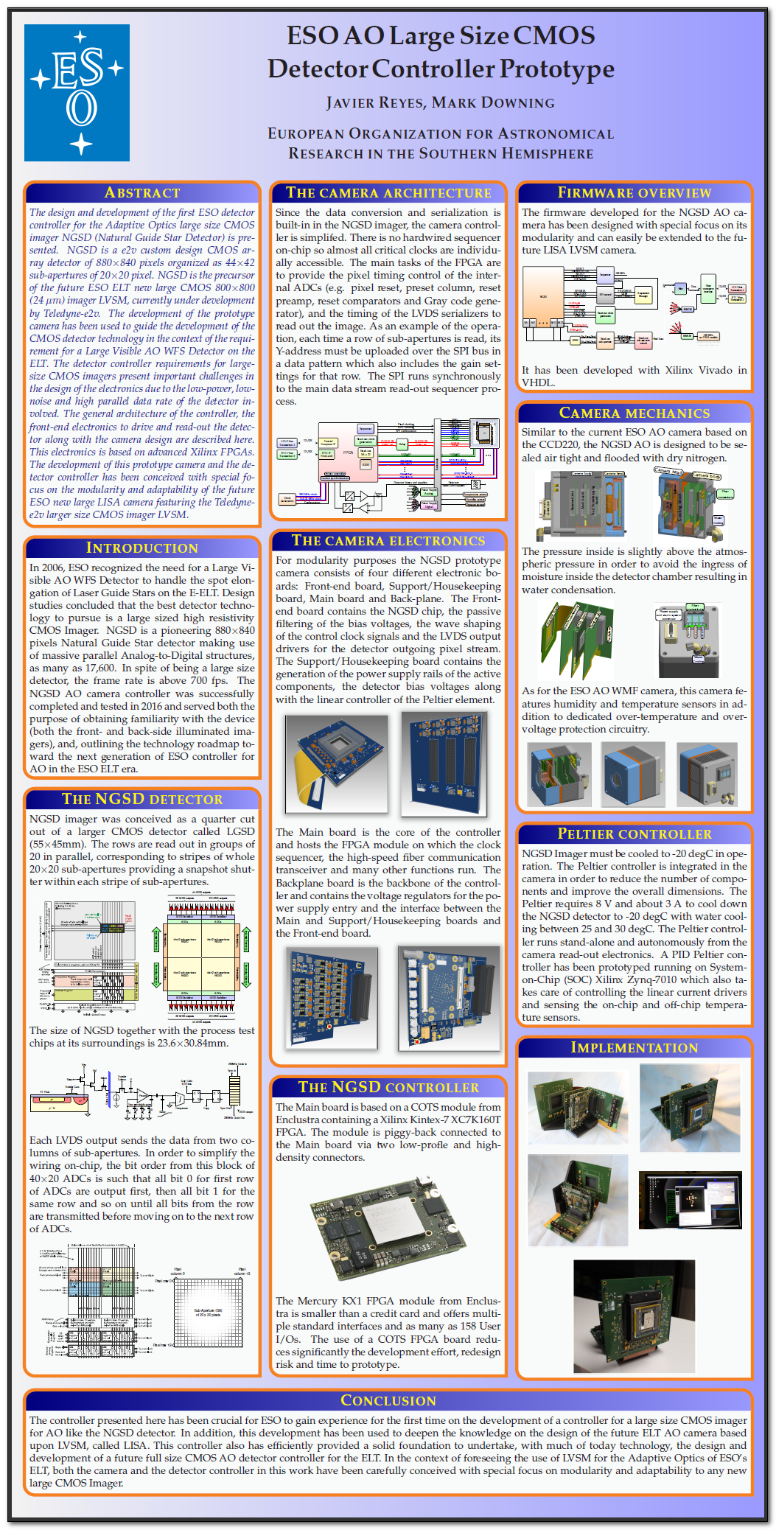
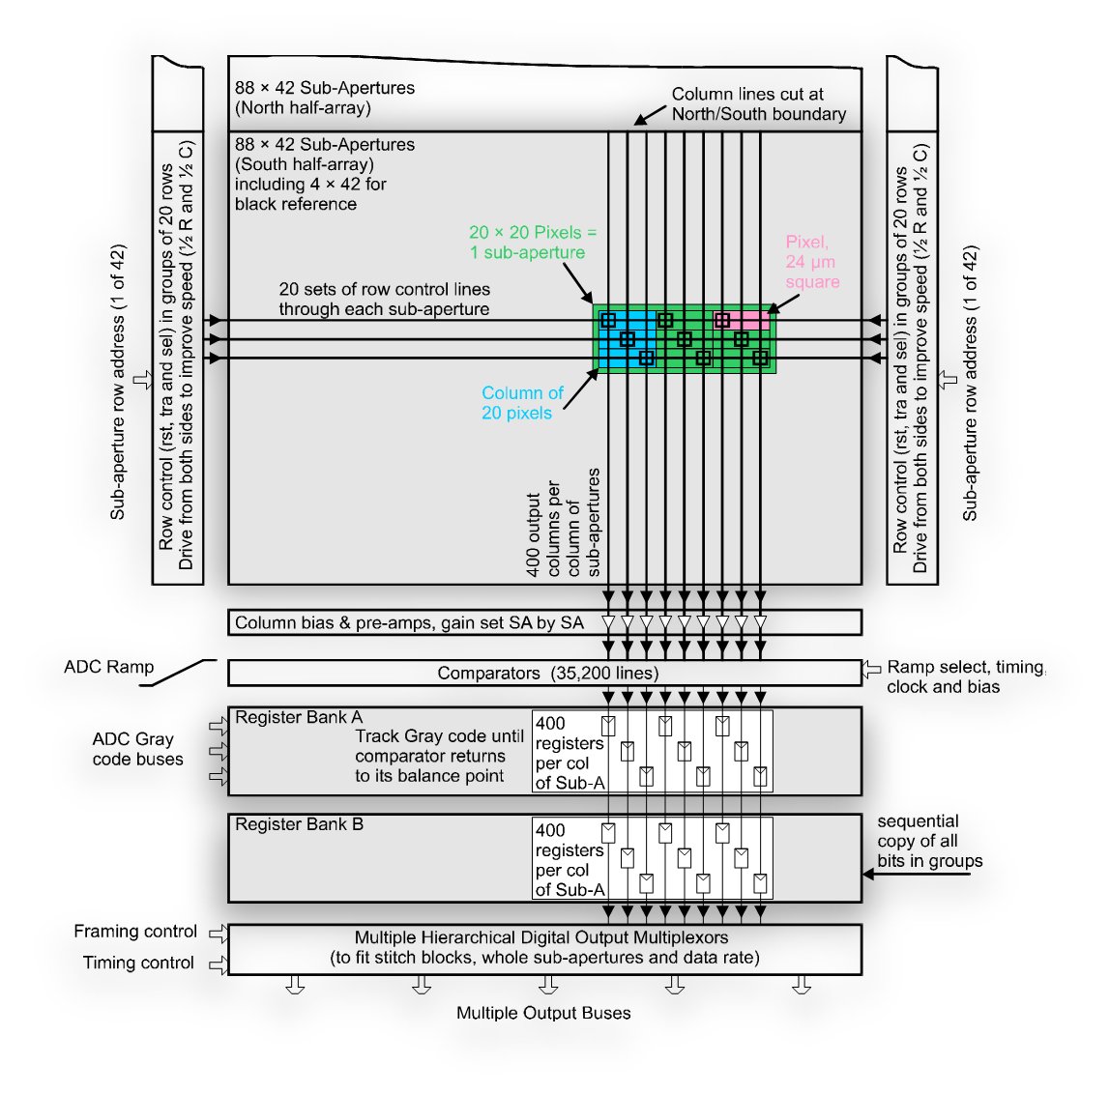
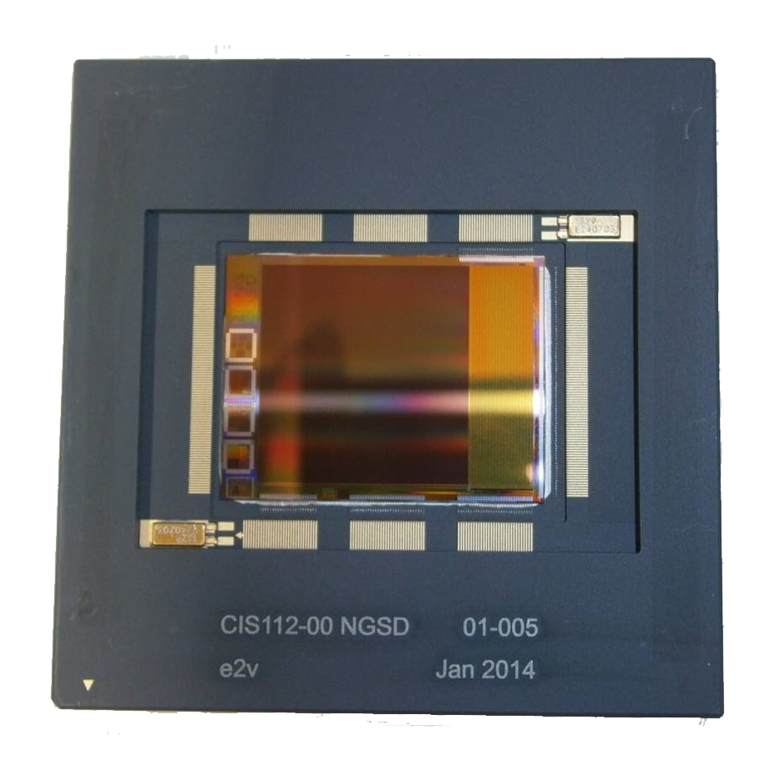
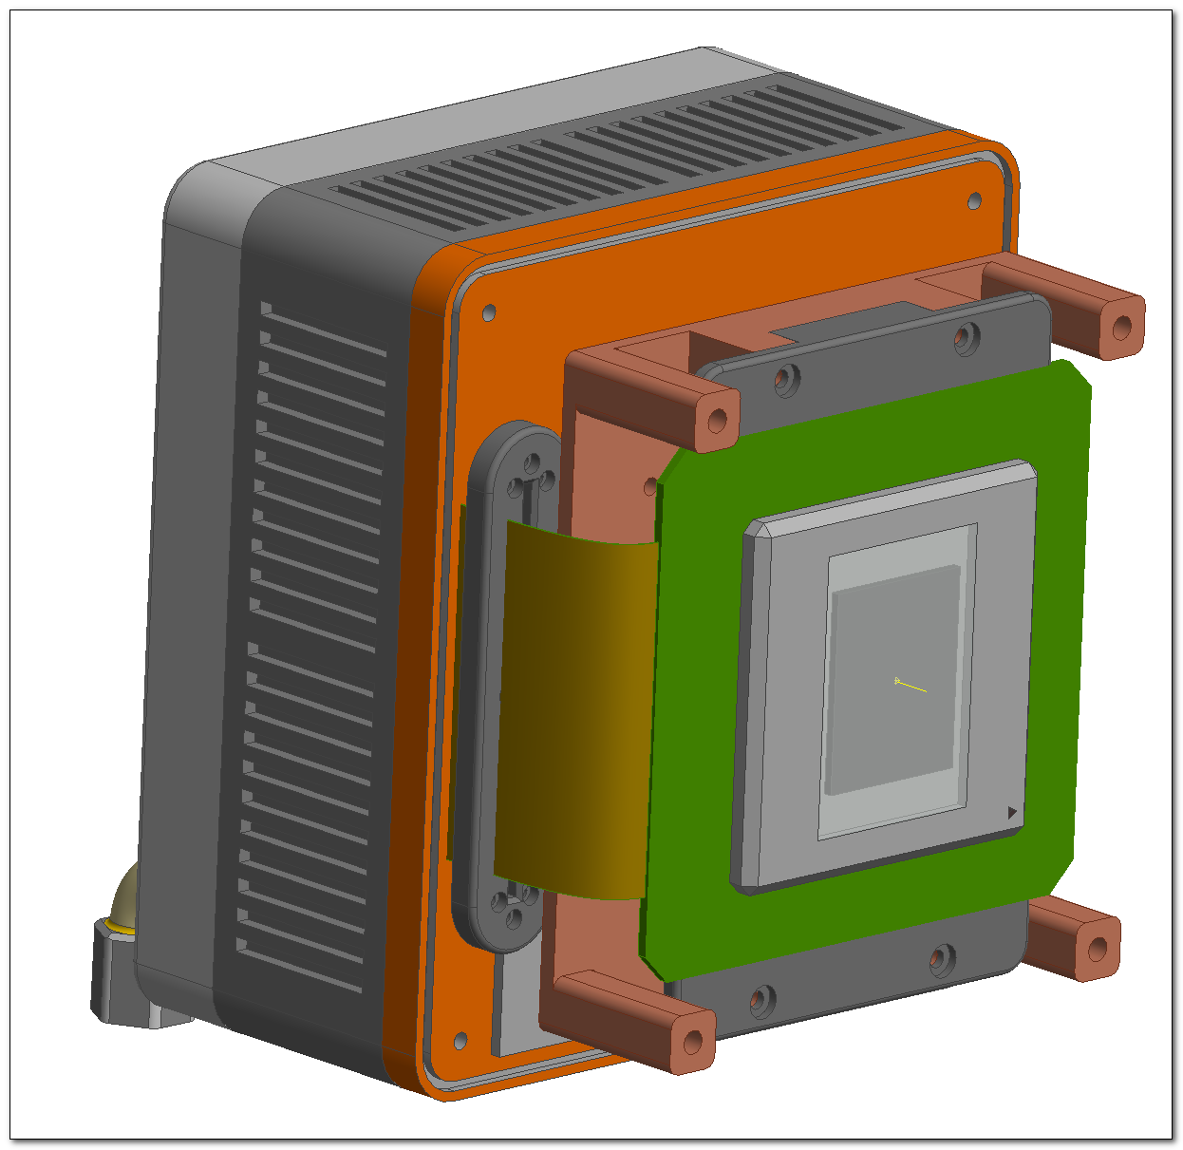
POSTER #1
ESO AO Large Size CMOS Detector Controller Prototype
CMOS camera developed from scratch but compatible with ESO NGC universal controller standards and interfaces
NGSD
Based on Teledyne-e2v NGSD: 880x840, 700 fps
Massive parallel architecture: 17600 ADCs, 10-bit
Precursor of the ESO LISA AO ELT camera
Key to stablish the technology of future LISA

Slide 3
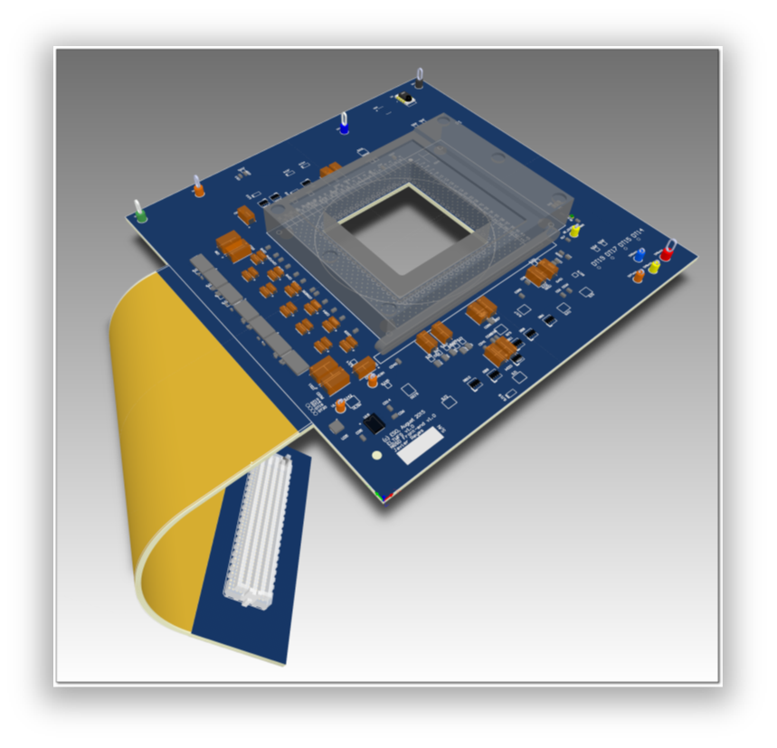
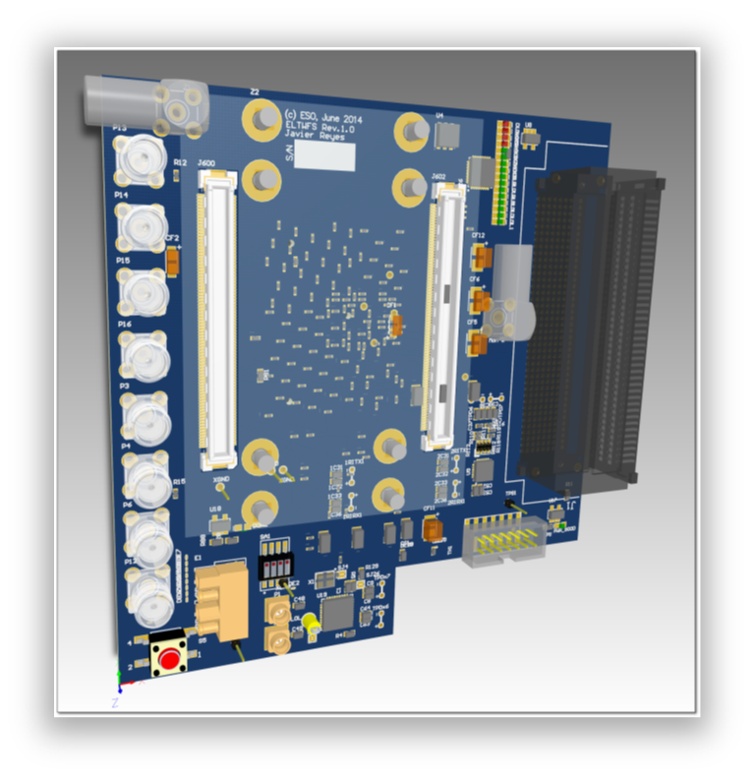
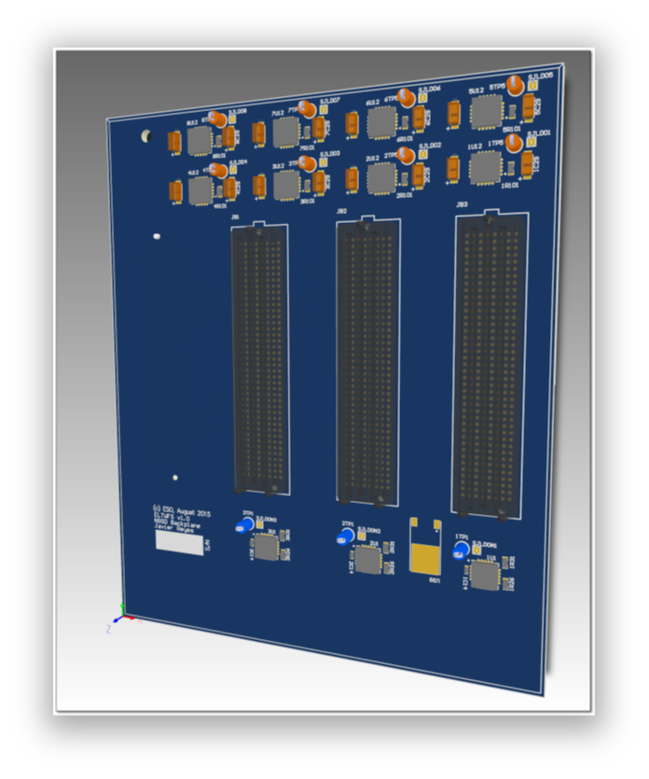
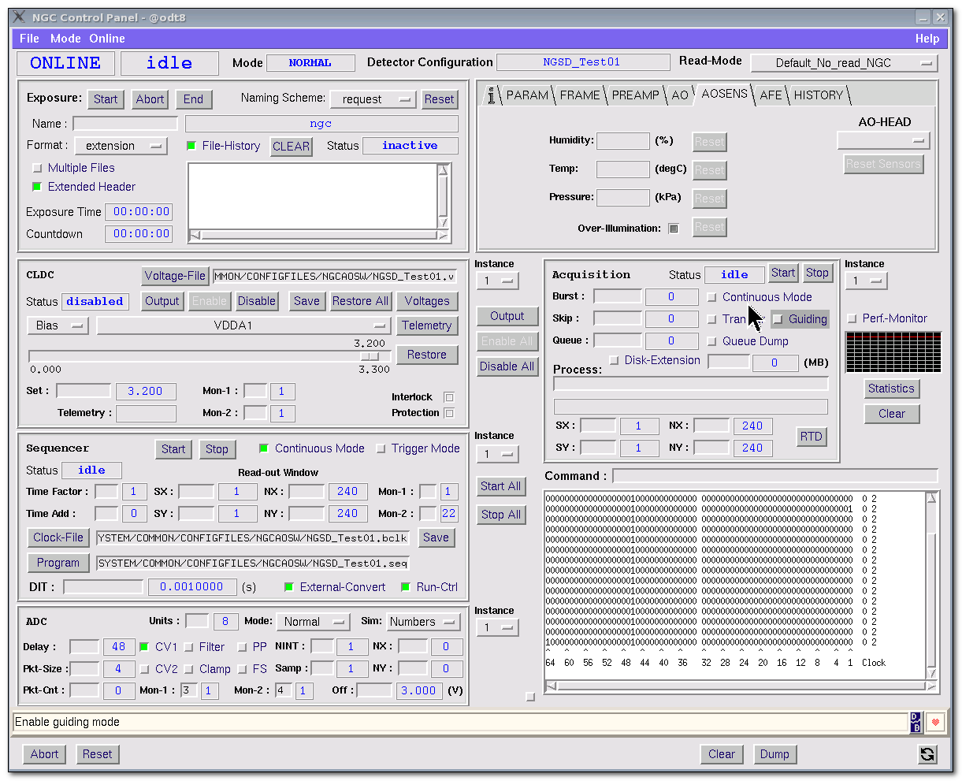
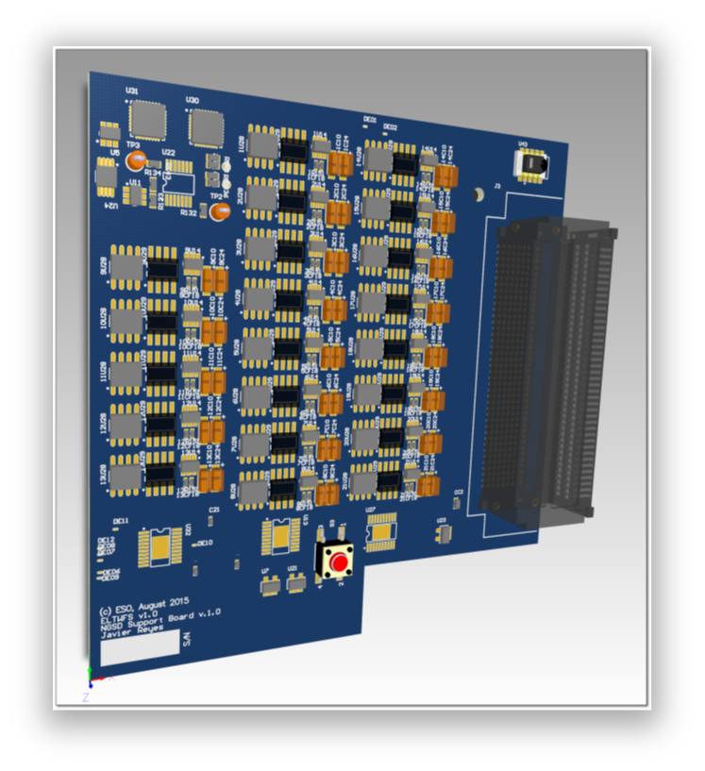
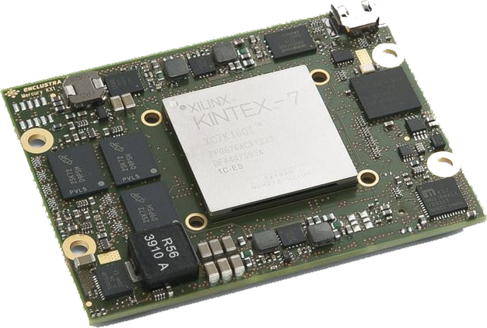
POSTER #1
Compact
Modular
Low-power
Based on Xilinx Kyntex-7 FPGA
Front-end
Main board
VHDL firmware
Backplane
Bias/House keeping
COTS FPGA module
NGSD camera prototype completed in 2016
ESO AO Large Size CMOS Detector Controller Prototype

Slide 4
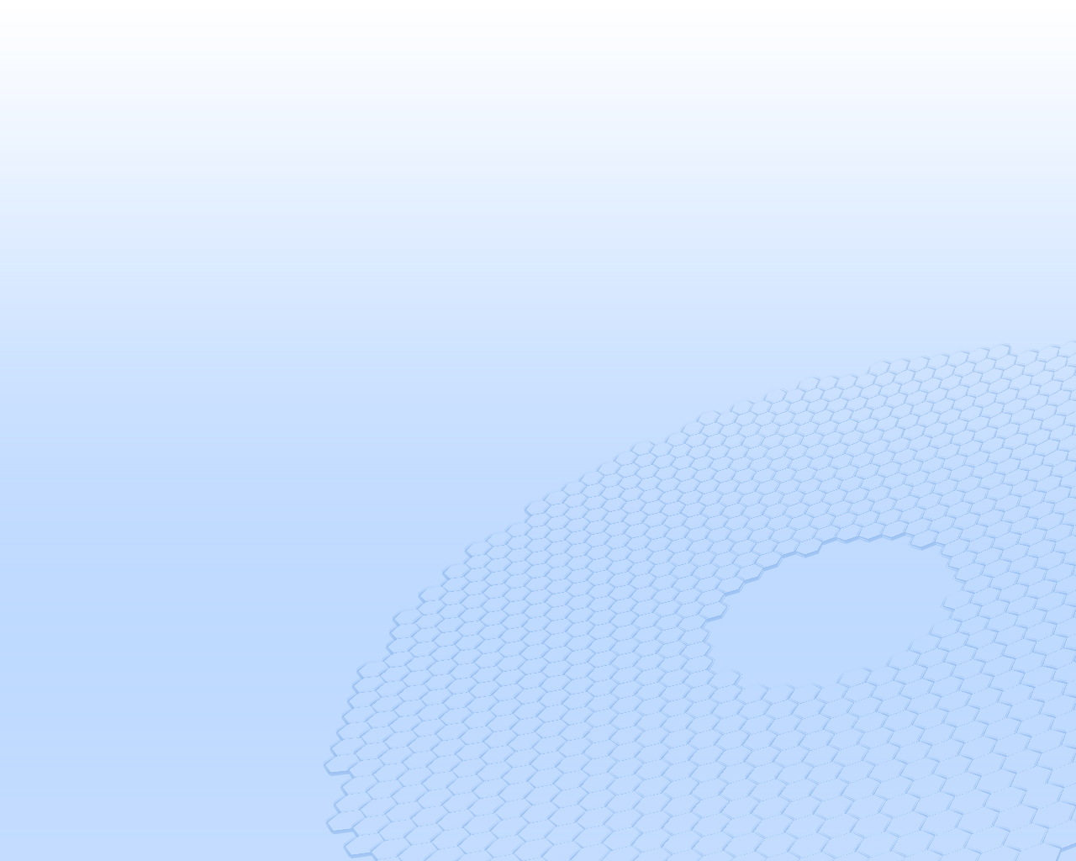
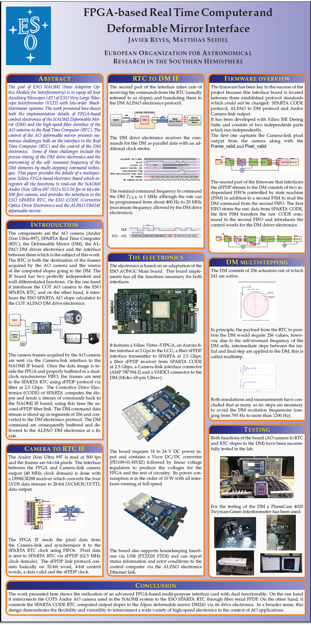
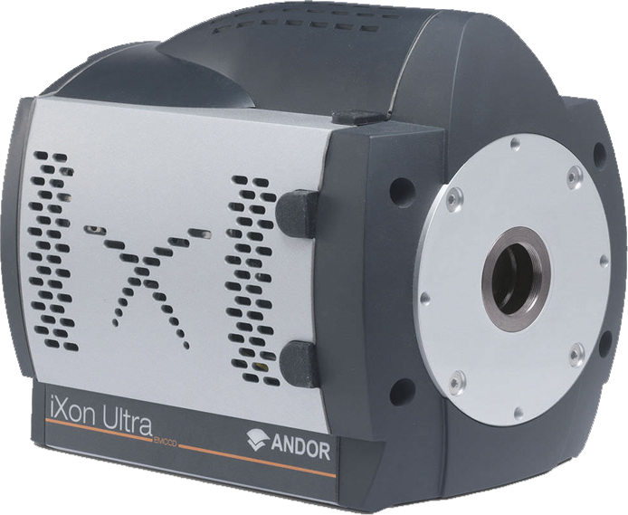
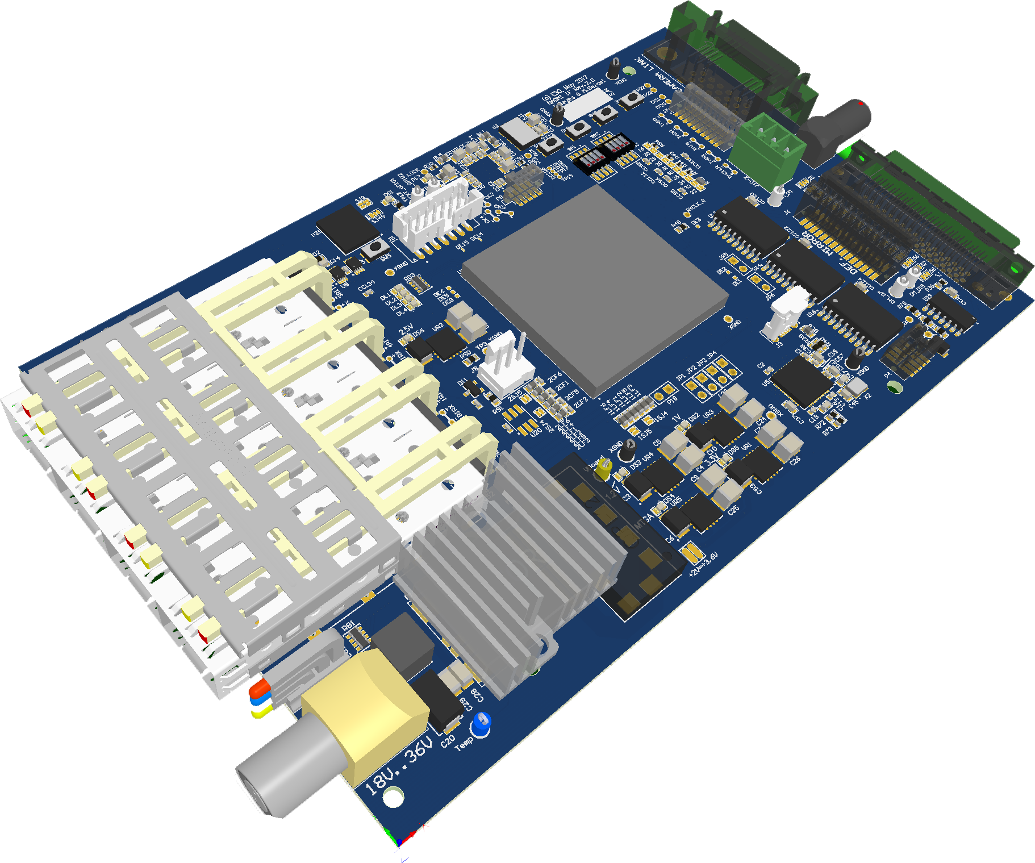
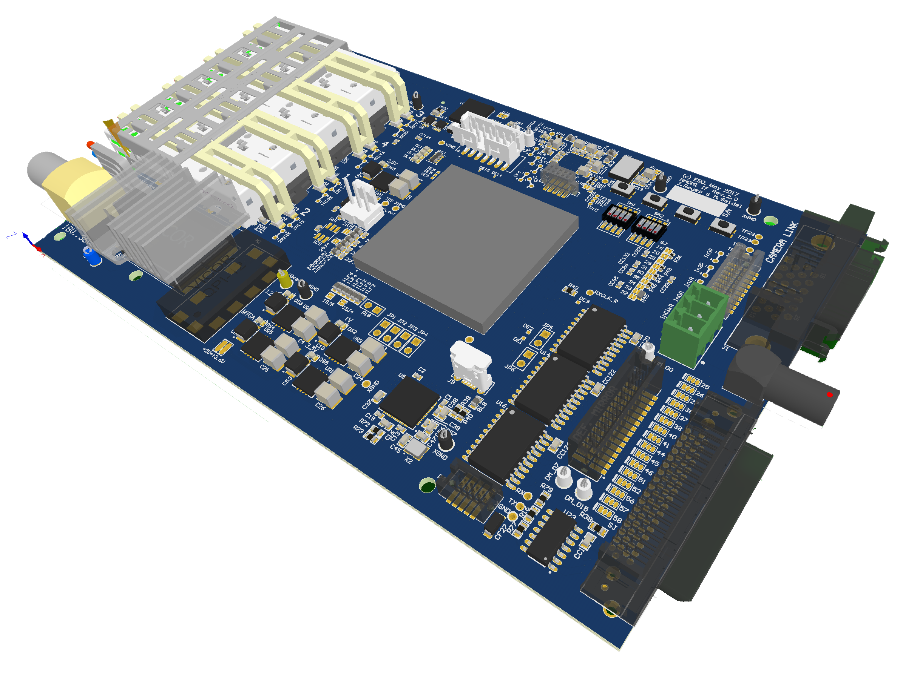
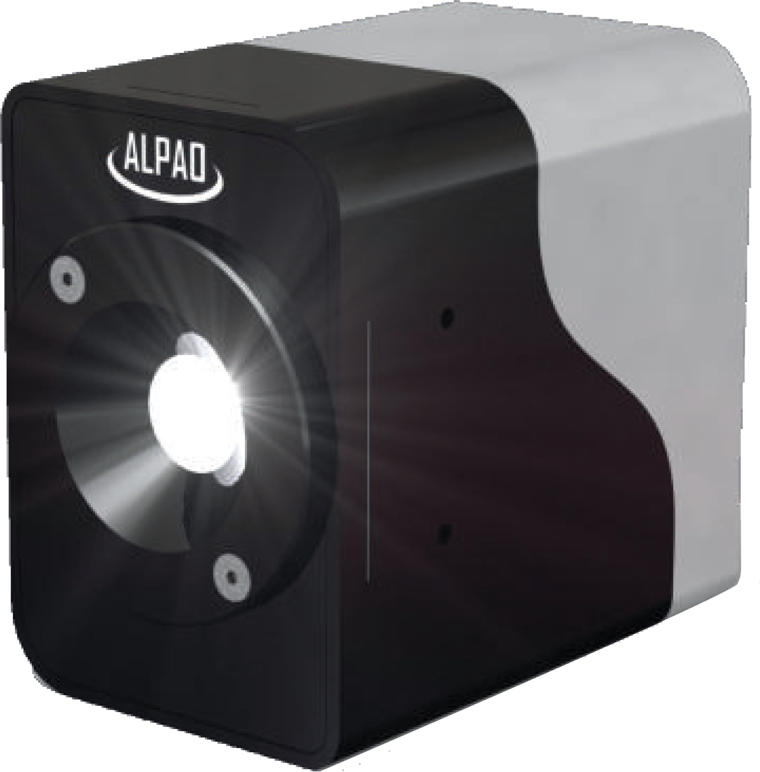
POSTER #2
FPGA-based Real Time Computer and Deformable Mirror Interface
Multi purpose board for VLTI NAOMI:
Adaptive Optics Module for Interferometry for ESO Very Large Telescope Interferometer (VLTI)
AO camera to RTC interface:
Corrective Optics to Alpao Deformable Mirror (DM241):
Alpao DM241

Slide 5
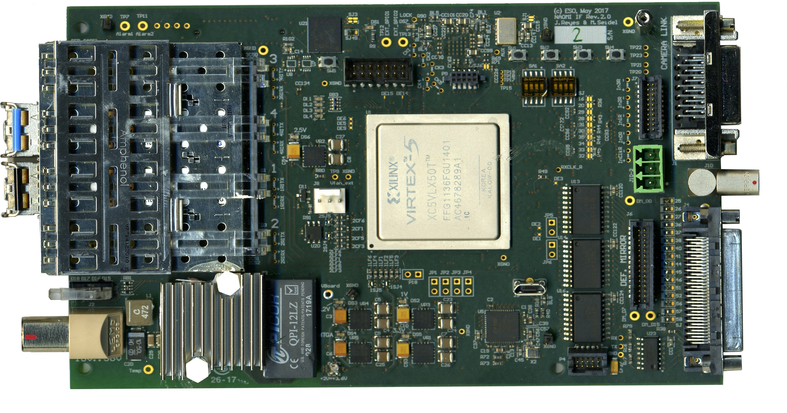
POSTER #2
FPGA-based Real Time Computer and Deformable Mirror Interface
Based on Xilinx Virtex-5 FPGA
High-speed 2 Gbps fiber sFPDP connection to RTC
High-speed 2.5 Gbps fiber sFPDP connection to Corrective Optics computer
Design fully tested
x 12 systems in production
Support for deformable mirro multi stepping

Slide 6
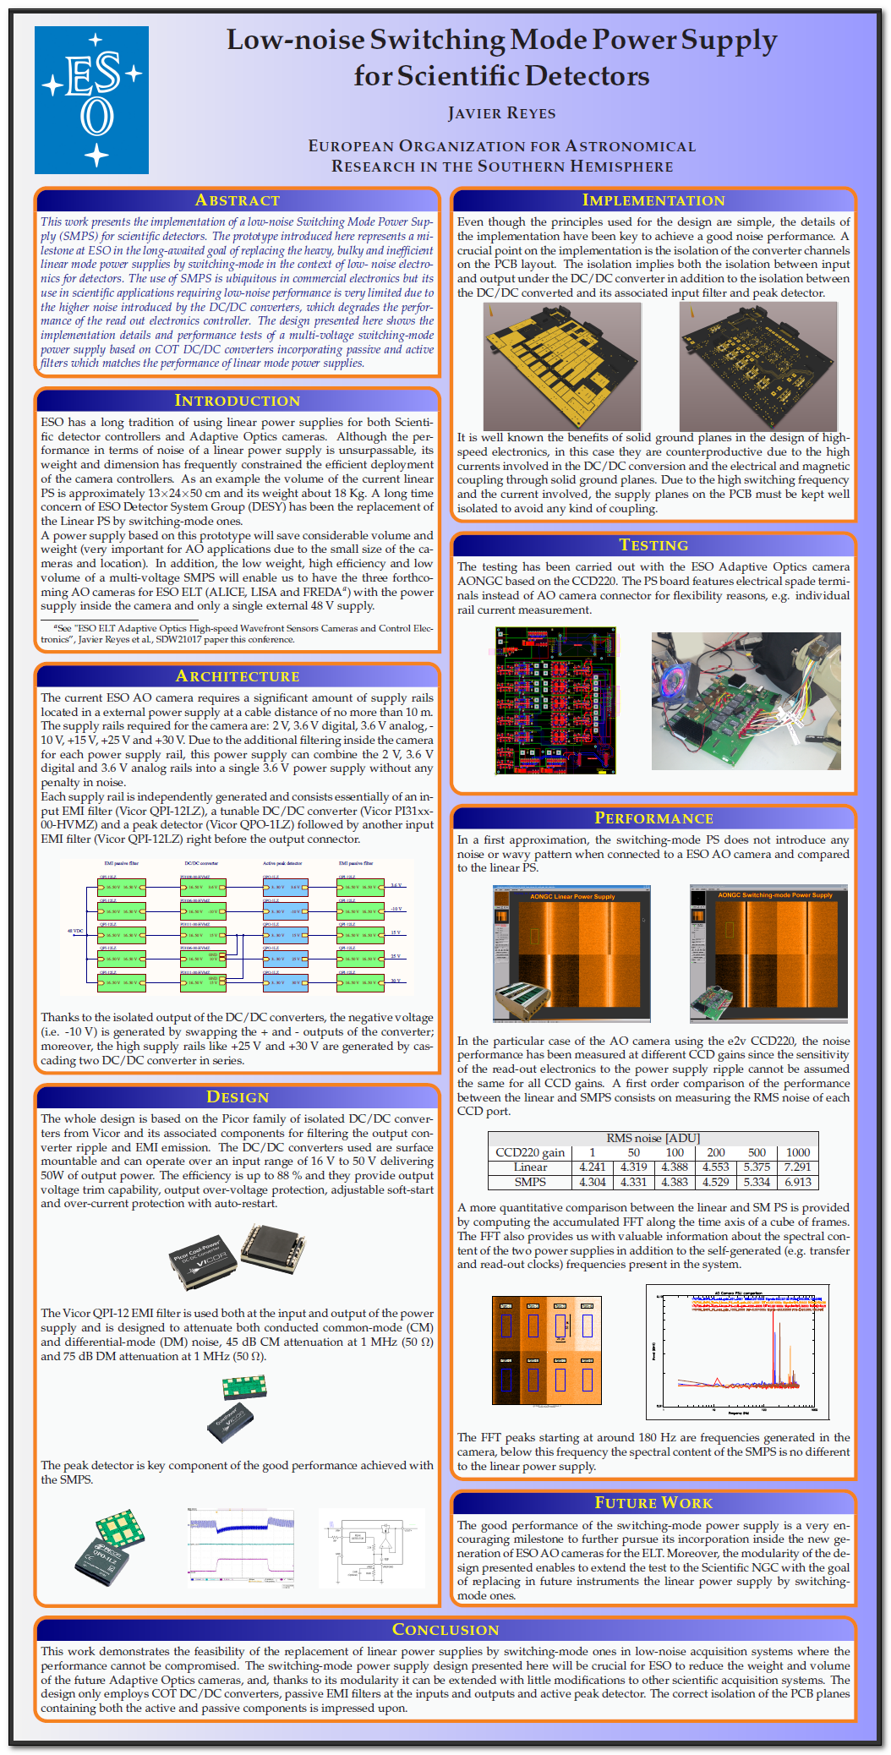
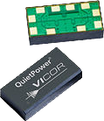
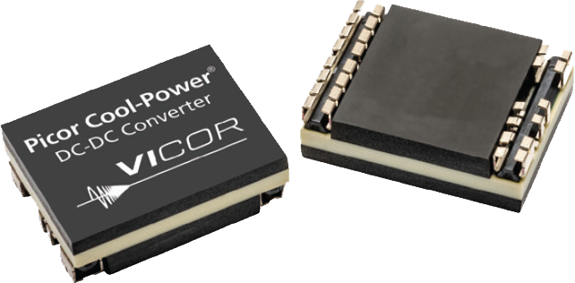
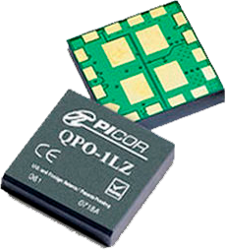
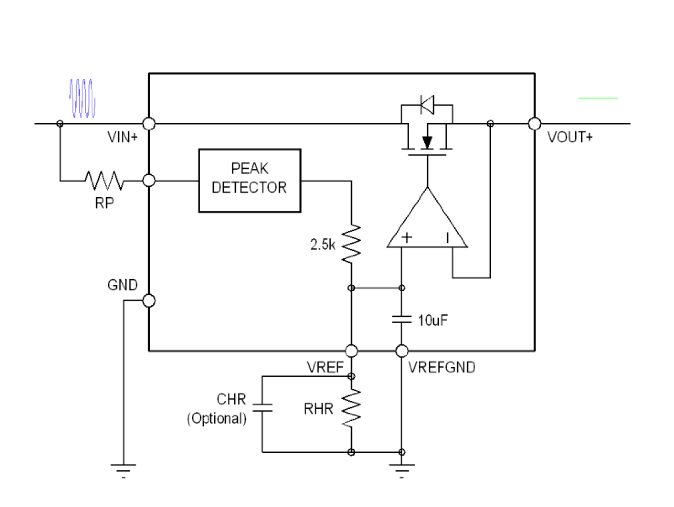
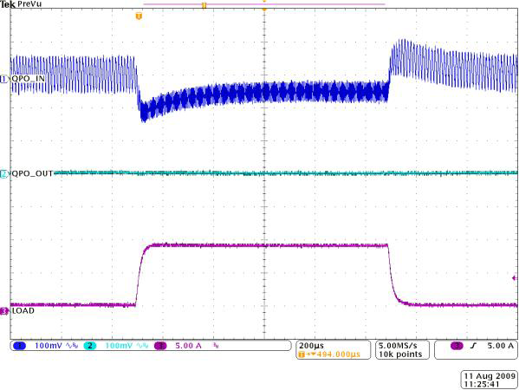
POSTER #3
Low-noise Switching-Mode Power Supply for Scientific Detectors
The architecture
48 VDC input
Many outputs: 3.6 V, -10 V, +15 V, +25 V and +30 V.
EMI filter, 900 kHz notch filter
DC/DC converter
Fast peak detector

Slide 7
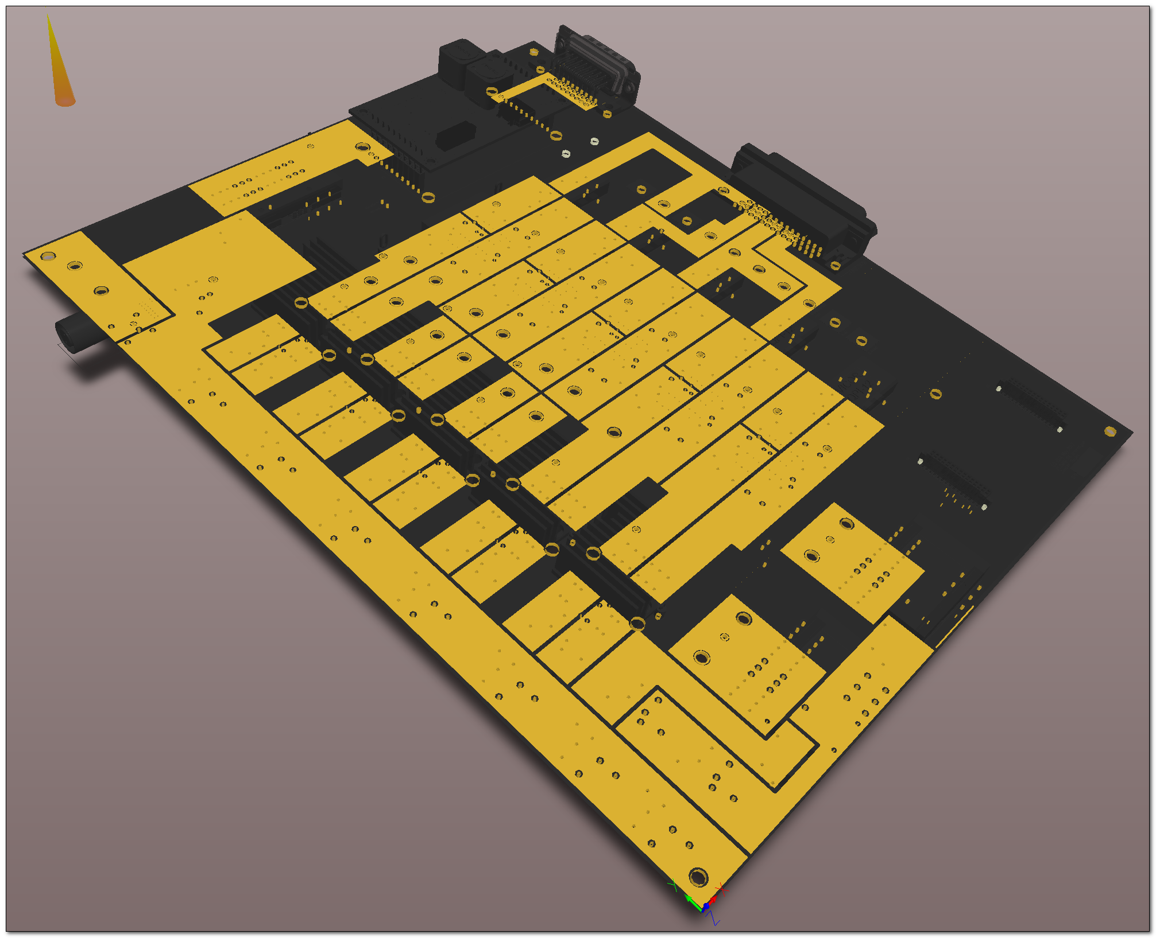
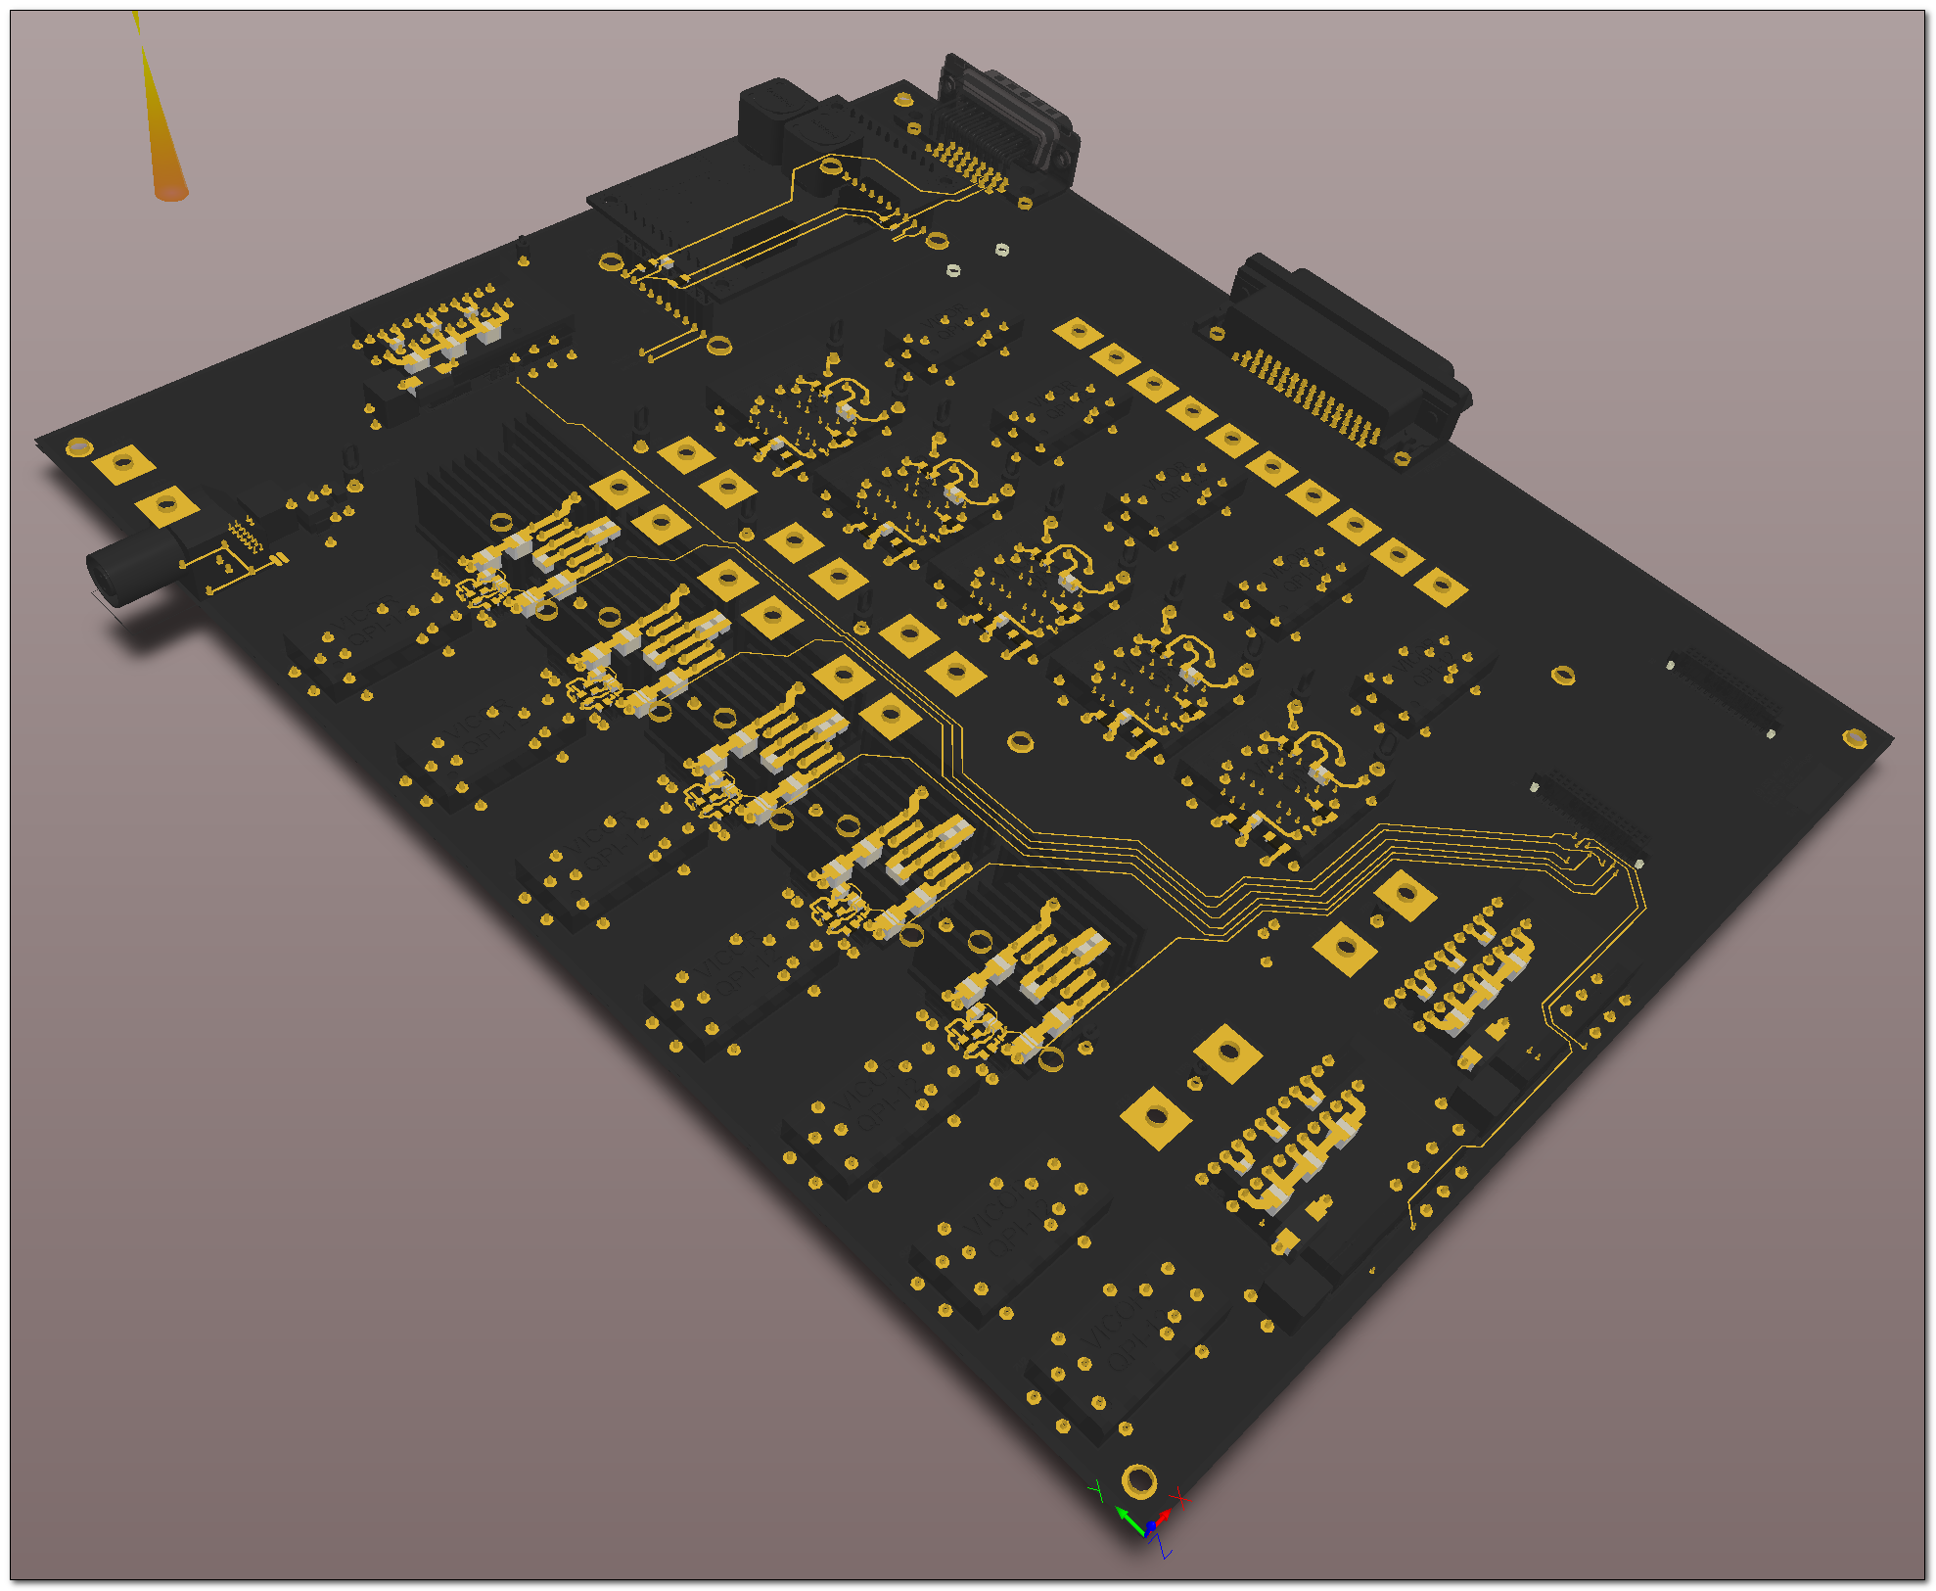
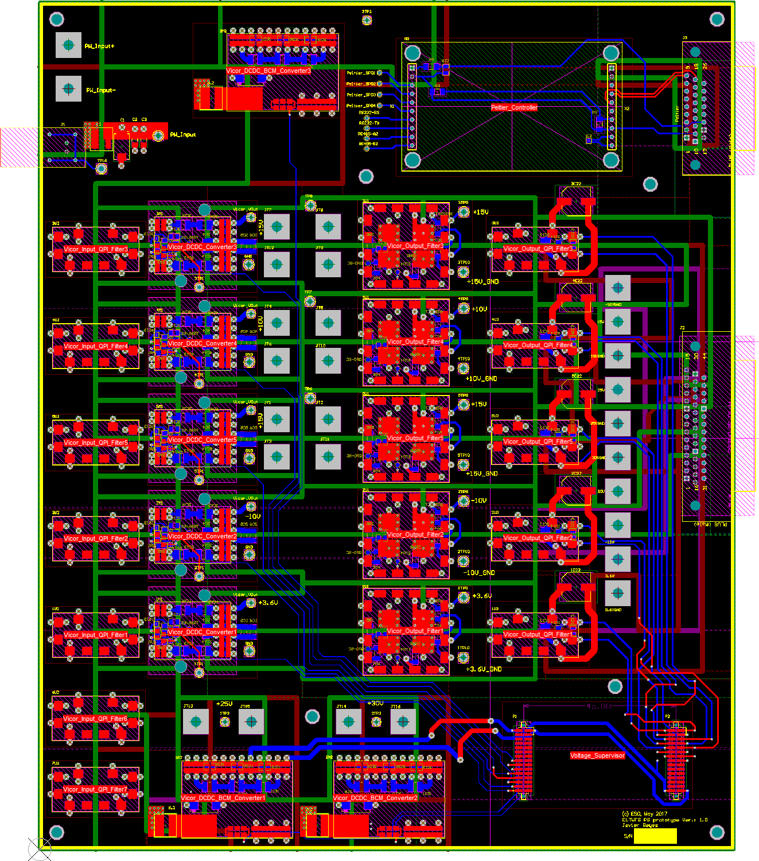
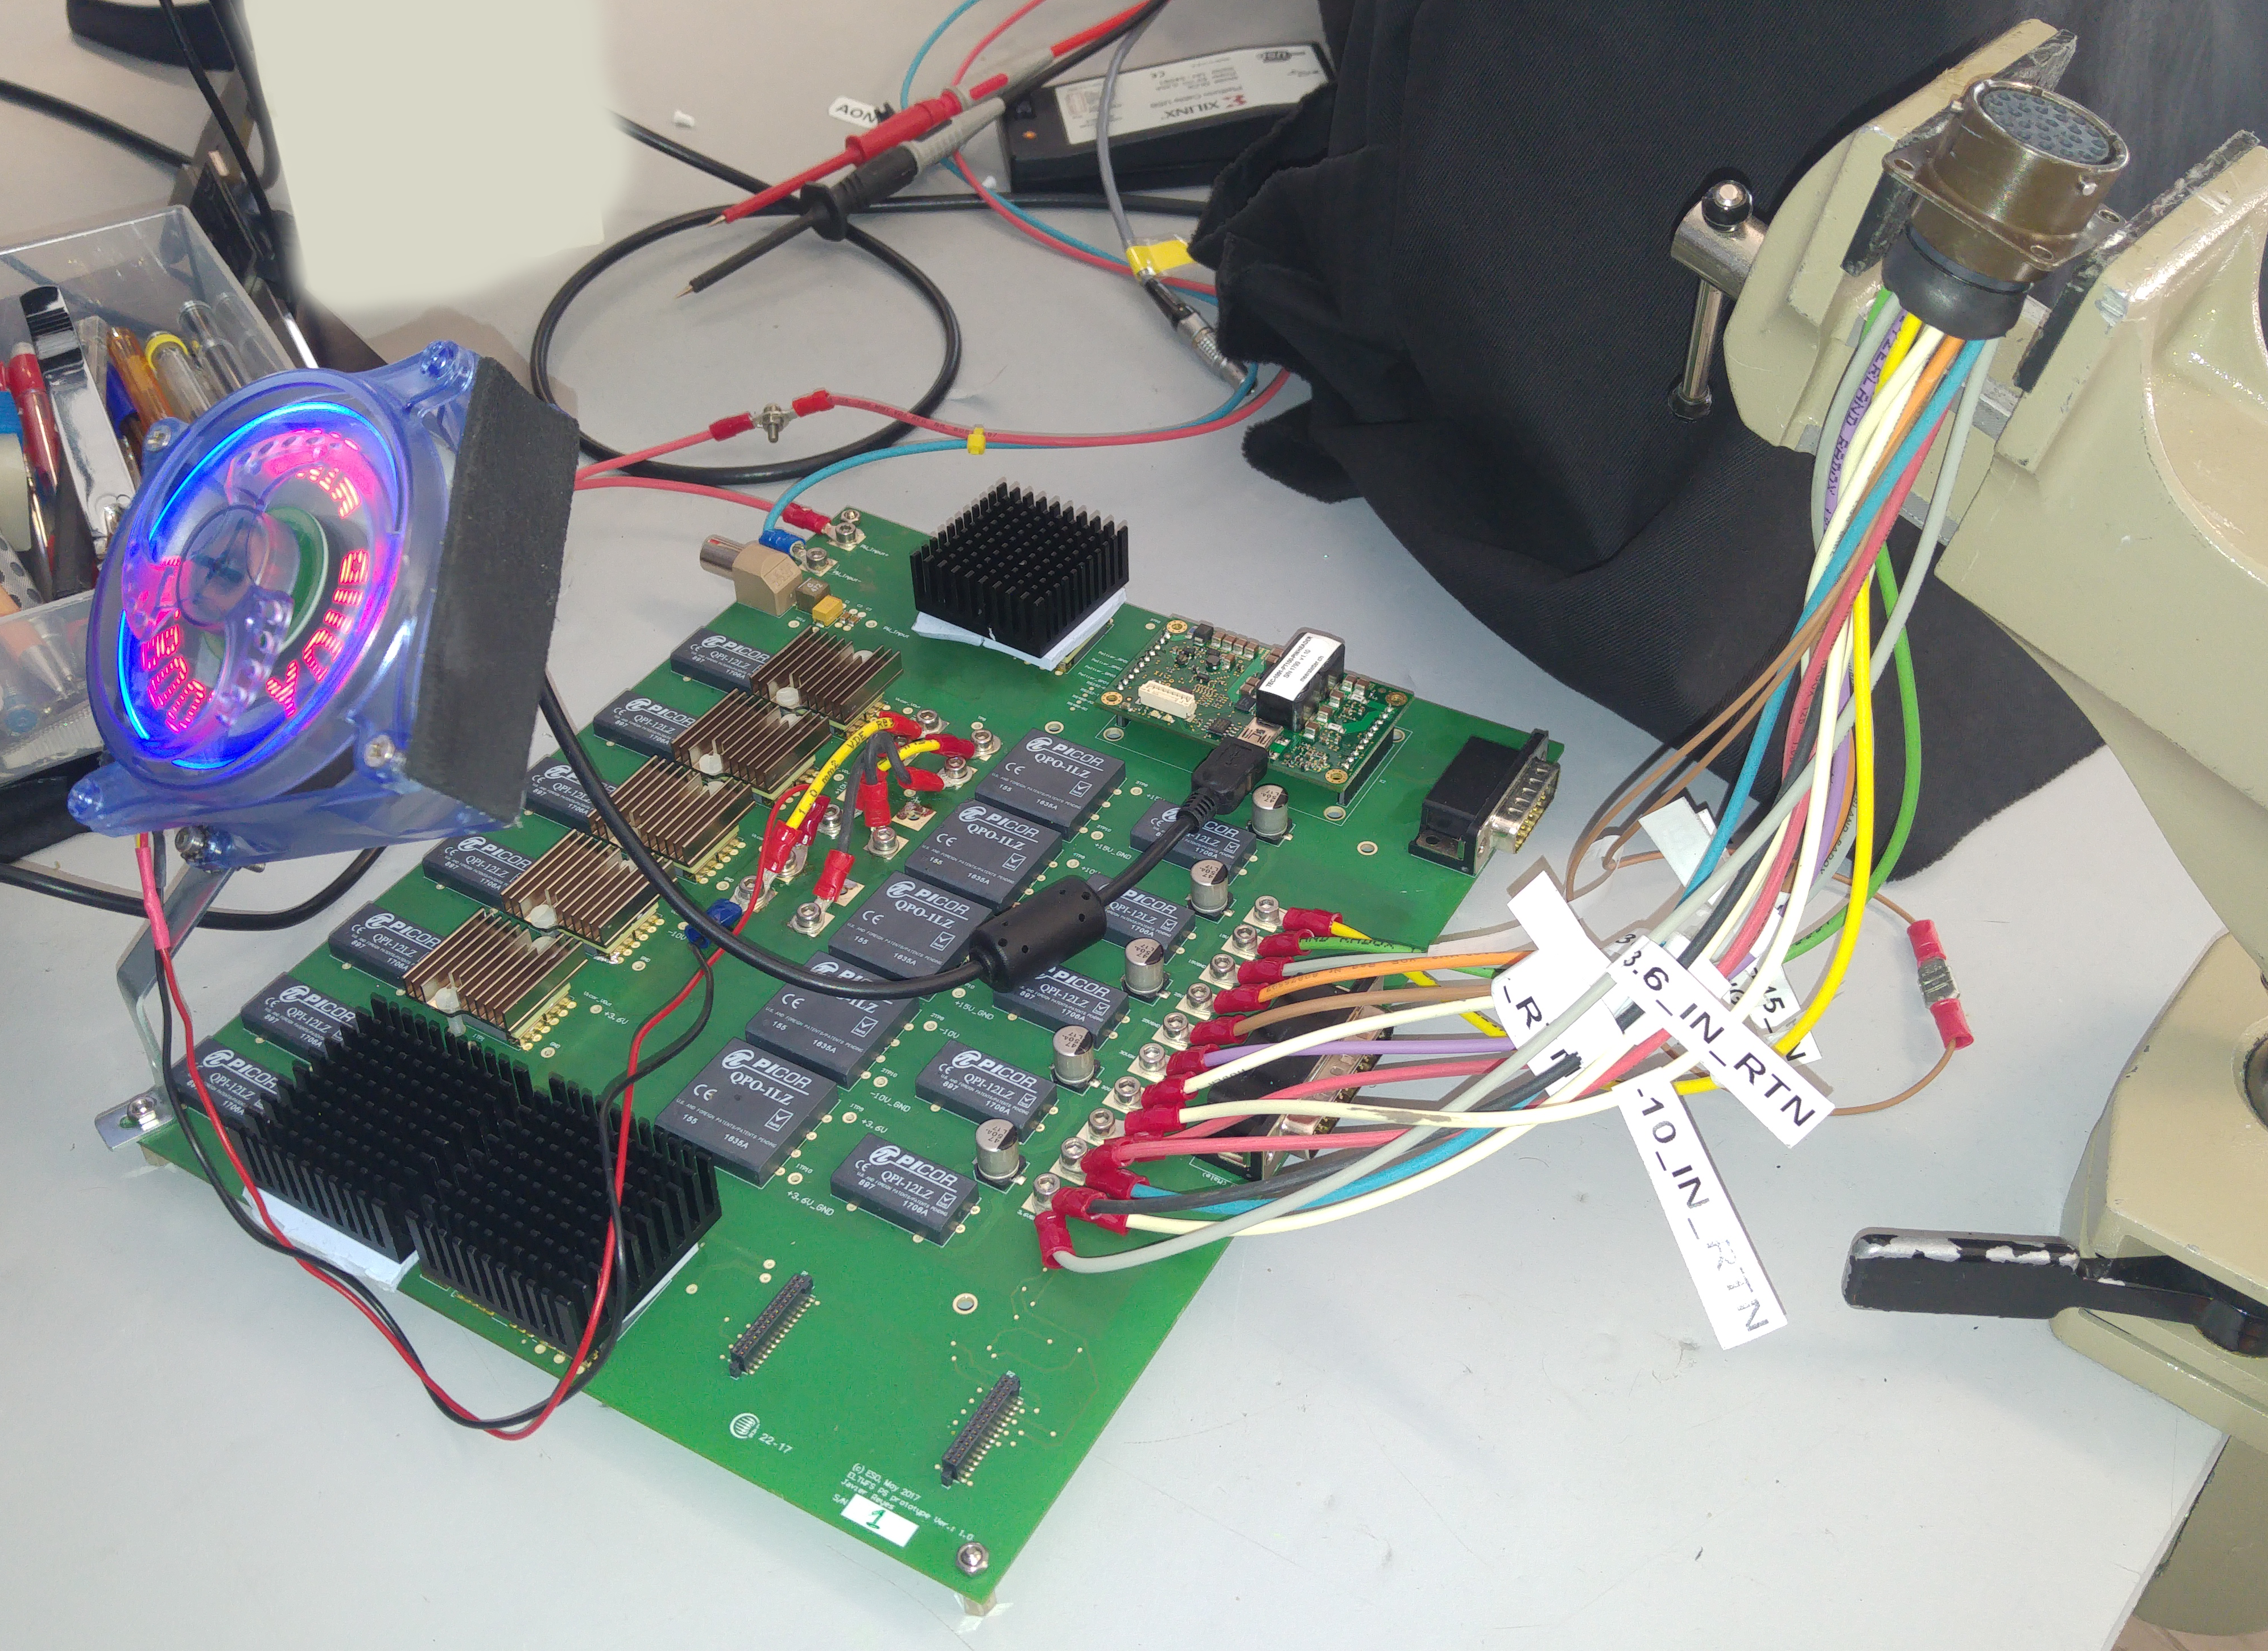
POSTER #3
Low-noise Switching-Mode Power Supply for Scientific Detectors

Slide 8
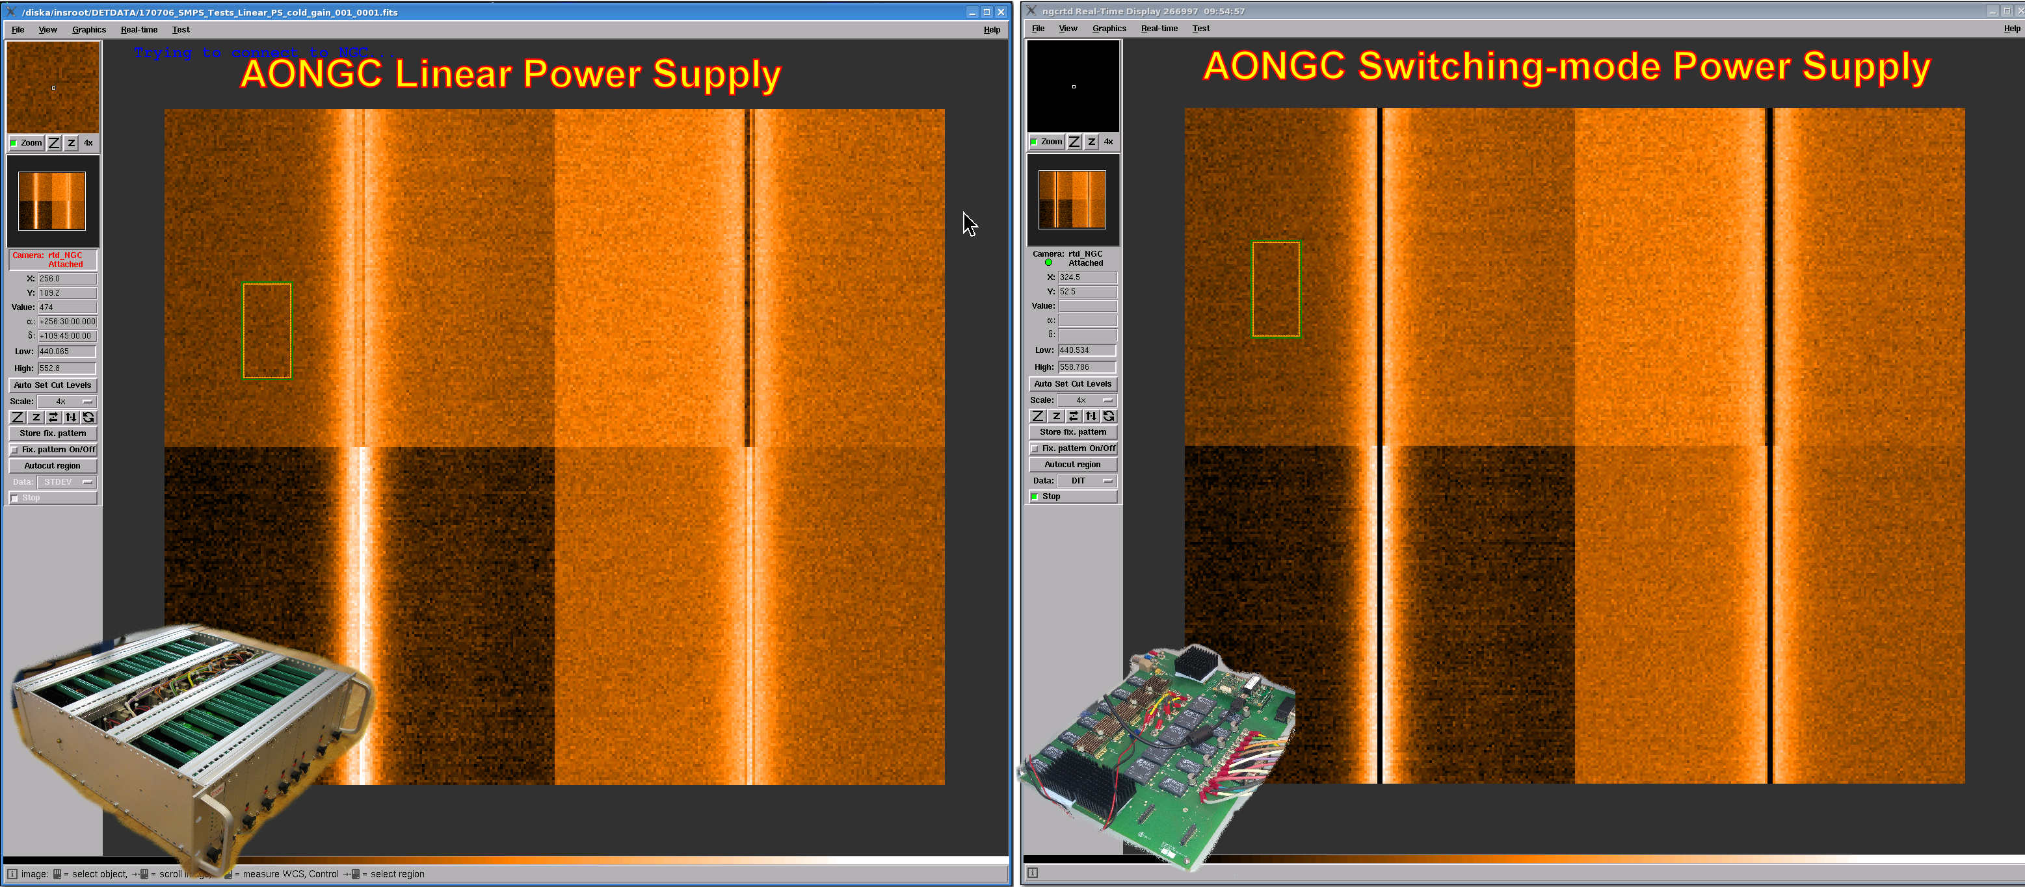

POSTER #3
Low-noise Switching-Mode Power Supply for Scientific Detectors
Spectral content of the SMPS is no different
to the linear power supply
Switched-mode power supply
Linear power supply
¾ Moleskin notebook, twice its height and a couple of kilos
13 x 24 x 50 cm and about 18 Kg

