Slide 1
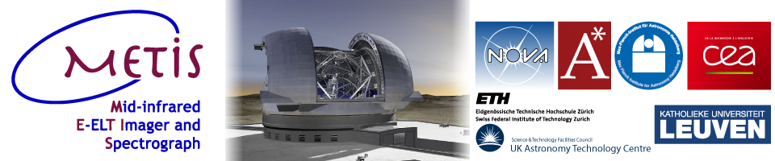


Issues with the N band detectors for METIS,
the mid-infrared instrument of the European ELT
S. Mouzali¹, O. Boulade¹, D. Ives², P. Galdemard¹
¹ The French Alternative Energies and Atomic Energy Commission (CEA), IRFU, Astrophysics Department, Orme des Merisiers, 91191 Gif-sur-Yvette, France
² European Southern Observatory (ESO), Karl-Schwarzschild-Straße 2, D-85748 Garching, Germany
METIS : The Mid-infrared ELT Imager and Spectrograph ⁽¹⁾
Spectral coverage : thermal/mid-infrared wavelength range: 3-13,5 µm (Goal : 3–19 µm)
Sub-system | Spectral band | Wavelength range
Imager | L / M | 2.9 to 5.2 µm
High resolution IFU spectrograph | L / M | 2.9 to 5.2 µm
Imager | N | 7.5 to 13.5 µm
High resolution IFU spectrograph* | N | 7.5 to 13.5 µm

Slide 2
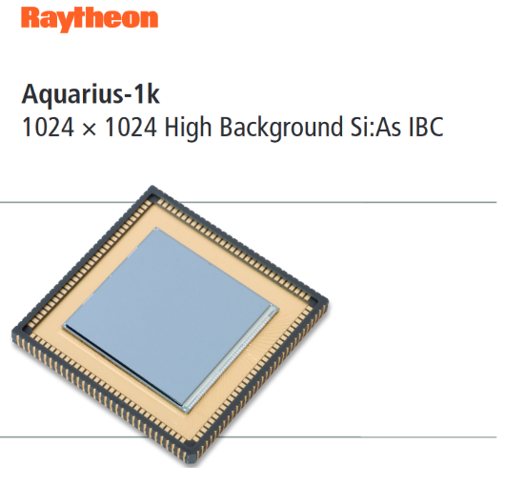

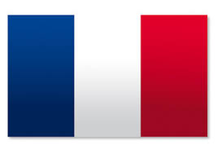


Noise issues with Aquarius
METIS high fluxes -> Excess low frequency noise
Raytheon : New batch of Aquarius?
DRS : MEGAMIR detector?
Teledyne : GeoSnap (CTIA)?
SOFRADIR : ALFA ?
AIM?
Leonardo (Selex)?
Alternatives?
Si : As
MCT
METIS spectroscopic mode -> low dark current specification

