Slide 1
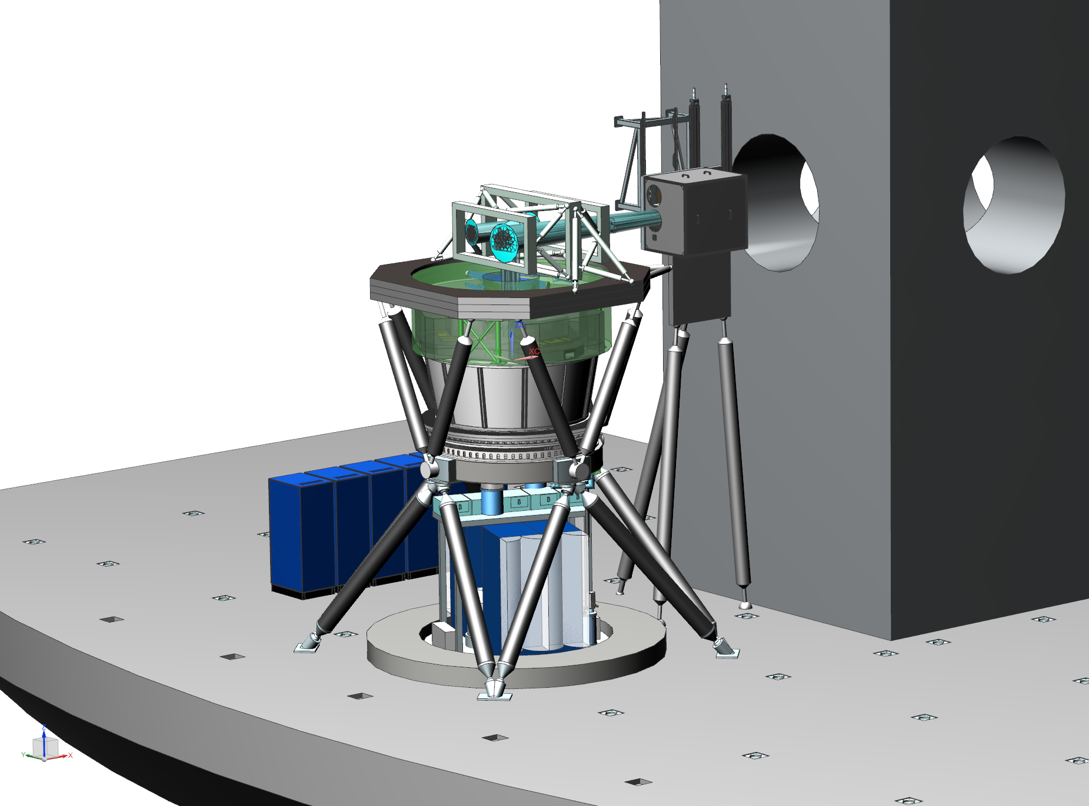
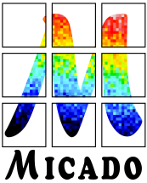
SDW 2017 – MICADO for the ELT
Baltimore, September 26th 2017
Christopher Mandla
Max Planck Institute for
Extraterrestrial Physics, Germany
On behalf of the MICADO
Consortium

Slide 2
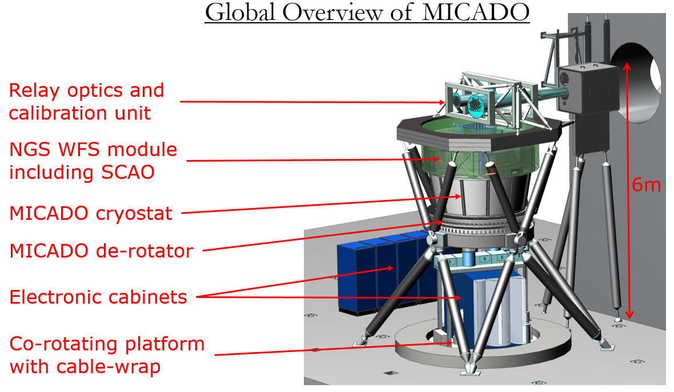
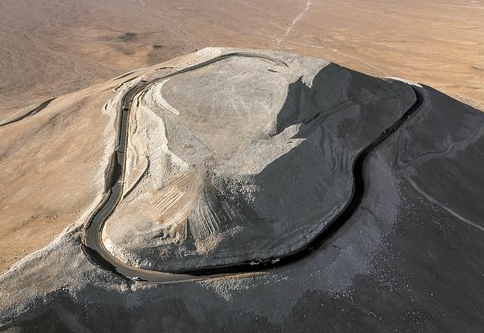
MICADO Overview
MICADO (Multi-AO Imaging Camera for Deep Observations)
First Light imager/spectograph at ELT
Near Infrared (0.8-2.4µm) Diffraction limited imaging
Optimised for laser guide star multi-conjugate adaptive
optics module (MCAO)
Stand-alone function with single-conjugate adaptive
optics (SCAO) by using a single natural guide star
First Light date: 2024
Spectral Resolution:
R~ 8000 across slit
R~ 15000 for point sources
ELT location
Cerro Armazones
Atacama Desert
Chile

