Slide 1
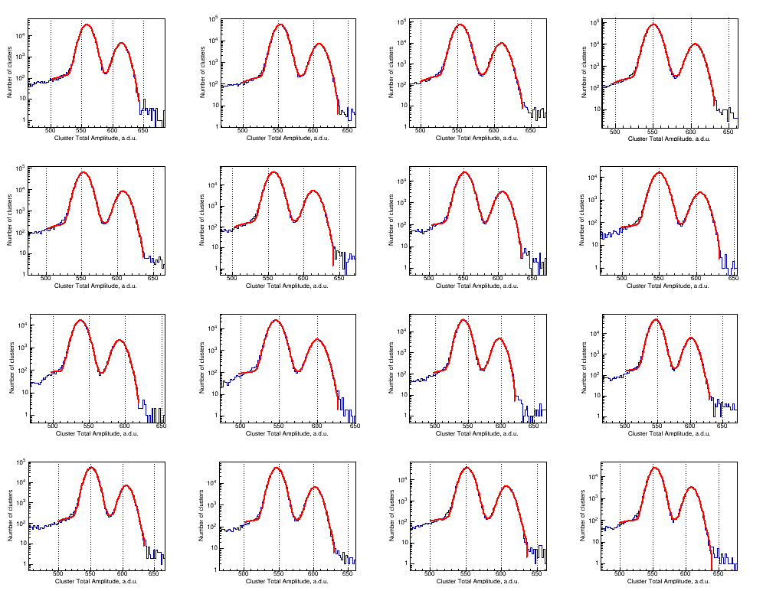
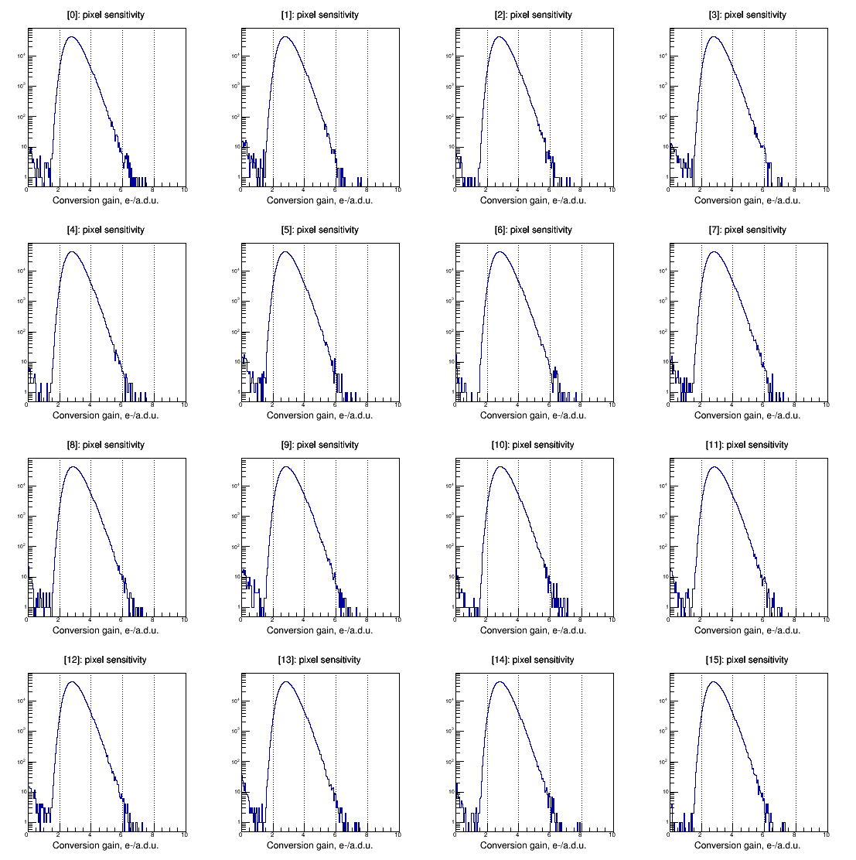
Pair creation energy and Fano factor of Silicon measured at 185 K using ⁵⁵Fe X-ray
Ivan Kotov, Homer Neal, Paul O’Connor
SDW 2017
Goal: achieve accuracy in pair creation energy measurements better than 1%
Method:
use Mn K_{alpha} X-rays to created e-h pairs in CCD250
use property of Poisson distribution to measure CCD gain

Slide 2
Pair creation energy
The number of electrons created by Mn Ka X-ray is
1613.8e-, rms 4.8e- using gain from 0.1s data
1616.1e-, rms 4.0e- using gain from 0.13s data
1615.4e-, rms 3.6e- using gain from 0.27s data
1615.1e- is the average. This corresponds to
w = 3.65 +/- 0.009
There are 2 K-alpha lines in K-alpha peak:
K-alpha1 5898.75 eV, probability 16.2%
K-alpha2 5887.65 eV, probability 8.2% → weighted average 5895.0 eV
Fano factor
The Mn Ka line width is used for Fano factor measurement.
F =0.129 +/- 0.001
Measurements of the pair creation energy in Si are
in excellent agreement with theoretical calculation
agree with other measurements within measurement errors
the accuracy achieved is 0.25%, factor of ~4 better than other measurements
High accuracy method was implemented for gain measurements.

