Slide 1
MOONS
ESO VLT

Slide 2
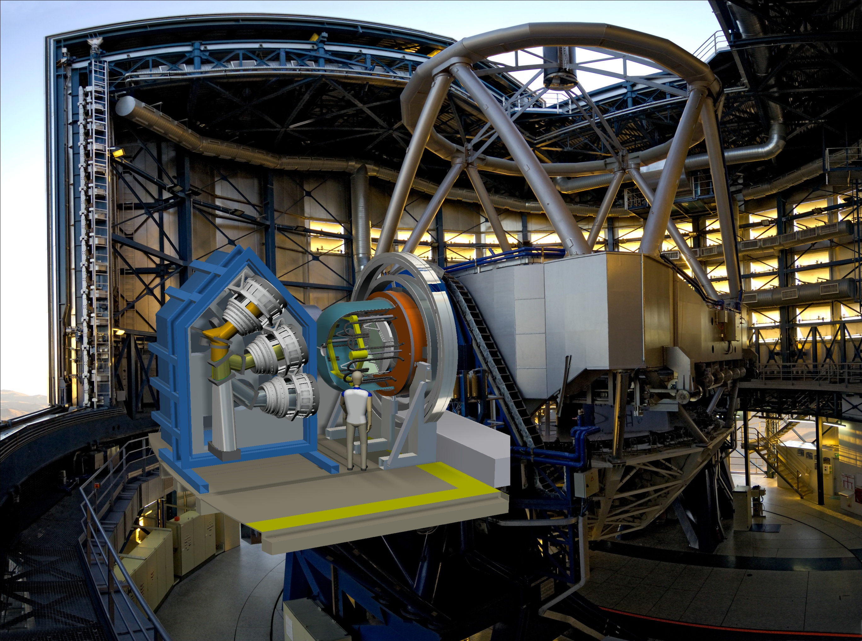
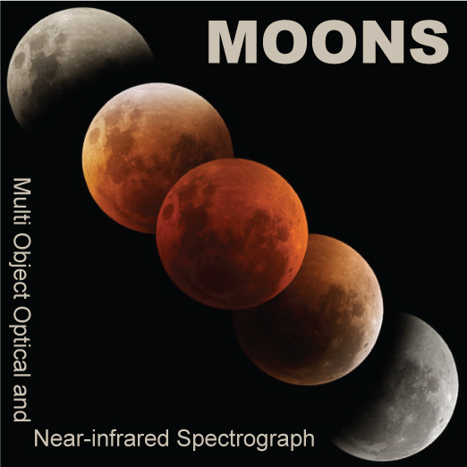
Highly red sensitive detectors inside the visible channels of MOONS on ESO’s VLT –
illuminated by a fast Schmidt camera
Olaf Iwert et al., ESO
Spectrograph on VLT
simultan. 0.64 - 1.8 µm

Slide 3
Visible Detector System Overview:
Amongst others the following key areas are illustrated:
the MOONS (optical) layout
the integration of visible channels directly into the IR vessel
the incorporation of visible and IR detector units into the beam of a Schmidt camera with minimal obscuration
their illumination by an F 0.95 camera optics
the selection of the LBNL detectors w.r.t. requirements
the application of a cryogenic pre-amp
a discussion of side effects of fully depleted detectors in
spectroscopic application

