Slide 1
Interpixel Capacitance (IPC)
Kevan Donlon
KevanADonlon@gmail.com
Rochester Institute of Technology
Center for Imaging Science
Laboratory for Advanced Instrumentation Research

Slide 2
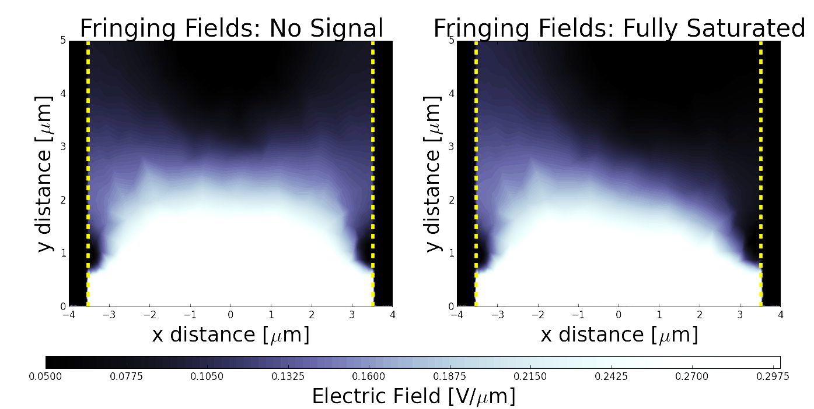
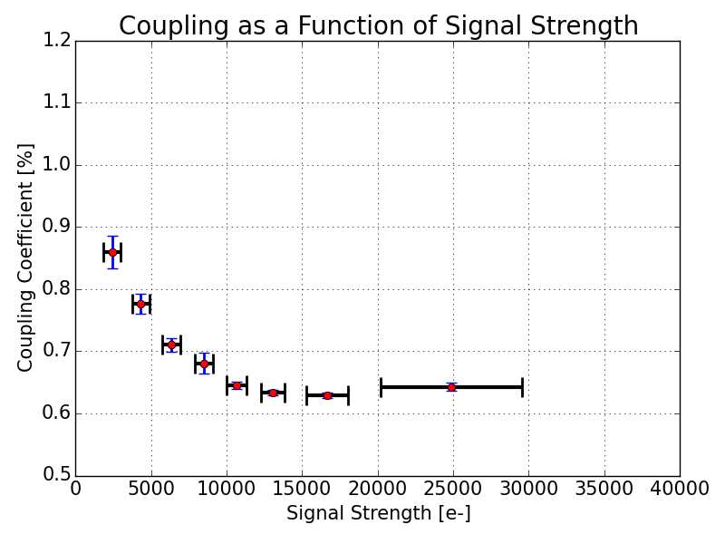
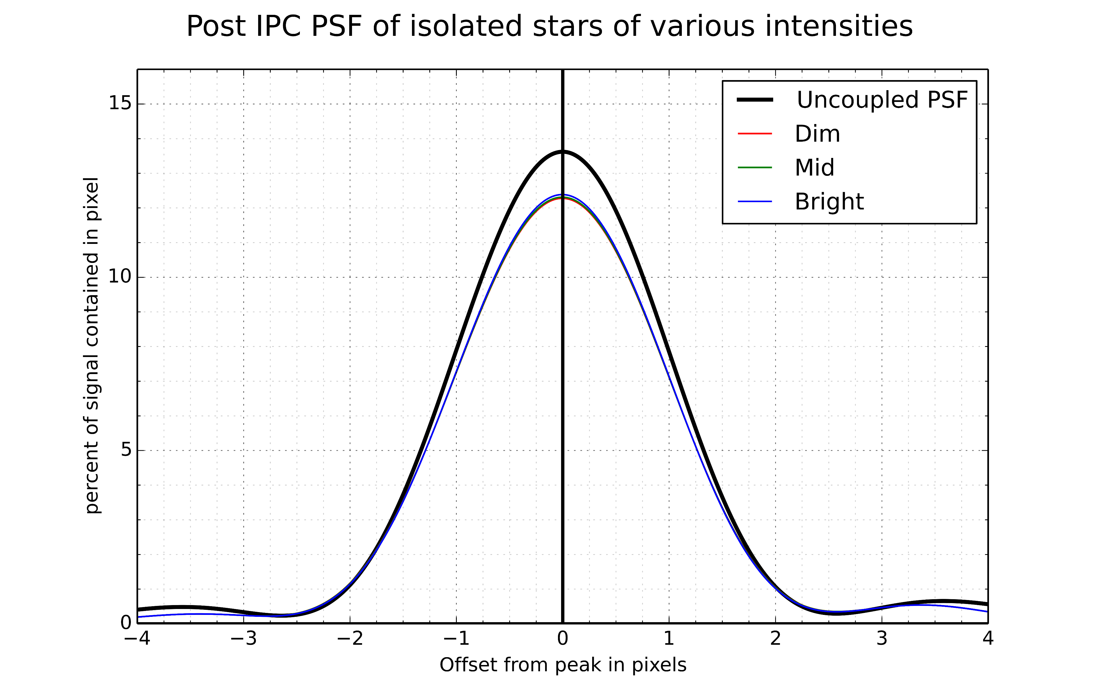
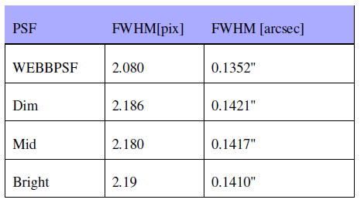
Simulation, characterization, and photometric ramifications of IPC
Semi-conductor physics, simulations and observations indicate that IPC coupling varies as a function of signal strength in hybridized arrays.
This results in PSFs changing as a function of signal strength, introducing errors into estimations of flux and centroid locations.

