Slide 1
Mid and Far-IR Detectors for the Origins Space Telescope
Scientific Detector Workshop SDW2017
Mike DiPirro/NASA-GSFC
For the OST Study Team

Slide 2
Key Parameters
Cover the wavelengths from 6 to 600 µm
High resolution spectroscopy (R = 1e5 to 1e7)
Mapping the Far IR with medium spectral resolution (R~500)
Imaging and polarimetry with R~15 over the entire wavelength range
Pointed imaging in the Mid-IR (6-30 µm)

Slide 3
Why 4 K?

Slide 4
Temperature Limits JWST in the Mid-IR
Due to Telescope
Background

Slide 5
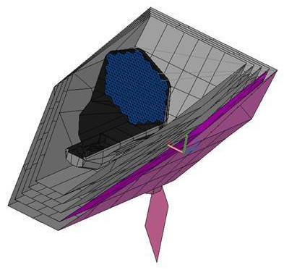
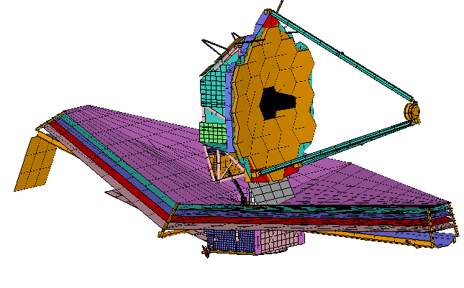

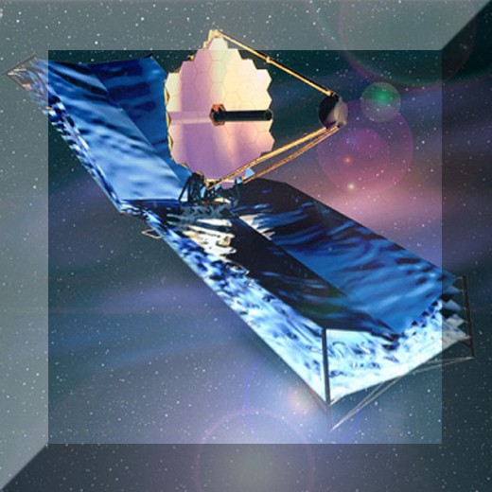
Mission Architecture
Concept 1
4 K Region
16 m
OST 9.1 m primary
JWST 6.7 m primary
25.4 m
14.4 m
19.8 m

Slide 6
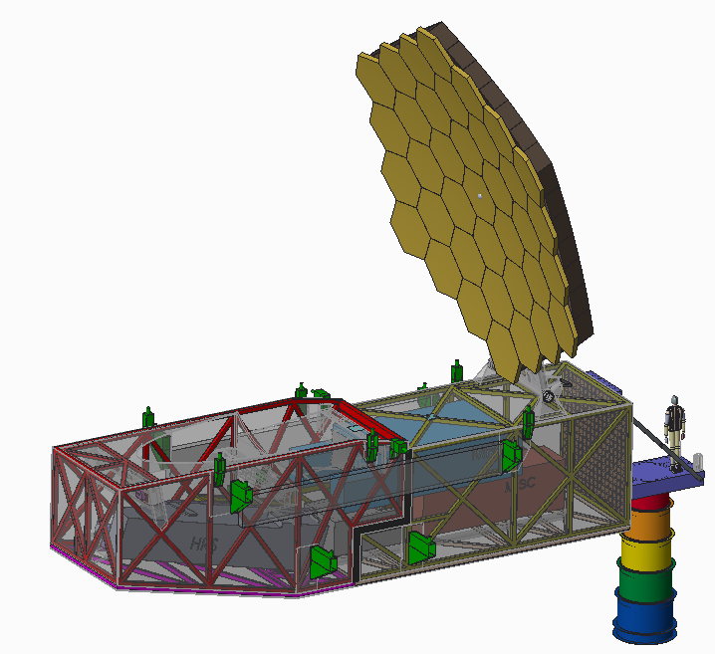
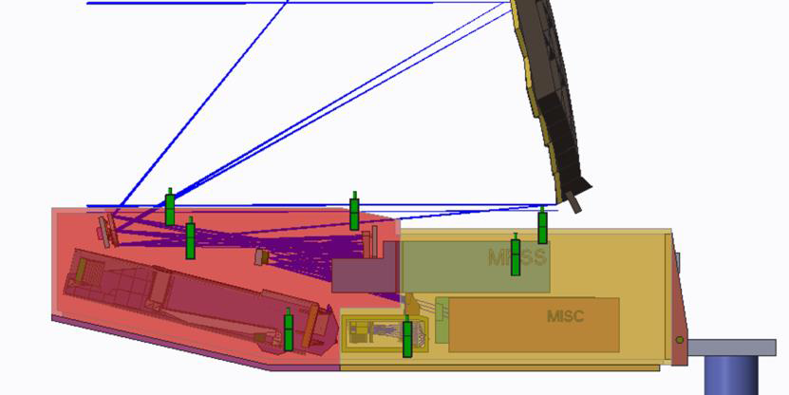
Telescope and Instruments

Slide 7
Instrument Suite
Mid Infrared Imager, Spectrometer, and Coronagraph (MISC)
  6-38 µm, 4 K detectors
Far Infrared Imager and Polarimeter (FIP)
  40-500 µm, 50 mK Direct Detectors
Medium Resolution Survey Spectrometer (MRSS)
  30-800 µm, 50 mK Direct Detectors
High Resolution Spectrometer (HRS)
  25-160 µm, 50 mK Direct Detectors
Heterodyne Instrument (HERO)
  63-600 µm (63, 112,122, 157, 205,250-270, 500-600)), 4 K, Heterodyne detectors with SIS mixers

Slide 8
Mid IR Detectors
Characterization of the atmospheres of transiting exoplanets requires sensitive spectroscopy in the 6-30 micron
Direct imaging and spectroscopy of exoplanets will have strict requirements on the detectors. High stability, high sensitivity (~ 10x better than JWST/MIRI) mid-IR detectors are needed for exoplanet spectroscopy.
OST Needs: Mid-IR detectors with ~10x better sensitivity and stability
compared to the JWST/MIRI detectors
and/or schemes to improve the instrument sensitivity with existing detectors

Slide 9
Direct Detectors
SOA:
  325 bolometers with 4x10⁻¹⁷ W/√Hz NEP (TRL9 Herschel/SPIRE)
  5120 pixels with low x10⁻¹⁶ W/√Hz NEP (TRL 5 SCUBA 2)
  Sensitive (NEP low 10-19 W/√Hz), fast detectors (TES bolometers, and MKIDs in kilo pixel arrays) are at TRL 3.
OST Needs:
  10⁴ scalable to 10⁶ pixels with <1x10⁻¹⁹ W/√Hz NEP (imaging)
  <3x10⁻²⁰ W/√Hz NEP (spectroscopy) with 3x10⁻²¹ enabling background limited detection
  Antenna vs. absorber coupling
    Low heat capacity/high isolation
  Reaching enabling numbers decreases the observing time by factor of ~100 and increases areal coverage by 10-100 times

Slide 10
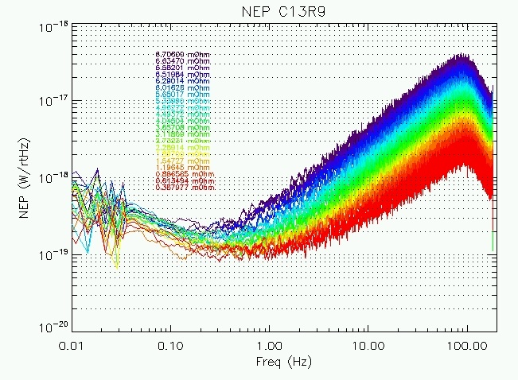
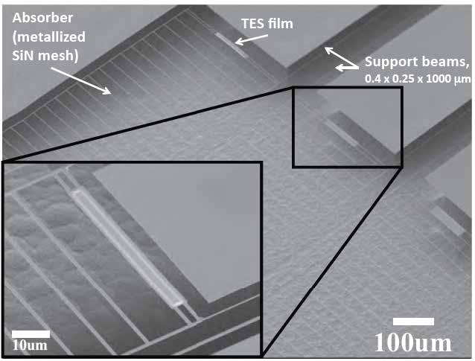
Direct Detectors(1/3): TES Bolometers
Principle of operation: Photon flux heats suspended island, superconducting thermistor encodes temperature
Demonstrated NEP: <1x10⁻¹⁹ W Hz^{-1/2}
Operating temperature: 50 mK System TRL: 5-6
Format prospects: ~10k-30k (limited by complicated SQUID readout)
Comments: JPL, GSFC, SRON pushing technology – leading candidate for SPICA.
JPL far-IR leg-isolated TES bolometers.
Silicon nitride forms mesh.
Thermistor from MoCu biylayer with Tc~70-100 mK.

Slide 11
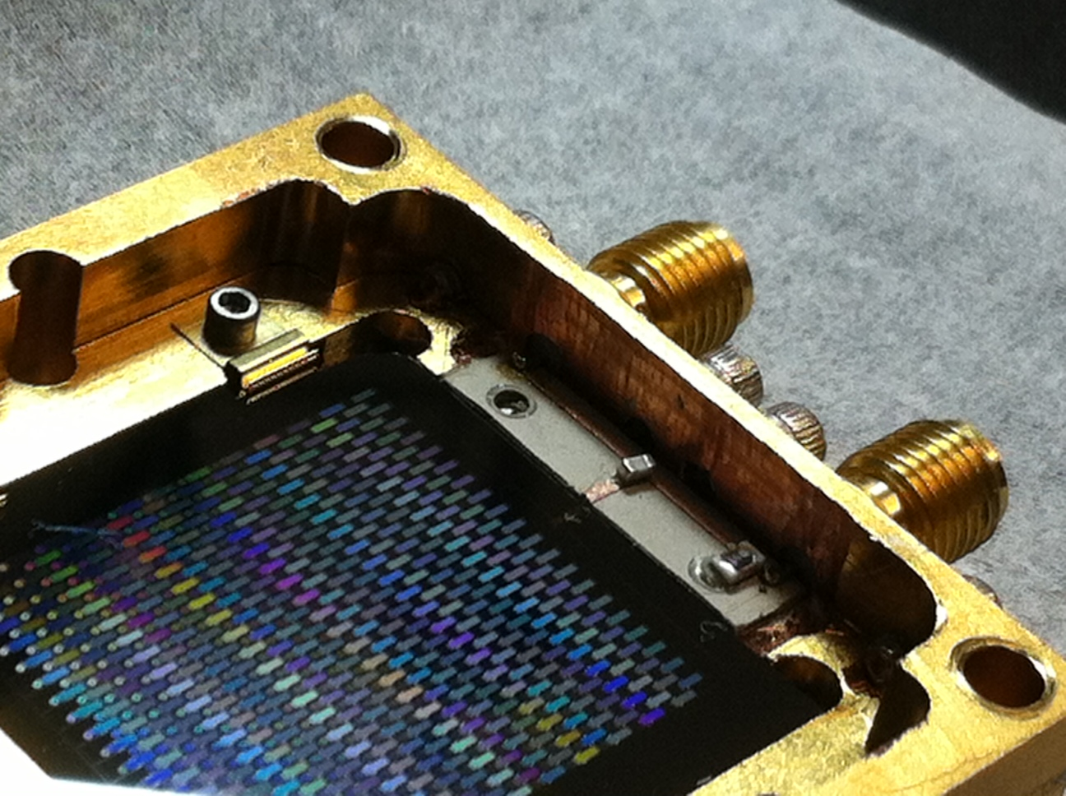
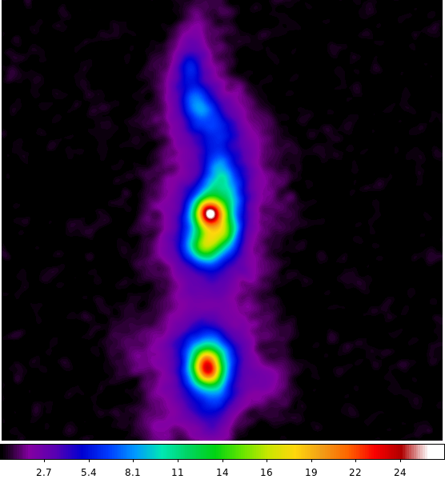
Direct Detectors(2/3): Kinetic Inductance Devices (KIDs)
Principle of operation: Photons break Cooper pairs in superconducting resonator, shifts resonant frequency
Demonstrated NEP: 3x10⁻¹⁹ W Hz^{-1/2} for antenna-coupled, 3x10⁻¹⁸ W Hz^{-1/2} for direct-absorbing
Operating temperature: 100-300 mK System TRL: 5
Format prospects: ~100k – 1M (benefits from frequency-domain multiplexing)
Comments: Under development at JPL, Goddard, NIST, SRON, Cardiff.
NEPs improving, but difficult to scale to FIR Surveyor sensitivities
JPL KIDs: demonstrated on sky for 350, 850 micron imaging. Photon background limited at 350. 850 improving rapidly.
Simple, robust design using titanium nitride. Aluminum also under development.
50-200 MHz readout frequencies mean can read out 1000-2000 detectors per RF line.
Small-volume TiN implemented in on-chip spectrometer, also background-limited with NEP < 1e-17 W Hz^{-1/2}
C. McKenney, C.D. Dowell, S. Hailey-Dunsheath, M. Hollister, E. Shirokoff, H.G. LeDuc, J. Zmuidzinas, C.M. Bradford et al.

Slide 12
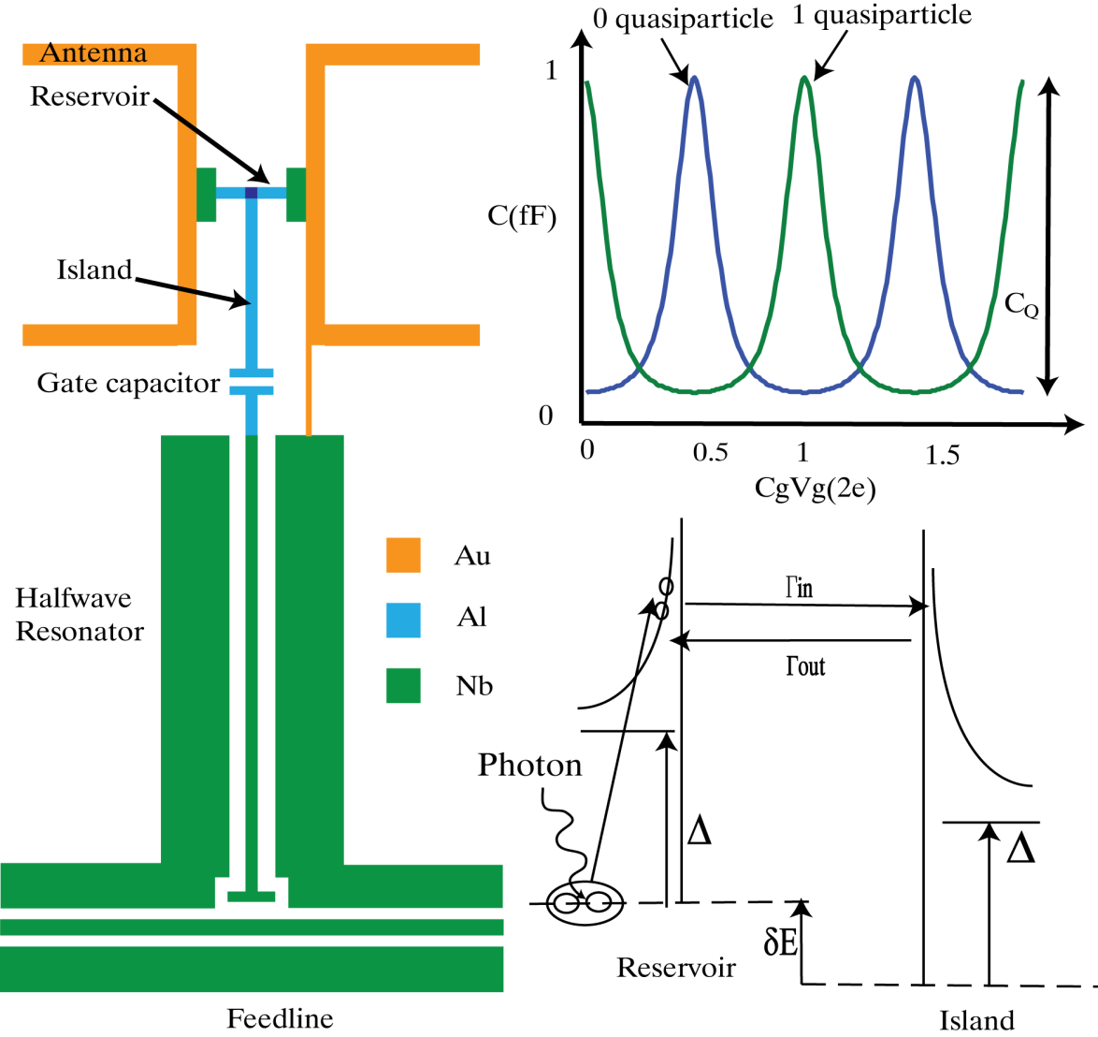
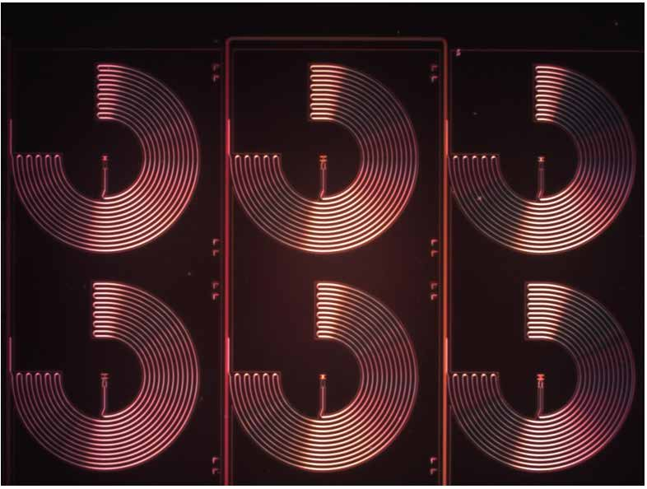
Direct Detectors (3/3): Quantum Capacitance Detector (QCD)
Principle of operation: Photons break Cooper pairs, resulting electrons tunnel in and out of small single-electron island, sensed via capacitance shift in a resonant circuit.
Demonstrated NEP: 1x10⁻²⁰ W Hz^{-1/2}
Operating temperature: 50 mK System TRL: 4
Format prospects: ~100k – 1M (benefits from frequency-domain multiplexing like KIDs)
Comments: Under development at JPL, Excellent noise performance, device yield and efficiency improving.
Photo-produced quasiparticles tunnel through junction from reservoir into single-cooper-pair island, and back.
Occupation state of island quantized with large capacitance shift due to tunneling.
Large frequency shift in resonator due to tunneling, can detect with IQ plane.
Naturally extremely sensitive devices.
Operating range tuned via volume of reservoir (like KIDs)
Multiplexed via microwave resonators
P. Echternach, B. Pepper, T. Reck, C.M. Bradford et al.
NEP Measurement in Low-Background Testbed
Response from cold black body with pinhole, bandpass filter
Device is shot noise limited down to very low power.
Exceeds FIR Surveyor requirements
Illustrates advantages of pair-breaking detectors: insensitivity to RF a big advantage.
Part of a 5x5 array
(Fresnel lenses not shown)
NEP vs applied photon power:
NEP scales as sqrt (P) as expected for photon shot noise
Credit: P. Echternach / JPL

Slide 13
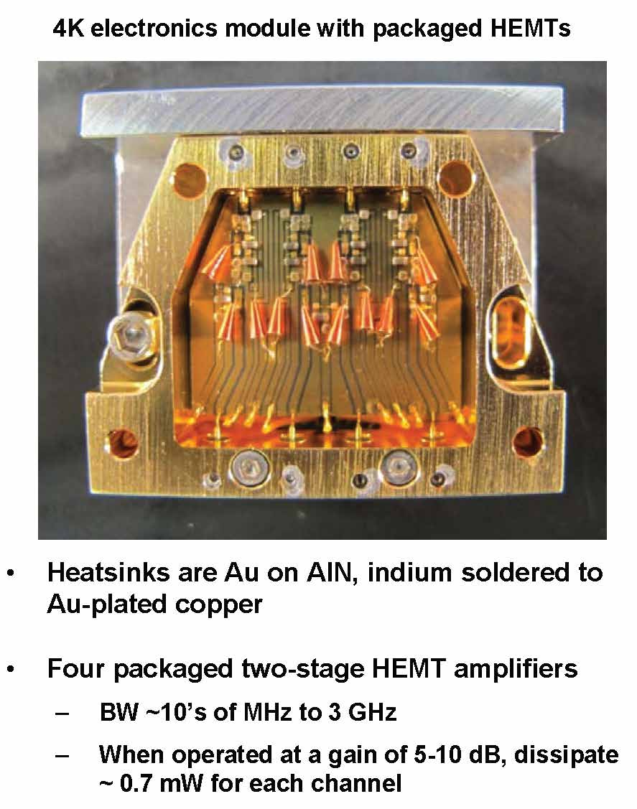
Direct Detector Multiplexing at Low T
Readout schemes using HEMT or SiGe amplifiers and frequency-multiplexed (FDM) resonant circuits are in development. (see right)
Near-term, this scheme should result in 1000-3000 pixels per amplifier channel
Adding Code Division Multiplexing (CDM) will lead to even more pixels per channel
OST Needs: 1000 to 3000 pixels per channel with low noise and low power dissipation

Slide 14
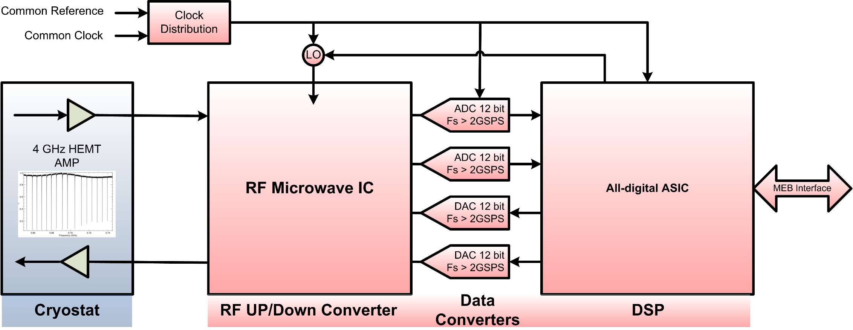
Room T Readout for Direct Detectors
Current SOA: Room temperature readout of cryogenic amplifier outputs currently use FPGAs and ADCs for bandwidths up to 4 GHz having power dissipation of about 30W per channel.
Dedicated ASICs would potentially lower the input power requirement by a factor of 10.
OST Needs: Recovering the signal to noise with lower-power room-temperature electronics with lower input power by a factor of 10.

Slide 15
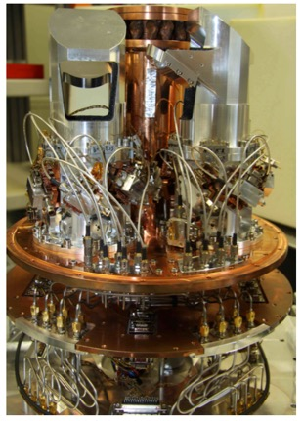
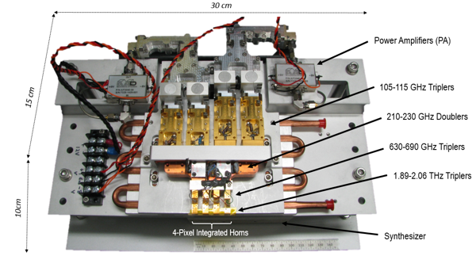
Heterodyne Detectors
Quantum Cascade Laser (QCL) – multiple units for different frequencies
Herschel HIFI: up to 2 THz but a SINGLE PIXEL
Detector Technology: HEB mixers work throughout the frequency range; T_{sys} < 1000 K (DSB)
Advances since HIFI: Frequency range extended to 4.7 THz using QCL for Local Oscillator (LO)
Focal plane array technology for increased imaging speed
4-pixel 1.9 THz LO for STO-2 balloon
(JPL & Univ. Arizona)
1.9 – 2.1 THz 16-pixel LO chain for SHASTA; individually adjustable power outputs derived from single 23-26 GHz source (JPL)
upGREAT 14-pixel 2 THz RX on SOFIA (Univ. Koeln; Risacher+ 2016)
QCL Beam pattern
OST Needs: extend range to 63 µm (4.7 THz)
Increase pixel count to 128

