Slide 1
JWST Persistence:
Modeling, Characterization, & Correction
Michael Regan
&
Eddie Bergeron

Slide 2


Slide 3
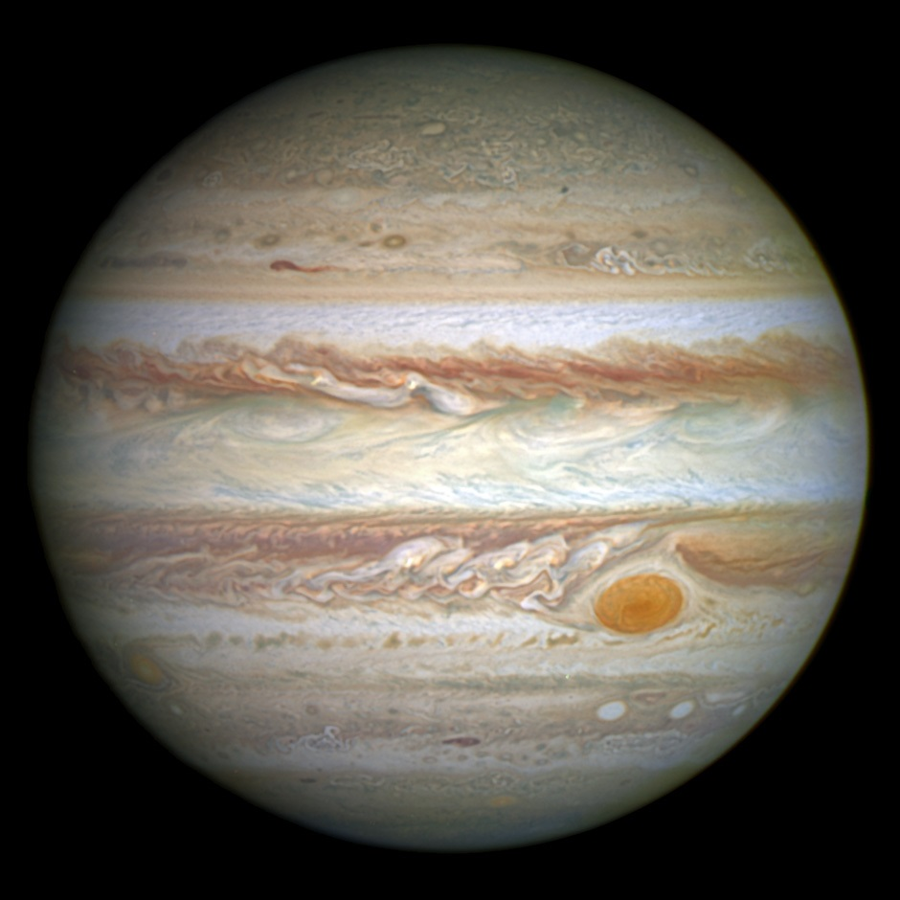

Slide 4
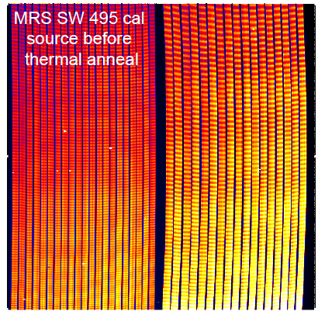
JWST
MIRI Medium Resolution Spectrograph (MRS)
13-minute exposure

Slide 5
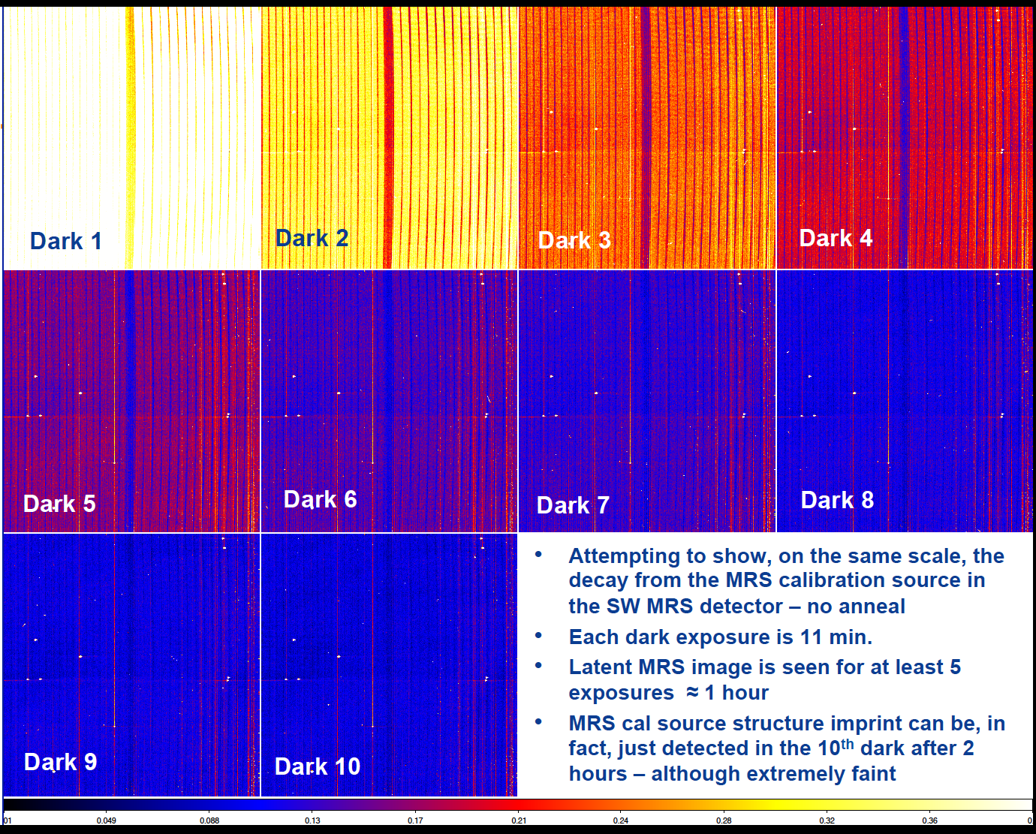
Persistence is visible for 2 hours after exposure
55 minutes
110 minutes

Slide 6
Persistence is visible for 2 hours after exposure
55 minutes
110 minutes

Slide 7
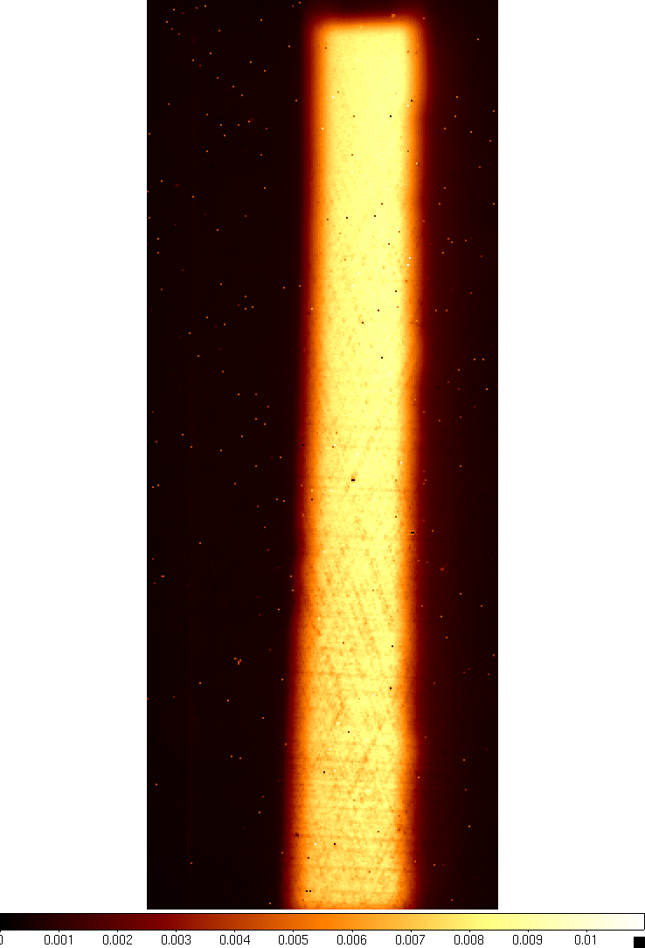
Slot Image

Slide 8
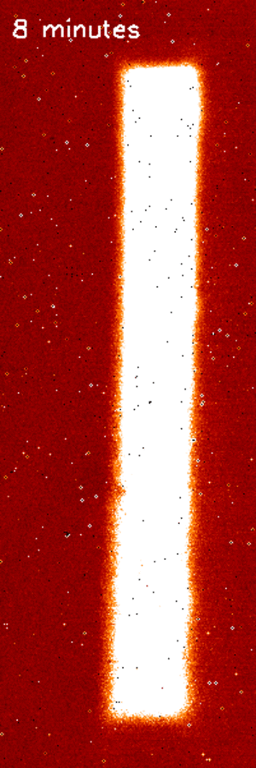

Slide 9
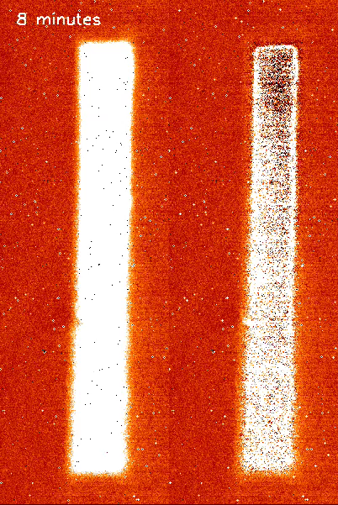

Slide 10
The Model

Slide 11
Extension of Smith 2008

Slide 12
Extension of Smith 2008

Slide 13
+
Extension of Smith 2008

Slide 14
+
Extension of Smith 2008

Slide 15
Extension of Smith 2008

Slide 16
Testing the predictions of the model

Slide 17
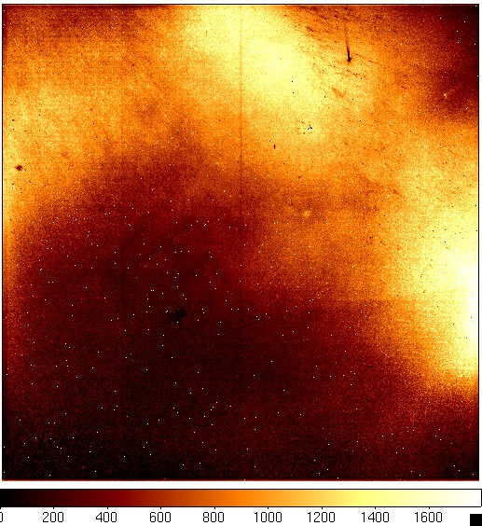
Traps
decay during dark

Slide 18
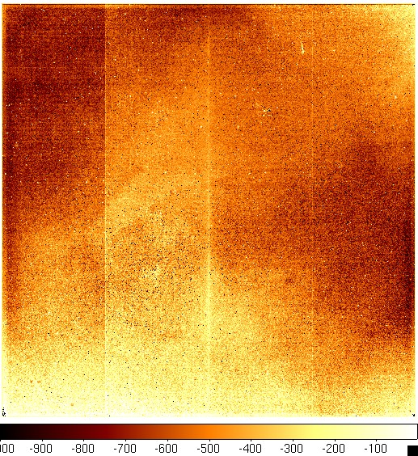
Traps captured during soak

Slide 19
Persistence decay is unaffected by resets

Slide 20
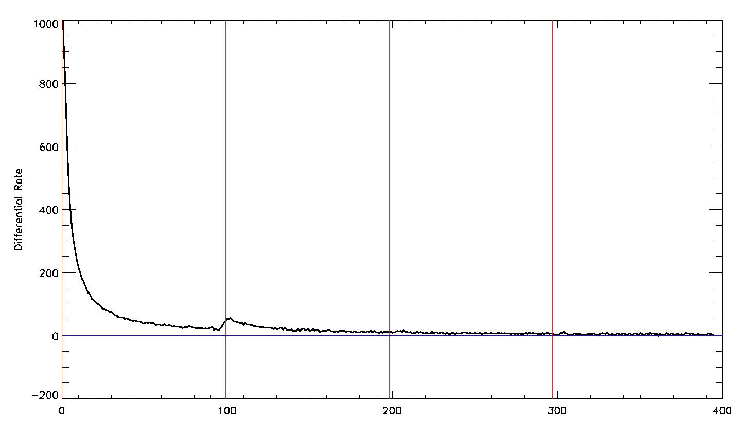
Resets do not help
1000
2000
3000
4000
Time since stimulus image (secs)

Slide 21
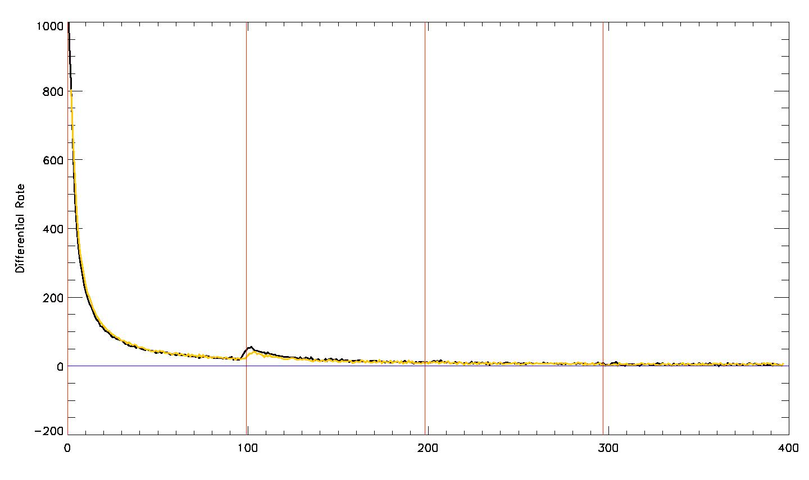
Resets do not help
1000
2000
3000
4000
Time since stimulus image (secs)

Slide 22
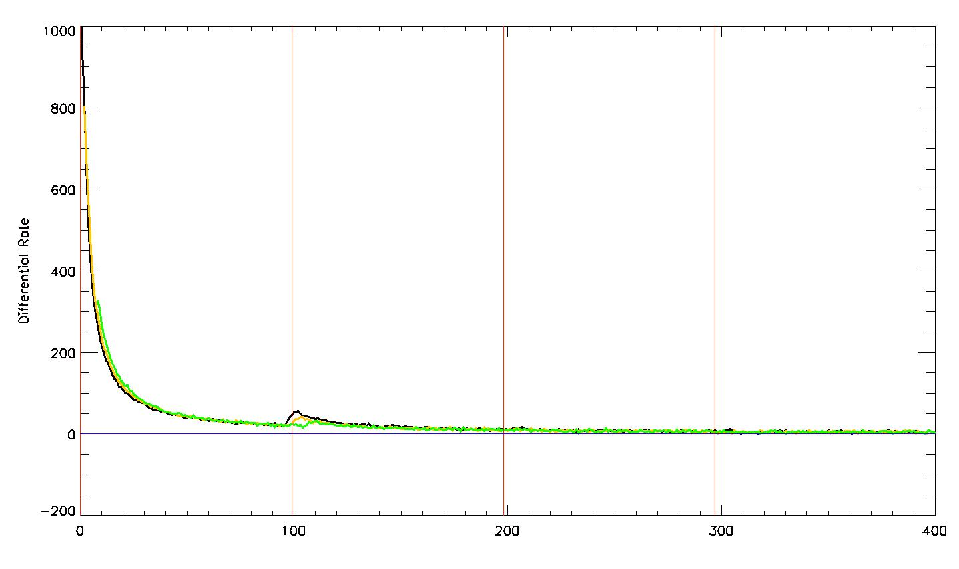
Resets do not help
1000
2000
3000
4000
Time since stimulus image (secs)

Slide 23
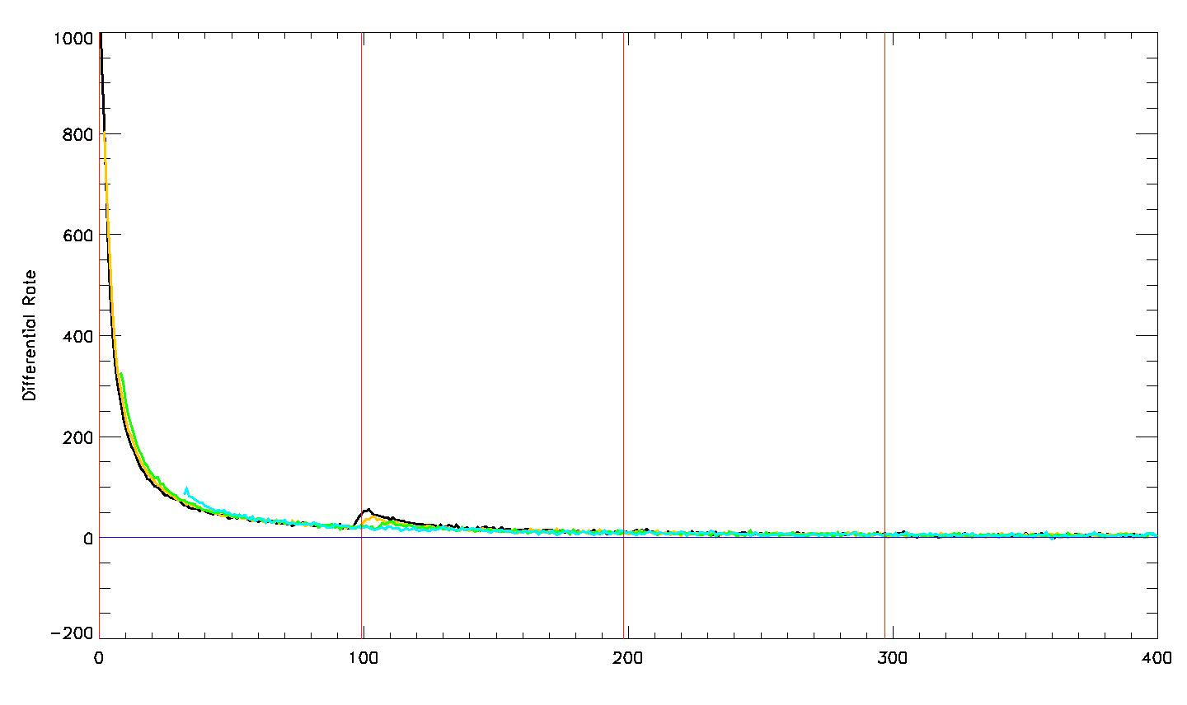
Resets do not help
1000
2000
3000
4000
Time since stimulus image (secs)

Slide 24
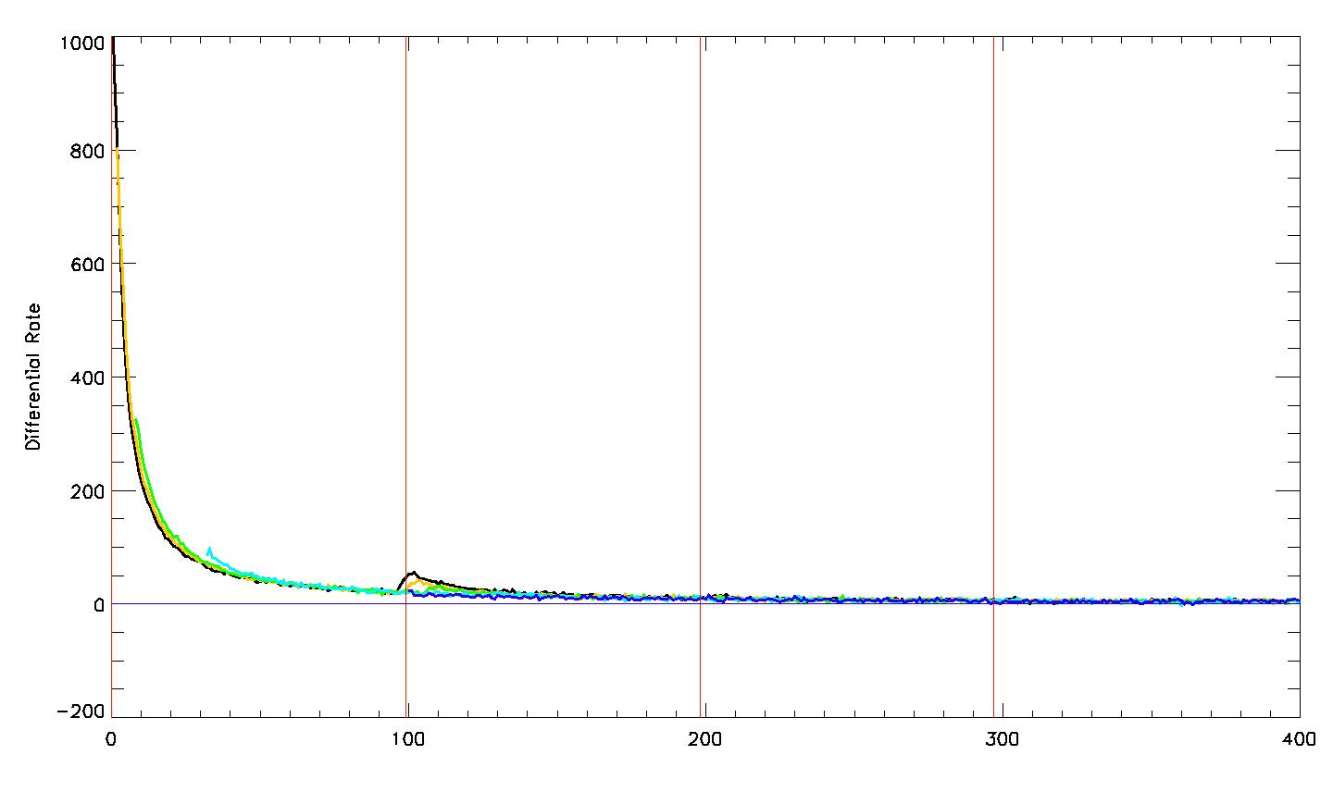
Resets do not help
1000
2000
3000
4000
Time since stimulus image (secs)

Slide 25
Soak time affects persisence

Slide 26
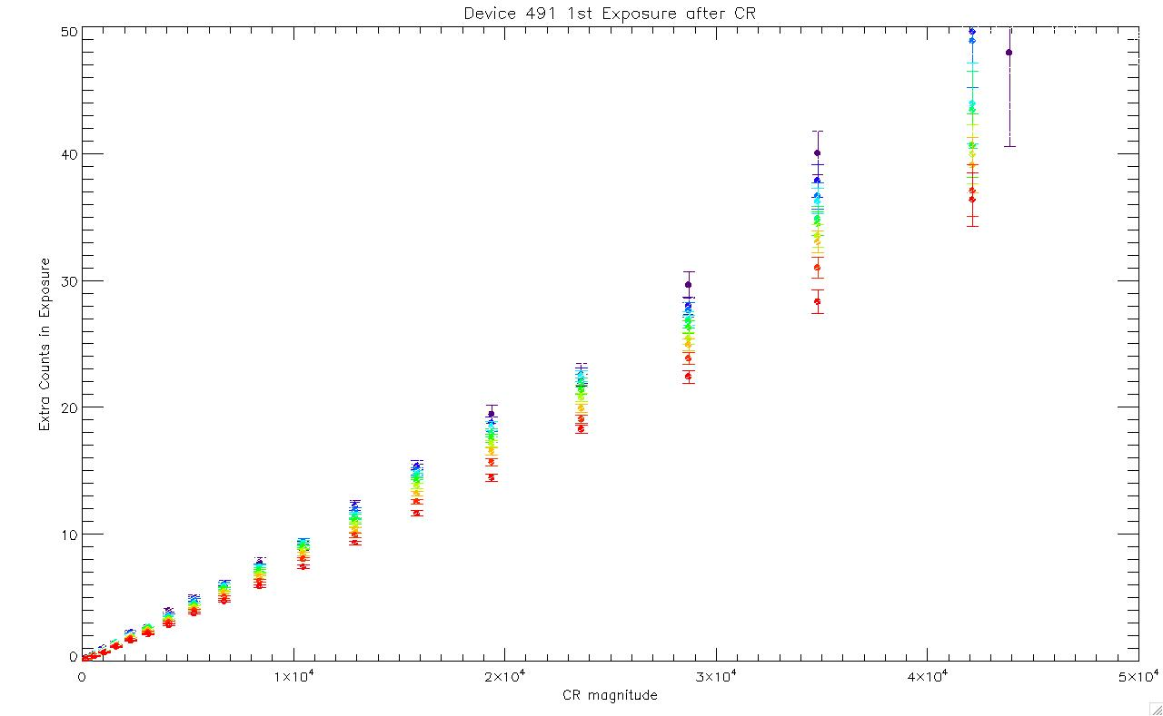
CR in 1st 10th of exposure
CR in last 10th of exposure

Slide 27
Mitigating and Correcting Persistence

Slide 28
The best correction is the one you don’t have to make.

Slide 29
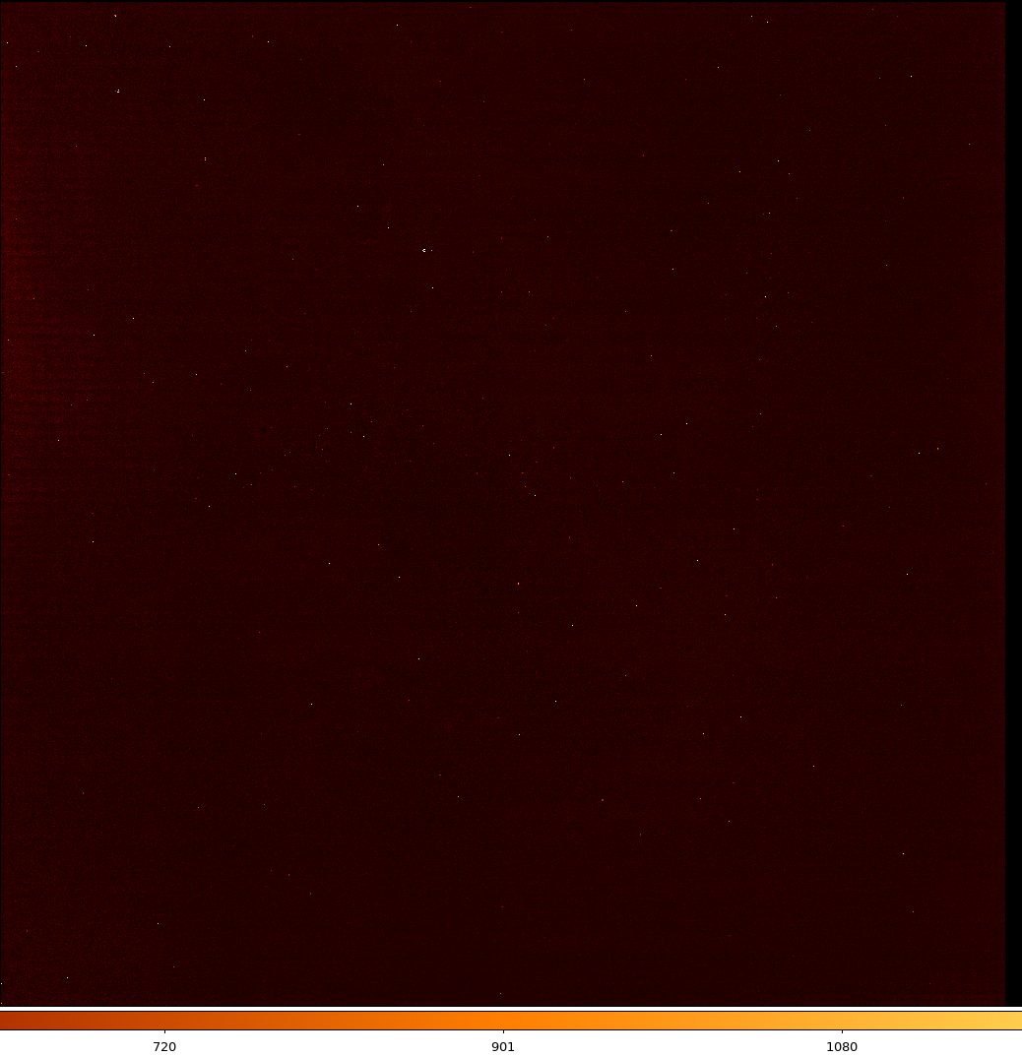
Get Better Detectors (less traps)
Early Engineering Part
Rejected Flight Part
Almost Flight Part
Peak is 1/6 of EE part peak

Slide 30
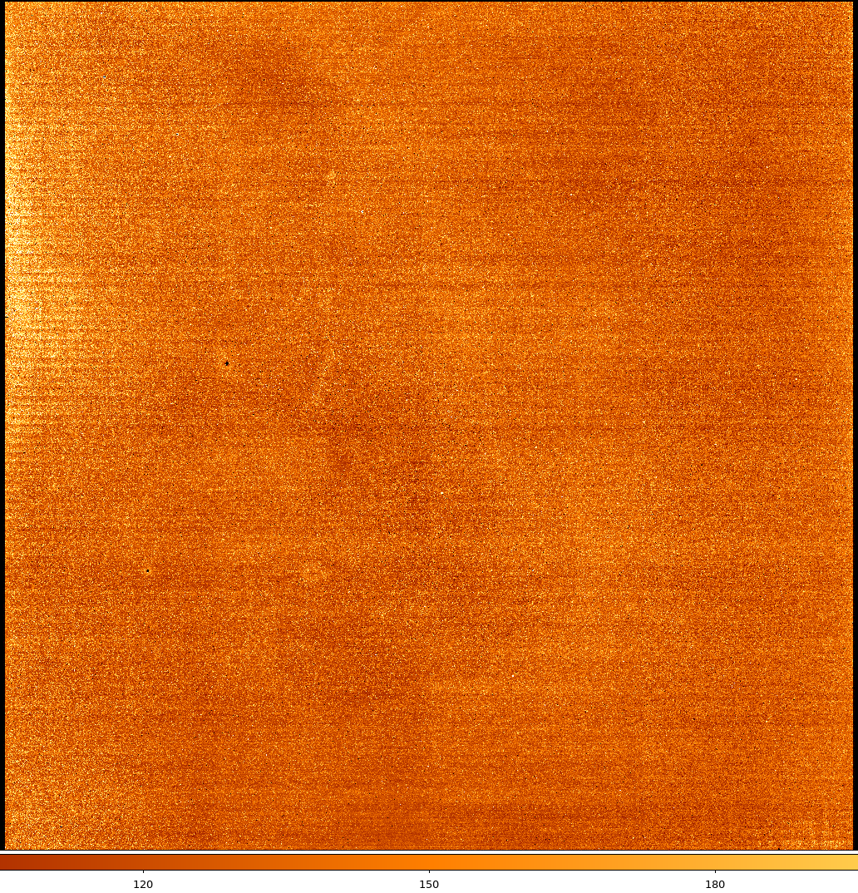
Get Better Detectors (less traps)
Early Engineering Part
Rejected Flight Part
Almost Flight Part
Peak is 1/6 of EE part peak
Peak 1/6 of Rejected Part

Slide 31
Short integrations are better than long ones.

Slide 32
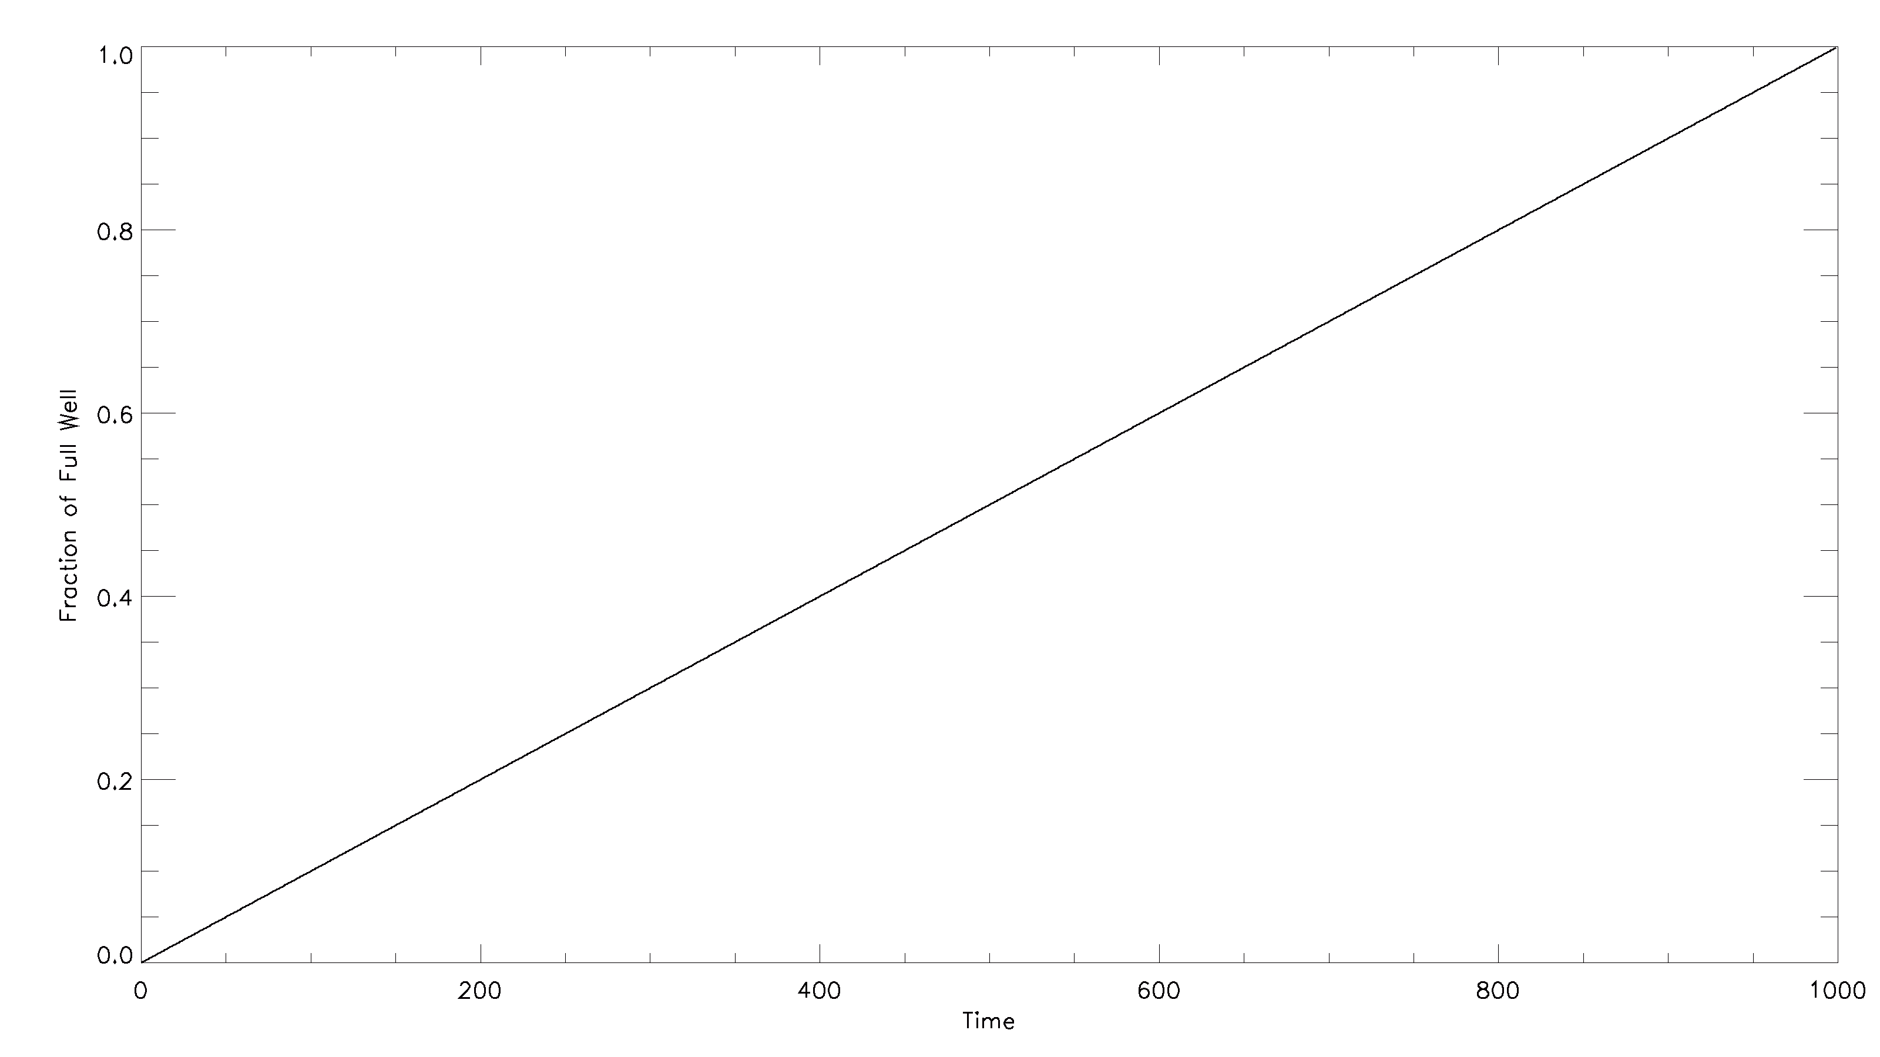

Slide 33
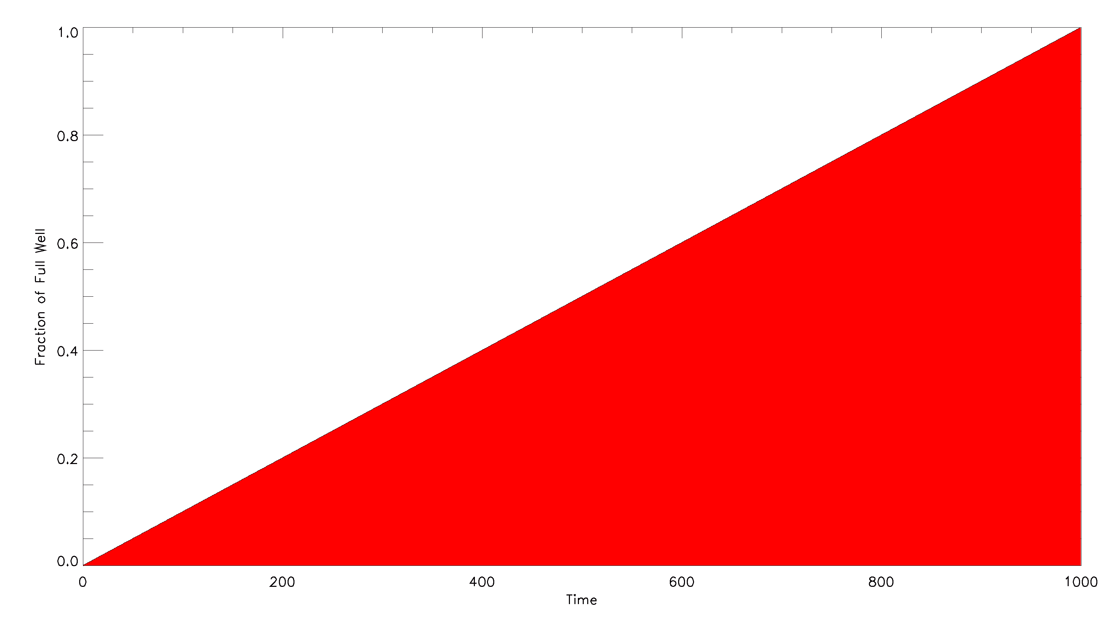

Slide 34
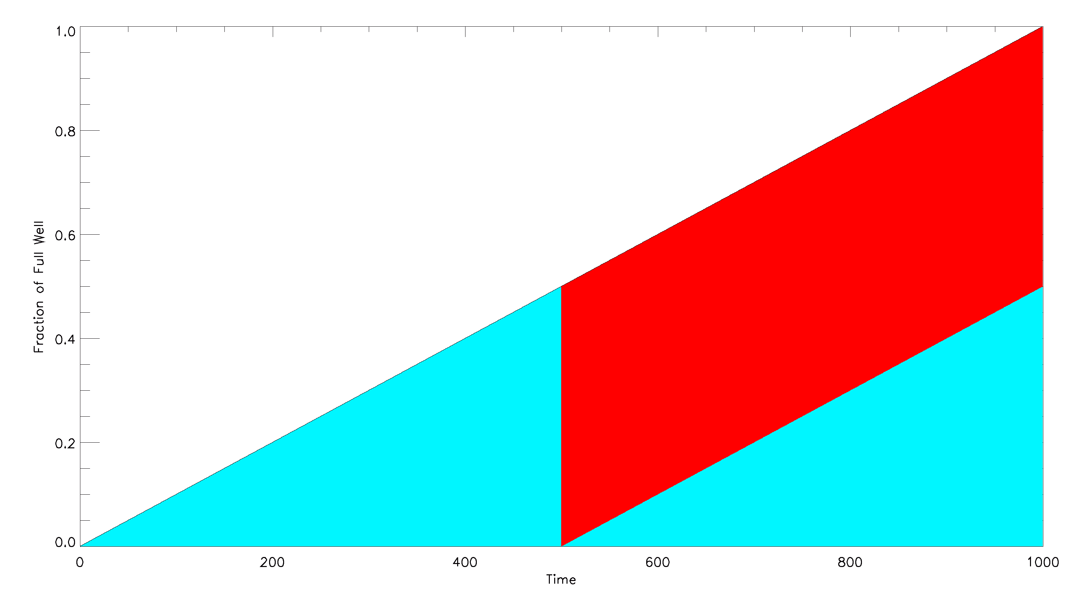

Slide 35
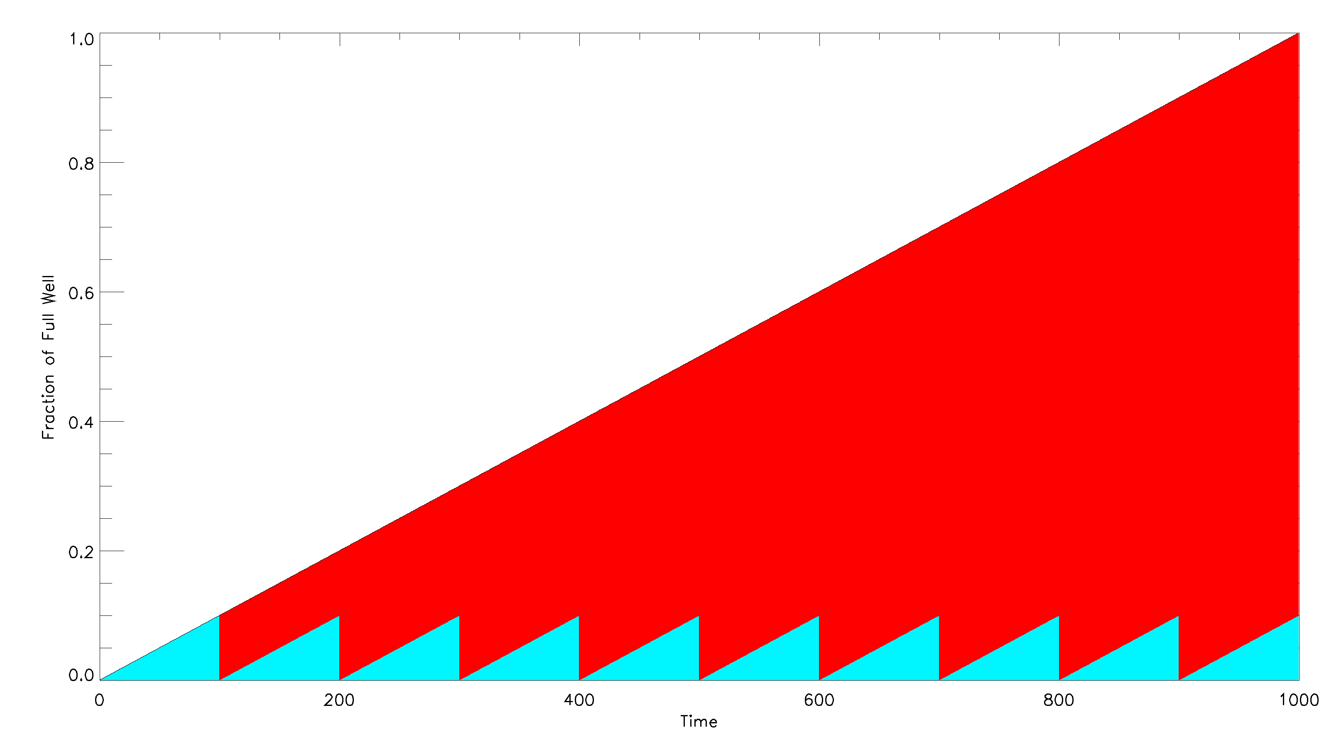

Slide 36
What parameters does the model need?

Slide 37
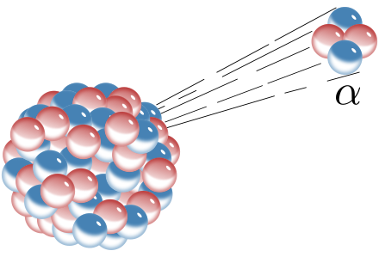

Slide 39
For every trap: capture rate decay rate

Slide 40
But there are an
a large number
of traps

Slide 41
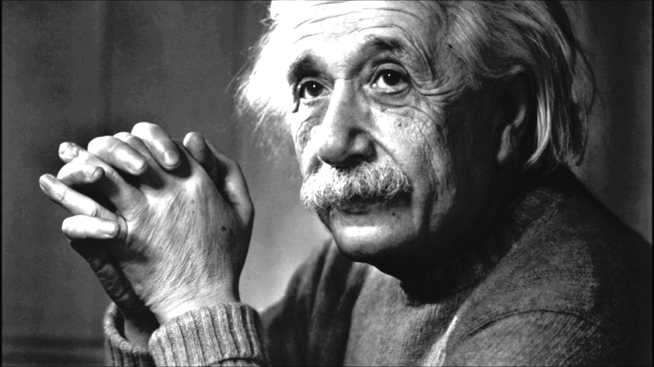
“Everything should be made as simple as possible, but not simpler.” Albert Einstein

Slide 42
Assume a
spherical trap…

Slide 43
Assume there are
a limited number
of trap families

Slide 44
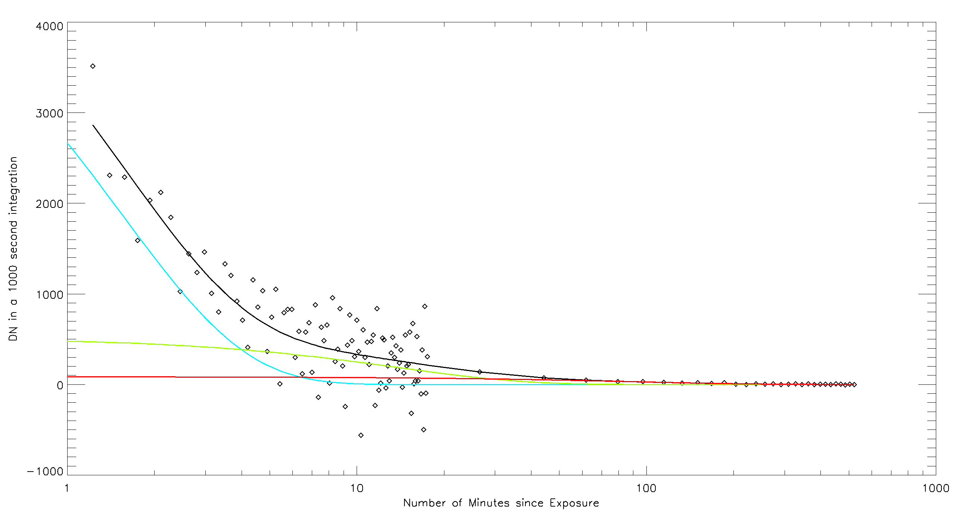
Dark after 200 frame (~2100 sec)
electronic persistence exposure
at hard saturation level

Slide 45
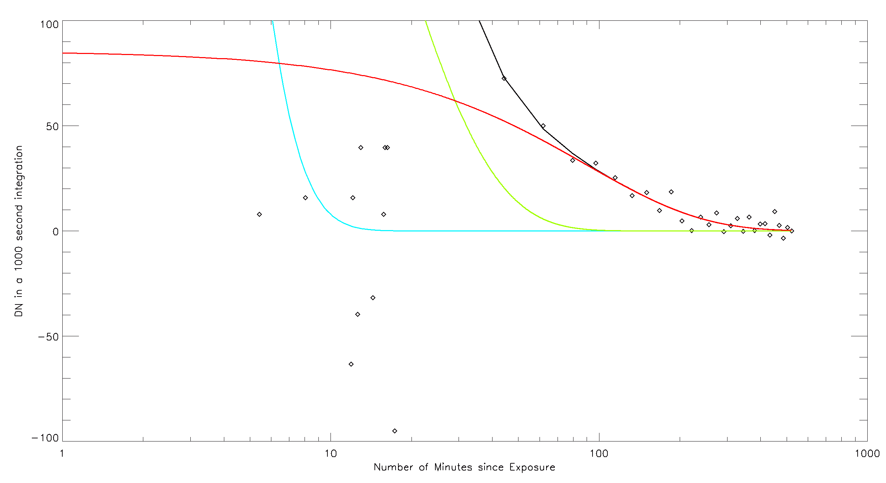
Half life = 1 hour
Half life = 1 min.
Half life = 9 min.

Slide 46
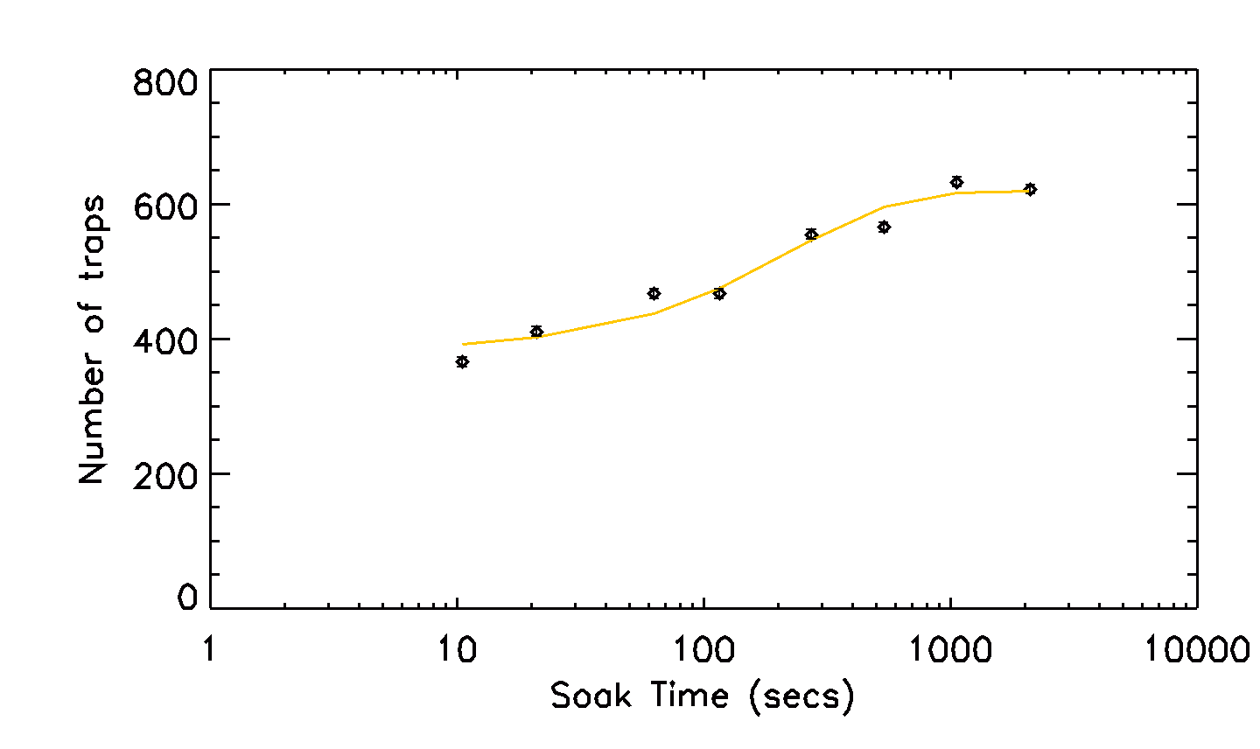
Instantaneous Capture Function

Slide 47
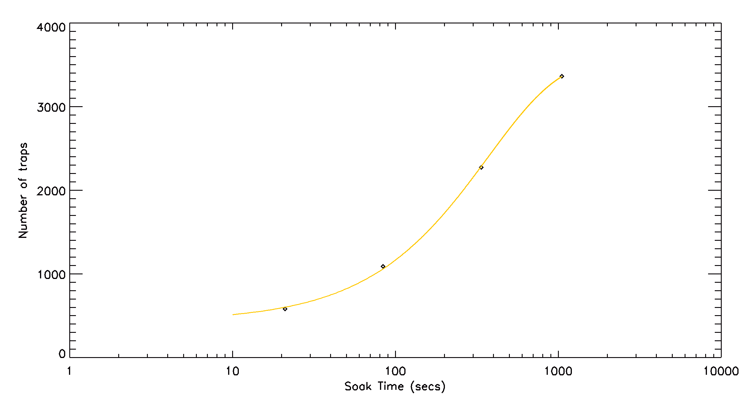
Instantaneous Capture Function

Slide 49

Ramp Capture Function
Slope dt

Slide 50
Slope

Slide 51
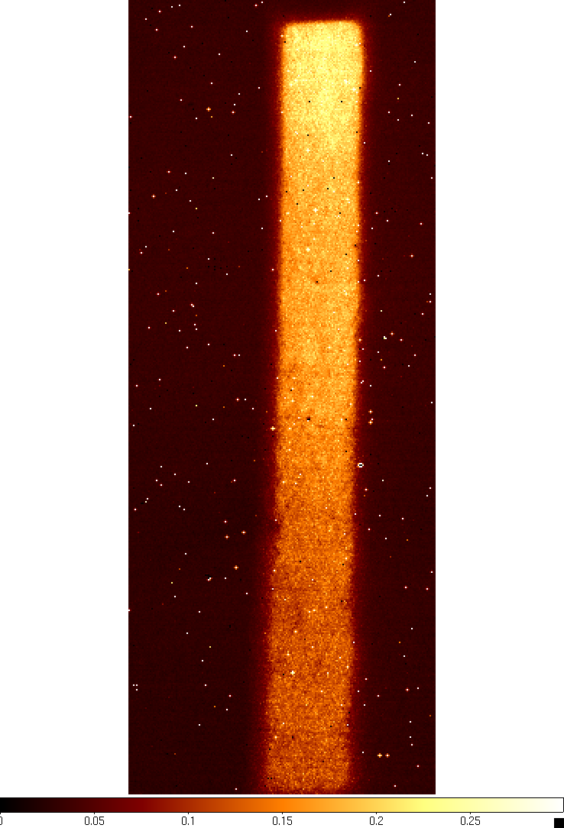
Persistence

Slide 52
Distance traveled matters
Photo-generated
Undepleted
-
-
-
-
-
Depleted
-
+
Undepleted
+
+
+
+
+

Slide 53
Distance traveled matters
Photo-generated
Persistence
Undepleted
-
-
-
-
-
-
-
-
-
-
Depleted
-
+
+
+
Undepleted
+
+
+
+
+
+
+
+
+
+

Slide 54
Gain varies with distance
Gain = t * Slope

Slide 55
Ramp Capture Function
t*Slope² dt
Gain = t * Slope

Slide 57
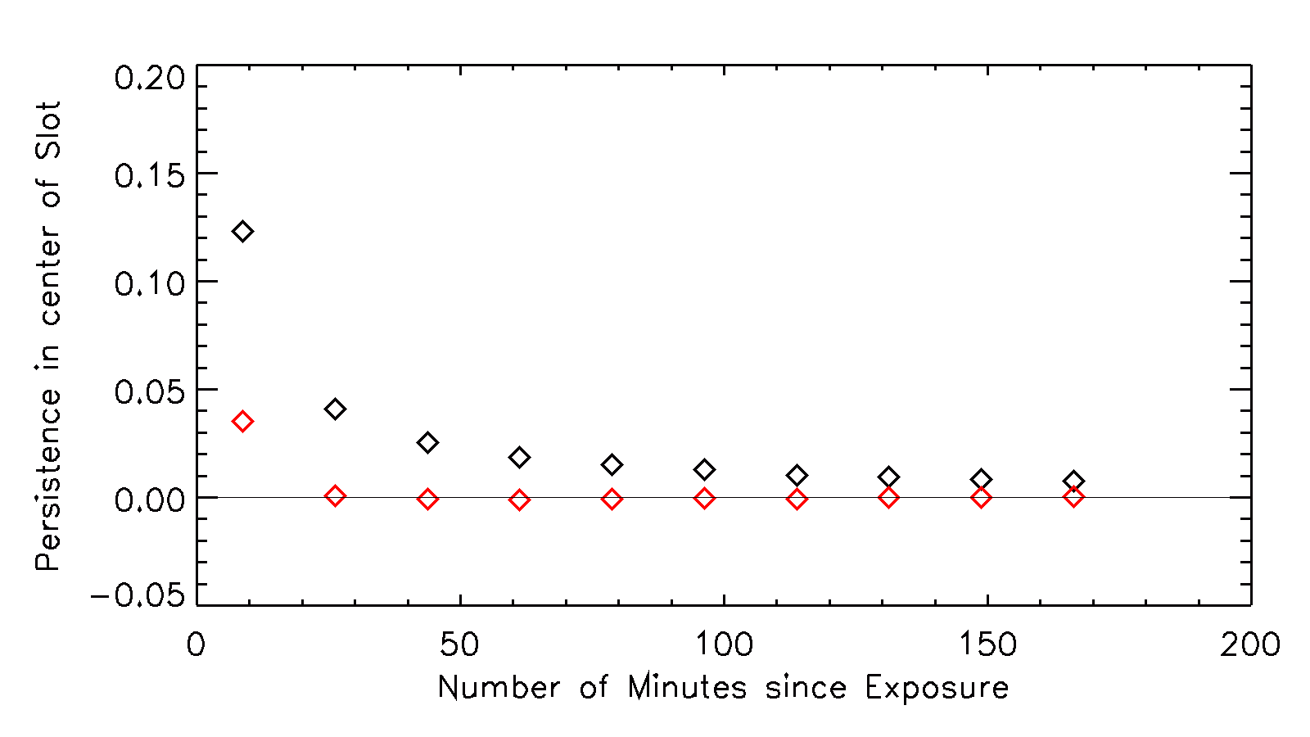
Persistence
Residual

Slide 58
Conclusions
Trap Capture/Decay Model works
Correction significantly removes effects of persistence
Shorter integrations lead to significantly less persistence

