Slide 1
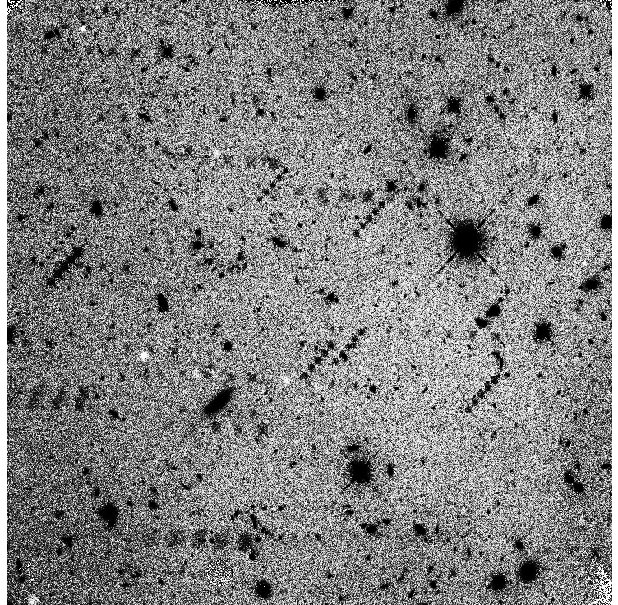
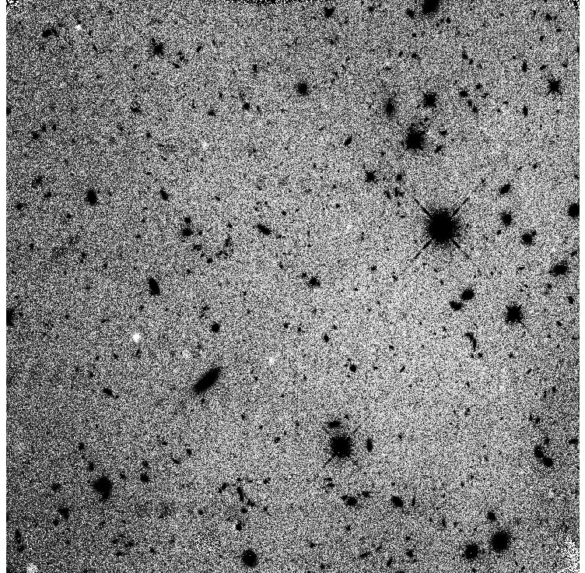
Persistence in the WFC3 IR Detector
Knox S. Long
Sylvia S. Baggett, Mario Gennaro & John MacKenty
Science Detector Workshop
STScI
September, 2017

Slide 2
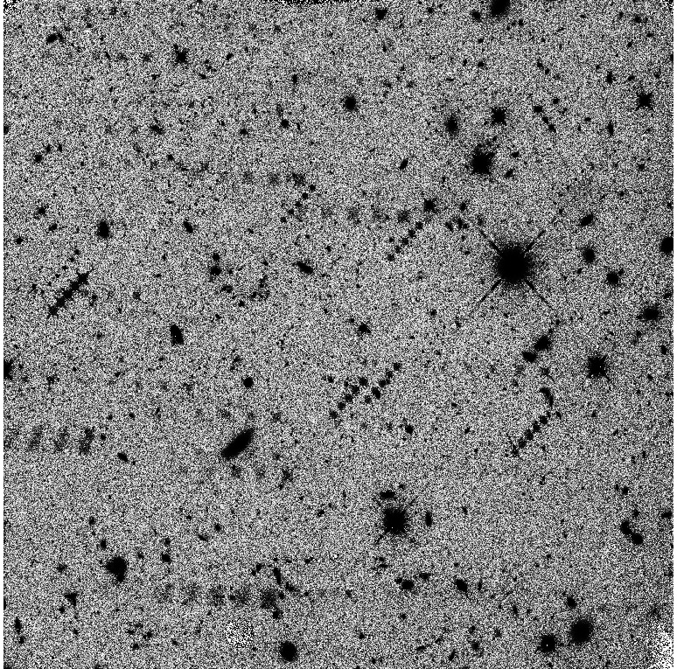
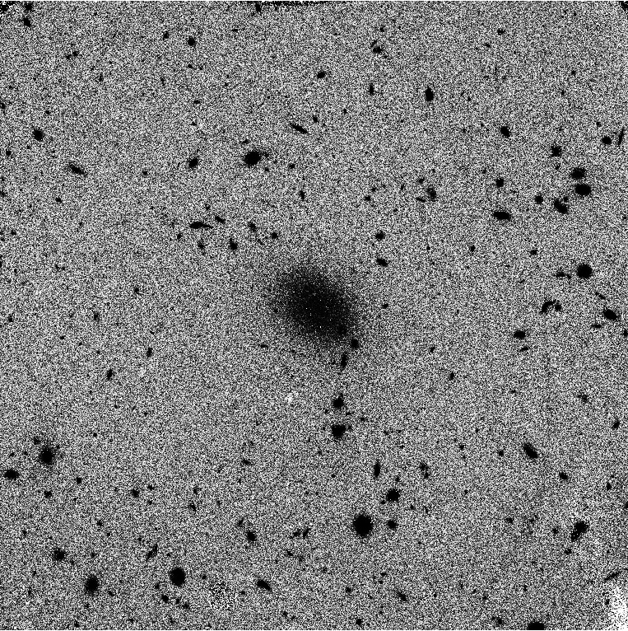
Persistence Examples

Slide 3
Conceptual model of persistence
Trapped electrons
Trapped holes
Mobile electrons
-
-
-
-
-
-
-
-
N
-
-
-
-
-
-
-
-
-
-
-
-
-
-
-
-
-
-
Depleted
-
+
+
+
+
+
P
+
+
Mobile holes
+
+
+
+
+
+
+
+
+
+
+
+
+
+
+
+
+
+
+
+
dark idle
(large reverse bias)
All traps have released their charge in depletion region
high flux signal
(low bias)
As signal accumulates the depletion width is reduced. Traps newly exposed to charge can capture some mobile carriers.
reset
(large reverse bias)
At “reset” the wider depletion region is restored, but trapped charge stays behind.
next dark exp.
(small bias reduction)
The released charge reduces the bias voltage. persistence
R.Smith, SPIE 7021-22, Marseille 2008-06-24

Slide 4
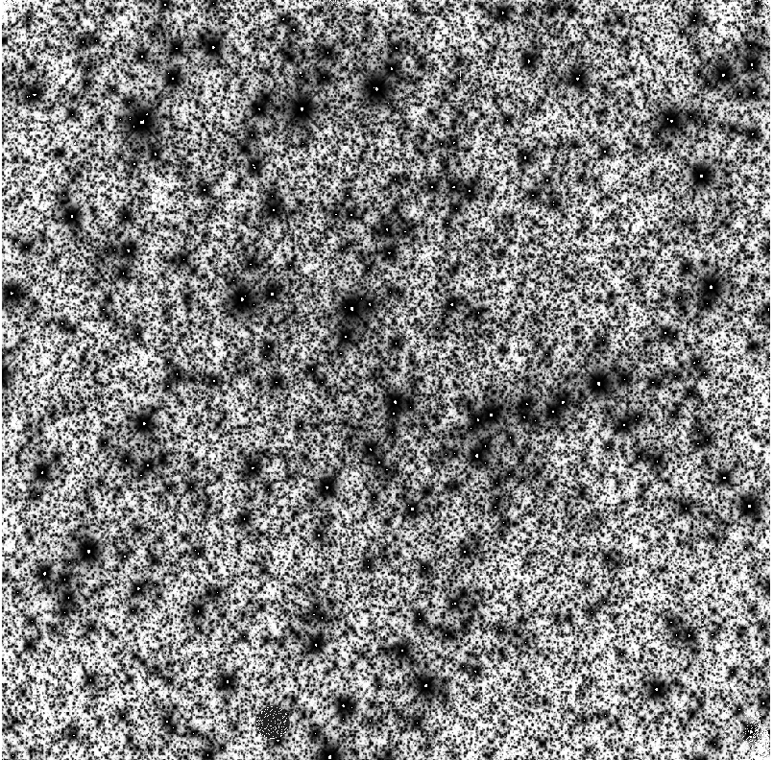
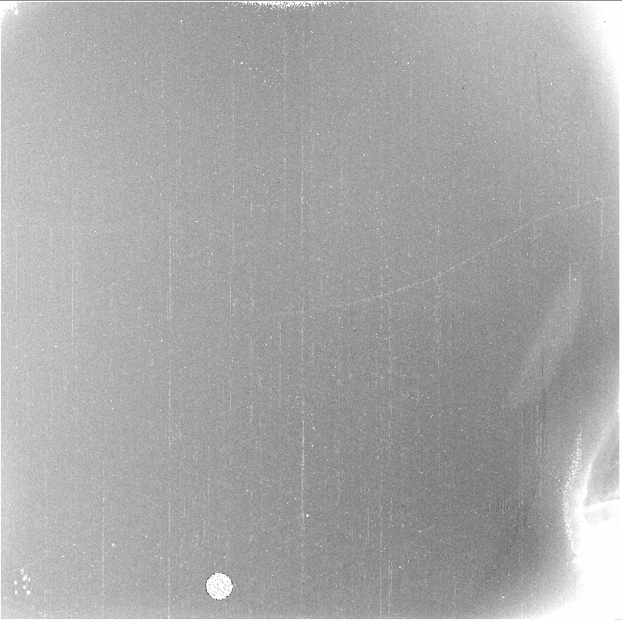
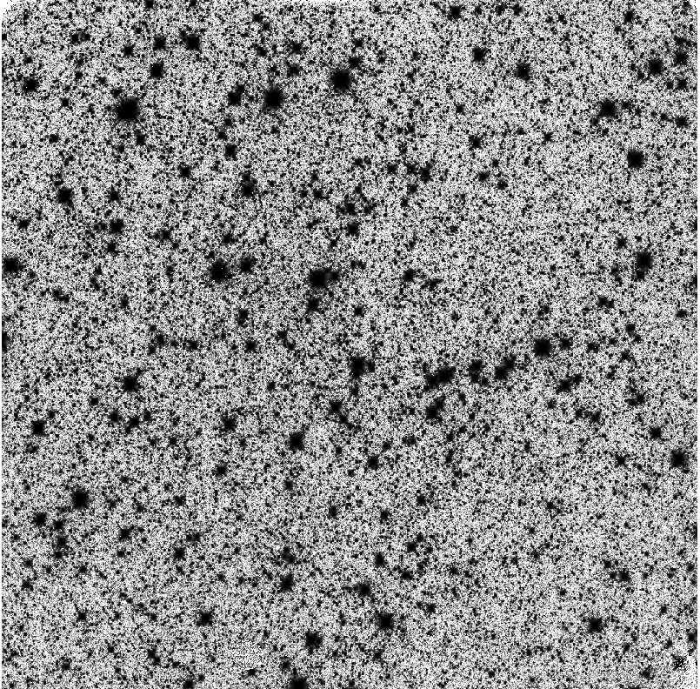
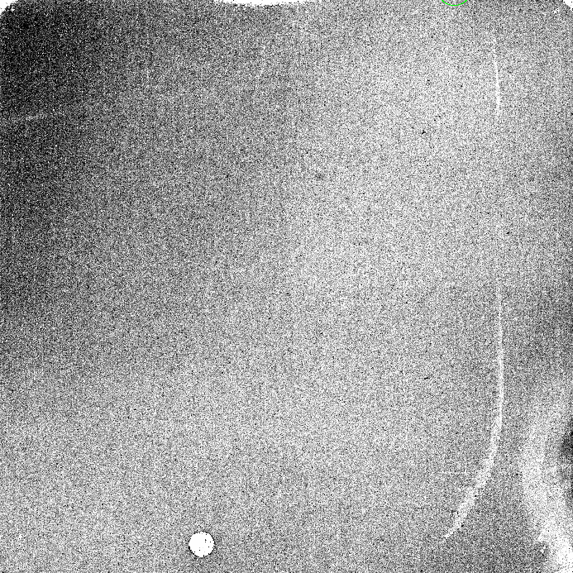
On-orbit characterization of Persistence
Use either a bright star field of Tungsten lamp to produce an image with lots of saturation
Measure persistence in a from 200 – 6000 seconds with a series of identical dark exposures
(Add darks after some programs to see how much persistence they cause)

Slide 5
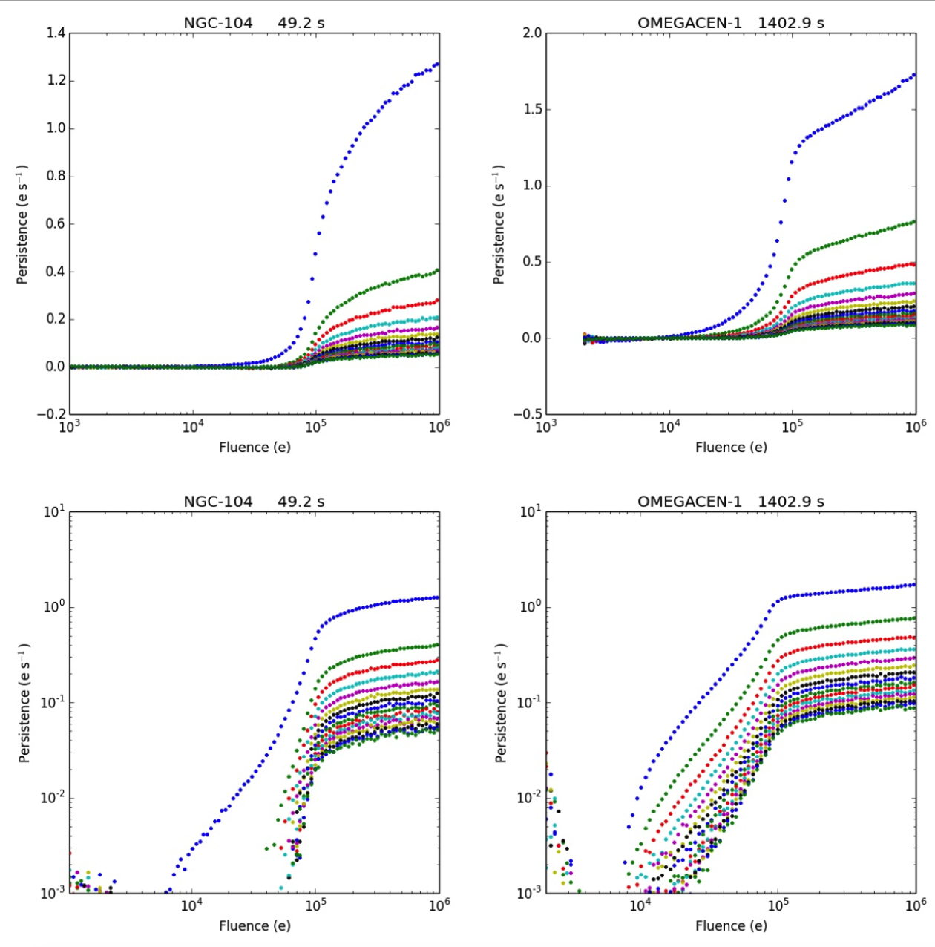
Persistence
Note different shapes between 49 and 1100 s examples,
And also short term behavior at 49s in early exposures

Slide 6
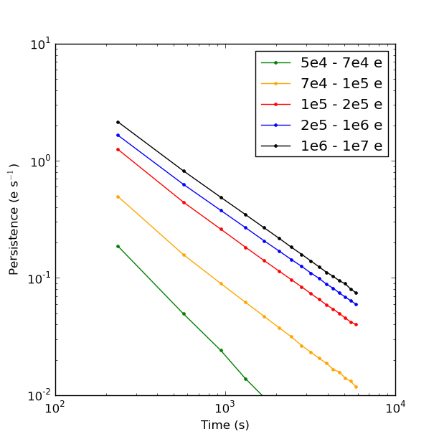
Persistence is ~ a power law function of time
Notes:
This is a sky-subtracted fit

Slide 7
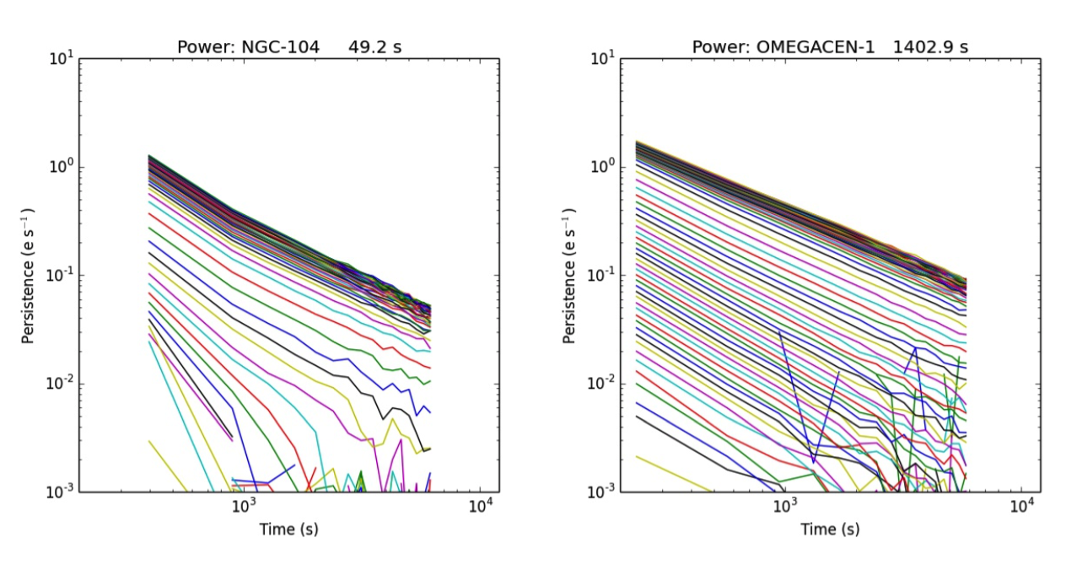
Power Law decay also varies with exposure time

Slide 8
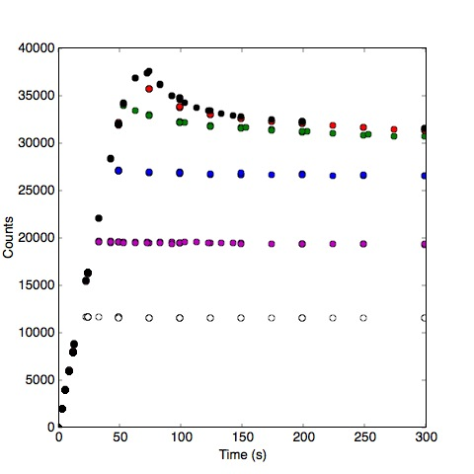
Persistence varies with hold time
In the context of a trapping model, we expect that there will be more persistence if traps are exposed to free charge longer
To check this we conducted a test:
  where the tungsten lamp was used to expose the detector
  Then instead of a normal read/reset sequence, we omitted the reset, so that charge was held on the detector varying amounts of time
  Afterward, measure the persistence in a series of darks

Slide 9
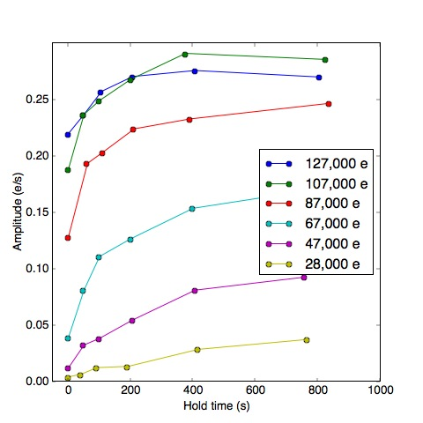
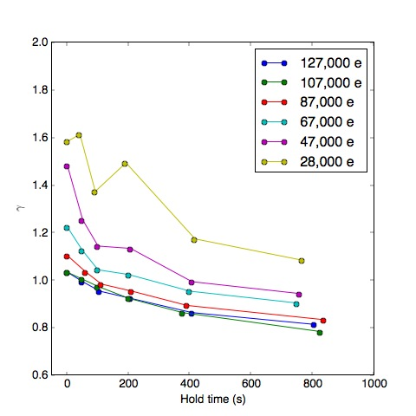
Variation with hold time
Longer hold times result in more persistence, which lasts longer.
The traps involved in persistence have finite trapping times
Long+ ISR 2013-6

Slide 10
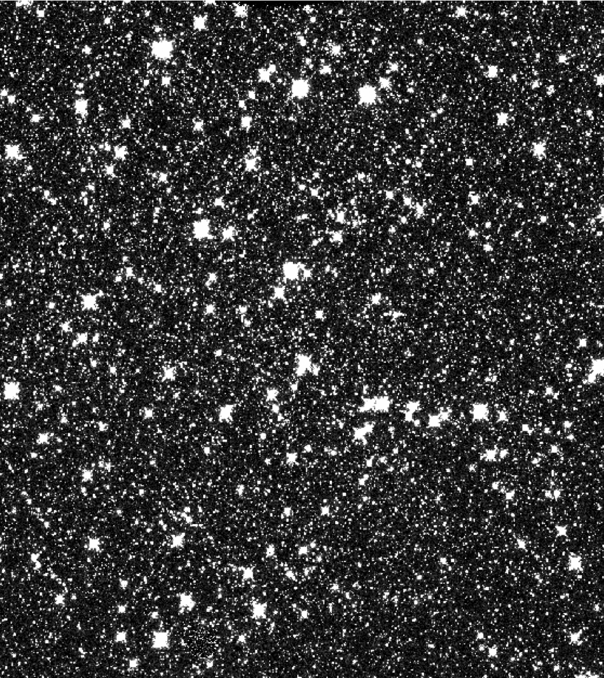
Variation with number of exposures
Test 2: Determine whether multiple exposures to the same level produce more persistence than a single exposure
Method
  Observe a field in Omega Cen
  Vary the number of exposures without dithering from 1 to 5

Slide 11
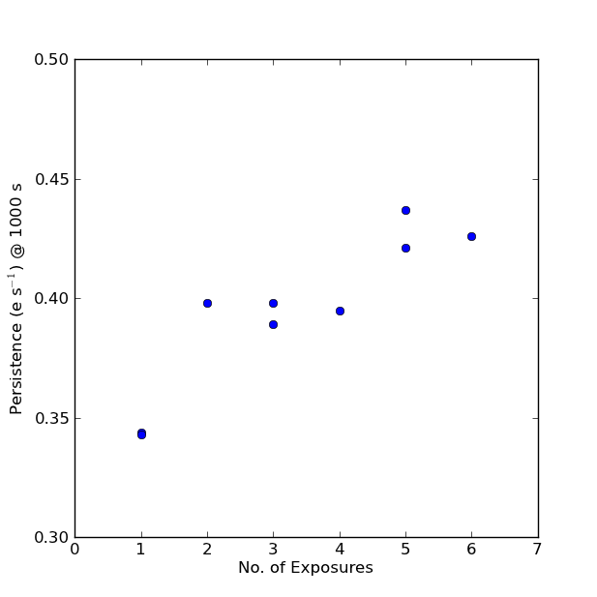
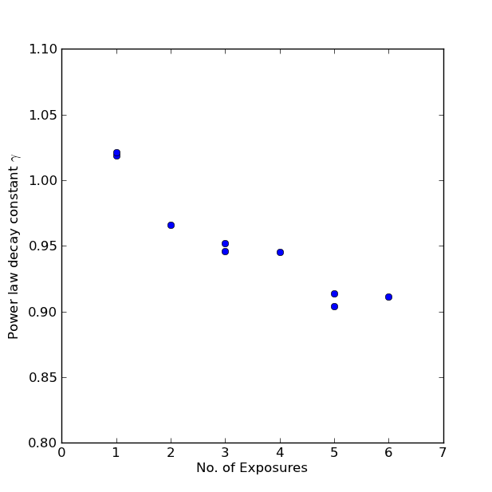
Variation with number of exposures
Persistence amplitude and duration increases with # exposures
The traps which cause persistence have finite trapping times
Long+ ISR 2013-07

Slide 12
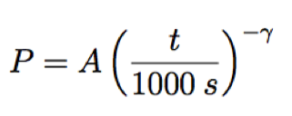
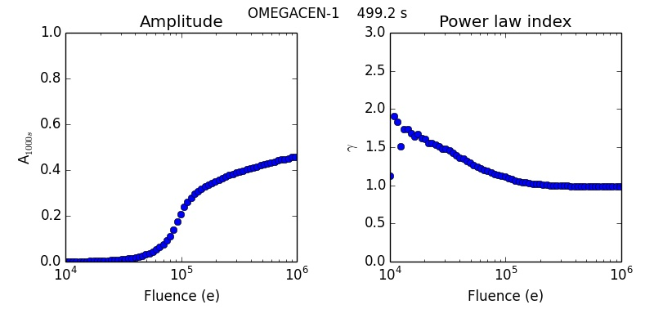
Phenomenological Model
At each fluence level, fit the persistence to a power law of the form:

Slide 13
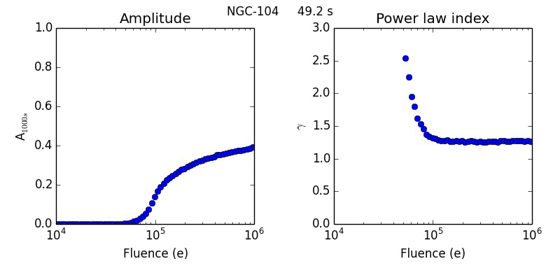
Variation with exposure time

Slide 14
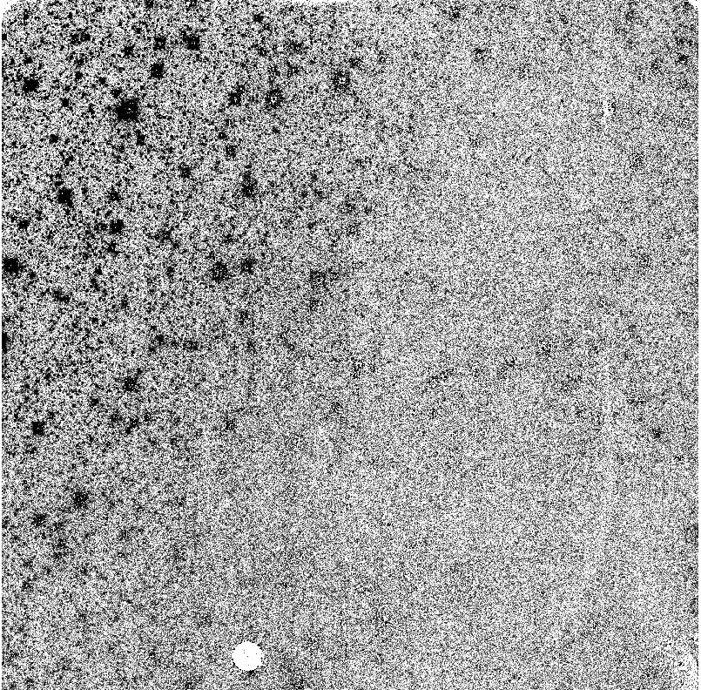
Persistence is not completely uniform
Omega Cen Dark after model subtraction which does not allow for variability across detector

Slide 15
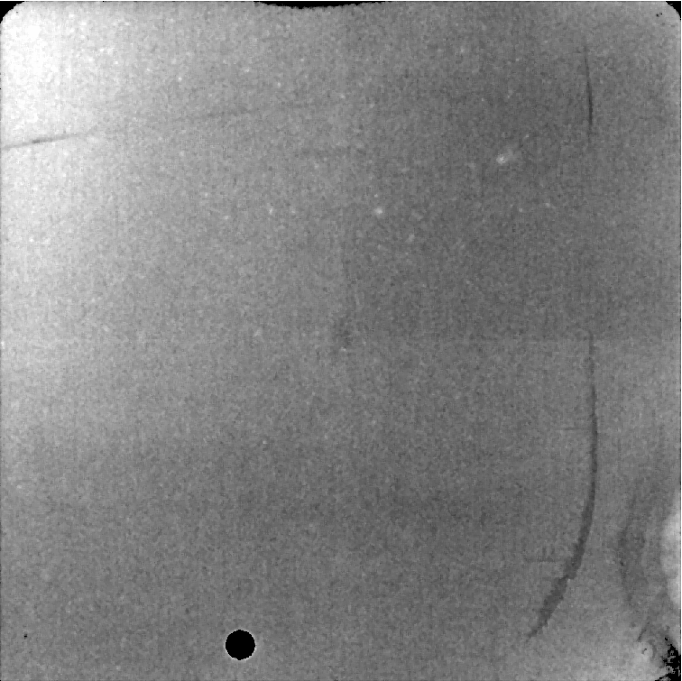
Correction “flat”

Slide 16
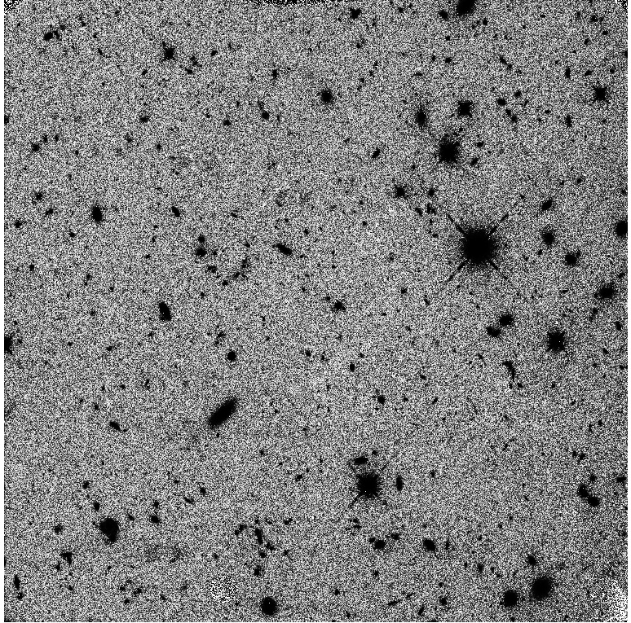
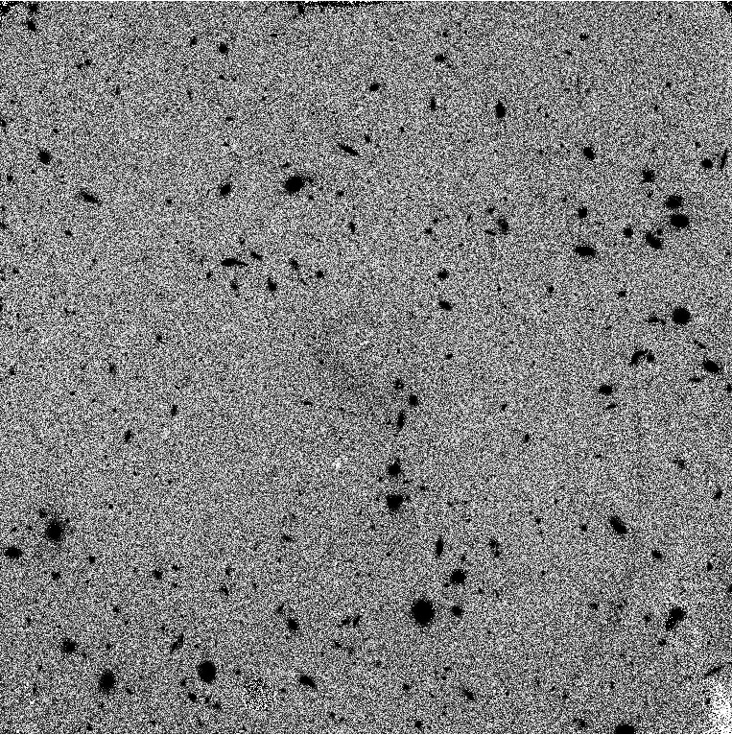
Results

Slide 17
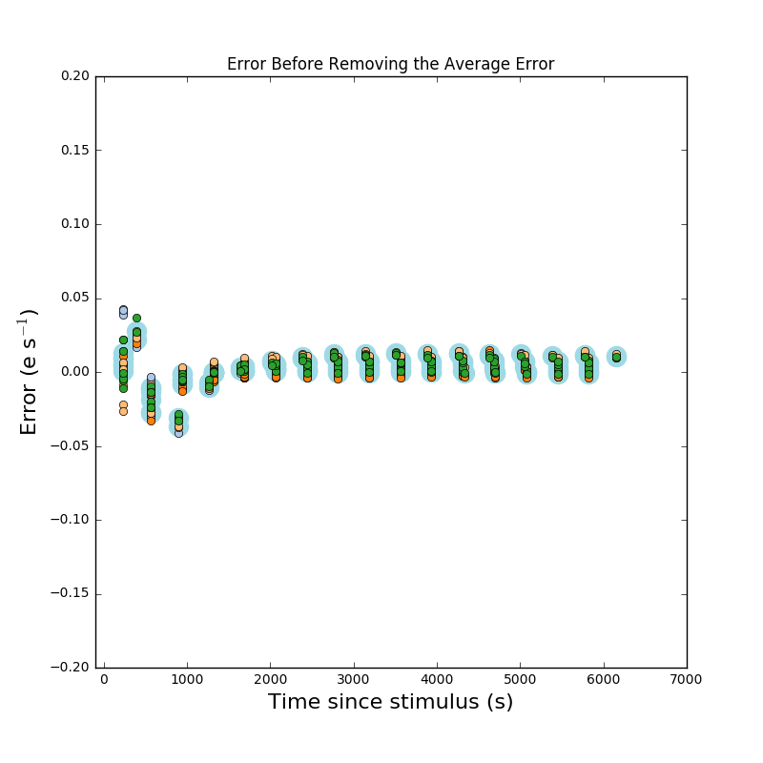
How do you measure the quality of the fit
Goal: isolate the average error from the spatial error
Run the persistence pipeline on one or more visits from a set of observations
Examine the persistent corrected image
Divide image into n’ x m’ different regions (not necessarily the same as used to create model)
First calculate the residual persistence in the corrected image for a stimulus in a user defined range (e.g. 10⁵ – 10⁶ electrons, or 1.5 -15 x saturation)
Then calculate the spatial variations

Slide 18
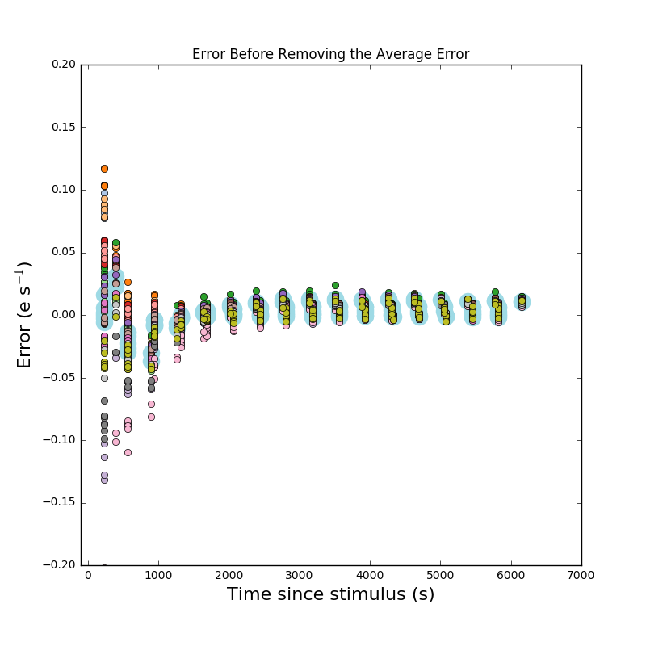
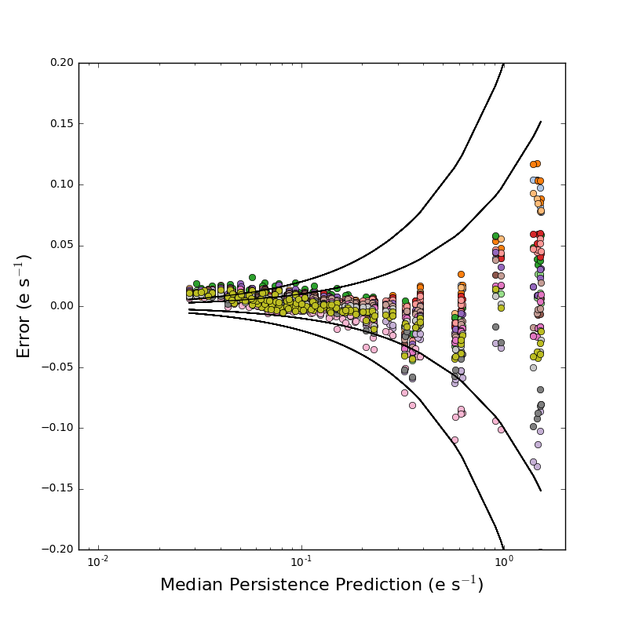
4 x 4 grid test– 1.5-15 X Saturation
Error with time
Error compared to prediction

Slide 19
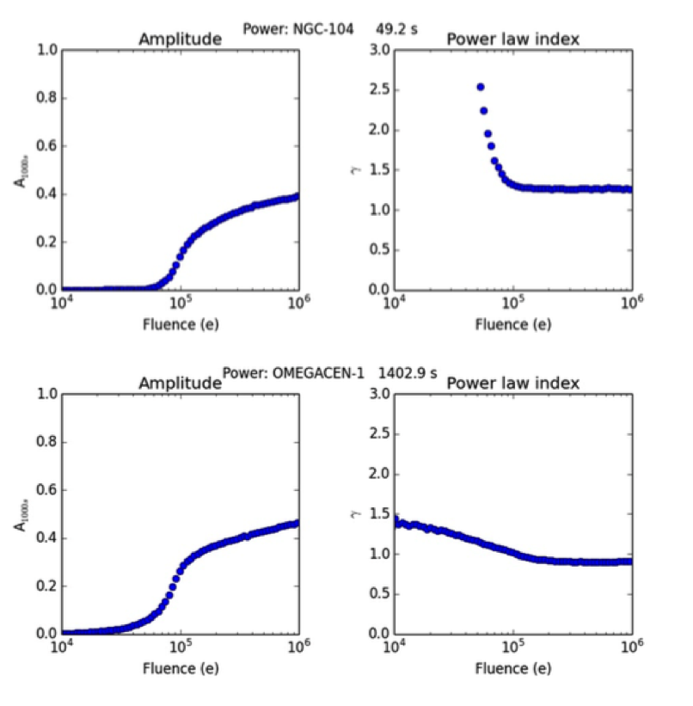
Persistence Mitigation Strategy
Before observations, we predict persistence for observations that are going to occur using 2MASS data
  If the number of pixels likely to be affected by persistence in the next orbit is less than about 1% we do nothing
  If >1% restrict IR observations for varying periods after such observations
After observations, we process all WFC3/IR data and produce products which estimate expected persistence
  We recommend that users mark pixels predicted to have persistence as having poor data quality, and use dithering of observations

Slide 20
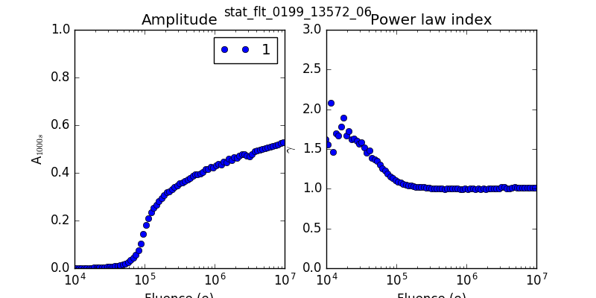
Improvements to Persistence model
Divide detector into n x m sections
Calculate separate power law model for different regions
Different curves for different exposure times
Example: 14015, 9 different exposures from 49 s to 1599 s and a 2x2 grid

Slide 21
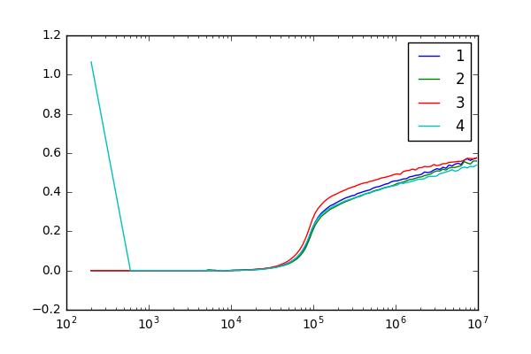
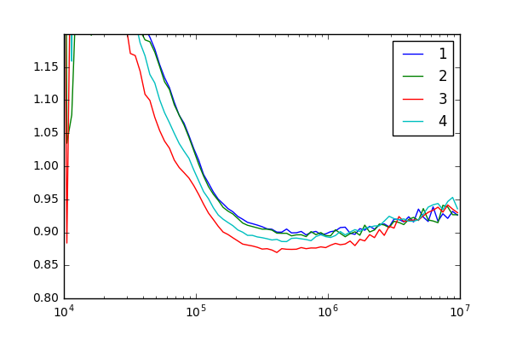
Are the quadrants different? Yes
Here 3 is the upper left part of detector (Quadrant 1 in normal terminology)
Amplitude is higher and persistence last longer in the upper left.

Slide 22
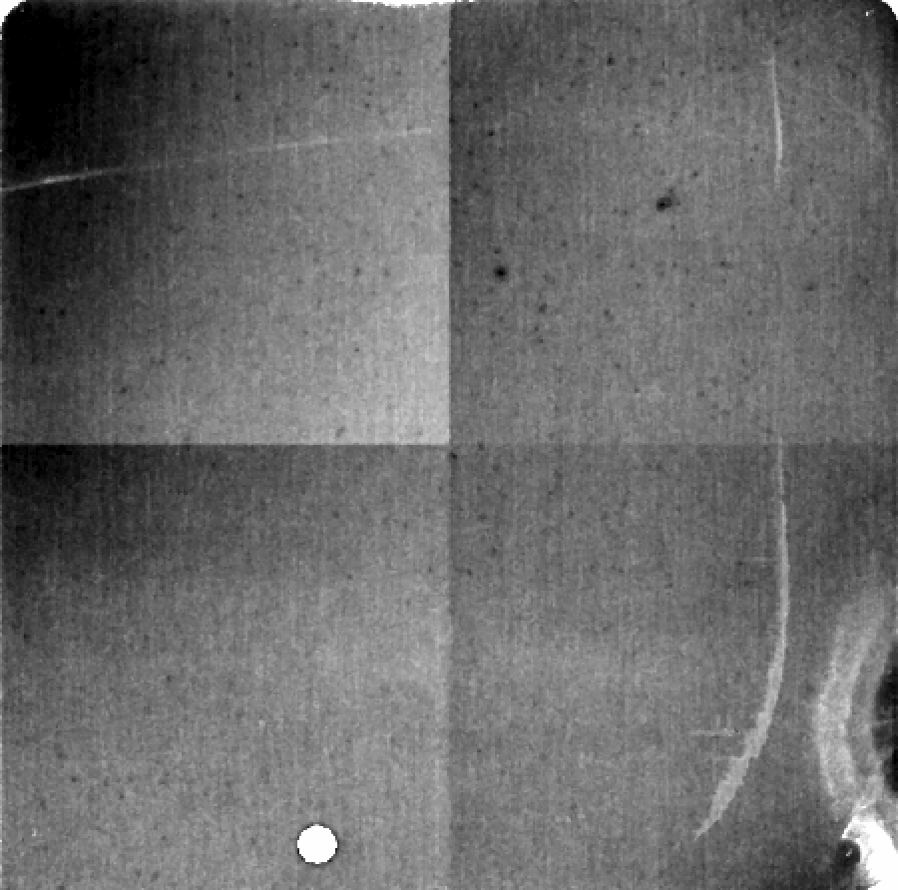
Area-dependent flat
Process
  Carry out a fit in the standard manner
  Calculate a correction flat for this data set
  Incorporate this as a correction factor to the model

Slide 23
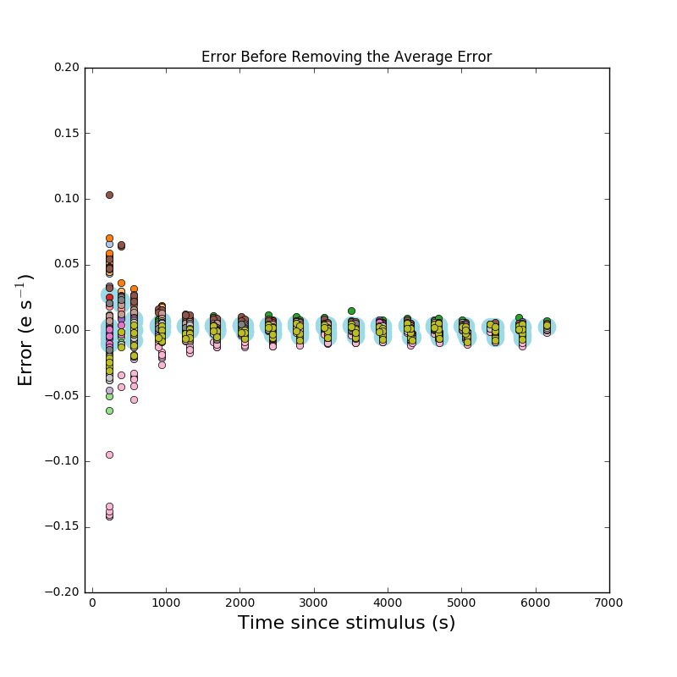
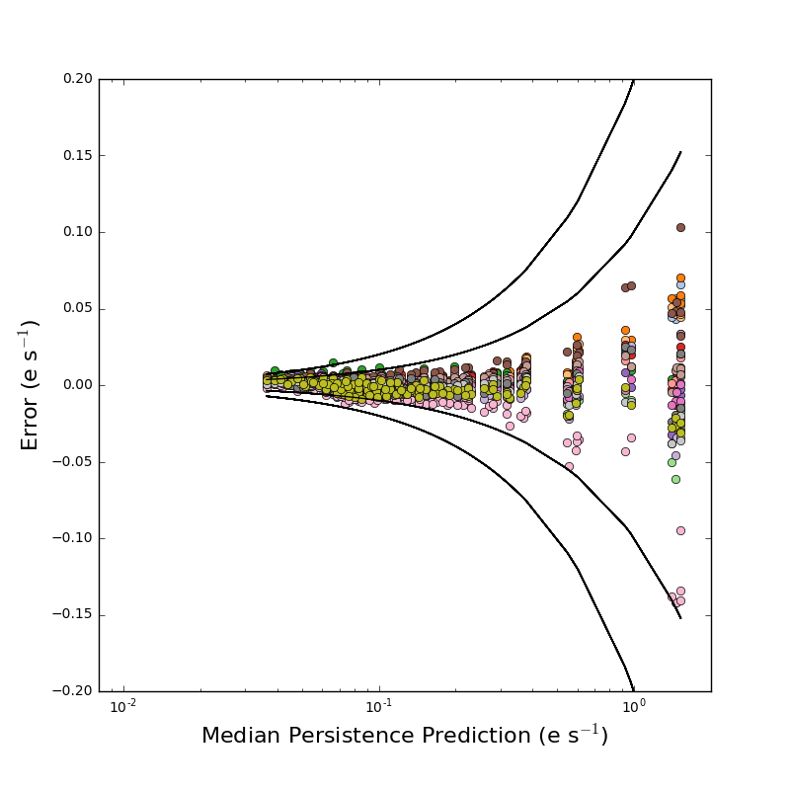
2 x 2 model – 4 x 4 grid test
Notes:
This was calculated today in test spatial and was not what I was hoping

Slide 24
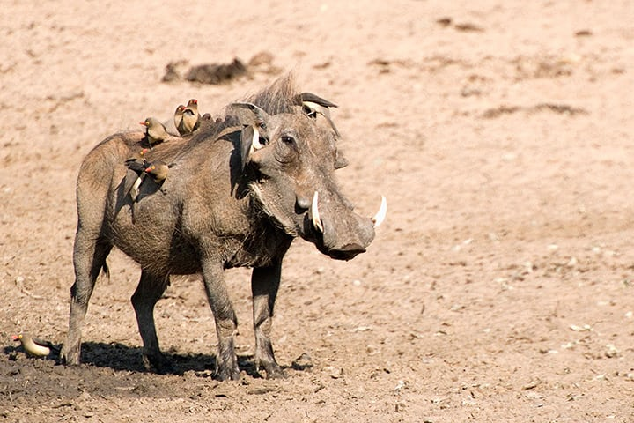
Warts

Slide 25
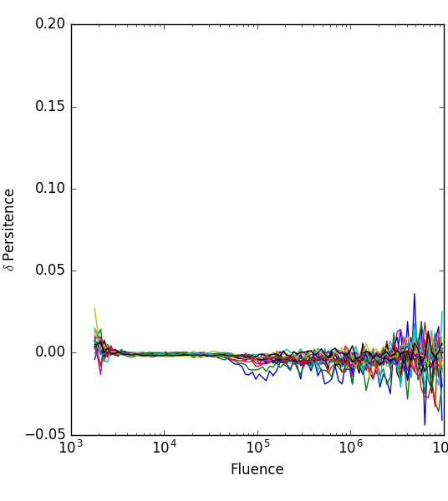
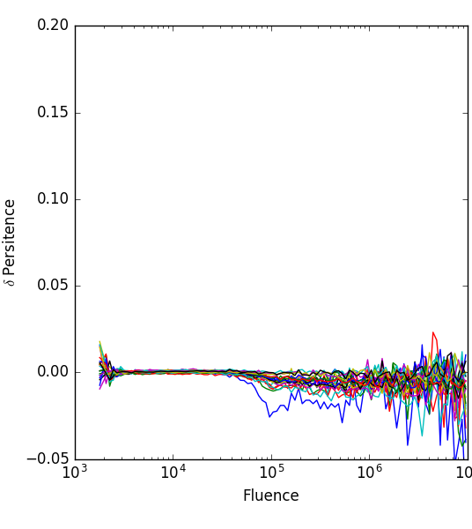
Wart: Variability
We have now conducted enough calibration observations of persistence in the WFC/IR array that we can compare results from nominally identical experiments
Example:
  We have 3 visits beginning with 1200 s of Omega Cen, followed by the a series of darks
  Simple comparisons of most visits show very little variation, and the variation can mostly be attributed to counting statistics or the fat that different pixels are actually illuminated in the different visits
However, occasionally …

Slide 26
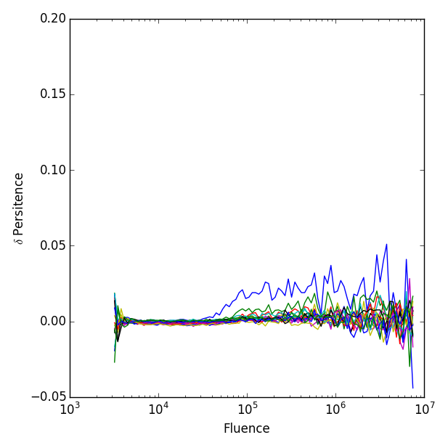
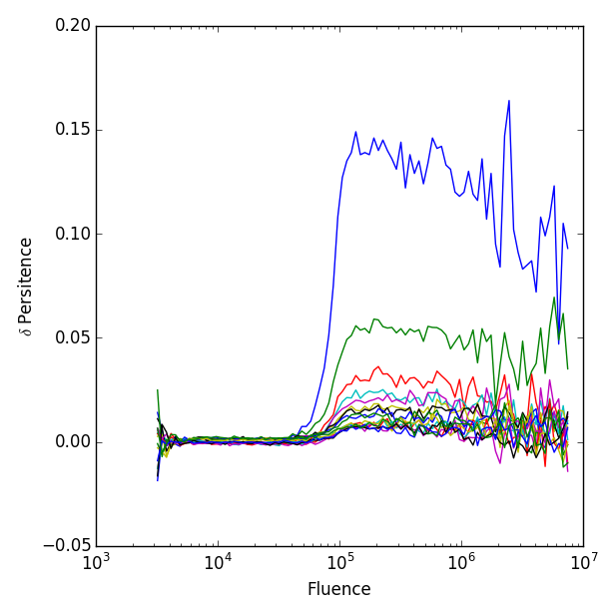
The Ringer- 3 identical 274 s exposures
The third visit of this type has much more persistence than the other two
Nothing unusual about visit 3 (or the history of illumination prior to it)
Differences are too large to be due to the fact that different pixels are illuminated.
Notes:
The time delay for the 4th dark is 1316 s

Slide 27
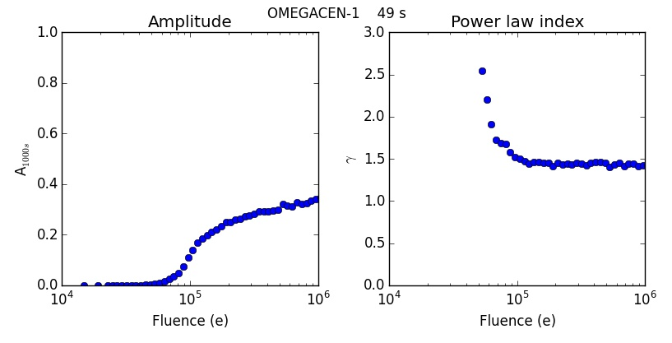
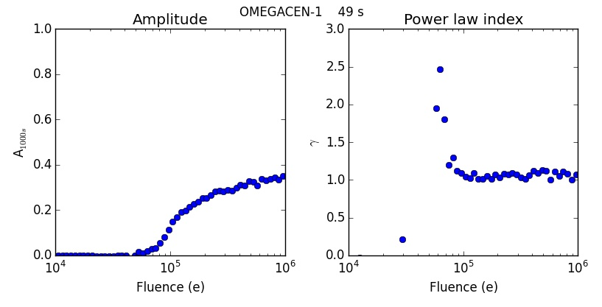
Wart: Changes in slope
Current model is based on a single power law, and has the largest errors at short times
There appears to be a steepening of the power law decay at short time
Omega Cen @ 49 s
  Top: 0 – 1000 s
  Bottom: 1000-3000 s

Slide 28
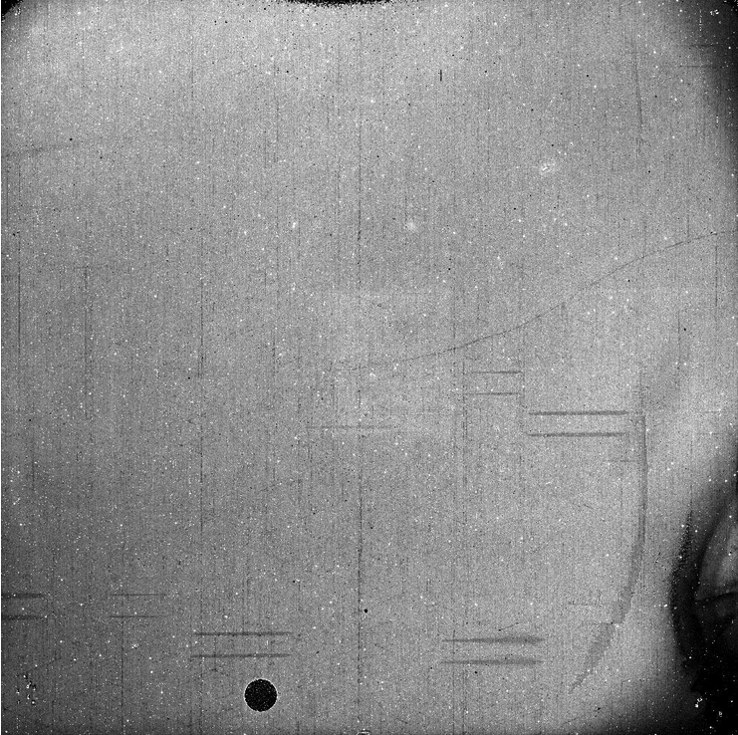
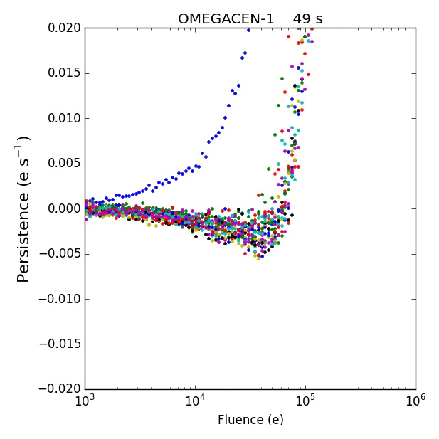
Wart: Negative Persistence
Dark current can be suppressed by light from earlier exposures

Slide 29
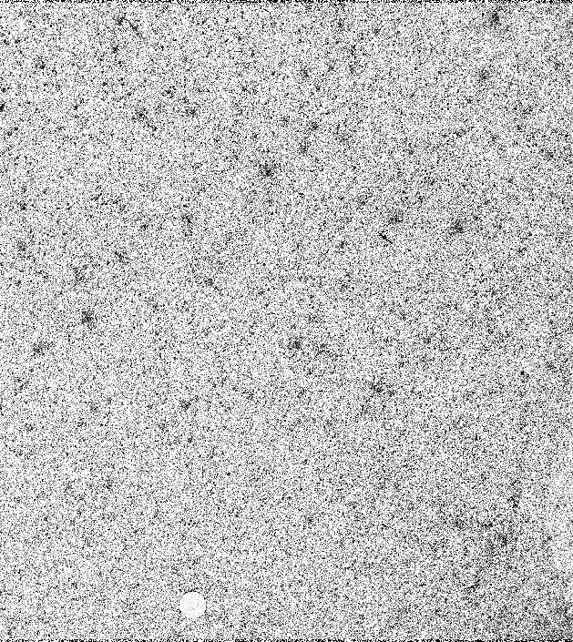
Wart: Burps
Exposure of the detector to bright light can increase the persistence signal
Example
  Dark after a Tungsten lamp exposures of the detector
  Persistence model predicted very little persistence, but the image showed clear evidence of an earlier external exposure
  Investigation showed this visit followed and observation of Omega Cen in a persistence calibration program 12694
  Persistence visit consisted of 5 identical Omega Cen exposures and a series of darks
As if the Tungsten flat moved trapped charge to traps with shorter decay times

Slide 30
Summary – Persistence is not a virtue, but …
WFC3 IR array, like all IR arrays, shows some persistence
Unlike most other HgCdTe IR arrays, the persistence decays as a power law, which is unfortunate in the sense that its effects are relatively long-lived
A phenomenological model for persistence in the WFC3/IR channel exists
An improved model will be incorporated into the products we make available to users
  The improved model removes about 90% of the persistence
  The improved model does not account for multiple exposures of the same image
As a result of persistence, we have had to redo some WFC3/IR observations due to excessive persistence
  Aside: Some of the “worst actors” from the point of view of persistence have been calibration observations
However, ultimately the effect on science has been relatively small, partly as a result of the mitigation strategy that has been developed
  Encourage users to avoid saturated images if possible
  Prohibit IR observations after some “bad actors”
  Provide tools so users can evaluate effect of persistence on their observations
A number of “warts” exist with persistence and persistence related phenomena that we do not fully understand
  It would be helpful in this regard to have a better physical model of persistence
Future missions need to take persistence into account in data processing pipeline and in archiving
  Aside: Because persistence is due to (often proprietary) images of other observers that take place earlier in the timeline, a persistence pipeline has to be run at a location with access to all of the data

