Slide 1
Persistence Characterisation of Teledyne H2RG detectors
Simon Tulloch
European Southern Observatory

Slide 2
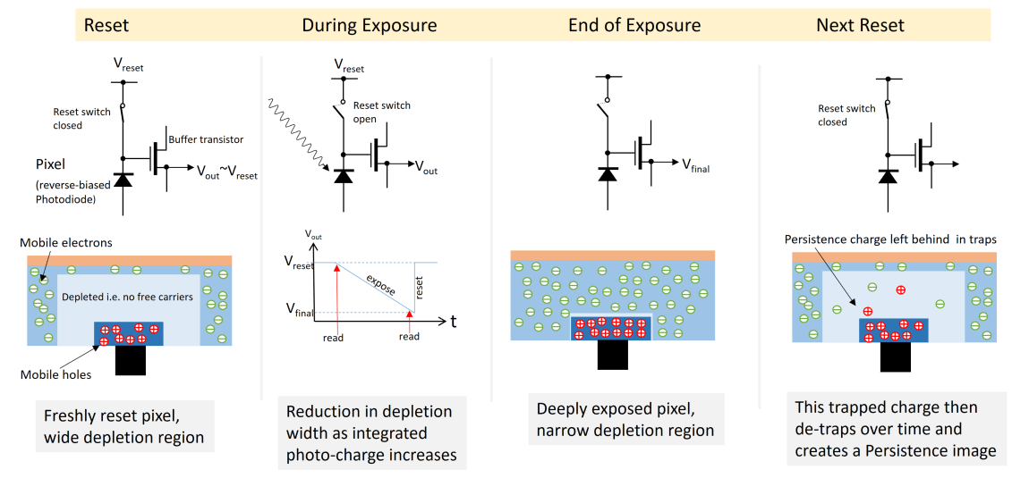
Depletion Region Model
R.Smith “A theory for image persistence in HgCdTe photodiodes”, SPIE 7021-22, 2008

Slide 3
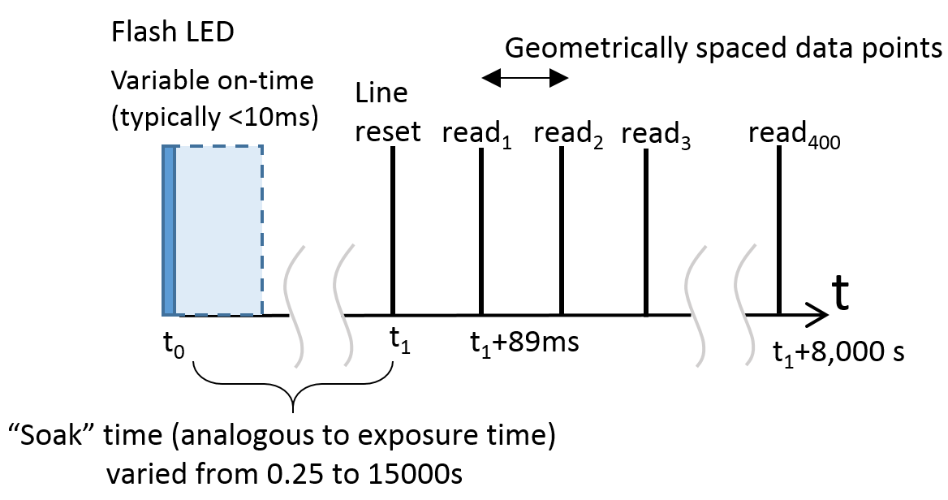
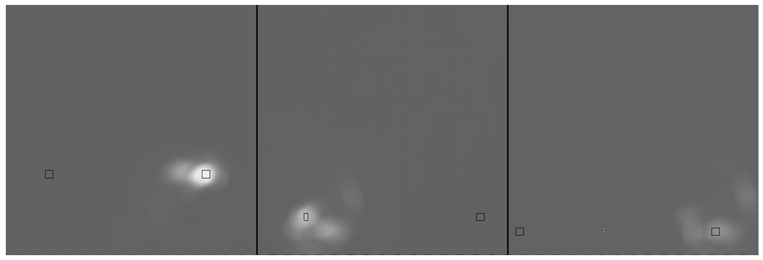
Measurement Technique
Method: “delta” flash from LED, followed by a variable delay in which the pixel is “soaked” in the photo-charge followed by 8000s of non-destructive reads.
(dark reference window included)
Ultra-low background cryostat containing mosaic of three 5.3um H2RGs
#17308
#17306
#17310

Slide 4
Typical result: de-trapped charge versus time since reset.
Increasing soak

Slide 5
Can also differentiate data to yield persistence current versus time since reset.

Slide 6
Simply comparison of persistence between devices is difficult
At longer time scales its poor persistence performance becomes apparent.
Below 1000s the red
chip looks best

Slide 7
Long period traps the real problem, can degrade data for a whole night.

Slide 8
Suggestion for an alternative metric for comparison of persistence behaviour
The “Tau spectra” : plot trap density as a function of the trap time constants.
Trap density electrons per pixel
Trap time constant , seconds

Slide 9
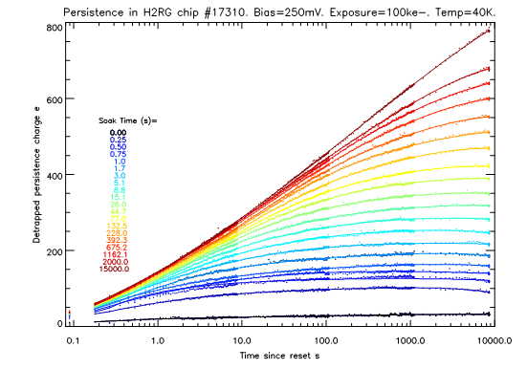
Generation of Tau Spectra.
Step 1 : represent data as a 3D pyramid
All traps full
˜
All traps empty
˜
Same data, replotted in 3D
Pyramid Edge 1 ->
information on de-trapping
time constants
Pyramid Edge 2 ->
information on trapping
time constants
Increasing Soak
Increasing De-trap time

Slide 10
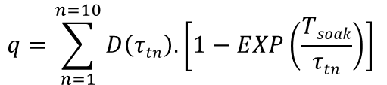
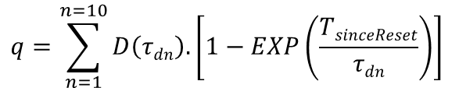
Step 2 : fit each edge with an ensemble of exponential functions.
$$q=\sum_{n=1}^{n=10}{D\left(τdn\right).\left[1−EXP\left(\frac{TsinceReset}{τdn}\right)\right] }$$
Trap densities
De-trapping time
constants
$$q=\sum_{n=1}^{n=10}{D\left(τtn\right).\left[1−EXP\left(\frac{Tsoak}{τtn}\right)\right] }$$
Trapping time
constants

Slide 11
Finally plot trap densities as a function of time constant
#17308. Worst kind of persistence: immediate charge trapping, de-trapping over tens of hours.
<
>
#17306.Trapping and de-trapping over a wide range of time constants. De-trapping is slower than trapping.
<
>

Slide 12
Additional investigations into persistence behaviour
Electrically induced persistence (through manipulation of detector bias voltages).
Statistics of persistence charge.
Effect of cooling.

Slide 13
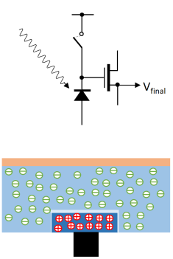
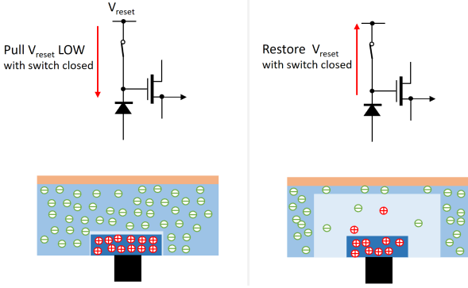
Electrically Induced Persistence
Electrical “exposure”
Optical exposure

Slide 14
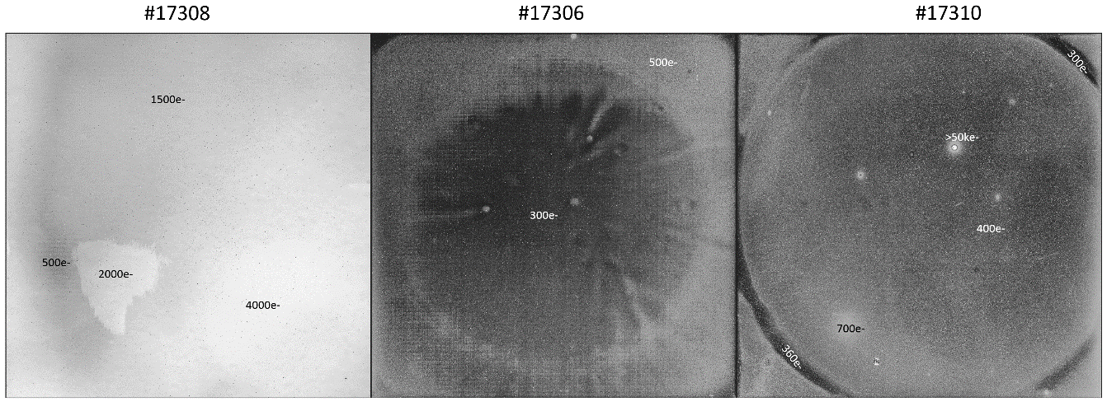
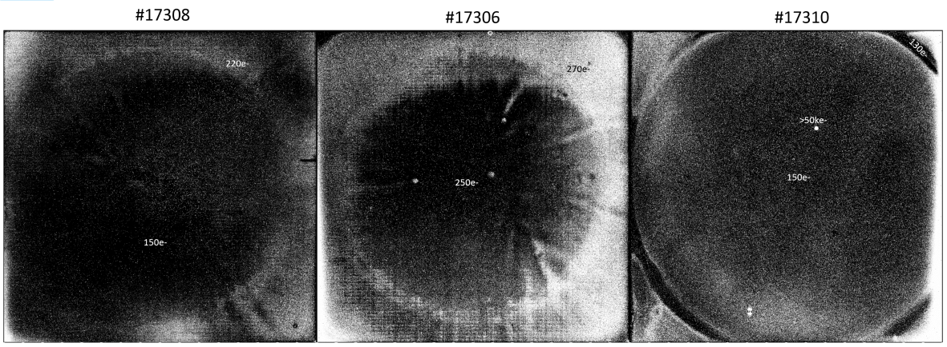
Optical/Electrical comparison
optical
Glue void
Glue void
v
electrical

Slide 15
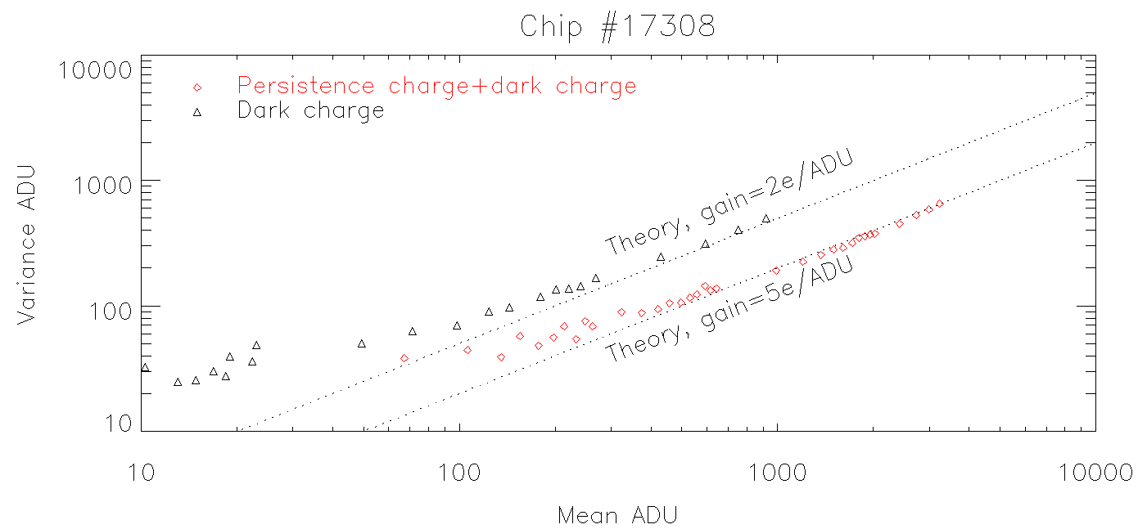
Statistics of Persistence Charge
Persistence charge is sub-Poissonian, consistent with it being released from traps within depletion region.
System gain for persistence charge different than for photo-generated charge!
Read noise
limited regime
Poisson noise
limited regime

Slide 16
Effect of Cooling
Cooling to 41K gives a huge improvement
with device #17308.
Note that device #17308 traps at least 2.5%
of the total photo charge during a 100s soak
when at 55K. Photometrically significant.

Slide 17
Additional conclusions
Surprising differences between chips with near consecutive serial numbers.
“Red” device was likely dominated by a second population of traps that had very
short trap times and very long de-trap times and could only be stimulated optically.
Cooling helps reduce persistence (by a huge factor in the case of the second
trap population.

Slide 18
END

