Slide 1
Trap Pumping Method Importance of inter-phase trapping
Centre for Electronic Imaging
Jesper Skottfelt
David Hall, Ben Dryer, Nathan Bush, Andrew Holland
Scientific Detector Workshop, STScI, Baltimore, 28th September 2017

Slide 2
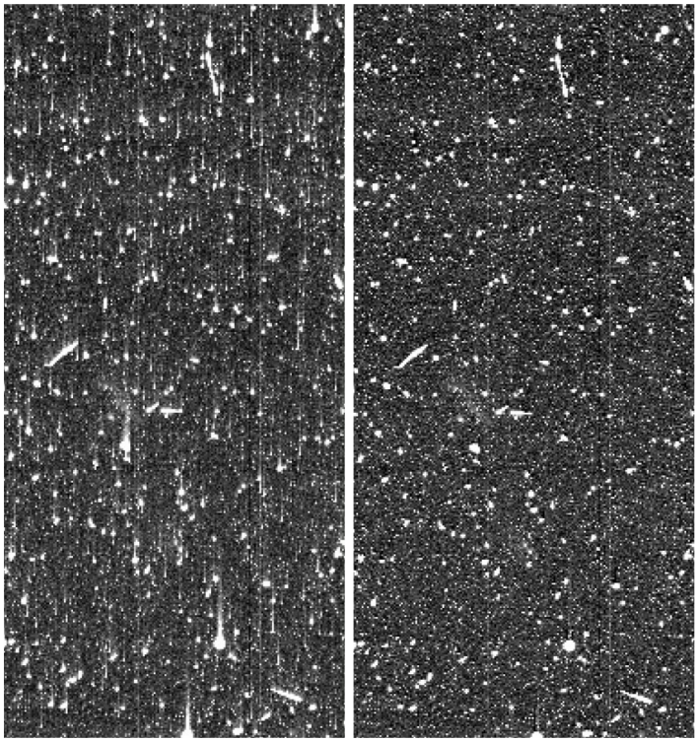
Radiation damage
High energetic particles from the Sun can damage the silicon lattice in the CCD
Creates defects
These defects (or traps) can capture electrons and release them later in time
Leads to smearing of the data
For most space missions radiation damage over mission lifetime will be major issue
Euclid VIS is to measure galaxy shapes to infer Dark matter distribution
High level of correction is needed
Requires improved knowledge of trap species and parameters
Trap pumping method can identify and characterise single defects (or traps) as shown by Nathan Bush earlier today
Before Correction
After Correction
From: Massey et al. (2010)

Slide 3
Trap pumping theory
Trap pumping works by clocking charge back and forth between phases
If the phase time ($t_{ph}$) resonates with the emission time constant ($τ_{e}$) of the trap
Charge will be effectively shuffled from one pixel to the other
Repeating this cycle a number of times ($N$) will result in a dipole for each trap
Pixel
Φ1
Φ2
Φ3
Φ1
Φ2
Φ3
Φ1
Φ2
Φ3

Slide 4
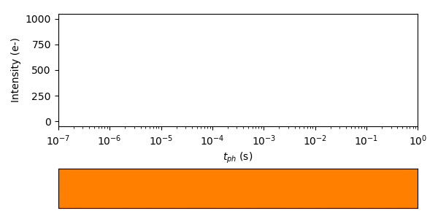
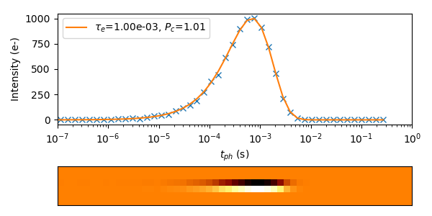
Trap pumping theory
The intensity of the dipoles is given by
Different $t_{ph}$ values will give different dipole intensities for each trap
Fitting Eq. 1 to the intensity curve will give $τ_{e}$ and capture probability $P_{c}$
$$I=NP_{c}\left[exp\left(\frac{−t_{ph}}{τ_{e}}\right)−exp\left(\frac{−2t_{ph}}{τ_{e}}\right)\right]$$
(Eq. 1)

Slide 5
Simulating trap positions
Dipole intensities also depends on position of the trap in the pixel, signal size, clocking scheme, pixel geometry, etc.
All these parameters can be simulated using the CEI CCD Charge Transfer Model (C3TM) developed for simulating CTI effects in CCDs (Skottfelt et al. 2017)
Simulating 3 phase device with standard clocking scheme (1-2-3-1’-3-2-1)
Single trap under $Φ3$
Single trap under $Φ2$
Single trap under $Φ1$
Direction and shape of dipole can thus give subpixel information
Simulating all subpixel positions to get map of dipoles for traps across the pixel
Comes in handy in more complex situations
Pixel
$t_{ph}$

Slide 6
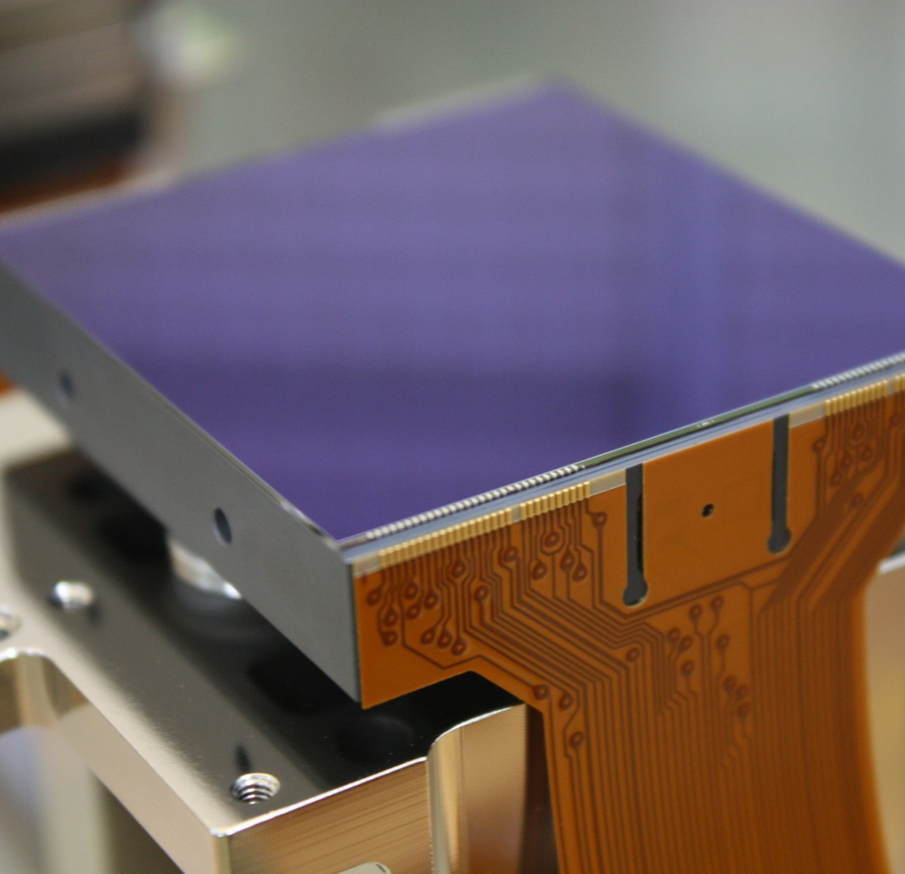
CCD273 – Euclid device
Test performed as part of Euclid radiation testing campaign
CCD273
4k x 4k pixels with 4 readouts
2k x 2k per readout
4 phase device
4-2-4-2 um phase widths
Many more trap pumping scheme options to consider than for 3-phase device
Pre-irradiation data

Slide 7
Trap pumping – 4-phase
Pumping four phase device 1-2-3-4-1’-4-3-2-1
Different types of dipoles depending on where in pixel the trap is
$t_{ph}$
100,000 e⁻
$$I_{23}=NP_{c}\left[exp\left(\frac{−2t_{ph}}{τ_{e}}\right)−exp\left(\frac{−3t_{ph}}{τ_{e}}\right)\right]$$
$$I_{14}=NP_{c}\left[exp\left(\frac{−t_{ph}}{τ_{e}}\right)−exp\left(\frac{−4t_{ph}}{τ_{e}}\right)\right]$$
Difficult to determine which equation to use!

Slide 8
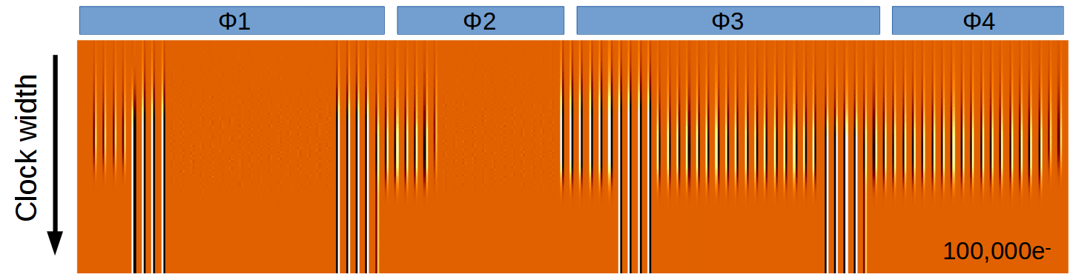
Trap pumping – 4-phase
Pumping four phase device 12-23-34-41’-1’2’-41’-34-23-12
I₁₂ , I₂₃ , I₁₄ , and introducing ‘always pump’ dipoles
Difficult to disentangle the many types of dipoles to find the true τ_{e}-value
$t_{ph}$
$$I_{ap}=NP_{c}\left[1−exp\left(\frac{−k t_{ph}}{τ_{e}}\right)\right]$$

Slide 9
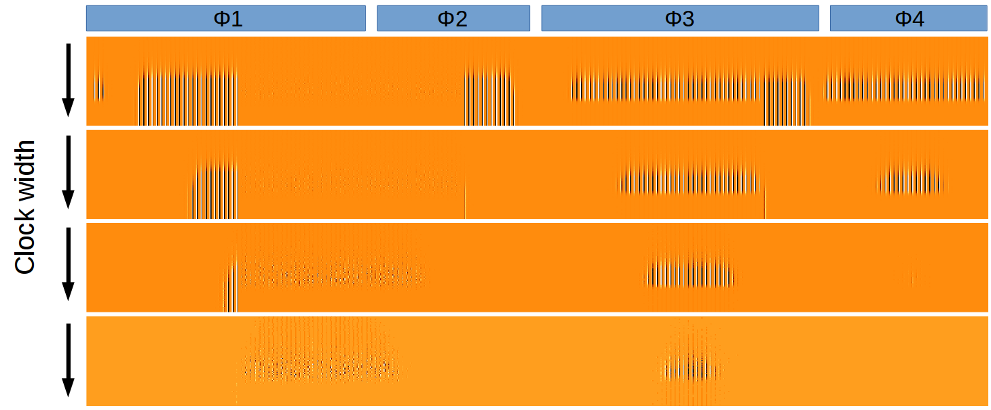
Trap pumping – pseudo-3-phase
Pumping four phase device 12-3-4-1’2’-4-3-12
Only I₁₂ and I_{ap} dipoles
For the I₁₂ dipoles, only traps under $Φ3$ and $Φ4$ is pumping (similar to 3-phase)
Repeating for 23-4-1’-2’3’-1-4-23 and 34-1’-2’-3’4’-2’-1’-34 makes it possible to cover the whole pixel, and disentangle the I_{ap} dipoles to get sub-pixel position
100k e⁻
10k e⁻
$t_{ph}$
1k e⁻
100 e⁻

Slide 10
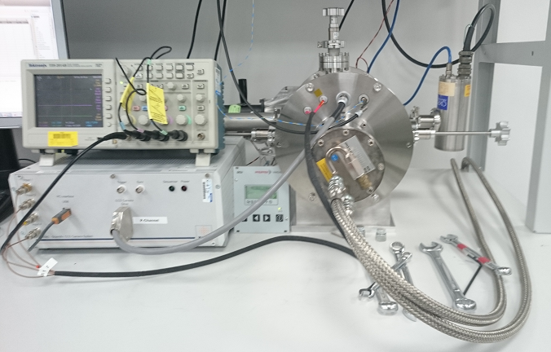
Taking data…

Slide 11
Trap pumping analysis
Automated fitting algorithm used
Plotting I₁₂ dipoles only
Three double-peaks
Plotting $P_{c}$ vs $τ_{e}$

Slide 12
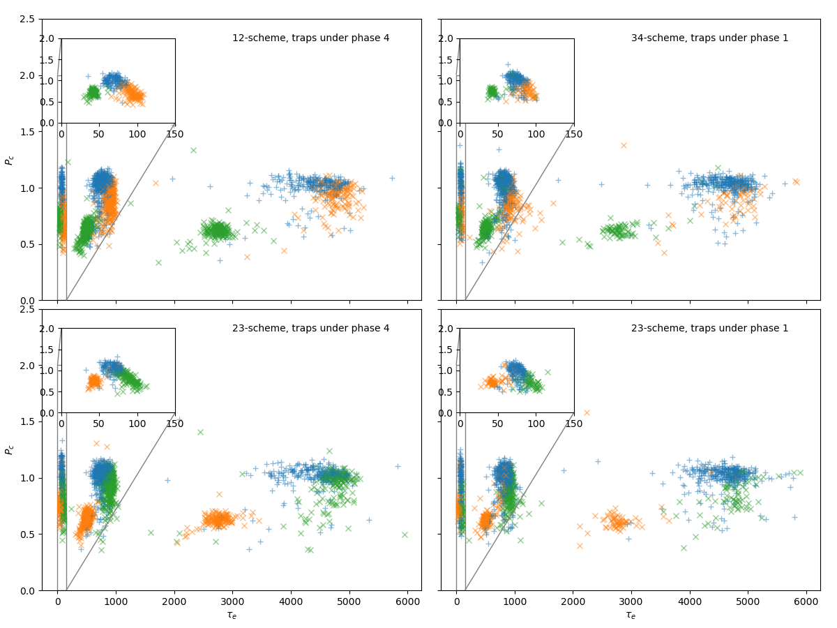
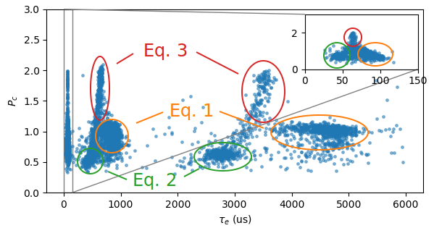
Investigating double peaks
Determining the pixel and phase for all traps
Comparing between schemes
Same traps give different τ_{e} and P_{c} values
Finding that 2nd peak is alias peak, because fitting I₂₃ dipoles with I₁₂ gives
0.6 τ_{e} and 0.6 P_{c}
fitting I₁₄ dipoles with I₁₂
0.7 τ_{e} and 1.8 P_{c}

Slide 13
Trap pumping analysis
Only I₁₂ dipoles
All three types: I₁₂ , I₂₃ , I₁₄

Slide 14
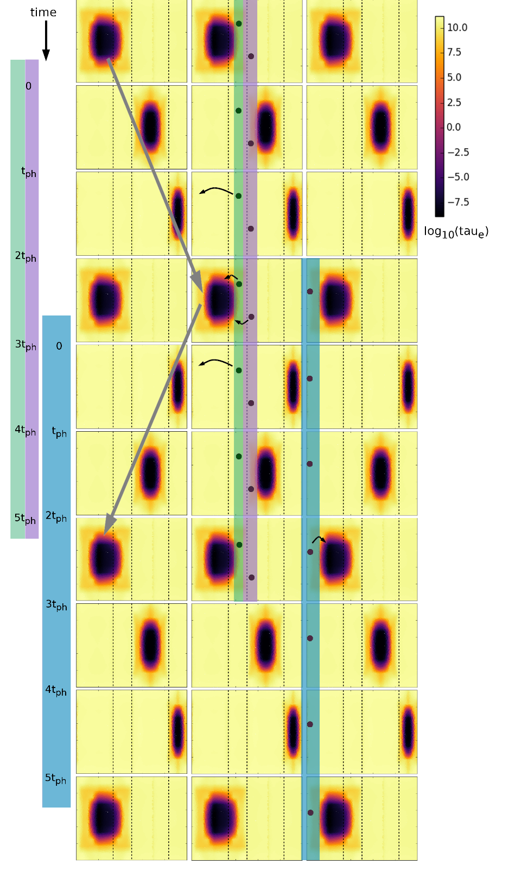
Trap pumping analysis
Why does the I₂₃ , I₁₄ dipoles appear?
Standard assumption is that no charge is captured during transition between phases
However, allowing for capture during phase transitions explains the existence of the I₂₃ and I₁₄ dipoles

Slide 15
Comparing with simulated data
Trap pumping data from un-irradiated Euclid CCD, Pseudo-3-phase pumping
Simulated trap pumping data, pseudo-3-phase pumping, without transition step

Slide 16
Comparing with simulated data
Trap pumping data from un-irradiated Euclid CCD, Pseudo-3-phase pumping
Simulated trap pumping data, pseudo-3-phase pumping, with 100ns transition step

Slide 17
Trap pumping – pseudo-3-phase
Pumping four phase device 12-3-4-1’2’-4-3-12 simulation, no transition step
Only I₁₂ and ‘always pump’ traps
100k e⁻
10k e⁻
$t_{ph}$
1k e⁻
100 e⁻

Slide 18
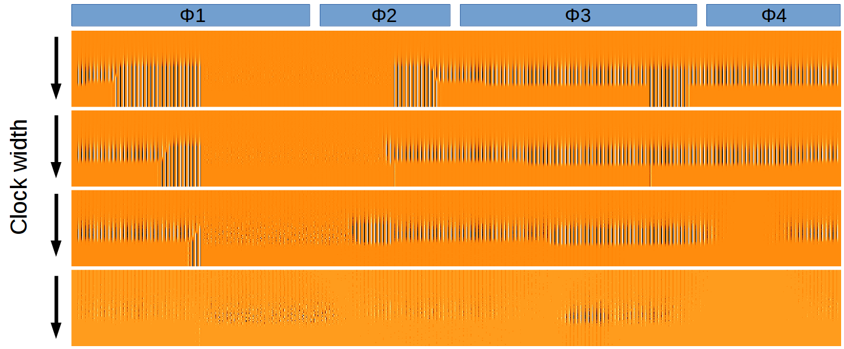
Trap pumping – pseudo-3-phase
Pumping four phase device 12-3-4-1’2’-4-3-12 simulation, 100 ns transition step
I₁₂ , I₂₃ , I₁₄ and ‘always pump’ traps
Very difficult to disentangle
100k e⁻
10k e⁻
$t_{ph}$
1k e⁻
100 e⁻

Slide 19
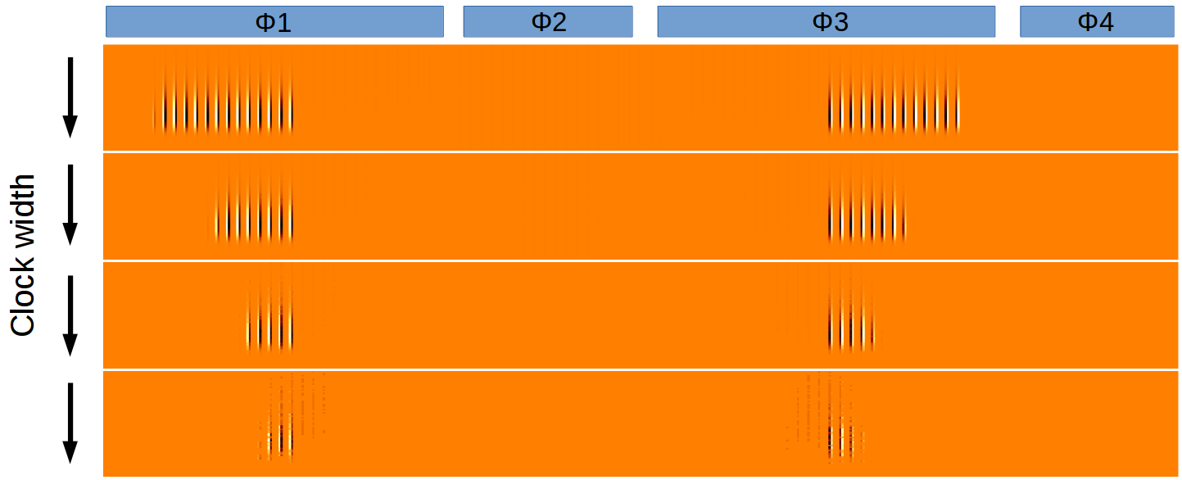
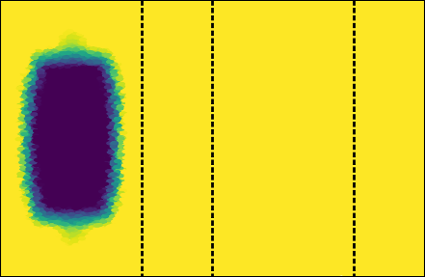
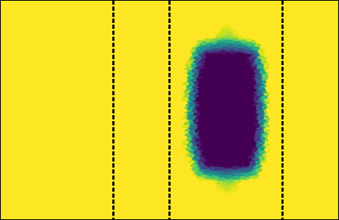
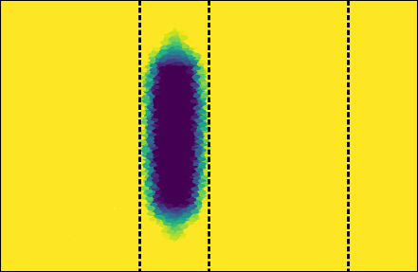
Sub-pixel clocking scheme
Sub-pixel pumping scheme (1-2-3-2-1) chosen because of its simplicity
Small part of pixel probed
low risk of dipoles cancelling at higher radiation levels
Direction of dipole and size of charge cloud can give sub-pixel and sub-phase positions
100k e⁻
10k e⁻
1k e⁻
100 e⁻
$t_{ph}$

Slide 20
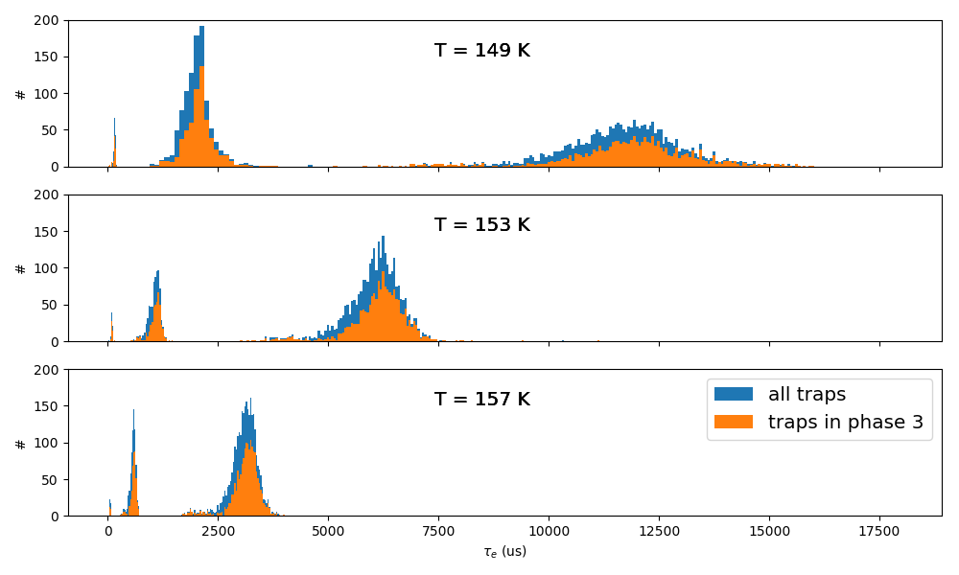
Trap pumping analysis
This shows data from pre-irradiated devices (1600 e⁻)
3 peaks
$τ_{e}$ scales with temperature

Slide 21
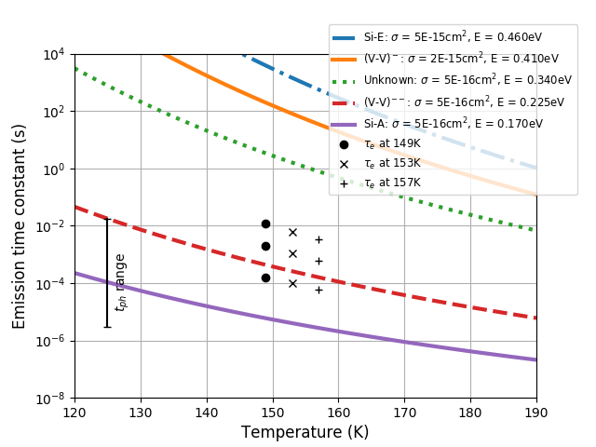
Trap species
Plotting the peaks found at the three different temperatures
$τ_{e}$ peaks matches defects from Phosphorus and Boron (used as dopants)
mixed with Carbon and Oxygen impurities
C_{i}P_{s} (0.23, 0.26 eV)
B_{i}O_{i} (0.24 - 0.27 eV)
(Pichler, 2004)

Slide 22
Summary
Weak lensing experiment on Euclid mission requires high resolution imaging
Radiation damage degrades the data and therefore needs to be corrected for
Trap pumping method can identify and characterise single traps in silicon lattice
Several trap pumping schemes simulated and testing for Euclid
Test done as part of CEI radiation damage study performed
Simulations shows that some schemes make it hard to extract correct $τ_{e}$ value
Pseudo-3-phase clocking scheme tested in lab
Data analysis reveals that capture in inter-phase regions must occur
Contradicting previous understanding
Sub-pixel pumping scheme chosen as part of Euclid in-orbit calibration
Easy extraction of $τ_{e}$ value
Sub-phase positions of traps

