Slide 1

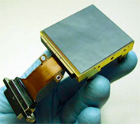
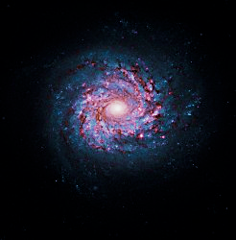
Precision Characterization of Hawaii-2RG Near-Infrared Detectors
Chaz Shapiro
SDW2017, Space Telescope Institute, 2017-09-28
Collaborators: Eric Huff, Andrés Plazas-Malagon, Roger Smith
© 2017 California Institute of Technology. Government sponsorship acknowledged.

Slide 2
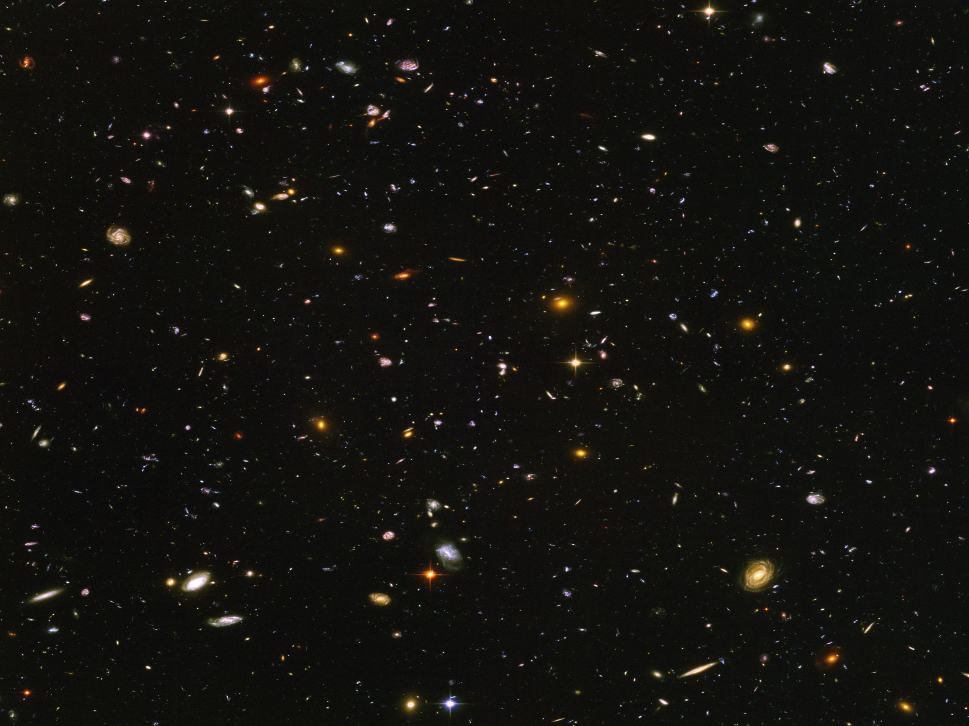
“With great statistical power
comes great systematic responsibility”
-Daniel Gruen
Einstein Fellow, SLAC/KIPAC
Dark Energy Survey

Slide 3
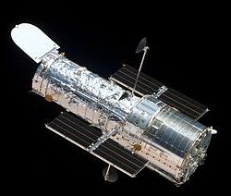

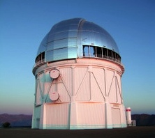
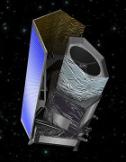
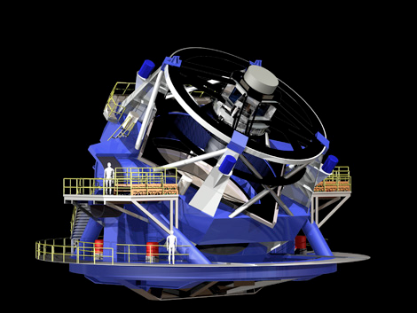
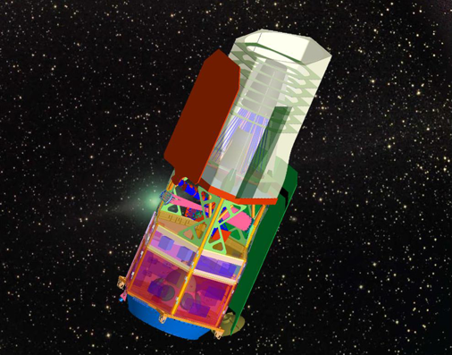
Partial list of telescopes measuring weak gravitational lensing
HST/COSMOS
1.7 deg², ~0.5M galaxies
CFHTLenS
154 deg², ~6M galaxies
Dark Energy Survey
5000 deg², ~200M galaxies
WFIRST
Euclid
15,000 deg², ~1.5 B galaxies
Large Synoptic Survey Telescope
~20,000 deg², ~4B galaxies
Wide-Field Infrared Survey
Telescope (WFIRST)
(the only IR imaging survey)
2000-10000 deg², 300M-1.6B galaxies
Notes:
CONTEXT: Gravitational lensing surveys, which average together many galaxy measurements (photometry, shapes) to constrain theories of dark matter and dark energy
Original detections done with 10’s thousands of galaxies, < 1 deg^2
Galaxy number, width aren’t the only features – just a flavor. Ngal roughly determines dark energy FoM
Euclid – 2020
LSST – 2023
WFIRST - 2024

Slide 4
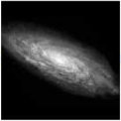
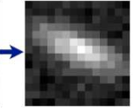
Large surveys (WFIRST, Euclid, LSST…) depend on unprecedented control of detector systematics to avoid biased dark energy measurements from gravitational lensing
Total Error Budgets (can’t all come from the detector!):
Ellipticity (e) errors: O(10⁻⁴)
Photometry errors: O(10⁻²)
|e| = 0
e₁ = 0.1
e₂ = 0.1

Slide 5
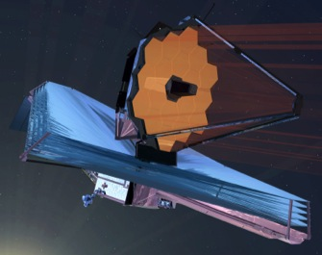
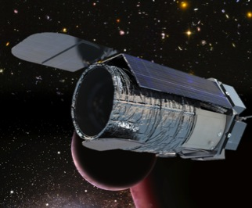
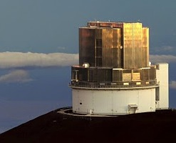
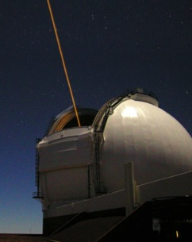
Precision Projector Laboratory
Detector Characterization
& Astronomical Emulation
JWST
WFIRST
Premise
Astronomy missions increasingly rely on detectors with a stable, predictable pixel response. Surprises in detector operation which fall beyond the scope of conventional tests/requirements are common. They risk delays, increased cost, or failure to meet science goals. Mitigation strategies can take years to develop.
Goal
Identify and mitigate detector-related risks to science goals, thereby increasing the Technology Readiness Level of instruments and providing proof-of-concept for mission proposals
Approach:
Emulate UV/VIS/NIR mission concepts under realistic observing conditions, by projecting stable and customizable “scenes” (stars, galaxies spectra) onto large format detectors.
Assemble a multi-disciplinary team to design custom tests and study how detector effects impact specific scientific measurements.
Euclid
Subaru/PFS
Keck

Slide 6
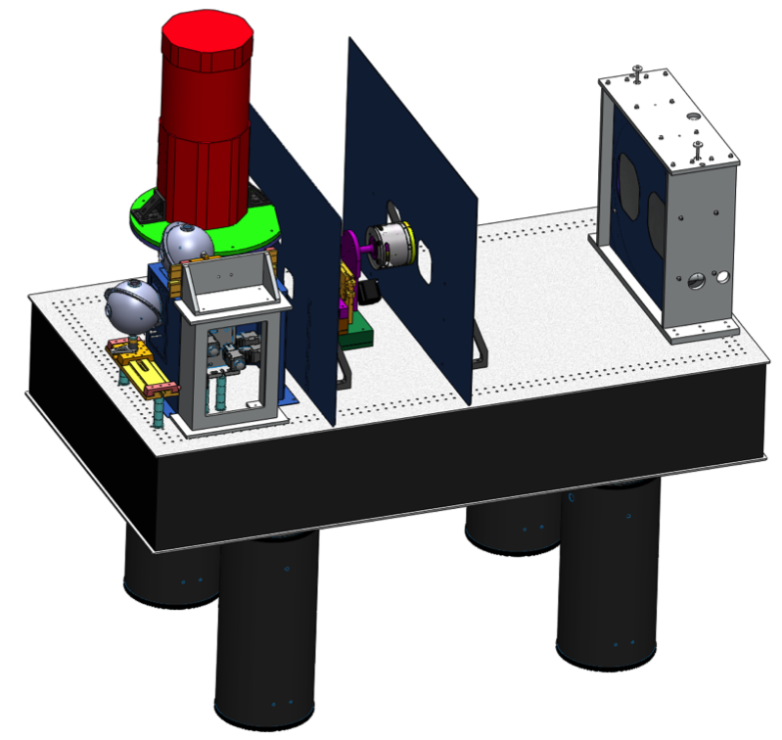

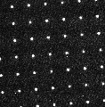
Precision Projector Laboratory testbed
Detector, filter in dewar
Baffles
Primary mirror
in sling mount
Turntable
Integrating spheres connect to LEDs or
lamp
Projector System Features:
Diffraction-limited optics with simple point spread function (PSF).
High image stability through passive damping.
Custom image masks, adjustable f/#, stages & illumination provide a range of signals for investigating various detector effects and mission conditions.
Servo controls on mask and tip-tilt mirror allow fine image positioning for dithering or scanning.
IMage COMbination algorithm implements WFIRST image reconstruction strategy with dithered, undersampled images.
Dedicated 144 core cluster allows near real-time analysis of 1000’s of images.
Huge multiplexing advantage
Secondary mirror with variable pupil
(f/8-f/44) on 360º rotational stage
6-axis stage positions one of several target masks
Temperature–regulated bench sits on pneumatic legs
Image of 3µm spot grid
(emulated stars)
f/22,
λ = .880µm

Slide 7

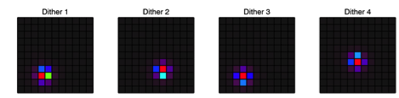
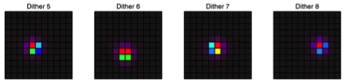

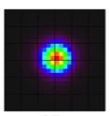
Weak Gravitational Lensing Emulation for WFIRST
Emulate stars
on the detector
Dither & reconstruct oversampled images with IMCOM
Intensity
relative to peak
IMCOM
reconstruction
Measure/map ellipticities of “stars”
Compute ellipticity correlation function:
analogous to science goal
ξ_{ii}(r) = mean(e_{i}ªe_{i}^{b} ; r)
ξ(r) x 10⁶
Notes:
This is what we want to do

Slide 8
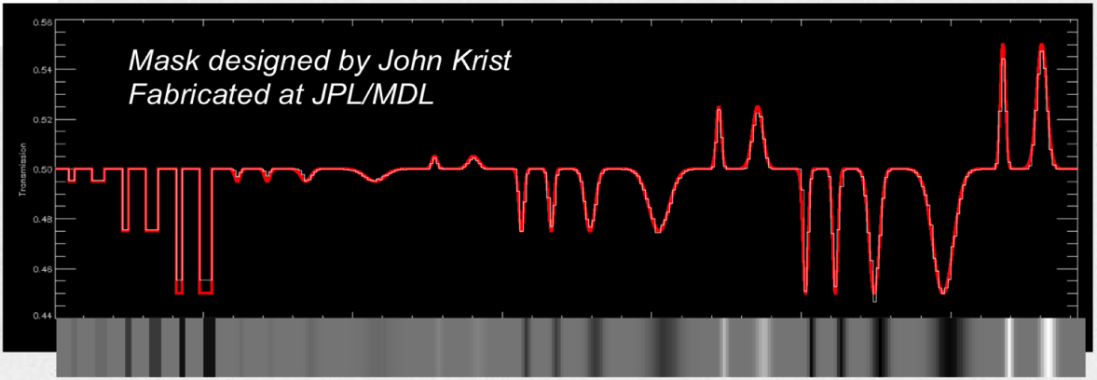
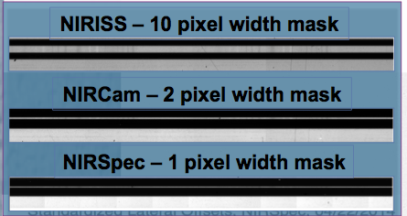
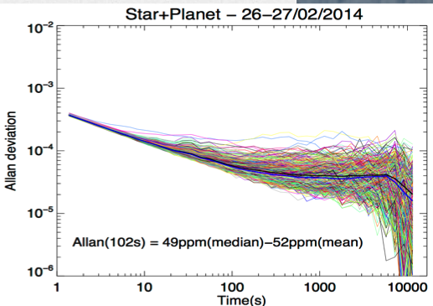
JWST Exoplanet Emulation
(D. Touli, C. Beichman, G. Vasisht, J. Krist)
Caltech/IPAC
Used 2 lamps and a custom mask to emulate an exoplanet spectrum embedded in a bright stellar continuum
~50 ppm median photometric precision achieved with the engineering grade H2RG. Improvement is expected after modifications to projector and detector readout. (just good enough to detect exoplanet transits)
Star Lamp : Planet Lamp = 600:1
After de-correlation
Image Credits: Dimitra Touli, IPAC

Slide 9
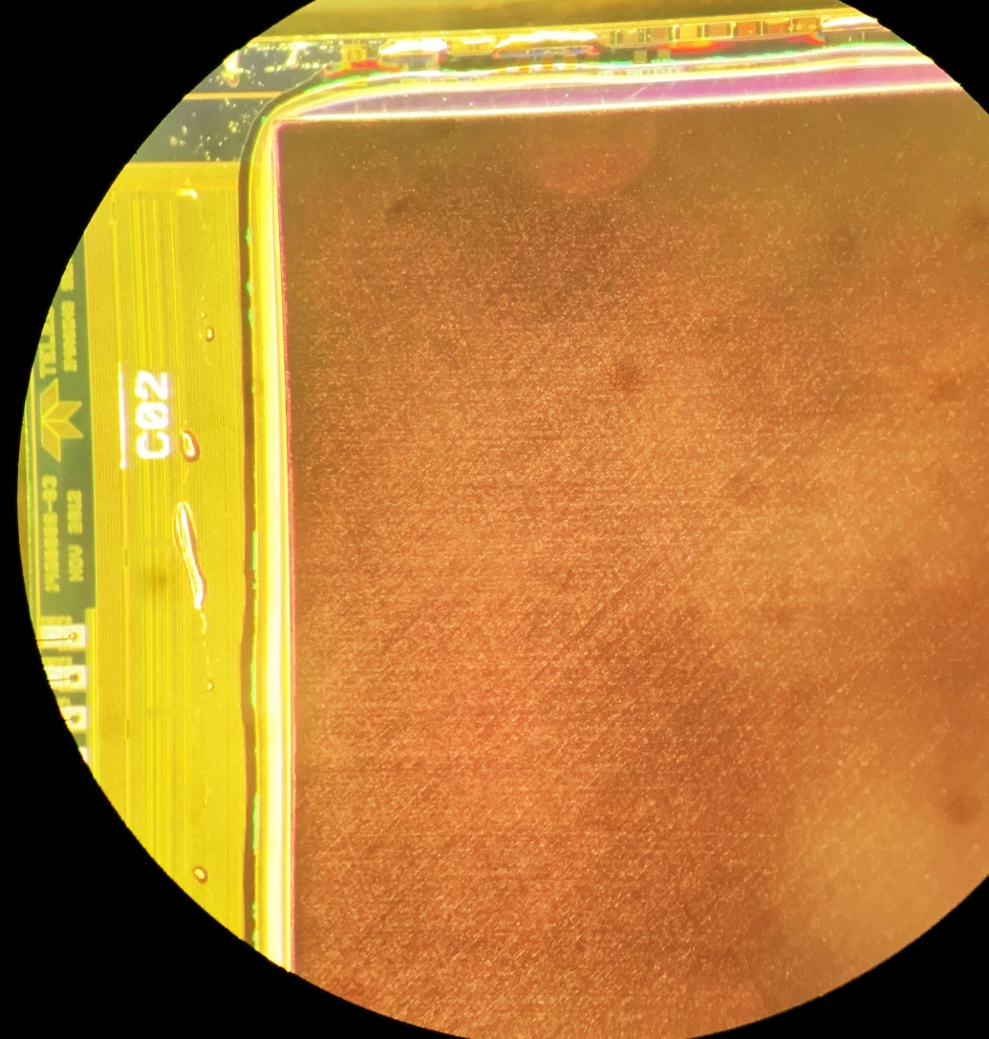
Euclid photometry emulation to study
“cross-hatch pattern”
Engineering grade H2RG (#18546) was lent to JPL to investigate the cross-hatch pattern seen in flat-field images.
Teledyne Hawaii-2RG, engineering grade ; HgCdTe detector; 18µm pixels, 2k x 2k format; Cutoff wavelength 2.4 µm
Pattern is visible under an optical microscope. Related to defects in the HgCdTe crystal?
At PPL, H2RG was cooled to 95K, operated by Leach controller at 166 kHz.
Image of H2RG #18546 taken with iPhone held up to microscope

Slide 10
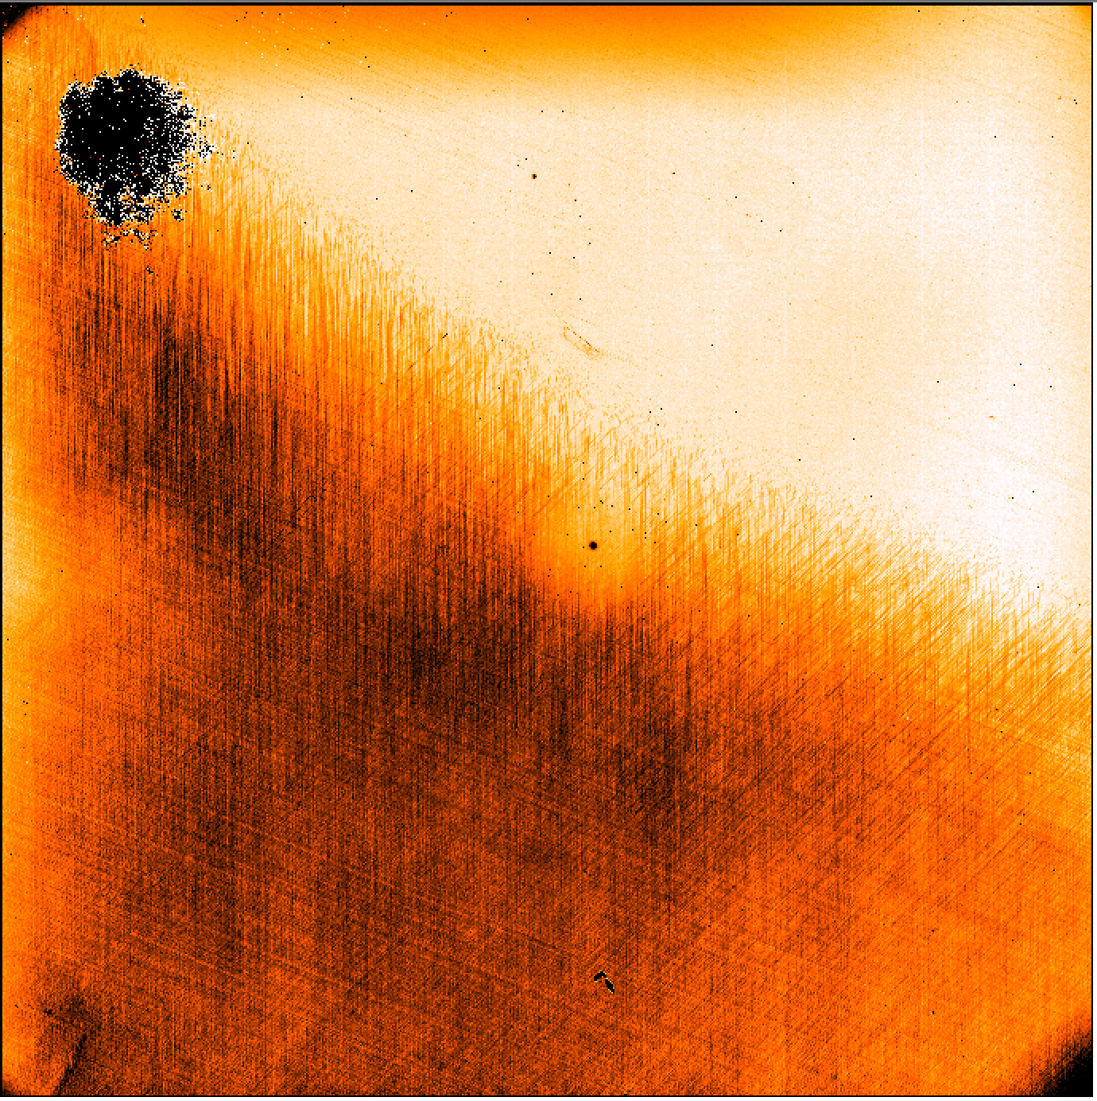
Euclid photometry emulation to study
“cross-hatch pattern”
Bad pixels
Cross-hatch pattern easily visible in Y-band (0.97-1.07µm) flats.
Euclid flight detectors look like the upper region with less cross-hatching.
This “feature” may correspond to sub-pixel variations in quantum efficiency (QE) or charge redistribution (like “tree rings” in CCDs), making photometric calibration difficult.
GOAL: Emulate Euclid-like point sources; measure the nature of this pattern and what effect it has on photometry
QE ~ 1
QE ~ 0.8
Illumination
blocked
Diffuse image at ~1µm. Contrast adjusted to emphasize cross-hatch.

Slide 11
Flat Field Power Spectrum
Clean
Cross-hatched
“spikes” are at 0, 45, 112 (-68) degrees
Power is for ΔFLUX/<FLUX> - 1 of subregion
Gaussian weight applied

Slide 12
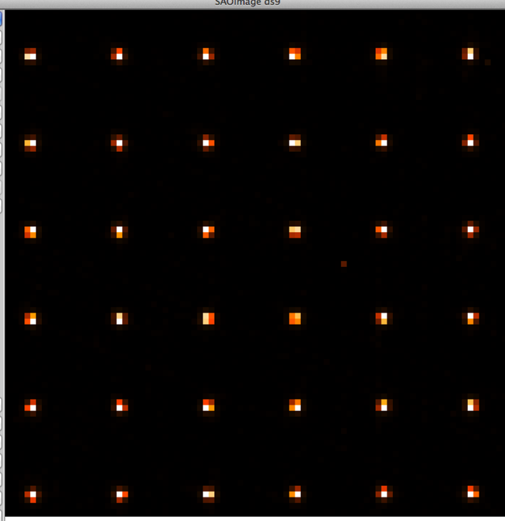
Spot grid scanning
A spot grid image (~16,000 spots) covers most of the detector. Spacing = 274.5µm = 15.25 pixels.
Using f/11 aperture and 1µm illumination, the minimum spot width with charge diffusion and jitter is ~ 14µm = 0.78 pixels (full-width half-max)
The grid was scanned in 6µm step (1/3 pixel) raster pattern
Calibrations applied to images: dark subtraction, flat fielding, conversion gain, pixel-wise nonlinearity, “bad” (outlier) pixels set to 0
Not corrected: IPC, persistence
A spot is discarded if its centroid comes within 5 pixels of a known bad pixel at any point in the scan
Spot grid focused on 90x90 pixel region of H2RG #18546

Slide 13
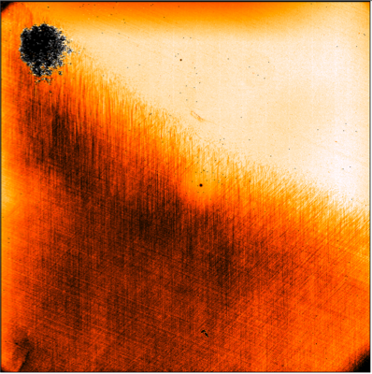
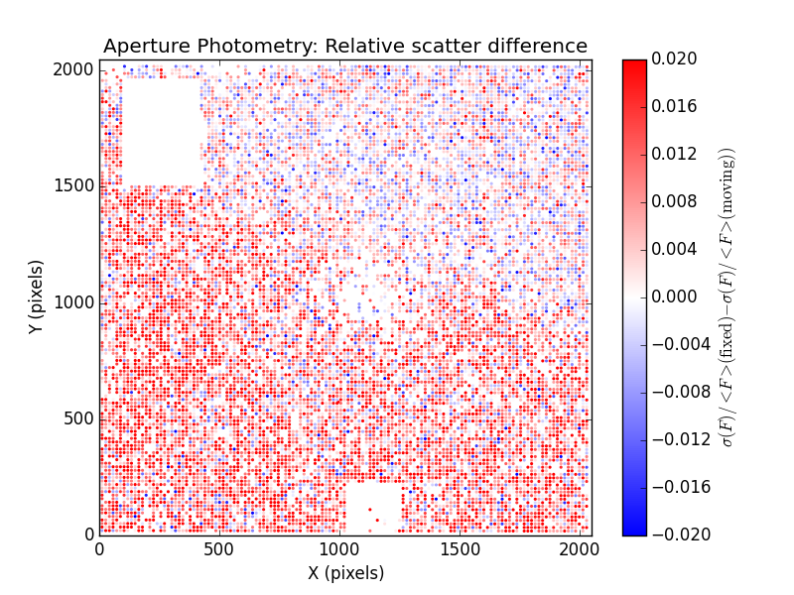
Measuring the effect of small image translations on photometry
In a calibrated detector, photometry should not vary with position. Flat-fielding suppresses QE variations larger than 1 pixel but will not remove sub-pixel variation.
We map the difference in scatter (σ/mean) for individual spot fluxes over sequences of scanned images at different positions (“moving”) or at the same position (“fixed”).
“Fixed” sequence = 9 images at same position
“Moving” sequence = 10 images in 1/3 pixel steps; spans 3 pixels
Difference in σ/mean: Moving - Fixed
Δ(σ/mean) averaged over large regions:
GOOD: 0.0002 ± 0.0006
BAD: 0.010 ± 0.0005

Slide 14
“Bad” region
Sub-pixel QE inference (E. Huff)
Model each pixel as containing 3x3 sub-pixel QE
Photometry is a linear combination of sub-pixels weighted by PSF; with photometry measurements at many positions, we can obtain the QE map by matrix inversion
Axes = H2RG pixels (18µm) ; color scale = [-1,1]
Map is relative to flat field!

Slide 15
“Clean” region
Sub-pixel QE inference (E. Huff)
Model each pixel as containing 3x3 sub-pixel QE
Photometry is a linear combination of sub-pixels weighted by PSF; with photometry measurements at many positions, we can obtain the QE map by matrix inversion
Axes = H2RG pixels (18µm) ; color scale = [-1,1]
Map is relative to flat field!

Slide 16
Sub-pixel power (real minus randomized) averaged over many regions
Detector nyquist rate: k=0.5/px
Power is modulated by the PSF
P = monopole mean
Q = quadrupole mean
Credit: E. Huff (JPL)

Slide 17
Interpretation
Scanning the spots over 3 pixels has no significant effect on photometric stability in the good detector region. Average spot in the cross-hatched picks up a 1.5% scatter. Flat fielding reduces this to 1%.
This is consistent with sub-pixel QE variations. Photometry is measured by summing all pixels in an aperture; if the cross-hatch pattern were due to charge redistribution, we expect no effect in the uncorrected images, and flat fielding would make the photometry worse.
CAVEAT: Averaging over a large detector area misses isolated defects in the “good” region.

Slide 18
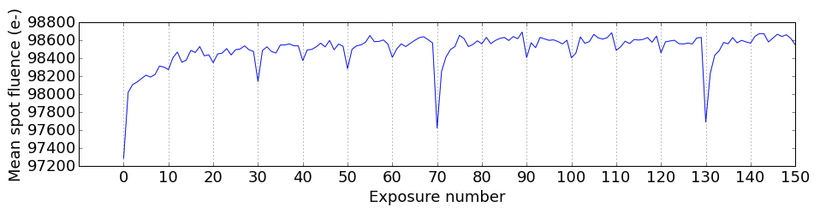
“Burn in”
Photometric variation with exposure
1st shutter
open
Shutter
closed ~3s
Shutter closed
longer
Measured spot fluxes are ~1% lower just after opening shutter
We discard 1-2 exposures per series, de-trend the remaining data
OPEN QUESTION (S. Wachter): Does differential “burn in” contaminate flats?
Related to count-rate nonlinearity?

Slide 19
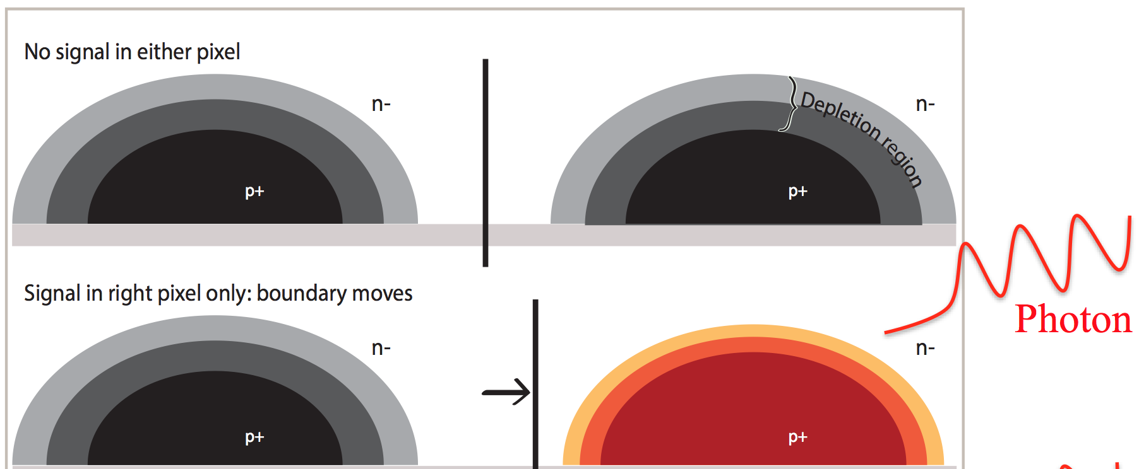
Brighter-fatter in HxRGs?
CCD model Image Credit:
Augustin Guyonnet
Cartoon model in HxRG (R Smith)
In either case, pixel boundaries are effectively shifted

Slide 20
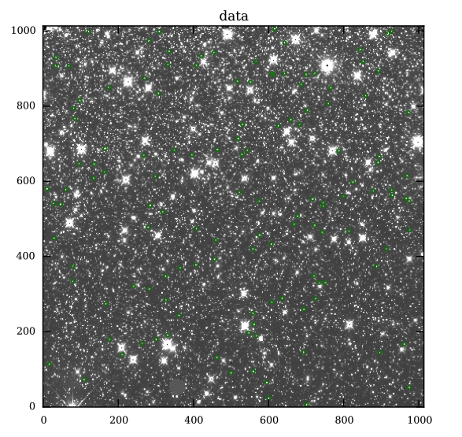
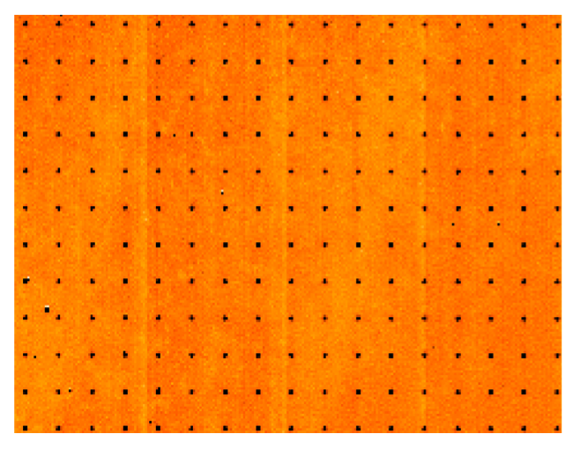
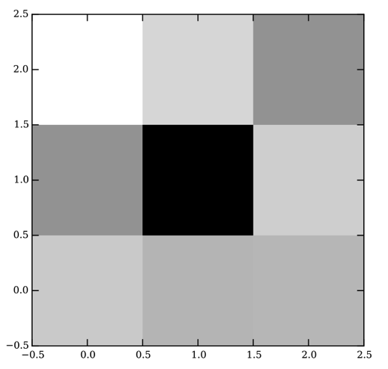
“Direct“ measurement of brighter-fatter effect with non-destructive reads
A. Plazas-Malagon, inspired by J. Anderson (STScI)
Ω-cen cluster (WFC3 H1RG)
Use undersampled sources nearly centered on a pixel
BF should cause post-calibration nonlinearity: bright pixels lose flux (e-/s) while neighbors gain flux “up the ramp”
Possibly contaminated by nonlinear IPC
PPL “stars” (Euclid H2RG)
Single star/”star”
Notes:
The data were downloaded from the Mikulski Archive for Space Telescopes database, and correspond to program 13606, which targets the globular cluster Ω-cen; it was taken about 6 arc minutes off the center of the cluster, providing about ×4 less crowding but still enough density of bright stellar sources. The processing of WFC3- IR exposures produces intermediate SUTR files with N samples. For these images, N = 6. These files (known as MULTIACCUM or IMA files) have reductions and calibrations applied, including dark frame subtractions, flat-fielding, and classical nonlinearity. For the latter, the correction is based on an average curve, fitted to a third degree polynomial ([16]).

Slide 21
Flux changes up the ramp (H2RG)
Δ pixel flux / <spot flux>
averaged over stars
Charge conservation?
Credit: A. Plazas-Malagon (JPL)

Slide 22
Flux changes up the ramp (WFC3)
Δ pixel flux / <spot flux>
averaged over stars
Charge conservation?
Credit: A. Plazas-Malagon (JPL)

Slide 23
Thank you
-Chaz Shapiro
Jet Propulsion Laboratory

