Slide 1
Electro-optic qualification of LSST production rafts
P. O’Connor¹*, Andrei Nomerotski¹, Homer Neal²
¹Brookhaven National Laboratory, Upton, NY
²SLAC National Laboratory, Menlo Park, CA
* Subsystem scientist, LSST science rafts
Scientific Detector Workshop 2017

Slide 2
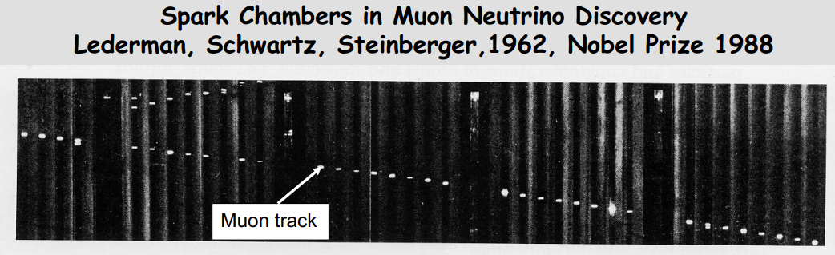
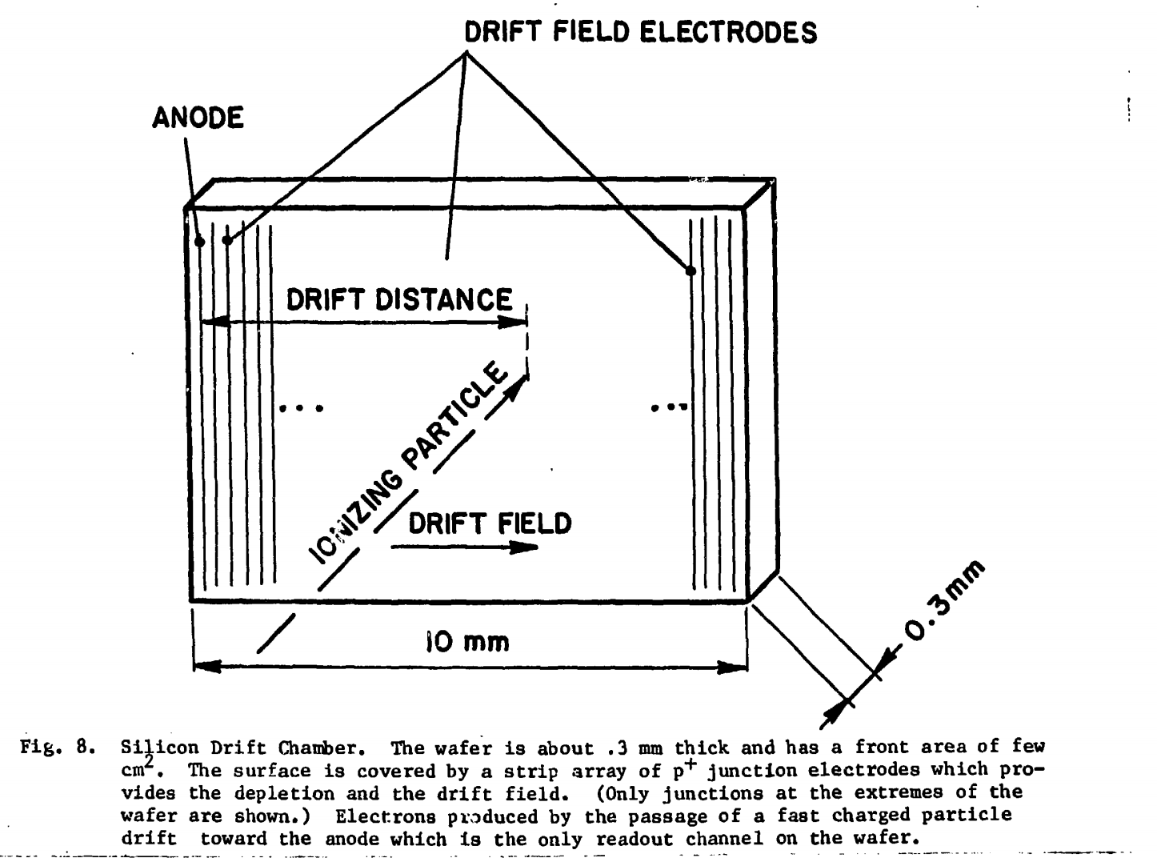
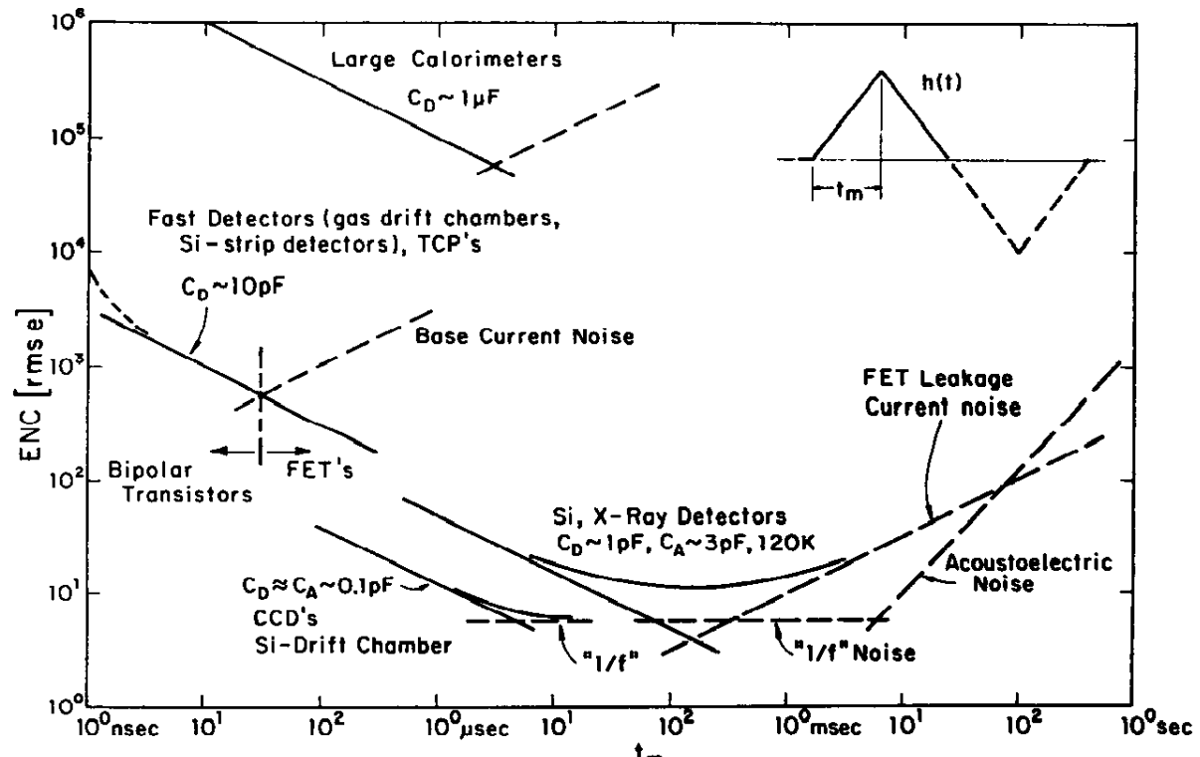
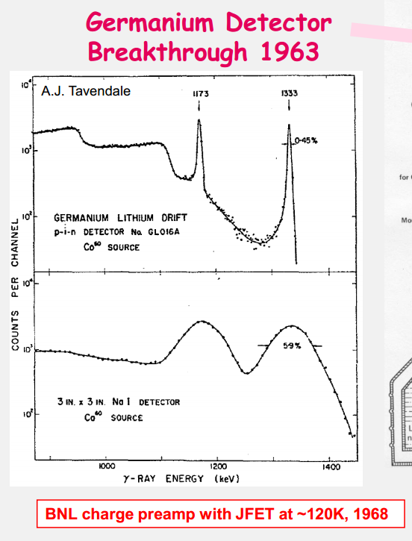
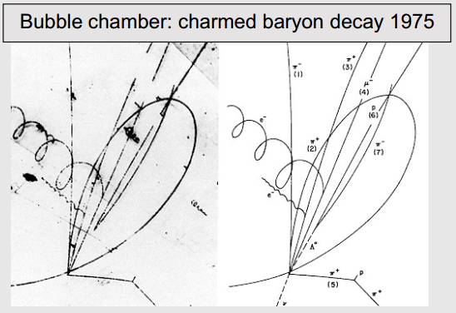
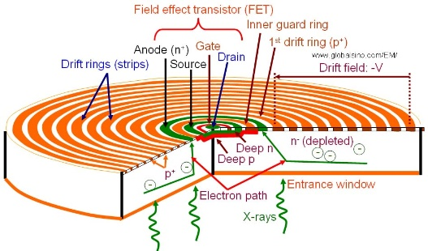
Brookhaven Instrumentation detector development: first 35 years
Silicon drift detector 1983
Preamp optimal filtering1983
Cylindrical SDD for x-ray spectroscopy

Slide 3
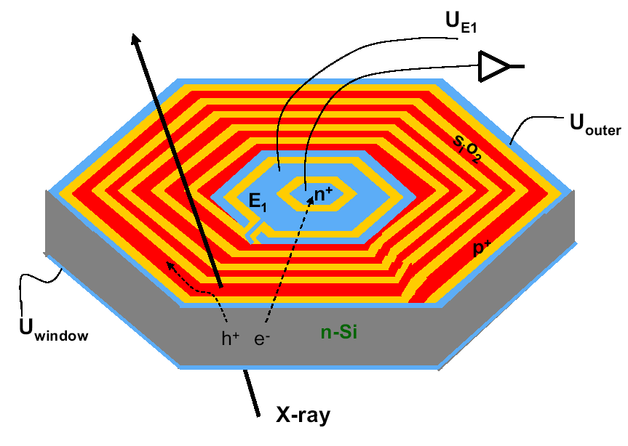
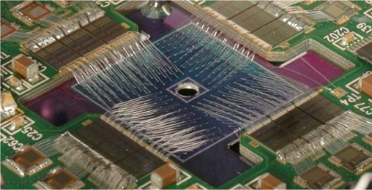
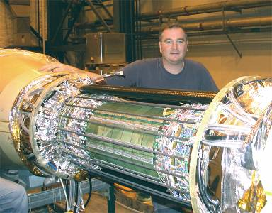
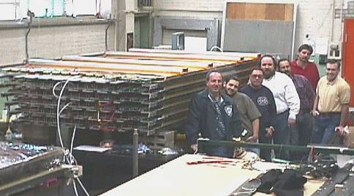
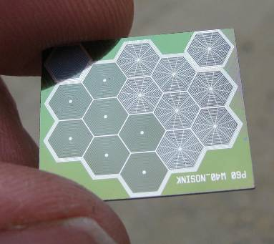
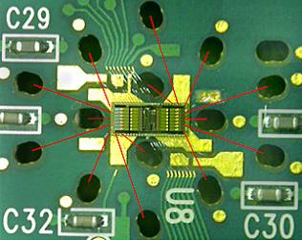
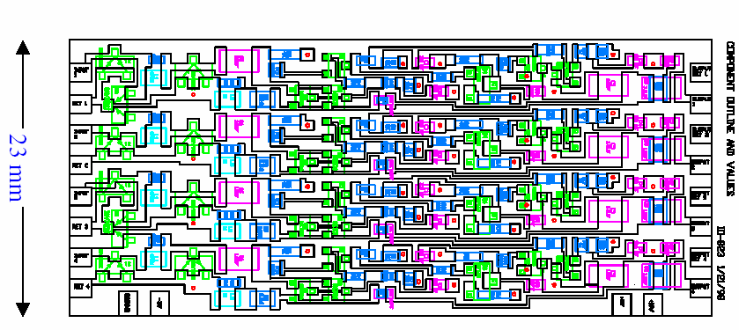
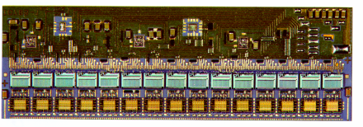
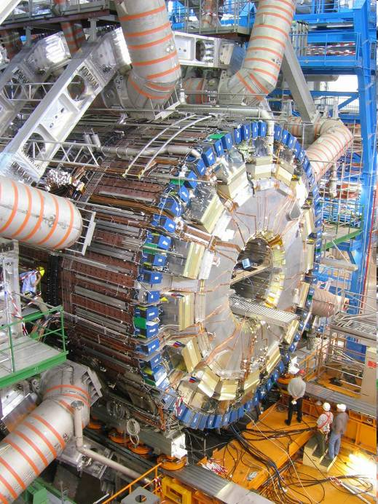
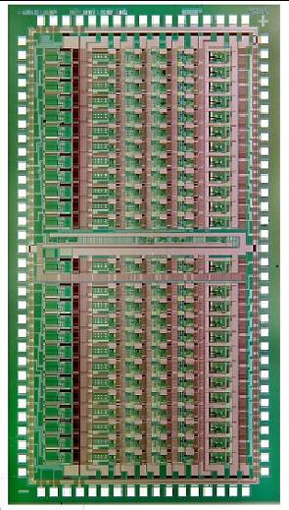
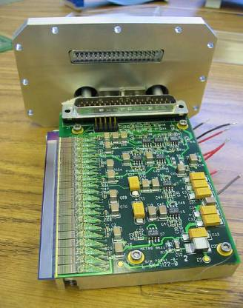
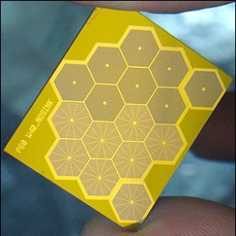
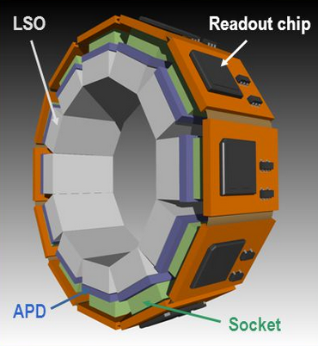
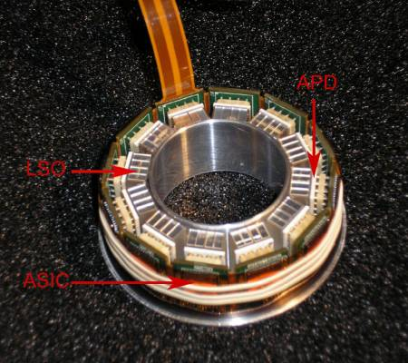
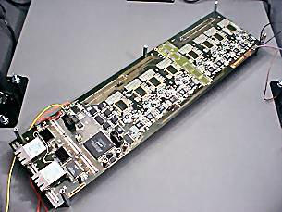
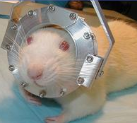
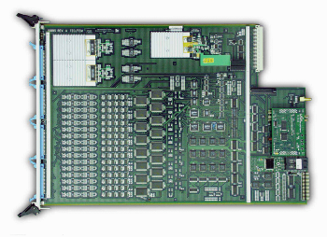
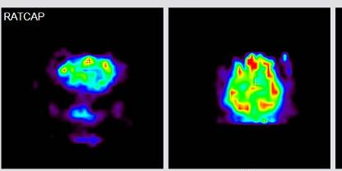
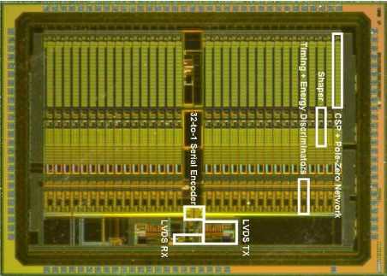
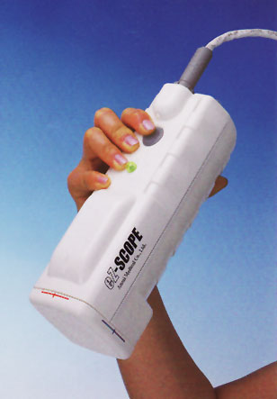
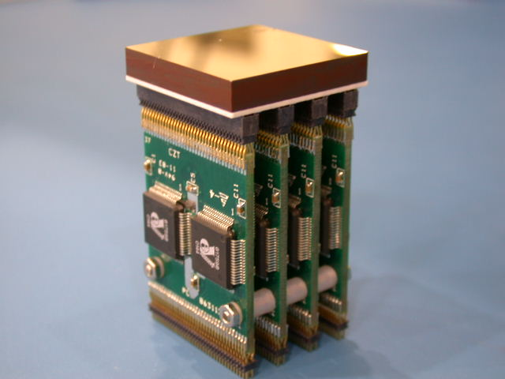
Last 25 years
silicon vertex tracker
time expansion chamber
384-element EXAFS array
HERMES readout
SDD readout ASIC
8e⁻ noise
j
240-channel multichp module
high resolution hexagonal SDD array
quad hybrid preamp
16-element SDD array
24-channel ASIC preamp/shaper
Electromagnetic calorimeter
image of conscious rat brain
640-element strip detector
HERMES readout
Compact Gamma Camera
TEC front end module
32-channel RatCAP ASIC
sampling/digitizing board
30,000 channels total

Slide 4
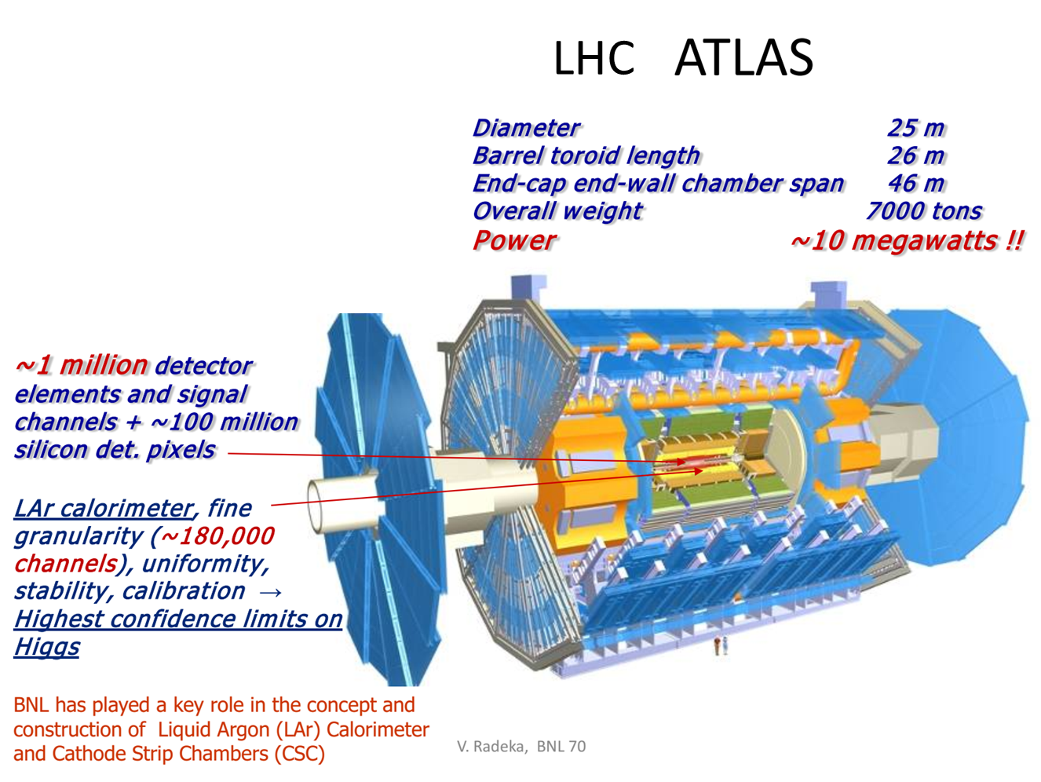
A large detector

Slide 5
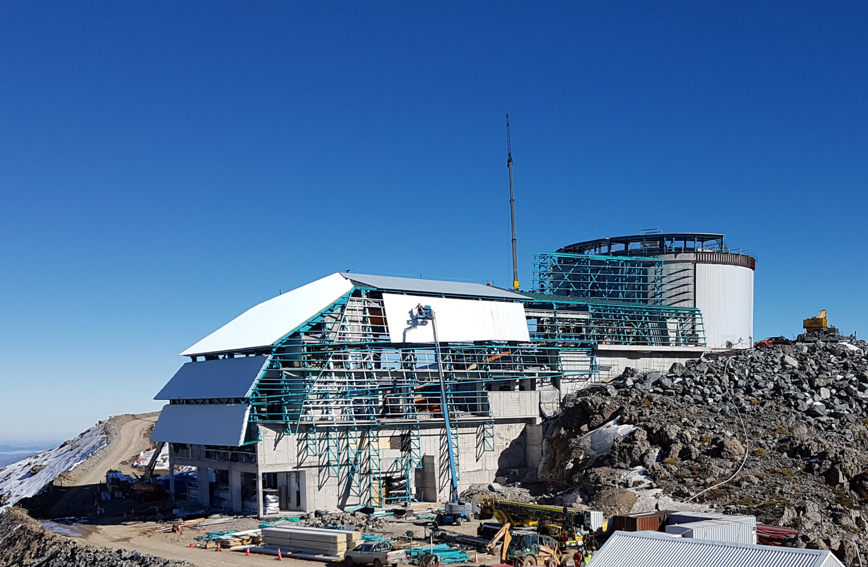
Observatory construction at Cerro Pachon
3.2Gpixel camera on 8.4m telescope
Dedicated 10-year deep optical-NIR survey
Rapid cadence to image entire sky to r=24 every 3 nights
Broad science goals:
  Cosmology: dark matter and dark energy
  Milky Way assembly history
  Solar System minor bodies
  Transients

Slide 6
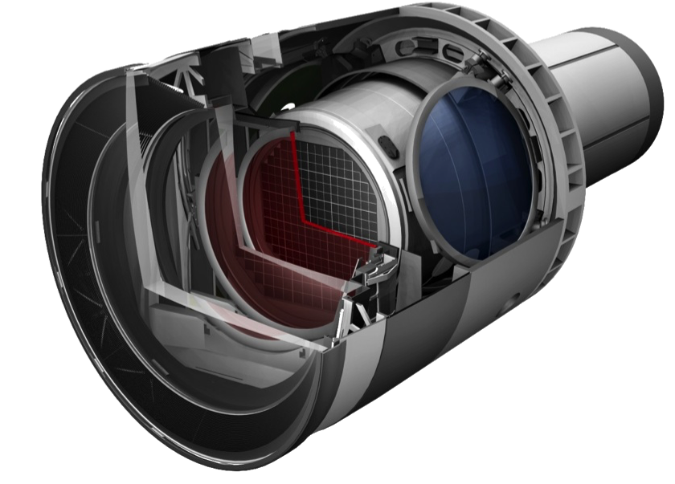
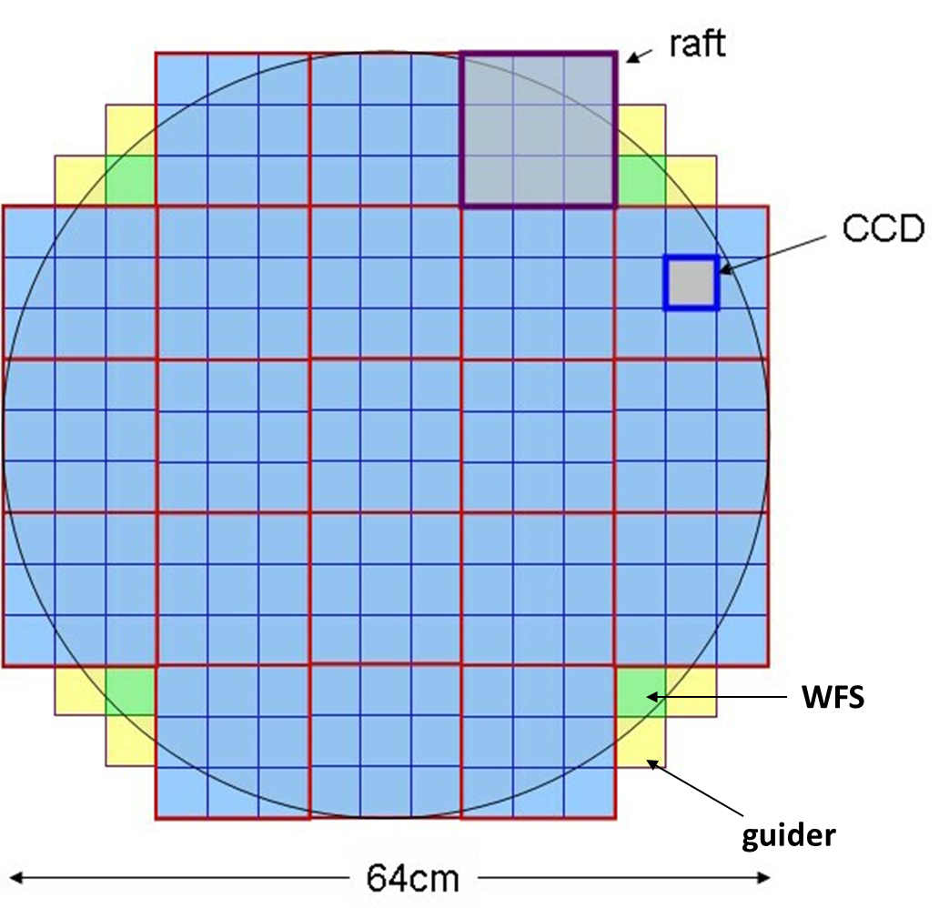
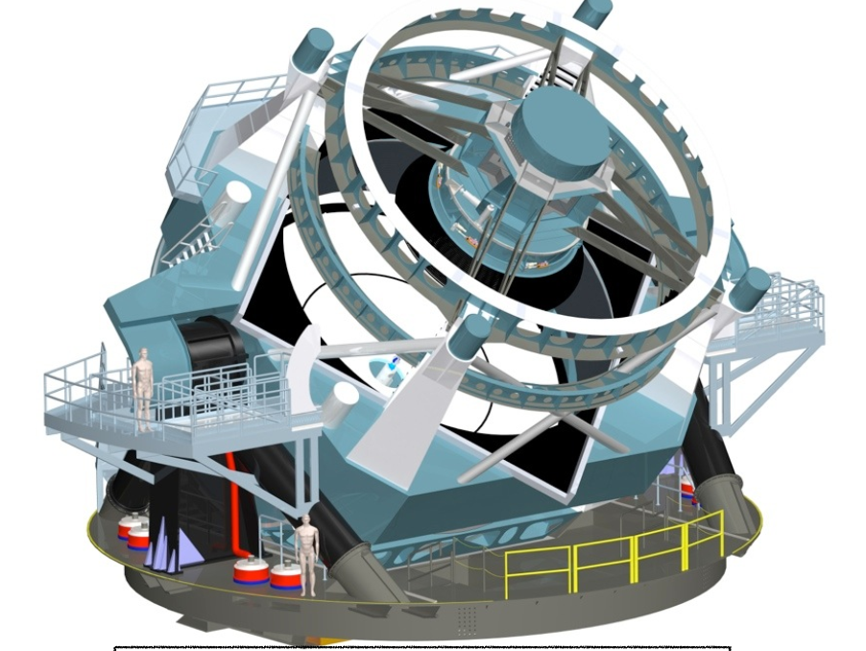
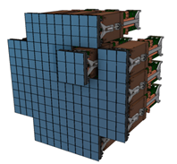
Telescope, camera, and focal plane
requirements
3024 video channels
4347 clock and bias signals
2 sec frame readout
  550kpix/s pixel rate
< 9e- rms noise
18b digitization
Focal plane thermal control
System health monitoring
Sensor protection
1200 W total power
  400 mW/channel
170 l volume
Vacuum operation
Flat ±10um

Slide 7
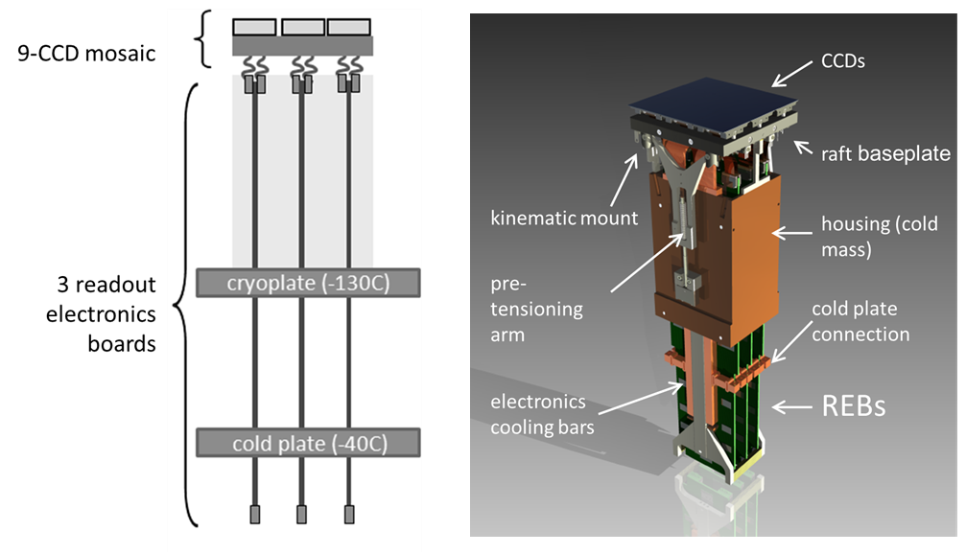
Raft Tower Module
Complete 12K x 12K imager
Support sensors mechanically to meet strict coplanarity
Thermal management of sensors and electronics
Provide bias, timing, and control signals for CCD operation
144 video channels with low noise analog signal processing, digitizing, multiplexing of pixel data
Diagnostics + monitoring
12.7 x 12.7 x 42cm³
20 kg
39W
Photons in – bits out

Slide 8
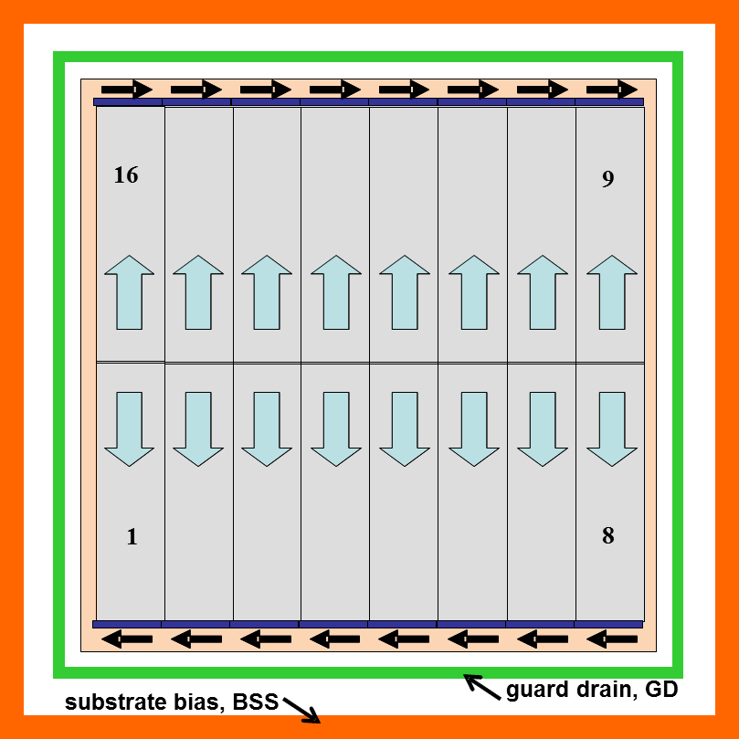
Detectors
100μm-thick, high resistivity silicon CCDs, fully-depleted with transparent conductive window and AR coating, back-illuminated
  for broadband QE and small PSF
4K x 4K format
  4 die sites/6”wafer
16-fold parallel output
  for low noise readout at 2s frame read time
10μm pixels
  for optimum sampling at LSST plate scale
Buttable, thermally-matched packaging
  >92% fill factor
Flatness and alignment tolerance to bring image surface of all CCDs coplanar to ±9μm
  for use in fast f/1.2 beam
Mechanical mounting and alignment features and electrical interface specified
  Interchangeability between vendors
Operating temperature -100C
  Suppress dark current to negligible levels

Slide 9
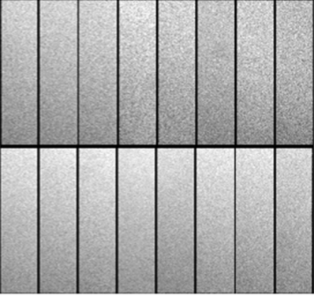
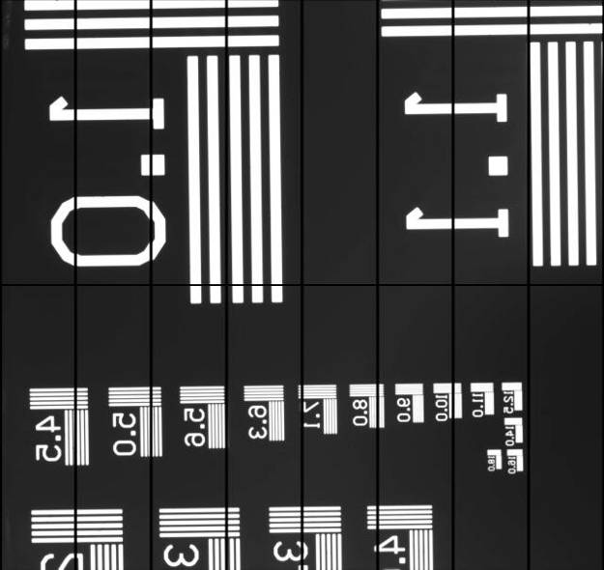
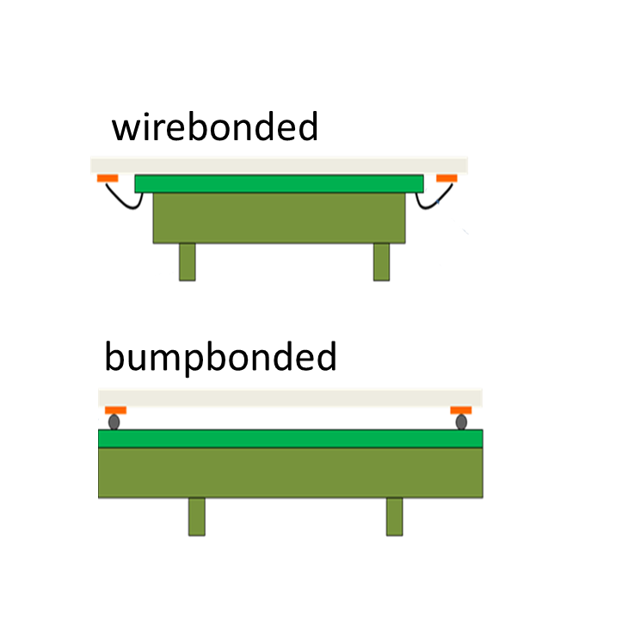
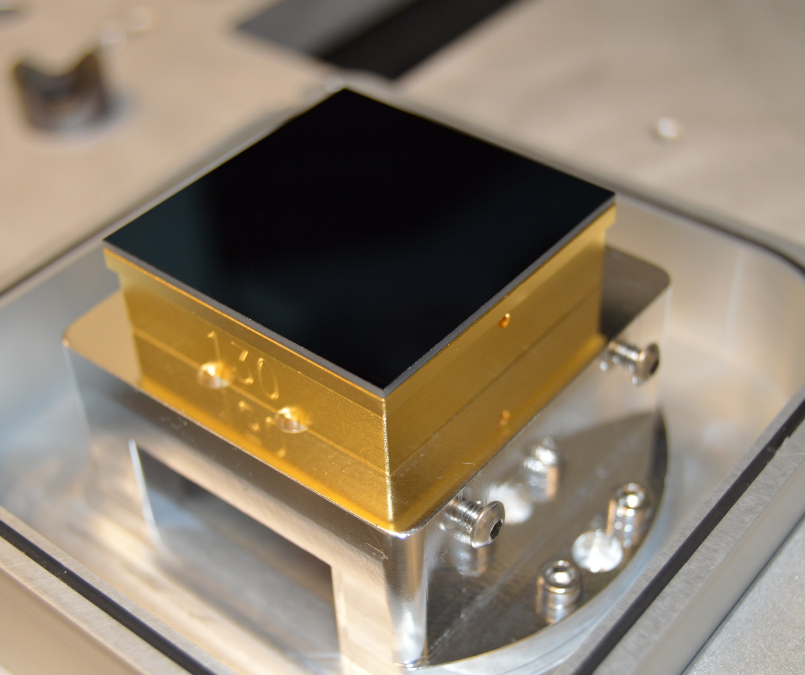
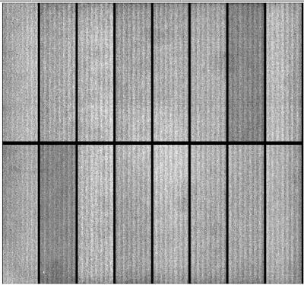
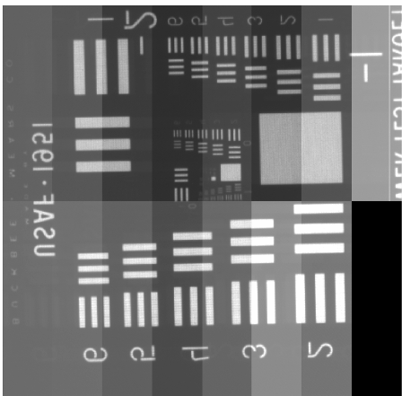
2 detector variants
CCD in test fixture
Uniform illumination
Test target image
T-E2v CCD250
T-DALSA/ITL STA3800C
(overscan displayed)
(overscan suppressed)

Slide 10
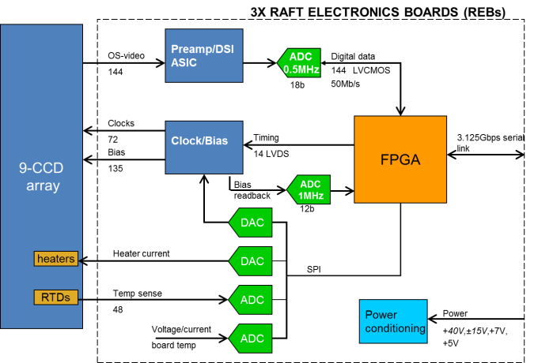
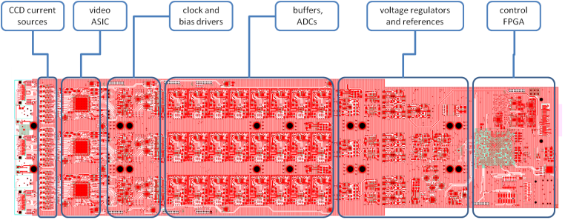
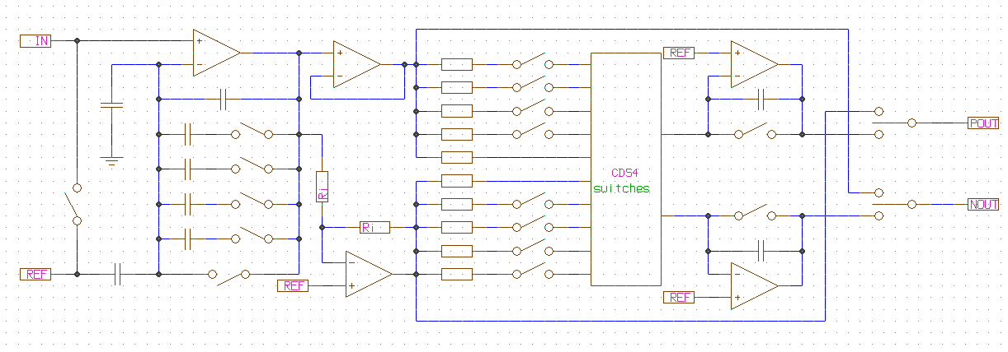
Raft electronics
Functions:
Video CDS processing
18-bit digitization and serialization
HV clock and bias generation
CCD temperature monitoring and control
Onboard diagnostic features including waveform recorder
Implementation:
Three 4” x 16”, 14-layer boards
Video processing in CMOS ASIC (x18)
Xilinx XC7K160T FPGA (x3)
AD7982 18-bit 1MSa/s SAR ADC (x144)
+40/±15/+8/+7/+5V supplies, onboard regulators

Slide 11
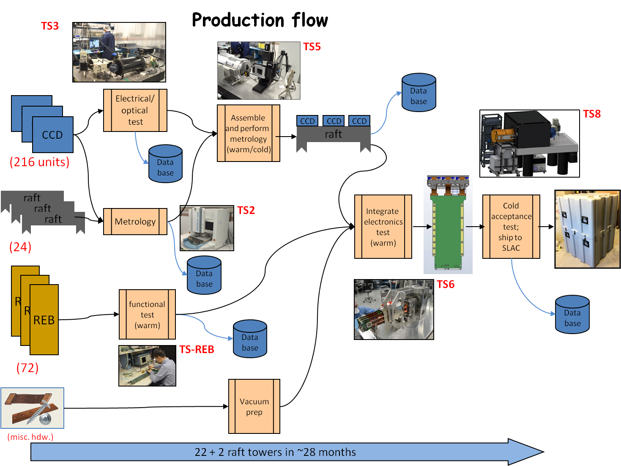
ASIC
functional test
Data base
functional test
REB
Data base
Burn-in,
Thermal cycle

Slide 12
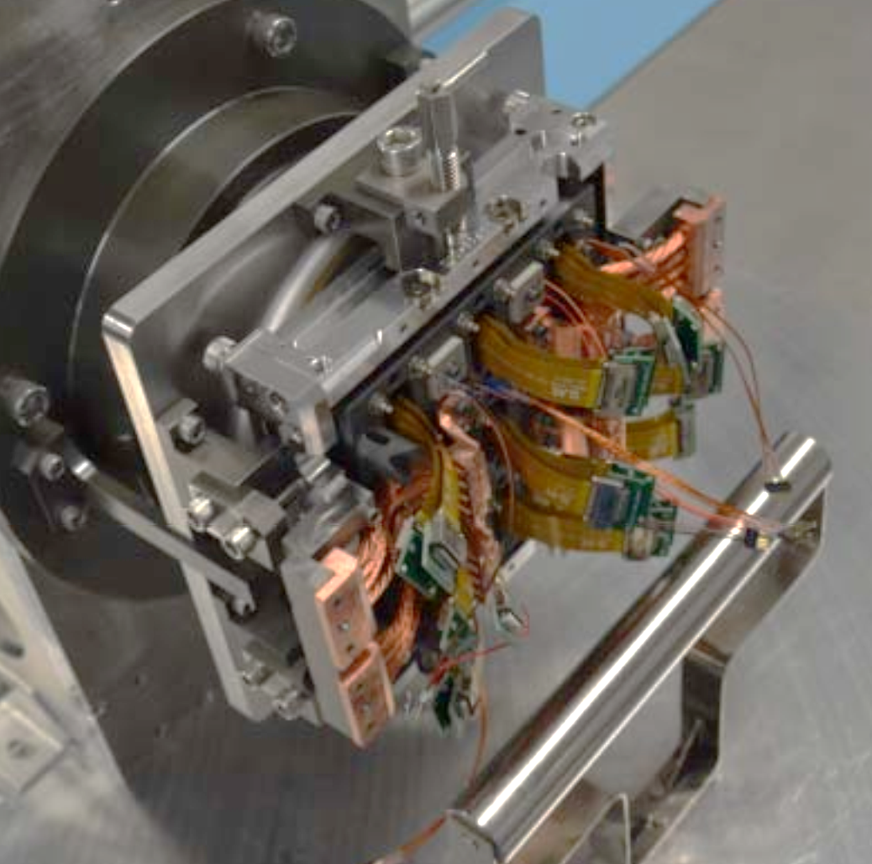
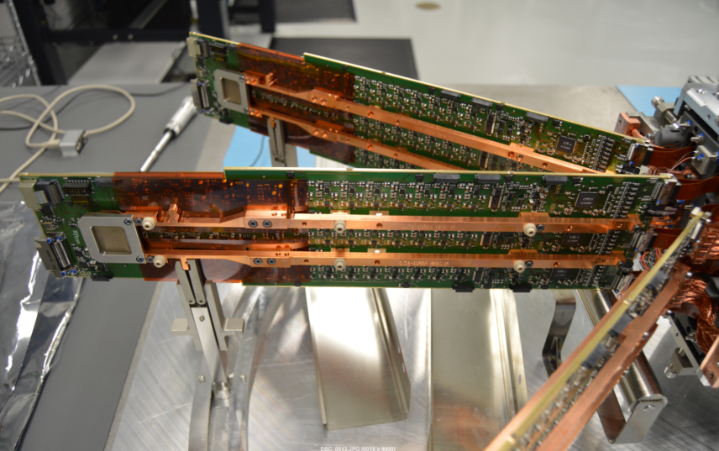
Raft tower assembly (1)

Slide 13
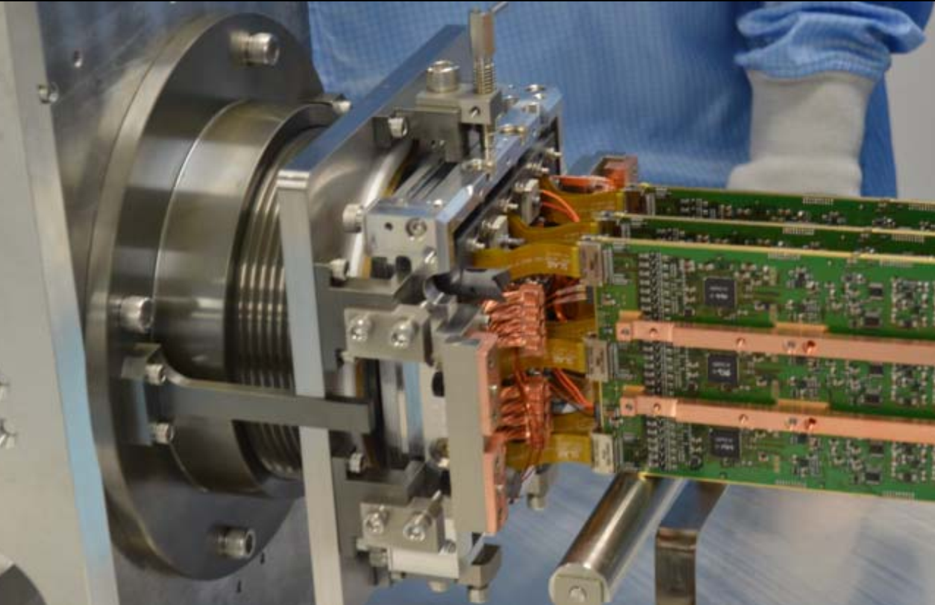
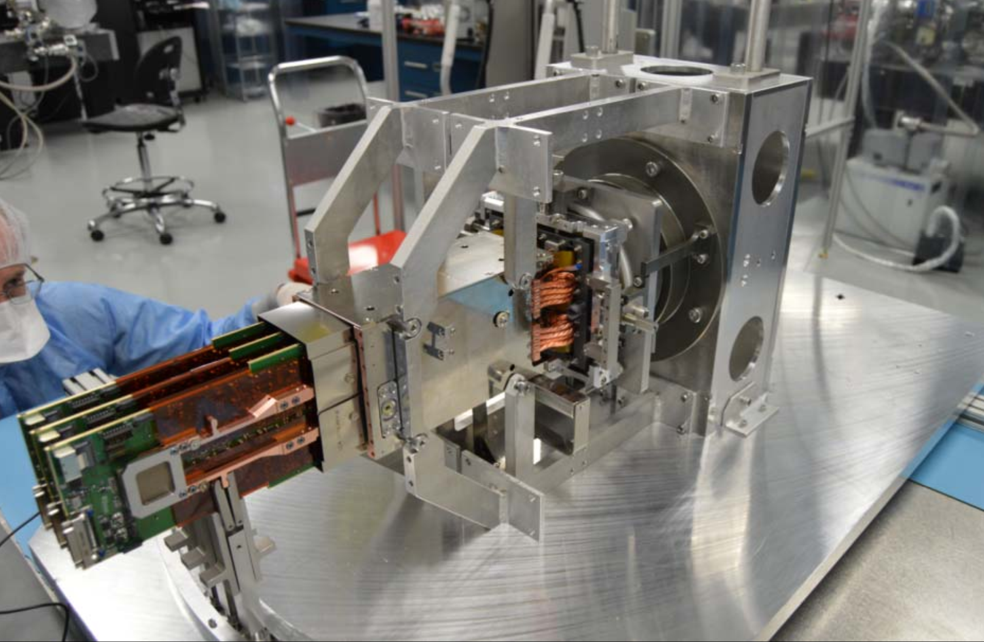
Raft tower assembly (2)

Slide 14
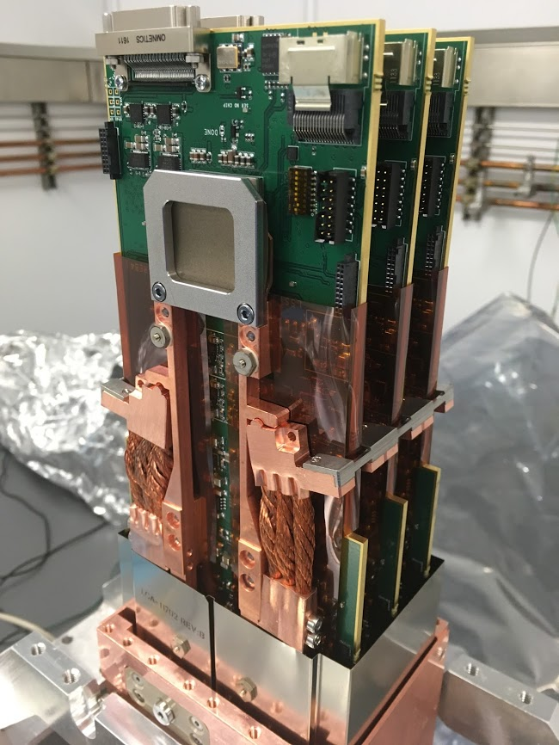

Completed Raft Tower

Slide 15








Warm connectivity test
0 sec image
4 sec image
SF bias currents
counts vs. channel

Slide 16





Tower test cryostat

Slide 17


Cryocooler refrigeration capacities
Single PT-30 cryo head for RSA
Dual NF-55 cold head for electronics
2X
ΔT
PT-30
expected Q
expected Q
ΔT

Slide 18


Tower in cryostat
Friday, Jan 27 2017
ETU#1 in TS-8 at BNL

Slide 19

RTM production status Sept. 2017
assembled and tested
ETU1
ETU2
we’re going to need a bigger assembly bench…
this presentation
RTM1
RTM2
RTM3
RTM4
RTM5
RTM6
RTM7
RTM8
RTM9
RTM10
RTM11
RTM22
…
T-e2v sensors
ITL sensors
future production

Slide 20




Bias images: 3 towers (432 channels)
Bias10%FS
max FWC 82%FS

Slide 21


First step – gain determination
144 channel ⁵⁵Fe spectra
144 channel PTC

Slide 22



350nm flatfields

Slide 23



750nm flatfields
4389

Slide 24



1000nm flatfields
4389

Slide 25




Intra- and inter-raft uniformity
Signal vs. exp time 144 chan. RTM2
QE vs. λ 144 chan. RTM2
Mean intra-CCD PRNU
Mean inter-CCD PRNU

Slide 26






EO performance statistics: 3 rafts
gain e-/ADU
spec | --
<x> | 0.70
1σ | 0.02
95% | 0.08
read noise e-
spec | 9
<x> | 4.66
1σ | 0.16
95% | 0.68
full well ke-
spec | <175
<x> | 136
1σ | 5.5
95% | 20.3
PSF σ
spec | 5
<x> | 4.12
1σ | .062
95% | .160
nonlin %
spec | 3
<x> | 0.15
1σ | 0.03
95% | 0.11
HCTI ppm
spec | 5
<x> | 0.72
1σ | 0.76
95% | 2.69

Slide 27






Parameter maps
gain e-/ADU
noise e-
nonlinearity %
PTC_gain e-/ADU
full well e-
dark current e-/pix/s

Slide 28




Within-CCD crosstalk
aggressor in segment 6
Xtalk from single aggressor
victim vs. aggressor pixel
Full 16x16 crosstalk matrix (prototype elx.)

Slide 29




Noise correlations – good, bad, ugly

Slide 30
Performance goals
  2 second readout time
  9e- read noise
  QE > 75% (450 < λ < 870nm)
  QE > 20% from 320 < λ < 1050nm
  > 99.9995 % CTE serial and parallel
  99.0% operable pixels
  91.4% area fill factor
  < 0.24’’ FWHM diffusion PSF
  0.3% electronic crosstalk
  < 58W power per RTM

Slide 31
Performance goals achieved
  2 second readout time 1.975s
  9e- read noise 4.7 ± 0.17 e-
  QE > 75% (450 < λ < 870nm) 85%
  QE > 20% from 320 < λ < 1050nm 23%
  > 99.9995 % CTE serial and parallel 99.9999%
  99.0% operable pixels 99.97%
  91.4% area fill factor 92.97%
  < 0.24’’ FWHM diffusion PSF 0.18”
  0.3% electronic crosstalk 0.03%
  < 58W power per RTM 39W

Slide 32

THANK YOU

Slide 33
REFERENCES
SDW2013 “System Tests of LSST Integrated Readout Chain” Florence, POC
SPIE2016 “Integrated System Tests of the LSST Raft Tower Modules”, Edinburgh, POC
”Electro-optical testing of fully depleted CCD image sensors for the Large Synoptic Survey Telescope camera”, Vol. 9154 (2014), pp. 915418-915418-17, doi:10.1117/12.2056733 by Peter E. Doherty, Pierre Antilogus, Pierre Astier, et al.
LSST sensor requirements and characterization of the prototype LSST CCDsV Radeka, J Frank, JC Geary, DK Gilmore, I Kotov, P O'Connor, P Takacs, Journal of Instrumentation 4 (03), P03002
Development of the LSST raft tower modules, Society of Photo-Optical Instrumentation Engineers (SPIE) Conference Series, Vol. 8453 (July 2012), doi:10.1117/12.926645 by P. O'Connor, I. Kotov, P. Z. Takacs, et al.
Technology of the LSST focal plane, Nuclear Instruments and Methods in Physics Research Section A: Accelerators, Spectrometers, Detectors and Associated Equipment, Vol. 582, No. 3. (01 December 2007), pp. 902-909, doi:10.1016/j.nima.2007.07.120, by P. Oconnor, J. Geary, K. Gilmore, J. Oliver, V. Radeka, P. Takacs
Lu, W., et al. "CCD emulator design for LSST camera." SPIE Astronomical Telescopes+ Instrumentation. International Society for Optics and Photonics, 2016.
O'Connor, P., J. Fried, and I. Kotov. "An advanced CCD emulator with 32MB image memory." SPIE Astronomical Telescopes+ Instrumentation. International Society for Optics and Photonics, 2012
P. O'Connor, I. Kotov, P. Z. Takacs, J. S. Frank, S. Plate, R. Van Berg, M. Newcomer, P. Antilogus, Hervé Lebbolo, V. Tocut, C. Juramy, P. Doherty, N. Felt, "Development of the LSST raft tower modules", Proc. SPIE 8453, High Energy, Optical, and Infrared Detectors for Astronomy V, 84530L (25 September 2012); doi: 10.1117/12.926645; http://dx.doi.org/10.1117/12.926645

Slide 34
Cryocooler refrigeration capacities
Single PT-30 cryo head for RSA
Dual NF-55 cold head for electronics
2X
ΔT
expected Q
expected Q
ΔT

Slide 35

Camera Control System (CCS) monitoring GUI

Slide 36


Slide 37


Slide 38
Production status Sept. 2017
RTMs assembled: 10
Engineering models: 2
I think we’re going to need a bigger table…

Slide 39


Slide 40




