Slide 1

Infrared Detectors Grown on Silicon Substrates
September 27, 2017
Joong Lee, Don Figer, Liz Corrales, Jonathan Getty, Lynn Mears, Erik Stassinos

Slide 2
Outline
Project overview
Device design
Characterization results
Summary
Future work

Slide 3
Project Overview
Center for Detectors (CfD) and Raytheon Vision Systems (RVS) are developing HgCdTe detectors grown on silicon substrates on a project called SWIR Advanced Technology Instruments for NSF and NASA (SATIN) funded by NSF and NASA.
  develop cost effective HgCdTe detectors for astronomy by growing them on silicon wafers
Significant cost savings are gained through the use of silicon wafers, instead of CdZnTe (CZT) wafers.
  Si wafers are less expensive than CZT wafers
  Silicon wafers being available in large sizes, more die per wafer can be printed, reducing cost per die
Silicon wafers are available in large sizes, providing for scalability to very large formats.
Project goal is to fabricate 1K×1K & 2K×2K MBE HgCdTe/Si detectors with competitive performance.
Parameter | Project Goal | Long-term Goal
Format | 2K×2K | 8K×8K
Pixel Size | 20 μm | 15 μm
Read Noise (Fowler-16) | 5 e⁻ | 2 e⁻
Wavelength Range | 0.4 – 2.5 μm | 0.4 – (2.5-5.5) μm
Dark Current (e⁻/s/pixel) | <0.05 @80 K (95% Operability) | <0.05 @80 K (95% Operability)
Substrate | Si | Si
DQE (w/AR coating) | >70% | >70%
Persistence (after 100% saturation) | <0.1% | <0.1%

Slide 4
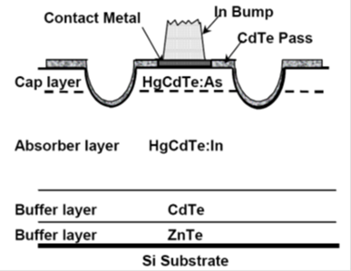
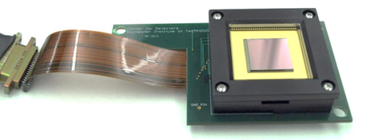
Detector Design
Over the last few years, we have been studying effects of design changes
Current Progress
  Last fabrication lot produced detectors with high persistence and large tails in per pixel dark current distribution
  RVS addressed these issues in latest fabrication round by
    increasing the buffer thickness
    alternative annealing and substrate removal processes
      yielded good results on other projects.
  Three thinned 1K×1K devices (F10, F12 & F13) were characterized
    F13 characterized before and after having the substrate removed
      allowing for the change in the detector characteristics after thinning to be studied

Slide 5
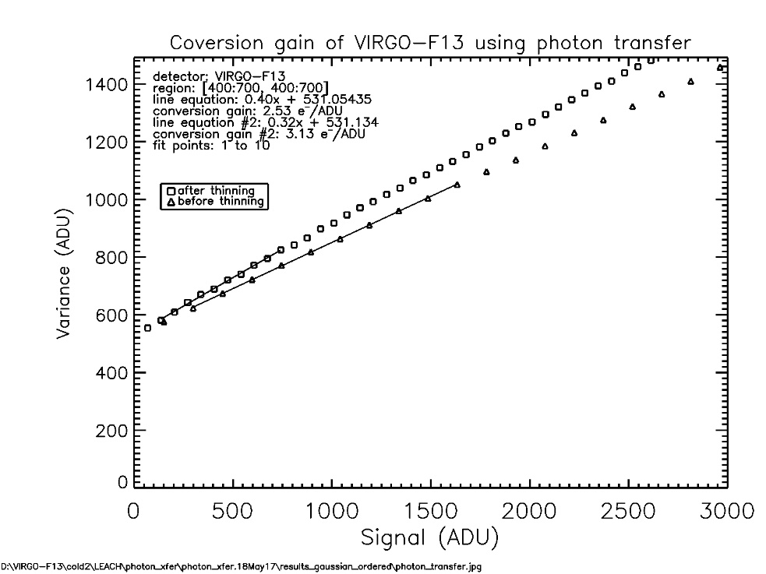
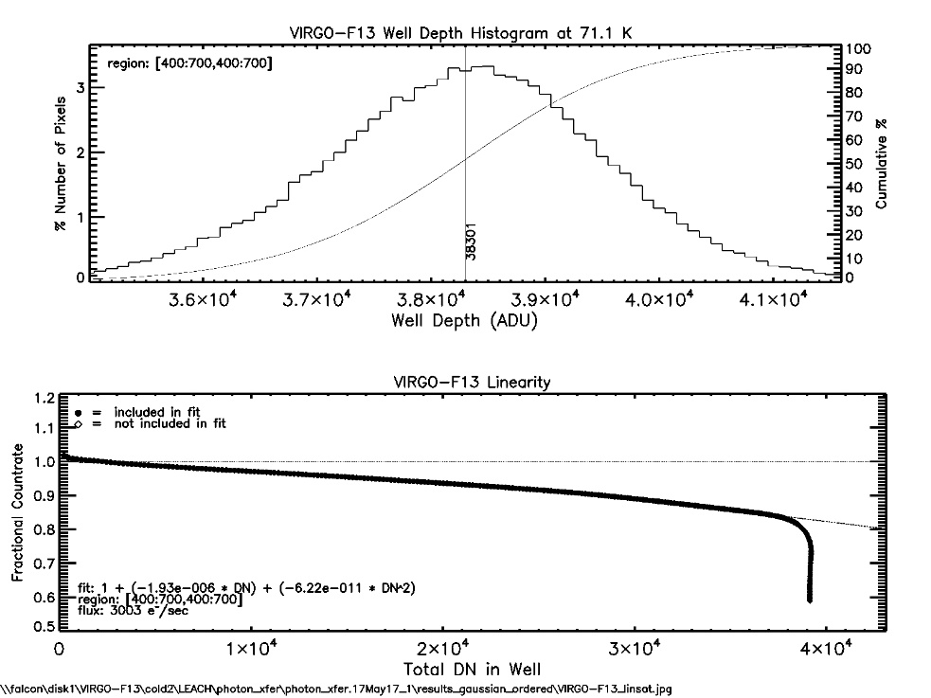
Conversion Gain/Linearity/Well Depth
Conversion gain is measured through photon transfer using flat field illumination
Conversion gain of F13 decreased from 3.1 e⁻/ADU before thinning to 2.5 e⁻/ADU after thinning, corresponding to a decrease in pixel capacitance from 47 fF to 38 fF
Well Depth ~400,000 e⁻
  After thinning
Linearity = 1+aDN+bDN²
  DN – Cumulative Signal
  a = -1.93 × 10⁻⁶
  b = -6.22 × 10⁻¹¹
Linearity is ~80% by the time the well is saturated.

Slide 6
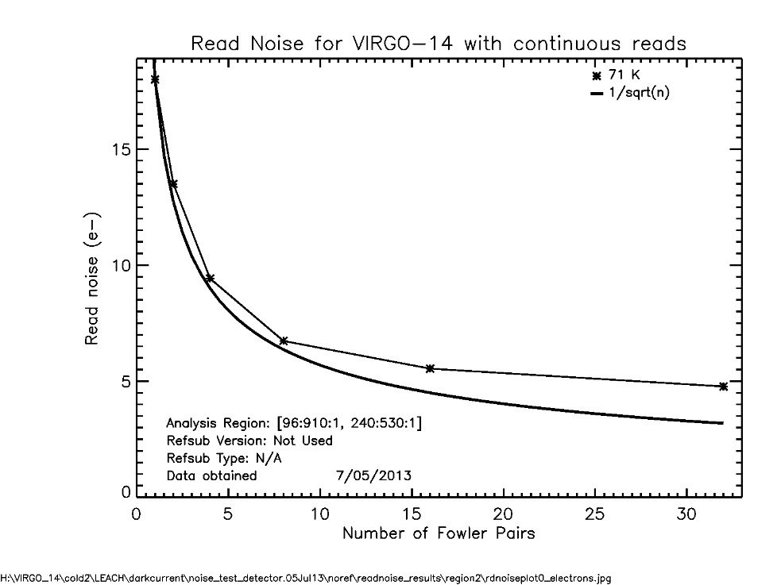
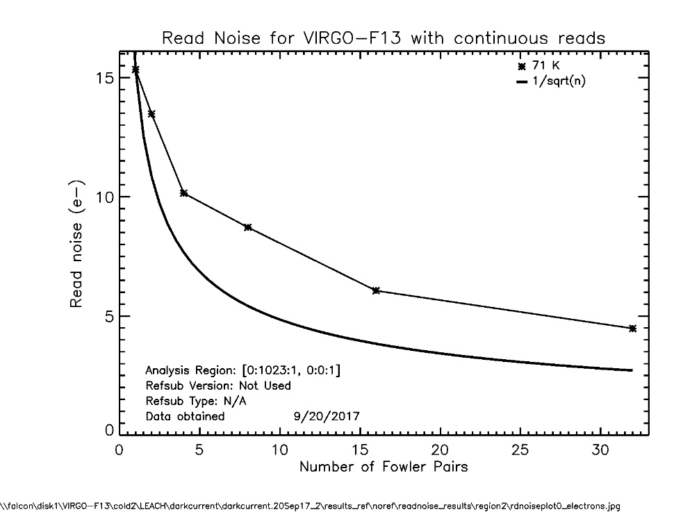
Read Noise
The read noise is 6 e⁻ (Fowler-16) in both the science pixels (left) and the reference row (right).
The read noise is higher in the science pixels of some devices, depending on the growth recipe and the processing steps.

Slide 7
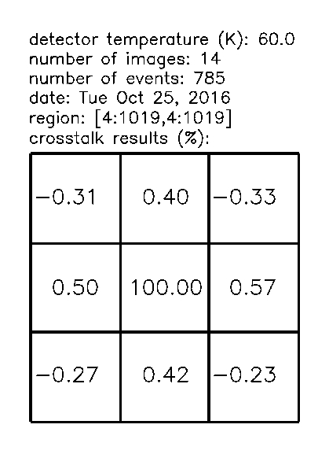

Crosstalk
Crosstalk is obtained by identifying cosmic ray hits and the induced signals in the neighboring pixels.
Crosstalk is around 0.5% in the nearest neighbors prior to thinning (left).
After being thinned, crosstalk increases two- to three-fold (right).
  Crosstalk nearly identical on F10, F12, and F13
The detectors are back filled with epoxy for mechanical integrity after being thinned.
  RVS is exploring the option to use softer epoxy which performs better in crosstalk.
  Softer epoxy added bonus of putting less stress on the lattices which should help with dark current.

Slide 8
Quantum Efficiency
Use diode replacement method
Cutoff wavelength is 2.7 µm
QE ~ 90% at highest point
The short wavelength QE extends below 1.1 µm
  Substrate has been removed
QE nearly identical on F10, F12, and F13

Slide 9
Dark Current
Dark current of VIRGO-14 increases slowly over increasing temperature, doubling every ~30 K.
  Very close to meeting project goals at 80 K
In comparison with VIRGO-14, F3 and F13 (after being thinned) perform on par or better at 40 K and 60 K but start to diverge at 80 K
  F10 and F12 are nearly identical to F13

Slide 10
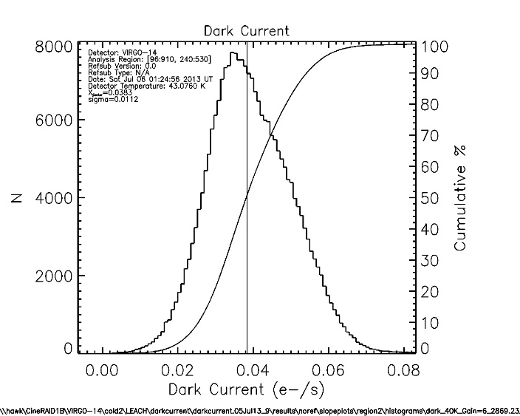
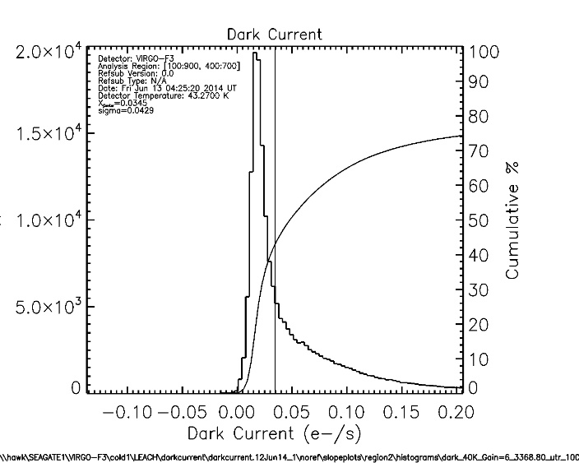
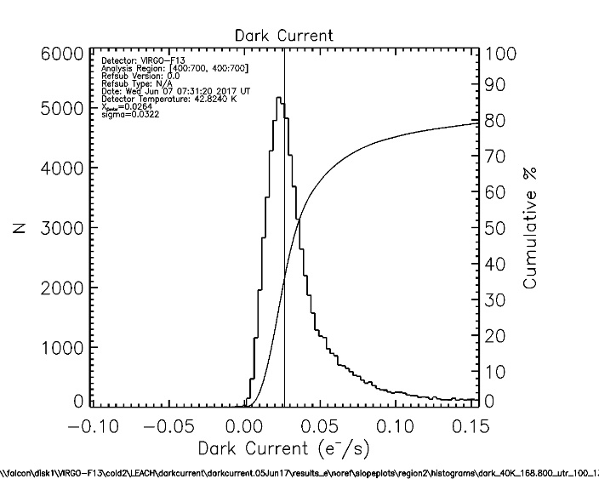
Dark Current
VIRGO-14
VIRGO-F3
VIRGO-F13
The mode of the distributions on all three parts nearly identical at 40 K.
Virgo-14 has symmetrical dark current distribution
Compared to VIRGO-14, the dark current distribution of F3 has a large tail.
Compared to F3, F13 has a more symmetrical distribution with a smaller tail.
  Increasing the buffer thickness reduced the tail in dark current distribution in this fabrication run.
    F10, F12, and F13 all have smaller tails compared to F3.
Notes:
VIRGO-14 symmetrical.

Slide 11
Persistence
Persistence is the increase in dark current after a detector is illuminated.
Persistence is quantified in terms of the percentage of the fluence.
In this example, the cumulative persistence collected over an hour is 0.4% after being illuminated to a fluence equivalent to 150% of the well depth.
  Most of persistence is released within the first 1000 seconds.
  Nearly all persistence is released within one hour.

Slide 12
Persistence
Cumulative persistence collected over one hour
  wavelength = 1.75 µm
Persistence low for all fluences for F13 before thinning
  0.2% at the highest point
After thinning, persistence of F13 is high
  It can be as high as 1.5% for low fluences
Persistence of F3 is just as high as, if not higher than, persistence of F13 after thinning
Persistence of F13 before being thinned is an order of magnitude lower than persistence of thinned F13 and F3
  Almost meets the project goals
  F3 is an unthinned device

Slide 13
Persistence
Measured wavelength dependence of persistence of thinned F13
The longer the wavelength, the larger the persistence for <100% fluence
  Correlated with absorption depth
Persistence for different wavelengths converge and meet at the same point past 100% fluence
The wavelength dependence is also present on F10, F12, and F3
F13, before being thinned, did not have appreciable wavelength dependence

Slide 14
Summary
Parameter | Project Goal | Delivered/Achieved
Format | 1K×1K & 2K×2K | 1K×1K and 2K×2K
Pixel Size | 20 µm | 20 um
Read Noise (Fowler-16) | 5 e⁻ | 6 e⁻
Wavelength Range | 0.8 – 2.5 um | 0.5 – 2.5 um
Dark Current (e⁻/s/pixel)* | <0.05 @ 80 K (95% Operability) | <0.05 @ 80 K (70% Operability)
Substrate | Si | Si
Minimum readout time (s) | 1 | 0.3
Number of readouts | 4,16 | 4, 16
Reference pixels | Yes | Yes
Reference outputs | Yes | No
Window mode | No | No
Well size (e⁻) | 300,000 | 400,000
Gain at unit cell (µV/e⁻) | >8 | >8
DQE (w/AR coating) | >70% | >75%
Pixel readout rate (kHz) | 100 | 100
Readout system | SFD | SFD
Buttability | 3-side, <2 mm gap | Package not design for large gaps
Persistence (after 100% saturation) | <0.1% | > 0.1%
Read noise (Fowler-16) is 6 e⁻ for both science pixels and reference row.
Best Dark current achieved at 80 K is 0.05 e⁻/sec (70% operability).
F13, before substrate removal, almost meets the project goals for persistence.
  0.2% at the highest point
  On the previous fabrication run, unthinned devices had persistence that is an order of magnitude higher.

Slide 15
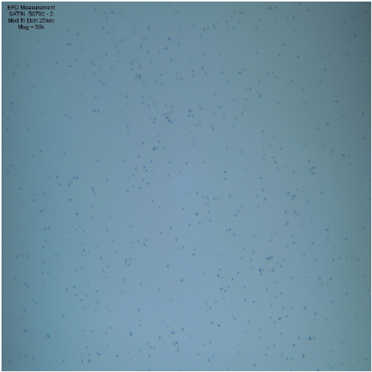
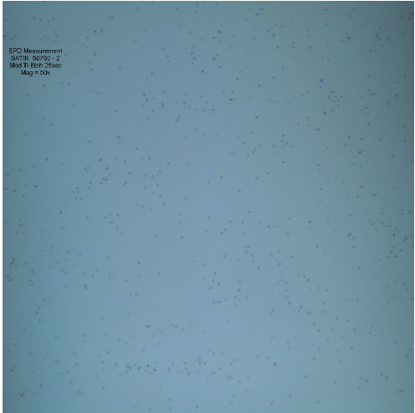
Future Work
RVS has determined that in order to meet the project goals, the etch pit density (EPD) has to be reduced at least four-fold.
RVS has successfully produced experimental wafers that have EPDs that meet the constraints.
RVS will only process wafers with EPDs that satisfy the specifications in the next fabrication run.

Slide 16



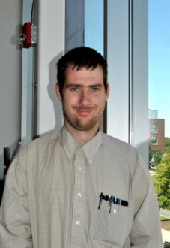
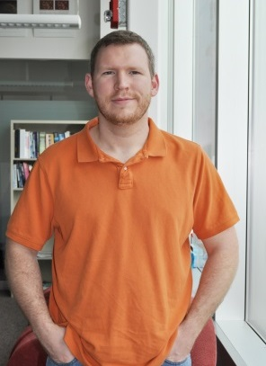
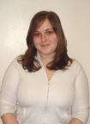

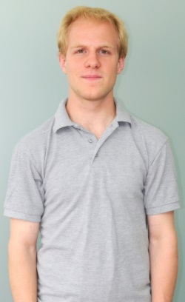
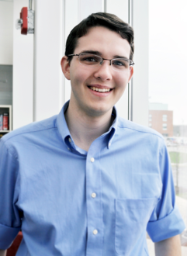
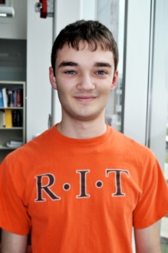
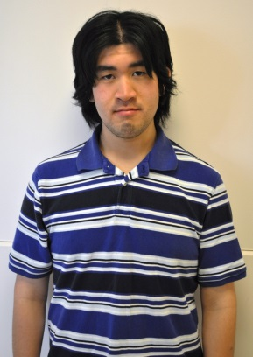
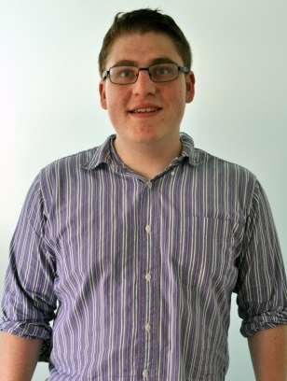
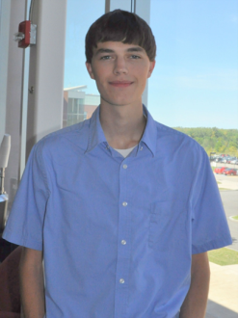
Acknowledgments
Don Figer
Joong Lee
Brandon Hanold
Iain Marcuson
Dan Grant
Kim Kolb
P.I.
Engineer
Engineer
Engineer
Engineer
PhD, IS
Matt Davis
Neil Guertin
Jon Zimmermann
Mike Every
John Hatakeyama
Tre DiPassio
Kenny Bean
MS, EE
BS, CS
MS, EE
BS, Physics
BS, EE
MS, EE
BS, ME
Funding:
  NSF ATI Program, Grant No. AST-1509716
  NASA APRA Program, Grant No. NNX13AH70G
Notes:
I would like to acknowledge all of the students and staff that have contributed to this work at the Center for Detectors.
16

