Slide 1
Germanium Charge-Coupled Devices for SWIR and X-Ray Imaging
DISTRIBUTION A. Approved for public release; distribution unlimited.
C. Leitz, S. Rabe, I. Prigozhin, M. Zhu, B. Burke, K. Ryu, M. Cooper, R. Reich, K. Johnson, W. Hu, B. Felton, M. Cook, C. Stull, V. Suntharalingam
September 27, 2017
This material is based upon work supported under Air Force Contract No. FA8721-05-C-0002 and/or FA8702-15-D-0001. Any opinions, findings, conclusions or recommendations expressed in this material are those of the author(s) and do not necessarily reflect the views of the U.S. Air Force.
© 2017 Massachusetts Institute of Technology.
Delivered to the U.S. Government with Unlimited Rights, as defined in DFARS Part 252.227-7013 or 7014 (Feb 2014). Notwithstanding any copyright notice, U.S. Government rights in this work are defined by DFARS 252.227-7013 or DFARS 252.227-7014 as detailed above. Use of this work other than as specifically authorized by the U.S. Government may violate any copyrights that exist in this work.

Slide 2
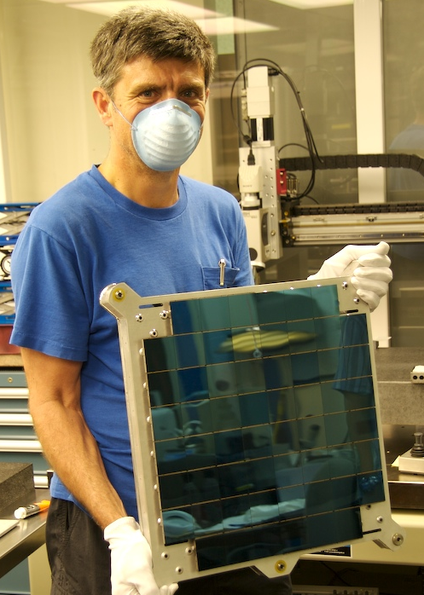
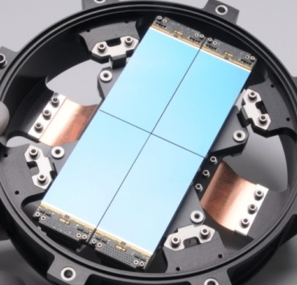
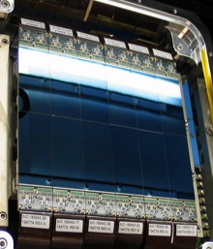
MIT-LL Silicon Charge-Coupled Devices (CCDs)
Exquisite sensitivity and dynamic range from soft X-ray to near infrared
Noiseless, efficient charge transfer enables time delay integration (TDI) operation, pixel binning
High spatial uniformity enables large-format imagers
PS1-2 (2007, 2015)
TESS (2015)
SST (2011, 2015)
Can we realize these advantages in other bands?

Slide 3
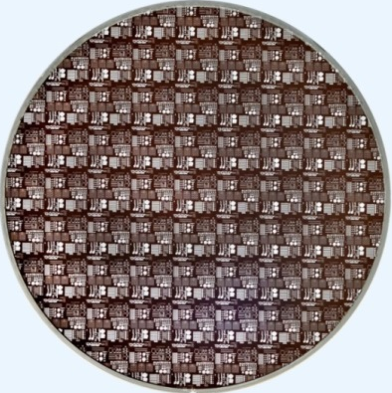
Motivation
SWIR & X-Ray Band Sensitivity [1-3]
Disruptive Potential for Imaging in These Bands
Wafer Size Comparison
Sensor Size Comparison
InGaAs (SWIR)
InGaAs (1.3 Mpix)
CZT (X-ray)
NuSTAR
(1 kpix)
Germanium
Germanium
(> 20 Mpix expected)
200 mm
5 cm
High-quality gate dielectrics enable CCDs
No bump-bonding required
Compatible with Si CCD tool set
[1] T. Martin & P. Dixon, Laser Focus World (11/2004); [2] MIT-LL measured; [3] average from Nakano et al., J. Non-Cryst. Sol. 358 (2012) 2249 & N. Posthuma et al., Proc. 3rd World Conf. Photo. Ener. Conv. (2003), scaled to 45 µm.

Slide 4
Path to a Germanium CCD
Discrete devices provide insights into CCD performance
CCD Viewed Along Charge-Transfer Direction
Metal
V_{low}
V_{high}
V_{low}
V_{low}
V_{high}
V_{low}
V_{OG}
Al₂O₃
1
3
GeO₂
Gate dielectric
Buried channel
Output
Germanium
Germanium substrate
2
100 nm
Back surface electrode
C. Leitz et al., “Germanium CCDs for large-format SWIR and X-ray imaging,” Journal of Instrumentation 12 (2017).

Slide 5
Estimating Dark Current in a Germanium CCD
Used measurements on building blocks to estimate dark current noise
Germanium
InGaAs
Silicon
Many key variables that govern device performance are nearly equivalent to silicon
Ge CCDs require cooling to achieve low dark current because of high intrinsic carrier conc.
Conservative dark current target of < 10 pA/cm² at 150K
(40 e-/pixel/s for an 8-µm pixel)

Slide 6
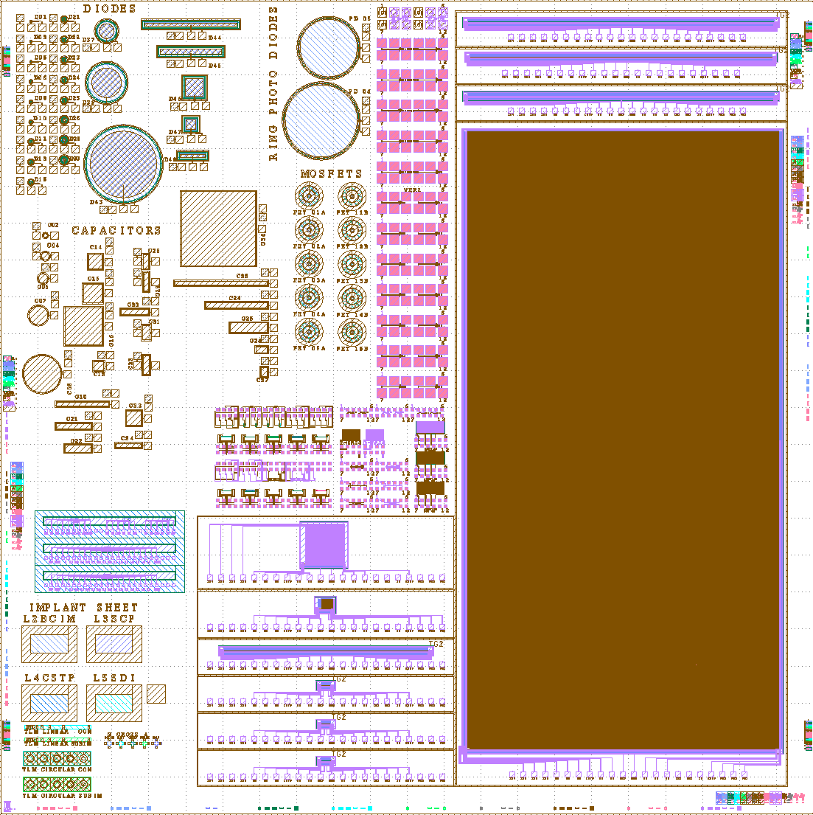
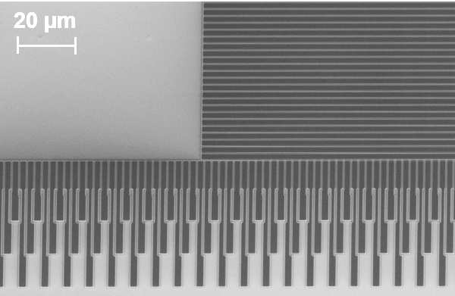
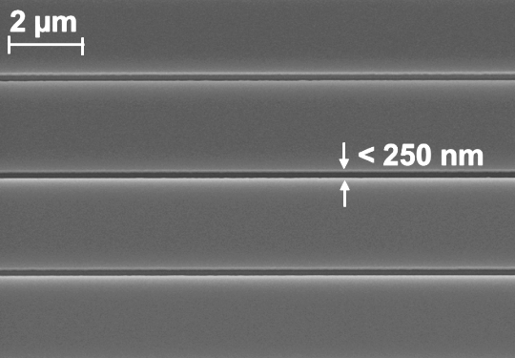
First-Generation Germanium Imagers
Reticle Layout
Metal Gate Detail
Processed 200-mm Wafer
  Shift registers
  128 × 128 x 8 µm OTCCD
  1k × 2k × 8.1 µm frame transfer CCD
Single pixel
  32 × 32 × 8.1 µm full-frame CCD
  Shift registers

Slide 7
Germanium CCD Fabrication Challenges
Silicon CCD
Germanium CCD
Silicon Dioxide
Poly 1
Poly 2
Poly 3
Metal Gate Electrode
Gate Dielectric
Gap Between Phases
Gap Between Phases
Fabrication Challenge | Mitigation Plan | Other Alternatives
Cannot use overlapping poly-silicon process to define phases | Single-level CCD | Low-temperature fabrication processes
Charge transfer inefficiency due to large gap between phases | 248-nm lithography to define sub-300 nm gap | 193-nm or e-beam lithography
Low sensitivity in front illumination due to metal shading | Back illumination | Engineered substrate for rapid prototyping
Column isolation | Dopant-based isolation | Develop LOCOS process

Slide 8
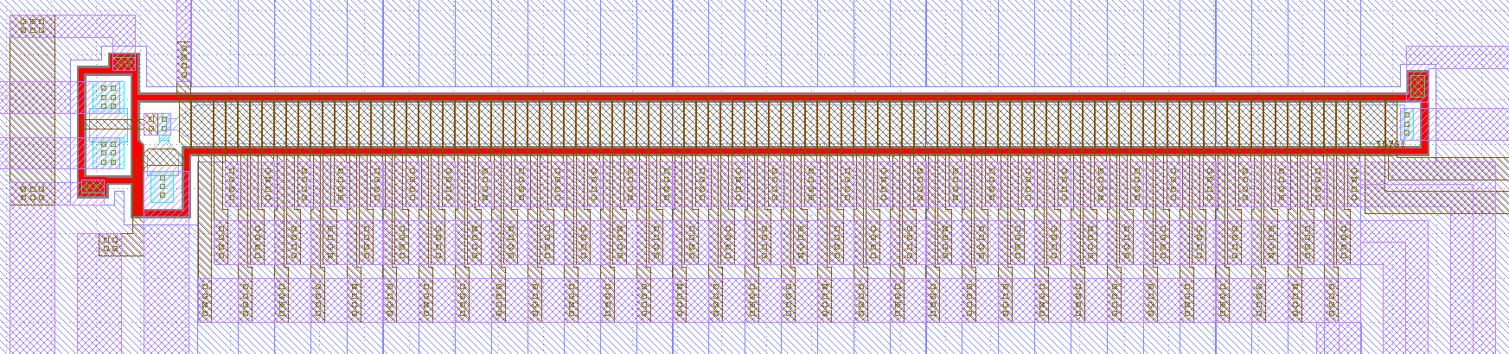
Diagnosis of First Ge CCDs
Unable to demonstrate charge transfer on devices from first wafer
32-stage shift register
Channel Stop
First CCDs saturated for all test conditions despite positive results from parametric tests (low diode leakage, no gate shorts)
Diagnosed problem as insufficient isolation from device periphery due to poorly functioning channel stop

Slide 9
Diagnosis of First Ge CCDs
All Gates Biased
Only IG1 Biased
OG
IG2
IG1
IG1
Contact
Input Diode
Input Diode
RG
S1
S2
Reset Drain
S3
Reset Drain
Results indicate poor isolation from periphery, indicating channel stop barrier height insufficient

Slide 10
Contributors to Low Channel Stop Barrier Height
1. Lower-than-expected doping in channel stop
2. Rectifying contacts to channel stop region
10¹⁸
15
10
  Measured dose = 1.5e12 cm⁻²
  Active dose = 1e11 cm⁻²
10¹⁷
5
Current (µA)
  Contact resistance ~ 10⁴ Ω-µm²
Phosphorus Concentration (cm⁻³)
0
Total (SIMS)
10¹⁶
-5
  Contact resistance ~ 10⁵ Ω-µm²
Electrically Active (SRP)
-10
10¹⁵
-15
Addressed poor peripheral isolation by adjusting channel stop implant conditions

Slide 11
Demonstration of Linear Germanium CCDs
Improved isolation yields working 1-D Ge CCDs at -60°C
32 pixels
Input
Output
Well capacity
Estimates of CCD performance from 32-pixel linear CCD
75,000 h+ well capacity (8.1 × 8.1 µm pixel)
0.6 nA/pixel dark current (-60°C)
CTE > 98.5% initially, drops to 85% over span of minutes
Dark Current

Slide 12
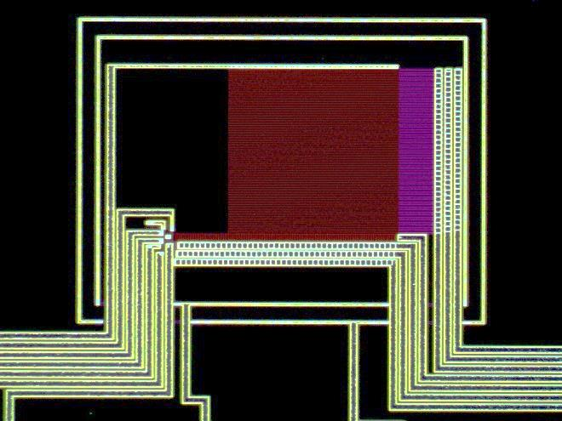
Demonstration of 32 × 32 × 8.1 µm Array
Further improvements to isolation led to operable pixel arrays at -60°C
Dark Response
Subtracted Image
Optical Micrograph of 32 × 32 Array
Scale: 4000-8000DN
Red LED Illumination
Scale: -500-2000DN
100 µm
Scale: 4000-8000DN

Slide 13
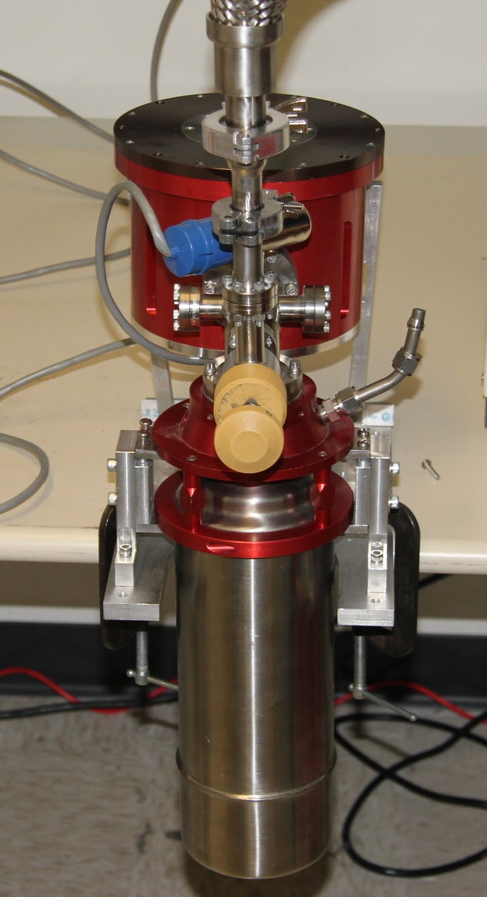
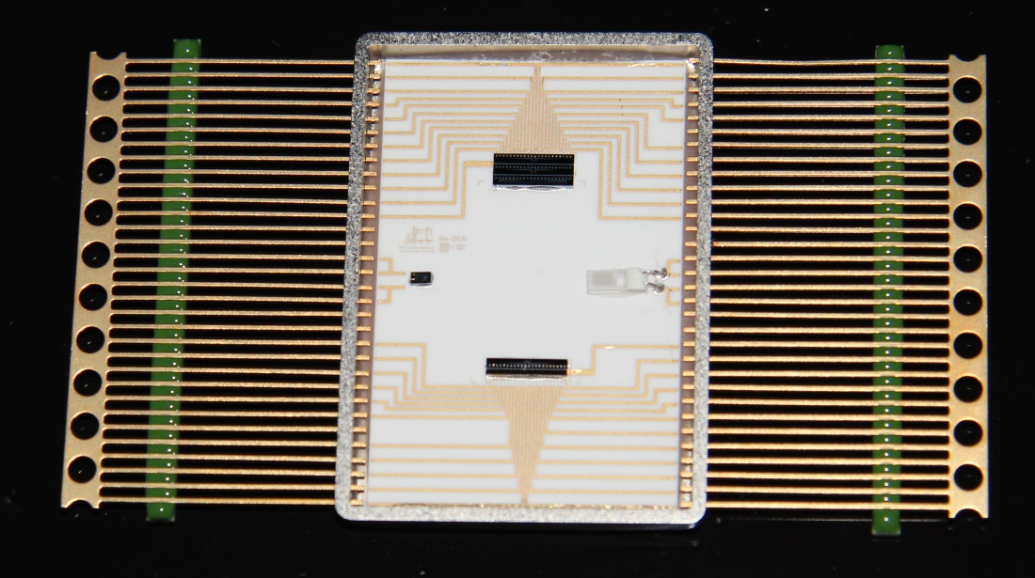
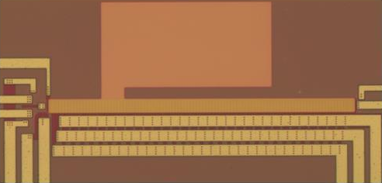
Next Steps
Device Testing
Test packaged shift registers and arrays in cryostat
Measure read noise, dark current
CTE Improvement
Characterize effect of field plate on shift registers
Fabricate devices with new metal mask (gaps shrunk from 230 nm → 180 nm)
30 µm

Slide 14
Conclusions
Germanium CCDs offer numerous advantages for X-ray and SWIR imaging
  Wide response
  Able to fabricate large-format CCDs on this material
Our work to date has validated the potential of germanium as a low-noise CCD material
Our first 32 × 32 CCDs are operational, and we are focused on improving CTE and scaling to larger arrays

