Slide 1
Large Format Array developments
at Sofradir and CEA for Science and Astronomy applications

Slide 2
Sofradir in a few words
  30 years of heritage on Infrared detectors design and manufacture, mainly for HgCdTe technology
  800 people, >100 people dedicated to space applications
  80 Flight Models delivered over the past decade ; 18 already in space, 20+ planned for launch in 2017-2018
  Contractor of most of European space missions with IR imaging (Meteosat Third Generation, Sentinel satellites, METimage, 3MI, ExoMars)

Slide 3
Context of the studies
  The objective of the studies is to answer European Space Agency (ESA) needs for their Cosmic Vision program (2015-2025) including science and astronomy applications
  What ESA needs :
    SWIR Large Format Arrays (LFA)
    Products made by an European manufacturer
    Components capable of working in low fluxes environments
  These activities were initially competitive between Leonardo/UKATC and CEA-LETI/CEA-IRFU/Sofradir (technologies development)
  The current phase has been contracted with Sofradir only

Slide 4
Potential Applications
  ESA expected missions
    ARIEL : detection of exoplanetary systems ; large FPA imaging detector, pitch ≥ 15µm, 2 channels in MWIR and LWIR wavelengths
    THESEUS : exploration of the Early Universe by unveiling the faintest GRBs population ; NIR spectrometer
    Future missions to come…
  ESO ELT instruments
    HARMONI : spectrograph made of 4 channels of 8k x 4k pixels, pitch ≥ 15µm, Visible / SWIR wavelengths
    MICADO : diffraction limited imager, mosaic of 12k x 12k, pitch ≥ 15µm, SWIR wavelengths
    METIS : 4k x 4k spectrograph mosaic + 2kx2k imaging detector, pitch ≥ 15µm, MWIR wavelengths
    Future instruments to come…
  Others ? Contact us !

Slide 5
Scope of the presentation
Capability of our technologies to meet the specifications
  Specifications
  Detector under test definition
    Detection Circuit main characteristics
    Readout Circuit design
  Detector under test performances
Detector size scale up
  ALFA detector requirements
  Scale up capability
  Development schedule
  Astronomy projects roadmap

Slide 6
Capability of our technologies to meet the specifications
Detector size scale up
Capability of our technologies to meet the specifications

Slide 7
Specifications
Parameter | Requirement
Cut-on wavelength | ≤ 0.8 µm
Cut-off wavelength | < 2.3 µm
Quantum efficiency | ≥ 70%
Operating temperature | ≥ 100K
Dark current (at 100K) | ≤ 0.1 e-/pix/s
Linear well capacity | ≥ 60 ke-
Non-Linearity | ≤ 3%
Cross-talk | ≤ 2%
Readout noise (single CDS) | ≤ 18 e- rms
Readout speed | ≥ 100 kHz

Slide 8
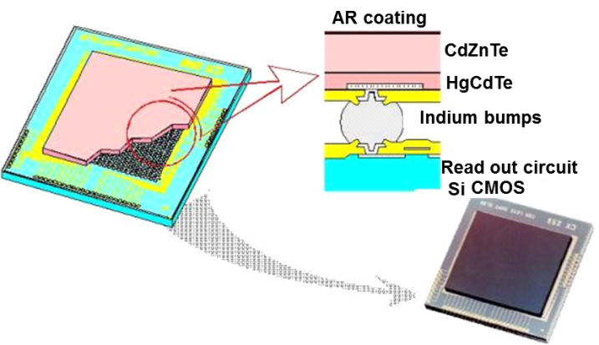
SWIR LFA detector under test definition
  Component tested in the previous LFA development studies
  HgCdTe material hybridized component
  Format :
    640x512 pixels
    15 µm pitch

Slide 9
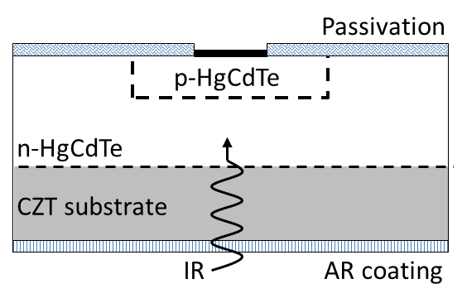
Detection Circuit main characteristics
  Epitaxy type : both MBE and LPE have been studied
  Diodes technology :
    p on n technology (more than 10 years of experience for CEA-LETI and Sofradir teams) ➔ better QE is expected compared to n on p technology
  Wavelength range:
    0.8µm cut-on (non removed CdZnTe substrate)
    2.1µm / 2.3µm cut-off

Slide 10
Readout Circuit design
  Source Follower per Detector : Integration on the PV diode capacitance
  Capabilities :
    Unitary diode reset
    Readout through follower MOS
    Non-destructive reading
  Advantages:
    High impedance
    Well adapted for low fluxes
    Low readout noise
Reset
Column select
Unbuffered output
Output buffer
Sub PV
Line select
Buffered output
Pixel
Column

Slide 11
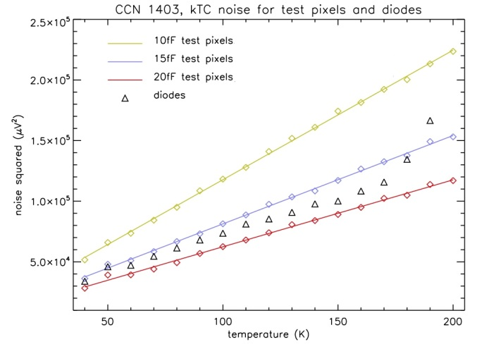
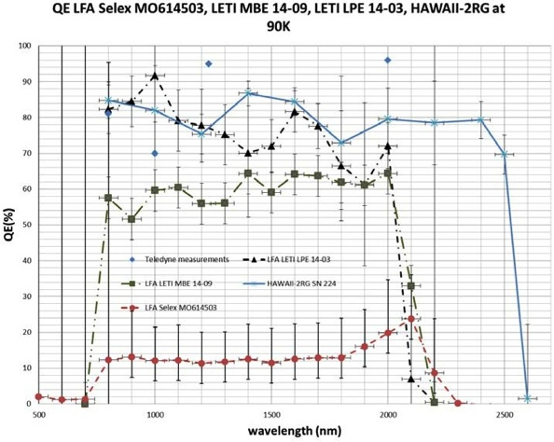
Detector performances
  Quantum efficiency measured by ESA :
    ~75% for LPE epitaxy components
    ~60% for MBE epitaxy components
  Dynamic range
    Diode capacitance :15fF to 20fF
  Non linearity
    ~3.2% for LPE components
    ~2.5% for MBE components
  Readout Noise
    11.4 e- to 11.5 e- on test pixels
  Cross-talk
    0.6% for LPE components
    1.1% for MBE components
LPE
MBE
500
1000
1500
2000
2500

Slide 12
Detector performances
  Dark Current at 100K : measurement is hardly achievable because of glow effect due to the ROIC
  It has been performed by reducing bias level : minimum dark current measured is 0.5e-/s
  We still need to work on glow reduction to reach lower measurements
Nominal Ouput node bias
Minimum Ouput node bias
0.5 e-/s

Slide 13


Performances summary
Parameter | Requirement | Value | Compliancy
Operating wavelength | 0.9 – 2.0µm | 0.8- 2.1µm
Cutoff wavelength | <2.3µm | 2.1µm
Quantum efficiency | ≥70% | 74% mean value
Operating temperature | ≥100K | 100K
Dark current (at 100K) | ≤0.1 e-/pix/s | <0.5e-/s
Linear well capacity | ≥60ke- | 60ke-
Non-Linearity | ≤3% | 3.2% and 2.5%
Cross-talk | ≤2% | 0.6% to 1.1%
Readout noise (single CDS) | ≤18e- rms | 11.4 to 11.5e-
Readout speed | ≥100kHz | 100kHz
ROIC glow hides dark current

Slide 14
Capability of our technologies to meet the specifications
Detector size scale up
Detector size scale up

Slide 15
ALFA detector requirements
Parameter | Value
Array size - pitch | 2048x2048 – 15µm
Spectral range | Cut-on ≤ 0.8µm, cut-off 2.1µm / 2.5µm
Operating temperature | 100 ± 1 K
Quantum efficiency | ≥ 70%
Dark current (at 100K) | ≤ 0.1 e-/pix/s
Linear well capacity | ≥ 60ke-
Non linearity | ≤ 3%
Cross talk (inter pixel capacitance / other contributions) | ≤ 2% / ≤ 3%
Readout noise (single CDS) | ≤ 18e- rms
Readout speed | ≥ 100kHz

Slide 16





ALFA program : NIR detector development
LETI : 50 years heritage in HgCdTe technology
Detection circuit development
IRFU : 40 years in developing and testing instrumentation for space missions
  Astronomy Large Focal plane Array
  ESA program + Labex FOCUS (french labs) fundings
  French consortium
2048x2048 Hybridized Circuit – 15µm NIR/SWIR
Component EO characterizations
30 years heritage in HgCdTe IR detectors manufacturing
ROIC design
Hybridization and Packaging
Involved in ESO METIS instrument

Slide 17

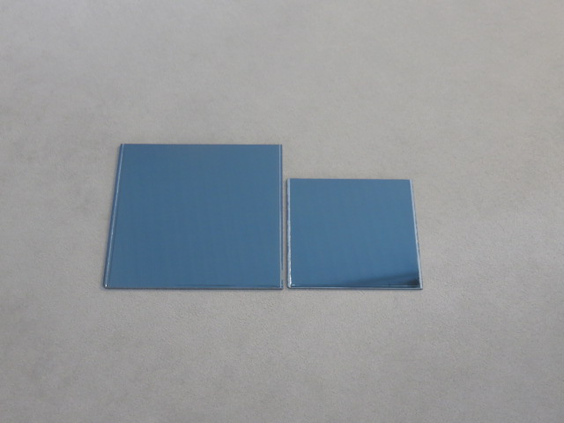
Asteroid program : manufacturing means
  ASTronomy EuROpean Infrared Detector
  European consortium (H2020 program contracted with European Commission)
  Main goal : to develop the technology that will make Europe non-dependent for large IR detectors compatible with large volume production
  Use of larger CdZnTe wafers
    From current 2.5 inches size (1 Detection Circuit) to 3.5 (4 DC)
    First batch already manufactured
3.5’’ vs 2.5’’

Slide 18
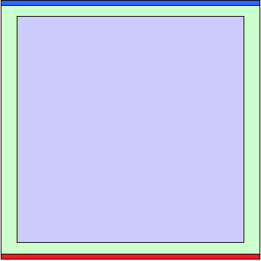
ALFA detector design
  2048x2048 pixels matrix, composed by:
    2042x2042 sensitive pixels
    A ring of reference pixels : fixed capacitance
    1 row of specific reference pixels : different capacitance values
    1 row of test pixels : ROIC functionality, pixel leakage, parasitic capacitance…
  ROIC capabilities
    Windowing capability
    Readout modes : rolling shutter, non-destructive readout
    Readout frequency : 100 kHz (Science mode)
    6MHz (Fast mode)
    1, 4 or 32 output
  Packaging designed with 4 sides buttability for mosaic imaging

Slide 19
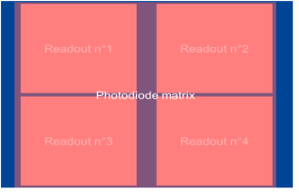
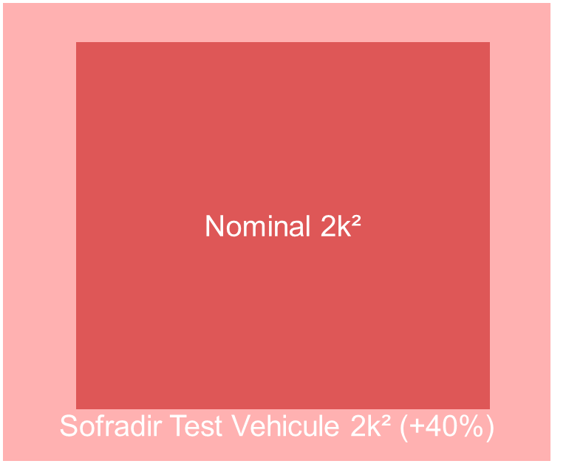
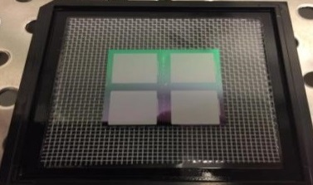
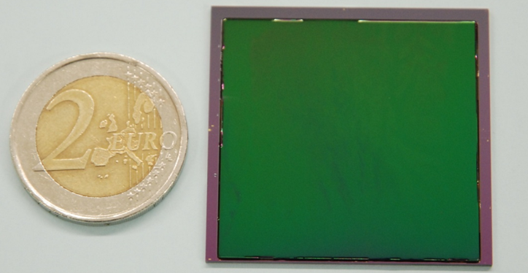
Hybridization capability
  Prototyping : hybridization of 4 NGP matrix (1024x1024) on a single test vehicle
  Total size of the prototype ~40% larger than the size of the LFA under development
  Number of good connections after hybridization > 99.9% of pixels
A block of 4 CMOS readout 1024x1024 - NGP
Equivalent 2428x2428 15µm pitch detector
Multi Cross sections on 2 axis → 99.999% rate of interconnection

Slide 20
ALFA development schedule
Tasks 1&2 : Review of requirements, Preliminary Design, Test Plan Preparation
Task 3 : Detailed Detector Design
Task 4 : Detectors manufacturing and sorting
Tasks 5 : Detectors Characterization
KO
PDR
CDR
TRR
Project end
11/2016
02/2017
11/2017
09/2018
02/2019
Nov.
Feb.
May
Aug.
Nov.
Feb.
May
Aug.
Nov.
Feb.
May
Aug.
2016
2017
2018
2019
Today

Slide 21
Astronomy projects roadmap
2016
2018
Already Available
On going
To come…
  MCT p/n technology with low dark current and high QE
  SFD input stage ROIC with low noise capability
  Technologies scale up (ROIC and MCT) up to 2Kx2K format keeping the EO performances
  Hybridization capability demonstration on 2Kx2K size FPA
  Packaging development for mosaic imaging
  Large volume production capability
  Potential development of 2k² MWIR detection circuit (5.3µm cut-off)
  ESA development of a FPA controller (ASIC) in order to have a full European-made system (FPA + controller)

Slide 22
Conclusion
  Sofradir / CEA technologies are meeting astronomy requirements
  The device scale up is on-going, using existing validated technologies
  The new European-made 2Kx2K 15µm pitch detector (ALFA) will be available in Q1/2019
  Large volume production capability is addressed through Asteroid program

Slide 23
Thank you !

