Slide 1

Overview of Teledyne Detectors
James W. Beletic, Ph.D.
President
Teledyne Imaging Sensors
Scientific Detector Workshop 2017
Baltimore, USA
27 September 2017

Slide 2
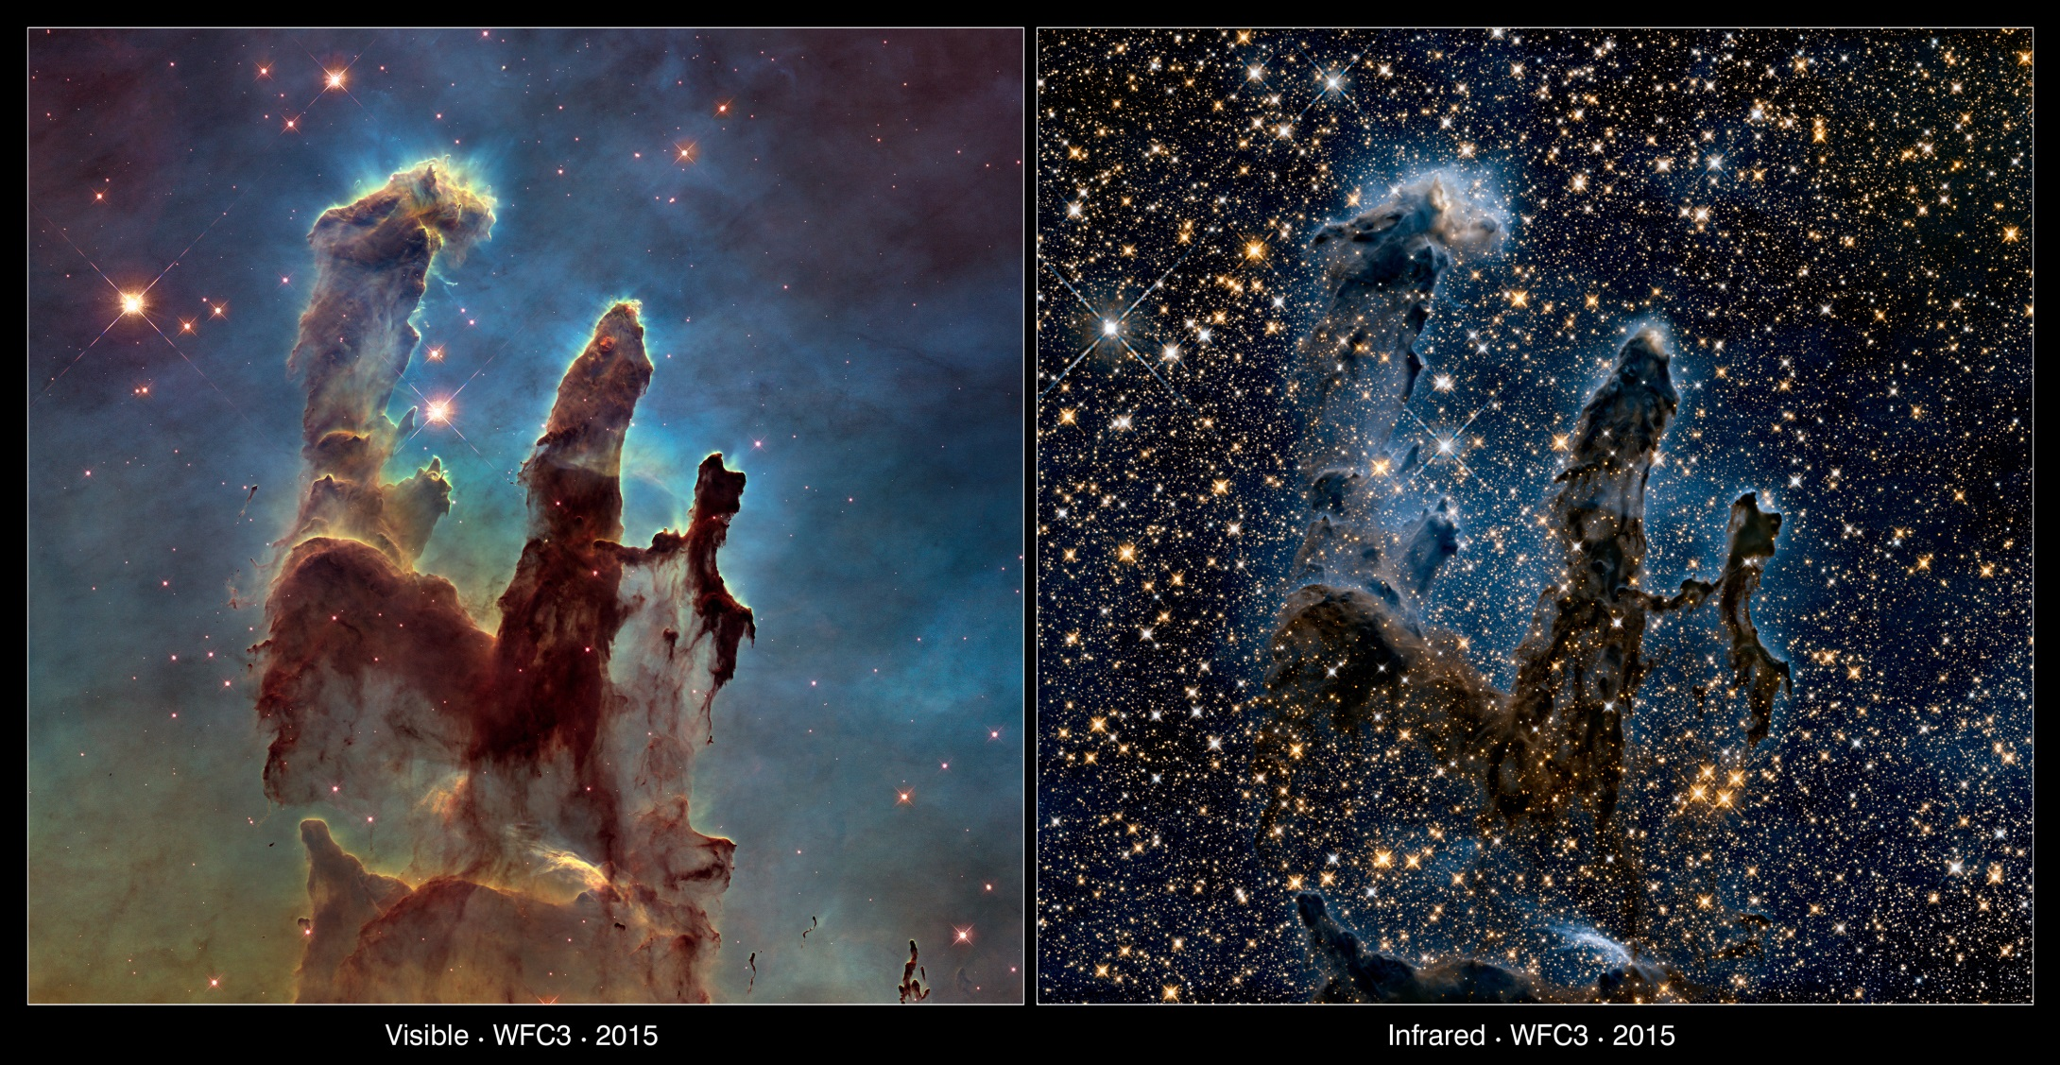
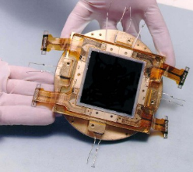
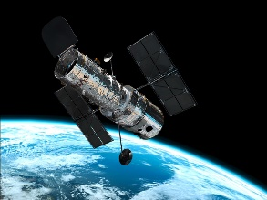
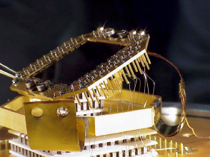

Teledyne Technologies High Performance Imaging Sensors
2.4-m Hubble Space Telescope
Two e2v CCDs, each 4096×2051, 15μm pixels. Gap of 31 pixels.
Teledyne 1024×1024 pixel 1.7 μm cutoff HgCdTe (18 μm pitch).
2

Slide 3


Teledyne High Performance Imaging Sensors
Teledyne DALSA
Waterloo, Ontario (Design, I&T)
Bromont, Quebec (CCD fab)
Teledyne e2v Space Imaging
Chelmsford, England (Design, Fab, I&T)
Grenoble, France (Design, I&T)
Teledyne Imaging Sensors
Camarillo, California
(Design, Fab, I&T)
Teledyne Judson Technologies
Montgomeryville, Pennsylvania
(Design, Fab, I&T)
Teledyne utilizes leading CMOS foundries for fabrication of CMOS image sensors
Including staff who work in machine vision (locations not shown on map), Teledyne employs 100 CMOS image designers and 7 CCD designers

Slide 4


Separated by a common language
NN
Sales
Custom
Program
Aluminum
Cookie
French fries
Chips
Schedule
Turnover
Bespoke
Programme
Aluminium
Biscuit
Chips
Crisps
Schedule
4

Slide 5
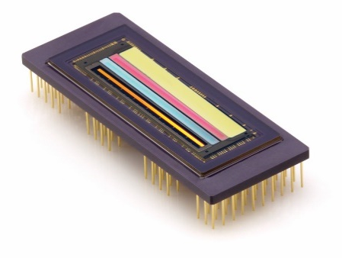
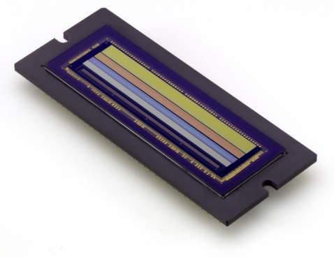
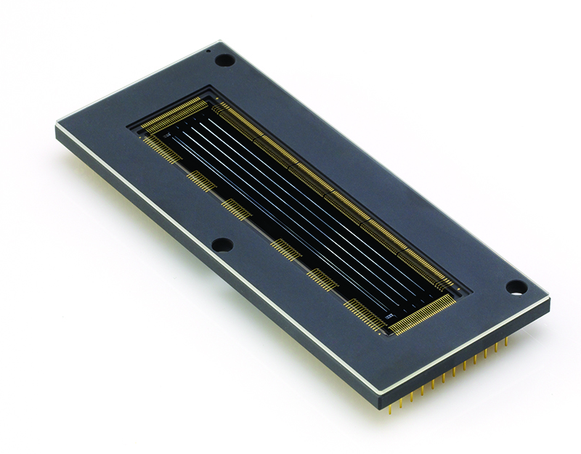
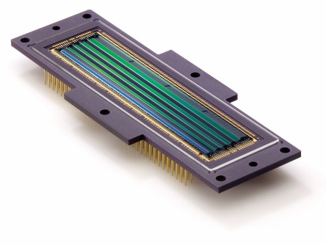
High Performance Time Delay & Integration (TDI)
CCDs are well-developed and proven for use in space (DALSA CCDs shown below)
  But CCDs require a lot of power and are analog devices requiring significant support electronics
  4-band, 4K MS CCD
  5-band, 6K MS CCD
  6K, 5-band TDI
  Backside illuminated
  12K, 5-band TDI
  Frontside Illuminated
Teledyne is developing charge domain TDI BSI CMOS for multispectral scanning
  Fully digital chip with ADCs on-chip
  Panchromatic + 4 band multi-spectral
  Monolithic CMOS, backside illuminated (BSI)
  12K cross-scan pixels
  Up to 128 TDI stages per color, TDI row rate: >100 kHz
  Charge transfer efficiency (CTE) > 99.999% demonstrated on test chips
  Anti-blooming
  5 µm panchromatic pixels, multi-spectral pixels 2-4 times larger in each dimension
  Full well: 30ke- to 100 ke-
  Readout noise: 15 to 30 e-

Slide 6
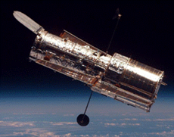
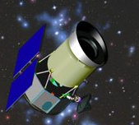
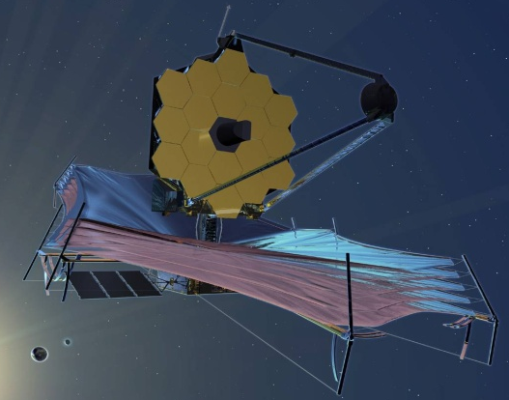
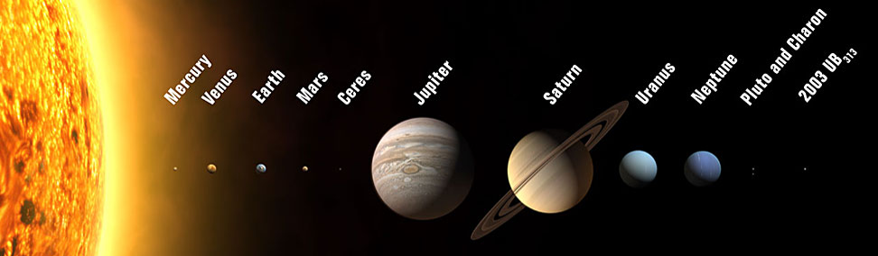
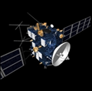
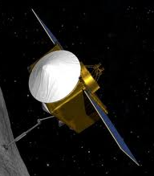

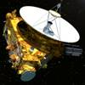

IR Space Astronomy & Planetary Science
HST
WISE
JWST
NICMOS, WFC3, ACS Repair
Bands 1 & 2
NIRCam, NIRSpec, FGS
SWIR & LWIR (62 Mpixels)
Rosetta
OSIRIS-REx
Mars
Reconnaissance
Orbiter
Deep Impact
& EPOXI
New Horizons
Lander (çiva)
IR spectrograph
CRISM (Vis & IR)
IR spectrograph
IR spectrograph

Slide 7
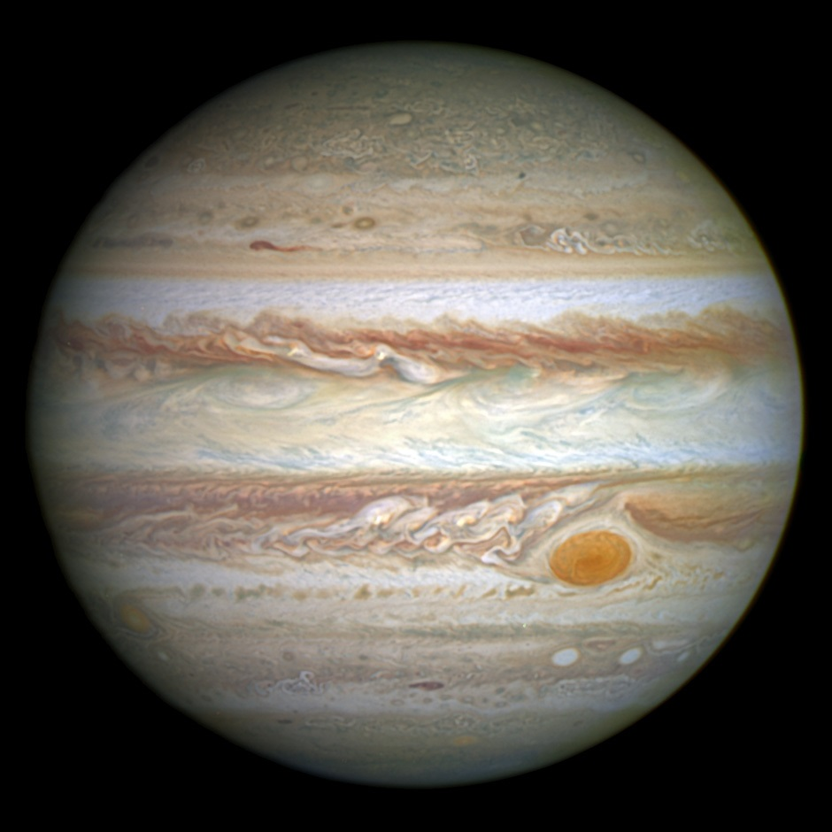
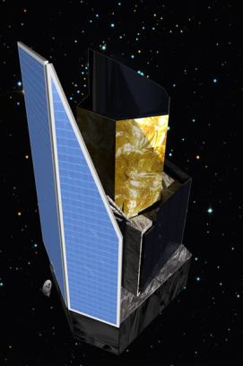
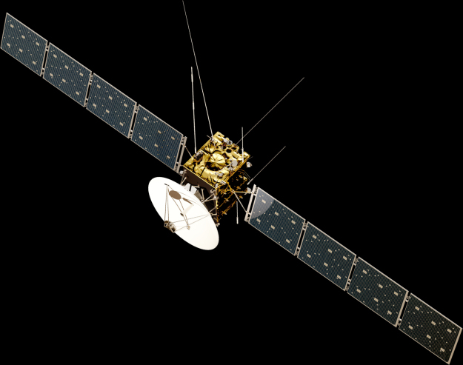
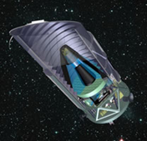
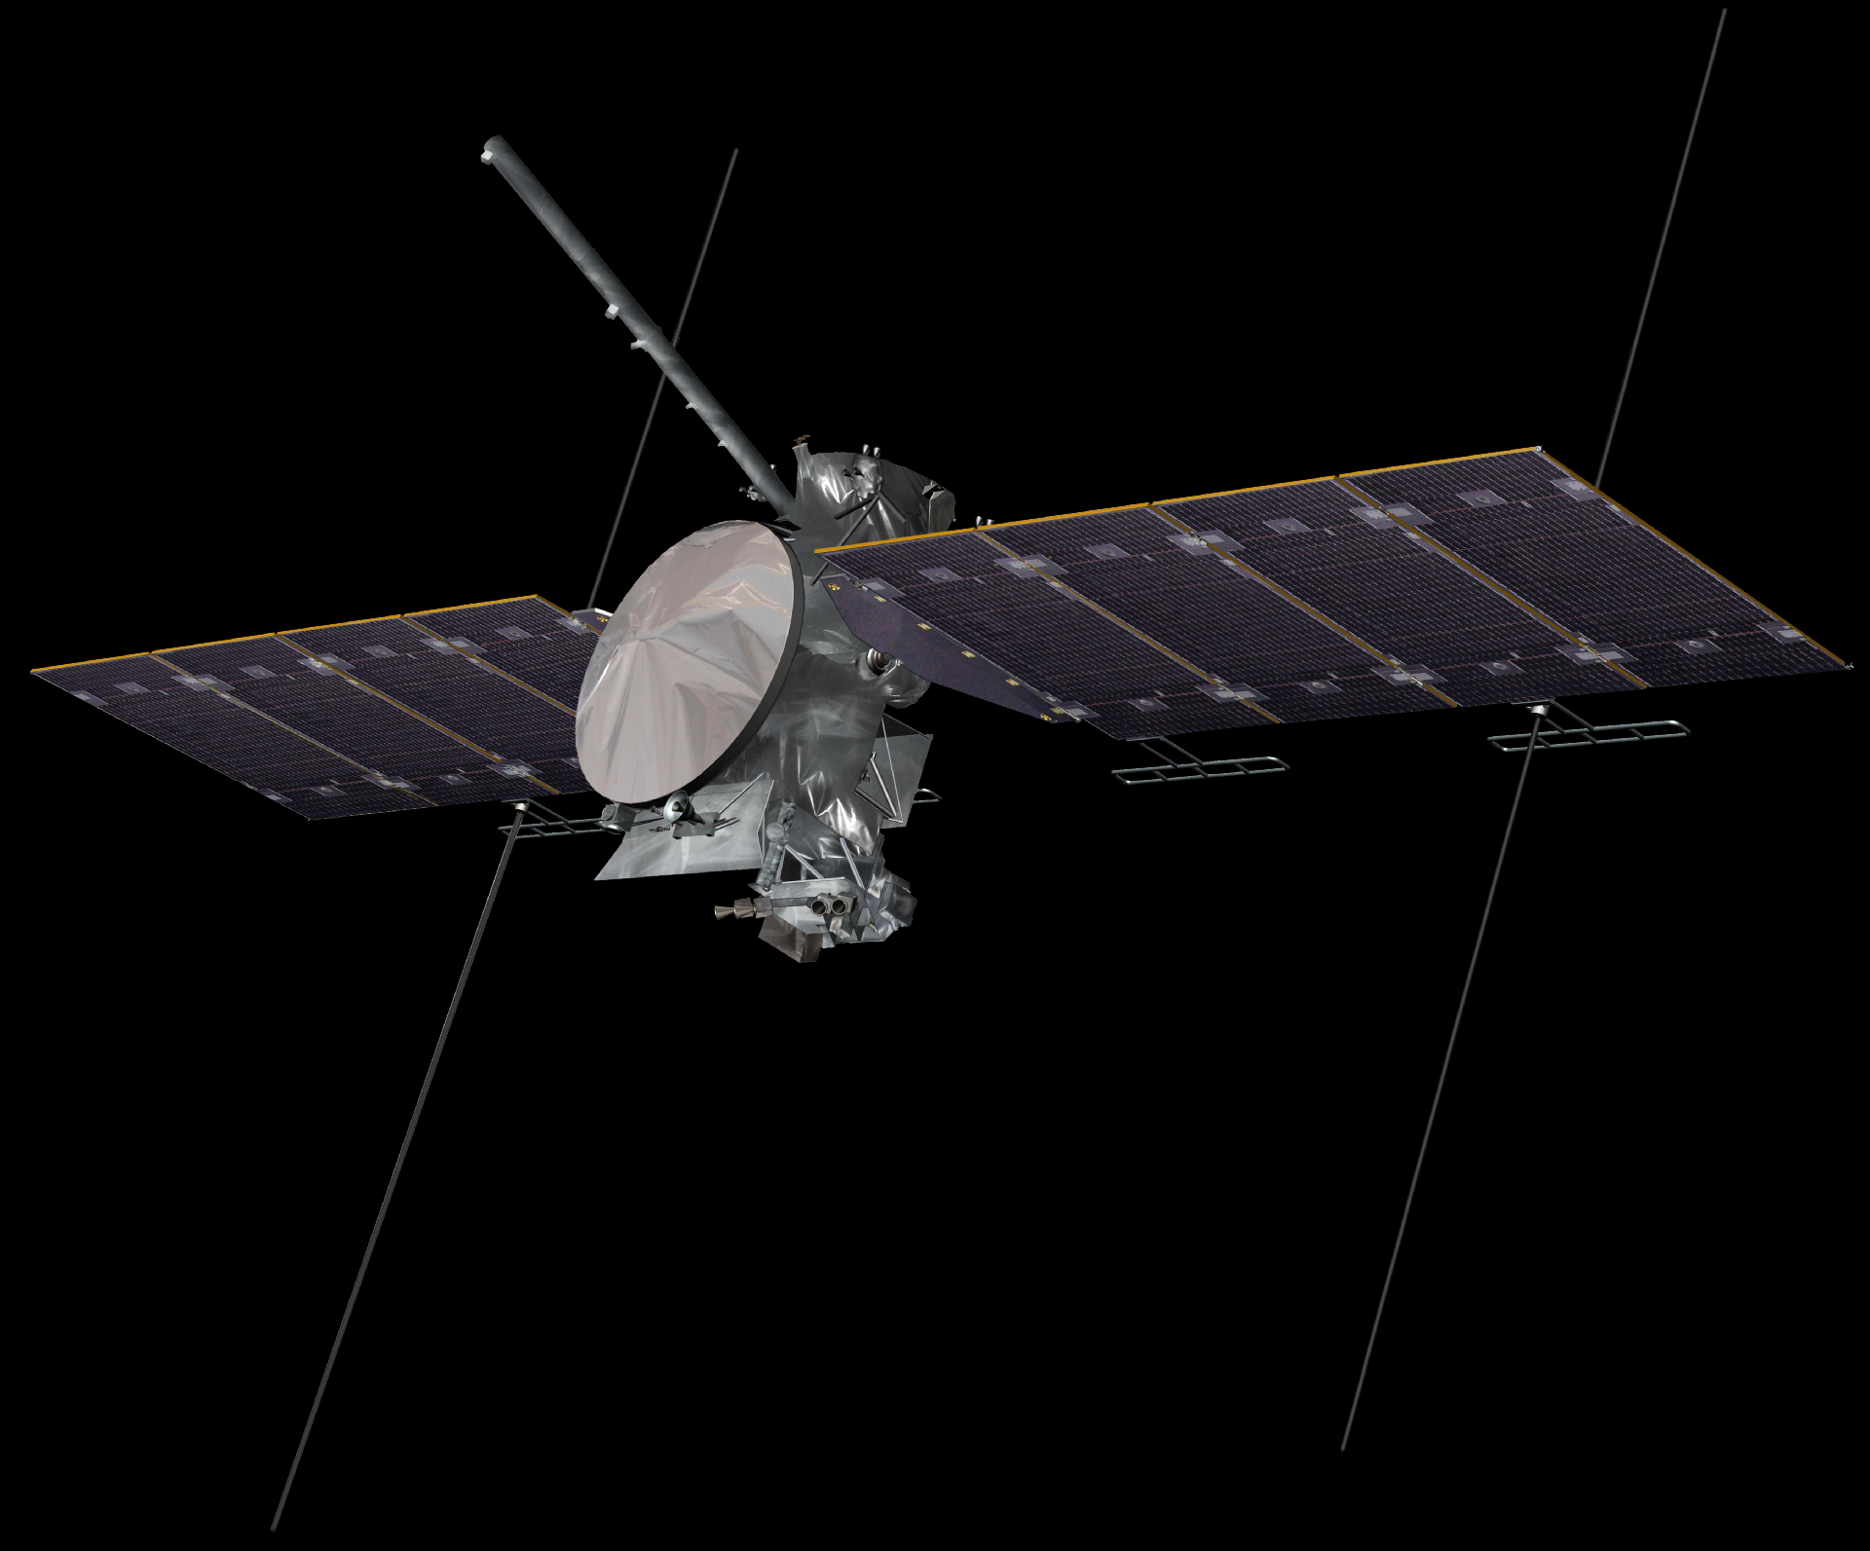
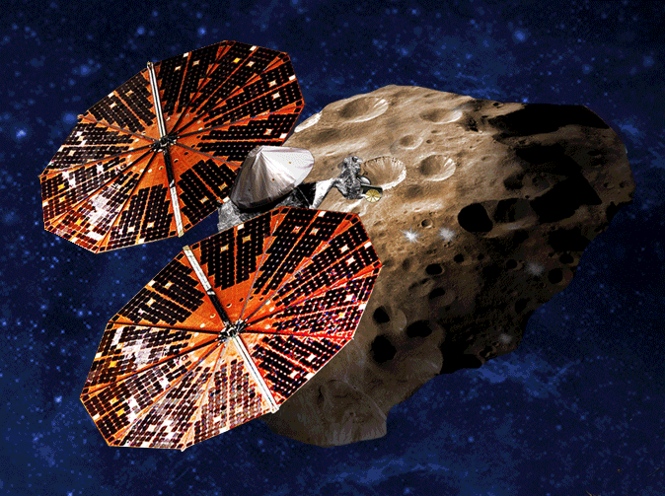
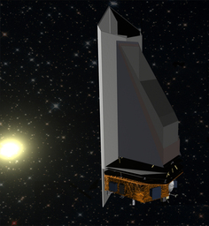
10 Active Space Science Programs
Space Astronomy Missions
Jupiter Missions
Euclid
Maps the Geometry of the Universe
16 H2RG SWIR arrays
16 SIDECAR ASIC Modules
JUICE
MAJIS
Jupiter + Ganymede, Calisto & Europa
1 H1RG SWIR array
1 H1RG MWIR array
2 SIDECAR ASIC Modules
WFIRST
Europa Clipper
Europa
CHROMA 320×480 VSWIR
Focal Plane Electronics
Wide Field IR Telescope
18 H4RG-10 SWIR arrays
Flight production commences 2018
MISE
Lucy
Trojan Asteroids
1 H2RG SWIR array
1 H2RG MWIR array
NEOCam
Near Earth Object Asteroid Survey
Extended Phase A
4 H2RG MWIR arrays
4 H2RG LWIR arrays
8 SIDECAR ASIC Modules
+ 4 Earth Science Missions
(GeoCarb, MAIA, SWIS, UCIS)

Slide 8
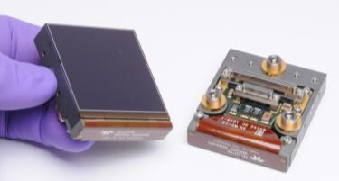
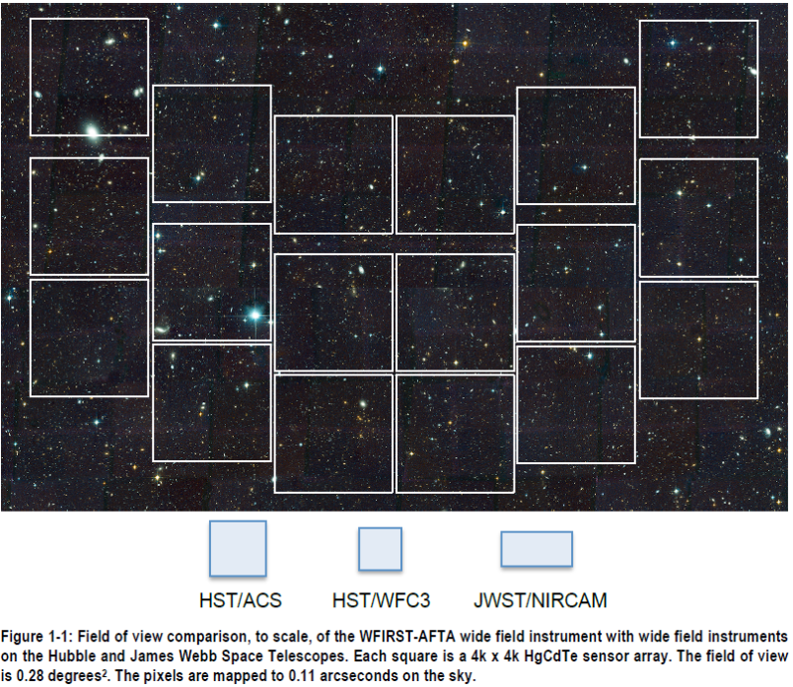
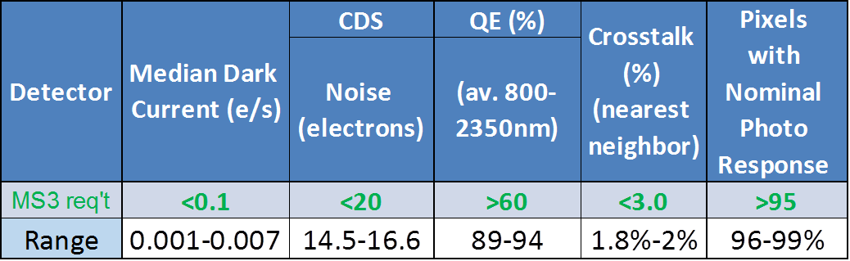
Refinement of the H4RG-10 for WFIRST
WFIRST
H4RG-10: 4K×4K pixels, 10 micron pixel pitch
Technical goals:
  Reduce H4RG-10 noise
  Increase operability of 16 megapixel IR arrays
  Demonstrate H4RG-10 flight performance
  Demonstrate yield required for flight production
  Make the arrays flatter (smaller peak-to-valley)
  Reduce image persistence
2.4 meter telescope
Measured by the Detector Characterization Lab
Goddard Space Flight Center

Slide 9
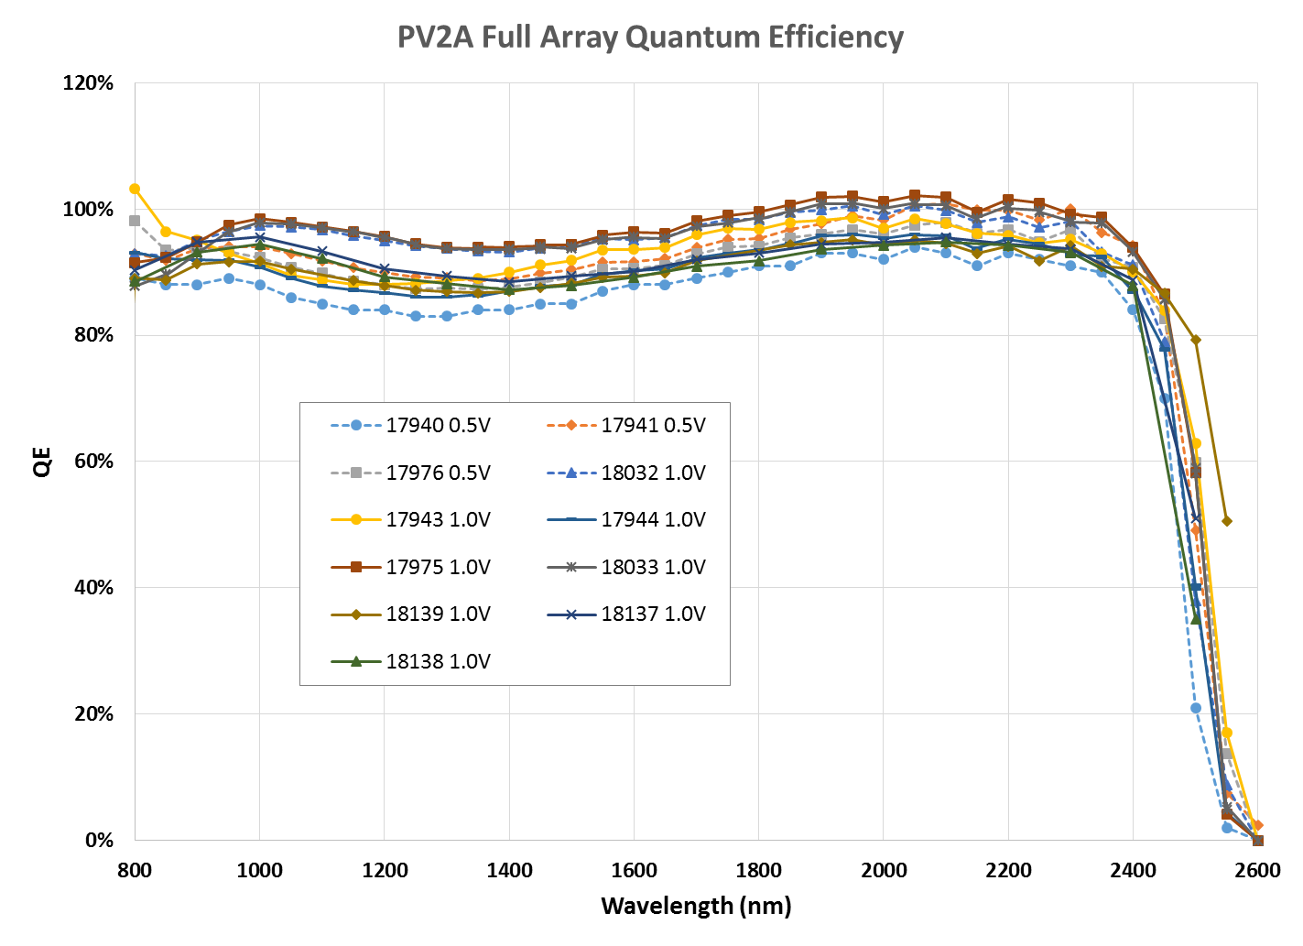
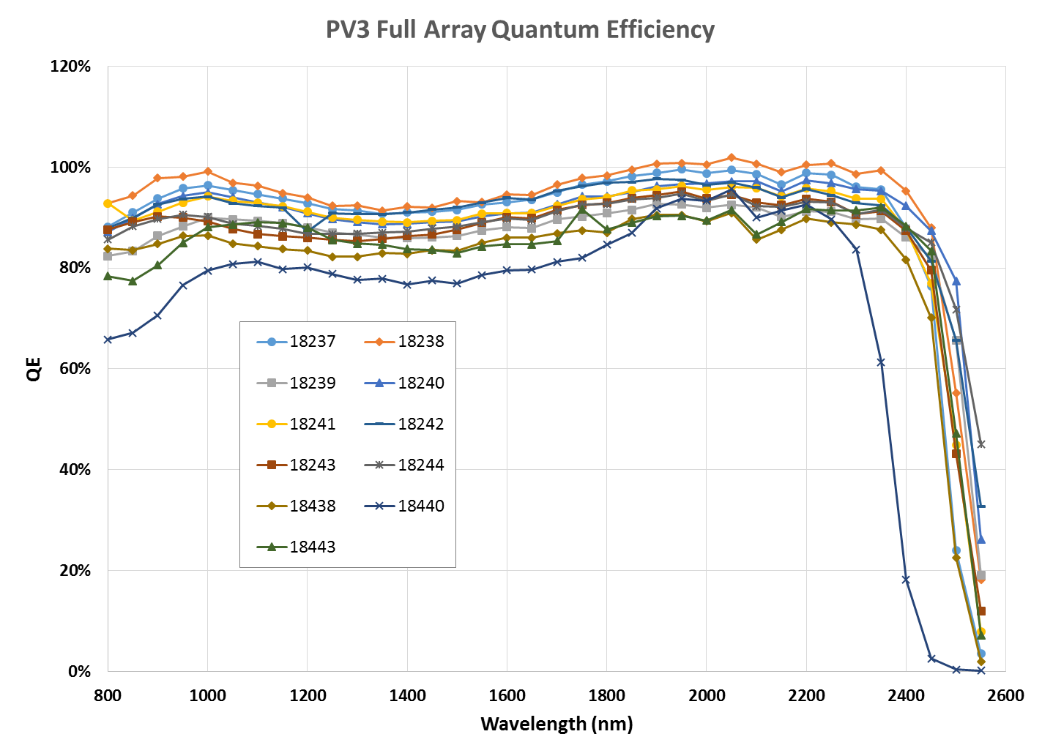
Quantum Efficiency

Slide 10
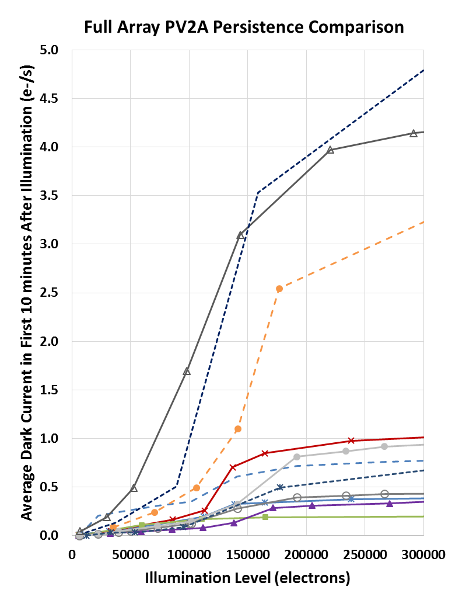
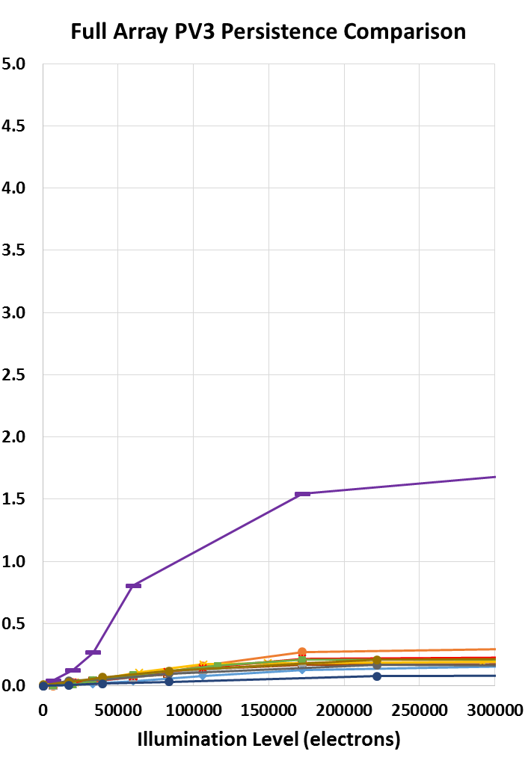
PV2A-PV3 Persistence Comparison

Slide 11
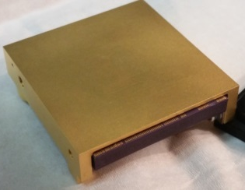
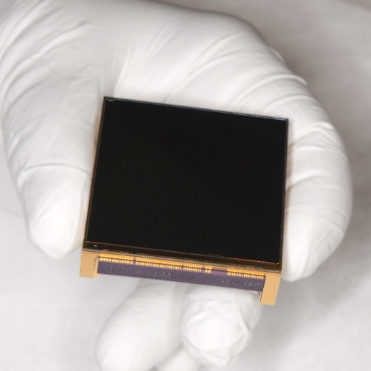
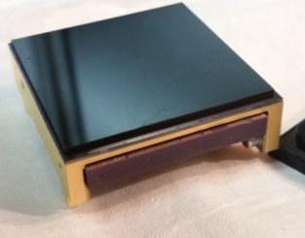
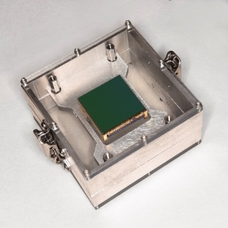
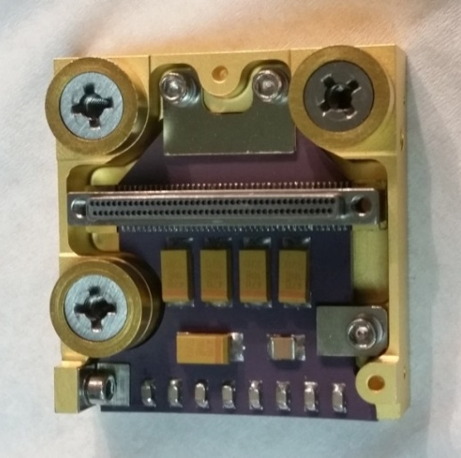
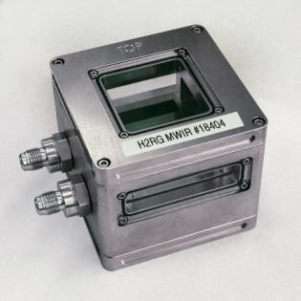
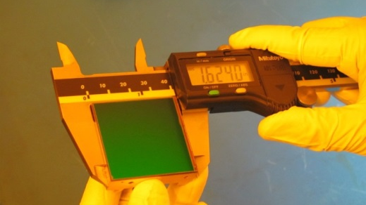
FRSBE - FouR Side Buttable Edge - H2RG Package
TRL-6 flight qualification completed
  Thermal Cycling to 25K
  Vibration - random response, sinusoidal
Baseline for 5 space missions (including NEOCam)
Being adapted to H1RG, H4RG-15, GeoSnap
85 grams mass (comparable to SiC)
Different baseplate materials for HgCdTe and Silicon detectors
32 output / 85 pin Nano connector
Ceramic board design
Precision planarization
Improved buttability & alignment
Temperature sensor & connector saver compatible

Slide 12

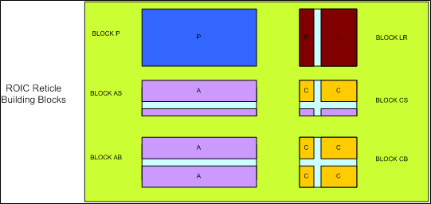
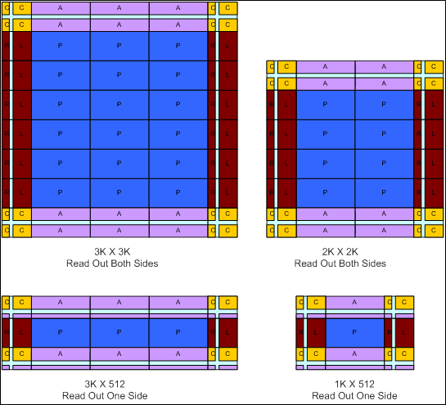
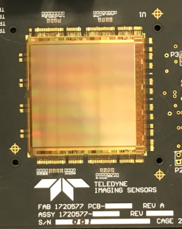
Large Format Digital ROIC (GeoSnap, CHROMA-D)
The GeoSnap / CHROMA-D family is a CTIA readout integrated circuit (ROIC) for visible and infrared low to moderate flux scientific applications
  High frame rate (120 Hz full frame)
  Programmable full well (100 ke-/1 Me-, or 180 ke-/2.7 Me-)
  Digital input / output (14 bit ADCs on-chip)
HgCdTe infrared (IR) and silicon PIN HyViSI™ visible detectors
Stitchable design that can be fabricated in a variety of formats
ROIC formats fabricated:
  2K×2K
  2K×512
  3K×512
Focal plane arrays made and tested with several types of detectors:
  Visible (Silicon)
  MWIR (5.3 µm HgCdTe)
  VLWIR (14.5 µm HgCdTe)
Space flight packaging in fabrication and qualification
GeoSnap
3K×3K
GeoSnap
2K×2K
CHROMA-D
3K×512
CHROMA-D
1K×512

Slide 13
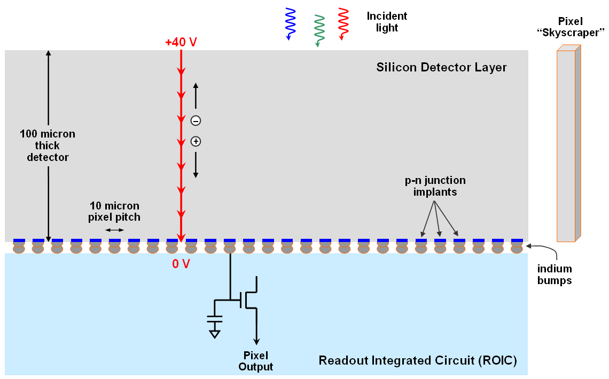
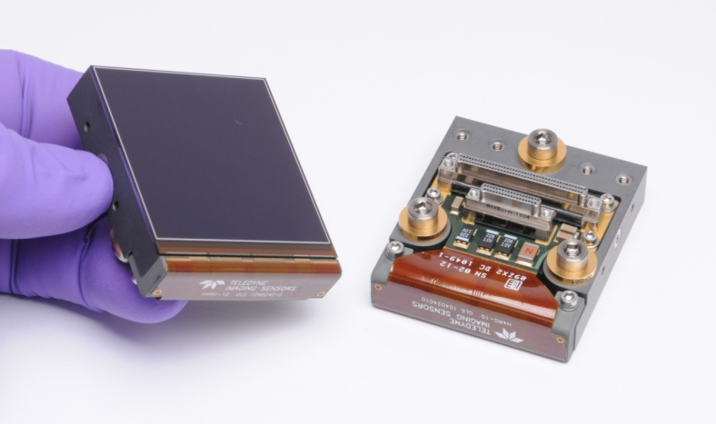
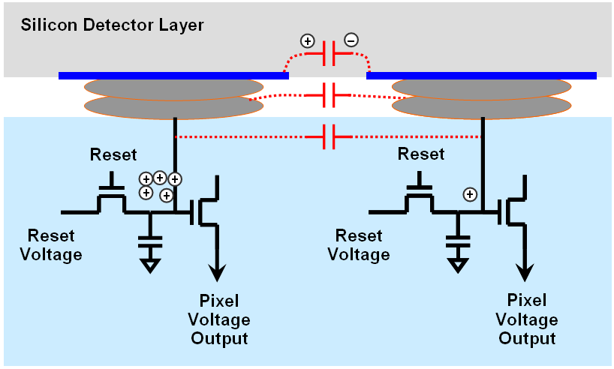
Visible hybrid sensors: H4RG-10 HyViSI
4096×4096 pixels
10 micron pixel pitch
Silicon Hybrid CMOS on SiC pkg
Challenges:
  Charge Diffusion Crosstalk
  Interpixel Coupling Crosstalk
  Readout noise

Slide 14

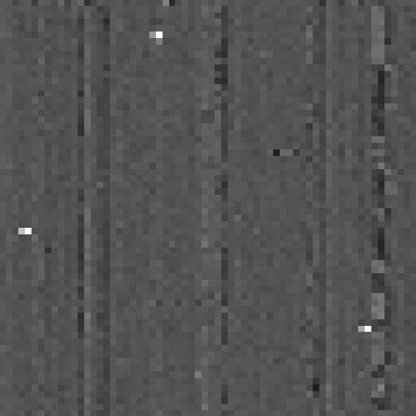
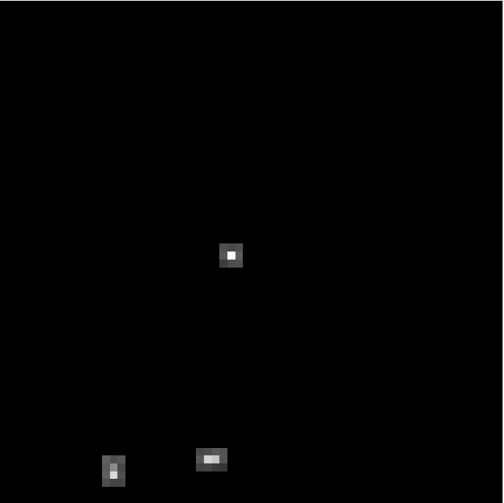
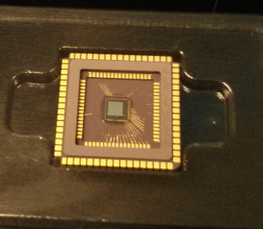
Developments for X-ray Astronomy
Speedster EXD (Event Driven Readout)
  Read only the pixels with x-ray events – orders of magnitude faster frame rates
  64×64 pixel array demonstrated. 40 µm pixel pitch. 100 µm thick silicon
  CTIA with in-pixel CDS, zero crosstalk, selectable gain (to 200 µV / e-), 12 e- noise
  512×512 pixel version with on-chip digitization in development
Full frame readout mode
3×3 sparse readout mode
Small Pixel Array Development
  12.5 µm pixel pitch. 200 µm thick fully depleted detector. 5.6 e- noise
  Scaling up to large format, reducing readout noise

Slide 15
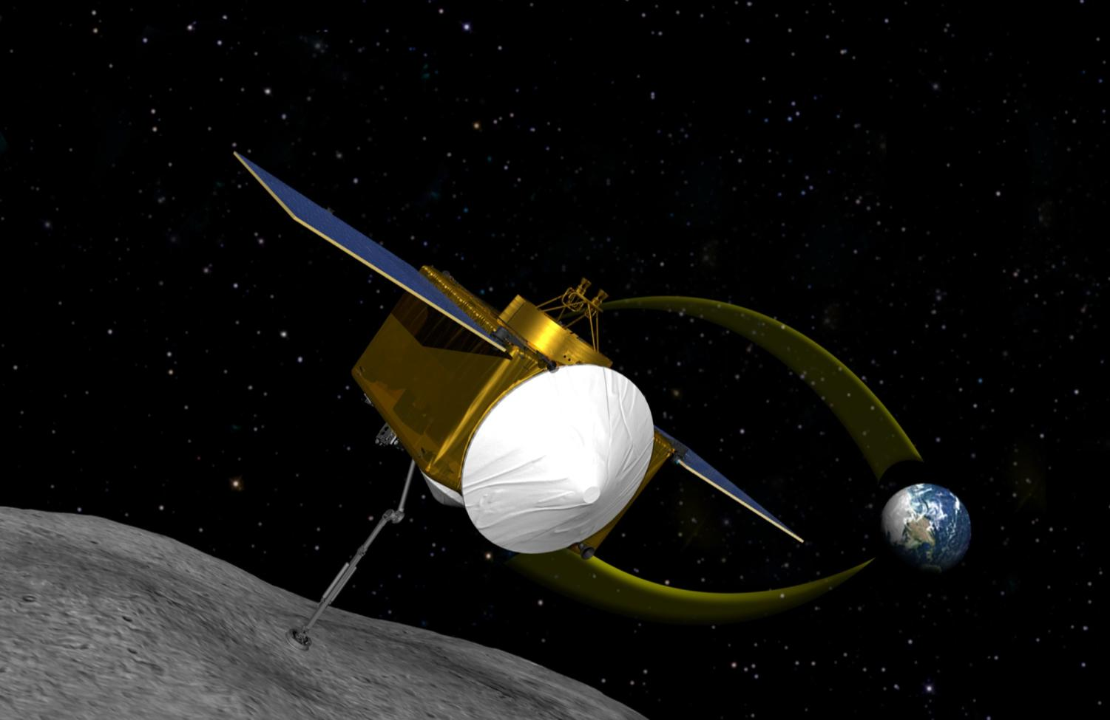
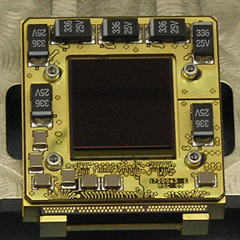
OSIRIS-REx Asteroid Rendezvous/Sample Return Mission
DALSA Visible CCDs 3 Cameras Visible Maps
Optech Lidar Maps Surface at cm Resolution Asteroid Shape
TS&I Visible-IR Sensor Measures 250 Colors (blue-MWIR) Mineral and Organic Maps
Teledyne providing most of the “eyes” of the spacecraft
2016 - 2019
Cruise to Asteroid
H1RG MWIR Array
~500 Days
Mapping Asteroid
Concludes with
Sample Collection
2016 Launch
2023
Sample Lands on Earth
2021 - 2023
Return Cruise to Earth
Notes:
OSIRIS-REx (Origins Spectral Interpretation Resource Identification Security Regolith Explorer.) is a planned asteroid study and sample return mission. The spacecraft will launch from Cape Canaveral in 2016 and will rendezvous with and return a sample from an asteroid. The target is a carbonaceous asteroid called Bennu and the sample return date is 2013.
By studying the return sample, scientists will learn more about the formation and evolution of the universe, initial stages of planet formation, and the source of organic compounds which led to the formation of life.
Teledyne, through three separate subsidiaries, provides all the “eyes” for this mission. Teledyne DALSA provides the visible sensors that will be used to essentially photograph the asteroid. Optech, a Teledyne-majority owned company in Toronto provides the a laser-ranging device called a lidar that will precisely map the surface to centimeter resolution. And Teledyne Imaging Sensors is providing a sensor that will be used in a spectral imaging camera to obtain information about the minerals and organic compounds in the asteroid.

Slide 16
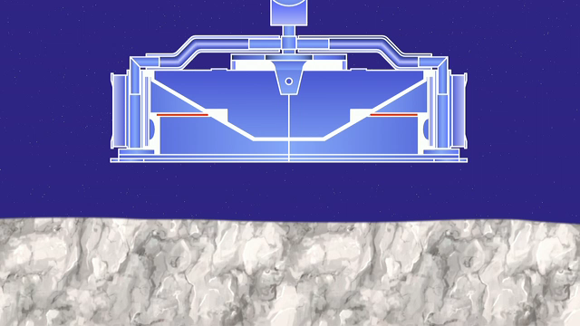
OSIRIS-REx - Sample Acquisition Mechanism
Notes:
Typical of Teledyne, we participate in many parts of the value chain in the space market.
We sell small, space-qualified components such as relays and dosimeters.
We develop and sell sophisticated subsystems such as amplifiers for satellite ground stations and sensor packages for space astronomy and Earth-observing payloads.
And we also face the market as prime contractor in the development of large systems or subsystems on major space programs.
Shown here are four of Teleydne’s premier, on-going space programs.
We are developing high-performance infrared detectors for the European Space Agency’s Euclid Dark Energy Mission. Detectors are being manufactured in Camarillo at Teledyne Imaging Sensors--about ten miles up the 101--as I speak today. Euclid launches in 2020.
In Huntsville, at Brown Engineering, we are designing and ultimately manufacturing a very large component of NASA’s giant rocket called the Space Launch System. This component, called the Launch Vehicle Stages Adapter, some 24 feet in diameter, will connect the core stage to the upper stage engine. It is pictured in the upper right panel.
The lower left panel depicts the GOES-R satellite that I mentioned in the previous slide. It carries Teledyne long wave and very long wave infrared detectors and operates with a Paradise Datacomm uplink.
On the lower right are Teledyne operators performing science operations for the International Space Station. The five year contract value is $120M.

Slide 17
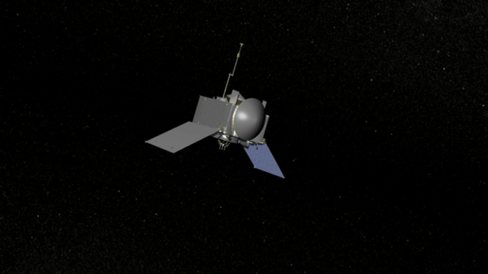
OSIRIS-REx – Sample Collection
Notes:
Typical of Teledyne, we participate in many parts of the value chain in the space market.
We sell small, space-qualified components such as relays and dosimeters.
We develop and sell sophisticated subsystems such as amplifiers for satellite ground stations and sensor packages for space astronomy and Earth-observing payloads.
And we also face the market as prime contractor in the development of large systems or subsystems on major space programs.
Shown here are four of Teleydne’s premier, on-going space programs.
We are developing high-performance infrared detectors for the European Space Agency’s Euclid Dark Energy Mission. Detectors are being manufactured in Camarillo at Teledyne Imaging Sensors--about ten miles up the 101--as I speak today. Euclid launches in 2020.
In Huntsville, at Brown Engineering, we are designing and ultimately manufacturing a very large component of NASA’s giant rocket called the Space Launch System. This component, called the Launch Vehicle Stages Adapter, some 24 feet in diameter, will connect the core stage to the upper stage engine. It is pictured in the upper right panel.
The lower left panel depicts the GOES-R satellite that I mentioned in the previous slide. It carries Teledyne long wave and very long wave infrared detectors and operates with a Paradise Datacomm uplink.
On the lower right are Teledyne operators performing science operations for the International Space Station. The five year contract value is $120M.

Slide 18
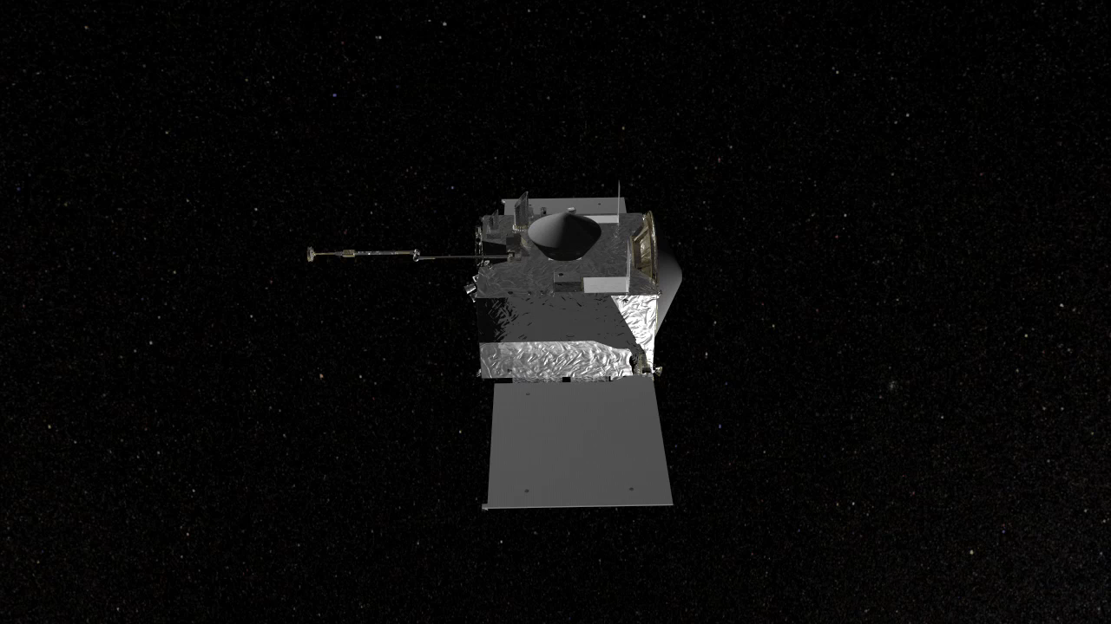
OSIRIS-REx – Measuring Mass
Notes:
Typical of Teledyne, we participate in many parts of the value chain in the space market.
We sell small, space-qualified components such as relays and dosimeters.
We develop and sell sophisticated subsystems such as amplifiers for satellite ground stations and sensor packages for space astronomy and Earth-observing payloads.
And we also face the market as prime contractor in the development of large systems or subsystems on major space programs.
Shown here are four of Teleydne’s premier, on-going space programs.
We are developing high-performance infrared detectors for the European Space Agency’s Euclid Dark Energy Mission. Detectors are being manufactured in Camarillo at Teledyne Imaging Sensors--about ten miles up the 101--as I speak today. Euclid launches in 2020.
In Huntsville, at Brown Engineering, we are designing and ultimately manufacturing a very large component of NASA’s giant rocket called the Space Launch System. This component, called the Launch Vehicle Stages Adapter, some 24 feet in diameter, will connect the core stage to the upper stage engine. It is pictured in the upper right panel.
The lower left panel depicts the GOES-R satellite that I mentioned in the previous slide. It carries Teledyne long wave and very long wave infrared detectors and operates with a Paradise Datacomm uplink.
On the lower right are Teledyne operators performing science operations for the International Space Station. The five year contract value is $120M.

Slide 19

OSIRIS-REx – Sample Storage
Notes:
Typical of Teledyne, we participate in many parts of the value chain in the space market.
We sell small, space-qualified components such as relays and dosimeters.
We develop and sell sophisticated subsystems such as amplifiers for satellite ground stations and sensor packages for space astronomy and Earth-observing payloads.
And we also face the market as prime contractor in the development of large systems or subsystems on major space programs.
Shown here are four of Teleydne’s premier, on-going space programs.
We are developing high-performance infrared detectors for the European Space Agency’s Euclid Dark Energy Mission. Detectors are being manufactured in Camarillo at Teledyne Imaging Sensors--about ten miles up the 101--as I speak today. Euclid launches in 2020.
In Huntsville, at Brown Engineering, we are designing and ultimately manufacturing a very large component of NASA’s giant rocket called the Space Launch System. This component, called the Launch Vehicle Stages Adapter, some 24 feet in diameter, will connect the core stage to the upper stage engine. It is pictured in the upper right panel.
The lower left panel depicts the GOES-R satellite that I mentioned in the previous slide. It carries Teledyne long wave and very long wave infrared detectors and operates with a Paradise Datacomm uplink.
On the lower right are Teledyne operators performing science operations for the International Space Station. The five year contract value is $120M.

Slide 20

Teledyne
Enabling humankind to understand the Universe and our place in it

