Slide 1
ZTF CCD and Controller Performance
Stephen Kaye
27 of September 2017

Slide 2
Introduction
Intro | System Overview | Controller Testing | VIB Testing | CCD Testing | Conclusion
A quick review of the ZTF instrument
Controller description and data collection modes
Controller testing and results
Vacuum interface board description, testing, and results
CCD Testing and results
Notes:
A review of the instrument to give context to everyone for the design of ZTF. We will then review the controllers to give that context as well

Slide 3
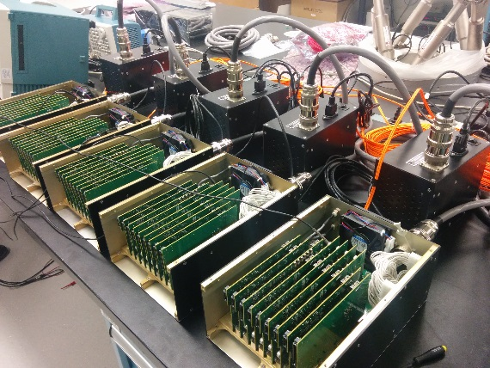
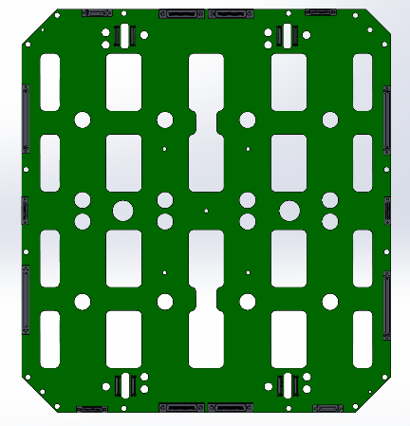
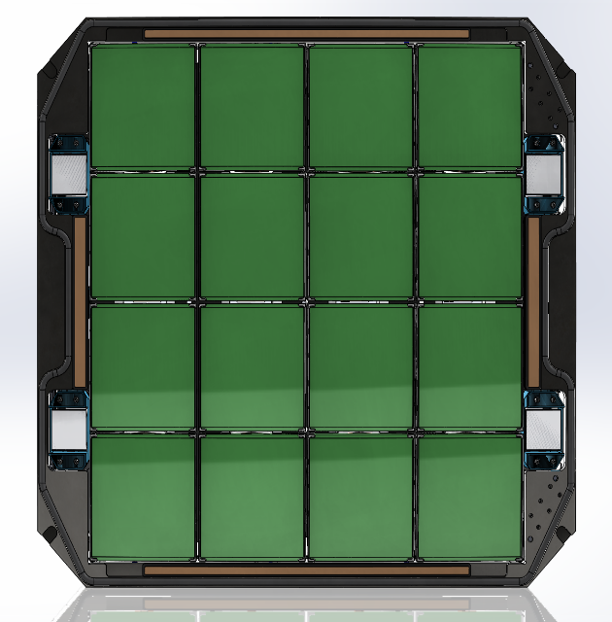
ZTF System
Intro | System Overview | Controller Testing | VIB Testing | CCD Testing | Conclusion
Controllers
Vacuum Interface Board
ZTF has 16 Science CCDs each with 6k x 6k, 4-channel readout
ZTF has 4 Guider/Focus CCDs each with 2 channel readouts
Five controllers provide clocks, biases, and converts the 72 channels of video signal.
A large system requires automated testing and analysis of each component of the system
Guider/Focus
CCDs
Science CCDs
Focal Plane
Notes:
Takeaway: The ZTF system design. We have a 16 CCD focal plane arranged 4 x 4 of 6k detectors. In addition there are 3 extra-focal imagers and a guider chip. We use multiple controllers to read out the CCDs. These controllers are STA Archon controllers which we have working synchronously through a daisy chain configuration to propagate the clock from controller to controller. The vacuum interface board provides the means for getting the signals in and out of the dewar in addition to some amplification and reset gate drivers.

Slide 4
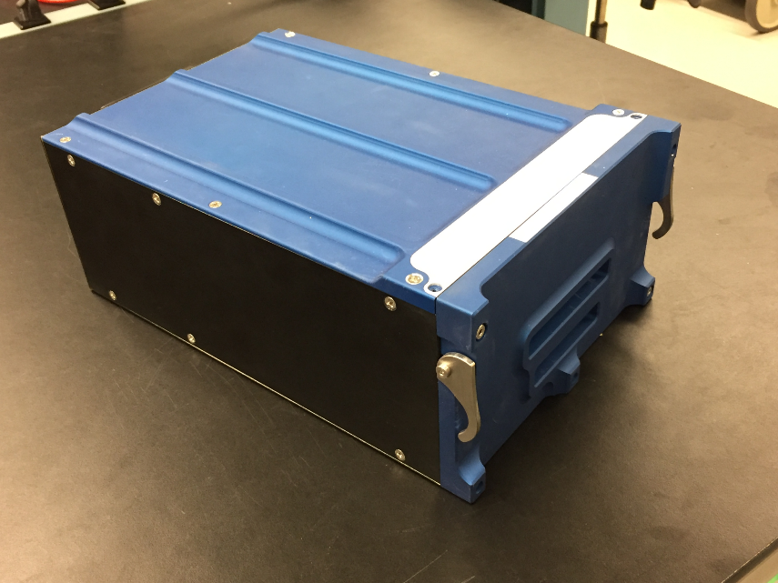
ZTF System
Intro | System Overview | Controller Testing | VIB Testing | CCD Testing | Conclusion
Testing occurs on components as the system builds up
Knowing the sources of problems before putting the system together
The key is that we use the system to test the system
  Software and analysis infrastructure is re-used at each level of testing
Notes:
We decided to break down the system for testing in its constituent parts – the controllers, the VIB, and the CCDs. Takeaway: ZTF is a complicated system and if each part can be characterized, we believe it can aid in quickly pinpointing the source of any problems we encounter later if the instrument goes out of specification.

Slide 5
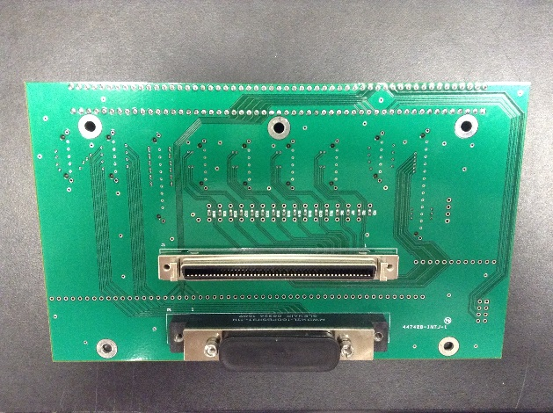
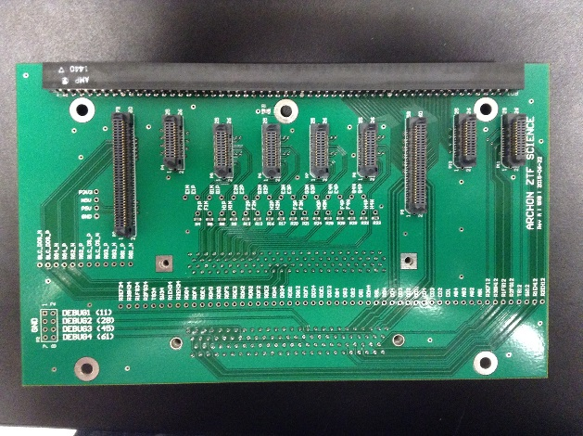
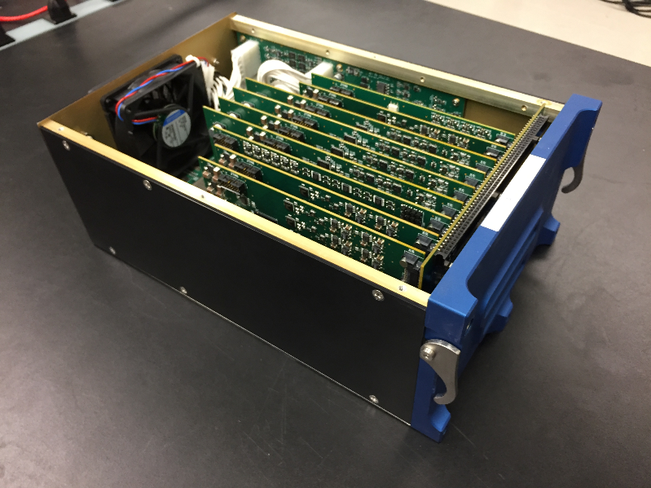
Controllers
Intro | System Overview | Controller Testing | VIB Testing | CCD Testing | Conclusion
Transition Card
Using Semiconductor Technology Associate’s Archon Controller
Controller chassis contains cards for each function: ADC card, Driver card, bias card, and LVDS card
Signals from cards are routed through a transition card for connections to standard off-the-shelf cables
Test connector for all transition card signals added
Front
Back
Controller
Notes:
Takeaway: Is the test connector with all of our signals is key to controller testing. It allows the ability to connect the multiplexer loopback board which can connect any ground, clock or bias to any ADC input in the system.
Note the cables too. They are Glenair 100 pin for the clock and bias signals and 3M shielded twisted pair for the video connection

Slide 6
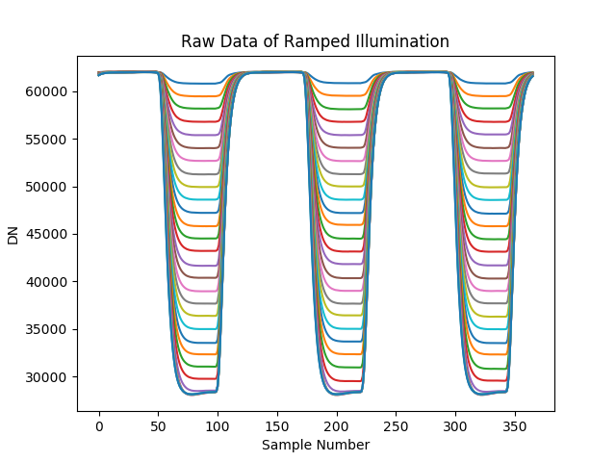
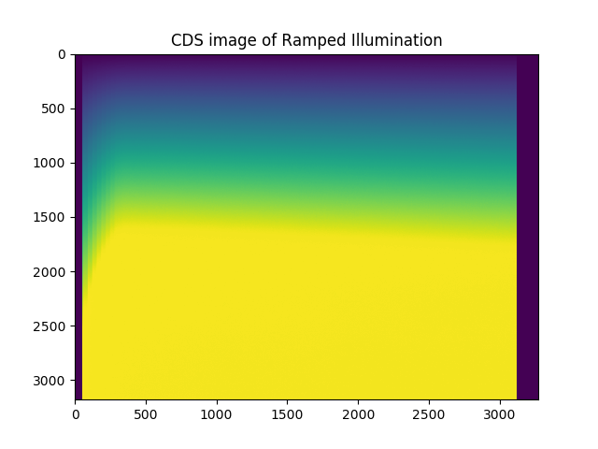
Controllers
Intro | System Overview | Controller Testing | VIB Testing | CCD Testing | Conclusion

Slide 7
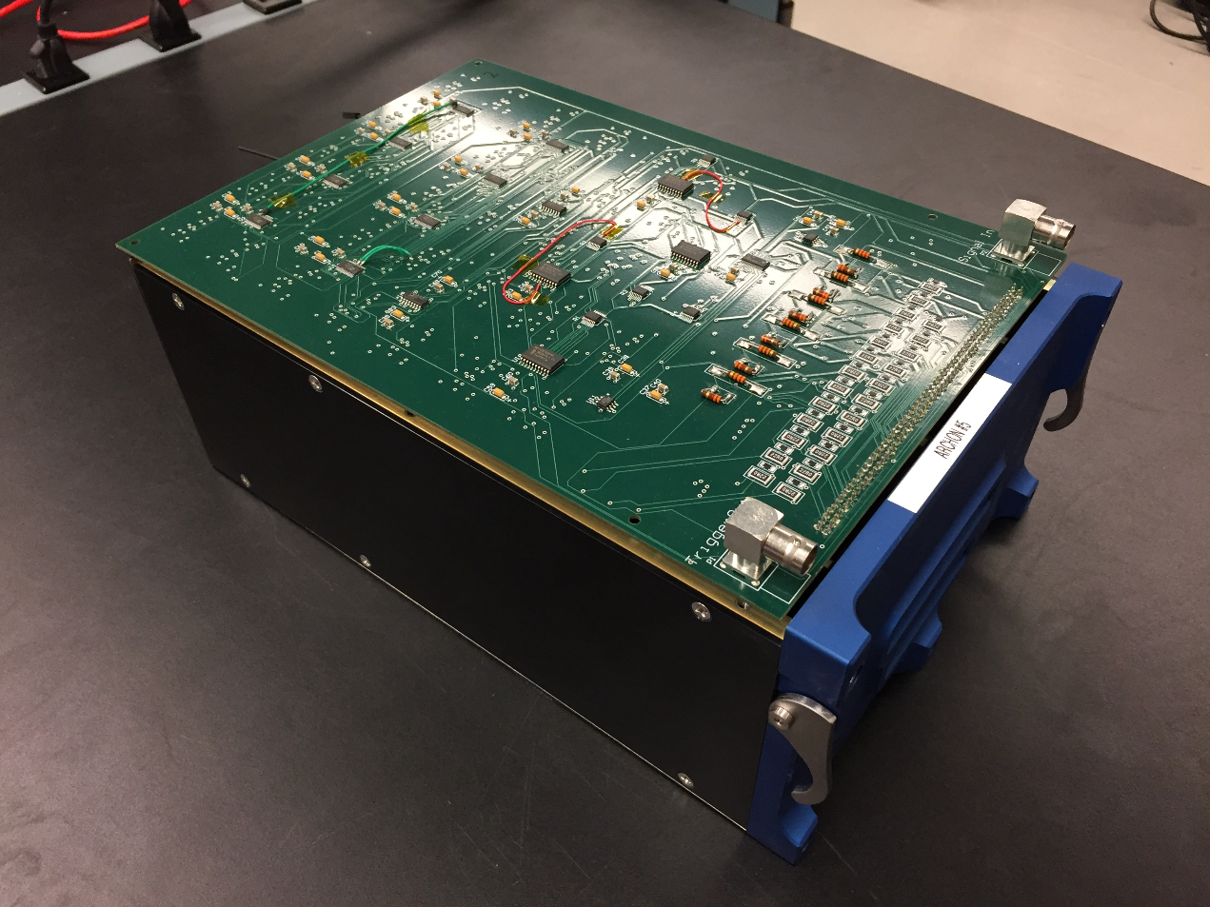
Multiplexer Loopback Board
Intro | System Overview | Controller Testing | VIB Testing | CCD Testing | Conclusion
The test point connector with all of the signals provides a connection point for a multiplexer board
Multiplexer board allows for any signal to be connected to any ADC input
LVDS signals are used to dynamically route ground, clock and biases to any ADC input via AC coupler at Archon video input.
The video channels can thus be used for all controller testing
Notes:
Takeaway: The multiplexer board can route any signal to any input of the ADC. It’s extremely flexible and can allow for many automated tests for the controller. Again, with 5 controllers – 16 input channels each, 30 biases each, 24 clocks each – this becomes a big problem. If it’s not automated, then characterizing quickly is difficult, time consuming, and prone to errors.

Slide 8
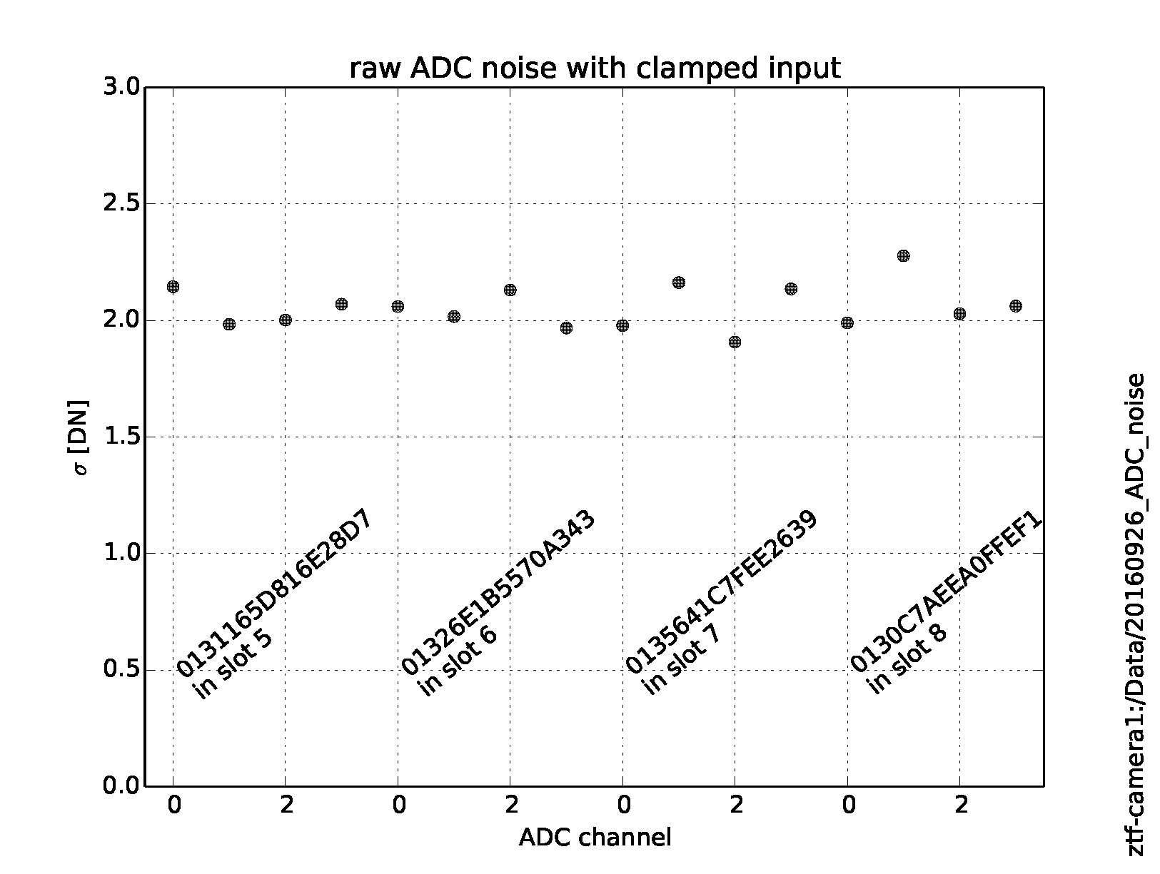
Controller Testing Noise
Intro | System Overview | Controller Testing | VIB Testing | CCD Testing | Conclusion
All inputs to the ADC are grounded
Raw data is collected and the standard deviation is calculated for the data
Notes:
Takeaway: We can characterize the noise for the ADCs in a very quick test. And in fact, can test multiple controllers simultaneously.

Slide 9
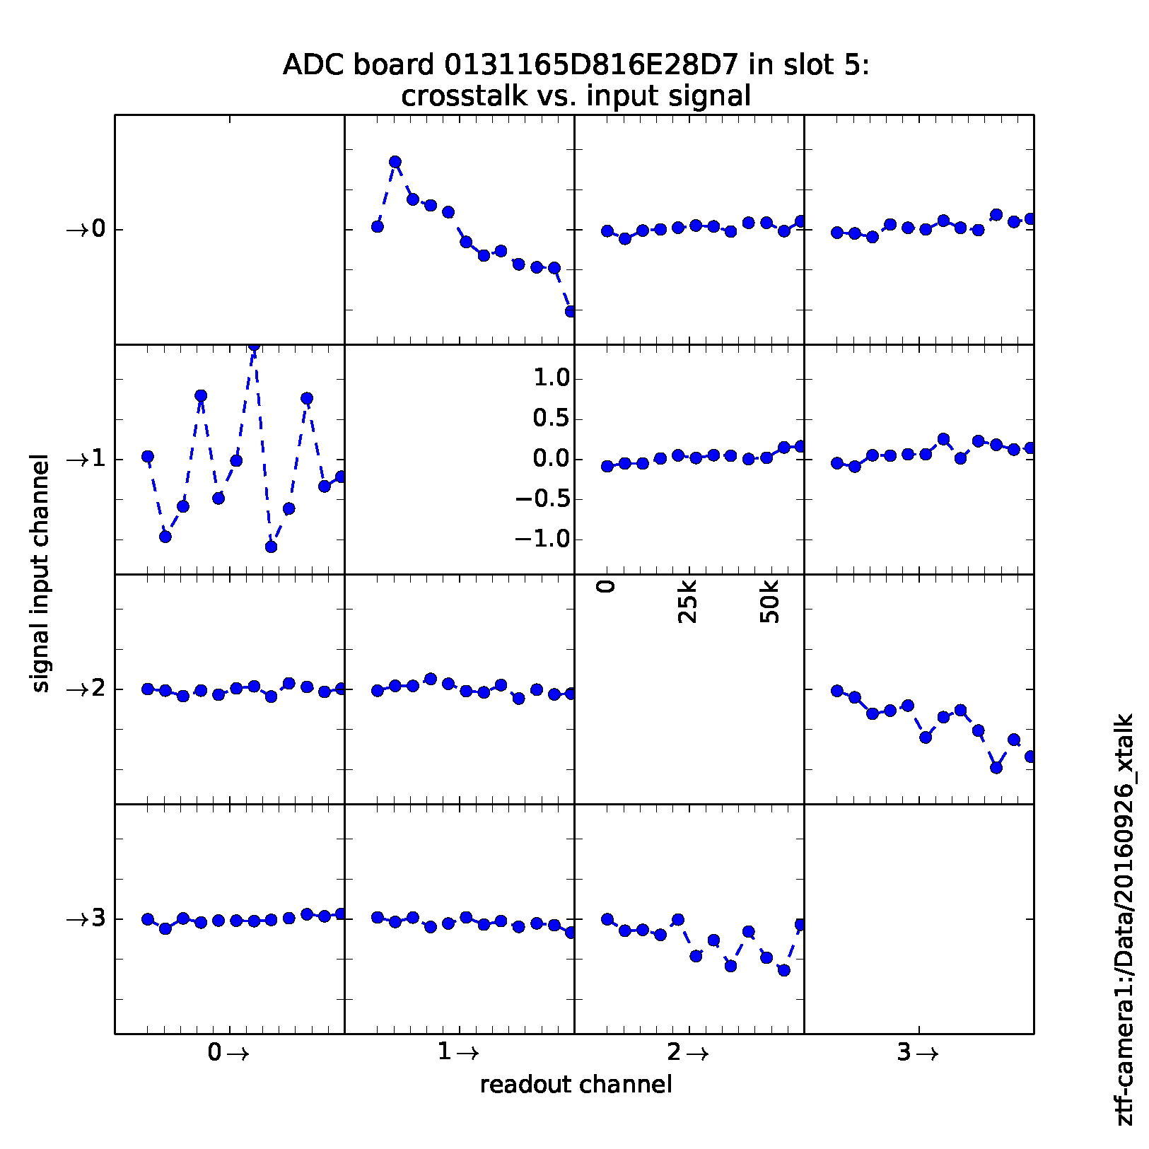
Controller Testing Crosstalk
Intro | System Overview | Controller Testing | VIB Testing | CCD Testing | Conclusion
Provide a signal to one input and ground the other video channels
Raw data for the grounded channels reveal the crosstalk on a single ADC board
This maps the crosstalk across any given ADC board.
Notes:
Takeaway: Crosstalk in mosaic cameras is a problem than can be solved post processing, but characterizing the crosstalk is necessary for the post processing. The hope here is that our differential configuration will mitigate crosstalk and we start with the controller for crosstalk. This is crosstalk an any given ADC board.

Slide 10
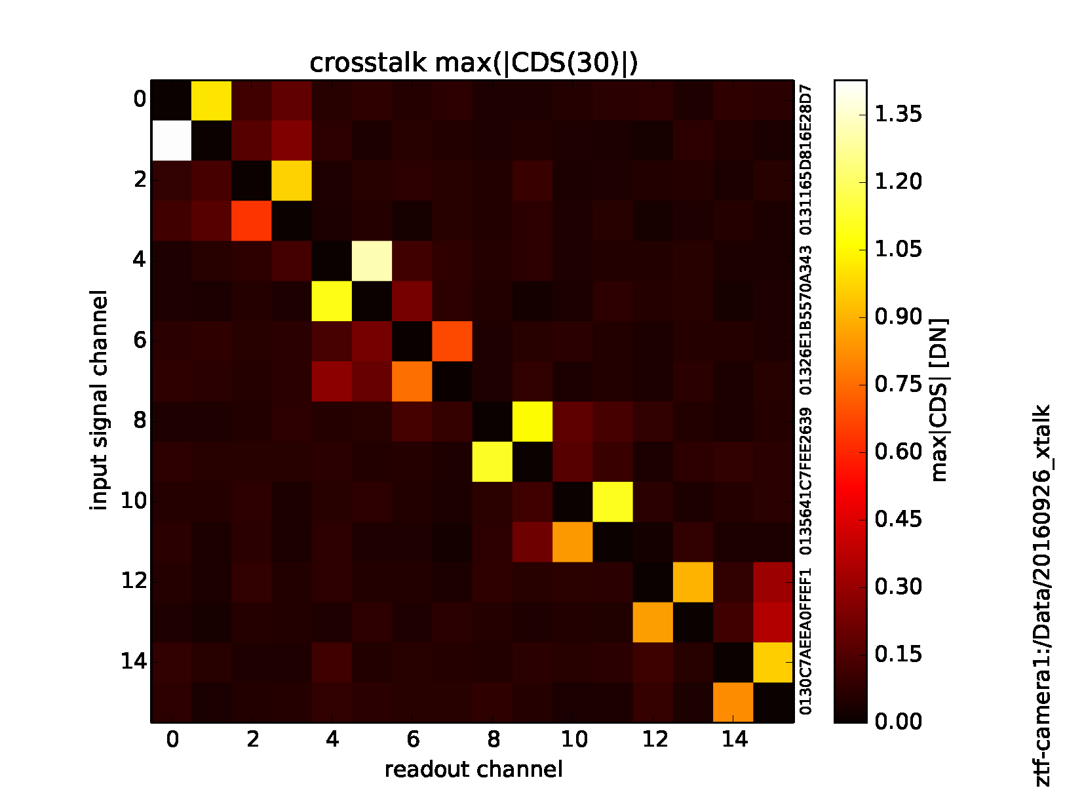
Controller Crosstalk
Intro | System Overview | Controller Testing | VIB Testing | CCD Testing | Conclusion
The crosstalk is also measured across the entire system of science controllers
This is the maximum signal in any of the crosstalk channels
Notes:
Takeaway: We can run the crosstalk over the full system

Slide 11
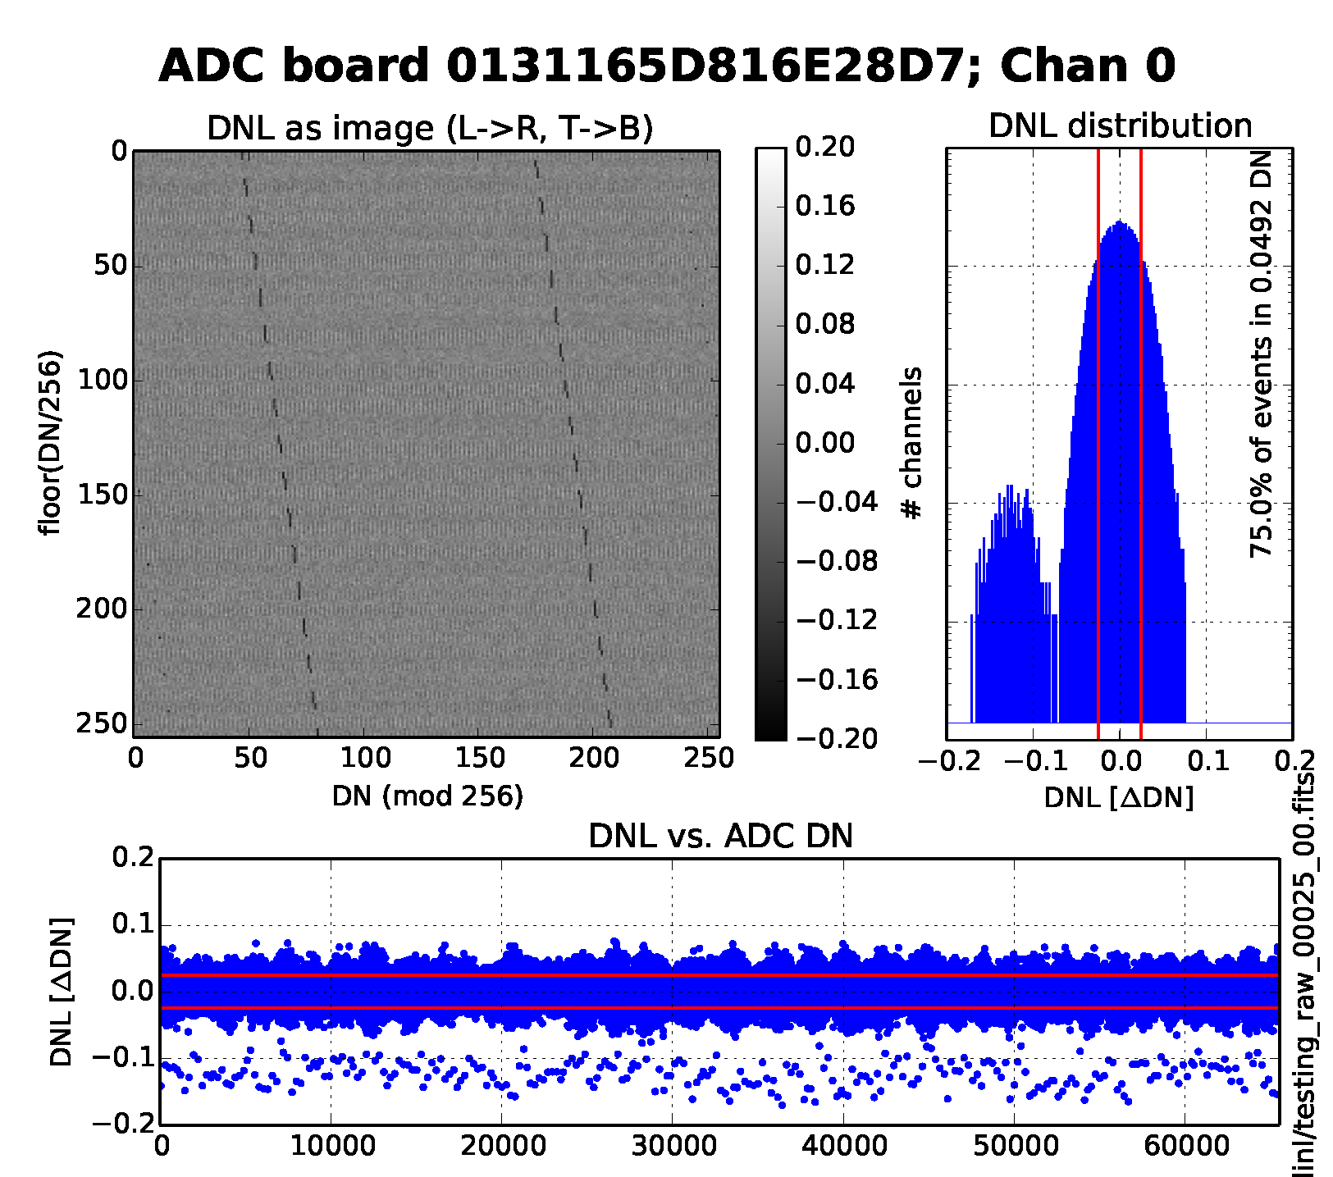
Controller DNL Testing
Intro | System Overview | Controller Testing | VIB Testing | CCD Testing | Conclusion
A triangle wave which spans the entire ADC range is input to an ADC channel
The input spans the complete range of the ADC
All codes are converted
This histogram is for the raw data stream, and improves further when digital CDS (averaging) is enabled.
Notes:
Takeaway: The DNL test.

Slide 12
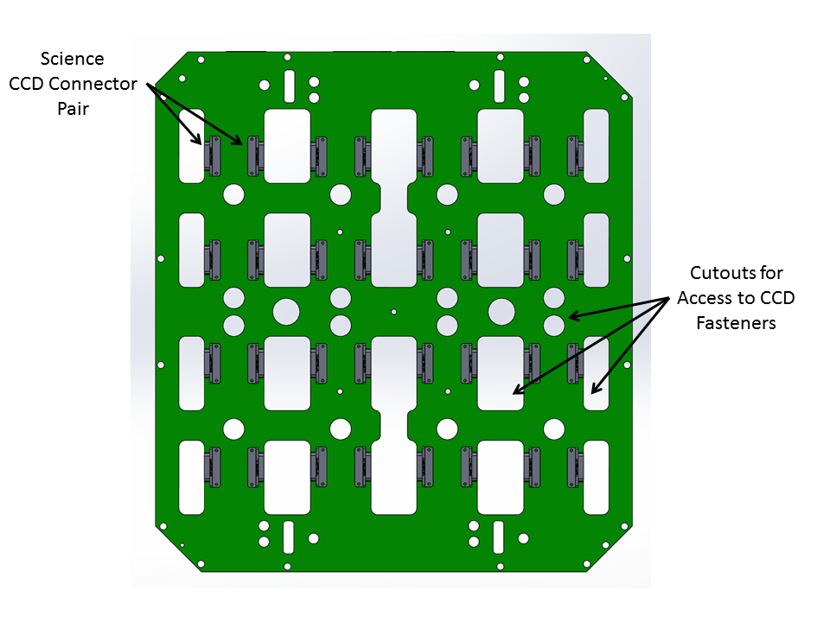
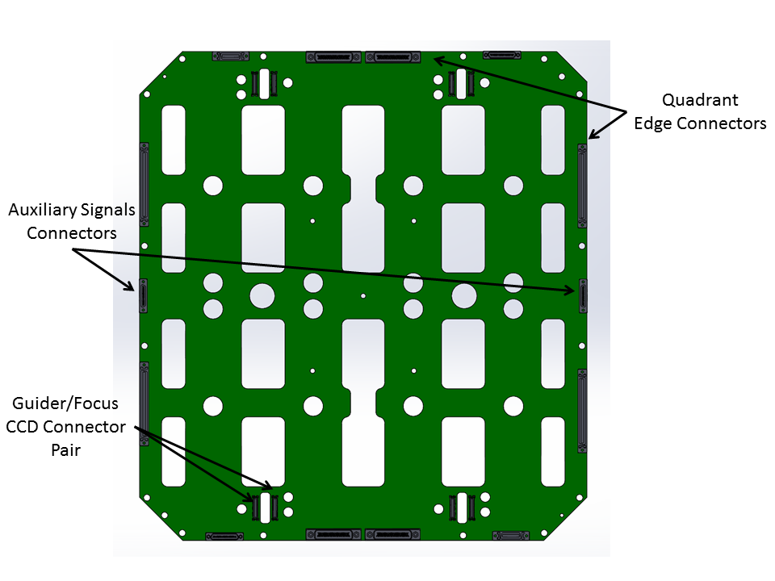
Vacuum Interface Board Overview
Intro | System Overview | Controller Testing | VIB Testing | CCD Testing | Conclusion
VIB Focal Plane Side
We now add the next component within the signal chain
The VIB routes the clocks and biases from the controller to the CCDs, generates high speed RG pulse, then clamps and preamplifies differential CCD outputs.
Cutouts are required as a hardware pass through and access to CCD flex cables
VIB Back Plate Side
Notes:
Takeaway: Familiarity with the VIB.

Slide 13
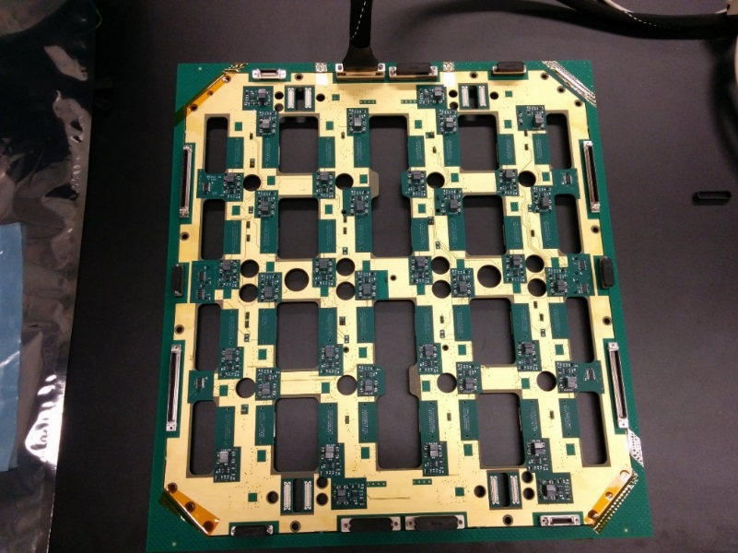
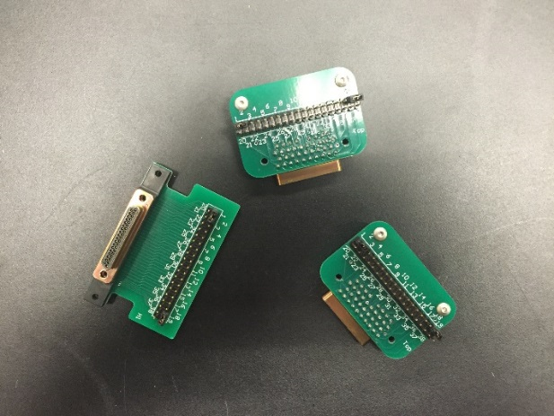
VIB Overview
Intro | System Overview | Controller Testing | VIB Testing | CCD Testing | Conclusion
Breakout boards are necessary to test the signals at the board and for loopback testing
Due to configuration of VIB automated testing is limited unless a companion VIB was made
  Added cost due to the many connectors
  Cable connections from companion VIB would be necessary
Vacuum Interface
Board (VIB)
Breakout Boards
For VIB

Slide 14
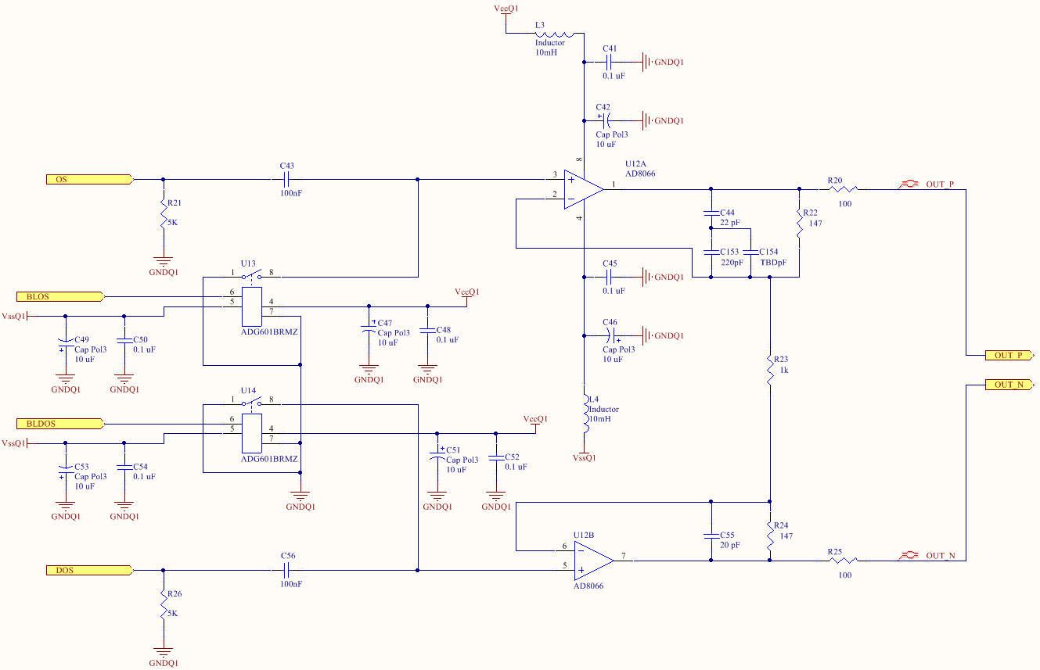
VIB Overview
Intro | System Overview | Controller Testing | VIB Testing | CCD Testing | Conclusion
Amplifiers necessary to send video signal through 2 meters of cable to controller
Differential amplifiers use output source and dummy output source
Goal is to reduce common mode noise and crosstalk
Gain set to 1.3 to match full well of device with ADC range of controller
  8 μV/e- * 350,000e- FW = 2.8 V
  ADC Range = 4.0 V
  Gain = 4.0/2.45 = 1.4 V/V

Slide 15
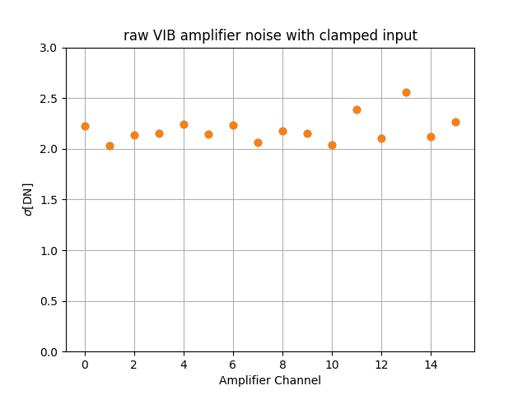
VIB Noise Testing
Intro | System Overview | Controller Testing | VIB Testing | CCD Testing | Conclusion
All amplifier inputs are grounded
Raw data is collected and the standard deviation is calculated for the data

Slide 16
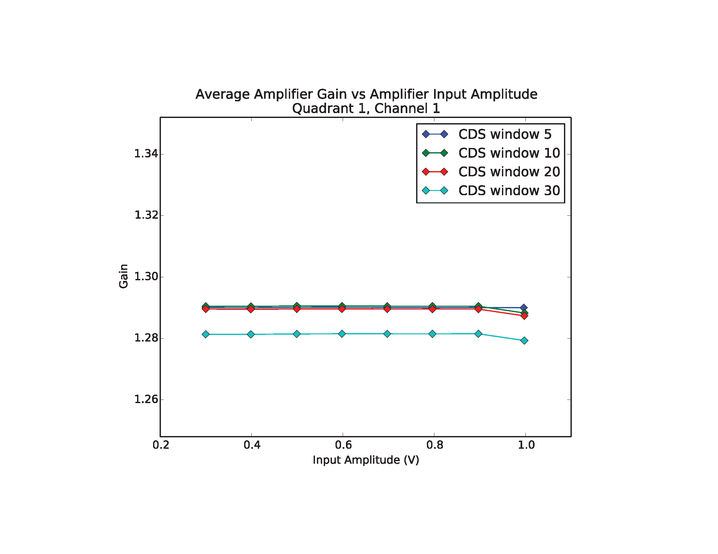
VIB Gain Testing
Intro | System Overview | Controller Testing | VIB Testing | CCD Testing | Conclusion
Small breakout boards are used for each set of CCD connectors
Clock signals are used as input test signals for the amplifiers
Note high amplitude signals fall off as well as the large CDS window
Gain slightly lower than expected due to resistor divider formed by driver output resistor and amplifier load resistor

Slide 17
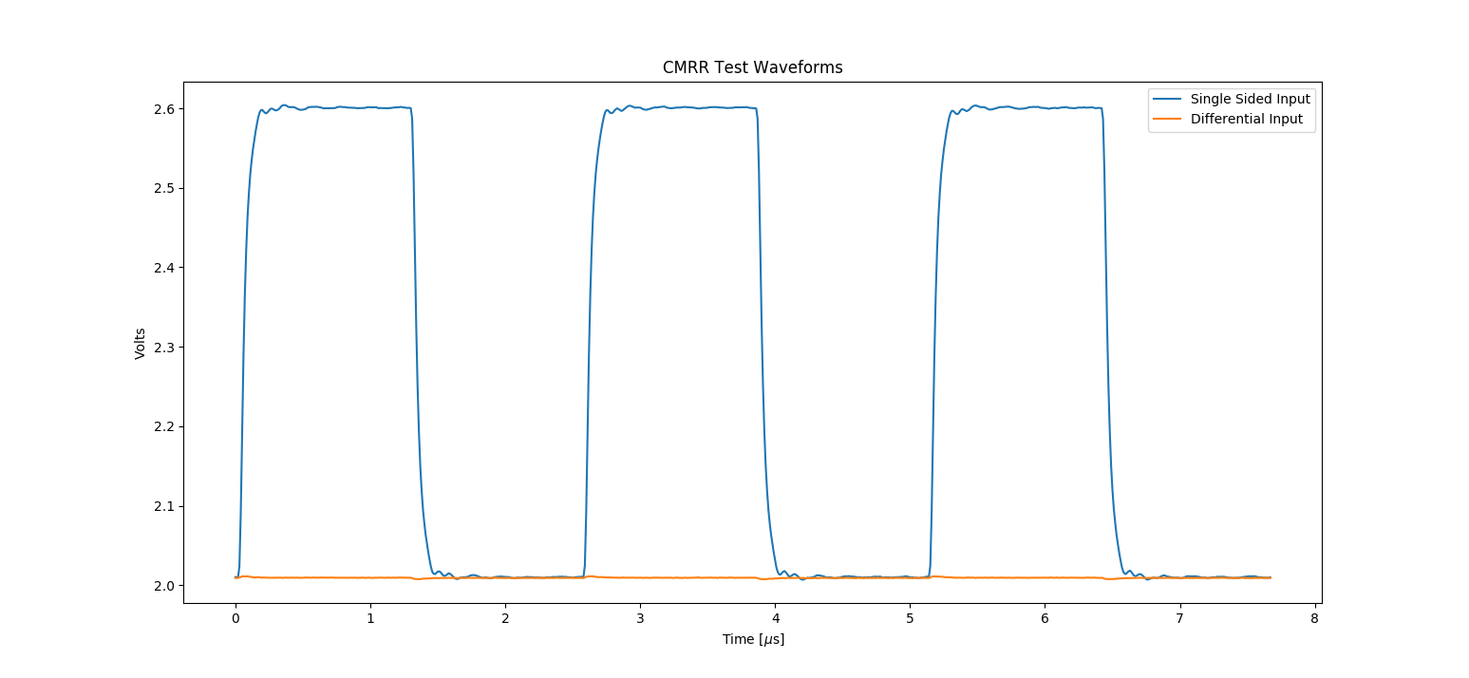
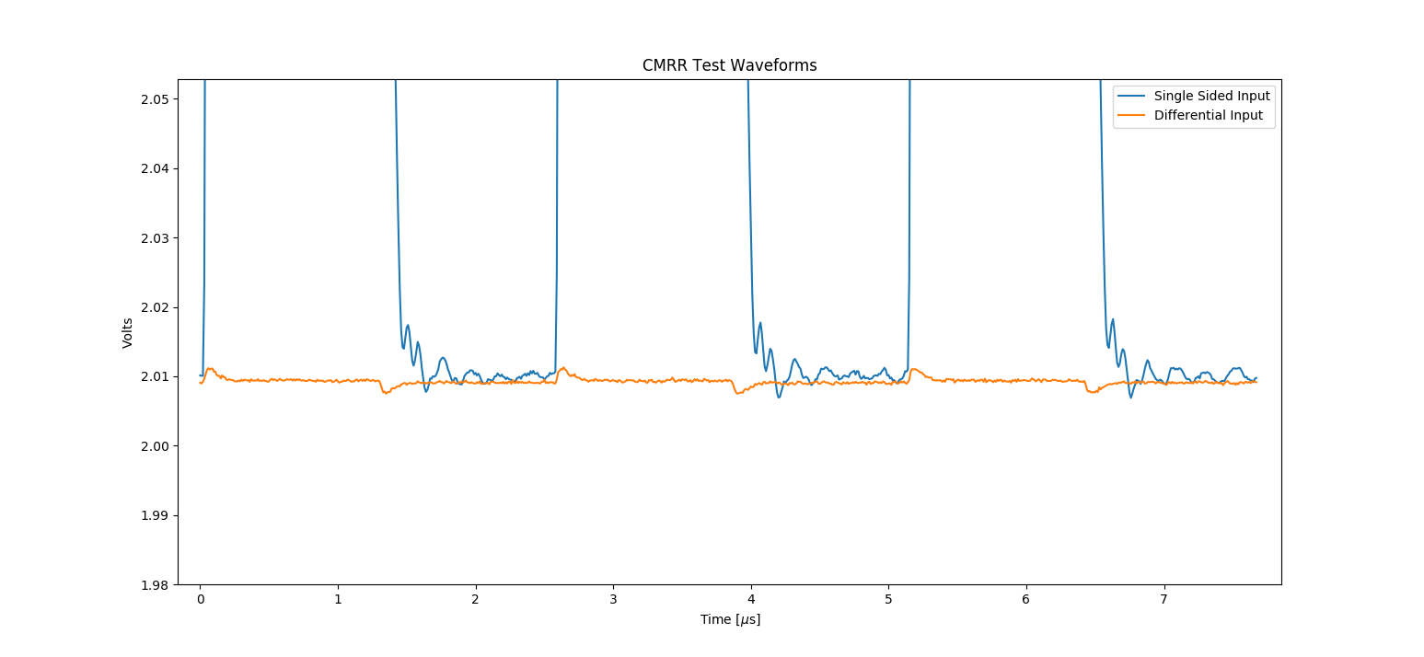
VIB CMRR Testing
Intro | System Overview | Controller Testing | VIB Testing | CCD Testing | Conclusion
Loopback a clock into one side of the amplifier
Then loopback the same clock into both sides of the amplifier
CMRR is poor at the square wave edges due to high frequency components
CMRR increases with lower frequency signals
Each amplifier has an extra capacitor in the feedback loop to tune the CMRR to increase performance

Slide 18
CCD Overview
Intro | System Overview | Controller Testing | VIB Testing | CCD Testing | Conclusion
We now complete the system with the fully populated dewar
Need to run parameterized automated tests
Software infrastructure developed through testing the controller and VIB is used to complete CCD testing

Slide 19
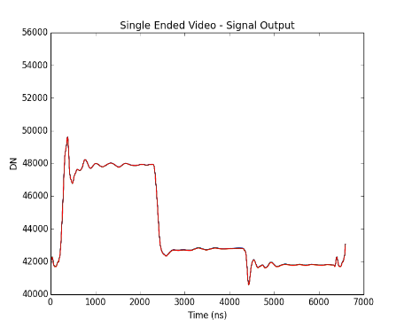
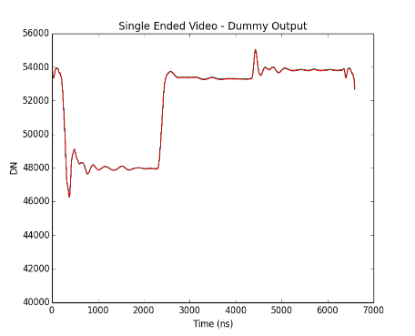
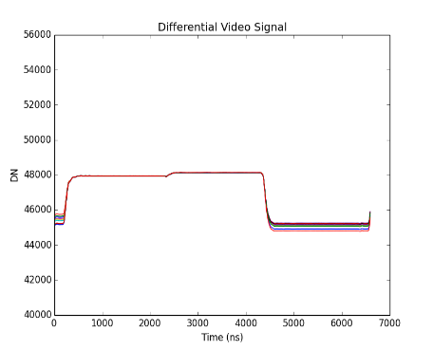
Single Sided vs Differential
Intro | System Overview | Controller Testing | VIB Testing | CCD Testing | Conclusion
Single sided operation of the amplifier with slow clocking shows the two halves of the signal
A digital combination of the single sided operation is the same as the analog differential signal
The differential operation reduces the reset feedthrough transient along with other common mode transients
Positive
Video Output
Negative
Video Output
Reduced Reset Feedthrough
Transient subtraction
Differential
Video Output
Notes:
Takeaway: Another positive reason for the differential signal chain.

Slide 20
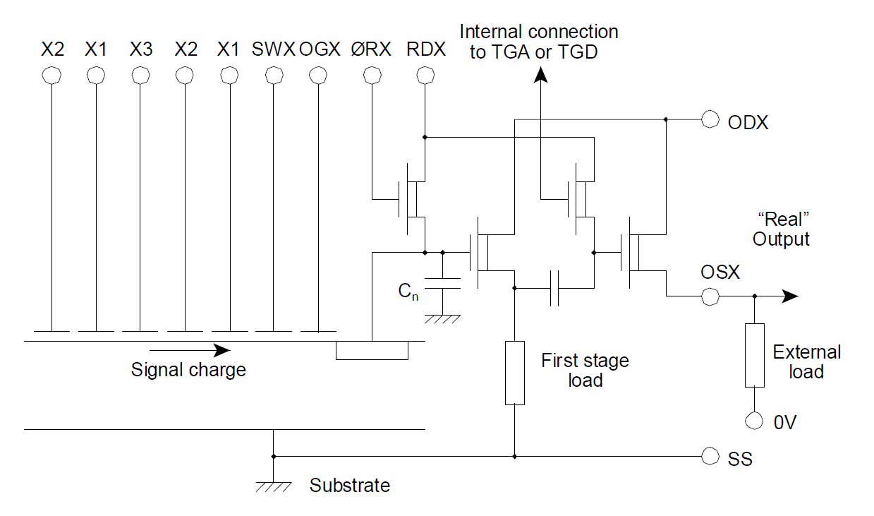
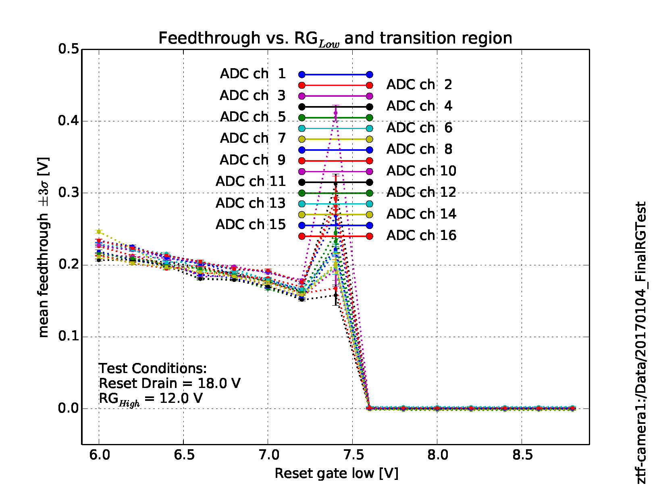
Reset Feedthrough Minimization
Intro | System Overview | Controller Testing | VIB Testing | CCD Testing | Conclusion
We increased the reset low voltage in order to decrease the reset gate pulse swing
A reduction in swing will translate to a reduction in the reset feedthrough
At some point, the reset gate low will be too high so that the reset FET is always on

Slide 21
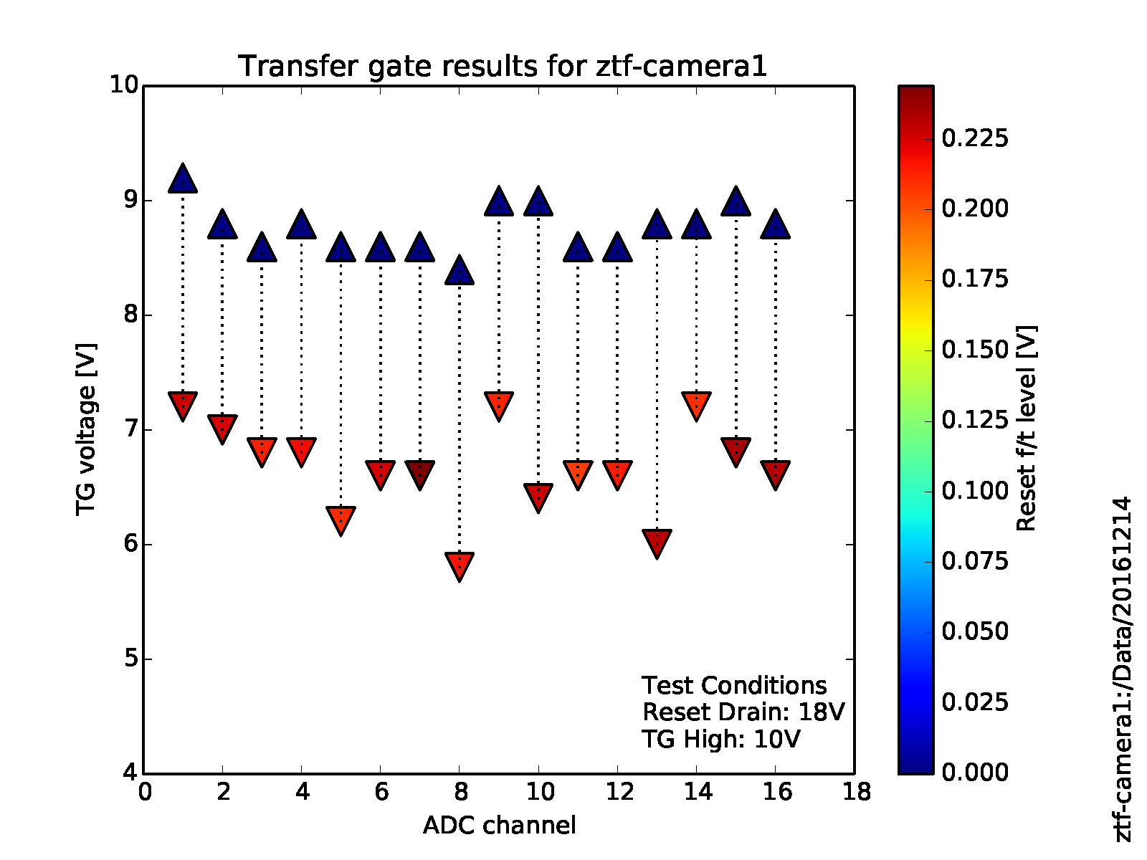
Transfer Gate Feedthrough
Intro | System Overview | Controller Testing | VIB Testing | CCD Testing | Conclusion
The transfer gate is necessary to reset the black level for the on-chip amplifier
Adjustments to the clock voltages may be desired for tweaking
Likewise, we must test when the transfer gate will reset the signal
Notes:
Takeaway: One must be careful adjusting the transfer gate levels since this can cause the on-chip black level clamp to not clamp. This causes a problem which will occur at a random time of usage depending on

Slide 22
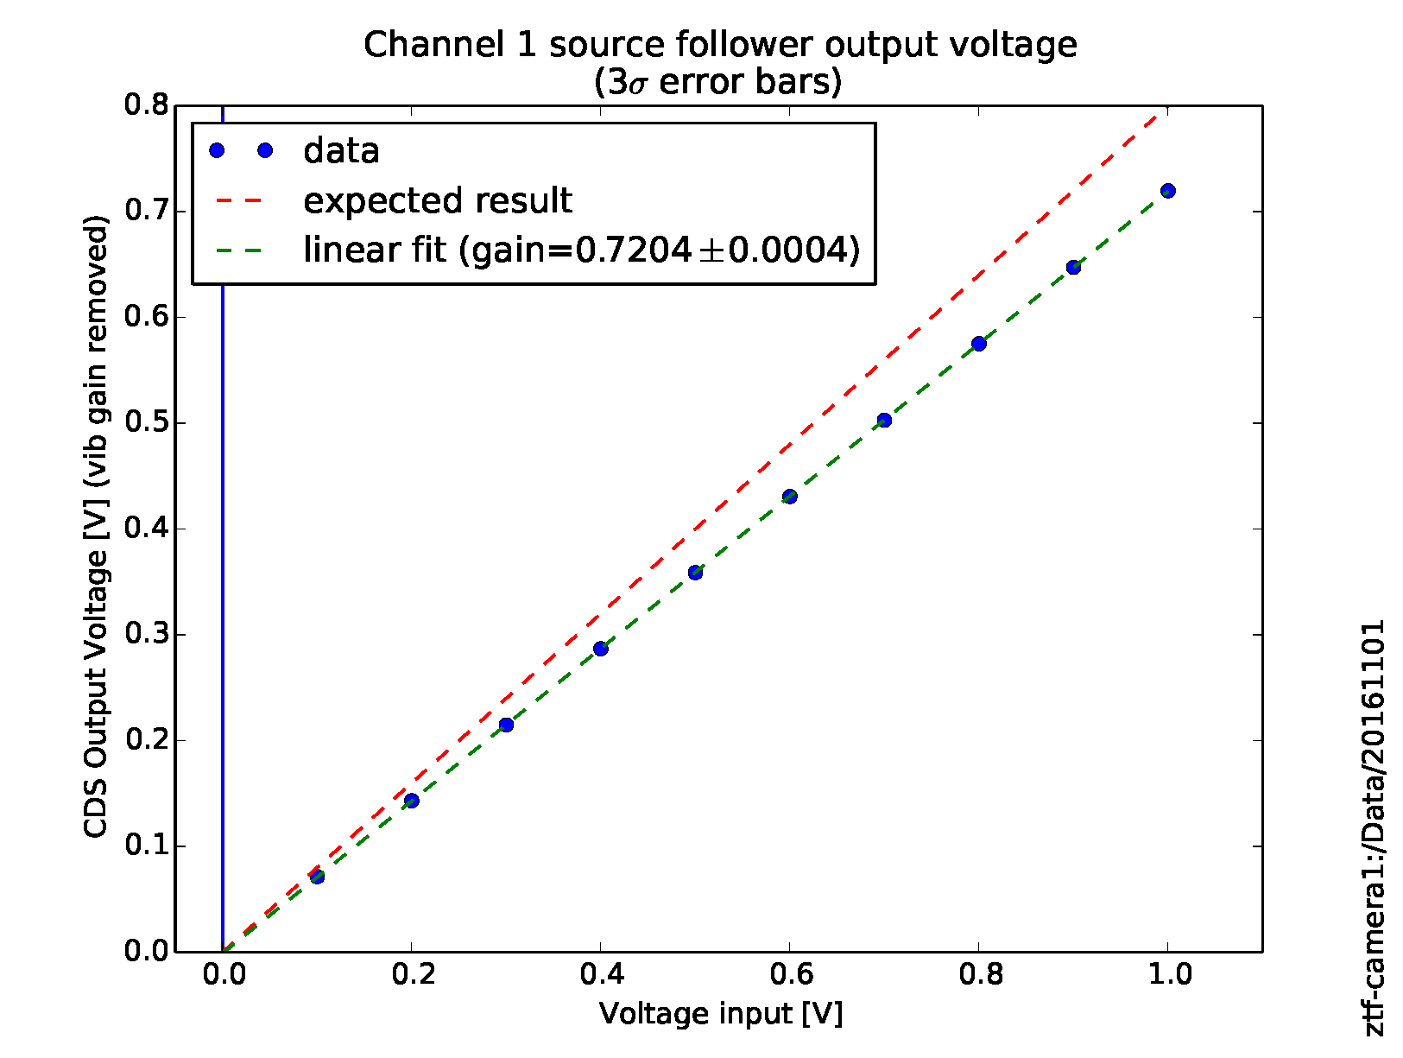
On-Chip Amplifier Gain
Intro | System Overview | Controller Testing | VIB Testing | CCD Testing | Conclusion
We attempt to measure the gain of the on-chip amplifier
Use Reset Drain voltage as the test input which is applied to the sense node with the Reset Gate
Since the two stages are capacitively coupled, the input voltage must be pulsed/stepped.
Notes:
Maybe not use this. Not too interesting to others and we never really got to an acceptable answer

Slide 23
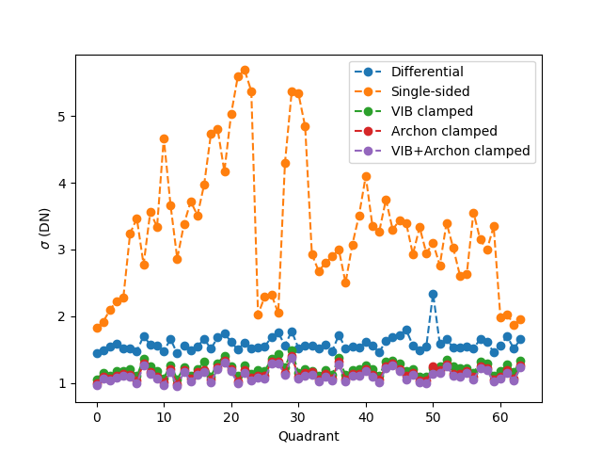
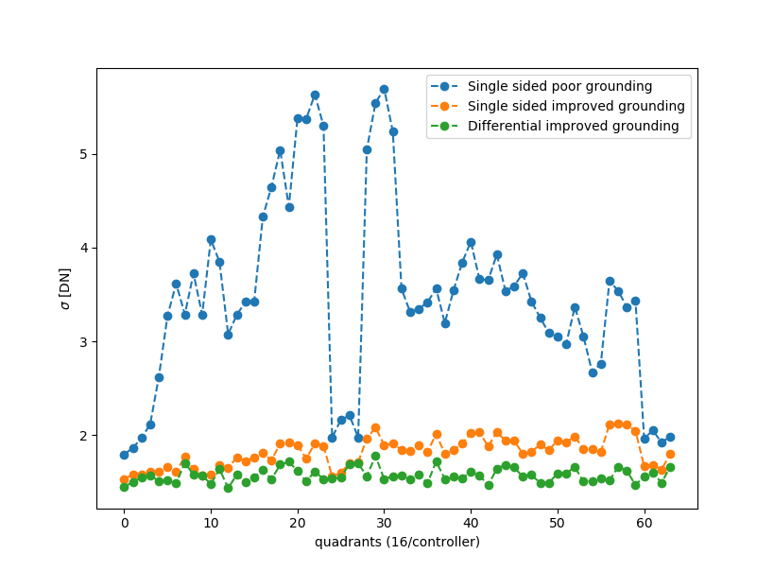
Noise
Intro | System Overview | Controller Testing | VIB Testing | CCD Testing | Conclusion
Test noise without any charge → No parallel clocks to advance the charge, but use serial clocks to keep clock feedthrough the same as normal operation. Enable parallels to clear out charge only during idle.
Single sided amplifier operation had largest noise figures due to grounding problem
Noise improved with proper grounding, yet the common mode noise cancellation is more than √2 penalty for differential operation

Slide 24
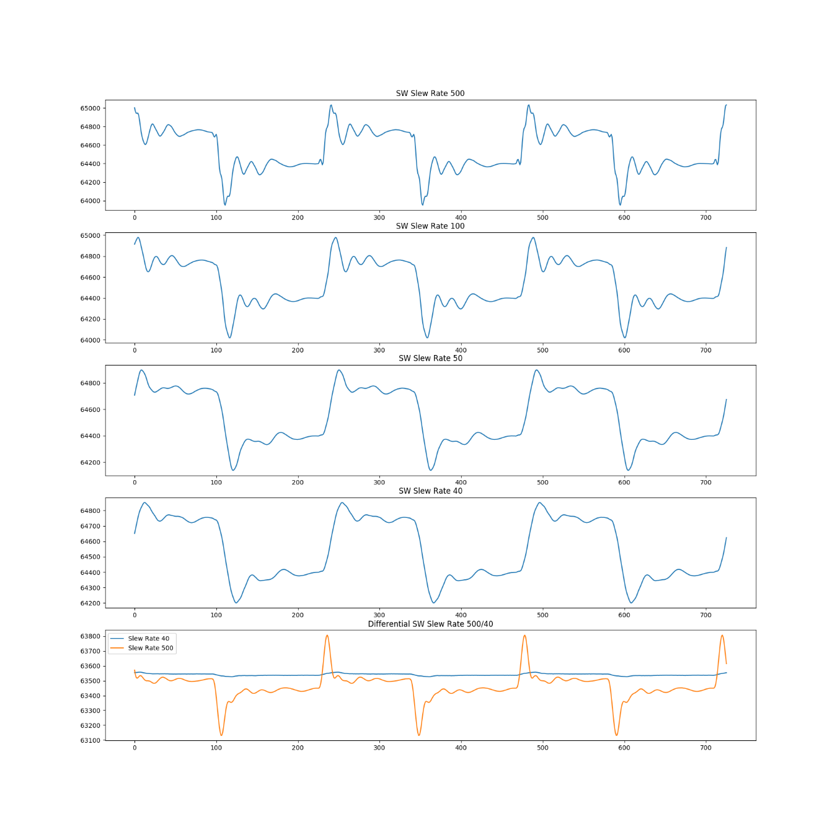
Slew Rate and Clock Feedthrough
Intro | System Overview | Controller Testing | VIB Testing | CCD Testing | Conclusion
Clock transition cause wiggles on the video signal
We can reduce the slew rate where possible to reduce these wiggles
Then differential mode can reduce them more since they are common to the output and dummy output
Notes:
Takeaway: The slew rate control helps in reducing clock feedthrough, and then the differential signaling takes care of even more.

Slide 25
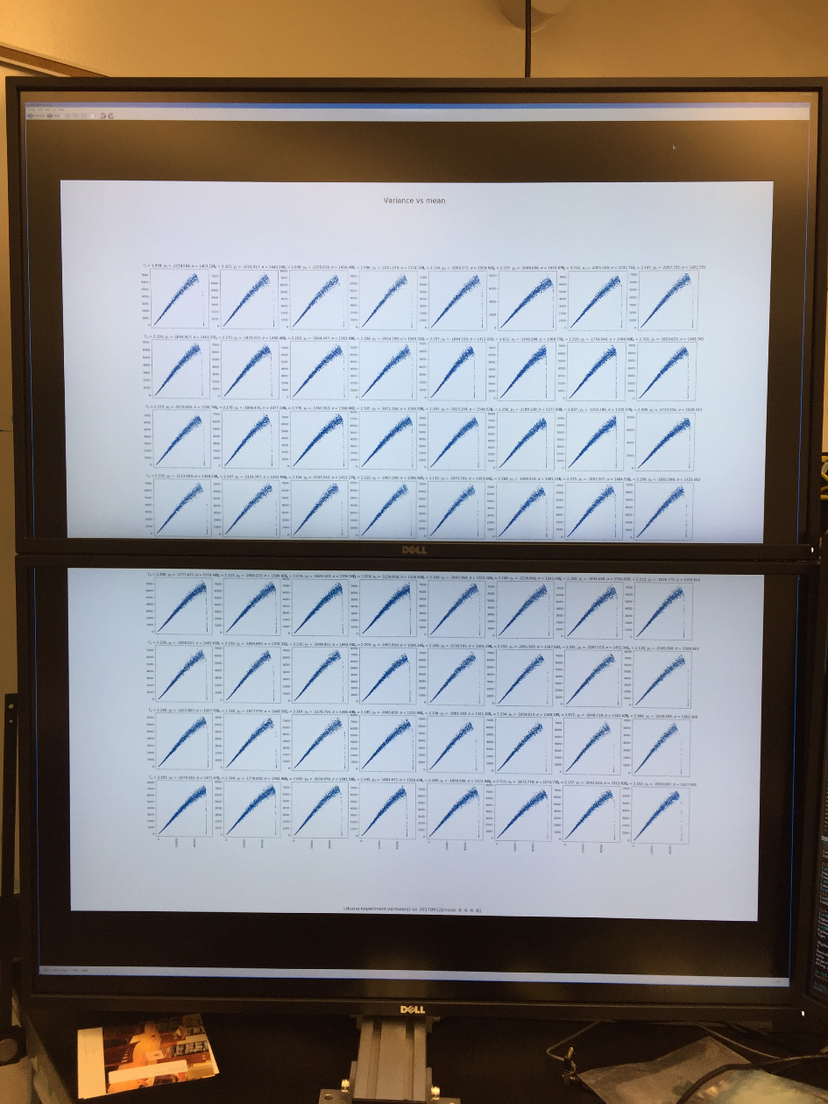
System Gain and Full Well
Intro | System Overview | Controller Testing | VIB Testing | CCD Testing | Conclusion
System gain and full well through a typical PTC
A pair of 43” Ultra-HD monitors stacked vertically, comes in handy for viewing lots of plots simultaneously.
Notes:
Takeaway: There are many channels to test, so large monitors are handy. We are processing all of these channels in parallel.

Slide 26
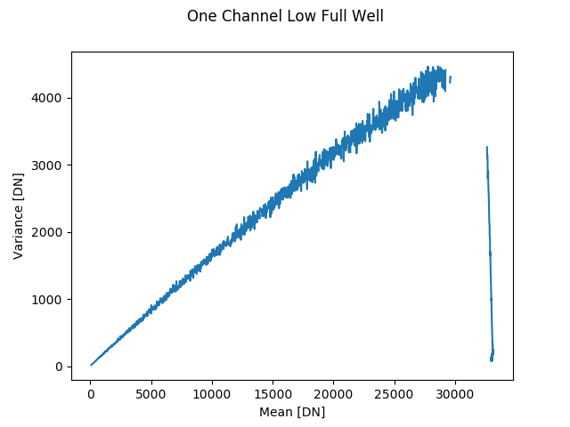
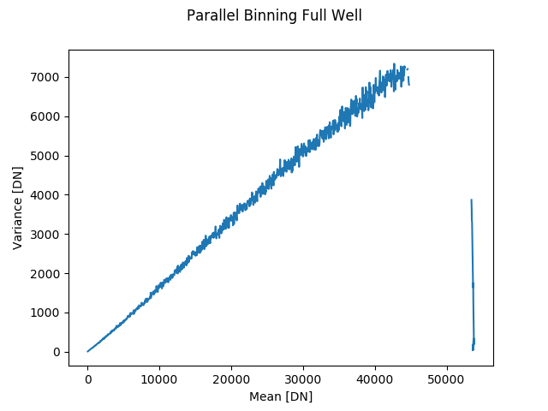
System Gain and Full Well
Intro | System Overview | Controller Testing | VIB Testing | CCD Testing | Conclusion
Testing revealed a full well problem
By parallel binning it was determined that the charge transfer problem was in the parallel direction

Slide 27
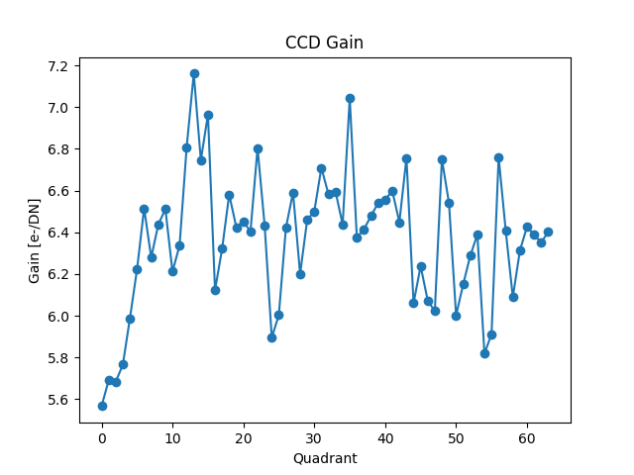
System Gain
Intro | System Overview | Controller Testing | VIB Testing | CCD Testing | Conclusion
Preliminary conversion gain has a fairly large range
Full well is now measured around 300ke-

Slide 28
In Conclusion
Intro | System Overview | Controller Testing | VIB Testing | CCD Testing | Conclusion
What’s next
  We are operating at ~800 kHz with a noise of ~7 e- to ~13 e-
  Yet there are some quirks with photon transfer curves
  There are more tests to be done
    Linearity
    Crosstalk
  There is more waveform optimizations to be done
    Triangular clocking and reducing clock feedthrough
  Get to the telescope

Slide 29
Backup slides Start Here

Slide 30
CCD Testing: Noise Single Sided vs. Differential
System Overview | Controller Testing | VIB Testing | CCD Testing | Backup Slides
Loop back

Slide 31
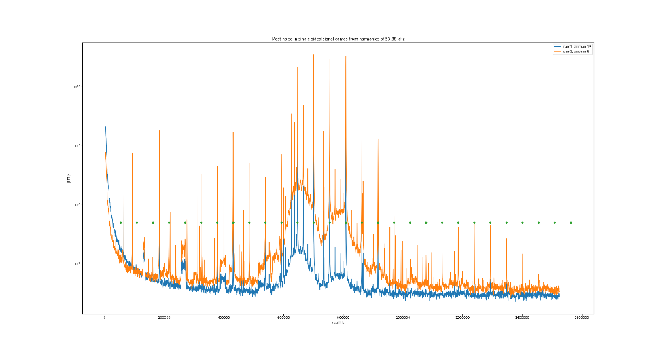
CCD Testing: Noise FFTs
System Overview | Controller Testing | VIB Testing | CCD Testing | Backup Slides
Using FFTs of the raw data to see dominant frequencies
Can we understand what is causing the noise by dominant frequency
Dominant frequency is 53.88 kHz. Maybe a switching supply?
FFTs were interesting, but minimally useful to solve the noise problem

Slide 32
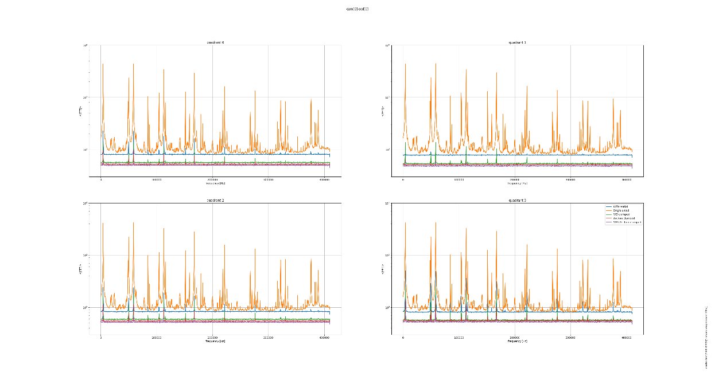
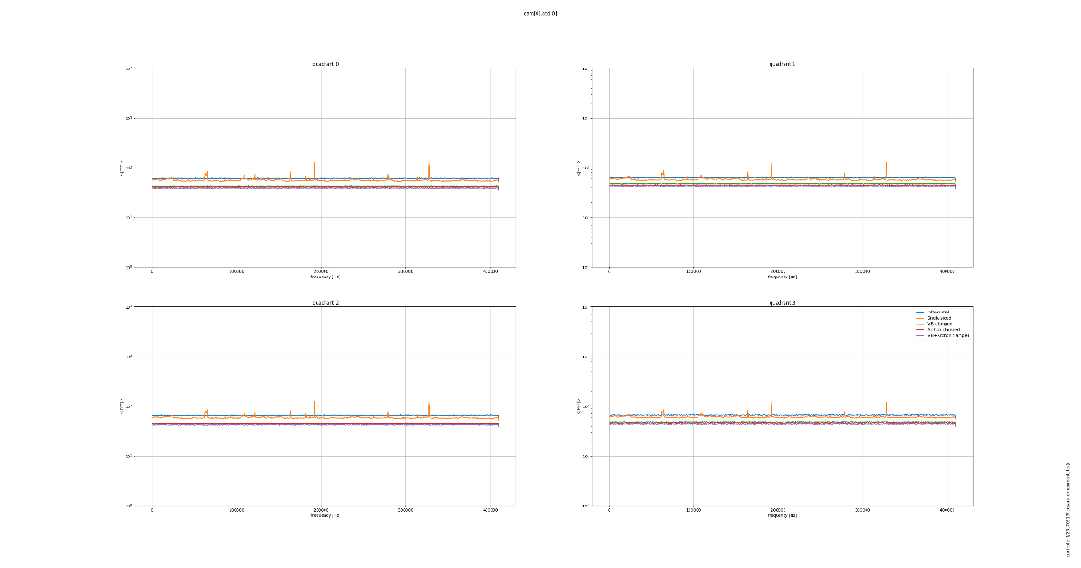
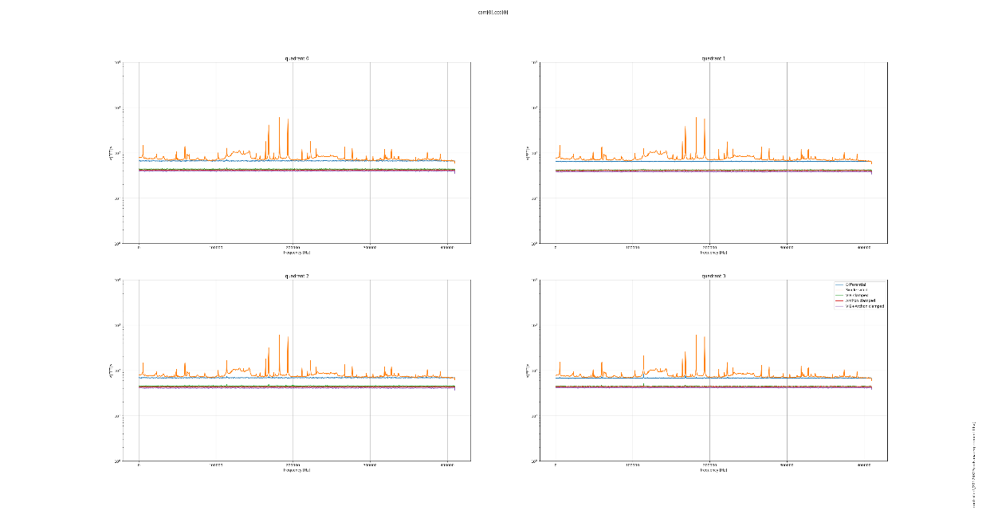
CCD Testing: Noise FFTs
System Overview | Controller Testing | VIB Testing | CCD Testing | Backup Slides
FFT In Lab
FFT at Palomar
FFT in Lab Mounted to Spider

