Slide 1
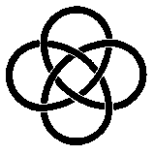
IUCAA Digital Sampler Array Controller (IDSAC)
SDW 2017
Pravin Chordia
Email :pravin@iucaa.in
SPIE PAPER
SPIE 2016 : 9915/1/IDSAC-IUCAA-Digital-Sampler-Array-Controller – Sabyasachi Chattopadhyay

Slide 2
IDSAC Unit Features
IDSAC is a Generic Focal Plane Array Controller that can handle wide
variety of detectors (FF-CCD, FT-CCD, IR-CCD, HYBRIDS, CMOS-CCD)
Smallest IDSAC unit has one IDSAC card and one Power supply card
packaged inside the box.
Single Board IDSAC Card has all the resources to run one CCD having up
to four outputs, with or without, dummy outputs.
Available in both backplane and non-backplane packaging architecture
options for easy scalability and flexibility, while running multiple CCDs
independently or in a mosaic.
Single 78 Pin standard HD D sub connector for CCD Connections
Few spare pins for Temperature Controller enabling use of Single
Connector at CCD end, either Hermetic or Vacuum interface board.

Slide 3
IDSAC Unit Features
Mains Powered Unit has all required Switched Mode Power Supplies in compact form factor on single Power Supply Card.
One Power Supply card has the ability to two drive two IDSAC Boards.
Power Consumption < 25 W and weight < 2.5 Kg
USB 3.0 interface provides connection to Linux host via optional, off the shelf, USB to Fibre converters.
Sustained Data Rate : 320 MBps
The host software can be installed either as a command line interface or an Application Programming Interface (API)
The simple “makefile” based installation process is very convenient.
It is written in C, C++ and is compatible with a variety of Linux flavours..

Slide 4
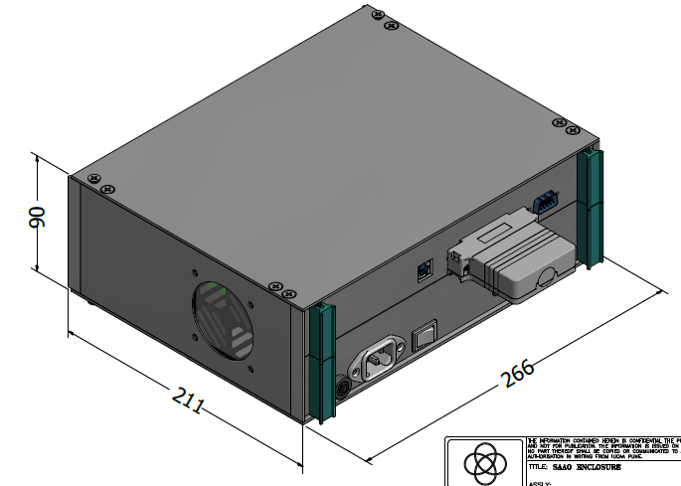
IDSAC Unit

Slide 5
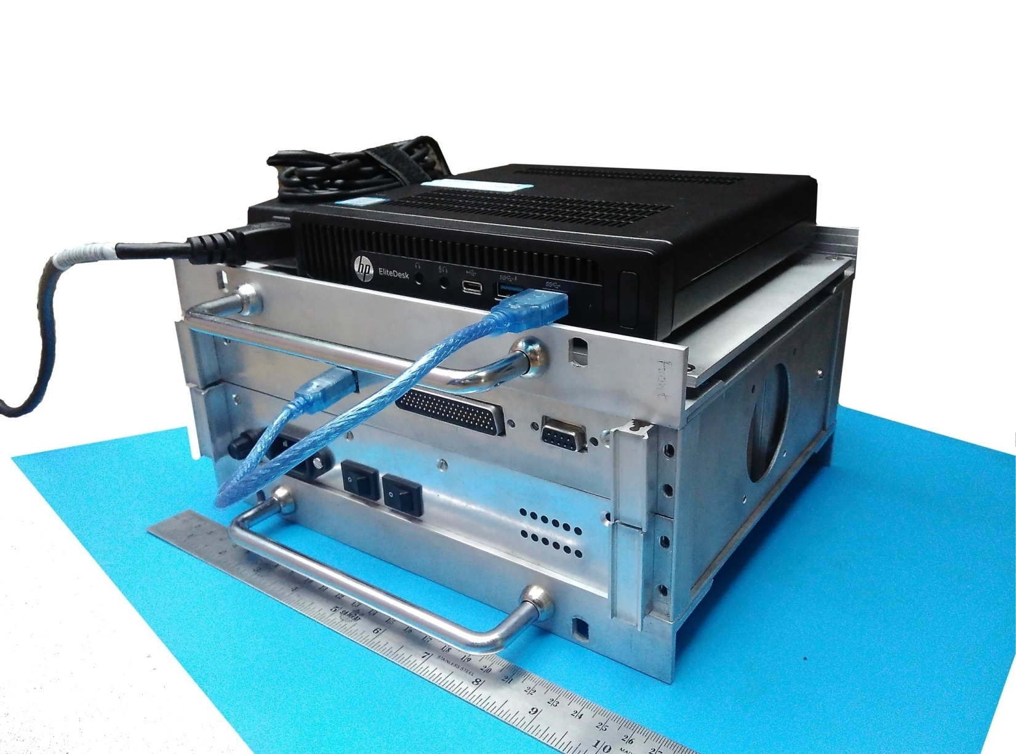
IDSAC Unit
Mini Desktop PC
Power Adapter for PC

Slide 6
Possible Full Frame Readout options With four output CCD
Any rectangular / square shape of frame from anywhere on the detector plane, can be read out.
H
G
H
G
H
G
E
F
E
F
E
F
H
G
H
G
H
G
H
G
E
F
E
F
E
F
E
F

Slide 7
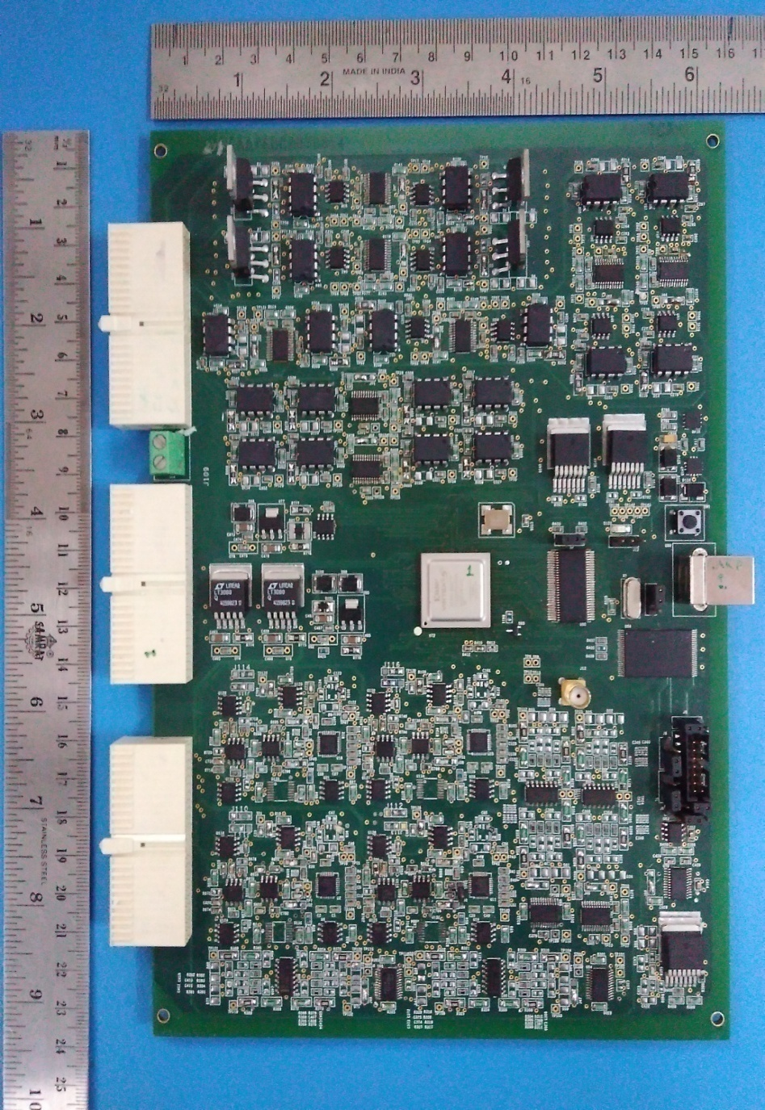
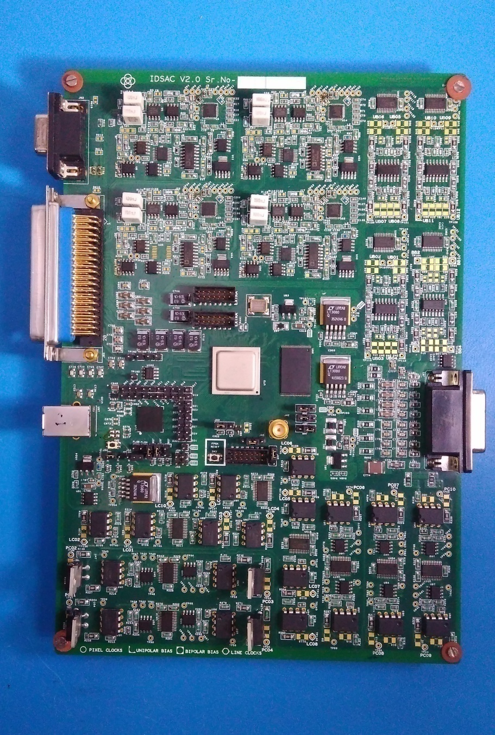
Backplane Version
Standalone Version
BACKPLANE HAS NO ACTIVE PARTS

Slide 8
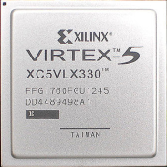
Video Processor (4 Video Channels) DCDS Throughput 500Kpps
ADC 16bit, LVDS, 10MSPS
BIAS Driver
(16 Nos.)
0-34V (12 Nos.)
-14V to +14V (4Nos.)
Shutter and Temperature
Four Channel Fully Differential Digital Correlated Double Sampling (DCDS) Video Processor for eliminating kTC noise and reducing read noise.
User selectable number of samples for both Reset and Signal levels
Programmable Speeds of up-to 0.5 Megapixels /Sec/Channel with 16 bit resolution. Can go up to 1Mpps per channel.
3 Programmable gain settings.
Gain and offset matching better than 0.5 %
16 bit, 10 MSPS, Differential Input, LVDS serial ADC having No missing code
9 pin D Sub
78 pin High Density D Sub
CCD Connector
Feed through Filters
15 pin D Sub
Voltage Regulators
Power Connector
USB 3.0 Chipset
JTAG for FPGA Programming
USB 3.0
Line or Parallel Clocks (Tri-level) clocks (10 Nos.)
Pixel or Serial Clocks (Bi-level) (10Nos.)

Slide 9
Video Processor (4 Video Channels) DCDS Throughput 500Kpps
ADC 16bit, LVDS, 10MSPS
BIAS Driver
(16 Nos.)
0-34V (12 Nos.)
-14V to +14V (4Nos.)
Noise characterization of the IDSAC CDS signal chain has been performed by analytical modelling, simulation and practical measurements.
Theoretical calculation matches very well
with practical measurements within 10%.
At a readout speed of 350 KSPS net noise of 3.5 electrons RMS from the controller and 2. 7 electrons at 200 KSPS.
On the fly configurable , 10 Pixel clocks
10 Line clocks and 16 Biases.
12 bit resolution for Both Bias and Clocks
Clock driver voltage range +/- 13V
Due to wide range clocks, CCDs can be operated in Inverted mode Operation.
Shutter and Temperature
9 pin D Sub
78 pin High Density D Sub
CCD Connector
Feed through Filters
15 pin D Sub
Voltage Regulators
Power Connector
USB 3.0 Chipset
JTAG for FPGA Programming
USB 3.0
Line or Parallel Clocks (Tri-level) clocks (10 Nos.)
Pixel or Serial Clocks (Bi-level) (10Nos.)

Slide 10
Video Processor (4 Video Channels) DCDS Throughput 500Kpps
ADC 16bit, LVDS, 10MSPS
BIAS Driver
(16 Nos.)
0-34V (12 Nos.)
-14V to +14V (4Nos.)
Shutter and Temperature
Average Current Driving - 130 mA.
Easy Rise & fall time control in hardware.
Multilevel Line clocks possible
Noise < 1 mV RMS for Biases and , 2 mV for Clock Driver Amplifiers
Out of 16, 12 are Unipolar Biases having range of 0 to 34 V and 4 Bipolar Biases with Range – +/- 14 V
Reconfigurable hardware (Xilinx Virtex-5 FPGA) as a master controller. Could easily be adapted or customized for specific requirements.
9 pin D Sub
78 pin High Density D Sub
CCD Connector
Feed through Filters
15 pin D Sub
Voltage Regulators
Power Connector
USB 3.0 Chipset
JTAG for FPGA Programming
USB 3.0
Line or Parallel Clocks (Tri-level) clocks (10 Nos.)
Pixel or Serial Clocks (Bi-level) (10Nos.)
10
Notes:
Tri or quad level clocks for no blooming (No Blooming is observed without Clocked Anti Blooming CAB ) and so the less clock induced charge (CIC)
Maximum Line Clock speed achieved using DACs is in excess of 10 KHz

Slide 11
Video Channel Noise V/S No. of samples ( With CCD )
No. of Samples | Overall Noise (Electrons)
 | Readout Speeds
 | 100Kpps | 200Kpps | 350Kpps
3 | 6.58 | 6.65 | 7.63
4 | 6.09 | 6.16 | 6.8
5 | 5.55 | 5.57 | 6.02
6 | 5.09 | 5.08 | Max. No. of Samples can accommodate are 5
7 | 4.90 | 4.87
8 | 4.62 | 4.55
9 | 4.38 | Max. No. of Samples can accommodate are 8
10 | 4.25
11 | 4.08
12 | 3.90
13 | 3.90
14 | 3.78
Notes:
CCD 42-40 2 output 2K*2K from the ccd graph
Noise at 100 KHz : 3.5 e- , at 200 Khz – 4.1 e-, at 350 KHz – 5.1 e-

Slide 12
Clock Driver Waveforms
Tri Level Line Clocks driving 47nF Load
Notes:
Tri or quad level clocks for no blooming (No Blooming is observed without Clocked Anti Blooming CAB ) and so the less clock induced charge (CIC)
Maximum Line Clock speed achieved using DACs is in excess of 10 KHz

Slide 13
Clock Driver Waveforms
Pixel Clocks Rise and Fall ~ 45 nS driving 470pF Load

Slide 14
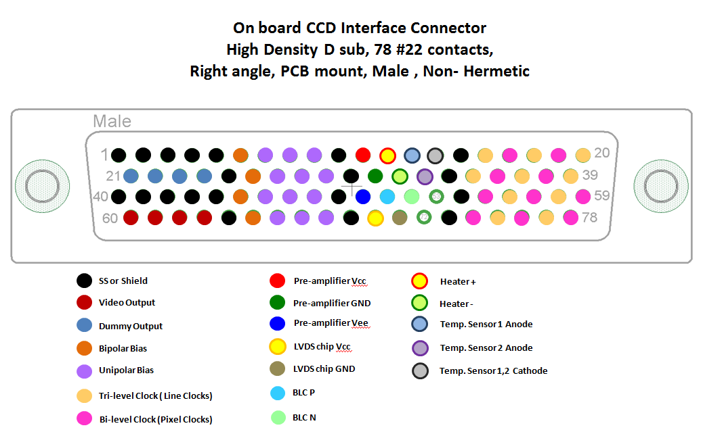

Slide 15
IDSAC S/W features
OS: Linux (Wide variety of flavors)
H/W Interface: USB 3.0
Makefile based installation
C++ Command line standalone program
Input to s/w: 11 Parameter files (flat files)
Output: Date Time stamped FITS with headers containing configuration information
Libraries Used: libusb, argtable, autoopts, cfitsio
API can be made available

Slide 16
Parameter files (Input to S/W)
ParameterFile.txt
DACParameterFile.txt
DumpLineDet1.txt
IgnorePixelDet1.txt
NoADCDataPixTxDet1.txt
PixelTxDet1.txt
TrilevelClockFile.txt (5 files)

Slide 17
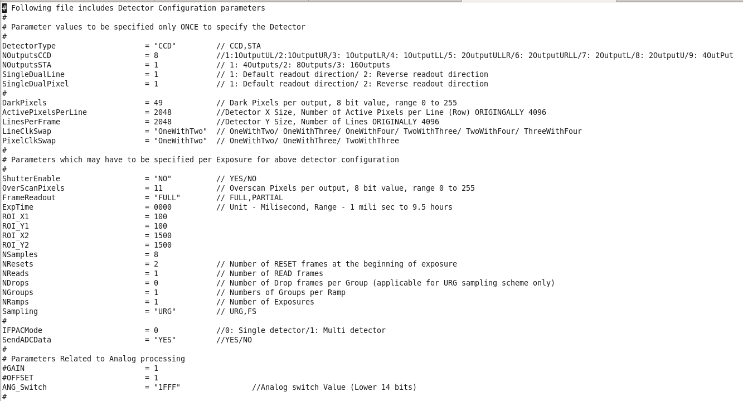
``
Exposure Parameter File

Slide 18
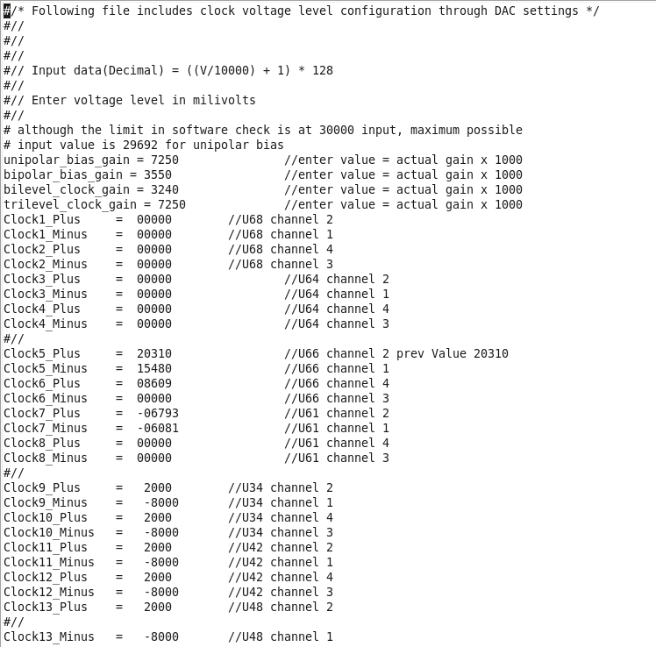
DAC Parameter File

Slide 19
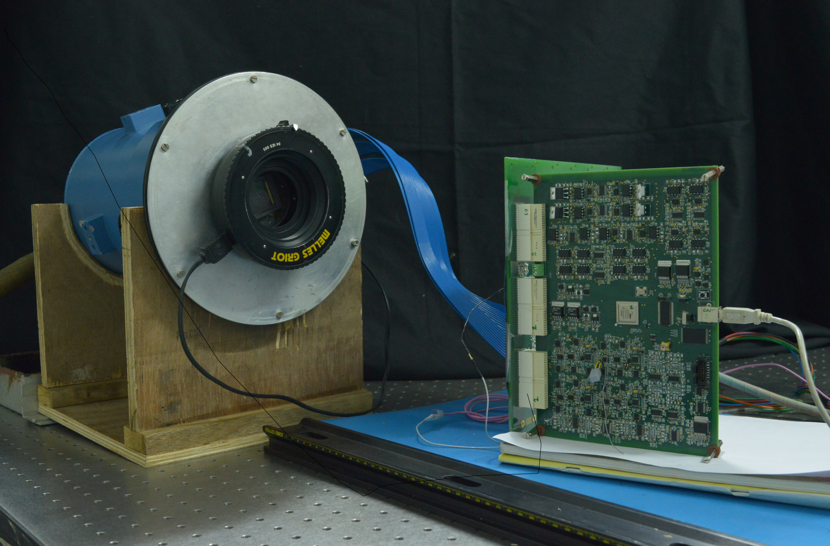
Test Setup

Slide 20
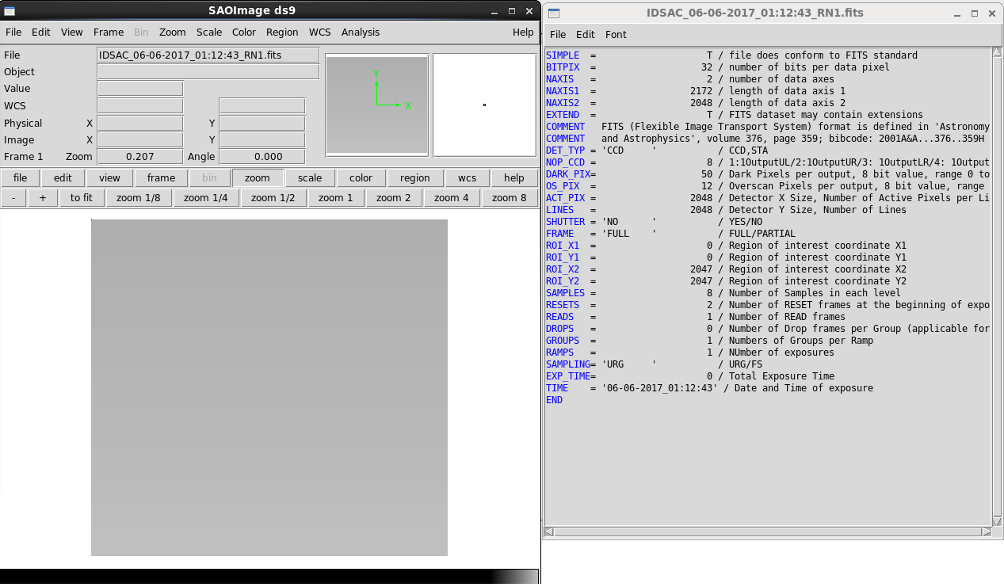
FITS Image and Header

Slide 21
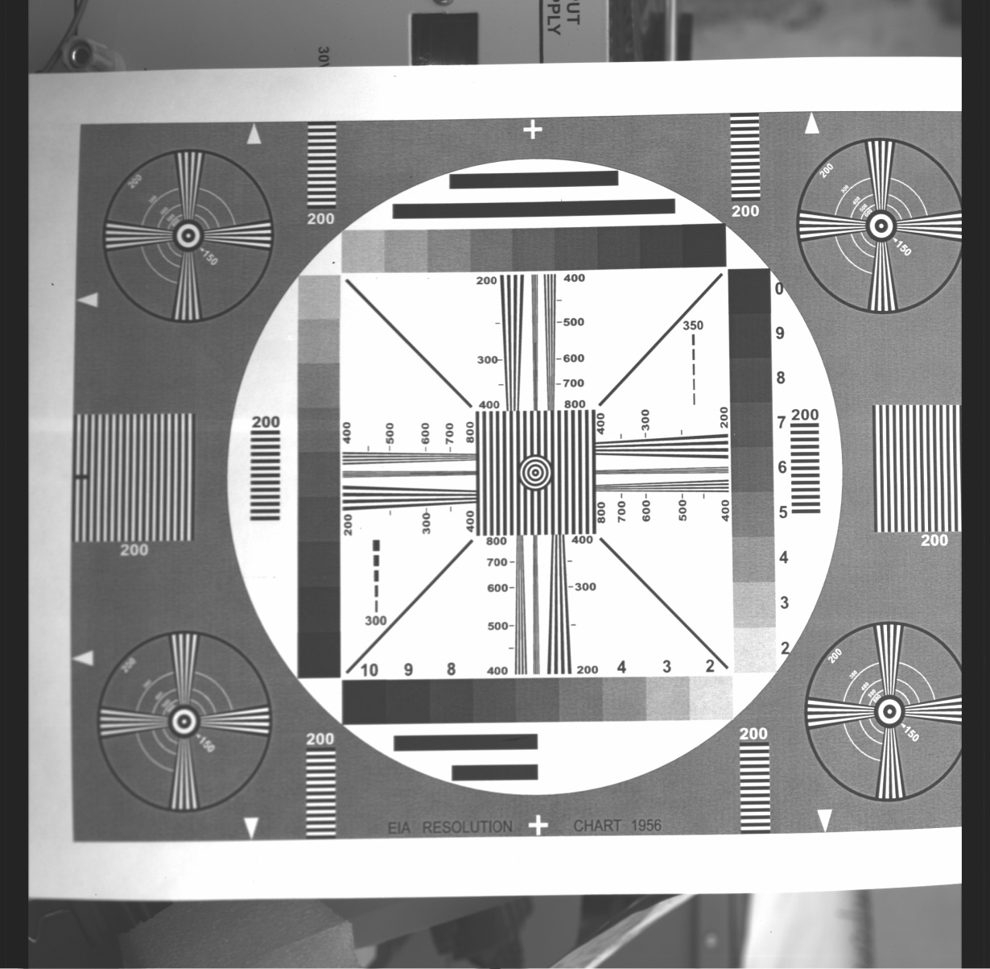
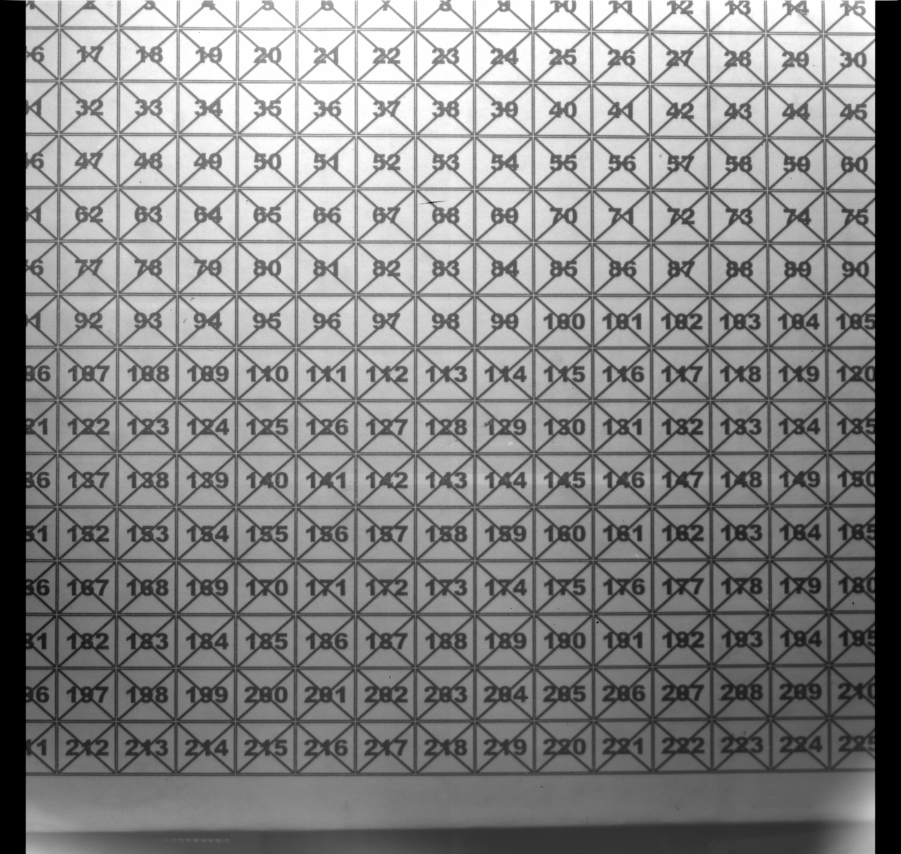
Images Taken Using IDSAC Controller in the LAB
Notes:
The Image on Left had side was used for ROI testing.
Right side image was taken to check proper fits creation and gray levels

Slide 22
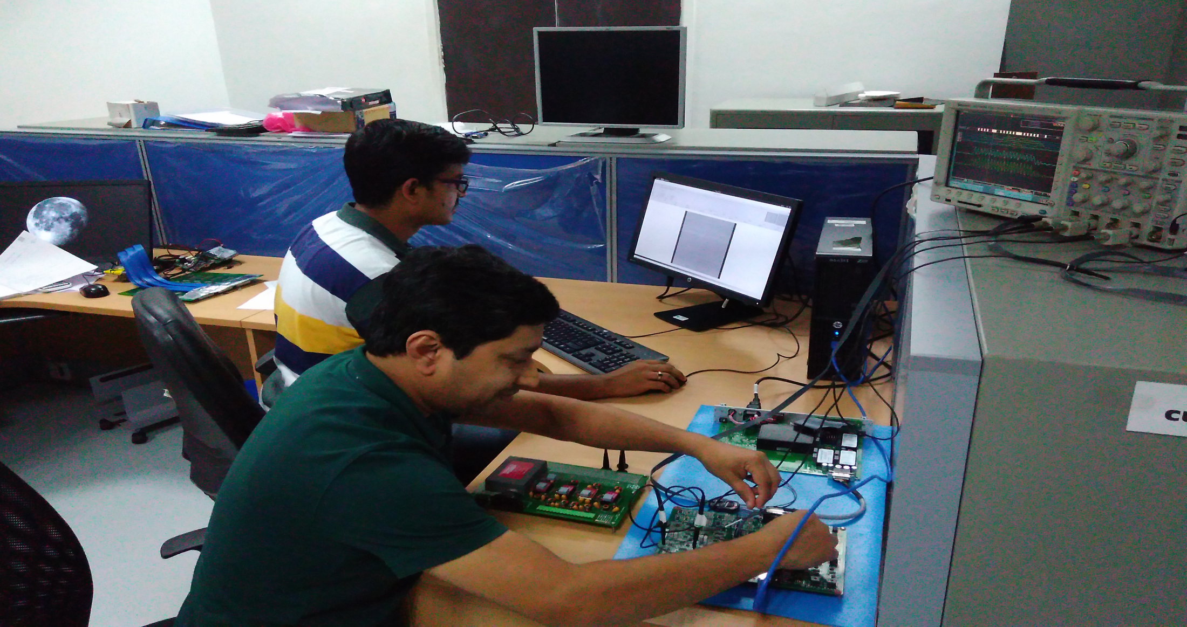
Engineers At Work!!!

