Slide 1



The ACADIA ASIC - Next Generation Detector Control and Digitization for WFIRST
Markus Loose, Brian Smith, Greg Alkire, Atul Joshi, Daniel Kelly, Eric Siskind, Steven Mann, Jing Chen, Atilla Askarov, Joseph Fox-Rabinovitz, Edward Leong, Amber Goodwin, Decosta Lindsay, Dino Rosetti, Jonathan Mah, Edward Cheng, Laddawan Miko, Harry Culver, Edward Wollack, David Content

Slide 2
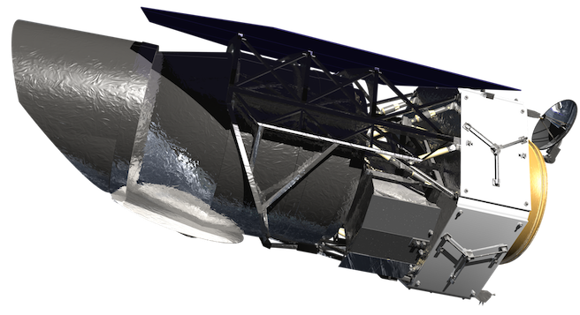
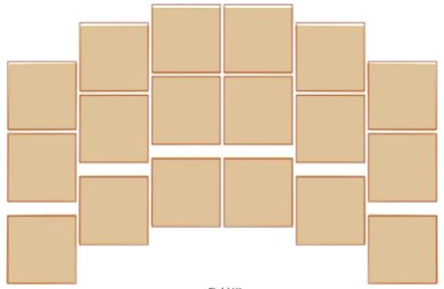
Motivation
Over the last decade, many instruments and missions have used ASICs as detector controllers
  HST (ASC-R), JWST, Euclid, OSIRIS-Rex, LDCM
  Several ground-based instruments
ASICs are particularly useful for large detector mosaics
  Can digitize many detector outputs in parallel
  Can operate cryogenically, close to the detector
Lower power, lower mass than conventional electronics
  Ideal for space applications
The WFIRST Wide Field Camera is a perfect application for ASICs
  Large Mosaic of 18 4k x 4k H4RG detectors in space
WFIRST decided to develop a new ASIC with improvements in several areas compared to prior technology (like the SIDECAR ASIC):
  Lower noise on bias voltages and currents
  Higher signal-to-noise ratio in digitization chain (Preamps & ADCs)
  Easier to use system design
  Some WFIRST specific capabilities like on-the-fly bright pixel detection)

Slide 3
ACADIA Overview
ASIC for Control And Digitization of Imagers for Astronomy
40 Digitization Channels, each providing
  Pre-amplifier with programmable gain, bandwidth, and feedback type (resistive or capacitive)
  16-bit ADC, up to 1 MHz sample rate (3 – 5 MHz at 14-bit)
  Digital processing capability for adding/multiplying and threshold detection
24 Analog bias outputs
  12-bit Digital-to-Analog Converters with configurable output buffer
  Programmable current sources
  Internal bandgap for reference voltage (operational across full temperature range)
32 Clock Inputs/Outputs
  Programmable drive strength, driver mode, and signal delays
  Additional dedicated SPI port for serial detector configuration
Custom Sequencer for Timing Generation
  Programmable timing patterns with 47 simultaneous signals (32 external, 15 internal)
  Small set of instructions achieves fast learning curve and easy programming
  Dedicated support structures like timers, DMA engines, and FIFO
  Open Source Microcontroller (MSP430) for applications that require more complex operations

Slide 4
ACADIA Block Diagram

Slide 5
ACADIA Floorplan

Slide 6
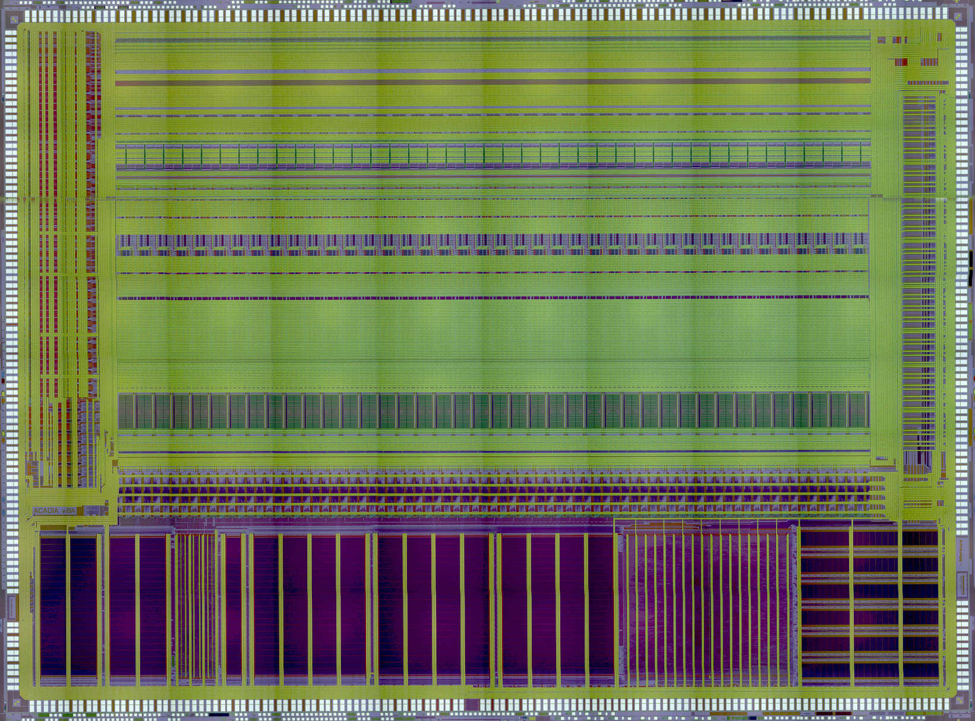
ACADIA Layout Micrograph
Die size:
20.5mm x 15.1mm
This is a stitched image made from several smaller microscope images.

Slide 7
Preamp Block Diagram

Slide 8
Two Different Preamp Options
Capacitive Feedback Preamp
Resistive Feedback Preamp
Slightly lower noise
High impedance inputs
Requires periodic resets -> kTC noise
Slightly higher noise
Continues operation (no resets required)
Requires additional buffers (for high impedance)

Slide 9
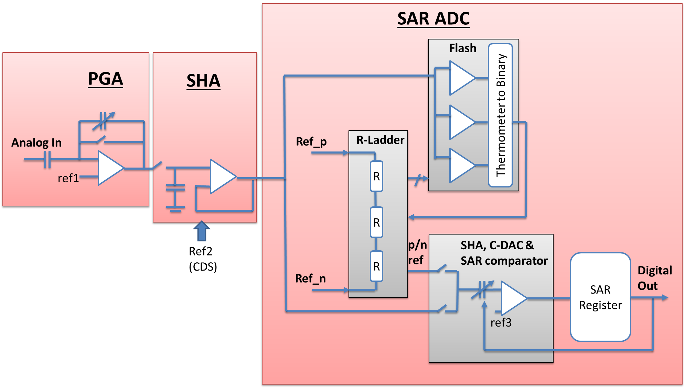
ADC Architecture
Preamp
Sample/Hold
Architecture is a combination of subranging ADC (flash) and successive approximation register

Slide 10
Bias Generator
24 programmable analog bias output channels
  Used for detector biasing and detector power
  Each channel can be configured as voltage source or current source
  Voltages and currents are programmable over full supply range
12 programmable internal voltage references
  Used as Preamp and ADC references
32 programmable internal bias currents
  Programmable over larger current range from 100nA to 6.4mA
  Used for biasing preamps, ADCs, and other auxiliary on-chip circuitry
Bandgap reference
  Operates from room temperature to cryogenic temperatures
Special measurement circuitry
  Measure voltage and current on all biases
  Internal temperature sensor

Slide 11
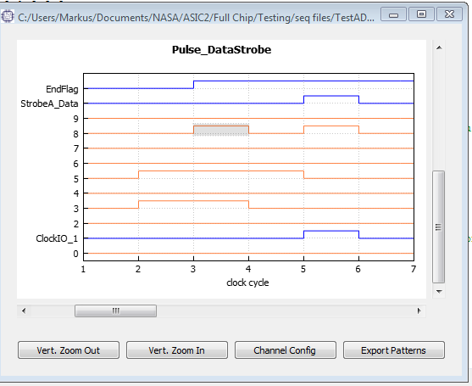
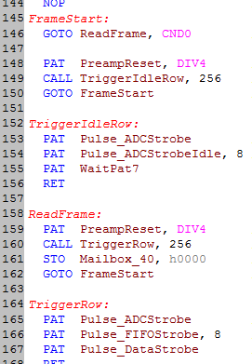
Sequencer

Slide 12
Microcontroller and Memories
An open source MSP430 microcontroller was chosen instead of a custom one
  Saves development time
  Has ample software support, including assembler, C-compiler, debugger, etc.
  However, performance is limited, not a perfect fit for the application
    Not a concern for WFIRST and most other possible applications.
Properties of the MSP430 as implemented into the ACADIA
  16-bit controller
  16 kword of program memory
  32 kword of data memory (paged access due to limited address access range by CPU)
  61 interrupt channels plus non-maskable interrupt
Other Memories and Registers (non-microcontroller related)
  16 kword of science data memory (FIFO)
  12 kword of sequencer and DMA configuration memory
  Over 1000 digital 16-bit configuration registers
Designed for radiation environments (Space)
  All memories, registers, and logic has been protected against Single-Event-Effects

Slide 13
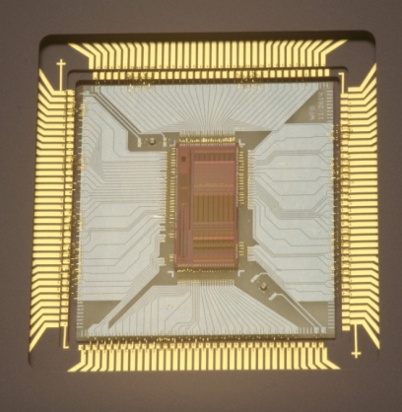
Development Status
Test structures chip (2014)
  Understand exact behavior of transistors and bandgap circuits under cryogenic conditions
  All tests completed, results applied to ACADIA design
ADC test chip (2015/16)
  8-channel ADC chip with complete preamp and representative bias circuits
  Performance has been characterized
    All circuits performed well
    ADC had some DNL issues with non-uniformities (spikes and low density areas)
  Revision of ADC test chip has been built
    Testing ongoing, but results so far indicate significant improvement in DNL
ACADIA Full Chip
  Design was completed in Spring 2017
  Wafers have been received back from the foundry in August 2017
  Testing of first packaged ASIC has begun
    Digital circuits have been successfully verified (command interface, registers, memories, science data outputs, microcontroller, etc.)
    Analog circuits not yet tested
ADC Test Chip

Slide 14
Noise Test Results Preamp + ADC
100 kHz ADC sample rate
Measured on ADC Test Chip
295K | 80K
C1 (pF) | C2 (pF) | Gain | Noise (ADU) (Output) | Noise (μV) (RTI) | Noise (ADU) (Output) | Noise (μV) (RTI)
4.8 | 4.8 | 1 | 1.13 | 67.8 μV | 0.77 | 46.4 μV
4.8 | 2.4 | 2 | 1.25 | 37.5 μV | 0.96 | 28.8 μV
4.8 | 1.2 | 4 | 1.36 | 20.4 μV | 1.12 | 16.7 μV
4.8 | 0.6 | 8 | 1.66 | 12.4 μV | 1.46 | 11.0 μV
4.8 | 0.3 | 16 | 2.27 | 8.5 μV | 2.166 | 8.1 μV
4.8 | 0.15 | 32 | 3.54 | 6.6 μV | 3.72 | 7.0 μV

Slide 15
Preamp & ADC Combined Noise Comparison
ACADIA (ADC Test Chip data)
  ADC noise: 1.1 ADU (67µV)
  Preamp noise (gain 16): 8.2µV
SIDECAR ASIC (HST test data)
  ADC noise: 2.6 ADU (150µV)
  Preamp noise (gain 16): 18µV
kTC noise removed:σ= 2.7 ADU

Slide 16

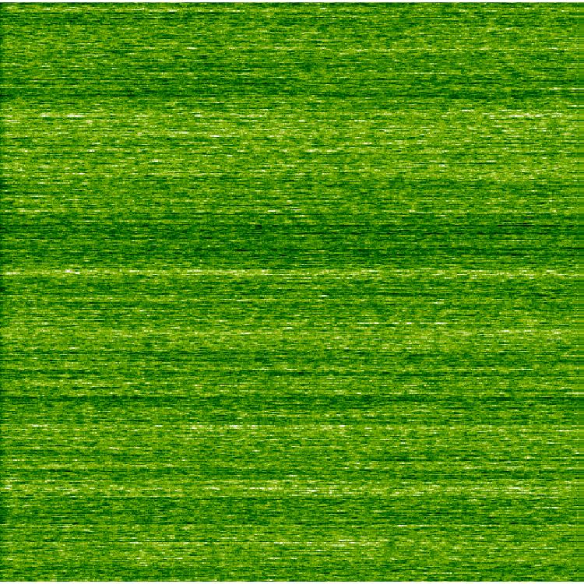
Voltage Bias Noise
ACADIA Design (ADC Test Chip data)
  Bias buffer noise: 6.8µV
SIDECAR ASIC (HST test data)
  Bias buffer noise: 35µV

Slide 17
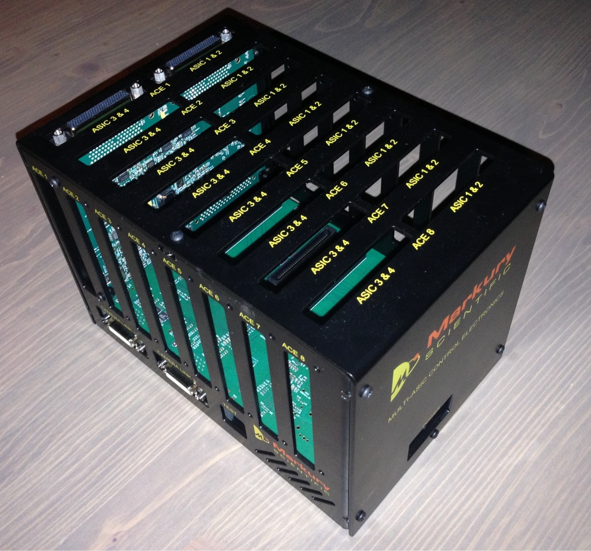
MCE - Multi-ASIC Control Electronics
Camera Link Acquisition System
  Can operate up to 32 ASICs in parallel
  Compatible with SIDECAR and ACADIA ASICs
  Individually programmable supplies (voltage, current limit, voltage limit)
  Integrated measurement functions of supply voltage levels and current consumption
  Software support for Linux and Windows
In use for several applications
  Euclid H2RG/SIDECAR ASIC testing and ground calibration
  WFIRST detector testing
  ACADIA testing

Slide 18
MACIE – Multi-purpose ASIC Control and Interface Electronics
Single-board controller card
  Gigabit Ethernet Interface
  USB 3.0 Interface
  Camera Link Interface
  Compatible with SIDECAR and ACADIA ASICs
  Individually programmable supplies (voltage, current limit, voltage limit)
  Integrated measurement functions of supply voltage levels and current consumption
  Operates up to 2 ASICs per board
  Software support for Linux and Windows

