Slide 1




Rule 07 revisited for LW and VLW
Current
Modeling dark matter of LW MCT IRFPA
Baier N., Gravrand O., Lobre C. - CEA-LETI, MINATEC, France
Boulade O. - CEA IRFU, France
Kerlain A., Péré-Laperne N. - SOFRADIR, France

Slide 2
OUTLINE
1
Overall presentation of IR MCT p-on-n technology in France
2
Challenges to overcome in IR detection
3
Status of dark current from MW (5µm) to VLW (17µm) bands
4
Dark current vs temperature: results and achievements
5
Conclusion

Slide 3
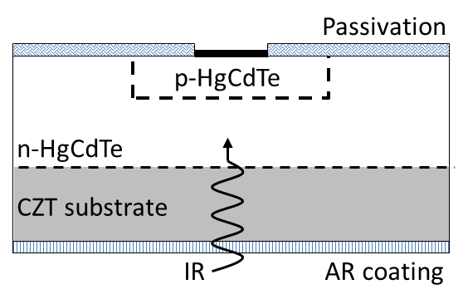
IR P-on-n mct at CEA-LETI & SOFRADIR
A French romance
A strong link between 2 major actors of IR detection
  IR technology dev @CEA from mid 70s ➔ 1986 SOFRADIR startup
  LETI: research & transfer ➔ SOFRADIR: improvements & FPA production
  Joint laboratory "DEFIR" to mutualize & improve our efforts
  SOFRADIR one of the 1st providers for tactical and space IRFPA
MCT p-on-n : low J_{dark}, low R_{s} ➔ large format and HOT FPAs
Planar p-on-on photodiode
  High quality LPE epi layers
  Indium n-type extrinsic doping
  As incorporation and activation
  Process with Hg annealing
2009
SW→LW
FPAs
2010
Transfert
1st product
2012
VLW
FPAs
2014
SW FPAs
low dark
2005
1st dev
2008
1st FPA

Slide 4
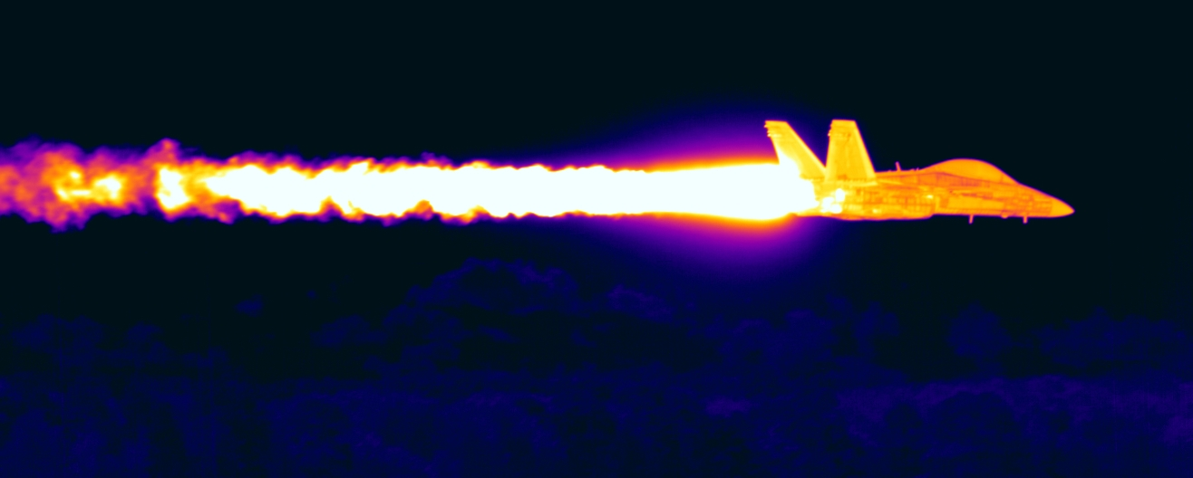
P-on-n challenges: from HOT to LOT
Developments IR-modules: reducing Size, Weight and Power (SWaP)
  Key factor: operating at higher temperature (HOT)
  Less needs in cooling system → gain in power consumption
  No loss in perf.: NETD, dark current & operability as key parameters

Slide 5
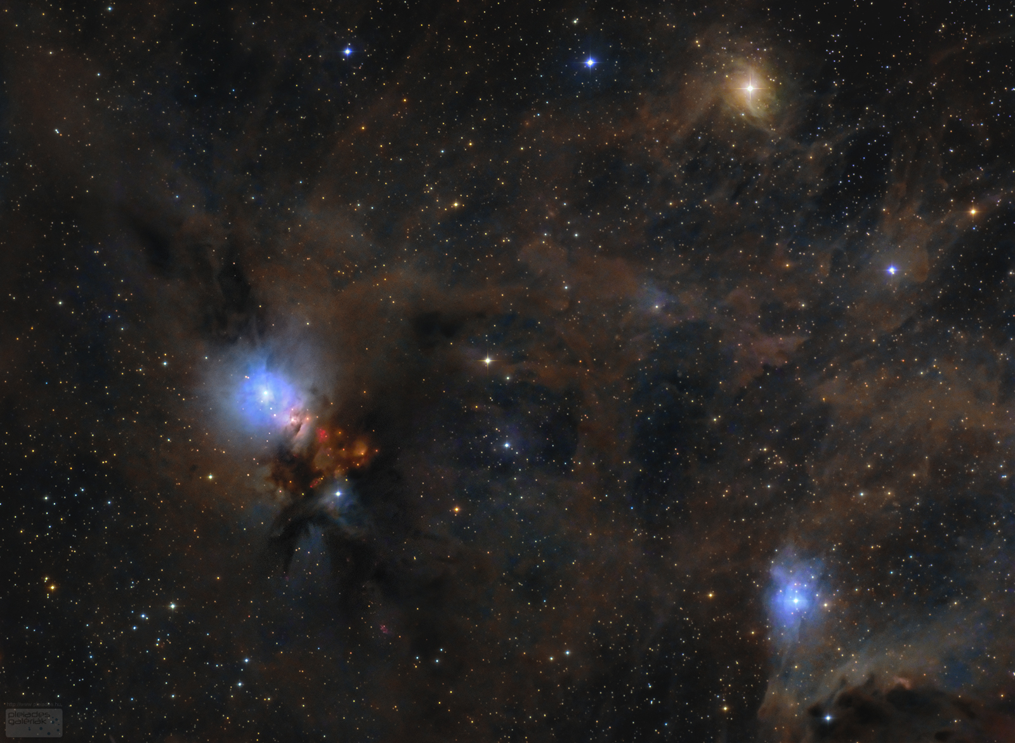
P-on-n challenges: from HOT to LOT
Developments IR-modules: reducing Size, Weight and Power (SWaP)
Space needs (ESA & CNES): low dark current and high cutoff wavelength
  Low flux conditions (long distance objects, transition spectroscopy, …)
  Long wavelength for earth and deep space observation
  Less constraints on operating temperature / power consumption
➔ Long wavelength & low dark current : 12.5µm @40K & 1400 e⁻/s/pix

Slide 6
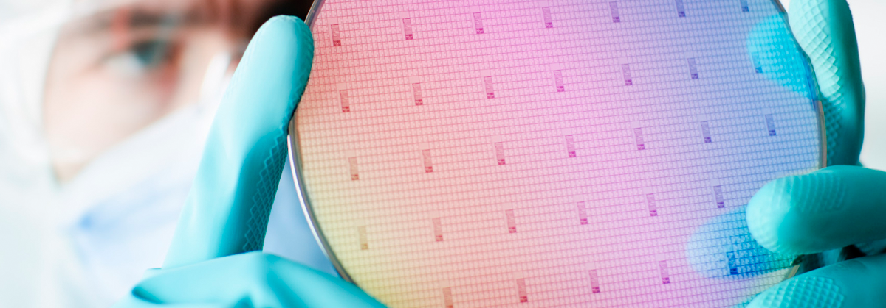
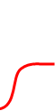
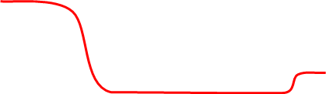

P-on-n challenges: from HOT to LOT
Developments IR-modules: reducing Size, Weight and Power (SWaP)
Space needs (ESA & CNES): low dark current and high cutoff wavelength
How to lower dark current: lower temperature?
  → Tunneling current and/or depletion current
Dark current: to be limited by the lowest current
  Diffusion $J_{diff}∝exp⁡(−{E_{g}}/{kT})$ ➔ dominate at high temp.
  Pure GR current $J_{GR} ∝exp⁡(−{E_{g}}/{2kT})$ ➔ dominate at low temp.
  Depletion-type $J_{depl}∝exp⁡(−{E_{g}}/{nkT})$ ➔ dominate at low temp.
Reduce depletion current: increasing bandgap in space charge region
➔ Bandgap engineering & process improvement
  Bandgap widening process
  BW not fully in SC ➔ no reduction
  BW larger than SC ➔ barrier ($↓QE$)
PN junction
N type
absorbing layer
E_{c}
CZT substrate
E_{F}
E_{v}
X
P type
cap

Slide 7
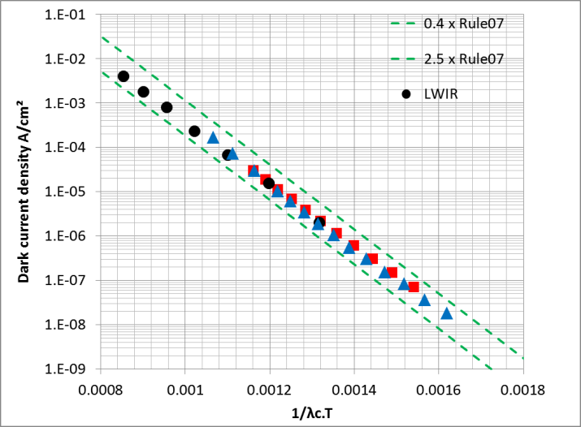
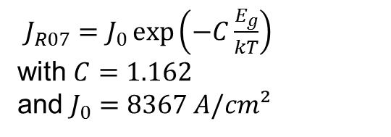
Dark current status in MW / LW bands at sofradir
P-on-n FPAs production @ SOFRADIR
Dark current level following Rule07
  Based on HgCdTe p-on-n technology
  (Teledyne) with [In]~10¹⁵ cm⁻³
  Verified for Teledyne, Raytheon, Sofradir
  Rule07 still reference for state-of-art IR FPA dark current
  "Diffusion limited"
SOFRADIR MW blue to LW
→ state of the art dark current
LWIR
MWIR blue (4.2µm)
MWIR red (5.3µm)
$J_{R07}=J_{0}\exp\left(−C\frac{E_{g}}{kT}\right)$
with $C=1.162$
and $J_{0}=8367 A/cm²$
A. Kerlain, JEM, Vol 45-9, pp 4557-4562 (2016)
W.E. Tennant, JEM, Vol 37-9, pp 1406-1410 (2008)
W.E. Tennant, JEM, Vol 39-7, pp 1030-1035 (2010)

Slide 8
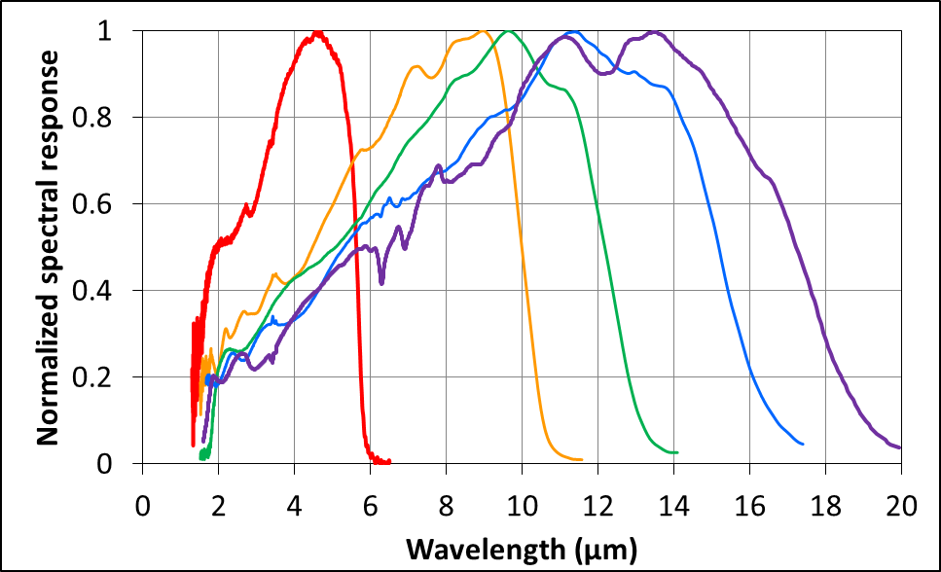
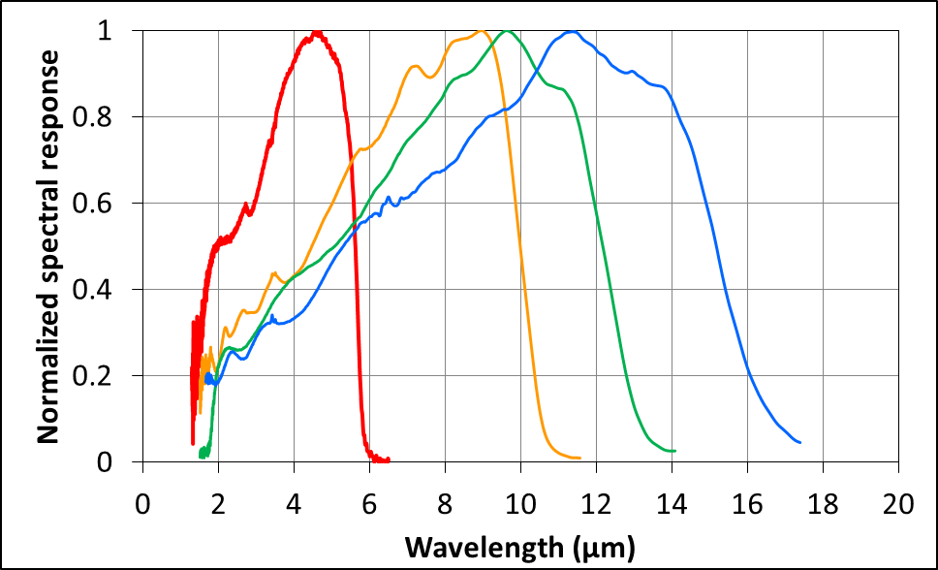
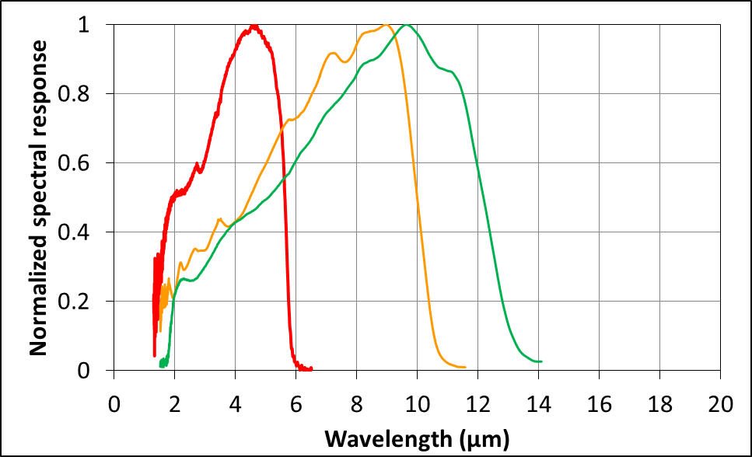
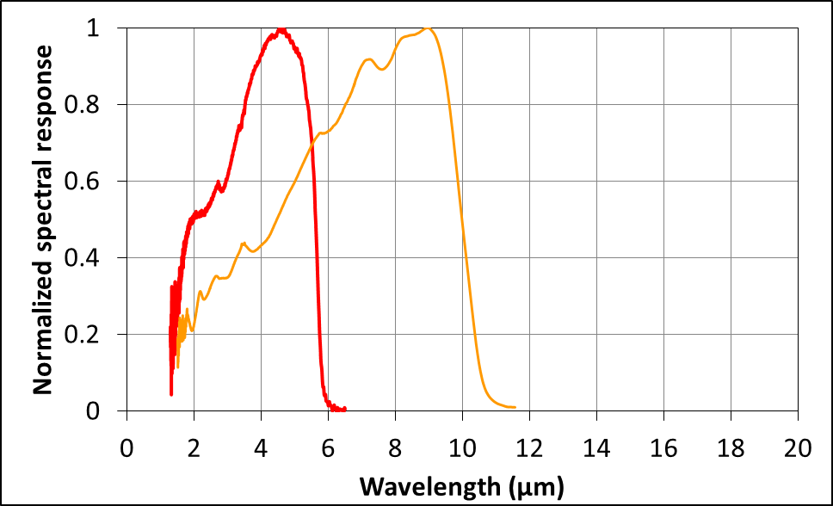
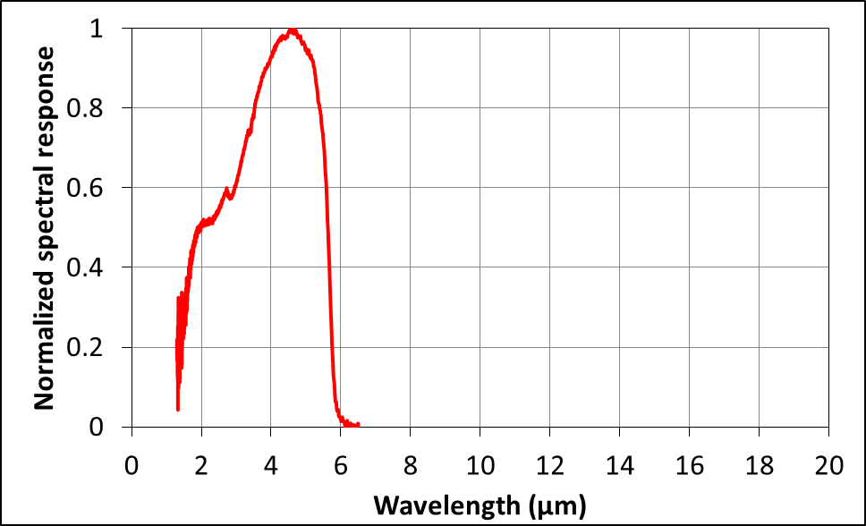

Spectral response & QE
Addressing long wavelength with MCT: pushing the limits
100% pixel fill factor → carriers diffusion length in P-on-N
Flat QE on spectral band with mean value 50 - 85%
(function of $λ_{c}$ and T_{FPA})
Achievements @78K
NIR = 2.1 µm
SW = 2.5 µm
MW = 5.6 µm
LW = 9.3 µm
= 10 µm
= 12.3 µm
VLW = 15.1 µm
= 17.2µm
Spectral response ∝ A/W

Slide 9
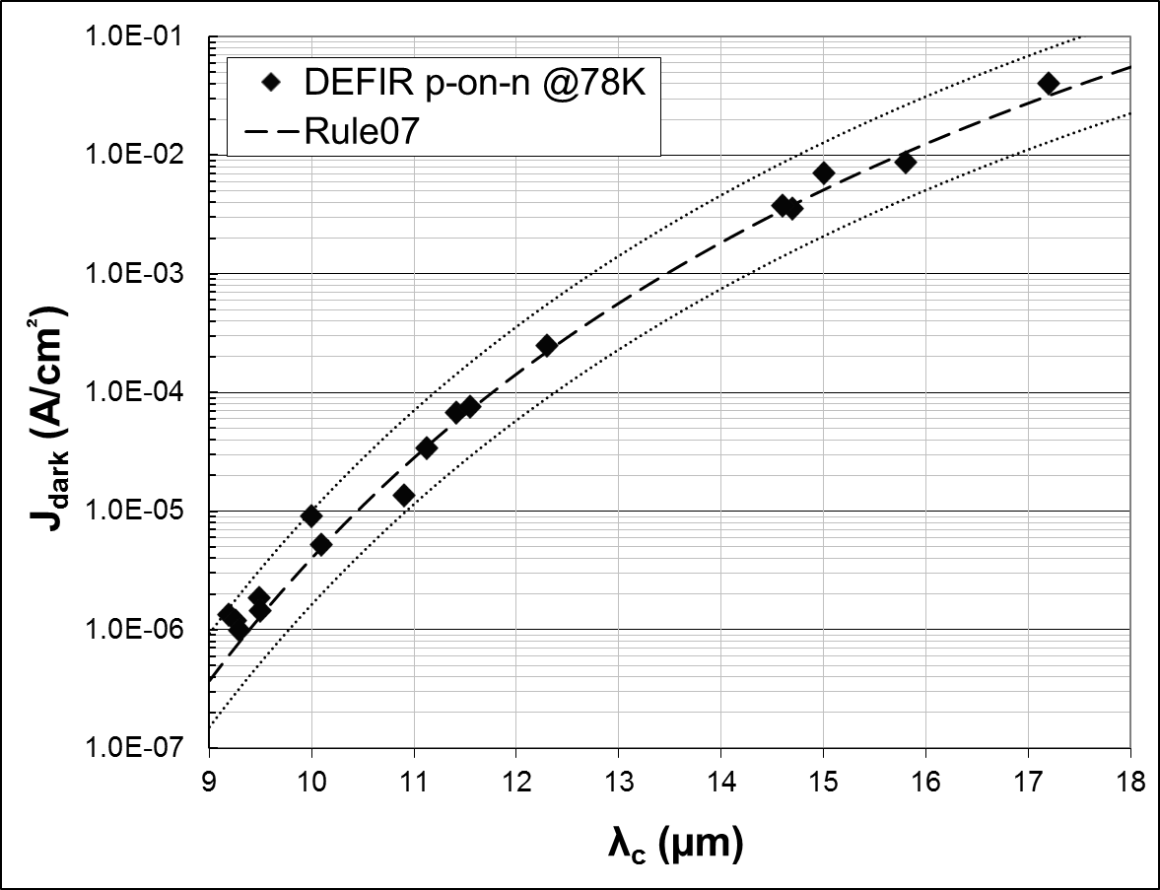
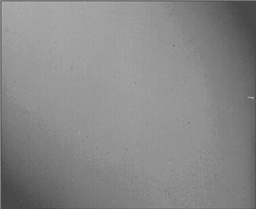
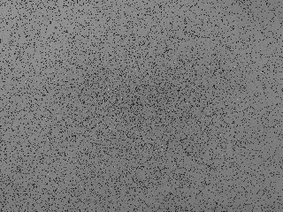
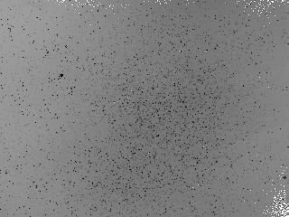
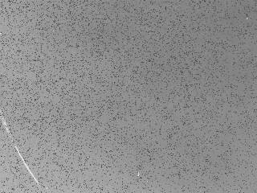
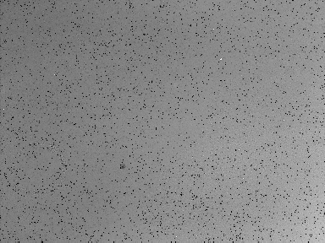
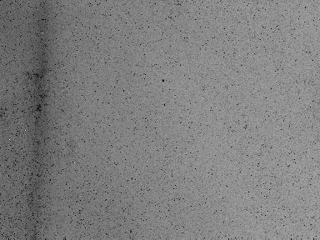
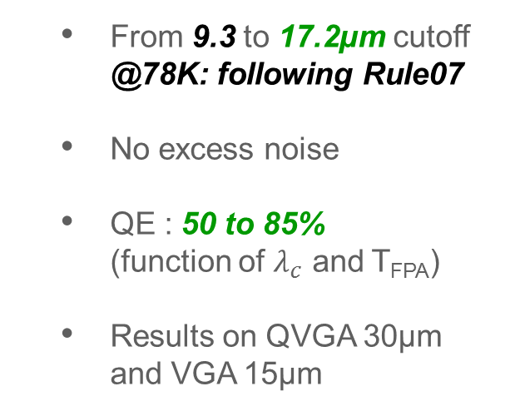
Dark current status in LW / VLW with LPE at LETI
Dark current @78K on LPE FPAs manufactured at LETI
  From 9.3 to 17.2µm cutoff @78K: following Rule07
  No excess noise
  QE : 50 to 85%
  (function of $λ_{c}$ and T_{FPA})
  Results on QVGA 30µm
  and VGA 15µm
VGA - 15µm - DI - 700fF
@81K
QVGA - 30µm - CTIA - 100fF
QVGA - 30µm - CTIA - 500fF
VGA - 15µm - CTIA - 70fF
QVGA - 30µm - CTIA - 6.4pF
QVGA - 25µm - DI - 0.9pF
QVGA - 25µm - DI - 0.9pF
@70K

Slide 10
Dark current status in LW / VLW with LPE at LETI
Dark current @78K on LPE FPAs manufactured at LETI
  From 9.3 to 17.2µm cutoff @78K: following Rule07
  No excess noise
  QE : 50 to 85%
  (function of $λ_{c}$ and T_{FPA})
  Results on QVGA 30µm
  and VGA 15µm
QVGA - 30µm - CTIA - 100fF
Standard technological process

Slide 11
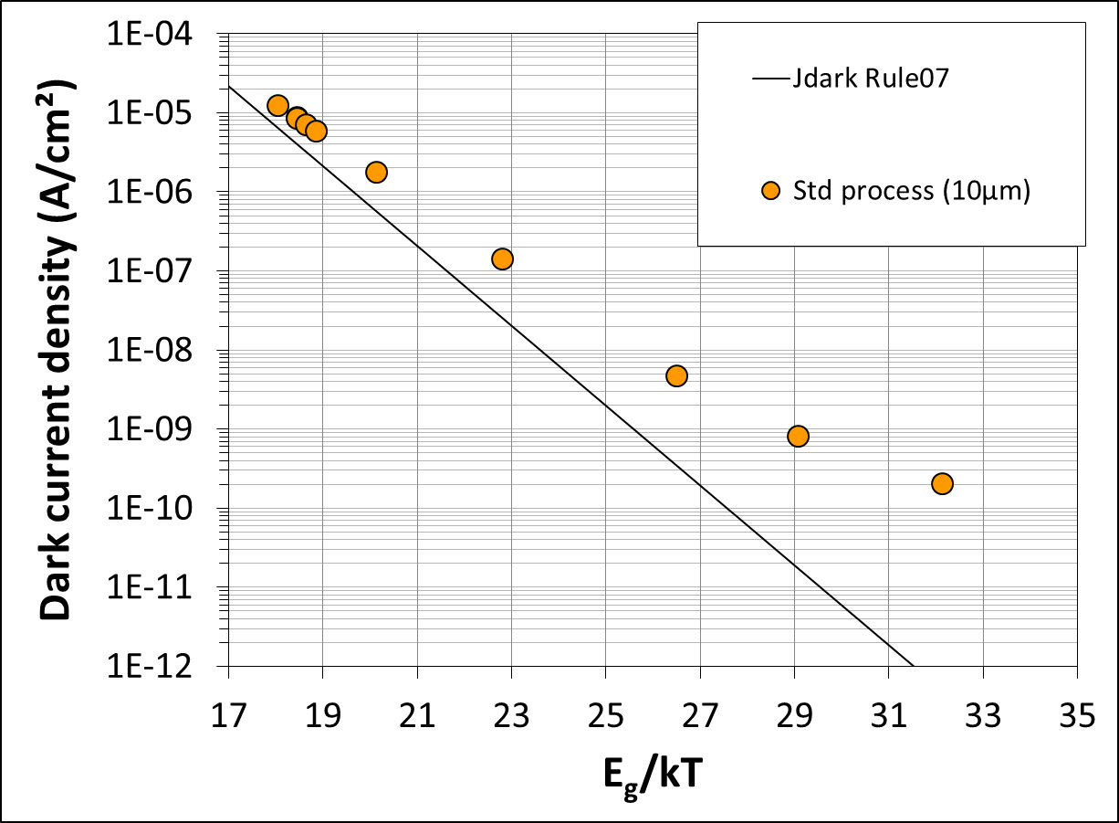
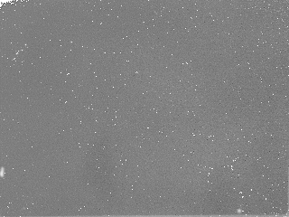

Standard p-on-n reference
Standard process evaluation: reference for comparison
  1 layer with standard process (10µm cutoff @78K, 11.2µm @40K)
ROIC: VGA/2, 30µm p. pitch, snapshot, CTIA in pixel
QVGA - 30µm - CTIA - 500fF
78K - f/1.91 - Resp
QE: 75%
<J_{dark}> = 8.6e-6 A/cm²
No excess noise
$λ_{c}$ = 10µm @78K

Slide 12
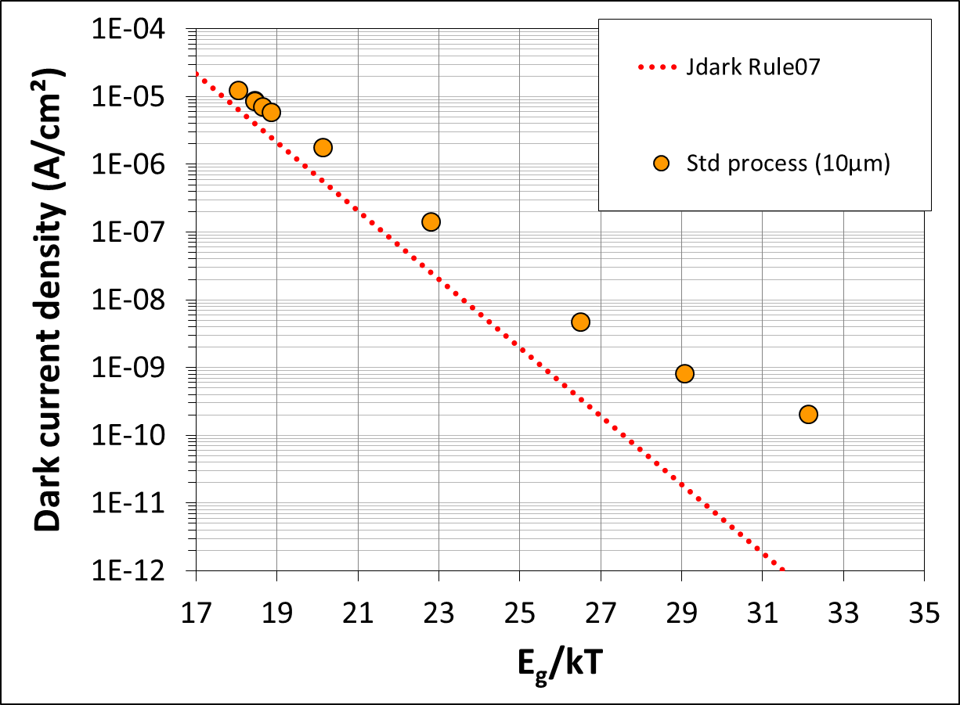
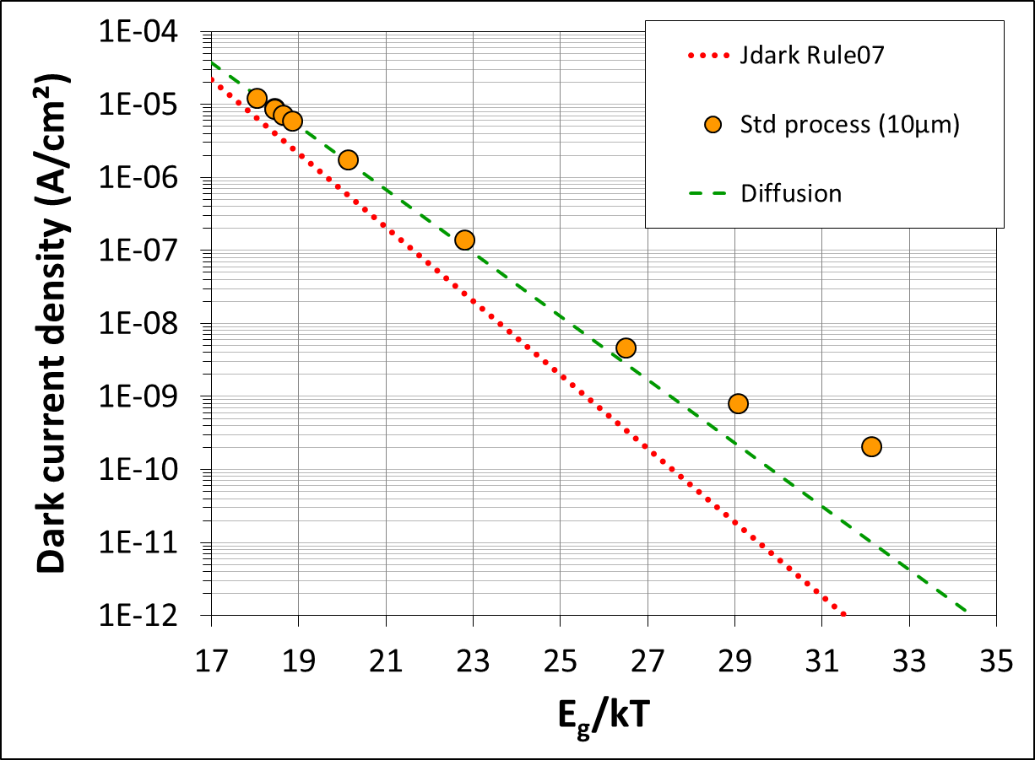
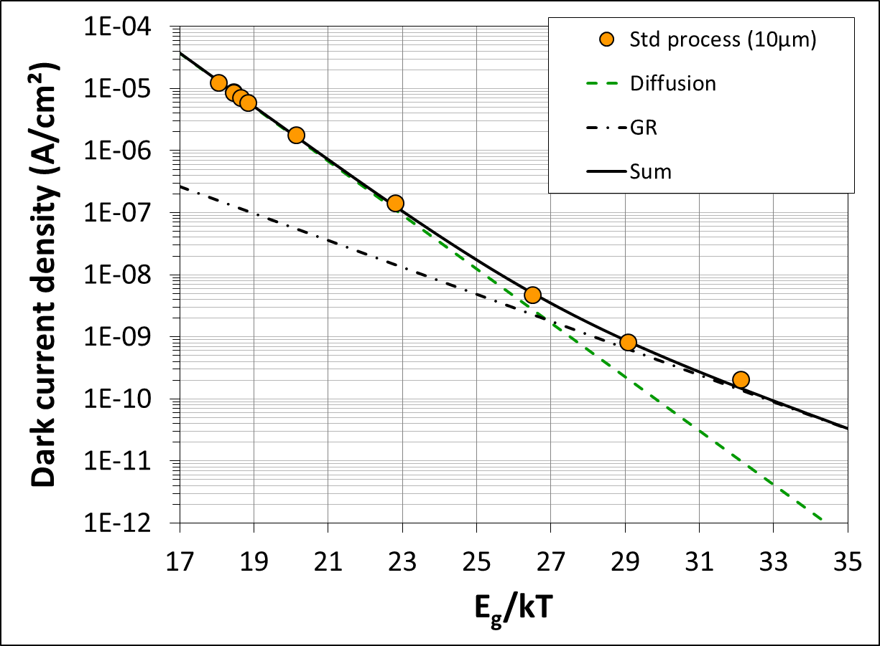
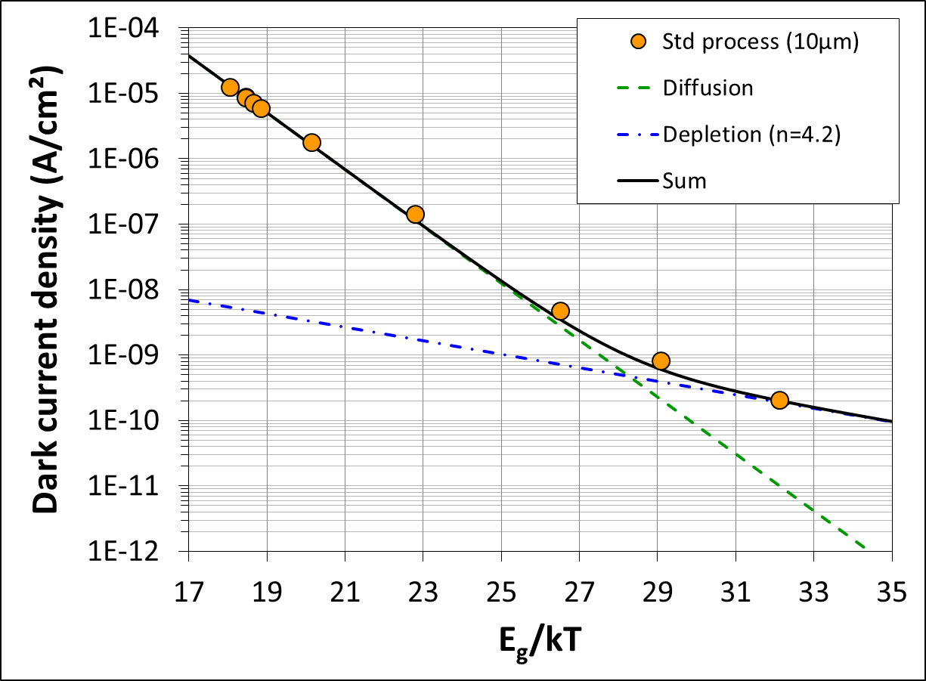


Standard p-on-n reference: dark current status
Standard process evaluation: reference for comparison
  1 layer with standard process (10µm cutoff @78K, 11.2µm @40K)
J_{dark} vs E_{g}/kT: $λ_{c}$ measured at each T_{FPA}
  Not following Rule 07
  Best fit at high temperature with pure diffusion law
  $J_{dark}=J_{diff}=J_{0}exp\left(−\frac{E_{g}}{kT}\right)$
  "GR"-type depletion current
  $J_{GR}=J_{0}^{′}exp\left(−\frac{E_{g}}{2kT}\right)$
  Depletion current contribution
  $J_{depl}=J_{0}^{′′}\exp\left(−\frac{E_{g}}{nkT}\right)$
  best fit with n=4.2
Transition @47K
Origin of this contribution
Tunnel-type current?
$λ_{c}$ = 10µm @78K

Slide 13
Dark current status in LW / VLW with LPE at LETI
Dark current @78K on LPE FPAs manufactured at LETI
  From 9.3 to 17.2µm cutoff @78K: following Rule07
  No excess noise
  QE : 50 to 85%
  (function of $λ_{c}$ and T_{FPA})
  Results on QVGA 30µm
  and VGA 15µm
QVGA - 30µm - CTIA - 500fF
VGA - 15µm - CTIA - 70fF
New bandgap widening process

Slide 14
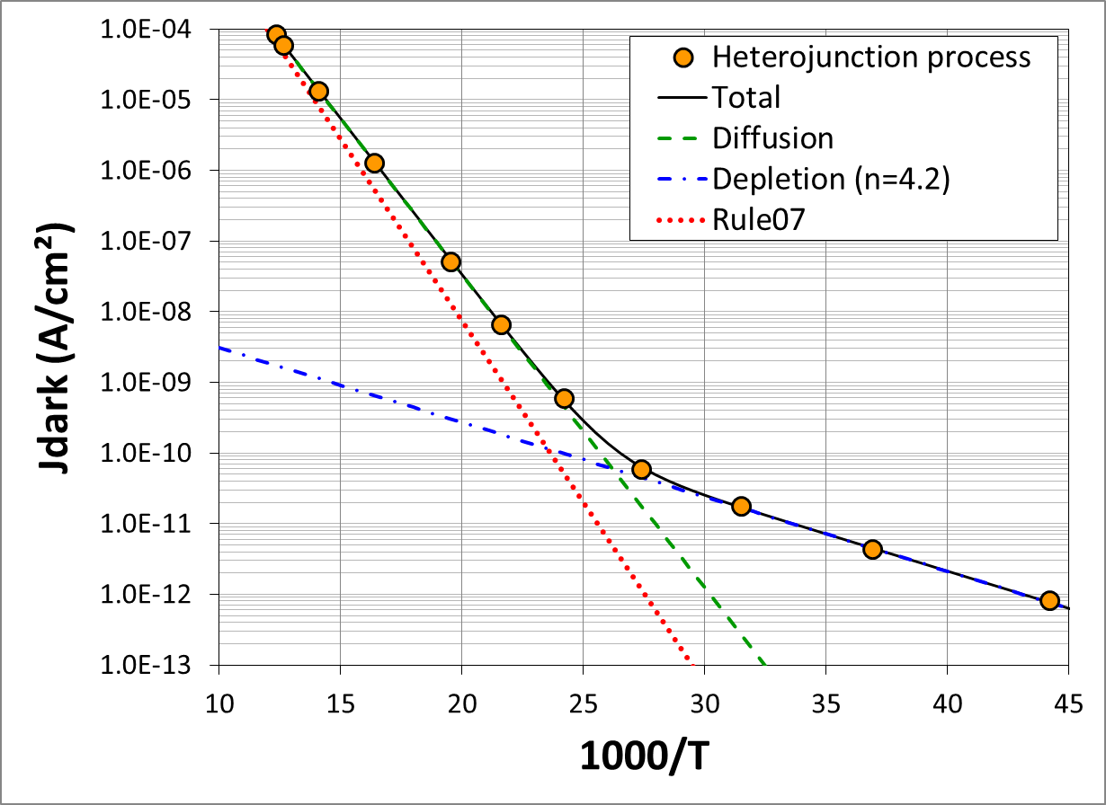
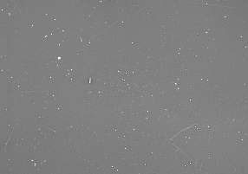


Bandgap widening process: results
Bandgap widening process evaluation
  2 BW variants ($λ_{c}$=11.4µm @78K, $λ_{c}$=12.7µm @40K)
➔ Validating BW process: lowering depletion current
QVGA - 30µm - CTIA - 500fF
78K - f/4.1 - Resp
Transition @38K
QE: 80%
No excess noise
Diffusion limited @38K
67K
50K
40K
30K
25K
$λ_{c}$ = 11.4µm @78K

Slide 15
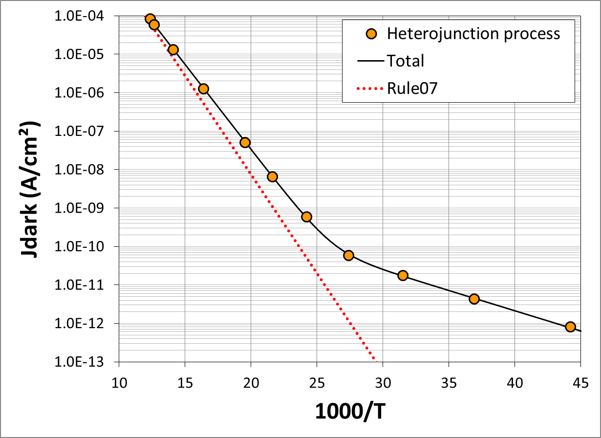

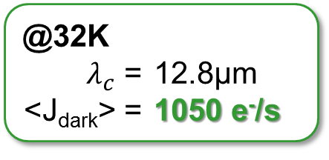
Bandgap widening process: results
Bandgap widening process evaluation
  2 BW variants ($λ_{c}$=11.4µm @78K, $λ_{c}$=12.7µm @40K)
40K
Requirements (ESA)
(12.5µm @40K)
Rule07 is not diffusion
underestimate J_{dark}
×10 lower @40K
2.5e-11 A/cm²
1400 e⁻/s/pix
@32K
$λ_{c}$ = 12.8µm
<J_{dark}> = 1050 e⁻/s
67K
50K
40K
30K
25K
$λ_{c}$ = 11.4µm @78K

Slide 16
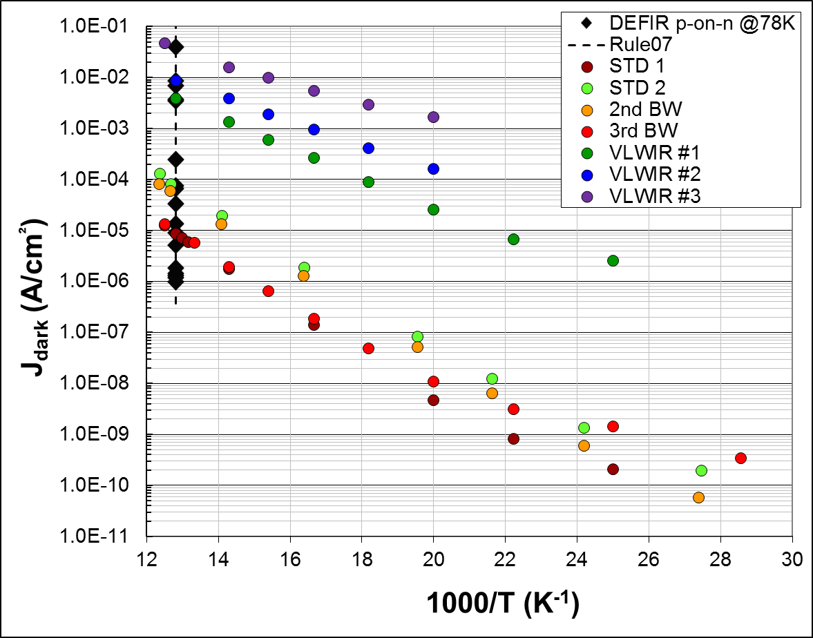
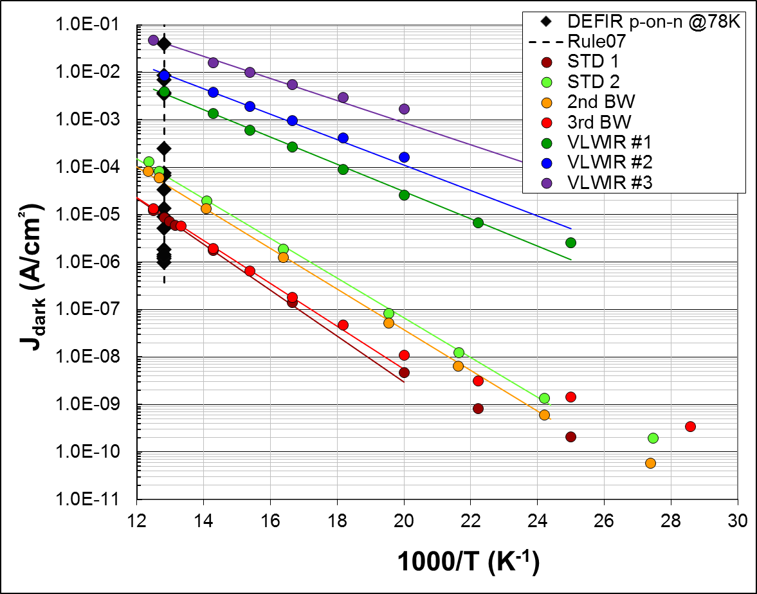
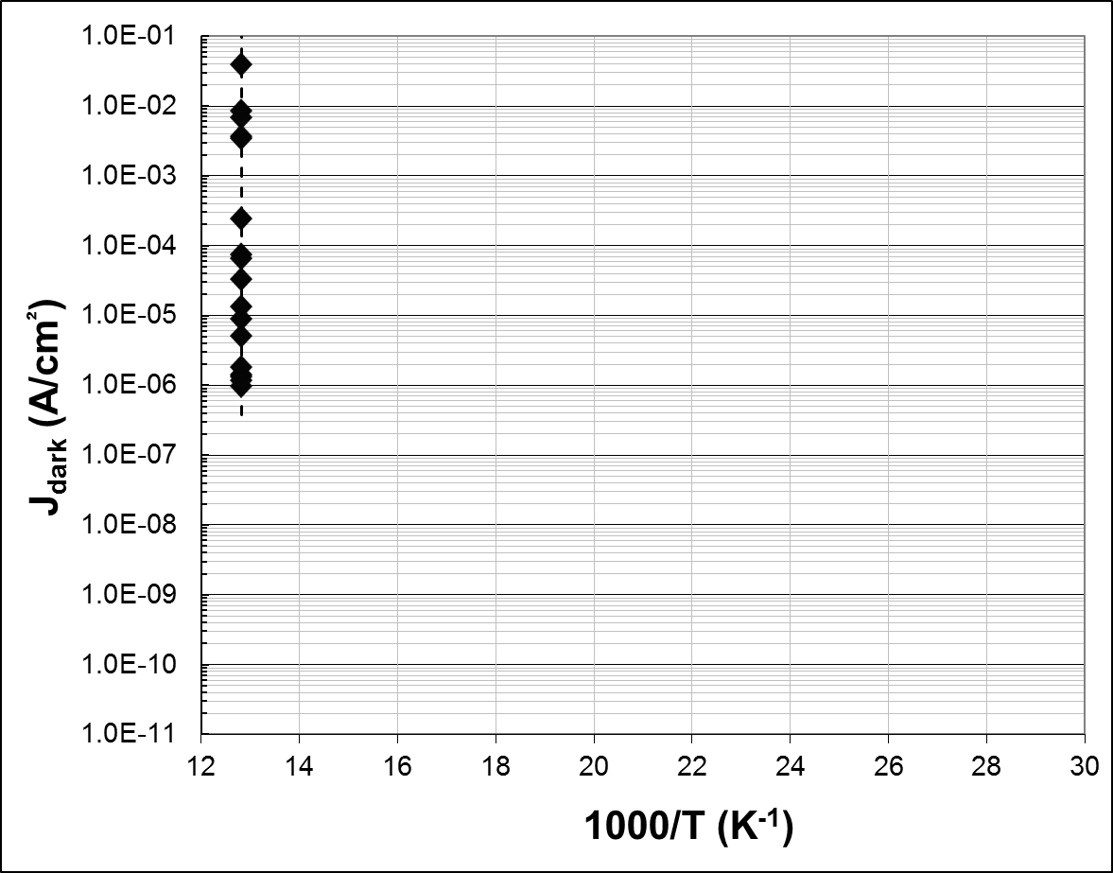

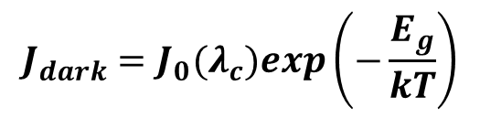
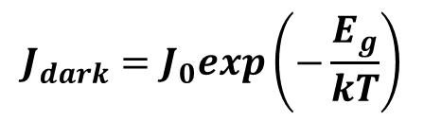
Dark current: Beyond Rule07
Rule07 is a good dark current predictor @78K
But not for J_{dark}(T), following diffusion law
Rule07 convenient:
fixed parameters
Diffusion fit:
adapted for each FPA
(7 FPAs tested)
$$J_{dark}=J_{0}exp\left(−\frac{E_{g}}{kT}\right)$$
$$J_{dark}=J_{0}(λ_{c})exp\left(−\frac{E_{g}}{kT}\right)$$
From Rule07 @78K
$$J_{0}\left(λ_{c} \right)=J_{07}exp\left(−\frac{α}{λ_{c}}\right)$$
$J_{07}=8367 A/cm²$
$α=29.96$
67K
50K
40K
33K

Slide 17
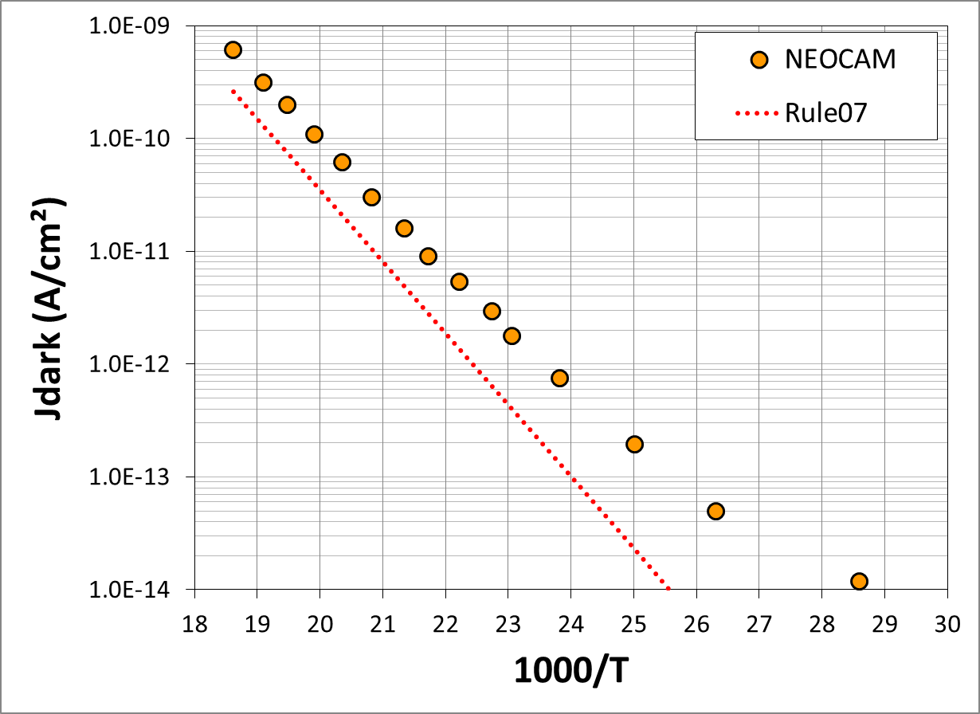
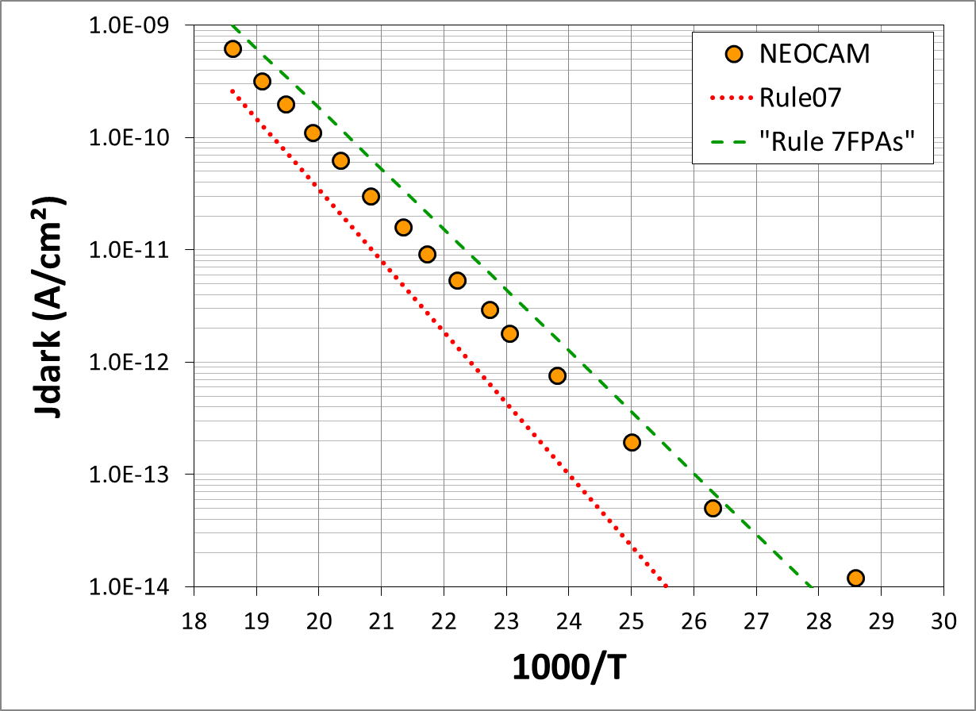

Are we alone in dark current universe?
Data from NEOCAM instrument @Rochester University
  Teledyne LW MCT on H1RG
Rule07 underestimate J_{dark}: ×10 lower @40K
Low-temp revisited Rule07:
☑ Right slope
☒ Still a factor 1.8
50K
40K
33K
$λ_{c}$ = 10.6µm @30K
C. McMurtry, Optical Engineering, Vol 52 (9), 091804-1 (2013)

Slide 18
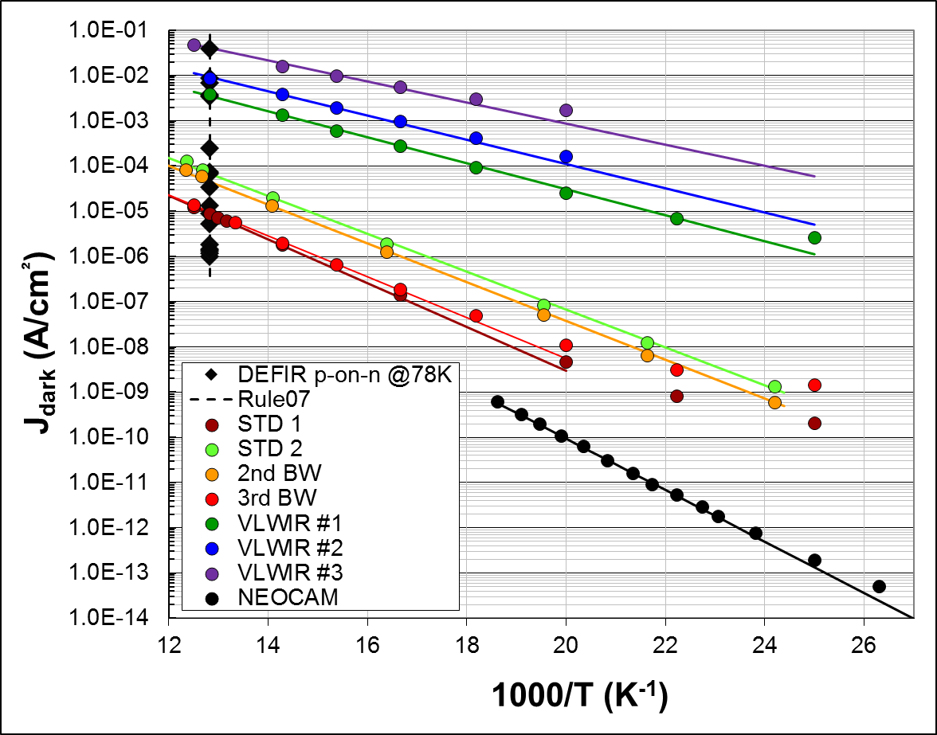

Conclusion
P-on-n MCT LPE technology @ DEFIR
Demonstration on FPAs
➔ LW to VLW 17.2 µm @78K
➔ Low dark current ≈ 1k e⁻/s/pix with 12.8 µm @32K
➔ 50 - 85% QE
Rule07 works @78K in LW / VLW
  Is not a diffusion trend line
➔ At low temperature: underestimate J_{dark}
Dark current ($λ_{c}$, T)
  Diffusion trend line till 50-40K
  ➔ intrinsic depletion-type current
➔ Diffusion Rule7FPAs: work in progress

Slide 19

Thank you
For your
Attention

