Slide 1

Novel Readout Integrated Circuit with Individual Pixel Programmability for Astronomy Infrared Focal Plane Arrays
Stefan Lauxtermann, P.O. Pettersson, Kadri Vural, Selmer Wong
Sensor Creations, Inc., 5251 Verdugo Way, Ste I, Camarillo, CA 93012
Scientific Detector Workshop 2017, Baltimore
September 24 – 29, 2017
This work is supported by NASA SBIR funding Contract # NNX17CG17C, COR/PM Laddawan R. Miko

Slide 2
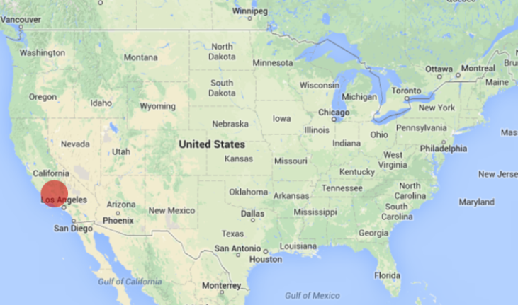
About Sensor Creations, Inc.
Founded in 2010
  Located in Camarillo, Southern California (USA)
  Staff of 7 engineers plus 1 operating manager
Core competencies and development services
  Large area ROIC for IR FPAs
    Analog and digital
    Low noise high performance
  Custom CMOS imagers
    Monolithic BSI CMOS sensor with
    > 50micron depletion thickness
  Sensors for high energy radiation
    X-rays, Minimum Ionizing Particles (MIP), Neutrons
  Packages for thinned BSI imagers and cooled IR FPAs
  Prototype testing
  Data acquisition electronics
Independent Supplier of Innovative Image Sensor Technology

Slide 3
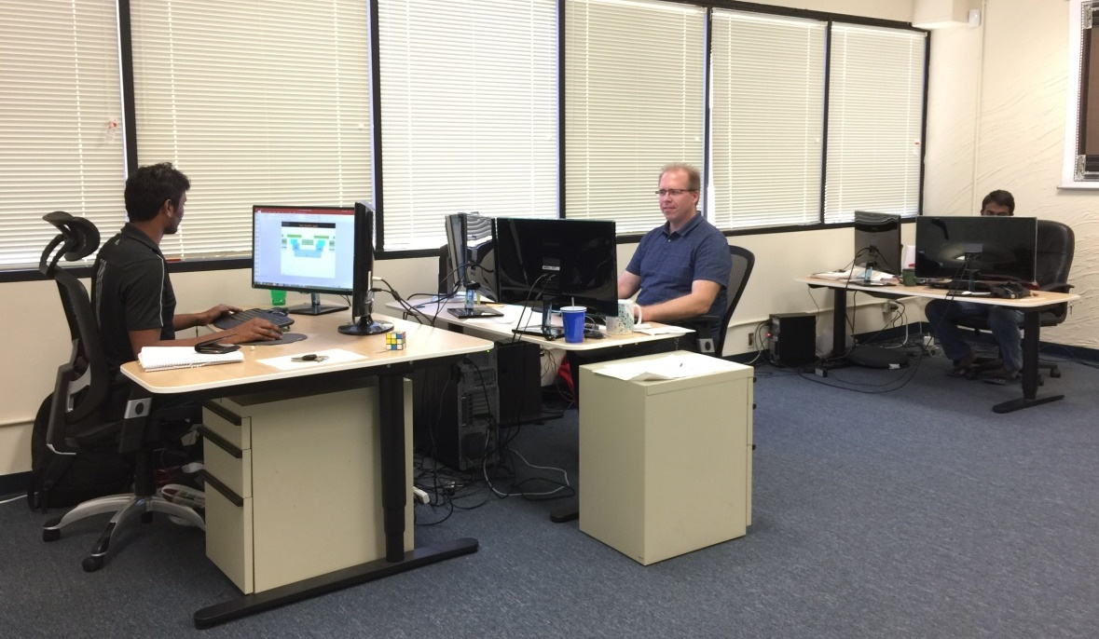
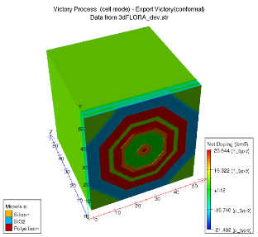
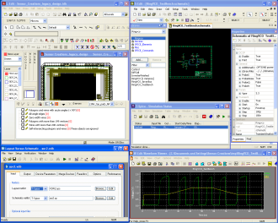
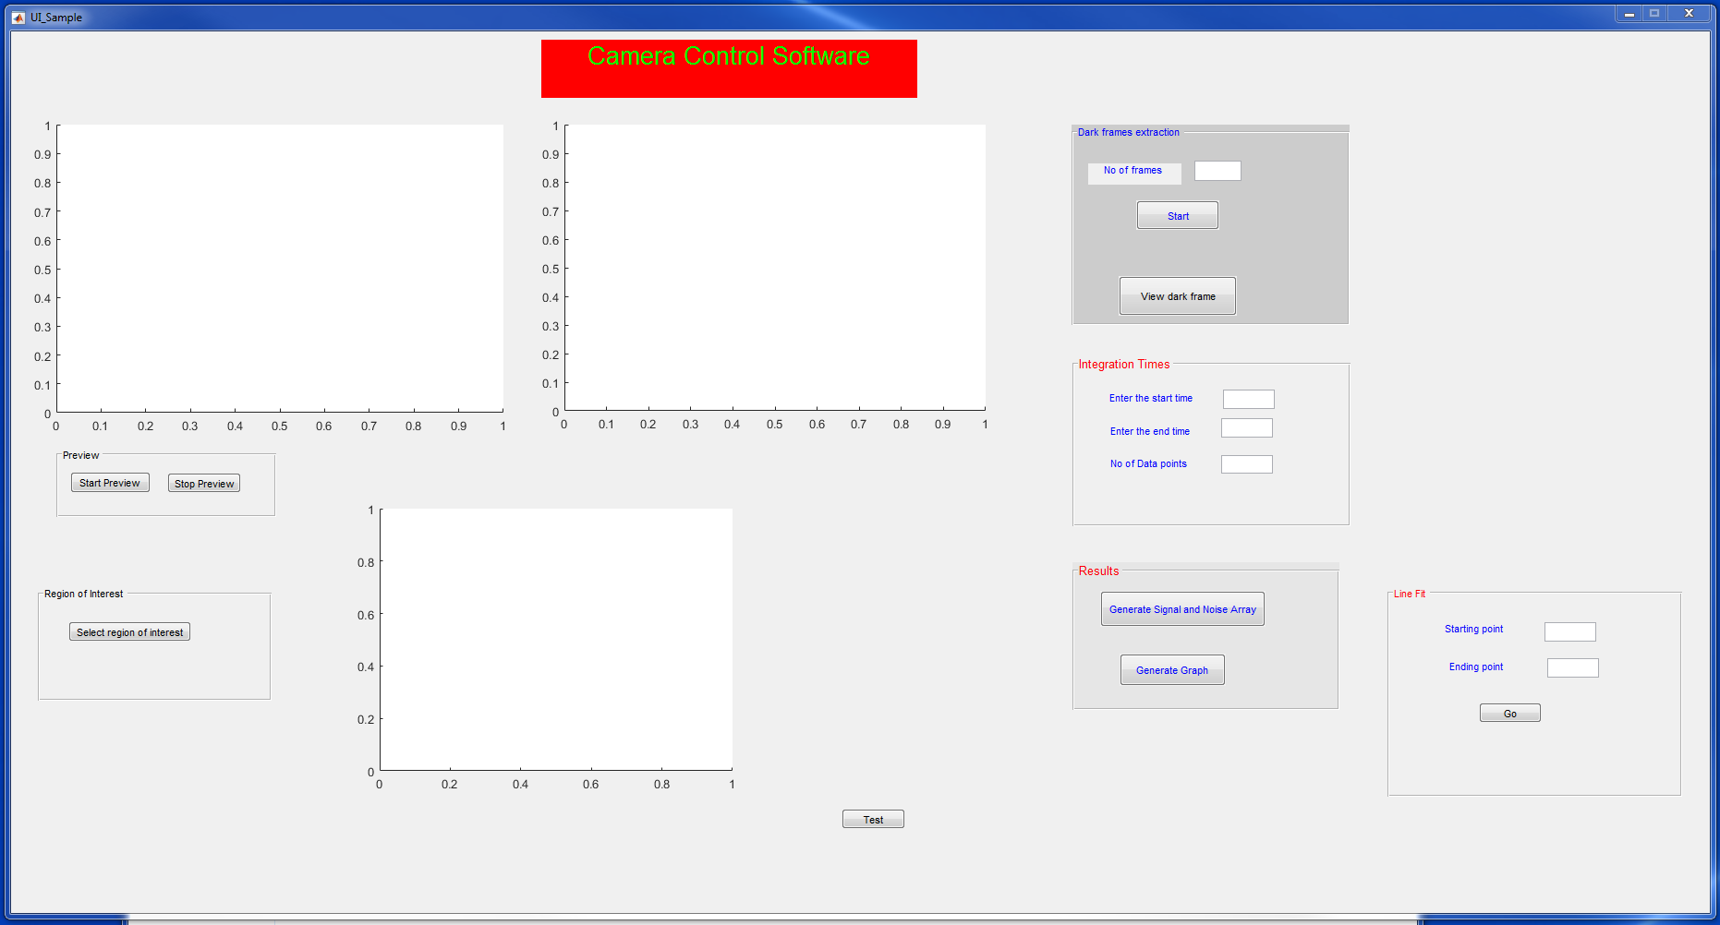
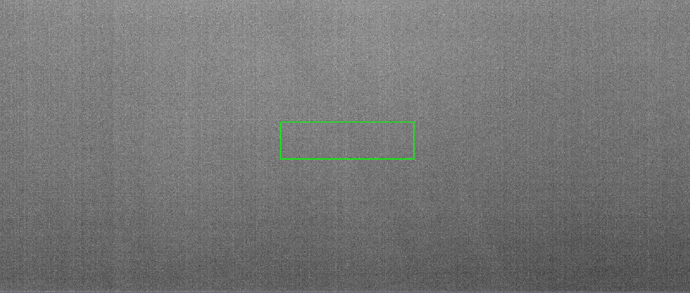
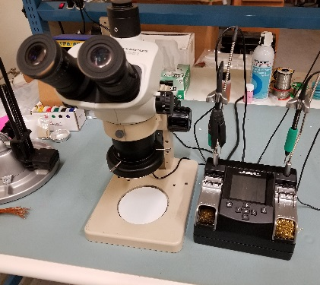
Sensor Creations Facilities and Equipment
15 x 10 ft Class 10,000 Cleanroom
EDA and TCAD Simulations
Optoelectronic characterization UV-NIR
Custom sensor test software
Packaging and inspection
Board assembly, rework, repair
Wafer-level probe testing
Die Attach and Ball Bonder
Complete Infrastructure for Design and Prototyping of Low Volume CMOS Sensor IC’s
8” Semi Automatic
Probe Station
Trinocular Microscope
Micro Solder Station

Slide 4
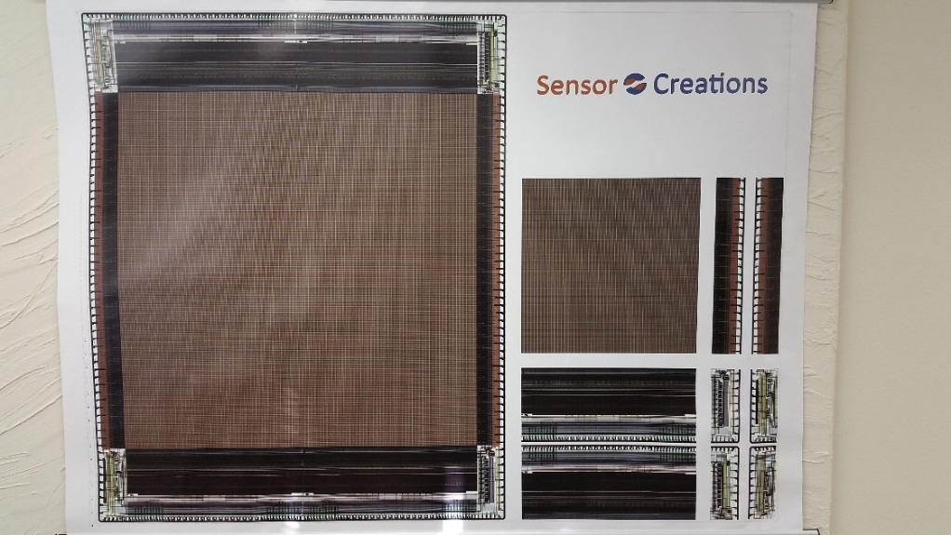
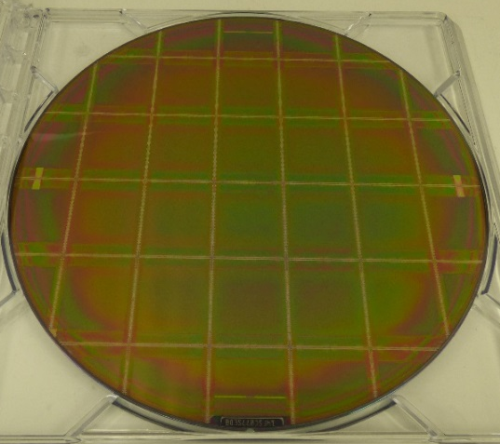
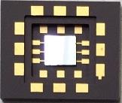
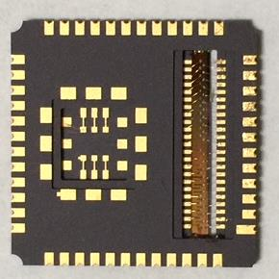
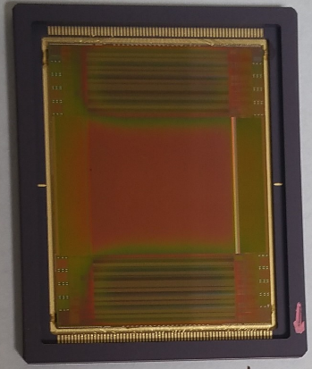
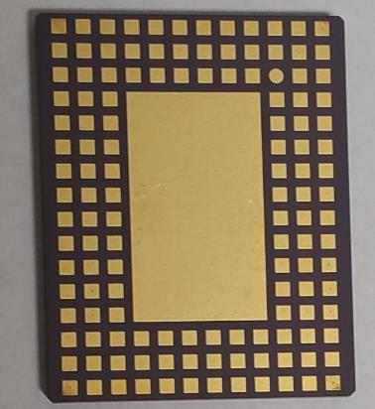
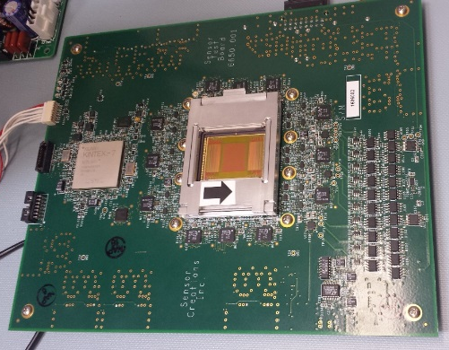
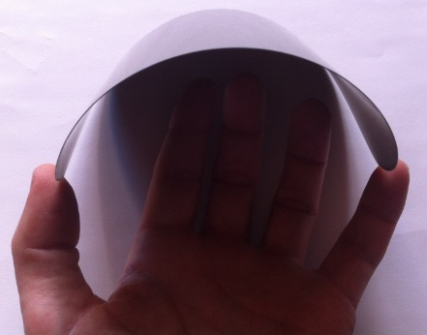
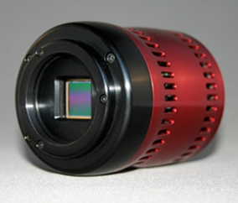
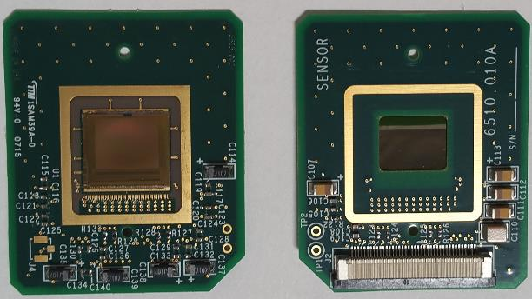
Examples of Previous Developments
Stitched ROICs
Custom wafer post processing
Packages
Cameras
Test Electronics
200 mm
8 mm
Test key flip-chip bonded into LGA
Layout of the 4 stitch blocks used to fabricate complete ROIC
Stitched ROIC wafer
16 mm
20 mm
130 mm
Sensor assembled and wire bonded into LCC package
Ceramic LGA Package
86mm
Custom electronics for low noise readout of ROICs and sensors with 10 Gbps digital data output via GigE
8‘’ High resistivity FZ Wafer thinned to 50 µm
20 mm
Chip on board assembly
Compact camera

Slide 5
Goal of New ROIC Development
Optimize performance and functionality of large area IR FPAs
  Independent guide star window readout
  Fewer blinking pixels in active array
  Isolate malfunctioning photodiodes
Platform to investigate and cure detrimental detector phenomena
  Image persistence
Maintain already solved ROIC problems
  Glow
  Inter Pixel Capacitance
Fabricate one of the largest ROICs for astronomy FPA
  Resolution: 4k x 6k
  Pixel type: SFD
Flexible CMOS manufacturing
  10 micron pixel arrays: > 2k x 2k
  15 micron pixel arrays: > 1k x 1k
Available and compatible
  Available to any detector vendor
  Suited for P on N and N on P detector
Innovative
Instrument compatible Affordable

Slide 6
Pixel Individual Set/Reset Options
4 reset options:
Periodic reset
  Standard operation
Set Pixel to Detector bias
  Pixel held in “white” state
Permanent reset
  Pixel held in “black” state
Reset disabled
  Photodiode in weak forward bias
Any Pixel Can be Individually Reset in 4 Different Ways

Slide 7
Parallel Readout/Reset of Guide and Science Pixel
Pixels affected by bus contention
Conventional SFD pixel suffers from bus contention
  Output of science data must be interrupted when guide window is read out in the same row or column
  Science and guide window pixels cannot be read in the same row or column
  Science and guide window pixels cannot be reset in the same row or column
Guide Star Window and Science Data Pixels can be Read out Simultaneously

Slide 8
Pixel Unit Cell Schematic
Detector Bias
Vertical
Vset
Horizontal
out_science
set_y
M_{ST}
rowsel_science
set_sample_y
C_{ST}
set_sample_x
out_guide
rowsel_guide
reset_y
vssa
M_{RS}
reset_x
reset_sample_y
C_{RS}
reset_sample_x
Vreset
27 Transistors, 2 DRAM Cells, 2 Output Ports

Slide 9
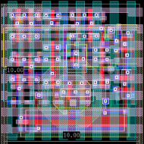
Pixel Functionality
x,y addressable pixel reset to v_{reset}
  Start/Stop integration
  Store reset state on C_{RS}
x, y addressable pixel set to v_{set} or [set_{y} – v_{th}(M_{set})]
  Start/Stop integration at v_{set} or [set_{y} – v_{th}(M_{set})] ≠ v_{reset}
  Store set state on C_{ST}
Continuous readout of staring pixels
  No interruption from guide star pixels
Stop integration in x, y addressable pixels permanently
  … when saturation is reached
  … if pixel has defect
Program offset voltage [set_{y} – v_{th}(M_{set})] into pixel
  Create offset for individual pixels
  Drain charge before detector PD goes into forward bias
Isolate pixels
  Leave integration node floating
10 micron
ROIC provides flexible and independent control of read and reset state in sience and guide star pixels

Slide 10
Other Features Common in Space Based Astronomy ROIC’s
Logic and slow scanners designed with SEU flip flops
  Horizontal scanner uses standard flip flops
Entire design based on 3.3V transistors
  No Level shifters
Contiguous light shield
  Connection to detector “pierces” light shield
  2 overlapping metals are used
Minimum IPC contribution from ROIC
  2D and 3D parasitic extraction
Identical pixels for entire array
  All pixels comply with stitch rules
Reference pixels
  Ring of columns and rows with fixed capacitance
… were implemented

Slide 11
Reset Mode Programmability
Uploading Reset Mode information into ROIC
  Pixel has permanent defect
  ← Information can be uploaded before start of exposure
  Single pixel saturates during exposure
  ← Information must be uploaded immediately after exposure to minimize persistence
Upload bandwidth is limited
  Data output clock should be the highest frequency on chip
  No additional pads availalbe
Data upload bandwidth requirements
  Up to 64 pixels per clock cycle
  Up to 4 states per pixel
  ← 128 bits/clock cycle
Only very few pixels will require “special” reset
  Default (right now): 1 reset state is uploaded per clock cycle
1 reset state is uploaded per clock cycle through 8bit parallel interface

Slide 12
ROIC Specifications (1/2)
Parameter | Value | Comment
General
Array format / resolution | 4096 x 6144 | Any 2D pixel array > 2k x 2k with steps of 1024x2048
Pixel size | 10 µm x 10 µm | Pitch defines other parameters like array size
Die size | ~ 42 x 63.5 mm² | Database will be prepared to implement a 4K x 6K array
Number of analog outputs | 1, 4,16, 32, 64 | User may select effective number of output channels
Electrical
Pixel polarity | p-on-n or n-on-p | SFD pixel suited for readout of either detector polarity
Pixel input circuitry | SFD | 15 micron pixel has circular source follower
Master clock (f_{clk}) | Programmable | ROIC has no lower clock limit; upper clock limit will be ~8MHz corresponding to 16 Mpixels/sec per channel
System clock | Internal / external option | Master clock and several timing control signals
Logic and bias voltages | 3.3V | No 1.8V devices will be used
Detector bias | Fixed | Provided externally through pad
ROIC biasing | Externally provided | Bias for 2 source followers in readout chain
Analog output swing | 2.0V | No voltage gain will be provided on-chip
Expected load drive | < 250pF | For pixel data rates <100 kHz
Charge capacity | 50 Ke⁻ to 200 Ke⁻ | Depending upon specific detector and operating temperature
Integration mode | Rolling line | Non-destructive read (NDR) to support up-the-ramp sampling
Integration time | Programmable | Via externally provided timing control signals
Pixel rate/output (p_{clk}) | 132 kPixel/sec | Exact rate defined by external f_{clk}; data is transferred off-chip on rising and falling edge of f_{clk}; p_{clk} = 2 x f_{clk}
Frame rate (F_{Hz}) | <1 Hz | Varies depending on array resolution and readout mode; F_{Hz} = f_{clk} x n_{ch}/M_{pix}
Input-referred noise | 5 e⁻ to 15 e⁻ | Difference of two non-destructive reads using off-chip correlated double sampling (CDS); less noise corresponds to lower detector capacitance
Power dissipation | 1mW | Two-output mode, 100 kHz pixel rate

Slide 13
ROIC Specifications (2/2)
Parameter | Value | Comment
Special features
Flexible reset | Yes | Programmable reset voltage and duration for every pixel
Guide window | Yes | Any number of guide star windows, with programmable location and size in multiples of 8 pixels in both dimensions
Independent guide window | Yes | Guide window can be read out independently and simultaneously with science data readout
Light shielding | Yes | Contiguous metal shield in top 2 CMOS metal layers prevent light emission from switching transistors and/or glowing amplifiers from reaching the detector
Other
CMOS technology | 0.18 µm CMOS with 6 LM | ONC18, Gresham (OR)
Operating temperature | 30 - 120K | Cryogenic models were used
Temperature sensor | Diode | Readout through Kelvin probe type pad configuration

Slide 14
4K x 6K ROIC Schematics
Schematic is segmented into stitch blocks
  Not required for manufacturing
  Beneficial when fabricating ROICs with other resolutions from the same mask set
Schematic is independent of pixel pitch
  The same schematic can be used for ROIC with different pixel pitch, if the resolution is the same
ROIC schematic has been completed

Slide 15
Floor plan for 4K x 6K ROIC with 10micron Pixels
D_top_left
512 Columns
B_top
1024 Columns
B_top
1024 Columns
D_top_right
512 Columns
162 pads
  All placed along top edge
Three side buttable
  No pixels on left, right or bottom
Chip size 41.76 x 63.21 mm²
Minimum Array size
  2k x 2k
C_left
A
1024 x 2048
A
1024 x 2048
A
1024 x 2048
A
1024 x 2048
C_right
C_left
A
1024 x 2048
A
1024 x 2048
A
1024 x 2048
A
1024 x 2048
C_right
D_bot_right
D_bot_left
D_top_left
1024 Columns
D_top_right
1024 Columns
A
1024 x 2048
C_right
C_left
Larger or smaller arrays with multiples of 1Kx2K pixels in X and Y can be built.
C_left
A
1024 x 2048
A
1024 x 2048
A
1024 x 2048
A
1024 x 2048
C_right
B_bot
B_top
1024 Columns
Reticle Size
11.74mm (H) x 25.08 mm (V)
D_bot_left
B_bot
B_bot
D_bot_right

Slide 16
Reticle with Stitch Blocks for 10µm and 15µm Pixel ROICs
15µm
10µm
B_bot
D_bot_right
D_bot_left
B_top
1024 Columns
D_top_left
1024 Columns
D_top_right
1024 Columns
Optimization of Resources
Fabricate ROICs with different resolution on same wafer
  Non very well compatible with CMOS fabrication constraints
Utilize Reticle for different designs
  Fabricate only one type of sensor per wafer
D right
512 Columns
A
1024 x 2048
C_right
C_left
A
1024 x 1024
Pitch:15µm
C
25080 µm
D left
512 Columns
B
< 32000 µm
Two Different ROICs can be Fabricated with only 1 Maskset

Slide 17
Floor plan for 4K x 4K ROIC with 15micron Pixels
D left
512 Columns
B
B
D right
512 Columns
C
A
1024 x 1024
Pitch:15µm
A
1024 x 1024
Pitch:15µm
A
1024 x 1024
Pitch:15µm
A
1024 x 1024
Pitch:15µm
32 stitch shots
  C left and right are together
  All other block are single
Minimum Array size
  2k x 1k
Chip size 41.76 x 63.21 mm²
C
A
1024 x 1024
Pitch:15µm
A
1024 x 1024
Pitch:15µm
A
1024 x 1024
Pitch:15µm
A
1024 x 1024
Pitch:15µm
C
A
1024 x 1024
Pitch:15µm
A
1024 x 1024
Pitch:15µm
A
1024 x 1024
Pitch:15µm
A
1024 x 1024
Pitch:15µm
Larger or smaller arrays with multiples of 1Kx1K pixels in X and Y can be built.
C
A
1024 x 1024
Pitch:15µm
A
1024 x 1024
Pitch:15µm
A
1024 x 1024
Pitch:15µm
A
1024 x 1024
Pitch:15µm

Slide 18
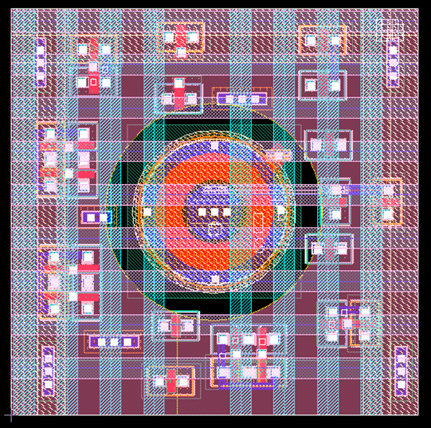
Pixel Derivative: 15 Micron Pitch
Source follower transistor with circular gate layout
  Source in center
  Effective width comparable to SF in 10 micron pixel
Same schematic as 10 micron pixel
  Pixel has the same functionality
Expected advantages
  Lower 1/f noise
  Less pixels with RTS
  Higher yield
15 micron
Pixel Array with Circular SF Expected to have “tighter” Noise Distribution
Pixel Population
Only M1 through M4 are shown
noise

Slide 19
Focal Plane Array Fabrication
FPA Hybrid Fabrication
Hybridization Marks
4K x 6K
Pixel Array
Stepper Marks
FPA Assembly
Center Mark
Reference Pixels
15 micron version should be compatible with existing packages
SCI is Currently Collecting Alignment Mark Information from Potential Detector Vendors

Slide 20
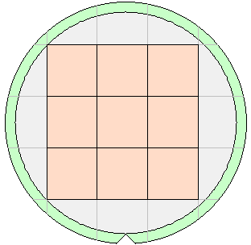
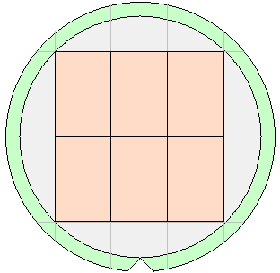
Wafer Maps – 10μm Pixels
4Kx4K-10µm ROIC
4Kx6K-10µm ROIC
200mm Wafers
Die Size
41.76mm x 42.73mm
9 Die per Wafer
Die Size
41.76mm x 63.21mm
6 Die per Wafer

Slide 21
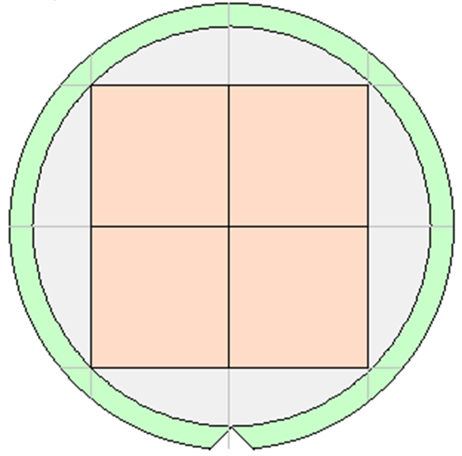
Wafer Map – 15μm Pixels
Wafer Map for the proposed 4k x 4k ROIC with 15micron pitch on 8 inch wafer.
4 ROIC’s can be fabricated per wafer.
20%-30% yield is Expected
  1 working die per wafer
“Working die” is not uniquely defined for these large ROICs
  Often defined in retrospect to match initial yield assumptions and budgets

Slide 22
Output Mode-1: 1-Output
ROIC Supports: 1, 4, 8, 16-Outputs per 1K Block
4Kx6K ROIC supports 1, 4, 16, 32, and 64 outputs in total
1-Output Mode:
1 Stripe of 4096 columns
4K x 6K
1-Output

Slide 23
Output Mode-2: 4-Output
ROIC Supports: 1, 4, 8, 16-Outputs per 1K Block
4Kx6K ROIC supports 1, 4, 16, 32, and 64 outputs in total
4-Output Mode:
4 Stripes of 1024 columns
4K x 6K
4-Output

Slide 24
Output Mode-3: 16-Output
ROIC Supports: 1, 4, 8, 16-Outputs per 1K Block
4Kx6K ROIC supports 1, 4, 16, 32, and 64 outputs in total
16-Output Mode
  - 16 Stripes of 256 columns
4K x 6K
16-Output

Slide 25
Output Mode-4: 32-Output
ROIC Supports: 1, 4, 8, 16-Outputs per 1K Block
4Kx6K ROIC supports 1, 4, 16, 32, and 64 outputs in total
32-Output Mode:
- 32 Stripes of 128 columns
4K x 6K
32-Output

Slide 26
Output Mode-5: 64-Output
ROIC Supports: 1, 4, 8, 16-Outputs per 1K Block
4Kx6K ROIC supports 1, 4, 16, 32, and 64 outputs in total
64-Output Mode:
- 64 Stripes of 64 columns
4K x 6K
64-Output

Slide 27
Output Mode-6: 64-Output of 64 Contiguous Pixels
High speed windowing
  Group of adjacent pixels multiplexed simultaneously to all outputs
Example: 64-Output mode,
  columns 0, 1, 2, …, 64 are simultaneously to 64 outputs
4Kx6K ROIC supports 1, 4, 16, 32, and 64 outputs in continuous multiplexing modes (mode-6)
4K x 6K
Group of 1 x 64 pixels

Slide 28
Design, Fabrication and Test Schedule
First Wafers are Expected to Become Available in Late Q1/2018

Slide 29
Acknowledgement
Thank You for your invaluable contributions through many discussions:
  Markus Loose
  Ed Cheng
  Srikanth Thota
  Viswa Ramireddy
  Raghu Singameni

Slide 30
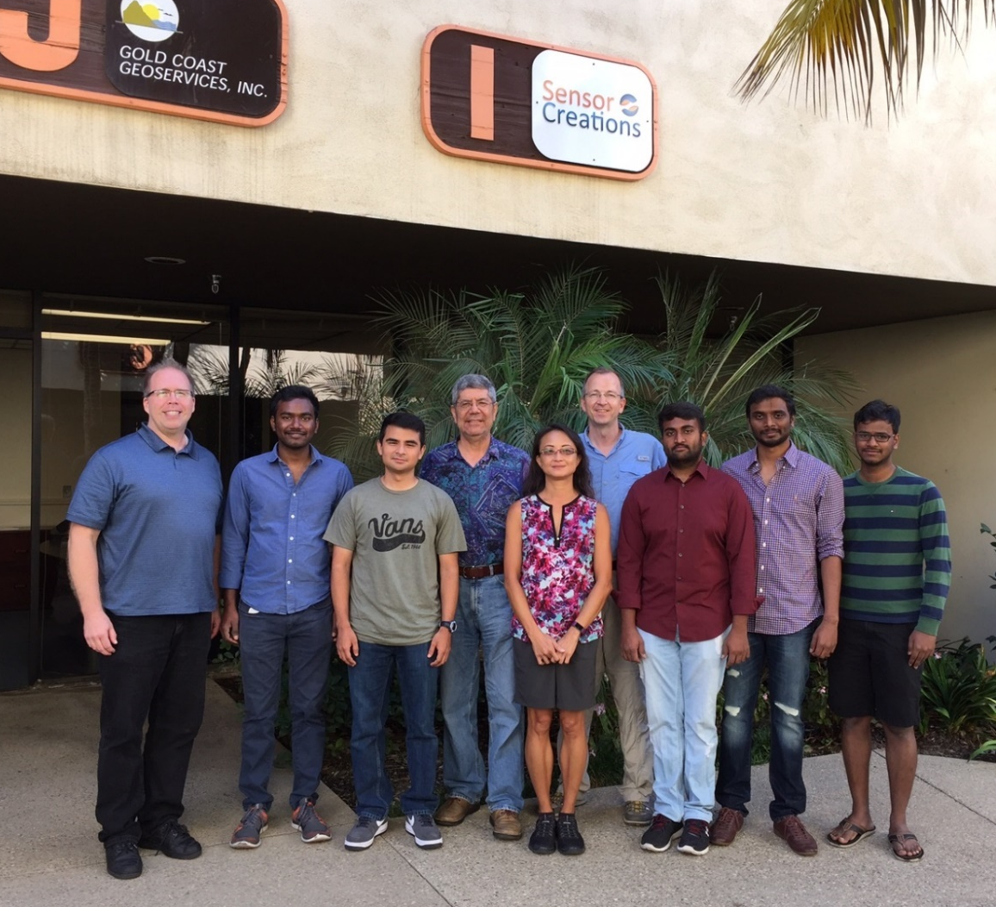
Thank You for your attention!
SCI team, Camarillo, CA

Slide 31
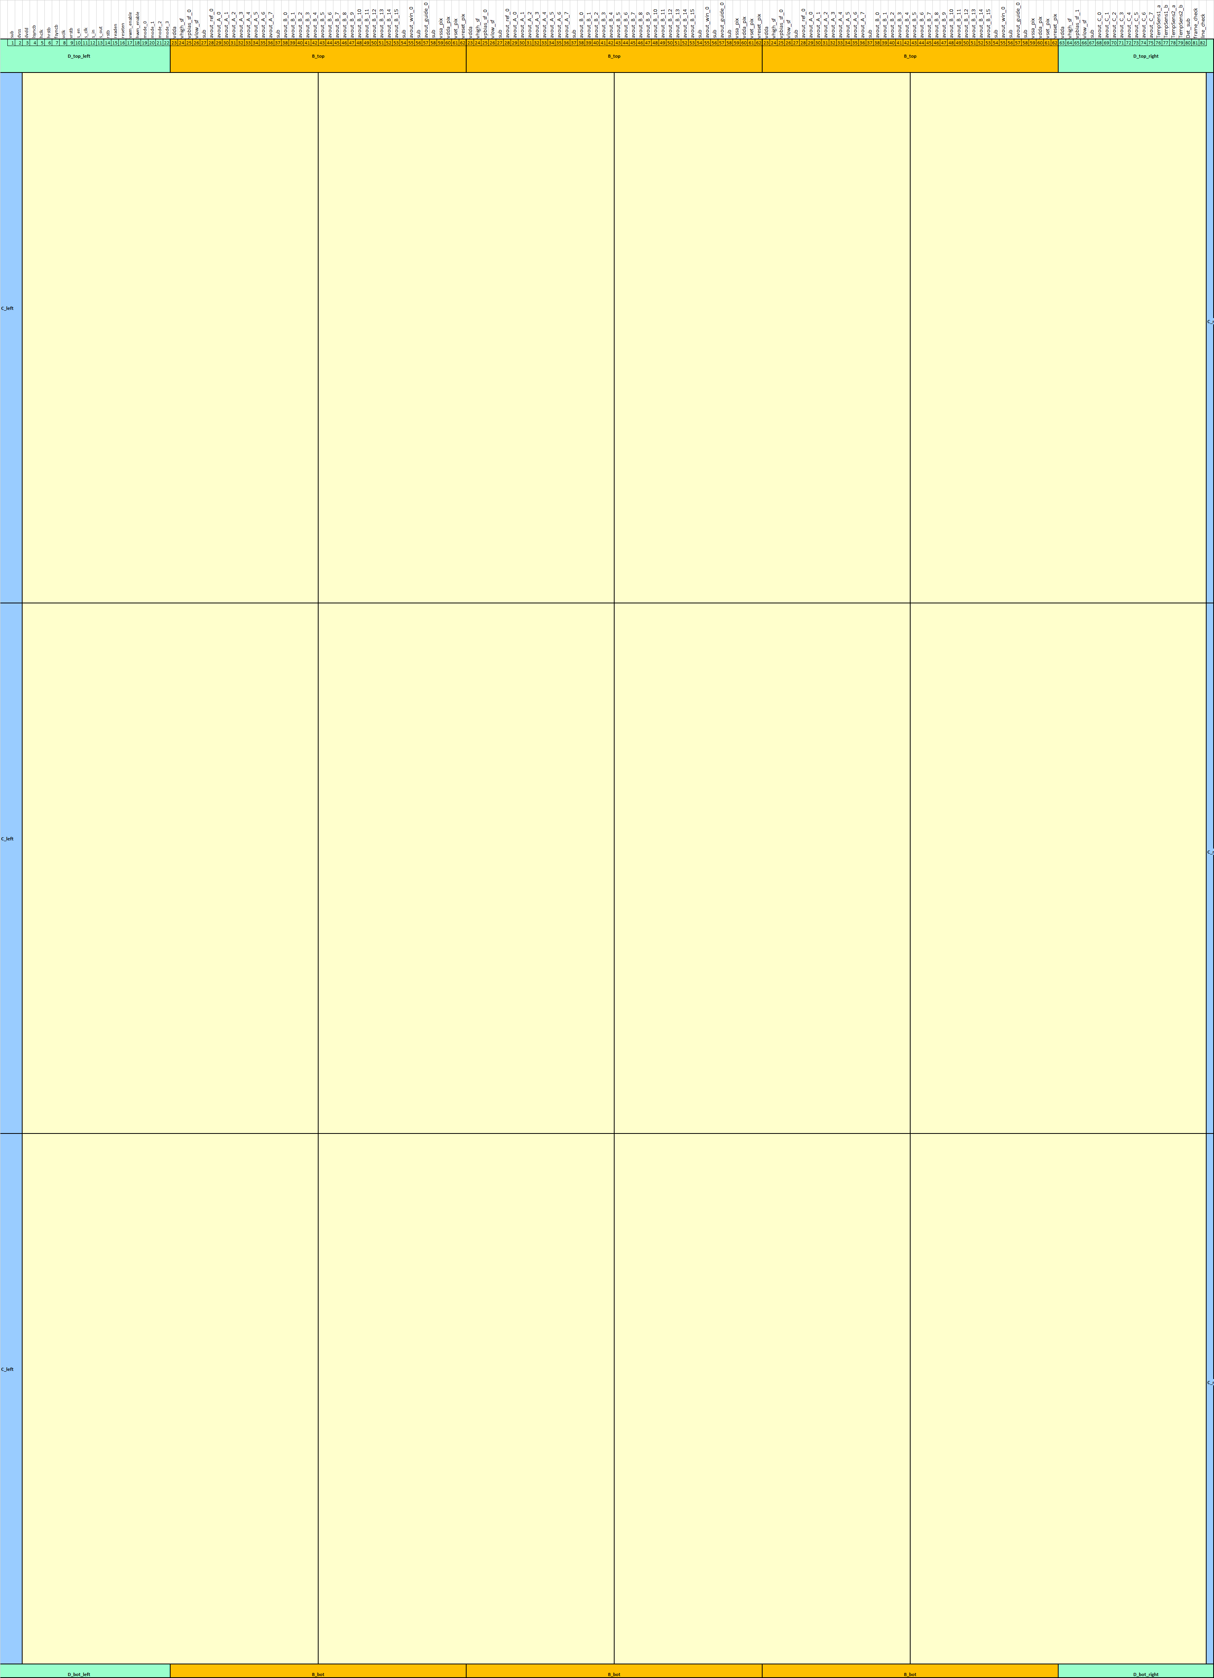
Pad Frame
PADs are located on the top side only.
Total PAD count: 162
for 4K x 6K format
Pad Pitch: ≥ 10 mil

Slide 32
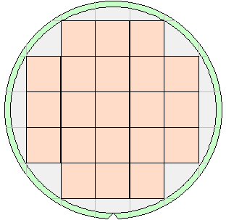
Wafer Maps – Various Configurations
4Kx4K-10µm ROIC
4Kx6K-10µm ROIC
2Kx2K-15µm ROIC
5mm Wafer Exclusion Zone
Die Size
41.76mm x 42.73mm
9 Die per Wafer
Die Size
41.76mm x 63.21mm
6 Die per Wafer
Die Size
31.52mm x 32.52mm
21 Die per Wafer
200mm Wafers

