Slide 1
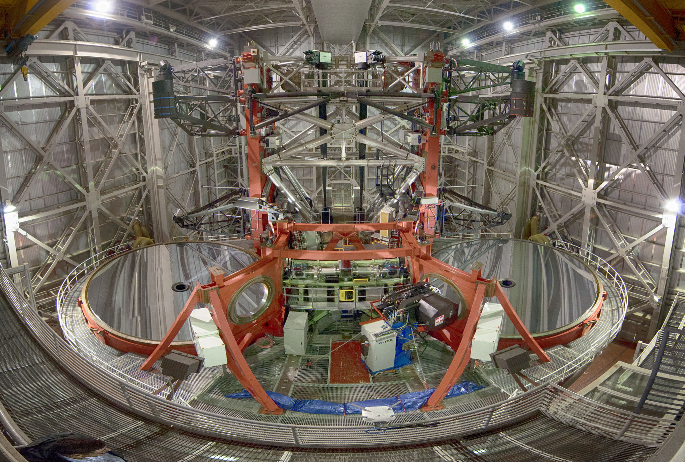
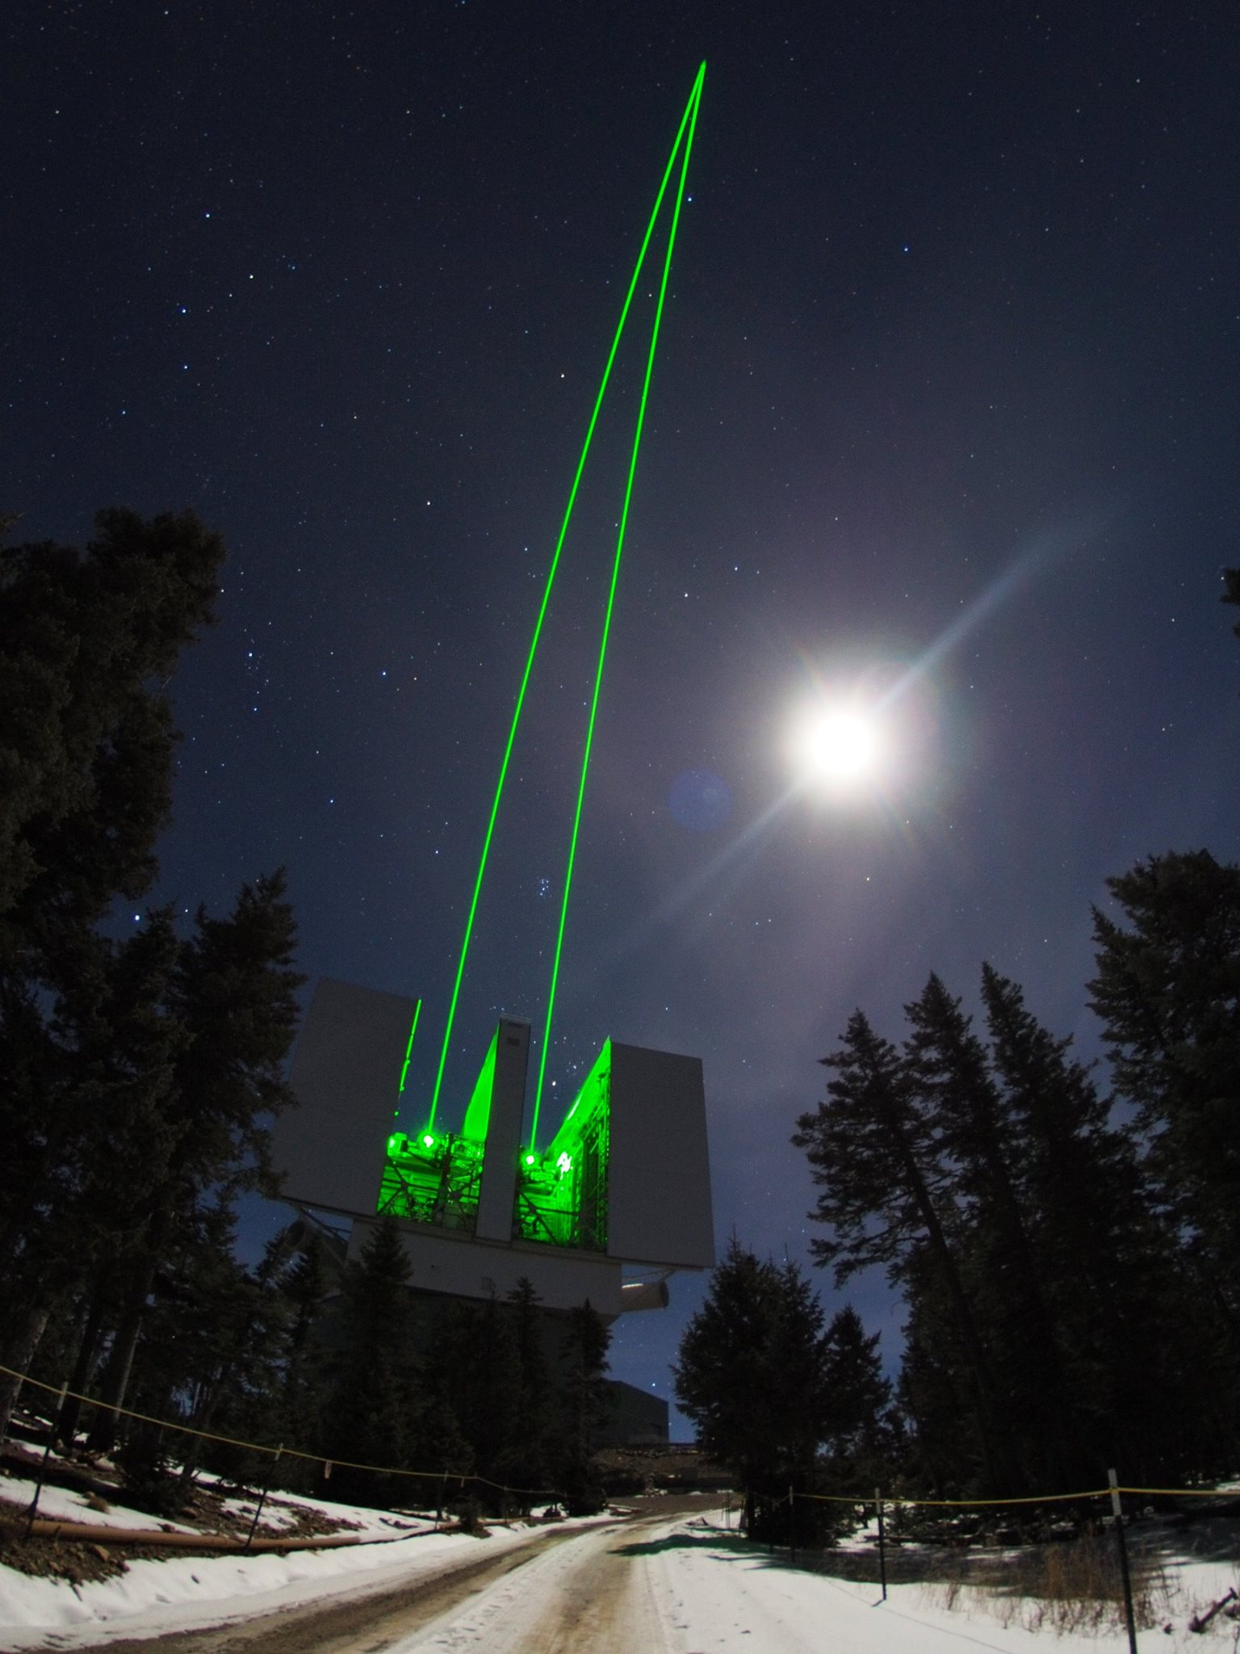

LBTO Instrumentation
The Future
Gustavo Rahmer
Large Binocular Telescope Observatory
SDW 2017 – Baltimore – 25/September/2017

Slide 2
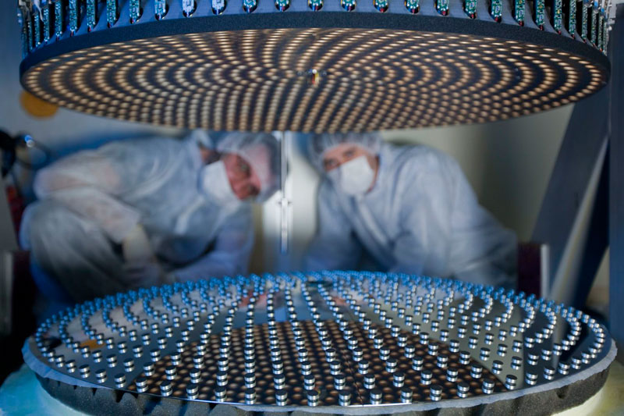
The Future is AO
ARGOS (in progress)
LINC-NIRVANA – Lean MCAO (in progress)
SOUL – The FLAO/LBTI WFS Upgrade (2018)
SHARK-VIS (2019)
SHARK-NIR (2019)
iLocater (2019)
Notes:
A picture of the movable secondary mirror during its installation in the Arcetri lab. The image shows the 672 tiny magnets spread over the back of the mirror. The reflecting face of the mirror is face down. The upper portion contains the electro-mechanical devices that control the magnets.

Slide 3
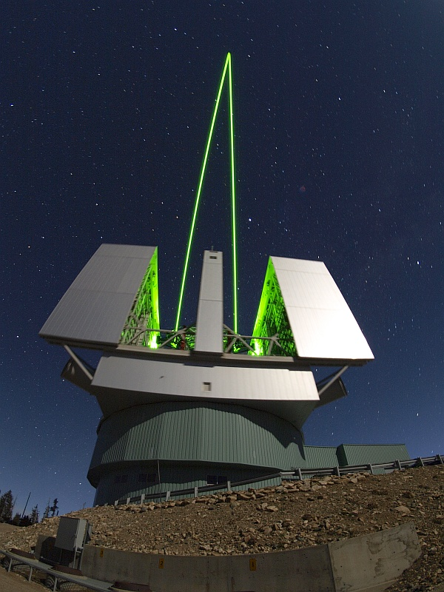

ARGOS
Advanced Rayleigh guided Ground layer adaptive Optics System
PI: Sebastian Rabien (MPIA Garching).
Designed to work with the two LUCI.
Ground-layer AO for wide-field corrections (4x4 arcmin) for a correction factor of 2-3.
3 “Rayleigh beacons” at 12 Km (above each mirror).
Each laser: Nd:YAG, 18 W, pulsed @10KHz, 532 nm.
Shack-Hartmann wavefront sensor.
LGS pulse gating with Pockels cell shutters.
WFS cameras by PNSensor GmbH.

Slide 4
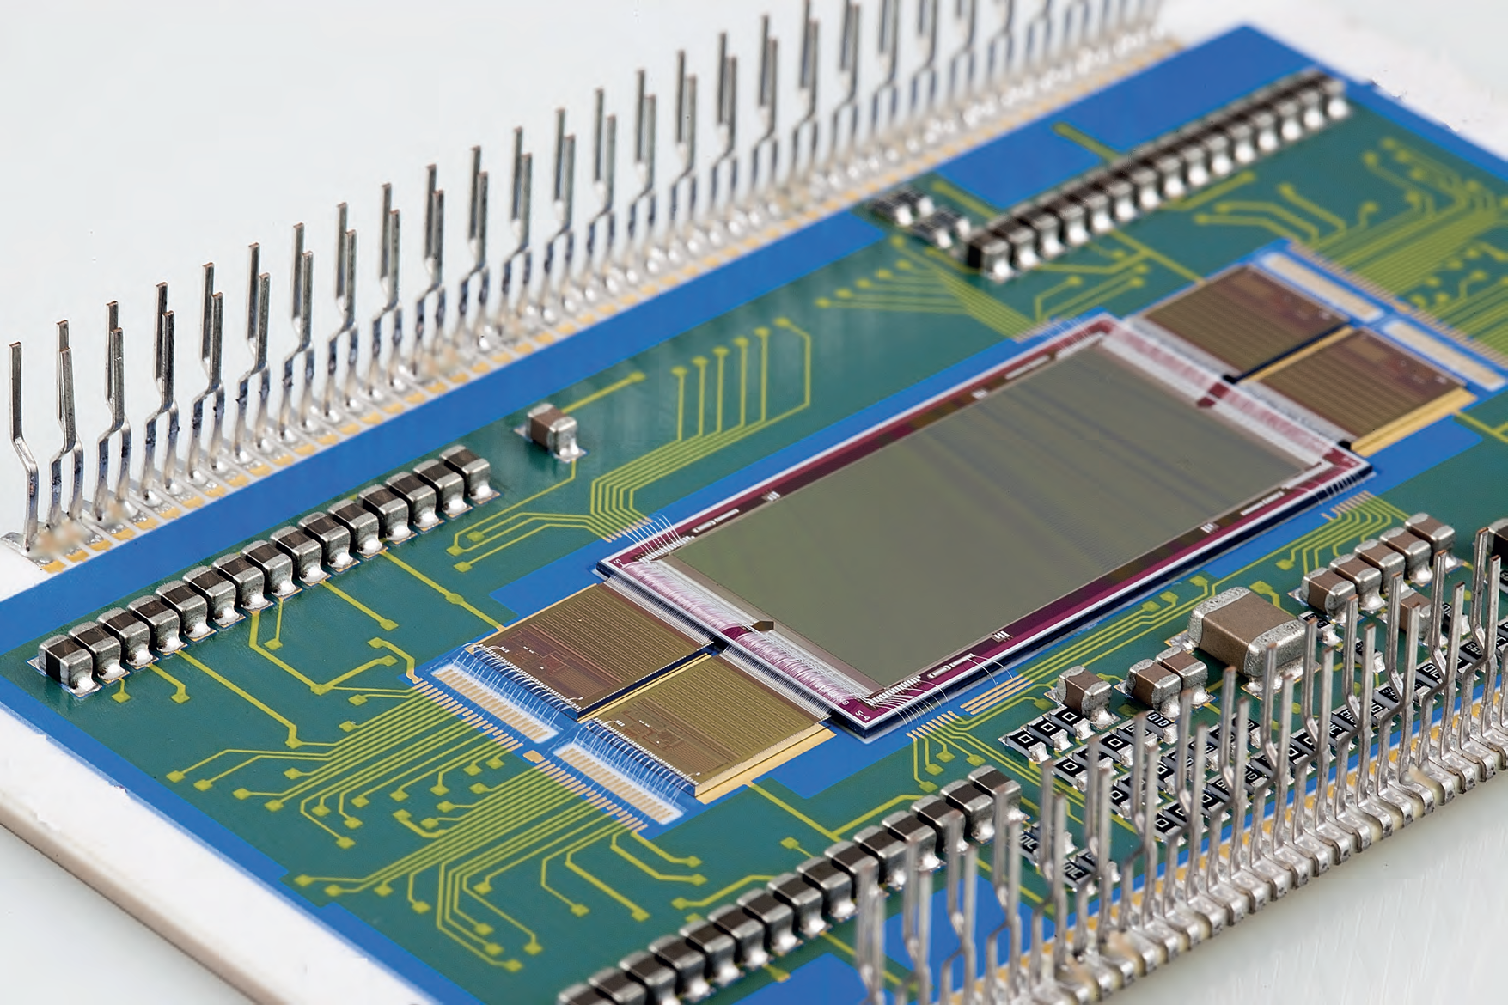
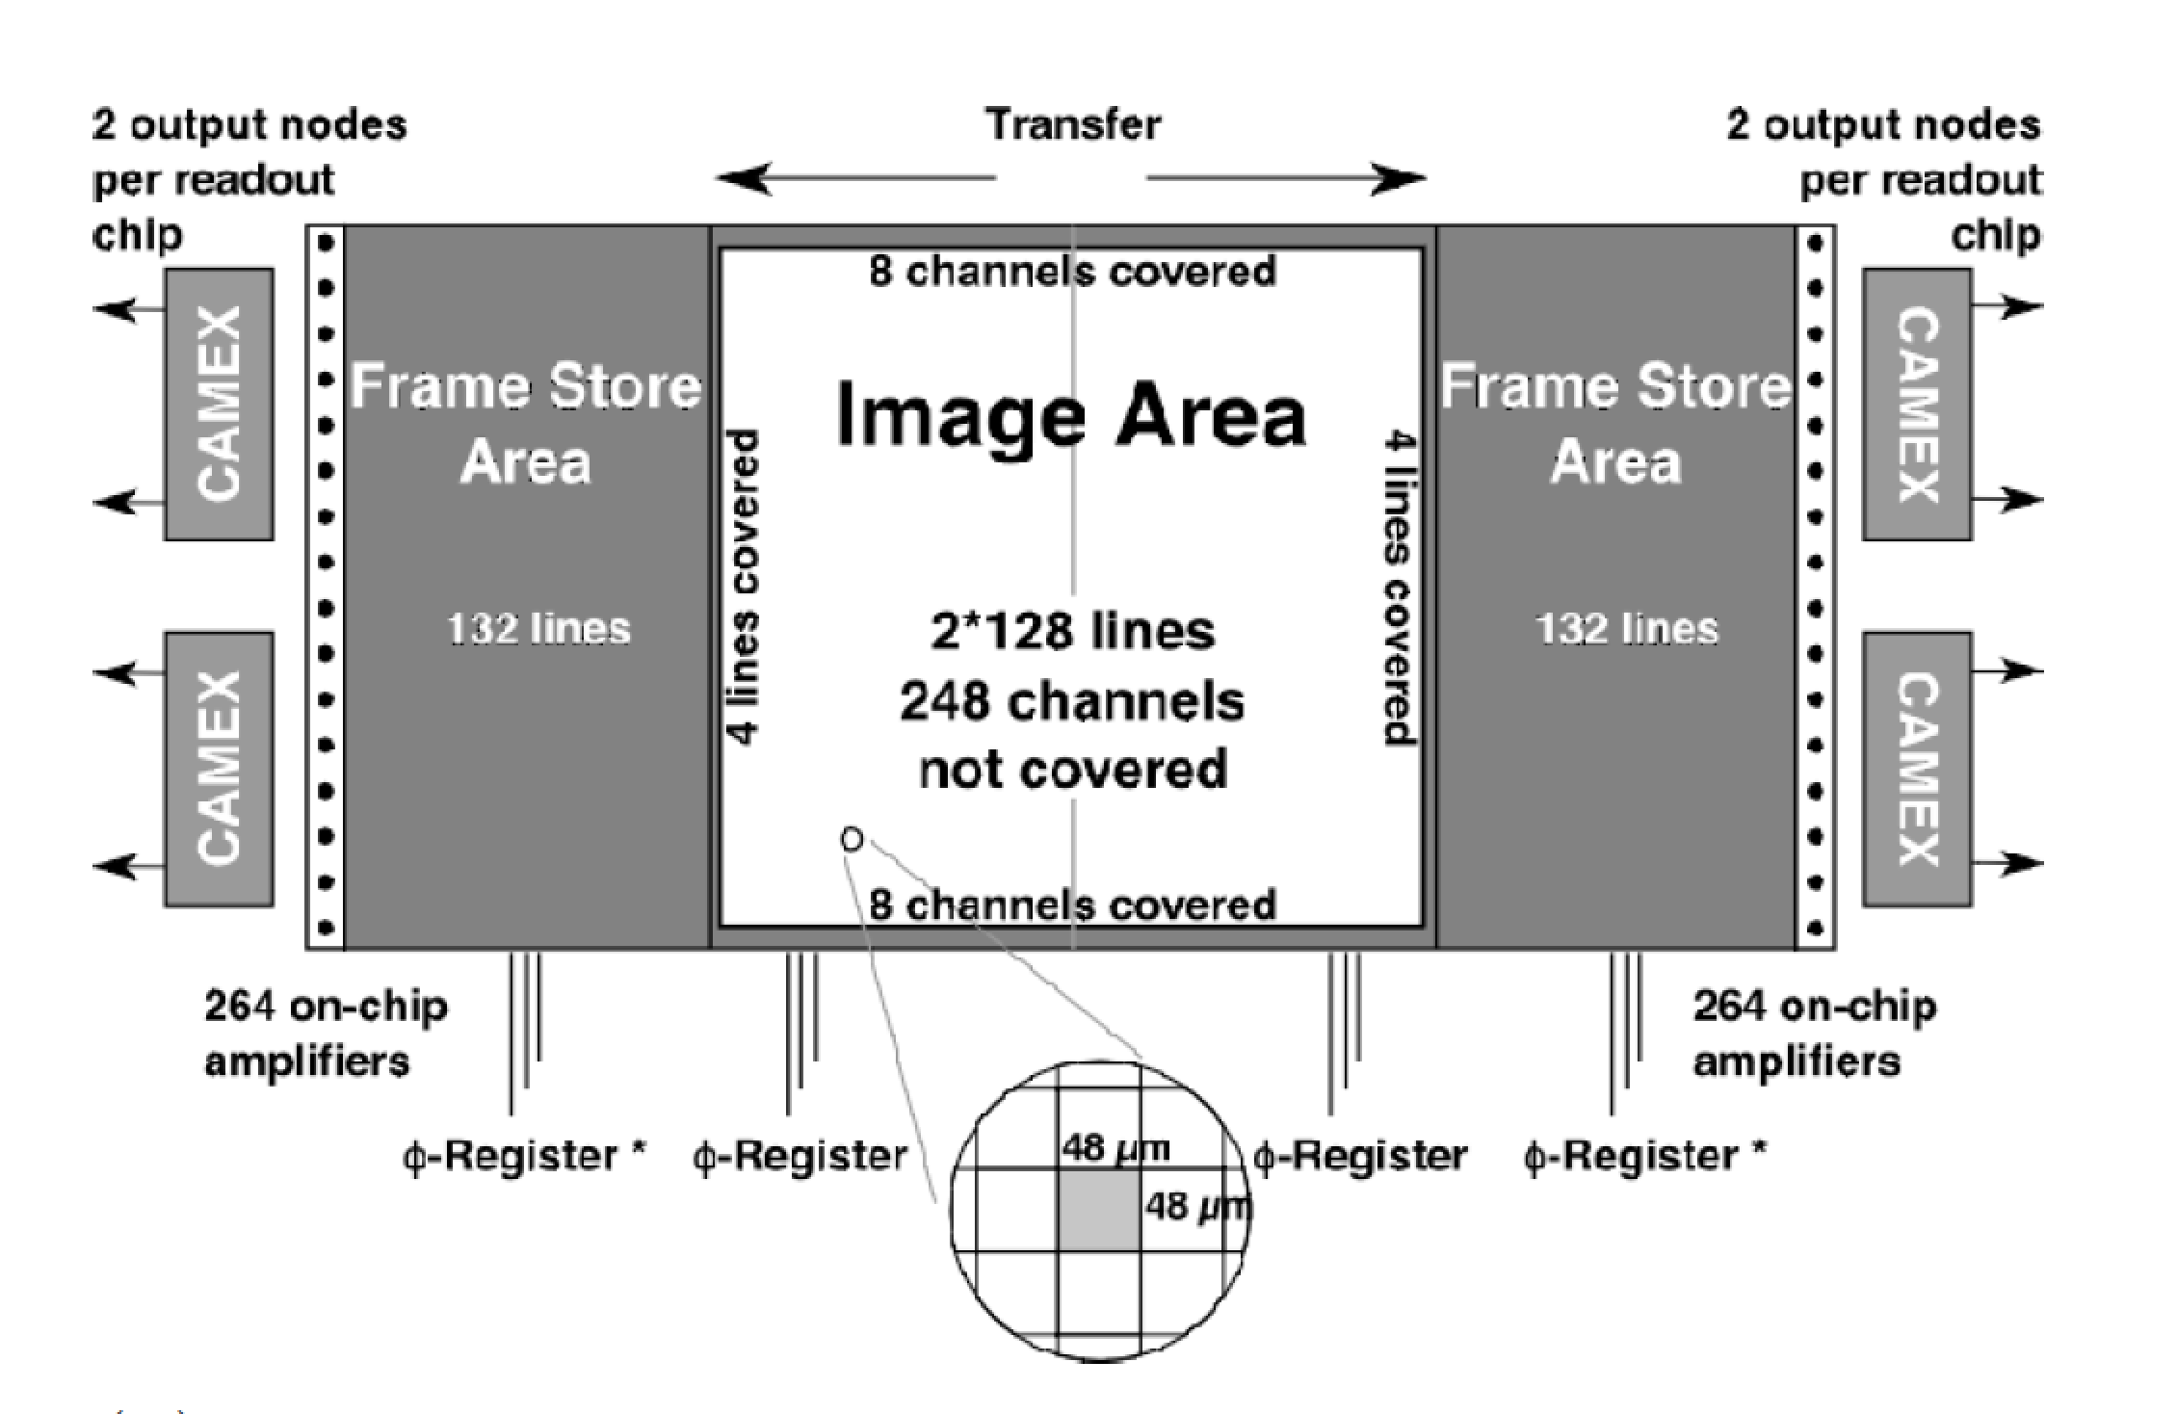
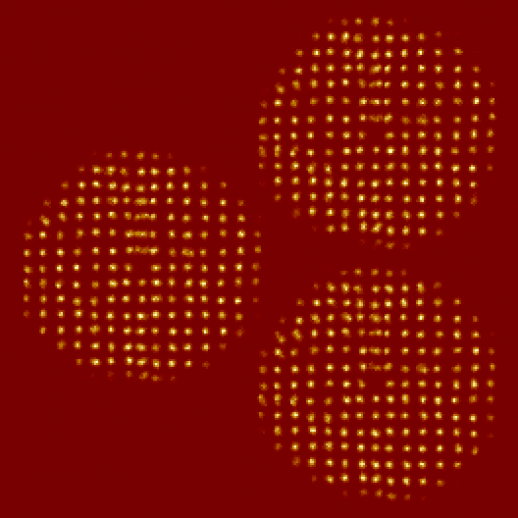
ARGOS Detectors
pn-CCD deep depletion CCD (HLL & PNSensor)
  248 x 256 illuminated pixels
  48 µm pixel size
  ~3 - 4 e- read noise
  QE ~1
  1 kHz frame rate (split-frame)
Notes:
pn-CCDs are backside illuminated, 3-phase CCDs on a fully depleted silicon substrate. Their functioning is based on the principal of sideward depletion. A schematic drawing is shown in the picture below. In contrast to commonly used MOS-CCDs, the transfer registers of a pn-CCD are formed by pn-junctions. This allows for high radiation hardness, fast transfer modes and high full-well capacitances. The ultrathin and unstructured radiation entrance window enables a high quantum efficiency from the near IR and optical to the X-ray regime.

Slide 5
LINC-NIRVANA
PI: Tom Herbst (MPIA Heidelberg).
High Resolution NIR Imager (MCAO).
Strategic Instrument.
Natural Guide Stars.
Multiple Pyramid Wavefront Sensors.
Two Layer Correction:
  Ground Layer:
    Up to 12 NGS.
    Adaptive Secondaries.
  Higher Layer (7.1 km):
    Up to 8 NGS.
    349 Element Xinetics Deformable Mirror.
Located at Rear Bent Gregorian Ports.

Slide 6
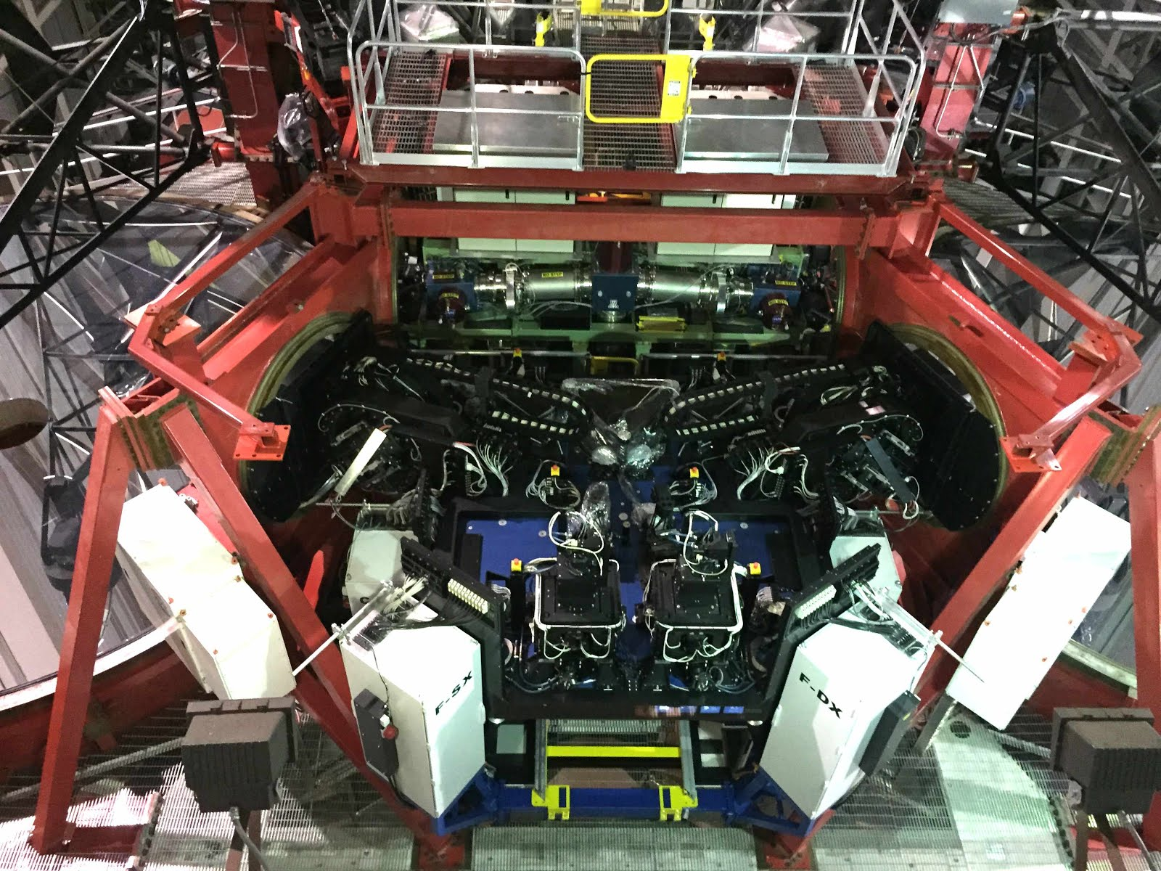
LINC-NIRVANA Detector Systems
Science channel: Hawaii-2 (MPIA controller).
CCDs for AO WFS:
  MHWS (Mid-High Layer): e2v CCD39 (SciMeasure).
  GWS (Ground Layer): e2v CCD50 (SciMeasure).
  Patrol Cameras: e2v CCD47-20 (SciMeasure).
Fringe/Flexure Tracker (future interferometric option): Hawaii-1 (MPIfR controller).

Slide 7
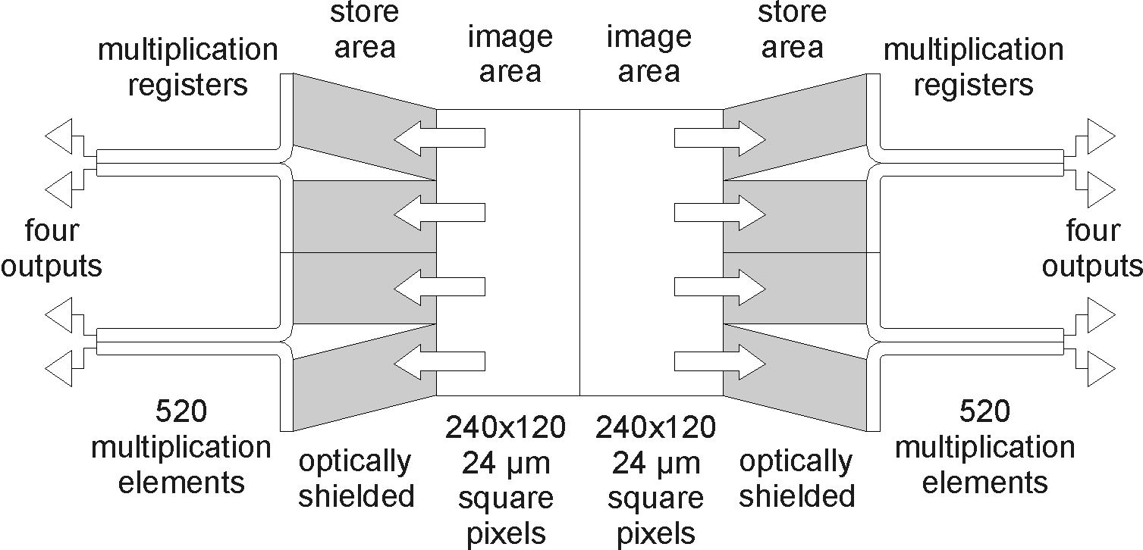
SOUL
Single conjugated adaptive Optics Upgrade for LBT
PI: Simone Esposito (INAF Arcetri).
4 units: 2 x FLAO + 2 x LBTI.
Wavefront Sensor Upgrade:
  Low-noise EMCCDs (First Light OCAM2K with e2v CCD220).
  40 x 40 sub-apertures.
Benefits of Upgrade:
  ~2 magnitude gain in sensitivity.
  Increased sky coverage.
Schedule:
  FLAO Upgrades - Summer Shutdown 2018.
  LBTI First Upgrade – 2018A.
  LBTI Second Upgrade – 2018B.

Slide 8
SHARK
System for coronagraphy with High-order Adaptive optics from R to K bands
Science cases:
  Direct imaging of exoplanets (detection and characterization).
  Proto-planetary disks and jets morphology.
  Minor bodies and moons of the Solar System.
  AGN, Black Holes, Supernovae at high resolution.

Slide 9
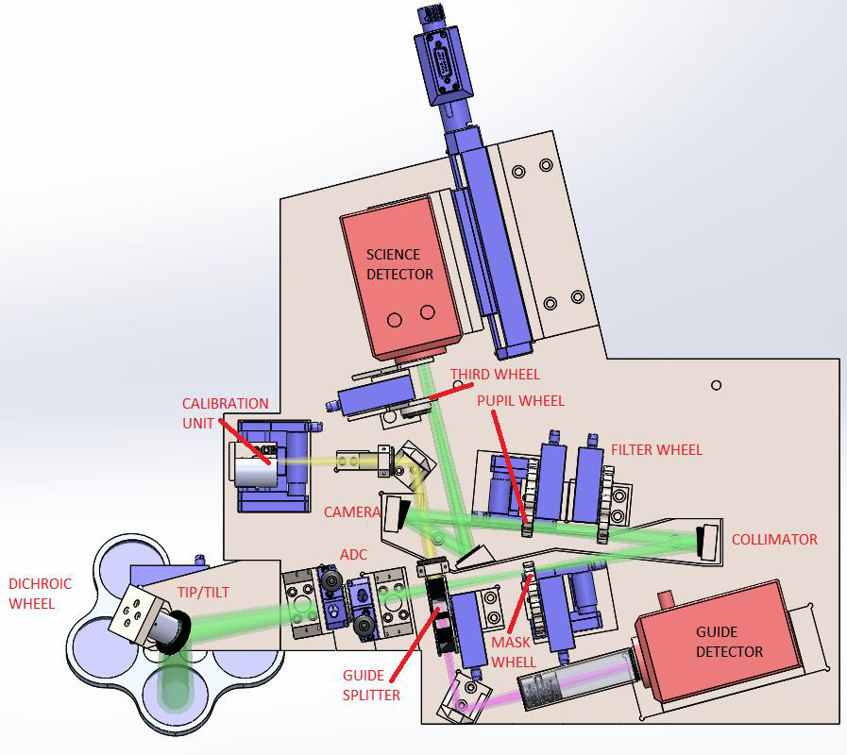
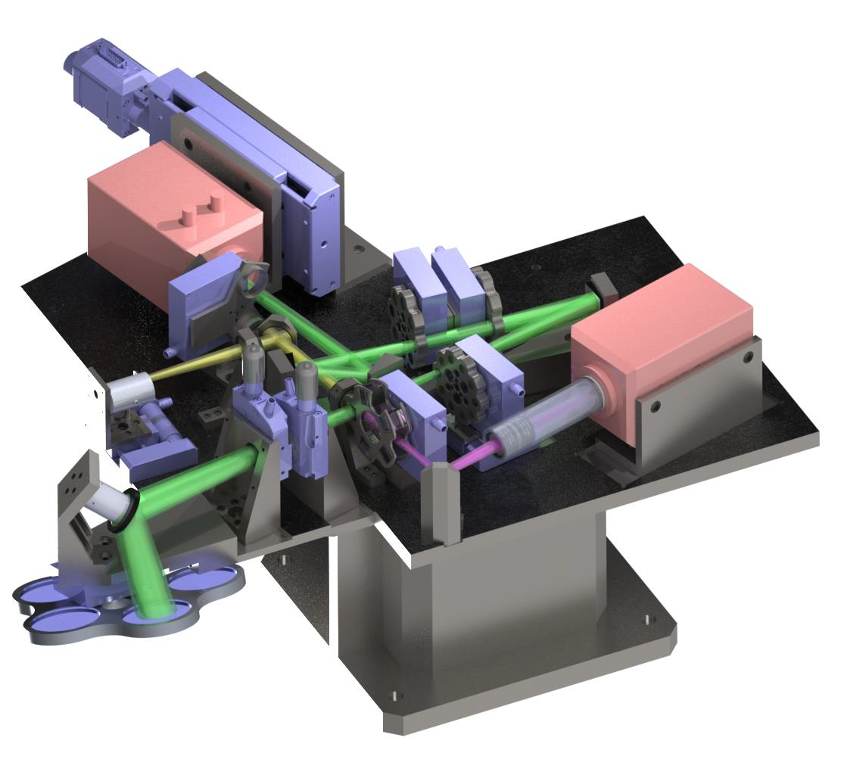
SHARK-VIS
PI: Fernando Pedichini (INAF Rome)
“Diffraction limited” high contrast imaging in the visible (from 400 to 1000 nm).
10 arcsec fields.
Highly configurable:
  Selectable pupil optics (stop, Wollaston, hologram, grism, ….).
  Coronagraphy and IFU ready.
First Light expected in 2019.

Slide 10
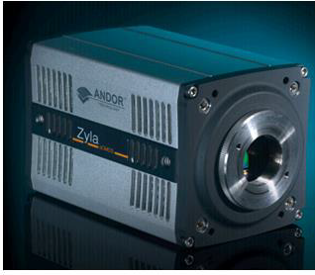
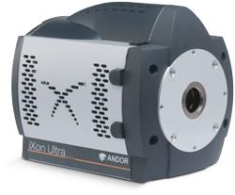
Detector Options for SHARK-VIS
sCMOS vs. EMCCD
Zyla 4.2+ (sCMOS 2K x 2K):
  Pros: efficiency, dynamic range, FOV, rolling shutter.
  Cons: requires LUT calibration.
Ixon 888 (EMCCD 1K x 1K):
  Pros: Low RON, no cal issues, high QE.
  Cons: lower dynamic range, frame transfer, blooming.

Slide 11
SHARK-NIR
PI: Jacopo Farinato (INAF Padova)
Coronagraphic camera with spectroscopic capabilities.
J and H bands.
Science camera: H2RG with SIDECAR.
First Light expected in 2019.

Slide 12
iLocater
PI: Justin Crepp (University of Notre Dame).
Diffraction-limited Doppler Spectrometer:
  λ/Δλ = 110,000.
  ~1 m/s at near-infrared wavelengths.
Single mode fiber-fed.
Y – J bands (complementing PEPSI coverage in the visible).
Acquisition camera mounted on LBTI.
Spectrograph located in the telescope pier.
  Science detector: 2x H2RG or 1x H4RG.
FDR in early 2018, commissioning in 2019.

Slide 13
Summary
System | Detector | Format | Pixel size (µm) | Controller
LBC Science LBC Auxiliary | e2v 42-90 (mosaic of 4) e2v 42-10 (2) | 4.6K x 2.5K 512 x 2K | 13.5 13.5 | Rome + Skytech Rome + Skytech
MODS | e2v 231-68 | 8K x 3K | 15.0 | OSU MkIX
LUCI1 LUCI2 | Hawaii-2 (2.5 µm) H2RG (2.5 µm) | 2K x 2K 2K x 2K | 18.0 18.0 | MPIA MPIA
LBTI - NOMIC LBTI - LMIRcam LBTI – Phasecam | Aquarius (25 µm) H2RG (5 µm) PICNIC (2.5 µm) | 1K x 1K 1K x 1K 256 x 256 | 30.0 18.0 40.0 | Cornell / FORCAST Cornell / FORCAST SciMeasure Little Joe
LINC-NIRVANA Sci LN Fringe/Flex Track LN MHWS LN GWS LN Patrol Cameras | Hawaii-2 (2.5 µm) Hawaii-1 (2.5 µm) e2v CCD39 e2v CCD50 e2v CCD47-20 | 2K x 2K 512 x 512 (1 quad) 80 x 80 128 x 128 1K x 1K | 18.0 18.5 24.0 24.0 13.0 | MPIA MPIfR SciMeasure Little Joe SciMeasure Little Joe SciMeasure Little Joe
PEPSI Science PEPSI AGW | STA 1600TA e2v CCD57-10 | 10.6K x 10.6K 512 x 512 | 9.0 13.0 | ARC Magellan
AGW | e2v CCD57-10 | 512 x 512 | 13.0 | ARC
FLAO | e2v CCD39 e2v CCD47-20 | 80 x 80 1K x 1K | 24.0 13.0 | SciMeasure Little Joe SciMeasure Little Joe
ARGOS | PnCCD | 248 x 256 | 48.0 | PNSensor GmbH

Slide 14
