Slide 1
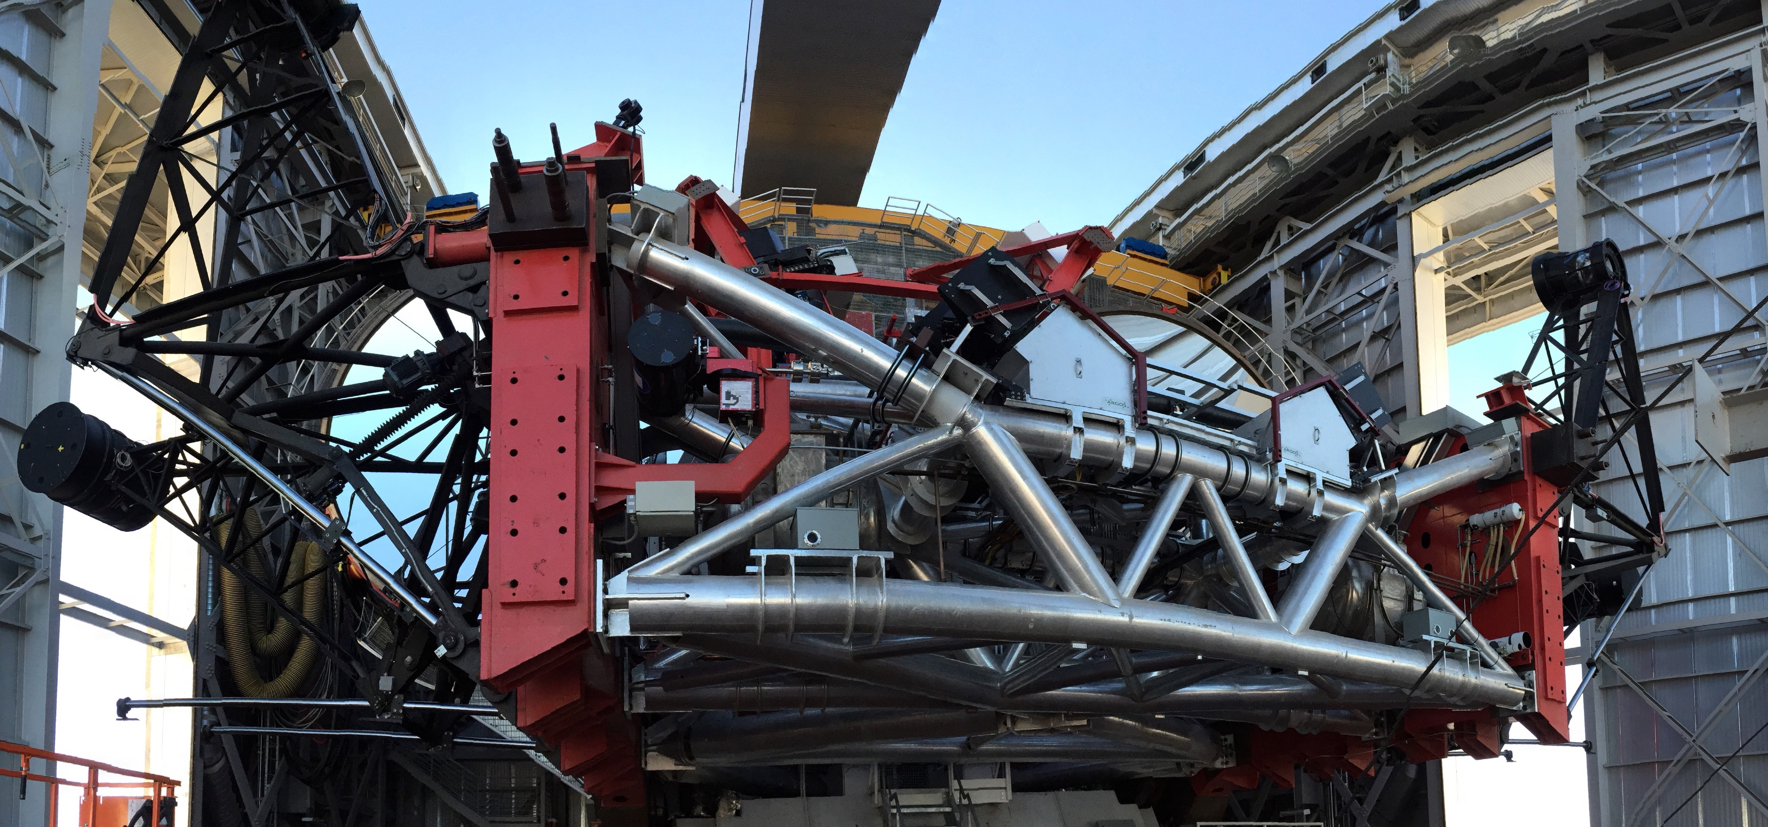
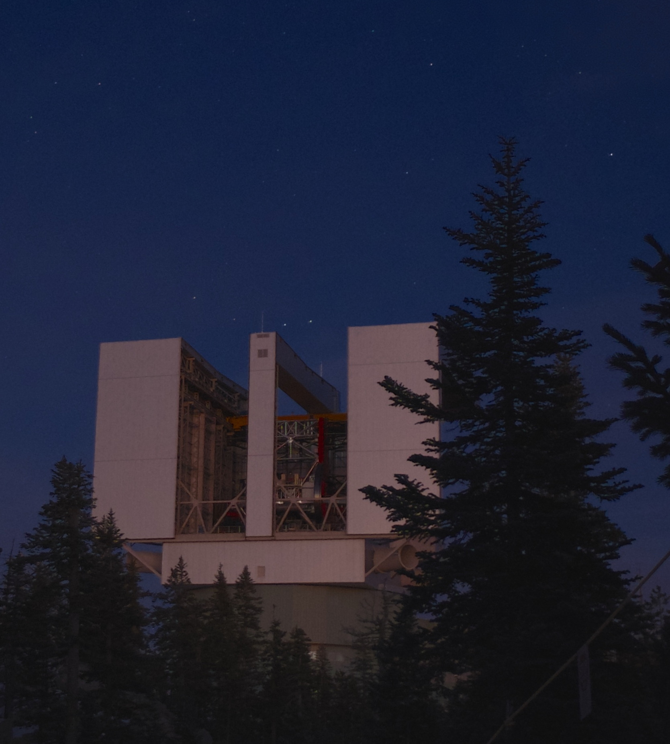

Current Status of the Instrumentation Suite at the Large Binocular Telescope Observatory
Dr. Barry Rothberg
Staff Astronomer
(LBTO)
(And special thanks to information provided by participants from the 2017 LBTO User's Meeting)

Slide 2
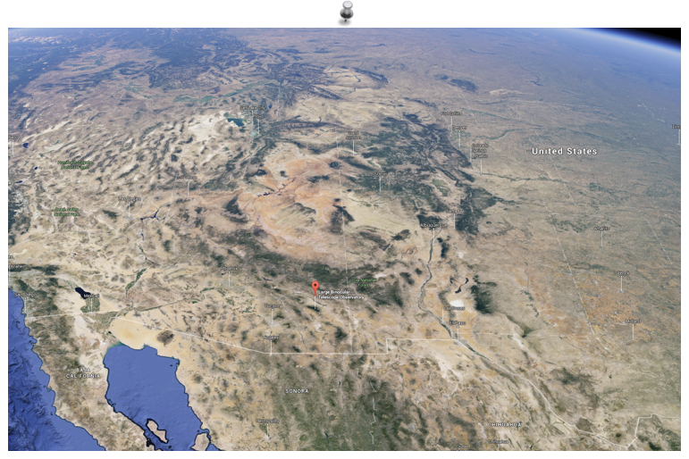
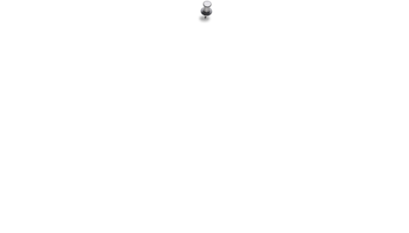
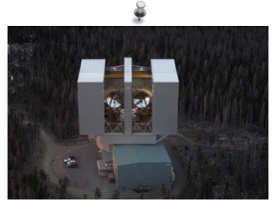

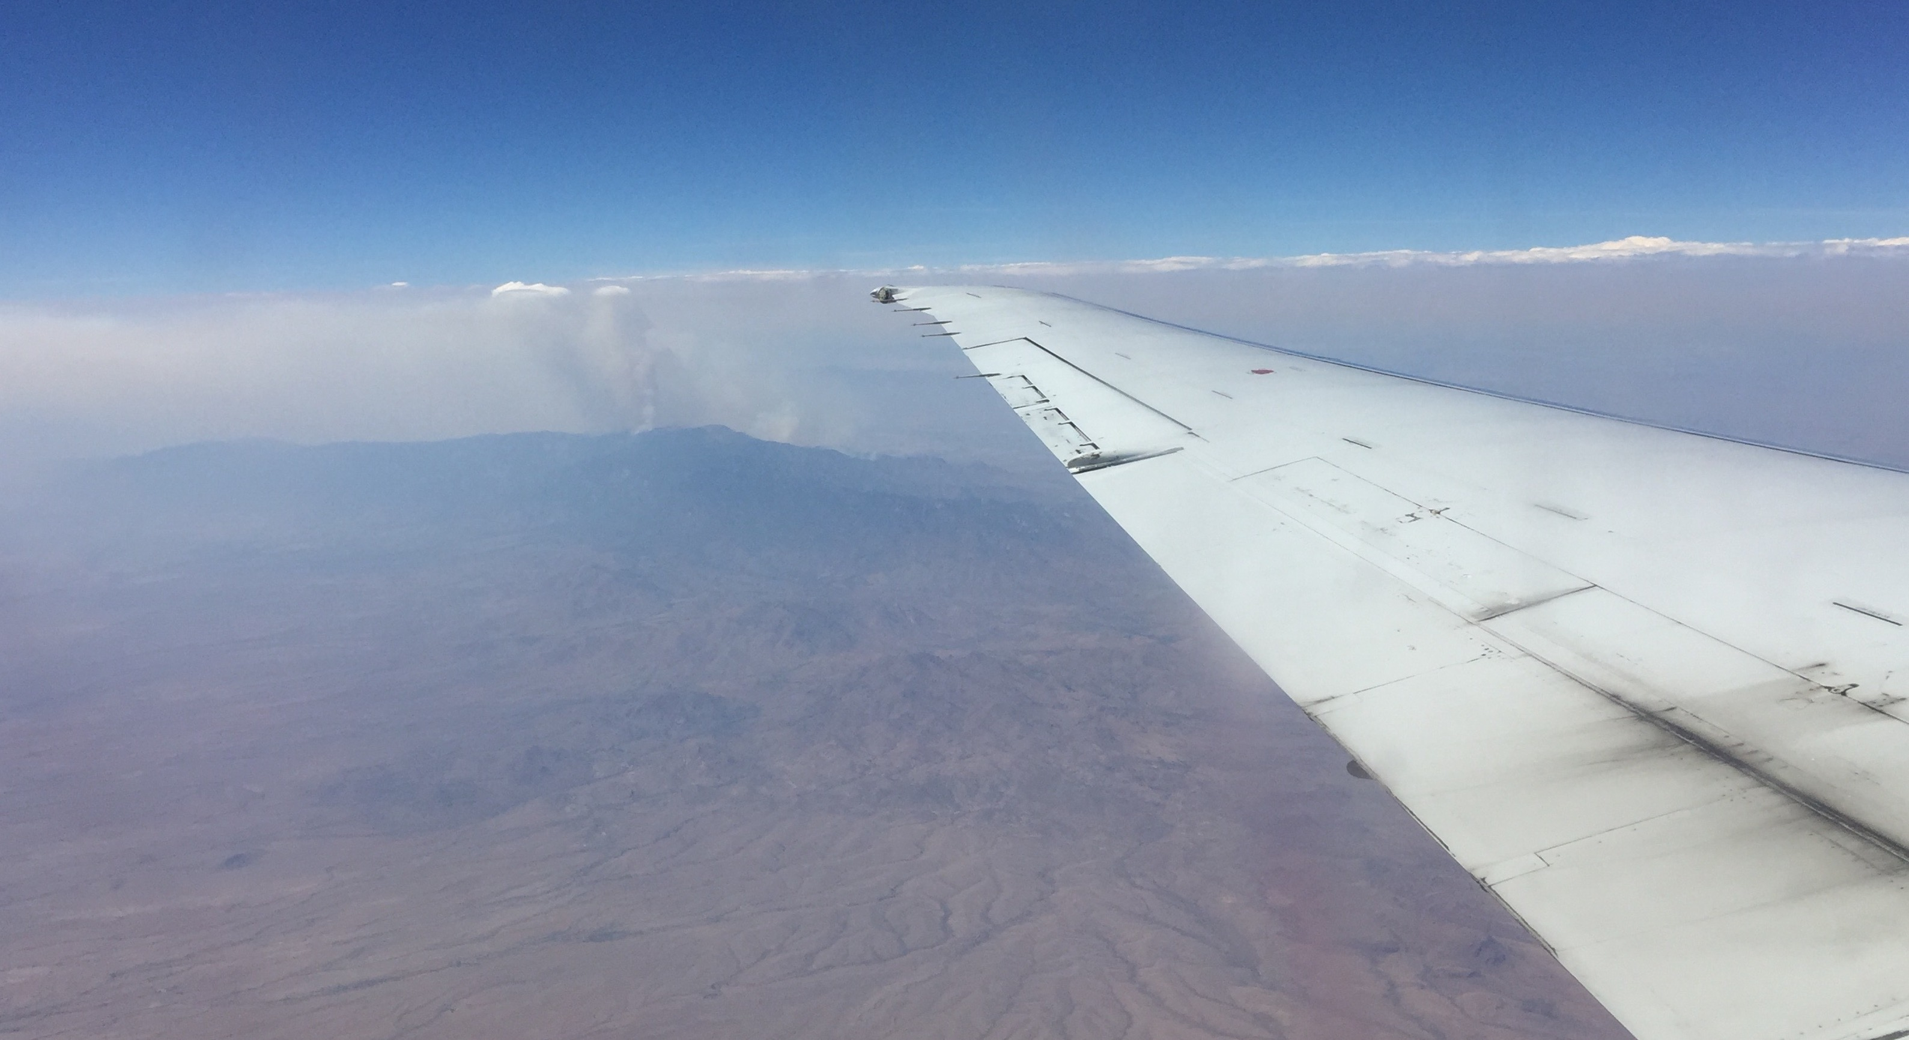



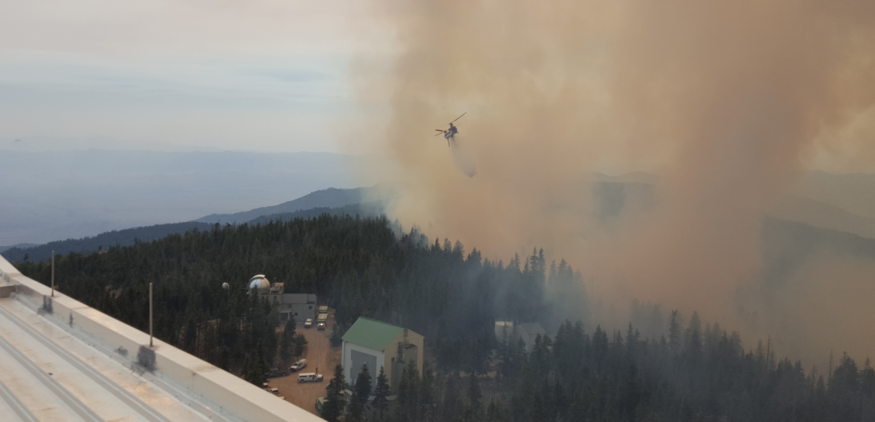
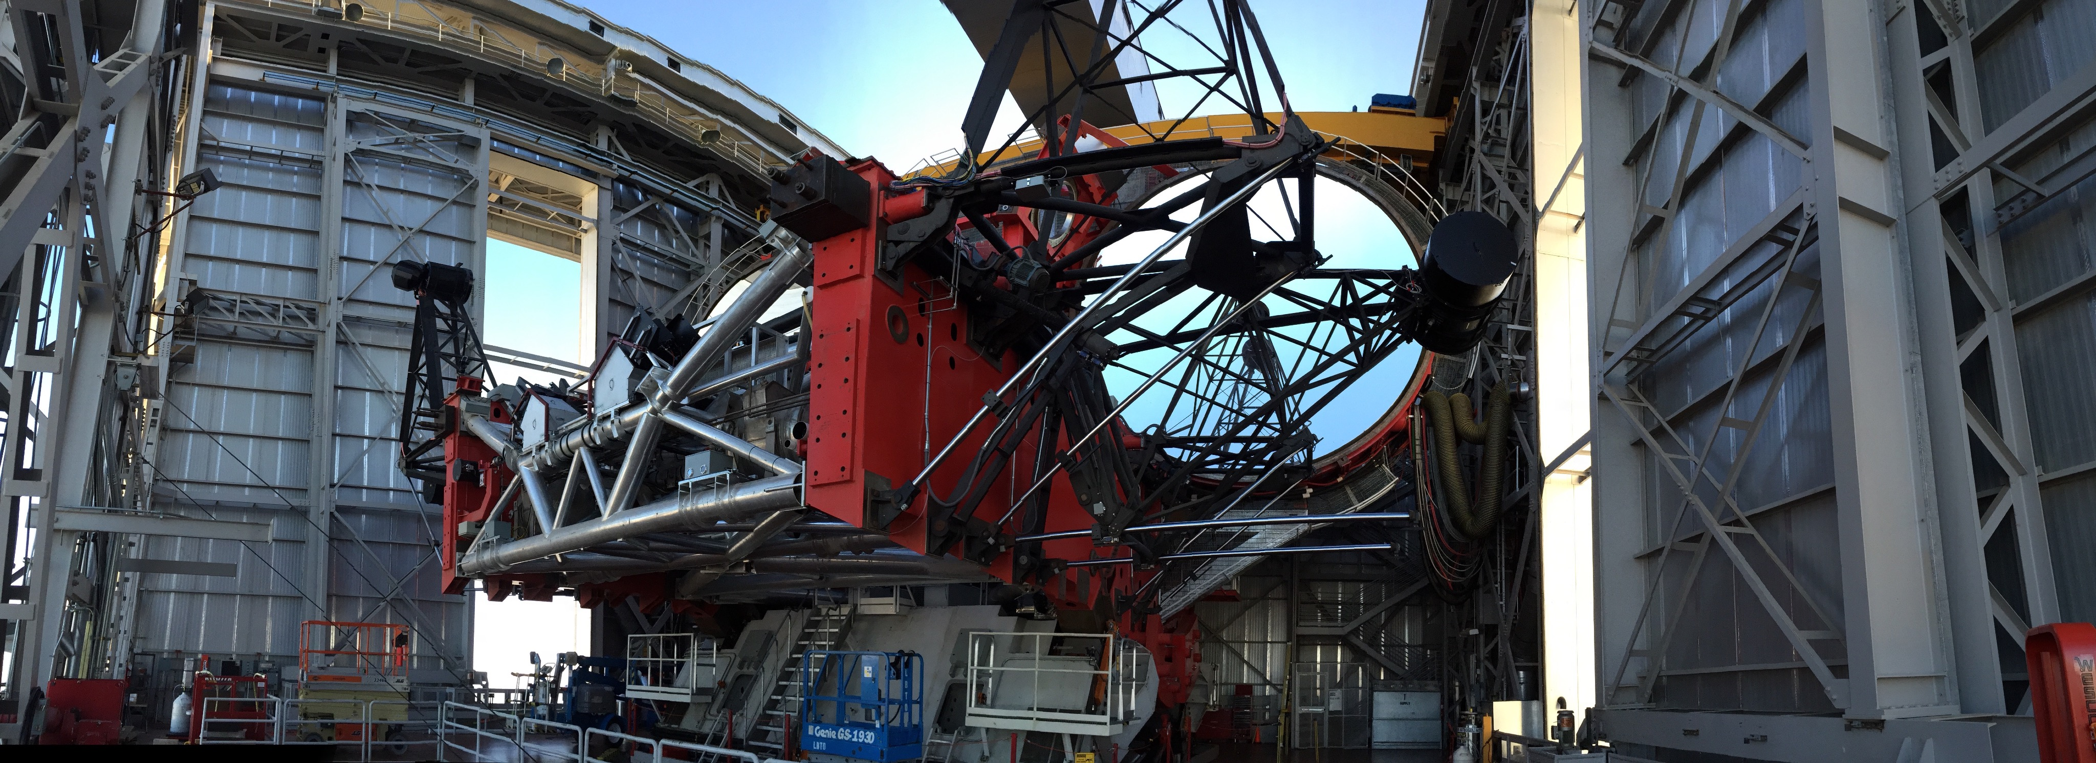

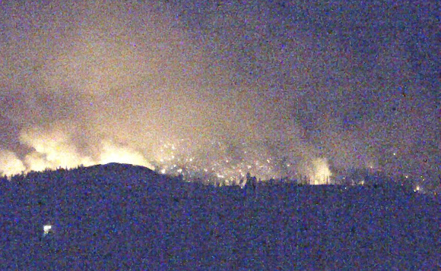

LBTO @ Emerald Peak, Mount Graham
California
Arizona
New Mexico
Texas
Mexico
Courtesy of S. Allanson
Located in southeast Arizona (near New Mexico) ~ 3hrs and 150 miles (241 km) from HQ in Tucson, Arizona
Emerald Peak @ 3192 meters elevation (~10,000 feet) - Mount Graham International Observatory (MGIO)
Site includes 1.8 m Vatican Advanced Technology Telescope & 10 m Arizona Radio Sub-mm Telescope
Nov 15-Mar 15 unpaved road is closed to public & requires 4WD vehicles
Wildfire June 2017 - ended observing early, personnel evacuated from summit, no damage to telescope.

Slide 3
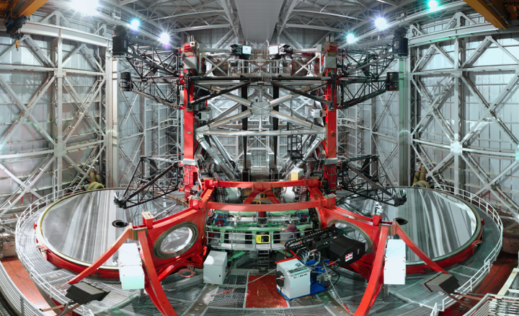
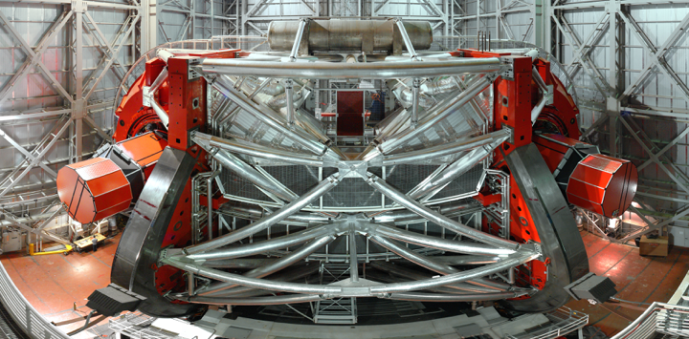
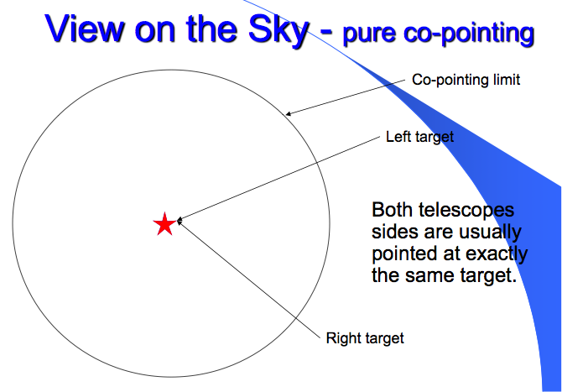
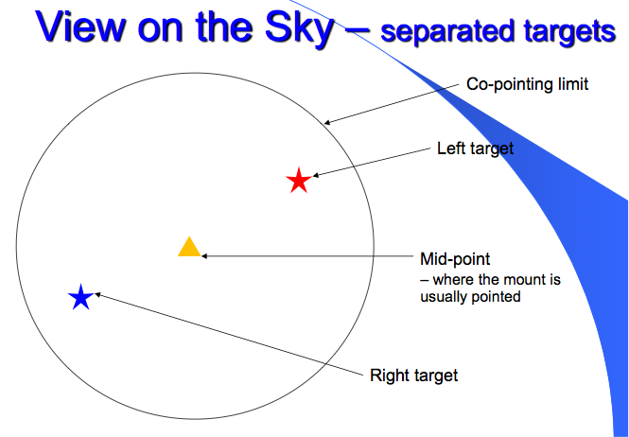

The Large Binocular Telescope
at
LBC Blue
LBC Red
LUCI-1
LUCI-2
LBTI
SX
DX
PEPSI
PEPSI
PEPSI Polarimeter*
PEPSI Polarimeter*
MODS-1
MODS-2

Slide 4
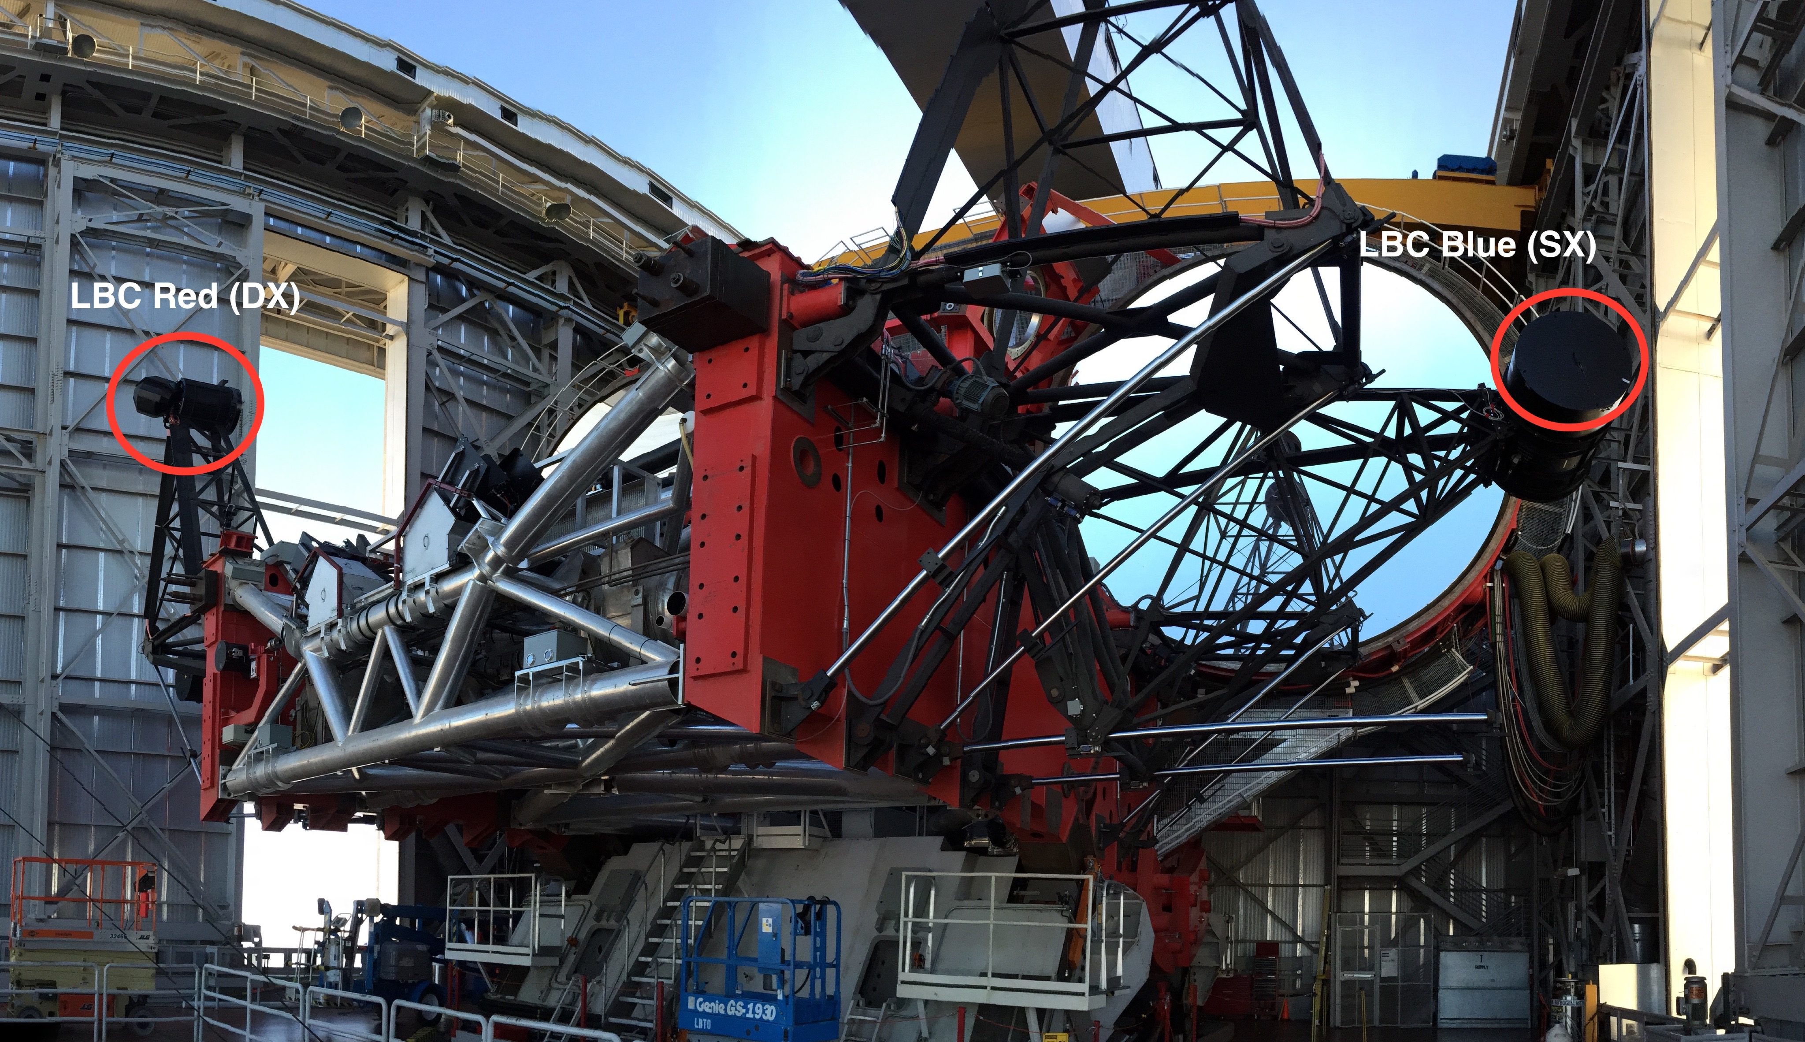
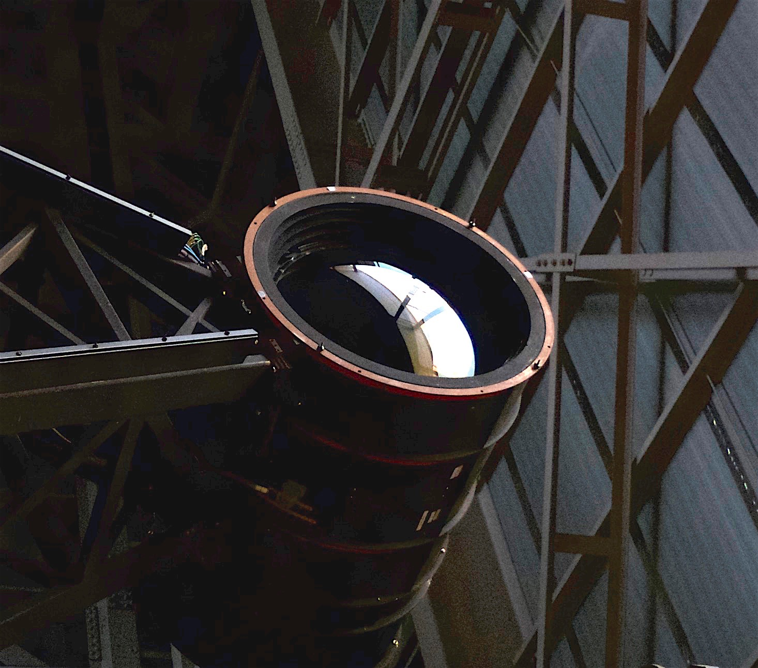
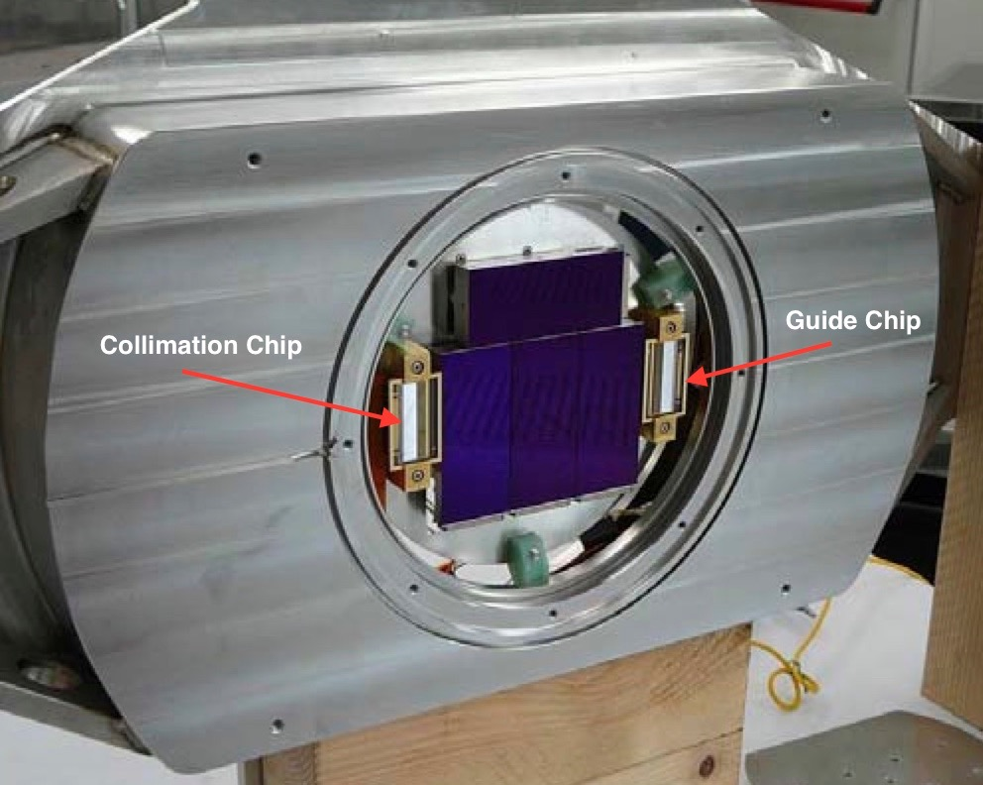
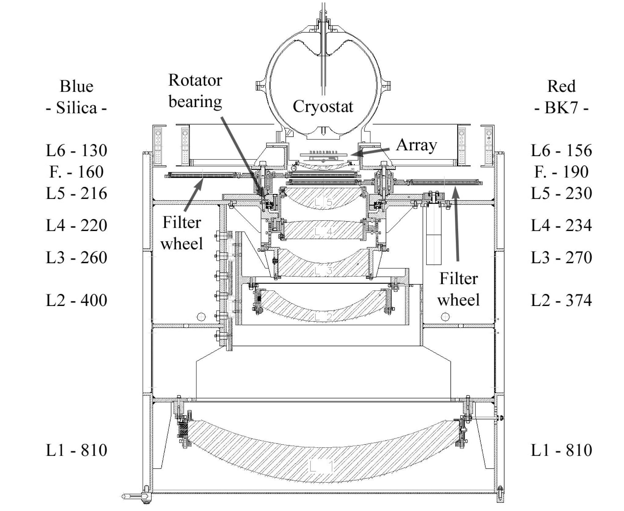
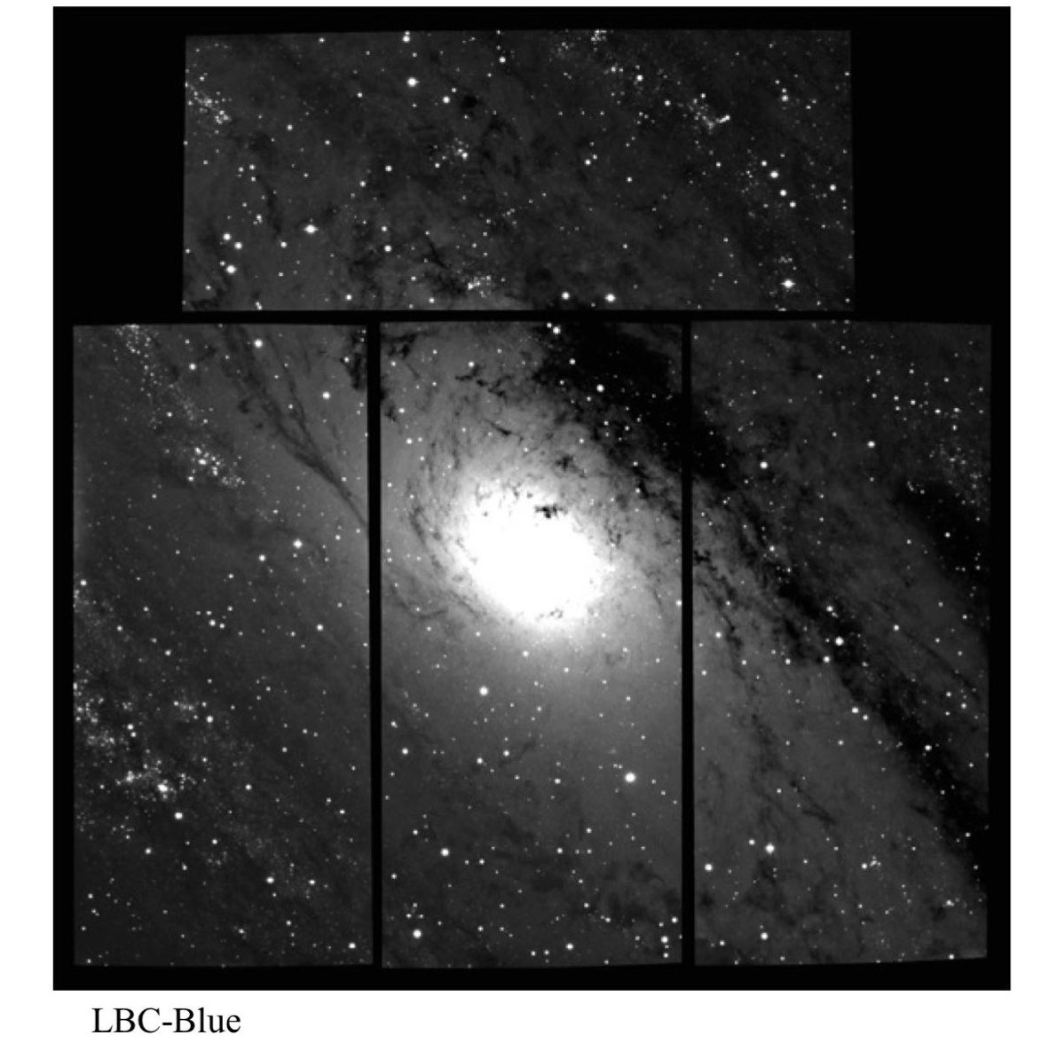
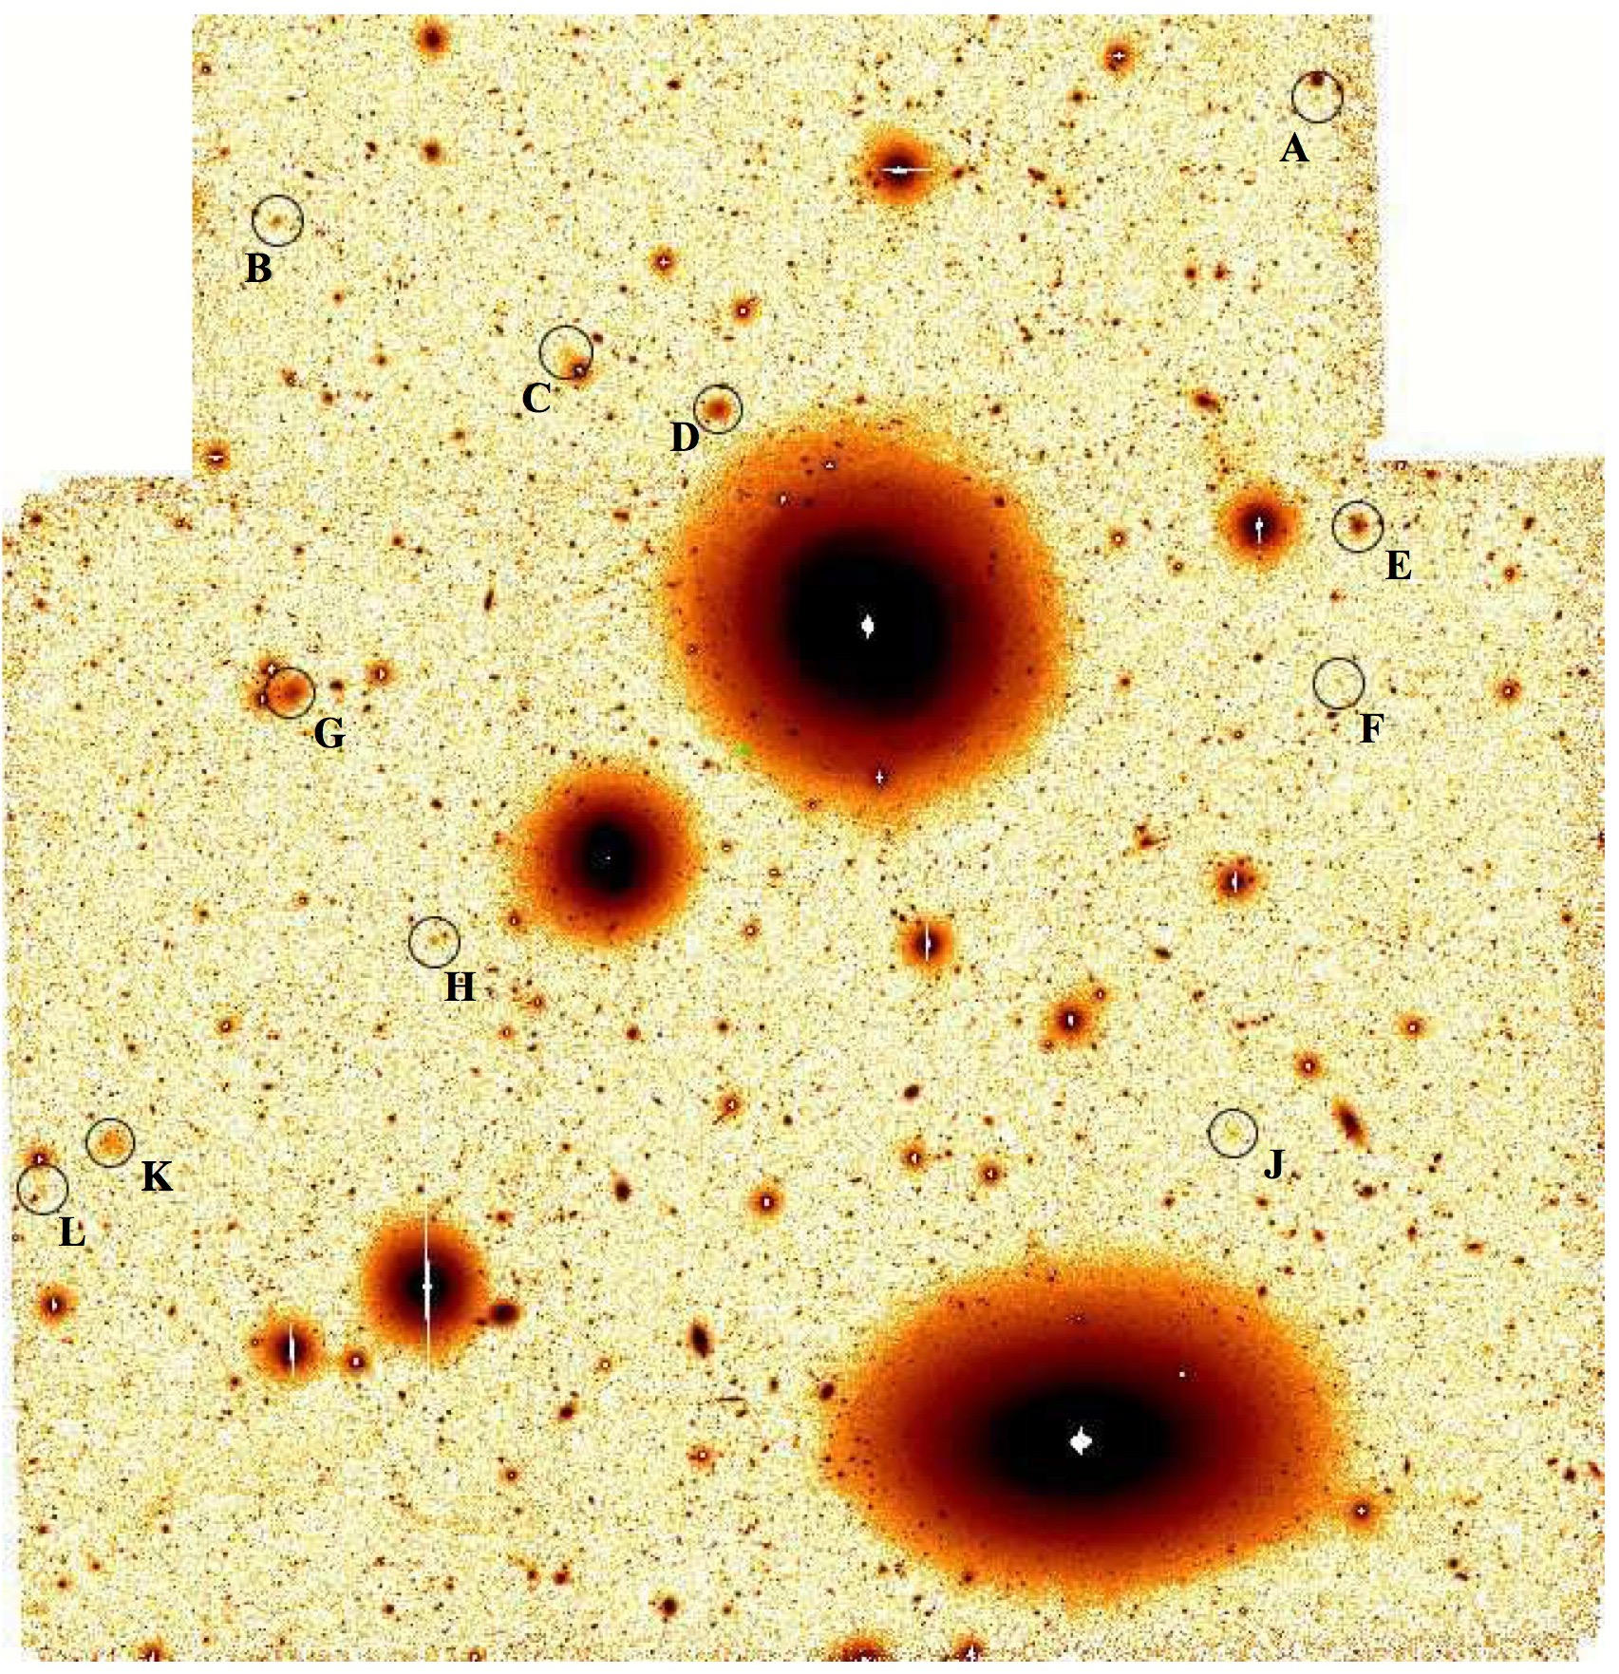
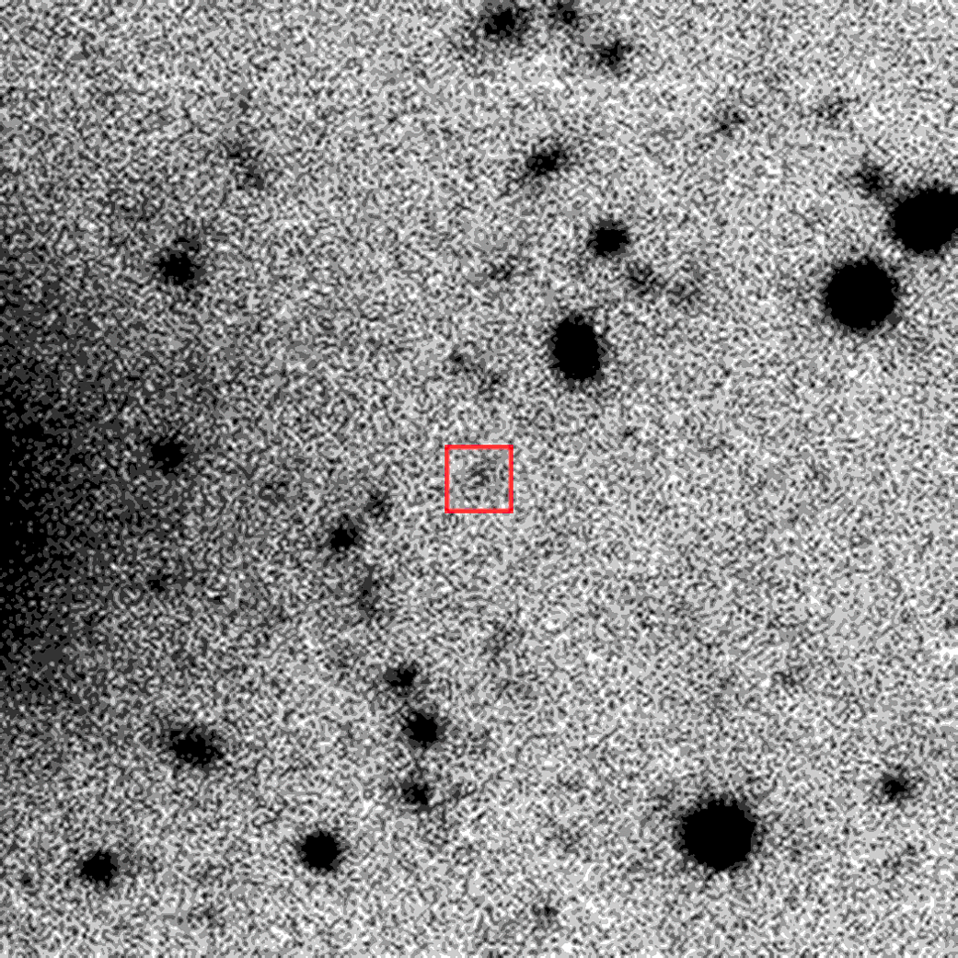
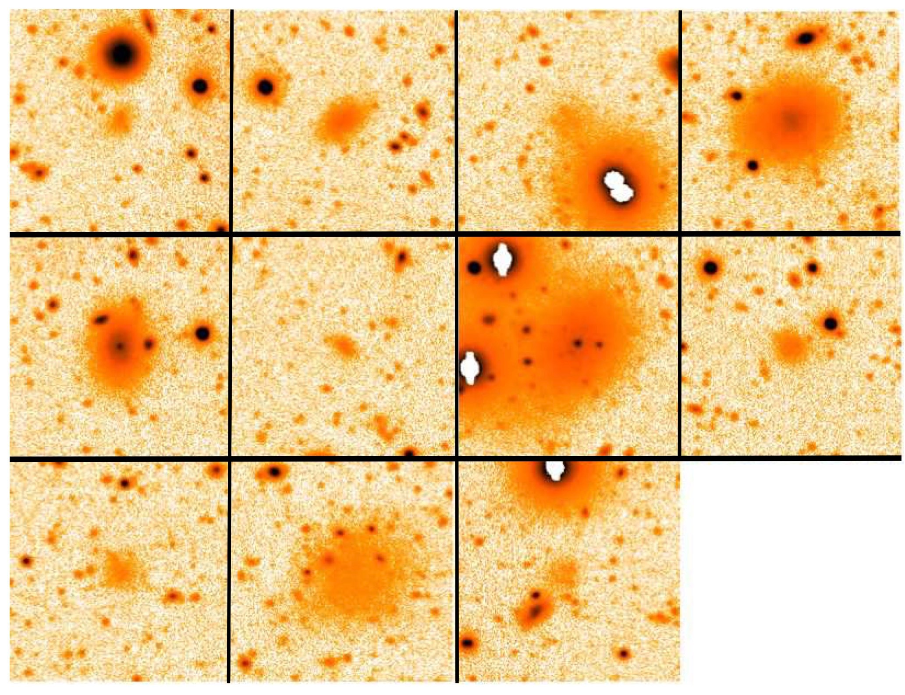
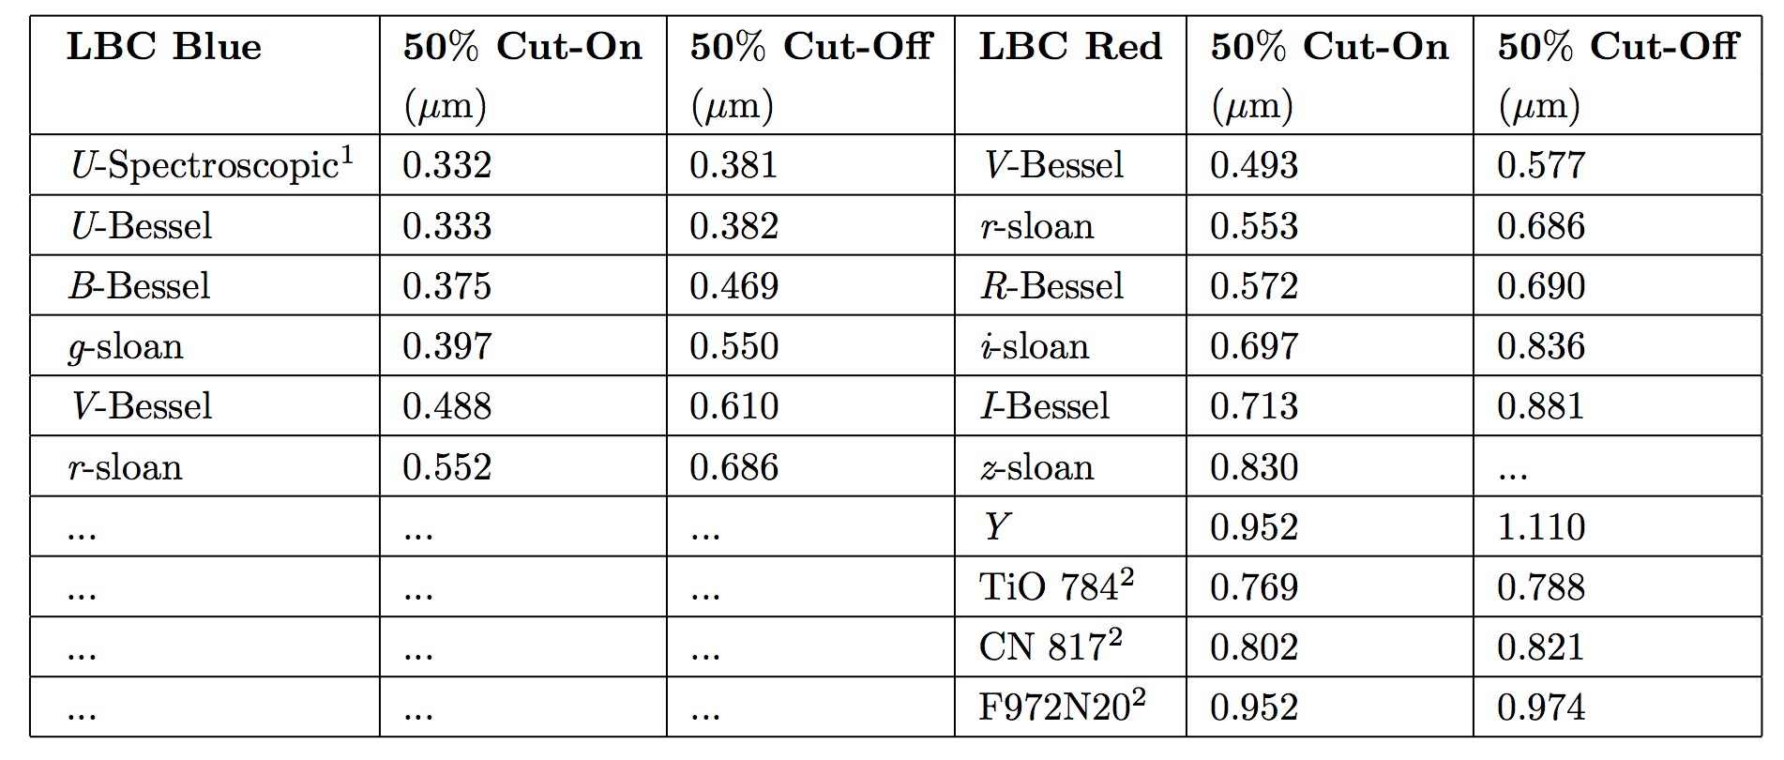
Large Binocular Cameras (LBCs)
Two prime mounted wide field imagers (f/1.14) - Field of view = 23’x25’
  4x 2048x4096 E2V CCD detectors for science
  2x shutterless custom 512x2048 CCDs for guiding & collimation
Distortions across the LBCs ~ few percent
Currently the ONLY prime-focus Wide Field Imager on an 8+m class telescope with UV capabilities
S/N = 3 @Uspec for AB Mag = 28.5 in 7.75 hrs
Flexibility to add new filters to both cameras
First Observation of OSIRIS-Rex (UT Sep 2, 2017) - V band
11 New low-surface brightness galaxies in Virgo
Detections ~ M > -9 (M = 10⁷ M⦿) @16-20 Mpc
Previous surveys detected LSB dwarf to M ~ -11
μ ~ 28 mag arcsec⁻²
Giallongo et al. 2015

Slide 5
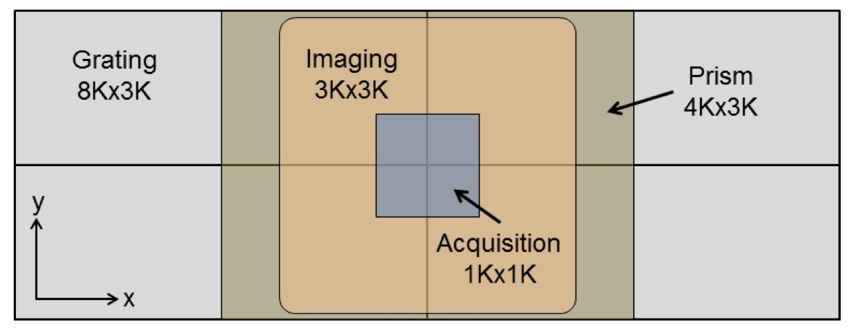
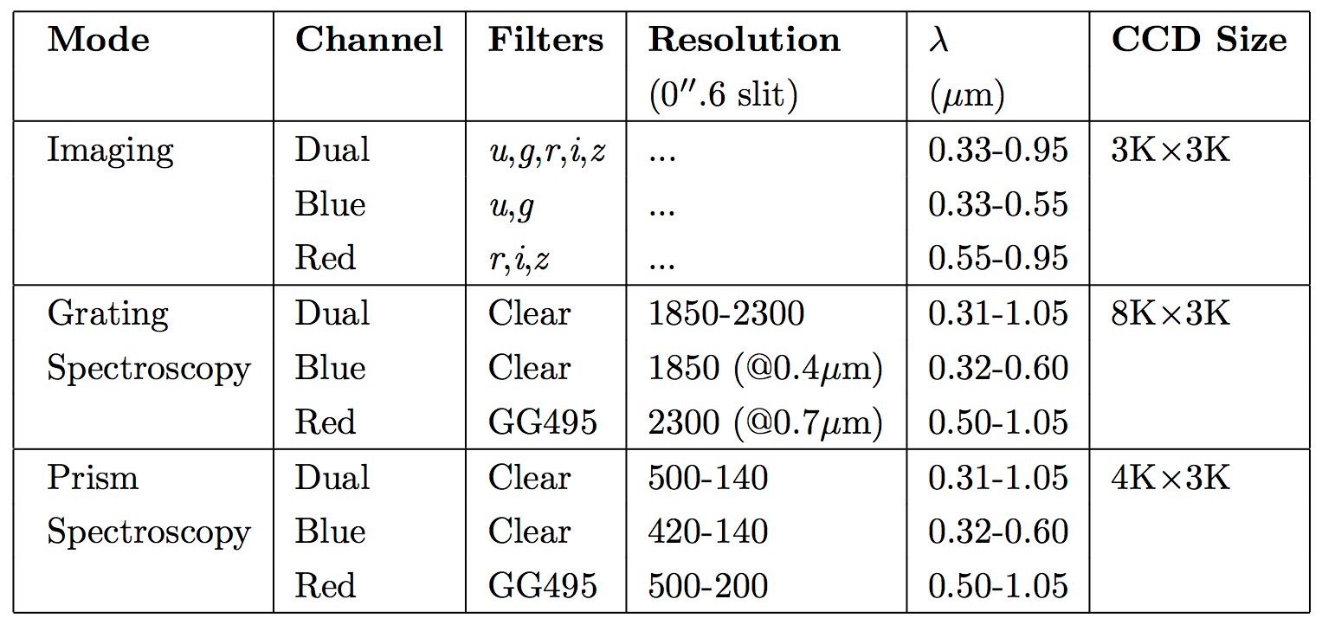
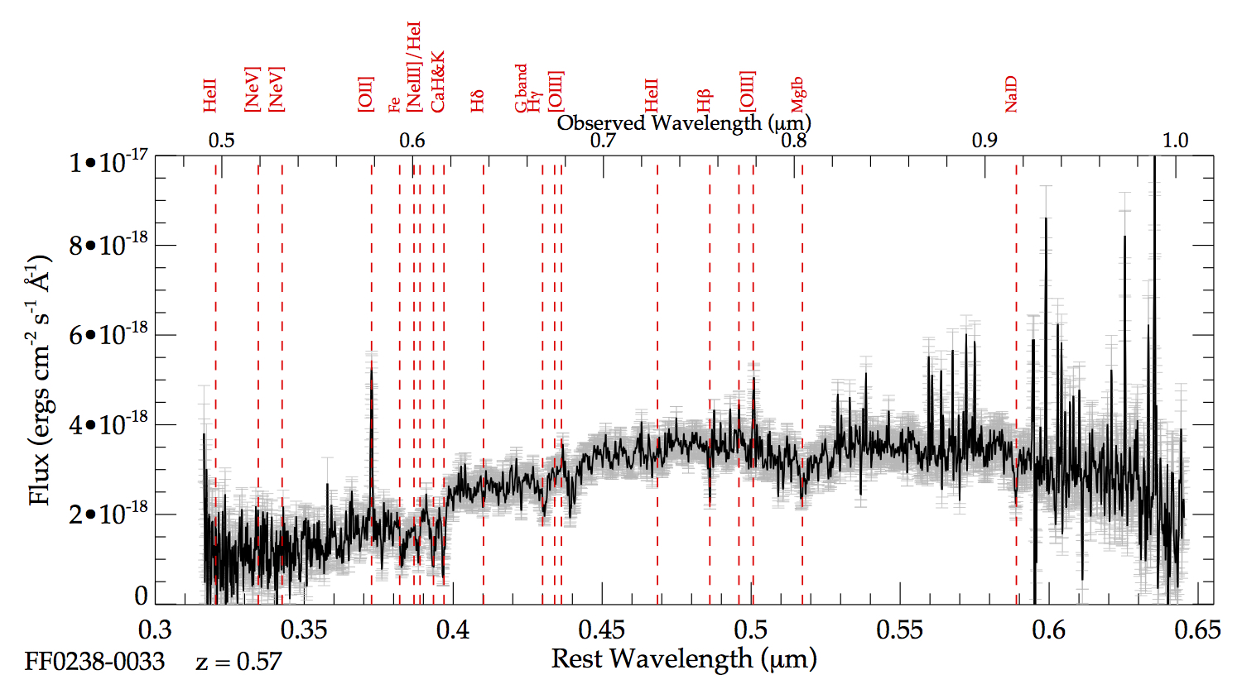
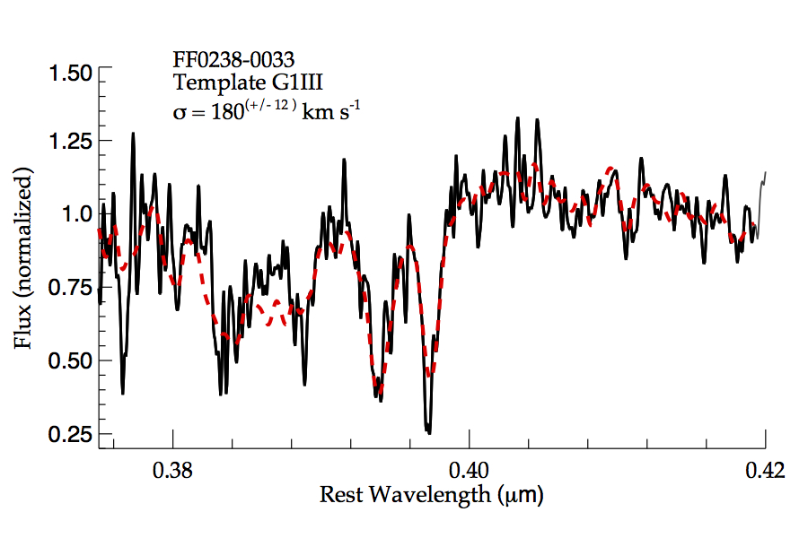
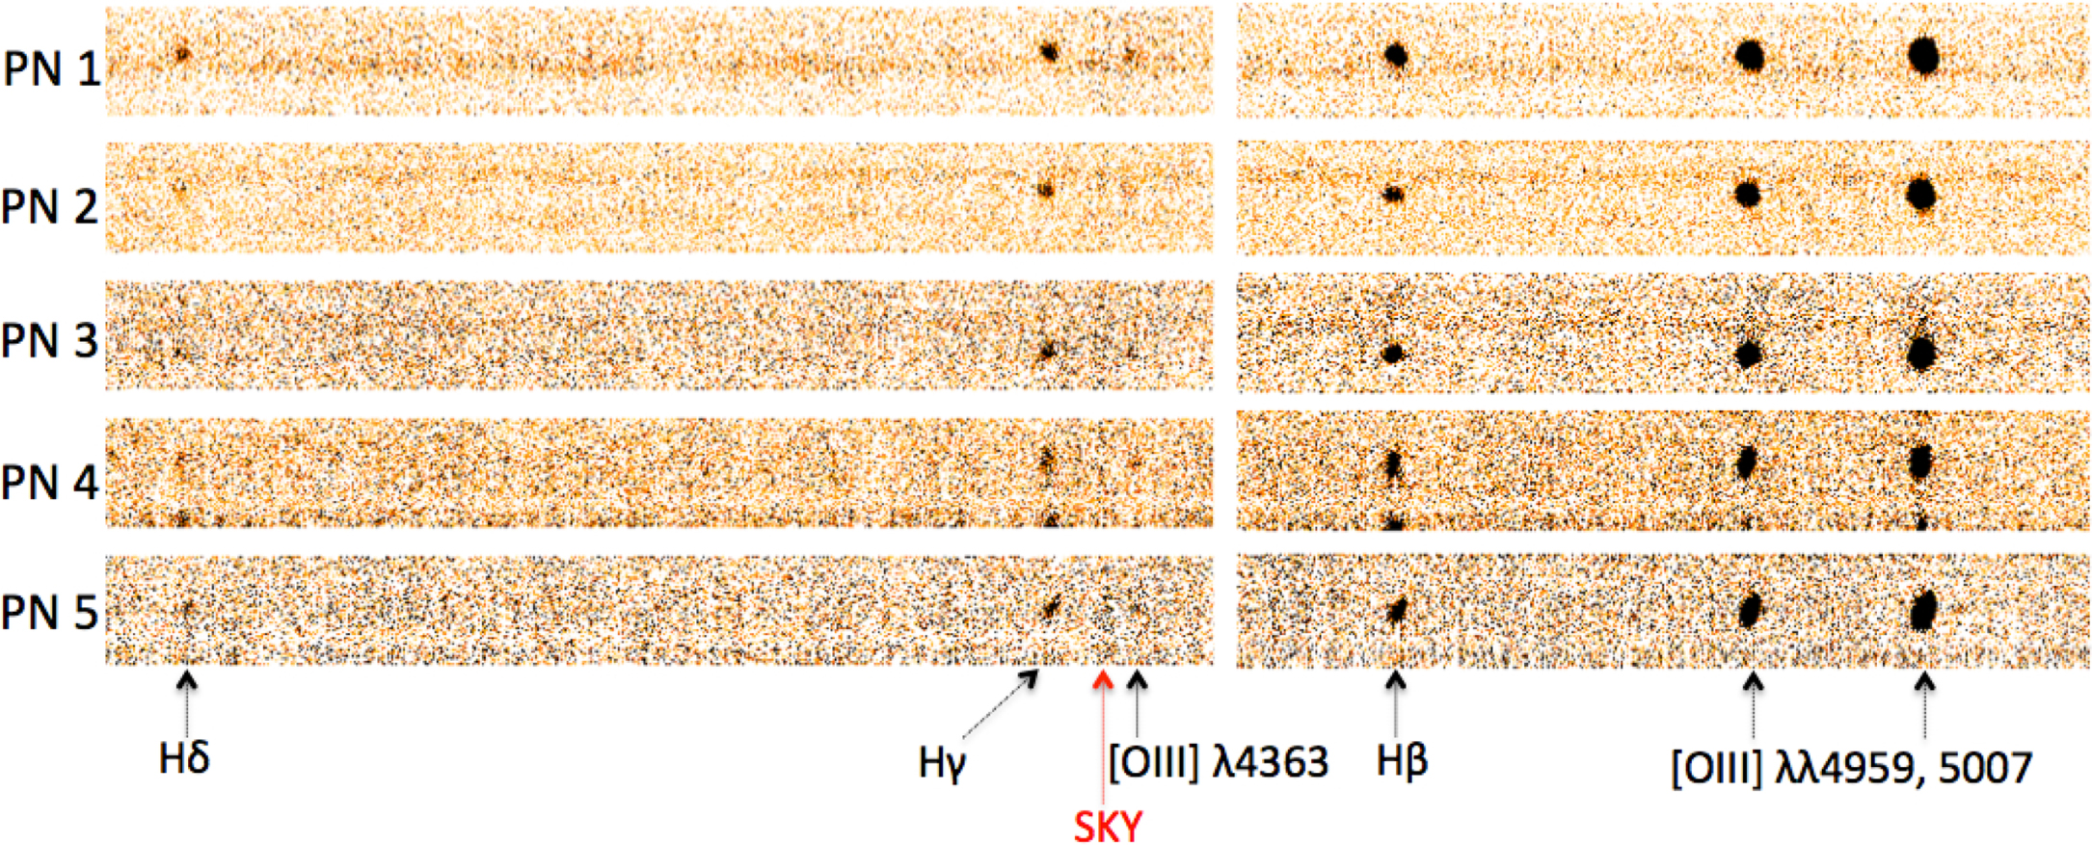
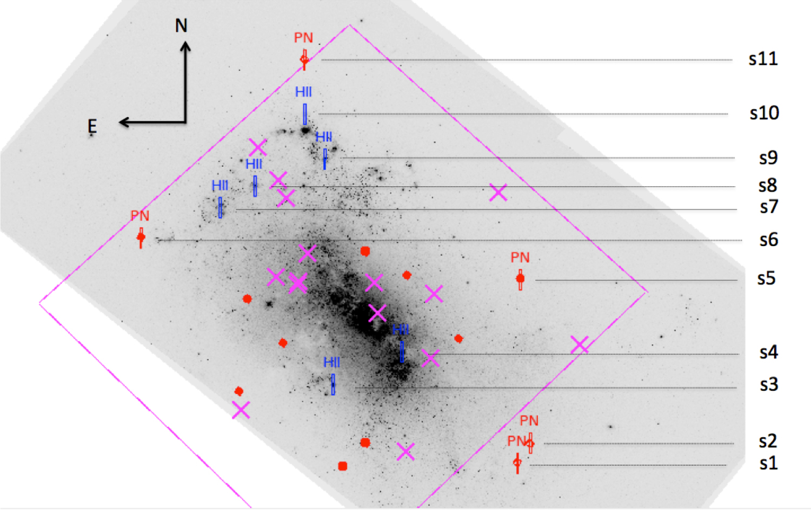
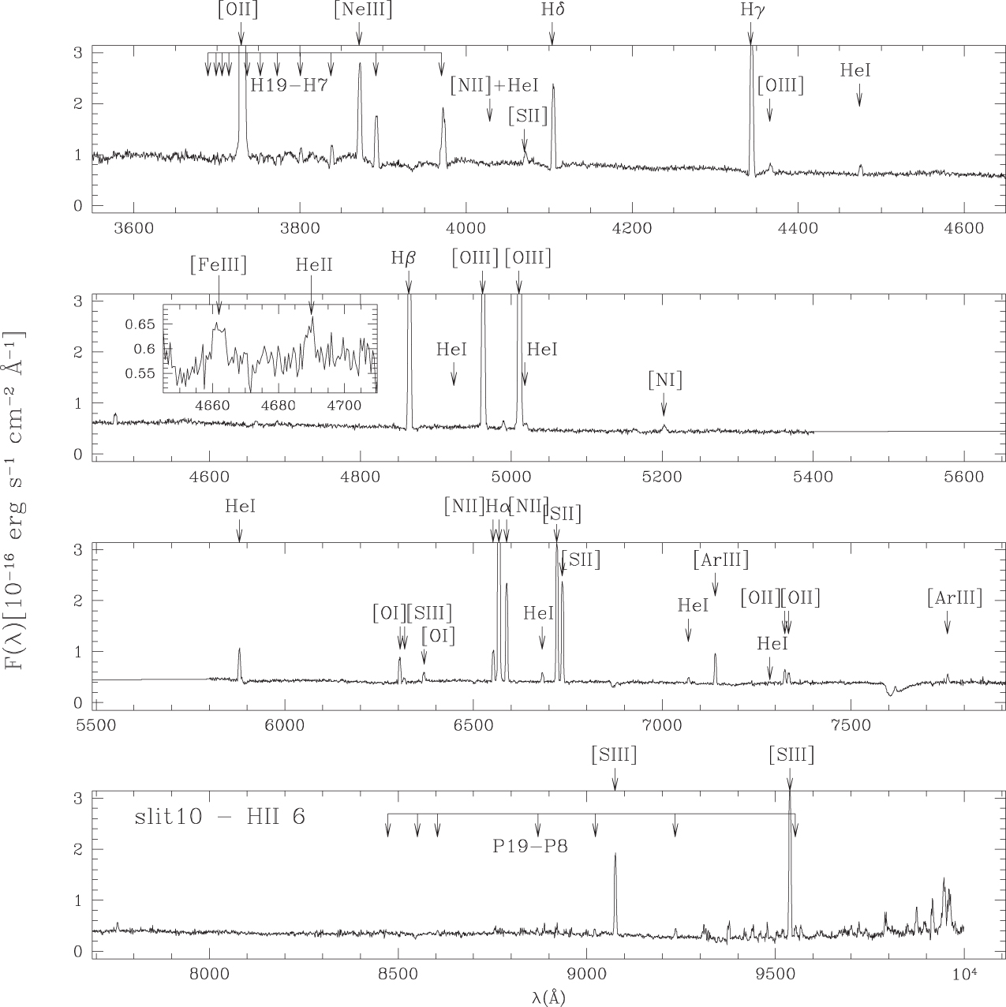
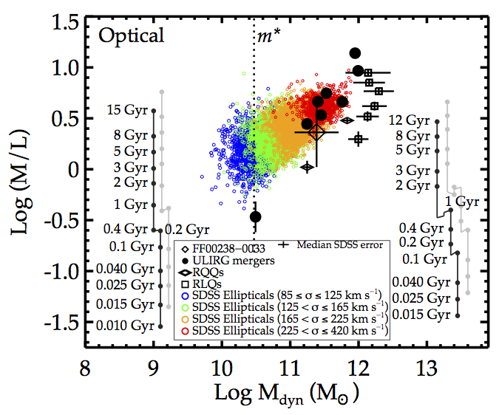
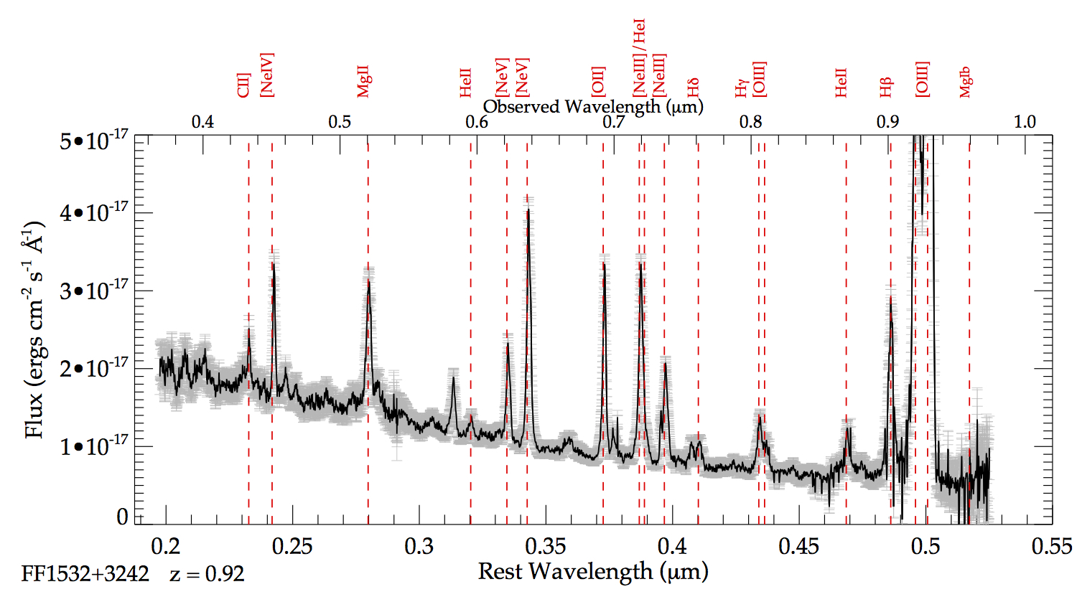
Multi Object Double Spectrographs (MODS)
Two identical optical imagers & spectrographs - twin (11.9m) or fraternal (2 x 8.4m) binocular
Mounted at the direct f/15 Gregorian focus 2 E2V 3Kx8K CCDs for imaging & spectroscopy
6’x6’ FOV (@ > 4’ image degradation)
Blue-only, Red-only, Dual modes (w/dichroic)
Coverage: 0.35-1.05μm - excellent UV sensitivity
Grating (R ~2000) or Prism (R ~200)
24 Longslit & Multi-slit masks housed in a cassette system
g = 22.2, 7200sec
0.6" slit
NGC 4449 - first observations
of PNe and HII regions in a
starburst irregular outside
the local group - MODS
MODS observations
(Annibali et al. 2017)
{
}
Intermediate redshift
Ultraluminous Infrared
Galaxy Mergers.
Direct measurement of:
Dynamical masses
& Super Massive Black
Holes
(Rothberg et al. in prep)
g = 19.9, 4800sec
0.6" slit
HII-1

Slide 6
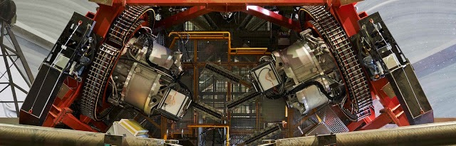
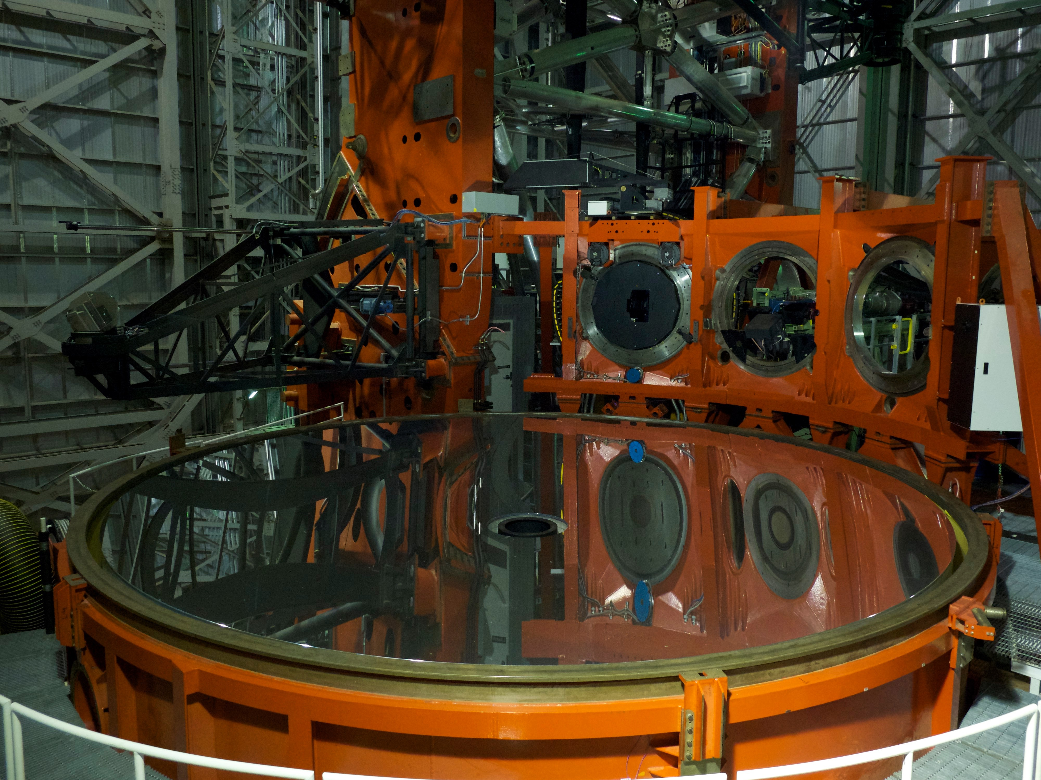
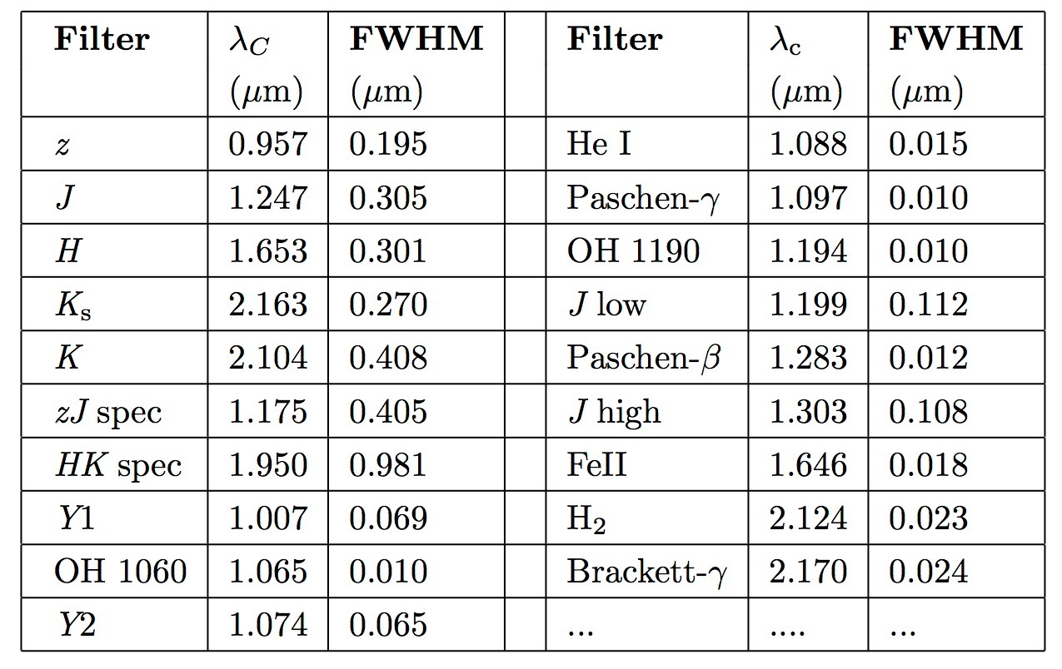
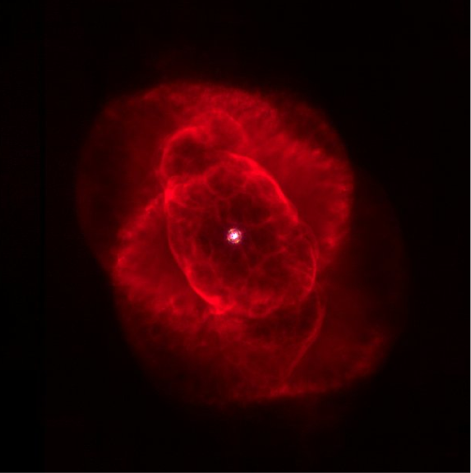
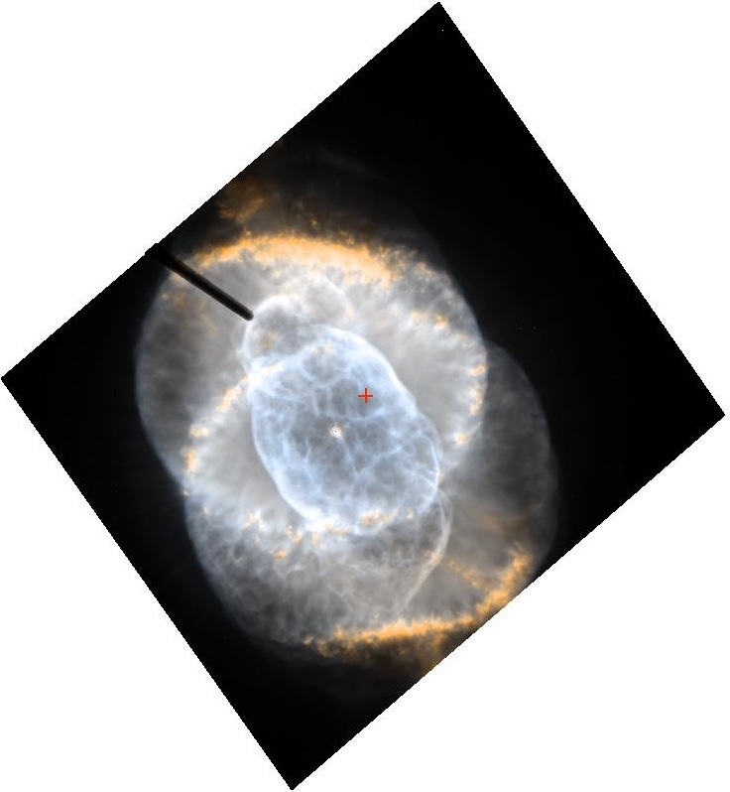
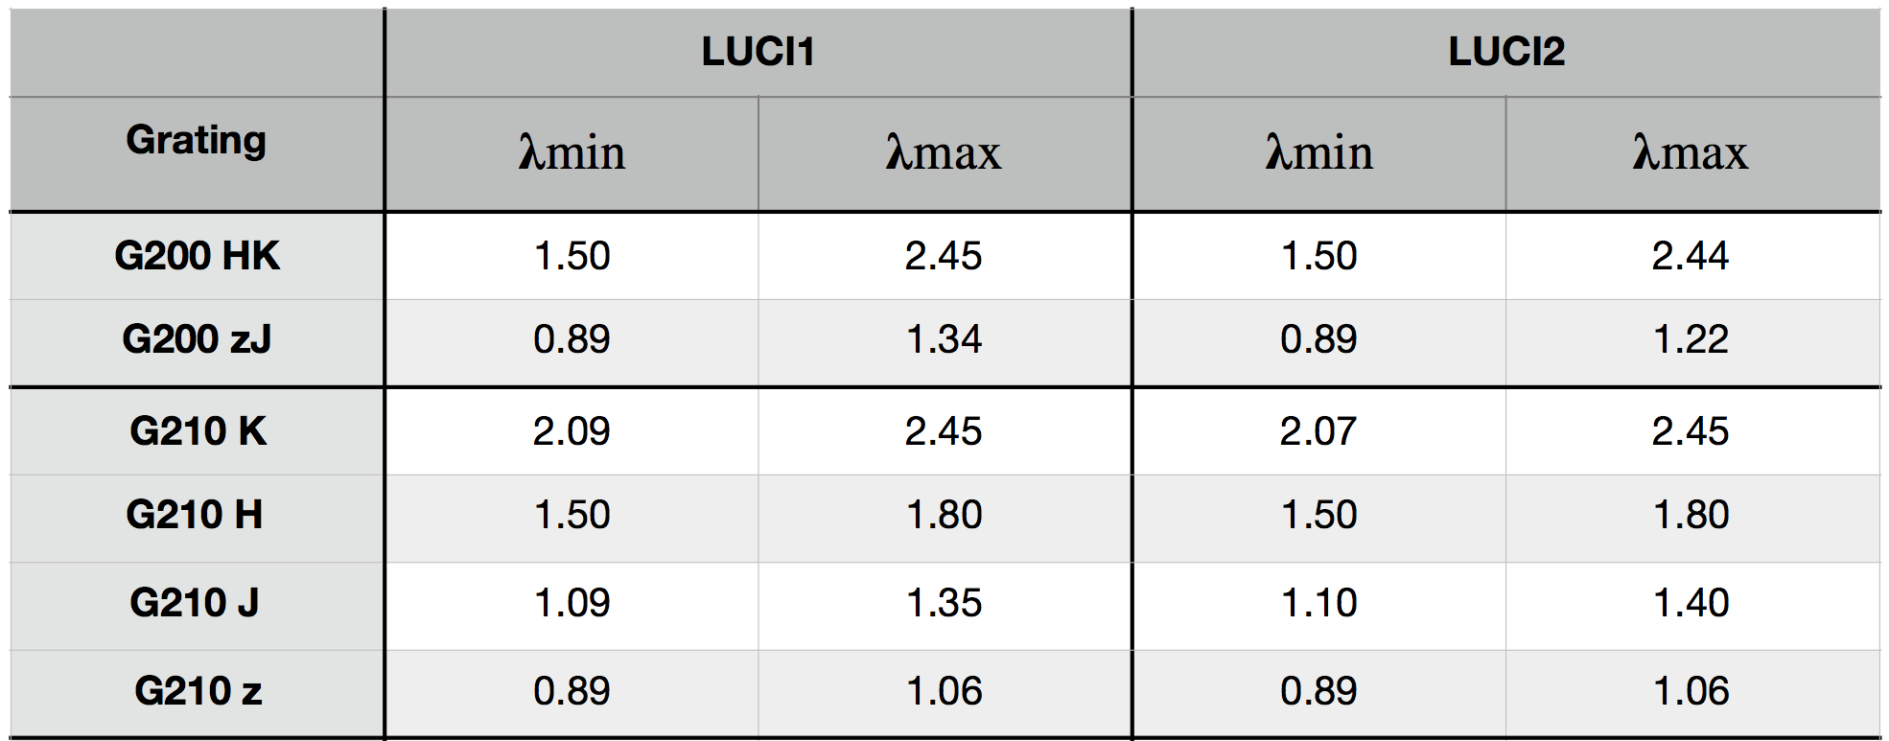
LBT Utility Camera for Infrared (LUCI)
Cryogenic near-infrared (NIR) instruments @ bent f/15 Gregorian
  Wavelength coverage 0.95-2.44μm
  Both equipped with same 2Kx2K Hawaii2RG detectors & filters
Imaging & spectroscopic capabilities (longslit & MOS masks)
  Cryogenic MOS unit with 32 interchangeable mask slots
  9 Facility masks (0”.13-AO up to 2” wide longslits)
  space for up to 23 user-designed multiple object slit masks
  Imaging FOV = 4’x4’ w/N3.75 Camera (30”x30” for AO w/N30)
  Both LUCIs contain a HiRes (R~5500) & LoRes (R~2200) grating
    LUCI-1: K-band R~4500 grating; LUCI-2 : grating designed for AO
Works with First Light Adaptive Optics (FLAO) System
  Full-AO Diffraction limited - 2'x3' patrol field, up to 400 modes, (R < 16)
  Enhanced Seeing Mode (ESM) - 12 modes, improves seeing over the entire 4'x4' FOV (R: R < 17)
LUCI-1
LUCI-2
Deployable Calibration Unit
LUCI-1
entrance window
Deployable Tertiary Mirror
SX Primary Mirror
HST ACS/HRC
F658N/F502N
Cat's Eye Nebula
29"x26" FOV
0.025"/pixel
PSF ~0.063"
Three color (Ks, Br γ, H2) image of NGC 6543
(Cat’s Eye Nebula) - 30”x30” FOV
0.015"/pixel - FWHM 0.066"
The G150 Ks grating is only available on LUCI-1 and the allowable λc wavelength range is 1.95-2.4 μm and ∆λ = 0.533 μm with R ∼ 4150 using a 2 pixel slitwidth (0′′.5 ). The G040 AO grating is only available on LUCI-2.

Slide 7
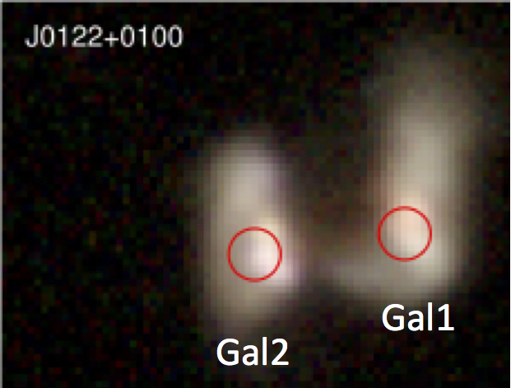
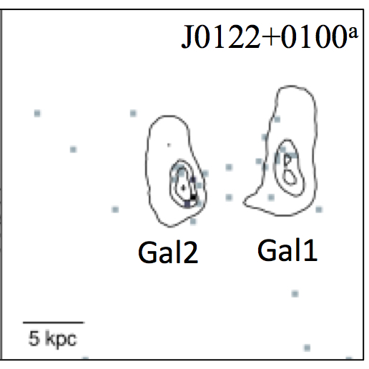
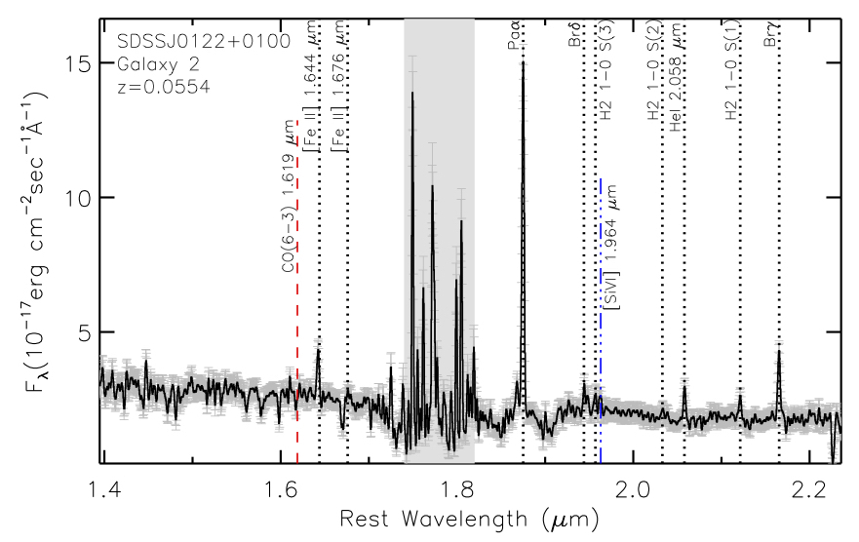
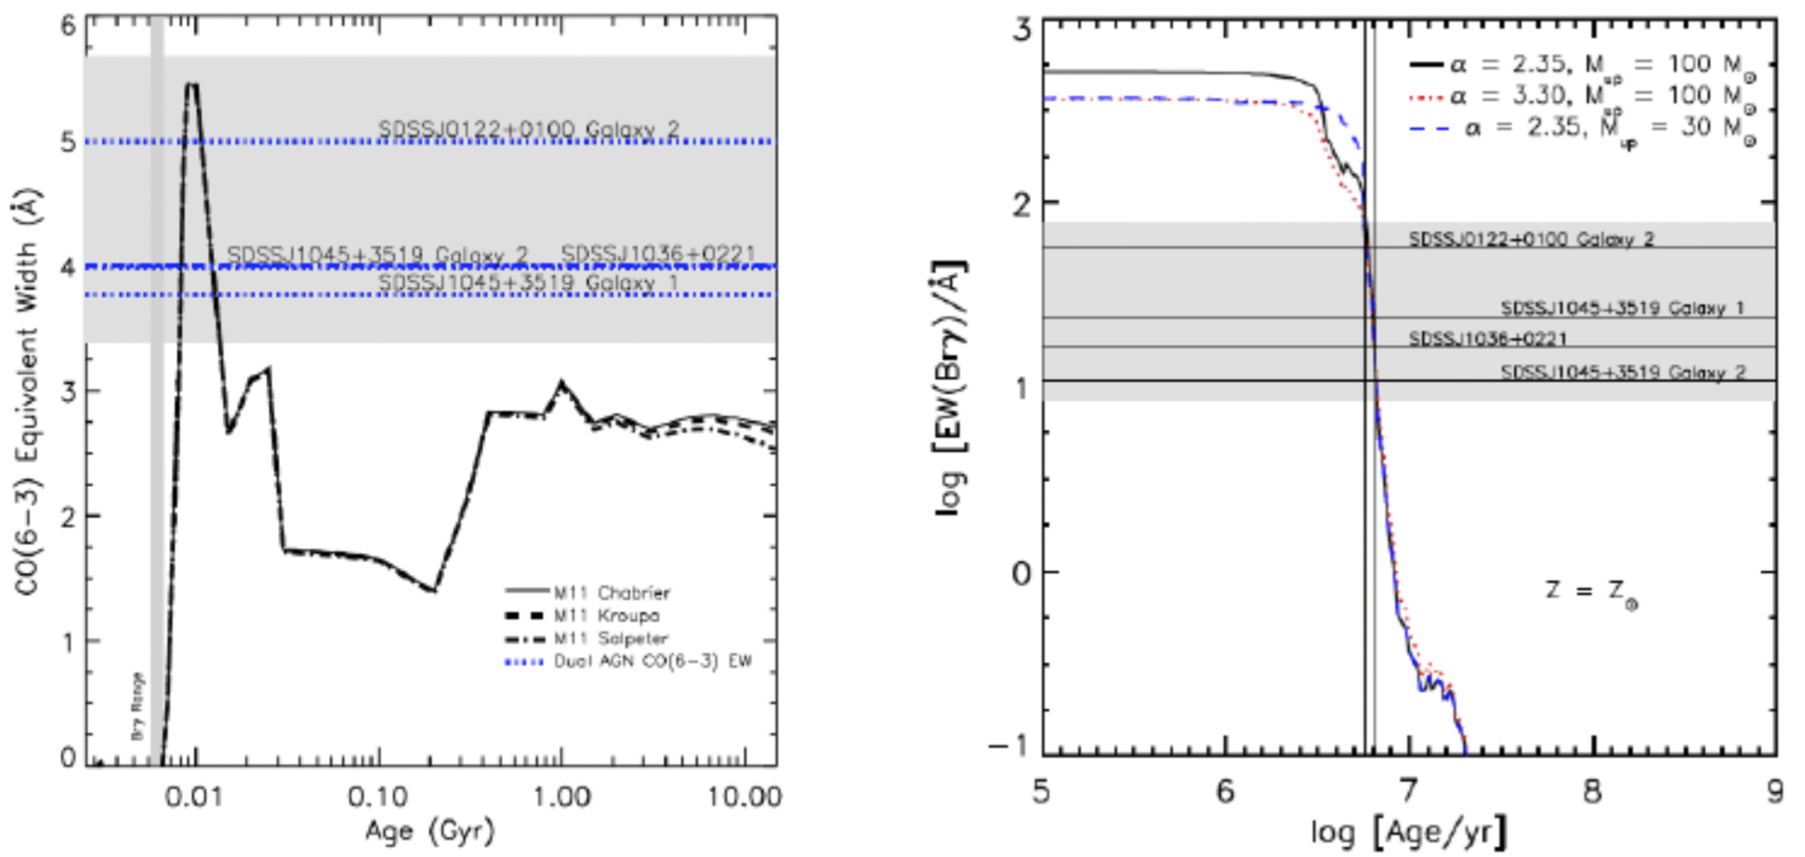
LUCI - Example Science:
Search for hidden Black Holes in Mergers
Satyapal et al. 2017 (ApJ Accepted - arXiv:1707.03921)
  NASA Press Release Soon
Optical wavelengths show no evidence of AGN/Black Hole
Use 3-25 μm WISE Colors to find hidden candidate AGNs from Galaxy Zoo Mergers
Chandra & XMM X-ray Observations detected X-ray emission
LBT - LUCI near-IR spectra observations:
  emission lines energized from hidden AGN/Black Hole
  absorption lines to determine ages of stars
Synergy between space and ground based telescopes

Slide 8
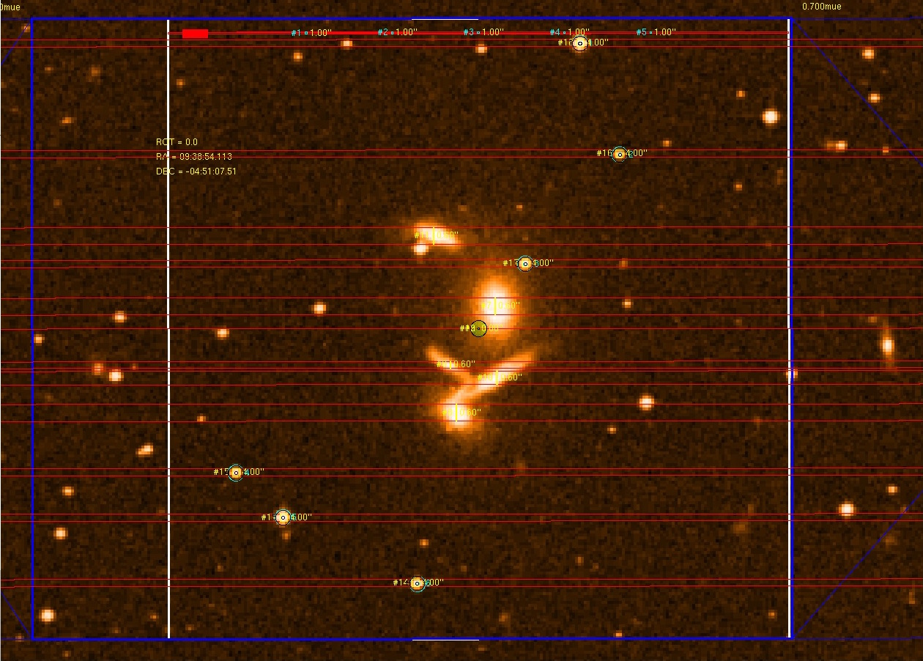
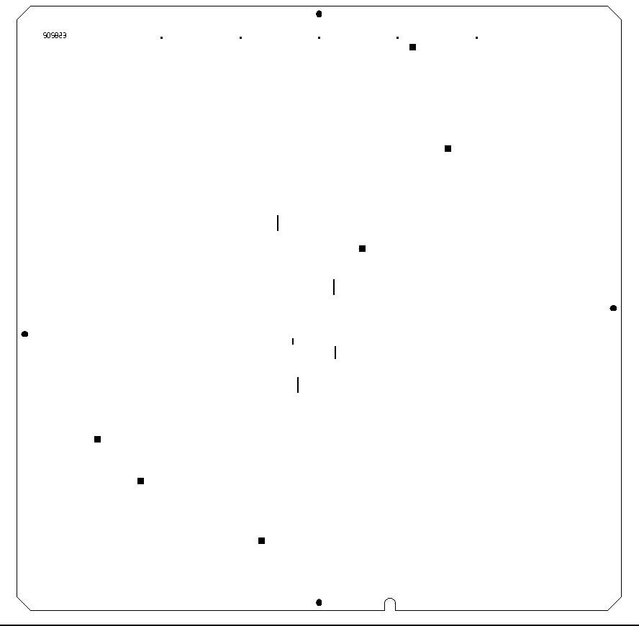
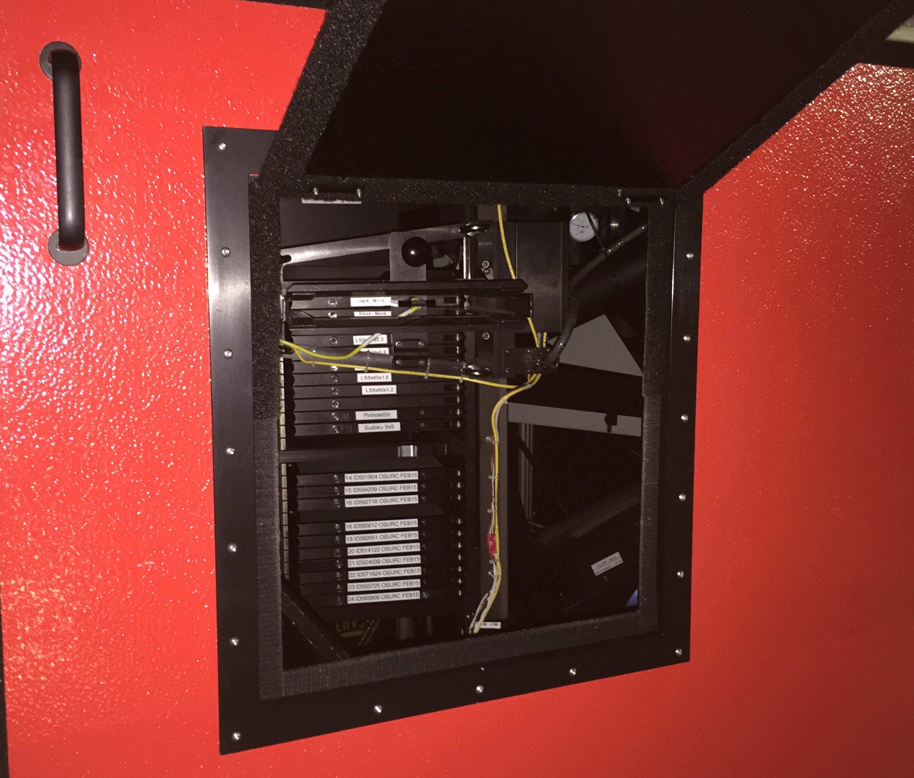
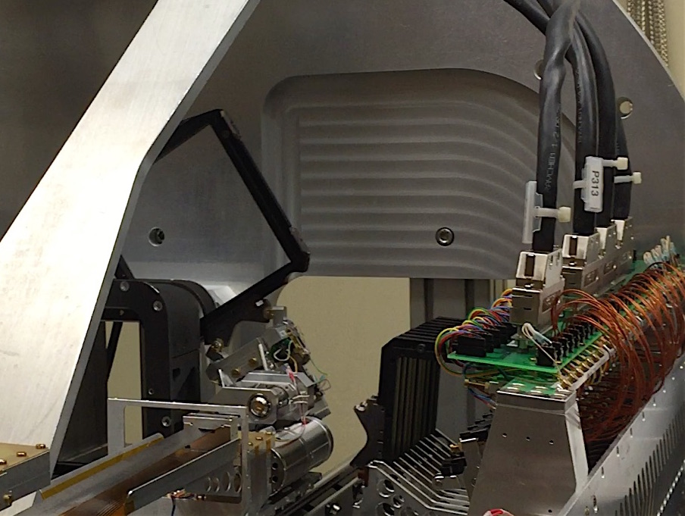
Multi-Object Spectroscopic Slit Masks (LUCI & MODS)
MOS capabilities allow PIs to create custom-designed masks
Can fit as many slits as possible - limited only by dispersion real estate and structural integrity of mask (too many holes is bad)
MODS and LUCI masks are designed with MODS Mask Simulator (MMS) and LUCI Mask Simulator (LMS) software
  Based on ESO SkyCat tool
  Load any fits file with valid World Coordinate Systems (WCS) or archival images with WCS information
Requires minimum of 3 alignment boxes around stars to determine rotation & translation (LUCI also uses 6 alignment holes along top of mask)
Both software generate a gerber file which is sent to a fabrication site at Univ. of Arizona
ALL Masks must be approved by LBTO Mask Scientist (me) before fabrication
All fabricated masks are kept in inventory - can be reused during the semester or over the course of multiple semesters
LUCI
MOS
unit
MODS
mask
cassette

Slide 9
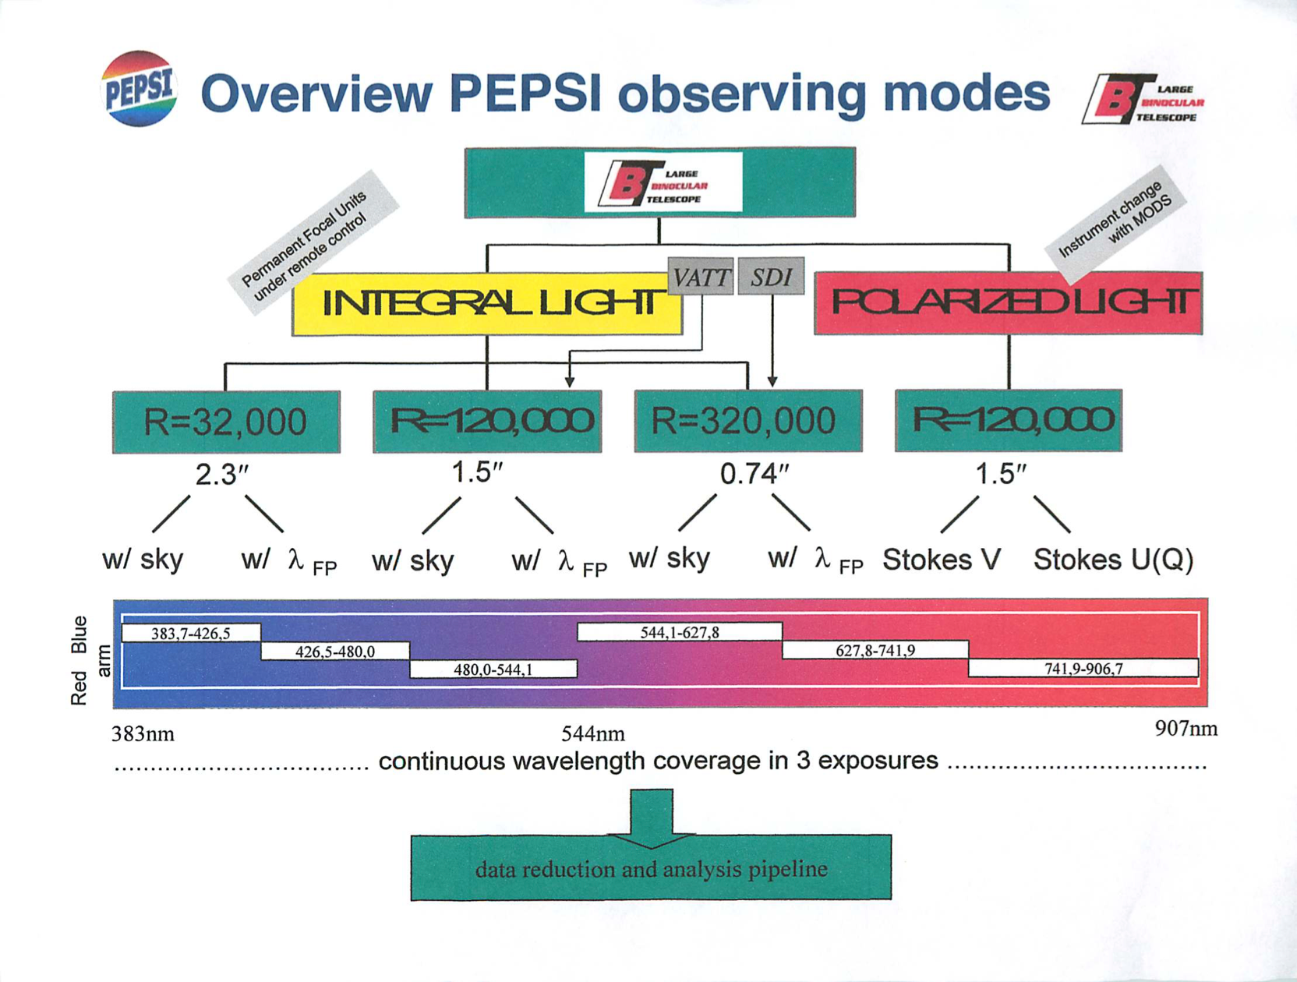
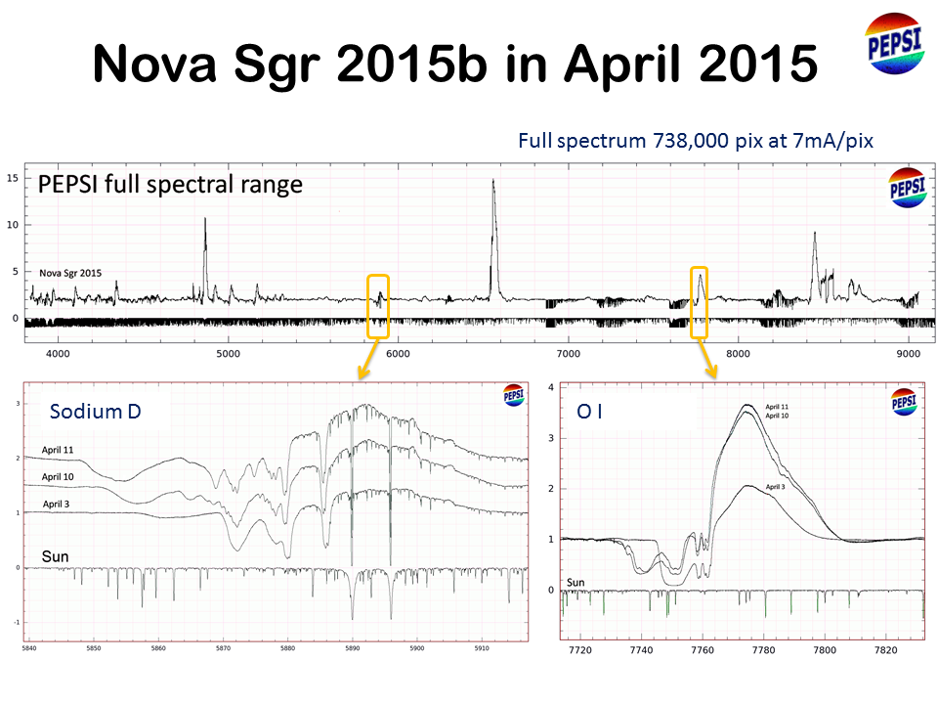
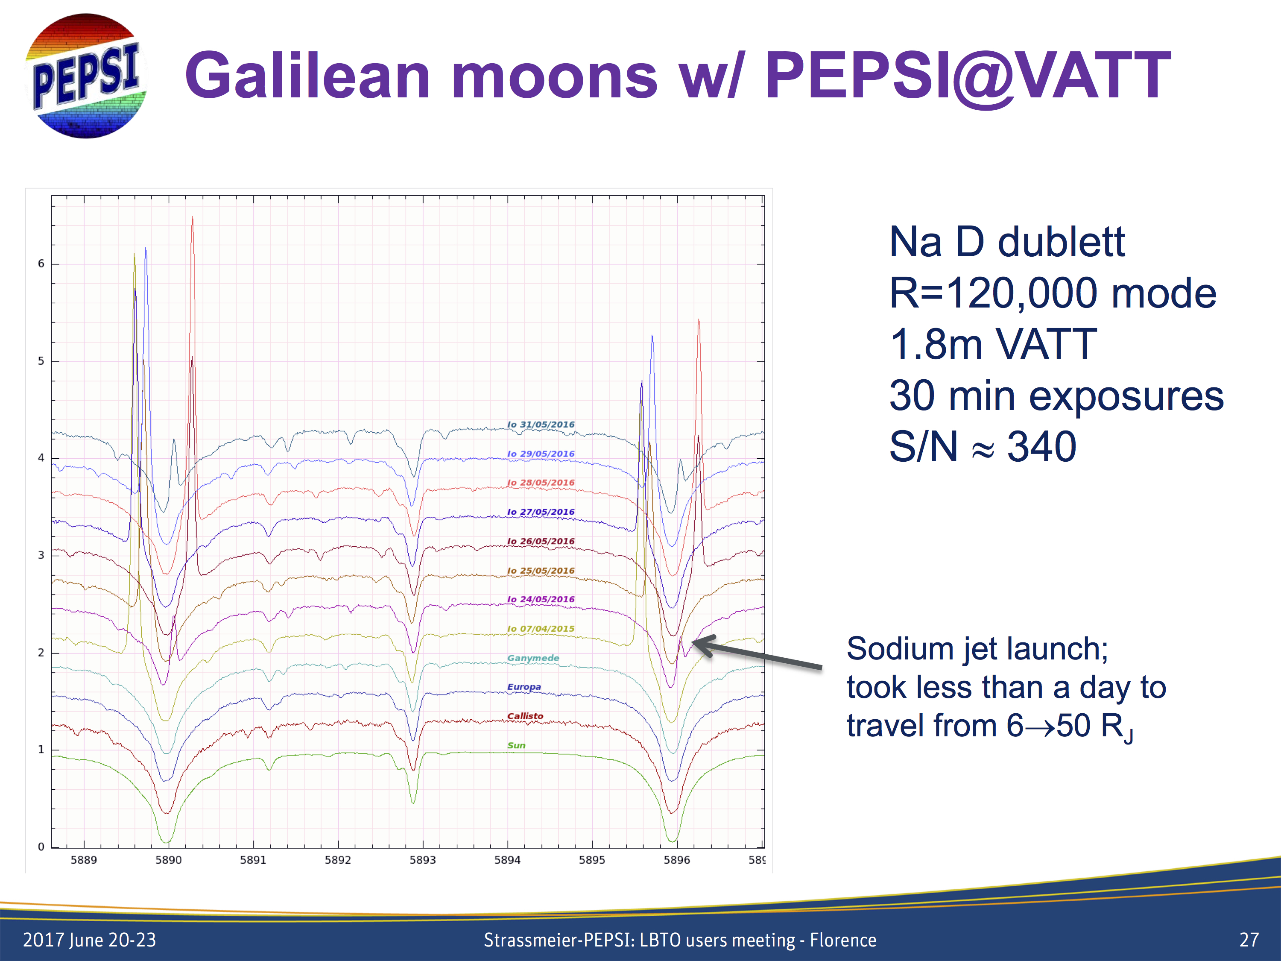
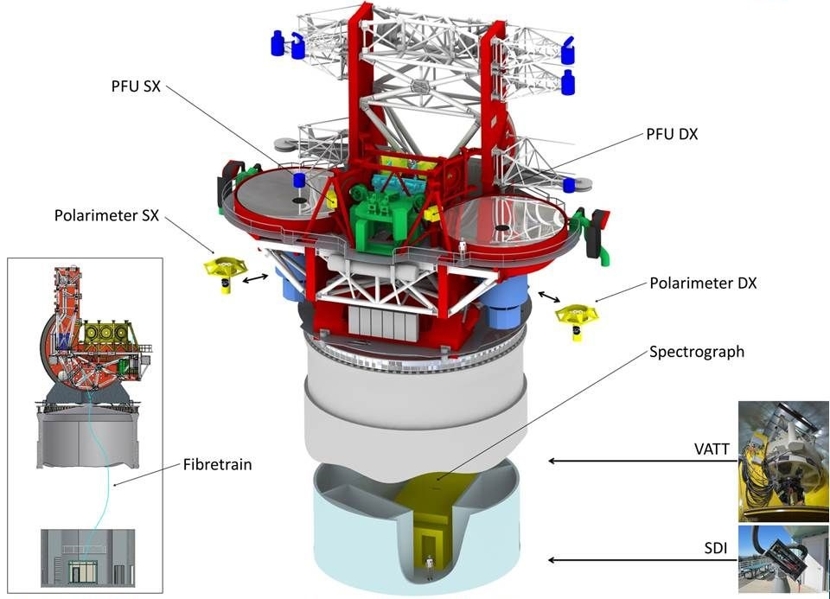
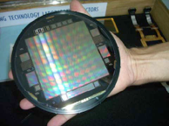
Postdam Echelle & Polarimetric Spectroscopic Instrument (PEPSI)
R=270,000
Classical Nova Sgr 2015 w/varying P-Cygni profile (R~270,000)
M. Wagner et al. 2016
Instrument P.I.: Klaus Strassmeier (Leibniz Institute für Astrophysik - Potsdam)
Fiber-fed echelle spectrograph - combines both mirrors
Wavelength covers 0.383-0.907 μm
Two polarimeters installed, first light on UT Sep 11, 2017 - can observe Stokes IQUV - only such facility at an 8m+ class telescope.
Fiber connection to VATT - can observe with VATT (120k resolution) or LBT
Connected to Solar Disk Telescope - Na observations of Aug 2017 eclipse

Slide 10





Large Binocular Telescope Interferometry (23m)
{
Instrument P.I. Phil Hinz (University of Arizona)
Fizeau imaging combines fringes - uses baseline to get improved PSF
Nulling interferometry - destructive interference acts as mask
Instruments can also be used in single-eye mode
  Can place the two beams onto single detector
  Can use "wall-eyed" mode - point mirrors at edge of limits to beat small FOVs
  L/M-band resolution ~ HST/optical or K-band AO (8-10m)
Occultation of Loki Patera on Io by Europa @4.8μm (M-band)
Water ice on Europa’s surface absorbs incident sunlight
Io’s surface is more reflective at this wavelength
at L-band (3.3μm) - spatial resolution on Io ~70km
Map of Io (Conrad et al. 2015) Left - LBTI, Right is from Voyager
De Kleer et al., (2017)

Slide 11

Current Status of the LBT
Currently running facility instruments in Binocular Mode since 2017A
  Duplex or "Twinned" - same position angle (PA), pointing center, and mask
  Fraternal mode - same pointing center, different filters, PAs and masks
LUCI-AO imaging & E.S.M. available shared risk
LUCI-AO spectroscopy still to be commissioned
PEPSI in operation, PEPSI Polarimeters are installed - commissioning run starts October 9th
LBTI operating on-sky - only one arm available start of 2018A
LBT time available through NOAO in 2018+ (7 nights per semester - facility instruments only)

