Slide 1
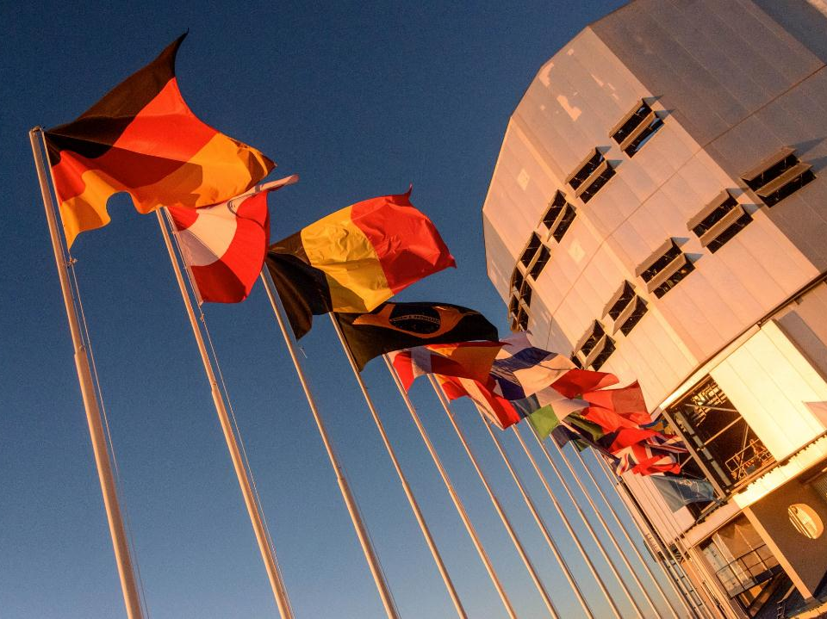
The European Southern Observatory
Derek Ives
ESO Detector Systems Group
Overview talk on ESO’s present and future detector requirements

Slide 2
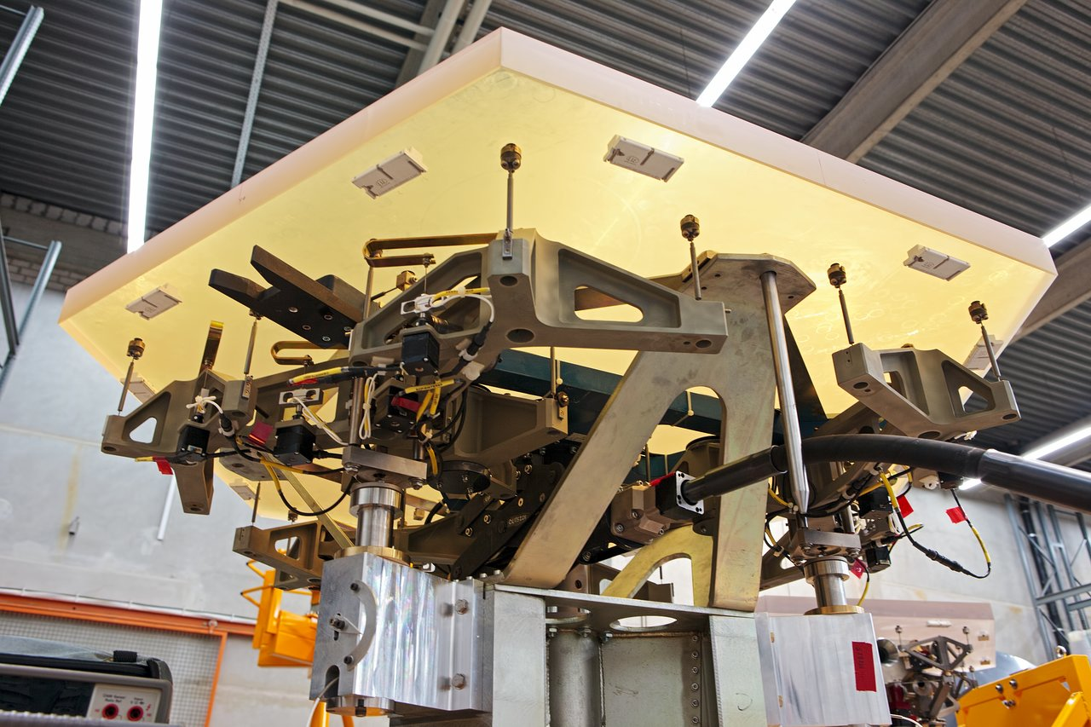
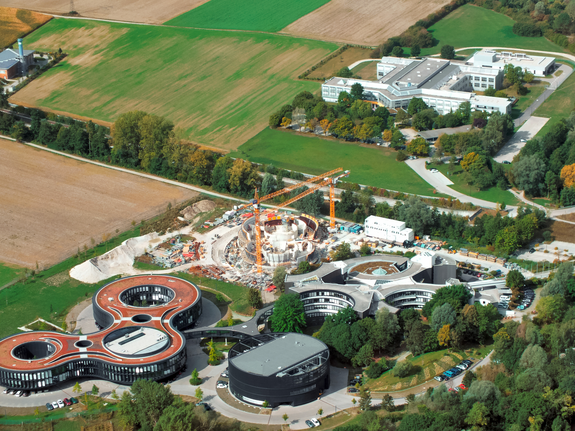
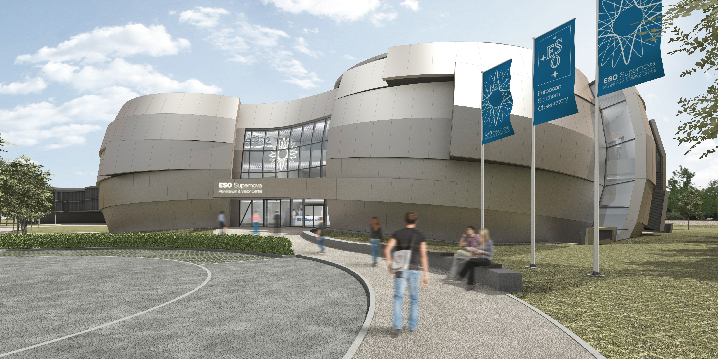

The European Southern Observatory
Mission
  Develop and operate world-class observing facilities
  for astronomical research
  Hosting, 22 telescopes at last count
Intergovernmental treaty-level organization
  Founded in 1962, by 5 countries
  Currently 15 Member States, including Poland
  New 10 year agreement with Australia
  ~700 staff (44 nationalities)
Observatories in Chile
HQ in Garching bei Munchen, Germany
New SuperNova Visitor Centre

Slide 3
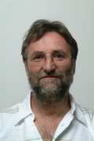
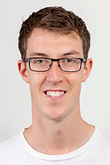
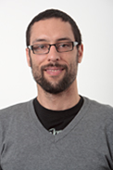
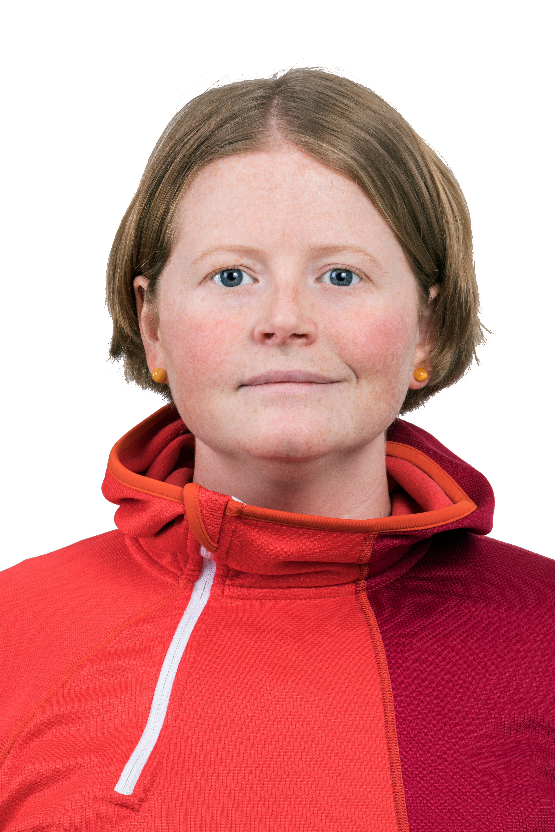
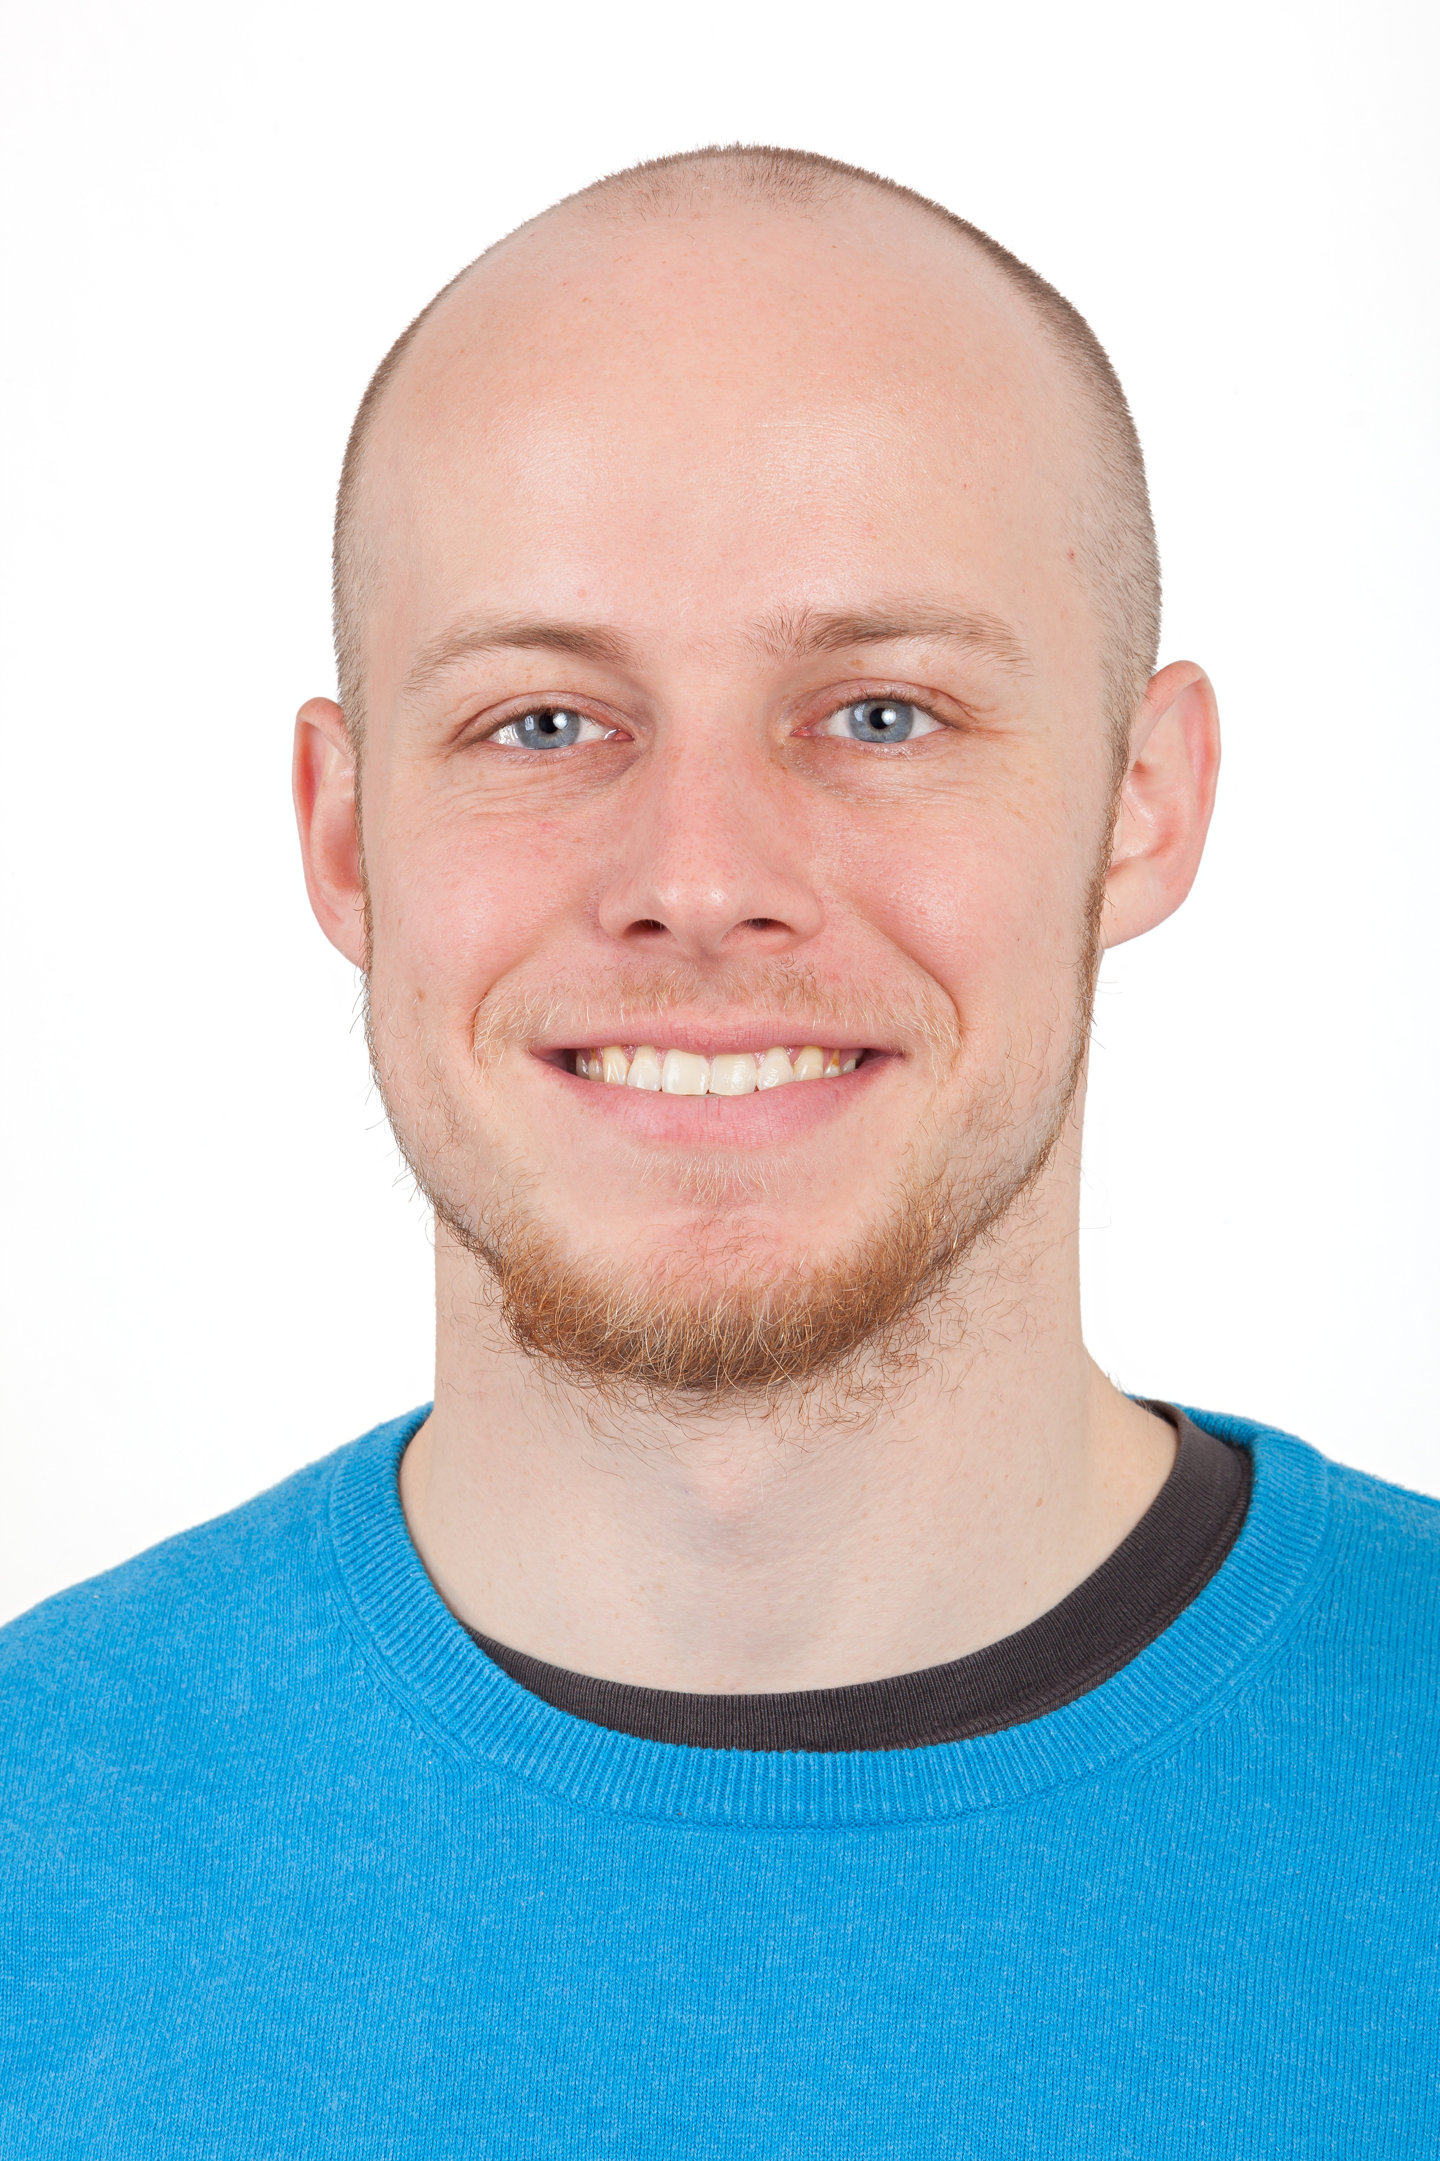

ESO Detector Group News
Retirement of Detector legend, >25 years – Gert Finger
ESO Detector Group expands to make up for loss
Group size, 6 to 13 members – new young scientists/engineers
+ 2 other “Oldies”
New labs and test facilities – FIAT and CRISLER
Strengthening of links with other European Organisations and manufacturers
Deliveries of NGC systems to universities, institutes and detector manufacturers
MPE

Slide 4
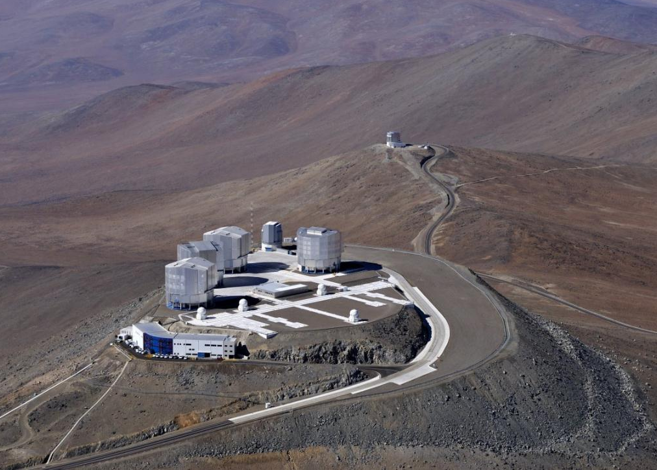
This Presentation
ESO Plans :-
Summary of VLT second and third generation instruments
Summary of ELT first light instruments
Other detector needs, e.g. AO, high frame rate, low noise, optical and IR
NGC detector systems and other controller developments at ESO
ESO, Paranal

Slide 5
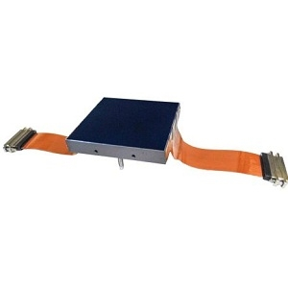
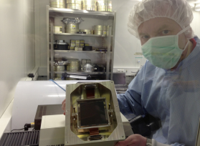
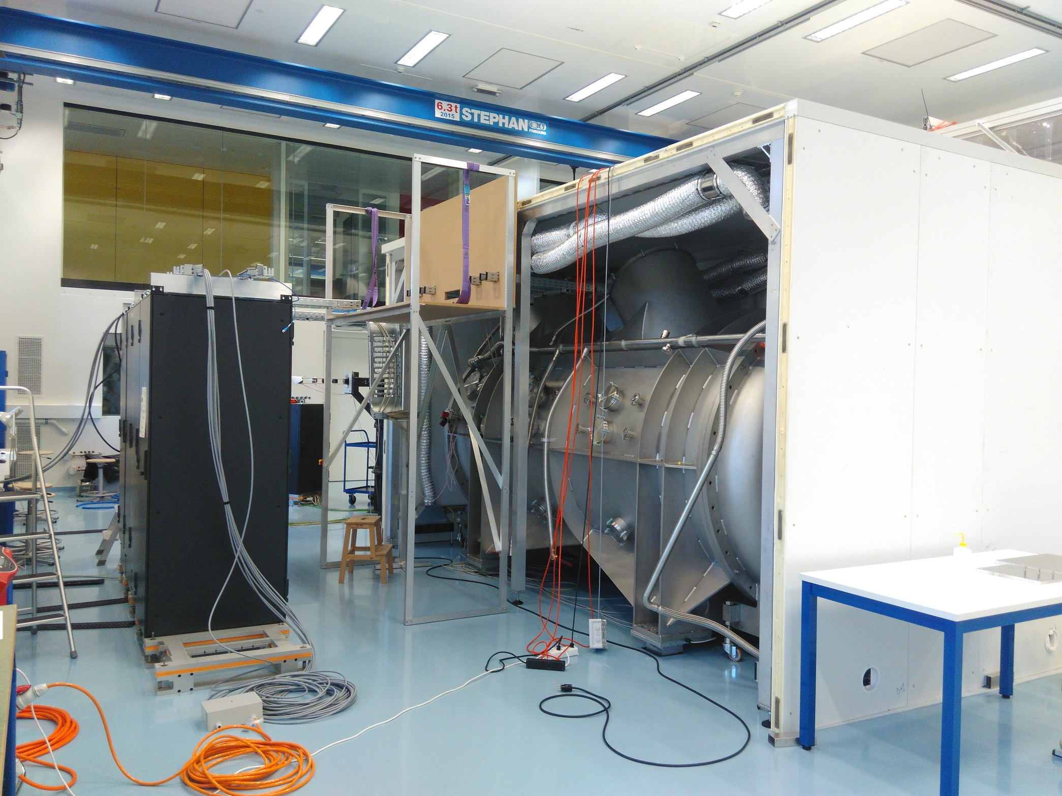
VLT 2nd generation instruments
ESPRESSO – high resolution ultra stable fibre fed spectrograph
Measurement of RVs of solar type stars to search for rocky planets, R~140k
Combine beams (non interferometrically) from 4 UTs => 16 metre telescope
RV precision < 5 m/second =>, detector operational thermal issues – speak to Olaf
Teledyne e2v CCD290 - 2 x 9kx9k CCDs
Ultra-stable cryostat
in thermally controlled room
Precision detector mount

Slide 6

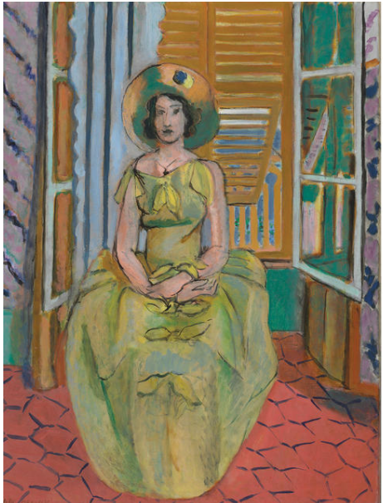
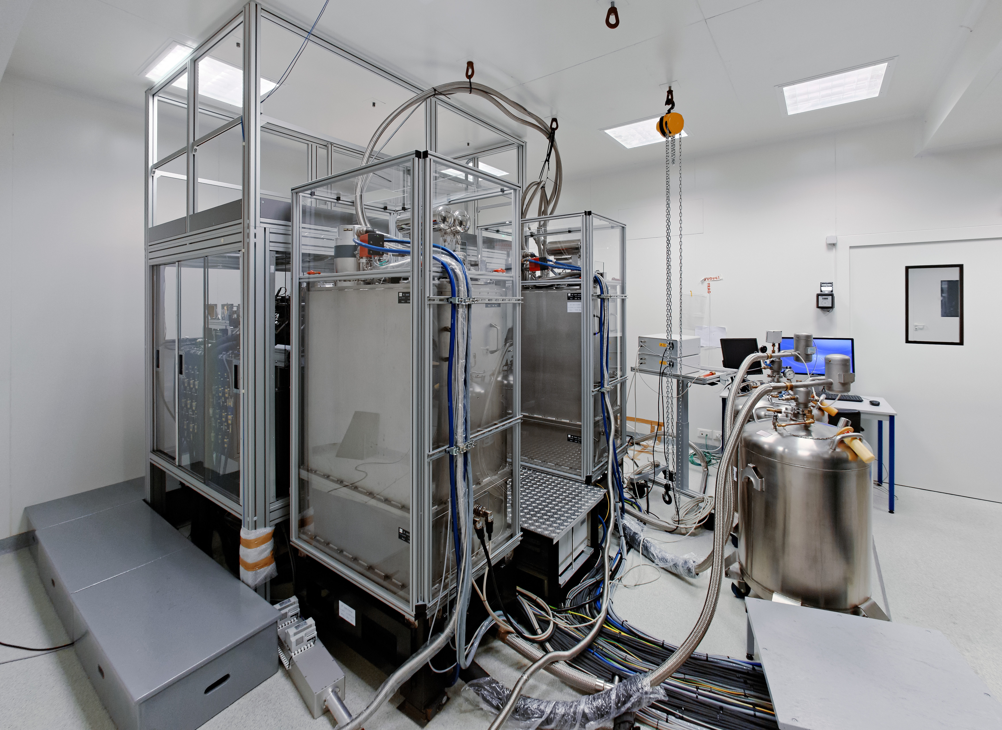
2nd generation instruments at the VLTI
GRAVITY - four-beam combiner, near-infrared (2-2.4 um), AO assisted,
fringe-tracking, astrometric and imaging instrument.
Resolves features ~4mas, Astrometry accuracy ~ 10 – 100 uas
Detectors for operation, 4 x SAPHIRA for AO, 2 x H2RGs for science – Gert’s talk
MATISSE - mid-infrared spectro-interferometer combining the beams of up to
4 UTs/ATs of the VLT Interferometer.
Detectors for Science - H2RG, 5.3 um cut-off,
2 MHz pixel operation, high speed developments
RVS AQUARIUS for 10 – 20 um channels,
3 MHz operation, 120 frames/s
Similar cryostat design, 1 at 40K, the other at 8K
Issues with 40K cryostat thermal background
MATISSE
Baltimore Museum of Art – large MATISSE collection
Notes:
Baltimore Museum of Art has one of the largest collections of MATISSE art work in the work, with 500 pieces.
The grandson of MATISSE came to us and the instrument to allow us to us the MATISSE name.

Slide 7
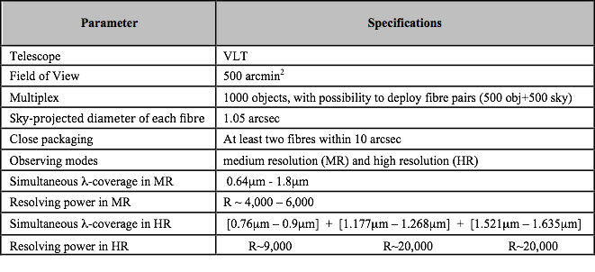
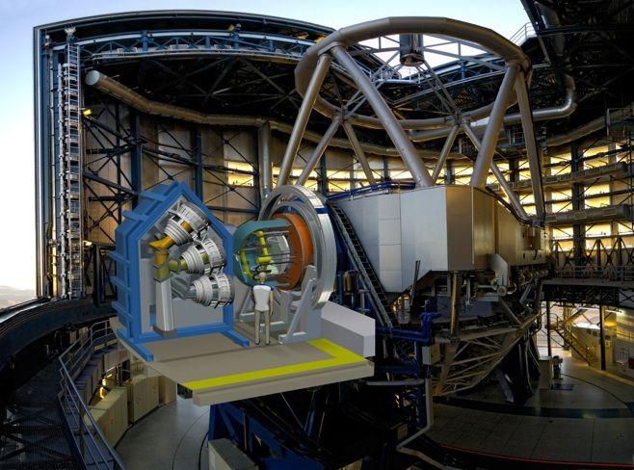
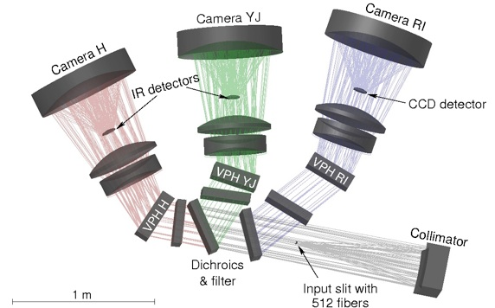
3rd generation instruments - MOONS at the VLT
4 x H4RGs 2.5 um cut-off
2 x 4kx4k CCDs, LBNL FD devices
Schmidt camera design
Fibre fed spectrographs
See Olaf’s poster

Slide 8
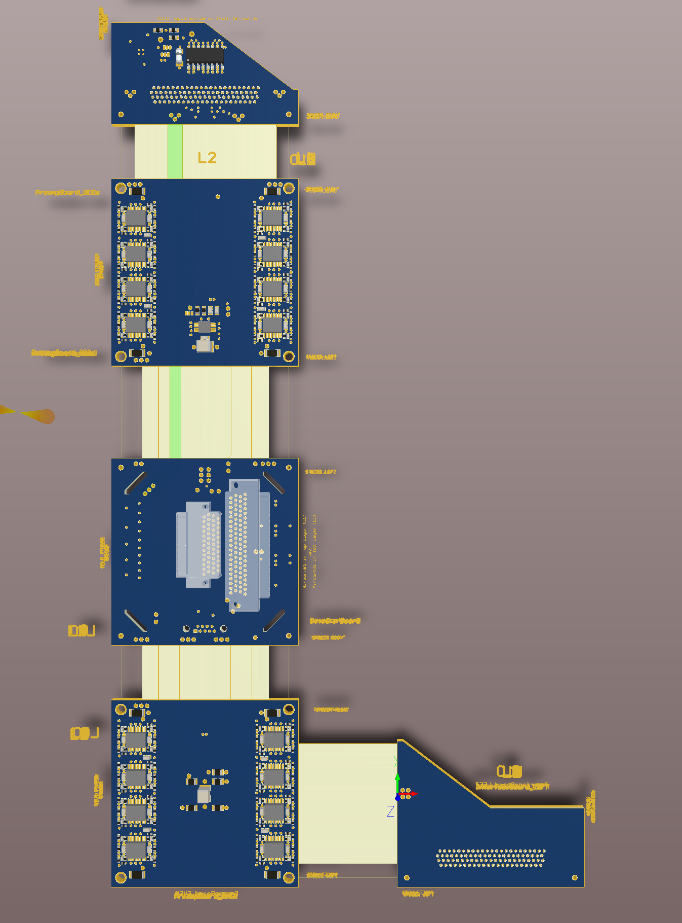
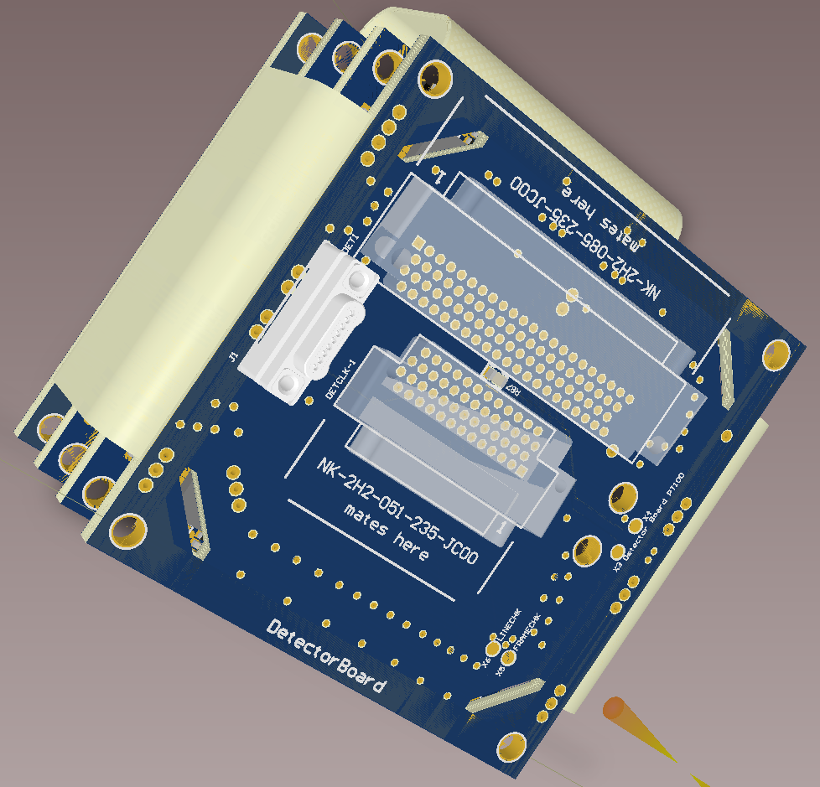
3rd generation - MOONS at the VLT
Preamp design – 65 channels
Detector Mount Design – minimize footprint
See Simon’s poster on DCDS
Notes:
Been using cryogenic preamplifiers for IR detectors for many years but never for CCDs. But now for MOONS because of the complexities
of Schmidt camera design need a cryogenic preamplifier for the CCDs, with analog switches etc

Slide 9
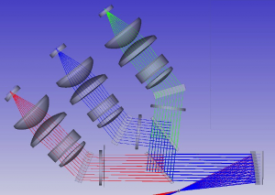
3rd generation - 4MOST at the VISTA
Putting “V” for Visible back into VISTA
Specification | Requirement | Goal | Design
Field-of-View in hexagon | >4 degree² | >5 degree² | 4.1 degree²
Fibre multiplex per pointing | >1500 | >2400 | 2436
Smallest target separation | <30″ | <15″ | <17″
Low-Resolution Spectrograph (LRS)
Fibre multiplex | >800 | >1500 | 1624
Spectral resolution | R> 4000 | R>7500 @800nm | R>4000–7800
Wavelength coverage | 400–885 nm | 390–950 nm | 370–950 nm
High-Resolution Spectrograph (HRS)
Fibre multiplex | >800 | >800 | 812
Spectral resolution | R>18,000 | R>20,000 | R>18,500
Wavelength coverage | 392.8–435.5, 521–571 & 610–675.5 nm | 392–460, 521–571 & 606–683 nm | 392.6–435.5, 516–573 & 610–679 nm
Teledyne e2v CCD231-C6 9 x 6kx6k CCDs
Compatibility with our MUSE
and ESPRESSO systems
Speak to the PI, Martin Roth
Notes:
Detectors same size as the ESPRESSO CCDs – 90 mm x 90 mm
Same functionality as MUSE 4kx4k detectors, MUSE was an instrument with 24 of these
So well prepared to designed and test for these.
VISTA = Visible and Infrared Survey Telescope for Astronomy
VISTA = Visible and Infrared Survey Telescope for Astronomy

Slide 10
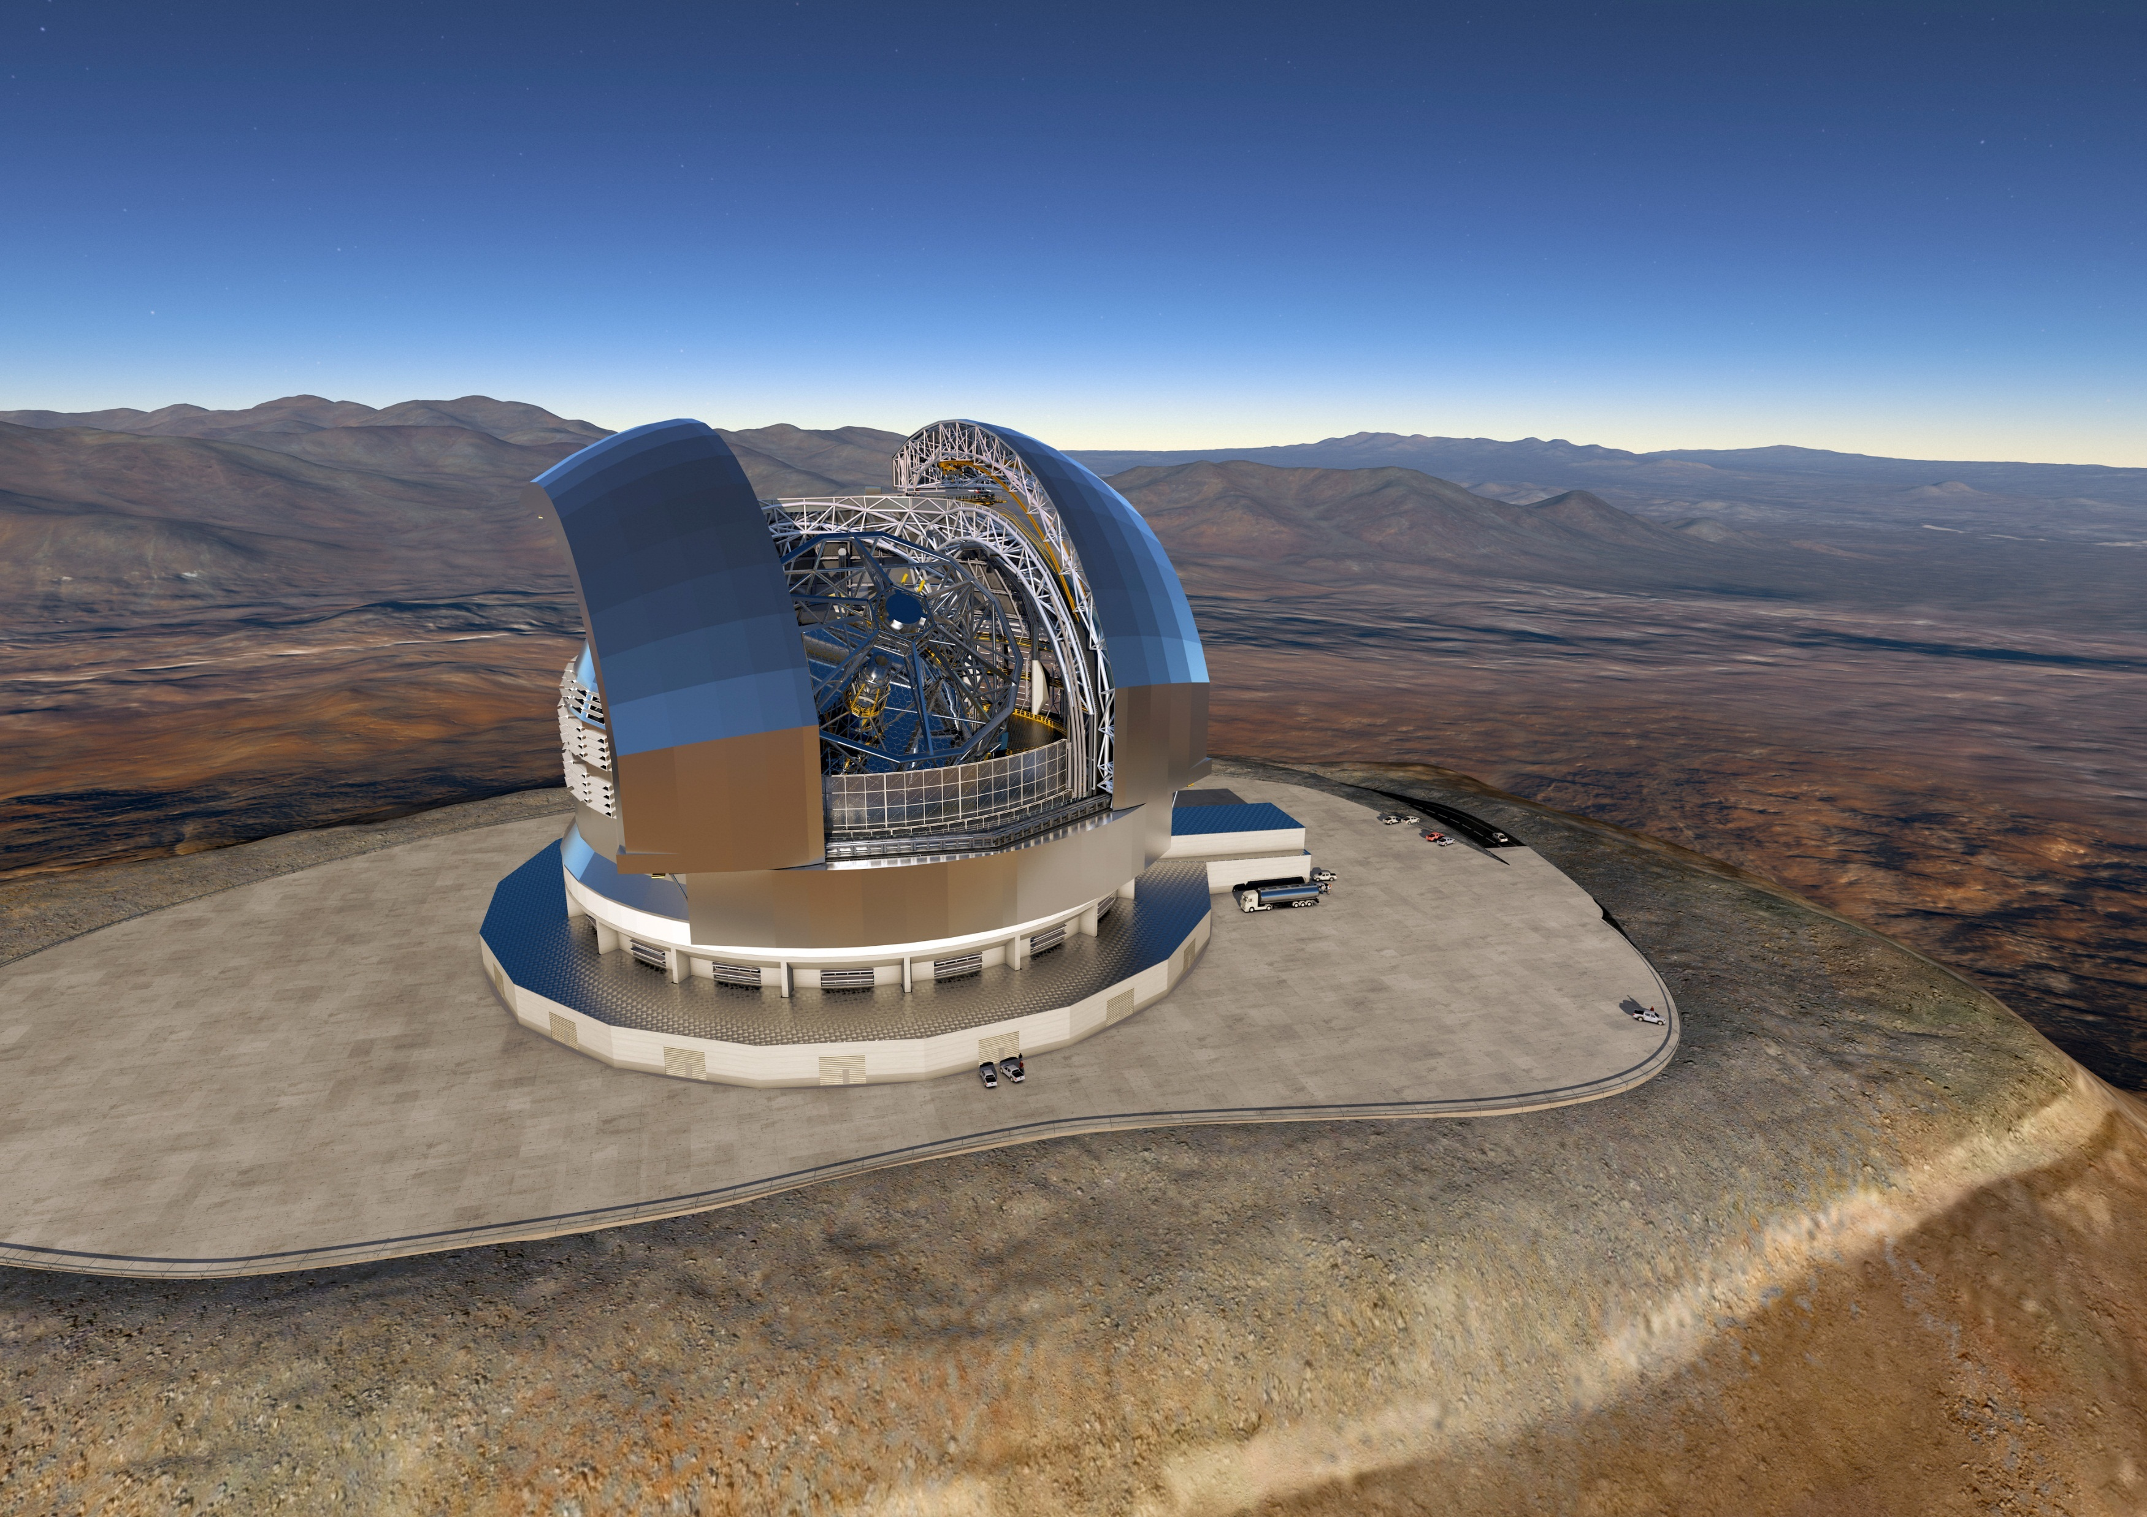
The ELT in numbers
ELT in numbers :-
M1 ~39 m
Light collecting ~978 m²
~800 segments
4.2m secondary/3.5 tonnes
5 mirror design with AO
3000 moveable tons
First light ~2024
Cost ~1B Euro

Slide 11
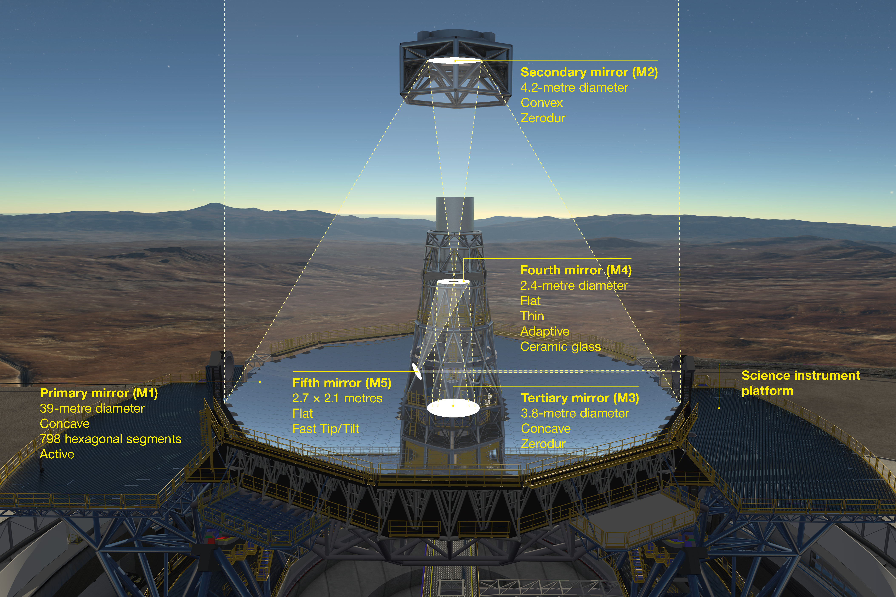
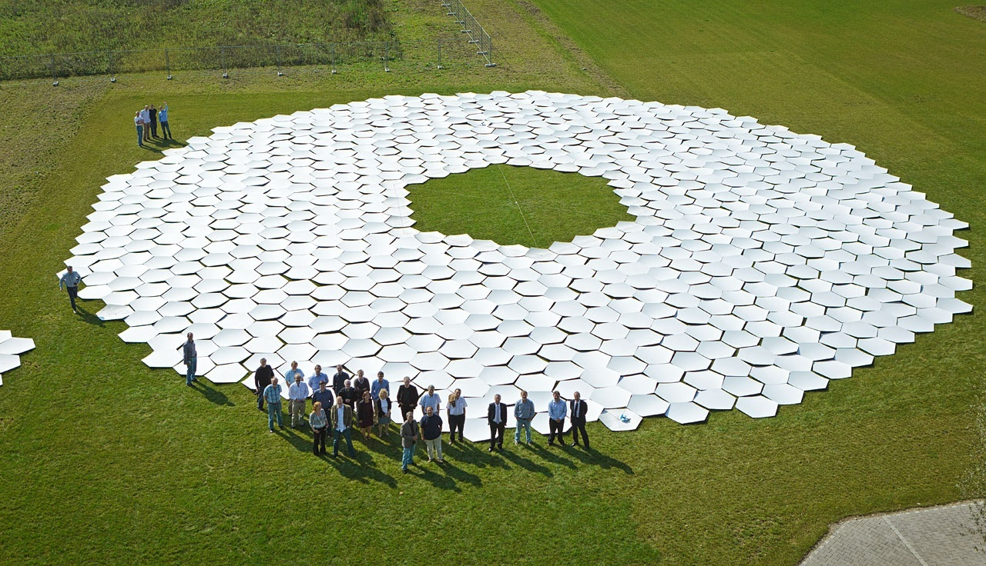
Telescope concept and M1 prototype
Diameter = 39 metres, cf. tennis court = 23.77 m
ESO, Garching, Open Day 2014
798 hexagonal segments (931 including spares)
Dome and main structure contract placed – largest ever !
Schott – to produce the blanks
Safran Reosc – to polish, mount and test
7 year production process plan

Slide 12
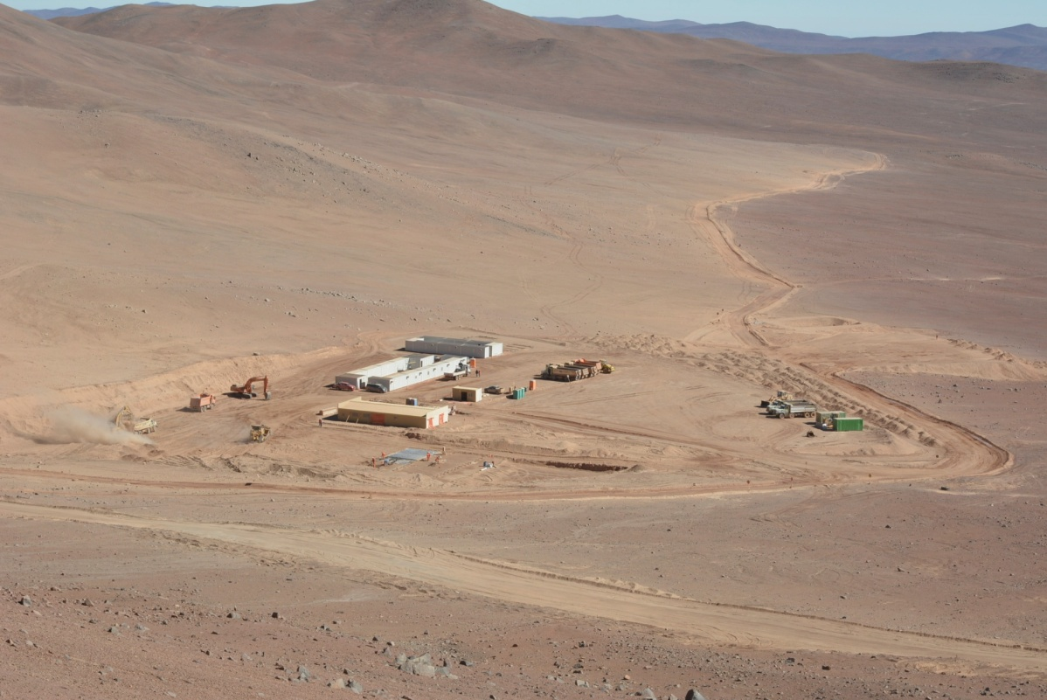
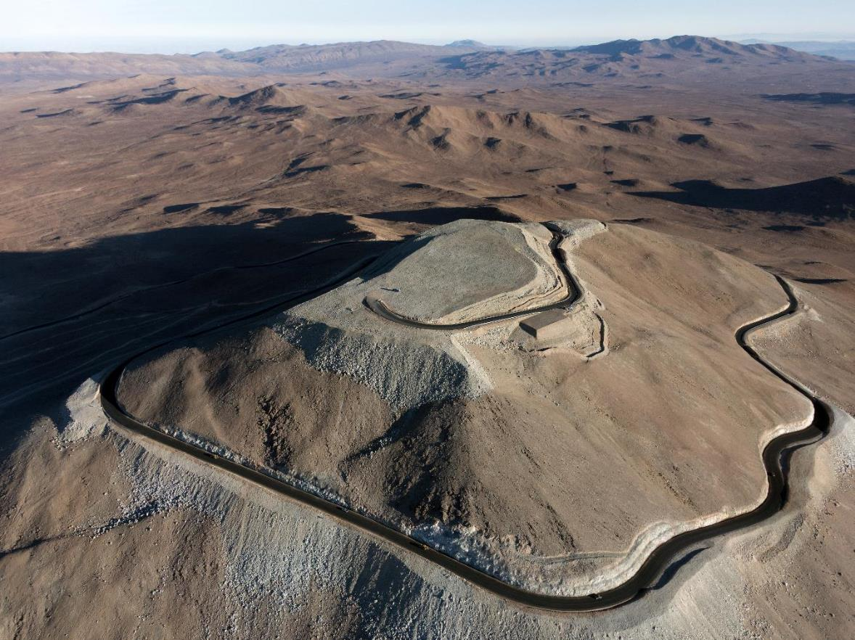
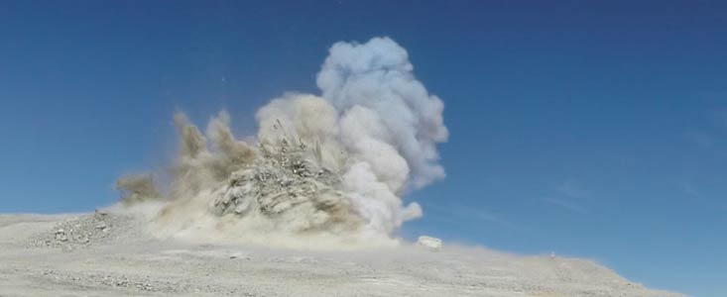
Site Preparatory Work;
Access Road & Platform completed

Slide 13
Approved instruments and The Roadmap
Instrument | Status
MICADO | Fully approved. To be delivered 2024.
MAORY(mcao) | Fully approved. To be delivered 2024.
HARMONI/LTAO | Fully approved. To be delivered 2024.
METIS | Fully approved. To be delivered 2024.
ELT-MOS | Call for Proposals issued July 2015
ELT-HIRES | Call for Proposals issued July 2015
ELT-6 | Call for proposals in 2016
ELT-PCS | To proceed when technology is ready (2019)
First Light
Instruments
2nd Generation
Instruments
Mix of Optical, NIR (1-2.5um), MWIR (3-5um) and LWIR (10-20 um) detector requirements
AO Detector Needs – low noise, optical and NIR (L3CCDs and SAPHIRA),
- large format optical, low noise – new developments

Slide 14
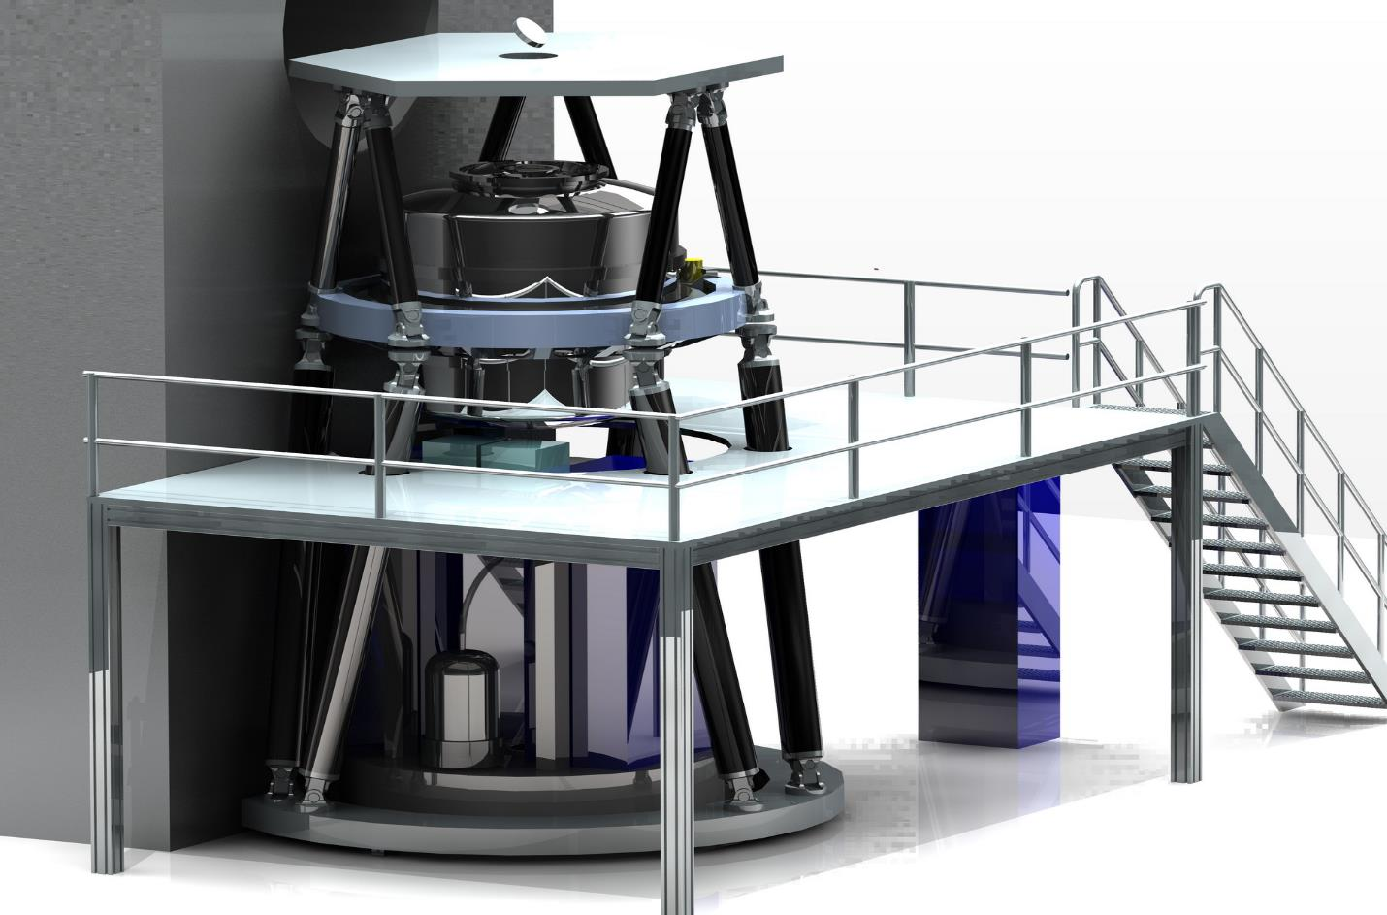

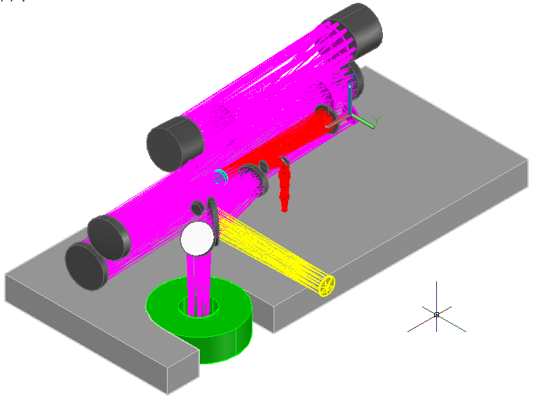

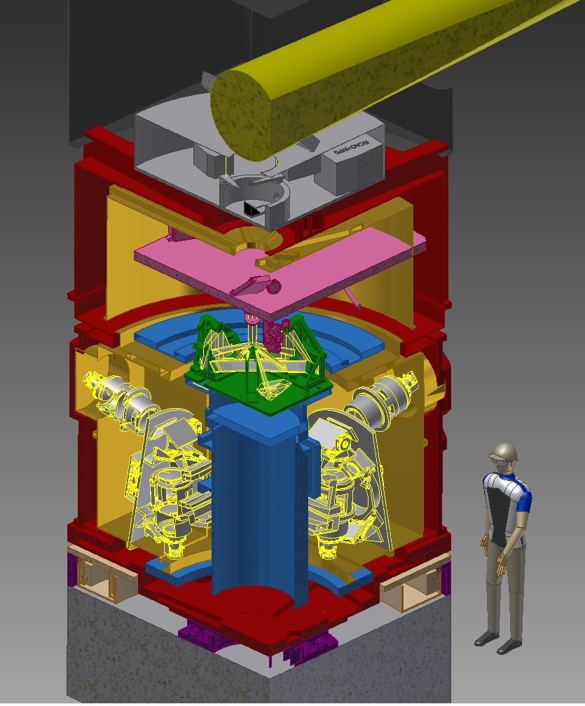
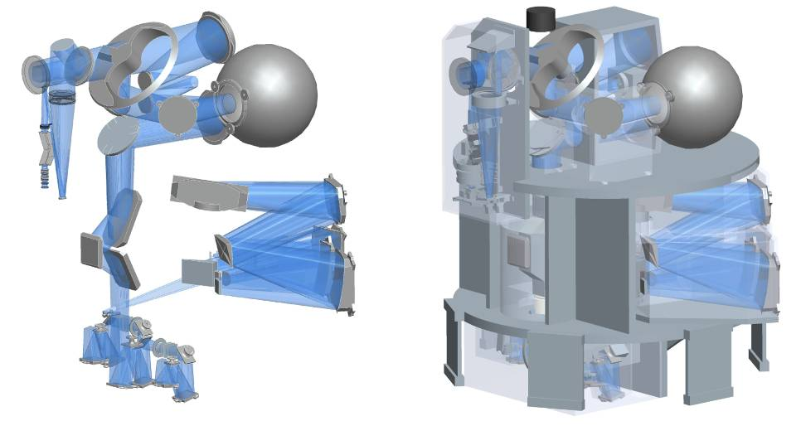
Instruments Construction Agreements
Mid-IR Imager and Spectrometer
- exo-planets
Multi-conjugate AO module
- 6 laser guide stars, 3 natural stars
- Fed to MICADO
  INAF OA Bologna
  IASF Bologna
  OA Arcetri
  OA Brera
  OA Capodimonte
  OA Padova
  INSU/CNRS-IPAG
5.5m
METIS
MAORY
12.5m
  NOVA, MPIA, CEA-Saclay, UK ATC, K.U.Leuven, ETH Zurich, A*
  Uni. Oxford,
  UK ATC,
  CRAL,
  CSIC,
  IAC,
  RAL,
  IPAG,
  ONERA,
  LAM,
  ESO
calunit
HARMONI
LM spec
MICADO
WFS
Imaging channels
Work-horse IFU optical/IR Spectrometer
- Local universe
- exo-planets
Diffraction limited Imaging
- Astrometry near black hole of our galaxy
- Coronographic mode

Slide 15
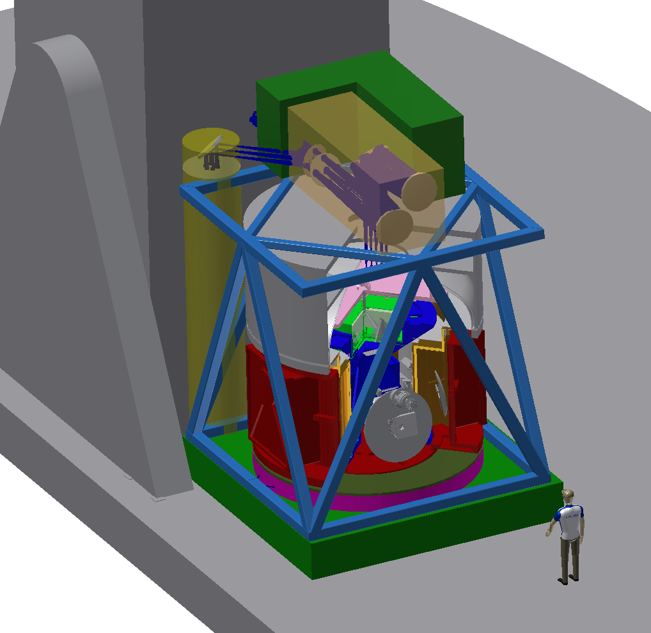
Typical first light instrument
Nasmyth platform
( ~1 tennis court)
Dimensions ~ 4x4x4 m
Weight ~ 10 – 20 tons
AO feeds
Cooled to 4K/40K/140K
Delivery ~ 2023
Capital cost ~ 20M Euro
Staff effort > 400 FTEs

Slide 16
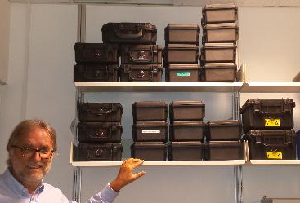
Challenges – numbers of future detectors required for VLT and ELT
IR Example - Teledyne HgCdTe H2RG arrays delivered to ESO
1 Hawaii2 for MAD
1 Hawaii2RG for SPIFFI
4 Hawaii2RG for HAWKI
1 Hawaii2RG for X-SHOOTER
1 Hawaii2RG for IRDIS in SPHERE
1 Hawaii2RG for IFS in SPHERE
3 Hawaii2RG for KMOS
1 Hawaii2RG for GRAVITY spectrometer
1 Hawaii2RG for GRAVITY acquisition camera
1 Hawaii2RG for MATISSE – 2018 delivery
3 Hawaii2RG for CRIRES mosaic – 2018 delivery
1 Hawaii2RG for CRIRES slit viewer – 2018 delivery
2 Hawaii2RG for SPIFFIER/ERIS/NIX – 2019 delivery
~18 x H2RGs, >10 year period
( a very simple metric?
number of pixels/year ~ 80M IR pixels or > 8M pixels/year)

Slide 17
ELT science instrument pixel count
Instrument | Number of Pixels | Pixel format | Wavelength um
HARMONI | >100M | 4kx4k/2kx2k Or other | 0.8-2.5
 | 128M | 4kx4k | 0.47-0.95
MICADO | >100M | 4kx4k/2kx2k modules | 0.8-2.45
METIS | 1M | 1kx1k | 5-14(28)
 | 4M | 2kx2k | 3-5
Speak to Liz
Christopher
Mandla’s poster
Salima Mouzali’s
poster
6 year period
simple metric, number of pixels ~ 300M IR pixels => 50M pixels/year – x7 more !
~ 100M optical
Notes:
Not counting requirements for VLT instruments or AO etc

Slide 18
Controller/ASIC developments at ESO ?
Full analog/digital ASIC design (such as SIDECAR) good fit for H*RG designs
Other detector types to support,
e.g. AQUARIUS, SAPHIRA, SOFRADIR ALFA, CCDs, CMOS, LBNL FDCCDs
Different outputs, ac/dc coupled, different clock swings, different biases etc
Implies inhouse controller needed for some detector types
Staff required to support 2 developments of own controller and ASIC ?
Controller issues – can be fixed cheaply, upgrades simpler
Interfacing requirements – e.g. to our AO systems
Legacy software and systems – updating old instruments

Slide 19
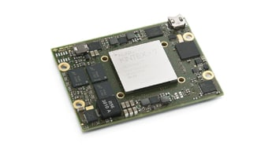
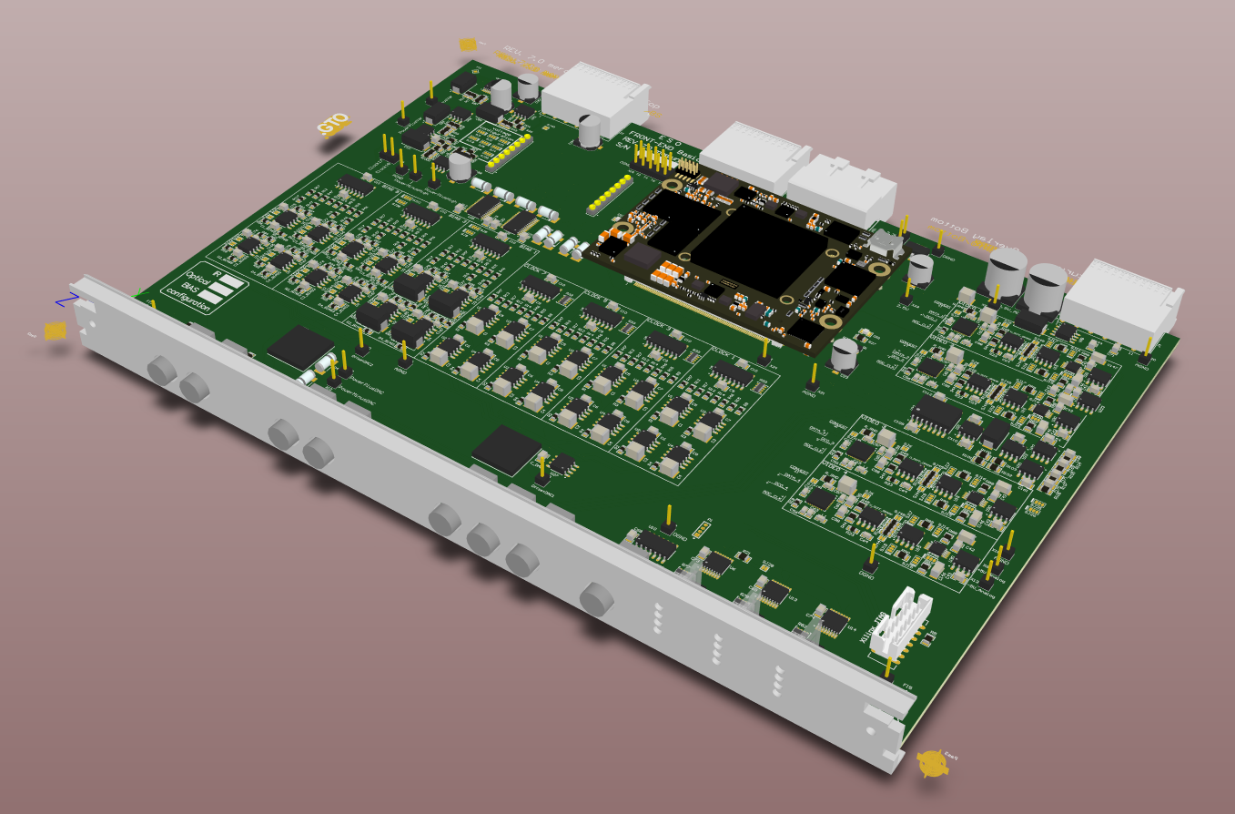
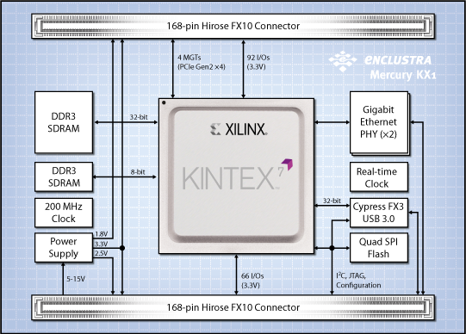
NGC v2.0 - Controller Developments
Enclustra Mercury ZX1 ZYNQ SoC board
NGC upgraded for motherboard
Board easy to upgrade to latest FPGAs
More real-time processing achievable
(Fowler + sub-pixel sampling at 10 MHz)
Obsolescence management
Notes:
It’s a pity Leander is not here, this would have been the basis of his poster with much more detail.
Problems throughout the VLTs already with obsolescence and even with NGC, older FPGAs no longer available.

Slide 20
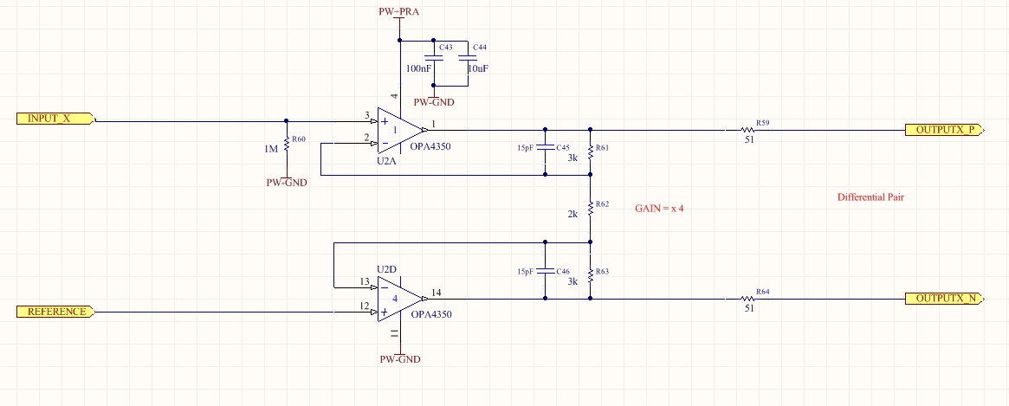
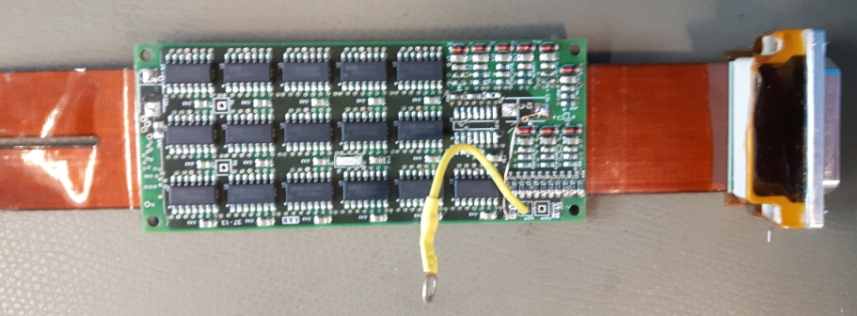

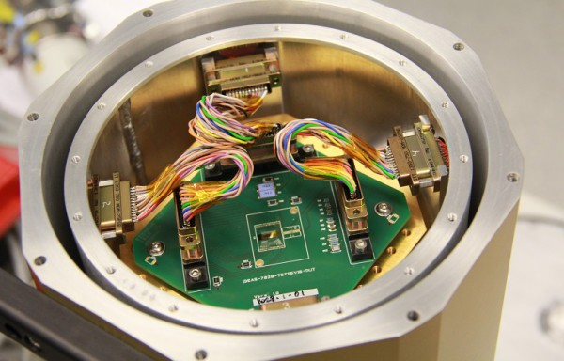
New Cryo Preamp ASIC development
ESO standard cryo preamp
Cryogenic testing of ASIC
Single chip solution
~32 differential amplifiers
Gain control
Bandwidth control
Matched to 2kx2k detectors
Operational at 77K
Minimises PCB cross-talk
ASIC single chip solution

Slide 21
Test Facilities Developments
FIAT and CRISLER
FIAT – Facility for Infrared Array Testing
Full astronomical instrument
For operation of MWIR detectors, 30K operation
Low thermal back-ground, cold stop design
Inhouse design - training
Designed for 4kx4k mosaics of detectors
30K at the detector, LN2 pre-cool
PLC controlled
Filter and ND wheels, cold shutter slide
Multiple cryogenic mechanisms
Darks, Flats, point sources
External black body, internal calibration diodes
Complete turn-around in 1 day
See Liz’s talk.

Slide 22
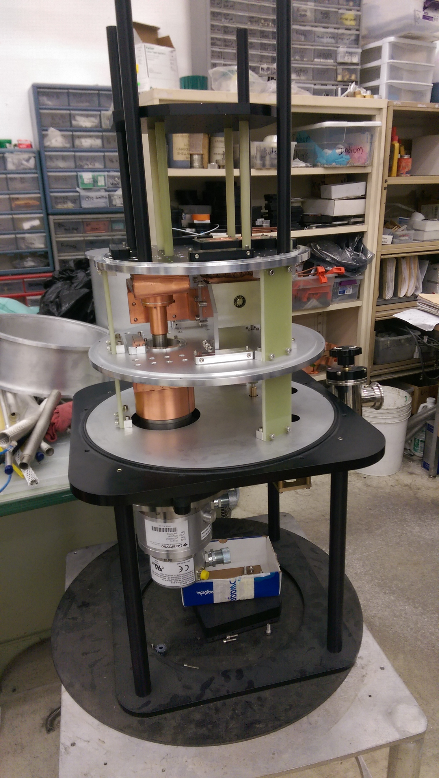
And CRISLER (good acronym required?)
CRISLER – Simple, fast manufacture, test facility
Off-the-Shelf”, from Universal Cryogenics, Tucson
Copy of proven already delivered design
4kx4k detector mosaic possible
30K cooling
Simple motorized filter wheel
Early days testing of detectors
Shared optical table and test facilities with FIAT

Slide 23
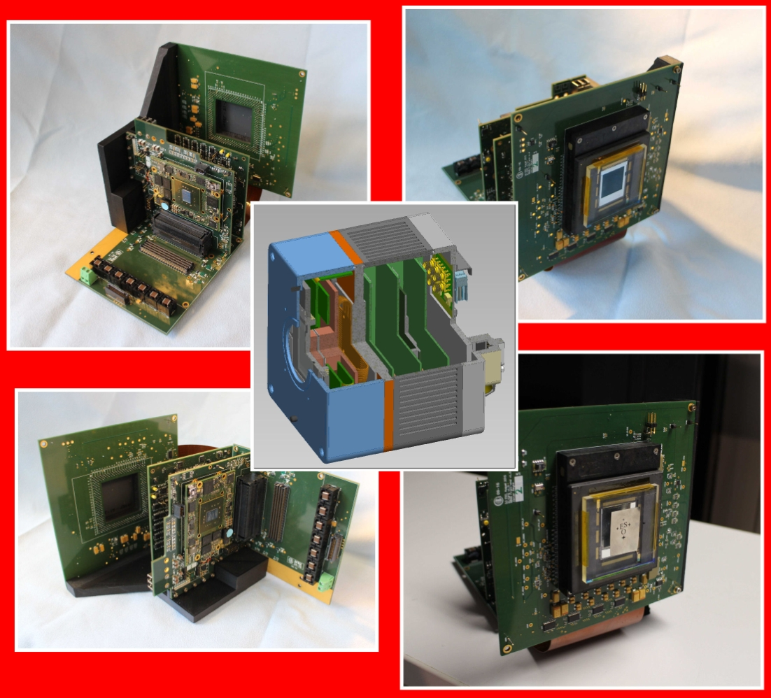
Optical/IR AO Detector Developments
FPGA machines/daughter board
Highly modular
Design
New AO detector development
LVSM Detector development – High speed CMOS imager for laser guide stars - see Mark Downing’s talk
ALICE/FREDA/LISA – new AO Camera developments - based on common FPGA platform
LVSM, L3CCD and SAPHIRA detectors
- See Javier Reyes’ talk + 3 posters
(LVSM – Large Visible Sensor Module)

Slide 24
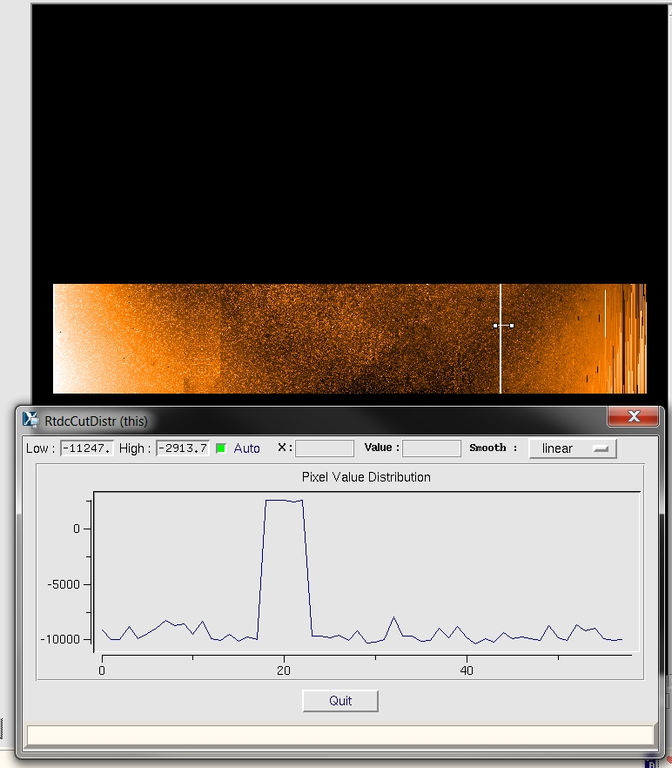
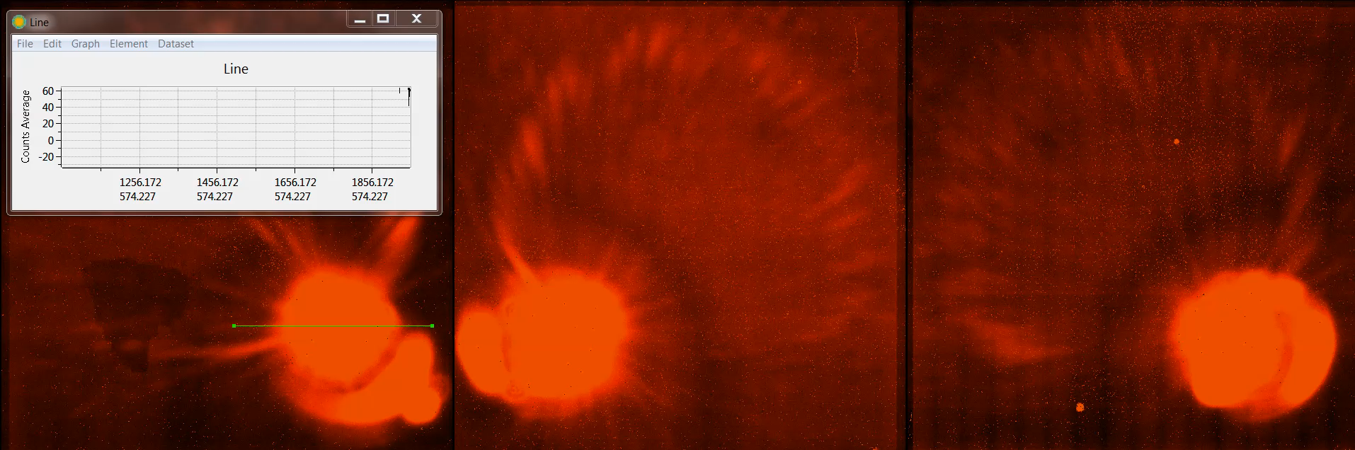
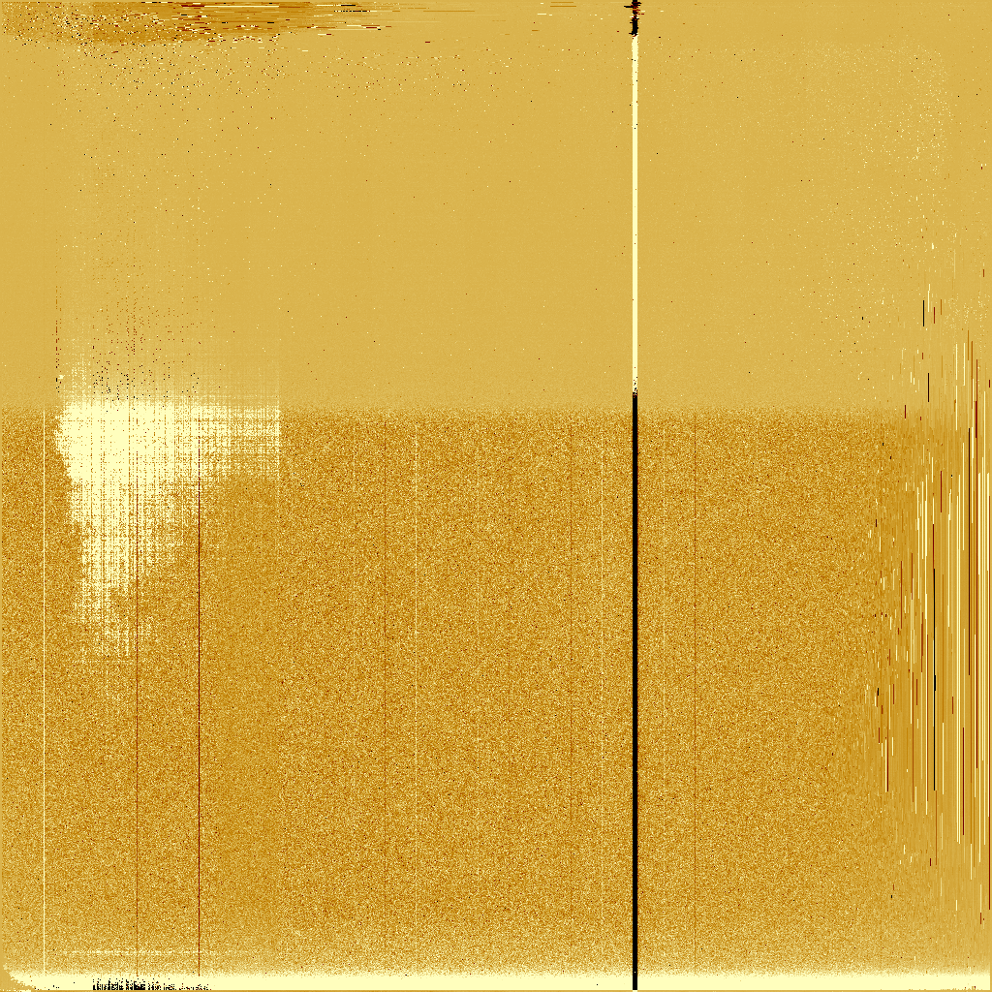
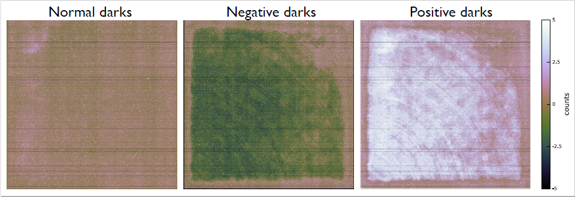
Detector optimisation
Pixel speed testing
Persistence – see Simon’s talk
Bias stability – effort to reduce noise further
Reset Window
See Liz’s talk on modelling, data-mining, testing etc
Cross talk signals – Liz’s poster

Slide 25
Conclusions
Exciting times for ESO Detector Group :-
Many projects, staff effort now in place to deliver.
(many FPGA engineering needs)
New developments, new AO cameras, will be commercialized.
NGC v2.0 developments, but low level ASIC program also supported.
New test facilities to allow quicker testing and characterization.
Overview talk – go see the ESO posters and listen to the ESO detailed talks to come !

