Slide 1
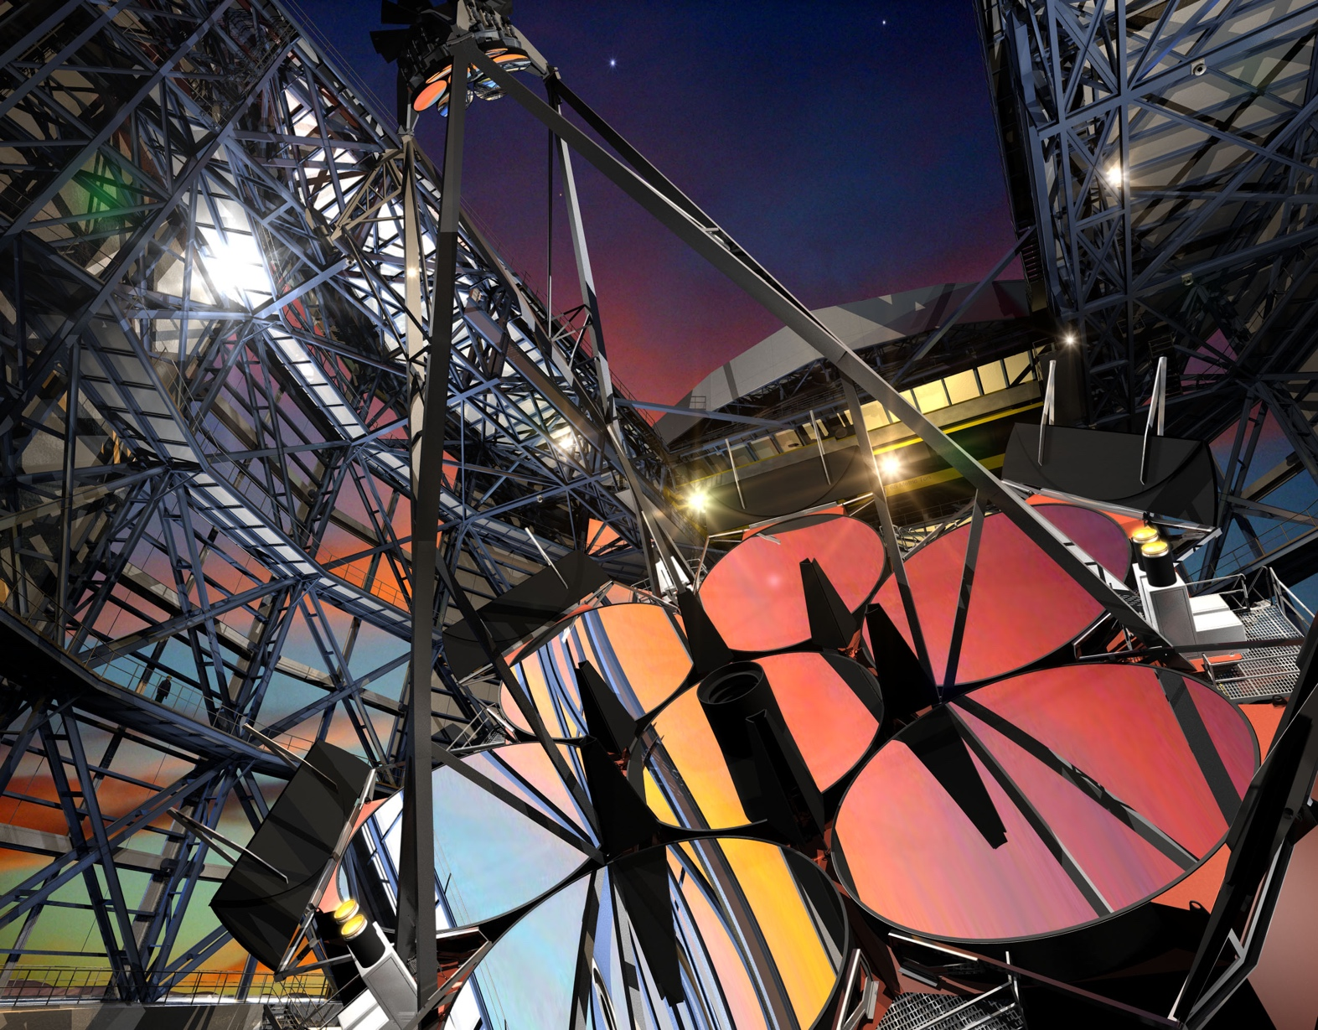
Detector Systems for the GMT
Robert Sharp, ANU, GMTIFS PI
Adam Contos, GMTO, Instrument Manager

Slide 2
Presentation Overview
GMT Overview
  Giant Magellan Telescope optical path and science instrument configuration
  Las Campanas site
  Primary mirror status
  Science instruments description & organization
GMT IR Instruments
  GMTIFS
  GMTNIRS

Slide 3
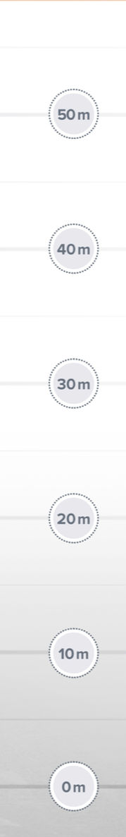
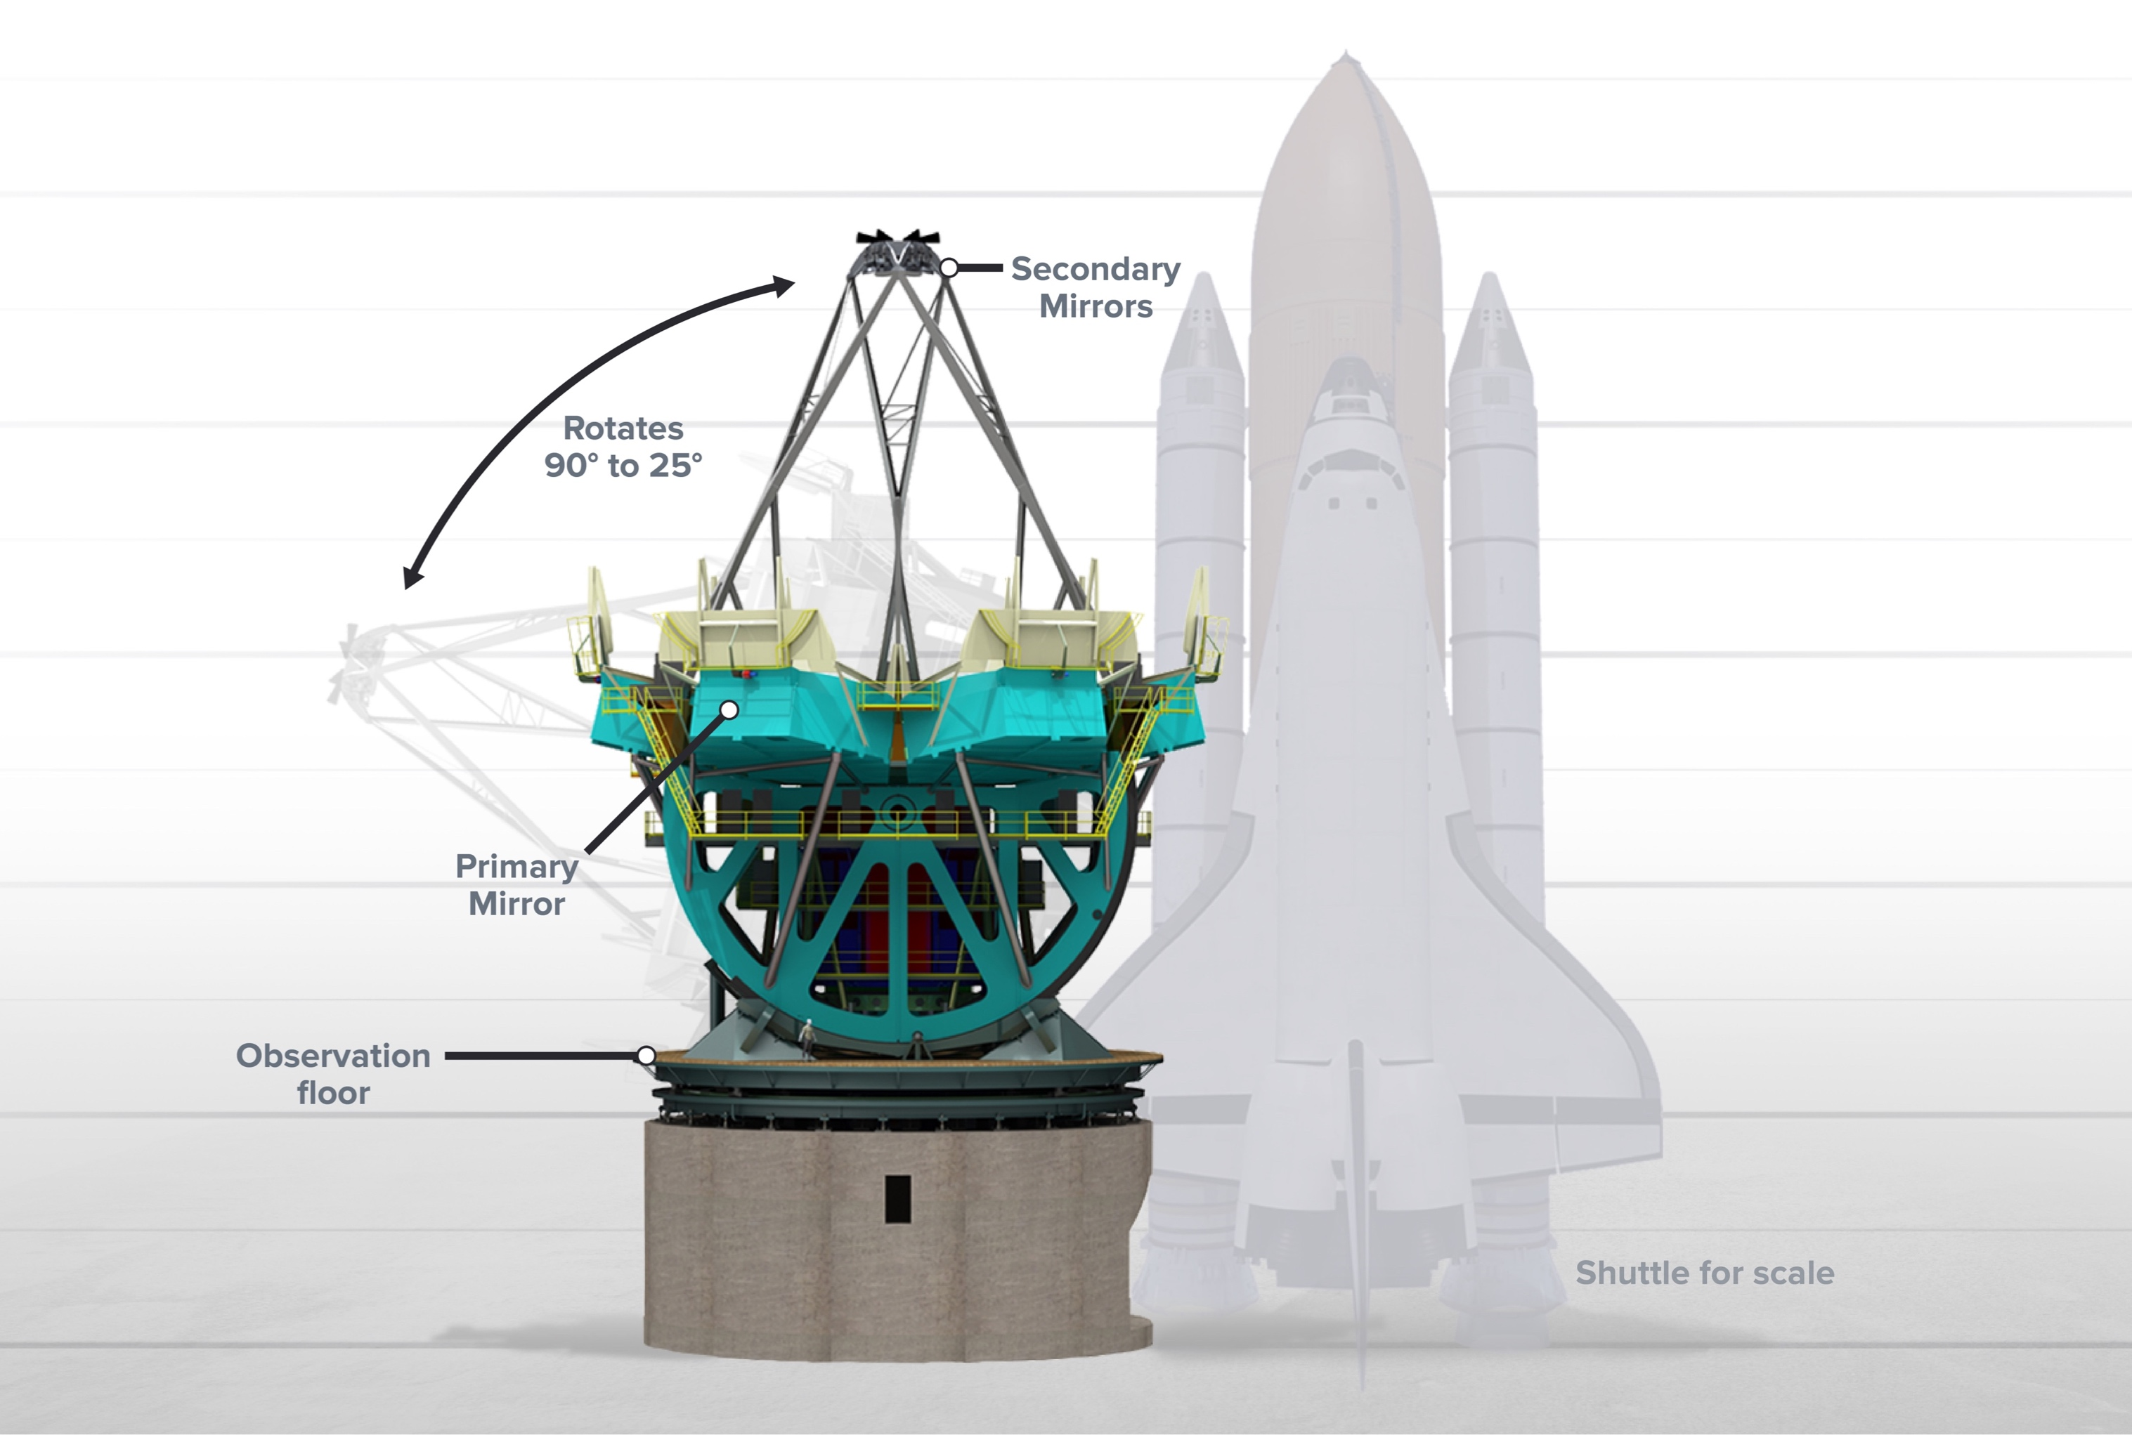
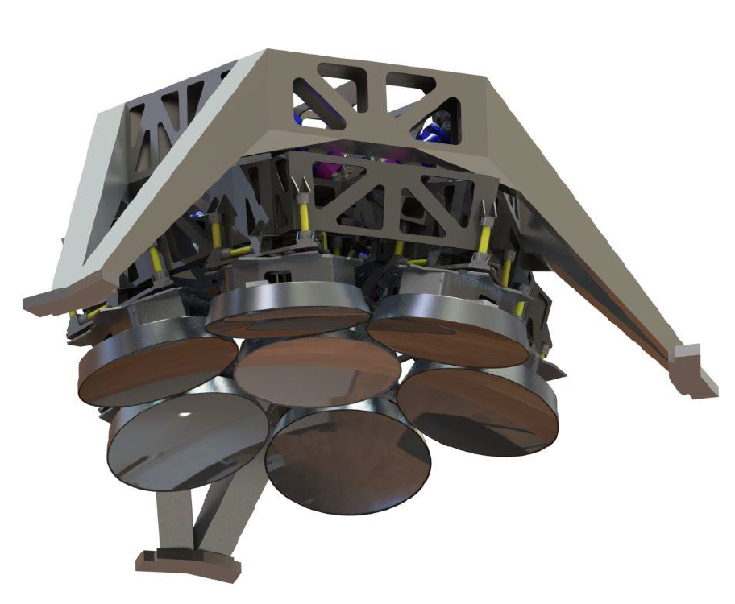
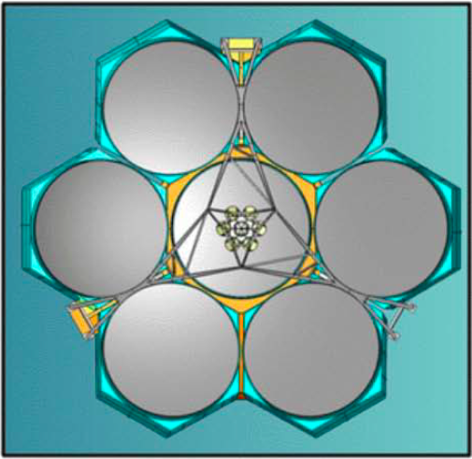
Giant Magellan Telescope Configuration – Large but compact
48 m

Slide 4
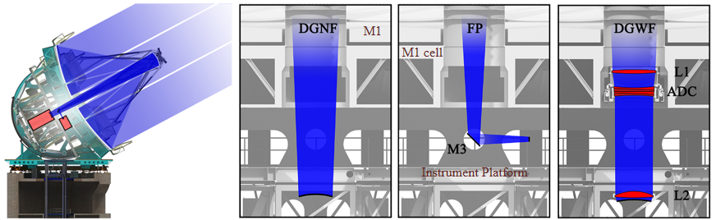
Optical Configuration
Aplanatic Gregorian design
  20 arcmin field of view
Doubly segmented
  8.4 meter active primary mirror segments
  1 meter adaptive secondary mirror segments
  M1 and M2 segments are conjugate one-to-one
24.5 meter aperture
Optical/Infrared (0.3 – 25µm)
Fast beam: F/8.2 (F/0.7 M1)
Efficient (few reflections)
Config | Unvignetted FOV | Instrument ports/stations
DGNF | 20 arcmin, ~10 arcmin well corrected | Direct Gregorian narrow-field focus
FP | 3 arcmin | Folded ports, Auxiliary Ports, Instrument Platform stations (Gravity Invariant Station pick-off)
DGWF | 20 arcmin | Direct Gregorian wide-field focus

Slide 5
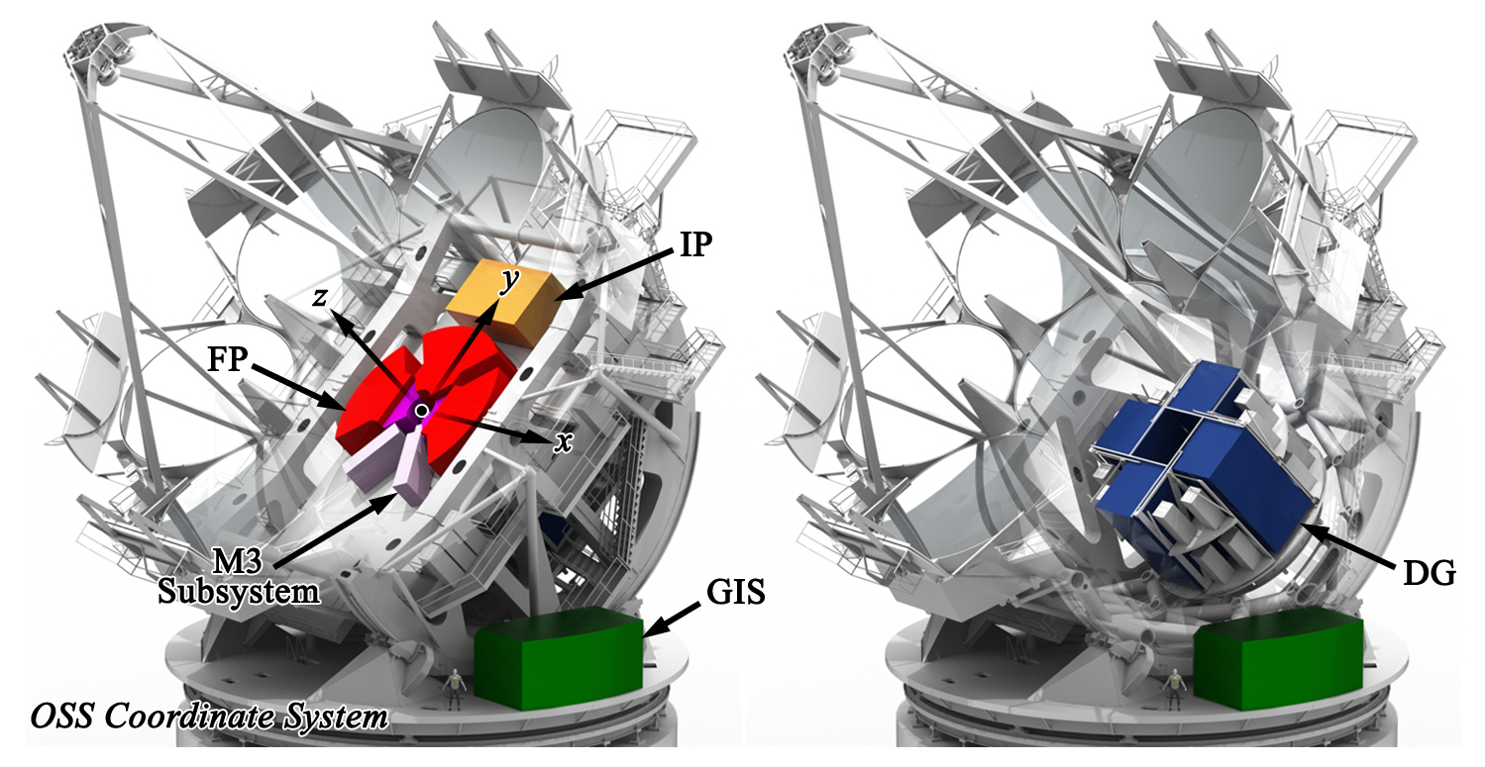
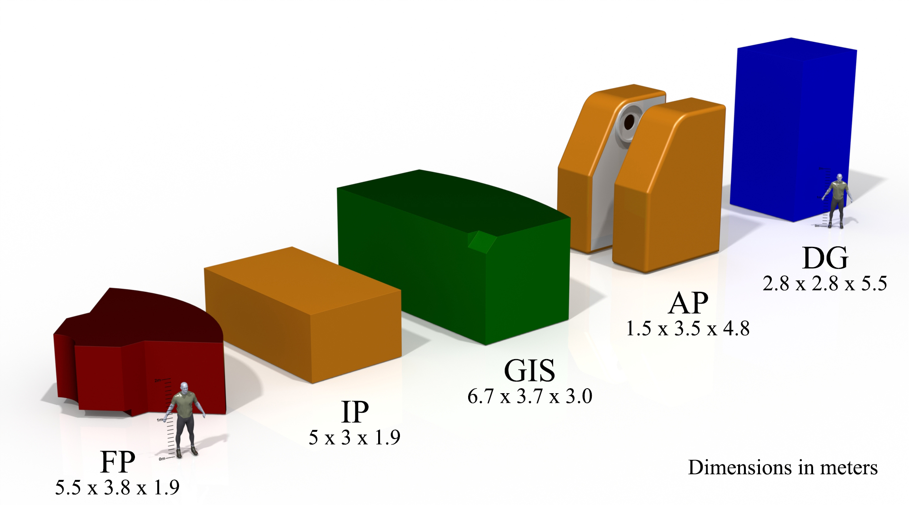
Science Instruments
Folded Port (FP)
Instrument Platform (IP)
Gravity Invariant Station (GIS)
Auxiliary Port (AP)
Direct Gregorian (DG)

Slide 6
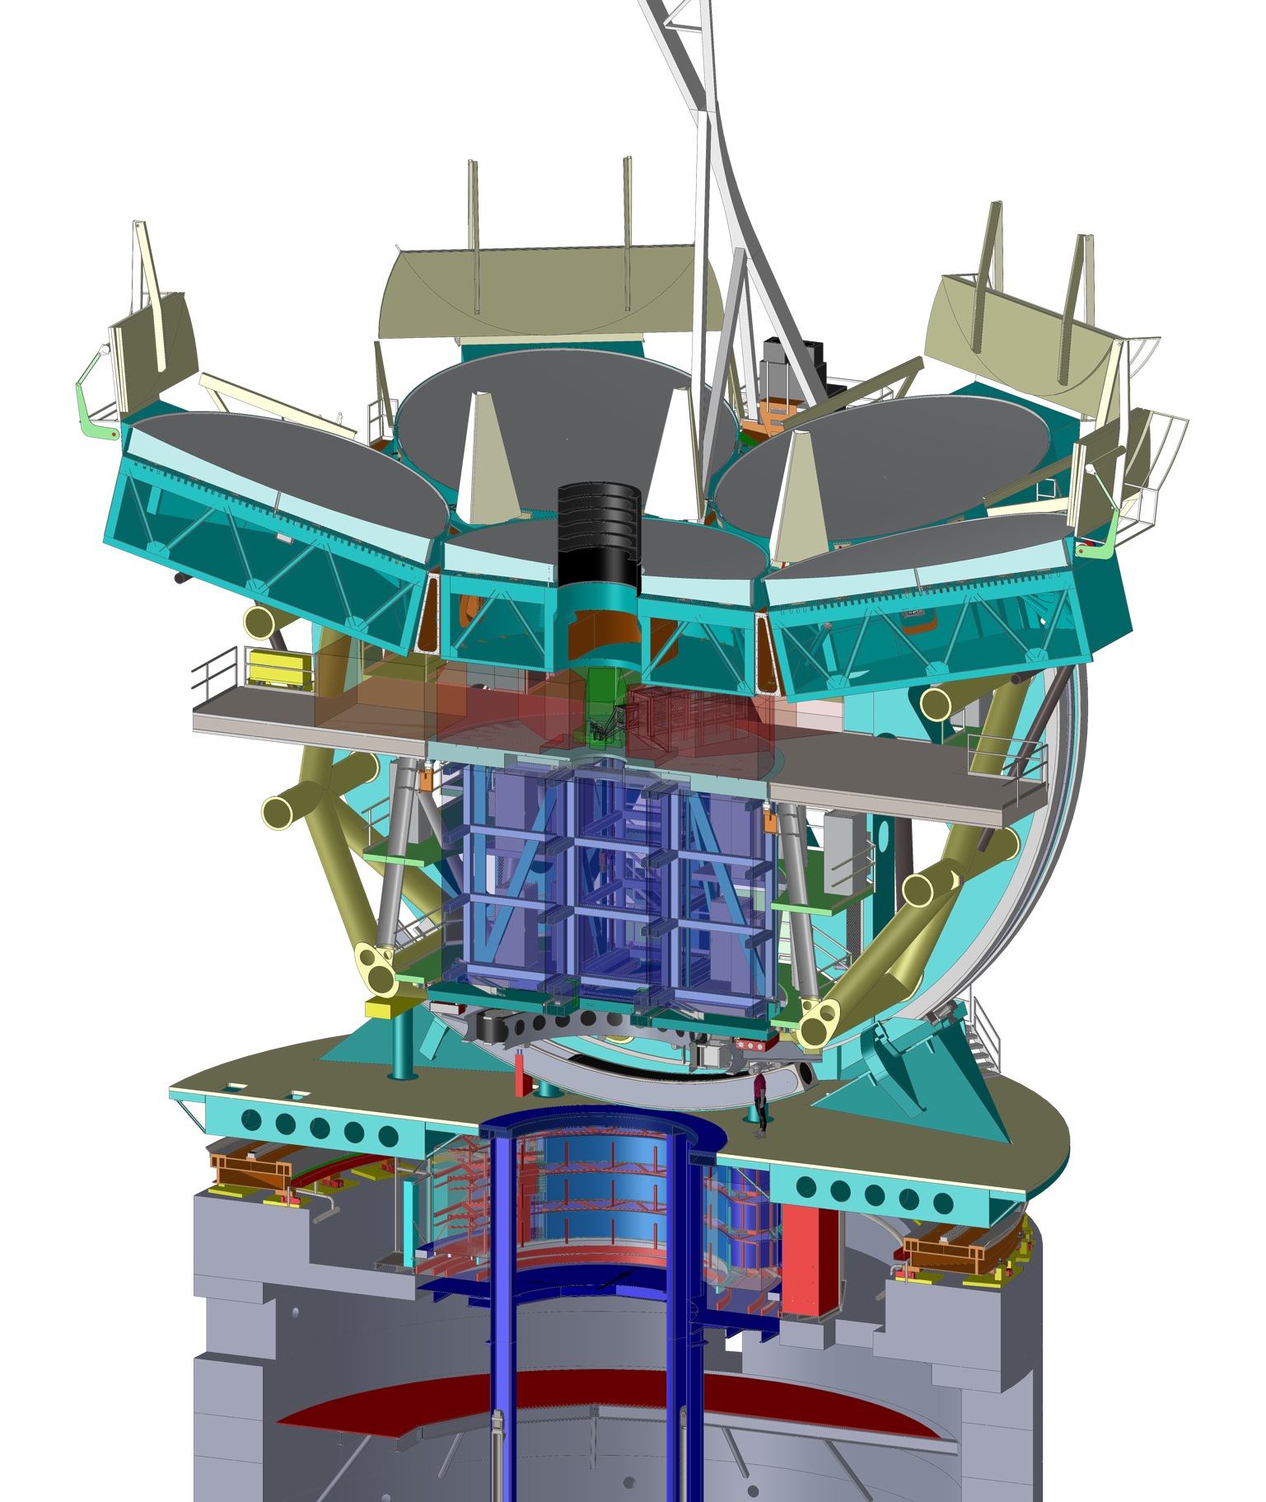
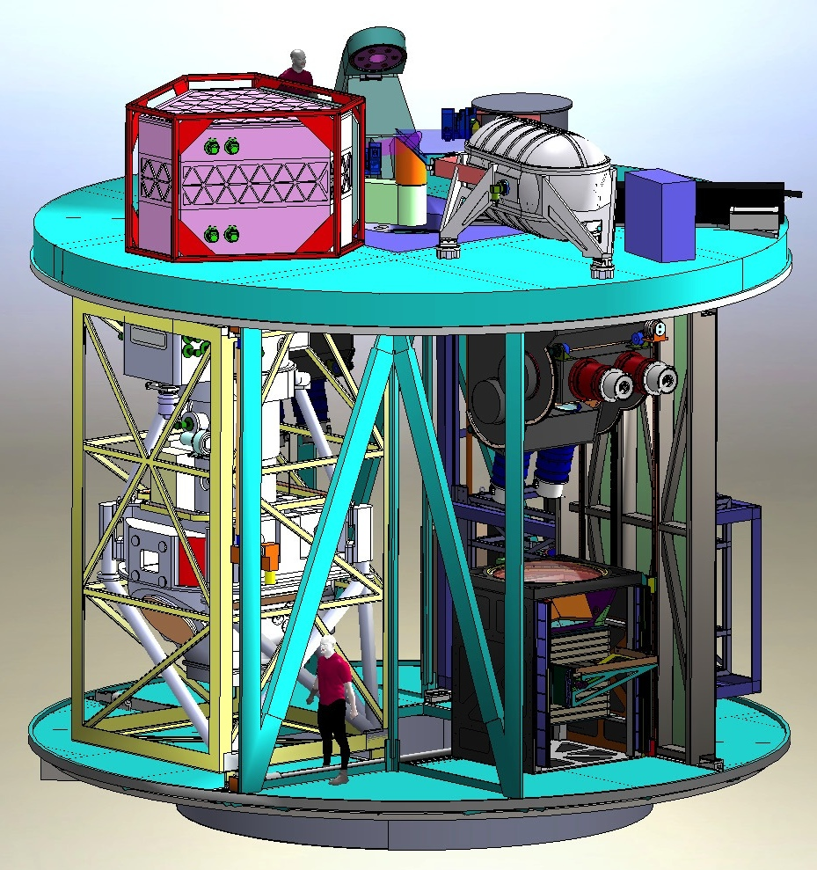
Gregorian Instrument Rotator (GIR) is the third rotating axis of the telescope structure
GIR carries the science instruments + acquisition, guiding & wavefront sensing system

Slide 7
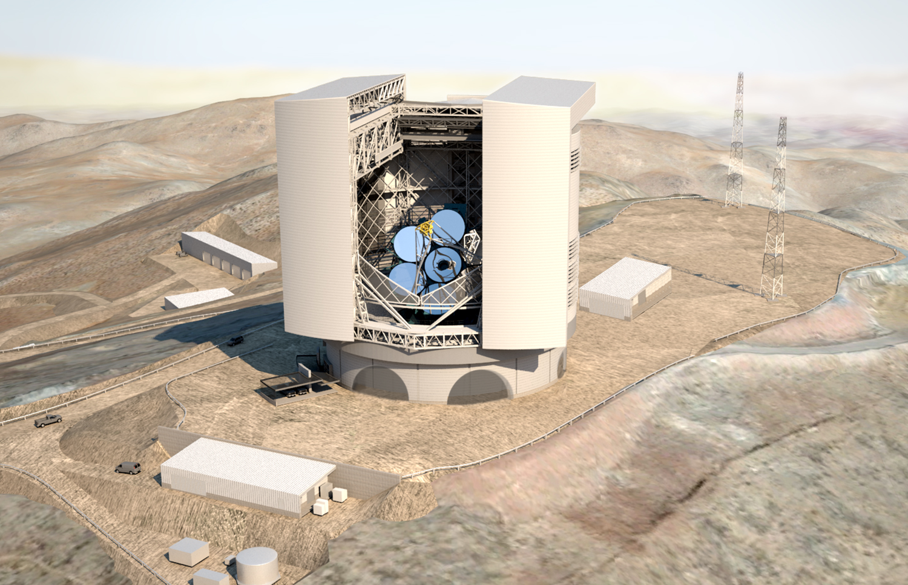
Rendering of GMT at Las Campanas Site (Chile)
Warehouse / M1 Factory /
M2 Metrology
Summit Support Building
Summit Utility Building
Enclosure

Slide 8
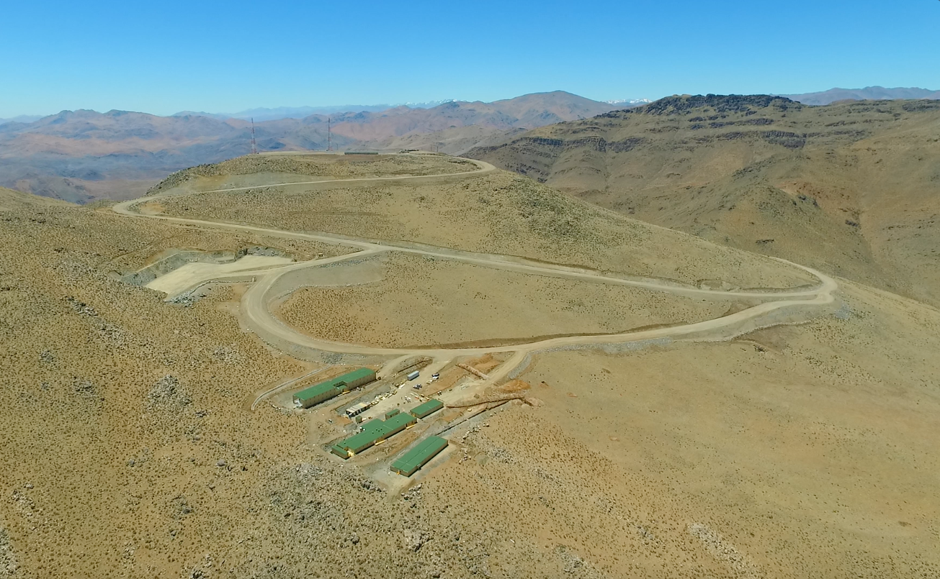
Summit facilities & infrastructure (from drone video)
Summit
Warehouse / M1 Factory /
M2 Metrology
Main Access Road
Support Site Loop Road
Construction Camp /
Future Lodge

Slide 9




Staged Project Completion Achieves First Light Early
Engineer entire observatory to enable build-out to final configuration in staged manner and achieve first light capability at earliest date, ~2023
Staged completion
  First Light: Natural seeing, starting with 4 primary mirror segments + 4 Fast Steering SM, ComCam and GCLEF
  4 Adaptive SM for natural guide star GLAO & AO, M3, wide-field corrector
  Full AO capability with laser guide stars
Mold Under Construction
Rear Surface Polishing
5
Glass on Hand
Ready for Front Surface Generating
3
6
4
2
7
Glass on Order
1
Front Surface Polishing
Polishing Complete

Slide 10
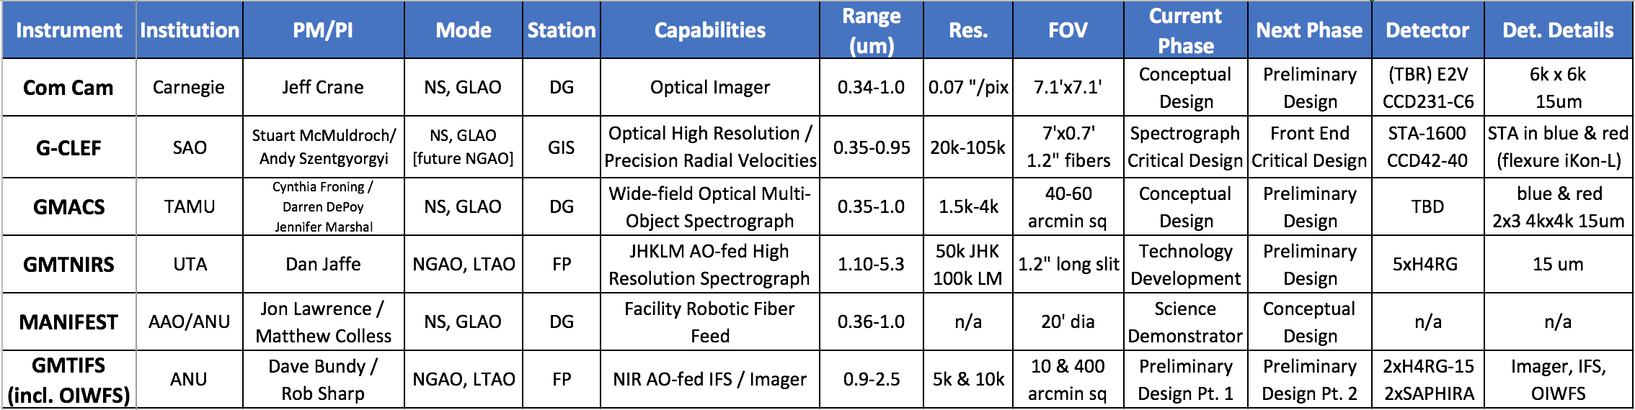
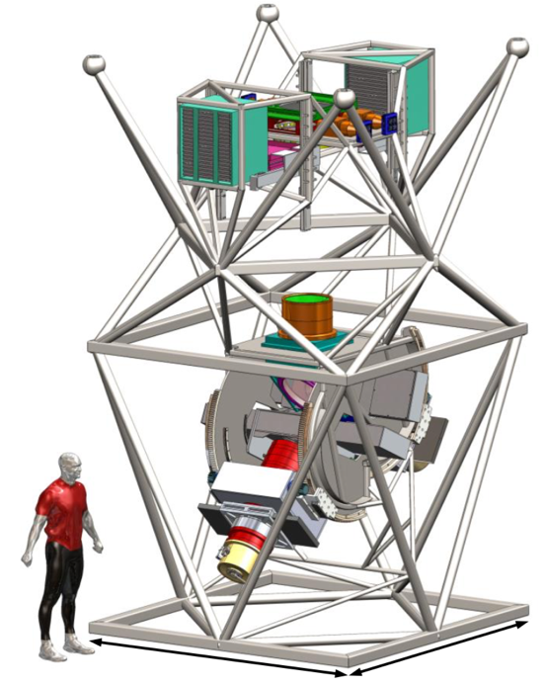
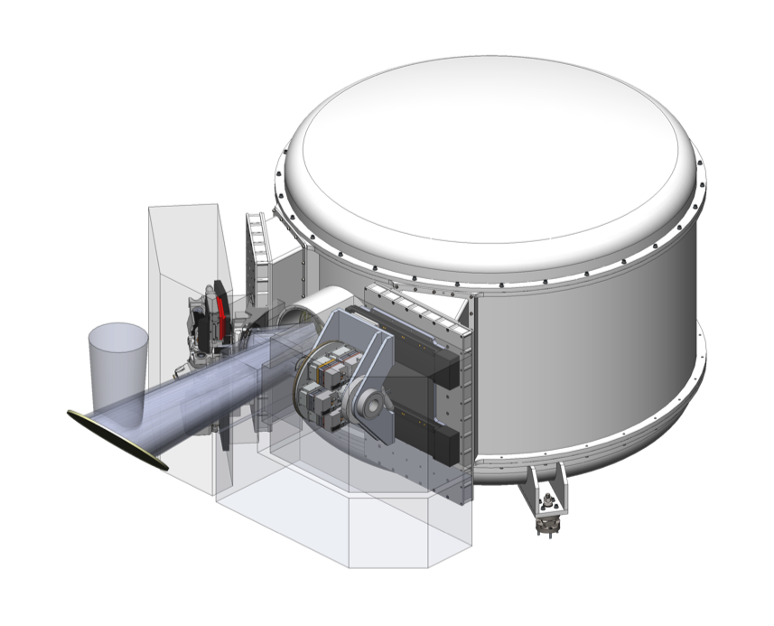
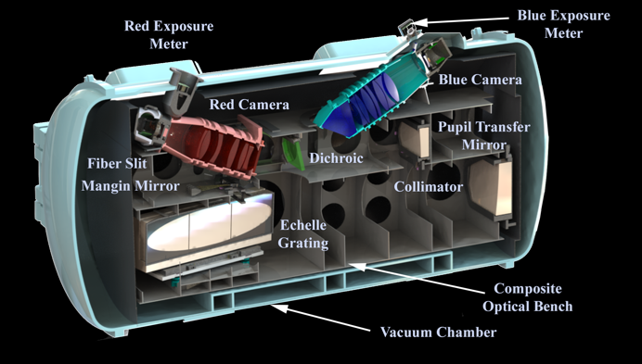
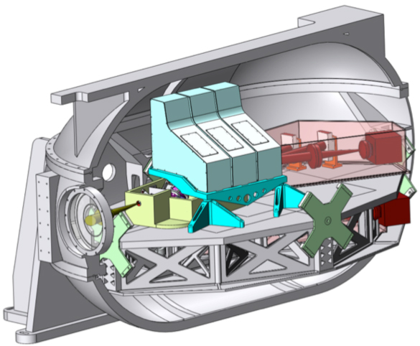
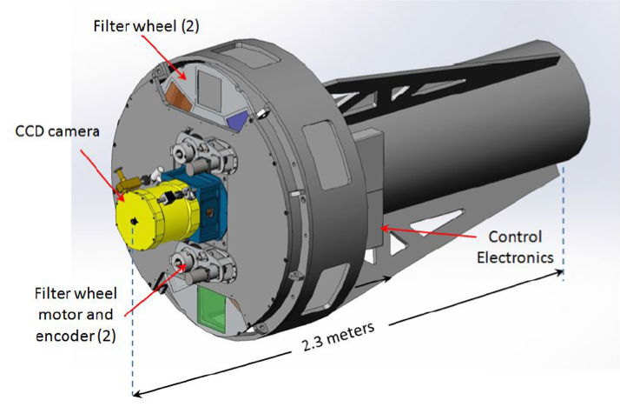
Science Instruments: Description & Organization
NS=Natural Seeing, NGAO=Natural Guidestar AO, GLAO=Ground Layer AO, LTAO=Laser Tomography AO, DG=Direct Gregorian, GIS=Gravity Invariant Station, FP=Folded Port
GMACS
MANIFEST
G-CLEF
GMTNIRS
GMTIFS
Com Cam
TAIPAN positioner as forerunner to MANIFEST

Slide 11
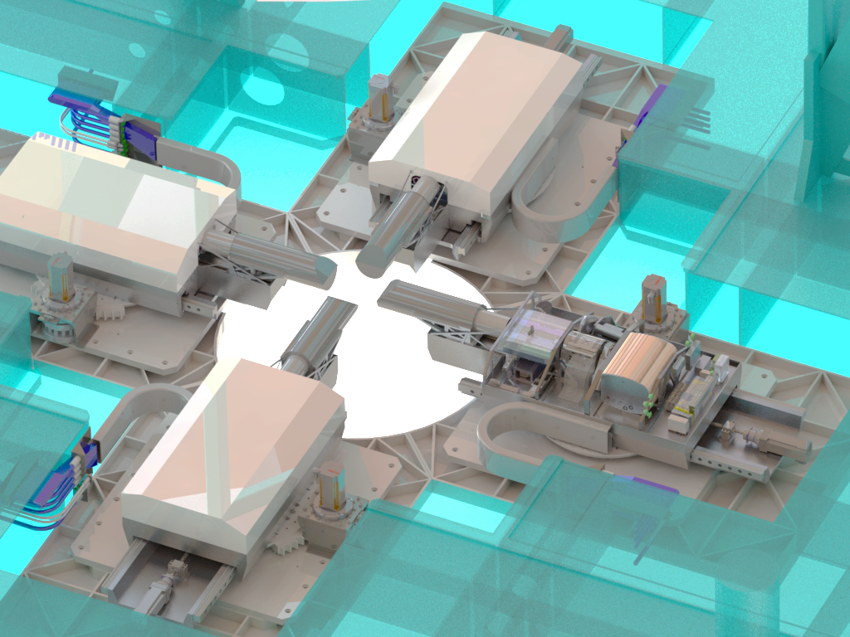
Acquisition, Guiding and Wavefront Sensing (AGWS)
Visible: 4 x E2V CCD201 based detector (baseline but may change)
  Considering switching to an alternative visible cameras which use the E2V CCD351 detector
  Designed to run faster, enables GLAO frame rate of 196 Hz, rather than 88 Hz with the CCD201
  Several manufacturers are planning to sell cameras which use it, but only one which we know currently exists is from Princeton Instruments.
  Interested in performance of the CCD351, or the development of COTS cameras which use it
Infrared: 4 x Firstlight C-RED1, which uses the Selex SAPHIRA detector
  Placed an order for a C-RED1 camera for prototype phasing sensors at Magellan in 2018
The AO wavefront sensors use the following:
  Natural Guide Star WFS: 2 x Firstlight OCAM2K, which use the E2V CCD220 detector
  Laser Guide Star WFS: 6 x E2V LVSM (the successor to the NGSD detector dev. program); custom camera
  On-Instrument WFS: 2 x Selex SAPHIRA detectors with custom electronics (lives inside the instrument)
    These will be replicated for each diffraction-limited instrument, so in the first generation of instruments (GMTIFS, GMTNIRS), we’re already talking about 20 detectors!

Slide 12

GMT IR Instruments: GMTIFS and GMTNIRS

Slide 13
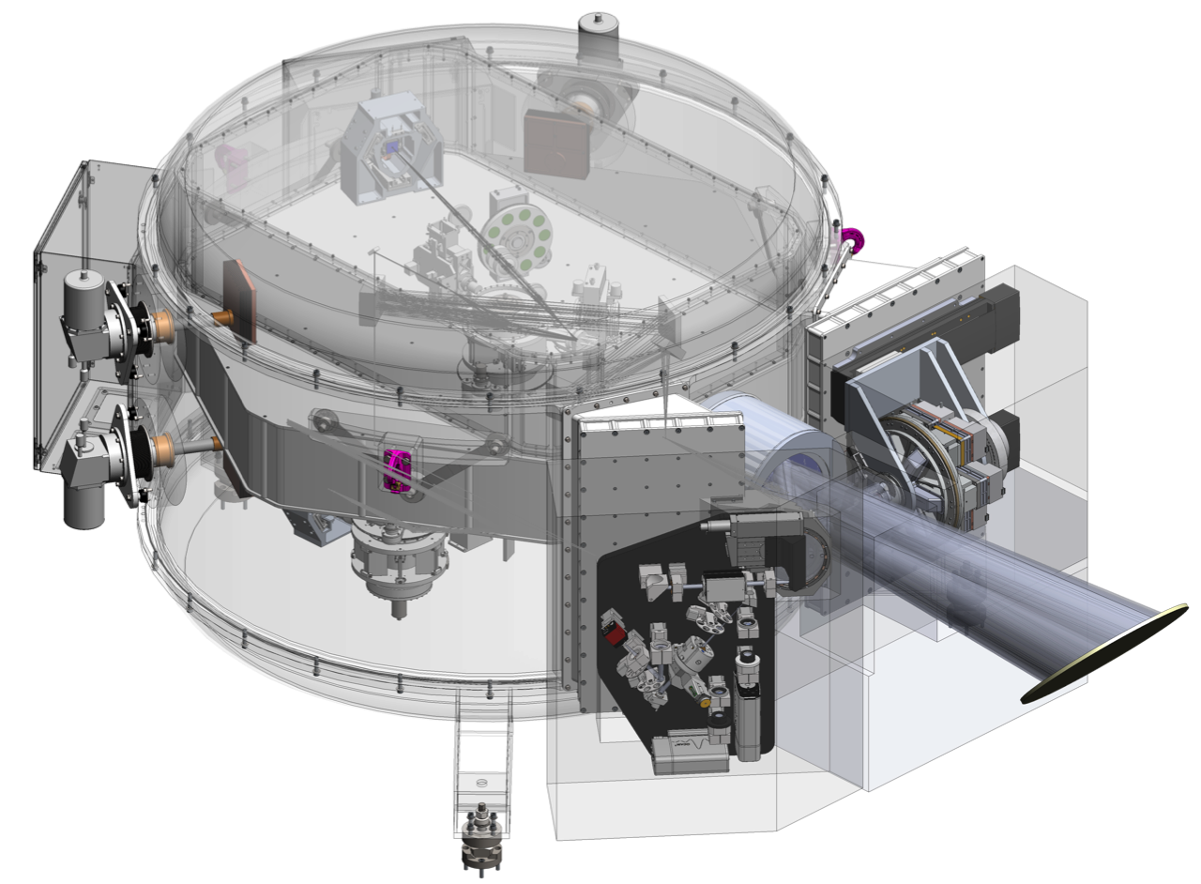
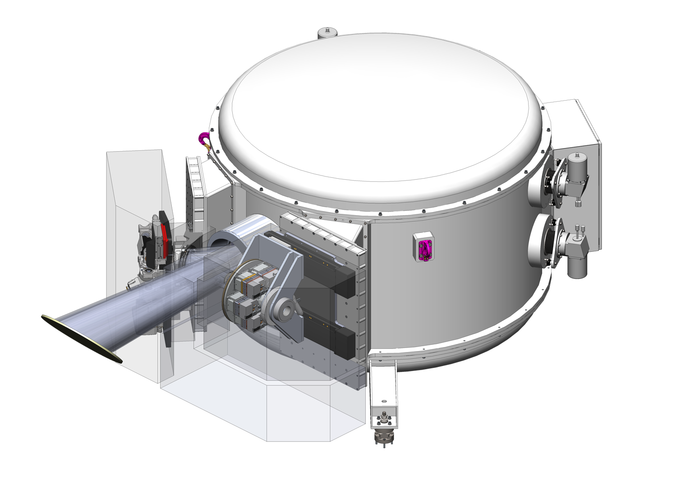
GMTIFS: What is it?
Competitive Conceptual Design Review process
  Jacoby et al., 2012, SPIE, 8446, 1
Selected as First-generation AO instrument
  Commissioning GMTIFS ~2025
  GMTAO modes: NGS, LTAO (and GLAO - calibration)
Imager 22x22 arcsecond
  Matched to the expected ASM corrected field
Integral Field Spectrograph
  Aspect ratio 2:1 for efficient sky subtraction
  Field of view ~4x2 arcseconds with 50 mas spaxles
  Three finer scales (25, 12, 6 mas) with proportionally reduced fields
  Spectral resolution R~5,000 and R~10,000
  Wavelength range λ ~ 1-2.4 μm
Occulting masks – NOT a high-end extreme-AO chronograph system
  Minimalist system
  Range of disks to allow observation of high contrast systems
  Imager and IFS masks
Detector baseline
  2xH4RG-15μm
  2xSAPHIRA eAPD
Control electronics
  ANU cryo preamps
  SDSU ARC-III …

Slide 14
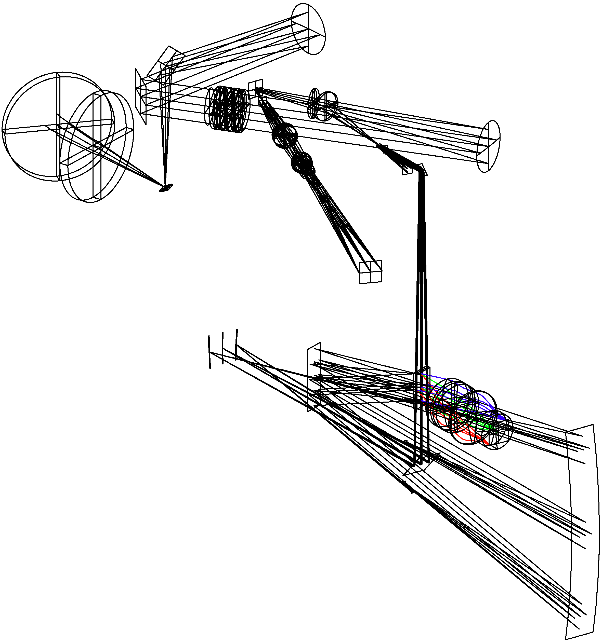

GMTIFS: What is it?
Moving parts (minimal)
Science selector dichroics
Gratings
IFS plate scale
Pupil mask
ADC
Imager:
  Pupil imaging
  NCP calibration
OAP relay, Collimated beam,
ADC+coldstop
Tilted dichroic window pair
Science pickoff
Imager arm
Image slicer,
Grating turret,
Refractive camera
IFS scale selection,
Anamorphic projection

Slide 15
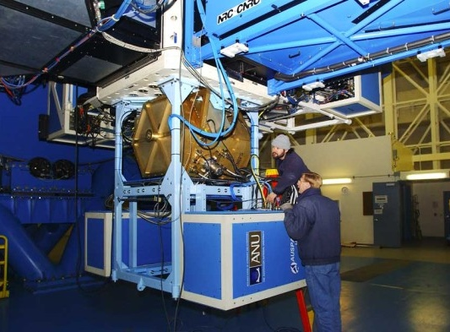
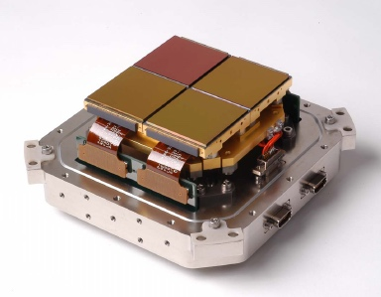
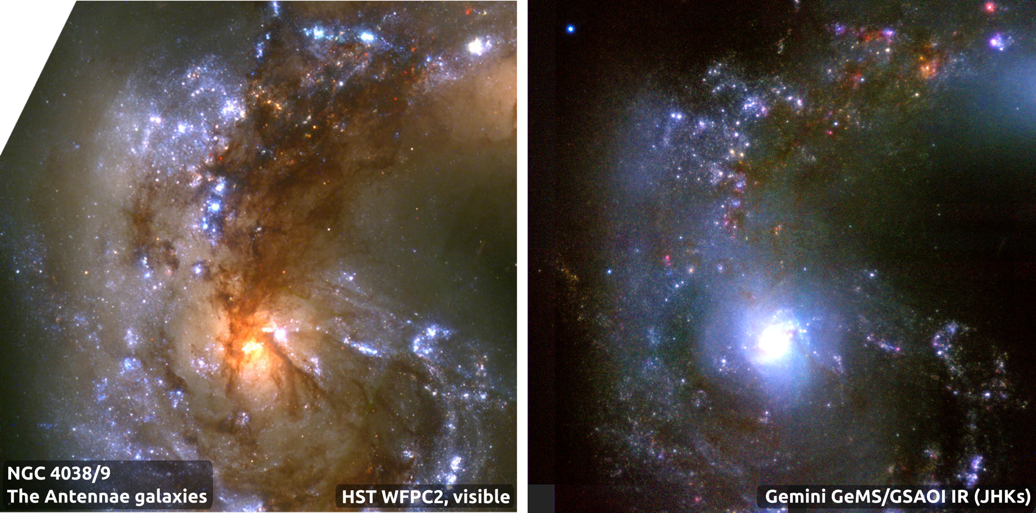
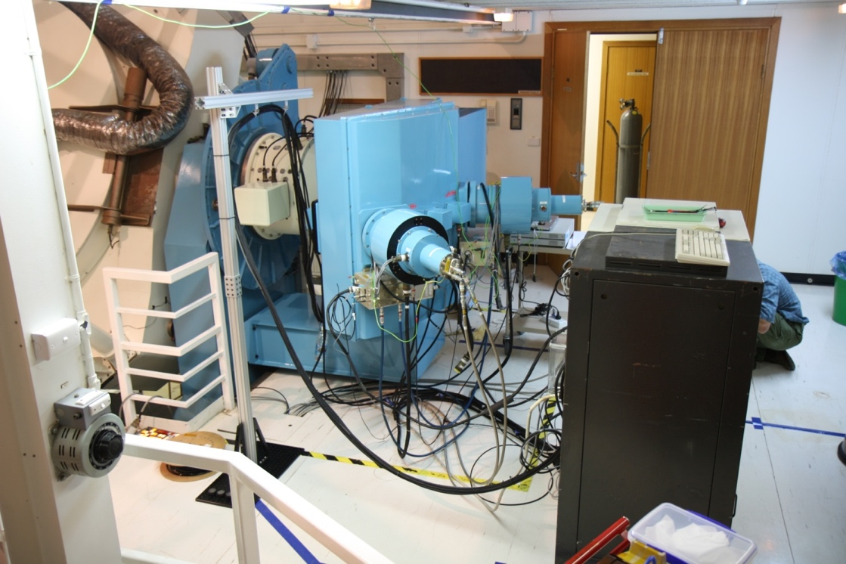
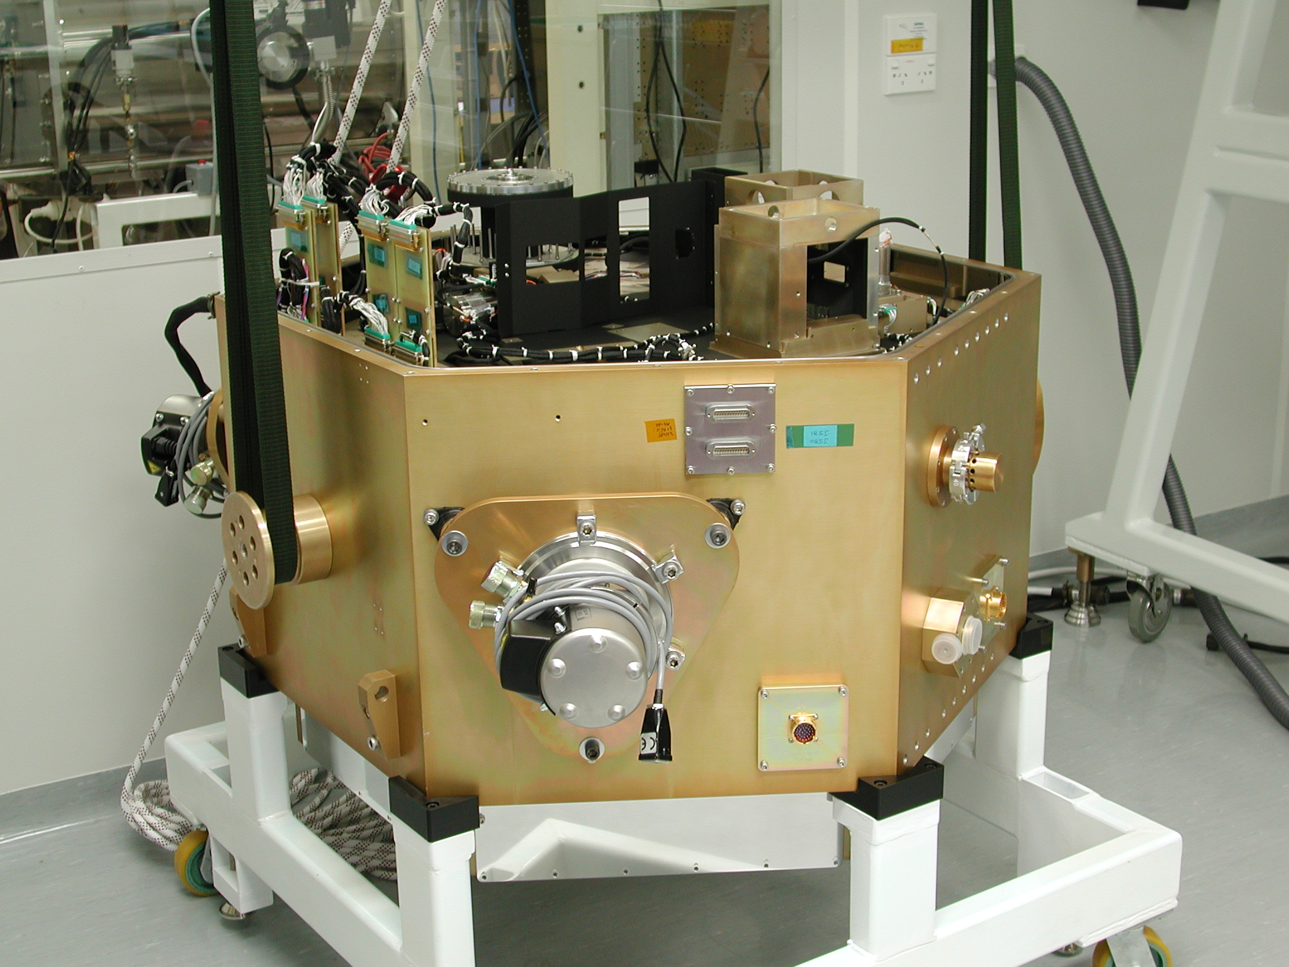
GMTIFS: ANU AO/IFS heritage
GSAOI imager of Gemini/GeMS MCAO
Gemini/NIFS with ALTAIR AO
ANU 2.3m
WiFeS optical IFS

Slide 16
K/I ~ 3.1, Gemini/HST ~ 3.3, GMT/JWST ~ 3.8
Sweet, Sharp, McGregor et al. (2017): Gemini/GeMS guaranteed time
z = 1.067 galaxy cluster SPT-CL J0546-5345, Brodwin et al. (2010)
Gemini/GeMS (K_{s}-band)
HST/ACS F840W (I-band)

Slide 17

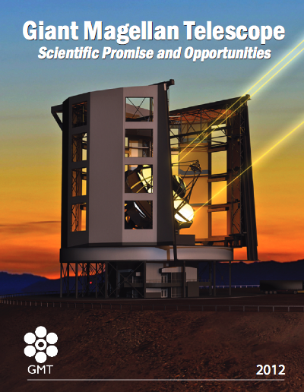

GMTIFS science
Formation & Properties of Exoplanets
  Angular Differential Imaging
  YSO spectroscopy
Stellar Populations And Chemical Evolution
  Resolved stellar populations in nearby galaxies
Galaxy Assembly and Evolution
  Dynamic and morphological studies
  Black-hole growth
Dark Matter, Dark Energy and Fundamentals
  Somewhat tortured links via other key science goals
First-Light & Reionization
  Direct spectroscopy of first light galaxies
  Gamma-ray burst IGM probes
Transient Phenomena
  Gamma-ray bursts, Supernovae

Slide 18
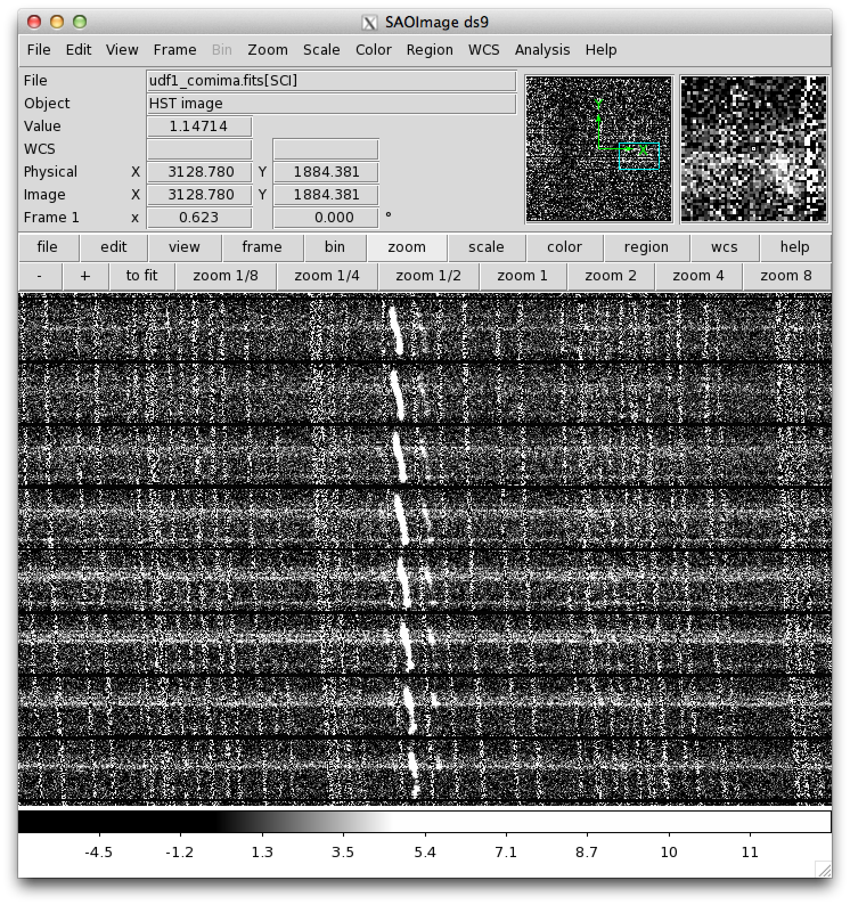
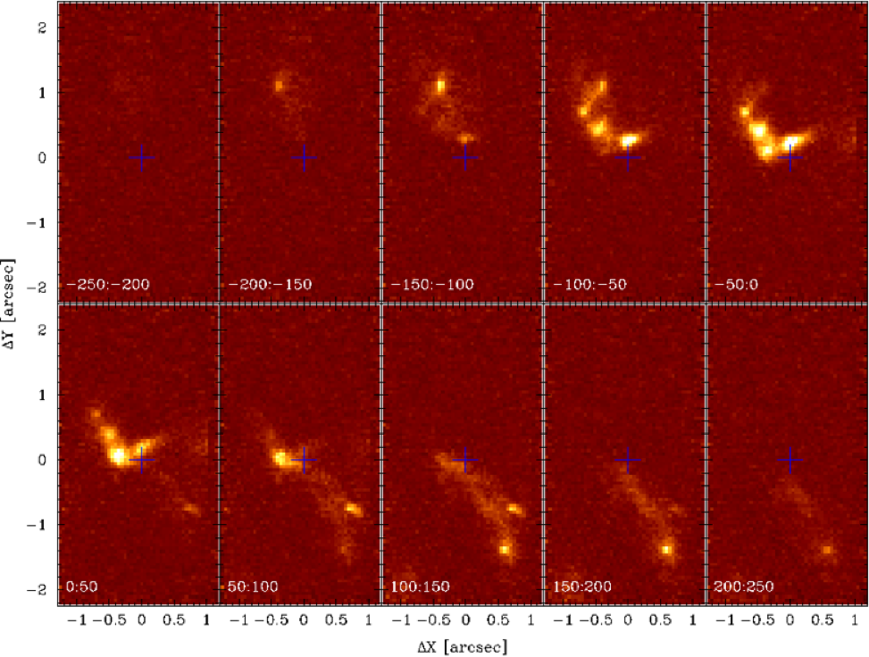

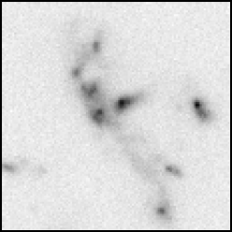
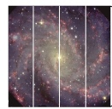


Data format: GMTIFSsim
Simulated Hα data cube, at 100 mas LTAO spatial resolution, representative of galaxies at a redshift z~1-3.
Insert shows HST UDF I-band reference image.
The key is to work at medium resolution R~5,000-10,000
Get between the OH lines
Readout noise becomes an issue

Slide 19
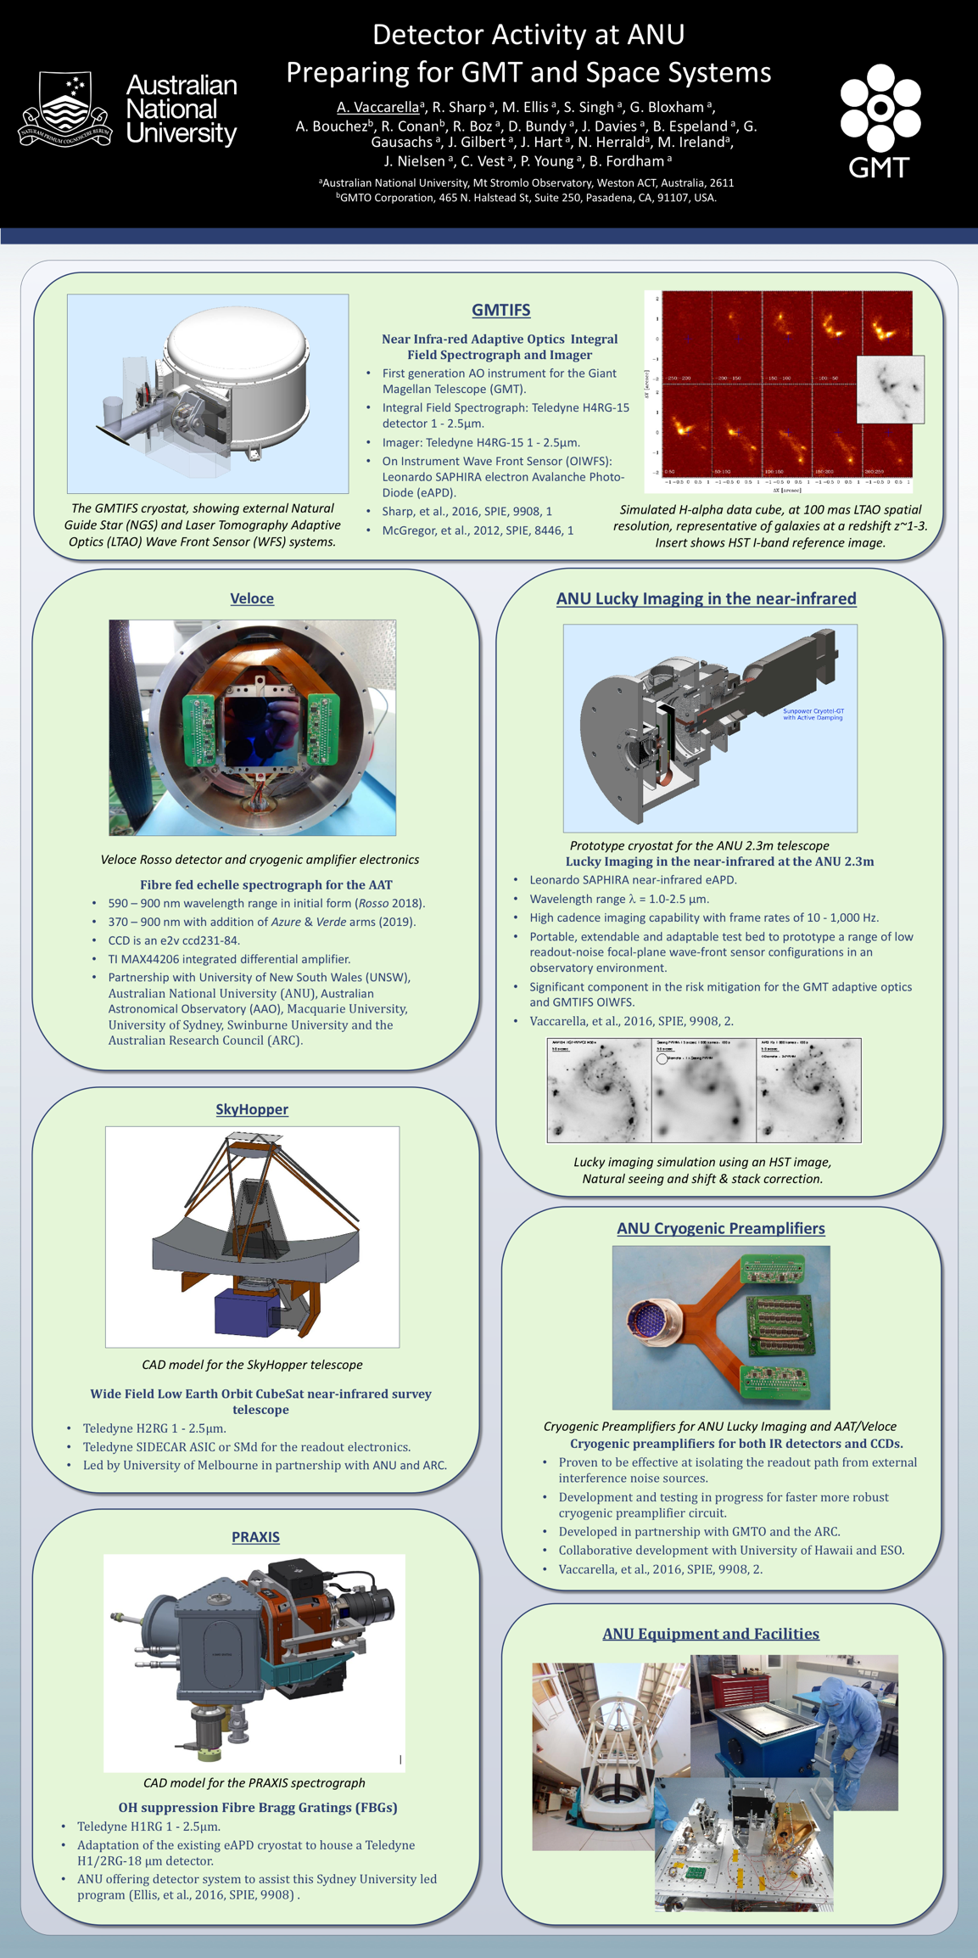
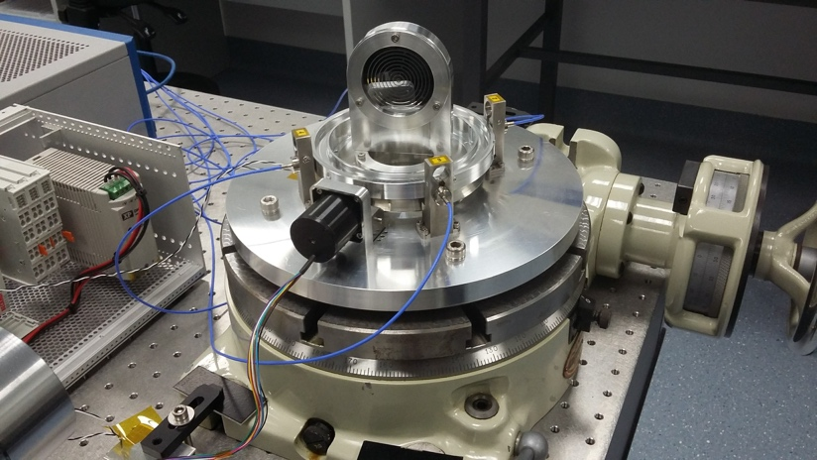
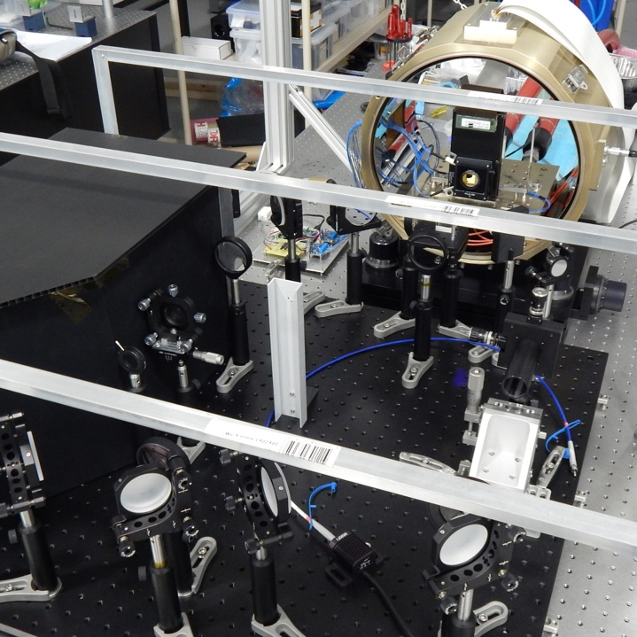
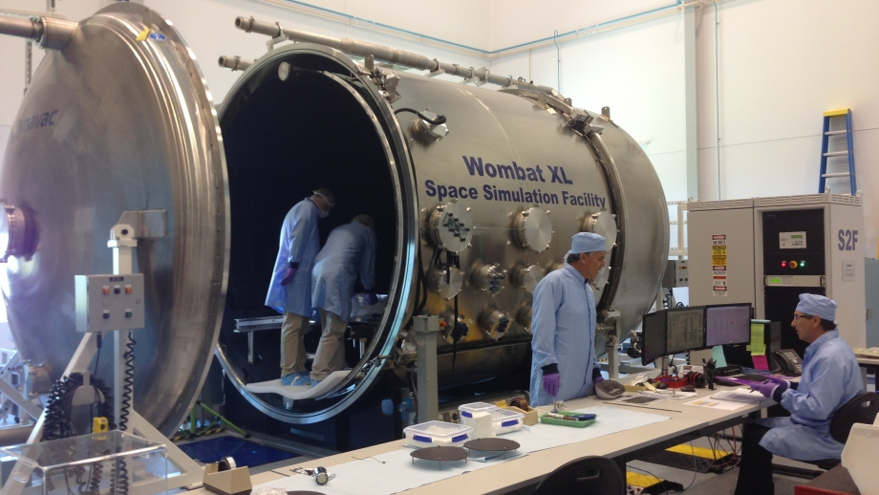
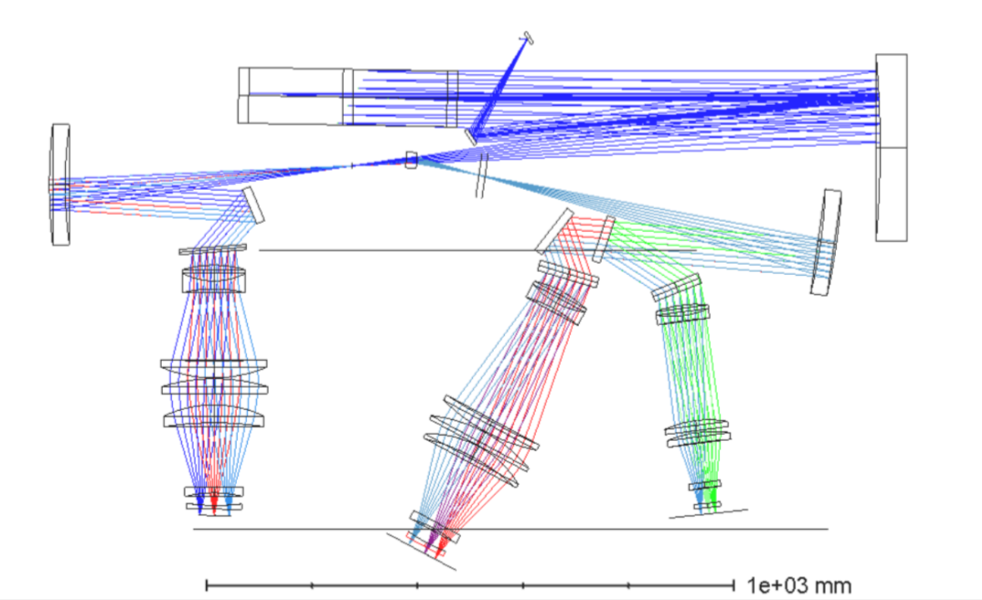
Instrumentation program at ANU
GMT
  GMTIFS
  Cold deformable mirror testing
  LTAO
    Fourth generation sodium laser (semiconductor laser)
Gemini
  NGS2 for GeMS
  Ghost spectrograph
    Software control & Data processing
Subaru
  MCAO preliminary design (F. Rigaut)
AAT
  Veloce Rosso spectrograph
  Taipan (GMT/MANIFEST path finder
    Software control & Data processing
Satellite laser ranging and debris tracking
Laser communications
Remote sensing instrumentation
See Annino Vaccarella for more information

Slide 20
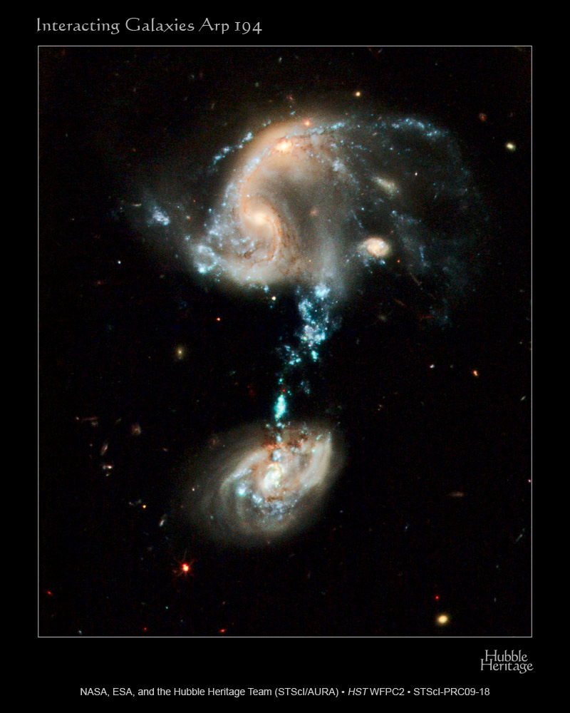
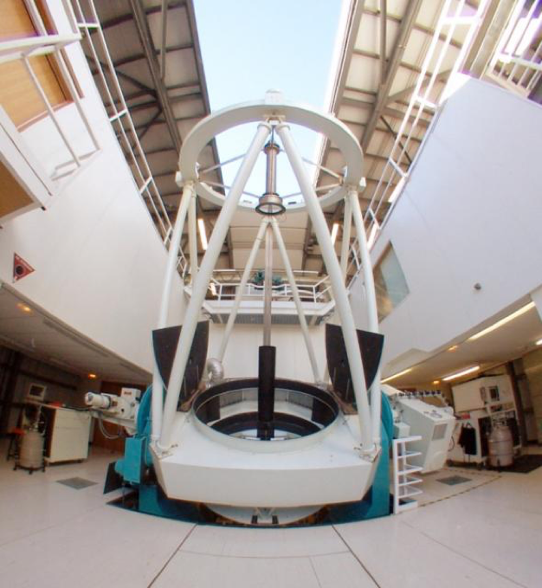
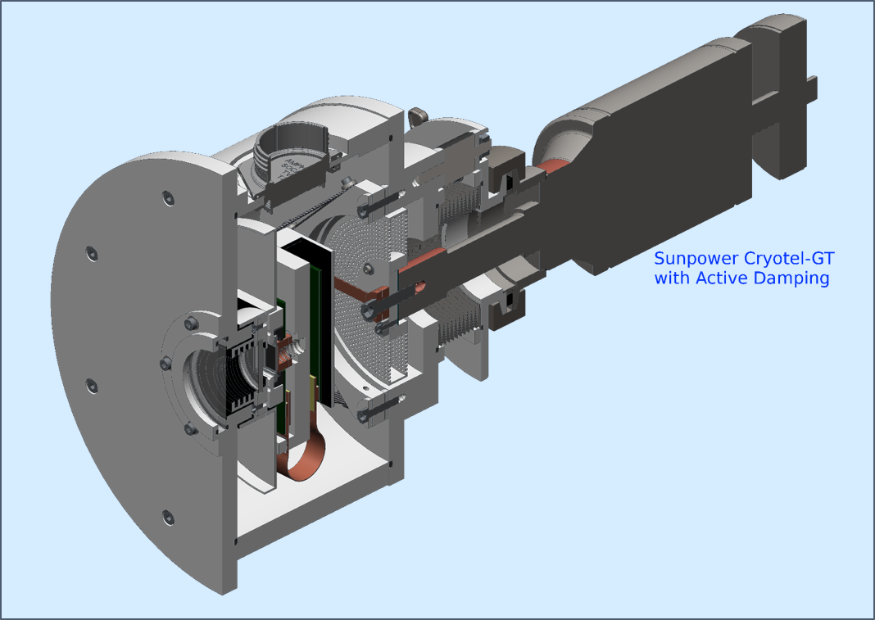

On-Instrument WFS: Technology development
Near-infrared Lucky Imaging at the ANU 2.3m
Simulated
Leonardo
SAPHIRA eAPD

Slide 21


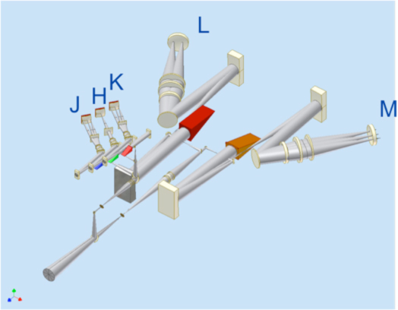
GMTNIRS
First generation AO near/mid-infrared
High resolution spectrograph (R~50,000-100,000)
Polychromatic JHK & LM bands
AO assisted for reduced background
Evolution of a successful calibration
  UT Austin
  KASI
Silicon immersion grating technology

Slide 22
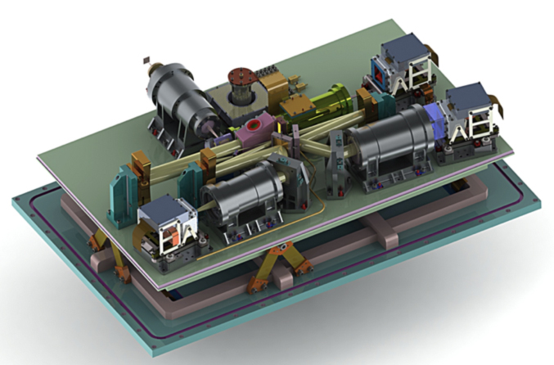
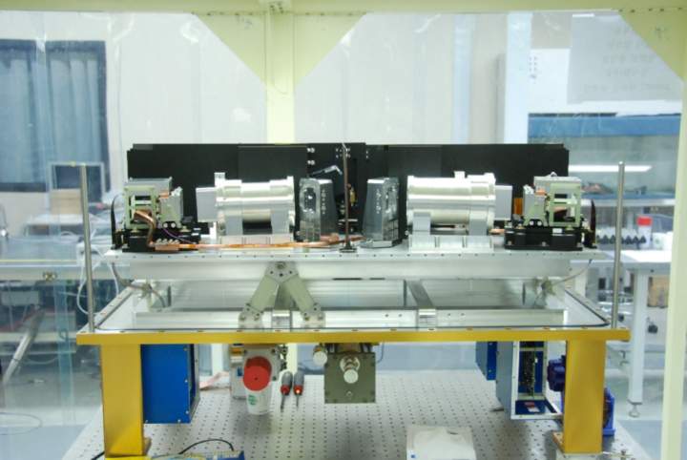
Base on IGRINS heritage
Highly successful instrument
Demonstrate the critical Silicon immersion grating technology on sky
  McDonald telescope
  Discovery Chanel telescope
  Visiting Gemini

Slide 23
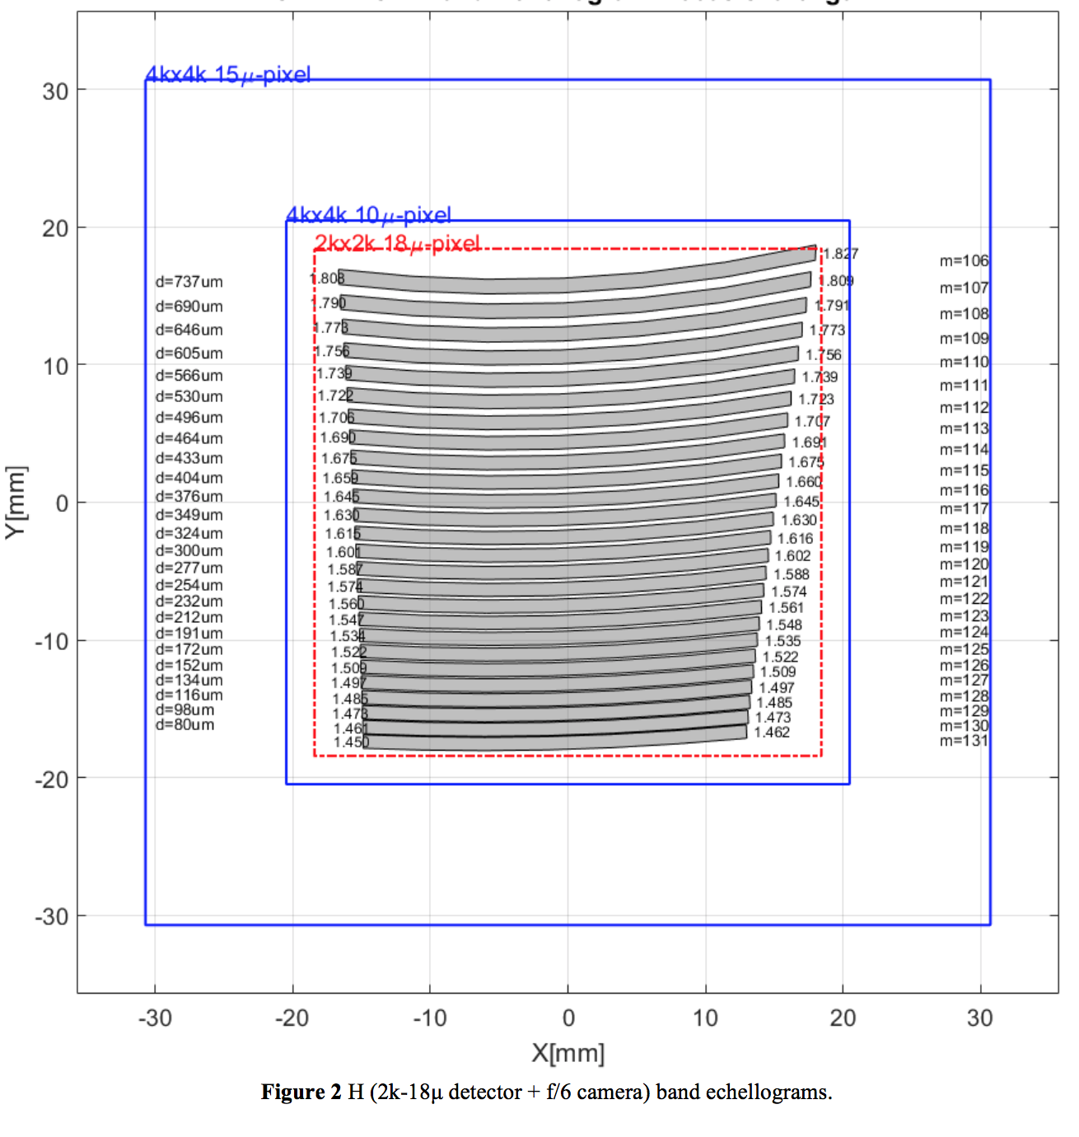
Detector specifications
H-band echellogram
Many requirements in common with GMTIFS
Others complementary
Tolerant to distributed defects (preserve wavelength coverage).
Readout noise
  Low readnoise is important at short wavelengths
  Thermal background at long wavelengths dominates
IGRINS H2RGs exhibits persistence
  As a function of detector temperature
Large defects, even if of low global cosmetic significance, remove wavelength coverage irrecoverably.

Slide 24

Exploring the critical detector properties
The relative importance of common detector specification is considered in the context of the key components of the GMTIFS instrument.
Items are rated from critical to of limited impact.
When assigning a lower rating, the high standards of contemporary detectors are assumed
All properties are of course significant.
  A Lower rating implies the item is not considered a stressing requirement based on contemporary specifications for near-infrared detectors

Slide 25
Detector operations:
Concepts & limitation
Operating mode has a strong interaction with the critical detector performance metrics
6 mas, R~10,000
50 mas, R~5,000
5 mas, Imager

Slide 26
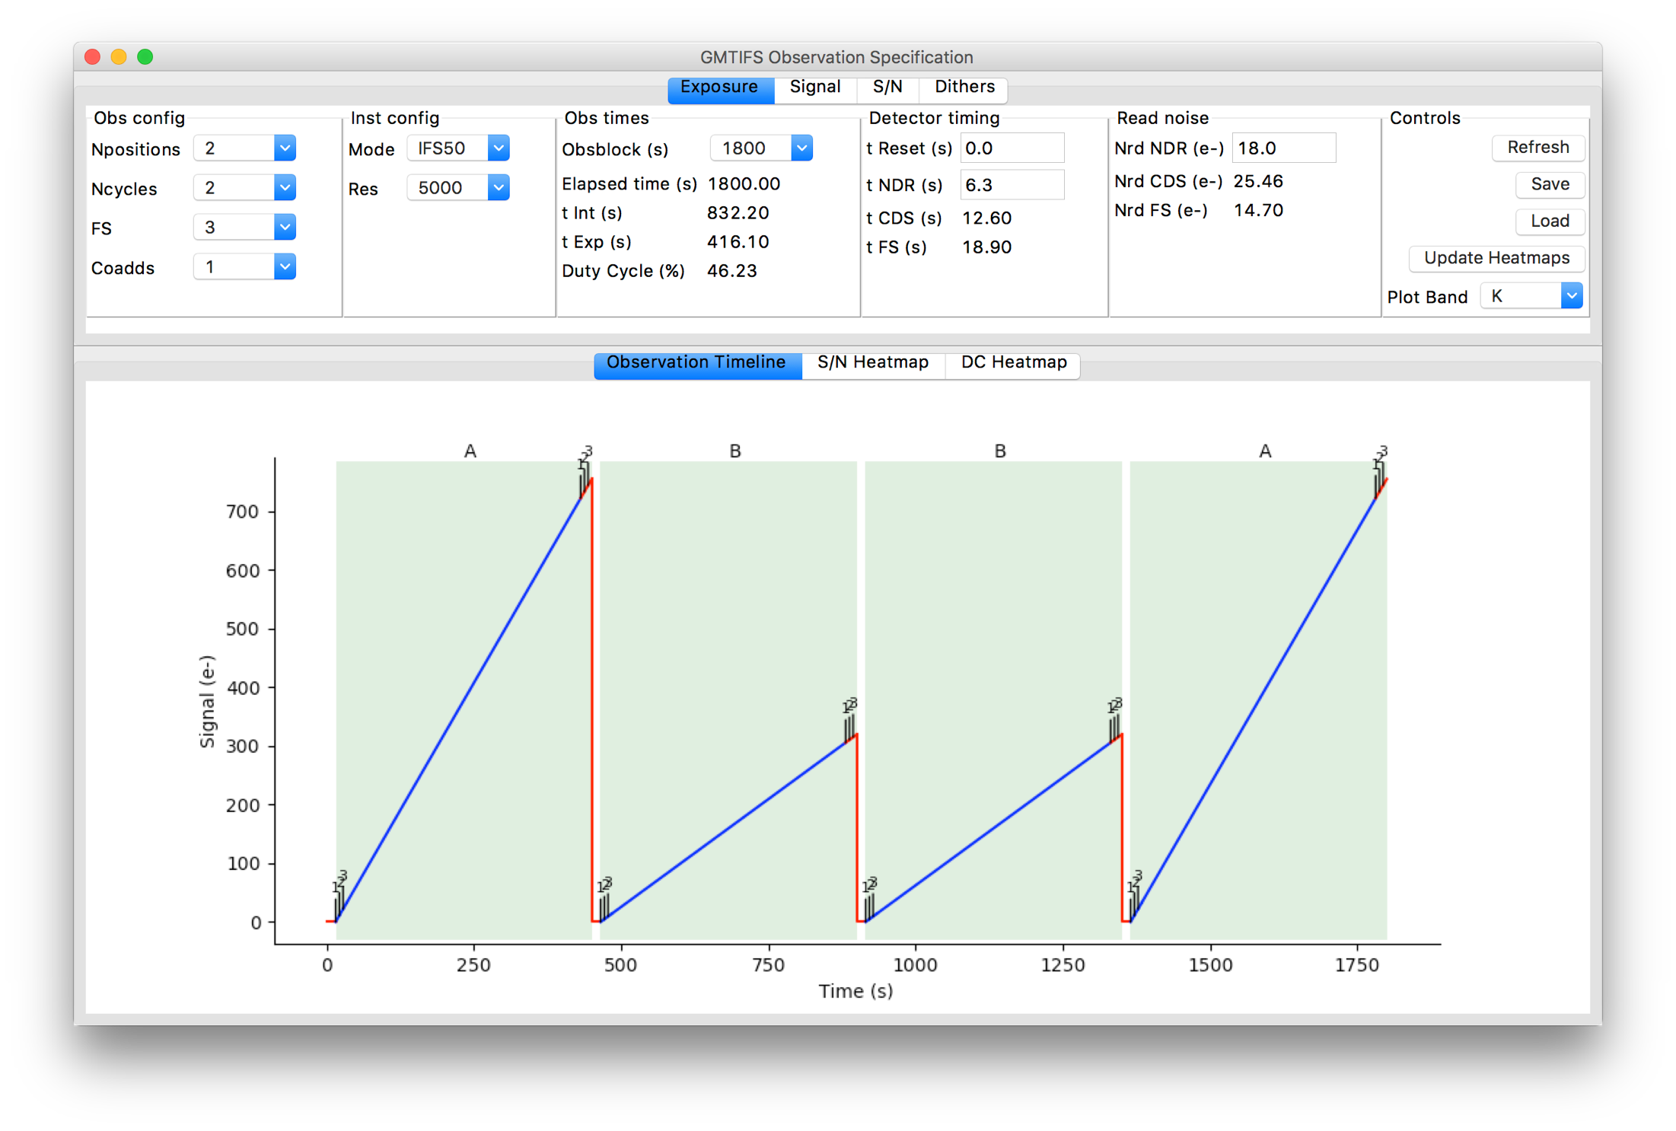
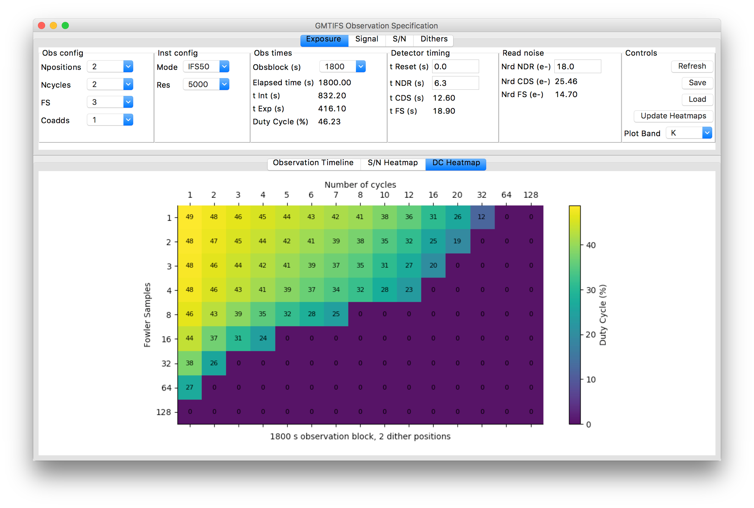
GMTIFS integrated operational modeling

Slide 27
Backup Slides

Slide 28
Abstract
Although detector and control systems for astronomy have evolved since the last Scientific Detectors Workshop, the scientific challenges that the ELTs will address still place demanding and often unexpected requirements on detectors for science, wavefront sensing, and tracking systems. Spectroscopy represents a challenge, with effective readout-noise performance across the full detector system often a critical concern. We give a brief overview of the GMT and its full range of detector systems necessary for science operations with its diverse instrument suite before expanding upon some of the specific concerns associated with near-infrared spectroscopy, using the GMTIFS and GMTNIRS instruments as reference.

Slide 29









GMT Founders consist of universities and scientific institutions
Korea
Sao Paulo, Brazil
Texas A&M
Arizona
New partners are welcome

Slide 30
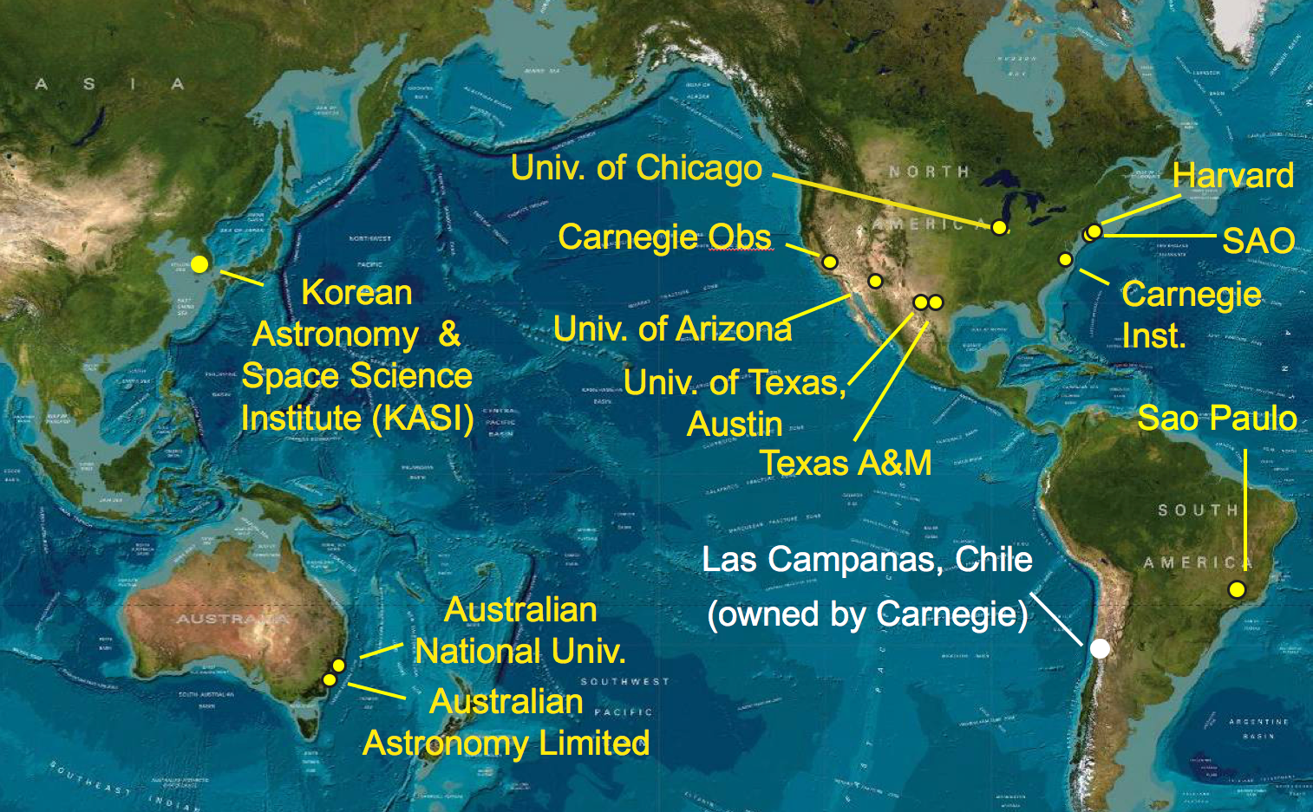
The GMT partnership is global
Las Campanas, Chile
(owned by Carnegie)
Notes:
Academic & research institutions, not governments, which is unique among the ELT projects and in fact unique for a project of this scale.

Slide 31
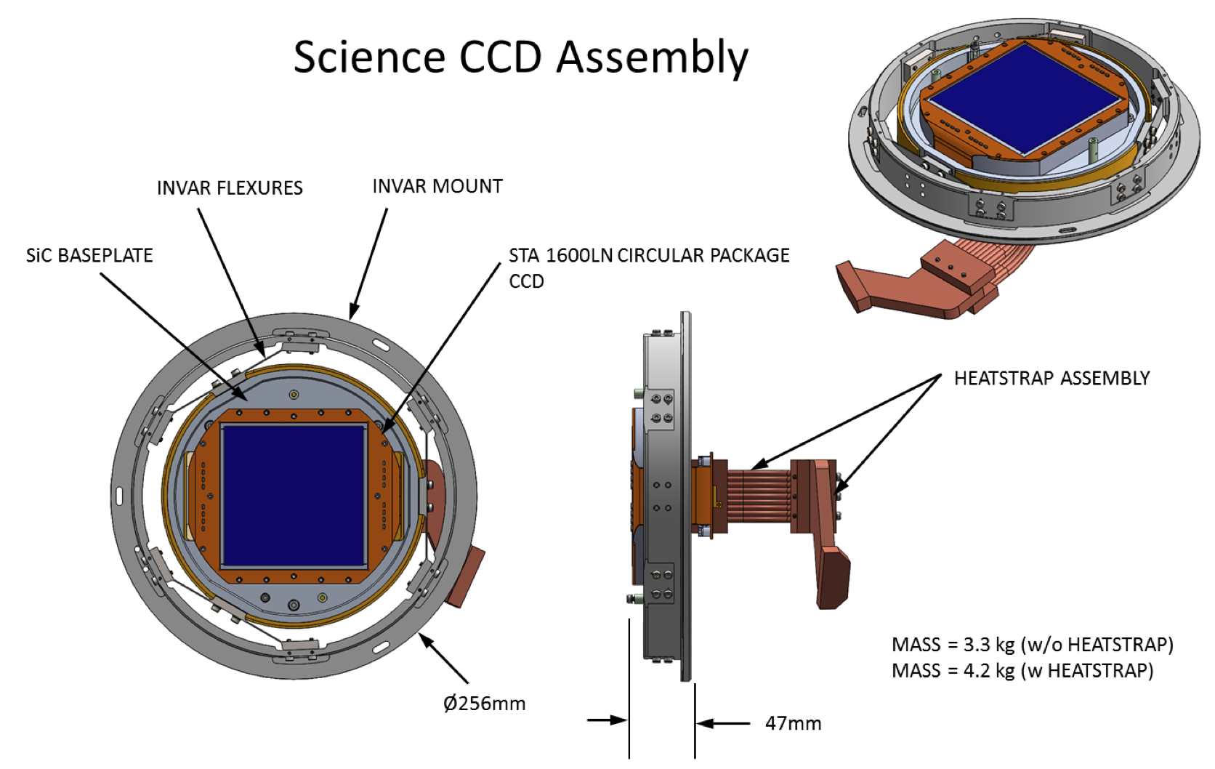
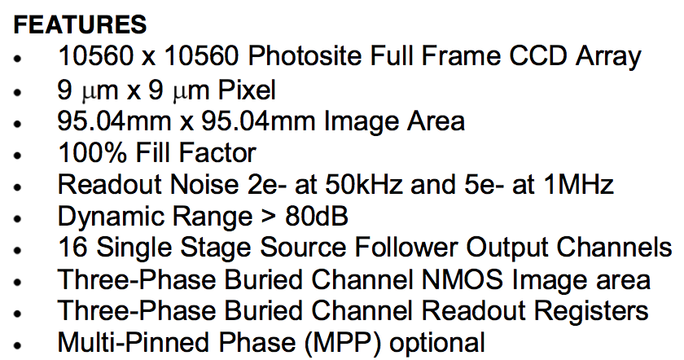
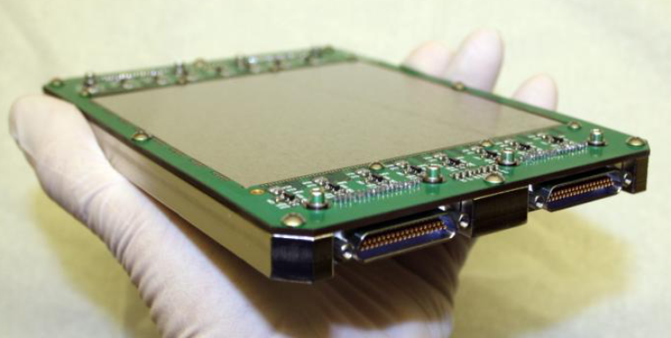
GCLEF Science Detector (in each blue/red channel):
Semiconductor Technology Associates (STA 1600LN)

Slide 32

GCLEF Flexure Control Detector (PDR Design Report)
Preference is to use a GigE data interface on the G-CLEF Flexure Control Camera. Although current baseline camera (Andor iKon 936) has excellent performance, they do not have plans to upgrade this interface to GigE data interface. Therefore, we may replace Andor camera with PIXIS 2048B camera of Princeton Instruments. PIXIS CCD camera has same CCD and USB interface but they are planning to implement GigE interface.

Slide 33

Commissioning Camera (ComCam) Detectors
Detector QE > 75%; > 50%, wavelength ranges: 450 – 750 nm; 375 – 875 nm; goals: 375 – 1000 nm; 350 – 900 nm
e2v CCD231-C6 (under consideration)
6144 x 6160, 15x15 μm pixels
92.2 x 92.4 mm total image area
Read-out noise 5 e- at 1MHz, 2 e- at 50kHz (<5 e- required, <3 e- goal)
Dark current 3 e-/pixel/hour @ -100°C (<10 e-/pix/hr required, <3 goal)
0.06 arcsec/pixel @f/2.16 (<0.07”/pix required)

