Slide 1
GravityCam: Wide-field Imaging Surveys in the Visible from the Ground
Craig Mackay,
Institute of Astronomy, University of Cambridge.
(https://arxiv.org/pdf/1709.00244.pdf )

Slide 2
Introduction and Outline
GravityCam originated as a project because of two very different astronomical programs that were greatly limited by atmospheric seeing, even on the best sites.
The detection of weak gravitational shear.
The detection of large numbers of Earth-sized exoplanets.
But both programs call for fast wide-field imaging with significantly better seeing from the ground.
Lucky imaging could certainly provide that even with 100% selection. That removes tip-tilt and gives images improved in resolution by factors of 2.5-3.

Slide 3
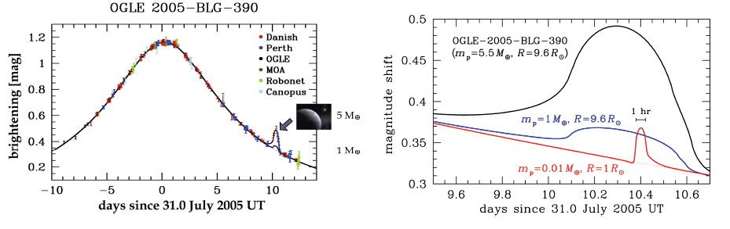
GravityCam: Detecting Earth-Size Exoplanets
The only technique that allows us to detect significant numbers of Earth size planets is gravitational microlensing.
OGLE-2005-BLG-390 was a star ~9.6 R_{sun} and planet of ~5M_{earth}.
An Earth mass planet at the same location around that giant star would have given a ~3% deviation.
A Moon mass object (1.2% mass of the Earth) around a Sun-like star would have given ~1% deviation lasting over only one hour.

Slide 4
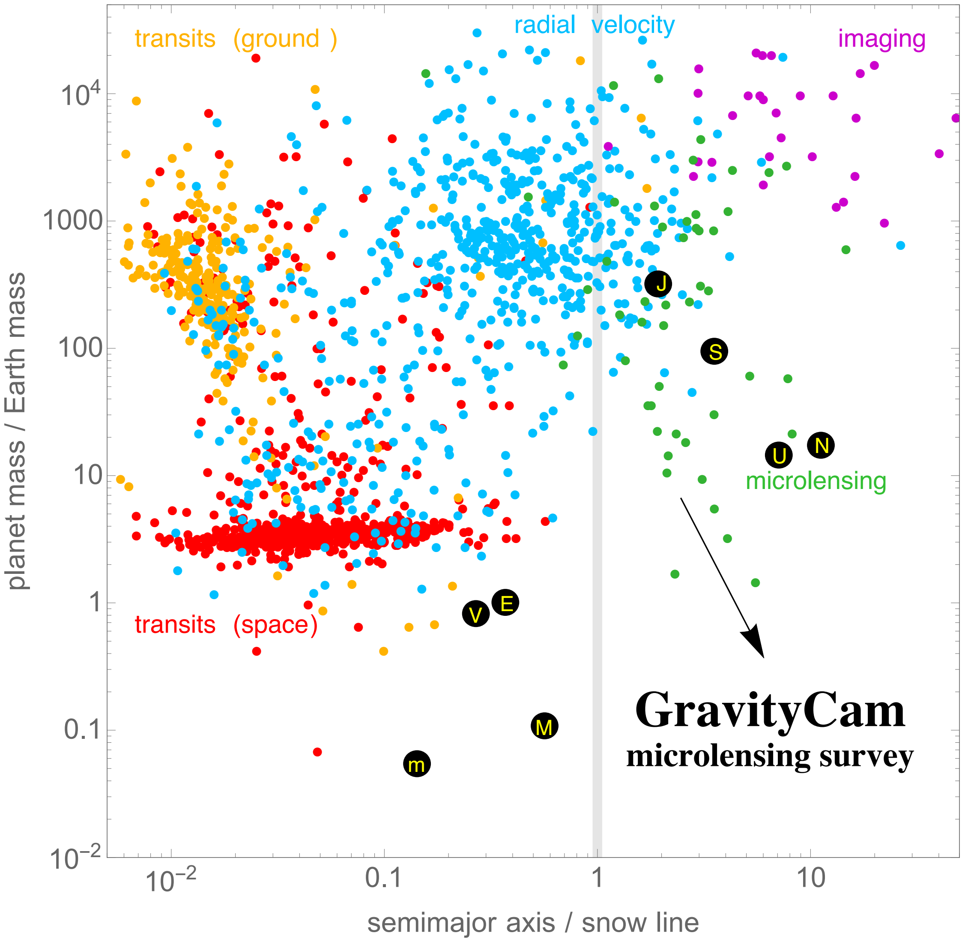
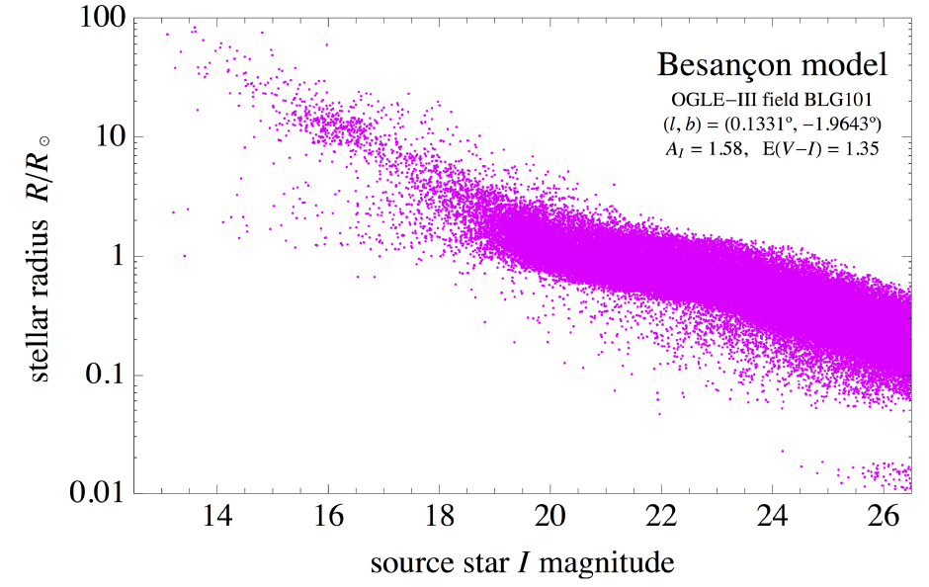
Detecting Exoplanets
Gravitational microlensing is the only technique that can detect good numbers of Earth-size planets.
These events are rare so we must observe lots of stars.
Use Baade’s window in the Milky Way bulge.
Only main sequence stars: giant stars are too big to show microlensing.

Slide 5
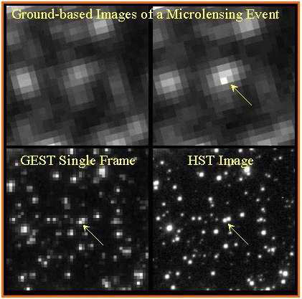
These images are of the bulge, microlensing event MACHO-96-BLG-5.
The top images are ground-based with 1 arcsec seeing.
Most current surveys use even poorer images.
The lower images are HST (single frame and multiframe).
From I ~ 18-22mag (M_{I}=3-7), star densities are ~1/sq arcsec.
At I~24.5, 25 million stars in each of 6 fields.
Seeing critical for rapid discovery. GravityCam does that.
What is the problem we have?
From Bennett, arXiv: astro-ph/0404075v1, 2004

Slide 6
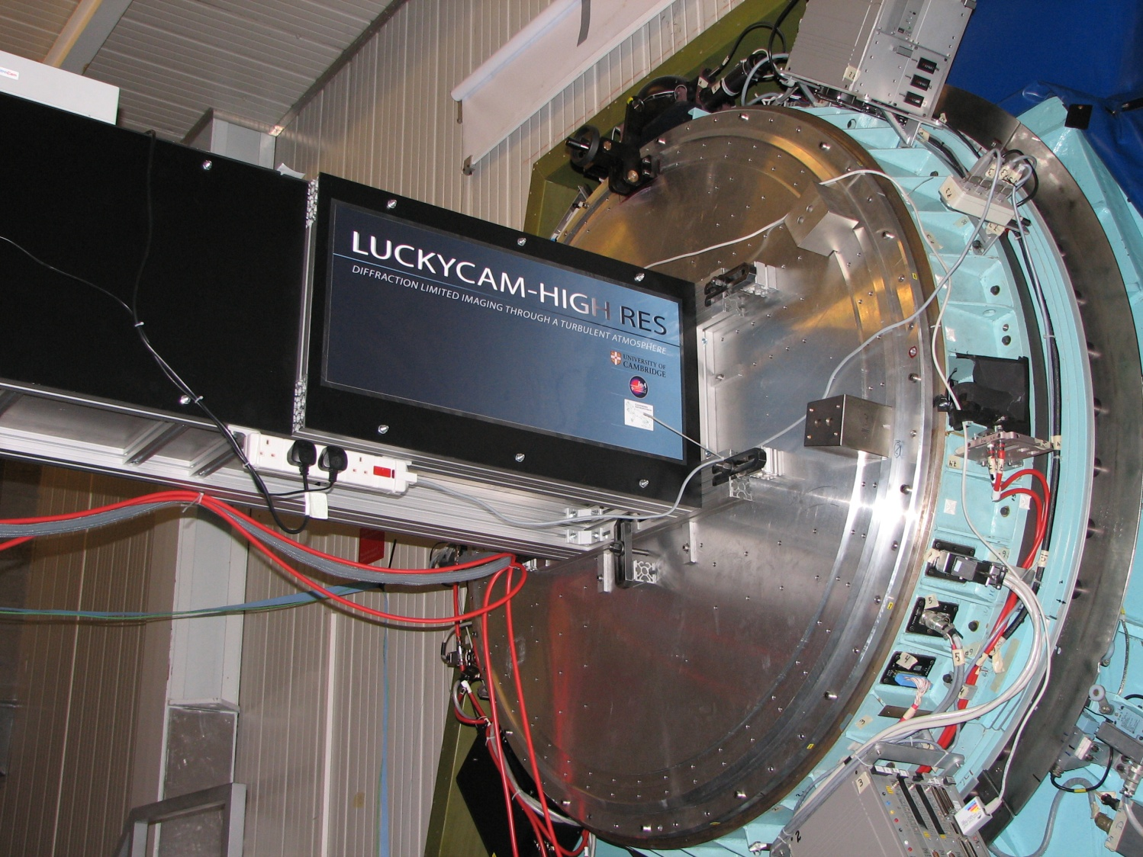
Most telescopes > 2.5 m diameter have small fields of view.
The NTT (3.6 m at La Silla in Chile) has excellent optical performance and a field of view of 30 arcminutes diameter.
GravityCam would mount directly on the NTT Naysmith focus.
The NTT has excellent optical performance and space for GravityCam.
GravityCam

Slide 7
GravityCam
The lucky images would deliver resolution of 0.2-0.35 arcseconds FWHM using 50% - 100% of the images, seeing dependent.
Detailed simulations of the performance have been carried out.
Optically very simple: atmospheric dispersion corrector then directly onto focal plane array of detectors.
Virtually all the technologies needed have already been demonstrated and the cost need not be excessive ($10-15 million).
The biggest cost and uncertainty is the detector array if we use CMOS, our current baseline.
Should not take too long to build (3 years: software main challenge).

Slide 8
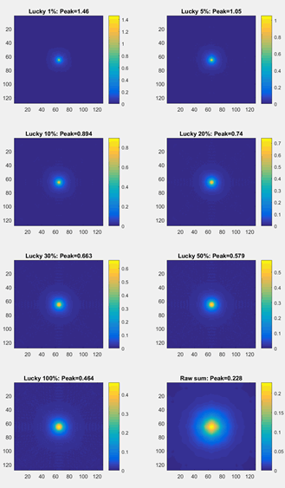
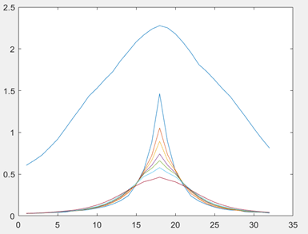
GravityCam
Simulated performance with median seeing on 3.6m NTT.
Plots show raw(x10) in blue upper, then percentages as per figure.
100% gives 0.3 arcsec images, 50% gives 0.22 arcsec images and 15% Strehl ratio.

Slide 9
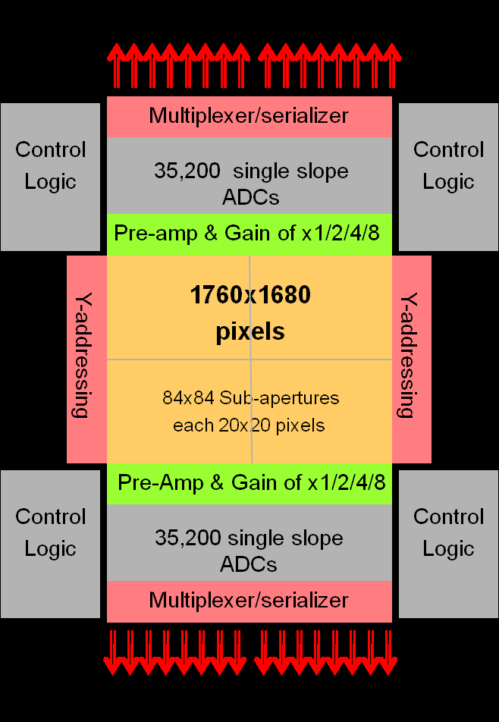
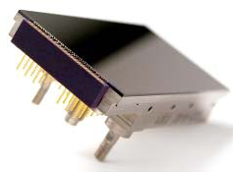
New Advanced Designs Key.
There are some advantages in using faster frame rate detectors if they were available.
A new generation of solid-state detectors, scientific CMOS (sCMOS) are beginning to be used, with over 100 Hz frame rate.
With massively parallel outputs and a buttable package, much higher focal plane coverage is possible.
Compared with EMCCDs, CMOS doubles DQE, increases filling from 0.17 to 0.95.
Increase star imaging rates x6 or so.
Major cost for the project, but only takes ~2 years to design detectors.

Slide 10
Outline CMOS Detector Spec.
GravityCam needs a CMOS array.
Must be three-edge buttable, preferably large format per device.
To cover focal plane ~34 cm diam.
16-20 micron pixels.
Preferably 25 Hz. frame rate.
Readout noise << one electron RMS.
Digitising etc on chip.
Deep depletion silicon for optimum 800-900 nm sensitivity.
Very low cost!!! Project leader Scottish, notoriously mean!
Will also need focal plane assembly.

Slide 11
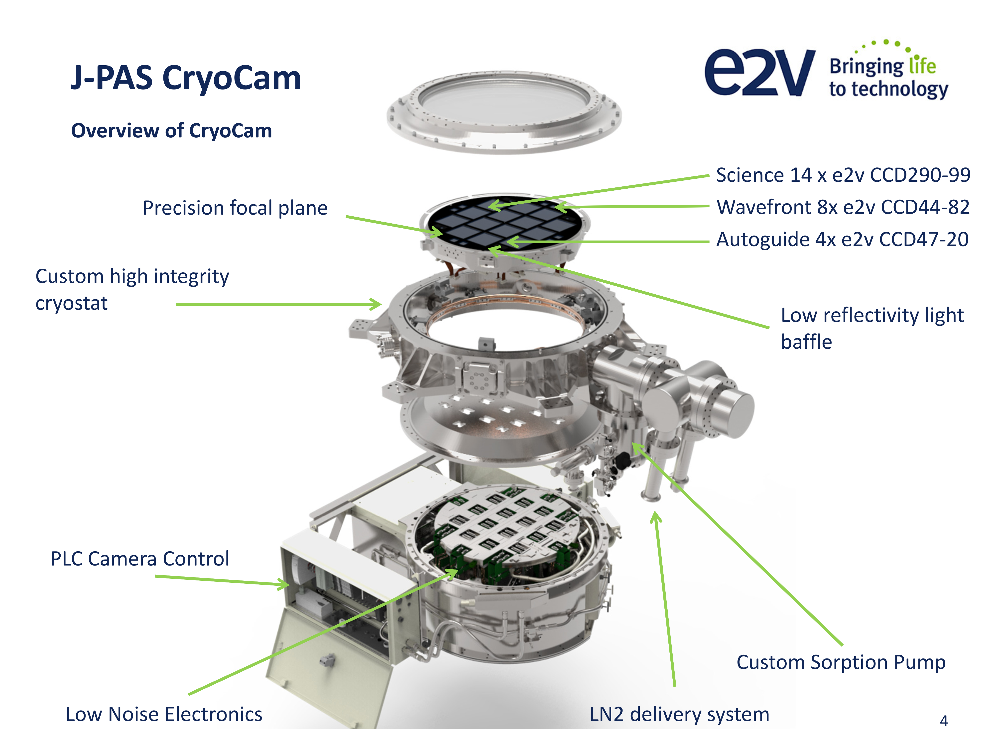
GravityCam: Filling the Focal Plane

Slide 12
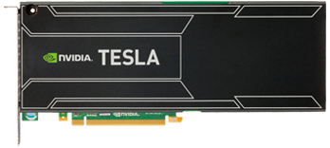
GravityCam: Advanced Technologies
Data management will be interesting!
Each of 36, 9Mpx CMOS will generate ~ 450 Gb/sec (at 25 Hz frame rate).
Total ~500 Tb per night! Must be substantially processed in real-time.
Each CMOS chip would have its own CPU, plus GPU with direct data transfer.
The lucky imaging process could be significantly improved using techniques described by Bramich (MNRAS, 1210.2926, Difference Image Analysis).
Nvidia Volta core PCI-e card.
~25 Tflops/card.
~900 GB/sec memory bandwidth, 384 bit.
5760 CPU cores.
Under $1000/card.
Direct data access to cards is key.

Slide 13
GravityCam: Predicted Performance
In a field such as Baade's Window, a single pointing of GravityCam will see approximately 2.5x10⁷ stars with I<24.5.
The I=24.5 stars will have ~1000 photons detected in 10 min, so with SNR ~ 25-30 after sky background correction.
Clearly detector read-noise is critical.
With an optical depth of ~2.4x10⁻⁶ (MACHO & OGLE estimates) we expect to see a few new events every hour.
Can survey at least six fields (so ~1.5x10⁸ stars) per night so should detect ~200-500 new microlensing events/night.
Planet detection probabilities (Bennett & Rhie ApJ,472,660,1996) suggest we should detect a small number of Earth size planets each night.

Slide 14
Other applications of GravityCam.
Study dark matter via weak lensing regime in galaxy clusters (high spatial resolution of distortions, wide field coverage of clusters).
Asteroseismology with many bright stars in one pointing.
Variable stars in crowded fields (galactic bulge, clusters, Magellanic clouds), including sensitivity to very short period variability.
Wide field multi-filter high-resolution imaging for many purposes (e.g. stellar populations).
Occultation of stars by small solar system bodies. Access to the small end of the Kuiper Belt size distribution and first detection of true Oort cloud objects via serendipitous occultations.

Slide 15
Conclusions.
Lucky Imaging offers a relatively inexpensive way of improving the seeing on ground-based telescopes by a factor of 3-5 (9-25 by area) under most conditions on a good site.
GravityCam allows much larger numbers of stars in high density fields towards the Galactic Bulge to be surveyed.
By observing ~1.5x10⁸ (I<24.5) and seeing lensing at A>10 on those stars per night should allows several new Earth size planets to be detected each night.
GravityCam will let several important research programmes (exoplanet detection, dark matter distribution, Kuiper belt population and others to make progress.

Slide 16

Lucky Imaging Group
Institute of Astronomy
University of Cambridge, UK cdm@ast.cam.ac.uk

Slide 17
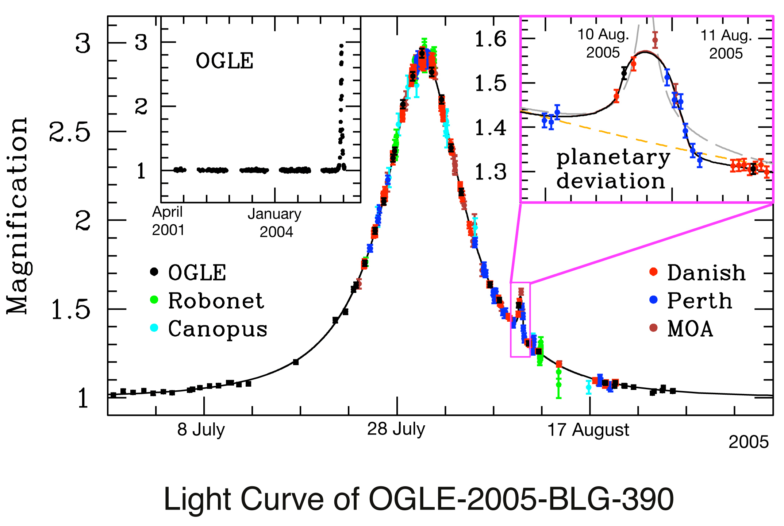
The Photon Budget Is Also a Problem
On a 4 m telescope, a star with I~22 will give 25-100 detected photons per second depending on band pass (achromatic).
Sharper PSF gives a much fainter background per star image.
A 2% (10%) planet lensing effect will require an SNR of 150(30) which will take 250 (10) seconds, neglecting sky background (can’t do this).
SNR much better than this because lensing brightens source, often by large factor.
This is only possible if we have much better seeing than ~1 arcsec.

Slide 18
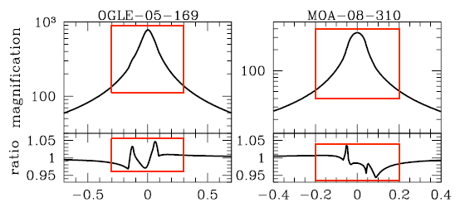
And We Need Good Time Resolution!
We cannot assume that high speed, high resolution follow-up will be available elsewhere.
The microlensing signature from an earth-mass event may only last for a few hours or less.
We need to be able to carry out accurate photometry every few minutes in order to get the most information from the event.
That photometry must be done at the full resolution of the instrument to avoid confusion/contamination in crowded fields.
From Bennett, arXiv:0911.2703v2 (2010)

