Slide 1
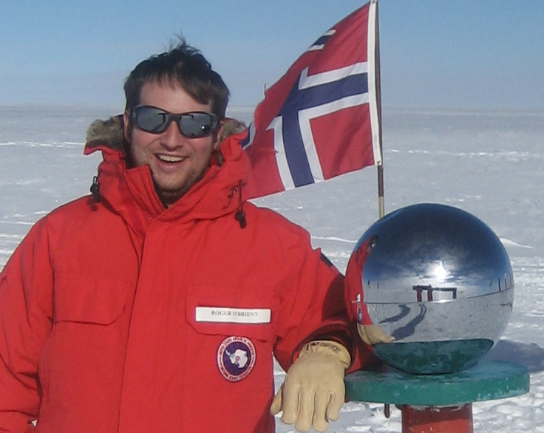
School of Physics & Astronomy
Center for Detectors
Seminar
Moore’s law and astrophysics: detectors that teach us about physics beyond the standard model
Roger O’Brient
NASA JPL / California Institute of Technology
Friday • February 13, 2015• 1pm • GOS 3365

