Slide 1

Pistol Star song by Supergiant
http://supergiant.bandcamp.com/track/pistol-star

Slide 2
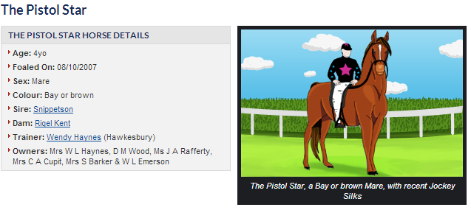
Pistol Star the race horse

Slide 3
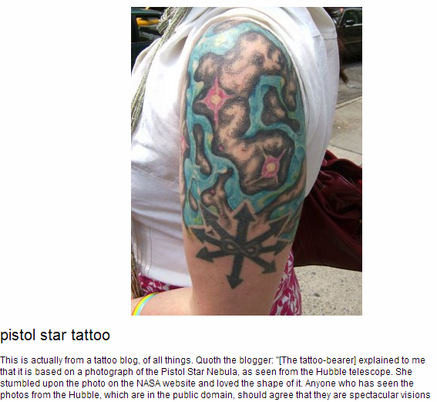
Pistol Star tattoo

Slide 4
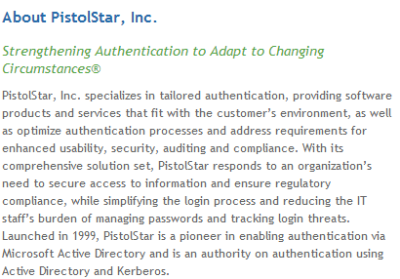

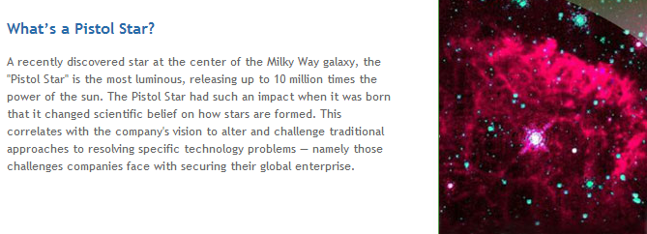
Pistol Star, Inc.

Slide 5
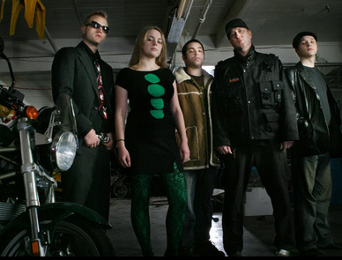
Pistol Star the band
http://www.myspace.com/pistolstar

Slide 6

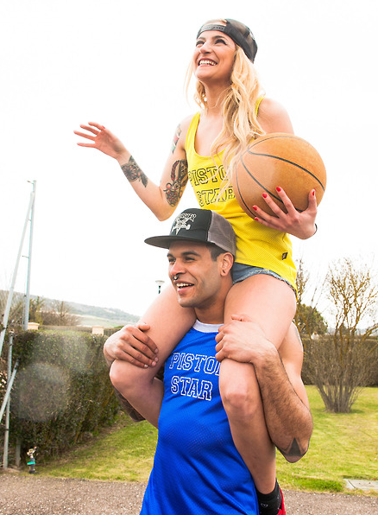

Pistol Star clothing company

