Slide 1
National Quantum Initiative
Ed White – National Photonics Initiative
23 January 2019

Slide 2
The National Photonics Initiative
Established in 2012
Recommendation born out of the National Academy of Sciences study – “Optics and Photonics: Essential Technologies for our Nation”
Collaboration of Industry, Academia and Government
Founding Sponsors: OSA (The Optical Society), SPIE (the international society for optics and photonics)
https://www.lightourfuture.org/home/
An umbrella organization to identify and advance areas of photonics critical to maintaining U.S. competitiveness and national security

Slide 3
NPI – Sponsors & Collaborators

Slide 4
NPI – Key Priorities
NATIONAL
QUANTUM
INITIATIVE
NQI
NPI – Advocating for & Supporting Key Priorities

Slide 5
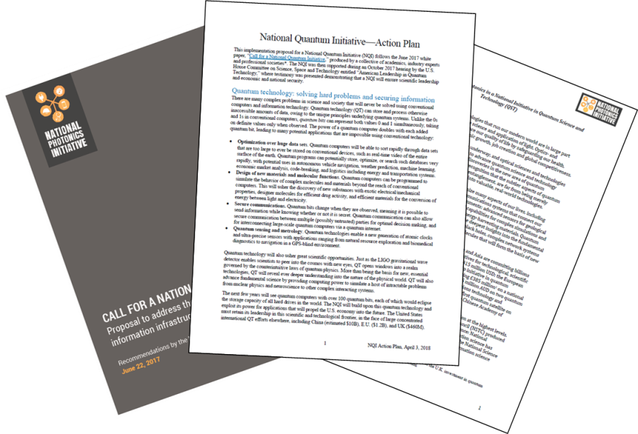
The National Quantum Initiative
Background
The National Quantum Initiative began with a collaboration between the NPI and Dr. Chris Monroe and Dr. Mike Raymer
NPI embraced NQI as one of our Key Priorities… consistent with NPI’s mission of focusing on National Security and the National economy.
With NQI as a Key NPI priority, several enabling efforts were initiated:
In collaboration with Dr. Monroe and Dr. Raymer, a series of Quantum white papers were created focused on educating legislators and the public and proposed a structure for the National Quantum Initiative

Slide 6
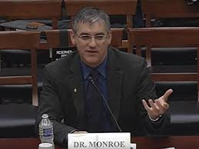
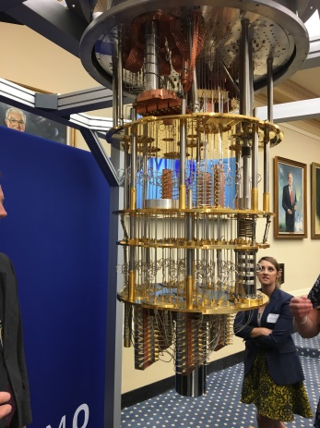
The National Quantum Initiative
Background (cont.)
Collaborative efforts with other professional & industry organizations were initiated to improve effectiveness in advocating for the NQI.
Additional technical experts were invited to provide input to the NQI.
Interested Industry, Academic institutions and professional organizations were encouraged to join the NQI Stakeholder group to provide input, feedback and assist with advocacy.
Chris Monroe
House Science Comm. Event
IBM - House Science Comm.
Event
NPI and Stakeholders collaborated to work with House and Senate Committees to provide important input.

Slide 7
The National Quantum Initiative
NQI Team
NPI
Technical
Experts
GR/PR
Relations
Dr. Chris Monroe
Dr. Mike Raymer
Stakeholders
One Team – Many Organizations- Speaking in One Voice

Slide 8
NQI - Stakeholders
IonQ
The Bagley Group LLC
49 Organizations = more than 100 Individuals

Slide 9
NQI – the Organizational Structure
Coordination Office
OSTP
Subcommittee on QIS
Chairs: NIST/NSF
NQI Advisory Committee
Performing Agencies
NIST
NSF
DOE

Slide 10
NQI – Coordination & Advisory
Coordination Office
OSTP
Provide technical & Admin support to QIS Subcomm. and Advisory Comm.
Oversee interagency coordination
POC on Fed civilian QIST activities
Coordinate collaborative ventures
Conduct public outreach
Promote access to early quantum technologies
Promote access to quantum computing & communication systems
Subcommittee on QIS
Chairs: NIST/NSF
NQI Advisory Committee
NIST, NSF, DOE,NASA, NI, OMB, OSTP, other
Presidential Appt’d: Qualified representatives of industry, Academia and Federal Labs
Coordinate QIST research , use, education & programs within Fed Agencies
Establish knowledge & wrkfrce Goals & priorities
Assess & recommend Fed infrastructure needs
Assess the Quantum workforce
Assess global outlook for QIS R&D
Advise the President & Subcommittee and make recommendations to the President on revisions to the Program
Conduct periodic, independent assessments of the program

Slide 11
The National Quantum Initiative
NIST
Support and expand basic and applied QIST R&D of measurement and standards infrastructure to advance commercial Quantum applications
Use existing NIST programs in collaboration with other Federal departments/agencies to train QIST scientists
Establish/expand collaborative ventures or consortia with other public or private sector entities, including industry, universities, and Federal laboratories for the purpose of advancing the field of QIST
Enter into & perform contracts, including cooperative R&D arrangements/grants/cooperative agreements or other transactions, as to conduct the work of NIST
Convene a consortium of stakeholders to identify future measurement, standards, cybersecurity, other appropriate needs to support QIST
Allocation: up to $80M per year for 5 years = $400M

Slide 12
The National Quantum Initiative
NSF
QIS Research & Education
Support basic interdisciplinary Quantum information science & engineering research
Support human resources development in all aspects of Quantum information science & engineering
May establish a program to provide traineeships to graduate students
Multidisciplinary Centers for Quantum Research & Education (2-5 ctrs):
Advance quantum information science and engineering;
Support curriculum and workforce development in quantum information science and engineering
Foster innovation by bringing industry perspectives to quantum research and workforce development, including leveraging industry knowledge and resources.
Allocation: up to $50M per year for 5 years = $250M

Slide 13
The National Quantum Initiative
DOE
QIS Research Program
Formulate Goals for QIS research
Leverage the collective body of knowledge from existing QIS research
Provide research experiences and training for additional undergraduate and graduate students in QIS
QIS Research Centers
Conduct basic research to accelerate scientific breakthroughs in QIST through the creation of 2-5 Research Centers which will serve the needs of the DOE, industry, academia, other entities
Allocation: up to $125M per year for 5 years = $625M

Slide 14
The National Quantum Initiative
Next Steps
Advocacy efforts will focus on the Appropriations process to fund the Quantum effort.
Late January – Early February
Meet with DOE (NSF when the Fed gov. re-opens) to discuss funding QIST and the establishment of Quantum centers
The goal is to have the federal agencies support the appropriations request/s.
February
Review/analyze the President’s budget for funding opportunities
Meet with key member offices and the Appropriations committee to target funding opportunities

Slide 15
The National Quantum Initiative
Next Steps
February 25 – 26
NQI Stakeholders meet in DC with their respective Representatives/Senators to advocate for appropriated fund
NQI Stakeholders meet with appropriations committee staff to advocate for appropriated funds for the NQI.
Late February – Mid March
Appropriations requests are submitted to committee staff and respective members of Congress.
2nd quarter - 3rd quarter
Follow up with member offices
Meet with the targeted Representatives/Senator in their home locations
Goal is to appropriate $1.275B to fund the NQI

