Slide 1


Electro-optic Quantum Transduction between Superconducting Microwave Qubits and Optical Photons
Mo Soltani, PhD
Leonardo Ranzani, PhD
Quantum Engineering & Computing Group
Physical Sciences & Systems Department
This document does not contain technology or technical data controlled under either the U.S. International Traffic in Arms Regulations or the U.S. Export Administration Regulations.
Space & Airborne Systems

Slide 2
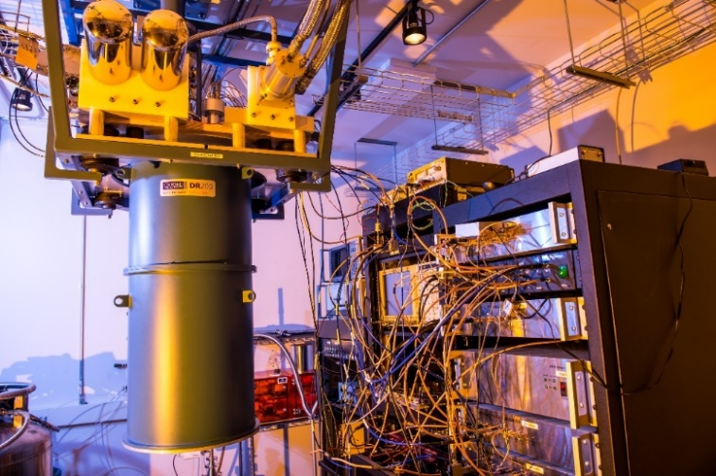
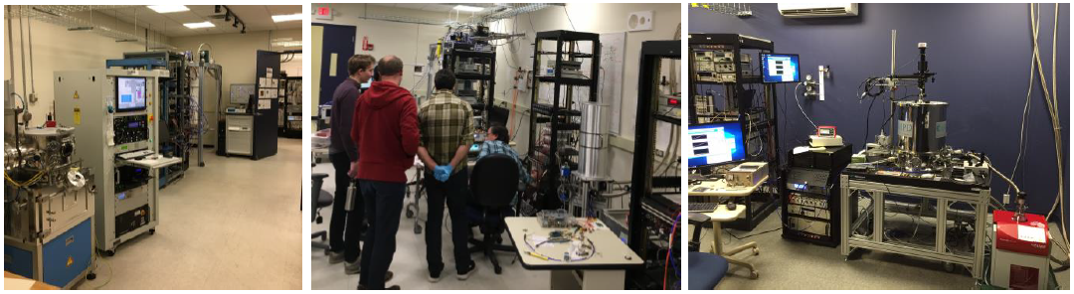
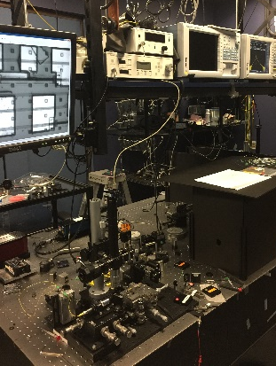
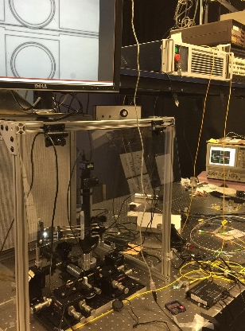
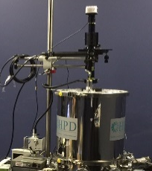
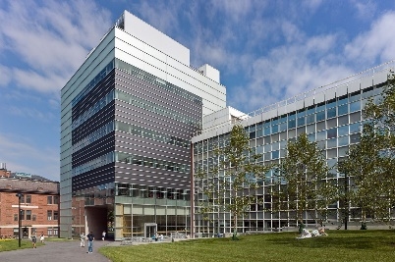
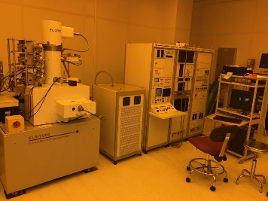
Photonics and Superconducting Quantum Technologies at Raytheon BBN
Cryogenic/Superconducting Electronics Labs
Optics & Integrated Photonics Testbeds
Raytheon DOD trusted III-Nitride (GaN) foundry at Andover MA
UV/Visible/Telecom Range
Cryogenics
Access to Harvard Nanofabrication Facility

Slide 3
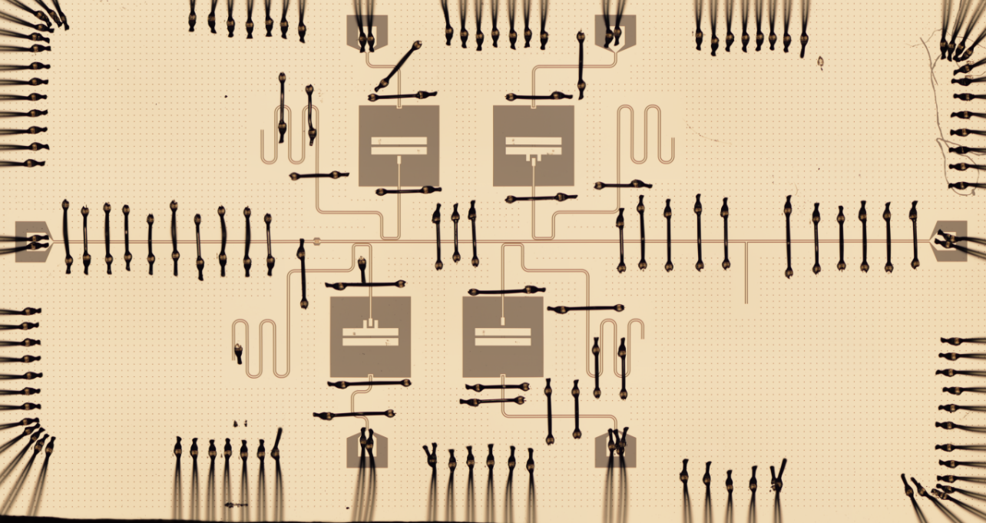
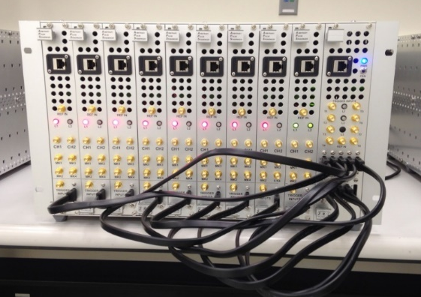
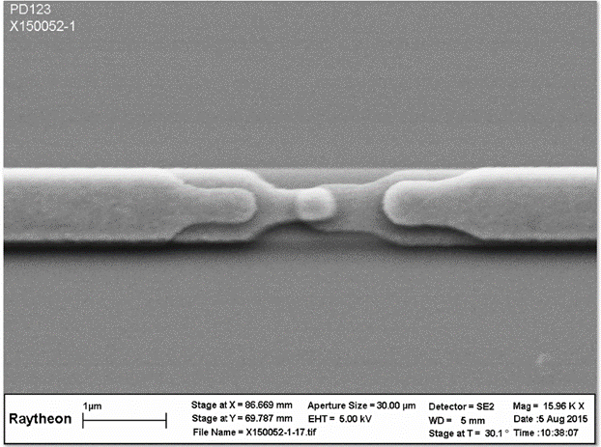
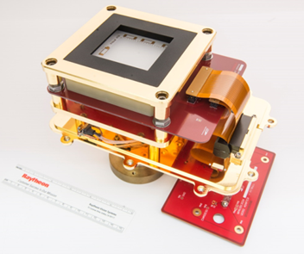
Quantum Engineering and Computing @Raytheon BBN
Algorithms
Novel uses of quantum walks for optimization problems
Randomized methods for characterizing circuits
Programming Languages
Quantum Gate Language
Extensive research in higher-level language design
Classical Control
Custom AWGs and Digitizers
Cryogenic digital and microwave circuits
Devices
  Photonic Integrated Circuits
  Novel quantum-limited amplifiers
  Multi-qubit circuits
Multiqubit and amplifier chips circuits
Quantum control circuits
Fabrication and packaging
Qubit specs:
T1 and T2 from 15-25 us
Resonant frequency = 7.1-7.4GHz
  First demonstration of metro area QKD in Cambridge, MA (DARPA Quantum Network Program)

Slide 4
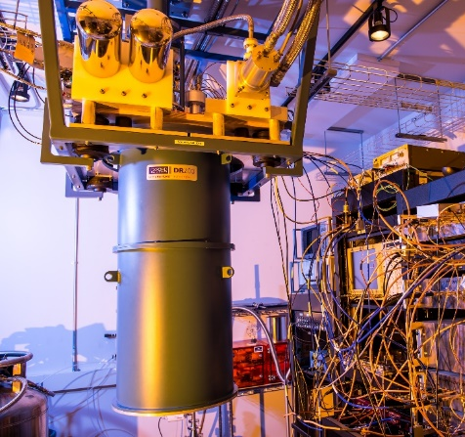
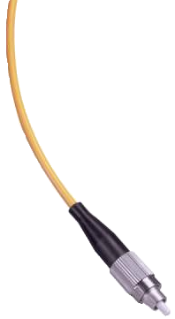

Interfacing Superconducting and Optical Technology
Cryogenic Classical/Quantum Computing
Optical comm for classical/quantum data transfer to remote distance
Dilution fridge
I/O via Optical MUXING,
analog field generation CryoCMOS, limited DSP
RT
Coherent quantum state transfer between cryogenic and room temp on fiber
Replacing traditional copper cable I/O with optical fiber for massive classical data transfer
Cryomemory
Digital SFQ (logic/ADC)
MMIC
77K
Cryogenic computing/sensing node A
4K
Quantum Packaging
0.1K
Quantum Devices
0.01K
Cryogenic computing/sensing node B

Slide 5
Quantum Technologies: Superconducting vs. Optical
 | SC Quantum Technology | Optical Quantum Technology
Qubit operation frequency | 5-10 GHz | 193 THz
Operation Temperature | 10 mK | Room temperature
Single photon nonlinearity | Strong (enables high fidelity gates) | Weak
Quantum memory | Yes (tens of microseconds and more) | No
Long distance comm/interconnect | No (stationary qubit) | Yes (flying qubit)
 | Strong candidate for computing | Strong candidate for comm. (~km travel with no need for quantum repeater)

Slide 6
Pursued Transduction Schemes
Technology | g/2π | Thermal & Mechanical stability | Scalability | Tunability | Comment
Optomechanics | Hz-100 KHz | Low | Low | Low | Suspended, hard to scale
Piezo-mechanics | 50 KHz | Low | Low | Low | Similar to optomechanics
Magnon | 10 Hz | High | Low | Low | Small g < 10 Hz, suspended
Electro-optics | 100 Hz-10 KHz | High | High | High | High g, ultrahigh optical Q (10⁷), moderate microwave Q (10³-10⁵)

Slide 7
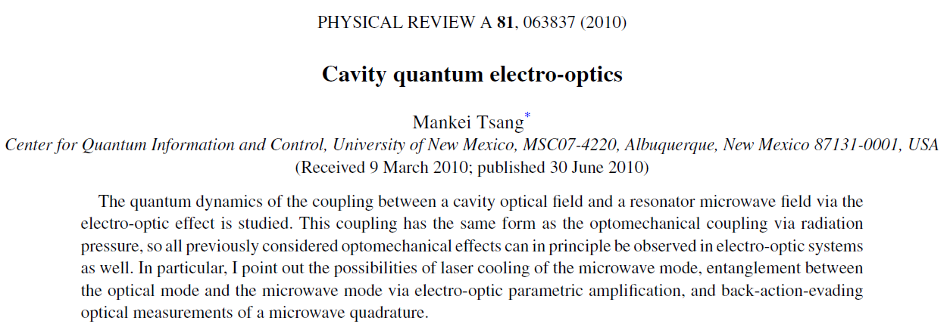
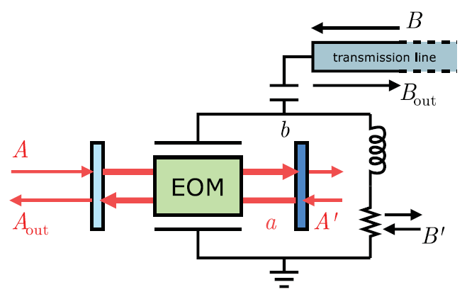
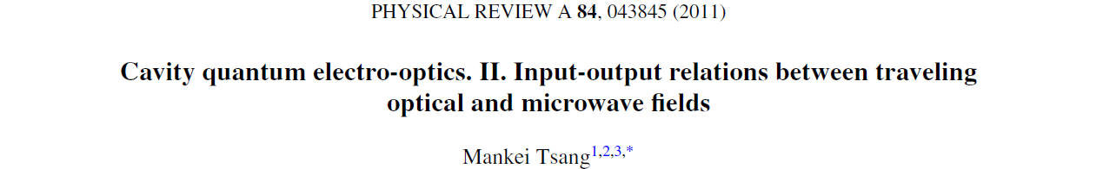
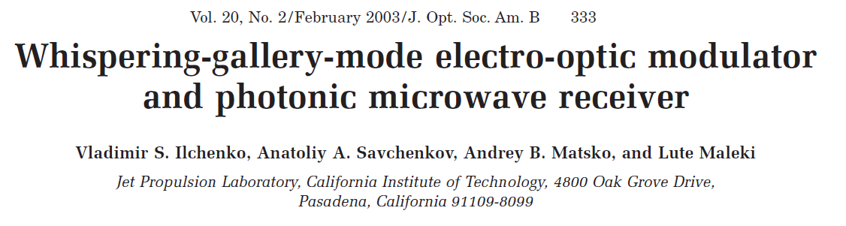
Quantum Electro-Optic Transduction

Slide 8
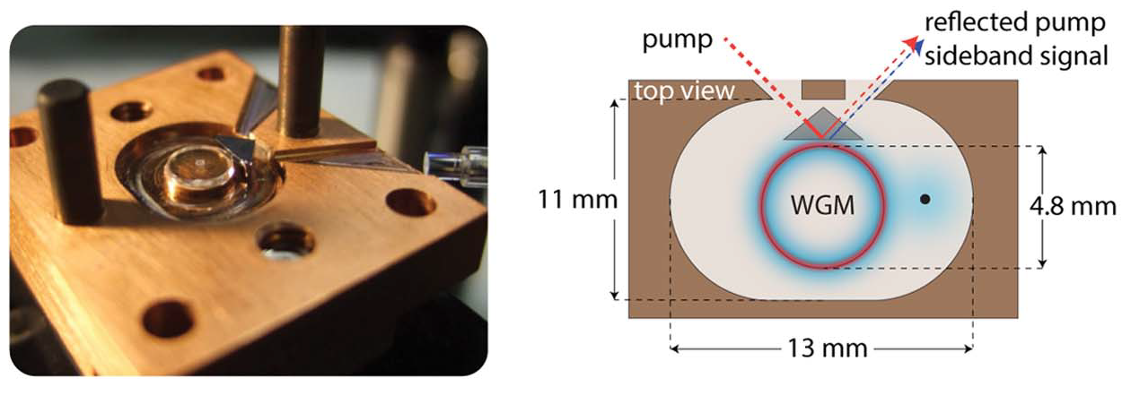
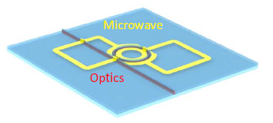
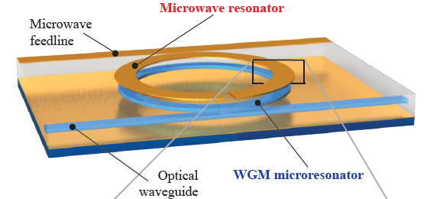
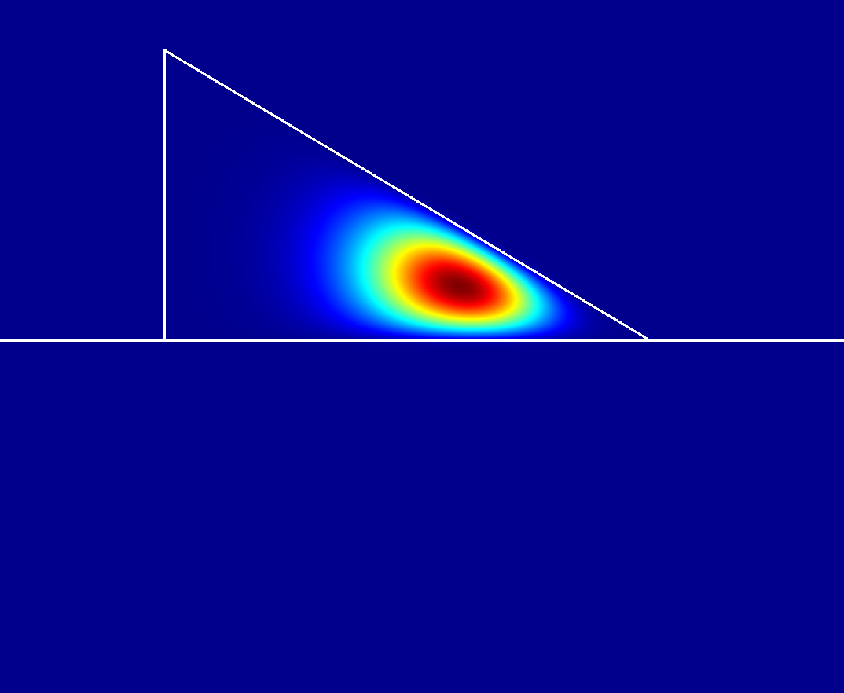
Example of EO Transduction Schemes
WGM EO Resonators, Harald Schwefel
Integrated AlN resonators, Hong Tang (Yale)
Early work of our group in collaboration with OEWaves and IBM
Integrated LiNbO₃ resonators, Kippenberg (EPFL)
WGM
RF electrodes
RF electrode
Si Waveguide
WGM resonator
Oxide substrate
Si wafer

Slide 9
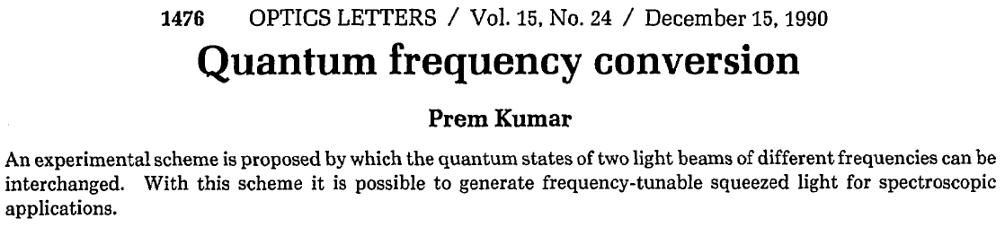
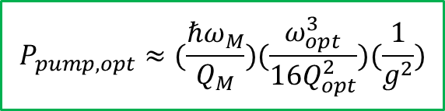

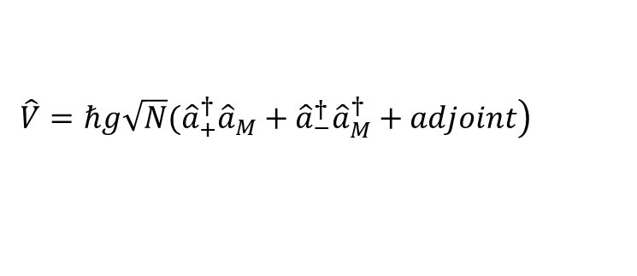


Transduction using Single WGM Electro-Optic Resonators
$${\hat{S}}_{in, M}(ω_{M})$$
Optical FSR
Microwave cavity
$$ω_{M}≈FSR$$
Optical resonator
optical pump
down conversion
pump
up conversion
$$P_{pump, opt}≈(\frac{ℏω_{M}}{Q_{M}})(\frac{ω_{opt}^{3}}{16Q_{opt}^{2}})(\frac{1}{g^{2}})$$
(*)
$${\hat{H}}_{0}=ℏ(ω_{+}{\hat{a}}_{+}^{†}{\hat{a}}_{+}+ω_{−}{\hat{a}}_{−}^{†}{\hat{a}}_{−}+ω_{M}{\hat{a}}_{M}^{†}{\hat{a}}_{M})$$
optical
microwave
$$\left.\hat{V}=ℏg\sqrt{N}({\hat{a}}_{+}^{†}{\hat{a}}_{M}+{\hat{a}}_{−}^{†}{\hat{a}}_{M}^{†}+adjoint\right)$$
Optical pump photon number in the resonator
The down-conversion sideband is undesired and a noise term
*: A. Matsko, et. al. “On fundamental noise of whispering gallery resonators,” Optics Express 15, 17401 (2007).
*: M. Soltani, et. al. “Efficient quantum microwave-to-optical conversion using electro-optic nanophotonic coupled-resonators,” PRA 96, 043808 (2017).

Slide 10

Transduction using Single WGM Electro-Optic Resonators
$${\hat{S}}_{in, M}(ω_{M})$$
Optical FSR
Microwave cavity
$$ω_{M}$$
Optical resonator
optical pump
down conversion
pump
up conversion
Optical Q | Microwave Q | g/2π | Pump power (on-resonance) | Pump power (off-resonance)
10⁶ | 10⁵ | 10 kHz | ~3 µW | ~9 mW
Off-resonance pump though suppresses the down-conversion, heats up the fridge

Slide 11
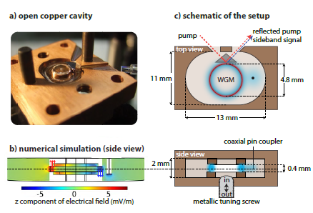
Mechanically Polished WGM LiNbO₃ EO Resonators
Discrete coupling
Integrated coupling
WGM
RF electrode
Laser light
RF electrodes
Si Waveguide
WGM resonator
Si Waveguide
Oxide substrate
Si wafer
A. Rueda, et. al., Optica 3, 597 (2016)
$$g\sim 100 Hz, Optical Q\sim 108−109, Microwave Q?$$

Slide 12
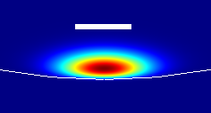
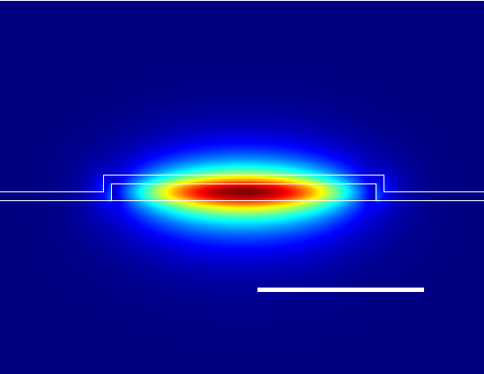
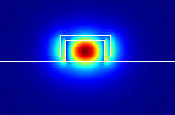
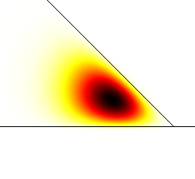
Efficient Coupling Design between Si Waveguide and WGM LN Resonators
20 µm
Si Waveguide
WGM resonator
Oxide substrate
Si wafer
air
air
sio₂
400 nm
sio₂
1 µm
LT
SiO₂
Coupling Q ( million )
Δx
coupling Q
Δx (µm)
WG-resonator gap (nm)
Simulation results showed phase matching and efficient coupling between a Si waveguide WGM Resonator

Slide 13
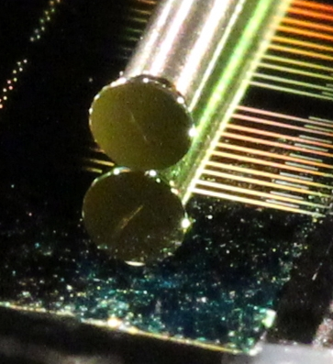
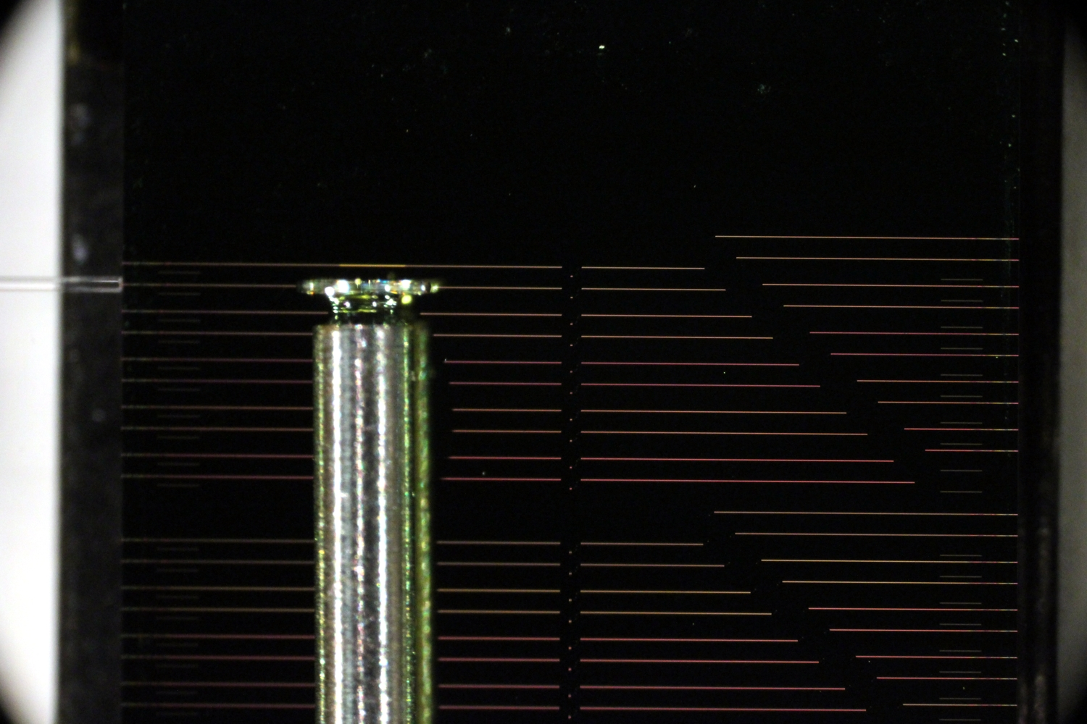
Demonstration of Efficient Coupling between Si Waveguides and WGM LN Resonators
Si waveguide
1550 nm
laser light
3 µm
Normalized transmission
under-coupled
Q ~ 180 millions
~ critically coupled
Q ~ 45 millions
Frequency (MHz)
Frequency (MHz)
Efficient coupling demonstration between a Si waveguide and a WGM LN Resonator (Q~10⁸)
M. Soltani, et. al. “Ultra-high Q whispering gallery mode electro-optic resonators on a silicon photonic chip,” Opt. Letters 41, 4375 (2016)

Slide 14
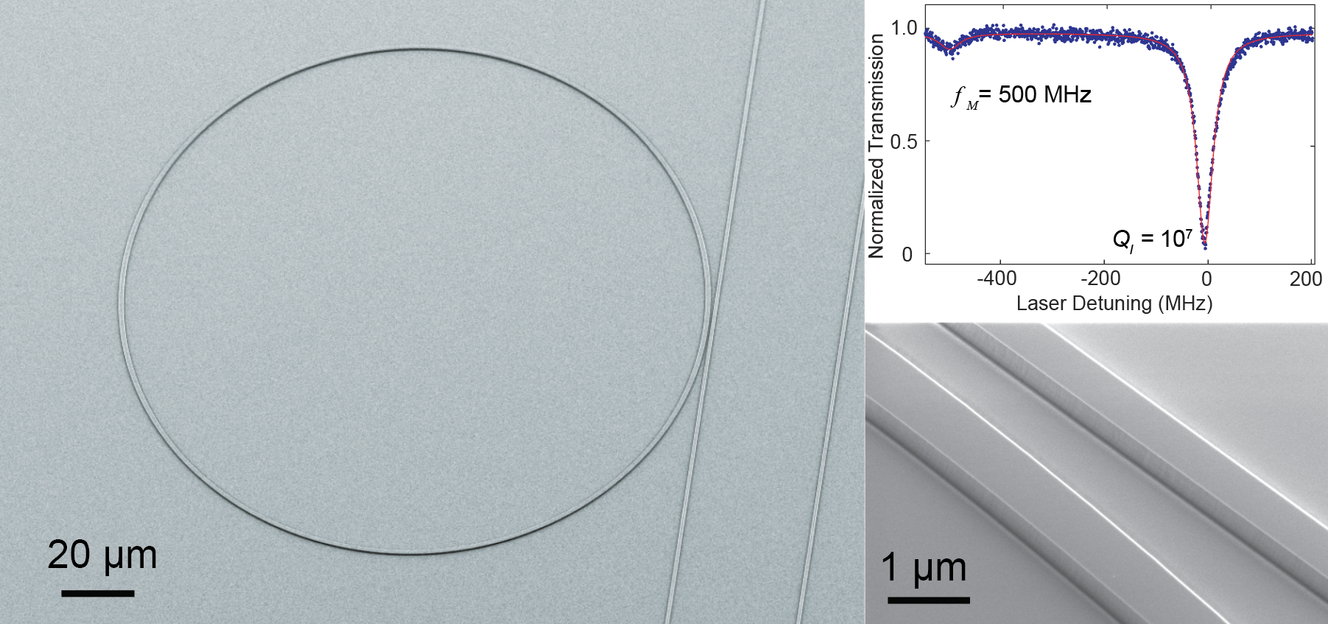
Migrating to Integrated Nanophotonic EO Resonators
Work of Loncar’s group (Harvard) M. Zhang, et al., Optica 4 (12), 1536–1537 (2017)
LiNbO₃
Q ~ 10,000,000
Integrated Ultra-high Q Nanophotonic EO Resonators Results in much higher g factors

Slide 15

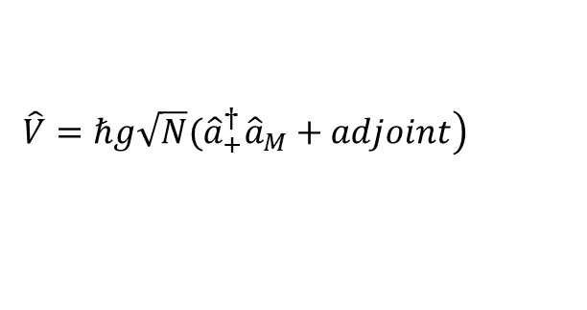








Coupled Nanophotonic EO Resonators
Conventional scheme
Our new scheme
$${\hat{S}}_{in, M}(ω_{M})$$
Optical doublet spectrum
$${\hat{S}}_{in, M}(ω_{M})$$
$$ω_{M}=2μ≪FSR$$
$$ω_{0}$$
Supermodes resonances
Microwave cavity
Optical resonator
$$μ$$
$$\overline{ω}=ω_{0}±μ$$
optical pump
Optical pump
$$ω_{0}$$
Suppressed down conversion
Pump
up conversion
$${\hat{H}}_{0}=ℏω_{+}{\hat{a}}_{+}^{†}{\hat{a}}_{+}+ℏω_{M}{\hat{a}}_{M}^{†}{\hat{a}}_{M}$$
$$\left.\hat{V}=ℏg\sqrt{N}({\hat{a}}_{+}^{†}{\hat{a}}_{M}+adjoint\right)$$
Optical FSR
$$ω_{M}≈FSR$$
optical
microwave
This scheme has also been proposed by Milos Popovic in silicon photonics and in classical domain for single sideband modulation
down conversion
pump
up conversion
Y. Ehrlischman, et. al. “Dual-cavity resonant modulators for efficient narrowband RF/microwave photonics” IEEE Topical Meeting, Microwave Photonics, 2016
Coupled nanophotonic EO resonator with doublet resonance integrated with a microwave resonator provide an ultracompact triply-resonant system with enhanced g and suppressed down-conversion

Slide 16
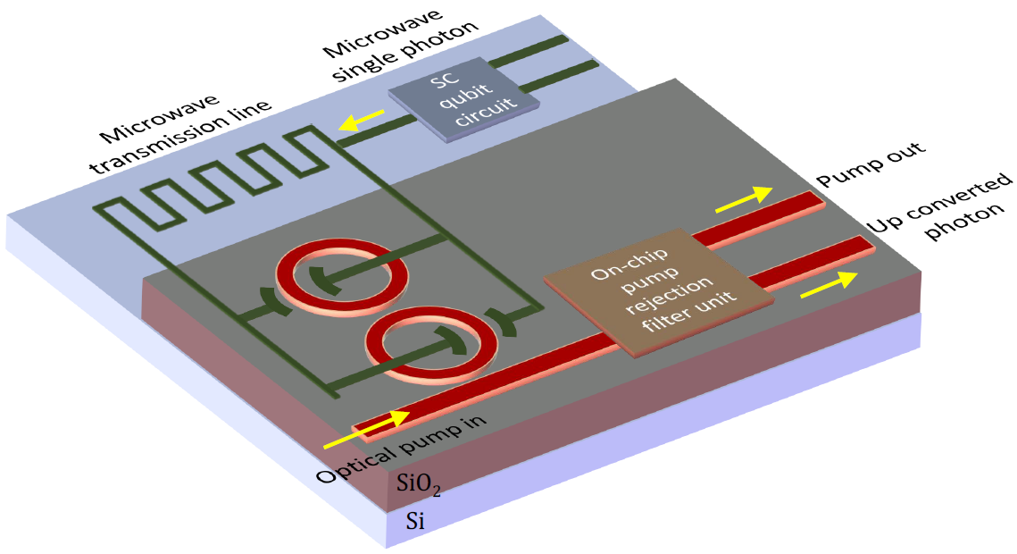
Monolithic Quantum Transduction Chip

Slide 17
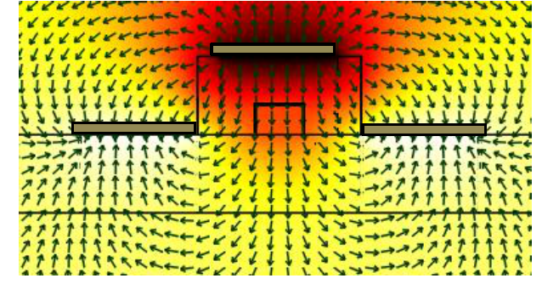




Calculation of g Factor for Nanophotonic Coupled Resonator
Metal electrode
C > 40 fF
$${\hat{S}}_{in, M}(ω_{M})$$
LN
H
SC qubit circuit
SiO₂
W
g/2π (kHz)
Si
H = 1000 nm
$${\hat{S}}_{in, opt}(ω_{s})$$
$${\hat{S}}_{out, s}$$
H = 750 nm
$$g≈n_{e}^{2}r_{33}ω_{0} \sqrt{(ℏω_{M}/U_{M}) }αE_{M}$$
Resonator FSR (GHz)
Significant enhancement in g factor (~10 kHz)

Slide 18












Figure of Merits for Efficient Conversion
Microwave
$${\hat{S}}_{in, M}(ω_{M})$$
$$a_{p}$$
$$a_{M}$$
$$ω_{M}$$
$$a_{s}$$
$$a_{p}$$
$$\frac{da_{s}}{dt}=−iga_{P}a_{M}$$
Optical
EO mixer
$$ω_{0}$$
$$ω_{0}$$
$$ω_{0}+ω_{M}$$
optical pump
Intrinsic conversation rate
Cooperativity factor
$$g≈n_{e}^{2}r_{33}ω_{0} \sqrt{(ℏω_{M}/U_{M}) }αE_{M}$$
$$C=4g^{2}N/(γ_{opt}γ_{M})$$
Refractive index
EO coeff.
Microwave mode energy
Overlap factor of microwave and optical mode
Microwave E field
# pump optical photons in resonators
Optical cavity decay rate
Microwave cavity decay rate

Slide 19

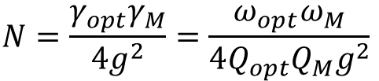



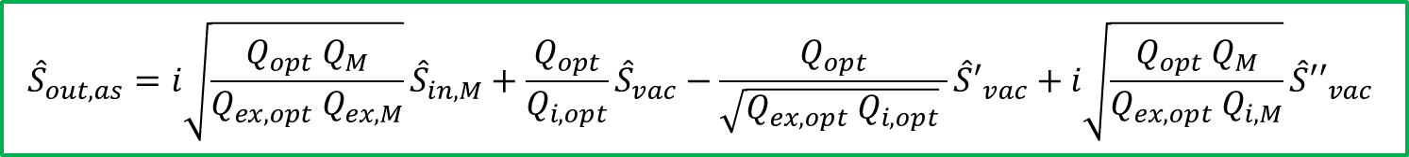






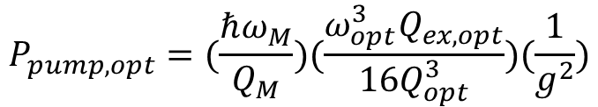
Figure of Merits for Efficient Conversion
$${\hat{S}}_{in, M}(ω_{M})$$
Optimal conversion occurs at C=1
$${ \hat{S}′′}_{vac}$$
$$ω_{s}$$
$$ω_{as}$$
$$ω_{M}$$
$${ \hat{S}′}_{vac}$$
$$N=\frac{γ_{opt}γ_{M}}{4g^{2}}=\frac{ω_{opt}ω_{M}}{4Q_{opt}Q_{M}g^{2}}$$
$${ \hat{S}}_{vac}(ω_{as})$$
$${\hat{S}}_{out, as}$$
Pump
up conversion
$$P_{pump, opt}=(\frac{ℏω_{M}}{Q_{M}})(\frac{ω_{opt}^{3}Q_{ex,opt}}{16Q_{opt}^{3}})(\frac{1}{g^{2}})$$
$${\hat{S}}_{in, opt}(ω_{s})$$
$${\hat{S}}_{out, s}$$
Microwave-to-Optical Quantum Transduction
$${\hat{S}}_{out,as}=i\sqrt{\frac{Q_{opt} Q_{M}}{Q_{ex,opt} Q_{ex,M}}}{\hat{S}}_{in,M}+\frac{Q_{opt}}{Q_{i,opt}}{\hat{S}}_{vac}−\frac{Q_{opt}}{\sqrt{Q_{ex,opt} Q_{i,opt}} }{\hat{S}′}_{vac}+i\sqrt{\frac{Q_{opt} Q_{M}}{Q_{ex,opt} Q_{i,M}}}{\hat{S}′′}_{vac}$$
Efficient and low noise transduction requires the optical and the microwave resonators in overcoupled regime
M. Soltani, et. al. “Efficient quantum microwave-to-optical conversion using electro-optic nanophotonic coupled-resonators,” PRA 96, 043808 (2017)

Slide 20
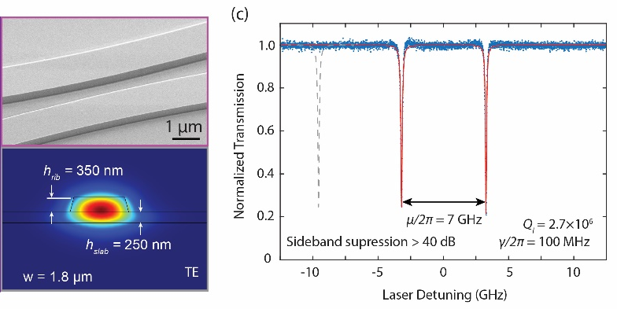
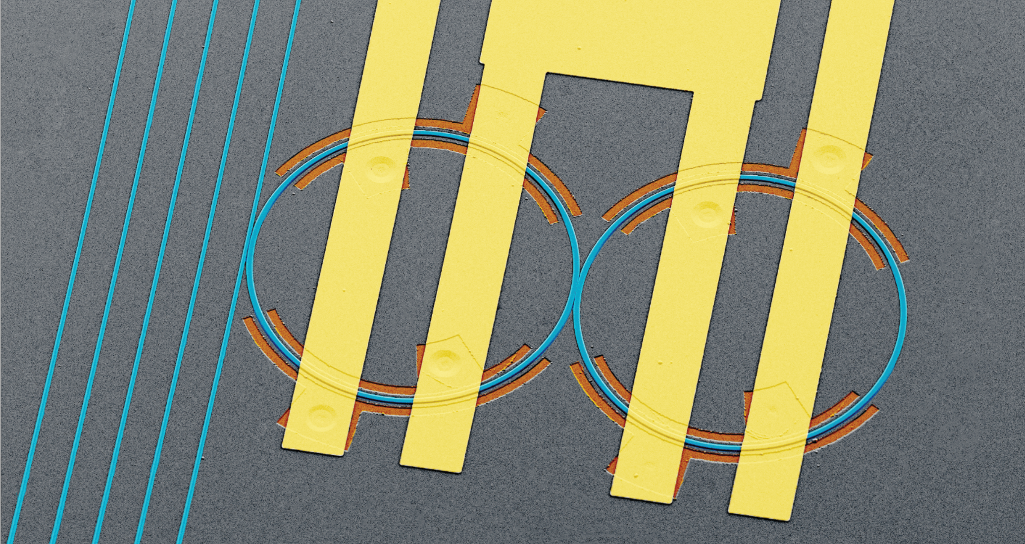
Demonstration of Nanophotonic LN Coupled Resonators
M. Zhang, C. Wang, Y. Hu, A. Shams-Ansari, G. Ribeill, M. Soltani, M. Loncar, “Microwave-to-Optical Converter based on Integrated Lithium Niobate Coupled-Resonators,” CLEO 2017
20 μm
Loncar group (Harvard)
The experimental results show resonance doublet with intrinsic Q ~ 3 millions

Slide 21
Conclusion
Quantum Electro-optic Transduction
Technology: Nanophotonics coupled LN resonator modulator integrated with SC qubits on silicon platform
g/2π | ~1-10 kHz
Thermal & Mech. stability | High
Scalability | High
Tunability | High
Any suspended component | No
Required optical resonator Q | 10⁶-10⁷
Required microwave resonator Q | ~10000
Optical pump power | ~ µW
Transduction efficiency | ~>80 %
Fidelity of transferred Fock state | >80 %

Slide 22
Collaborators & Acknowledgement
Acknowledgement:
  Marko Loncar Group (Harvard)
    Mian Zhang
    Cheng Wang
  Dirk Englund (MIT)
  OEWaves,
  IBM
  Kartik Srinivasan (NIST)
Funding: US Army, DARPA, Raytheon BBN

Slide 23
Backup

Slide 24
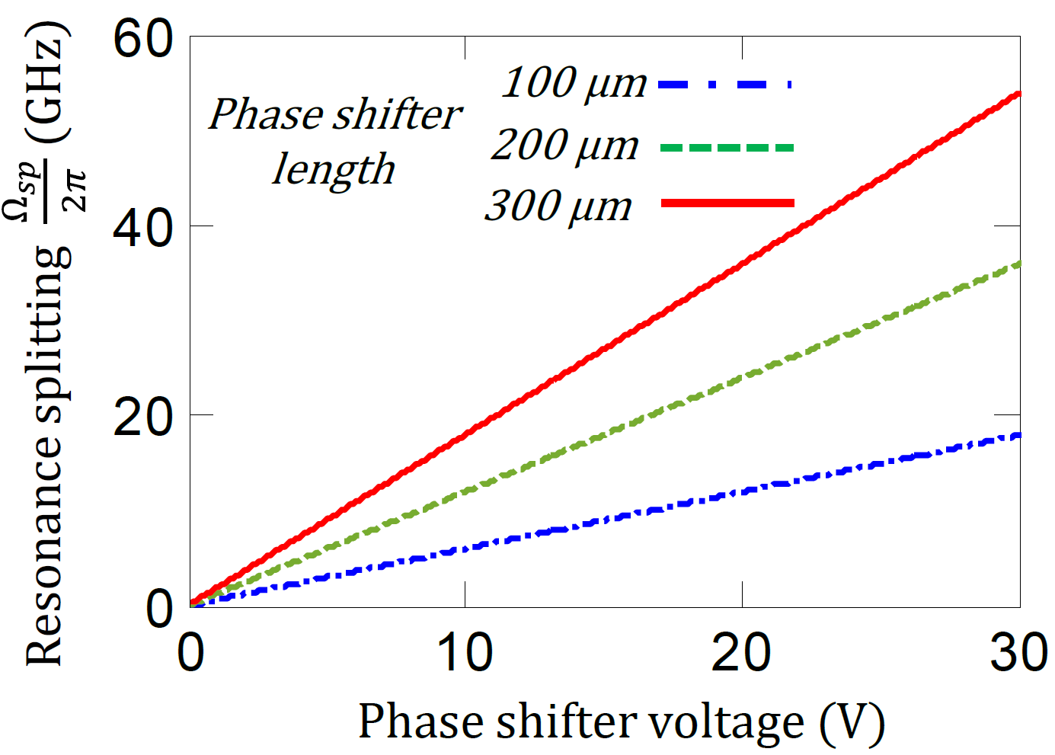
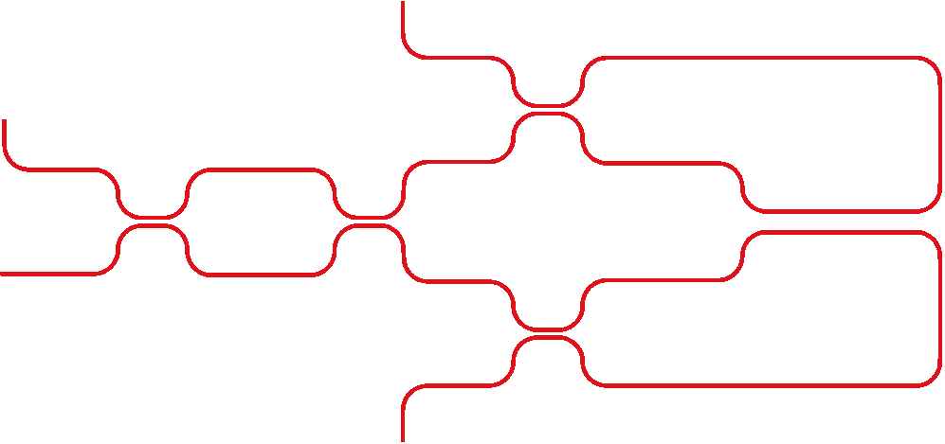




Coupled Resonator with Tunable Doublet Spacing
Microwave cavity
Resonator 1
$$Ω=2π\frac{n_{g}FSR}{n_{eff}}\frac{ φ }{ π }$$
φ
Tunable coupling (µ)
-φ
$$\left[\begin{matrix}0 & j \\ j & 0\end{matrix}\right]$$
Resonator 2
1.5
$$ω_{s}$$
$$ω_{as}$$
In
Out
Tuning of doublet spacing allows perfect frequency matching to microwave resonance

