Slide 1

Quantum Careers & Education Panel
Photonics for Quantum Workshop, Jan 23, 2019
Moderator: Ben Zwickl, RIT School of Physics and Astronomy

Slide 2
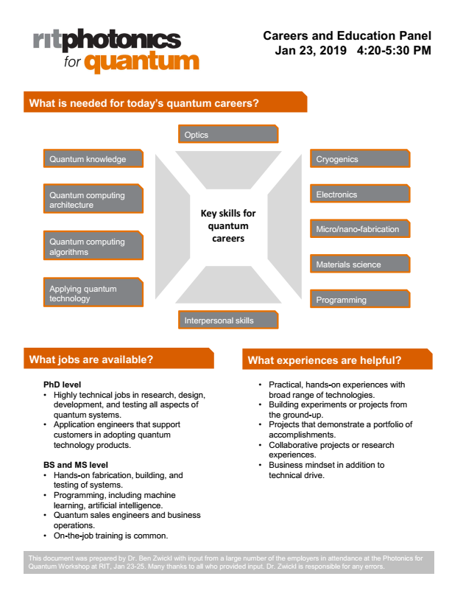
Quantum Careers Flyer for Students
Will be posted on the conference website.

Slide 3
Schedule
4:20-4:55 Panel Discussion
  Intro
  Moderator’s questions
  Audience questions
5-5:30 PM, Student Networking Q&A (adjacent in the 1829 room)
  All employers are welcome
  All students (all majors, undergrad and grad, from RIT and elsewhere)
  Refreshments and hors d'oeuvres

Slide 4
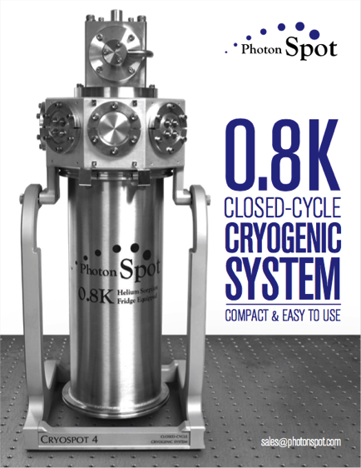
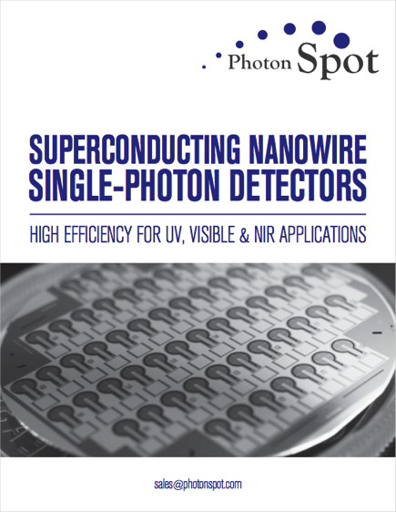
VIKAS ANANT, Ph.D.
FOUNDER & CEO
PHOTON SPOT, INC.

Slide 5
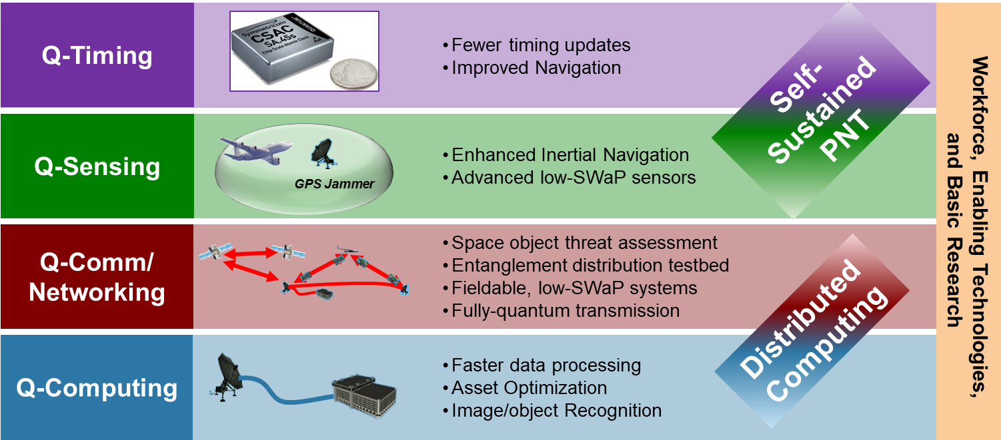
Quantum Information Science
Dr. Bryant Wysocki
Air Force Research Laboratory

Slide 6

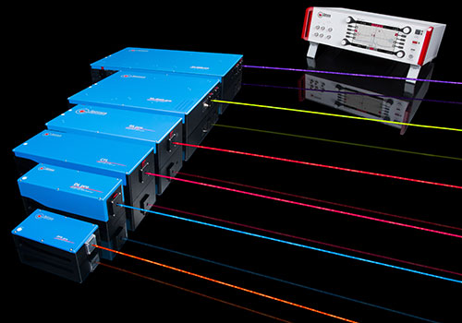
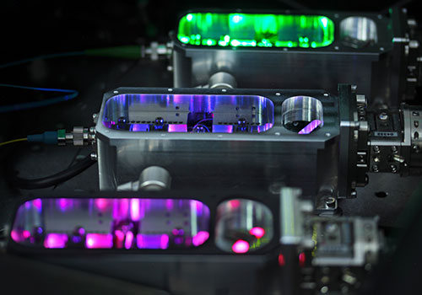
TOPTICA's products for applied quantum technology:
Tunable Diode Lasers
ps/fs Fiber Lasers
Frequency Combs
Wavelength Meters
Laser Diodes
Single Mode Diode Lasers
Single Frequency Lasers
Customized Solutions
High-end laser systems for scientific and industrial applications.
Tom Tongue, TOPTICA Photonics
www.toptica.com

Slide 7
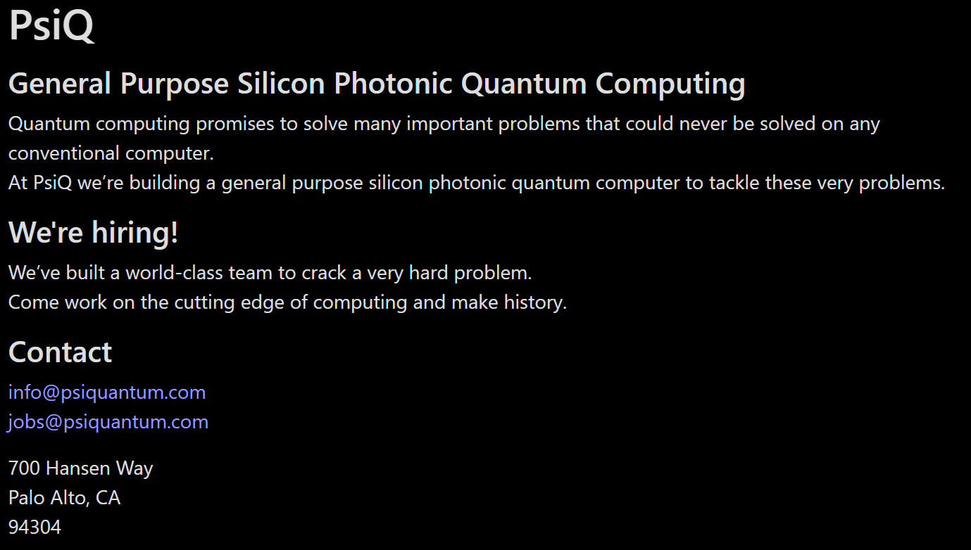
Eric Dudley, PsiQuantum

Slide 8
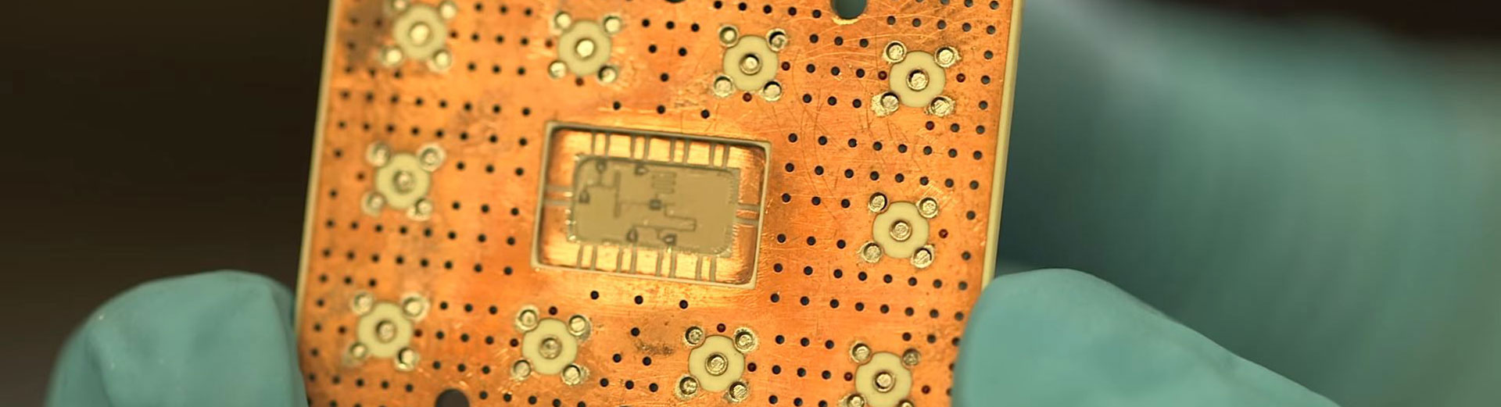
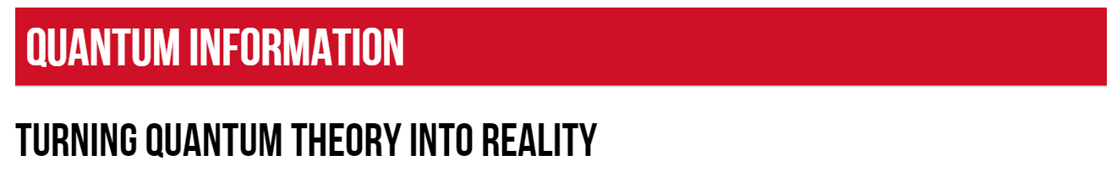
Superconducting qubits
Quantum process verification
Algorithms
High-speed, low-power memory
Quantum key distribution
Low-probability-of-detect communications
Quantum imaging testbed
Nanophotonics
Mo Soltani, Raytheon
https://www.raytheon.com/capabilities/products/quantum

Slide 9
Q1:
Could you give examples of quantum technology jobs that your organization has hired recently or will hire soon?

Slide 10
Q2:
What are the pathways into quantum technology jobs?
Are there opportunities at all levels (BS, MS, PhD)?

Slide 11
Q3:
What kinds of quantum-related skills and knowledge are useful in your organization?

Slide 12
Q4:
What other kinds of supporting technologies and knowledge are useful (e.g., cryogenics)?

Slide 13
Audience questions

Slide 14
Student Networking Q&A
5-5:30 PM, (adjacent in the 1829 Room, this building)
  All employers are welcome
  All students (all majors, undergrad and grad, from RIT and elsewhere)
  Refreshments and hors d'oeuvres

