Slide 1
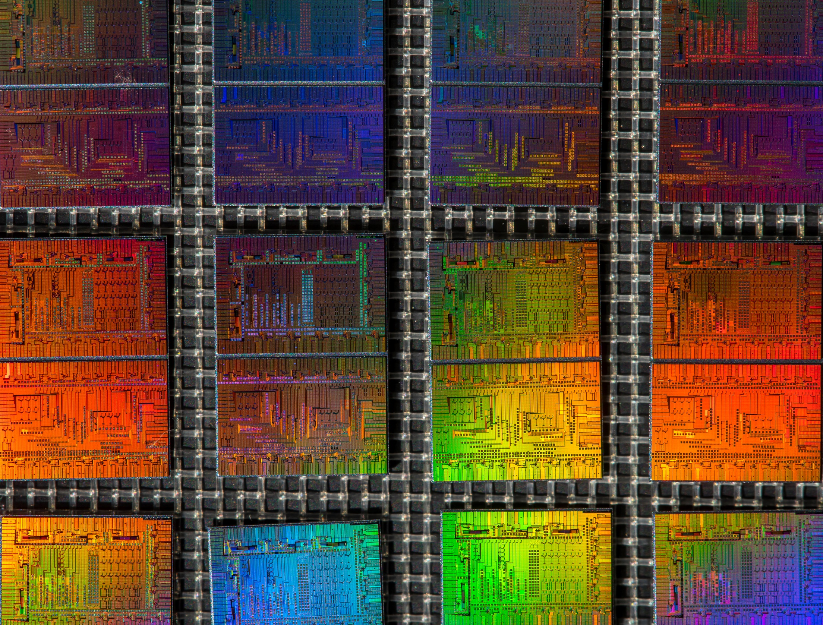







Quantum integrated photonics
Stefan Preble
Rochester Institute of Technology
Jeff Steidle
Greg Howland
John Serafini
Paul Thomas
Matthew van Niekerk
Mario Ciminelli
Thomas Palone
Peichuan Yin
Air Force Research Laboratory
Paul Alsing
Michael Fanto
Chris Tison
Matt Smith
Kathy-Anne Soderberg
Massachusetts Institute of Technology
Dirk Englund
Tsung-Ju Lu
DISTRIBUTION A. Approved for public release: distribution unlimited. (88ABW-2016-1422)

Slide 2
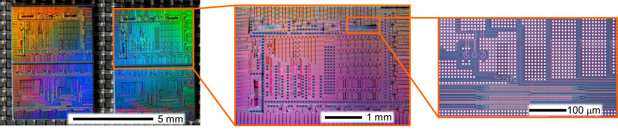
Integrated Quantum Photonics
Motivation: Integrated photonic waveguides provide a scalable and stable platform for the implementation of quantum photon sources and circuits.
  Quantum information science requires:
    Sources of quantum bits (qubits)
    Manipulation of the qubits
    Storage of the qubits
Silicon Entangled Photon Source - CMOS Fabricated Photonic Circuit

Slide 3
Integrated Quantum Photonics
  Quantum information science requires:
    Sources of quantum bits (qubits)
    Manipulation of the qubits
    Storage of the qubits
Quantum bit (qubit) – any two level system
  Polarization states of a photon : Horizontal or Vertical
  Energy levels in an atom : Ground or Excited
  Direction of current in a superconducting circuit: Clockwise or Counter clockwise

Slide 4
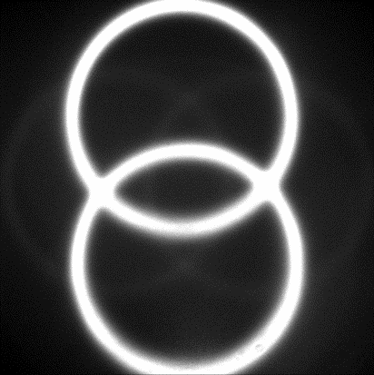
Integrated Quantum Photonics
  Quantum information science requires:
    Sources of quantum bits (qubits)
    Manipulation of the qubits
    Storage of the qubits
Quantum bit (qubit) – any two level system
  Polarization states of a photon : Horizontal or Vertical
  Energy levels in an atom : Ground or Excited
  Direction of current in a superconducting circuit: Clockwise or Counter clockwise
Entanglement – two or more particles that interact such that they cannot be described independently.
H
E
E
H&V
H&V
$$Ψ=\left[\left|H\right.\left.V\right\rangle ±e^{iφ}\left|V\left.H\right\rangle \right.\right]$$
G
Atom
Atom
G
$$Ψ=\left[\left|G\right.\left.E\right\rangle ±e^{iφ}\left|E\left.G\right\rangle \right.\right]$$
V

Slide 5
Integrated Quantum Photonics
  Quantum information science requires:
    Sources of quantum bits (qubits)
    Manipulation of the qubits
    Storage of the qubits
Qubit – any two level system
  Polarization states of a photon : Horizontal or Vertical
  Energy levels in an atom : Ground or Excited
  Direction of current in a superconducting circuit: Clockwise or Counter clockwise
Superposition – every valid quantum state can be represented by the sum or two or more other distinct quantum states.
Atom 1 | Atom 2
G | G
G | E
E | G
E | E
$$States=2^{n}$$
2 particles $=2^{2}=4 states$
$$50 particles=2^{50}$$
$=1.1x{10}^{15}$ states
or 140 TB of space
E
E
G
Atom
G
Atom

Slide 6
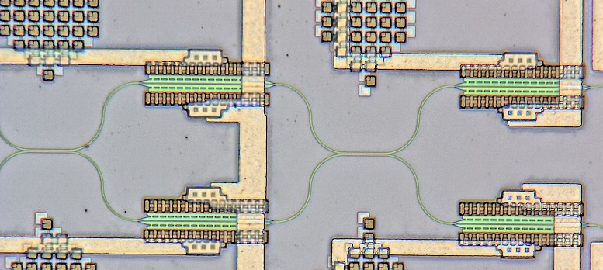
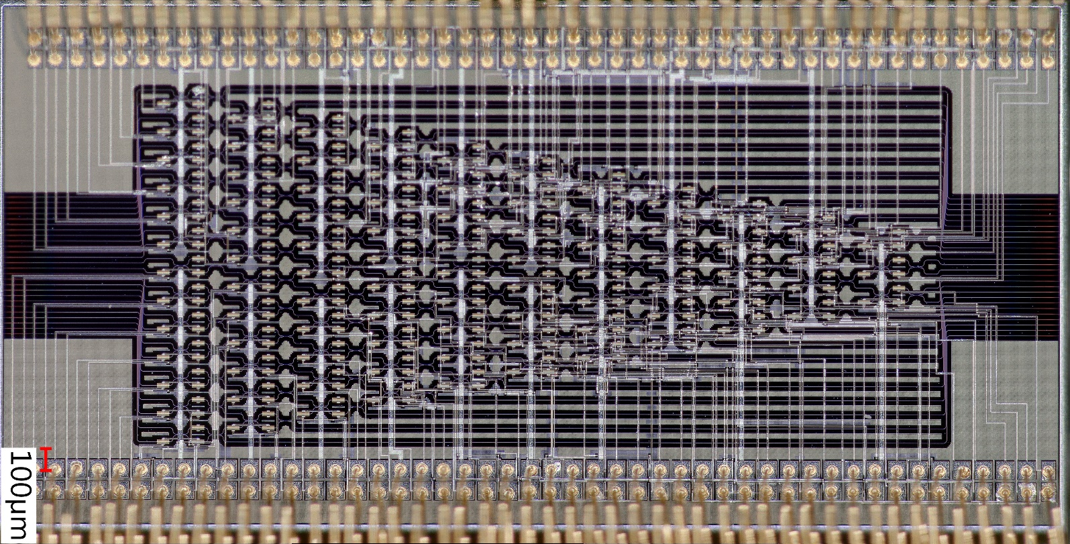

Integrated Quantum Photonics
  Quantum information science requires:
    Sources of quantum bits (qubits)
    Manipulation of the qubits
    Storage of the qubits
Unit cell
Qubits are manipulated through interference.
Professor Dirk Englund

Slide 7
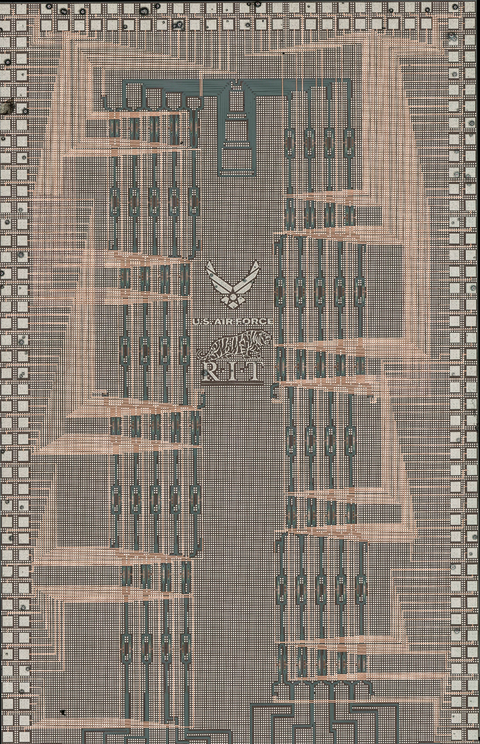
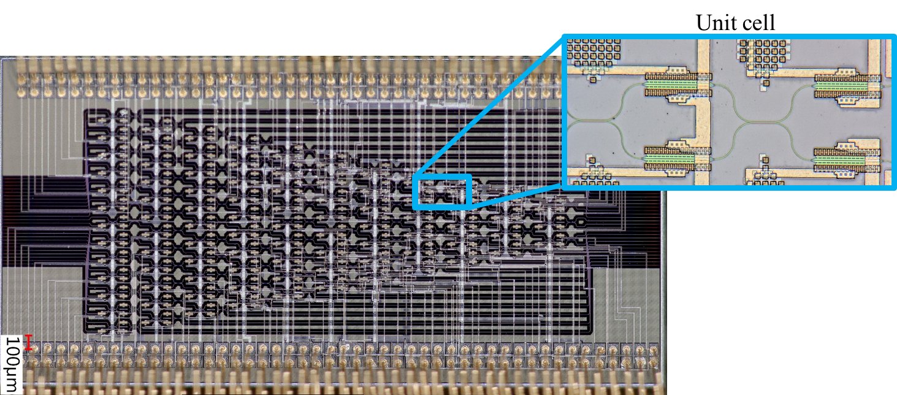
Integrated Quantum Photonics
Allows for phase and amplitude manipulation of a quantum state
  Manipulation of qubit to/from memory
Fully reconfigurable at kilohertz speeds
Interface QPP with interposer chip
  Interposer chips can be active or passive
  On-chip photon sources are possible
No feed forward currently available

Slide 8

Integrated Quantum Photonics
  Quantum information science requires:
    Sources of quantum bits (qubits)
    Manipulation of the qubits
    Storage of the qubits
    Trapped Ions: longest lived quantum memories
    Storage time > 15 minutes (clock states)
    Ions typically produce photons in the UV
      Ytterbium Ions – Transition at 369.5nm
      Requirement: bandgap of >3.6eV
(Trapped Ytterbium ions, AFRL)

Slide 9
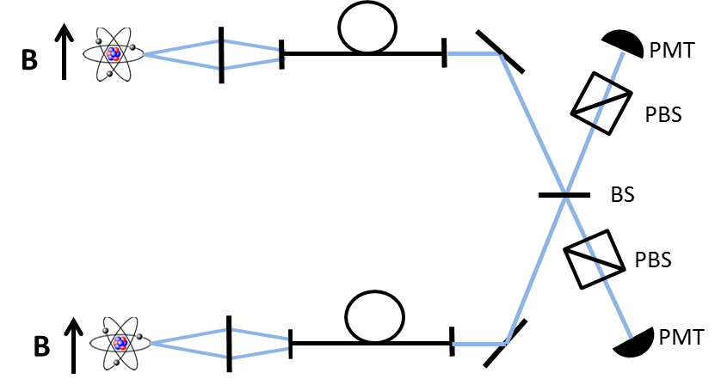
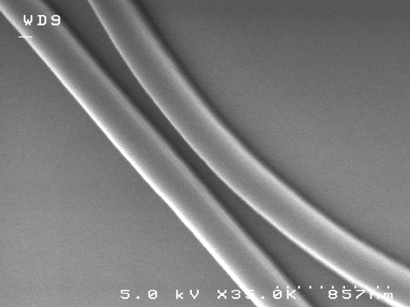
Entangling Memories
Transfer Information: Teleportation
369.5 nm
369.5 nm
Aluminum nitride waveguide
Create ion-ion entanglement
Measure ion 2
Based on that measurement rotate the state of ion 1 before measurement to complete the teleportation protocol

Slide 10
Integrated Quantum Photonics
Motivation: Integrated photonic waveguides provide a scalable and stable platform for the implementation of quantum photon sources and circuits.
  Quantum information science requires:
    Sources of quantum bits (qubits)
    Manipulation of the qubits
    Storage of the qubits
Silicon Entangled Photon Source - CMOS Fabricated Photonic Circuit

Slide 11
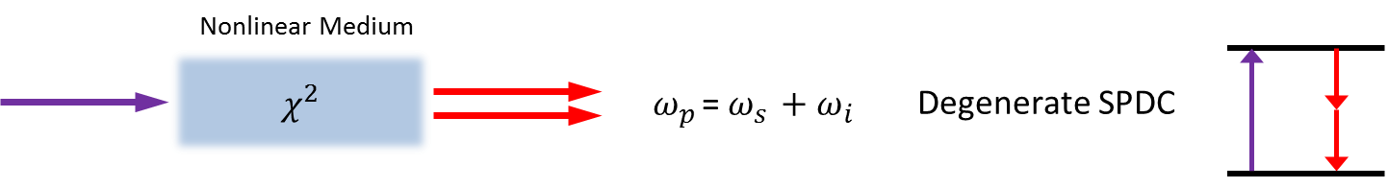
Photon sources from Nonlinear Interactions
Polarizability
$$P\left(t\right)= ε_{0}\left[χ^{\left(1\right)}E(t)\right.+ χ^{\left(2\right)}E^{2}\left(t\right)+χ^{\left(3\right)}E^{3}\left(t\right)\left.+...\right]$$
$$P\left(t\right)= P^{\left(1\right)}\left(t\right)+P^{\left(2\right)}\left(t\right)+P^{\left(3\right)}\left(t\right)+…$$
Input wave $E\left(t\right)=Ee^{−iωt}+c.c.$
Looking at the second term
$P^{\left(2\right)}(t)= ε_{0}χ^{\left(2\right)}\left[\right.\left(Ee^{−iωt}+c.c.\left.\right)\right.$ $\left(Ee^{−iωt}+c.c.\left.\right)\right.\left.\right]$
$$P^{\left(2\right)}(t)=ε_{0}χ^{\left(2\right)}\left(\right.2EE^{∗}+E^{2}e^{−i2ωt}+c.c.\left.\right)$$
$$P^{\left(2\right)}(t)=2ε_{0}χ^{\left(2\right)}EE^{∗}+{ε_{0}χ^{\left(2\right)}E}^{2}e^{−i2ωt}+c.c.$$
A wave of twice the frequency interacts with the fundamental waves
(second harmonic generation or spontaneous parametric down conversion)
Pump
Bi-photons

Slide 12
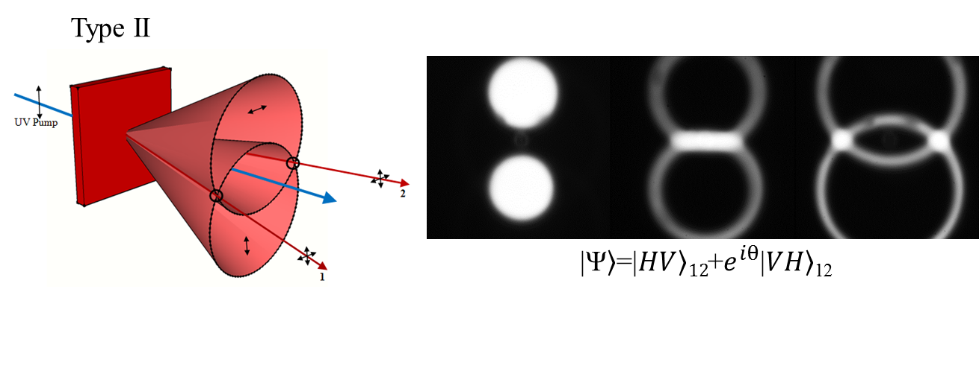
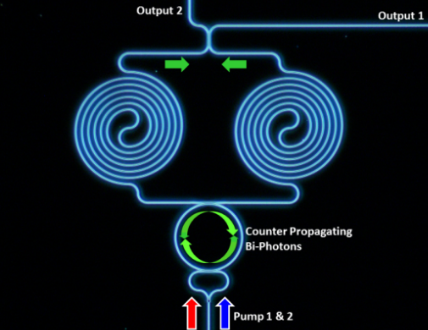


Photon Sources
$$P\left(t\right)=ε_{o}\left(χ^{(1)}E\left(t\right)+χ^{(2)}E^{2}\left(t\right)+χ^{(3)}E^{3}\left(t\right)+…\right)$$
$$P\left(t\right)=ε_{o}\left(χ^{(1)}E\left(t\right)+χ^{(2)}E^{2}\left(t\right)+χ^{(3)}E^{3}\left(t\right)+…\right)$$
Nonlinear Medium
Pump
Bi-photons
Pump 1
Bi-photons
$$χ^{3}$$
Pump 2
$ω_{p1 }+ω_{p2 }$= $ω_{s }+ω_{i }$
Degenerate Four
wave mixing
ω_{s}
ω_{i}
Pump 1
Bi-photons
Pump 2
ω_{i}
ω_{s}

Slide 13
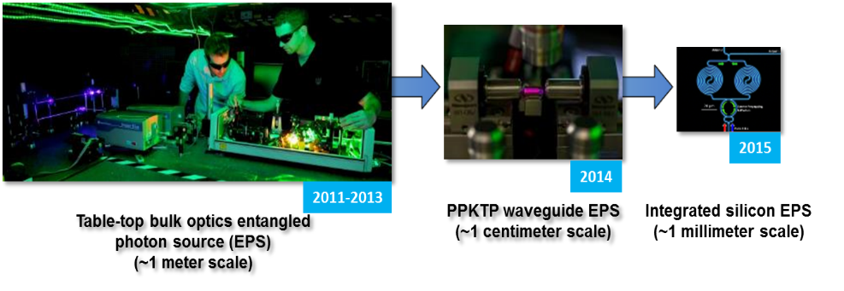
Integrated Quantum Photonics
2017
Silicon Entangled Photon Source - CMOS Fabricated Photonic Circuit

Slide 14
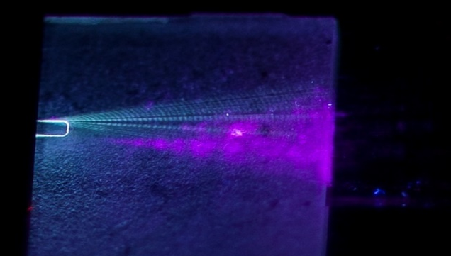
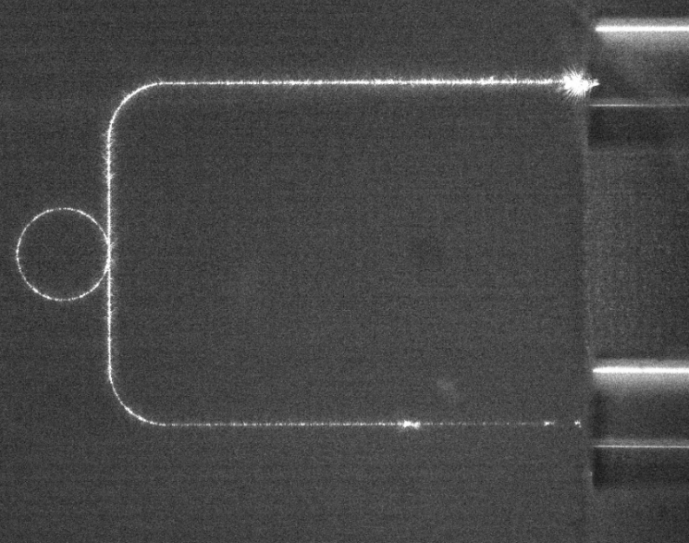
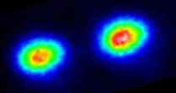
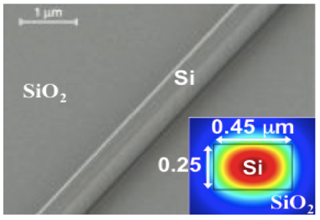
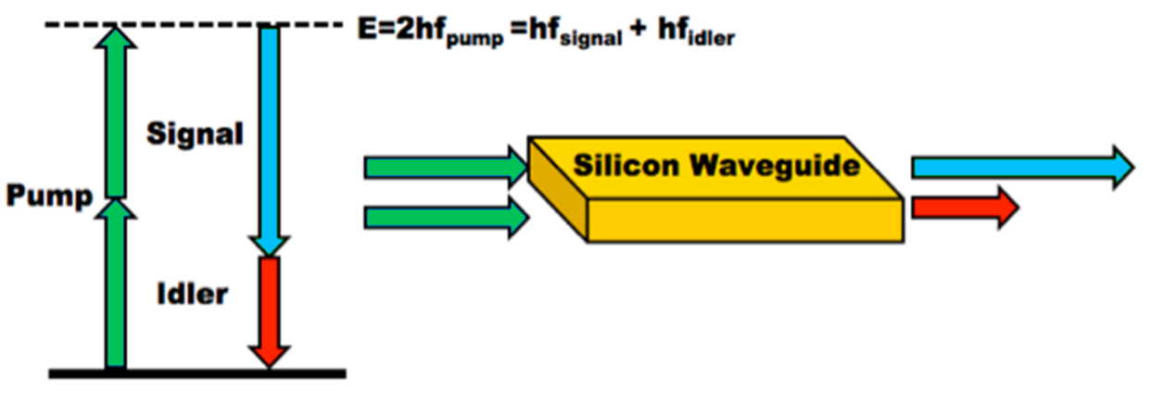
UV & Telecom Photon Sources
Ultraviolet (UV) wavelengths: Directly interface to the ¹⁷¹Yb⁺ ion transition
Aluminum nitride platform: large bandgap (6.2eV) and strong second and third order nonlinearity
Yb⁺ ions
396nm SHG generated in AlN waveguide
Ring resonator operation in the UV (369 nm)
Telecom wavelengths: directly interface with low loss fiber and free-space network infrastructure
Silicon photonic platform: has a strong third-order Kerr nonlinearity
Frequency conversion bridges the separation between UV and Telecom

Slide 15
Telecom Photon Sources

Slide 16
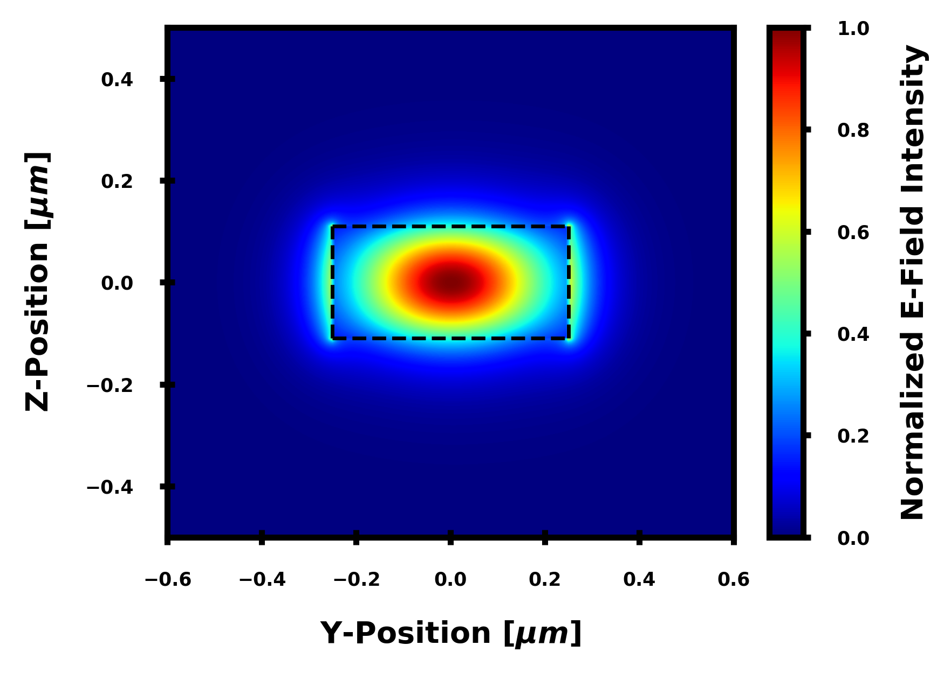
Silicon Microring Photon Source
Signal
Pump 2
Degenerate
Biphoton
Pump
Idler
Pump 1
Correlated Photon Source – Spontaneous Four Wave Mixing (SFWM)
  χ⁽³⁾ equivalent of Spontaneous Parametric Down Conversion
Silicon has a very strong third-order Kerr nonlinearity:
  n₂ ~ 5E-14cm²/W, two-hundred times larger than Silica
  Strong confinement yields a large effective nonlinearity:
    ϒ~400 (Wm)⁻¹ = ωn₂/cA_{eff}
Low Noise - Raman Scattering is narrowband and shifted ~15.6THz away from pump
Resonators enhance performance – higher brightness

Slide 17
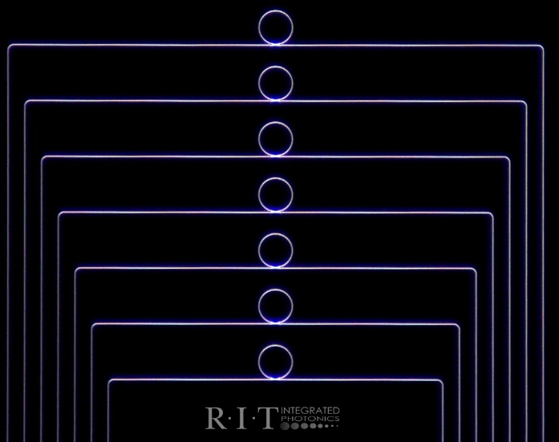
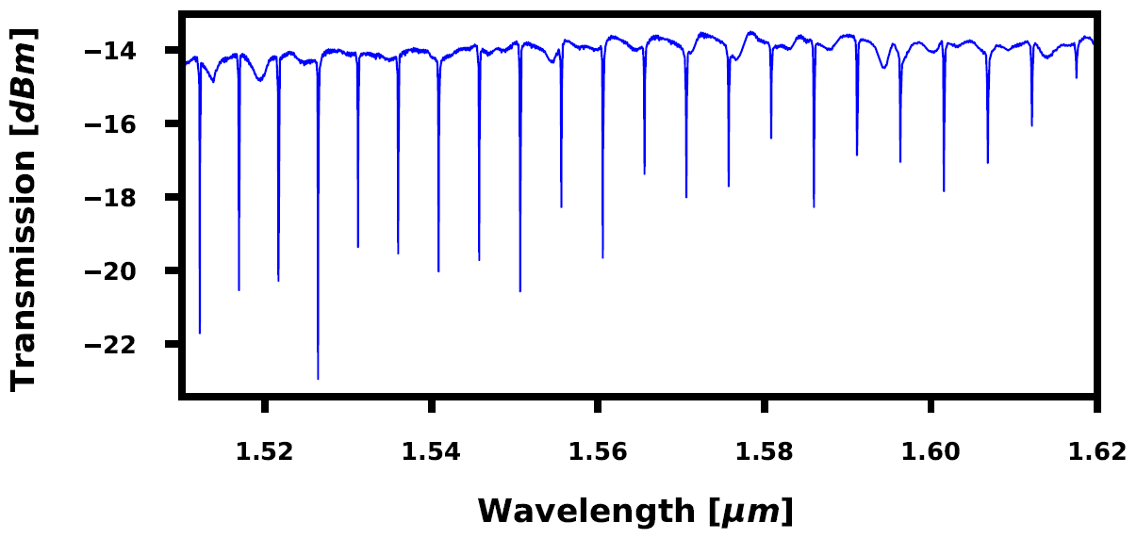
Demonstration of SFWM in a Ring - Device
Device Parameters:
  WG Width = 500nm
  WG Thickness = 220nm
  Ring Radius = 18.75um
  Coupler Gap = 150nm
FSR ~ 5nm
Q Factor up to 50k

Slide 18
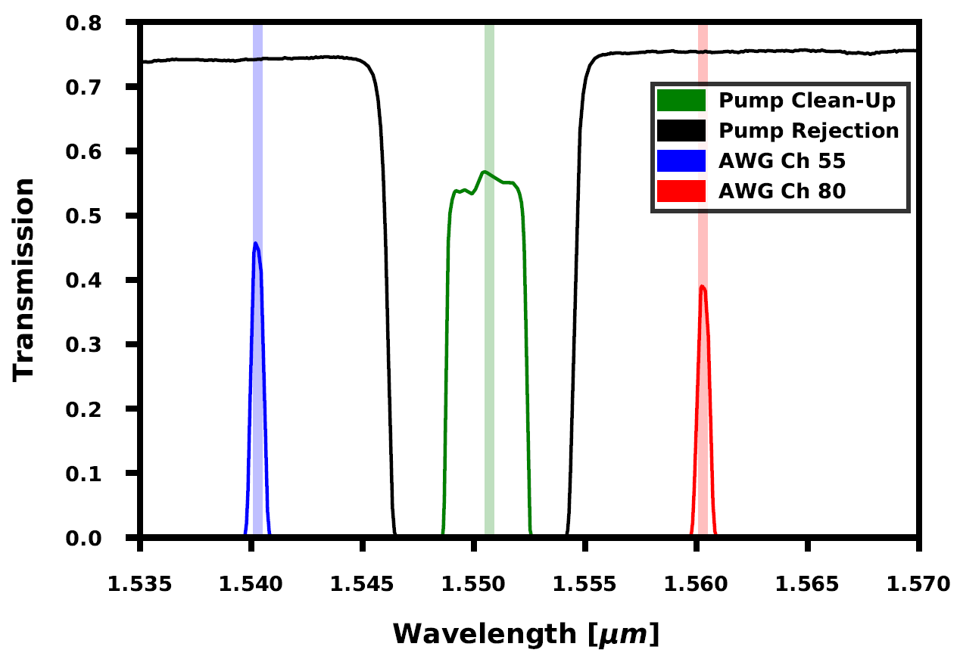

Demonstration of SFWM – Non-Degenerate Pairs
Superconducting Detectors
Polarization Controllers
Arrayed
Waveguide Grating
Power
Meter
AWG
Pump Rejection Filters
Coincidence Correlator
Ring Resonator Circuit
Pump
Laser
Polarization Controller
High Index SMF
Signal
Pump
Pump Clean-Up
Filters
Idler

Slide 19
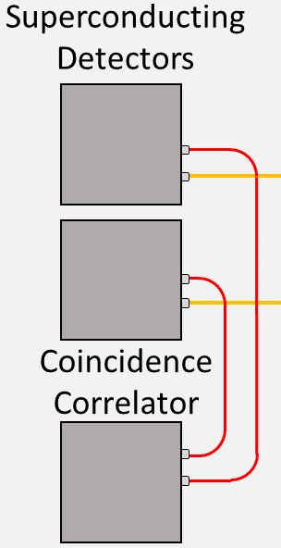
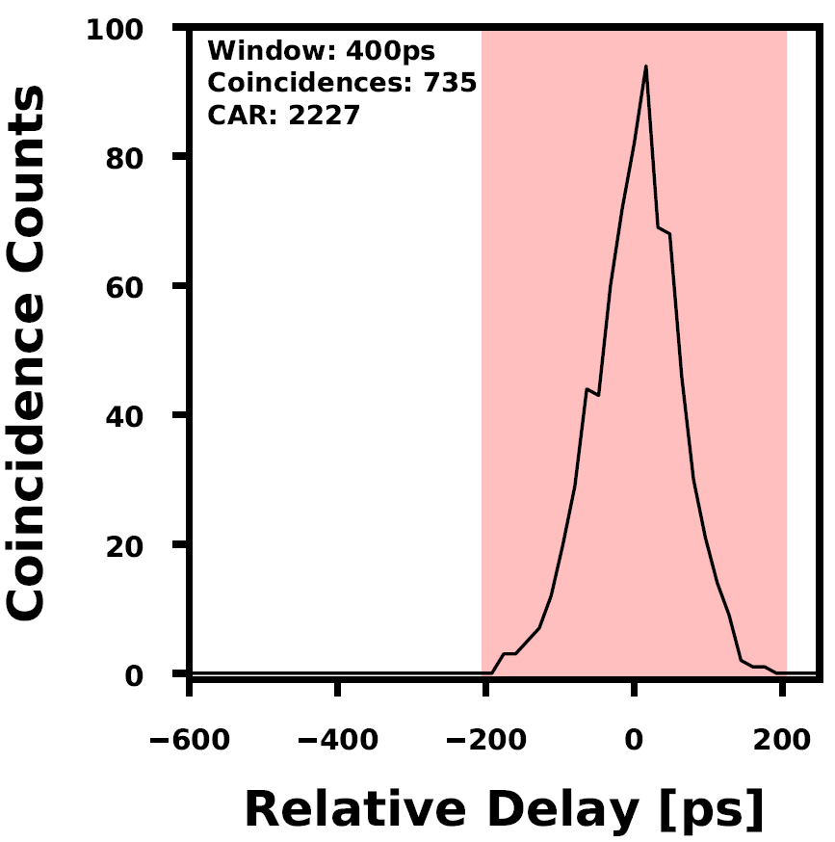
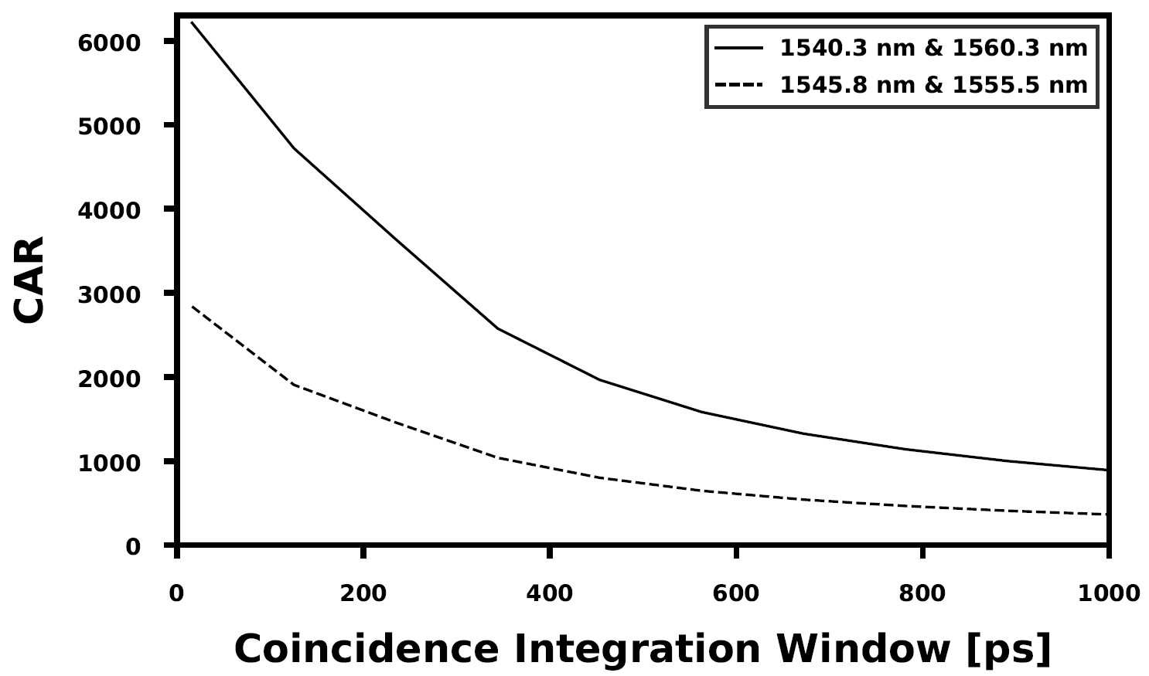
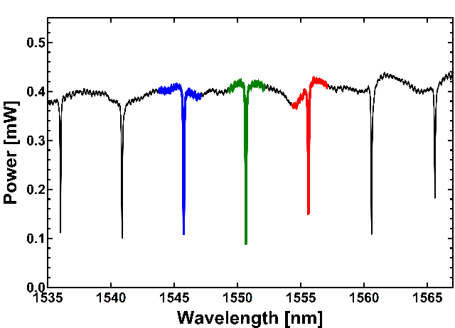
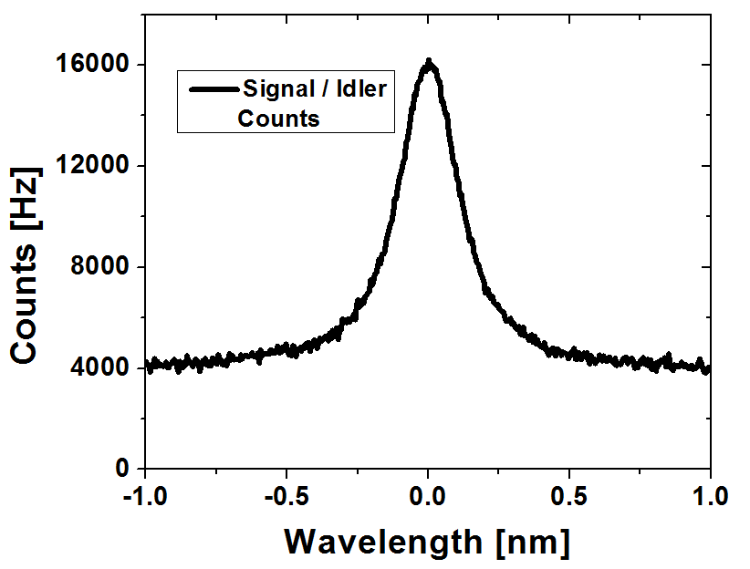
Non-Degenerate Photon Coincidences
CAR=Coincidence to Accidental Ratio
Large CAR: >2000 with a 400ps window
  Enabled by:
    high coupling efficiency
    optimized filtering
    superconducting detectors
Larger CAR possible with narrow time windows
Pump
Signal
Idler
Narrow Bandwidth: Measured to be ~0.2 nm (25.0 GHz)
  We were limited by our measurement filter
  Resonator Bandwidth = 3.88 GHz (31.1 pm)

Slide 20
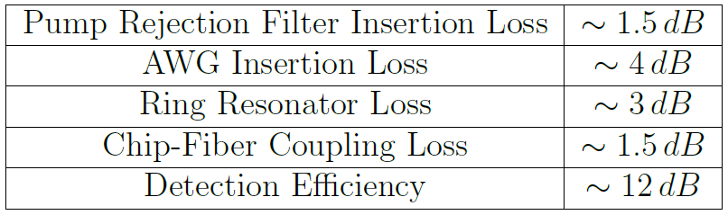
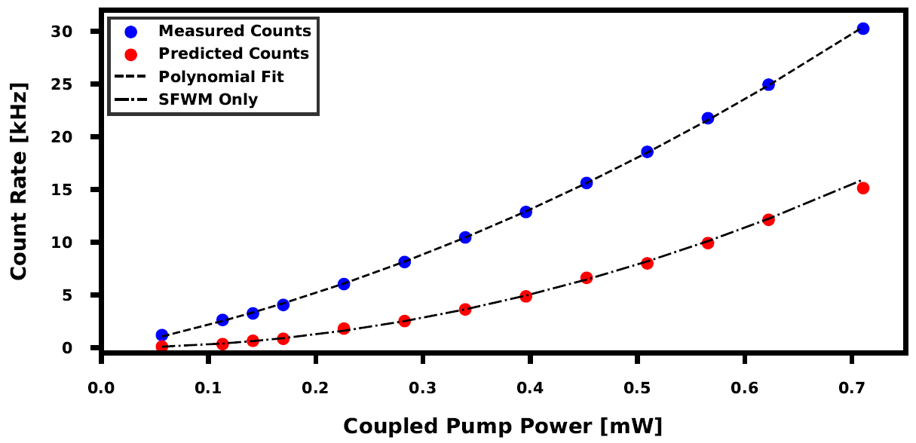
Additional Analysis
Photon Counts $≈SFWM×power2+Raman Noise×power+Dark Counts$
Measured Counts vs Pump Power was fit with 2nd order polynomial to determine the contribution from SFWM
Counts from SFWM can also be predicted with coincidences and system losses
Both methods are in agreement
From this and the bandwidth, the brightness was determined to be 1.32E6 pairs/s/mW²/GHz
J. Steidle, M. Fanto, C. Tison, Z. Wang, S. Preble, P. Alsing, “High spectral purity silicon ring resonator photon-pair source,” Proc. SPIE 9500 (2015)

Slide 21
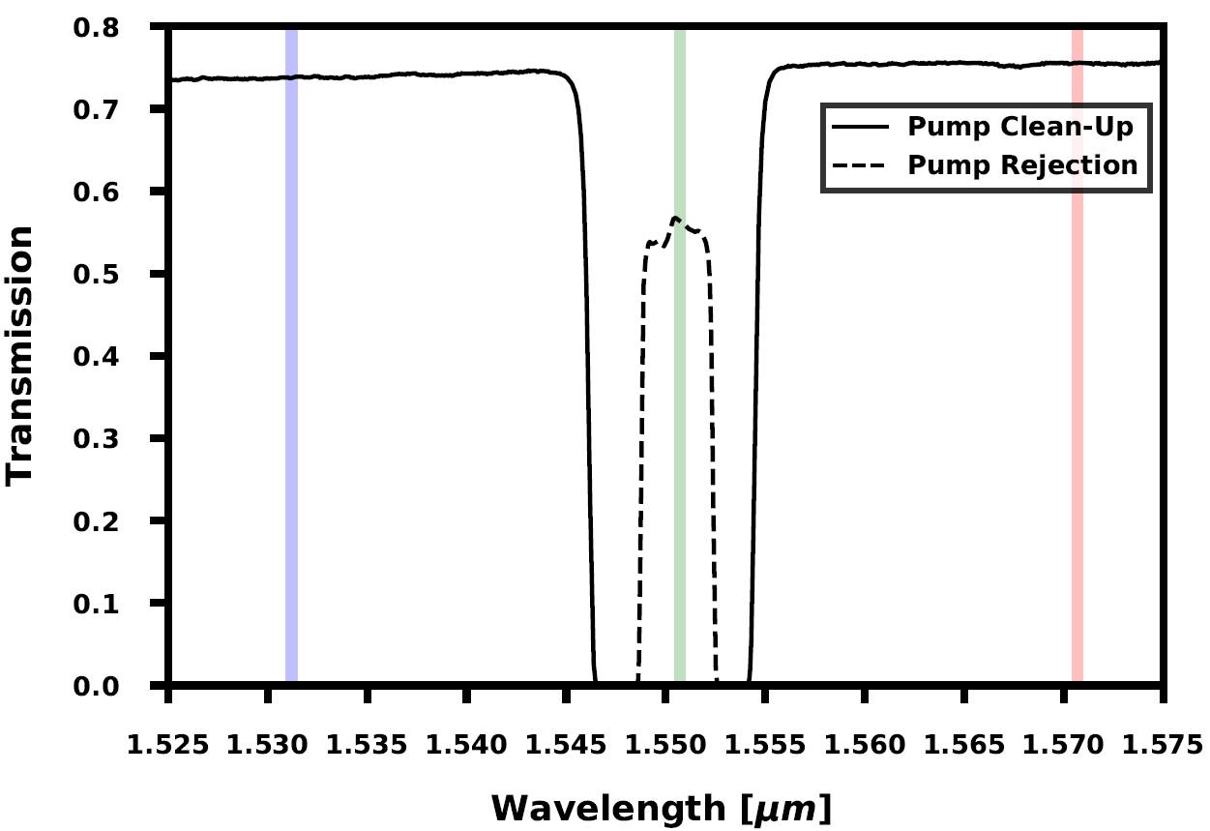
Demonstration of SFWM – Degenerate Pairs
Superconducting Detectors
Polarization Controllers
Power
Meter
3dB
Coupler
Pump Rejection Filters
Coincidence Correlator
Ring Resonator Circuit
Pump
Lasers
Polarization Controllers
High Index SMF
Pump 1
3dB
Coupler
Bi-photon
Pump 2
Pump Clean-up
Filters

Slide 22
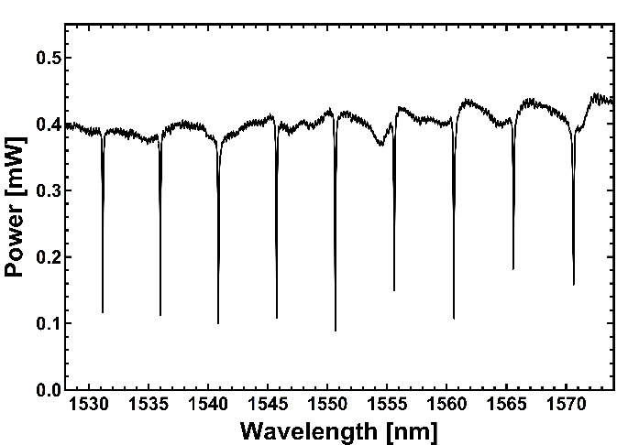
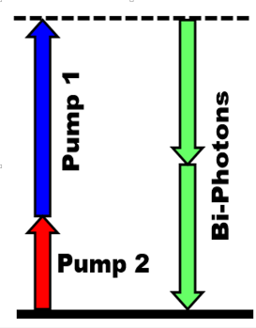
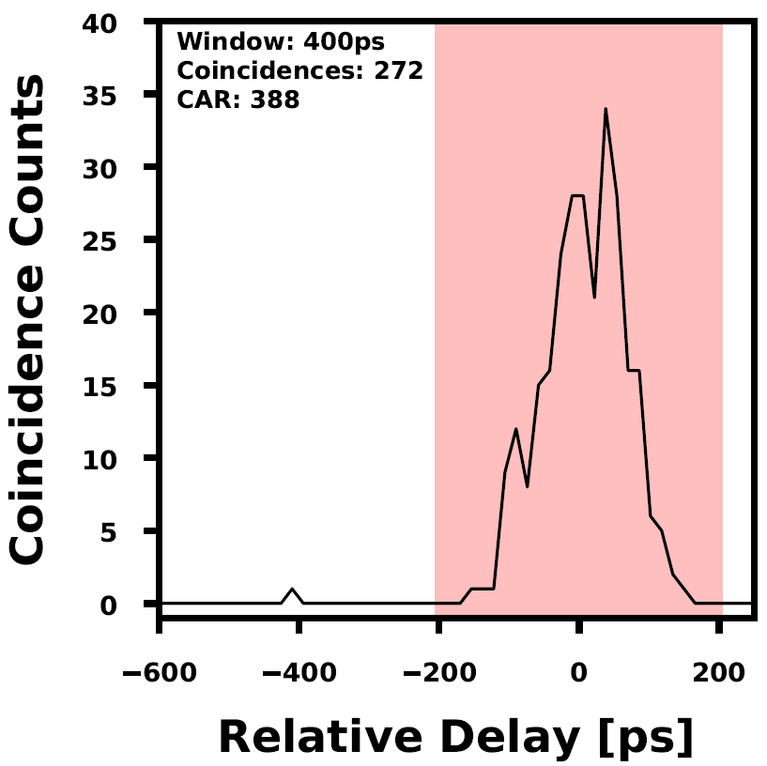
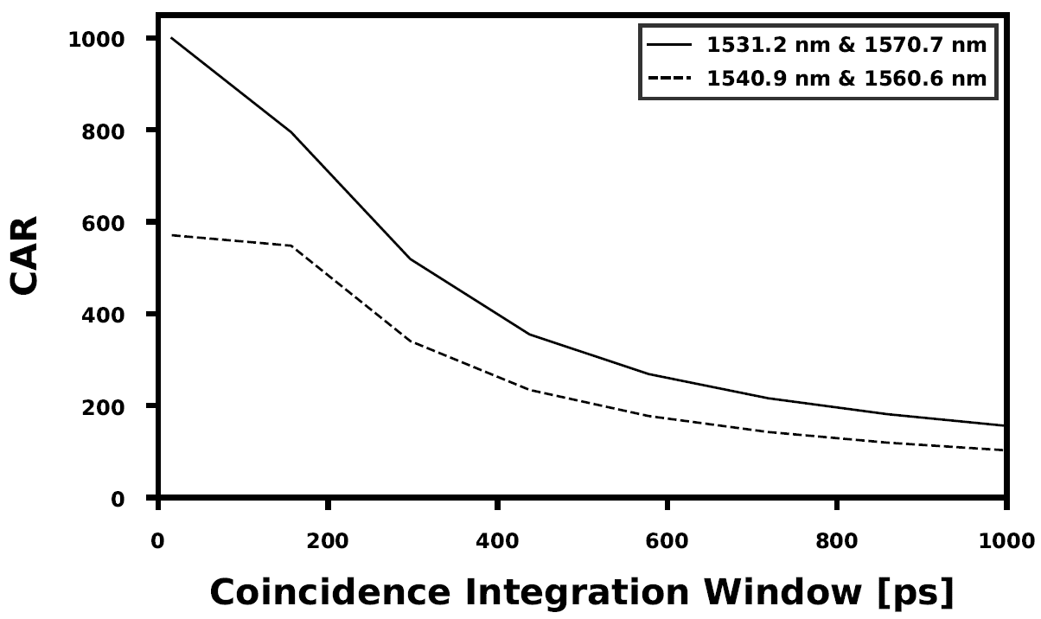
Degenerate Photon Coincidences
Signal
Idler
Signal
Idler
CAR of ~400 with a 400ps window
CAR of up to 1000 with smaller windows
Less efficient than non-degenerate production
  Competing Non-degenerate process
Pump
Pump
Pump 1
Bi-Photons
Pump 2
J. Steidle, M. Fanto, C. Tison, Z. Wang, S. Preble, P. Alsing, “High spectral purity silicon ring resonator photon-pair source,” Proc. SPIE 9500 (2015)

Slide 23
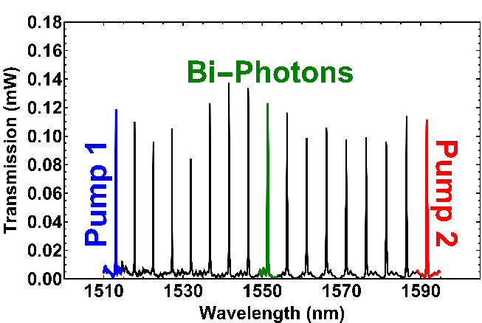
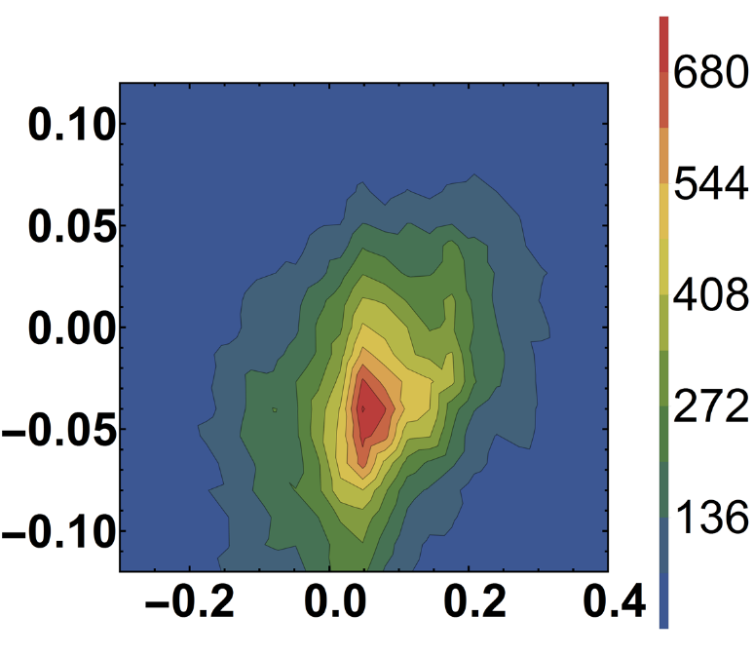
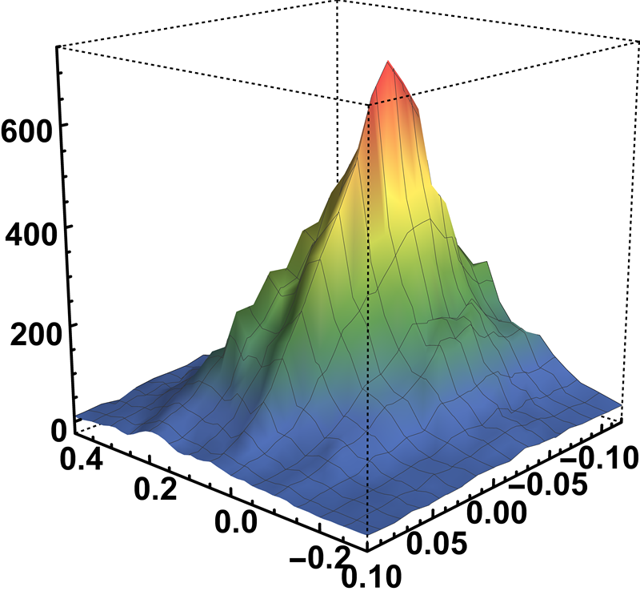
Spectral Selectivity
Wavelength (nm)
Wavelength (nm)
Coincidences
Photon generation only happens when both pumps are on their resonances - Confirmation of resonator enhanced generation of photons
Wavelength (nm)
Wavelength (nm)

Slide 24
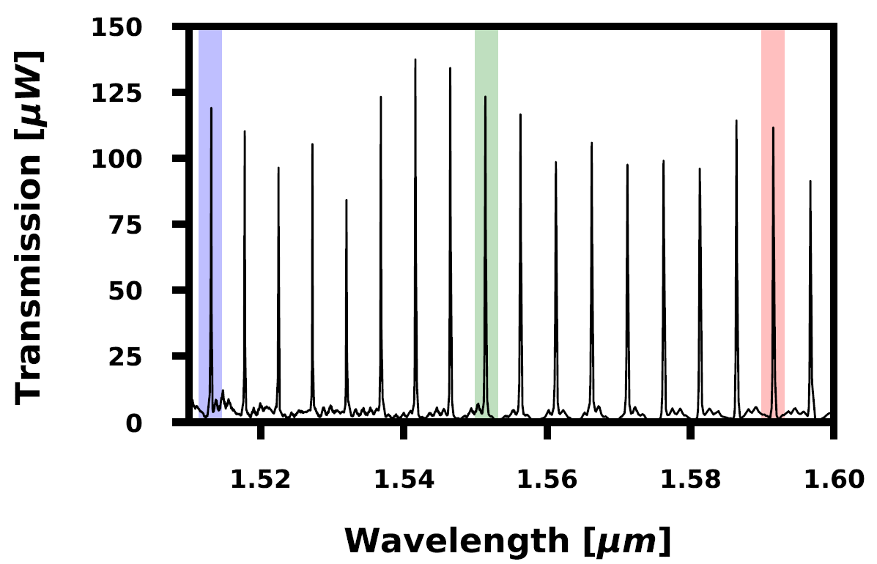
On-Chip Two Photon Interference
Pump 1
Bi-photon
Pump 2
Interferometer
Device Parameters:
  WG Width = 500nm
  WG Thickness = 220nm
  Ring Radius = 18.75um
  Ring Coupler Gaps = 150nm
  Spiral Lengths ~ 1mm
  DC Gap = 150nm
  DC Length = 9um
Photon
Source

Slide 25
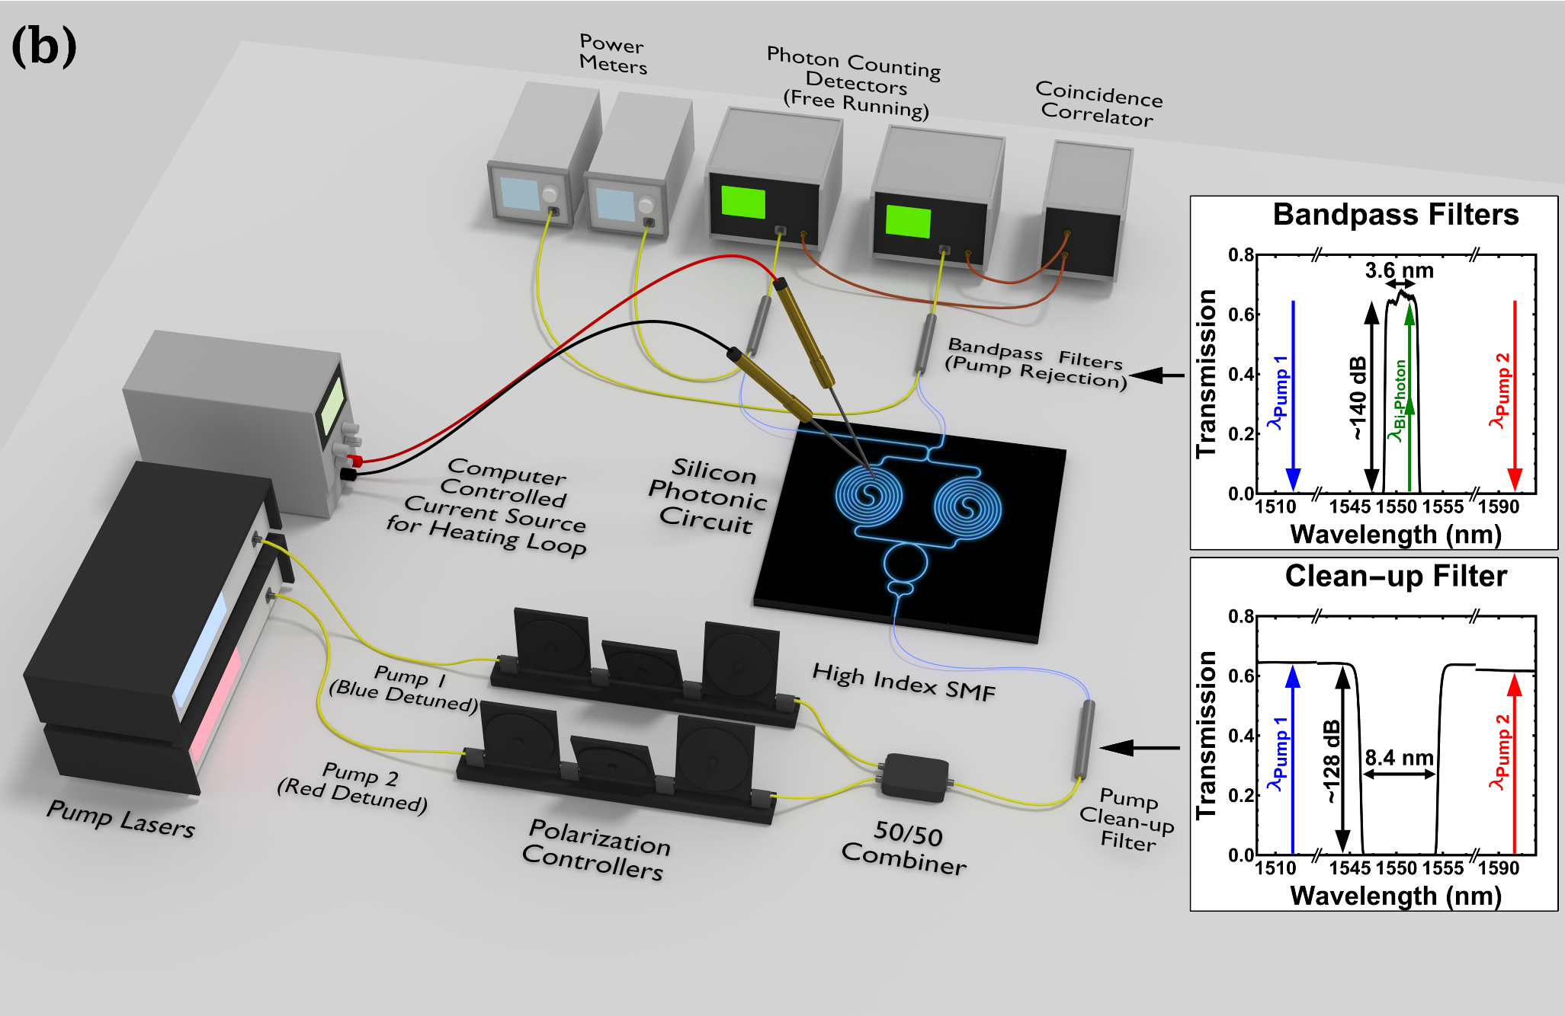
On-Chip Two Photon Interference

Slide 26
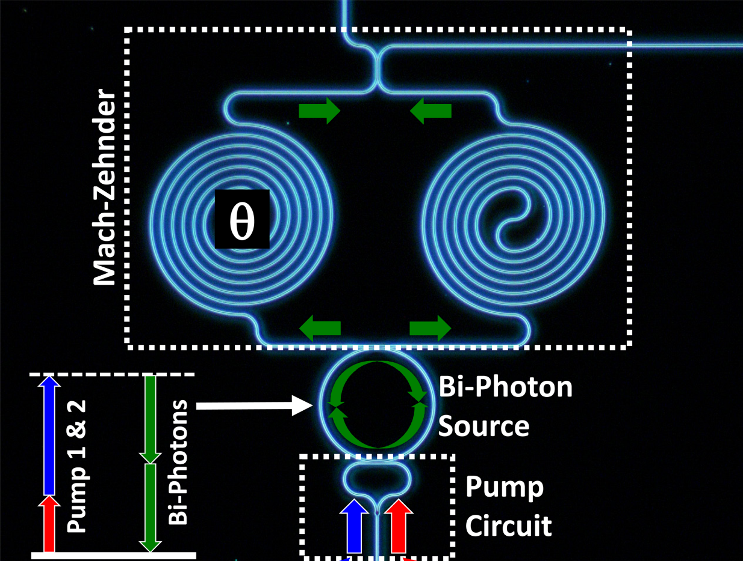
On-Chip Two Photon Interference
Creation of a single photon:
Creation of two photons:
Creation of two-photon N00N state :
Coincidence and zero coincidence states:

Slide 27
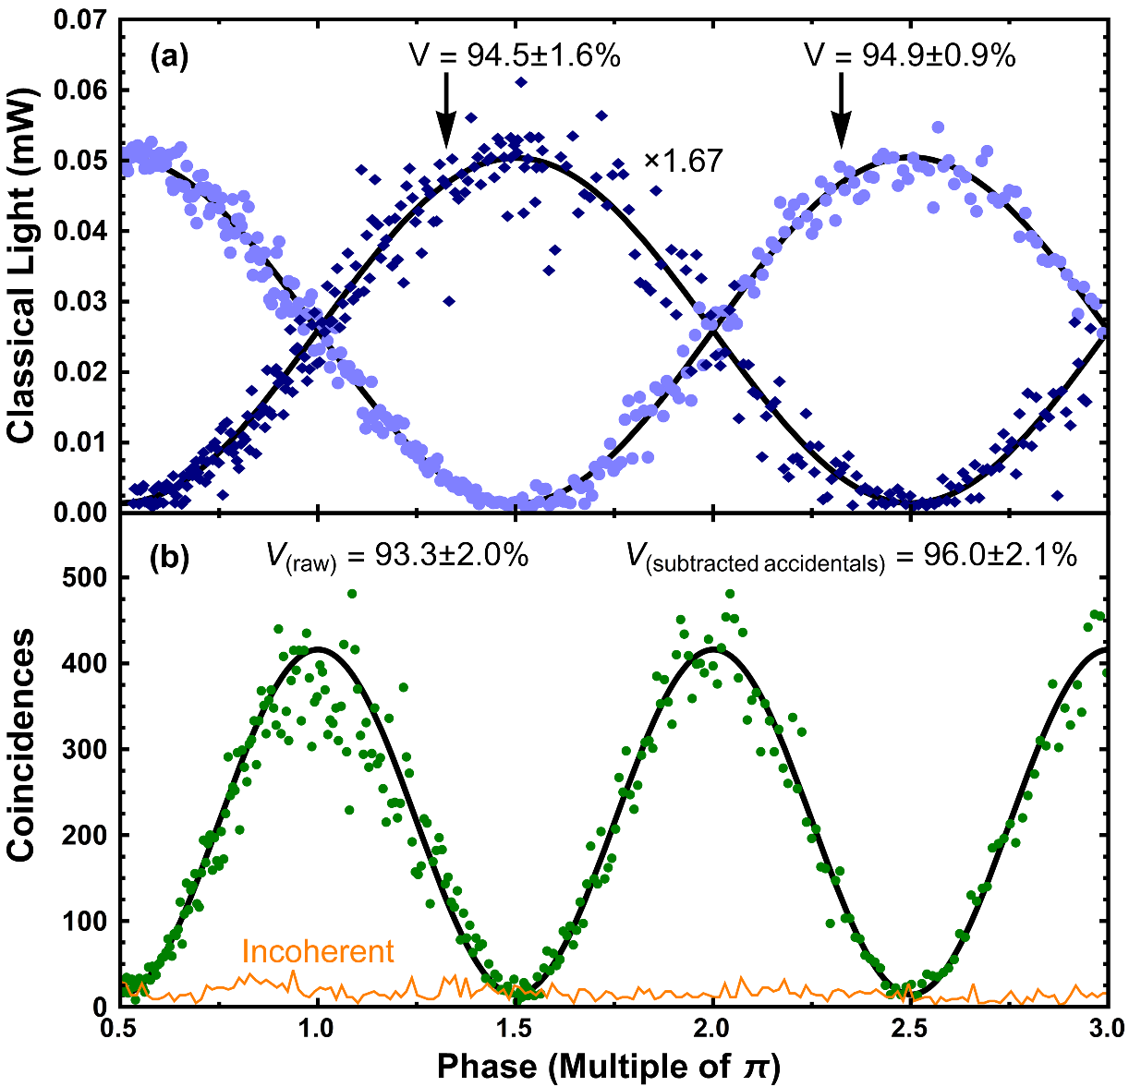
Two Photon Interference
Coincidences are in agreement
  Oscillates twice as fast as classical light
High visibility interference
“Incoherent” – Misaligned pumps
  No bi-photon generation
  Confirmation of path-entangled bi-photon quantum state
Physical Review Applied, August 2015

Slide 28
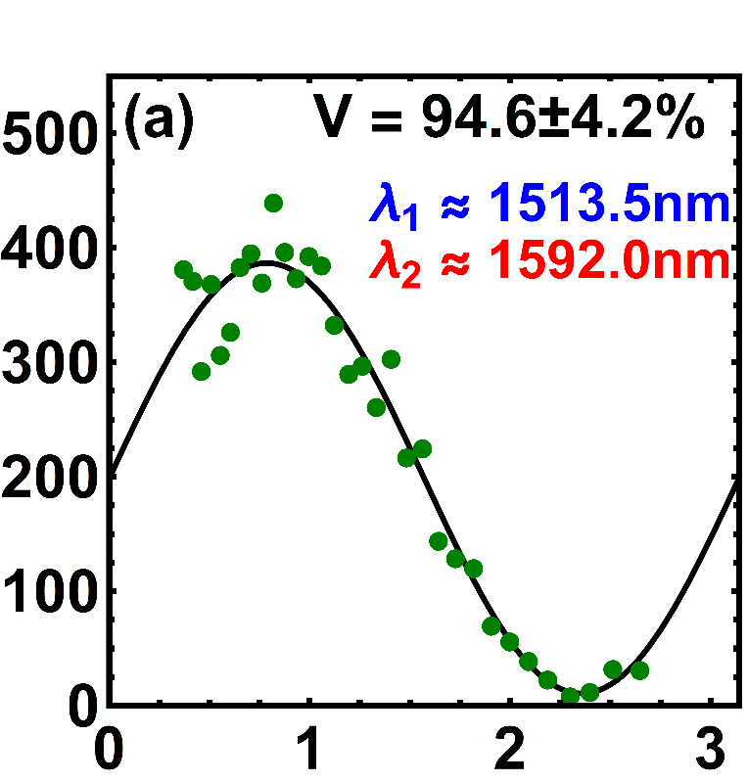
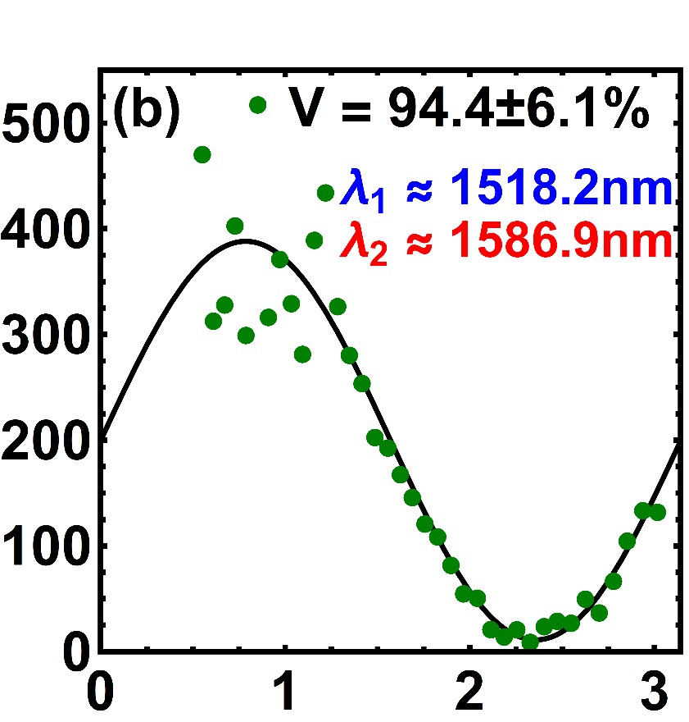
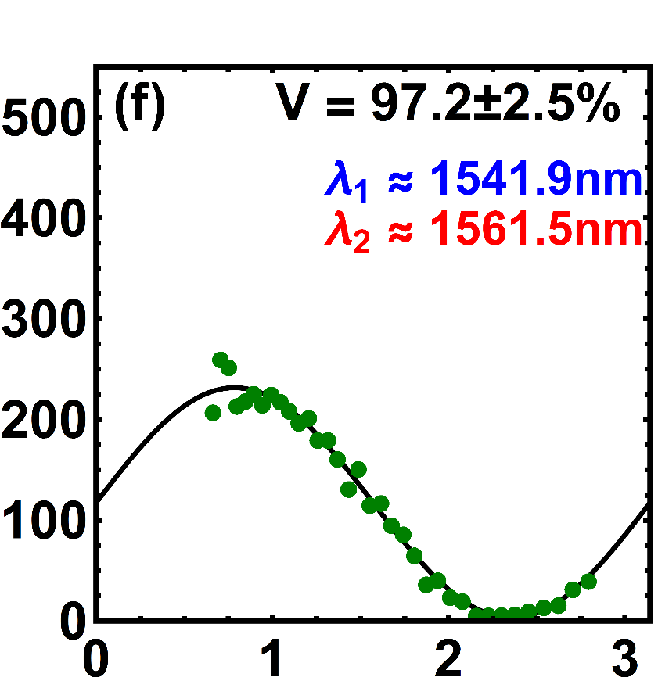
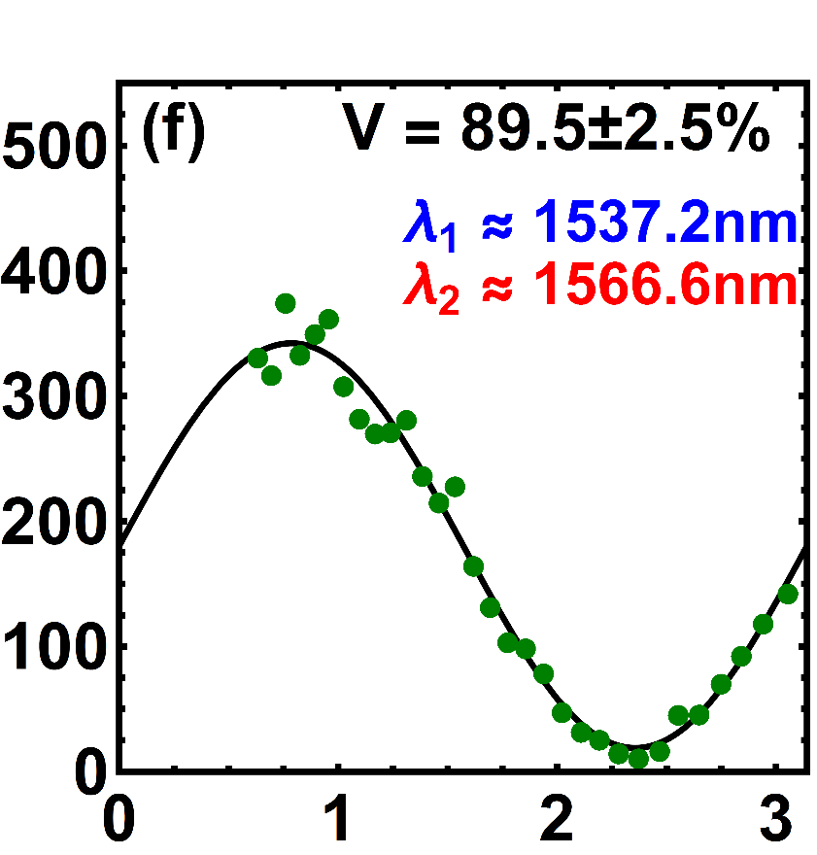
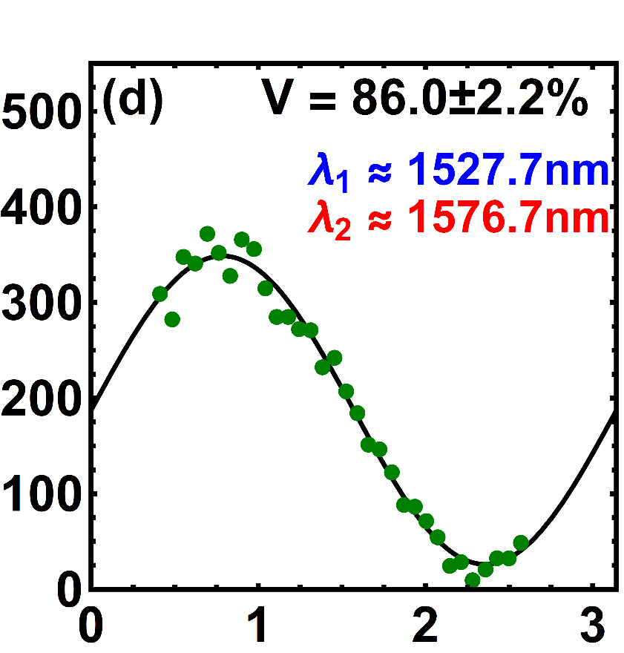
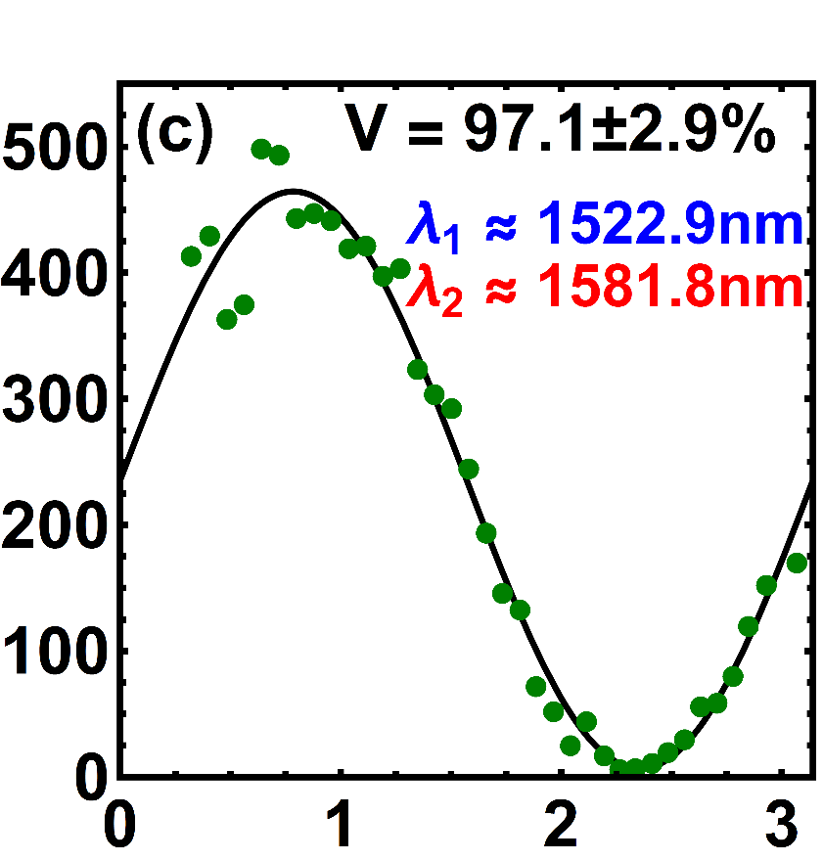
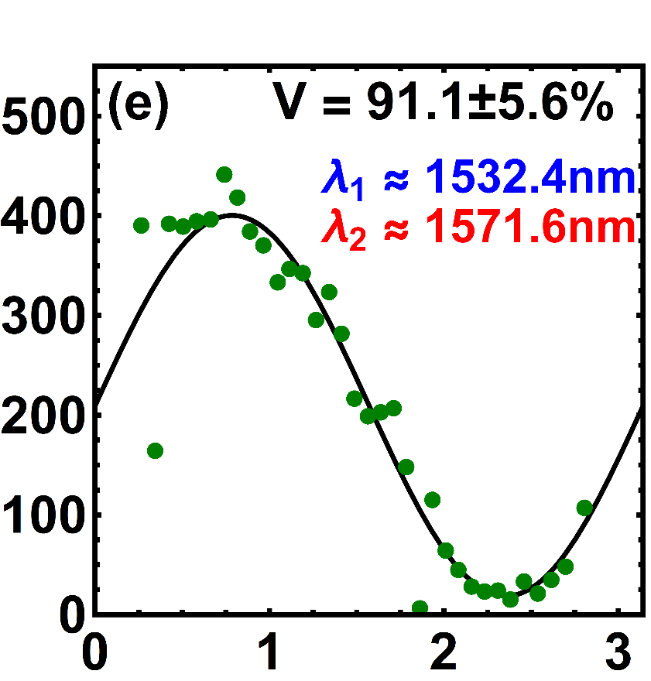
Broadband Phase Matching
We achieved high visibility interference measurements for all available resonance pairs
Coincidences
Relative Phase
Notes:
Amplitude variation comes from the wavelength dependence of the silicon circuit (particularly the directional coupler)

Slide 29
Photon Loss in Microring Sources
Photon
Source

Slide 30
Photon Loss in Microring Sources
Unfortunately, photons generated in a symmetric ring can leave through any port – an effective loss of 50%
Add
Drop
Add
Drop
Through
Input
Through
Input
Add
Drop
Add
Drop
Through
Input
Through
Input

Slide 31
Performance Metric for Heralded Sources
Commonly used metric is heralding efficiency
  A ratio of probabilities between coincident detection and single photon detection
  Can be used for any heralded source
  Difficult to determine as it relies on absolute system losses
    IL, PDL, $η_{coupling}$, $η_{detection}$
$$η_{heralding}=\frac{p_{coincidence}}{p_{signal} or p_{idler}}$$
The metric used here is coincidence efficiency
  A ratio of probabilities between coincident detection from the desired port to coincident detection from all possible ports
  Only useful for a multi-port heralded source
  Relies only on relative losses between paths in the system
    Much easier to determine
$$η_{coincidence}=\frac{p_{coincidence; desired port}}{p_{coincidence; all}}$$

Slide 32
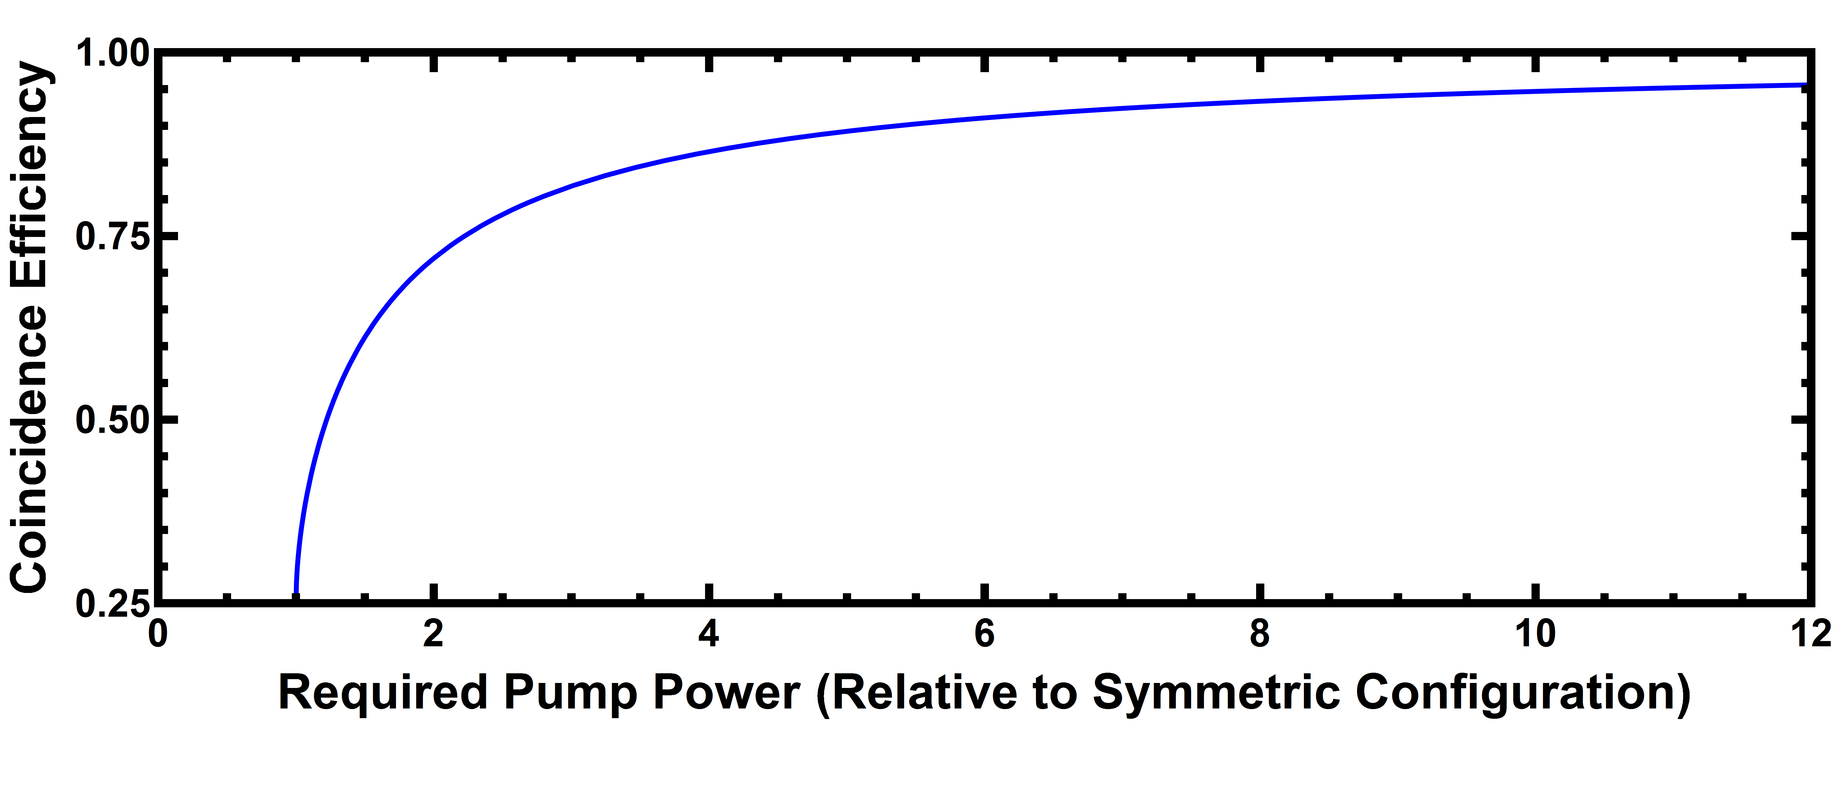
Asymmetrically Coupled Microring
Add
Drop
Through
Input
$$p_{thru}=\frac{{\left|κ_{1}\right|}^{2}}{{\left|κ_{1}\right|}^{2}+{\left|κ_{2}\right|}^{2}}$$
$$p_{drop}=\frac{{\left|κ_{2}\right|}^{2}}{{\left|κ_{1}\right|}^{2}+{\left|κ_{2}\right|}^{2}}$$
$$η_{coincidence}=\frac{{p_{drop}}^{2}}{{\left(p_{thru}+p_{drop}\right)}^{2}}={\left(\frac{{\left|κ_{2}\right|}^{2}}{{\left|κ_{1}\right|}^{2}+{\left|κ_{2}\right|}^{2}}\right)}^{2}$$

Slide 33
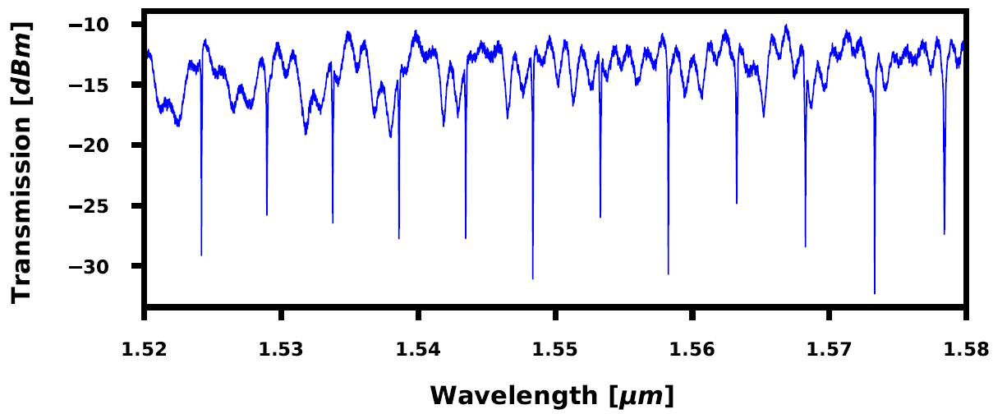


Asymmetrically Coupled Microring - Device
Device Parameters:
  WG Width = 500nm
  WG Thickness = 220nm
  Ring Radius = 18.75um
  Input Side Coupler Gaps = [150nm, 225nm, 300nm, 350nm]
  Output Side Coupler Gaps = 150nm
150nm
225nm
300nm
350nm

Slide 34

Asymmetrically Coupled Microring - Setup

Slide 35



Asymmetrically Coupled Microring - Coincidences
Device with 150nm Input Gap
Device with 350nm Input Gap
Through port coincidences primarily due to SFWM in waveguides
  Confirmed by coincidences when pump was not on resonance
10.1x the pump power required for the same power within the ring
Coincidence Efficiency: 0.967
Fairly equal distribution of coincidences between the four possible paths
Coincidence Efficiency: 0.370
(Off-Resonance Pumping)

Slide 36

Asymmetrically Coupled Microring - Results
C. Tison, J. Steidle, M. Fanto, Z. Wang, N. Mogent, A. Rizzo, S. Preble, P. Alsing, “Path to increasing the coincidence efficiency of integrated resonant photon sources,” Opt. Express (2017)

Slide 37

No Free Lunch?

Slide 38
What Makes the Ideal Microring Source?
Properties of the ‘Ideal’ Microring Photon Source from Different Perspectives
From the pump photon perspective
From the signal/idler photon perspective
Critically coupled
  Nothing is lost to the through port
Single-bus ring
  Pump photons trapped within the ring
High Q
  Low loss – higher power density
Over coupled – Low Q
  The photons quickly leave the ring
Single-bus ring
  All of the photons leave through the same port
How can a single-bus ring be both critically coupled with a high Q and over coupled with a low Q?
It Can’t!
Instead, maybe a dual-bus ring can be made to act like two independent single-bus rings…
Notes:
Ideally 30 minutes

Slide 39

Interferometrically Coupled Microring Source
The use of a two point coupler makes the bus waveguide and part of the ring into a Mach-Zehnder interferometer
The easiest way understand the response of such a device is to consider the two point coupler a point coupler with the spectral dependence of a MZI

Slide 40




A Different Approach to Coupling
Mach-Zehnder Interferometer (MZI)
Δφ
Microring Resonator

Slide 41



Interferometric Coupling - Simulation
Device Parameters:
  WG Width = 500nm
  WG Thickness = 220nm
  Ring Radius = 15um
  Coupler Gap = 150nm
  Loss in Ring = 7dB/cm
  Path Length Difference = 47.44um

Slide 42


Interferometric Coupling - Simulation
The addition of a second bus waveguide perfectly out of phase with the first enables the two ports of the ring to be decoupled from each other
Device Parameters:
  WG Width = 500nm
  WG Thickness = 220nm
  Ring Radius = 15um
  Coupler Gap = 150nm
  Loss in Ring = 7dB/cm
  Input Side Path Length Difference = 47.125um
  Output Side Path Length Difference = 47.44um
Excess pump photons are lost in the ring
Generated photon pairs leave the ring through the drop port
Coincidence efficiency of ~100% possible with no penalty to pumping + Built-in Pump Filtering!
MZI1
Input
Through
Drop
Add
MZI2

Slide 43
Interferometrically Coupled Ring
Metal
Metal
Fabricated at SUNY Poly in Albany, NY
  Doped Si heater element
  Hermetically sealed (much better longevity)
  300mm Wafer – Lots of devices!
Si
Doped Si
Doped Si
SiO2
Si

Slide 44




Spectral Response
Non-Ideal Heater Configuration
(Equivalent to a Lossy Add-Drop Ring)
Ideal Heater Configuration
(Directional Photon Source)
Input Side
Output Side
Exhibits behavior of asymmetrically coupled dual-bus ring resonator
  All of the resonances are supported by both sides of the device
The pump resonance is nearly critically coupled at the input side and suppressed at the output side
The signal/idler resonances are suppressed at the input side and supported at the output side

Slide 45




Coincidence Measurements
Non-Ideal Heater Configuration
(Equivalent to a Lossy Add-Drop Ring)
Ideal Heater Configuration
(Directional Photon Source)
Laser Power = 5dBm
Integration Time = 300s
Laser Power = 5dBm
Integration Time = 300s
Weakly coupled pump results in low pair generation rate.
Biased toward the drop port due to a built-in asymmetric coupling
η_{coin} = 0.785
Critically coupled pump results in greatly enhanced generation rate
Negligible coincidence rates for thru and split cases
η_{coin} = 0.998

Slide 46


Fine Tuning of Coincidence Efficiency
Non-Ideal Heater Configuration
(Equivalent to a Lossy Add-Drop Ring)
Ideal Heater Configuration
(Directional Photon Source)
By tuning the interferometric couplers, the coincidence efficiency can be varied from less than 0.7 to (near) unity

Slide 47


Unentangled Photon Pairs
Vernon Z, Menotti M, Tison CC, Steidle JA, Fanto ML, Thomas PM, Preble SF, Smith AM, Alsing PM, Liscidini M, Sipe JE. Truly unentangled photon pairs without spectral filtering. Optics letters. 2017 Sep 15;42(18):3638-41.

Slide 48
UV Photon Sources
(Qubit Storage)

Slide 49





UV Quantum Integrated Photonic Circuits
Yb⁺ ions– long lifetime quantum memory, quantum repeaters
Challenge: Producing and manipulating entangled UV photons
Yb⁺ ions
Aluminum Nitride (AlN) Quantum Waveguide Circuits
AlN Waveguide (300x200nm)
AlN UV Photon Source (Four wave mixing):
Large refractive index (n=2.2)
Large bandgap (6eV) – Transparent above λ~200nm
Large nonlinearity - n₂ ~ 2 × 10⁻¹⁵ cm²/W
Commercially available on sapphire substrates (n=1.7)
SEM images of AlN waveguides
AlN Waveguides and Ring Resonators:
Optimizing fabrication process to minimize etch roughness
Cladding based on Si-Oxy-Nitride (matched to sapphire)
40 μm
5 μm
200 nm
Collaboration with Dirk Englund, MIT Quantum Photonics Laboratory

Slide 50



UV Integrated Photonic Circuits
First demonstration of fiber coupled integrated circuits at 369.5 nm
  Q > 20k
Characterization Setup
150 fs Pulsed Ti:Sapphire SHG (360-470 nm)
  Average Power up to 20 mW
  Spectrum taken from high resolution OSA
CW Tunable Ti:Sapphire SHG (367-372 nm)
  Average Power 1-10 mW
Singlemode operation in the UV (369.5 nm)

Slide 51



UV-Vis Ring Resonator Performance
Pulsed Ti:Sapphire SHG (360-470 nm)
  Pulse width ~150 fs
  Average Power up to 200 mW
Waveguide output coupled to optical fiber
Spectrum taken from high resolution OSA
  High Q’s measured 15-70K

Slide 52







UV Integrated Photonic Circuits
$$Q=\frac{λ}{Δλ}$$
$$n_{g}= \frac{c}{v_{g}}$$
$$Q= \frac{2πn_{g}}{λα}$$
Q at 369.5 nm: ~20,000
(in literature 7K)
Propagation loss at 369.5 nm: 67-75 dB/cm
(in literature 80 dB/mm)
$$loss=10\log_{10}(e^{−α})$$
UV (369.5 nm) Resonance

Slide 53
Packaging

Slide 54


AIM Photonics TAP Facility
300mm Wafer Compatibility
Chip Scale Packaging
Fiber Attach
Laser Attach
Die Attach
Wire Bonding
Wafer Dicing
High speed Electro-optic testing
Metrology
Reliability Testing
>100 Capabilities
AIM Photonics Test, Assembly and Packaging (TAP) Facility
Within the ON Semiconductor Facility
1964 Lake Ave. Rochester, NY

Slide 55






Optical Fiber Attach
Automated Fiber Attachment
UV Curing, Laser Soldering, Micro-Welding (Nd:YAG), Filament Fusion Splicing, Laser Cleaving
Fiber Arrays (Edge Coupled)
Single Fibers
Evaluation Kits

Slide 56




Efficient Coupling
Demonstrated ultra low loss (<0.15dB) splicing between SMF-28 and ultra-high numerical aperture (UHNA) fibers.
Efficient coupling to AIM Photonic chips (with C+L Band TE/TM Edge Coupler)
  <3dB Connector-to-Connector loss
  <1dB Polarization Dependent Loss
Ultra-low loss splice
Splicing Loss
Connector-to-Connector Loss [TE]
Connector-to-Connector Loss [TM]

Slide 57

Acknowledgements
Thank You!

