Slide 1
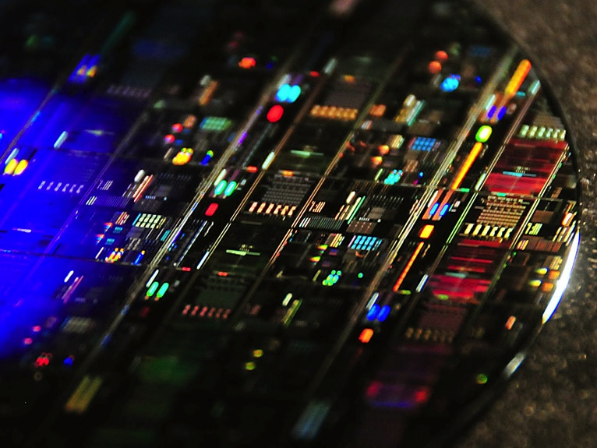
Very-Fast Photon Sources and Detectors
Shayan Mookherjea
UC San Diego, Micro/Nano-Photonics Group
http://mnp.ucsd.edu
PfQ Workshop, Jan 2019

Slide 2
Outline
1. Explanation of what I mean by “very-fast …”
  … entangled-photon sources
  … single-photon detectors
2. We develop and study silicon photonics & 3D technologies:
  Entangled photon pair generation, filtering and routing using silicon photonics
  InP-on-Si lasers, and LN-on-Si modulators, through bonding,
  Uses, and can be packaged with, microelectronics.
We use foundry fabrication, including multi-project wafer runs, as far as possible, and develop new solutions where needed.

Slide 3
Very-fast versus ultra-fast …
[ this term is already in wide use ]
Femtosecond pulses
Dynamics of electrons, excitons etc.
(Repetition rates ~ 100 kHz - 100 MHz)
[Sources] Speed up each “trial” i.e., use of the resources in the quantum channel (pump, modulator, …, detector gate).
[Detectors] Detect (very) broadband waveforms at (very) low powers, e.g., a sampling oscilloscope.

Slide 4
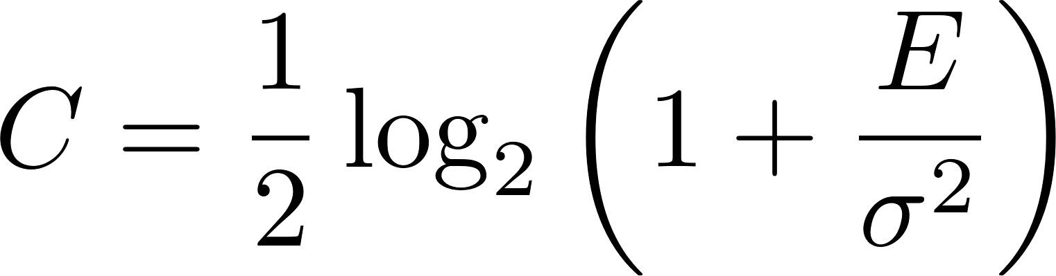
What is a “trial”?
In communications, a “trial” is often called “channel use”.
e.g., Discrete-time Gaussian Channel capacity:
bits per channel use
E = average energy of the received symbol
σ = st. dev. of noise (iid random variable)
Given the rate of trials, e.g., one channel use per microsecond, we can calculate the usual C_{bps}, capacity in bits per second.
Integrated optics can improve “per channel use” rate by 100 -1000 x.

Slide 5
Completion time is proportional to
time needed per bit / attempt i.e., “trial”
Quantum Key Distribution
Transceiver for quantum state
Nordholt & Hughes, Los Alamos Science (2002)
Sangouard et al., Rev Mod Phys (2011)
Metcalf … Walmsley et al., Nature Photonics (2014)

Slide 6
Transceiver for quantum state : entanglement distribution time
A : direct transmission
Sangouard et al. Rev Mod Phys (2011)
1000
Time to distribute a single entangled photon pair
( seconds )
100
10
1
400
500
600
700
800
Distance (km)
A: Single photon source: 10 GHz repetition rate, Fiber loss 0.2 dB/km, 90% detector efficiency
Quantum Repeater protocols: B : DLCZ protocol, C : entanglement swapping [Jiang et al. 2007], D : Chen et al (2007), E : Simon et al. (2007) photon-pair sources + multimode memories, F : Sangouard et al. single-photon sources (2007), G : Sangouard et al. entangled-pairs

Slide 7
Louisell et al. (1961)
L_{c}
Signal
Nonlinear crystal
N_{s}
Pump
Idler
N_{i}
SPDC, SFWM
Differential noise is suppressed
i.e., Var [N_{s} – N_{i}] at detector = 0.
Cavity photon lifetime proportional to L_{c}:
make small, efficient cavities for “fast” photons.

Slide 8
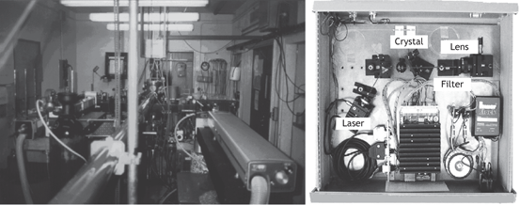
Photon generation & entanglement creation apparatus
Integrated
microchip
Room-sized
Breadboard-sized
?
Alain Aspect (1982)
Nicolas Gisin (1997)
Trial rate:
kHz
MHz
GHz
THz
Size:
m²
cm²
mm²

Slide 9
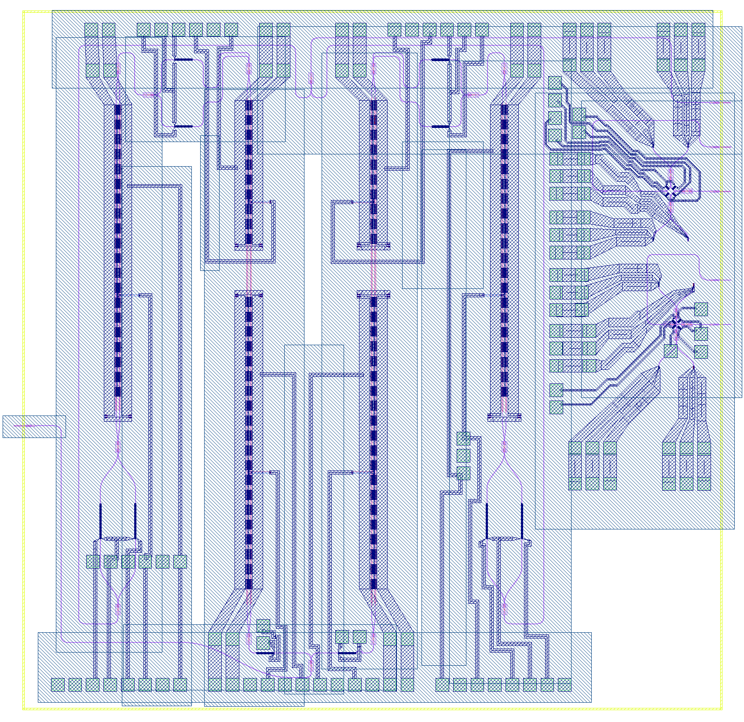
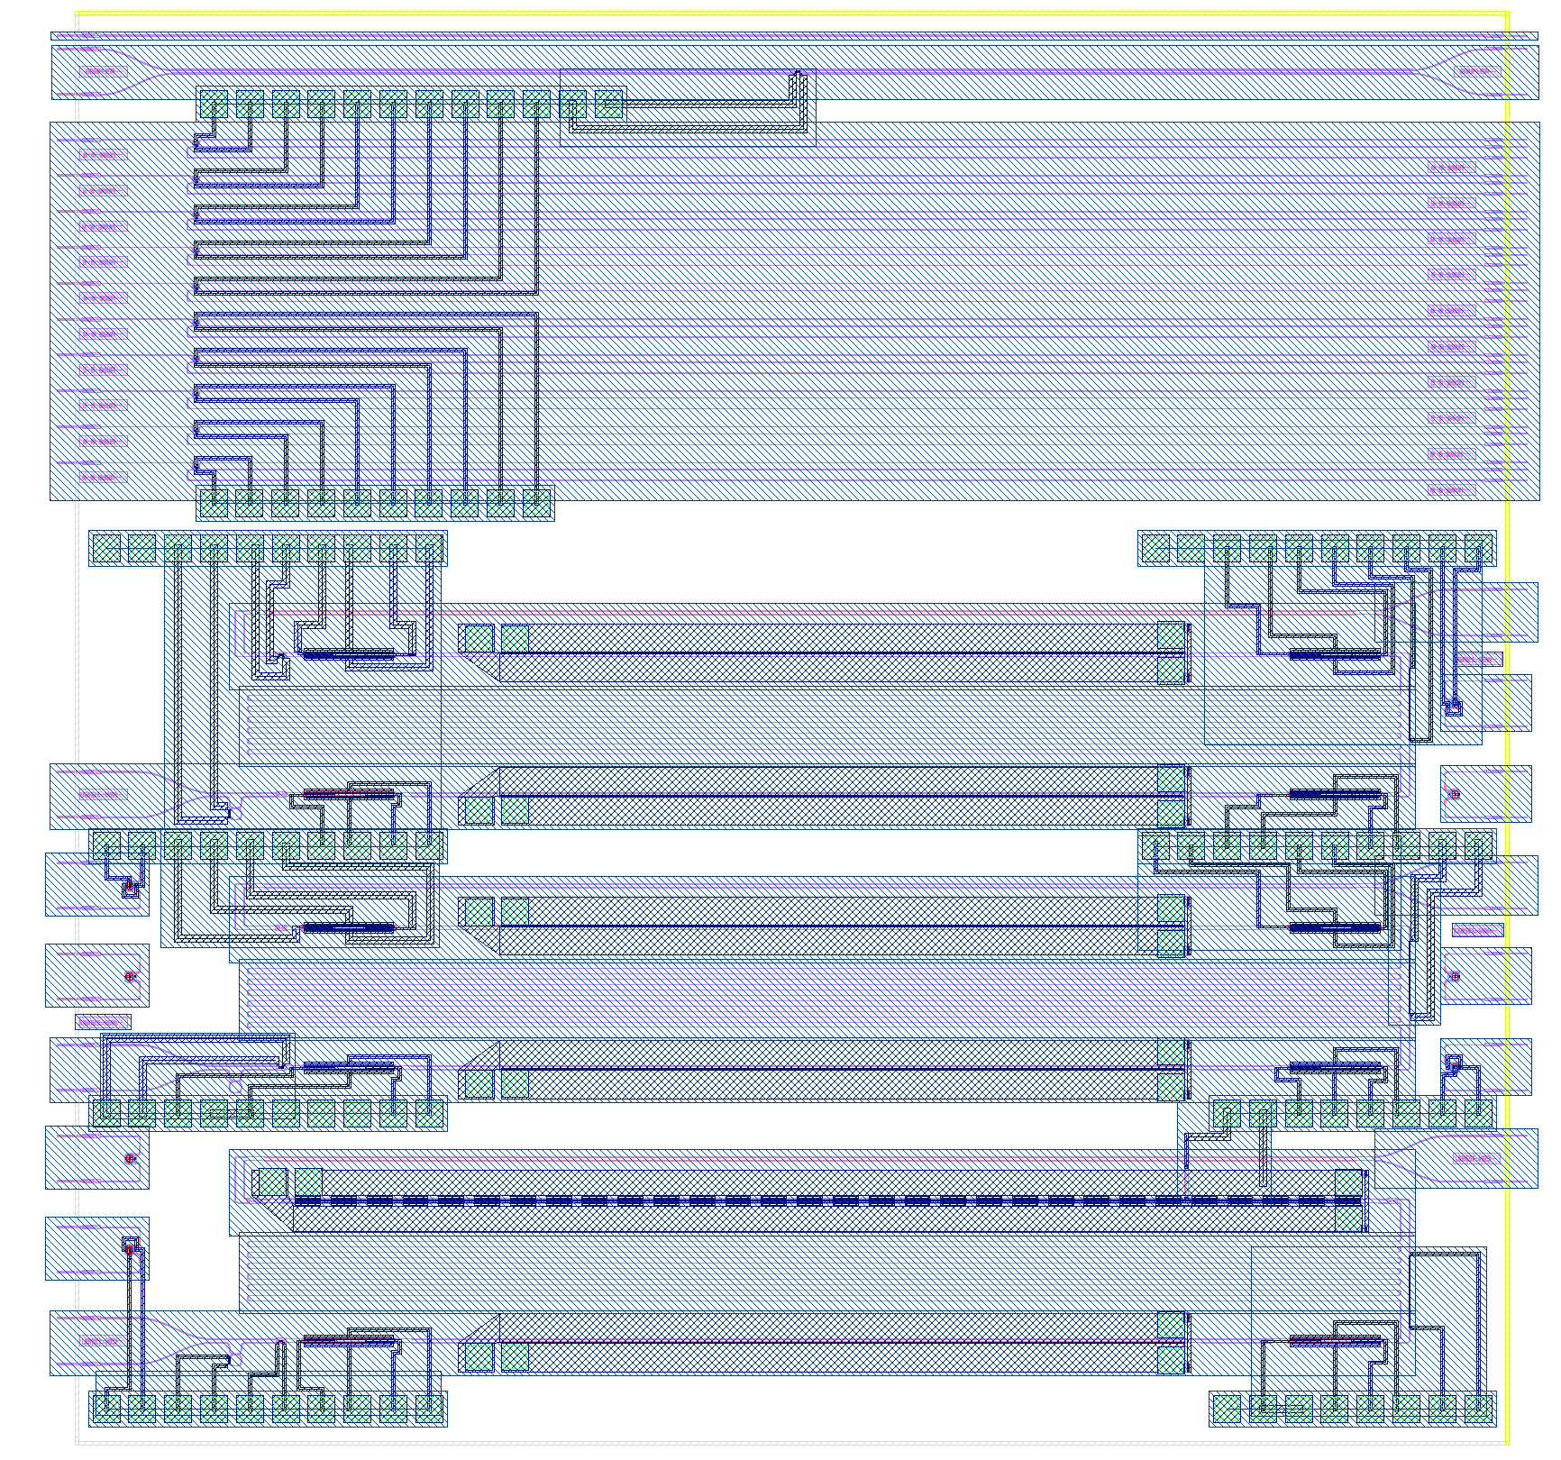
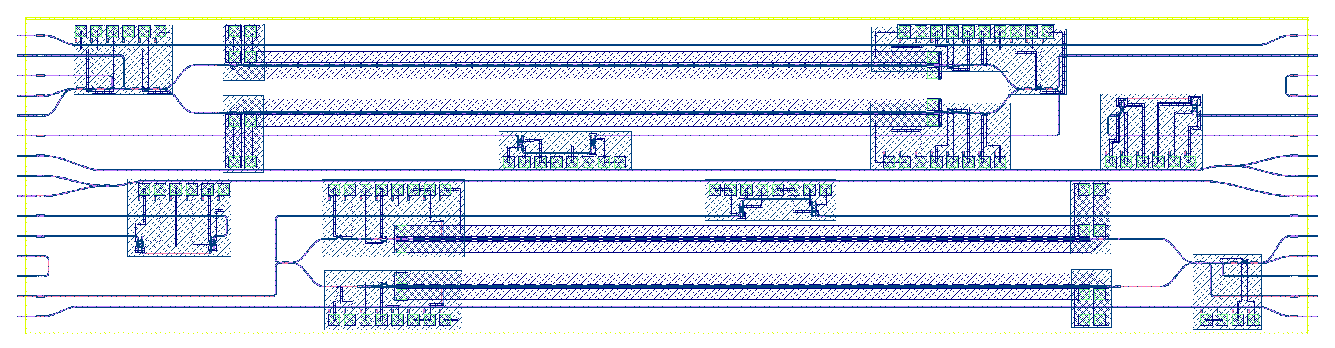
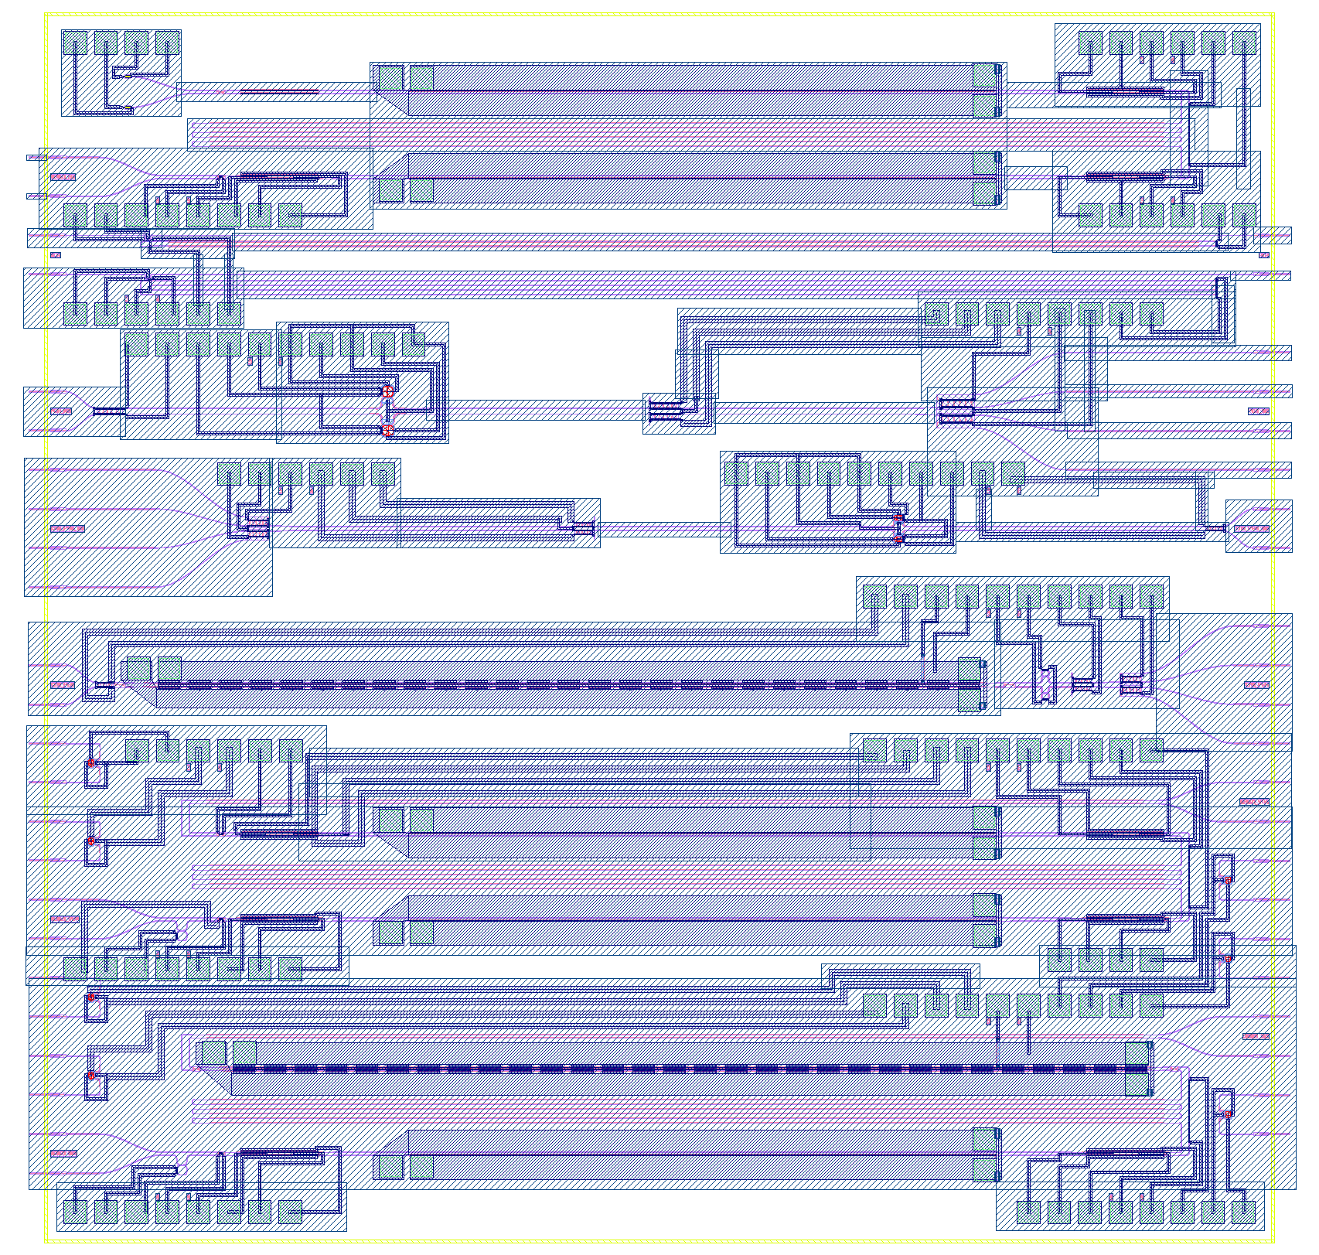
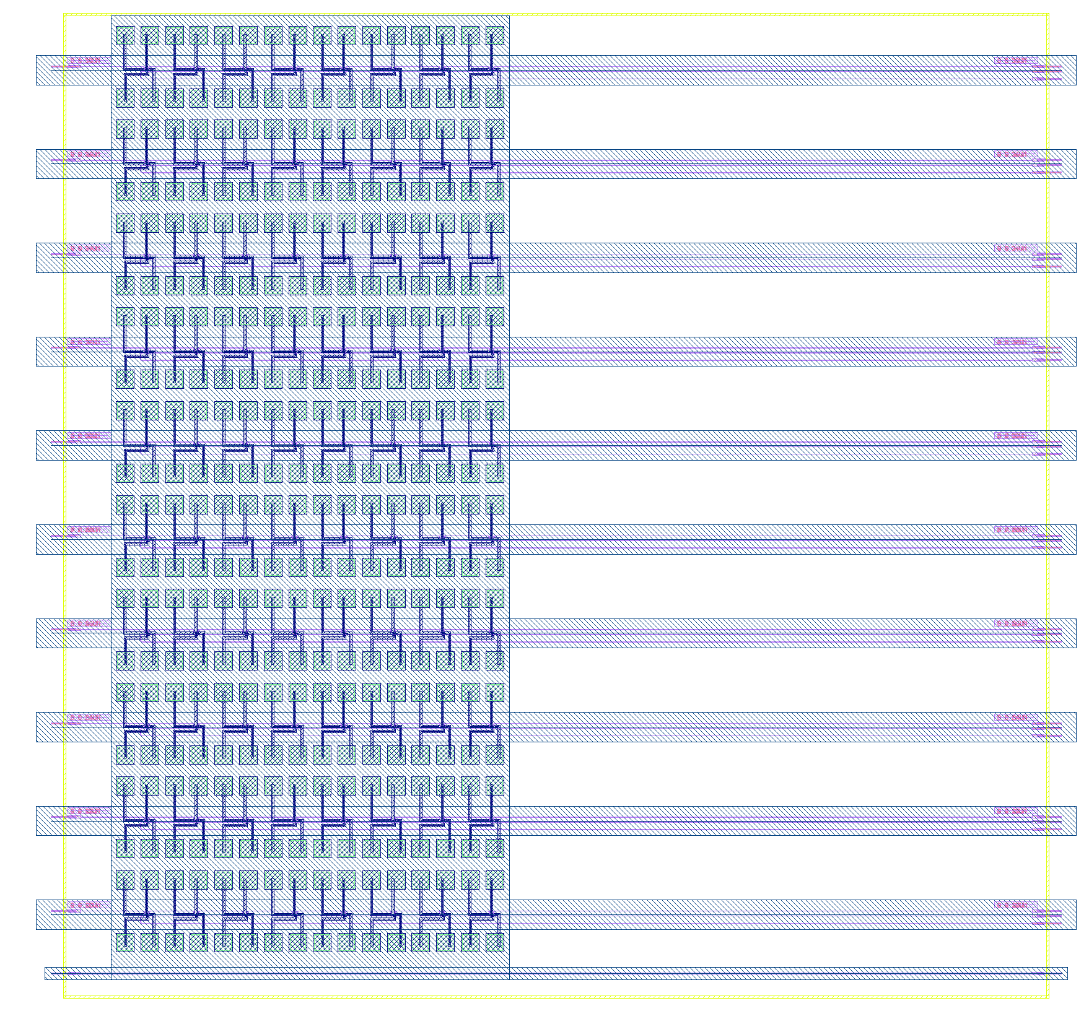
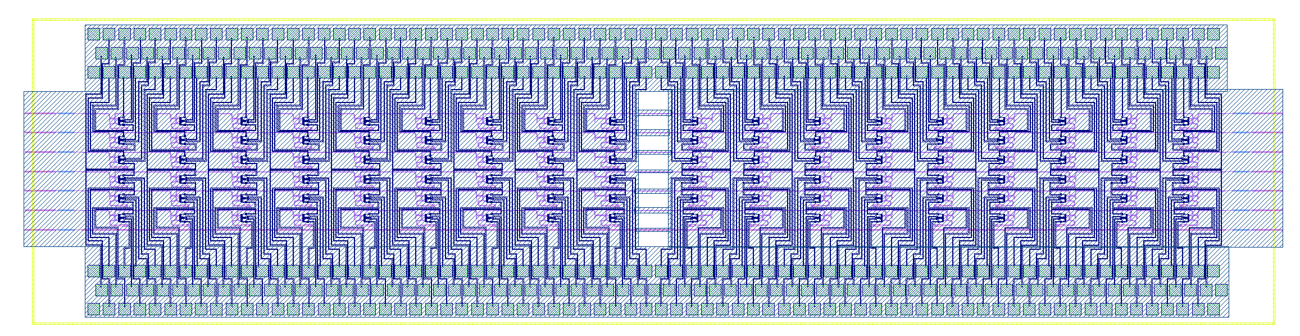
Requirements to speed up “trials” 10 … 100 GHz
Small devices (e.g., photon lifetime < 100 ps) … natural candidate for integrated optics.
High intrinsic generation rate (highly nonlinear material + phase-matched pair generation process), e.g., Si microring resonators: pair generation rate 150 MHz.mW⁻²
Ability to use, process & measure upto 100 GHz (approx. 1 nm) bandwidth.
Methods of generating pump pulses, and operating the source that are scalable, manufacturable, parallelizable, low-cost.
Leveraging multi-project wafer shuttles

Slide 10
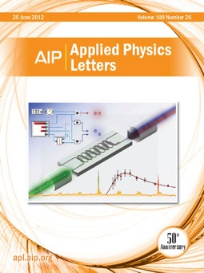
“Telecommunications-band heralded single photons
from a silicon photonic chip”
Cover article Appl. Phys. Lett. 100:261104 (2012)
Selected as Editor's Picks of 2012, as one of the
most notable APL articles published in 2012
Collaboration with NIST and IBM T. J. Watson Labs
Based on microring resonators (in this case, coupled microrings). All wavelengths near 1550 nm. Spontaneous four-wave mixing, with an optical pump beam (mW powers).
Our subsequent experimental work:
Wavelength-division multiplexing with single photons: Optics Letters (2013)
Controlling the entanglement of photons at the source: Nature Communications (2014)
Experimental proof of entanglement (2-photon interferometer): Optics Express (2015)
Temperature-stabilized pair generation using microrings: Applied Physics Letters (2015)
Microwatt-scale pump power pair generation: Optics Express (2016)

Slide 11
Entangled photon pair generation
simultaneously at the 1310 nm and 1550 nm wavelength bands
IoP Quantum Science and Technology, Vol. 3, No. 3, 034001 (2018)
1310 / 1550 DEMUX
Franson visibility (1310 nm) 97.4 ± 13.4 %
2 MHz
1310 nm pump
1550 nm pump
power ~ 0.1 mW
CAR : 650
40.037
Resonances at both 1310 nm and 1550 nm
1 MHz
Franson visibility (1550 nm) 97.8 ± 4 %
CAR : 530
Transmission (dB)
Transmission (dB)
wavelength (nm)
wavelength (nm)

Slide 12
Pair generation without mode-locked lasers
Applied Physics Letters, 108, 251102 (2016)
Step recovery diode
2-terminal p-i-n diode whose junction impedance depends on internal charge storage.
Can generate pulses of a few tens of picoseconds, at approx. GHz rates.

Slide 13
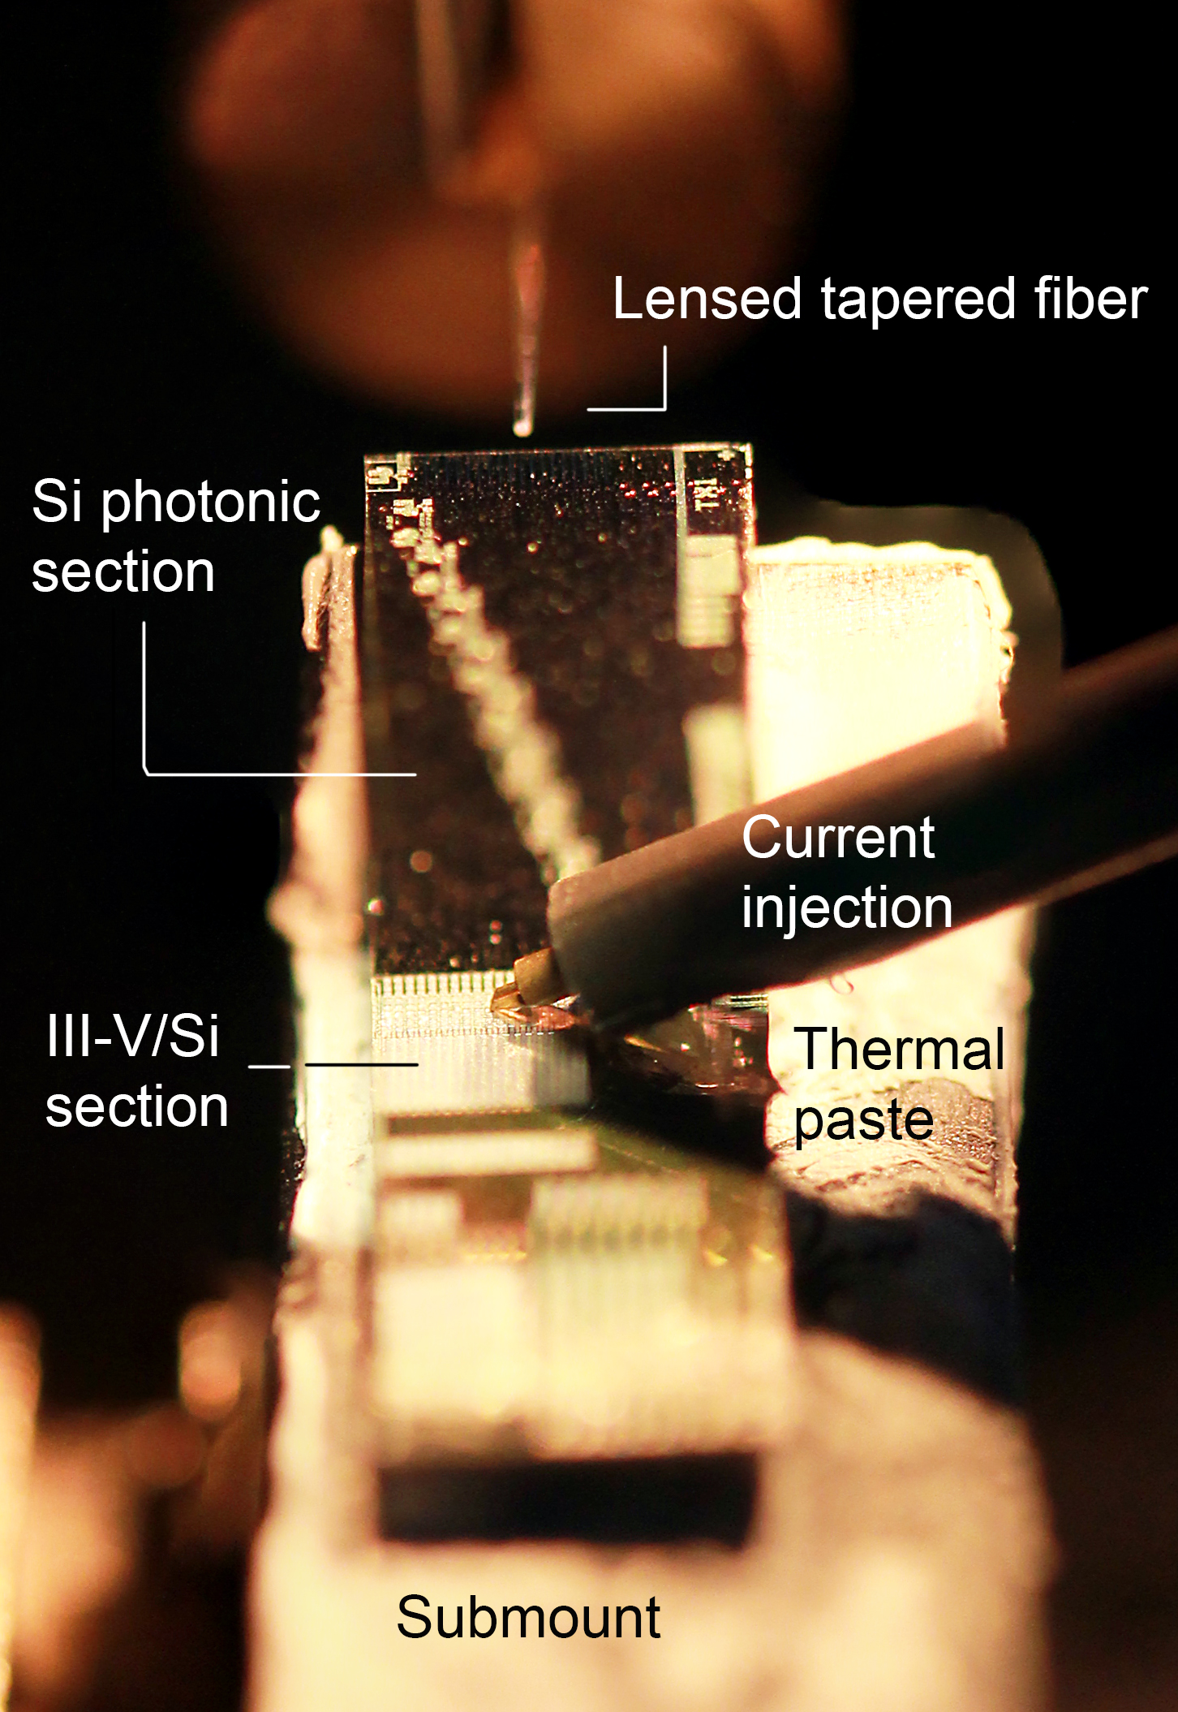
Photon Pair Generation
using Silicon Photonic Microring and Hybrid Laser
CLEO 2017 Post-deadline paper JTh5C
APL Photonics, Vol. 3, No. 10, 106104 (2018)
Room temp. pair & heralded single photon
generation for data-center applications (at 1310 nm)
CAR: 417
Heralded single-photon: g⁽²⁾(0) = 0.095
Pair generation rate: 300 kHz at 1 mW pump
Heralding efficiency: ~ 6%
CW, or pulsed.
< 100 mA current, ~ 1 Volt, electrically-pumped hybrid silicon laser [collab. w/ Intel]

Slide 14
Previous (typical) results
(Si Photonics SFWM):
CAR ~ 100 – 1,000
g⁽²⁾(0) ~ 0.1
V_{2-photon} ~ 92%
(see Table 1
in paper)
Dec 2017
1.5 x 10⁸
The spectral brightness (# pairs / s / GHz / mW²) of this device is:
  100x higher than reported by other groups [Ref. 22],
  24x higher than our previous results [Ref. 8],
  2x greater than that of the silicon microdisk [Ref. 7].
Paper also reports entanglement verification through 2-photon Franson interferometer (time-energy entanglement)

Slide 15
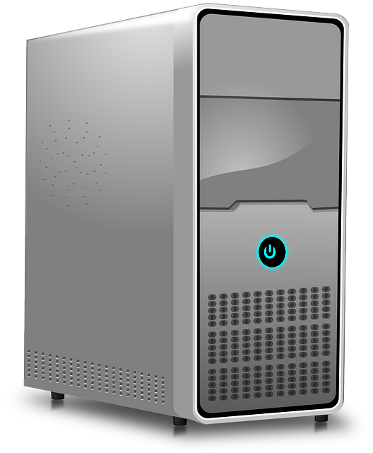
Optics Express, Vol. 26, No. 18, 22904 - 22915 (2018)
Pair generation using spontaneous four-wave mixing in a silicon microring resonator
“Pump laser” = [ tap fraction of ] 10 Gbps NRZ data stream.
Rest of the 10 Gbps data stream available e.g., for classical link.
No need for separate pump laser!
Classical 10 Gbps link
ALICE
BOB
tap
Photon pair generation
Still need photonics components: polarization control, filters, monitor PD etc.

Slide 16
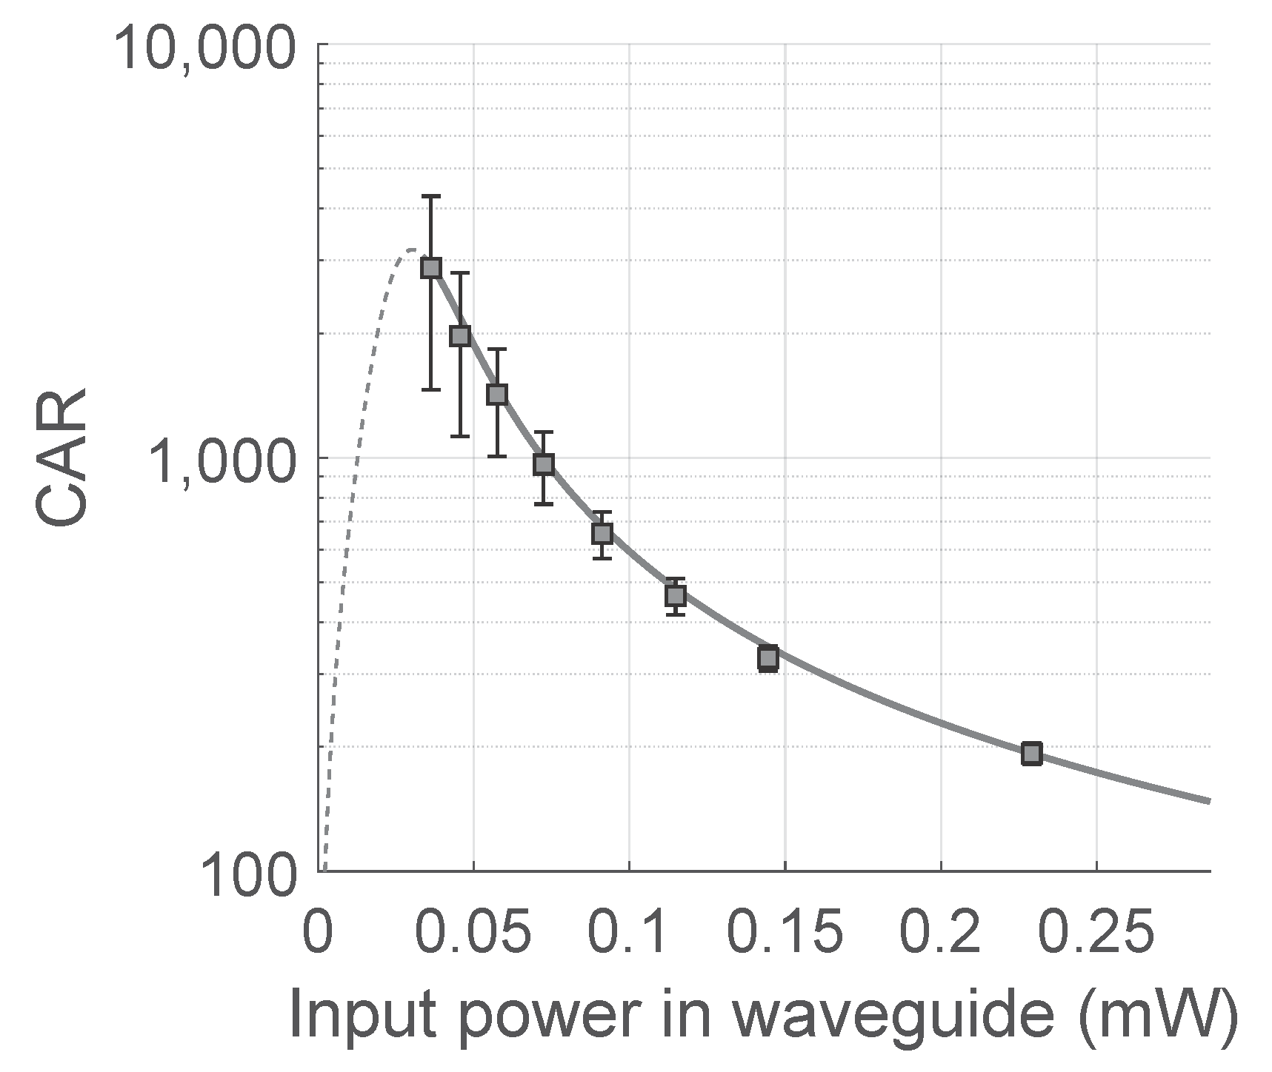
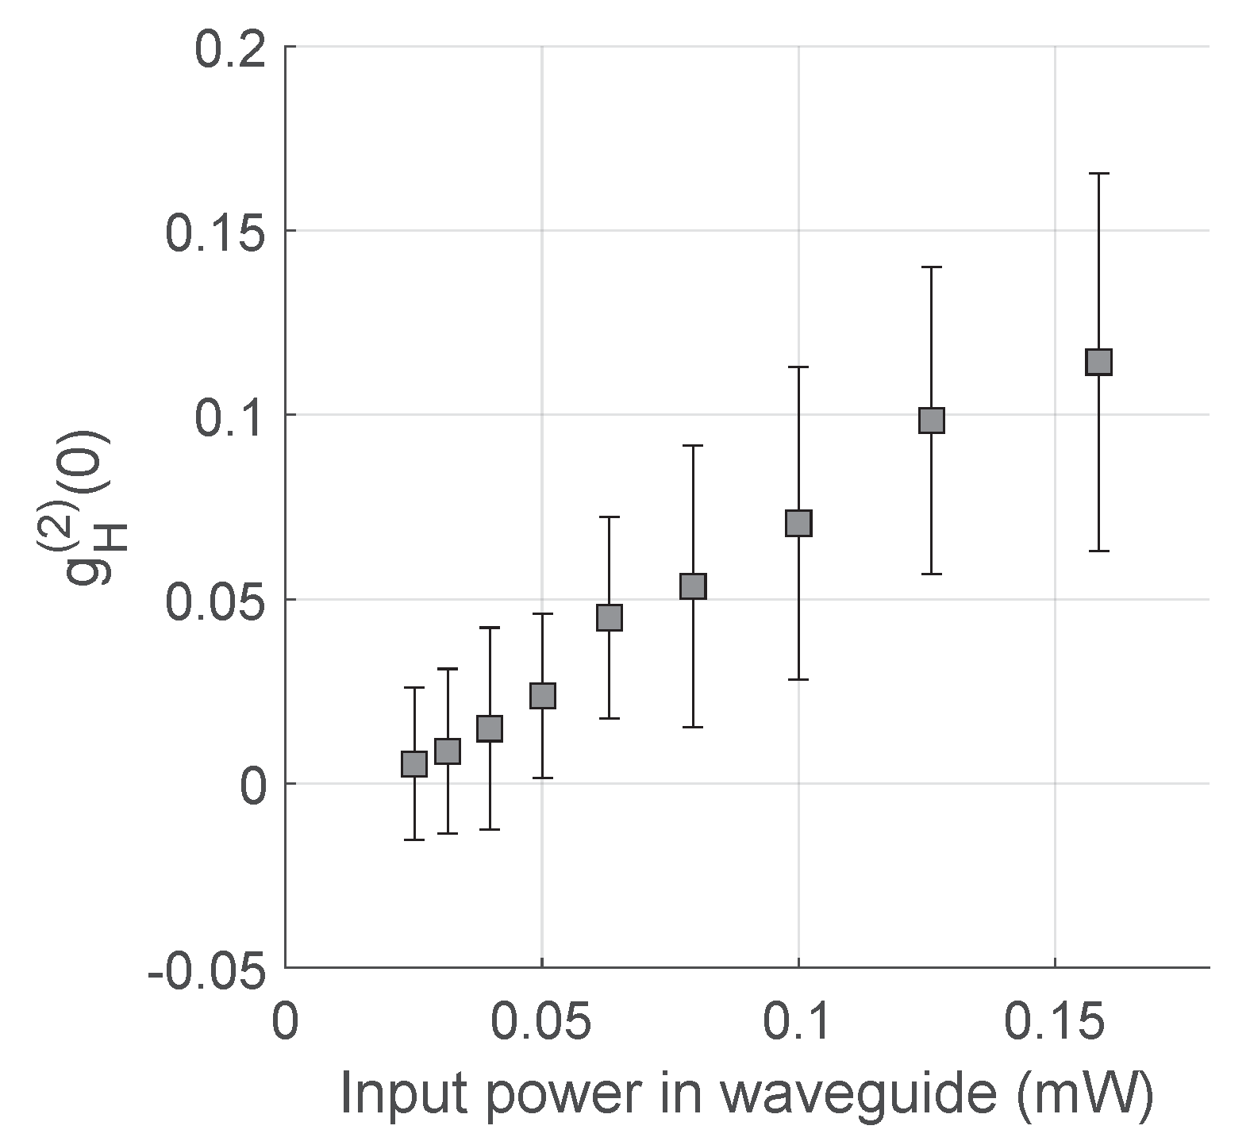
Good performance of photon-pair and
heralded single photon generation
Microring resonator pumped by 10 Gbit/s NRZ data stream (tap fraction)

Slide 17
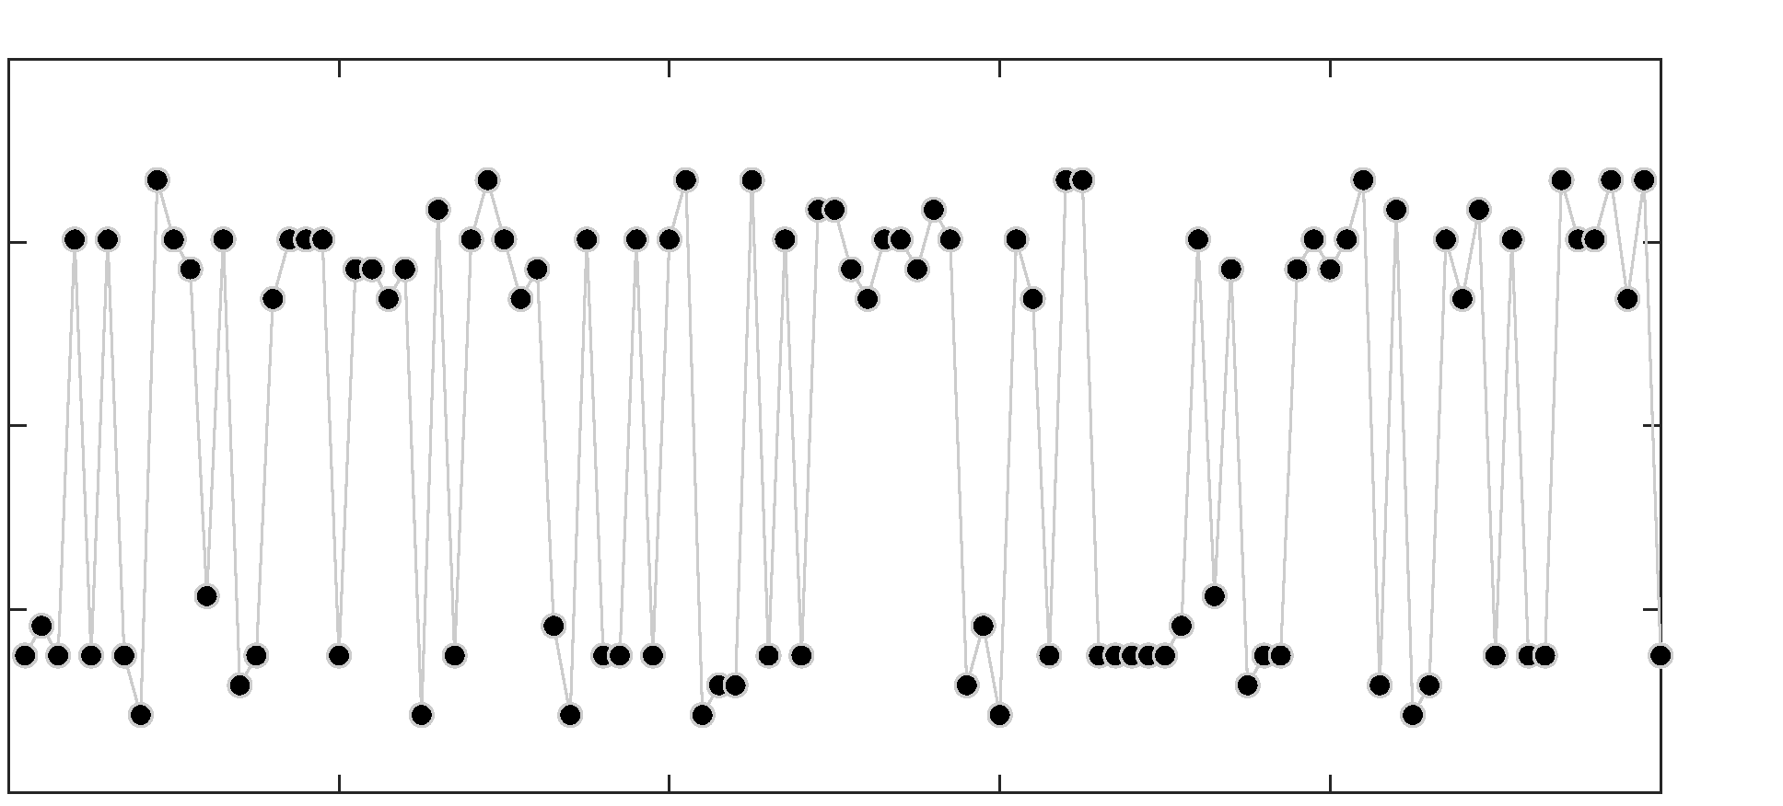
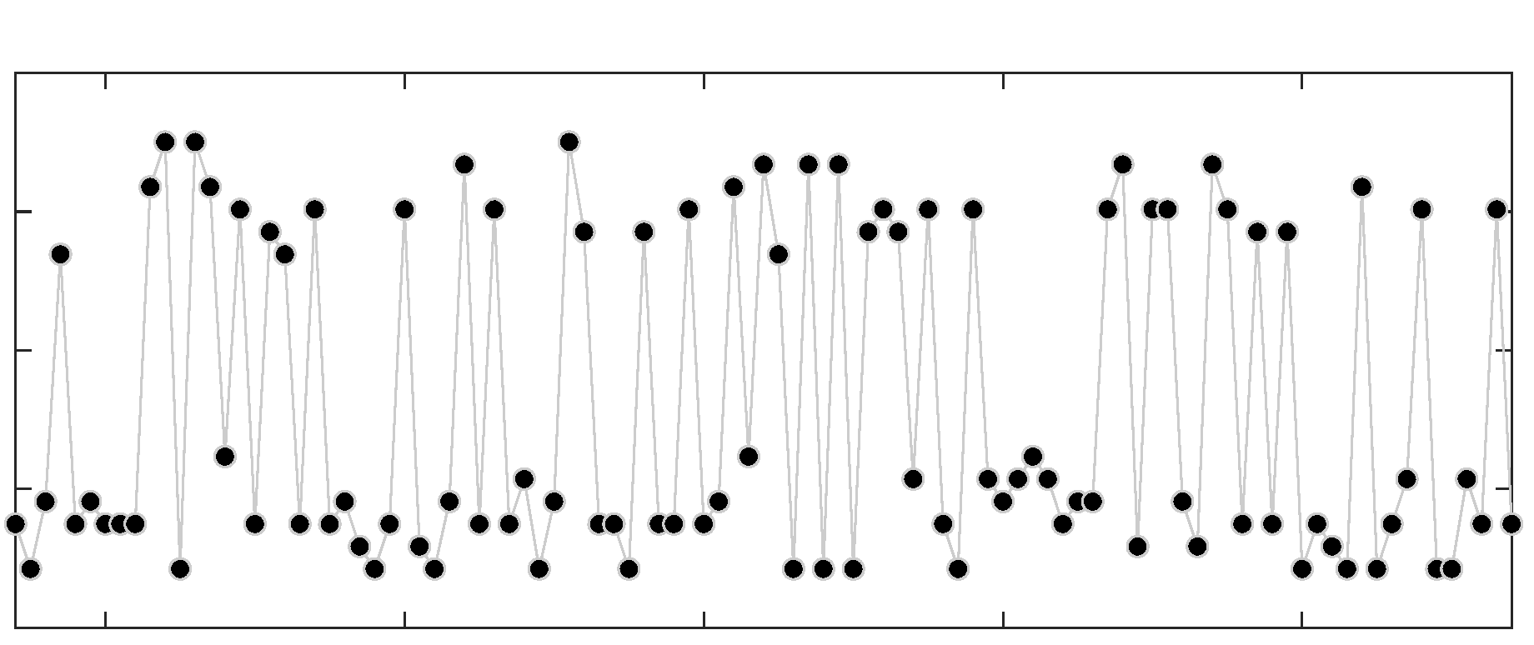
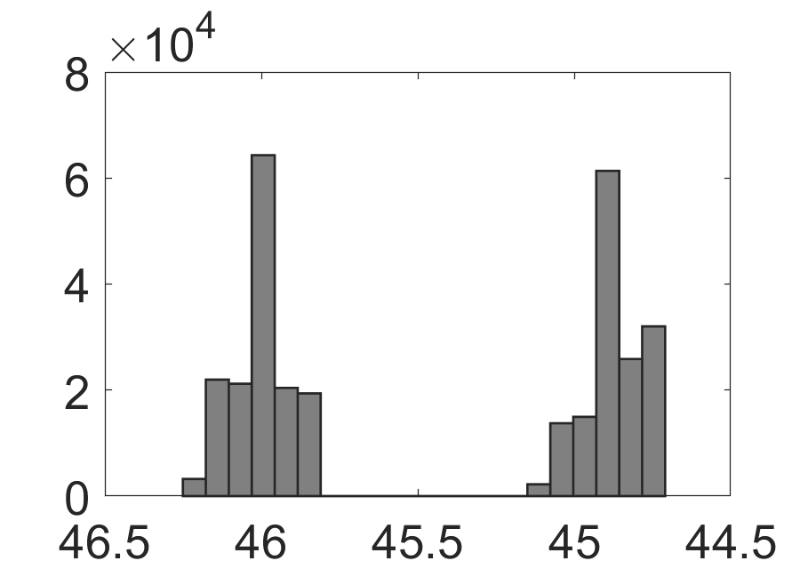
Time-bin encoded single-photon transmission
Microring resonator pumped by 10 Gbit/s NRZ data stream (tap fraction)
Classical 10 Gbps NRZ link
ALICE
BOB
FPGA
clock
data
Time bin encoder
tap
SPD
ΔL
TDC
Photon pair generation
switch
coupler
SPD
Heralding photon
(c)
0
40k
80k
+1
+1
ns
0
ns
0
-1
-1
0
20
40
60
80
100
300,520
300,560
300,600
Bit number
Bit number

Slide 18
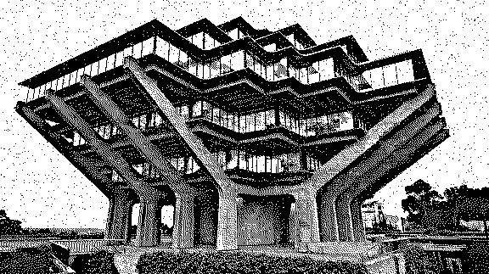
Alice has an image (sequence of bits).
Alice and Bob generate a mutual key over the heralded single photon channel. No basis change at this time.
Alice sends (Original image) XOR (mutual key) to Bob over the classical channel.
Bob decodes using his key.
Alice’s original message
Alice’s key
XOR
=
Sent over classical channel
=
XOR
Bob’s key
Wavelengths: pump diode : generated photon pair : | 1555 nm 1535 & 1575 nm
Clock for pair generation : Optical pump power used : | 10 GHz -5.5 dBm
Pair gen. rate (Alice) : Photon detection (Bob) : | ~ 5 MHz 20-200 kilo-count/s
Time bin width : | 2 ns
Message size: 188223 bits | QBER 1.9% [ ‘0’, ‘1’ ] = [2.2%, 1.6%]
Bob’s decoded message

Slide 19
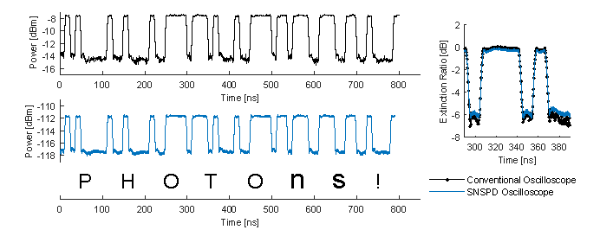
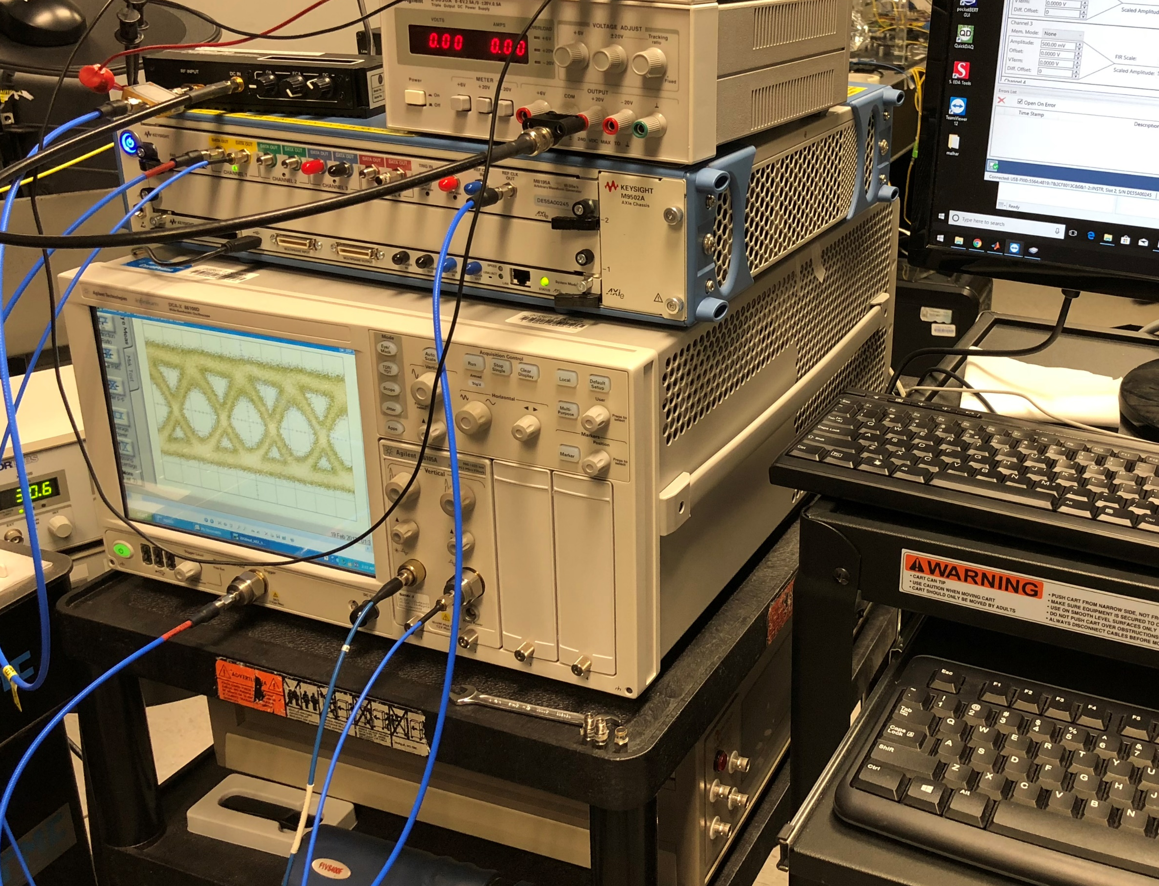
Optical Sampling oscilloscope – an application of detectors
Typical equipment:
Keysight DCA-X sampling oscilloscope with optical front-end module.
Cost: $50K, approx.
Min detection power: ~ -20 dBm [10 uW]
Time to acquire nice eye: ~ 0.5 - 1 minute.

Slide 20
Optical Sampling oscilloscope at femtowatt power levels

Slide 21
How it works:
histogram
Clock
+1
Δt
Δt
single photon detector

Slide 22
How it works:
histogram
Clock
Δt
+1
Δt
single photon detector

Slide 23
How it works:
histogram
Clock
+1
Δt
Δt
single photon detector

Slide 24
How it works:
histogram
Clock
+1
Δt
Δt
single photon detector
Eventually, the histogram = the waveform being acquired.
More precisely, a sampled version of the waveform,
but most waveforms are generated from discrete samples, anyway.

Slide 25
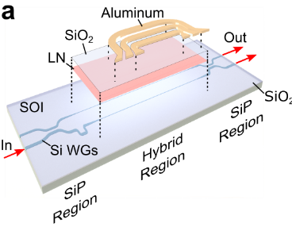
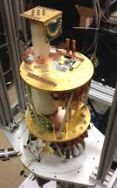
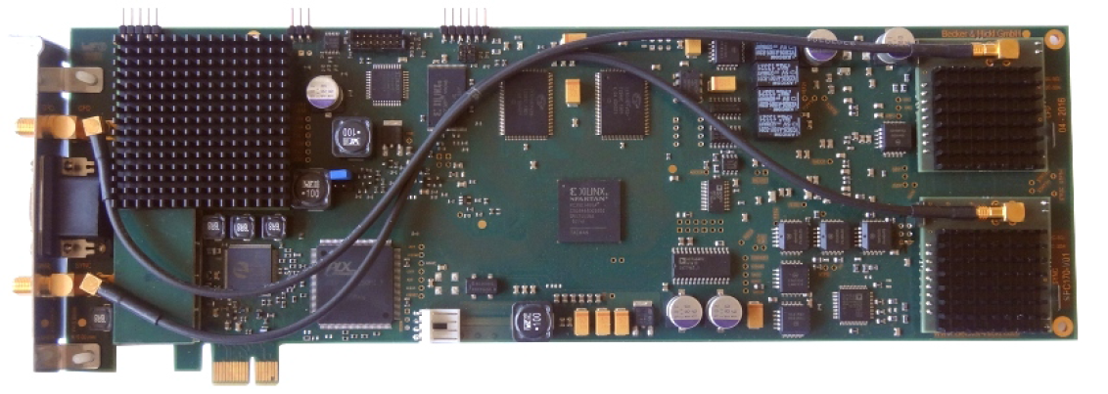
New, state-of-the-art
ultrafast electro-optic modulator
New, state-of-the-art
single photon detector
New, state-of-the-art
TCSPC card
Optical waveform
RF waveform
Clock
can measure any bandwidth generated by the best-available
Arbitrary Waveform Generators, AWG’s [ 92 GSa.s⁻¹ , 32 GHz analog BW ]
…
at < 100 femtowatts of received power!

Slide 26
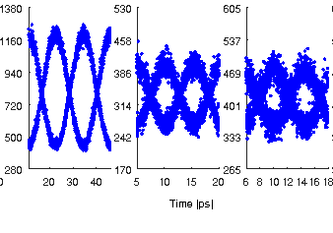
Optical eye diagrams at –100 dBm optical power
[ measured at receiver front-end ]
40 GHz
90 GHz
102 GHz
Length to resolution ratio: ~ 4,000
Measurement time: 2 minutes *
* 150 milliseconds enough for identification of signal frequency at 100 GHz.

Slide 27
Outline
What do I mean by “very-fast …
  … entangled-photon sources
  … single-photon detectors
Integrated photonics can be used to :
  reduce the size, weight and power (SWaP) of optical assemblies,
  to improve functionality,
  and improve performance in some cases.
How can collaboration between universities, leveraging foundry fabrication, help? I will present a case study.

Slide 28
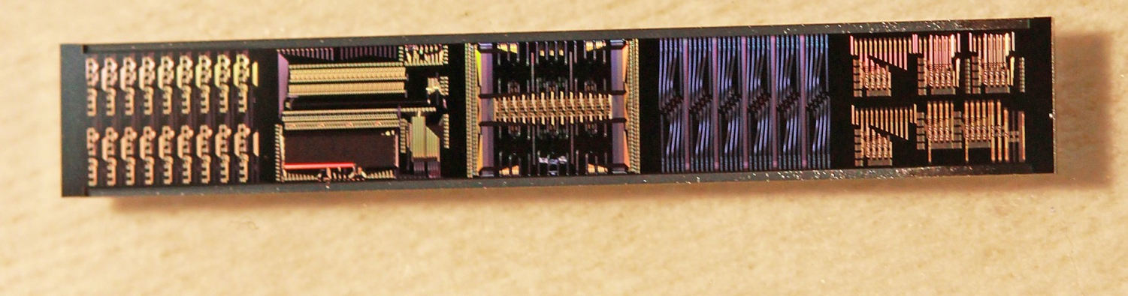
CIAN: NSF Center for Integrated Access Networks
10-year, $40M+ multi-institutional program
C2.1 Silicon Photonics
Univ. Arizona
UC Berkeley
UC San Diego
UC Berkeley
Cornell
Photonic Chip participants:
Cornell (Michal Lipson)
UC San Diego (Shayan Mookherjea [coordinator])
UC Los Angeles (Bahram Jalali)
UC Berkeley (Connie Chang-Hasnain)
University of Arizona (Robert Norwood)
UC Berkeley (Ming Wu)
Caltech (Axel Scherer)
Sandia National Labs,
Albuquerque, New Mexico
Notes:
28

Slide 29
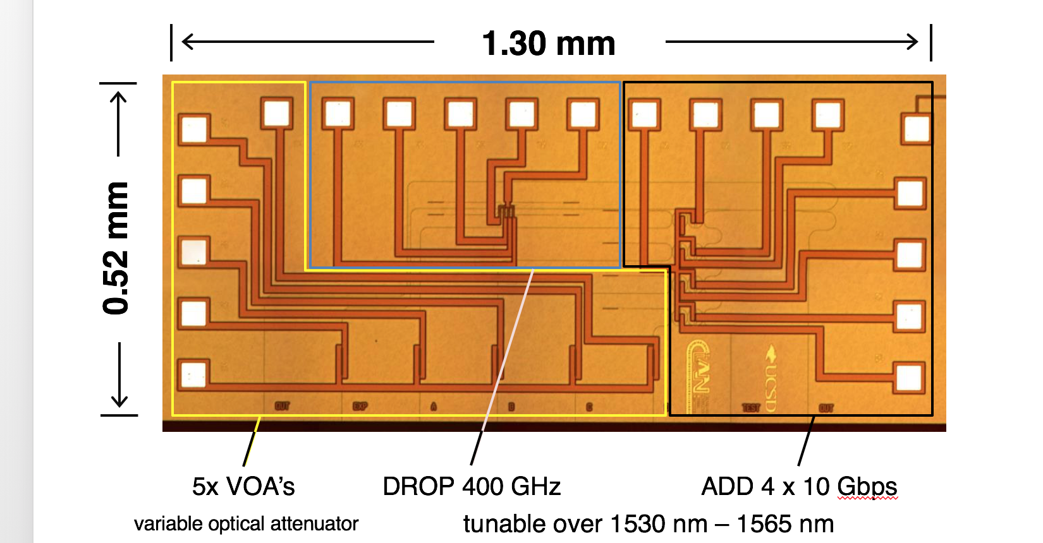
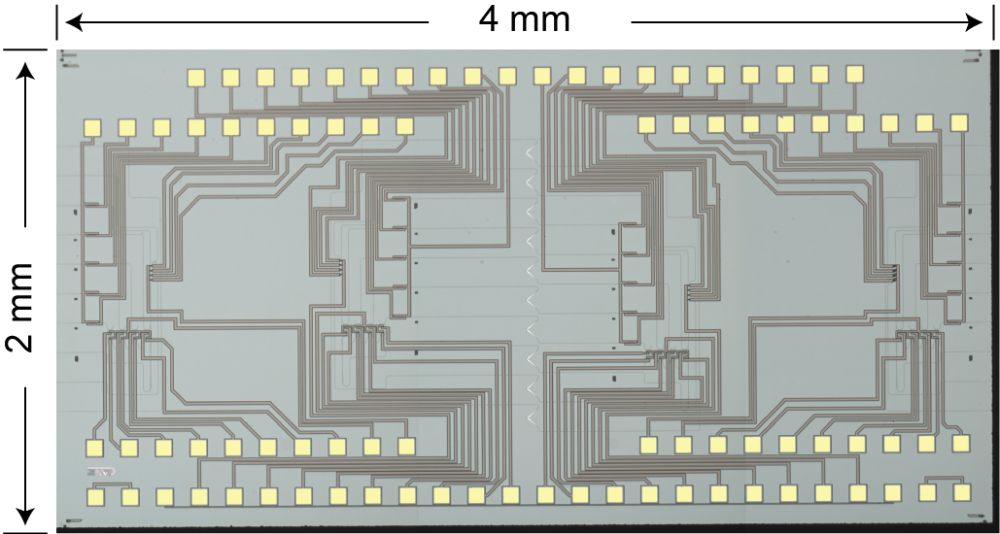
Chip V1
2014-15
Chip V2
2015-16
Notes:
The first version of the chip was a test platform – it was edge coupled, single polarization, limited tuning range.
We have improved that for the second chip, now being measured.
This is small enough that you can fit it inside the transceiver module.
No extra external fibers to bring ROADMs into a network – a sub-microsecond mini-ROADM can be built into the transceiver itself.

Slide 30
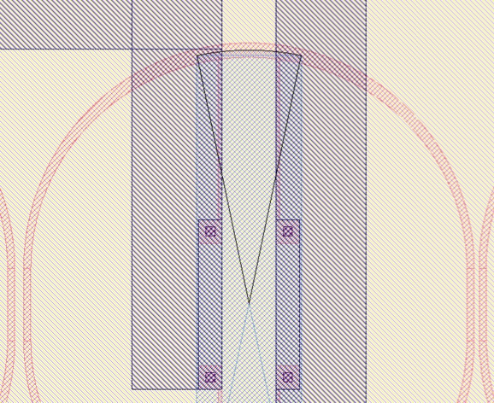
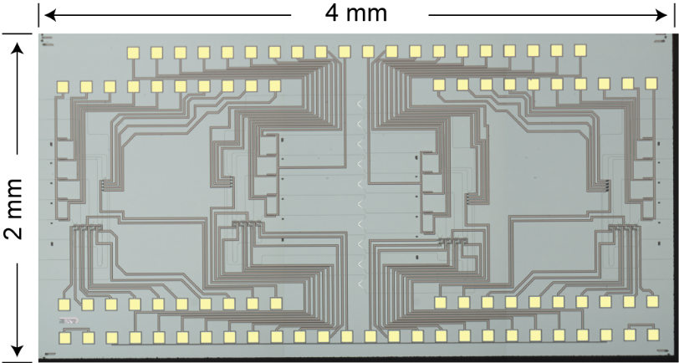
Chip design details
1. Widened rings + tunable heaters
2. Wideband (> 40 nm) adiabatic directional couplers
wide waveguide
Current heats the silicon on the inside of the ring
narrow waveguide
Conventional directional couplers in silicon photonics are highly wavelength dependent
25 um
3. Integrated variable optical attenuator on each input
4. MORDIA has asymmetric add/drop specifications
50 um length
approx. 5 – 10 mW power
fast (sub-ns)
single 400 GHz tunable drop; multiple 100 GHz tunable adds

Slide 31
Wide-wavelength-span directional coupler
(used in several places)
100 um
MORDIA
C. T. DeRose et al.
OFC OThM3 (2011)

Slide 32
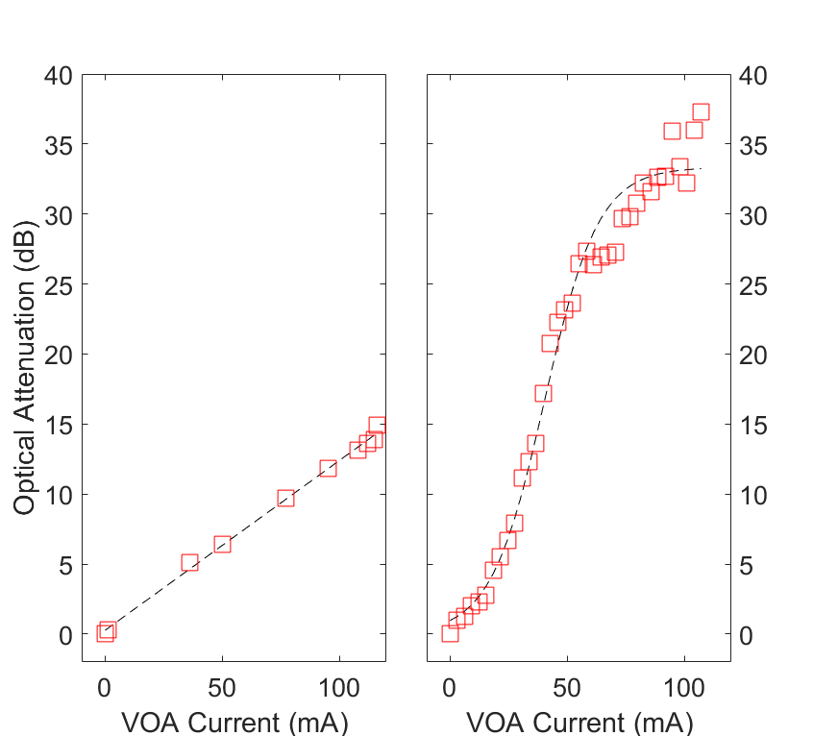
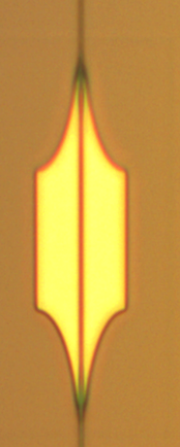
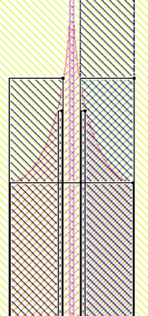
X. Wang, et al. "Compact Silicon Photonic Resonance-Assisted Variable Optical Attenuator"
Optics Express, Vol. 24, No. 24, 27600-27613 (2016)
waveguide in
V1, 2013-4
V2, 2015-6
rib-to-ridge waveguide transition
GDS
p-dopant
35 dB range
15 dB range
50 um
n-dopant
optical image
metal contact
waveguide out

Slide 33
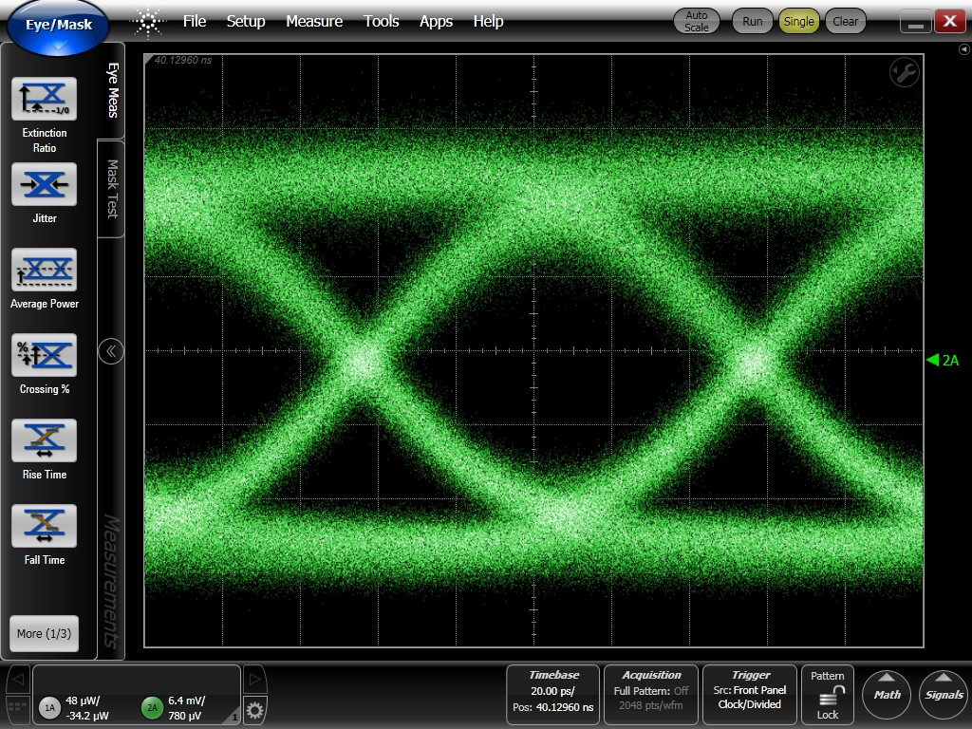
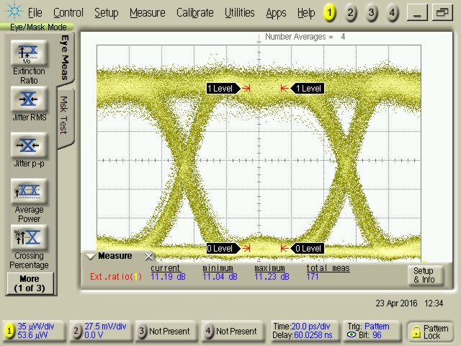
The net result: improved channel ‘eye’ [10 Gbps NRZ]
V1
2013-4
V2
2015-6
@ THRU
@ THRU
Eye SNR = 9 dB
Eye SNR = 11 dB

Slide 34
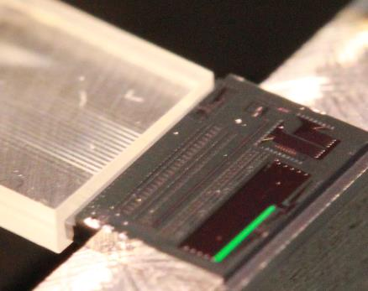
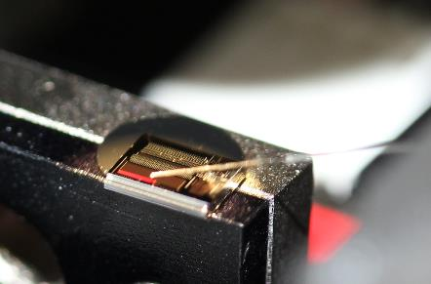
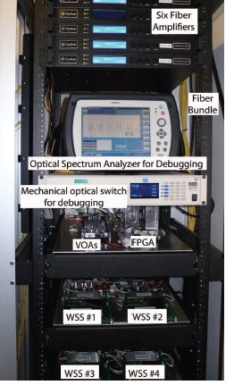
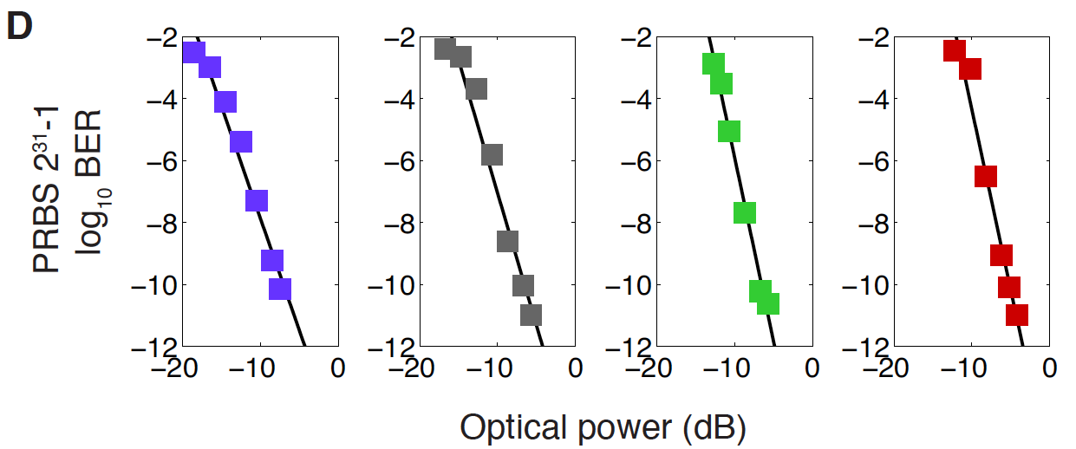
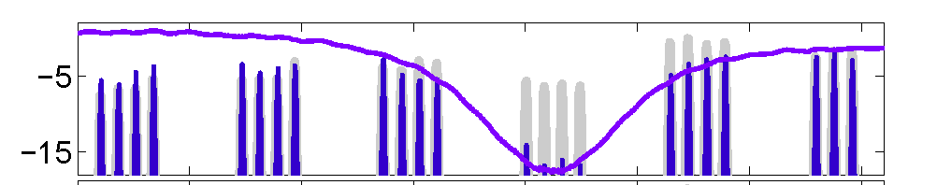
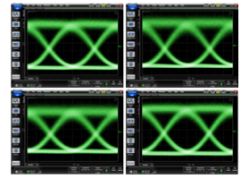
4λ 40 Gbit/s Add-Drop-VOA Node on-a-Chip
R. Aguinaldo et al. IEEE Photonics Conference, post-deadline paper PD.3 (2014)
Objectives:
Edge-coupled fiber array
Grating – tilted fiber readout
chip-scale integration of:
  tunable drop
  4-channel tunable add
  4+1 channel VOA
  (optical power control)
in, through, add
drop
Si Photonic chip
1.3 mm
x 0.5 mm
Si photonic chip
4 x 10 Gbps ADD
(2^31 – 1 PRBS)
e.g., ITU-T 100 GHz grid channels 22-25 added:
10 Gbps NRZ
DROP 4
MORDIA today
Wavelength (nm)

Slide 35
Many positive outcomes
Initiated a (continuing) collaboration between universities and a national lab, under a shared research theme.
More than 25 graduate students and post-doctoral scholars directly worked on layout and measurements. (In most cases, this was their first exposure to photonics TCAD).
Many collaborations with existing companies. Some students hired straight out of PhD (or before).
New companies were started, some directly within the ERC, and some in follow-on projects (e.g., 3 from UCSD).
New international collaborations came out of this work.

Slide 36
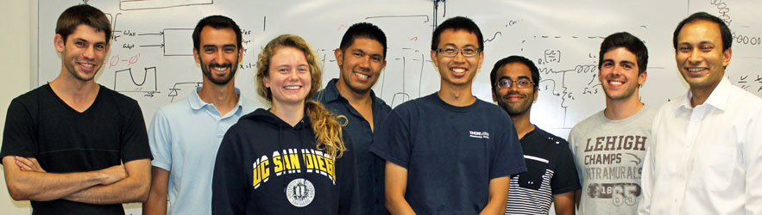
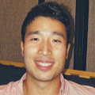
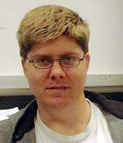
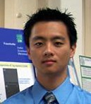
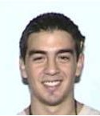



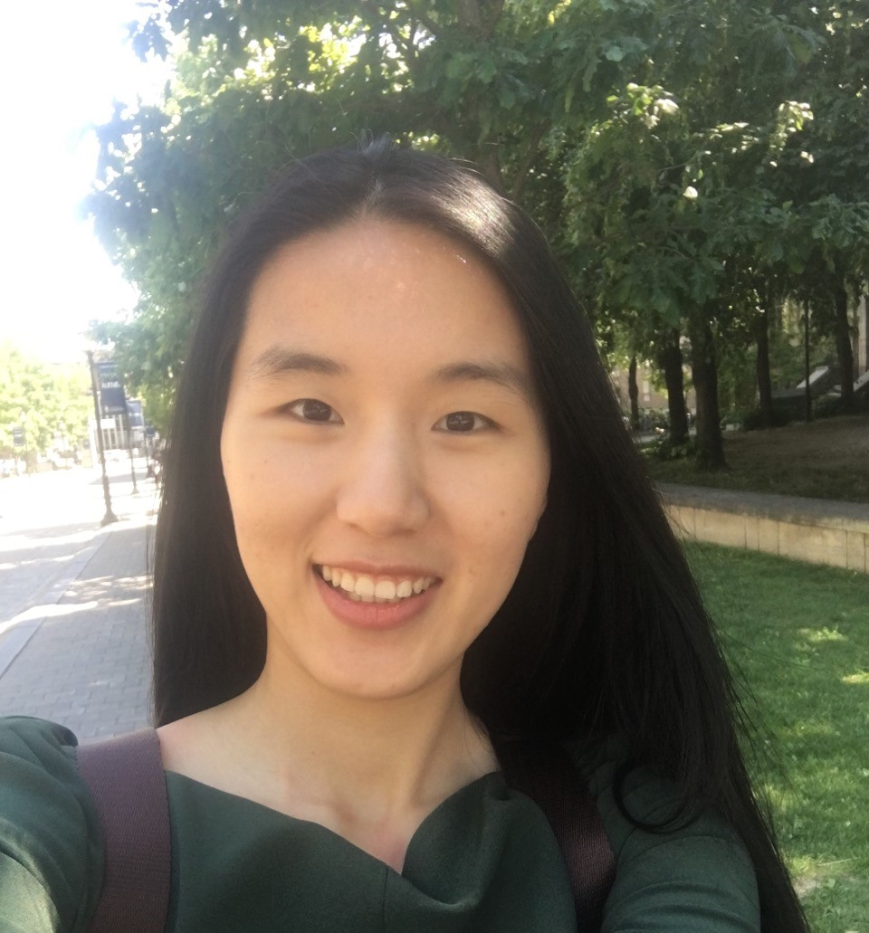

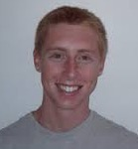
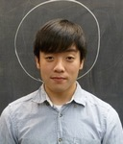

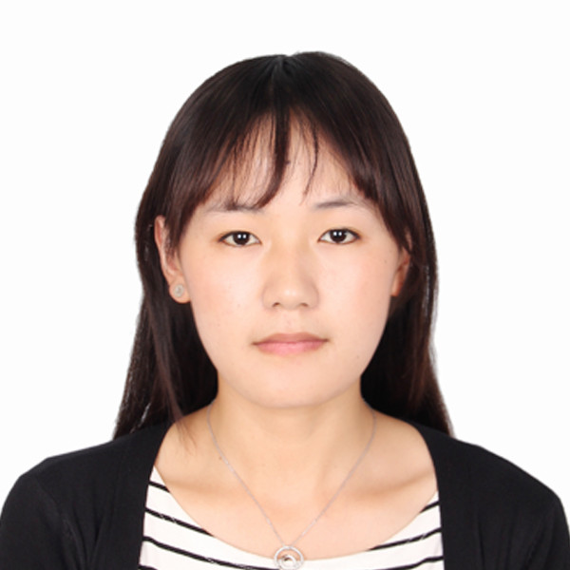
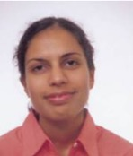




Micro/Nano-Photonics at Univ. California, San Diego
mnp.ucsd.edu
Government support:
Industry sponsors:

Slide 37

http://mnp.ucsd.edu
University of California San Diego - La Jolla, California

