Slide 1
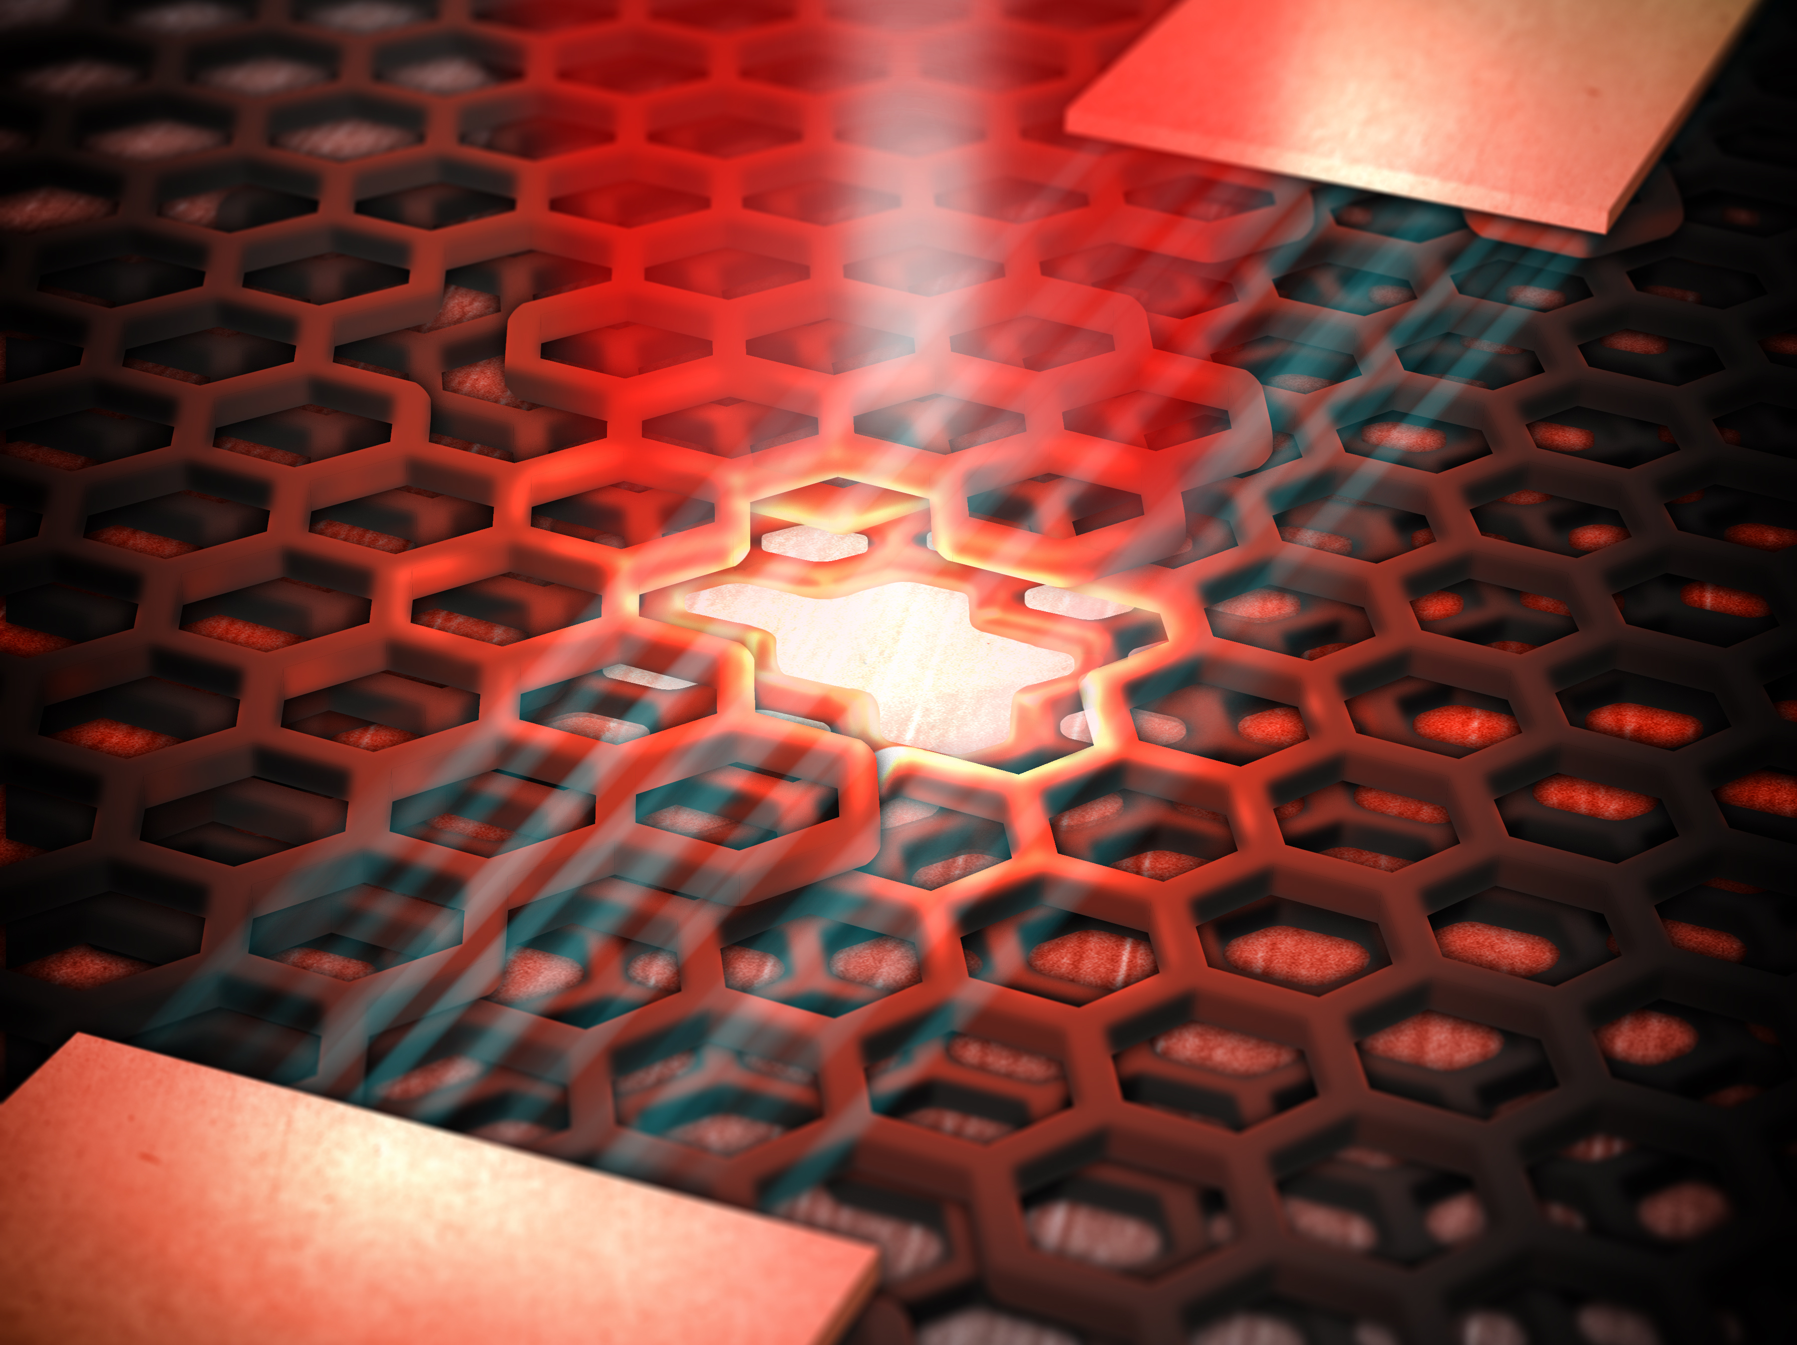


Nick Vamivakas
University of Rochester
The Institute of Optics
Department of Physics
Materials Science
Center for Coherence and Quantum Optics
solid-state quantum photonics
PfQ RIT 01/24/19

Slide 2
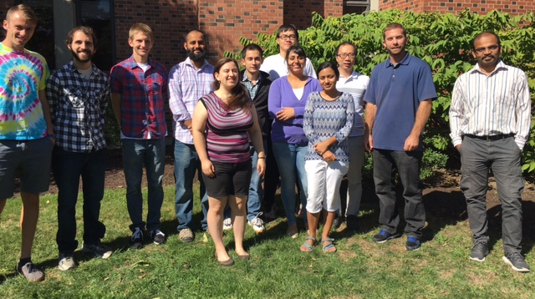






the work described today has been a team effort
UoR colleagues
Mishkat Bhattacharya; RIT
Mete Atature; Cambridge
Greg Fuchs; Cornell
Dirk Englund; MIT
Igor Aharonovich; Sydney
multiple post-doc positions available

Slide 3
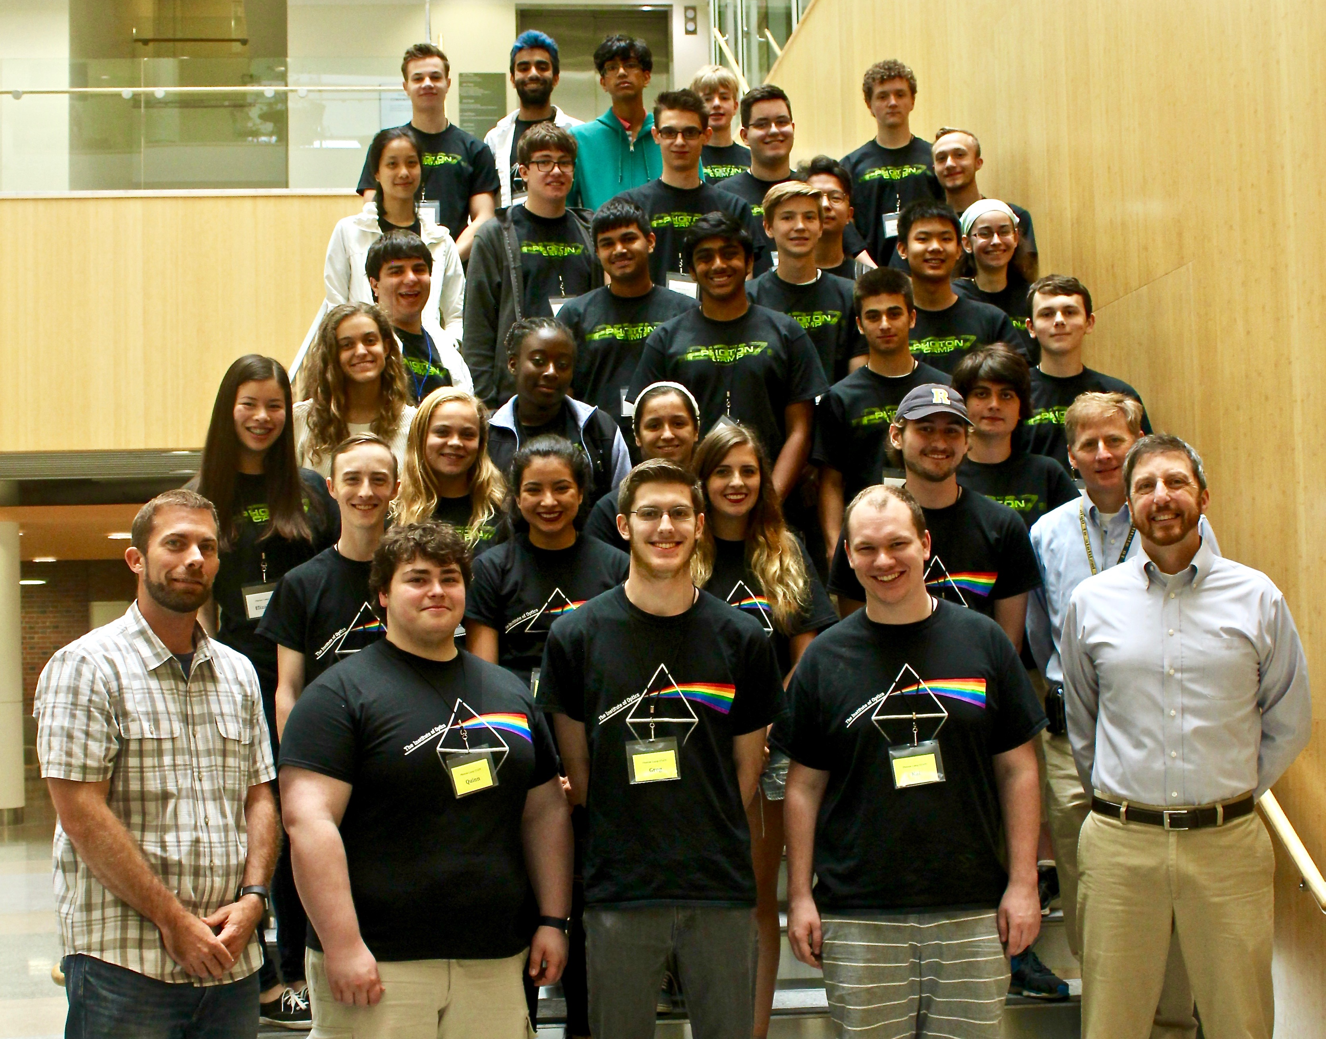
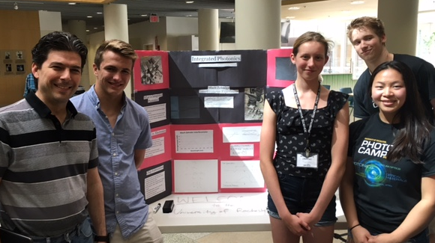
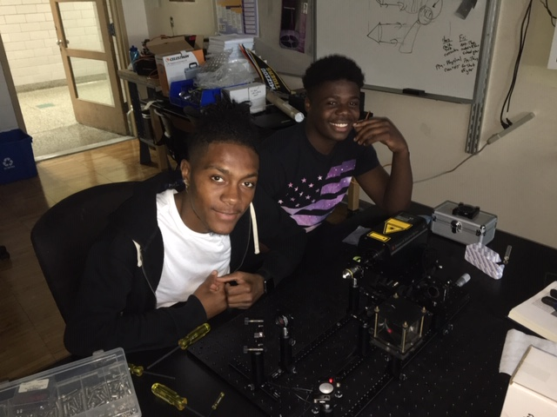
quantum photonics workforce development @ UR
The Institute of Optics Photon Camp (6th year; July 4-8, 2019)
→ rising high school seniors, 9-5 free + lunch provided
integrated photonics
East High

Slide 4
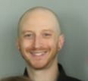
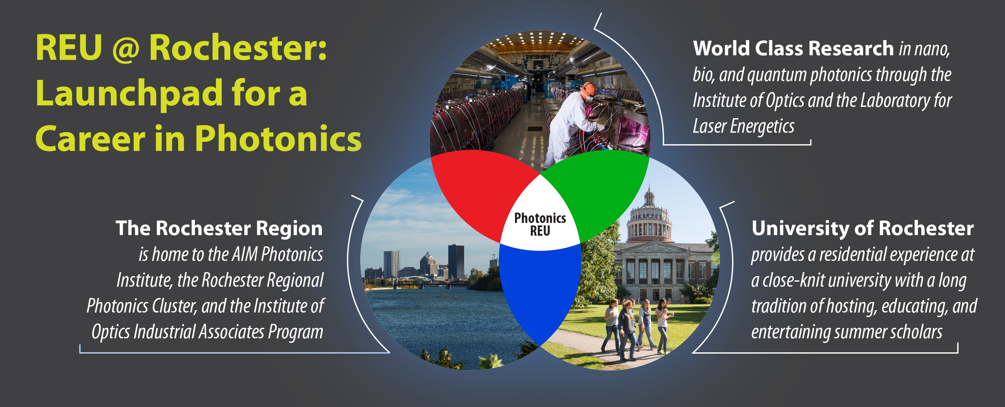
quantum photonics workforce development @ UR
The Institute of Optics Photon Camp (6th year; July 4-8, 2019)
→ rising high school seniors, 9-5 free + lunch provided
integrated photonics
East High
Nano-, Bio-, and Quantum Photonics at University of Rochester
→ accepting applications
David Spiecker
from RIT was in the 2018 REU

Slide 5
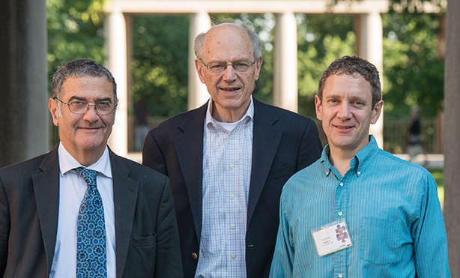
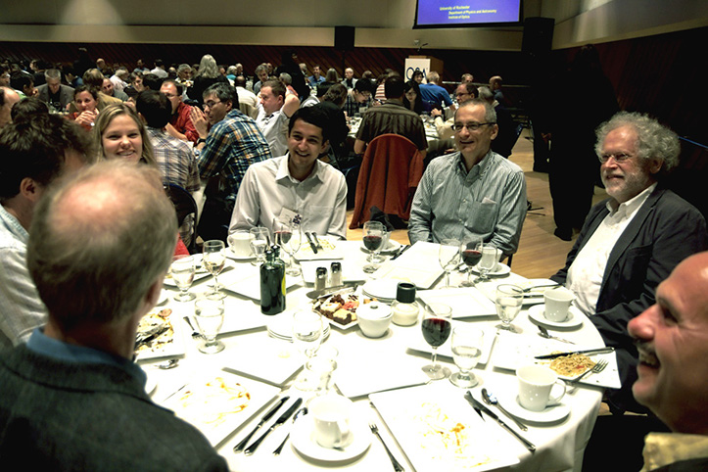
Conference on Coherence and Quantum Optics
11th Conference on Coherence and Quantum Optics
save the dates: 8/4/19-8/8/19
CCQO 10 - 2013
Center for Coherence and Quantum Optics
Serge Haroche (Nobel 2012)
Joe Eberly
Nick Bigelow
The 10th Rochester Conference on Coherence and Quantum Optics (2013) featured two hundred physics and optics researchers from 20 countries. The University of Rochester has hosted this meeting every six years since 1960.
>160 papers

Slide 6
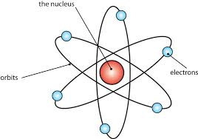
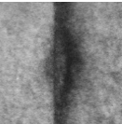
what is solid-state quantum optics?
understand & manage the nanoscale quantum pathways relevant in the interaction of light and solid-state matter to elicit desirable macroscale responses
science aspect
replace with “artificial atom”
Ex.
GaAs
InAs
GaAs
atom/ion
2 - 5 nm
quantum dot

Slide 7
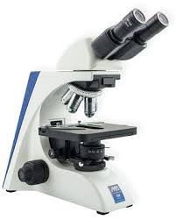
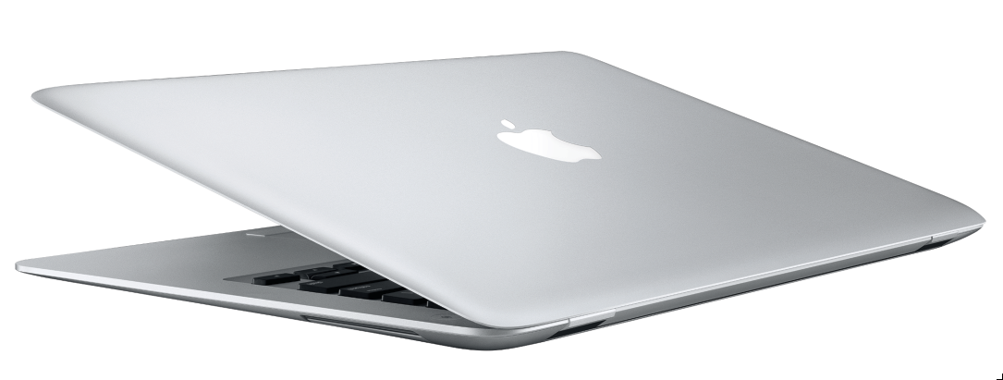

why explore solid-state quantum optics?
technology opportunities = on-chip quantum photonics
Information processing
sensing
novel light sources
|Ψ>
|Ψ>
|Ψ>

Slide 8
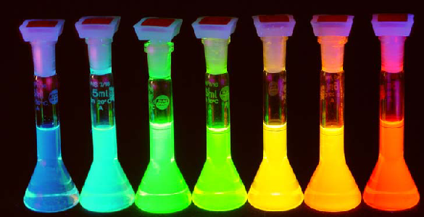
why explore solid-state quantum optics?
technology opportunities = on-chip quantum photonics
Information processing
sensing
novel light sources
|Ψ>
|Ψ>
|Ψ>
why solid-state materials?
→ leverage semiconductor fabrication infrastructure
→ potential scalability
→ quantum engineer device resonances
→ robust on-chip quantum hardware

Slide 9
critical for solid-state quantum science
efficient & stable quantum light solid-state matter interfaces
→ connect internal states of quantum emitters with quantum light
→ typically spin with single photons

Slide 10

critical for solid-state quantum science
efficient & stable quantum light solid-state matter interfaces
→ connect internal states of quantum emitters with quantum light
→ typically spin with single photons
one example: InAs QD as the solid-state matter with e⁻ spin
+
-
-
$$≈$$
-
-
lambda-system in quantum optics

Slide 11
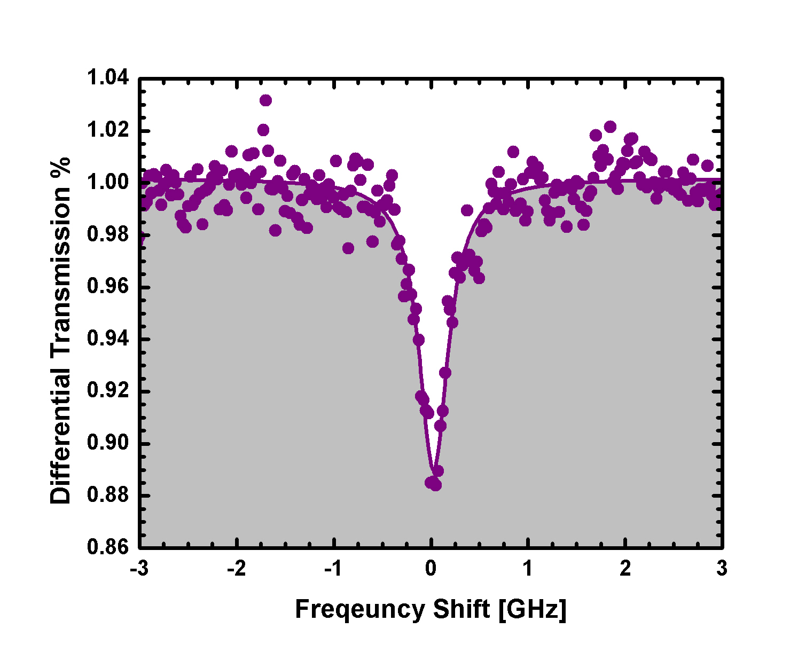
critical for solid-state quantum science
efficient & stable quantum light solid-state matter interfaces
→ connect internal states of quantum emitters with quantum light
→ typically spin with single photons
one example: InAs QD as the solid-state matter with e⁻ spin
science ?: how increase QD light-matter interaction?
transmission
laser frequency
structured photonic environment enhances extinction XS
by > an order of magnitude

Slide 12
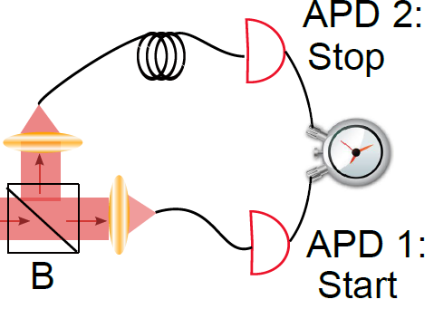

solid-state quantum photonic technology
exemplary quantum technologies
→ 1: a source of quantum light (single & entangled photons)
quantum light

Slide 13
solid-state quantum photonic technology
exemplary quantum technologies
→ 1: a source of quantum light (single & entangled photons)
quantum light
0.5

Slide 14
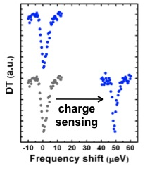
solid-state quantum photonic technology
exemplary quantum technologies
→ 1: a source of quantum light (single & entangled photons)
→ 2: quantum sensor (all-optical electrometer)
quantum sensing
1e⁻
1e⁻
~ 6x10⁻⁷ e/Hz^{1/2} at 12 nm
comparable to RF-SET

Slide 15
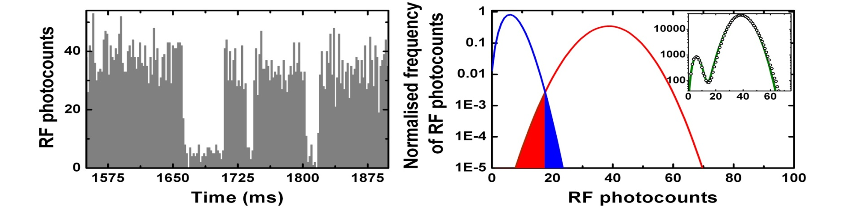
solid-state quantum photonic technology
exemplary quantum technologies
→ 1: a source of quantum light (single & entangled photons)
→ 2: quantum sensor (all-optical electrometer)
→ 3: a quantum memory
information processing
with single spins
“spin quantum jumps”

Slide 16
solid-state quantum photonic technology
exemplary quantum technologies
→ 1: a source of quantum light (single & entangled photons)
→ 2: quantum sensor (all-optical electrometer)
→ 3: a quantum memory
→ 4: quantum networks; distributed entanglement
chip 1
chip 2

Slide 17
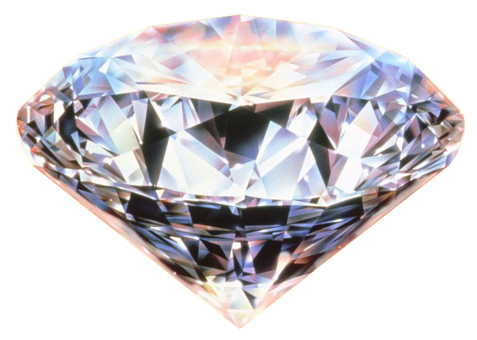
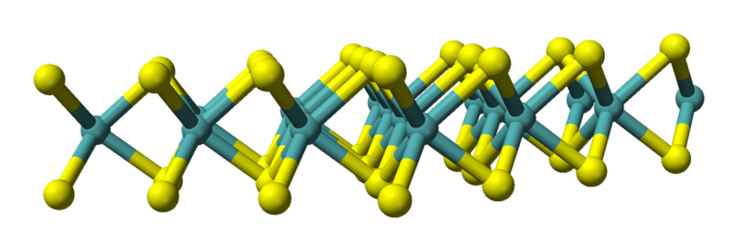
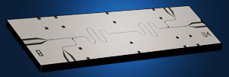
solid-state quantum science: materials
many natural & artificial platforms can serve as light-matter interface & often want to use more than 1 quantum system!
defects/dopants in crystals
semiconductor heterostructures (wells & dots)
GaAs
InAs
GaAs
2 - 5 nm
quantum dot
quantum dot
quantum dot
two-dimensional van der Waals materials
lithographically defined materials

Slide 18
a perspective on quantum technology & innovation
quantum technology timeline (~15-20 years)
spectroscopy
lifetimes & coherences
proof-of-principle
demonstrations
materials science discovery
new quantum emitter
maybe interfacing/ hybrid systems
better devices & translation to quantum technology

Slide 19
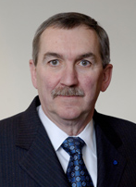
a perspective on quantum technology & innovation
quantum technology timeline (~15-20 years)
spectroscopy
lifetimes & coherences
proof-of-principle
demonstrations
materials science discovery
new quantum emitter
maybe interfacing/ hybrid systems
better devices & translation to quantum technology
quantum technology is not quantum innovation
“Duncan” Moore’s Law
Duncan Moore
(Optics & TEAM)
market opportunity x quantum technology
= quantum innovation
industry participation is critical to identify market opportunity since this helps focus what system(s) are pursued

Slide 20
solid-state quantum science: materials
many natural & artificial platforms can serve as light-matter interface & often want to use more than 1 quantum system!
defects in crystals
semiconductor heterostructures (wells & dots)
GaAs
InAs
GaAs
2 - 5 nm
quantum dot
quantum dot
quantum dot
two-dimensional van der Waals materials
lithographically defined materials

Slide 21
solid-state quantum science: materials
many natural & artificial platforms can serve as light-matter interface & often want to use more than 1 quantum system!
defects in crystals
semiconductor heterostructures (wells & dots)
GaAs
InAs
GaAs
2 - 5 nm
quantum dot
quantum dot
advantages:
cost effective
easy to integrate
additional degree of freedom (valley)
quantum dot
two-dimensional van der Waals materials
lithographically defined materials

Slide 22
solid-state quantum science: materials
large palette of materials for quantum optics & photonics!
Physics today Sep 2016

Slide 23
putting single photons to work
revisiting wave-particle duality and Bohr complementarity
Bohr’s complementarity is a qualitative attempt to address wave-particle duality
if physical object admits multiple descriptions they should be mutually exclusive & jointly complete

Slide 24
putting single photons to work
revisiting wave-particle duality and Bohr complementarity
→ can this be quantified?
1
single photon source
2
source
detector
Wootters, et al Phys Rev D (1979) and many times since!

Slide 25


putting single photons to work
revisiting wave-particle duality and Bohr complementarity
→ can this be quantified?
irradiance
1
single photon source
2
source
detector
D = 1
distinguish
$$D=p_{1}−p_{2}$$
Wootters, et al Phys Rev D (1979) and many times since!

Slide 26
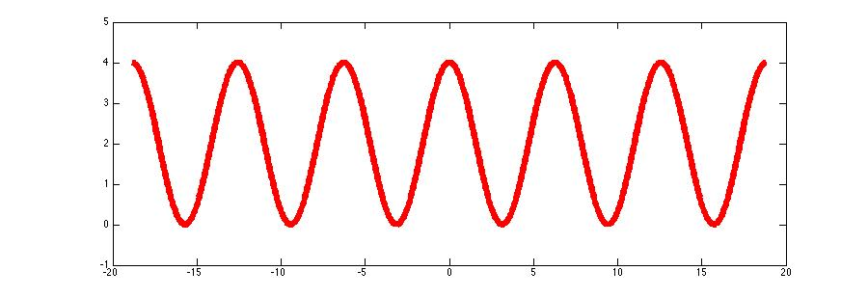
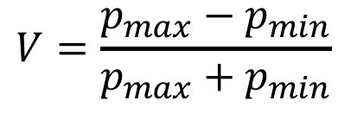
putting single photons to work
revisiting wave-particle duality and Bohr complementarity
→ can this be quantified?
irradiance
1
single photon source
2
source
detector
V = 1
waviness = V; the interferogram visibility
$$V=\frac{p_{max}−p_{min}}{p_{max}+p_{min}}$$
Wootters, et al Phys Rev D (1979) and many times since!

Slide 27

putting single photons to work
revisiting wave-particle duality and Bohr complementarity
→ can this be quantified?
irradiance
1
single photon source
2
source
detector
V = 1
$$D^{2}+V^{2} ≤1$$
Wootters, et al Phys Rev D (1979) and many times since!

Slide 28

putting single photons to work
what is going on here?
irradiance
waveplates
1
single photon source
2
source
detector
V = 0
D = 0
$$D^{2}+V^{2} ≤1→0^{2}+0^{2} ≤1$$
Wootters, et al Phys Rev D (1979) and many times since!

Slide 29
putting single photons to work
what is going on here?
Bohr’s complementarity is a qualitative attempt to address wave-particle duality
if physical object admits multiple descriptions they should be mutually exclusive & jointly complete
Point 1: V = D = 0, but still photons not complete
$$D^{2}+V^{2} ≤1→0^{2}+0^{2} ≤1$$
Wootters, et al Phys Rev D (1979) and many times since!

Slide 30

putting single photons to work
what is going on here?
Bohr’s complementarity is a qualitative attempt to address wave-particle duality
if physical object admits multiple descriptions they should be mutually exclusive & jointly complete
Point 2: V & D do not trade with each other with respect to unity; not mutually exclusive
degree of polarization P
$$P^{2}=D^{2}+V^{2} ≤1$$
Polarization Coherence Theorem
Qian et al Polarization Coherence Theorem, Optica 4, (2017).

Slide 31



putting single photons to work
what is going on here? entanglement
single photon state
$$\left|Ψ\right\rangle =c_{1}\left|1_{1}\right\rangle |p_{1}⟩+c_{2}|1_{2}⟩|p_{2}⟩$$
irradiance
waveplates
1
$$|p_{1}⟩$$
single photon source
2
source
$$|p_{2}⟩$$
detector
V = 0
D = 0
entanglement can be measured → concurrence (C)
$$P^{2}+C^{2}=1→D^{2}+V^{2}+C^{2}=1$$
Qian et al Optica 5, 942 (2018) ; Qian et al in preparation; Jakob and Bergou, arXiv: 0302075 (2003)

Slide 32
putting single photons to work
what is going on here? entanglement
single photon state
$$\left|Ψ\right\rangle =c_{1}\left|1_{1}\right\rangle |p_{1}⟩+c_{2}|1_{2}⟩|p_{2}⟩$$
complementarity sphere
$$P^{2}+C^{2}=1→D^{2}+V^{2}+C^{2}=1$$
Qian et al in preparation

Slide 33
putting single photons to work
what is going on here? entanglement
single photon state
$$\left|Ψ\right\rangle =c_{1}\left|1_{1}\right\rangle |p_{1}⟩+c_{2}|1_{2}⟩|p_{2}⟩$$
complementarity sphere
David, as part of the REU, was our “V” guy & is a paper co-author.
$$P^{2}+C^{2}=1→D^{2}+V^{2}+C^{2}=1$$
Qian et al in preparation

Slide 34
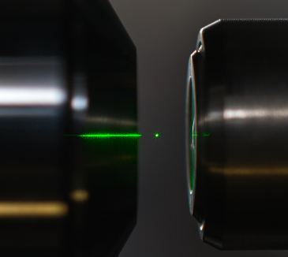
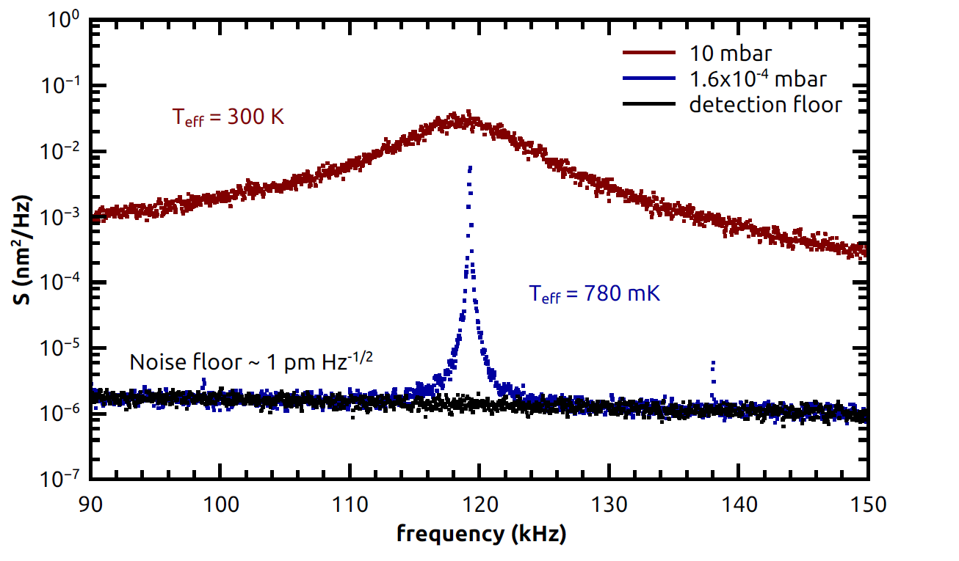
emerging areas: quantum phononics
new frontier in optomechanics:
→ levitated optomechanics* (optical tweezer in vacuum)
→ Q’s approaching 10¹¹
toward the q. ground state
phonon #’s of 10-ish
*Collaborate extensively with Mishkat Bhattacharya @ RIT on this

Slide 35
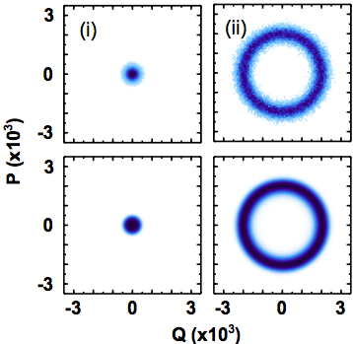
emerging areas: quantum phononics
new frontier in optomechanics:
→ levitated optomechanics* (optical tweezer in vacuum)
→ Q’s approaching 10¹¹
→ an optical tweezer phonon laser (coherent states)
phase-space plots
below threshold
above threshold
below threshold
above threshold
*Collaborate extensively with Mishkat Bhattacharya @ RIT on this

Slide 36
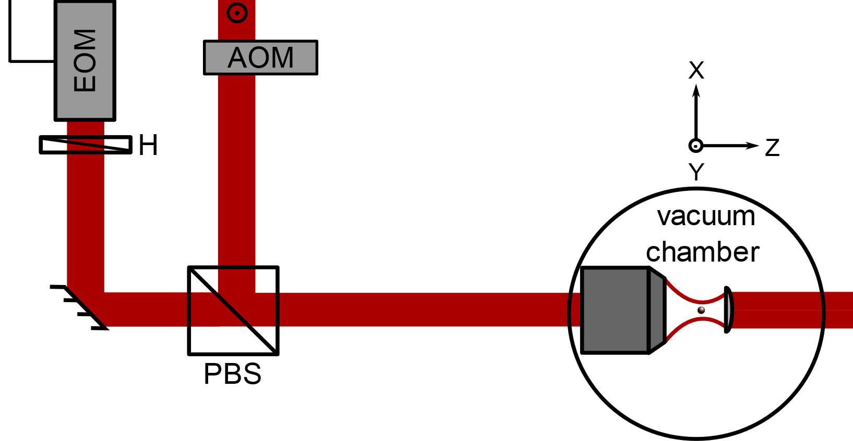
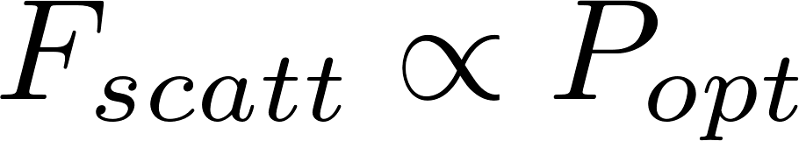
emerging areas: quantum phononics
new frontier in optomechanics:
→ levitated optomechanics* (optical tweezer in vacuum)
→ Q’s approaching 10¹¹
→ an optical tweezer phonon laser (coherent states)
→ phonon lasers for quantum metrology
532 nm
532-laser generates an external applied force via optical scattering
AOM
AOM modulates the force amplitude
*Collaborate extensively with Mishkat Bhattacharya @ RIT on this

Slide 37
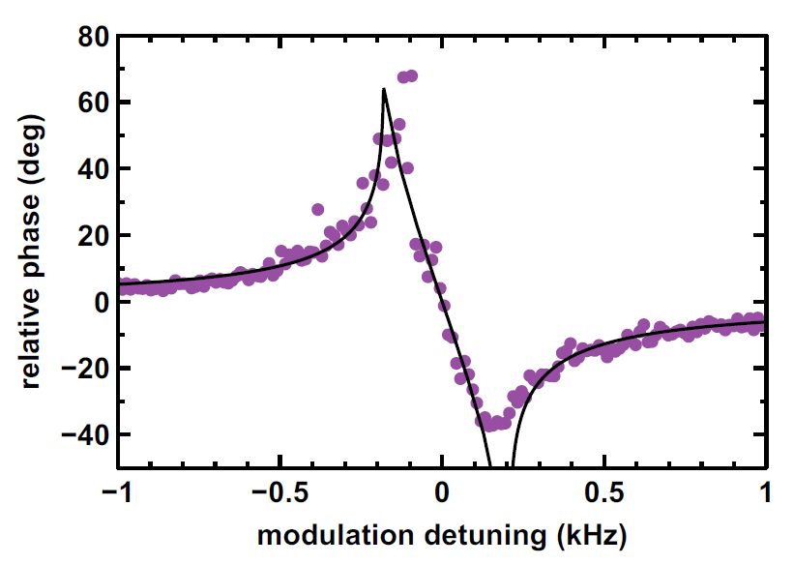
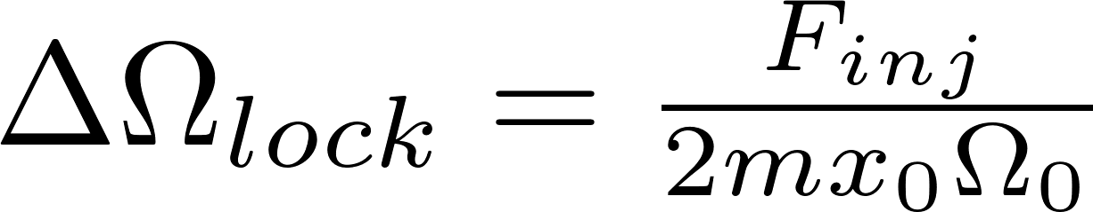
emerging areas: quantum phononics
new frontier in optomechanics:
→ levitated optomechanics* (optical tweezer in vacuum)
→ Q’s approaching 10¹¹
→ an optical tweezer phonon laser (coherent states)
→ phonon lasers for quantum metrology
532 nm
injection locking
AOM
locking range
*Collaborate extensively with Mishkat Bhattacharya @ RIT on this

Slide 38
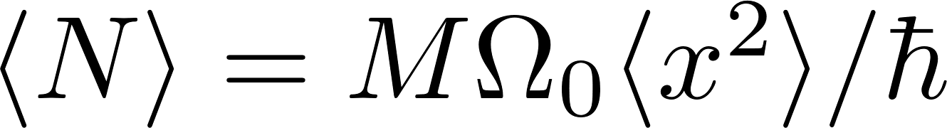
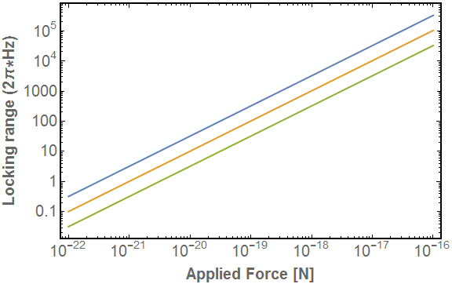
emerging areas: quantum phononics
new frontier in optomechanics:
→ levitated optomechanics* (optical tweezer in vacuum)
→ Q’s approaching 10¹¹
→ an optical tweezer phonon laser (coherent states)
→ phonon lasers for quantum metrology
new opportunities for quantum sensing!
force magnitude is measured by the locking range
injection locking
~ 30 aN
<N> ~ 100
<N> ~ 1,000
<N> ~ 10,000
locking range
*Collaborate extensively with Mishkat Bhattacharya @ RIT on this

Slide 39
solid-state quantum photonics
summary:
quantum light (solid-state) matter interfaces
→ q. light states, sensing, networks
“Duncan” Moore’s Law
market opportunity x quantum technology
= quantum innovation
single photons at work
→ making sense of complementarity
$$D^{2}+V^{2}<1→D^{2}+V^{2}+C^{2}=1$$
quantum phononics → coherent states
→ levitated optomechanics
→ new quantum sensors

Slide 40
Questions??
Mishkat Bhattacharya; RIT
Mete Atature; Cambridge
Greg Fuchs; Cornell
Dirk Englund; MIT
Igor Aharonovich; Sydney
multiple post-doc positions available

