Slide 1
Why you should not use the electric field
to quantize in nonlinear optics
J.E. Sipe
Department of Physics
University of Toronto

Slide 2
Optics Letters 42,
3443 (2017)
Nicolas Quesada
Xanadu Quantum Technologies,
Inc.

Slide 3
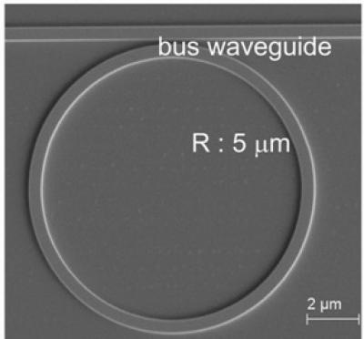
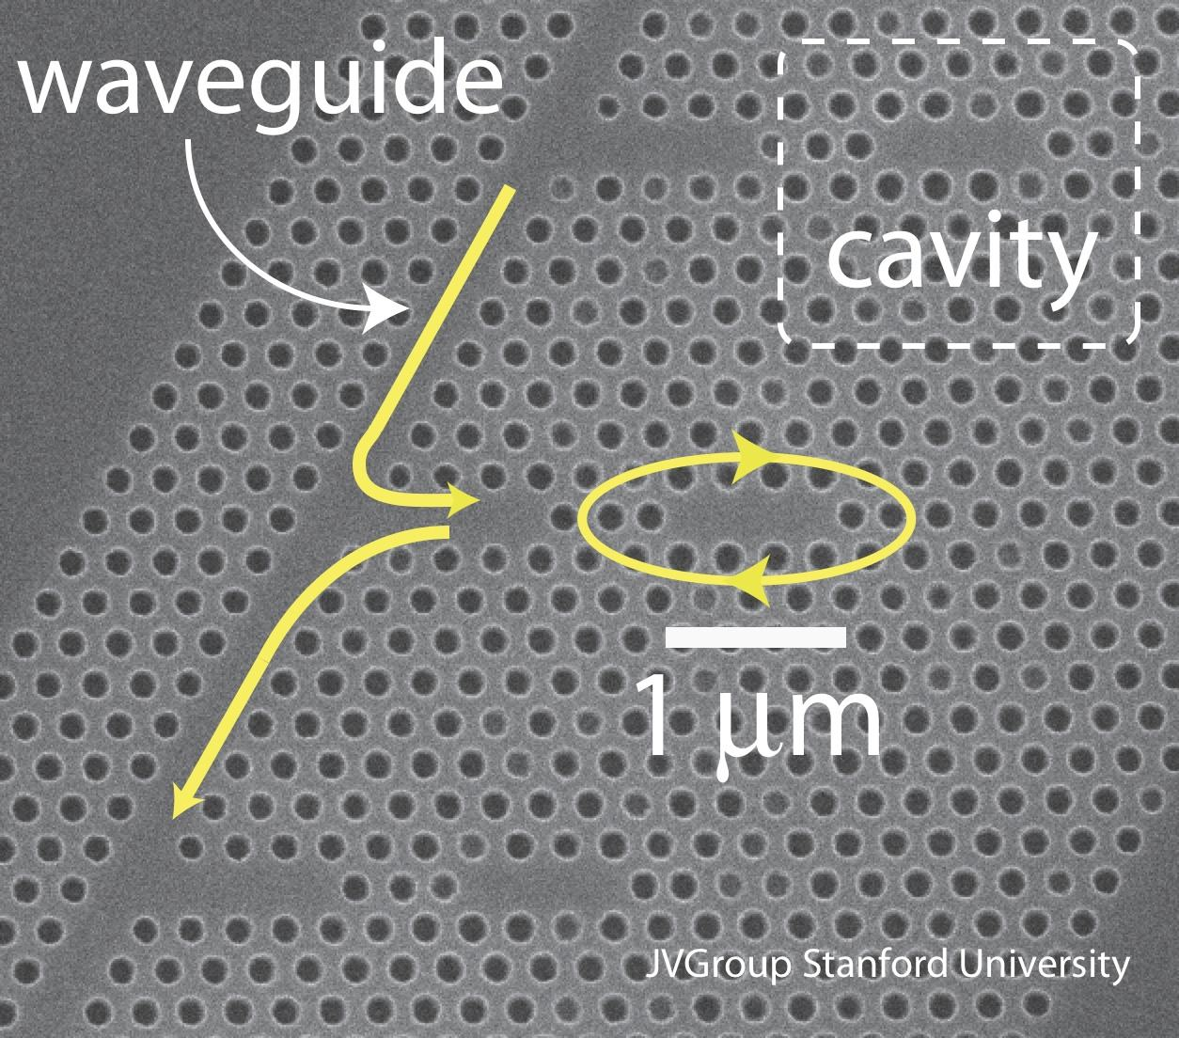
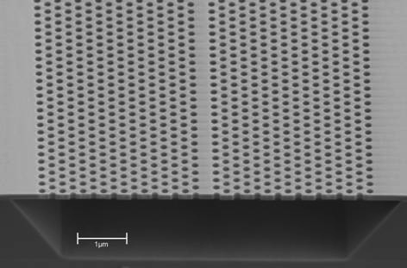

Slide 4
spontaneous parametric
down conversion
spontaneous
four wave mixing

Slide 6
M. Hillery and L. Mlodinow, Phys. Rev. A (1984, 1985, 1997)
P.D. Drummond and M. Hillery, Phys. Rev. A (1999)
J.E. Sipe, N.A.R. Bhat, et al. Phys. Rev. E (2004)
N.A.R. Bhat and J.E. Sipe, Phys. Rev. A (2006)
L. Helt et al., J. Opt. Soc. Am. B (2012)
P.D. Drummond and M. Hillery, Cambridge (2014)
N. Quesada and J.E. Sipe, Optics Letters (2017)

Slide 7
Outline
The underlying classical equations
and the energy in nonlinear dielectrics
(uncontroversial)
Quantization in the linear regime
(uncontroversial)
How you can mess-up in the nonlinear regime
How you can get it right in the nonlinear regime
Conclusions

Slide 8
Outline
The underlying classical equations
and the energy in nonlinear dielectrics
(uncontroversial)
Quantization in the linear regime
(uncontroversial)
How you can mess-up in the nonlinear regime
How you can get it right in the nonlinear regime
Conclusions

Slide 9
linear and
nonlinear response

Slide 10
𝟂₁ + 𝟂₂ = 𝟂
𝟂₁ + 𝟂₂ + 𝟂₃ = 𝟂

Slide 15
electromagnetic energy

Slide 16
energy in volume

Slide 17
energy in volume

Slide 18
energy in volume

Slide 19
energy in volume

Slide 20
energy in volume

Slide 21
Outline
The underlying classical equations
and the energy in nonlinear dielectrics
(uncontroversial)
Quantization in the linear regime
(uncontroversial)
How you can mess-up in the nonlinear regime
How you can get it right in the nonlinear regime
Conclusions and Extensions

Slide 24
R

Slide 25
R

Slide 26
Find solutions of
linear Maxwell
equations for
E and B:
R
L=2πR

Slide 29
Outline
The underlying classical equations
and the energy in nonlinear dielectrics
(uncontroversial)
Quantization in the linear regime
(uncontroversial)
How you can mess-up in the nonlinear regime
How you can get it right in the nonlinear regime
Conclusions and Extensions

Slide 30
energy

Slide 31
H_{L}
energy

Slide 32
H_{L}
take H = H_{L}+H_{NL}
with

Slide 33
H_{L}
take H = H_{L}+H_{NL}
with
for a third order nonlinearity:

Slide 40
linear in
a and a†

Slide 41
not
linear in
a and a†
linear in
a and a†

Slide 42
not
linear in
a and a†
linear in
a and a†

Slide 43
The Hamiltonian must numerically equal
the energy (which it does) but it must also
generate the correct equations (which it
does not)

Slide 44
Is the mistake serious?

Slide 45
Is the mistake serious?

Slide 46
Is the mistake serious?

Slide 47
Is the mistake serious?

Slide 48
Outline
The underlying classical equations
and the energy in nonlinear dielectrics
(uncontroversial)
Quantization in the linear regime
(uncontroversial)
How you can mess-up in the nonlinear regime
How you can get it right in the nonlinear regime
Conclusions

Slide 49
Hillery and Mlodinow
Drummond and Hillery
Joseph-Louis
Lagrange
(1736-1813)

Slide 50
William Rowan
Hamilton
(1805-1865)
Joseph-Louis
Lagrange
(1736-1813)

Slide 52
initial conditions

Slide 53
initial conditions

Slide 54
initial conditions
for a third order nonlinearity:

Slide 55
energy in volume

Slide 57
(Born and Infeld 1934)

Slide 63
E and B
are
fundamental
fields
D and B
are
fundamental
fields
Hamiltonian =
energy in
terms of
E and B
Hamiltonian =
energy in
terms of
D and B

Slide 64
D and B
are
fundamental
fields
Physics
Police
Hamiltonian =
energy in
terms of
D and B

Slide 65
Find solutions of
linear Maxwell
equations for
D and B:
R
L=2πR

Slide 69
Outline
The underlying classical equations
and the energy in nonlinear dielectrics
(uncontroversial)
Quantization in the linear regime
(uncontroversial)
How you can mess-up in the nonlinear regime
How you can get it right in the nonlinear regime
Conclusions

Slide 70
As easy to do it right as it is to do it wrong

Slide 71
As easy to do it right as it is to do it wrong
Easily extended to include dispersion
and even loss
N. Bhat and J.E. Sipe, Phys. Rev. A73 063808 (2006)
J.E. Sipe, J. Opt.A: Pure Appl. Opt. 11, 114006 (2009)
A.C. Judge et al., Phys. Rev. A87, 033824 (2012)
A.C. Judge et al. New. J. Phys. 16, 043028 (2014)

Slide 72
As easy to do it right as it is to do it wrong
Easily extended to include dispersion
and even loss
N. Bhat and J.E. Sipe, Phys. Rev. A73 063808 (2006)
J.E. Sipe, J. Opt.A: Pure Appl. Opt. 11, 114006 (2009)
A.C. Judge et al., Phys. Rev. A87, 033824 (2012)
A.C. Judge et al. New. J. Phys. 16, 043028 (2014)
If you do it wrong:
cavity energy shifts wrong
self- and cross-phase modulation wrong
nonlinear propagation effects
wrong

Slide 73
As easy to do it right as it is to do it wrong
Easily extended to include linear dispersion
and even loss
N. Bhat and J.E. Sipe, Phys. Rev. A73 063808 (2006)
J.E. Sipe, J. Opt.A: Pure Appl. Opt. 11, 114006 (2009)
A.C. Judge et al., Phys. Rev. A87, 033824 (2012)
A.C. Judge et al. New. J. Phys. 16, 043028 (2014)
If you do it wrong:
spontaneous parametric
down conversion

