Slide 1
Engineering non-classical light in photonic integrated devices
Marco Liscidini

Slide 2
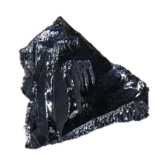
Outline

Slide 3
Spontaneous Four-Wave Mixing
SFWM
1mW
@1550 nm
10¹⁶ photon/s
χ⁽³⁾
50 pairs/s
1 cm of Silicon
A=100 μm²
Elastic scattering between two photons in a χ⁽³⁾ nonlinear medium
1mW
@1550 nm
10¹⁶ photon/s
18 pairs/hour
1 cm of silica
A=100 μm²

Slide 4
Spontaneous Four-Wave Mixing
SFWM
Small footprint
Large nonlinearity
χ⁽³⁾
Scattering losses (db/cm)
Nonlinear losses (TPA)
High index
material
Elastic scattering between two photons in a χ⁽³⁾ nonlinear medium
Small linear losses (.01 db/cm)
Negligible nonlinear losses
Larger footprint
Smaller nonlinearity
Low index
material

Slide 5
Option 1: Going big
e.g. X.Li et al, Opt. Express 2004

Slide 6
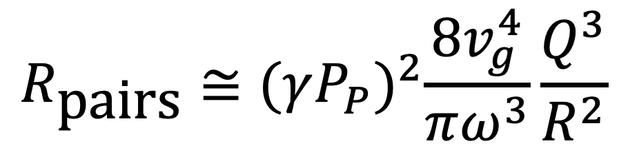
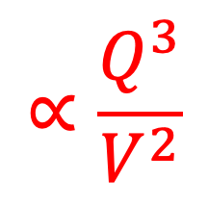
Option 2: Going small
$$R_{\text{pairs}}≅{(γP_{P})}^{2}\frac{8v_{g}^{4}}{πω^{3}}\frac{Q^{3}}{R^{2}}$$
$$∝\frac{Q^{3}}{V^{2}}$$
e.g. microring
resonators
Transverse
enhancement
Resonant
enhancement
L.G. Helt JOSA B 2012

Slide 7
Pump
Generation rate
Total
enhancement
1 mW →1MHz
10⁸
10⁶
10²
High index contrast (Si/SiO₂)
(e.g. Azzini et al. Opt. Express 2012)
10¹⁰
10⁴
10⁶
Low index contrast (Si₃N₄/SiO₂)
S. Ramelow et al. arXiv 1508.04358

Slide 8
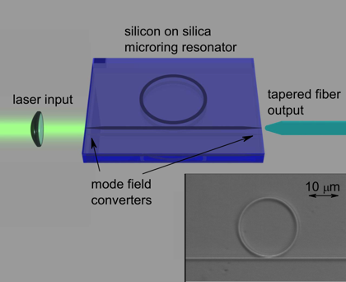
Some examples
J.W. Silverstone et al., Nat. Comm. 2015
D. Grassani, et al., Optica 2015
J.A.Jaramillo-Villegas et al. Optica 2015
M. Kues, Nature 2017

Slide 9
1.Flexibility
2.Tunability
3.Efficiency
Complexity

Slide 10
One example
C.M. Gentry JTu5A.17 ,
CLEO 2016
Z. Vernon et al., Optics Letter 2016
P=0.92
P=0.9991

Slide 11
Problem 2: Characterization
D. Grassani et al., Sci. Rep. 2016
M. Liscidini & JE Sipe “Stimulated Emission Tomography,” PRL 2013

Slide 12
Problem 0: Modelling?
M.Liscidini et al. PRA 2012

Slide 13
A possible approach
Coupling more resonators

Slide 14
Coupled resonators
M. Davanço, et al., APL 2012

Slide 15
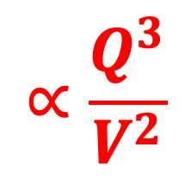
Coupled resonators
$$∝\frac{Q^{3}}{V^{2}}$$
ω
S. Azzini et al. APL 2013

Slide 16
Coupled resonators
Gentry et al OL 2014
Zeng et al OL 2015

Slide 17
What all these examples have in common?
The resonators are LINEARLY coupled

Slide 18
Is it possible to have NONLINEAR COUPLING of LINEARLY UNCOUPLED resonators?
Is it useful?

Slide 19
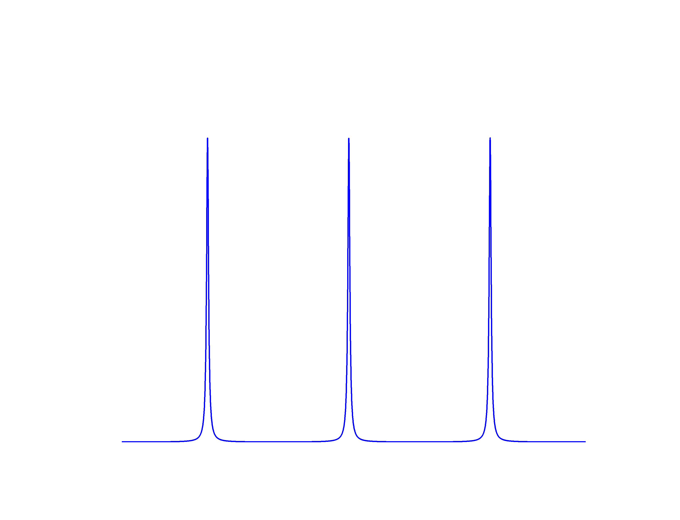
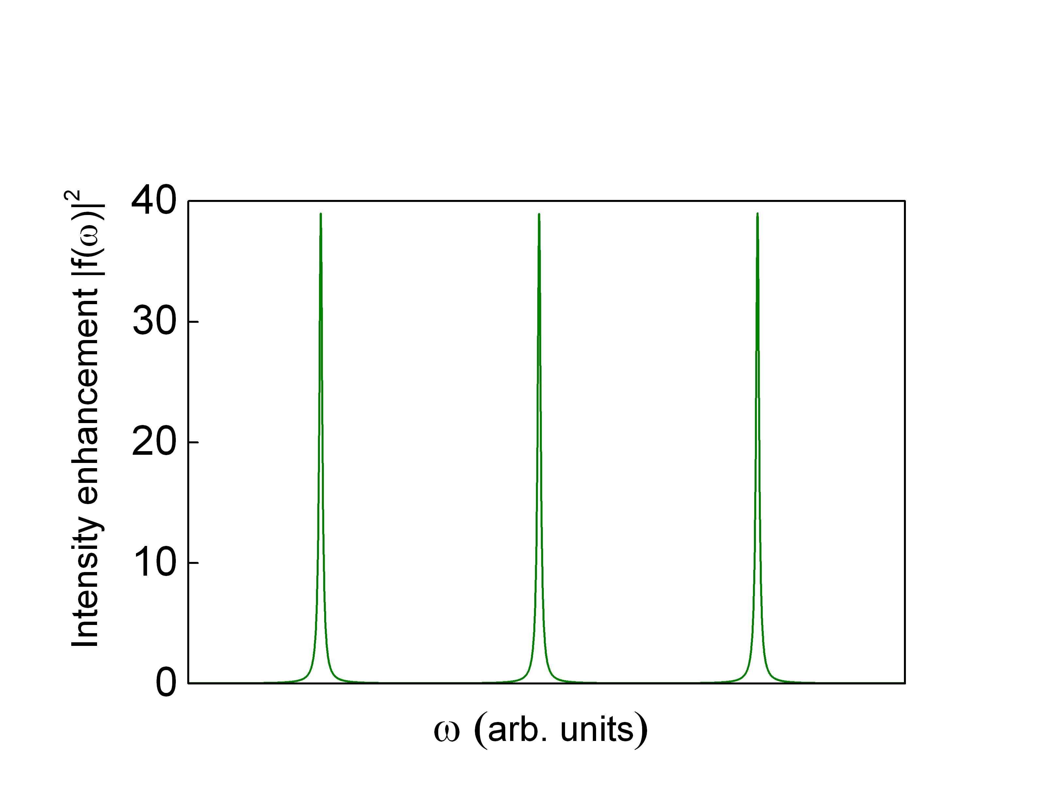
Heater
Resonator 2
Resonator 1
M. Menotti et al. PRL 2019

Slide 20
Resonator 2
Generation takes place only in the coupling region, thus efficiency is reduced...
…but “only” by one order of magnitude
Resonator 1
M. Menotti et al. PRL 2019

Slide 21
Resonator 2
Parasitic processes are suppressed
Dispersion engineering is not critical
Pump can be suppresses of several tens of dBs
With a tuning mechanism, the same device can operate at different power levels
Resonator 1
M. Menotti et al. PRL 2019

Slide 22
Preliminary results
In collaboration with

Slide 23
Complexity

Slide 24
N. Bergamasco , et al. Phys. Rev. Appl. 2017

Slide 25

Take Home Messages

Slide 26
Integrated Photonic
and Quantum Nonlinear Optics
Significant enhancement of process efficiency
Control of photon correlations beyond some limits of bulk sources
New configurations of nonlinear light-matter interaction

Slide 27
Acknowledgements
Stefanio Azzini
Nicola Bergamasco
Davide Grassani
Daniele Bajoni
Matteo Galli
Zachary Vernon
Matteo Menotti
Blair Morrison
Kenneth Tang
John E. Sipe

Slide 28
Thanks for your attention!

Slide 30
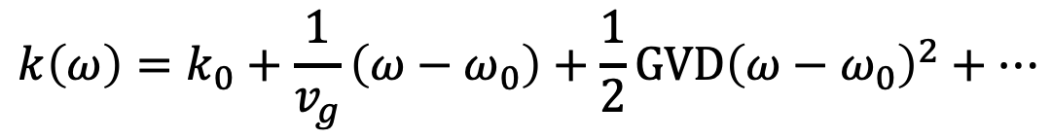
Is that easy?
Δωm
Δω
ω_{s}
ω₀
ω_{i}
$$k\left(ω\right)=k_{0}+\frac{1}{v_{g}}\left(ω−ω_{0}\right)+\frac{1}{2}GVD{\left(ω−ω_{0}\right)}^{2}+…$$
Dispersion
engineering

