Slide 1
Integrated photonic devices for controlling quantum properties of light
Qiang Lin
University of Rochester
TexPoint fonts used in EMF.
Read the TexPoint manual before you delete this box.: AAAAAAAA

Slide 2
Outline
Introduction
Silicon devices for controlling quantum states of light
Lithium niobate devices for quantum nonlinear photonics
Summary and outlook

Slide 3
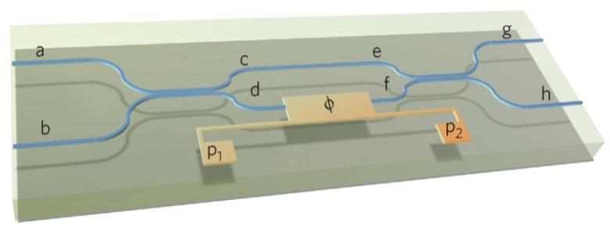
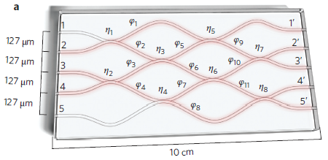
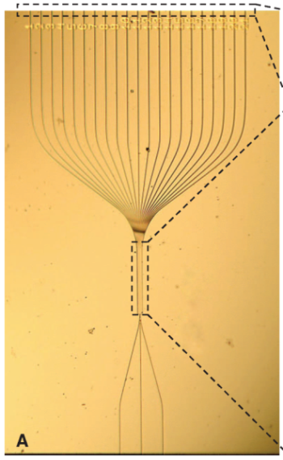
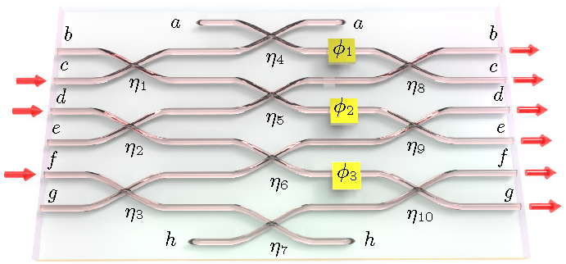
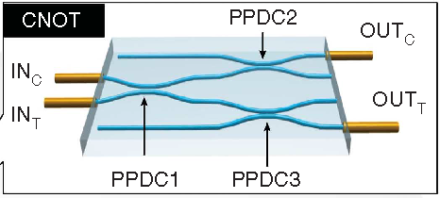
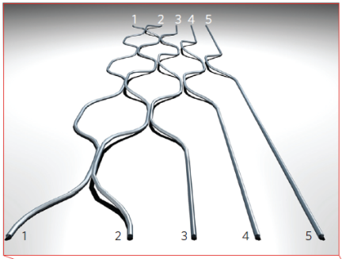
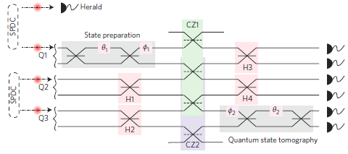
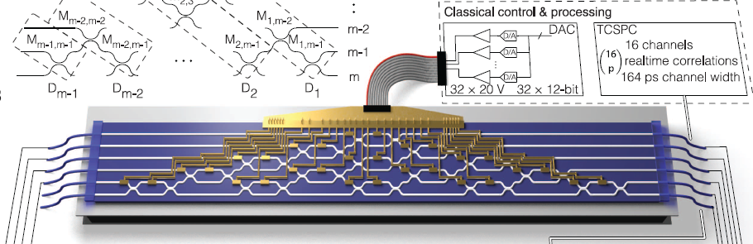
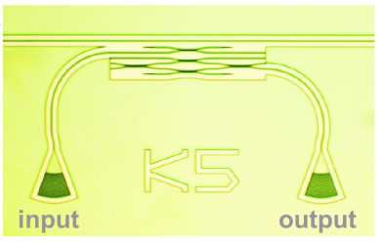
Introduction – integrated quantum photonics
A. Politi et al, Science 320, 646 (2008).
J. Matthews et al, Nature Photon. 3, 346 (2009).
A. Peruzzo et al, Science 329, 1500 (2010).
L. Sansoni et al, PRL 105, 200503 (2010).
A. Crespi et al, Nature Comm. 2, 566 (2011).
S. Ates et al, PRL 109, 147405 (2012).
B Metcalf et al, Nature Comm. 4, 1356 (2012).
J. B. Spring, et al, Science 339, 798 (2013).
A. Crespi, et al, Nature Photon. 7, 545 (2013).
M. Tillmann, et al, Nature Photon. 7, 540 (2013).
B. J. Matcalf et al, Nature Photon. (2014).
J. Carolan, et al, Science 349, 711 (2015).
M. Poot, et al, Opt. Express 24, 6843 (2016).

Slide 4
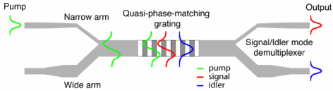
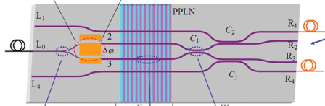
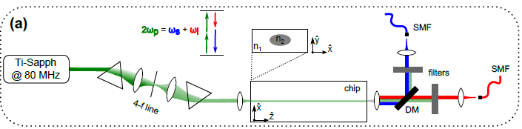
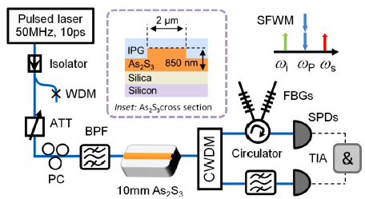
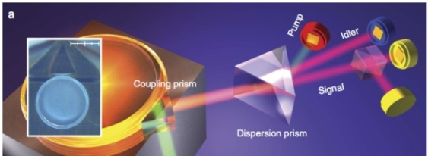
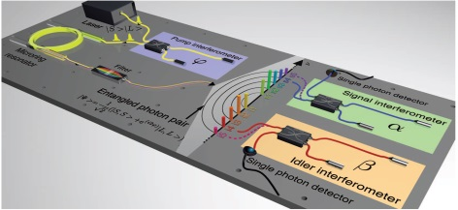
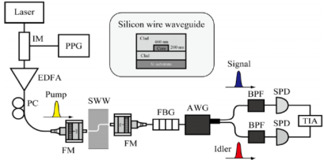
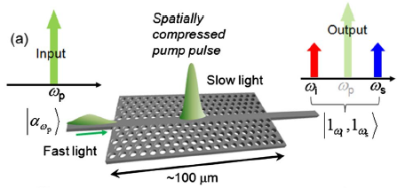
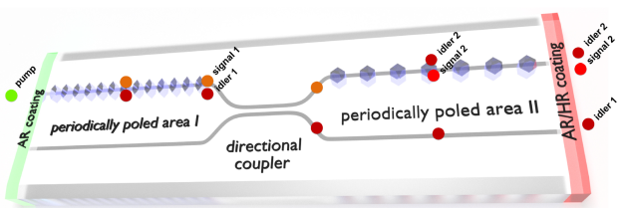
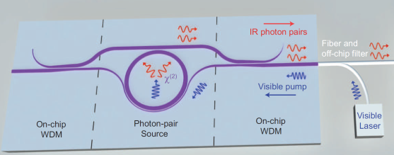
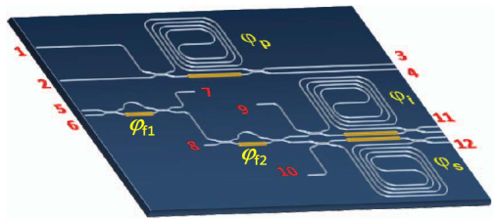
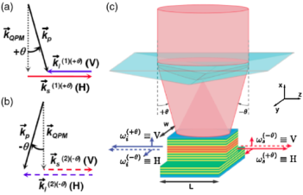
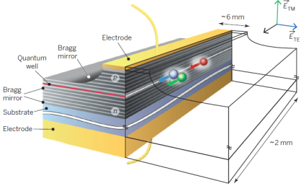
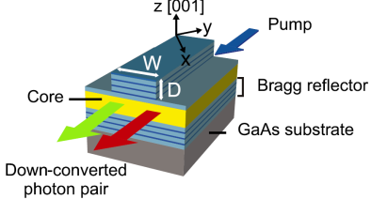
Introduction – integrated quantum photonics
LiNbO3 waveguide/resonator
Silica waveguide/resonator
As₂S₃ waveguide
Q. Zhang, et al, OE 15, 10288 (2007).
H. Jin, et al, PRL 113, 103601 (2014).
J. B. Spring, et al, OE 21, 1352 (2013).
M. J. Collins, et al, OL 37, 3393 (2012).
Si waveguides/resonators
M. Fortsch, et al, Nature Comm. 4, 1818 (2013).
C. Reimer, et al, Science 351, 1176 (2016).
AlN resonator
J. Sharping, et al, OE 25, 12388 (2006).
K. Harada, et al, JSTQE 16, 325 (2010).
C. Xiong, et al, OL 36, 3413 (2011)
M. J. Collins, et al, Nature Comm. 4, 2582 (2013).
S. Krapick, et al, OE 24, 2836 (2016).
Silicon nitride waveguide/resonator
X. Guo, et al, arXiv:1603.037261 (2016).
InGaAs waveguide
C. Xiong, et al, Optica 2, 724 (2015).
S. Ramelow, et al, arXiv:1508.04358 (2015).
A. Oriex et al, PRL 110, 160502 (2013).
F. Boitier et al, PRL 112, 183901 (2014).
R. Horn, et al, PRL 108, 153605 (2012).

Slide 5
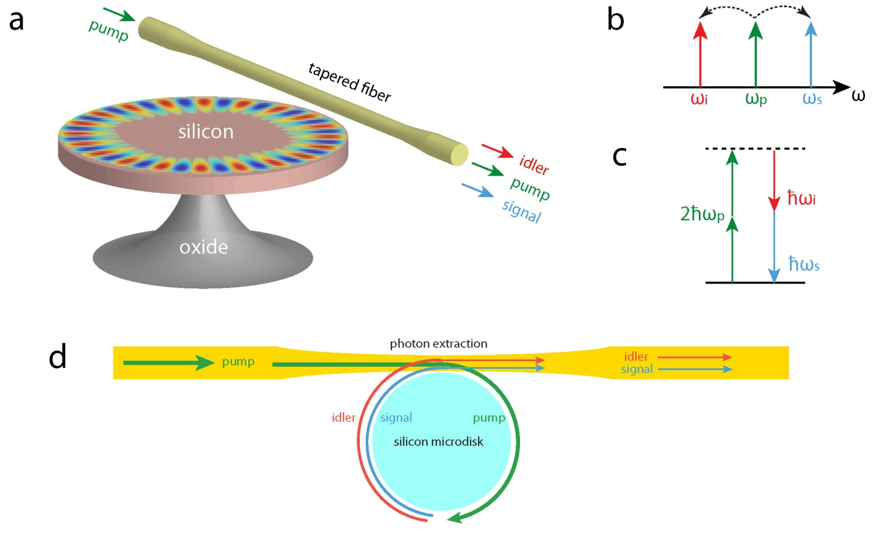
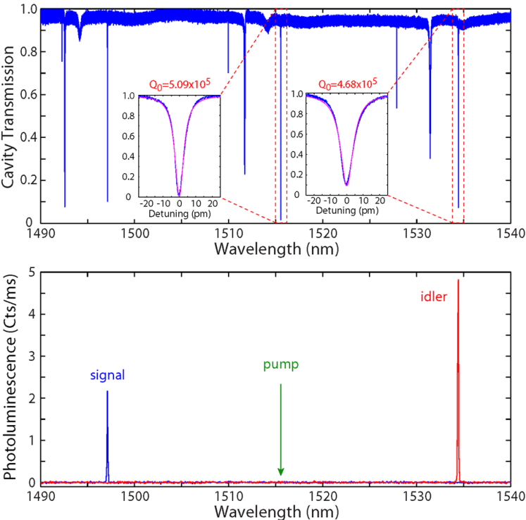
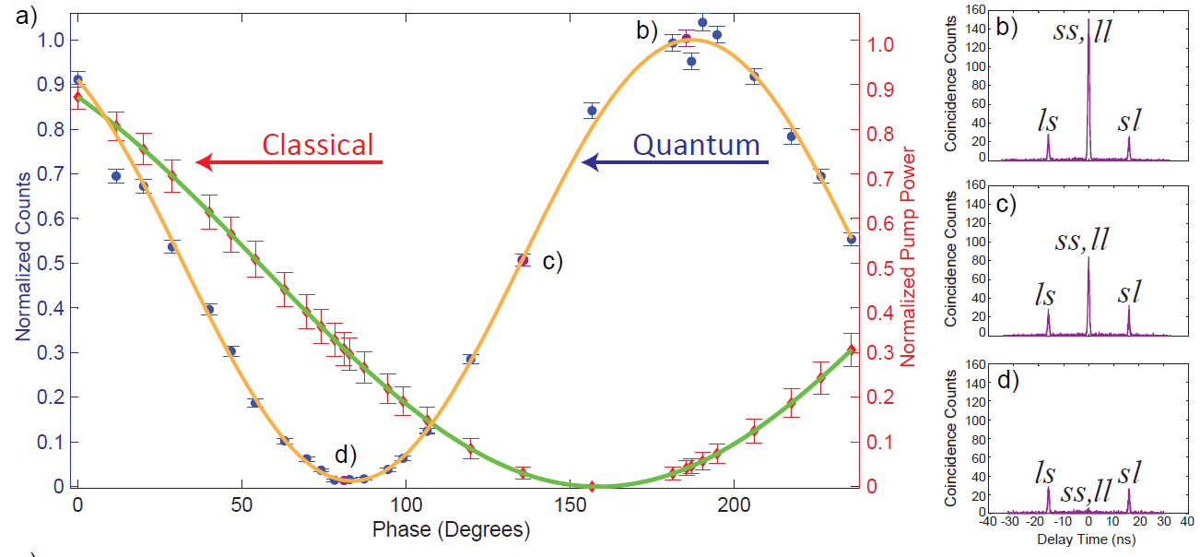
Photon pairs in Si microdisk
S. Rogers, et al, ACS Photon.3, 1754 (2016).
X. Lu, et al, Optica 3, 1331 (2016).

Slide 6
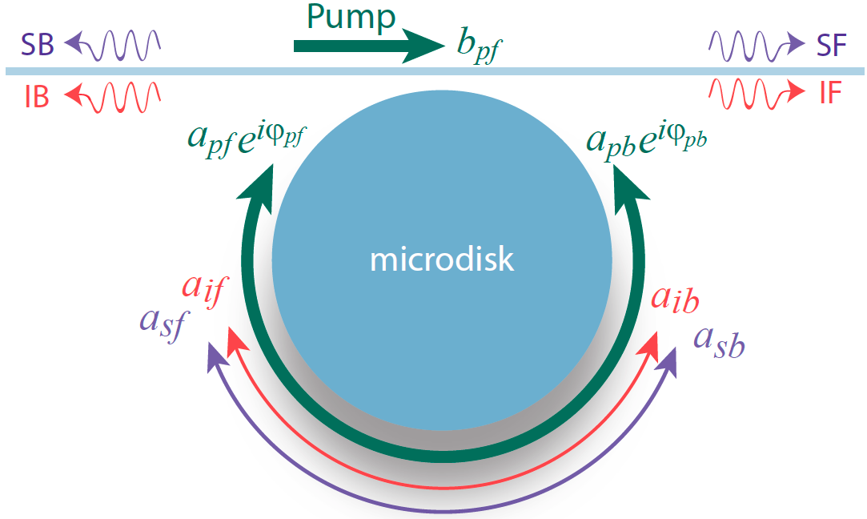
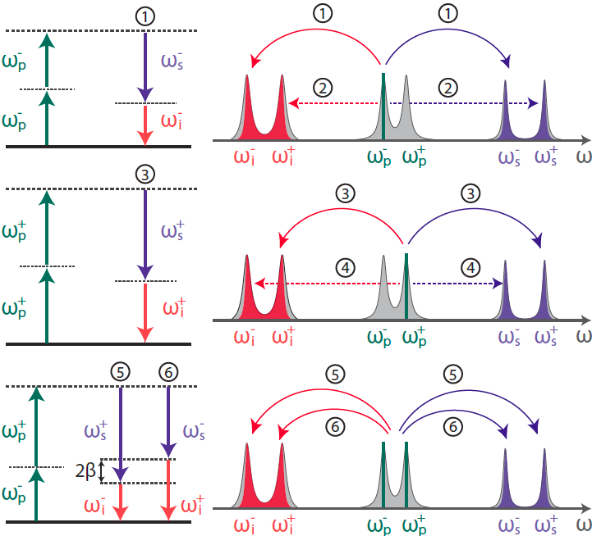
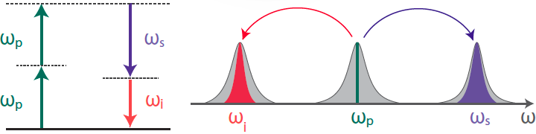
Coupling induced creation pathways

Slide 7
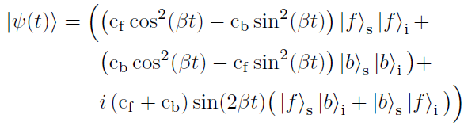
Coupling induced creation pathways
ω_{p}
ω_{s}
Cyclic evolution of Bell states
ω_{p}
ω_{i}

Slide 8
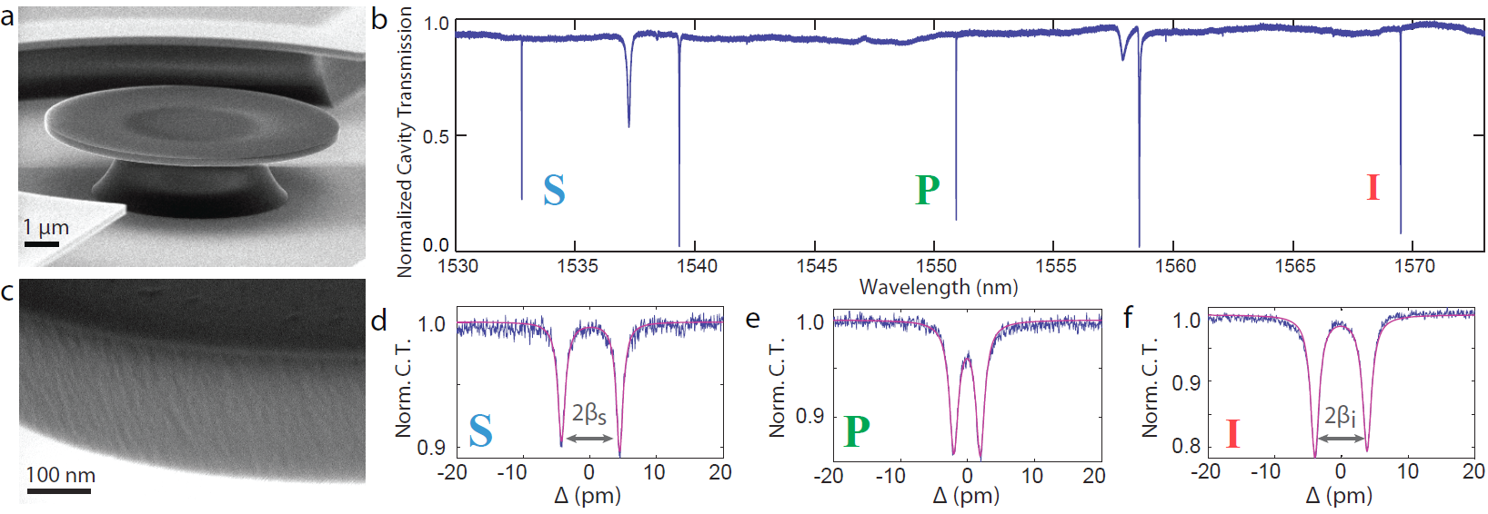







Device implementation
$$Q_{0s}=1.32 × {10}^{6}$$
$$Q_{0p}=1.27 × {10}^{6}$$
$$Q_{0i}=1.15 × {10}^{6}$$
$${2β}_{s}=1.11 GHz$$
$${2β}_{p}=0.6 GHz$$
$${2β}_{i}=0.97 GHz$$
S. Rogers, et al, ArXiv:1809.06872 (2018).

Slide 9
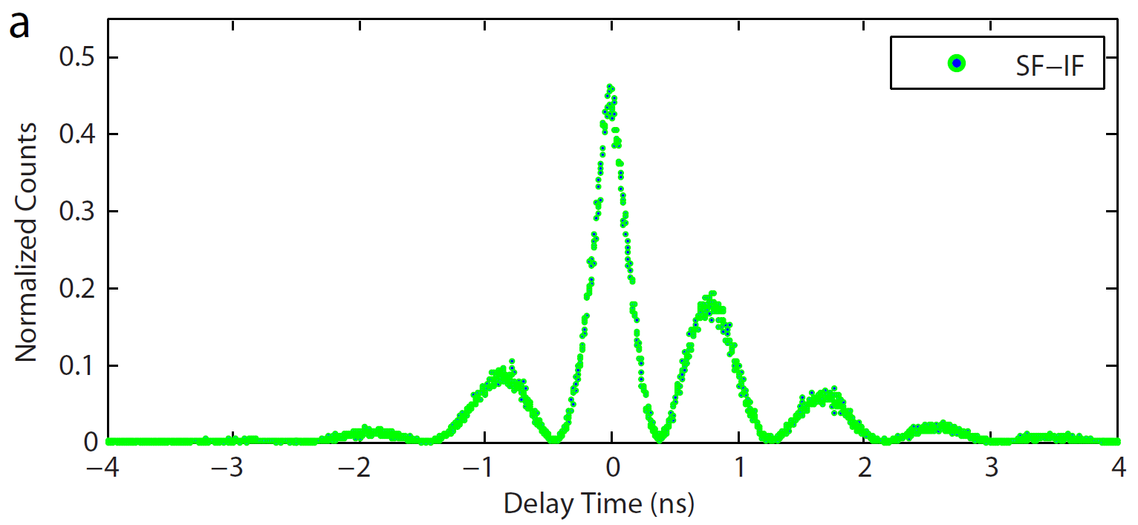
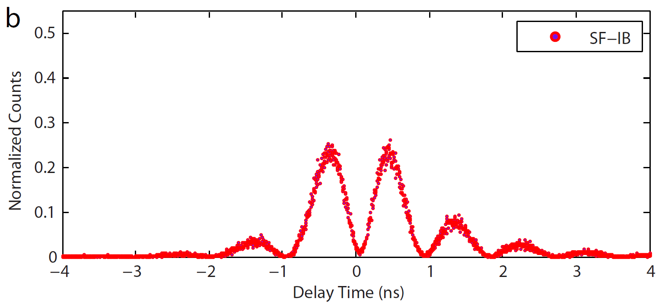
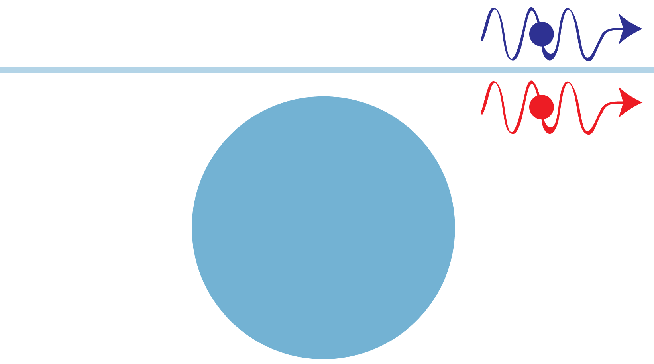
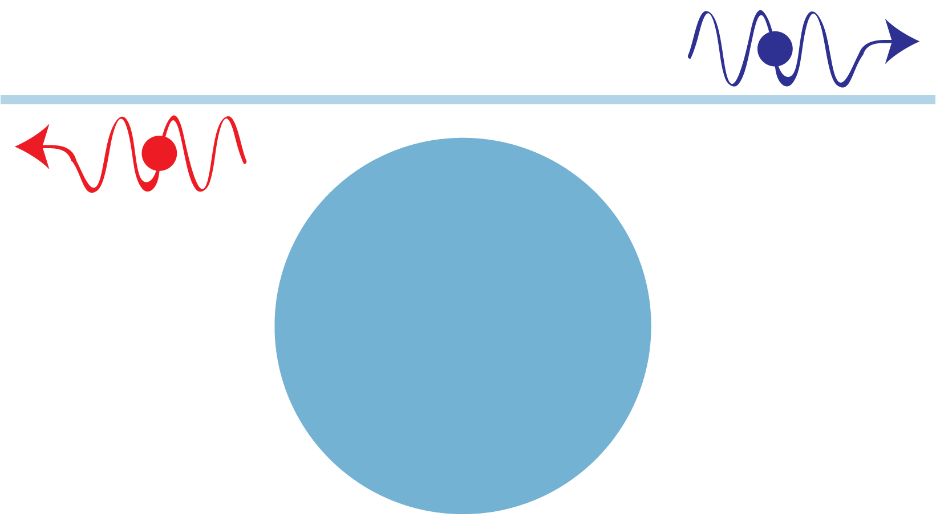
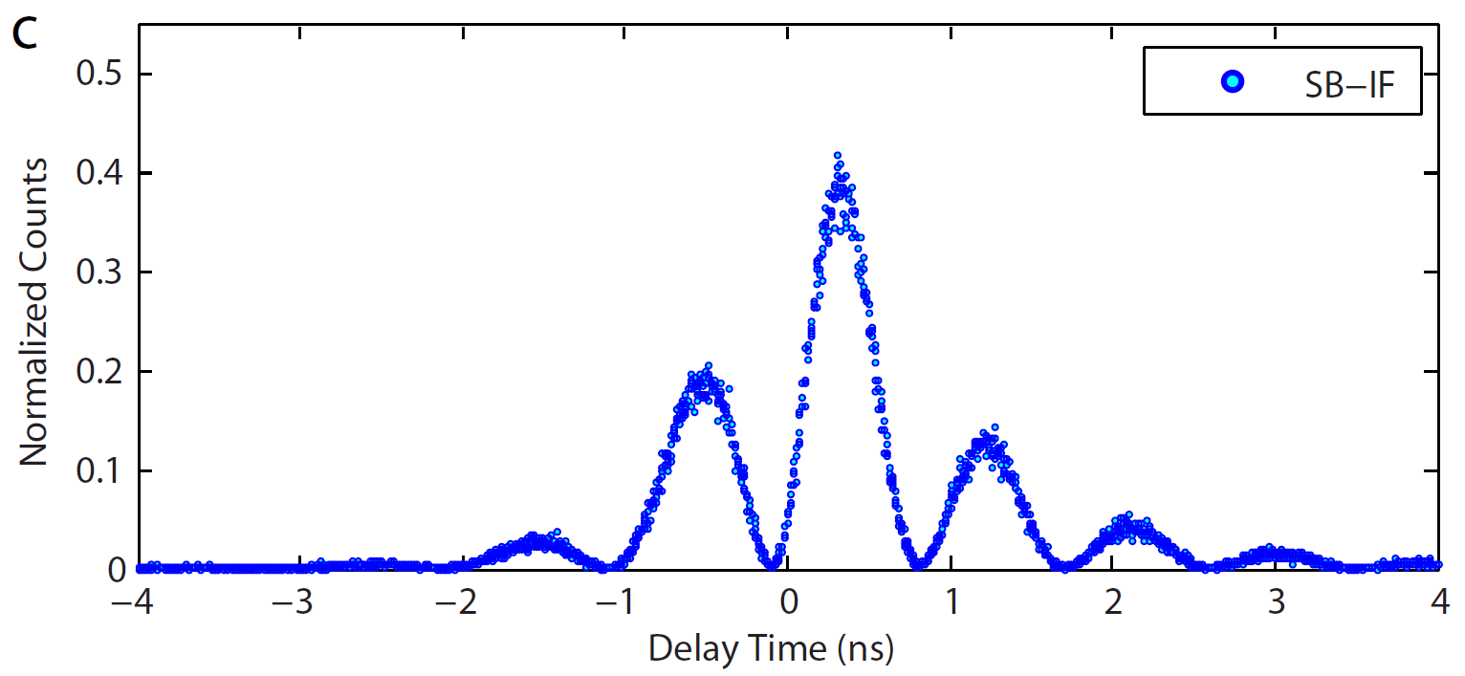
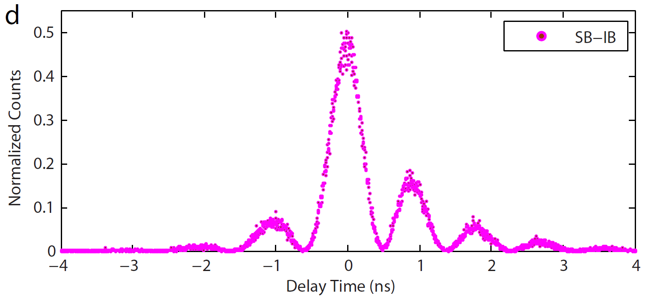
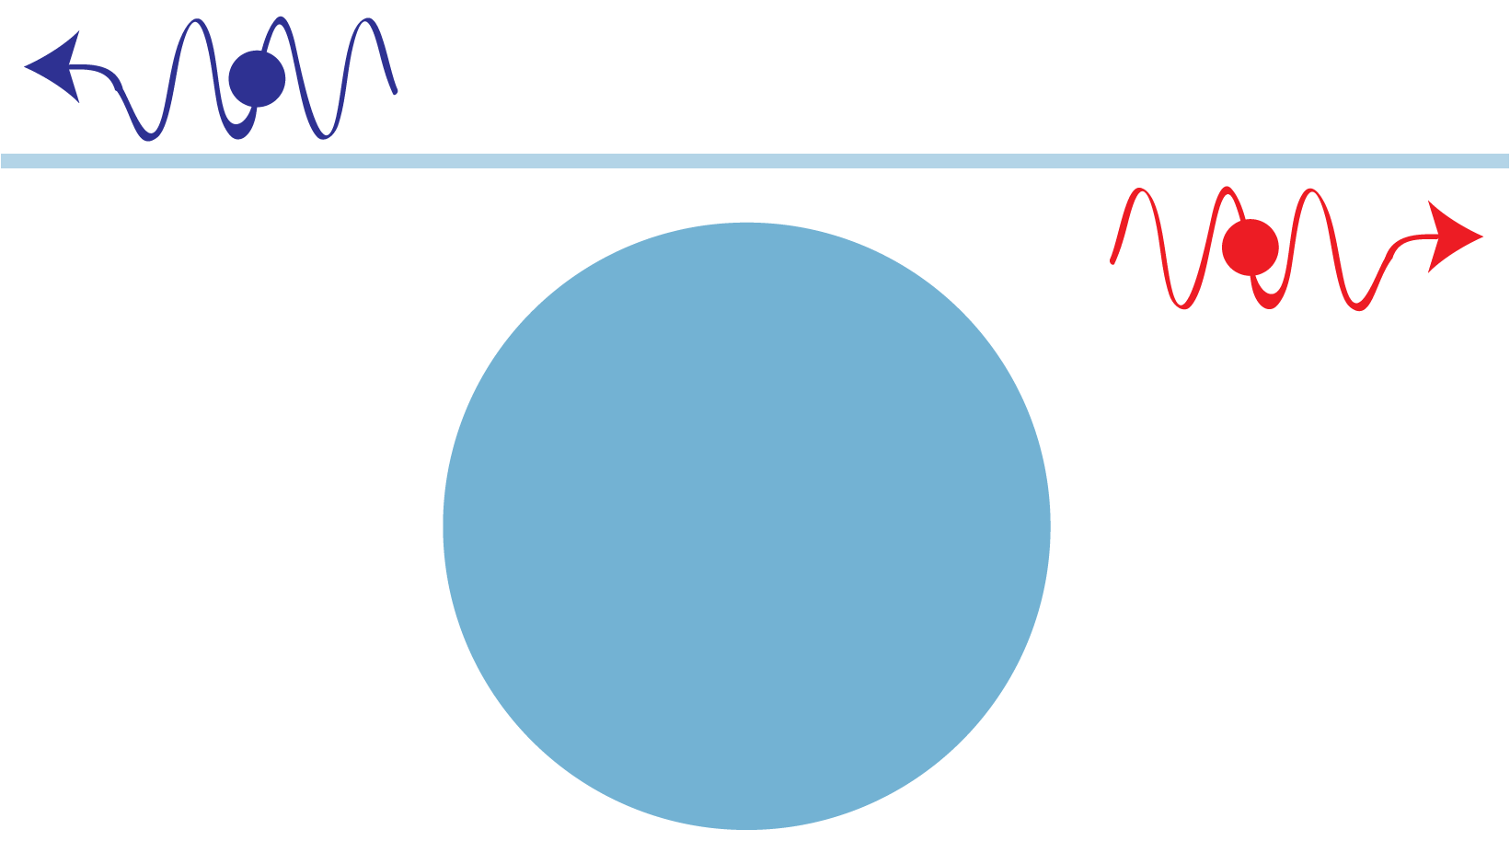
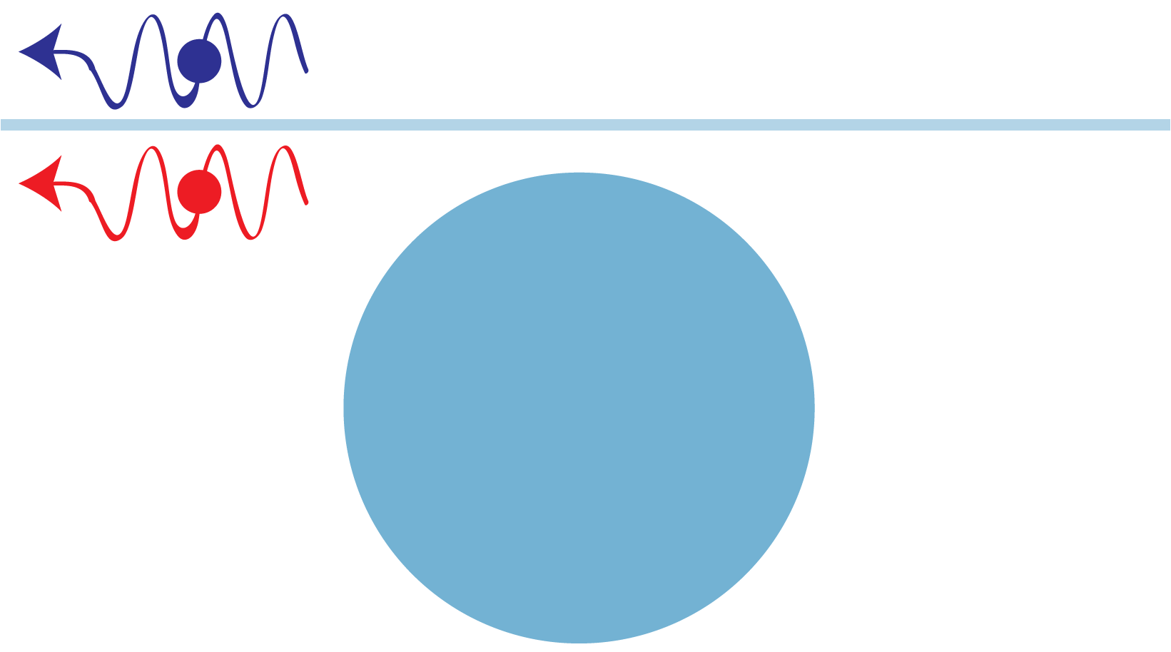

Correlation characteristics
Oscillation frequency matches doublet splitting
$$p_{c}\left(t_{sj},t_{ik}\right)=Ne^{−Γ_{tm}\left|τ\right|}{\left|α_{m}^{jk}\cos\left(β_{m}τ\right)+ε_{m}^{jk}\sin\left(β_{m}τ\right)\right|}^{2}$$
S. Rogers, et al, ArXiv:1809.06872 (2018).

Slide 10
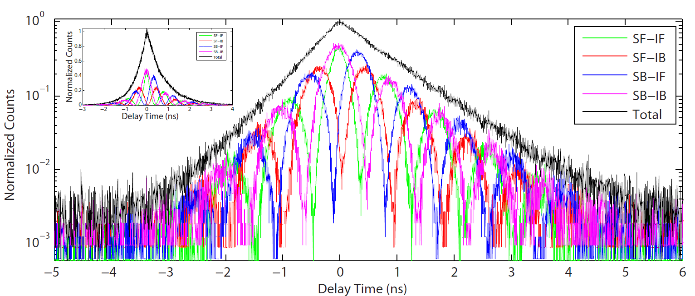

Correlation characteristics
High contrast oscillations ➔ an intrinsic time-evolving path entanglement
S. Rogers, et al, ArXiv:1809.06872 (2018).

Slide 11
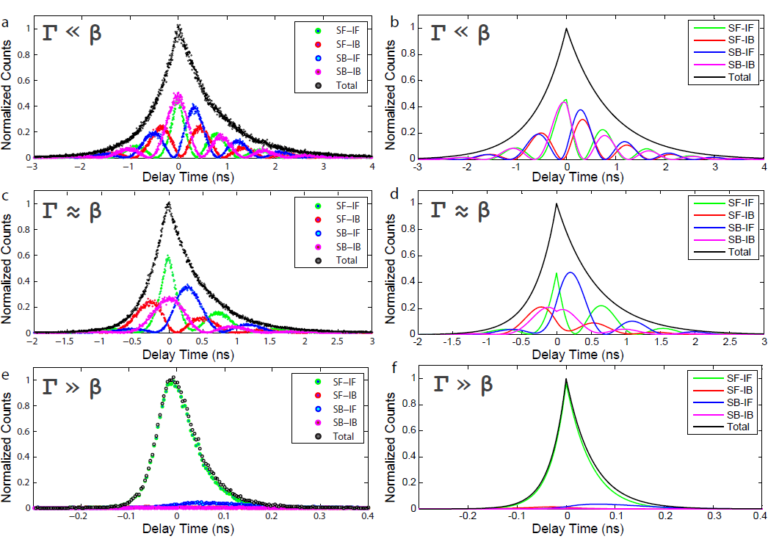
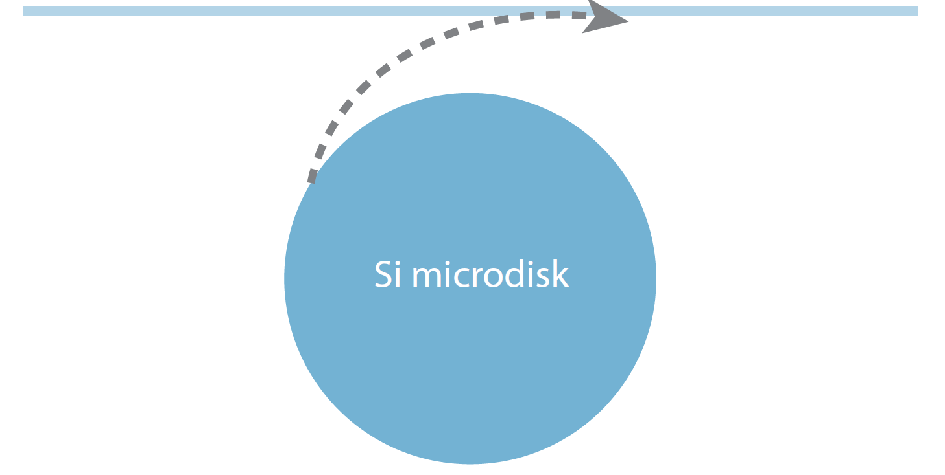
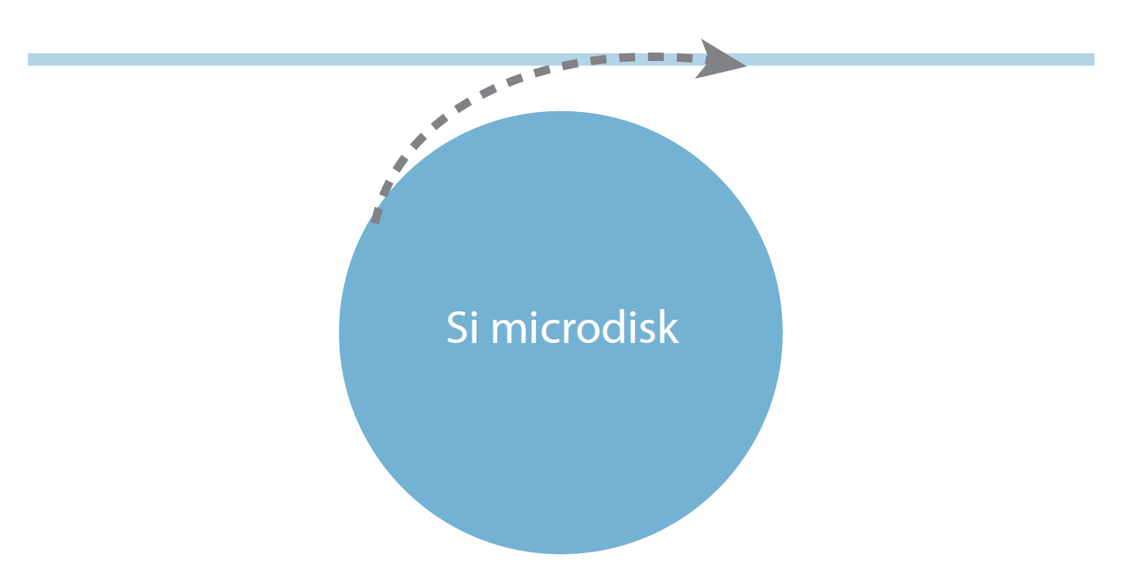
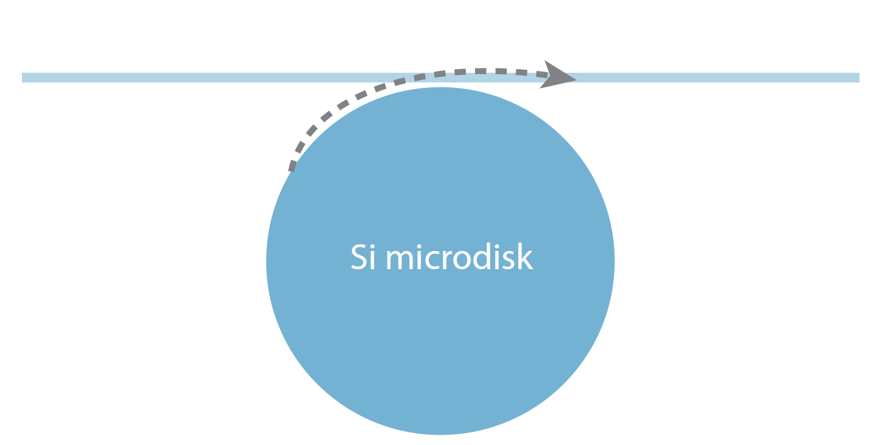



Quenching of path entanglement
Small $Γ_{e}$
Experiment
Theory
Medium $Γ_{e}$
Large $Γ_{e}$
S. Rogers, et al, ArXiv:1809.06872 (2018).

Slide 12
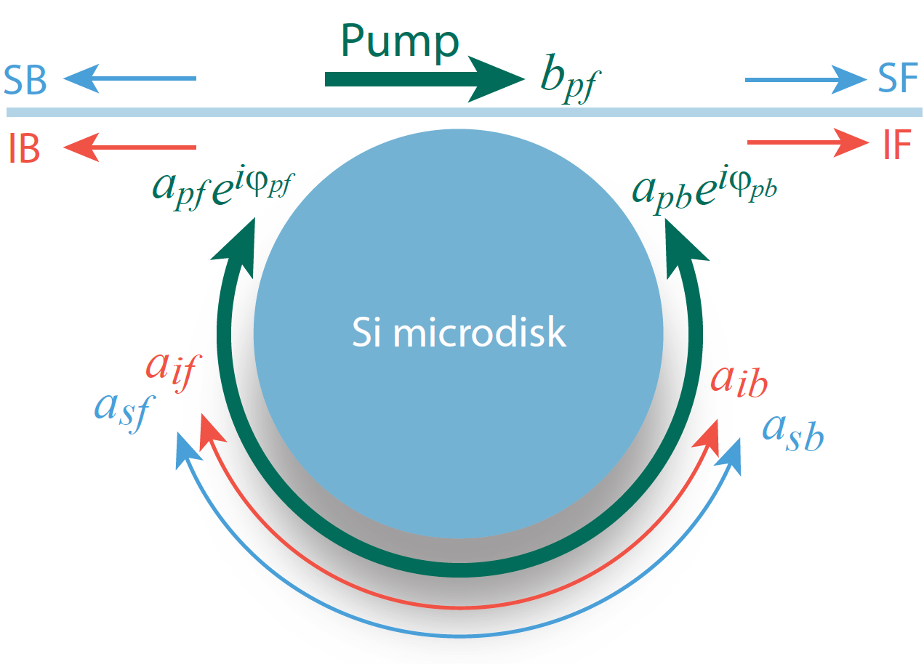
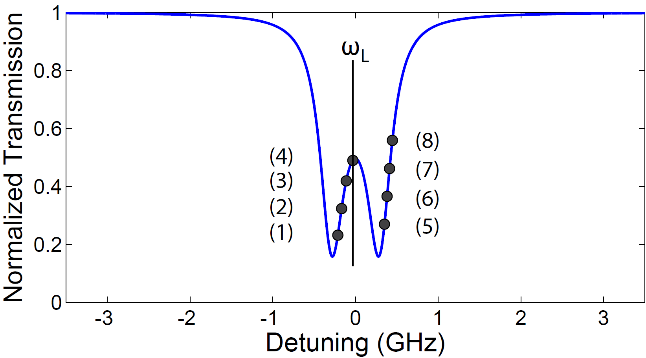
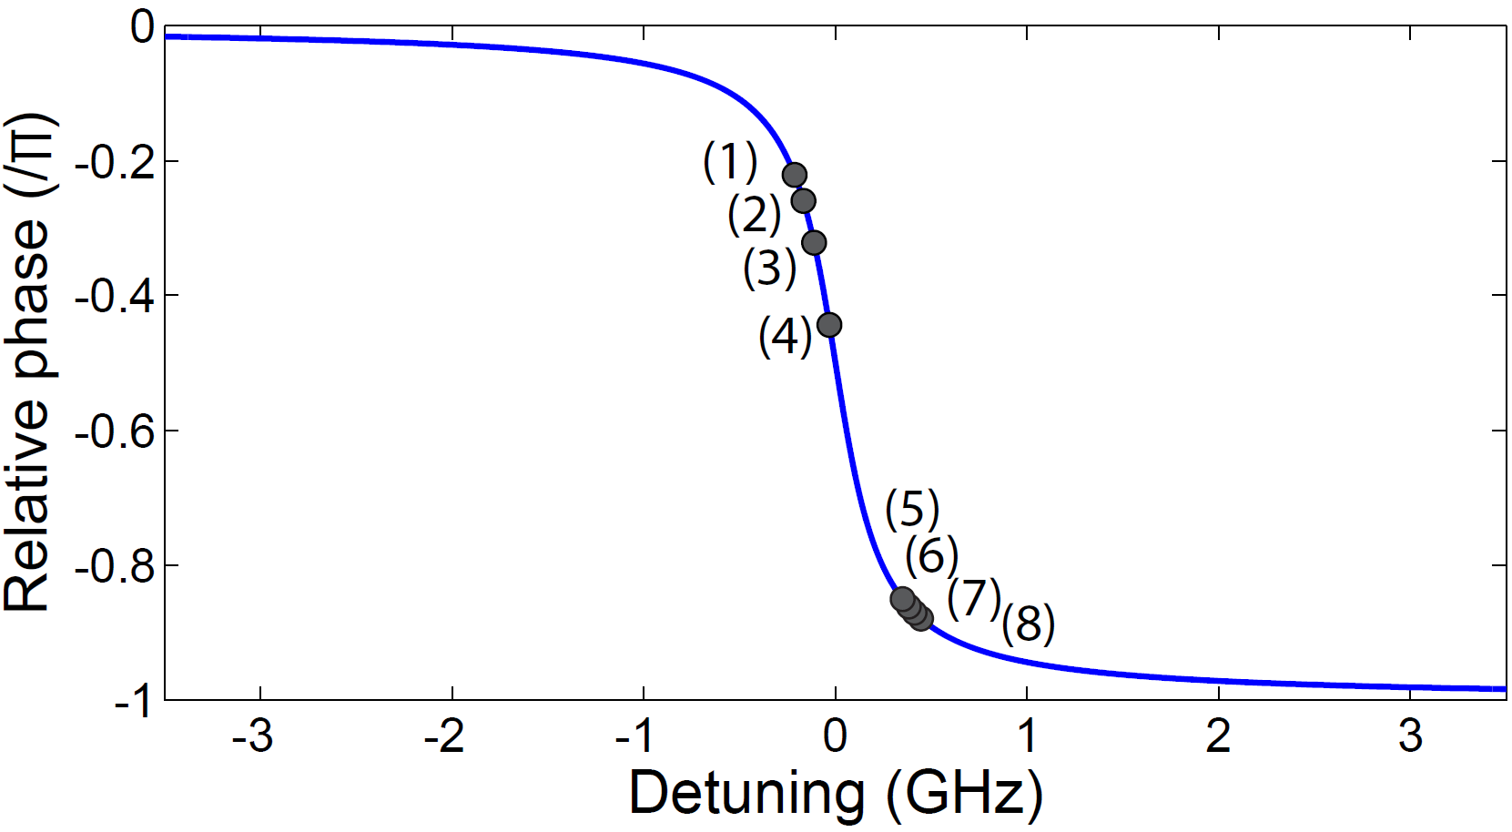



Tuning of quantum state
On the pump mode
Cavity transmission
Intracavity relative phase
$$p_{c}\left(t_{sj},t_{ik}\right)=Ne^{−Γ_{tm}\left|τ\right|}{\left|α_{m}^{jk}\cos\left(β_{m}τ\right)+ε_{m}^{jk}\sin\left(β_{m}τ\right)\right|}^{2}$$
$$α_{m}^{jk}=c_{1m}^{jk}{{|a}_{pf}|}^{2}e^{−iΔφ}−c_{2m}^{jk}{{|a}_{pb}|}^{2}$$
$$ε_{m}^{jk}=c_{3m}^{jk}{{|a}_{pf}|}^{2}e^{−iΔφ}−c_{4m}^{jk}{{|a}_{pb}|}^{2}$$
S. Rogers, et al, ArXiv:1809.06872 (2018).

Slide 13
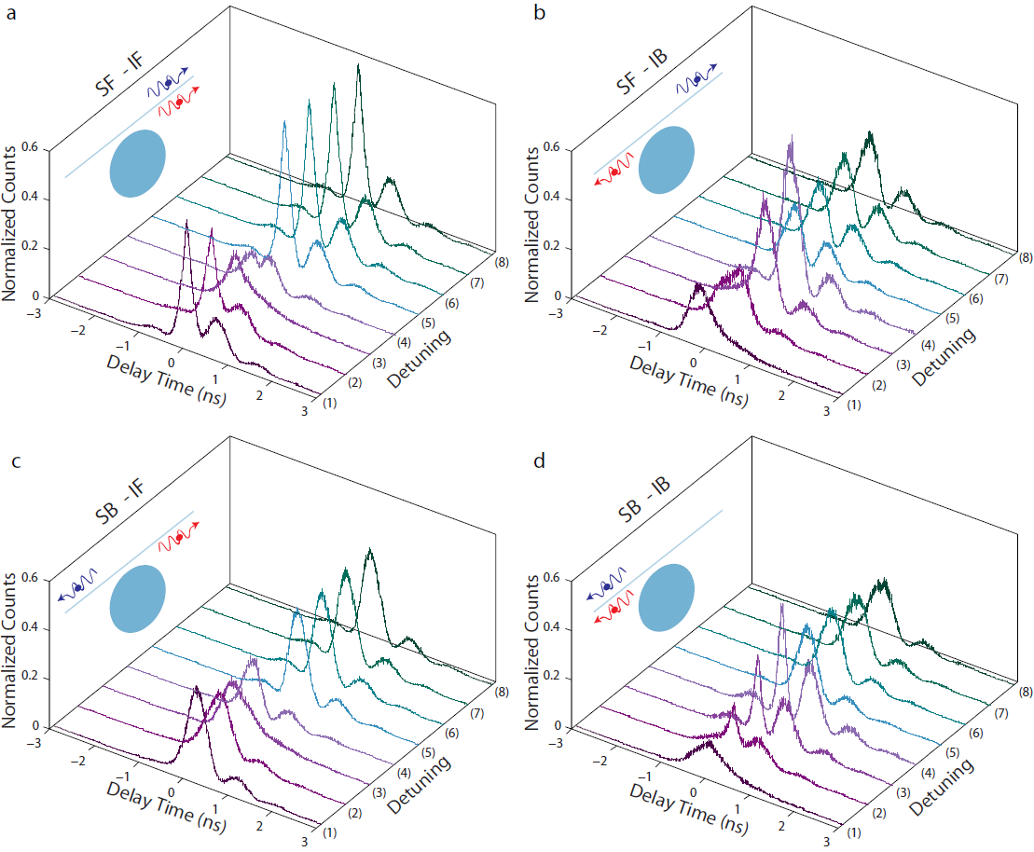

Tuning of quantum state
Laser-cavity detuning
Intracavity relative phase
$π$
S. Rogers, et al, ArXiv:1809.06872 (2018).

Slide 14
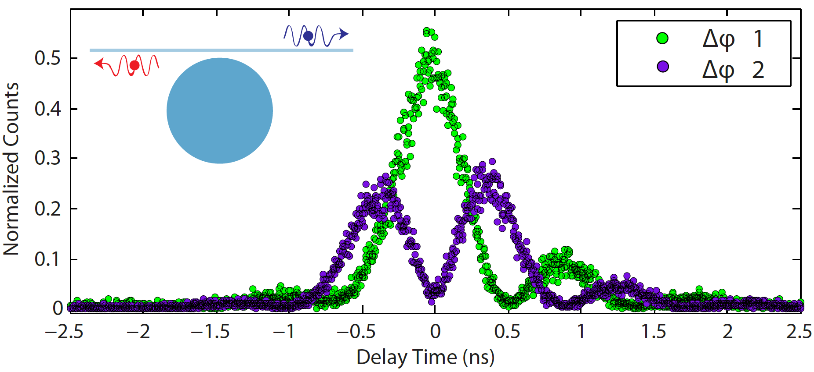
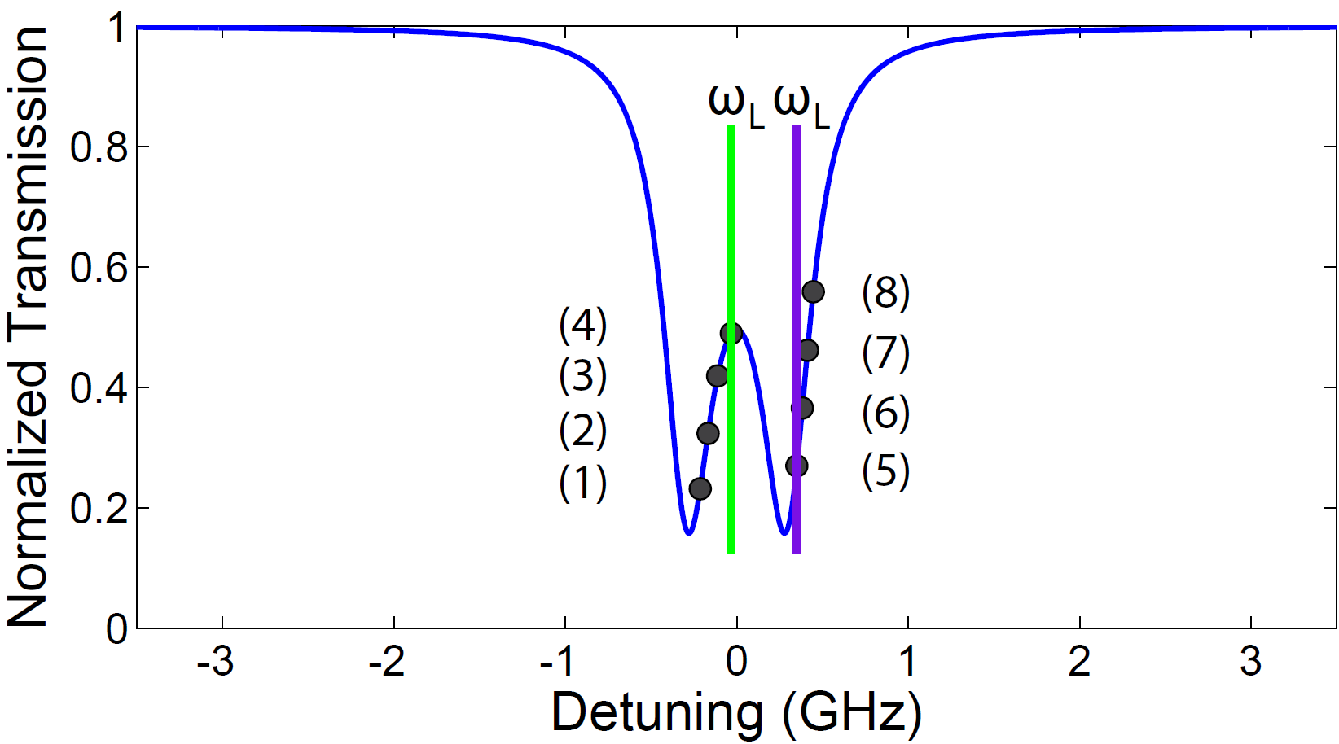


Tuning of quantum state
Laser-cavity detuning
Intracavity relative phase
$$Δφ 1$$
$$Δφ 2$$
S. Rogers, et al, ArXiv:1809.06872 (2018).

Slide 15
Material comparison

Slide 16





Introduction – Lithium niobate
Lithium niobate (LiNbO3) exhibits outstanding material properties:
Electro-optic effect
Piezoelectric effect
Pyroelectric effect
Nonlinear optical effect
Acousto-optic effect
Photorefractive effect
Photoconductive effect.
Material | Refractive index | Bandgap (eV) | Electro-optic: r_{ij} (pm/V) | Second-order nonlinear optical: d_{ij} (pm/V) | Piezoelectric: d_{ij} (pC/N)
LiNbO₃ | ~2.2 | ~4 | r₃₃ = 30.8 | d₃₃ = 25.2 | d₃₃ = 16, d₁₅ = 74
EO modulators
Wavelength converter
Surface acoustic wave filter
Optical communications
Photonic signal processing.
…
Nonlinear optics
Quantum photonics
…
Wireless communications
Sensing.
…
“Silicon” of photonics
http://www.pmoptics.com/lithium_niobate.html
http://www.smm.co.jp/E/products/material/lithium/
http://www.pmoptics.com/catvmodulator.html
https://en.wikipedia.org/wiki/Lithium_niobate
R. S. Weis, et al, Appl. Phys. A 37, 191 (1985).
M. M. Fejer, et al, C. R. Phys. 8, 180 (2007).
W. Wang, et al, J. Micro/Nanolith.8, 031306 (2009).

Slide 17



Conventional approaches to define LN waveguides
Method | Induced refractive index change | Disadvantage
Titanium diffusion | ~ 0.01 | Weakly guiding; dimension imprecision
Proton exchange | ~ 0.1 | Weakly guiding; dimension imprecision
Ion implantation | ~ 0.01 | Large waveguide loss, potential optical damage
D. Yang, et al, Opt. Eng. 53, 061605 (2013).
O. Yavuzcetin, et al, Opt. Mat. 36, 372 (2013).
F. Chen, et al, Opt. Mat. 29, 1523 (2007).
M. Bazzan, et al, Appl. Phys. Rev. 2, 040603 (2015).
F. Chen, et al, Opt. Mat. 29, 1523 (2007).

Slide 18





















Lithium niobate micro/nanophotonic devices
Machining
Laser writing
Direct etching
Optical Q~(10⁷ -10⁸)
(not on-chip)
Hybrid waveguiding
Optical Q~10⁵ -10⁶
Y. S. Ilchenko, et al, Phys. Rev. Lett. 92, 043903 (2004).
A .Guarino, et al, Nature Photon. 1, 407 (2007).
T.-J. Wang, et al, Opt. Express 20, 28119 (2012)..
C. Wang, et al, Opt. Express 22, 30924 (2014).
J. Chiles, et al, Optica 1, 350 (2014).
L. Chen, et al, Optica 1, 112 (2014).
J. Lin, et al, Sci. Rep. 5, 8072 (2015).
R. Geiss, et al, Opt. Lett. 40, 2715 (2015).
S. Li, et al, Opt. Express 23, 24212 (2015).
F. Bo, et al, Adv. Mat. 27, 8075 (2015).
J. Wang, et al, Opt. Express 23, 23072 (2015).
P. O. Weigel, et al, Sci. Rep. 6, 22301 (2016).
L. Chang, et al, Optica 3, 531 (2016).
W. C. Jiang, et al, Sci. Rep. 6, 36920 (2016).
L. Chang, et al, Opt. Lett. 42, 803 (2017).
H.-D. Nguyen, et al, Opt. Express 25, 3722 (2017).
A. Rao, et al, Appl. Phys. Lett. 110, 111109 (2017).
C. Wang, et al, Opt. Express 25, 6963 (2017).
R. Luo, et al, Opt. Lett. 42, 1281 (2017).
Dispersion engineering
Periodic poling

Slide 19




















Lithium niobate photonic crystals and nanocavities
Photonic crystals
Photonic crystal nanocavities
M. Roussey, et al, Appl. Phys. Lett. 87, 241101 (2005).
H. Lu, et al, Appl. Phys. Lett. 101, 151117 (2012).
Fabry-Perot cavity, optical Q ~ 100
G. Zhou, et al, Opt. Lett. 31, 2783 (2006).
H. Lu, et al, Opt. Express 20, 20884 (2012).
Fabry-Perot cavity, optical Q ~ 100
R. Geiss, et al, Appl. Phys. Lett. 97, 131109 (2010).
S Diziain, et al, Appl. Phys. Lett. 103, 051117 (2013).
L3 cavity, optical Q ~ 500
N. Courjal, et al, Appl. Phys. Lett. 96, 131103 (2010).
J. D. Witmer, et al, Sci. Rep. 7, 46313 (2017).
L. Cai, et al, J. Opt. 18, 035801 (2016).
Si photonic-crystal cavity on lithium niobate,
optical Q ~ 1.2×10⁵
Photonic wire cavity, optical Q ~ 156
L. Cai, et al, Opt. Lett. 39, 2094 (2014).

Slide 20

Development of lithium niobate nanophotonic devices
M. Li , et al, arXiv:1806.04755 (2018).
Y. He, et al, Opt. Express 26, 16315 (2018).
H. Liang, et al, Optica 4, 1251 (2017).
R. Luo, et al, Opt. Express 25, 24531 (2017).
W. C. Jiang, et al, Sci, Rep. 6, 36920 (2016).

Slide 21



Introduction to the photorefractive effect
O. Beyer, et al, APL 88, 051120 (2006).
A. A. Savchenkov, et al, APL 88, 241909 (2006).
Photorefraction causes resonance to blue shift.
It is generally a slow varying process.
It is unique feature to materials such as LiNbO3.
T. Volk and M. Wohlecke, Lithium Niobate (Springer, 2008).
G. T. Harvey, et al, JQE 22, 939 (1986).
T. Fujiwara, et al, Appl. Phys. Lett. 54, 975 (1989).
K. Kitamura, et al, JAP 82, 1006 (1997).
K. Buse, et al, Science 393, 665 (1998).
O. Beyer, et al, Appl. Phys. Lett. 88, 051120 (2006).
A. A. Savchenkov, et al, Appl. Phys. Lett. 88, 241909 (2006).
S. M. Korstritski, Appl. Phys. B 95, 421 (2009).

Slide 22





On the photorefractive effect
Photo excitation to generate free carriers
P. Günter and J.-P. Huignard, eds., Photorefractive Materials and Their Applications (Springer, 2006).
Notes:
Photoexite, Free carrier, drift/diffusion, recombine, trapped by acceptor, built up space charge distribution, produce electric field, change refractive index via EO effect, blue shift optical resonance.

Slide 23
On the photorefractive effect
Carrier drift or diffusion in space
P. Günter and J.-P. Huignard, eds., Photorefractive Materials and Their Applications (Springer, 2006).
Notes:
Photoexite, Free carrier, drift/diffusion, recombine, trapped by acceptor, built up space charge distribution, produce electric field, change refractive index via EO effect, blue shift optical resonance.

Slide 24
On the photorefractive effect
Carriers recombined and trapped by impurity defects
P. Günter and J.-P. Huignard, eds., Photorefractive Materials and Their Applications (Springer, 2006).
Notes:
Photoexite, Free carrier, drift/diffusion, recombine, trapped by acceptor, built up space charge distribution, produce electric field, change refractive index via EO effect, blue shift optical resonance.

Slide 25
On the photorefractive effect
Charge redistribution to produce electric field
P. Günter and J.-P. Huignard, eds., Photorefractive Materials and Their Applications (Springer, 2006).
Notes:
Photoexite, Free carrier, drift/diffusion, recombine, trapped by acceptor, built up space charge distribution, produce electric field, change refractive index via EO effect, blue shift optical resonance.

Slide 26
On the photorefractive effect
Space-charge electric field changes the refractive index via Electro-Optic effect
→ Blue shifts cavity resonance
P. Günter and J.-P. Huignard, eds., Photorefractive Materials and Their Applications (Springer, 2006).
Notes:
Photoexite, Free carrier, drift/diffusion, recombine, trapped by acceptor, built up space charge distribution, produce electric field, change refractive index via EO effect, blue shift optical resonance.

Slide 27


Photon-level resonance tuning
M. Li, et al, submitted for publication (2018).

Slide 28




Frequency up-conversion in LN nanoresonator
H. Jiang, et al, Appl. Phys. Lett 113, 021104 (2018).

Slide 29



Third-harmonic generation in LN nanoresonator
Second harmonic generation
Third harmonic generation
M. Li , et al, arXiv:1806.04755 (2018).

Slide 30




Potential for ultra-strong optical nonlinearity
ω: optical frequency
V: effective mode volume
d_{eff}: second-order nonlinear parameter
n₀: refractive index
Cavity linewidth corresponding to optical Q of 10⁶.
Shown for a telecom wavelength. It will be increased by an order of magnitude for a near-infrared wavelength (say, ~800nm).
Effective mode volume:

Slide 31




Broadband parametric down-conversion
SHG and PDC in LiNbO3 devices:
Observation of broadband second-harmonic generation and parametric down conversion
Frequency doubling from 1549.32nm
SHG
On-chip LiNbO3 microdisk
Broadband parametric down conversion from 774.66nm,
with bandwidth > 100 nm.
R. Luo, et al, Opt. Express 25, 24531 (2017).

Slide 32





Efficient frequency doubling in LN waveguides
Waveguide length: 2.35mm.
Theoretical efficiency: 2900% W⁻¹cm⁻², experimental recorded efficiency: 650%W⁻¹cm⁻².
4 times larger than best bulk PPLN. Comparable to most recent on-chip PPLN.
Potential & ongoing effort: quantum light in PT-symmetric systems.
R. Luo, et al, arXiv:1809.06476 (2018).

Slide 33



Tunable frequency doubling
Intermodal phase matching. Wavelength tuning is realized via temperature tuning.
Tuning slope ~0.84nm/K, about one order of magnitude larger than bulk PPLN.
R. Luo, et al, Optica 5, 1006 (2018).

Slide 34





Frequency doubling in LN microresonators
Optical Q: ~ 10⁵.
Experimental recorded efficiency: 1500%/W, theoretical value: 25000%/W.
The best result for LN microresonators. One of the best results for nonlinear microresonators.
Potential & ongoing effort: cavity-enhanced SPDC and quantum squeezing.
R. Luo, et al, arXiv:1810.01299 (2018).

Slide 35



Self-starting mode locking of Kerr solitons
Y. He, et al, arXiv:1812.09610 (2018).

Slide 36
Summary and Outlook

Slide 37



Summary and Outlook

Slide 38



Acknowledgement
Team member:
Silicon devices
Lithium niobate devices
Steven Rogers
Austin Graf
Usman Javid
Daniel Mulkey
Xiyuan Lu
Hanxiao Liang
Rui Luo
Mingxiao Li
Yang He
Wei Jiang
Collaborator:
Dr. Thomas Gerrits & Dr. Sae Woo Nam at NIST
Prof. Kerry Vahala’s group at Caltech
Support:
Thank you!
Notes:
(Read all)
Thank you.

Slide 40
Comparison of typical nonlinear optical media
Material | Refractive index | Kerr nonlinearity n₂ (× 10⁻⁷ cm²/GW) | Second-order: d_{ij} (pm/V) | Bandgap (eV)
MgF₂ | 1.38 | 1.5 (@1.06μm) | NA | 11
CaF₂ | 1.43 | 2.5 (@1.06μm) | NA | 10
SiO₂ | 1.45 | 2.6 (@1.5μm) | NA | 7.8
AlN | 2.12 | 23 (@1.5 μm) | d₃₃ = 4.7 (@1.5μm) | 6
Si₃N₄ | 1.98 | 24 (@1.5μm) | NA | 5
Diamond | 2.39 | 8.2(@1.5 μm) | NA | 5.5
Si | 3.48 | 450 (@1.5μm) | NA | 1.12
Ge | 4.0 | 3340 (@ 3.39 um) | NA | 0.67
SiC | 2.6 | 60-80 (@1.5μm) | d₃₃ = -13 − -24 (@1.06μm) | 2.3-3.0
As₂S₃ | 2.4 | 200 (@1.5μm) | NA | 2.3
As₂Se₃ | 2.8 | 1100 (@1.5μm) | NA | 1.77
ZnS | 2.40 | 168 (@1.06μm) | d₁₄ = 12 (@1.06μm) | 3.54
ZnSe | 2.48 | 376 (@1.06μm) | d₁₄ = 43 (@1.06μm) | 2.58
ZnTe | 2.79 | 2500 (@1.06μm) | d₁₄ = 119 (@1.06μm) | 2.26
BBO | 1.6 | 5.8 (@1.06μm) | d₂₂ = 2.3 (@1.06μm) | 6.2
KTP | 1.78 | 61 (@1.06μm) | d₃₃ = 14.6 (@1.06μm) | 3.54
LiNbO₃ | 2.2 | 18 (@1.06μm) | d₃₃ = 25.2 (@1.06μm) | 3.9
GaN | 2.3 | 53 (@1.23μm) | d₃₃ = -3.8 (@1.06μm) | 3.44
GaP | 3.1 | 600 (@1.04μm) | d₃₆ = 36.8 (@1.31μm) | 2.2
GaAs | 3.4 | 1590 (@1.5μm) | d₁₄ = 105 (@1.5μm) | 1.43
Data are from literature.
M. Sheik-Bahae, et al, IEEE JQE 27, 1296 (1991).
R. DeSalvo, et al, IEEE JQE 32, 1324 (1996).

Slide 41


Photorefractive damage in LN crystal
M. Carrascosa, et al, OE 16, 115 (2008).
D. Zheng, et al, Sci. Rep. 6, 20308 (2016).
One major challenge to the application of lithium niobate, particular on nonlinear photonics.
Conventional mitigation approaches are to dope lithium niobate to increase damage threshold.
TexPoint fonts used in EMF.
Read the TexPoint manual before you delete this box.: AAAAAAA

Slide 42

Quenching of photorefraction
A. A. Savchenkov, et al, APL 88, 241909 (2006).
Strong saturation observed for photorefraction.
Intriguing quenching of photorefraction.
The whole process is reversible.
H. Liang, et al, Optica 4, 1251 (2017).

Slide 43

Potential for nonlinear photonic applications
M. Carrascosa, et al, OE 16, 115 (2008).
Quenching of photorefraction may find an elegant solution to the optical damage issue of LN crystal.
LN nanophotonic devices might be of great potential for nonlinear phootonic applications.
Time response of photorefraction in LN photonic crystal nanoresonator?
Photorefraction for signal processing?

Slide 44






Single-photon nonlinearity - Current state of the art
Single atom and atom cloud inside a cavity
Single quantum dot inside a cavity
H. J. Kimble, et al, Nature 436, 87 (2005).
V. Vuletic, et al, Nature 448, 57 (2013).
A. Immamoglu, et al, Nature 445, 896 (2007)
Superconducting circuits.
M. D. Lukin, et al, Nature 508, 241 (2014).
A. Rauschenbeutel, et al, PRL 104, 203603 (2010).
Challenges:
Atom systems require high vacuum and optical trap.
Quantum dot systems require cryogenic temperature.
Superconducting circuits require cryogenic temperature and operate at microwave frequencies.
K. Semba, et al, Nature Phys. 13, 44 (2017).

Slide 45

Outlook
A Scalable Integrated Quantum Photonic Interconnect

Slide 46



Compared to state-of-the-art broadband PDC
M. B. Nashr, et al, Phys. Rev. Lett. 100, 183601 (2008).

Slide 47
Wavelength conversion in SiC devices
Conversion efficiency ~0.2/mW²

Slide 48

Optomechanics of LN microresonators
W. C. Jiang, et al, Sci, Rep. 6, 36920 (2016).

Slide 49

Optomechanics of LN photonic crystal nanoresonators
H. Liang, et al, Optica 4, 1251 (2017).

Slide 50



Potential for electro-opto-mechanical hybrid coupling
Potential for strong electo-opto-mechanical coupling.
Microwave to optical photon conversion.
Hybrid electronic – photonic signal processing mediated by high-frequency nanomechanics.
Current state of the art:
GaAs
AlN
A. N. Cleland, et al, Nature Phys. 9, 712 (2013).
K. Srinivasan, et al, Nature Photon. 10, 346 (2016).

Slide 51
Photorefractive damage in LN crystal
M. Carrascosa, et al, OE 16, 115 (2008).
D. Zheng, et al, Sci. Rep. 6, 20308 (2016).
One major challenge to the application of lithium niobate, particular on nonlinear photonics.
Conventional mitigation approaches are to dope lithium niobate to increase damage threshold.
TexPoint fonts used in EMF.
Read the TexPoint manual before you delete this box.: AAAAAAA

Slide 52


Self-starting mode locking of Kerr solitons
Y. He, et al, arXiv:1812.09610 (2018).

Slide 53
Frequency doubling of Kerr solitons
Y. He, et al, arXiv:1812.09610 (2018).

Slide 54

Soliton self-frequency shift
Y. He, et al, arXiv:1812.09610 (2018).

Slide 55






Application to integrated quantum photonics
Spontaneous four-wave mixing (FWM): Photon pair generation
ω_{p}
ω_{p}
ω_{s}
ω_{i}
ω_{s}
ω
ω_{p}
ω_{i}
Quantum interference
Silicon wire waveguide
Si photonic crystal
C. Xiong, et al, OL 36, 3413 (2011)
M. J. Collins, Nature Comm. 4, 2582 (2013).
J. Sharping, et al, OE 14, 12388 (2006).
H. Takesue et al, APL 91, 201108 (2007).
K. Harada, et al, JSTQE 16, 325 (2010).
J. Silverstone, et al, Nature Photon. 8, 104 (2014).
Silicon microring
Quantum photonic circuit
Silicon CROW
M. Davanco, et al, APL 100, 261104 (2012).
C. Clemen, et al, OE 17, 16558 (2009).
E. Engin, et al, OE 27, 27826 (2013).
Y. Guo et al, OL 39, 2526 (2014).
D. Grassani, et al, Optica 2, 88 (2015).
N. Matsuda, et al, OE 21, 8596 (2013).
N. C. Harris, et al, PRX 2, 041047 (2014).

