Slide 1
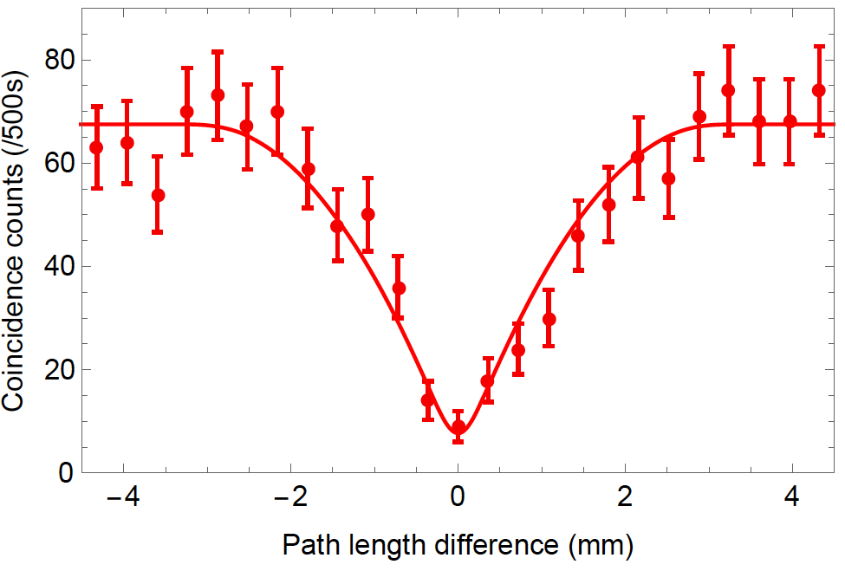



Quantum Photonics: How Far Can We Go
P. Kwiat

Slide 2
Quantum Photonics: How Far Are We Likely to Go in the Next Several Years
P. Kwiat

Slide 3
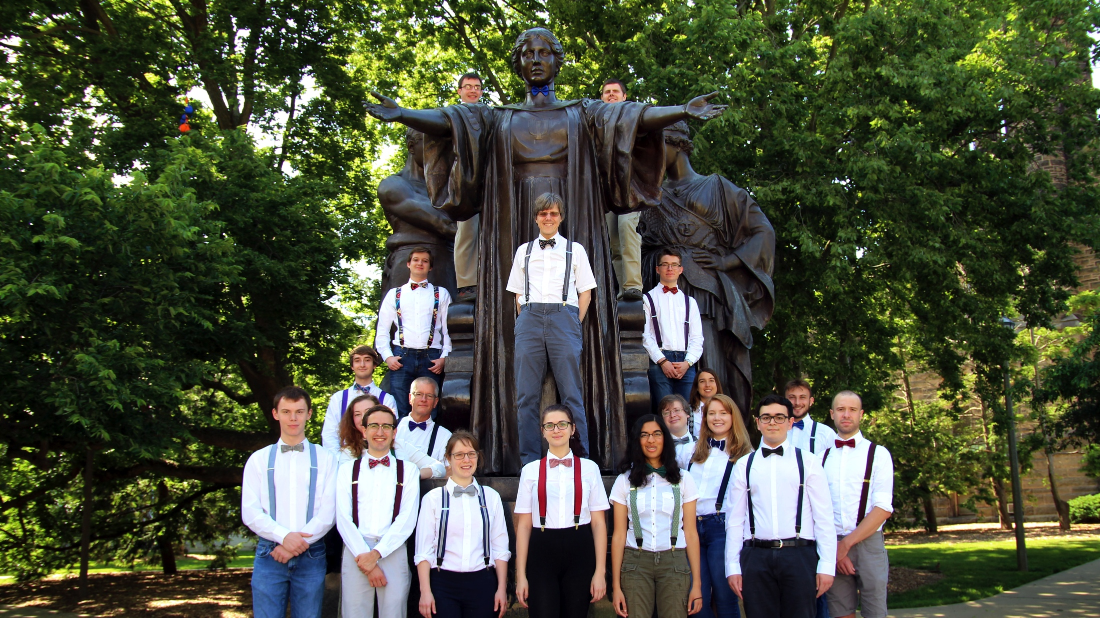
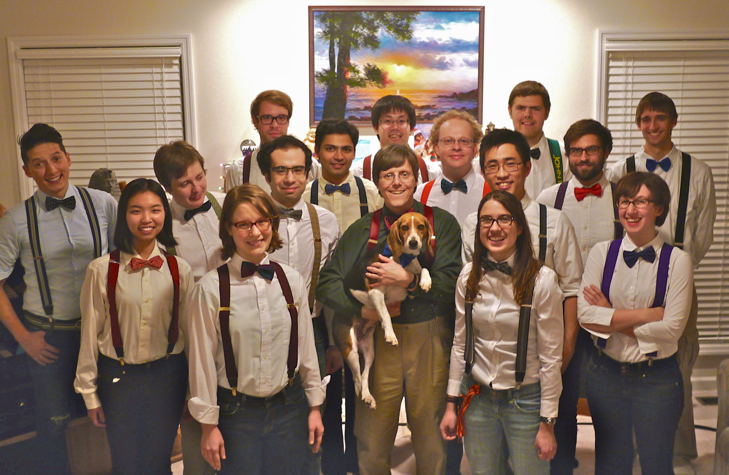
Kwiat’s Quantum Clan
Fumihiro Kaneda
Colin Lualdi
Currently looking for new graduate students/postdocs…
Will supply appropriate attire!

Slide 4


IQUIST:
Illinois
QUantum Information Science and
Technology
Center
- $15 M campus investment
- ≥ 8 new faculty in Phys, ECE, CS, etc.
- multi-node processor quantum testbed
- new educational programs

Slide 5

PGK at an Integrated Photonics
Workshop

Slide 6
Outline
Motivation
Temporal multiplexing
On the importance of PNR detectors
Looking forward

Slide 7
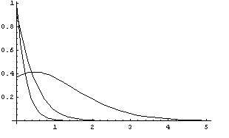
Deterministic Single-Photon Source
Classical (laser) source → Poisson photon number distribution
Probability
Number of photons
We wish to overcome this, yet retain controllable spectral
and polarization characteristics
- Quantum cryptography
- Quantum metrology
- Optical quantum computing and communication

Slide 8
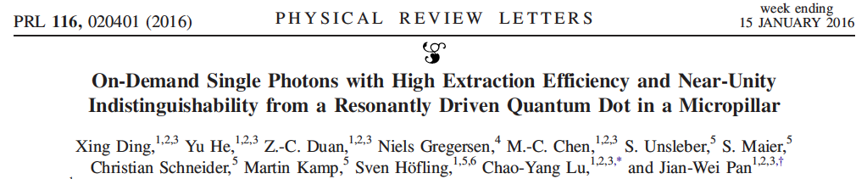
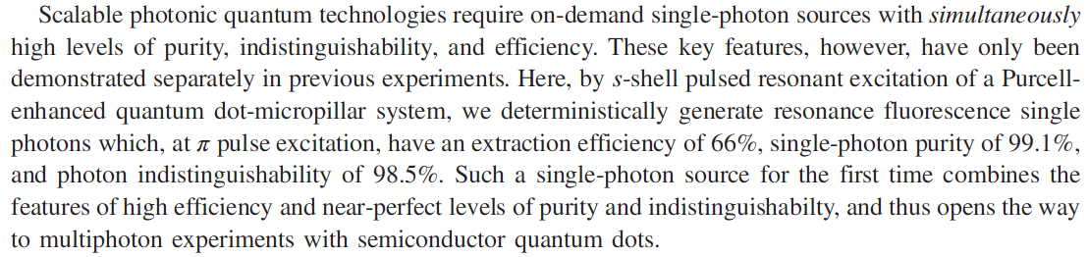
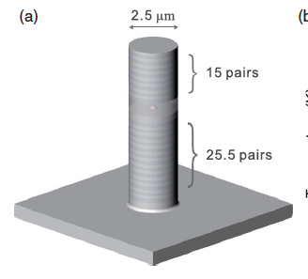
Actual efficiency = 3.7x10⁶/81 MHz
= 4.6% (~15% if we divide out η_{detector})
Note: They used a polarization filter to block the pump (~10⁷ extinction) → automatic 50% loss

Slide 9
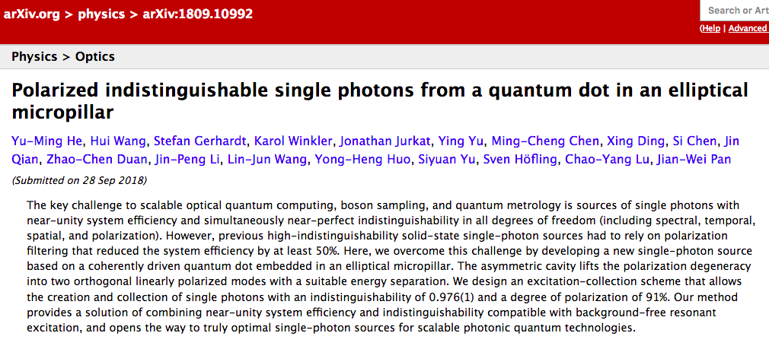
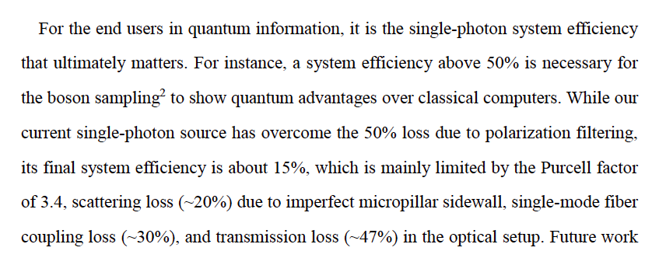
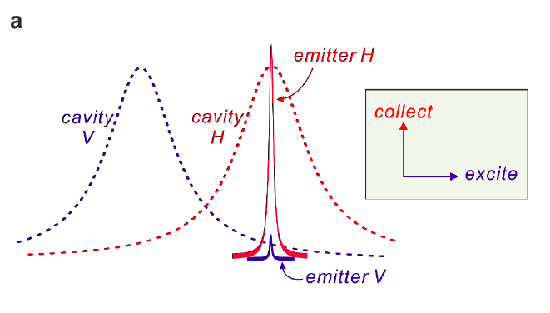

Slide 10

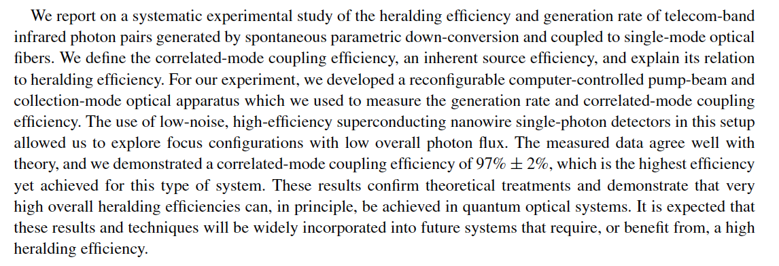
Heralded single-photon source
Signal
SPD
Hong and Mandel, PRL 56 (1986)
…..
…..
Laser
Non-linear crystal
Idler
…..
But the high heralding efficiency comes at the cost of low brightness…

Slide 11
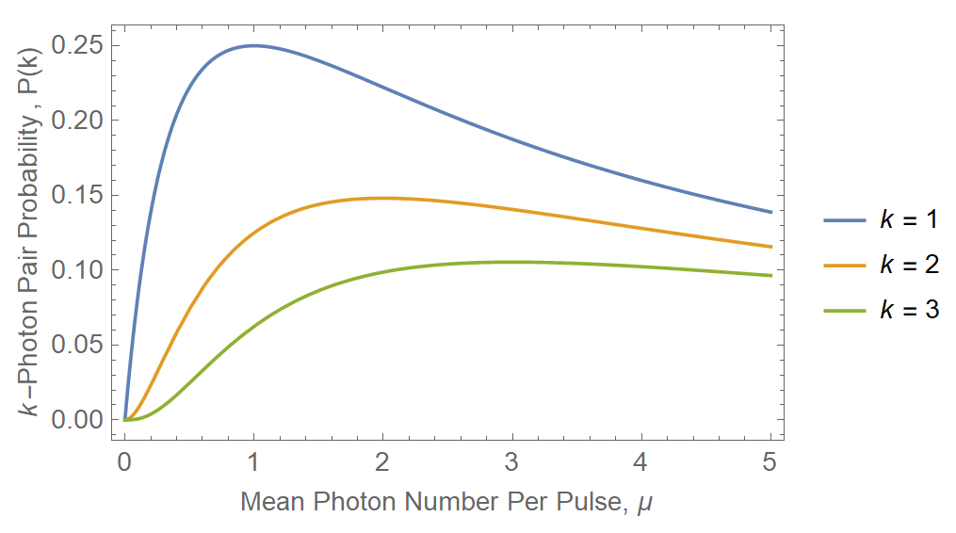
SPDC Theory
Heralding Photon
SPDC is described by thermal statistics
Pump
SPDC
Idler Photon
→ Single-photon probability P(k = 1) limited to ~25%
If you have a high probability to make 1 photon, you have a high probability to make > 1.

Slide 12
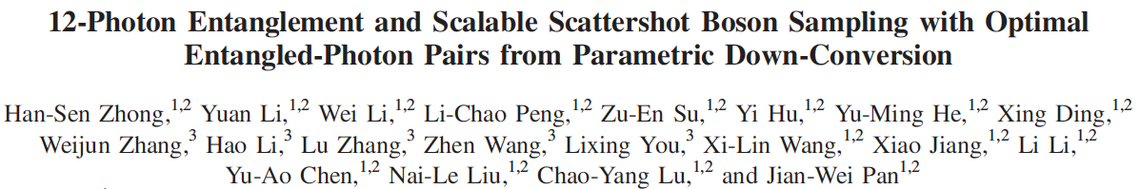
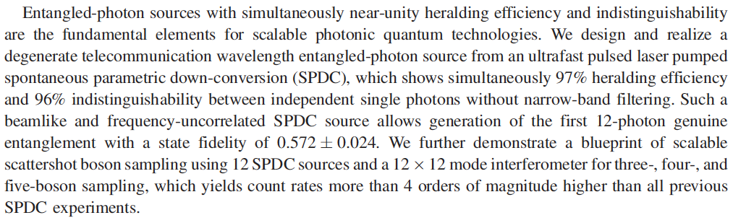
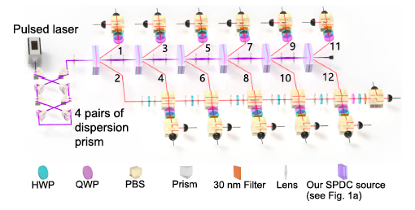
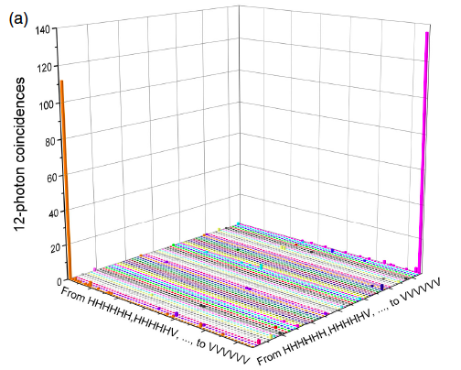
→ 1/hour ☹
Solution:
Deterministic generation by multiplexing…

Slide 13
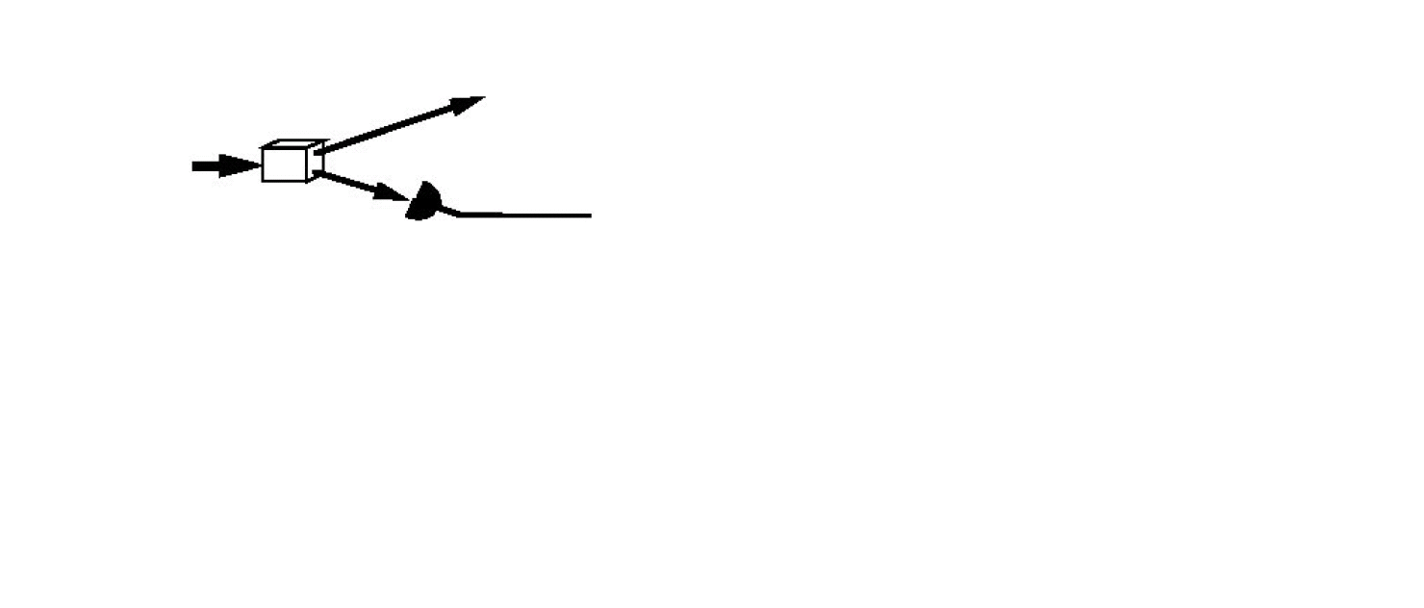
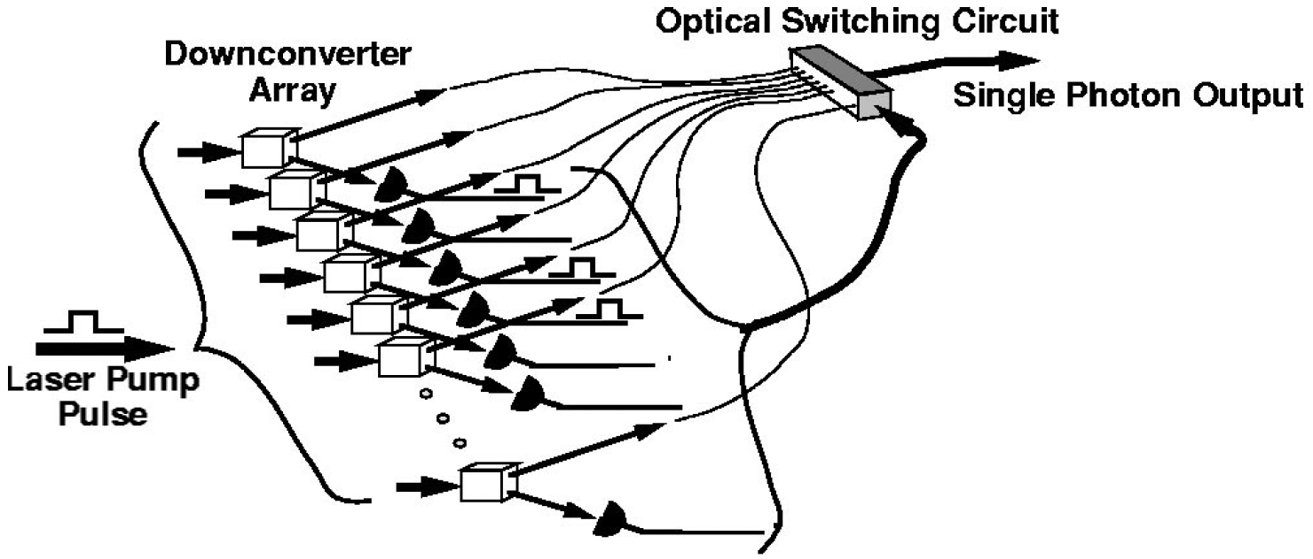
Downconversion as SPS
Spatial multiplexing requires:
many crystals,
many detectors,
low-loss photon
switchyard, …
A. L. Migdall, D. Branning, and S. Castelletto, PRA 66, 053805 (2002)

Slide 14
Outline
Motivation
Temporal multiplexing
On the importance of PNR detectors
Looking forward

Slide 15
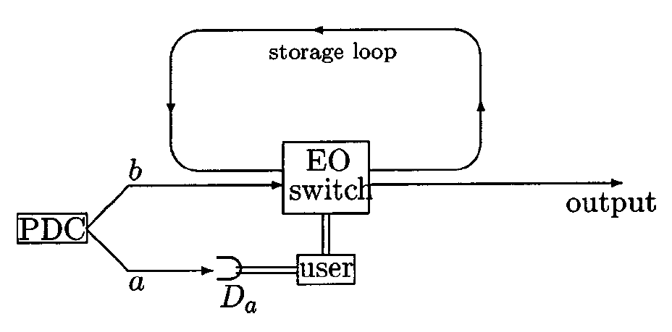
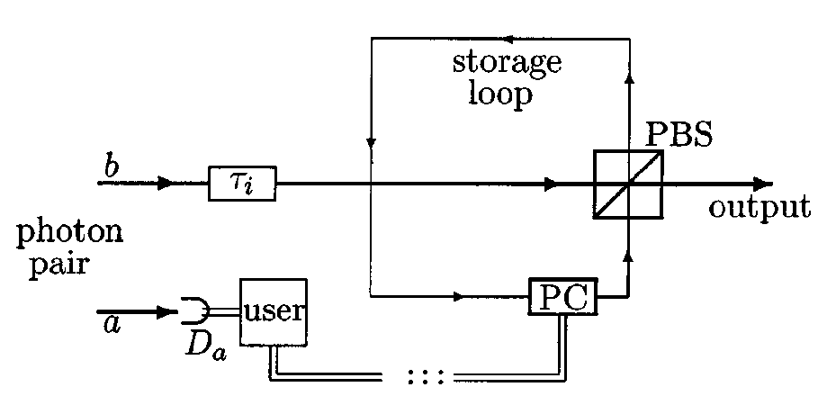
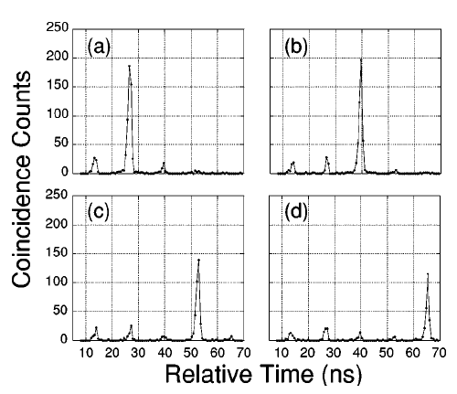
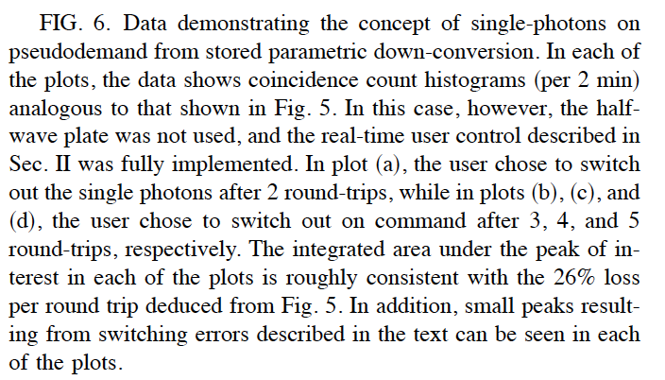
Single-photon source via time-multiplexing

Slide 16
Use time-multiplexed heralded single-photon source to create periodic source
N Pulses
τ
Pump
…..
Trigger
Output
time slot
Signal
…..
Storage
Idler
…..
  p: mean number of photon-pairs
t
Polarization switch
For p << 1 and ideal photon storage,
P₁ (N) = 1 – (1 – p)^{N} . (1 - p < 1)
Deterministic generation is possible for N >> 1.
g⁽²⁾(0) is approximately independent of N.
E. Jeffrey, et al., NJP 6, (2004)
Kaneda et al. Optica 2, 1010 (2015)

Slide 17
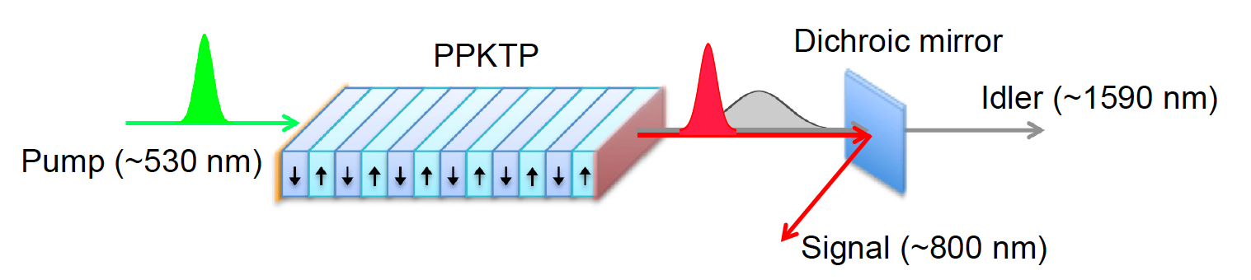


What about photon purity?
Need to avoid spectral entanglement or it won’t work in any multi-photon interference applications (e.g., Boson sampling, teleportation, etc.)
Solution: Source engineering to reduce entanglement!
Non-degenerate, collinear, periodically poled source, with group-velocity matching
F. Kaneda, K. Garay-Palmet, A. B. U’Ren, and PGK, “Heralded single-photon source utilizing highly nondegenerate, spectrally factorable spontaneous parametric downconversion” Opt. Expr. 24, 10733 (2016)
Notes:
p = 0.1, T_cav = 99%, T_idler = 95%, eta_det = 90%

Slide 18
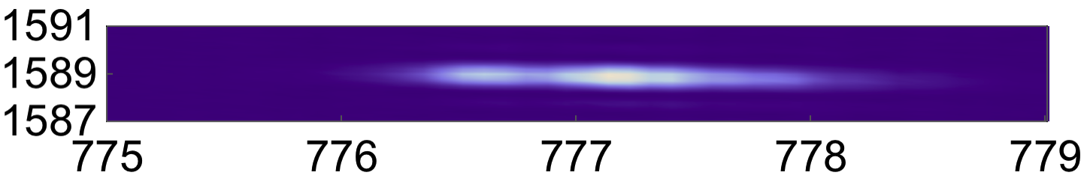
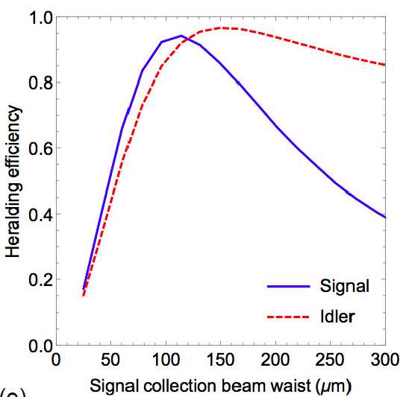

Optimized Unentangled Source
Joint spectral intensity
Idler wavelength (nm)
Signal wavelength (nm)
87% heralding efficiency
96% (91%) indistinguishability with (without) spectral filtering
F. Kaneda, et al. Opt. Expr. 24, 10733 (2016)
Notes:
p = 0.1, T_cav = 99%, T_idler = 95%, eta_det = 90%

Slide 19

Experimental setup (periodic time-multiplexed HSPS)
PPKTP
DM
Laser + SHG
1.2% loss/cycle
Photodiode
Fiber delay
521 nm
SMF
777 nm
Coaxial Cable
1590 nm
FPGA
Time-Tagging Module
FC
PBS
SPD
Lens
PC
NPBS
Important trick #1: hold entire train of 40 pulses in pre-memory, and only store the last one that has a heralded single photon → reduces the storage time in (lossy) switchable buffer → reduces loss → higher P(1)
HSPS
Trick #2: detector ‘cascade’ → approximate photon-number resolution

Slide 20
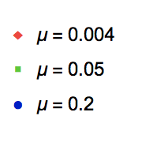
Results
Heralding probability vs N
Single-photon probability vs N
g⁽²⁾ vs N
→ 28x enhancement
→ 19x enhancement
→ 10x enhancement
F. Kaneda et al., “High-eﬃciency single-photon generation via large-scale active time multiplexing,” arXiv:1803.04803v1 (2018)

Slide 21
Results
HOMI of time-multiplexed and non-multiplexed HSPSs
V = 77 ± 3%
(92±3%)
V = 85 ± 3%
(90±3%)
V = 91 ± 4%
(91 ± 4%)
Solid line: raw coincidences
Dashed line: coincidences after subtracting accidental coincidences
μ ~ 0.007 for the non-multiplexed source
F. Kaneda et al., “High-eﬃciency single-photon generation via large-scale active time multiplexing,” arXiv:1803.04803v1 (2018)

Slide 22
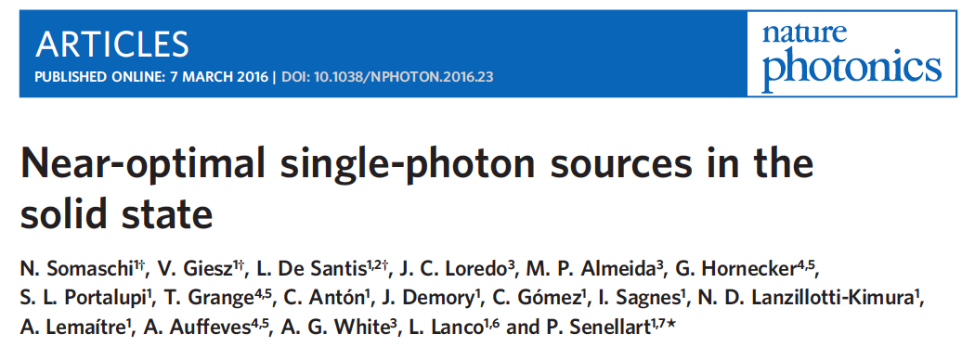
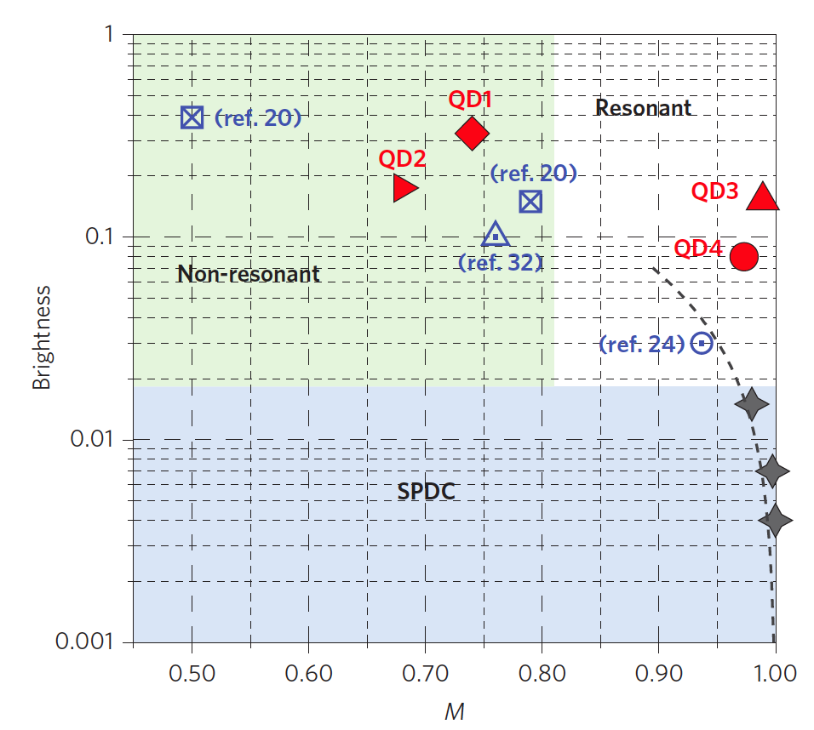
M: Indistinguishability
Brightness: Probability per pulse into collection lens
(<0.3 into SMF)
Time-multiplexed HSPS
Brightness: 0.67 (into SMF)
M ~ 0.91
What is the best we can do?
Kaneda & Kwiat, arXiv:1803.04803
Notes:
ROOM TEMPERATURE
p = 0.1, T_cav = 99%, T_idler = 95%, eta_det = 90%

Slide 23
Outline
Motivation
Temporal multiplexing
On the importance of PNR detectors
Looking forward

Slide 24
SPDC Theory
Heralding Photon
SPDC is described by thermal statistics
Pump
SPDC
Idler Photon
→ Single-photon probability P(k = 1) limited to ~25%
Concept:
Drive harder (μ =1), only keep k = 1 pulses

Slide 25
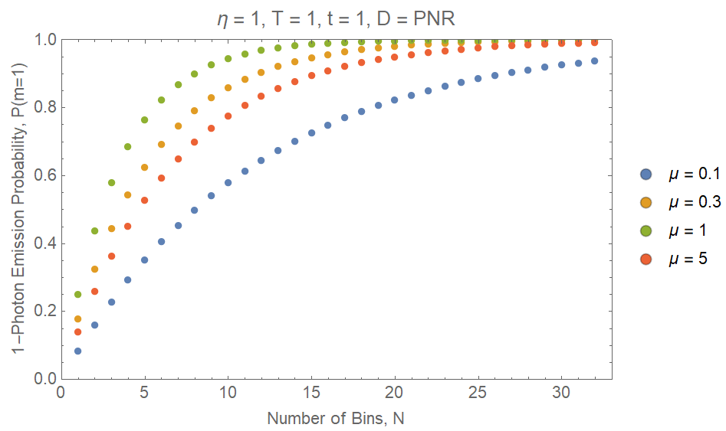
Time-Multiplexing vs Pumping
Idealized case: Perfect transmissions & detectors
Adding multiplexing time bins (N) increases single photon probability, P(m = 1) → 1
Pumping harder reduces the number of bins needed, but…
P(at least 1 bin out of M with a single photon)
= 1 – Prob(not even 1 good bin) = 1 – 0.75^{M}
For μ = 1, 16 bins produces at least one m=1 pulse >99%
η = Heralding Efficiency, T = Storage Loop Transmission, t = Idler Mode Transmission, D = Detector Type, PNR = Photon Number Resolving

Slide 26
Experimental setup
(periodic time-multiplexed HSPS)
PPKTP
DM
Laser + SHG
Photodiode
Fiber delay
521 nm
SMF
777 nm
Coaxial Cable
1590 nm
FPGA
Time-Tagging Module
FC
PBS
SPD
Lens
PC
NPBS
HSPS
Helps to have high-efficiency photon-number resolving trigger detectors (can drive harder, post-select only single-photon events)

Slide 27
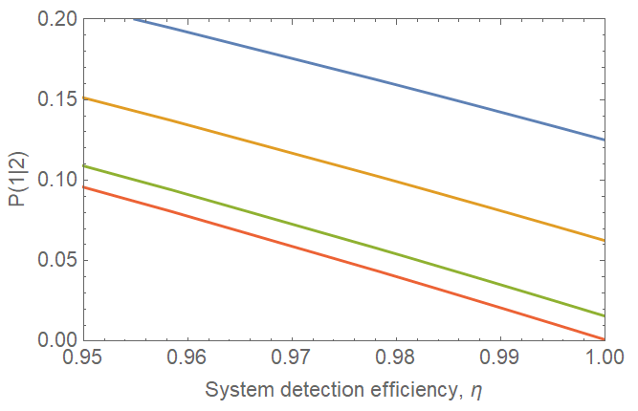
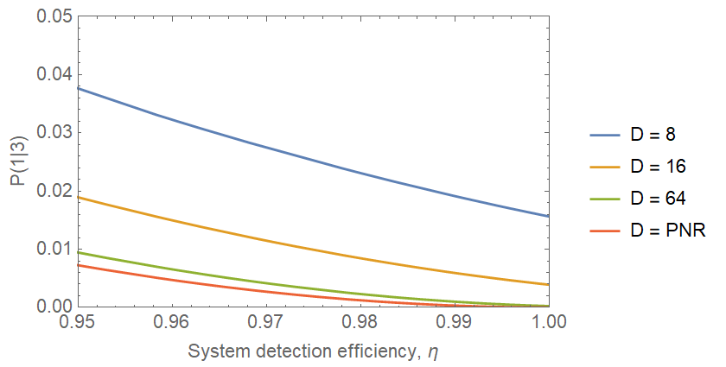
Heralding Detector Requirement
Photon Number Resolving Detectors: Required to discard multi-photon events
E.g., D-Detector Cascades: As , achieve true PNR detector
2-photon, 1-click error probability
Efficiency requirements more stringent for higher pumping powers
High-efficiency PNR detectors suppress probability of 2-photon emission from time-multiplexed single-photon source

Slide 28
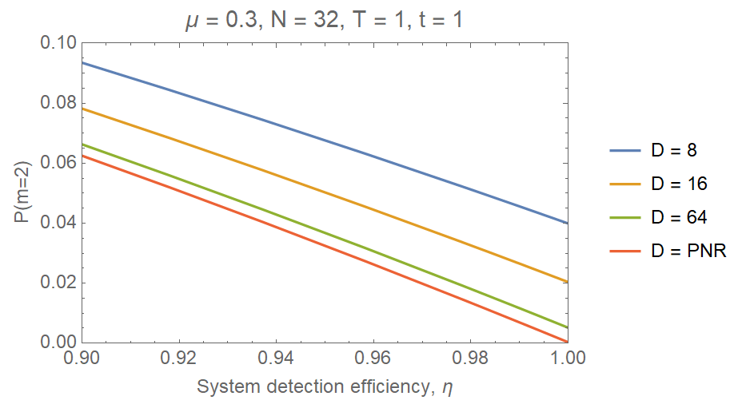
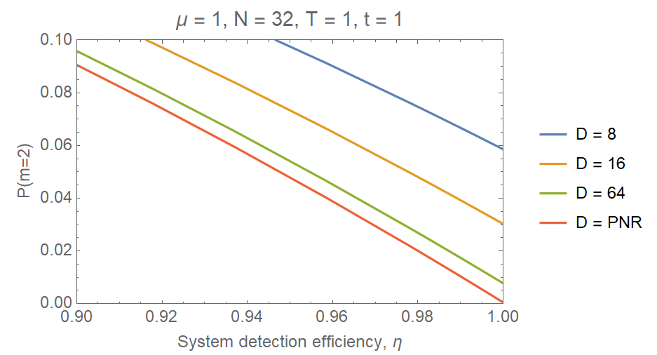
Suppressing Multi-Photon Component
High-efficiency PNR detectors suppress probability of 2-photon emission
Efficiency requirements more stringent for higher pumping powers

Slide 29
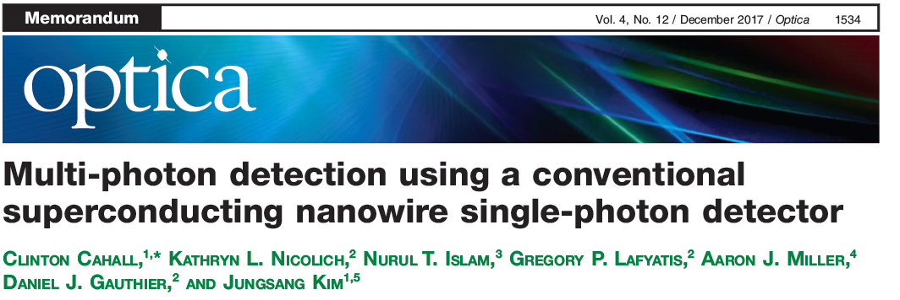
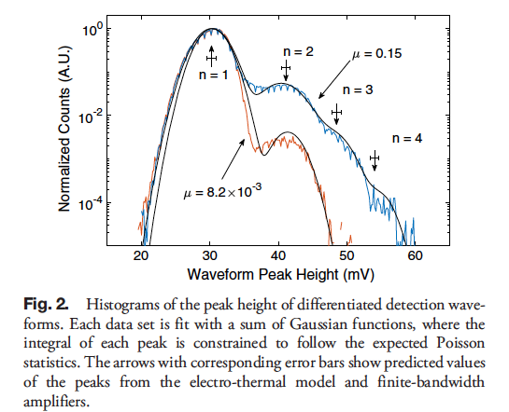
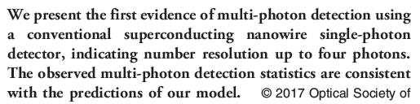

Slide 30
Multi-Photon Detection with SNSPDs
Photon absorption creates a resistive ‘hot-spot’
Bias current is diverted to a parallel load resistor
Rise time of the pulse depends on hot-spot resistance
Multi-photon events leads to faster rise times
1μm
Detector Bias,
I_{b}
~L_{k}/R_{hs}
L_{k}
I_{L}
I_{det}
R_{hs}
R_{L}
SNSPD
Notes:
When a photon is absorbed it creates a resistive hot-spot, represented by the resistor Rhs. Upon absorption, the switch opens and Idet is decreased and bias current is diverted out of the detector and in to the load resistor – usually the input of an amplifier.

Slide 31


Readout Circuit and Output Waveforms
Coax
Amp
Differentiating Circuit
SNSPD
Normal Waveform
Differentiated Waveform
3-Photon
3-Photon
2-Photon
2-Photon
1-Photon
1-Photon
Notes:
The steepness of the rising edge further increases, as well as the differentiated peak height, for 3-photon absorption .
Also, notice the decrease in the peak height difference between 2 and 3 photons compared to 1 and 2. This is due to the sqrt(n) dependence in the hotspot resistance, as well as bandwidth limiting effects from the electrical readout.
To further confirm that we are measuring multi-photon events we collect millions of these differentiated waveforms and construct a histogram of the peak voltage values for different mean photon numbers per optical pulse.

Slide 32
Outline
Motivation
Temporal multiplexing
On the importance of PNR detectors
Looking forward

Slide 33
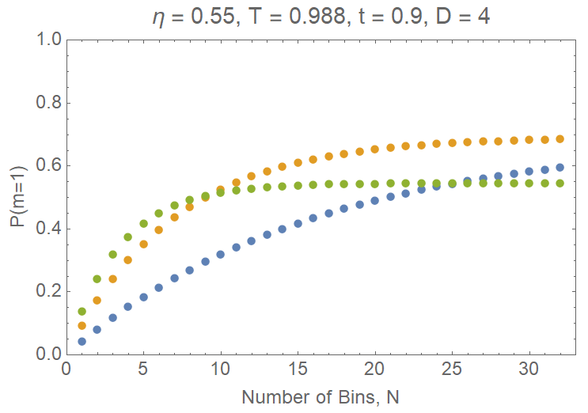
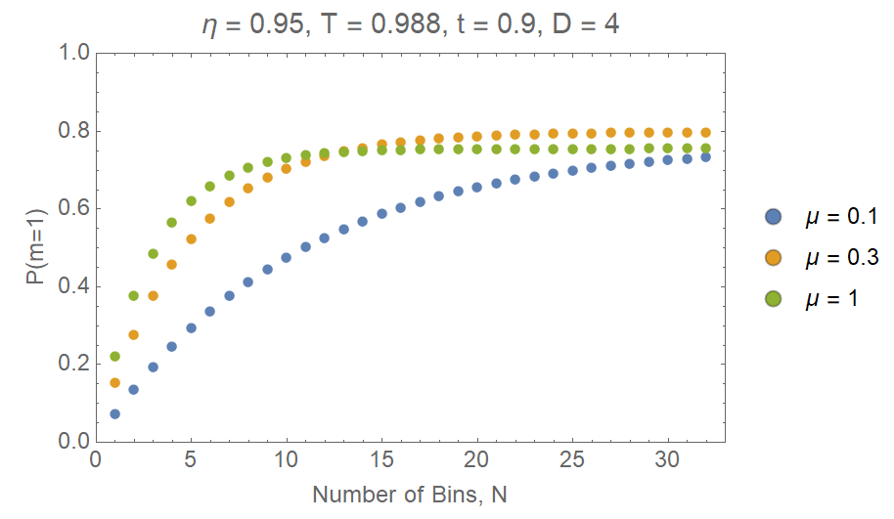
Expected performance
Trade-offs between maximum attainable P(m=1), number of bins N required, and minimizing g⁽²⁾(t=0)
Current Configuration (APDs)
Soon (SNSPDs)
μ | 0.1 | 0.3 | 1 | 0.1, N = 64
P(m=1)_{N=32} | 0.59 | 0.68 | 0.54 | 0.68
g⁽²⁾(t=0) | 0.15 | 0.29 | 0.46 | 0.16
μ | 0.1 | 0.3 | 1 | 0.1, N = 64
P(m=1)_{N=32} | 0.73 | 0.80 | 0.75 | 0.77
g⁽²⁾(t=0) | 0.06 | 0.13 | 0.23 | 0.06

Slide 34
M: Indistinguishability
Brightness: Probability per pulse into collection lens
(<0.3 into SMF)
Time-multiplexed HSPS
Brightness: 0.67 (into SMF)
M ~ 0.91
Improvements under way
Trig. detector η: 60 → 90% (SNSPDs)
P₁ → 0.74
g⁽²⁾ → < 0.1
M ~0.95 with aperiodic poling)
Kaneda & Kwiat, arXiv:1803.04803
Notes:
ROOM TEMPERATURE
p = 0.1, T_cav = 99%, T_idler = 95%, eta_det = 90%

Slide 35
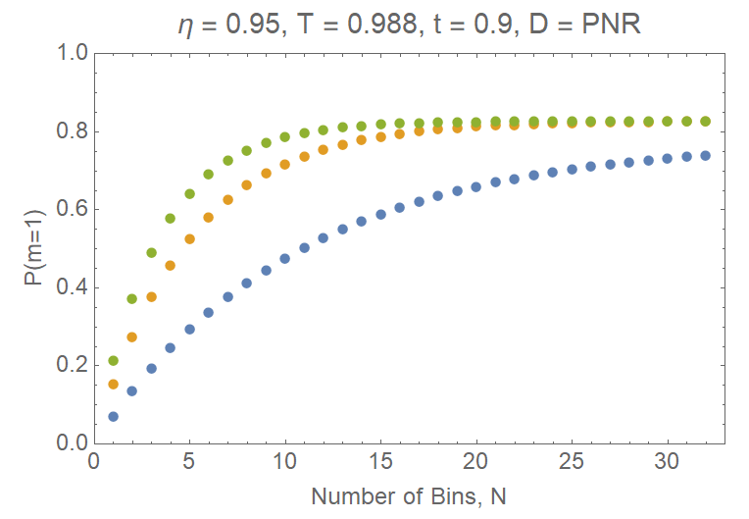
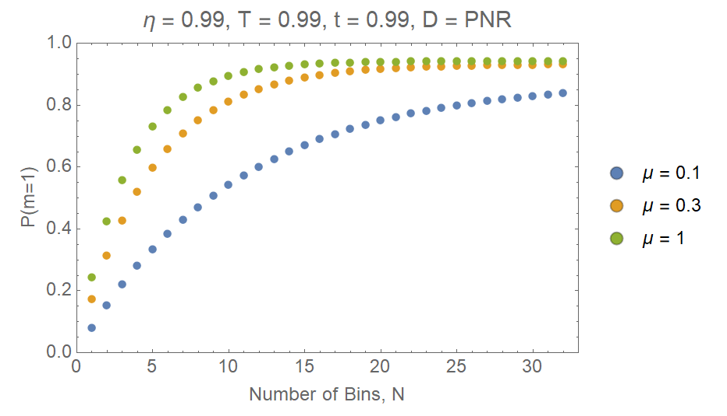
Expected performance
Trade-offs between maximum attainable P(m=1), number of bins N required, and minimizing g⁽²⁾(t=0)
Conservative Optimism (SNSPDs with PNR)
Hopeful Optimism
μ | 0.1 | 0.3 | 1 | 0.1, N = 64
P(m=1)_{N=32} | 0.74 | 0.83 | 0.83 | 0.77
g⁽²⁾(t=0) | 0.02 | 0.04 | 0.09 | 0.02
μ | 0.1 | 0.3 | 1 | 0.1, N = 64
P(m=1)_{N=32} | 0.84 | 0.93 | 0.94 | 0.88
g⁽²⁾(t=0) | 0.004 | 0.01 | 0.02 | 0.004

Slide 36
“Can I get it in RED”?
Our current source is non-degenerate, with a herald at 775 nm, and produced photon at 1590 nm.
To change the output wavelength:
  change the pump wavelength (if you can find one that exists and still meets your pump repetition rate and pulse duration and transform limit requirements)
  AND/OR
  change the heralding photon wavelength (if you have a high-efficiency, low-noise, ultra-fast detector at that wavelength. That can resolve photon number.)

Slide 37
“Assuming that’s all true, then can I get any color?”
No. ☹
Photon needs to be at a wavelength that has minimal dispersion in the quantum buffer optics
Otherwise, the precise spectral-temporal wavefunction will depend on which time bin the photon was created in → not a pure quantum state
Solutions:
Dispersion engineering – combine positive and negative dispersive elements (but need to keep total loss <1%)
Nonlinear frequency conversion at the end…

Slide 38
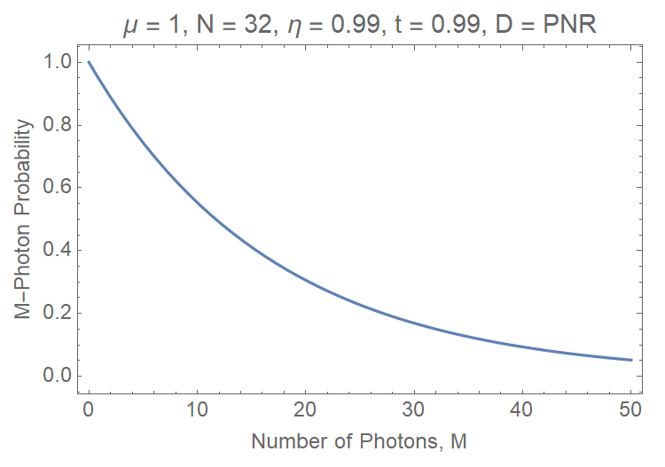
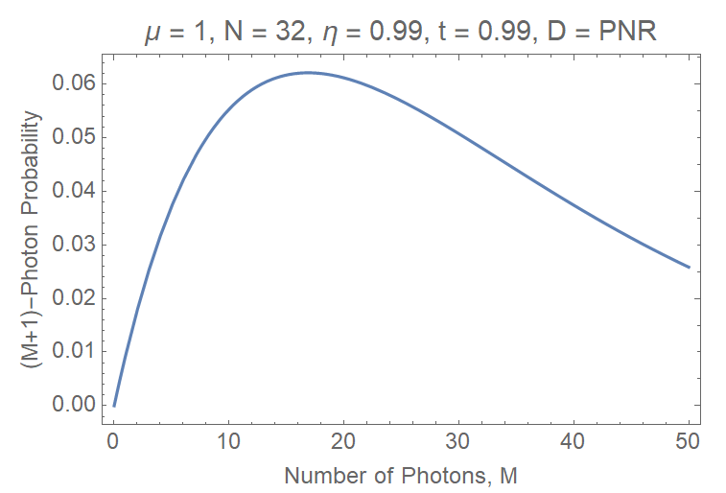
Time-Multiplexing Scalability
Time-Multiplexing technique scales well for creating M-photon states
Ex: (1 MHz repetition rate)*(5% probability for 50-photon state)
→ 50 50-photon states per second (!)
M Sources Emit 1 Photon Each (Total: M Photons)
M – 1 Sources Emit 1 Photon Each, 1 Source Emits 2 (Total: M+1 Photons)

Slide 39
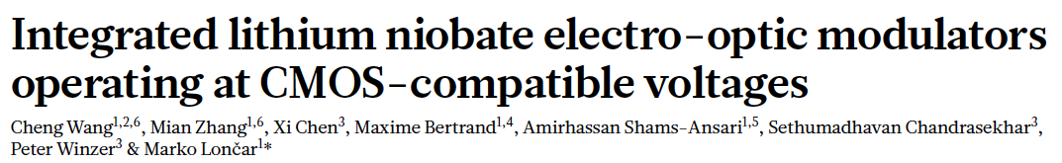
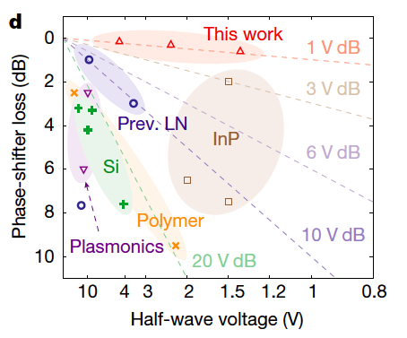
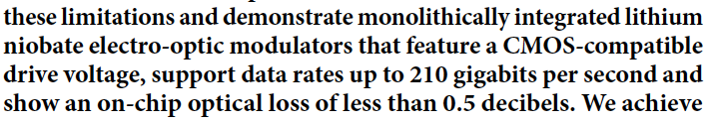
What limits our rate…
Bulk Pockel cell requires ~3000V to switch polarization in a few nanoseconds. Driver can only handle ~1 MHz…
- 0.5 dB = 11.5% loss
May be possible to drive harder
Device insertion loss:

Slide 40
What limits our rate…
We then become limited by detector saturation rate and jitter
For SNSPDs, jitter below 100 ps is achievable
  → can run at pulse spacing of 200 ps
  → 5 GHz pump rep rate
  (need at least 16 time bins to have P(1,μ) = 0.99)
  → 50-photon experiment at (0.98)⁵⁰ (5 x 10⁹)/16 = 110,000,000/s
  100-photon experiment at (0.98)¹⁰⁰ (5 x 10⁹)/16 = 40,000,000/s
  1000-photon experiment at (0.98)⁵⁰ (5 x 10⁹)/16 = 0.5/s

Slide 41
What does loss do?
Time-multiplexed heralded single-photon source
Need to keep losses <5%
Could be ‘hard’…
Ex. Si loss -1.5dB/cm But to allow detection-based multiplexing, need to delay by ~16 bin = 16 * 10 ps → 2.5 cm → -3.7 dB ( T = 0.43)
→ 50-photon experiment: 0.43⁵⁰ = 4 x 10⁻¹⁹
Notes:
p = 0.1, T_cav = 99%, T_idler = 95%, eta_det = 90%

Slide 42


Quantum Photonics: How Far Can We Go
P(1) up to 98% may be possible with g(2) ~0.01
Need
high detector efficiency
PNR very helpful
low-loss buffer
high-rate switches
low-dispersion elements

Slide 43
Another Possible Solu tion
Implement 1 → 32 switch (via integrated optic switchyard?)
32-Bin Delay
Heralding Signal
…
2-Bin Delay
…
Pump
SPDC
1-Bin Delay
1→ 32
Switch
Total buffer transmission is fixed at t*T

Slide 44
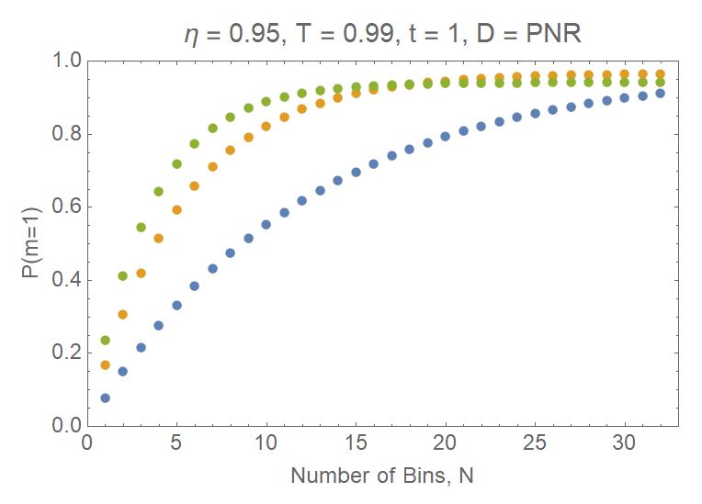
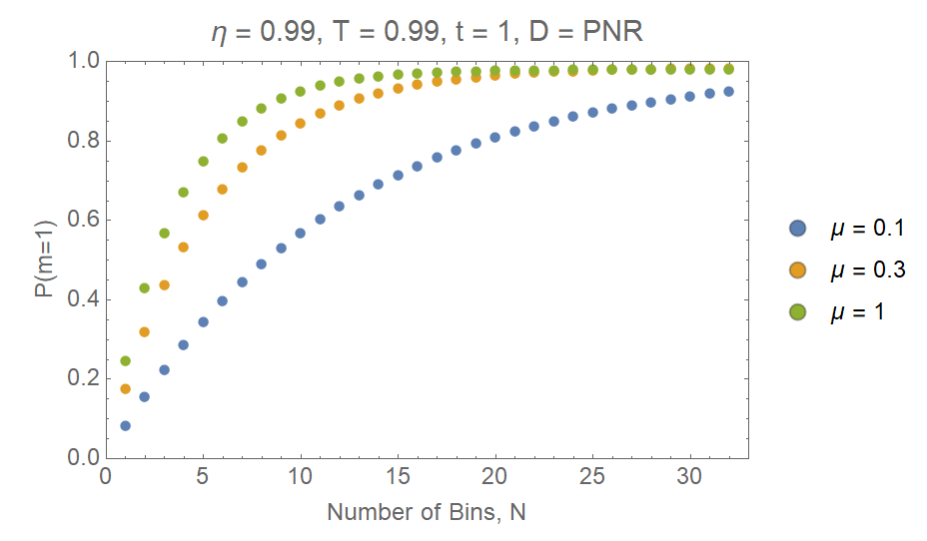
Will Integrated Optics Save the Day?
1 → 32 Switch: SNSPDs with PNR
1 → 32 Switch: Conservative Optimism
μ | 0.1 | 0.3 | 1 | 0.1, N = 64
P(m=1)_{N=32} | 0.91 | 0.97 | 0.94 | 0.98
g⁽²⁾(t=0) | 0.02 | 0.04 | 0.09 | 0.02
μ | 0.1 | 0.3 | 1 | 0.1, N = 64
P(m=1)_{N=32} | 0.92 | 0.98 | 0.98 | 0.98
g⁽²⁾(t=0) | 0.004 | 0.01 | 0.02 | 0.004

Slide 45
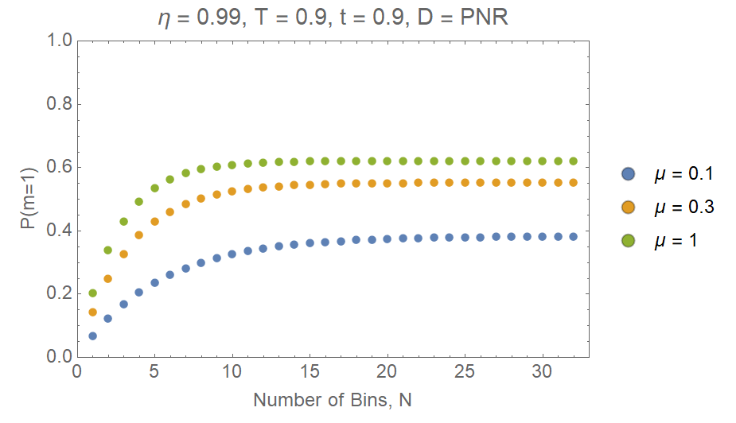
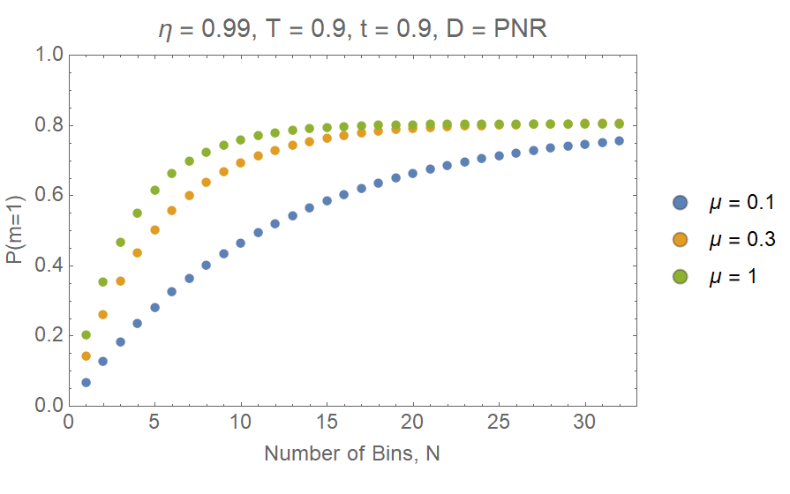
Integrated Optics Problems
Ordinary Multiplexing: (1-Loop)^{N}
1→32 Switch With Imperfect Coupling & Transmission
μ | 0.1 | 0.3 | 1
P(m=1)_{N=32} | 0.38 | 0.55 | 0.62
g⁽²⁾(t=0) | 0.005 | 0.01 | 0.02
μ | 0.1 | 0.3 | 1 | 0.1, N = 64
P(m=1)_{N=32} | 0.76 | 0.81 | 0.81 | 0.81
g⁽²⁾(t=0) | 0.004 | 0.01 | 0.02 | 0.004

Slide 46
Another Possible Solution
Implement 1 → 32 switch (via integrated optic switchyard?)
32-Bin Delay
Heralding Signal
…
2-Bin Delay
…
Pump
SPDC
1-Bin Delay
1→ 32
Switch
Total buffer transmission is fixed at t*T

Slide 47
Will Integrated Optics Save the Day?
1 → 32 Switch: SNSPDs with PNR
1 → 32 Switch: Conservative Optimism
μ | 0.1 | 0.3 | 1 | 0.1, N = 64
P(m=1)_{N=32} | 0.91 | 0.97 | 0.94 | 0.98
g⁽²⁾(t=0) | 0.02 | 0.04 | 0.09 | 0.02
μ | 0.1 | 0.3 | 1 | 0.1, N = 64
P(m=1)_{N=32} | 0.92 | 0.98 | 0.98 | 0.98
g⁽²⁾(t=0) | 0.004 | 0.01 | 0.02 | 0.004

Slide 48
Integrated Optics Problems
Ordinary Multiplexing: (1-Loop)^{N}
1→32 Switch With Imperfect Coupling & Transmission
μ | 0.1 | 0.3 | 1
P(m=1)_{N=32} | 0.38 | 0.55 | 0.62
g⁽²⁾(t=0) | 0.005 | 0.01 | 0.02
μ | 0.1 | 0.3 | 1 | 0.1, N = 64
P(m=1)_{N=32} | 0.76 | 0.81 | 0.81 | 0.81
g⁽²⁾(t=0) | 0.004 | 0.01 | 0.02 | 0.004

Slide 49
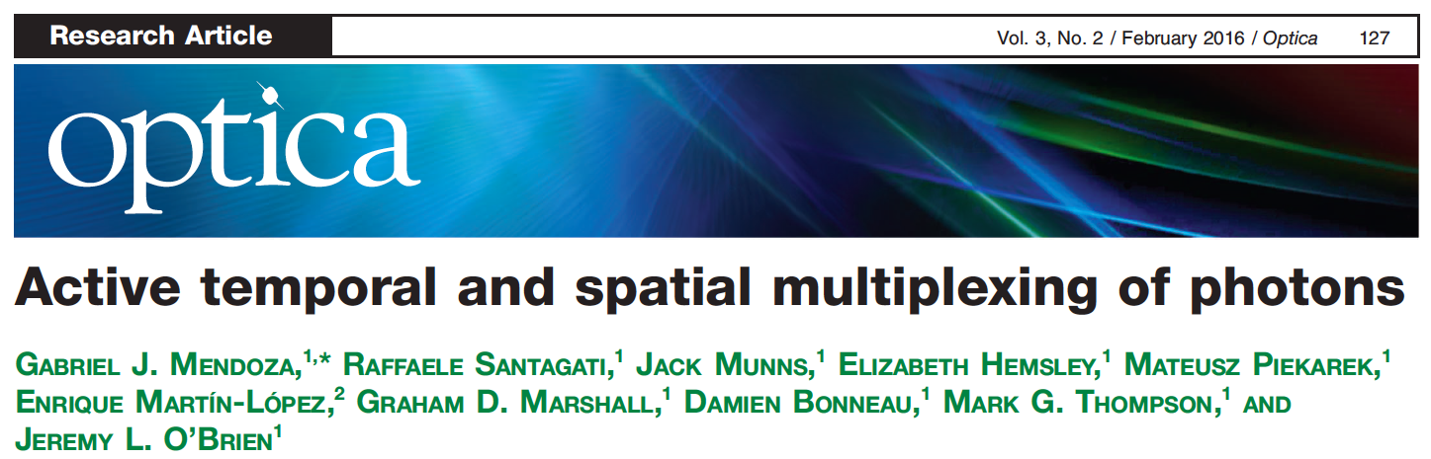



Slide 50





Slide 51
8-photon events:
~0.8⁸ (1 MHz) = 150k/s
Looking ahead…
Our new PCs ☺
30-photon events:
~0.8³⁰ (1 MHz) = 1000/s
Note: 1 MHz not an upper limit, just what our current Pockel cell can handle…
Notes:
p = 0.1, T_cav = 99%, T_idler = 95%, eta_det = 90%

Slide 52
|11>-state generation rate using two TM-HSPSs
(Time-multiplexed heralded single-photon source)
Log scale
Linear scale
But – we can do even better… We don’t care which particular time bin they both come in (“relative temporal MUX”) → use switchable delay to synchronize them…
|11>-state generation rate using two HSPSs and synchronizers
Pump repetition rate: 1 GHz (100 MHz for an asynchronized source)
Pump power: tunable
16 trigger detectors; η = 95%
Heralding efficiency: 90%
Maximum number of time slots used for synchronization: 40
Linear scale
Notes:
Calculation parameters
Pump repetition rate: 1GHz (100 MHz for an asynchronized source)
Pump power: tunable
Number of trigger detectors: 16
Trigger detector efficiency: 95%
Heralding efficiency: 90%
Loss in a synchronizer: 0, 1, 5,10% per cycle in a delay line.
Maximum number of time slots used for synchronization: 40

Slide 53
Generation of using 10 HSPSs and synchronizers
Linear scale
Log scale
Generation of using 20 HSPSs and synchronizers
Many multi-photon protocols may now be feasible (or less infeasible!).
But note the need for low loss – integrated optics needs work…
Linear scale
Log scale
Notes:
Our current system has 1.2% loss/cycle
Pump repetition rate: 1GHz (100 MHz for an asynchronized source)
Pump power: tunable
Number of trigger detectors: 16
Trigger detector efficiency: 95%
Heralding efficiency: 90%
Loss in a synchronizer: 0, 1, 5,10% per cycle in a delay line.
Maximum number of time slots used for synchronization: 40

Slide 54
Summary
Multi-photon experiments require high efficiency and photons in pure quantum states
Heralded sources typically get either one
Time-multiplexing → pseudo-periodic source
~40% achieved, 80% realistic
Engineered HSPS → >90% purity, η_{collection}
Experiments with 20-30 photons feasible!
“Digital” memory realized → 1 – 999 cycles
Time-multiplexing is a Good Thing!
Notes:
Chinese, Malay, Tamil

Slide 55
Photon synchronizer
Low-loss switchable delay line for each photon:
From Alice
From Bob
Pockels Cell
Pockels Cell
Bell State Analysis
From Alice
From Bob
Poor/clever man’s version:
only one Pockel cell
automatically relatively stabilized
Optical circulator
Pockels Cell
Bob’s photon
Alice’s photon

Slide 56
Synchronization enhancement
Sources produce 0.02 pairs/pulse → multi-pair contribution < 1%
Event rate of two HSPS sending heralding signals to a synchronizer during synchronization process
4-fold coincidence count rate
|11> preparation rate (estimated by 4-fold coincidence rate divided by detector efficiency)
4-fold coincidence rate enhancement factor over an asynchronous case
By going all the way to N = 100, we
get an enhancement factor of 50.
Notes:
I calculated 4-fold coincidence count rate for higher number of N:
saturated 4-fold coincidence is 5700/100s for N ~400. However, this
value is obtained by assuming that I can run synchronization process as
soon as the last synchronization process is finished.
Since I am currently running synchronization process periodically (with
pump reprate of 100MHz and synchronization process reprate of 1MHz), N
is limited by 100, and maximum 4-fold coincidence rate is 1900/100s (for
N=100).

Slide 57
Next steps
Characterize BSA.
Add time-bins, and encoding.
Realize synchronization-enhanced MDI-QKD.
Create pairs in time-bin entangled state (by creating two pump pulses separated by ~1 ns) → Demonstrate synchronization-enhanced entanglement swapping; critical component for quantum repeater network.
Look at synchronized generation of larger photon states…

