Slide 1
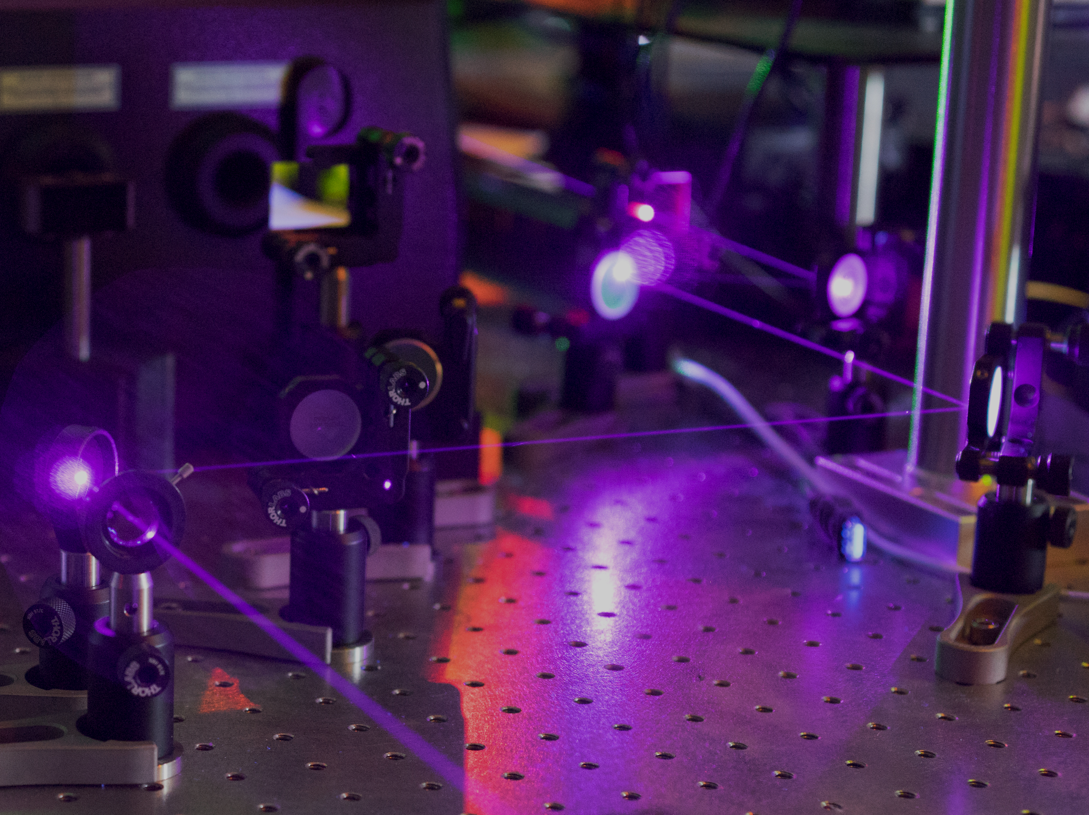




Photon Generation in Ultraviolet Integrated Photonic Circuits
Air Force Research Laboratory
Michael Fanto
Dr. Paul Alsing
Dr. Matt Smith
Dr. Christopher Tison
Dr. Kent Averett
Rochester Institute of Technology
Michael Fanto
Prof. Stefan Preble
Jeffrey Steidle
Zihao Wang
Dr. Paul Thomas
Dr. John Serafini
Dr. Gregory Howland
Massachusetts Institute of Technology
Prof. Dirk Englund
Tsung-Ju Lu
Hyeongrak Choi
Dr. Mohammad Soltani (Raytheon BBN)
Naval Research Laboratory
Dr. Matthew Hardy
DISTRIBUTION A. Approved for public release: distribution unlimited. (88ABW-2018-1765)

Slide 2
Integrated Quantum Photonics
Motivation: Integrated photonic waveguides provide a scalable and stable platform for the implementation of quantum photon sources and circuits.
Exploit quantum properties for the benefit of security, processing, sensing etc.
Entanglement
Superposition

Slide 3
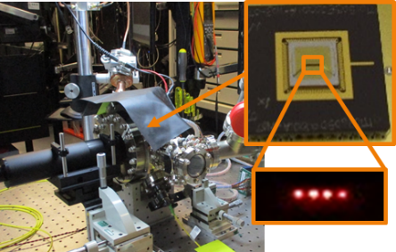
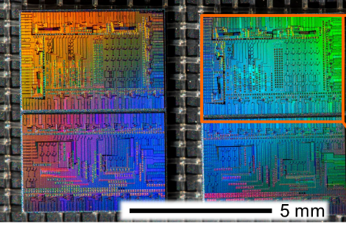
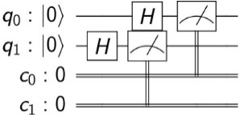
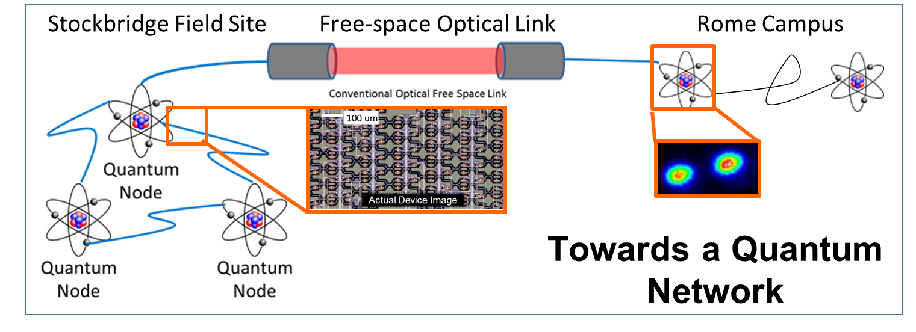


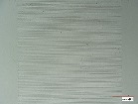
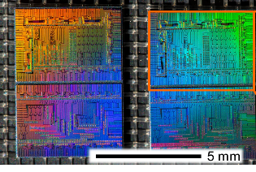
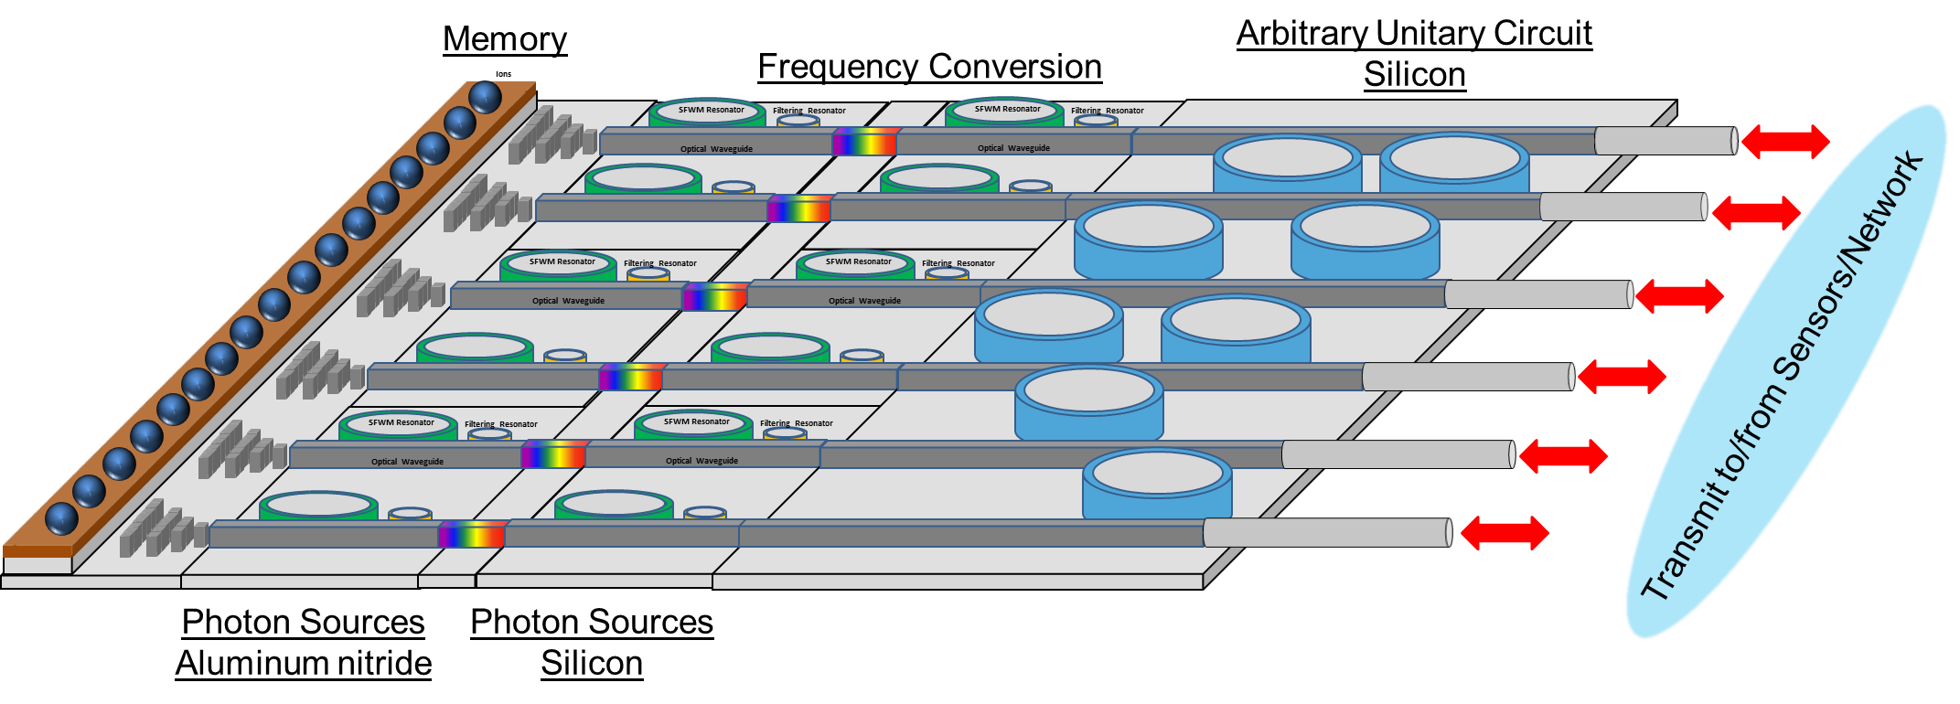
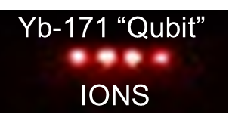
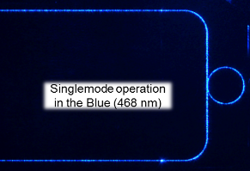
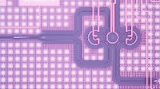
Long Term Vision: Integrated Circuit Based Repeater Nodes
Current Requirements:
Ultra-secure communication needed for distributed information processing and networking protocols.
Computationally challenging Air Force problems (e.g. C2, data processing and exploitation, signal processing,…) demand an escalating growth in computational power which cannot be met by conventional supercomputing resources.
Trapped-Ion Qubits
(Soderberg, Tabakov)
Photon Qubits
(Alsing, Fanto)
Quantum Algorithms
(Alsing, Wessing)
Key ideas:
Quantum mechanics allows for tamper-proof and tamper-evident protocols
Entanglement provides a platform to connect different functionalities
Entanglement allows for exponential scaling of the information space
Single photon transmission reduces probability of intercept
Quantum System Implementation Challenges:
Environmental decoherence effects
Access to/control of the individual qubits
Mid-term: Quantum Network
Program Research Areas:
Trapped-Ion Qubits: Develop and operate trapped-ion quantum memory nodes for long lived storage and processing quantum information. Photonic links connect memory nodes for quantum networking and distributed computing protocols.
Photon Qubits: Develop photon-based qubits and photonic circuitry for quantum information processing and transportation of quantum information between quantum network nodes.
Quantum Algorithms: Utilize current commercial quantum systems to solve relevant problems. Model new quantum hardware on the commercial quantum systems. Develop protocols and algorithms to execute on quantum systems.
Long-term: Compact Quantum Node
Trapped Ions
Sum/Difference Frequency Generation
Programmable Nanophotonics Processor
PPLN
waveguides
DISTRIBUTION A. Approved for public release: distribution unlimited. (88ABW-2019-0224)
Low Loss Optical Interconnects
Microring Resonators

Slide 4
Long Term Goal: Integrated Circuit Based Repeater Nodes
Sum/Difference Frequency Generation
Programmable Nanophotonics Processor
Trapped Ions
PPLN
waveguides
Low Loss Optical Interconnects
Microring Resonators

Slide 5
Integrated Quantum Photonics
  Quantum information science requires:
    Storage of the qubits
    Manipulation of the qubits
    Sources of quantum bits (qubits)

Slide 6
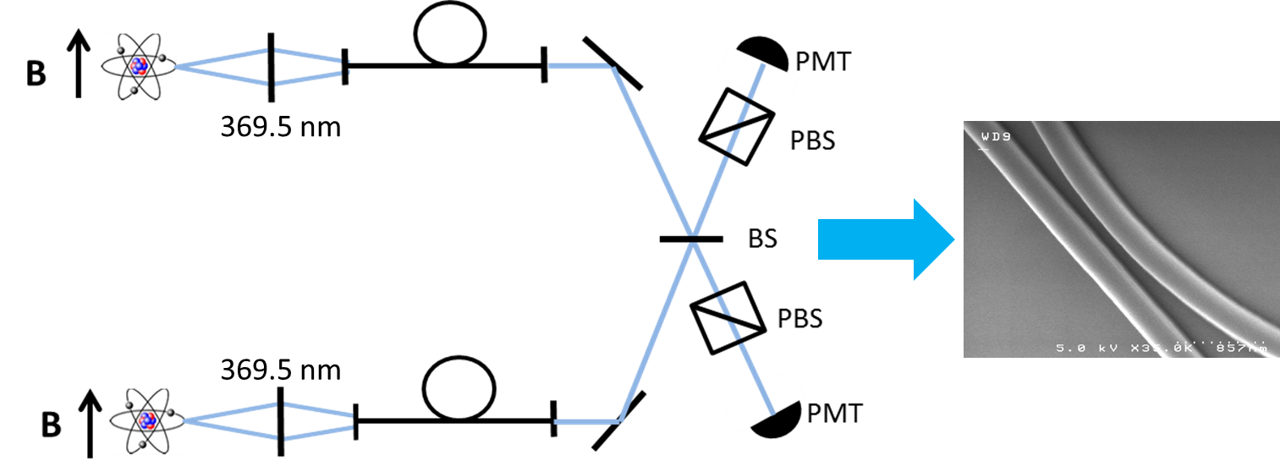
Integrated Quantum Photonics
  Quantum information science requires:
    Storage of the qubits
    Manipulation of the qubits
    Sources of quantum bits (qubits)
    Trapped Ions: longest lived quantum memories
    Storage time > 15 minutes (clock states)
    Ions typically produce photons in the UV
      Ytterbium Ions – Transition at 369.5nm
      Requirement: bandgap of >3.6eV
Transfer Information: Teleportation
(Trapped Ytterbium ions, AFRL)

Slide 7
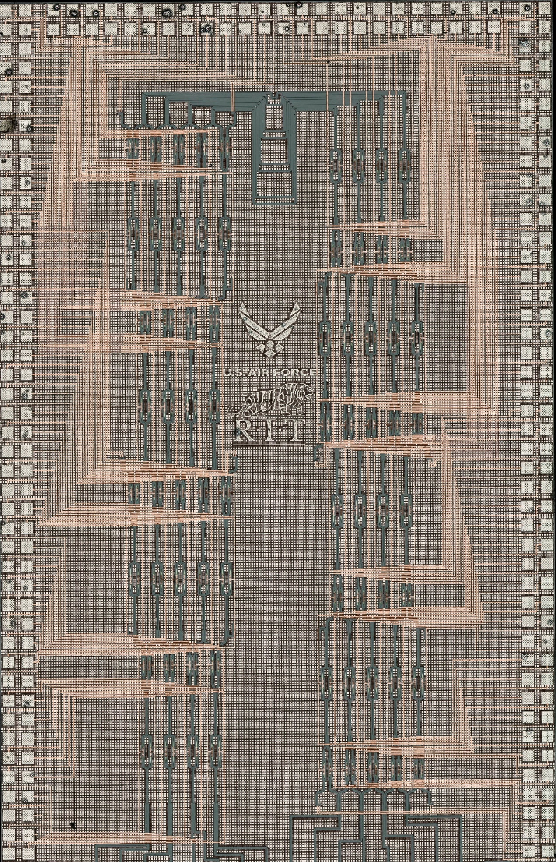
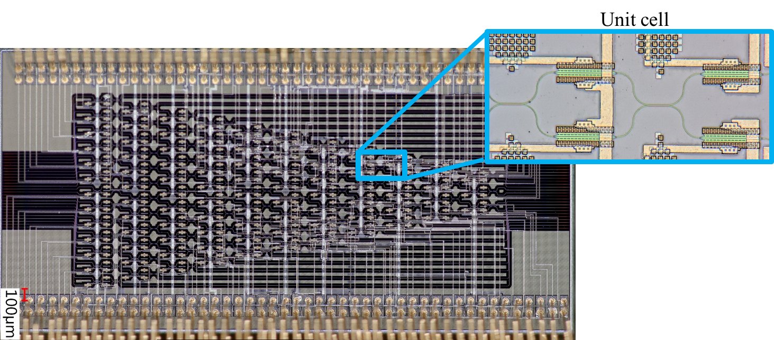
Integrated Quantum Photonics
  Quantum information science requires:
    Storage of the qubits
    Manipulation of the qubits
    Sources of quantum bits (qubits)
Allows for phase and amplitude manipulation of a quantum state
  Manipulation of qubit to/from memory
Fully reconfigurable at kilohertz speeds
Interface QPP with interposer chip
  Interposer chips can be active or passive
  On-chip photon sources are possible
No feed forward currently available

Slide 8
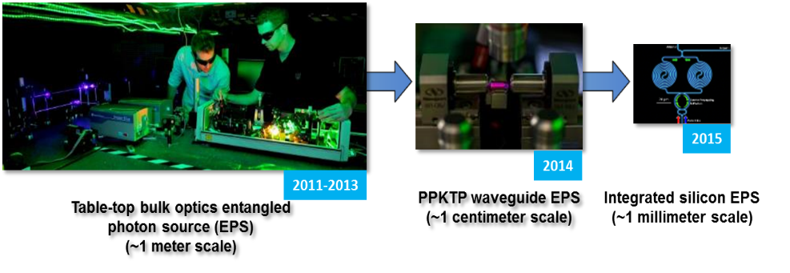
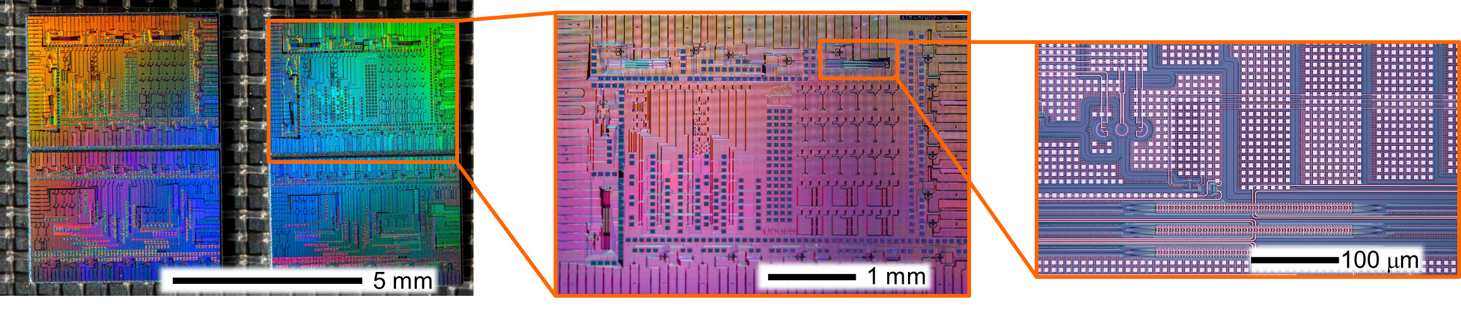
Integrated Quantum Photonics
  Quantum information science requires:
    Storage of the qubits
    Manipulation of the qubits
    Sources of quantum bits (qubits)
2017
Silicon Entangled Photon Source - CMOS Fabricated Photonic Circuit

Slide 9
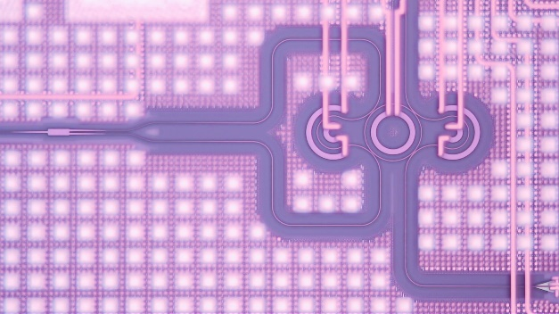
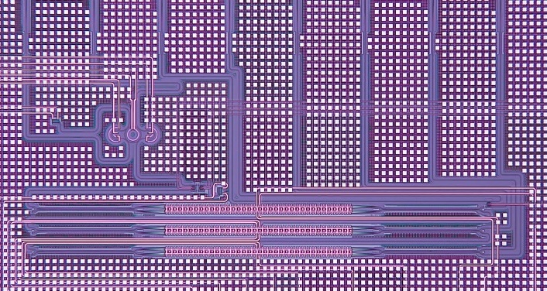
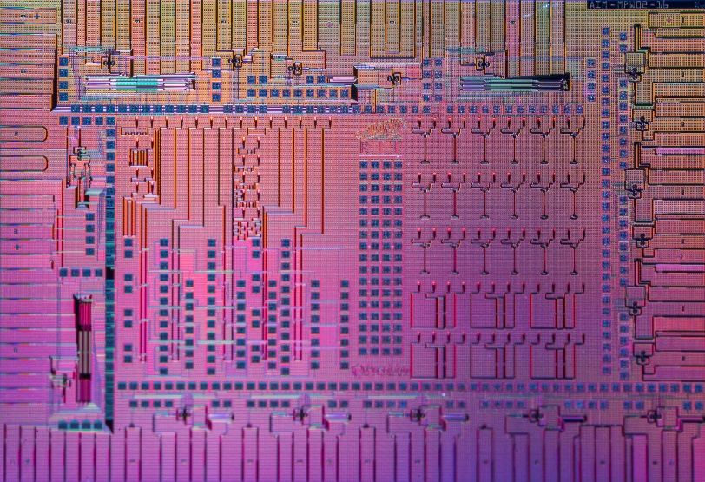
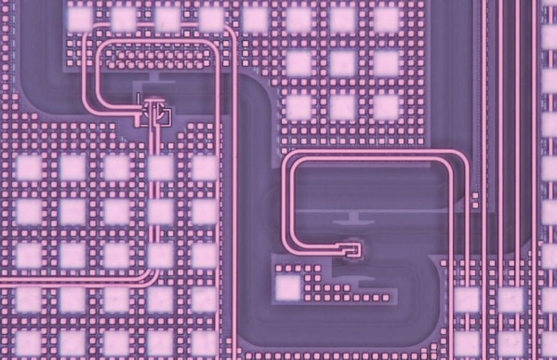
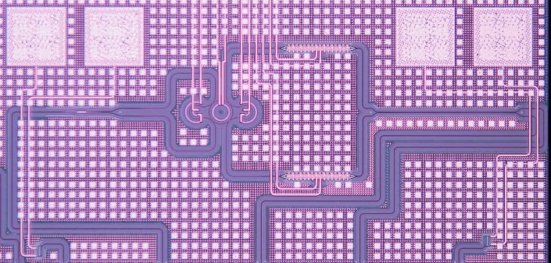


AIM Photonics Fab/Testing (Submitted Sep 2016, Received Jun 2017)
Photon Sources
W State Generators
Modulators
N00N State Generators

Slide 10
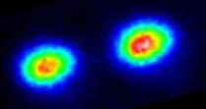
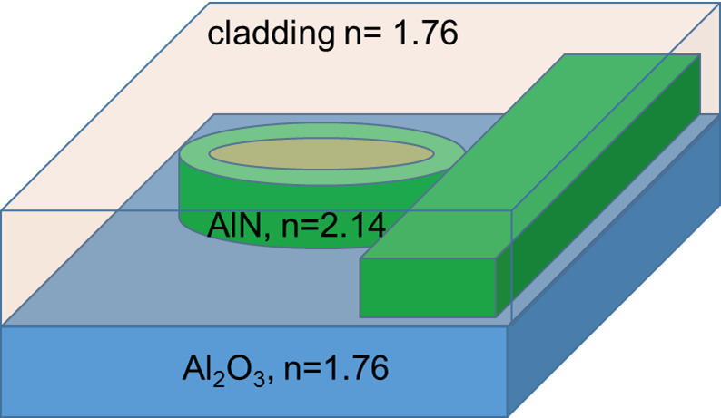
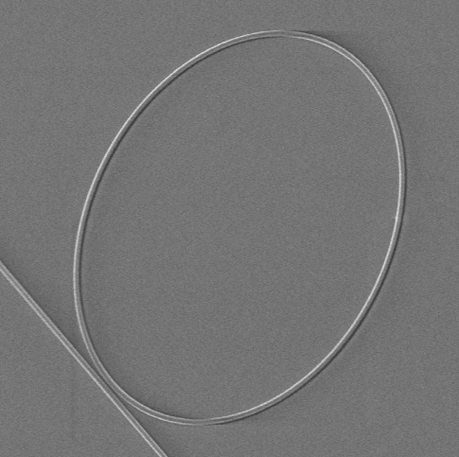
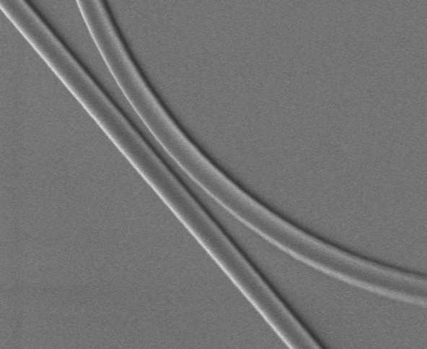
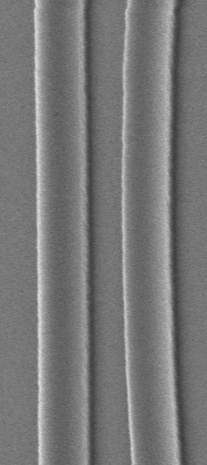
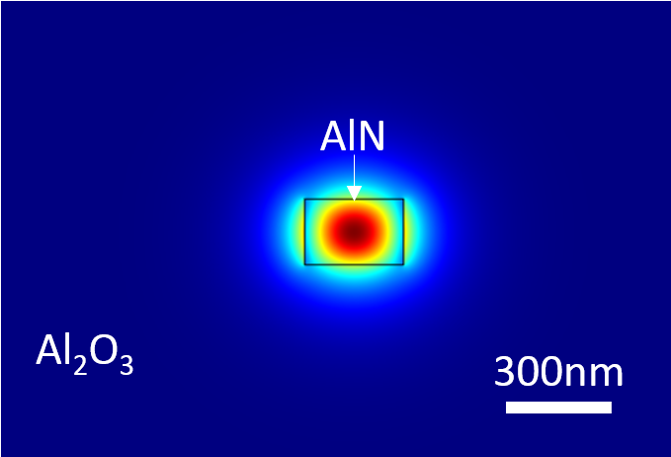
Aluminum Nitride Integrated Platform
Yb⁺ ions– long lifetime quantum memory, quantum repeaters
Challenge: Producing and manipulating entangled UV photons
Yb⁺ ions
Aluminum Nitride (AlN) Quantum Waveguide Circuits
AlN UV Photon Source (SPDC, SFWM):
Large refractive index (n=2.2)
Large bandgap (6.2 eV, ~200nm)
Large nonlinearity - n₂ ~ 2 × 10⁻¹⁵ cm²/W
AlN on Sapphire (commercially available from Kyma)
Plasma vapor deposited
200nm thick on Sapphire
Material schematic of AlN waveguides
SEM images of AlN waveguides
AlN Waveguide (300x200nm)
40 μm
5 μm
200 nm
Mode Simulation of AlN waveguide

Slide 11
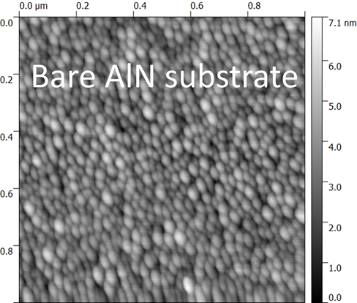
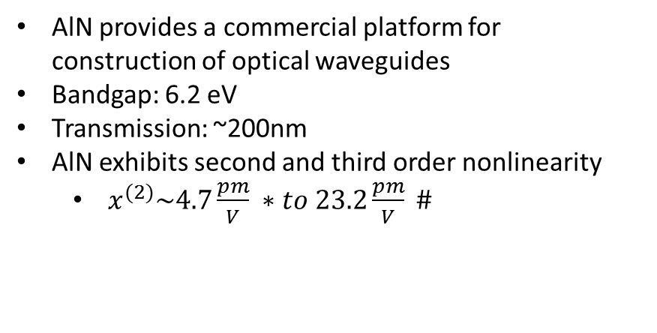
Aluminum Nitride Integrated Platform
AlN provides a commercial platform for construction of optical waveguides
Bandgap: 6.2 eV
Transmission: ~200nm
AlN exhibits second and third order nonlinearity
  $x^{(2)}\sim 4.7\frac{pm}{V} ∗$ $to 23.2\frac{pm}{V} \#$
AlN, 200nm
Al₂O₃
AlN wafer from Kyma structure
PVDNC – plasma vapor deposition of nanocolumns
Grain size: ~26.5nm, RMS roughness 0.9nm
Feature size: ~200-400nm for waveguides
Waveguides span defect and grain boundaries
  Source of Fluorescence
  Source of broadband Raman emission
  Scattering Sites
AFM image showing
crystal grains
*Pernice et al., APL 100, 223501 (2012); doi: 10.1063/1.4722941
#Fujii et al., APL 31, 815 (1977); doi 10.1063/1.89550

Slide 12
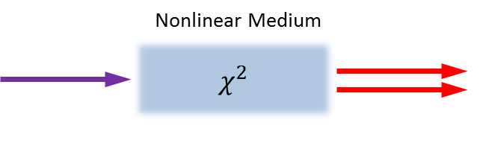
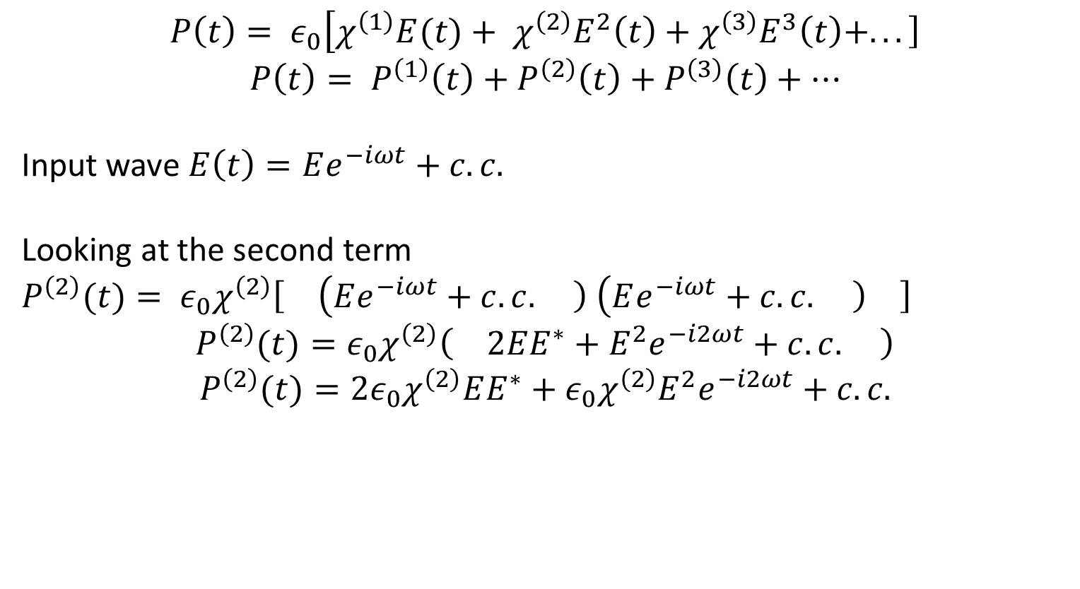
Nonlinear Interactions
Polarizability
$$P\left(t\right)= ε_{0}\left[χ^{\left(1\right)}E(t)\right.+ χ^{\left(2\right)}E^{2}\left(t\right)+χ^{\left(3\right)}E^{3}\left(t\right)\left.+...\right]$$
$$P\left(t\right)= P^{\left(1\right)}\left(t\right)+P^{\left(2\right)}\left(t\right)+P^{\left(3\right)}\left(t\right)+…$$
Input wave $E\left(t\right)=Ee^{−iωt}+c.c.$
Looking at the second term
$P^{\left(2\right)}(t)= ε_{0}χ^{\left(2\right)}\left[\right.\left(Ee^{−iωt}+c.c.\left.\right)\right.$ $\left(Ee^{−iωt}+c.c.\left.\right)\right.\left.\right]$
$$P^{\left(2\right)}(t)=ε_{0}χ^{\left(2\right)}\left(\right.2EE^{∗}+E^{2}e^{−i2ωt}+c.c.\left.\right)$$
$$P^{\left(2\right)}(t)=2ε_{0}χ^{\left(2\right)}EE^{∗}+{ε_{0}χ^{\left(2\right)}E}^{2}e^{−i2ωt}+c.c.$$
A wave of twice the frequency interacts with the fundamental waves
(second harmonic generation or spontaneous parametric down conversion)
Pump
Bi-photons

Slide 13
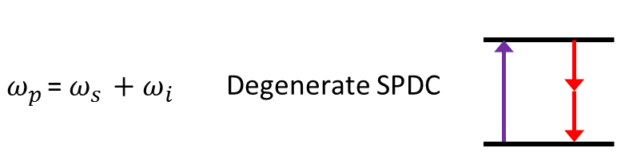
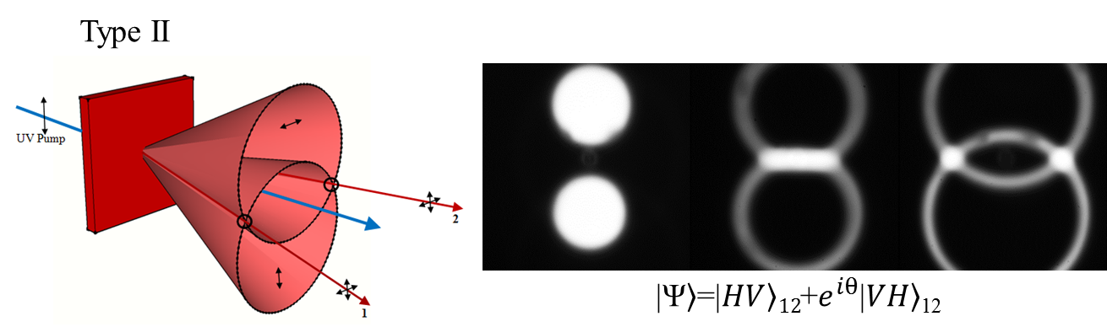
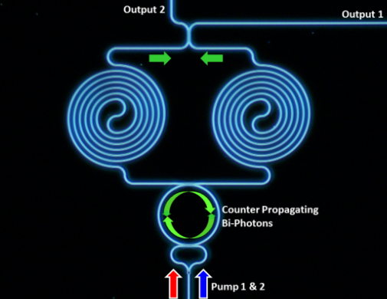


Photon Sources
$$P\left(t\right)=ε_{o}\left(χ^{(1)}E\left(t\right)+χ^{(2)}E^{2}\left(t\right)+χ^{(3)}E^{3}\left(t\right)+…\right)$$
$$P\left(t\right)=ε_{o}\left(χ^{(1)}E\left(t\right)+χ^{(2)}E^{2}\left(t\right)+χ^{(3)}E^{3}\left(t\right)+…\right)$$
Nonlinear Medium
Pump
Bi-photons
Pump 1
Bi-photons
$$χ^{3}$$
Pump 2
$ω_{p1 }+ω_{p2 }$= $ω_{s }+ω_{i }$
Degenerate Four
wave mixing
ω_{s}
Pump 1
Bi-photons
ω_{i}
Pump 2
ω_{i}
ω_{s}

Slide 14
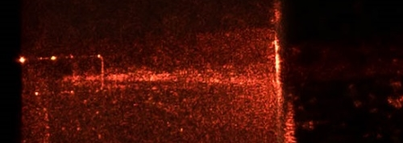
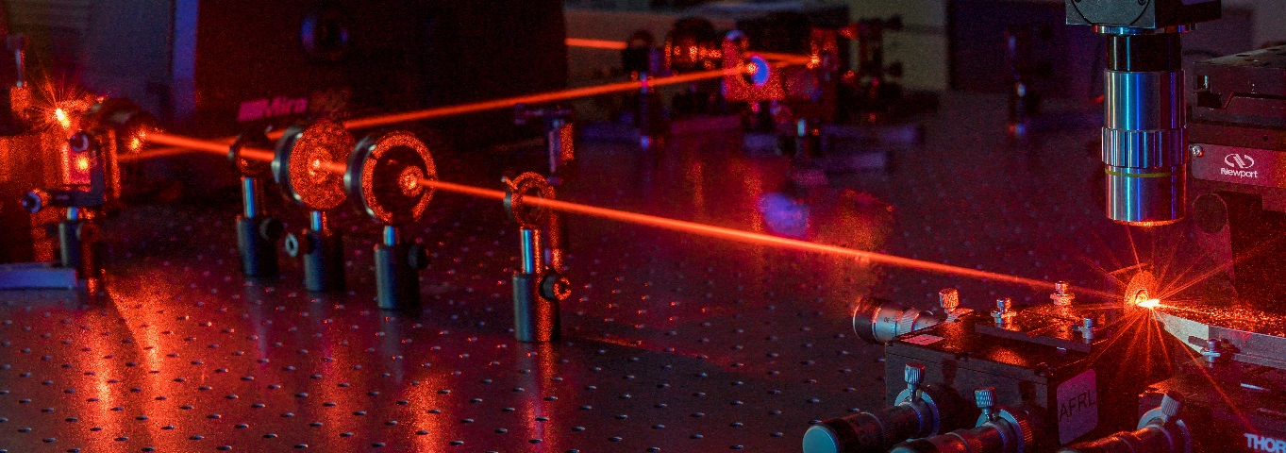
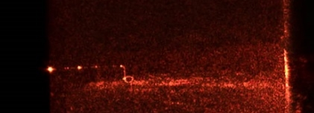
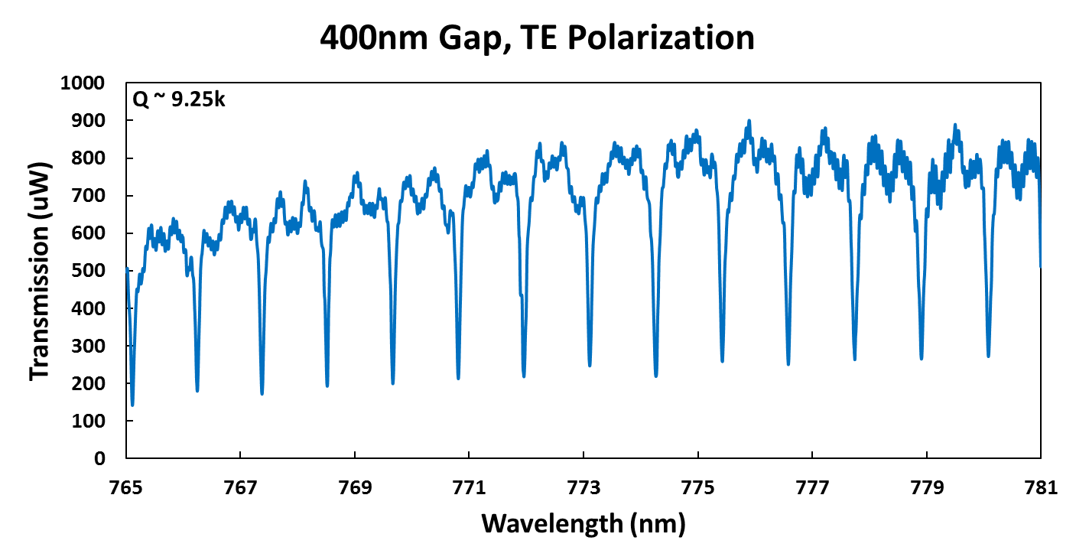
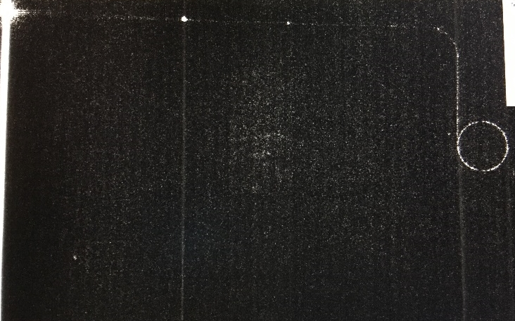
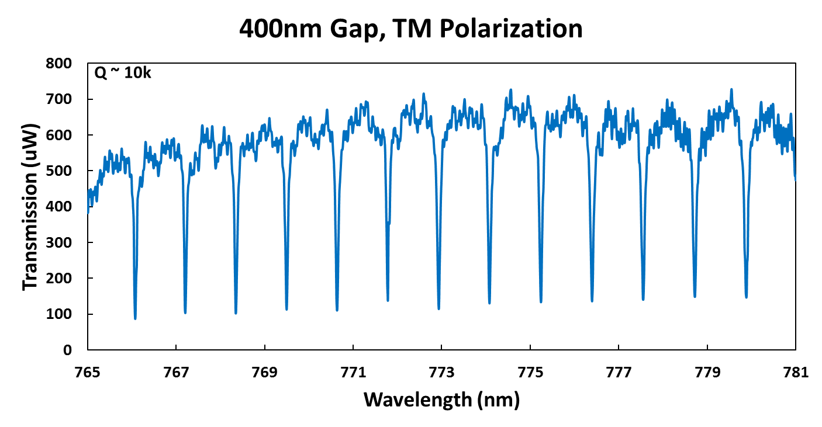
NIR Characterization
Off resonance
Input waveguide
On resonance
Aluminum nitride testbed at AFRL & RIT
TE
Critically coupled ring resonator
TM
AlN waveguide
  Quality factor (~20-80K)
  Coupling efficiency (>60%)

Slide 15
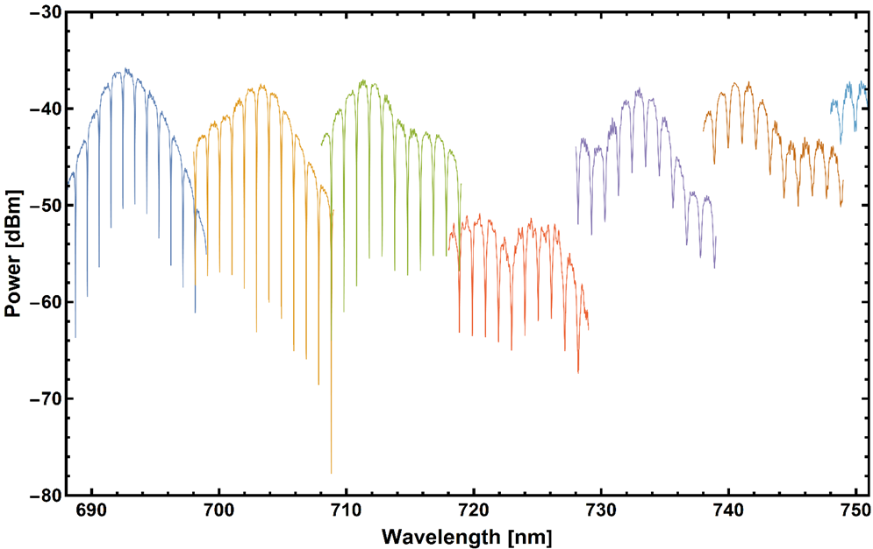

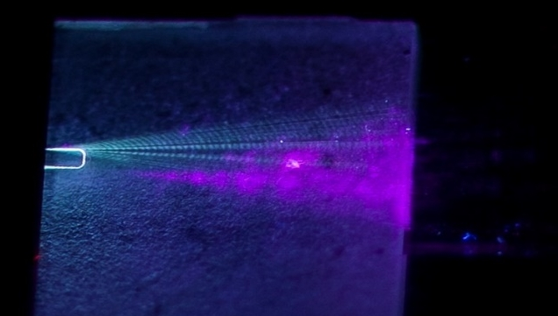
VIS – NIR Integrated Photonic Circuits
Ring resonators demonstrated from UV to NIR
  High Q > 2k from 690-750nm
High damage threshold
  CW power up to 1.6 W
High edge coupling efficiency: >40% (inverse tapers)
SHG of 350-450nm demonstrated
Dispersion analysis undergoing to optimize phase matching, mapping the Resonators Free Spectral Range (FSR)
AlN waveguide
396nm SHG generated in AlN waveguide

Slide 16
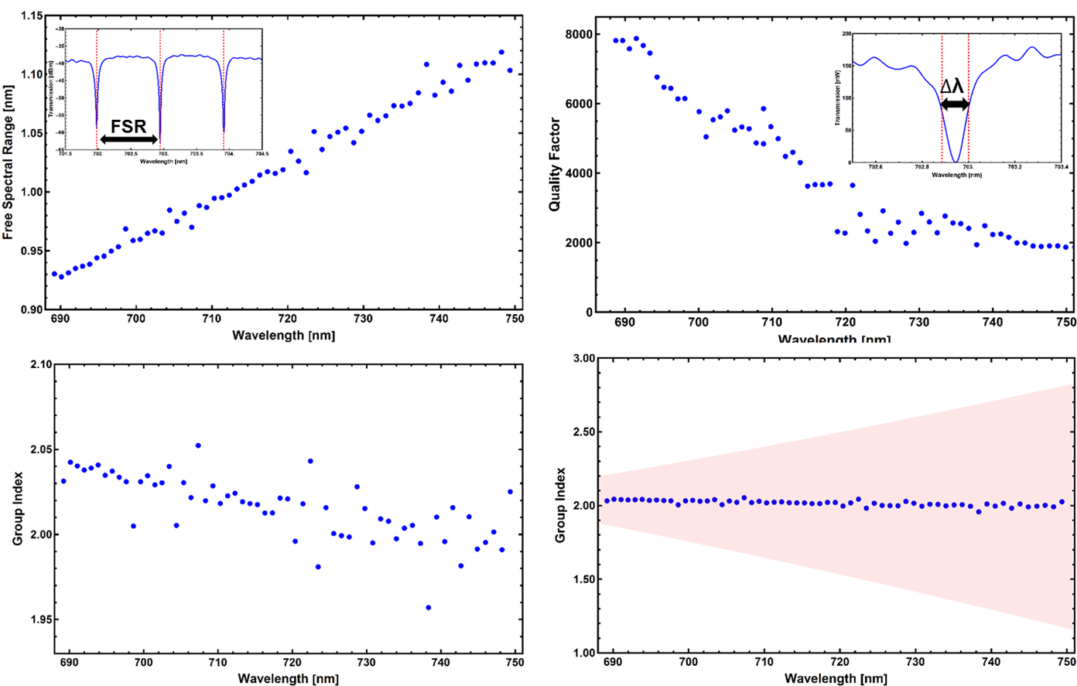
Vis-IR Integrated Photonic Circuits

Slide 17

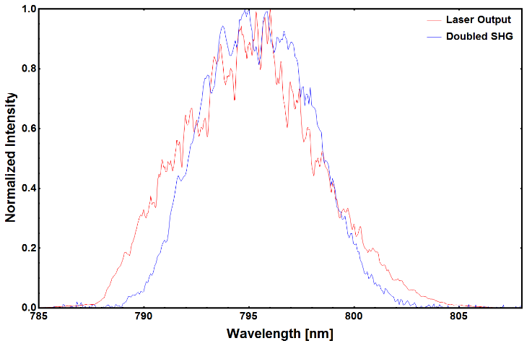
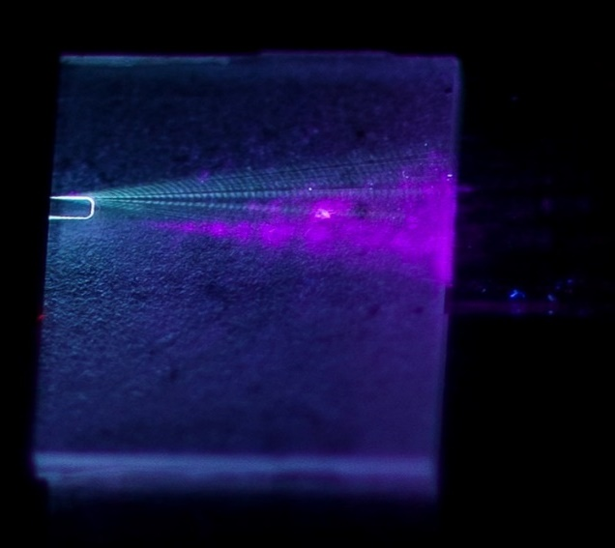
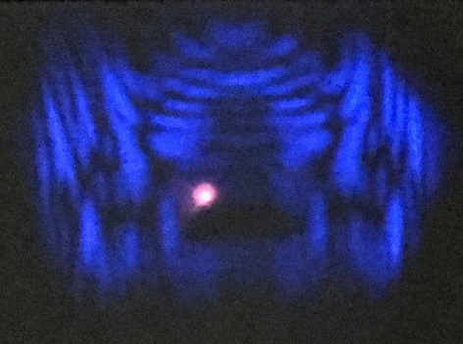
NIR-UV Second Harmonic Generation
Singlemode at 792nm, multimode at 396nm
Resonator Q (~2,000), optical pulses are filtered
Second harmonic generation (SHG) is produced in the waveguide
Demonstrated coupling to NV centers in PC cavities
SHG output superimposed on fundamental wavelength plot
Waveguide Mode,
fundamental + SHG
Scattered SHG
396nm SHG generated in AlN waveguide

Slide 18
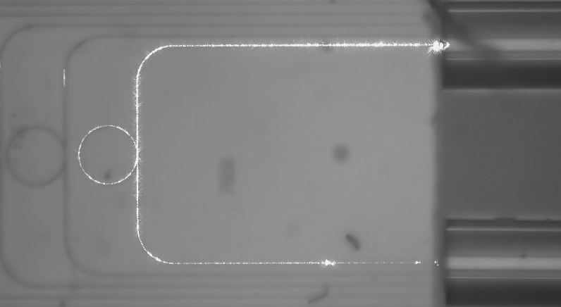
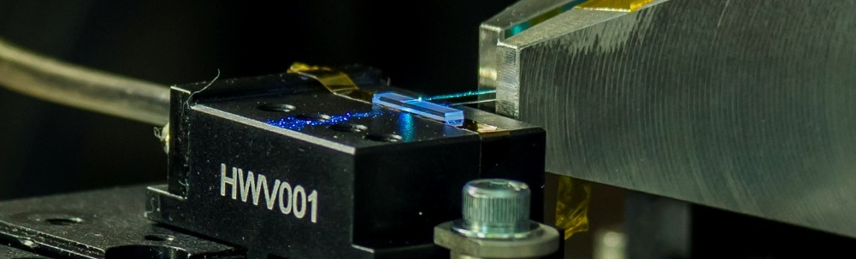
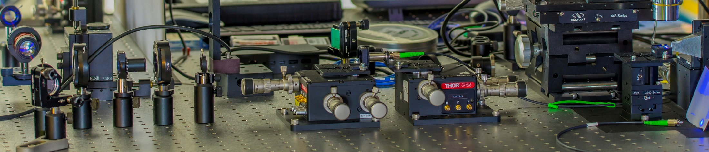
UV Integrated Photonic Circuits
150 fs Pulsed Ti:Sapphire SHG (360-470 nm)
  Average Power up to 20 mW
CW Tunable Ti:Sapphire SHG (367-372 nm)
  Average Power 1-10 mW
Spectrum taken from high resolution OSA
First demonstration of fiber coupled integrated circuits at 369.5 nm
Singlemode operation in the UV (369.5 nm)

Slide 19
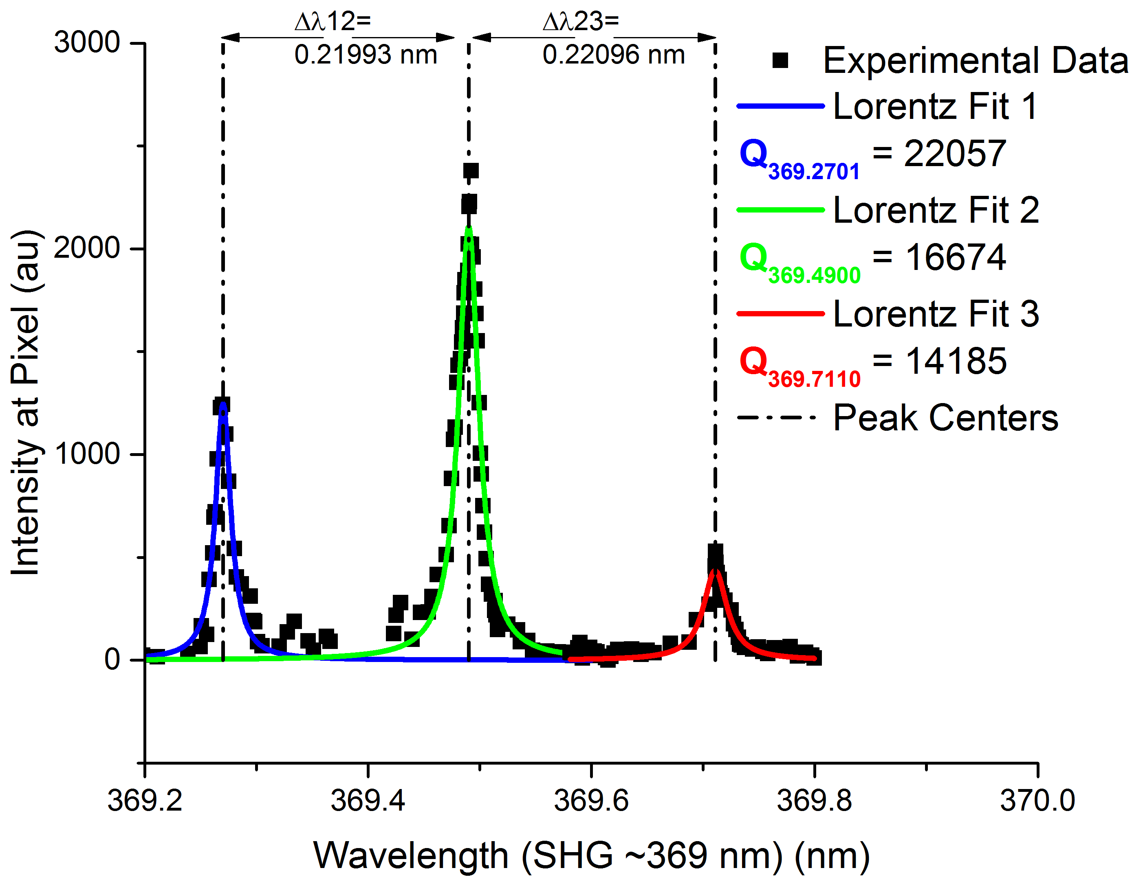



UV Ring Resonator Performance
UV (369.5 nm) Resonance
CW Ti:Sapphire Laser (SHG Doubled)
Q~20K at 369nm – Ideal for interaction with Yb⁺ ions
  Loss < 75dB/cm, order of magnitude better than previous reports
Dispersion matched for Spontaneous Four-Wave-Mixing (SFWM) photon generation over Δλ~10nm range
***Tsung-Ju Lu, et al.Opt. Express 26, 11147-11160 (2018)

Slide 20





UV Ring Resonator Performance
AlN Microring Resonances in the UV to Vis
Aluminum nitride microresonator
Aluminum nitride is a wide bandgap material for wavelengths of ~200nm to greater than 15μm.
Collaboration between AFRL/NRL/MIT/RIT for growth, fabrication, and testing of this material in bulk and waveguide regimes.
Critical coupling was achieved for these devices with quality factors of >20K for those devices in the ultraviolet regime and greater than 100K in the NIR.
  Loss was reduced to ~75 dB/cm with improvements in growth and fabrication.
    Loss <20 dB/cm should be achievable in the UV with single crystal material
  New single crystal material being grown at the moment
Active devices both thermal and electro-optic are in design at the moment.

Slide 21



Aluminum Nitride Integrated Platform
Defects change the transparency of the material
  Aluminum vacancy 3.59 eV
  Substitutional oxygen 5 eV
  Oxygen-Vacancy complex 4-4.55 eV
  Single oxygen 2.5-5 eV
Confirmed with Spectrometer measurements
Absorption Coefficient
$$α= −\frac{1}{d}\ln{\frac{T}{T_{0}}}$$
M. Bickermann, B. M. Epelbaum, O. Filip, P. Heimann, S. Nagata, and A. Winnacker, Phys. Status Solidi, vol. 24, no. 1, pp. 21–24, 2010.

Slide 22


UV Integrated Photonic Circuits
AlN grown by PEVDNC (Kyma)
Guides designed for critical coupling: 369 nm, 50-75 nm gap
Cladding: Alumina deposited by ALD (385 nm)
Silicon Oxynitride deposited by PECVD above Alumina as top
  1st version, alumina caused edge chipping
AlN grown by MBE
Collaboration w/Dr. Kent Averett (AFRL / RXAP)
AlN guides designed for critical coupling: 369 nm, 50-75 nm gap
Adjusting Silicon Oxynitride recipe for lower stress
AlGaN on AlN on SiC grown by MBE
Collaboration w/Dr. Matthew Hardy(NRL)
Waveguides and circuits have been fabricated
AlGaN guides designed for critical coupling: 369 nm, 50-100 nm gap
Adjusting Silicon Oxynitride recipe for lower stress
Evaluating deposition of AlN as an upper cladding

Slide 23









High Coincidence Efficiency Photon-Pairs
Drop
Symmetric
150nm
Gaps
Fairly equal distribution of coincidences between the four possible paths:
Heralding Efficiency: 37%
Through
Nearly all ring-generated coincidences now at the drop port only!
Through port coincidences primarily due to SFWM in waveguides
Heralding Efficiency: 96.7%
Tradeoff: 10x the pump power required
150nm Drop Port Gap
350nm Through Port Gap

Slide 24

High Coincidence Efficiency Photon-Pairs
Through Port (Pump) Gap Dependence
~Symmetric

Slide 25

No Free Lunch?

Slide 26

Breaking the trade-off
Interferometrically coupled ring resonator photon source

Slide 27




A Different Approach to Resonator Coupling
Mach-Zehnder Interferometer (MZI)
Δφ
Microring Resonator

Slide 28




Interferometric Ring Resonator Photon-Pair Source
MZI1
Input
Thru
Drop
Add
MZI2
Properly tuning the Mach-Zehnder’s results in decoupling of the two ports of the ring:
Excess pump photons are lost in the ring
Generated photon pairs leave the ring through the drop port
Coincidence efficiency of ~100% possible with no penalty to pumping – Free Lunch!
  + Built-in Pump Filtering!

Slide 29



AIM Photonics Testing
Electrical probes
V-groove array
AIM chip
Vacuum stage
Testbed for AIM Photonics chip evaluation
Chips coupled with V-groove arrays
Electrical probing of the chip
Automated stages and testing software for quick evaluation

Slide 30





Interferometric Ring Resonator Photon-Pair Source
Non-Ideal Heater Configuration
(Equivalent to a Lossy Add-Drop Ring)
Ideal Heater Configuration
(Directional Photon Source)
Silicon Microring Resonator
Metal electrodes
Input Side
Output Side
Exhibits behavior of asymmetrically coupled dual-bus ring resonator
  All of the resonances are supported by both sides of the device
The pump resonance is nearly critically coupled at the input side and suppressed at the output side
The signal/idler resonances are suppressed at the input side and supported at the output side
Doped Silicon Heaters
Silicon Waveguides
*** C. Tison, J. Steidle, M. Fanto, Z. Wang, N. Mogent, A. Rizzo, S. Preble, P. Alsing, “Path to increasing the coincidence efficiency of integrated resonant photon sources,” Opt. Express (2017)

Slide 31




Coincidence Characterization - ~Unity Directionality
Non-Ideal Heater Configuration
(Equivalent to a Lossy Add-Drop Ring)
Ideal Heater Configuration
(Directional Photon Source)
Laser Power = 5dBm
Integration Time = 300s
Laser Power = 5dBm
Integration Time = 300s
Weakly coupled pump results in low pair generation rate.
Biased toward the drop port due to a built-in asymmetric coupling
η_{coin} = 78.5%
Critically coupled pump results in greatly enhanced generation rate
Negligible coincidence rates for thru and split cases
η_{coin} = 99.8%

Slide 32



Frequency Conversion
Single stage DFG to convert from 369 nm
~1550 nm
369.5nm
485 nm pump
1553 nm
The hard part!
Single stage: First order QPM
  ADVR has made devices with 2um poling periods.
Collaboration with Alexander Sergienko of Boston University (started Oct 2017)
  Goal: advance fabrication techniques to create 1st order poling period in MgO:PPLN waveguides for single stage conversion of 369.5nm to 1550nm via a 485nm CW pump.
  Sergienko’s group will design electrodes and poling strategies, AFRL will test conversion efficiency
SFG/DFG in microring resonators from 369 nm 1550nm
AlN ring resonators
  AlN is transparent at 369 (bandgap 6.2 eV)
  Resonators enhance conversion from 369nm <->700nm.
  Preliminary AlN samples were received and waveguides fabricated.
  Testing underway
    ~40% coupling efficiency through device.
    Resonator Q ~2,000 @ 739 nm, 20,000 @ 369 nm
    Up to 1.6 watts CW pump power without damage.
On resonance

Slide 33




Where to next?
Entangled photon NOON state generator
Directional pump filtered photon pair source
Directional pump filtered entangled photon NOON state generator
Fully pump filtered photon pair source
Fabricated through AIM Photonics
Fabricated through AIM Photonics

Slide 34

Where to next?
MPW run
AFRL, RIT, MIT, Purdue, ORNL, ARL, RPI, and Precision Optical Transciever.
CAD for the fabrication run through AIM Photonics
Overview of the entire reticle encompassing all the devices on the chip
Showcases the density of devices compared to bulk optics
  Showcases scalability of devices for quantum applications.
Coupling efficiency < 3dB
SiN loss <0.1 dB/cm
Si loss <0.25 dB/cm
DISTRIBUTION A. Approved for public release: distribution unlimited. (88ABW-2019-0221)

Slide 35



Conclusions
Demonstrated UV to IR compatible integrated photonic circuits using AlN-on-Sapphire (200nm – 15um)
  High Q’s at 369nm - interface to quantum ion memories
  Fiber coupled integrated circuits at 369nm - first in literature
  Q >20K - highest in the literature
  Loss of ~75 dB/cm – lowest in literature
Integrated photonics enables the integration of:
  Photon sources
  Entangling/manipulation circuitry
  Quantum memories
Enables creation of quantum repeaters for quantum networking
Wide-bandgap Integrated Photonic Platform
Telecom Quantum Integrated Photonic Circuits

Slide 36






Acknowledgements
Questions?
Contact us for student and Postdoc opportunities

